Slide 2

Worship God
Ron Bert
28 July,2019

Slide 3

Is It Important
“HOW” we worship?

Slide 4


"God is Spirit, and those who worship Him must worship in spirit and truth." — John 4:24
Is it Important
to have proper worship?
The proper action
The proper object
The proper attitude
The proper authority
worship
Common delusions in Proper worship:
“I think” . . . “I feel” . . .
“It seems to me” . . .
“My heart is uplifted”
Careful not to:
~ worship in self and lies
God
in
in spirit
in truth
in

Slide 5
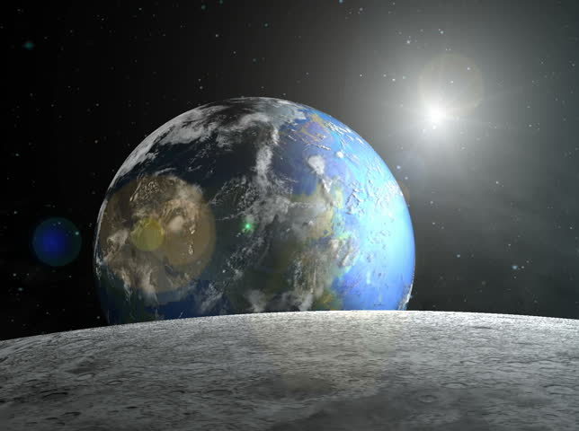
Thus says the LORD: "Heaven is My throne, And earth is My footstool. Where is the house that you will build Me? And where is the place of My rest? For all those things My hand has made, And all those things exist," Says the LORD. "But on this one will I look: On him who is poor and of a contrite spirit, And who trembles at My word. — Isaiah 66:1-2
LORD
LORD
LORD
My word

Slide 6
Give to the LORD the glory due His name; Bring an offering, and come into His courts. Oh, worship the LORD in the beauty of holiness! Tremble before Him, all the earth. — Psalms 96:8-9
God
Give to the LORD the glory due His name; Bring an offering, and come into His courts. Oh, worship the LORD in the beauty of holiness! Tremble before Him, all the earth. — Psalms 96:8-9
LORD
LORD
LORD
LORD
God
Bring an offering
But as for me, I will come into Your house in the multitude of Your mercy; In fear of You I will worship toward Your holy temple. — Psalms 5:7
"... but the LORD, who brought you up from the land of Egypt with great power and an outstretched arm, Him you shall fear, Him you shall worship, and to Him you shall offer sacrifice." — 2nd Kings 17:36
"... but the LORD, who brought you up from the land of Egypt with great power and an outstretched arm, Him you shall fear, Him you shall worship, and to Him you shall offer sacrifice." — 2nd Kings 17:36
Your house
But do not forget to do good and to share, for with such sacrifices God is well pleased. — Hebrews 13:16
But do not forget to do good and to share, for with such sacrifices God is well pleased. — Hebrews 13:16
But do not forget to do good and to share, for with such sacrifices God is well pleased. — Hebrews 13:16
to do good
Your mercy
to share
Him you shall worship
worship toward You
God is well pleased
offer sacrifice

Slide 7
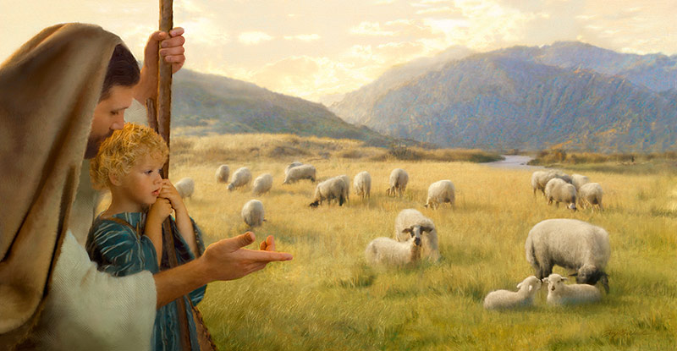
Oh come, let us worship and bow down; Let us kneel before the LORD our Maker. For He is our God, And we are the people of His pasture, And the sheep of His hand. Today, if you will hear His voice: "Do not harden your hearts, as in the rebellion, As in the day of trial in the wilderness, …" — Psalms 95:6-8
let us worship
I will worship
I will worship toward Your holy temple, And praise Your name For Your lovingkindness and Your truth; For You have magnified Your word above all Your name. — Psalms 138:2
submit
LORD
Your
He is our God
God
Your
Your
hear His voice
His
Your word

Slide 8
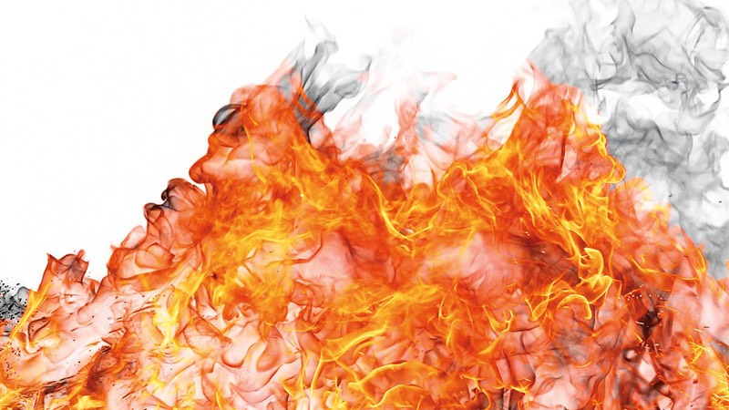
And Moses said to Aaron, "This is what the LORD spoke, saying: 'By those who come near Me I must be regarded as holy; And before all the people I must be glorified.'" So Aaron held his peace. — Leviticus 10:3
dislike
Therefore, as the fire devours the stubble, And the flame consumes the chaff, So their root will be as rottenness, And their blossom will ascend like dust; Because they have rejected the law of the LORD of hosts, And despised the word of the Holy One of Israel. — Isaiah 5:24
I must be glorified
I must be regarded as holy
spurn
root
reject
rottenness
loathe
holy
I must be regarded as holy
I must be regarded as holy
detest
I must
rejected
the LORD
be glorified
despise
despised the word

Slide 9
To Know The Church Jesus Built
Therefore, since we are receiving a kingdom which cannot be shaken, let us have grace, by which we may serve God acceptably with reverence and godly fear. For our God is a consuming fire. — Hebrews 12:28-29
• receiving
• grace
• serve
“The seed is the Word of God” (Luke 8:11)
receiving
receiving a kingdom
The Bible Alone
grace
Christian
let us have grace
serve
which we may serve God
Bible + Methodist Discipline
Methodist
acceptably with reverence
Different
Word
Bible + Baptist Manual
•
Doctrines of Mankind
Bible
Bible +
‒
Baptist
Bible + Book of Mormon
Mormon
Bible + Koran
Denominationalism necessitates different seeds!
Muslim
Men have tampered with the seed!!
Notes:
While God’s love is unconditional for the moment in which He allows us to exist (rains on the just and unjust), to achieve eternal life in His presence, one must understand His conditional entrance bounds. It is His plan and it cannot be superseded by the whims of man and or human self created doctrines excusing or even dismissing God’s own conditions.

Slide 10
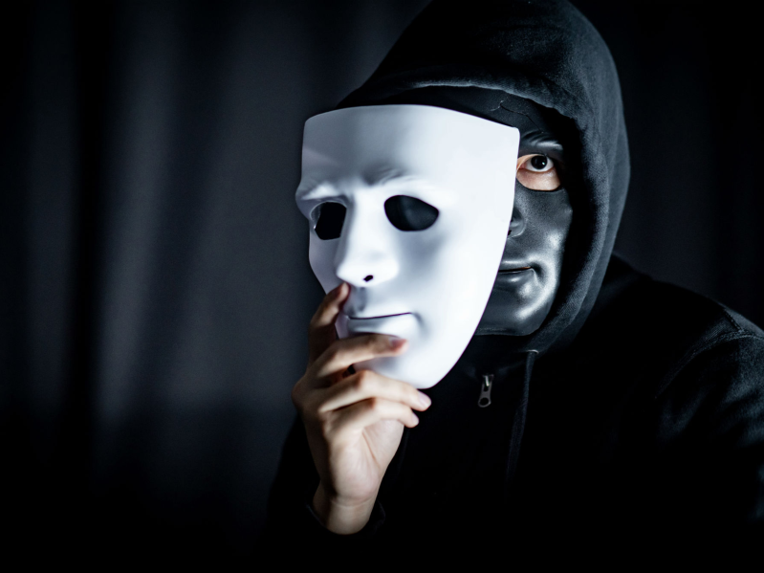
"Hypocrites! Well did Isaiah prophesy about you, saying: 'These people draw near to Me with their mouth, And honor Me with their lips, But their heart is far from Me. And in vain they worship Me, Teaching as doctrines the commandments of men.'" — Matthew 15:7-9
Therefore the Lord said: "Inasmuch as these people draw near with their mouths And honor Me with their lips, But have removed their hearts far from Me, And their fear toward Me is taught by the commandment of men, — Isaiah 29:13
people
removed their hearts far from Me
in
worthlessness
in vain
doctrines
of men
Notes:
People may pretend to worship in the light wearing the undercover mask of darkness.

Slide 11
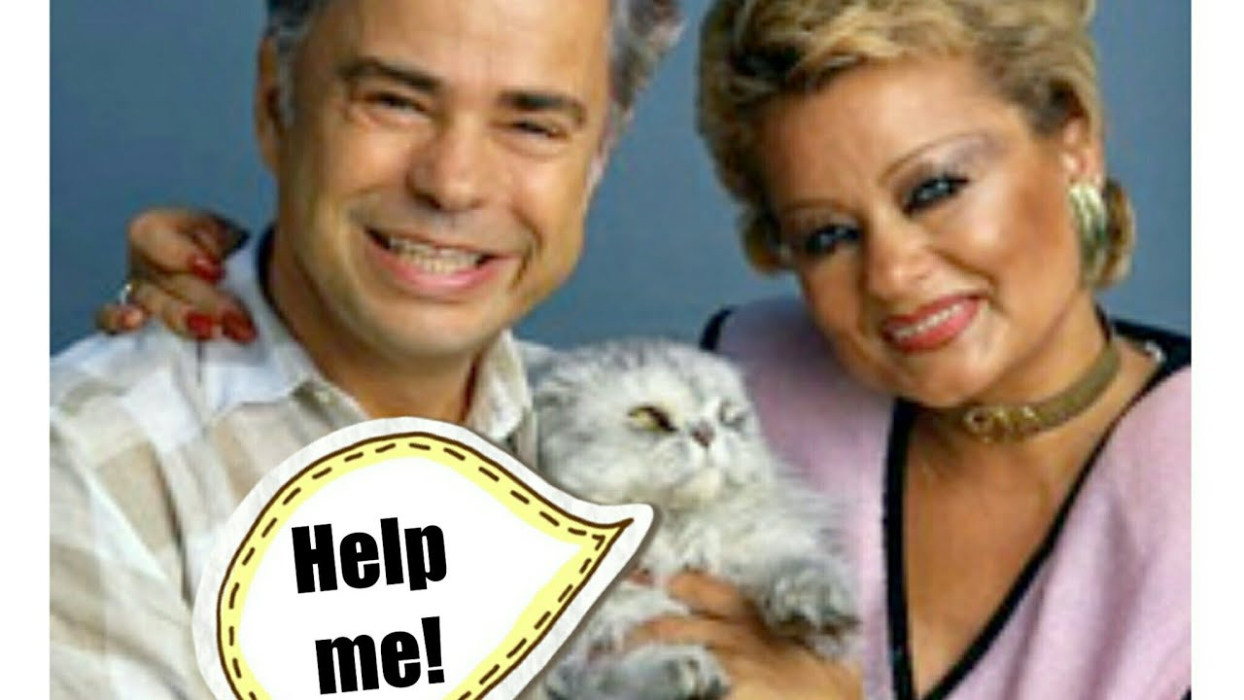
"So they come to you as people do, they sit before you as My people, and they hear your words, but they do not do them; for with their mouth they show much love, but their hearts pursue their own gain." — Ezekiel 33:31
hear your words
X
do not do them
$elf seeking ≠ God seeking

Slide 12
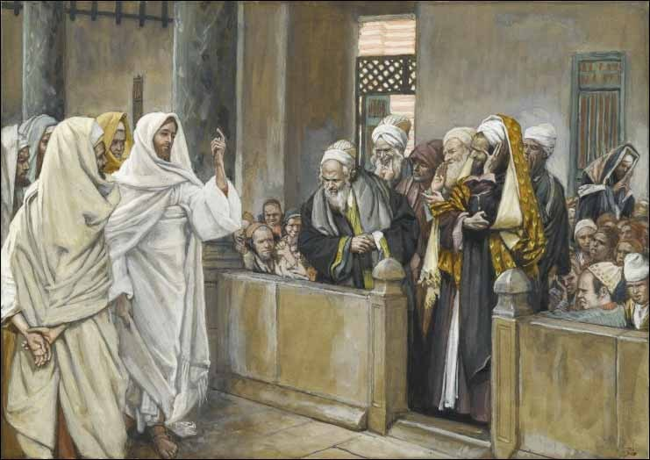
"The baptism of John -- where was it from? From heaven or from men?" And they reasoned among themselves, saying, "If we say, 'From heaven,' He will say to us, 'Why then did you not believe him?' But if we say, 'From men,' we fear the multitude, for all count John as a prophet." So they answered Jesus and said, "We do not know." And He said to them, "Neither will I tell you by what authority I do these things. — Matthew 21:25-27
Brethren, my heart's desire and prayer to God for Israel is that they may be saved. For I bear them witness that they have a zeal for God, but not according to knowledge. For they being ignorant of God's righteousness, and seeking to establish their own righteousness, have not submitted to the righteousness of God. — Romans 10:1-3
from heaven
Why
commandments
Word
Word
Word
Word
Word
Word
Word
Word
Word
Word
Word
Word
Word
Word
Word
Word
Word
Word
you not believe
proud insecurity
'
not according to knowledge
GOD
we fear the multitude
"But why do you call Me 'Lord, Lord,' and do not do the things which I say?" — Luke 6:46
Why do you not believe what's from heaven
we fear the multitude
Me
"If you love Me, keep My commandments." — John 14:15
do not do
_{people}
more than GOD
what
do
s
commandments
Notes:
Jesus is calling hearts to see Him and the qualities God wills for man.

Slide 13

"He who has My commandments and keeps them, it is he who loves Me. And he who loves Me will be loved by My Father, and I will love him and manifest Myself to him." — John 14:21
Jesus answered and said to him, "If anyone loves Me, he will keep My word; and My Father will love him, and We will come to him and make Our home with him. "He who does not love Me does not keep My words; and the word which you hear is not Mine but the Father's who sent Me. These things I have spoken to you while being present with you. But the Helper, the Holy Spirit, whom the Father will send in My name, He will teach you all things, and bring to your remembrance all things that I said to you." — John 14:23-26
loves Me, he will keep My word
commandments
keeps
precious
not love Me does not keep My words
not love Me
love
love
love
love

Slide 14
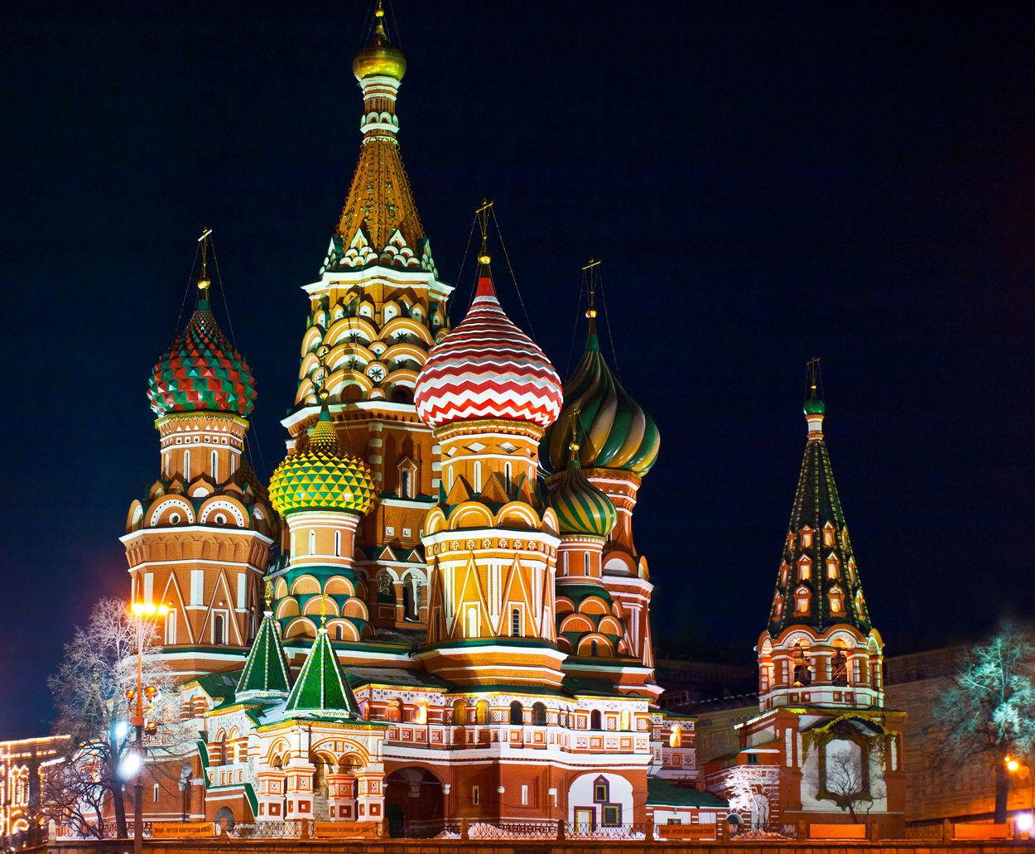

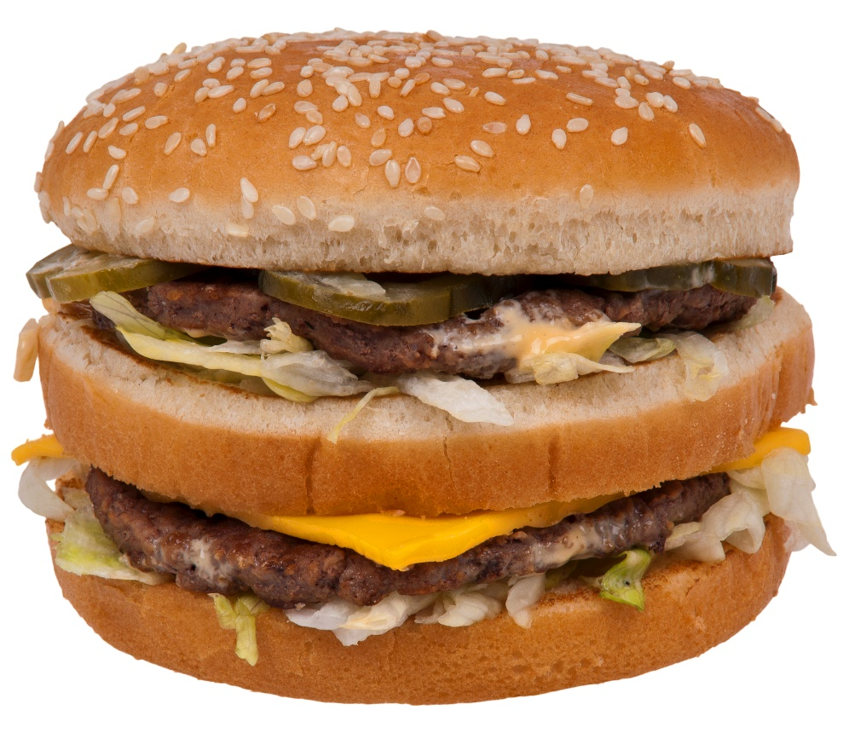

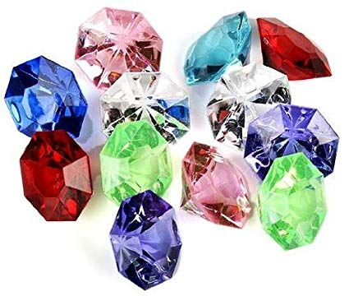
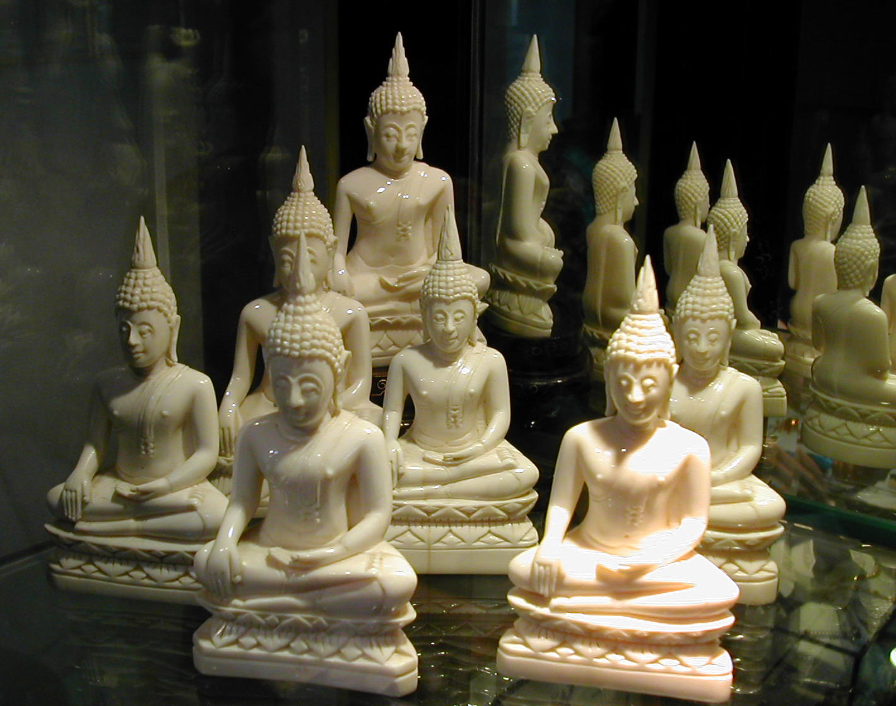

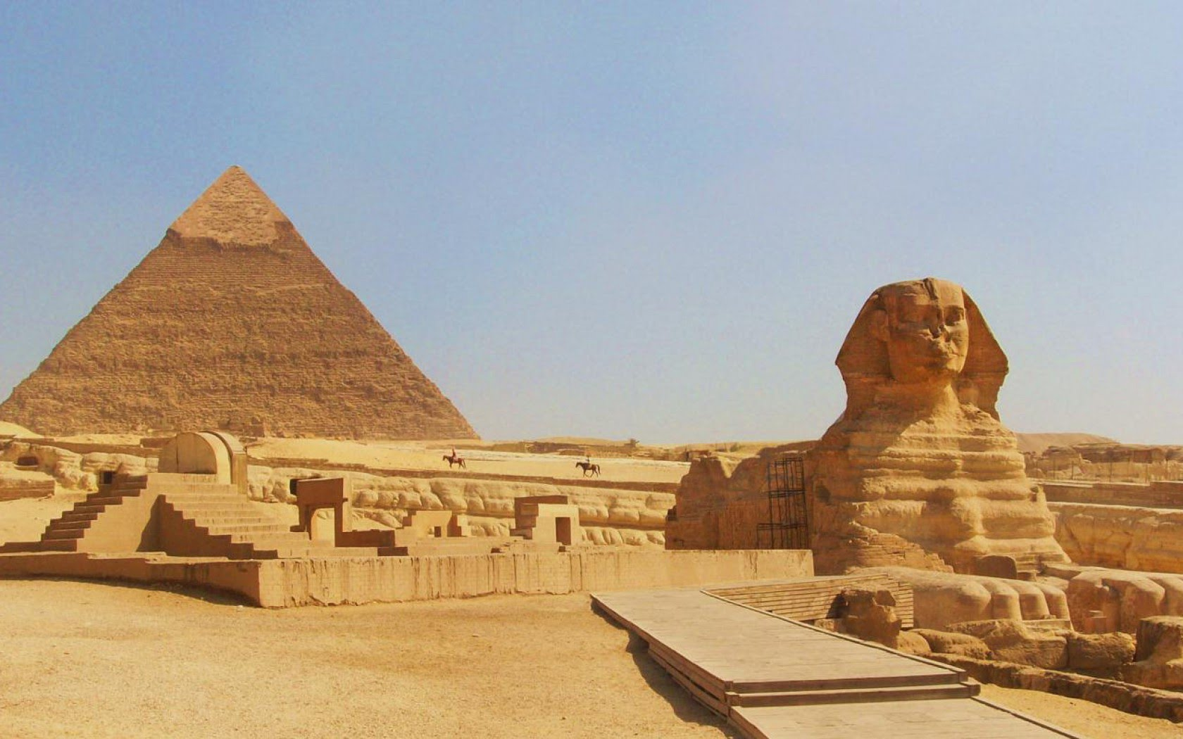

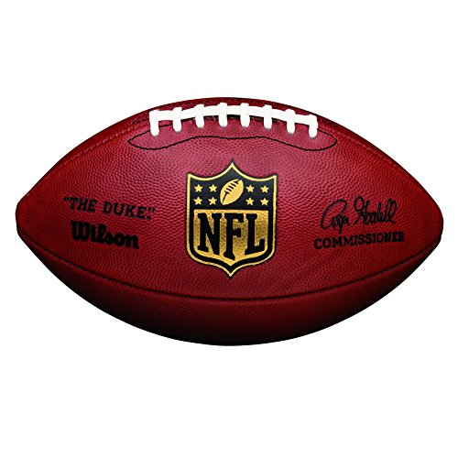



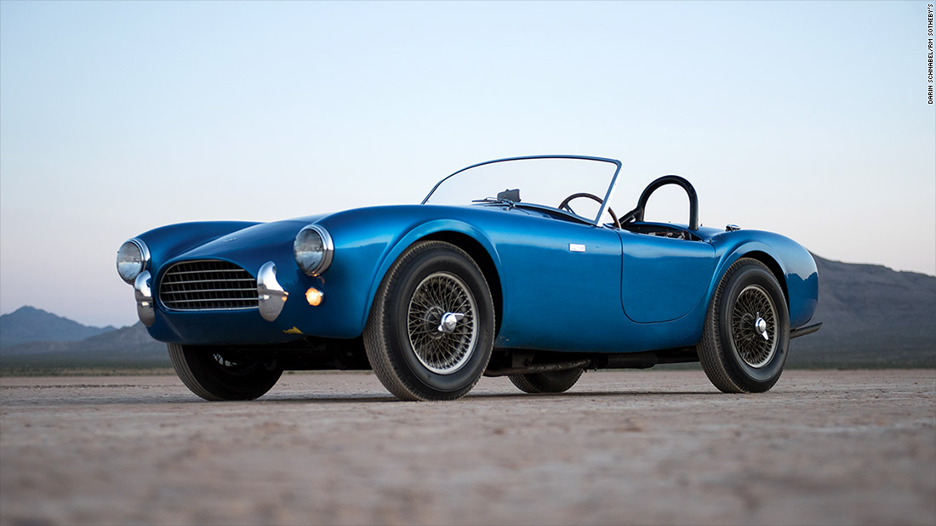
Then Paul stood in the midst of the Areopagus and said, "Men of Athens, I perceive that in all things you are very religious; for as I was passing through and considering the objects of your worship, I even found an altar with this inscription: TO THE UNKNOWN GOD. Therefore, the One whom you worship without knowing, Him I proclaim to you:" — Acts 17:22-23
objects of your worship
TO THE UNKNOWN GOD
I proclaim to you
… who exchanged the truth of God for the lie, and worshiped and served the creature rather than the Creator, who is blessed forever. Amen. — Romans 1:25
MATERIALISM
So then faith comes by hearing, and hearing by the word of God. — Romans 10:17
objects of your
objects of your
by the word
love
worship
worship
TO THE UNKNOWN GOD
I proclaim to you

Slide 15
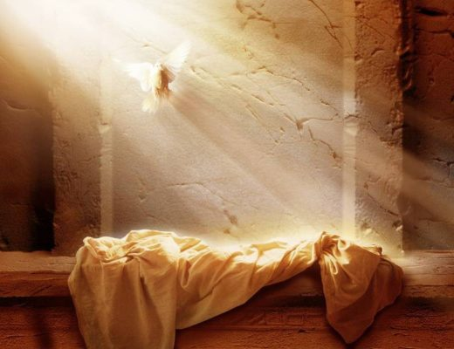
"You worship what you do not know; we know what we worship, for salvation is of the Jews." — John 4:22
"You worship what you do not know; we know what we worship, for salvation is of the Jews." — John 4:22
we know what we worship
For we are the circumcision, who worship God in the Spirit, rejoice in Christ Jesus, and have no confidence in the flesh, … — Philippians 3:3
worship God in the Spirit
In
In Christ Jesus

Slide 16

"But the hour is coming, and now is, when the true worshipers will worship the Father in spirit and truth; for the Father is seeking such to worship Him." — John 4:23
"Nor is He worshiped with men's hands, as though He needed anything, since He gives to all life, breath, and all things." — Acts 17:25
He gives to all life
breath
and all things
true worshipers
in
love
worship the Father in spirit
truth

Slide 17
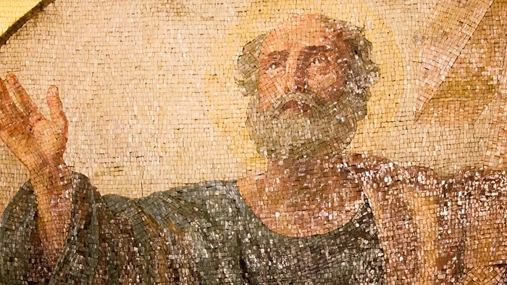
Then Paul, looking earnestly at the council, said, "Men and brethren, I have lived in all good conscience before God until this day." — Acts 23:1
Then Paul, looking earnestly at the council, said, "Men and brethren, I have lived in all good conscience before God until this day." — Acts 23:1
A good conscience does not necessitate proper worship
"Indeed, I myself thought I must do many things contrary to the name of Jesus of Nazareth." — Acts 26:9
"Indeed, I myself thought I must do many things contrary to the name of Jesus of Nazareth." — Acts 26:9
thought
good
conscience
Notes:
A good conscience does not necessitate proper worship

Slide 18
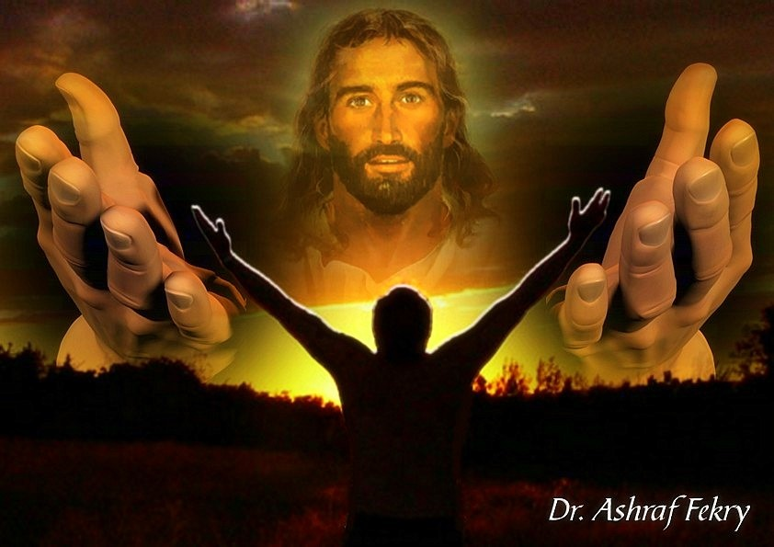
Let no one cheat you of your reward, taking delight in false humility and worship of angels, intruding into those things which he has not seen, vainly puffed up by his fleshly mind, and not holding fast to the Head, from whom all the body, nourished and knit together by joints and ligaments, grows with the increase that is from God. — Colossians 2:18-19
WARNING
worship of angels
intruding
gossip
arrogant
vainly puffed
not holding fast to the Head
ONE
all the body
is from God

Slide 19
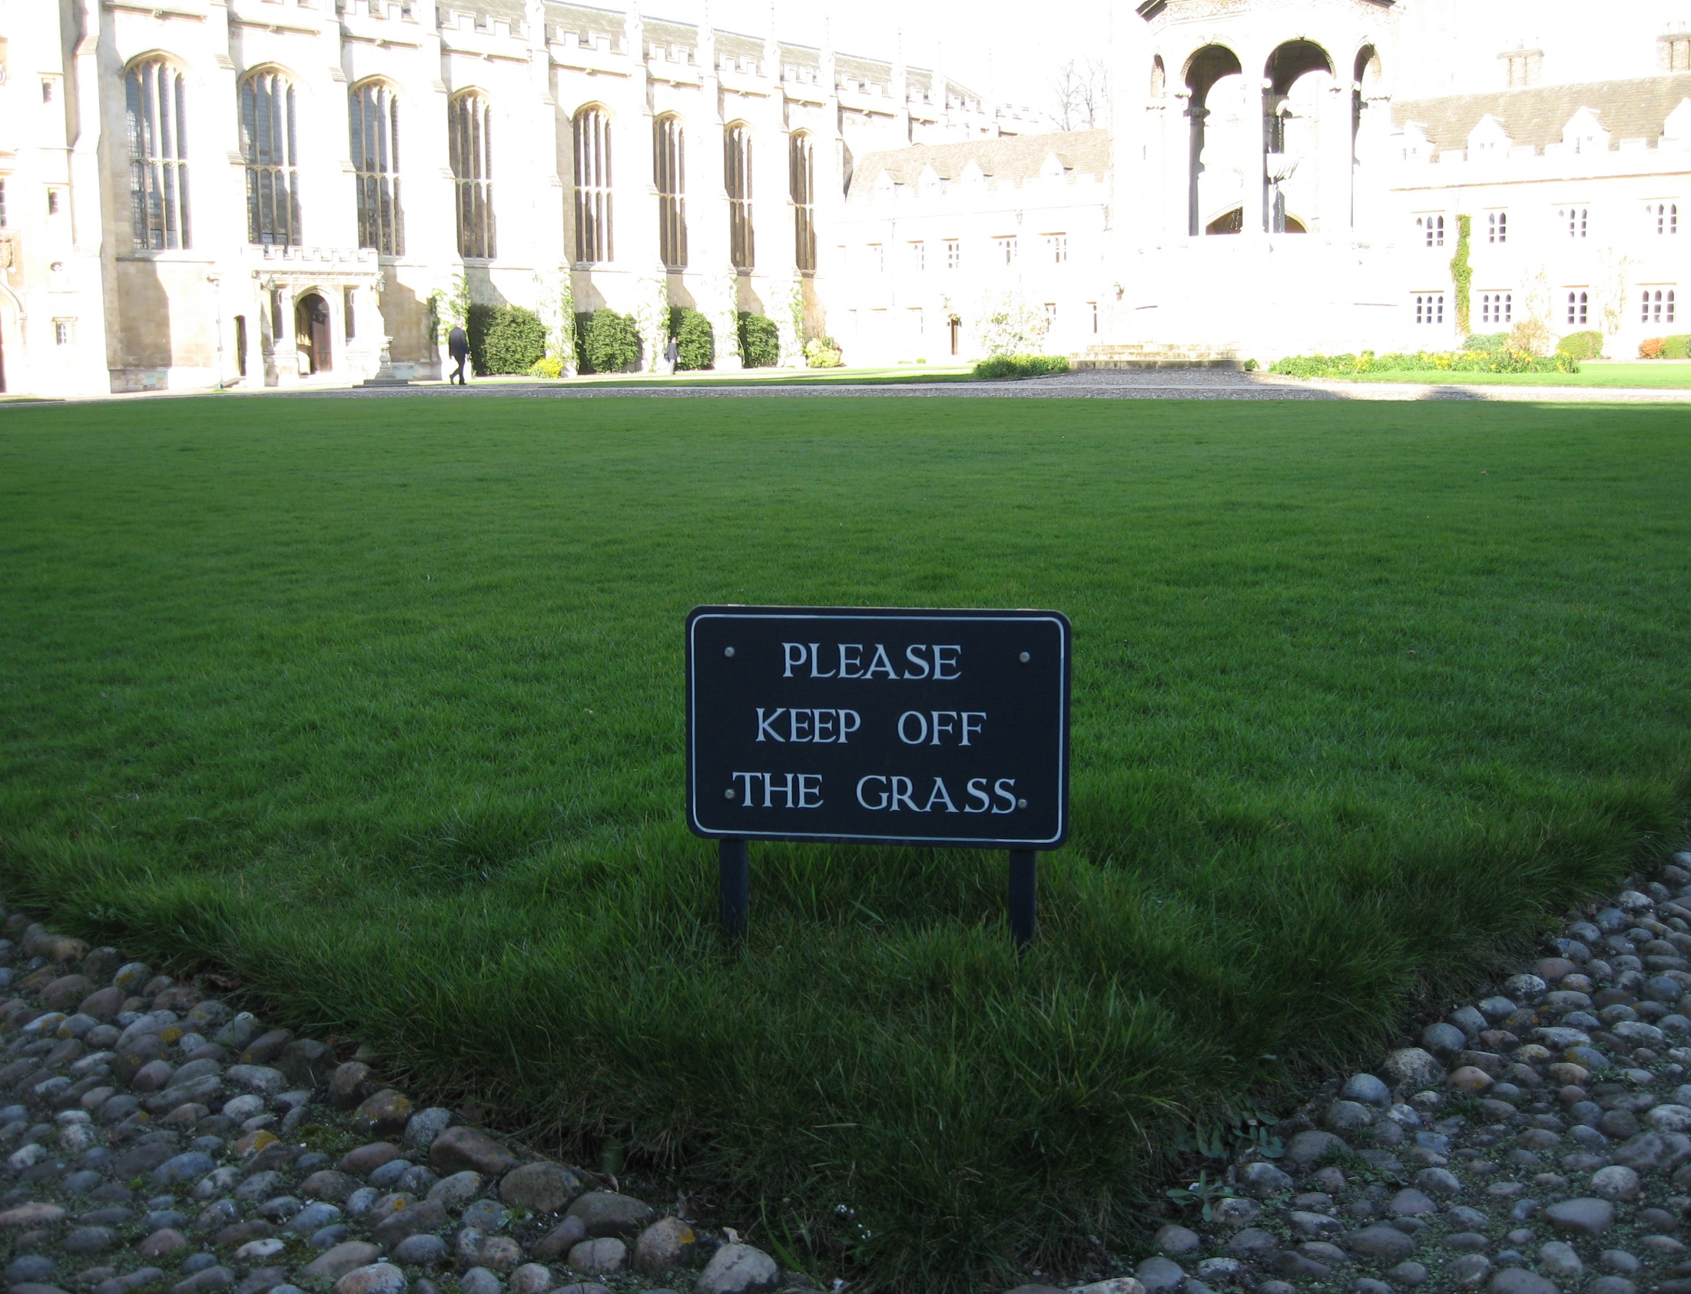
Therefore, if you died with Christ from the basic principles of the world, why, as though living in the world, do you subject yourselves to regulations -- "Do not touch, do not taste, do not handle," which all concern things which perish with the using -- according to the commandments and doctrines of men? These things indeed have an appearance of wisdom in self-imposed religion, false humility, and neglect of the body, but are of no value against the indulgence of the flesh. — Colossians 2:20-23
human tradition
regulations
God does not want us to avoid life in Him
doctrines of men?
BIBLE
appearance of wisdom
indulgence of the flesh
Notes:
God did no make life to be avoided.

Slide 20
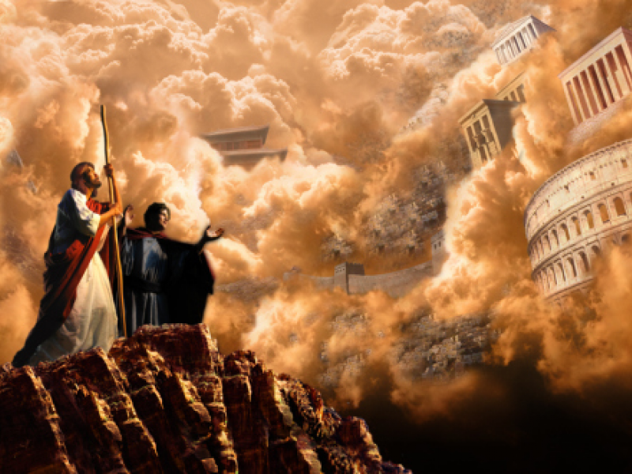
And he said to Him, "All these things I will give You if You will fall down and worship me." Then Jesus said to him, "Away with you, Satan! For it is written, 'You shall worship the LORD your God, and Him only you shall serve.'" — Matthew 4:9-10
God
worship the LORD
God
Him only you shall serve

Slide 21
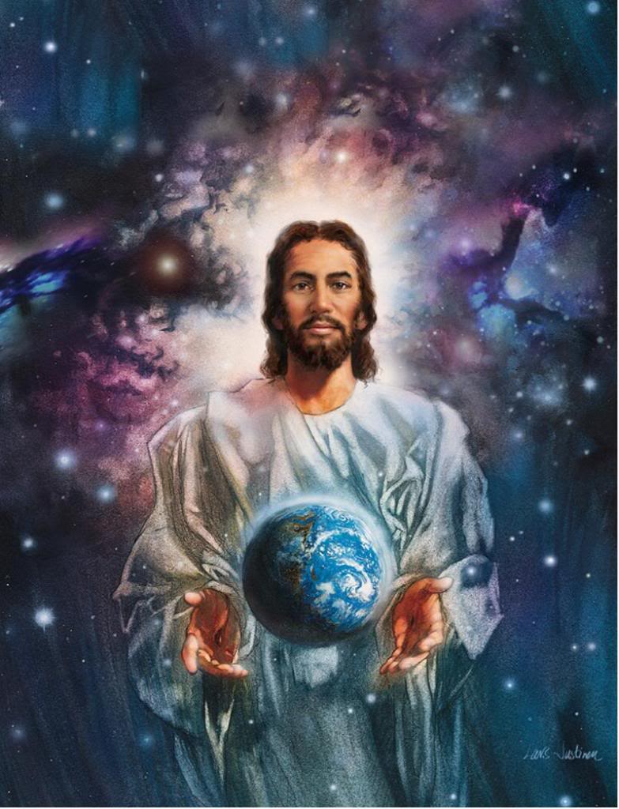
… saying with a loud voice, "Fear God and give glory to Him, for the hour of His judgment has come; and worship Him who made heaven and earth, the sea and springs of water." — Revelation 14:7
"... 'to open their eyes, in order to turn them from darkness to light, and from the power of Satan to God, that they may receive forgiveness of sins and an inheritance among those who are sanctified by faith in Me.'" — Acts 26:18
glory
turn them from darkness to light
give glory to Him
God
glory
in
sanctified by faith in Me

Slide 22
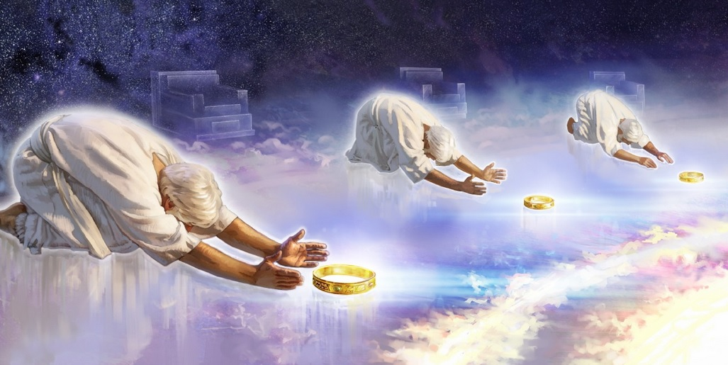
…. the twenty-four elders fall down before Him who sits on the throne and worship Him who lives forever and ever, and cast their crowns before the throne, saying: "You are worthy, O Lord, To receive glory and honor and power; For You created all things, And by Your will they exist and were created." — Revelation 4:10-11
worship
glory
worship

Slide 23
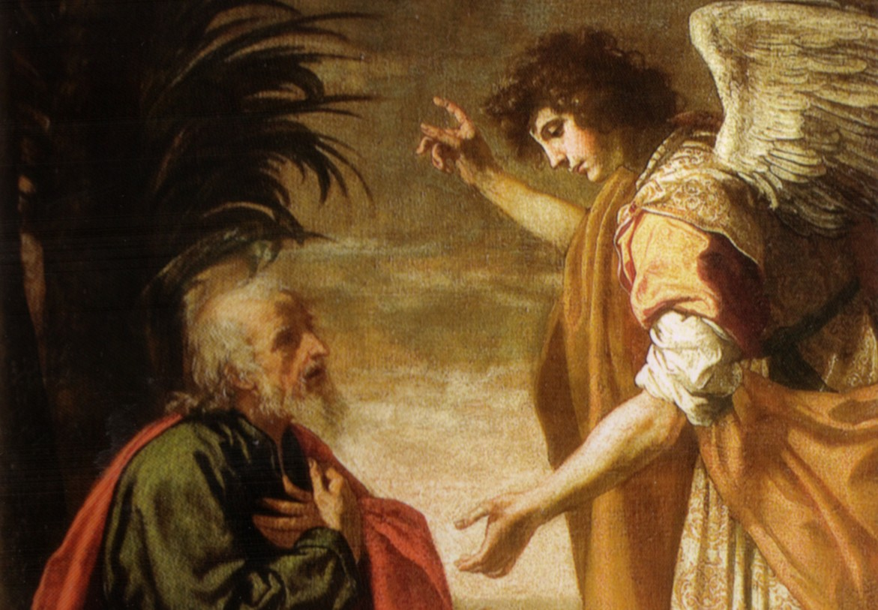
And I fell at his feet to worship him. But he said to me, "See that you do not do that! I am your fellow servant, and of your brethren who have the testimony of Jesus. Worship God! For the testimony of Jesus is the spirit of prophecy." — Revelation 19:10
worship
Then he said to me, "See that you do not do that. For I am your fellow servant, and of your brethren the prophets, and of those who keep the words of this book. Worship God." — Revelation 22:9
worship
Worship God
worship
Worship God
worship
Jesus

Slide 24
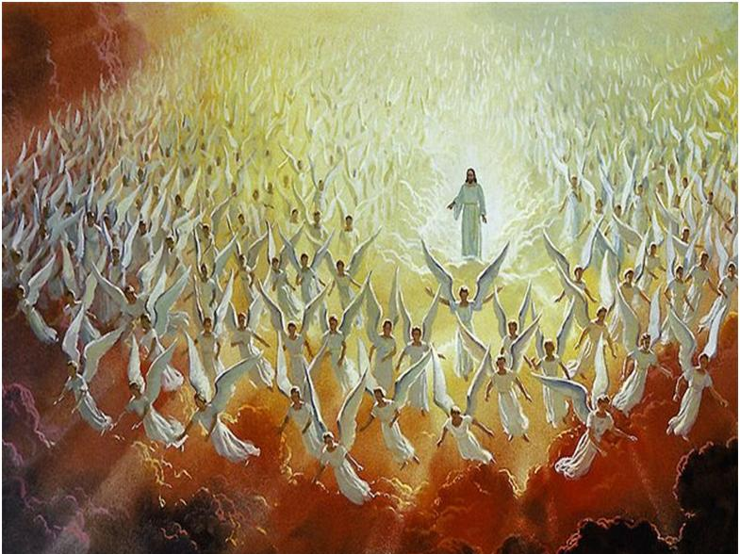
But when He again brings the firstborn into the world, He says: "Let all the angels of God worship Him." — Hebrews 1:6
worship
Him
worship
Him

Slide 25

Then he said, "Lord, I believe!" And he worshiped Him. — John 9:38
"Truly, these times of ignorance God overlooked, but now commands all men everywhere to repent, …" — Acts 17:30
worship
Him

Slide 26
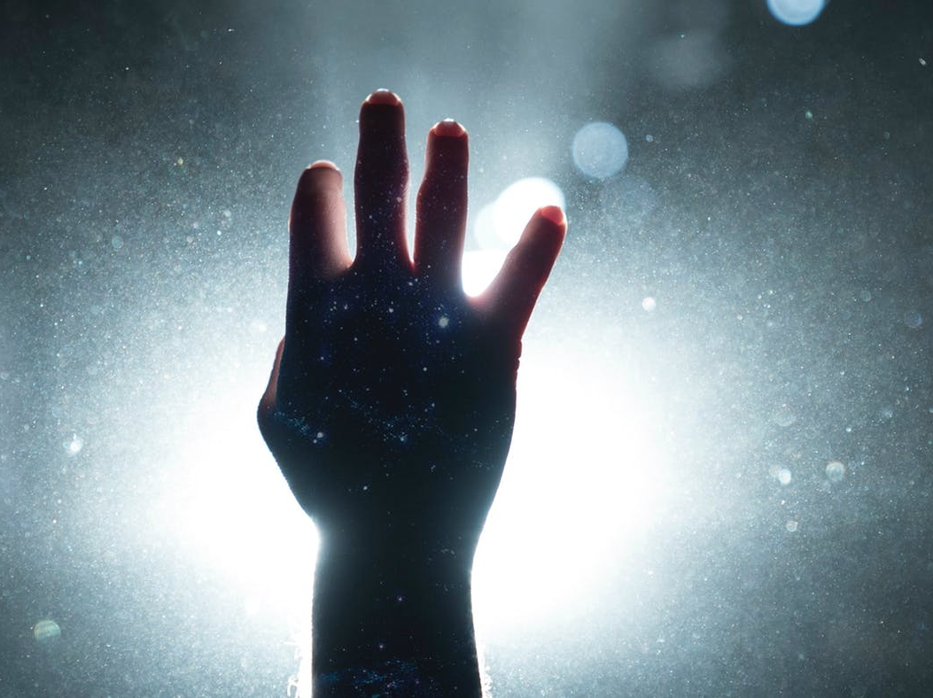
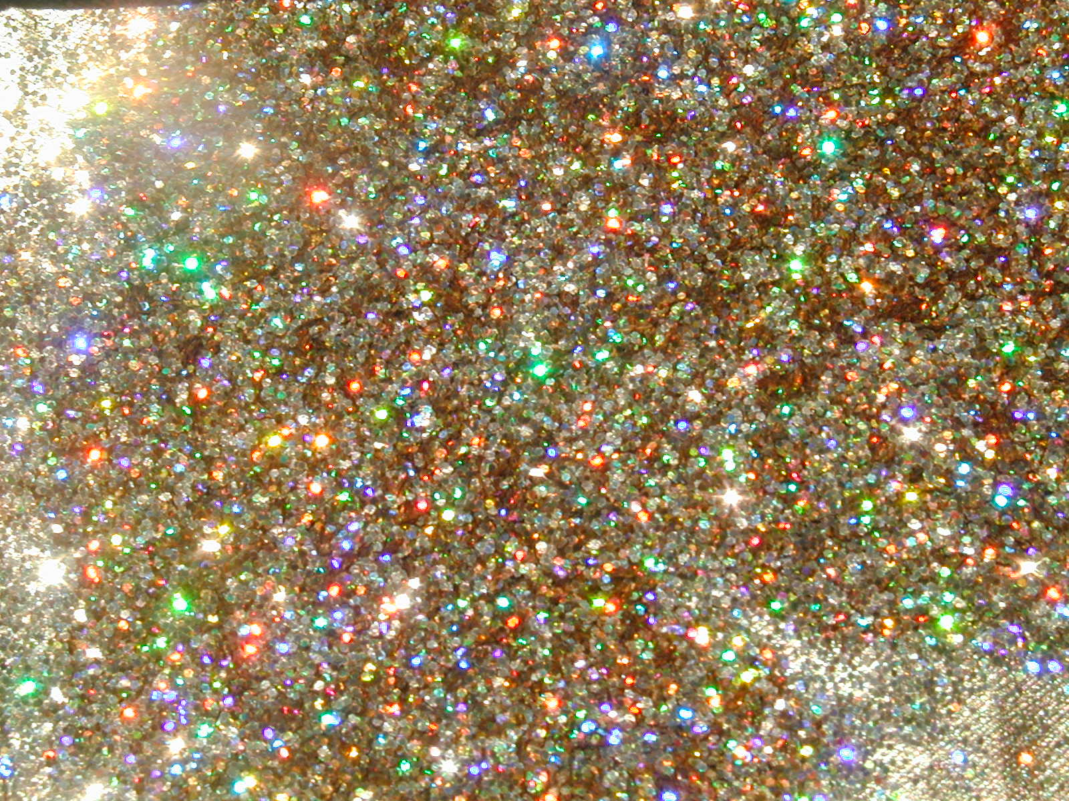
→ Proper worship comes by being in His Spirit of truth
→ Worship involves sacrifice to God on His terms
→ God deserves worship as maker of all things
→ God must be regarded as Holy and not trivialized
→ Rejecting the Lord’s word brings condemnation
→ Key is knowledge and understanding of God’s word
→ Worship involves increasing love of God & His word
→ Men mostly worship creation over the Creator
→ One has to hear the word to obtain true faith
→ God is not worshipped through material objects
→ Charlatans mislead one away from God’s truth
→ Worship the LORD God, & Him only you shall serve
→ Keeping God’s word is worshipping God
Worship is what God calls for in His word
Notes:
Worship is what God calls for in His word

Slide 28

Please visit http://www.LoveFromGod.com to explore further
Ronald Bert Channel on
Notes:
Eternity never ends.

