Slide 1
Notes:
In darkness there is nothing grateful.

Slide 2
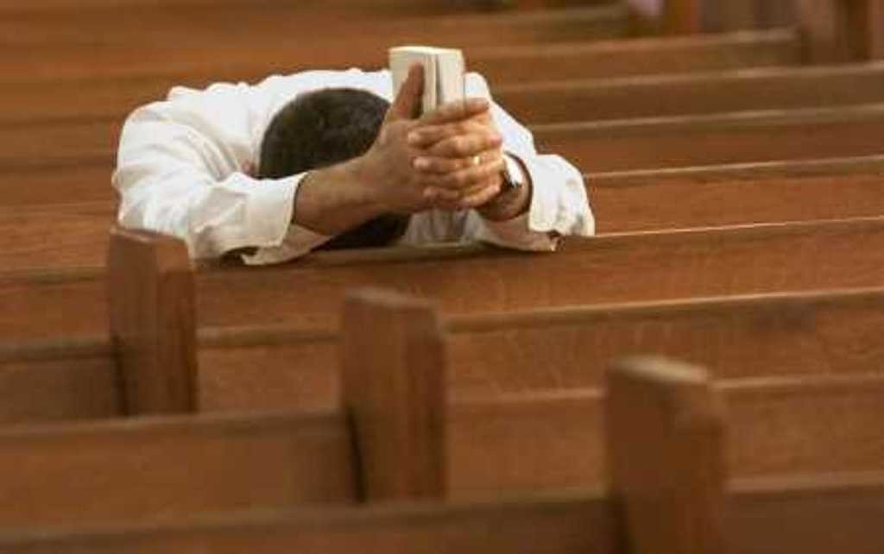
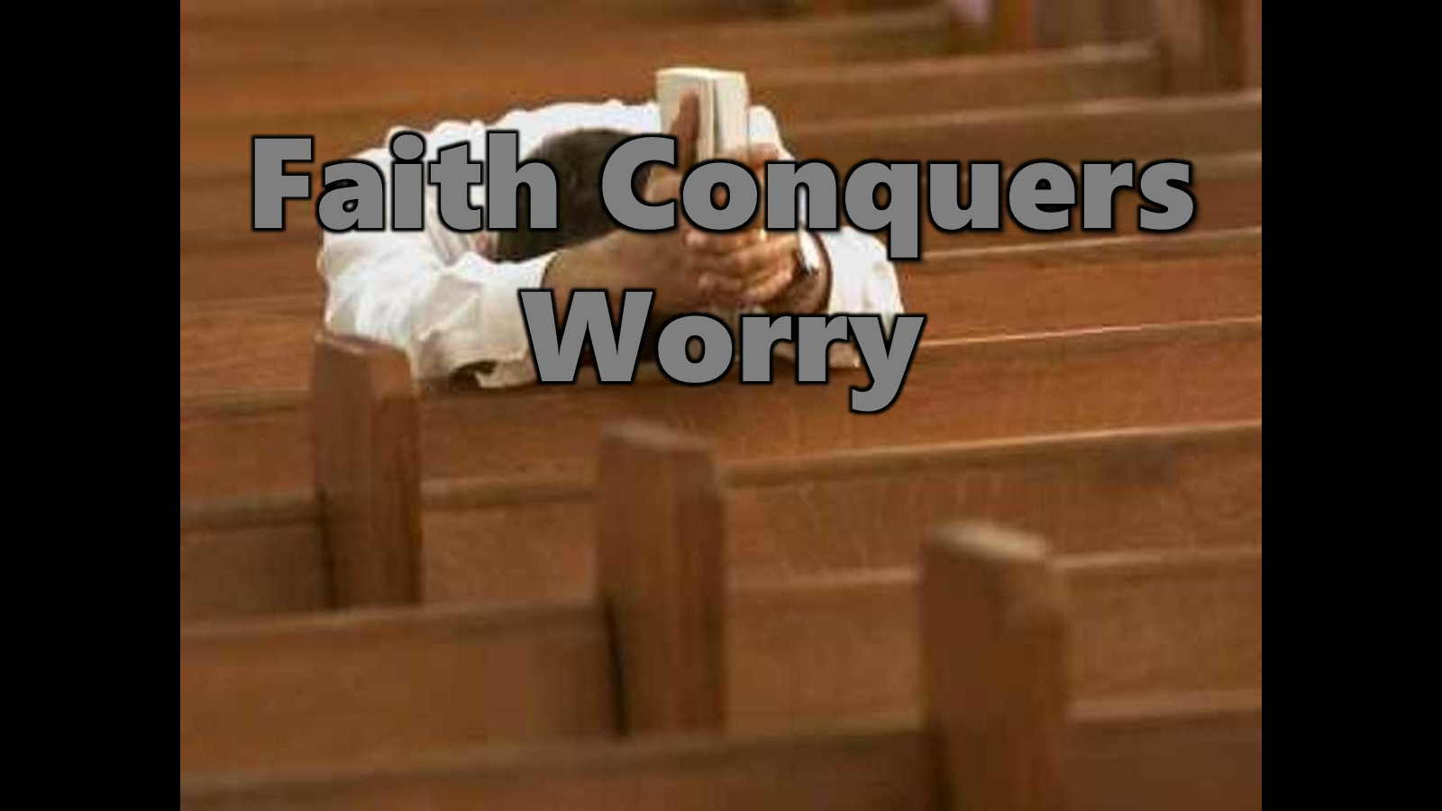


Faith Conquers Worry
Ron Bert
February 19, 2017
Notes:
Faith is to climb over the despair of death.
The heart is alone. Loneliness can inflict the most desperate of thoughts even while surrounded by others; we see the Robin Williams suicide. Anchors of despair and depression plague the general public. Lack of faith has led to a society of isolated individuals often termed as the “Cocoon Society.” Many children across time have been, and are, lost without direction with hope being a glimmer most foreign. The darkness of worry can only be addressed with faith in something greater. None of us can know for sure what is to be. Ambiguities are, by nature, the realm we have come to be in. There is no lasting material foundation where most focus. Without faith, freedom at best is elusive. To be free in spirit is a gift given by God. Worry deprives the spirit of living enthusiastically as the back of the heart rips in tears of fear. Life is said to contain a biorhythmic series of light and darkness effects. This is not only physical but also spiritual. To peel the mental infections afflictions ravage upon a soul, love is the sole answer from estrangement. Wisdom given by His inspiration teaches us how to cope developing patience of character in hope of His coming. There is no worry where those are who truly believe. Uncertainty has always left sorrow upon the ages of mankind of woman. Faith is surrendering to destiny’s portal as we shed the flesh. How often do we search for answers we can’t find?

Slide 3
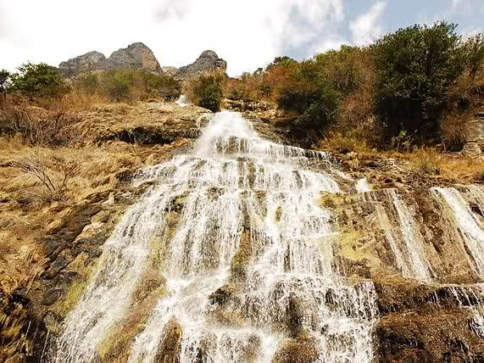
Why are you cast down, O my soul? And why are you disquieted within me? Hope in God; For I shall yet praise Him, The help of my countenance and my God. — Psalms 43:5
my God
praise Him
Hope in God
my God
praise Him
Hope in God
help of my countenance
disquieted within
cast down
my soul
my God
praise Him
Hope in God
help of my countenance
disquieted within
cast down
my soul
cast down
my soul
disquieted within
Hope in God
help of my countenance
praise Him
help
X
of my countenance
my God
Notes:
It is natural for a soul to come to its’ own. In being cast down to the feelings of life, most if not all have felt the tragedies, that cause sorrow. Everyone has a reason to worry. It is by the maturing of a soul that enables one to, say sort of, pick up the pieces. It is by one’s own thoughts and projections that inner help to encourage growth forward or sinking unconcern leads to positive or negative results, respectively. In the final analysis, one must help lift oneself for spiritual blessings to unfold. As hope in God increases to praise for Him, we return to the peace He intended, in the strength of being.

Slide 4
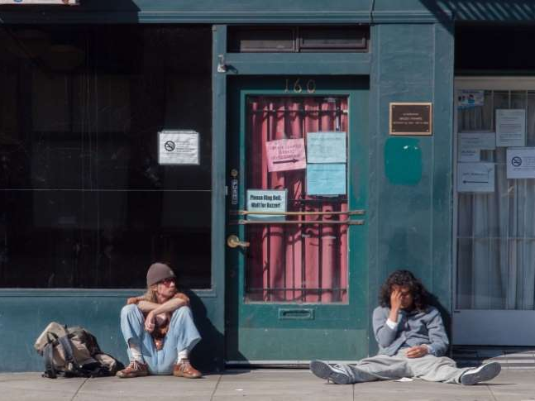
"Therefore I say to you, do not worry about your life, what you will eat or what you will drink; nor about your body, what you will put on. Is not life more than food and the body more than clothing? — Matthew 6:25
worry
life
more than food
body
worry
clothing
Notes:
Each of us has a mountain of life to climb. The spirit is a gauge revealing faith or the lack of it. What one surrenders to is what is released in living. Does love rule over despair? Life too often seems to send us that unwelcome spin of worry.

Slide 5

"Look at the birds of the air, for they neither sow nor reap nor gather into barns; yet your heavenly Father feeds them. Are you not of more value than they?
Which of you by worrying can add one cubit to his stature?" — Matthew 6:26-27
worry
worry
worry
worry
worry
worry
value
presence
Notes:
Without faith worry can creep in depriving the moment. Worry actually steals the time we have. At times it is hard to allow love to rise above the hardships. Worry complicates what is simple. Simple is the light that shines on us. Sensing value of presence is compromised when worries enter. He calls for us to rise in love over the worries that destroy life. Worry deflates our flight in life

Slide 6
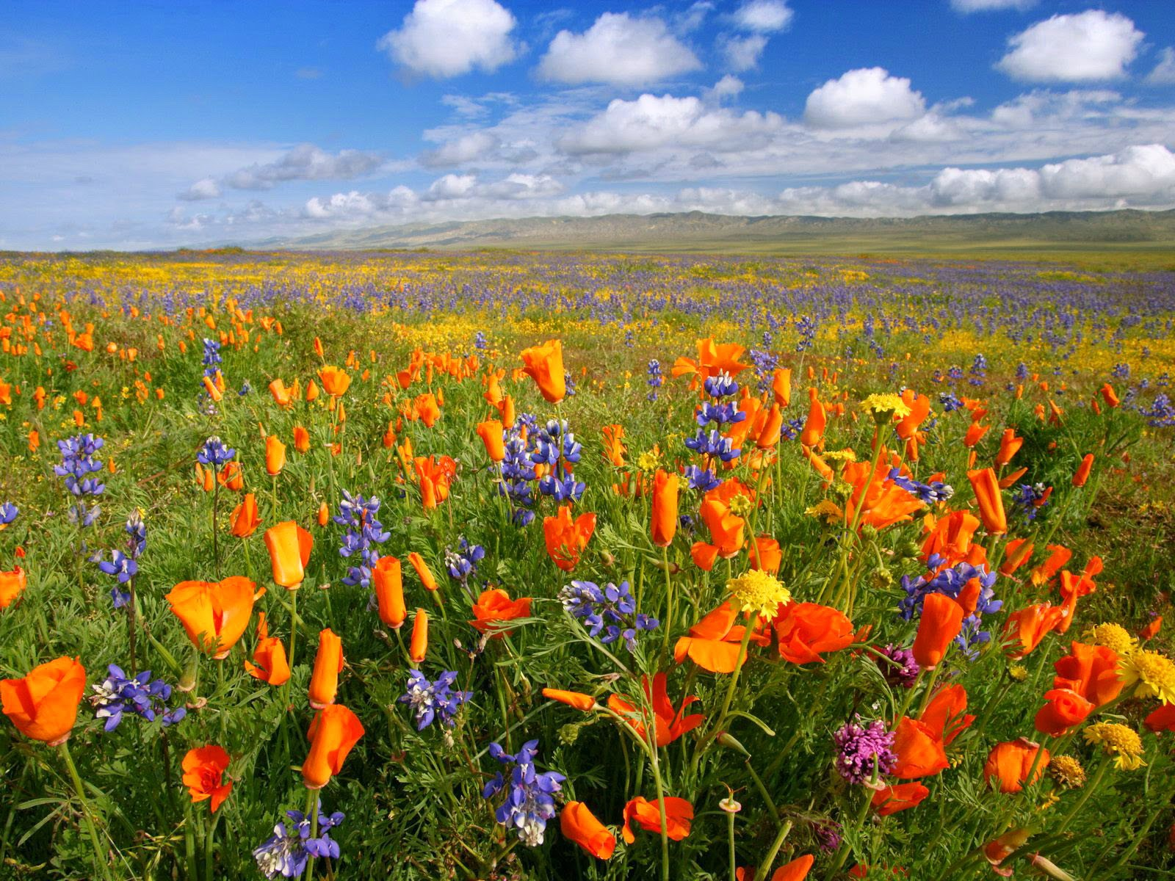
"So why do you worry about clothing? Consider the lilies of the field, how they grow: they neither toil nor spin; and yet I say to you that even Solomon in all his glory was not arrayed like one of these." — Matthew 6:28-29
worry
why do you worry
why do you worry
spin
LIFE
DEATH
LIFE
worry
Notes:
Nature itself reveals the glory God intends for all spouting life. To be enveloped in His vibrant colors brings out His approaching beatitudes. The spin on worry comes down to a choice between life or death.

Slide 7
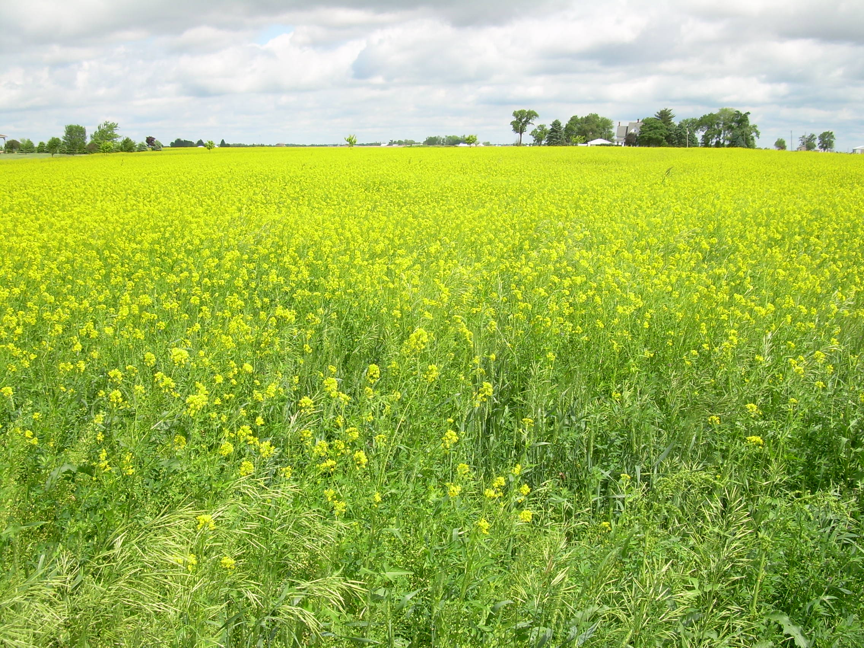
"Now if God so clothes the grass of the field, which today is, and tomorrow is thrown into the oven, will He not much more clothe you, O you of little faith? Therefore do not worry, saying, 'What shall we eat?' or 'What shall we drink?' or 'What shall we wear?'" — Matthew 6:30-31
s
e
seek
O you of little faith
O you of little faith
worry
do not worry
do not worry
k
e
Notes:
The material exposes what we are, and if we cling to the material over the spirit. It is a test of God to see what we surrender to. Worry invades one of little faith. What we desire cooks in the heart.

Slide 8

"And do not seek what you should eat or what you should drink, nor have an anxious mind." — Luke 12:29
heavenly
seek
seek
seek
seek
nor
earthly
undisturbed
have an anxious mind
Notes:
Many who worry forget to be thankful for what is. Disgust can blur the blessing of just living, and the opportunities it unendingly holds. To breathe, to know, and to love. Is what we seek as valuable from the outside or inside? Purpose in life has a lot to do with whether one is disturbed or not.

Slide 9

"For after all these things the Gentiles seek. For your heavenly Father knows that you need all these things. But seek first the kingdom of God and His righteousness, and all these things shall be added to you." — Matthew 6:32-33
Things
seek
things
seek
kingdom of God
Peace and joy in the Holy Spirit
Romans 14:17
love
contentment
Notes:
At the crossroads of living and dying, it is goodness that rises above all things. The kingdom of God is peace and joy in the Holy Spirit; this is accepting the love Jesus has for us. To do this overcomes worry with contentment in His saving Grace.

Slide 10

"Therefore do not worry about tomorrow, for tomorrow will worry about its own things. Sufficient for the day is its own trouble." — Matthew 6:34
Things that cause us to worry:
Things
m
Our stuff; money
Life being hard
The future is uncertain
We are not in control
d
i
er
t
not permit
not
trouble
Notes:
It is a lack of faith and trust that is the root of all worry. Worry does not permit us to love the way God wants us to. Verily, worry does not permit one to live where peace and joy dwells; in His light. Because God knows worry is a trouble of all, He instructs us not to extend those troubles beyond the day we live in. On our climb away from worry, to isolate it only to the day is the beginning of resolving and purging its’ affliction from the way we live. He has called us to live without worry as a goal of the noble.

Slide 11

The sleep of a laboring man is sweet, Whether he eats little or much; But the abundance of the rich will not permit him to sleep. — Ecclesiastes 5:12
releases cares
Faithful
s
e
Faithless
clings to cares
riches
not permit
rich
Notes:
We were created to work, and work well done holds such sweet calm. A life without purpose can be lost to worry. Spiritual purpose rises over material attachments; releasing verses clinging affects worries. Turmoil arises when isolated material delusions, from unfulfilled desires, embed upon an unthankful heart. Blessed are those thankful with the love of others.

Slide 12
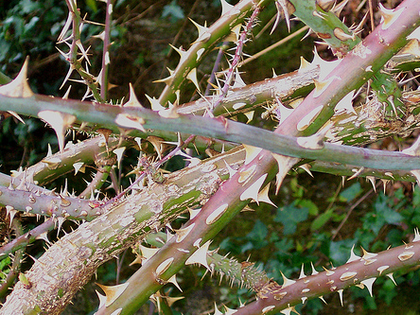
"Now he who received seed among the thorns is he who hears the word, and the cares of this world and the deceitfulness of riches choke the word, and he becomes unfruitful." — Matthew 13:22
cares of this
cares of this
world
world
riches
unfruitful
Notes:
Where thorns flourish is in extreme self-seeking unconcerned for the welfare of others. Evils of wrath and jealousy contribute to, and magnify, worry. When the cares of the world overwhelm us, darkness falls upon the heart.

Slide 13

And He said to them, "Take heed and beware of covetousness, for one's life does not consist in the abundance of the things he possesses." — Luke 12:15
beware of covetousness
beware of covetousness
1. My stuff; money
Notes:
What one sees as important really defines the soul. Can one see beyond the world is another test of God. The material can trap one in a cycle of turmoil's held in bondage by such things that fade over time. Existence is confining if only finite aspirations indulge the heart. Covetousness amplifies worries.

Slide 14
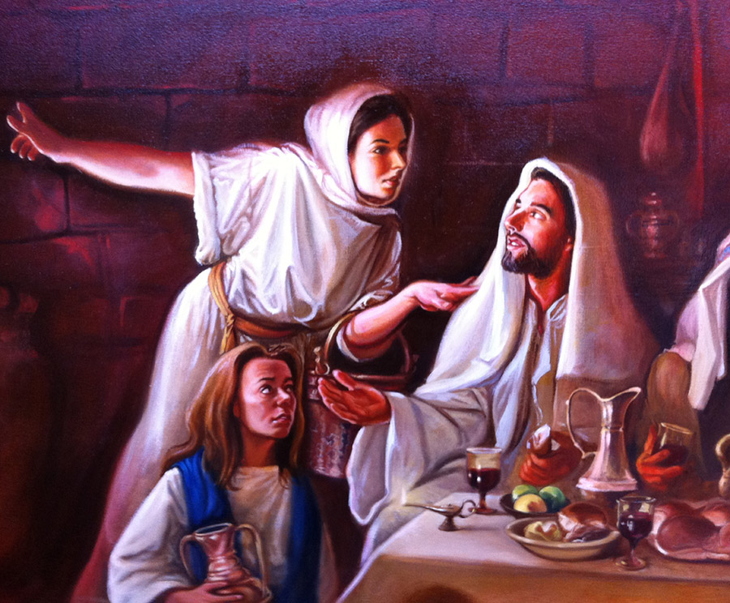
But Martha was distracted with much serving, and she approached Him and said, "Lord, do You not care that my sister has left me to serve alone? Therefore tell her to help me." And Jesus answered and said to her, "Martha, Martha, you are worried and troubled about many things." — Luke 10:40-41
much serving
worried and troubled
2. Life being hard
worried and troubled
Notes:
Misery places pressure on a heart to worry. To be free of worry one has to train one’s thinking to replace the undesirable drippings with higher thoughts where the peace of His love resides. Christ carried the sorrows of the world, and so we should let Him help us by allowing Him to lift the back of our hearts in salvations grace. For Jesus to carry our troubles, acceptance and surrender to Him has much to do with trading worry for faith, in the midst of our sorrows. Worry is commonly associated with complaining. He calls for thankful hearts.

Slide 15
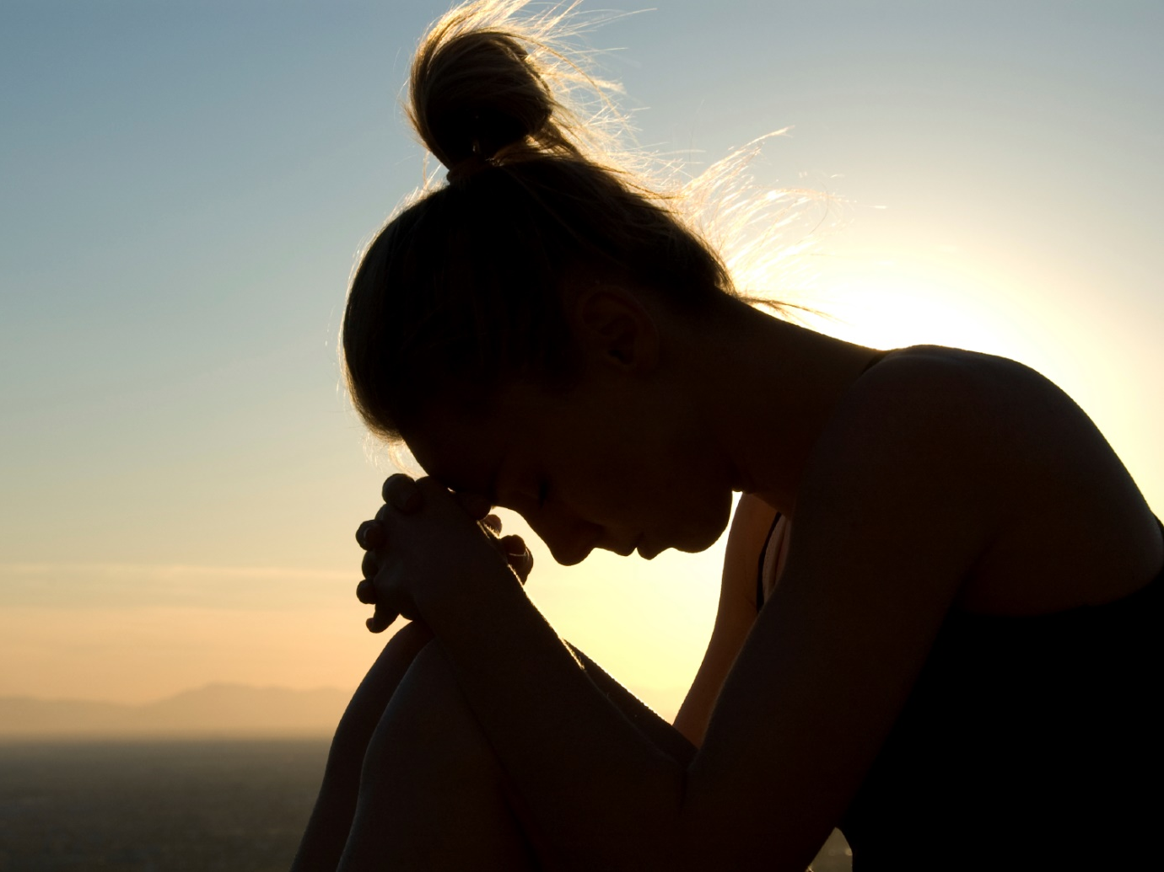
Cease from anger, and forsake wrath; Do not fret – it only causes harm. — Psalms 37:8
Many are the afflictions of the righteous, But the LORD delivers him out of them all. — Psalms 34:19
3. The future is uncertain
Do not fret – it only causes harm
Do not fret – it only causes harm
Notes:
Clearly worry is the cancer of peace. God is the healing we all seek, and by no other means can redemption be found in the lives of all men and women. God has made a promise to deliver us, even if it is from unwelcome or unfortunate circumstances. Misery does not justify worry.

Slide 16
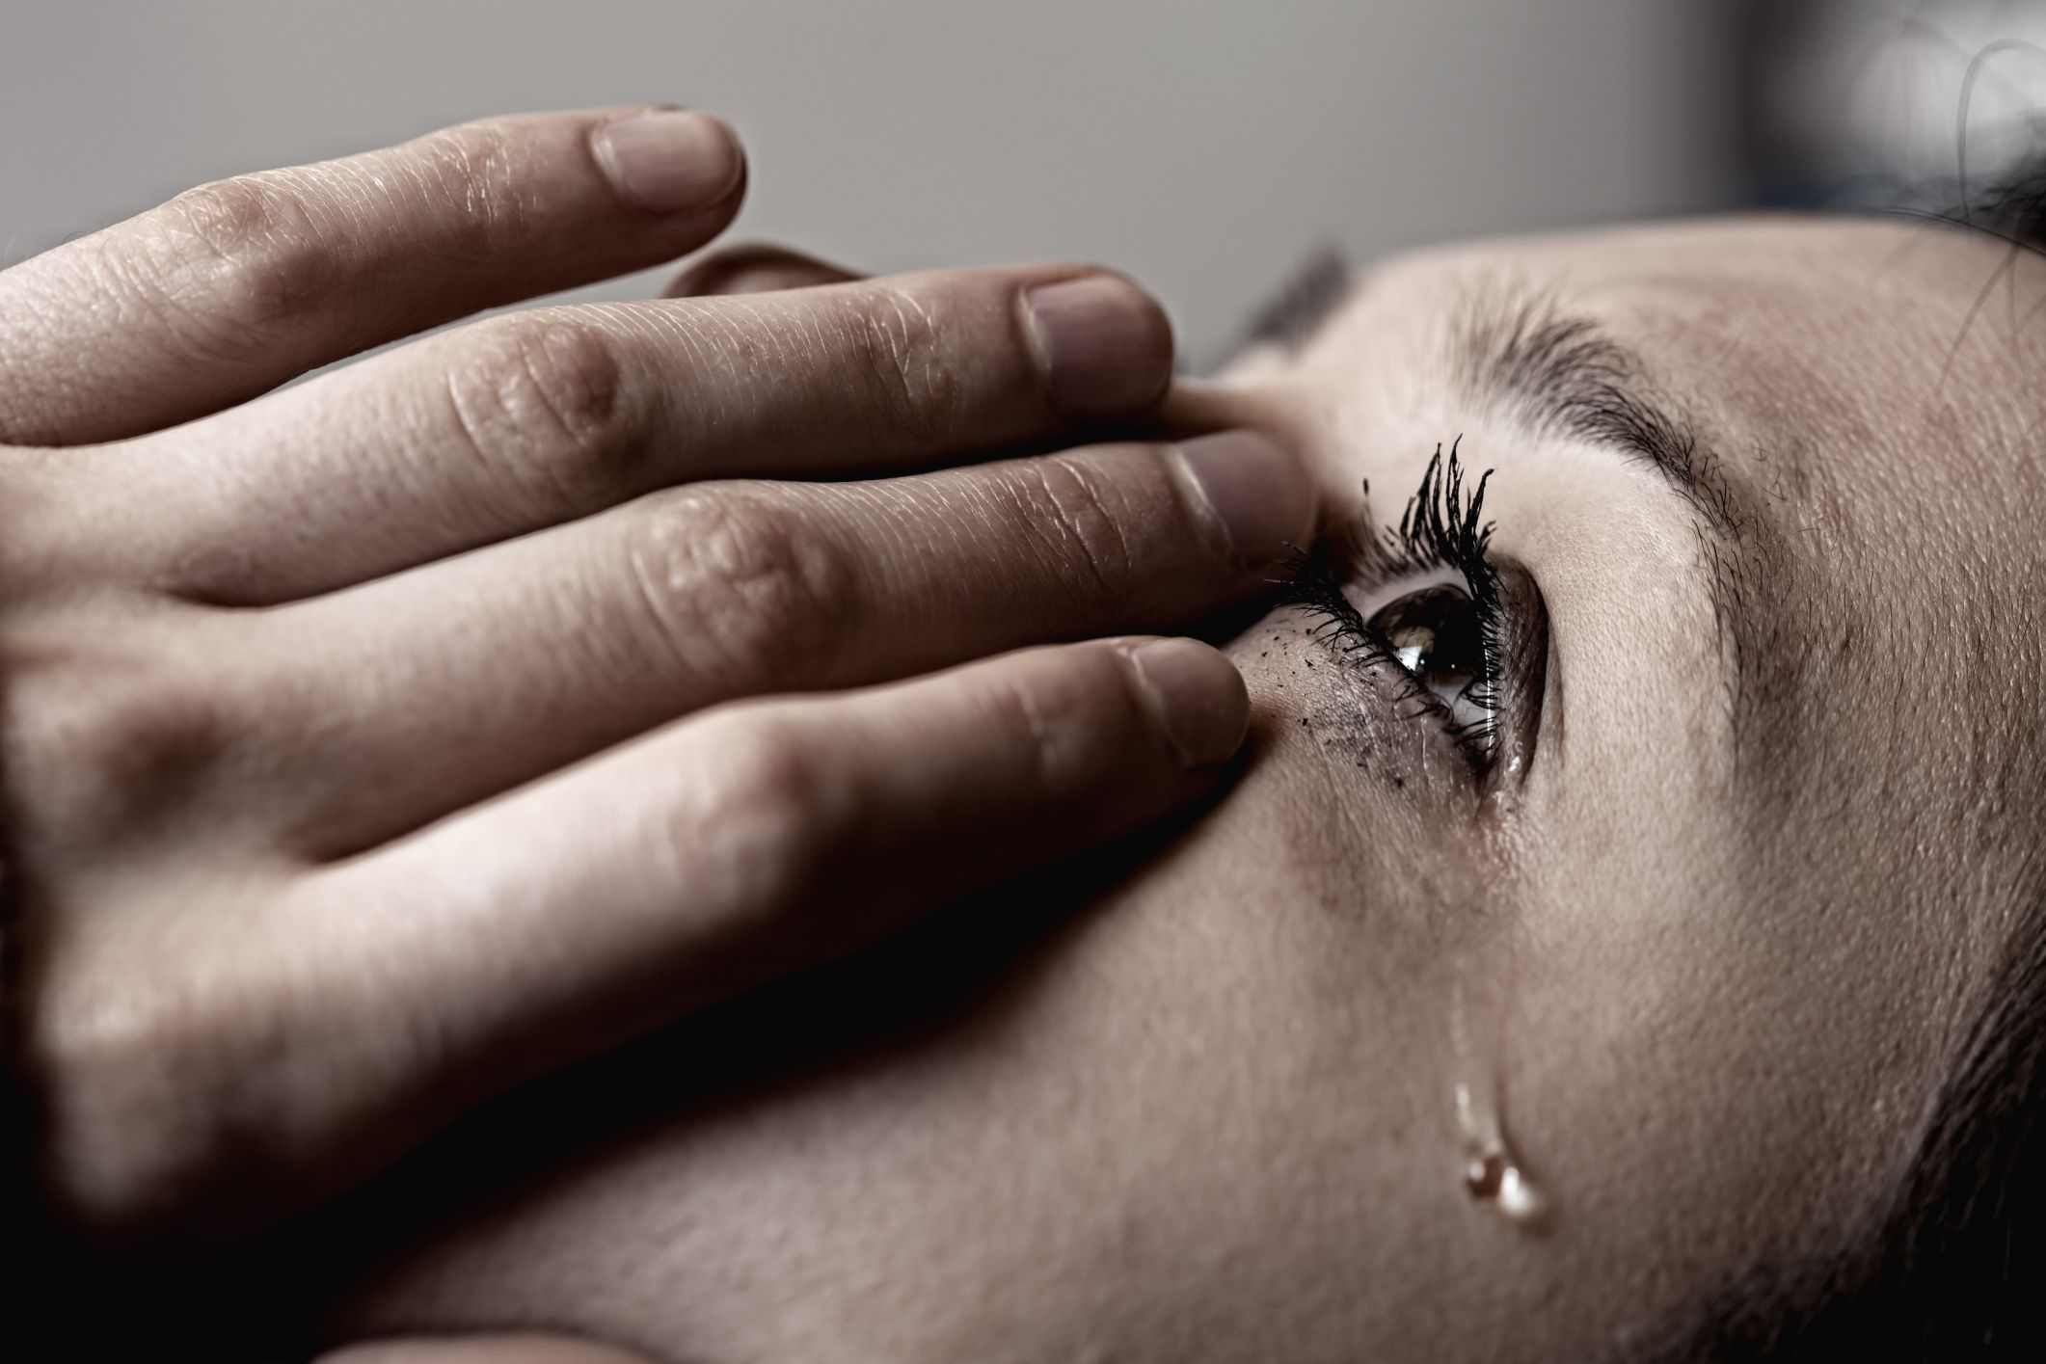
My eye has also grown dim because of sorrow, And all my members are like shadows. — Job 17:7
4. We are not in control
The LORD is near to those who have a broken heart, And saves such as have a contrite spirit. — Psalms 34:18
Notes:
Suffering is common to man, but in His light there is no separation from His love. Does one’s sorrow lead to God or rather drop to a condition of anger and or worries? Humble or arrogant?

Slide 17
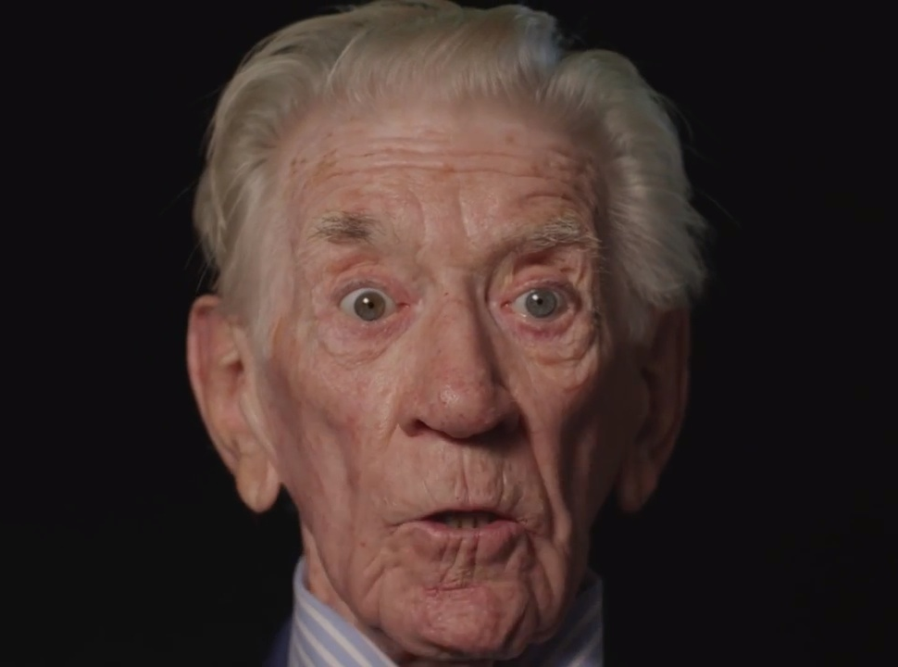
Remember now your Creator in the days of your youth, Before the difficult days come, And the years draw near when you say, "I have no pleasure in them": — Ecclesiastes 12:1
Remember now your Creator in the days of your youth, Before the difficult days come, And the years draw near when you say, "I have no pleasure in them": — Ecclesiastes 12:1
Remember now
in
difficult days come
come
difficult days come
no pleasure
no
pleasure
Notes:
It is what one has in habit that fills the coffers of the soul. In time, sorrows come upon all. It is the more one knows of God that causes a powerful defense from worries when sorrows avalanche. When He instructs us to remember now, this is of the concept of praying unceasingly and rejoicing always. Many are so connected to the world they have little godly connection. Petitions are consumed in worries and lusting desires. Time spent, and how, bears the fruit of a soul. Sorrow is best endured without worry.

Slide 18
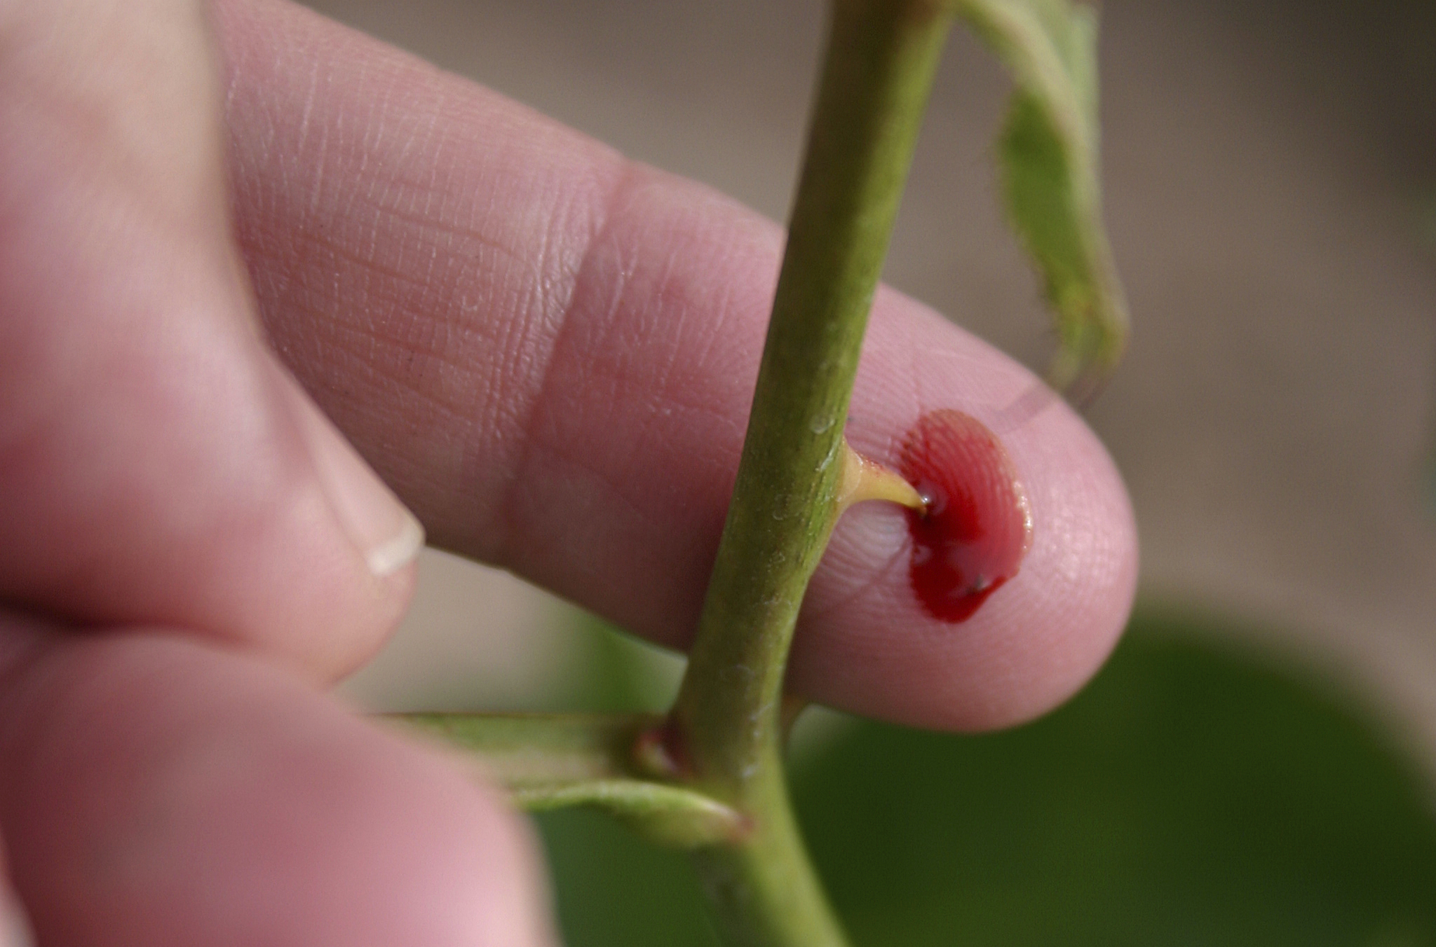
And lest I should be exalted above measure by the abundance of the revelations, a thorn in the flesh was given to me, a messenger of Satan to buffet me, lest I be exalted above measure. Concerning this thing I pleaded with the Lord three times that it might depart from me. — 2nd Corinthians 12:7-8
no pleasure
Notes:
Suffering is universal in the birth of all flesh. It is a safeguard tempering the spirit that the soul might not overextend past humble realizations.

Slide 19
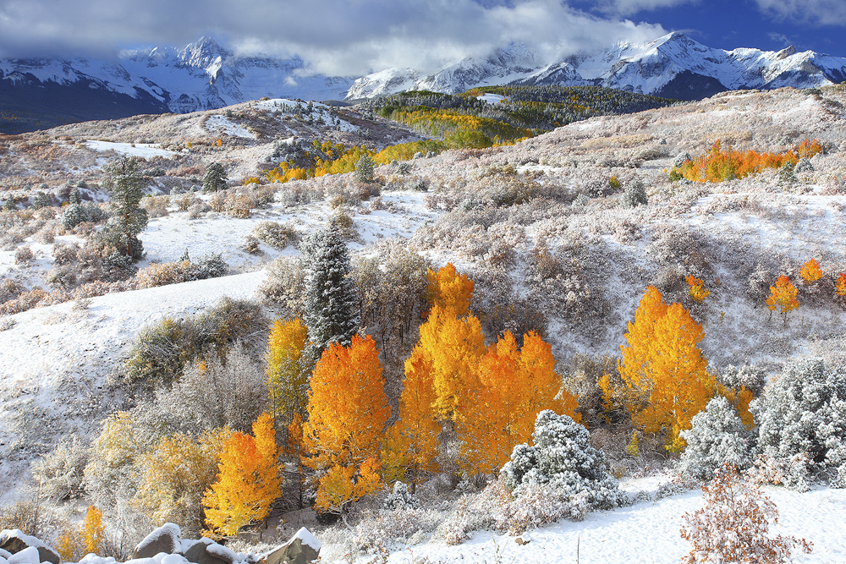
And He said to me, "My grace is sufficient for you, for My strength is made perfect in weakness." Therefore most gladly I will rather boast in my infirmities, that the power of Christ may rest upon me. — 2nd Corinthians 12:9
And He said to me, "My grace is sufficient for you, for My strength is made perfect in weakness." Therefore most gladly I will rather boast in my infirmities, that the power of Christ may rest upon me. — 2nd Corinthians 12:9
My strength
My strength
in
made perfect in weakness
made perfect in weakness
Christ
Christ
Christ
Notes:
Concepts such as grace transcend past mere temporal thoughts that bind us in the flesh. His power is above expression. God has made us weak on purpose that our strengths might be revealed. For the power of Christ to rest upon one is to accept His love; this is His light yoke. His wisdom is greater than we can know, but it is best for our spiritual growth, even though blatantly counterintuitive.

Slide 20
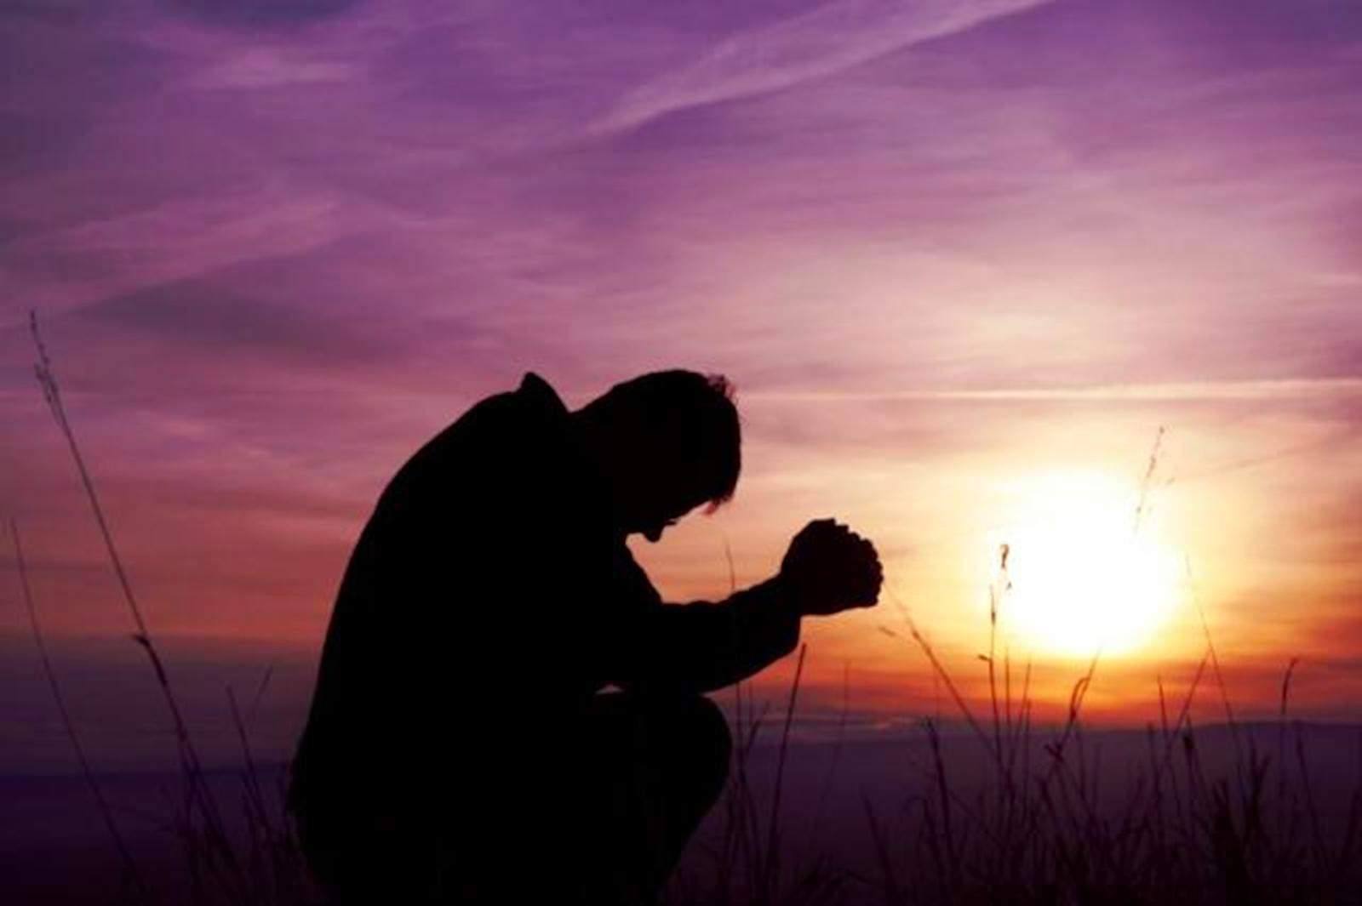
Therefore I take pleasure in infirmities, in reproaches, in needs, in persecutions, in distresses, for Christ's sake. For when I am weak, then I am strong. — 2nd Corinthians 12:10
contentment
I take pleasure in
● infirmities
● reproaches
● needs
● persecutions
● distresses
I take pleasure
in
infirmities
in
reproaches
needs
in
persecutions
in
in
in
distresses
for Christ's sake
Christ
for Christ
when I am weak, then I am strong
when I am weak, then I am strong
when I am weak, then I am strong
Notes:
It is in the weakness of flesh that brings on humble understandings and deepens the heart closer to God. The real test comes in strength while weaknesses afflicts us, through pain, misery, and desire; do we chose to turn away from the ways commanded by the Lord or do we further commit to the goodness He calls out for? Many professional psychologists would claim the advice the Bible delivers is self defeating and would cause dysfunctional personalities sadistically welcoming tragedy. This is where the wisdom of God surpasses the ignorance of man. Character is seasoned by the trials we rise from. Victory is the love and dedication one has in God through Christ.

Slide 21
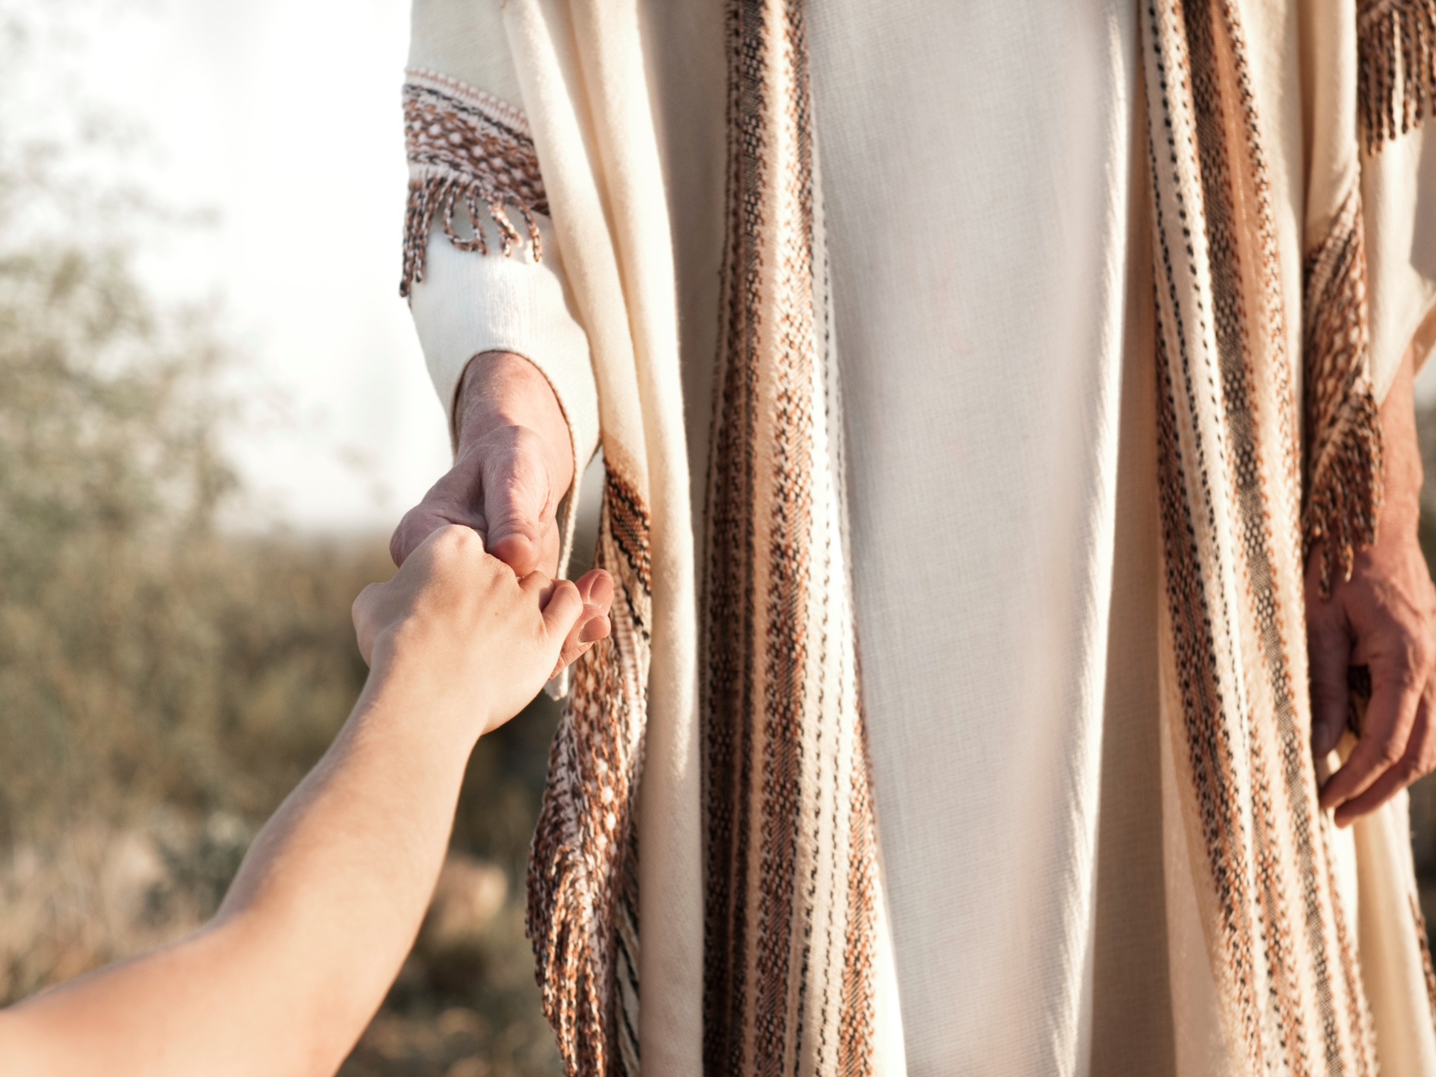
The LORD also will be a refuge for the oppressed, A refuge in times of trouble. And those who know Your name will put their trust in You; For You, LORD, have not forsaken those who seek You. — Psalms 9:9-10
LORD
SAFE HAVEN
in
times of trouble
times of trouble
in
LORD
. .
trust in You
seek
Notes:
Relying on God surely lessens the troubles that bump into us all. No pit is deep enough that He is unable to lift us in His love, if we allow it. Faithful hearts are also trusting ones.

Slide 22

No temptation has overtaken you except such as is common to man; but God is faithful, who will not allow you to be tempted beyond what you are able, but with the temptation will also make the way of escape, that you may be able to bear it. — 1st Corinthians 10:13
bear it
bear it
Notes:
Life certainly holds an upward climb with twists and turns on the staircase to enlightenment. Key is that we don’t give up the ghost, to be clichéish, but it is true that the strong spirit pushes forward with direction. Ascension over descending reveals one’s hopes and direction. Do you hope for life or death?

Slide 23
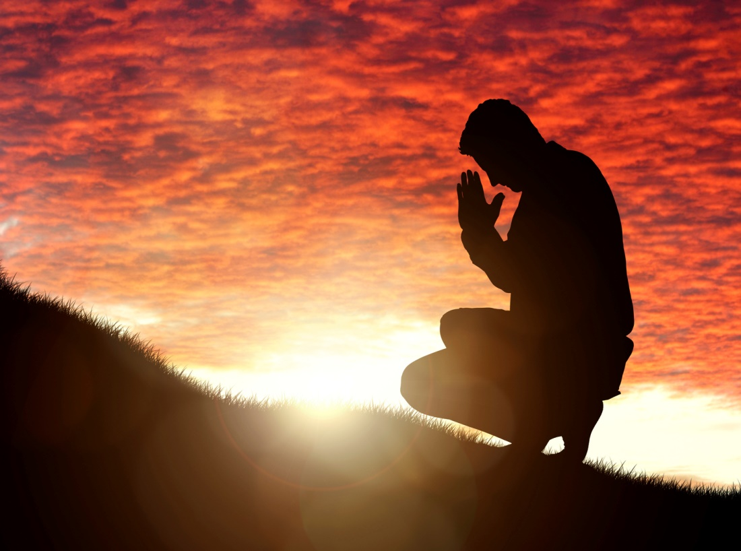

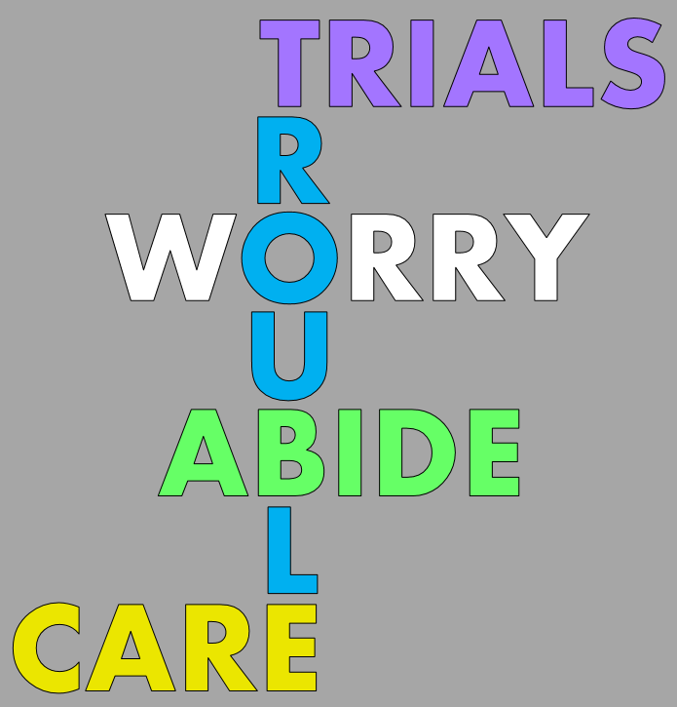
Whenever I am afraid, I will trust in You. — Psalms 56:3
TRIALS
T
ROU
B
L
E
bear it
ROU
B
L
E
ROU
L
ROU
B
L
W
O
R
R
Y
W RRY
WORRY
in
. .
trust in You
ABIDE
CARE
Notes:
It is purely trust in Him that enables one to overcome whatever life throws at us. If one feeds on worry, one has not yet fully come to God. Everyone at times has trouble enter into their life. The underlying questions during these trials are what one cares about, and where and what one abides in. Do you go to church or a bar? Facing reality is not the same as escaping from it. Worry warts are escape artists. Escape to reality where His light lifts us to the heights of heaven and beyond. Peace is the opposite of worry and what He wills for each of us.

Slide 24



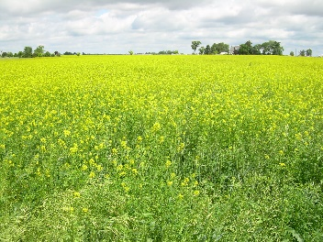




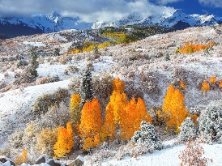




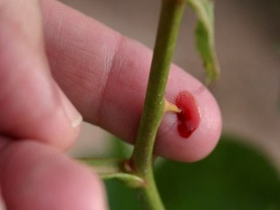

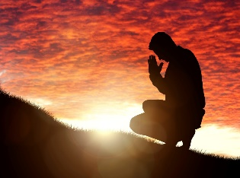
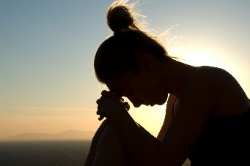
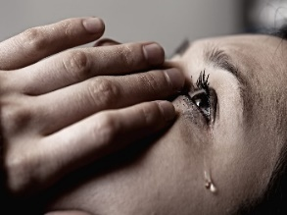

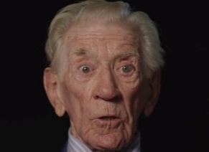


Slide 25

J
E
S
U
S
→ Hope in God / praising Him helps a disquieted heart
→ Do not worry about your life
→ Worry does not add any value to living
→ Do not have an anxious mind
→ Seek God’s Kingdom 1st & your spirit will be settled
→ Not worry about tomorrow, ample is todays trouble
→ Cares of this world and greed render one unfruitful
→ Worry / troubles lead to a selfish heart of disservice
→ Do not fret - it only causes harm
→ In our weakness our strength of spirit comes out
→ God’s a haven in troubles if one trusts & seeks Him
→ God supplies an escape for unbearable troubles
→ Trust in God overcomes fear
Worries are overcome when God is in control
Notes:
Worries are overcome when God is in control.

Slide 26
Notes:
In darkness there is the misery of nothing.

Slide 27

Faith Conquers Worry
2
Ron Bert
February 19, 2017
Notes:
Achieving a steadfast faith purges those worries that consume the faithless. There are many imaginary lions. What is not should not be regarded, as illusions do hamper the contentment that a soul can enjoy, as a natural part of living.

Slide 28
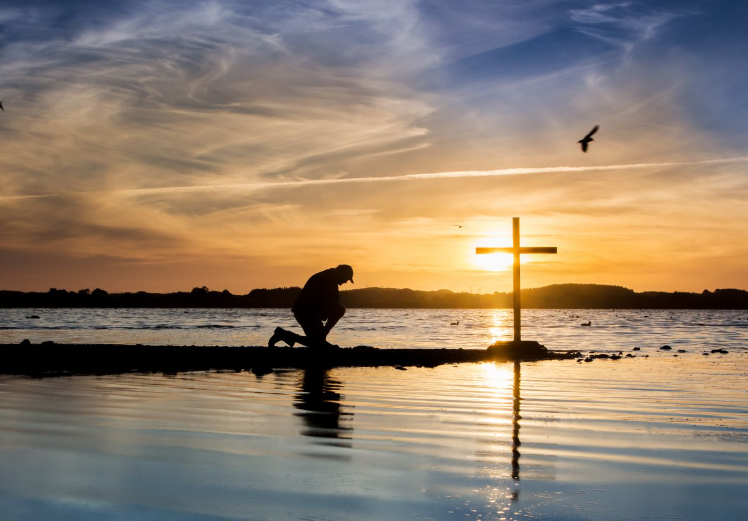
Do you have faith? Have it to yourself before God. Happy is he who does not condemn himself in what he approves. But he who doubts is condemned if he eats, because he does not eat from faith; for whatever is not from faith is sin. — Romans 14:22-23
h
faith?
hope
e
o
p
Happy
does not condemn
in
innocence
contentment
approves
worry
whatever is not from
whatever is not from
faith
sin
faith is sin
faith is sin
Notes:
One must own one’s own faith. Worry is an interference to a healthy productive faith. One can actually infer that worry is a sin. To overcome the guilt of the past largely release the worries of the past, which plagues one’s future if they remain lingering in the present. Worry can be an unreasonable time machine locking one out of the pureness the present holds. It is hope that returns us to innocence of spirit. God created hope to combat sorrow, not worry.

Slide 29
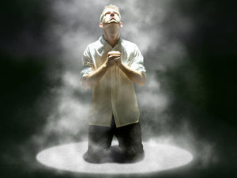
And not only that, but we also glory in tribulations, knowing that tribulation produces perseverance; and perseverance, character; and character, hope. — Romans 5:3-4
hope
character
perseverance
tribulation
hope
in
tribulation
perseverance
character
hope
Notes:
His light builds all that is great in us to realize our fullest potentials. Hope lifts us to the heights of heaven itself. We are all in common tribulations as it is a natural condition of sorrow. It is by the trials of a soul that enduring strength comes, and surely it deepens resolve for the hope of what is to come.

Slide 30


My brethren, count it all joy when you fall into various trials, knowing that the testing of your faith produces patience. But let patience have its perfect work, that you may be perfect and complete, lacking nothing. — James 1:2-4
trials
test
faith
produc
patience
trials test faith producing patience
perfect work
love
be perfect
ing
complete, lacking nothing
Notes:
There is no barrier built that can deter a faithful heart from welcoming His love. In His love a heart opens to reach inexpressible heights and depths. What stays is an eternal touch. In everything the Lord is doing He is preparing us for eternal life in Him.

Slide 31
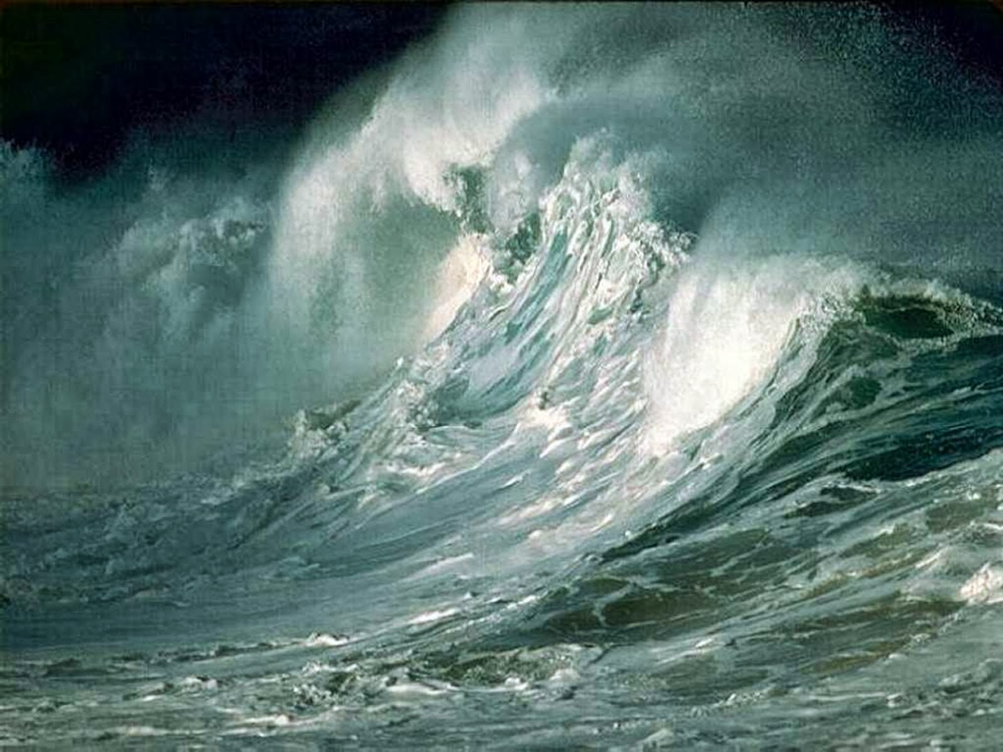

If any of you lacks wisdom, let him ask of God, who gives to all liberally and without reproach, and it will be given to him. But let him ask in faith, with no doubting, for he who doubts is like a wave of the sea driven and tossed by the wind. For let not that man suppose that he will receive anything from the Lord; he is a double-minded man, unstable in all his ways. — James 1:5-8
wisdom
wisdom
e
h
in
t
in faith
in faith
no doubting
no doubting
heart
Expectations
r
a
Notes:
It is God that opens a heart to understand. To ask for wisdom is a higher ideal than remaining mired in worry. Those that fall into worry may expect salvation although unappreciative embittered thoughts block what is simple; the lightness love delivers in peace. God is simply asking us to love where there is no worry. Sorrow is not the same as worry. Sorrow is a test of endurance molding character. To expect partiality from God is not the enlightenment He wants for us, but unfulfilled expectations can induce worry and bitterness against God.

Slide 32
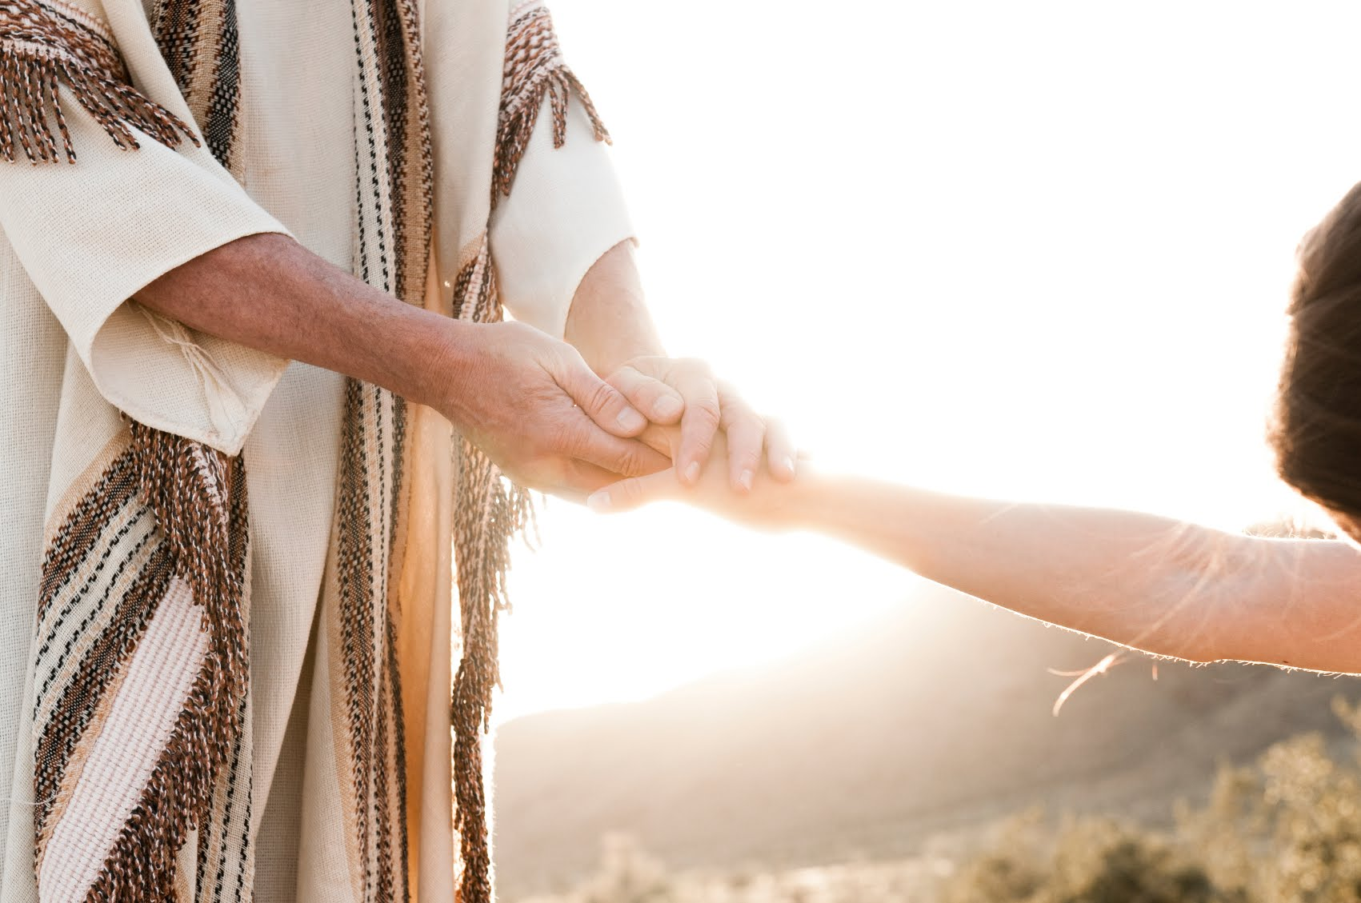
"Peace I leave with you, My peace I give to you; not as the world gives do I give to you. Let not your heart be troubled, neither let it be afraid." — John 14:27
peace
peace
heart
Let not your heart be troubled
Let not your heart be troubled
neither
afraid
neither
afraid
Notes:
Fearless are those who have joined in His truth.

Slide 33
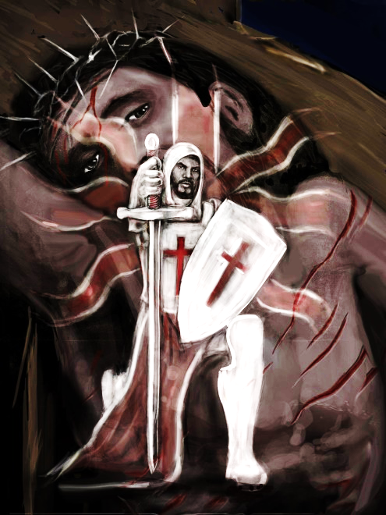
"These things I have spoken to you, that in Me you may have peace. In the world you will have tribulation; but be of good cheer, I have overcome the world." — John 16:33
i
n
in
in Me
in Me
peace
In
peace
In the world
peace
In the world
mind
tribulation
d
tribulation
be of good cheer
be of good cheer
m
Notes:
While turmoil's swirl in all directions, the peace of God is the foundation we stand on. To be of good cheer is to know our destination is more than the best of all that is. To overcome worry is the ultimate declaration of faith. His sacrifice seals the word upon our hearts with His blood. Is the sword of truth in your mind where we are healed by His stripes? Does the blood of Jesus cut to your heart?

Slide 34

Set your mind on things above, not on things on the earth. — Colossians 3:2
above
mind
above
mind
Notes:
Most of all that is exists above where we are, an insight sent by God. Unless one’s path includes a vertical route, faith is reduced to those things of earthly limitations.

Slide 35
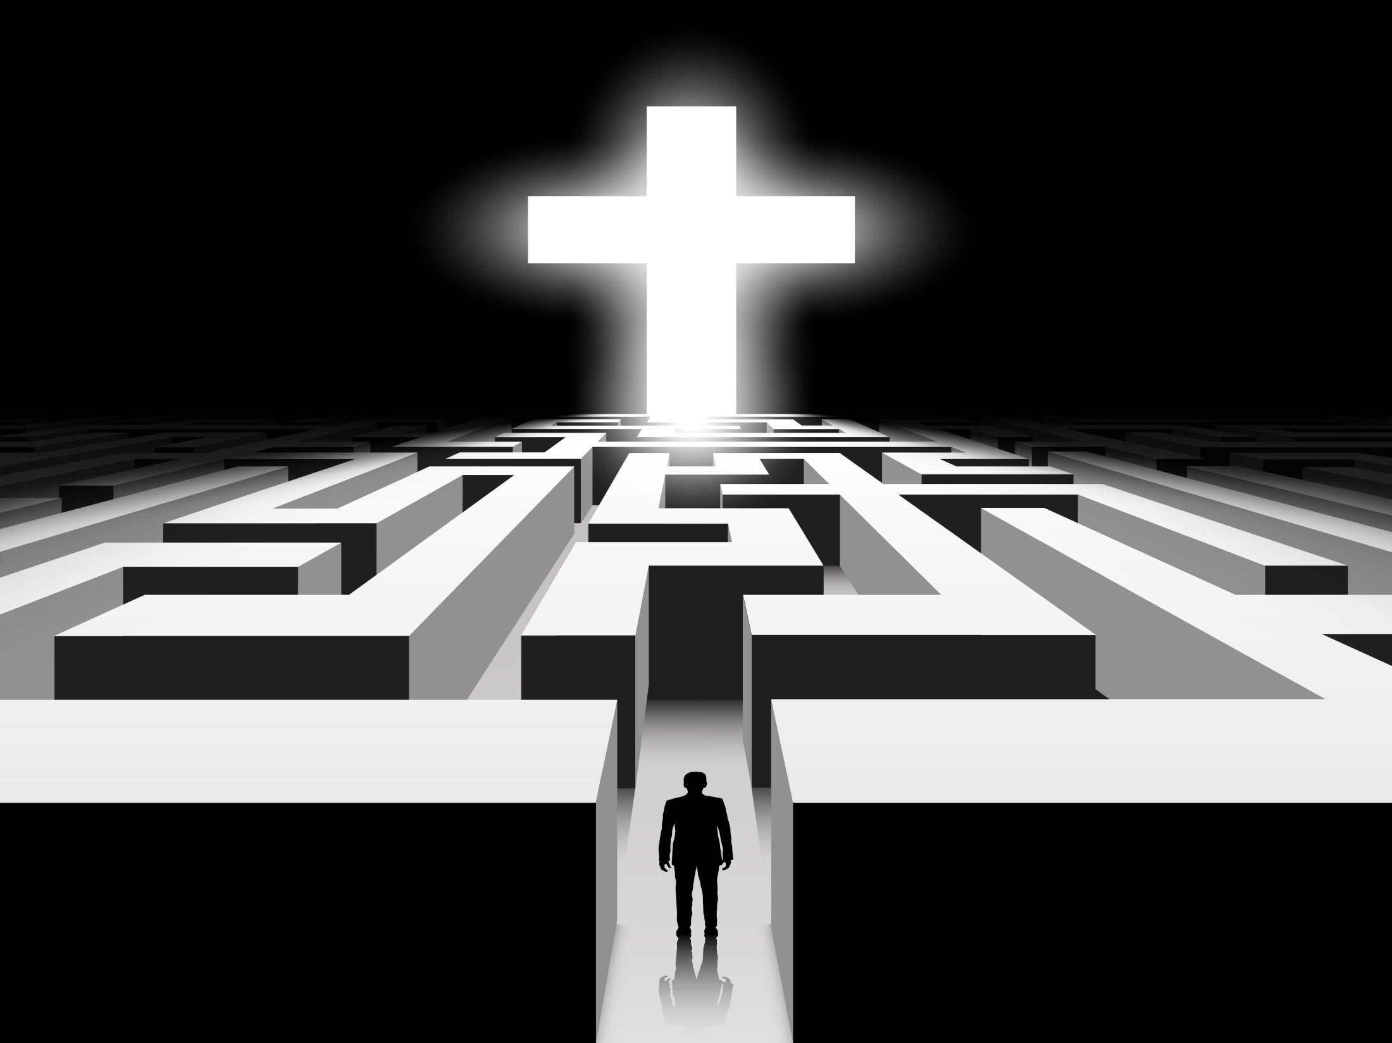
For godly sorrow produces repentance leading to salvation, not to be regretted; but the sorrow of the world produces death. — 2nd Corinthians 7:10
above
Apologetic Heart
Heart of Worry
Notes:
Faith overcomes no matter the obstacles any and all face, but without regard for God, a tortuous soup stirs the gut. Either one has a heart of worry or a spiritually apologetic one. Worry is embedded in a sinful nature and lacks the faith to believe. Worry often coincides with a heart of anger. One has to make a conscious effort to choose rising into the light of repentance verses descending into the darkness of worries.

Slide 36

Anxiety in the heart of man causes depression, But a good word makes it glad. — Proverbs 12:25
in
HIS DOOR
word
anxieties
His Word increases faith
In the multitude of my anxieties within me, Your comforts delight my soul. — Psalms 94:19
In
anxieties
comforts
Notes:
Truly it is one’s thoughts that control the corridors of the mind where the heart beats. To rejoice in His word is key in keeping worry abridged. It is the good word that draws us into faith. His word increases faith as it is the door to Him. How many actually enter through this door? What is in your heart drives your spirit. We may not be able to totally eradicate worry and anxieties all the time, but it is what He asks of us as we diligently pursue our faith in the comfort of Him.

Slide 37

Search me, O God, and know my heart; Try me, and know my anxieties; And see if there is any wicked way in me, And lead me in the way everlasting. — Psalms 139:23-24
heart
heart
anxieties
in
lead me in the way everlasting
lead me in the way everlasting
Notes:
Asking for God’s help to reveal one’s weaknesses strengthens faith to endure higher paths in Him. Worry discloses weakness in faith where doubt cripples the feeble. What is magnified upon the heart is what one worships. On the road to eternity, He is our guide.

Slide 38
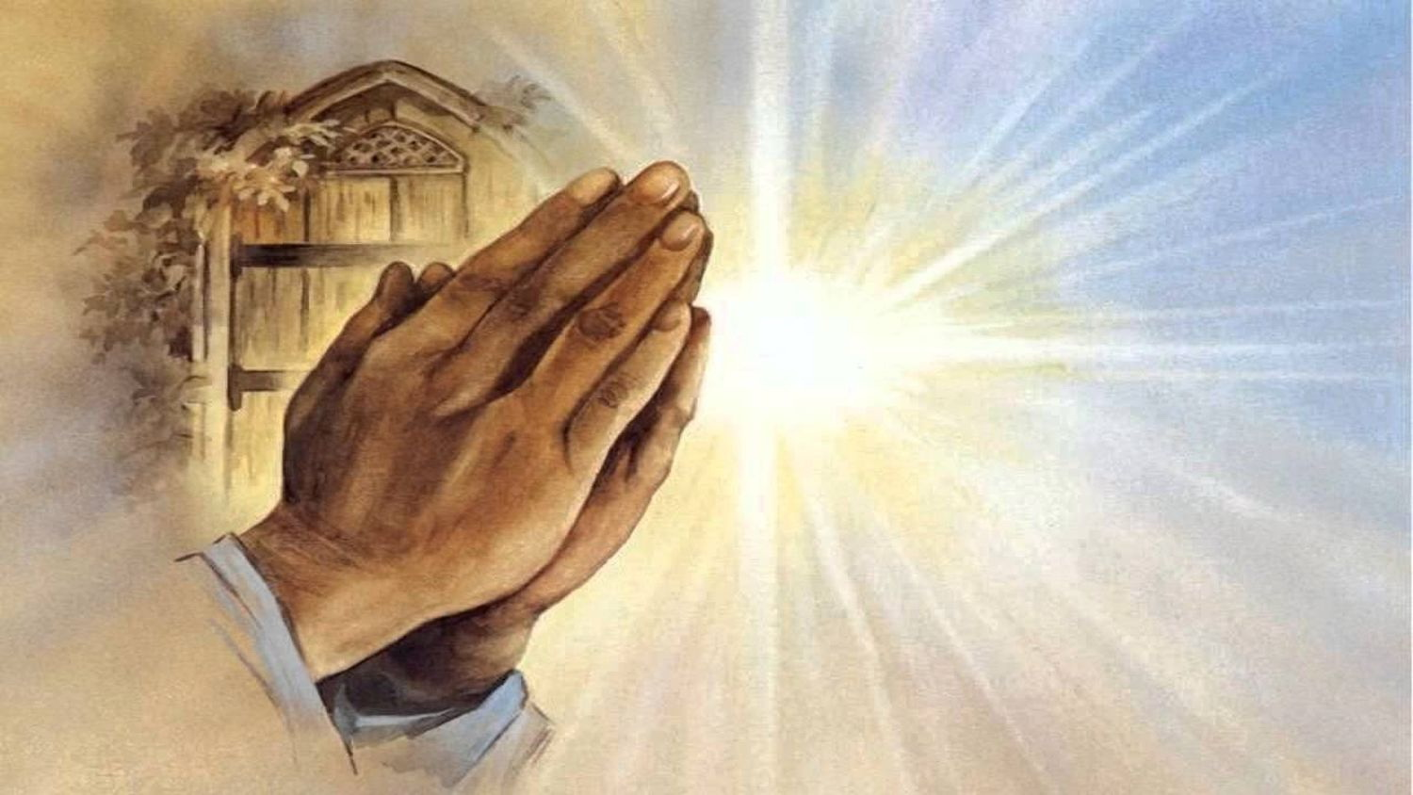
Then He spoke a parable to them, that men always ought to pray and not lose heart, … — Luke 18:1
heart
heart
not lose heart
not lose heart
not
heart
be troubled
not
be troubled
"Let not your heart be troubled; you believe in God, believe also in Me." — John 14:1
Notes:
Prayer is essential in divine relations where worry is replaced with bliss. It is when we lose heart that misery is amplified and worries encroach.

Slide 39
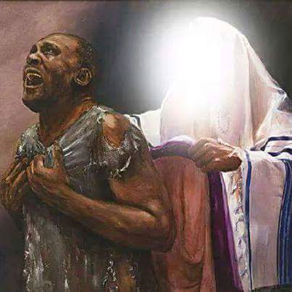
Therefore we do not lose heart. Even though our outward man is perishing, yet the inward man is being renewed day by day. — 2nd Corinthians 4:16
not lose heart
heart
not lose heart
in
Notes:
Our light in Christ is what carries us. The flesh can not carry the spirit onward as it is a temporary portal with ends buried in agony. It is the soul that lifts the spirit to a higher existence. To cling to the flesh denies the true nature of life's eternal purpose. Without a vertical awareness, the horizontal vision keeps one blind to this truer nature. Life is more than can be seen, across an entire lifetime, where time limits true vision. It is what is in us that renders life or death, faith or worries. No one can beat worry alone. It is only by the grace of His light that worries are expunged. To be fulfilled one must let go of the outside influences and develop that which emanates from within.

Slide 40
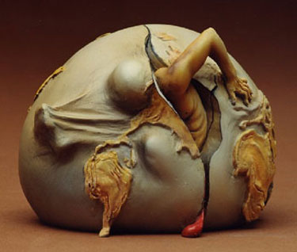
For our light affliction, which is but for a moment, is working for us a far more exceeding and eternal weight of glory, while we do not look at the things which are seen, but at the things which are not seen. For the things which are seen are temporary, but the things which are not seen are eternal. — 2nd Corinthians 4:17-18
look to the eternal
light affliction
that which is temporary
our light affliction
light affliction
our light affliction
o
is
a moment
a moment
eternal
t
look
the
at
th
which
temporary
Notes:
In the angst of becoming, our lesson becomes to see that which is larger than the self. One cannot see others if trapped in self pity. The defeat of worry is in the beneficial upward spiral love holds for all that embrace others as precious. The earth is an incubator of which womb we come forth.

Slide 41
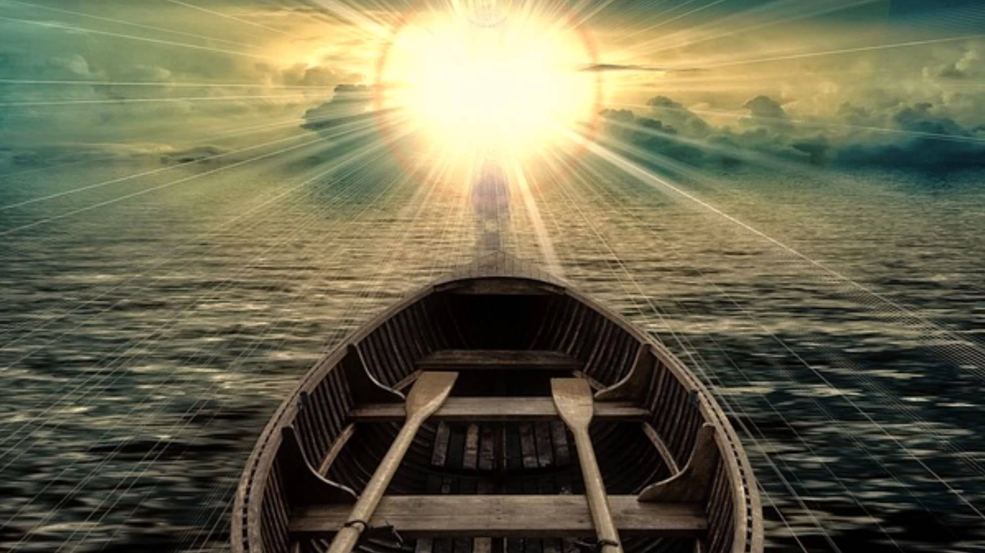
● WORRY
Anxiety
Fear
Doubt
Human Reasoning
Takes Away
eternal
● FAITH
Strength
Joy
Trust
Solves Problems
Gives
humble
h
um
ble
Notes:
Worry is the death of life where faith’s invigorations extend upon all possibilities. Part of faith is being able to soberly humble oneself in the face of His truth.

Slide 42
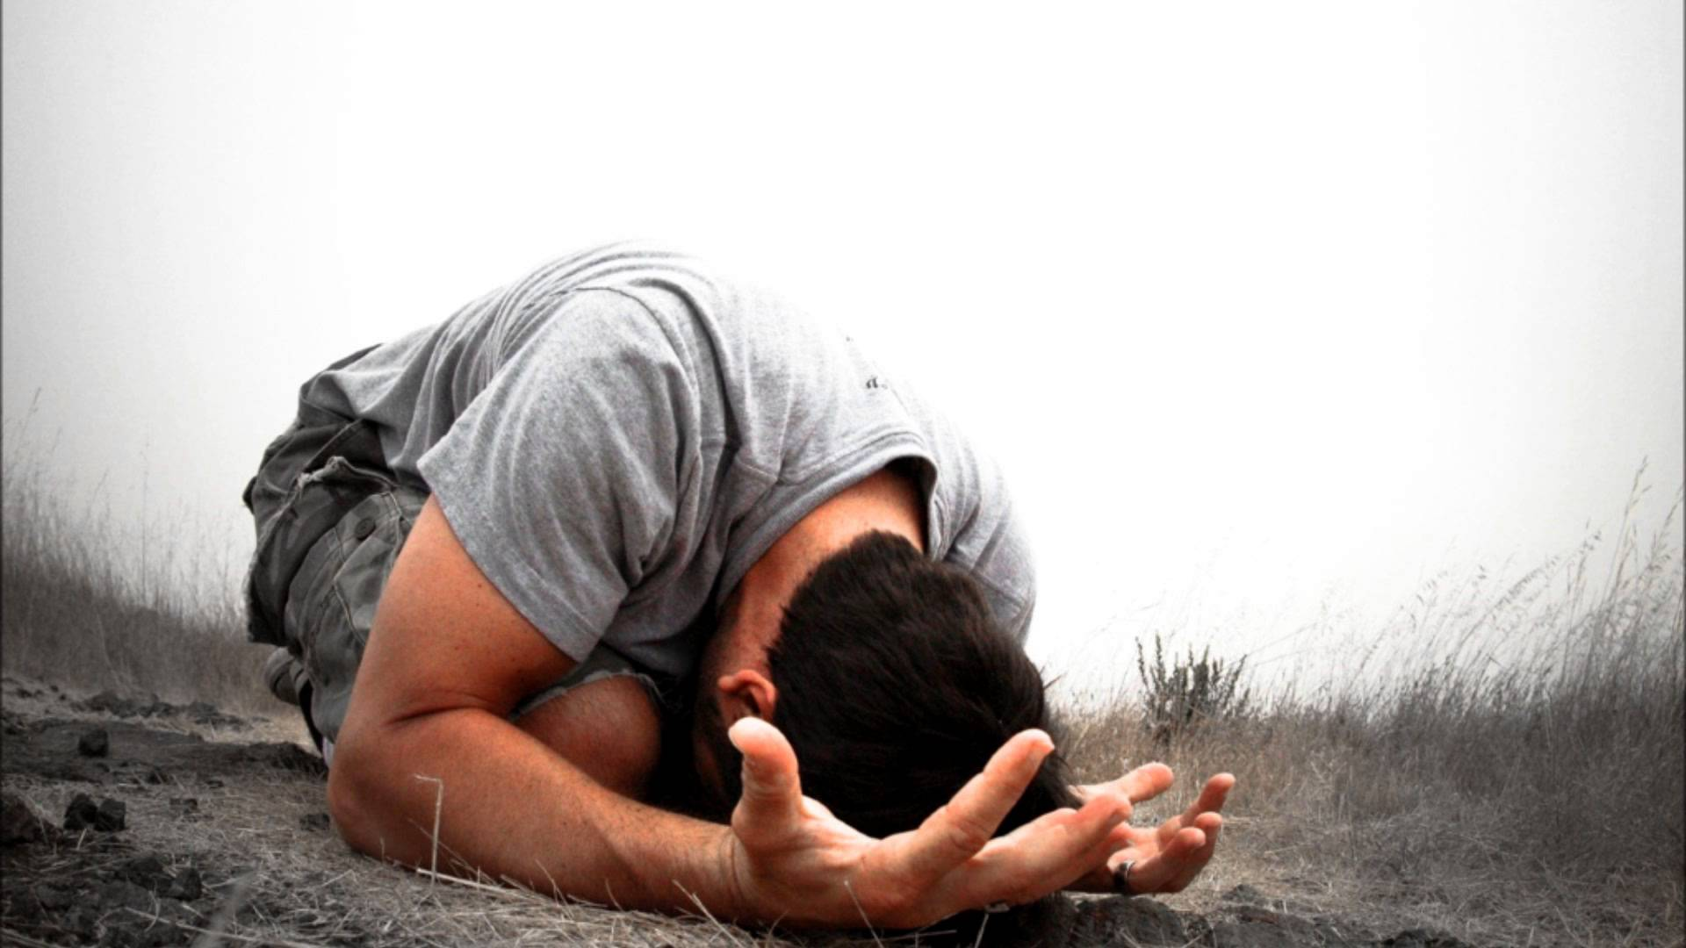
Therefore humble yourselves under the mighty hand of God, that He may exalt you in due time, casting all your care upon Him, for He cares for you. — 1st Peter 5:6-7
humble
God
in
in due time
God
casting all your care upon Him
casting all your care upon Him
Notes:
In God’s time a soul rises in spirit. All that one is comes to be in His light, for better or worse. We are all married to that which gives us life. Life and time is unequivocally a test to have patience in God. Better to kneel to God now rather than shockingly upon judgement. Without casting all cares upon Him, worry has no avenue of escape.

Slide 43
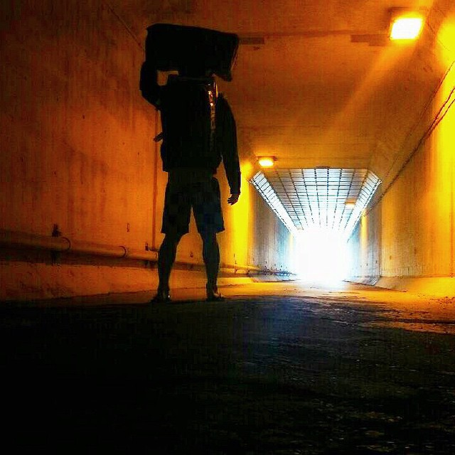
… who comforts us in all our tribulation, that we may be able to comfort those who are in any trouble, with the comfort with which we ourselves are comforted by God. For as the sufferings of Christ abound in us, so our consolation also abounds through Christ. — 2nd Corinthians 1:4-5
in
comforts us in
comforts
comforts
all
tribulation
able
to comfort those
in
comfort
comfort
● comforts us in tribulation
● able to comfort those in trouble
● as we are comforted by God
trouble
comfort
comfort
we
are comforted
comforted
comforted
by God
as
God
Christ
in
us
Notes:
Confronted with both darkness and the light, it is our choice to choose which path we pursue. Surrendering to the darkness rejects the ideals of all goodness He has delivered for us to know beyond any shadow of doubt. Fear, worry, and denial leads to an abyss left to the unfortunate. Many struggle for human attention in the midst of their lonely misery where there is no consolation. Knowing we all suffer together lessens said suffering in consolation of not being left alone. As we walk through the darkness in life, if we see the light of God, we carry those who come with us. God is the beacon that lights the way. Those who are in God comfort and edify one another. When purpose becomes for others, worries of the self evaporate.

Slide 44
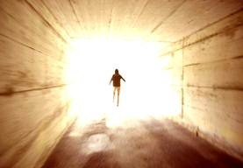
Take heed to yourself and to the doctrine. Continue in them, for in doing this you will save both yourself and those who hear you. — 1st Timothy 4:16
doctrine
in
e
evil
vil
Notes:
By pursuing the light God has delivered, others will know of one’s purpose, whether it be magnanimous or self-serving. Evil cannot support itself. To battle the evil of worry one must come to Him for help and comfort. To be immersed in His light is where there is no worry.

Slide 45

Depart from evil and do good; Seek peace and pursue it. — Psalms 34:14
evil
do
good
do
good
Seek
Seek
Notes:
To find purpose gives life reason. Goals define our desires. May those things we seek come from above turning from the darkness that devours all below.

Slide 46

And let us not grow weary while doing good, for in due season we shall reap if we do not lose heart. — Galatians 6:9
His Light
heart
do
good
in
in due season
due season
heart
not lose heart
not lose heart
Notes:
It is our climb back to His light that brings darkness clearly into view. Challenges for all will ever increase where faith is infinitely tested. To shine in His love is where worry has no light. Can we rise in heart to love those who hate us, and in this is where worries traverse to sorrow, for all mortal souls must carry sorrow on the path to eternity. When sorrow drops to worry, this is where faith sinks. It is in sorrow that the soul grasps those higher ideals of living through the darkness about us.

Slide 47
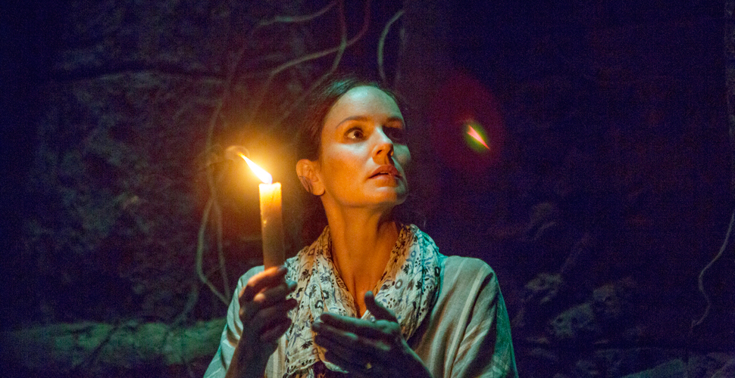
And let the peace of God rule in your hearts, to which also you were called in one body; and be thankful. — Colossians 3:15
And let worry rule in your hearts, to which you were not called in separate bodies; and be unthankful. — Not called
worry
in
peace
hearts
heart
not called
in
called
separate
one body
unthankful
thankful
hearts
Notes:
Our heart is where the fire of life burns. The light from within is brighter than any darkness that confronts us. To not trust in this inner light is to relinquish His gift to the realms of sensuous desires diverging from true humble faith. In the world of flesh, all walk through the darkness to find the light. This godly light turns from the darkness most swagger in. Worry actually separates one from the Holiness of God. As heart disease cripples life, so worry infects the spirit in fruitlessness. What we are “in” to defines who we are.

Slide 48
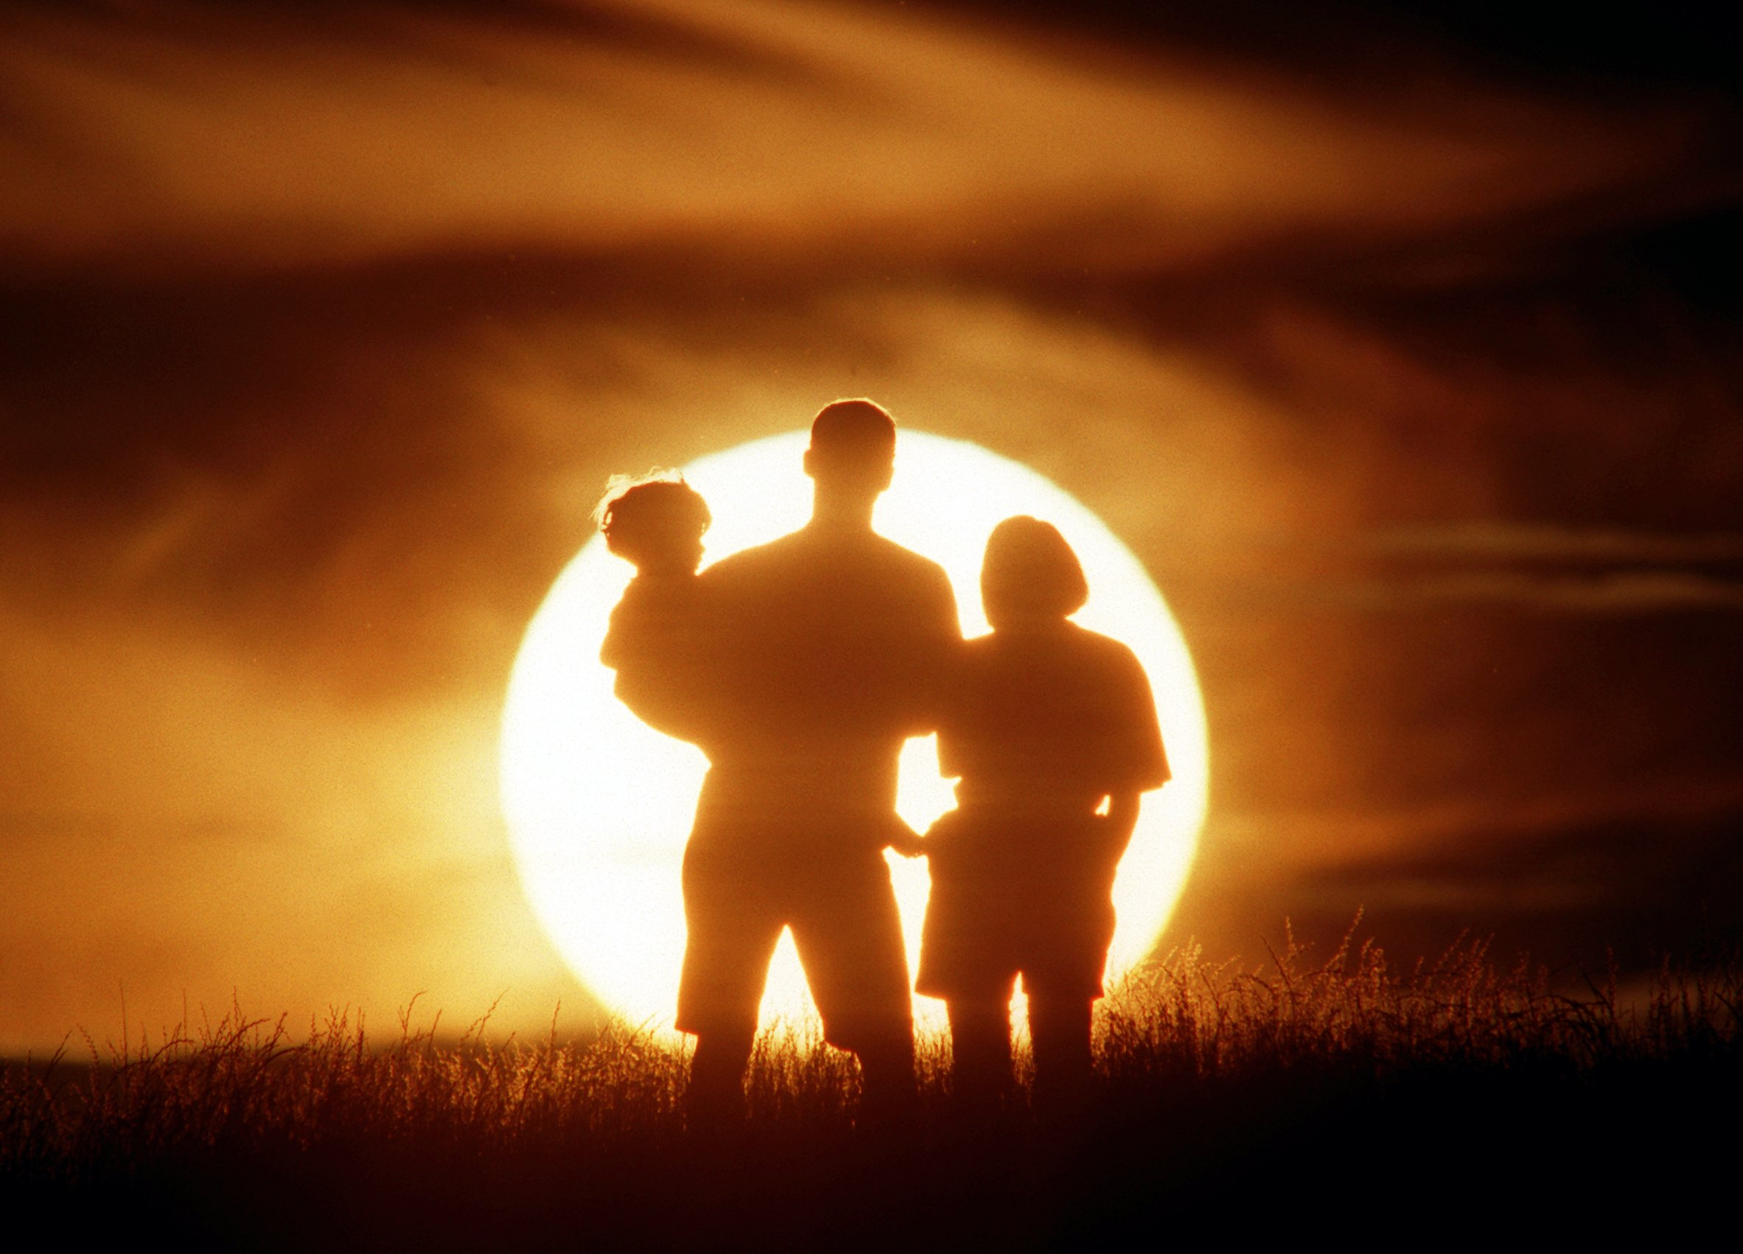
Be anxious for nothing, but in everything by prayer and supplication, with thanksgiving, let your requests be made known to God; and the peace of God, which surpasses all understanding, will guard your hearts and minds through Christ Jesus. — Philippians 4:6-7
in
everything
th
s
things
lifts higher
ing
surpasses all understanding
surpasses all understanding
hearts
through Christ Jesus
through Christ Jesus
Christ Jesus
Notes:
In a more than magical way, miraculous in nature, His love lifts us higher than ourselves. In honor of Him all is, and His blessings come bestowing upon us all to know life over death. In God there is no worry. It is those things important to us that either delivers or condemns us. It really is a question of things and how we think about or perceive them that declares our nature of spirit.

Slide 49

Finally, brethren, whatever things are true, whatever things are noble, whatever things are just, whatever things are pure, whatever things are lovely, whatever things are of good report, if there is any virtue and if there is anything praiseworthy -- meditate on these things. — Philippians 4:8
whatever things are
● true
● noble
● just
● pure
● lovely
● of good report
● any virtue
● anything praiseworthy
true
whatever things are
noble
just
pure
things
things
things
things
things
things
lovely
of good report
any virtue
anything praiseworthy
Notes:
To neglect this eternal offering of truth is to deny the life each of us have been given. In following His word, each of us is given the tools to eradicate worry. The things we should be seeking are clearly defined. If you want to eventually eliminate worry, faith in Him is the only eternal answer.

Slide 50

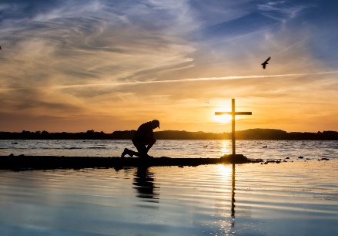



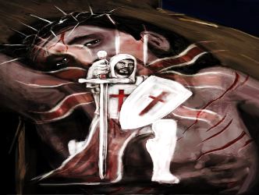


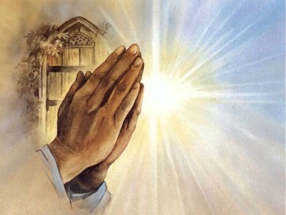






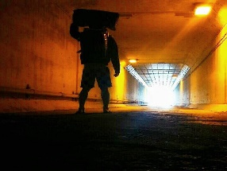

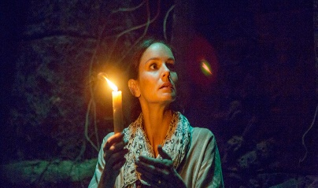


Slide 51
J
E
S
U
S
→ Whatever is not from faith is sin; worry snubs faith
→ Trials yield patience honing character sealing hope
→ Trials test faith producing patience in love
→ Do not have expectations of God
→ In tribulations we can have the peace of God
→ Anxiety in the heart of man causes depression
→ In the multitude of anxieties, He comforts
→ Let not your heart be troubled believe in God/Jesus
→ Our eternal destination lessens temporary troubles
→ Humbly cast all your cares upon God
→ Christ carries our sorrows enabling us to help others
→ Depart from evil & do good; Seek peace & pursue it
→ Be anxious for nothing, stay in prayer, be thankful
Faith in God lifts one past all worries
Notes:
Faith in God lifts one past all worries.

Slide 52
Notes:
Darkness has no stop signs; there is nowhere to go.

Slide 53

Please visit http://www.RonBert.com to explore further
Ronald Bert Channel on
Notes:
Eternity never ends.

