Slide 1
Notes:
Darkness has no glow.

Slide 2
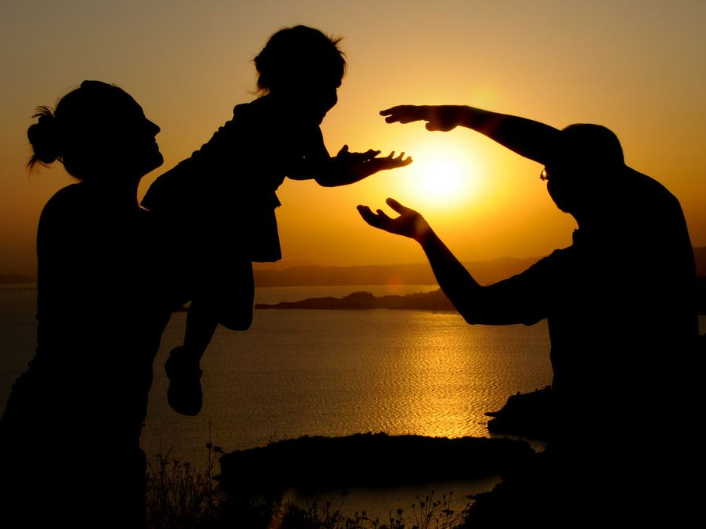
Faith Includes Works
(Not Once Saved Always Saved)
Ron Bert
June 18, 2017
Notes:
The belief in once saved always saved has no merit as scripture refutes this misnomer.

Slide 3
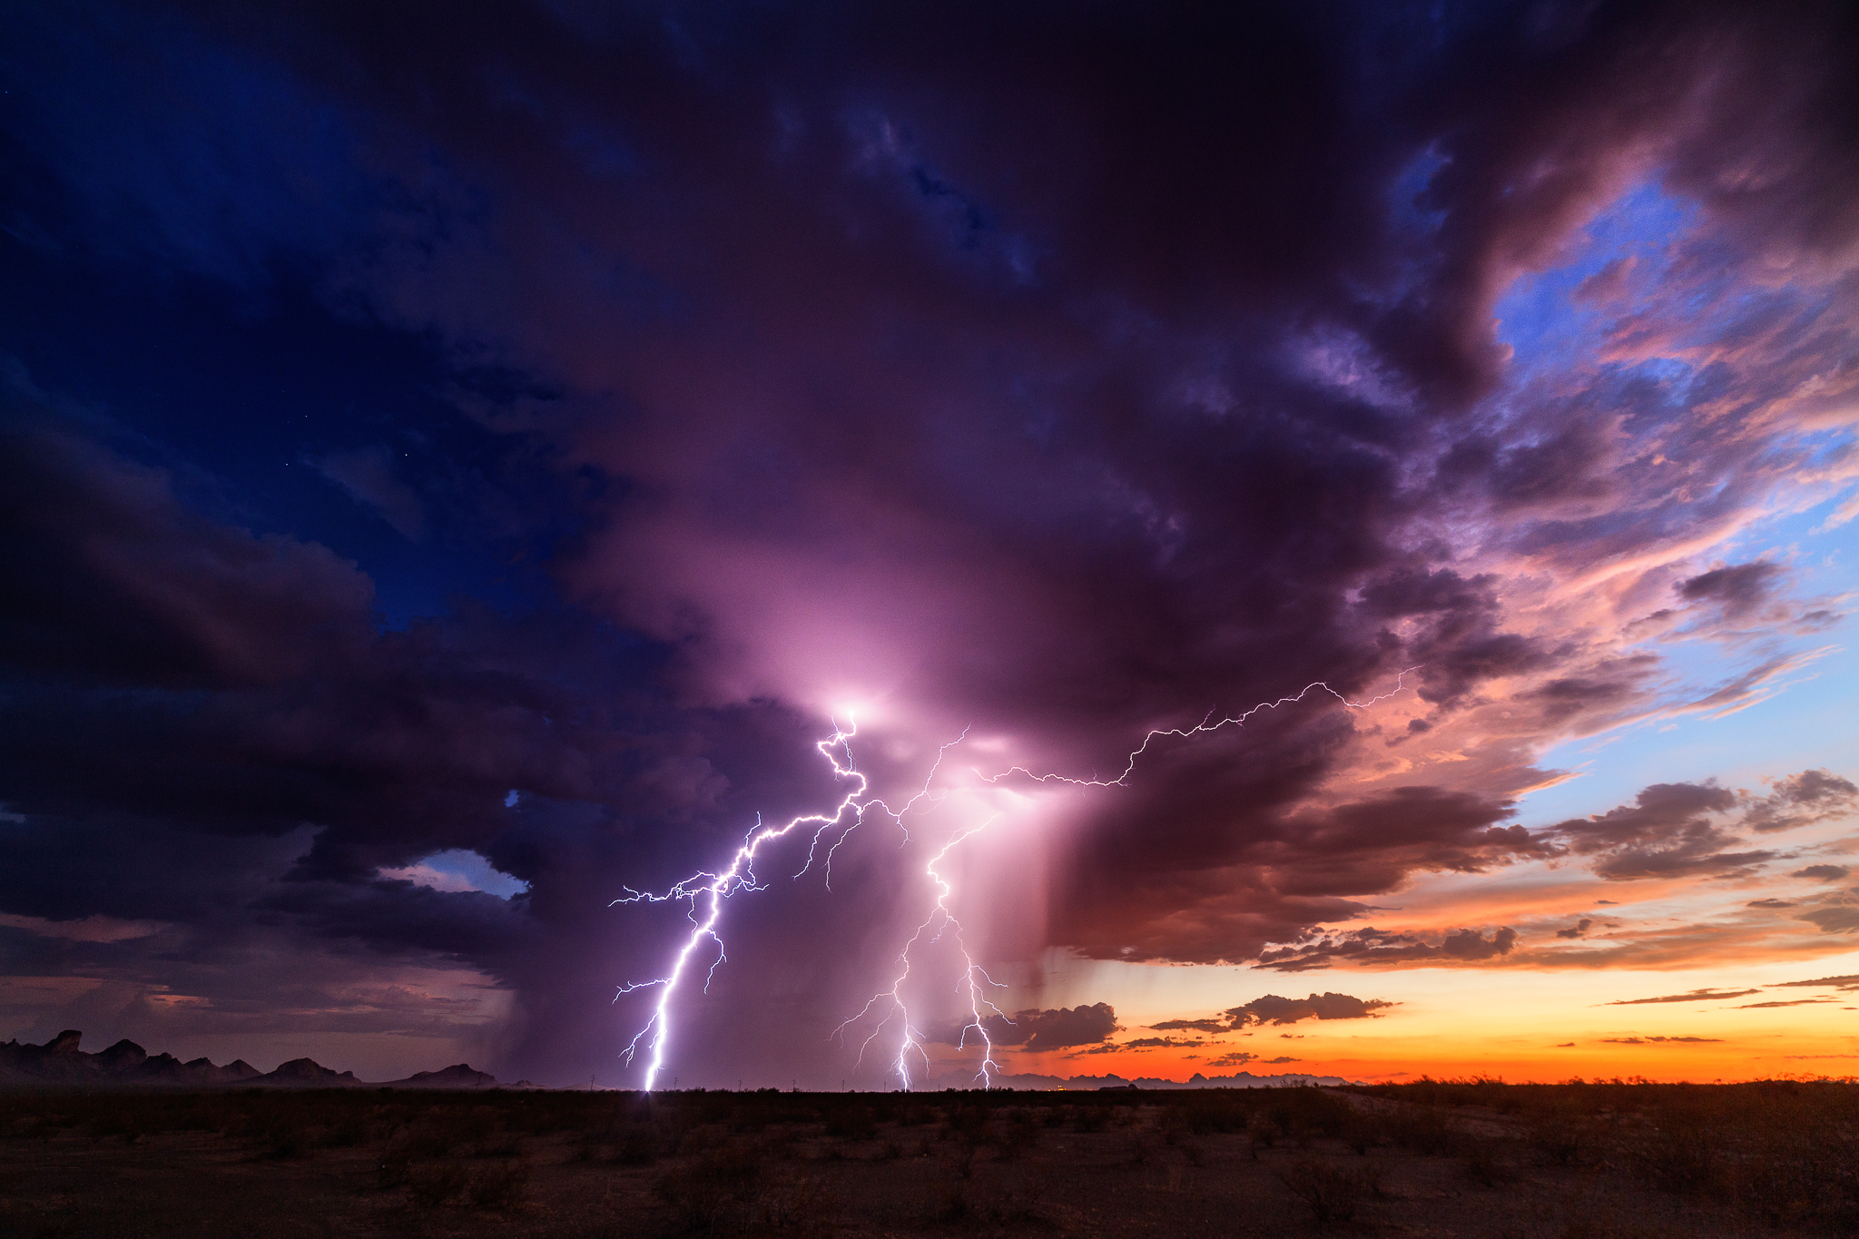
"Not everyone who says to Me, 'Lord, Lord,' shall enter the kingdom of heaven, but he who does the will of My Father in heaven." — Matthew 7:21
enter
enter
heaven
heaven
does the will
Almighty God
does the will
Notes:
Without submitting to God’s will, salvation is not an option for those choosing not to.

Slide 4

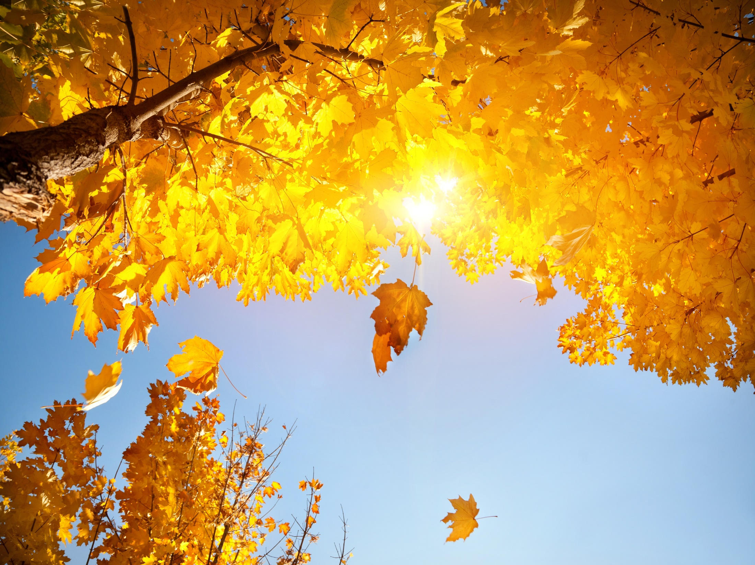
You therefore, beloved, since you know this beforehand, beware lest you also fall from your own steadfastness, being led away with the error of the wicked; — 2nd Peter 3:17
beware
fall
fall
fall
led away
with the error of the wicked
error
Notes:
Once saved always saved has in it a green light to act in any manner. Clearly God’s word proclaims one can fall away if choices are made to pursue wicked behavior.

Slide 5
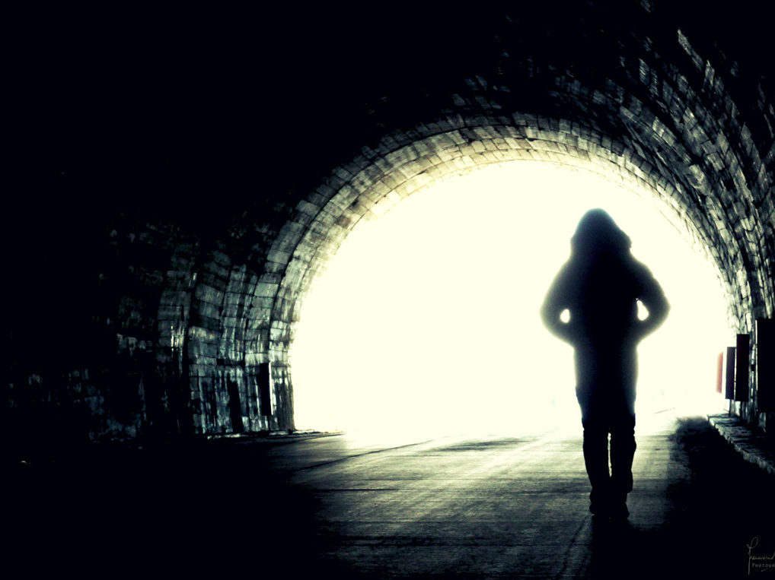
For it is impossible for those who were once enlightened, and have tasted the heavenly gift, and have become partakers of the Holy Spirit, and have tasted the good word of God and the powers of the age to come, if they fall away, to renew them again to repentance, since they crucify again for themselves the Son of God, and put Him to an open shame. — Hebrews 6:4-6
once enlightened
once enlightened
salvation
word
fall away
fall
lost again
fall away
Notes:
In truth one can fall away from His grace and mercy if choices are made to turn back to a habitual sinful life. This would be those who fall upon the stony ground and turn back to old desires, not in accordance with His will of declared goodness. Delusional creations of man such as once saved always saved are not supported in the truth He gives. Humble hearts do not argue with what has been delivered, and why argue to excuse sin? It is common for man to excuse himself with false principles, and by collecting the largest possible crowd, the made-up perception becomes foolishly accepted.

Slide 6
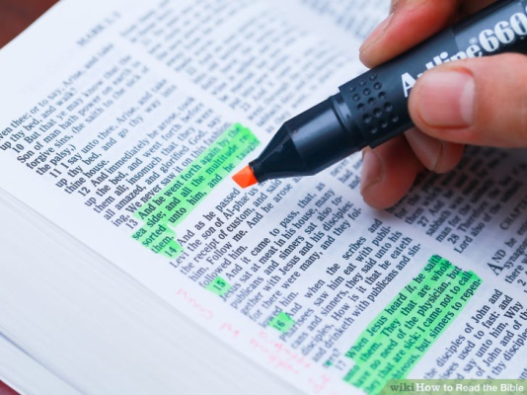
Therefore lay aside all filthiness and overflow of wickedness, and receive with meekness the implanted word, which is able to save your souls. But be doers of the word, and not hearers only, deceiving yourselves. — James 1:21-22
receive
receive
word
implanted word
doer
implanted word
save your soul
be doers
doer
be doers
hearers only
hearers only
deceiving yourselves
Notes:
And it is His good word that expresses salvation through His sacrifice to set us free.

Slide 7
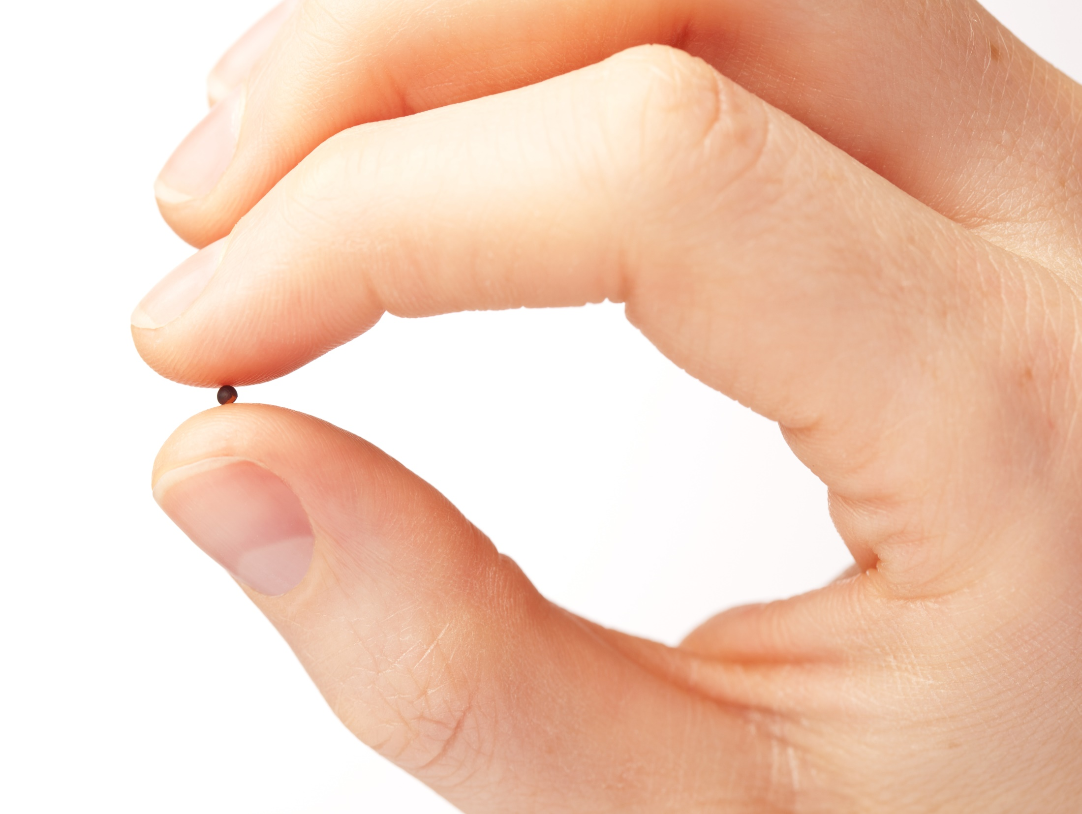
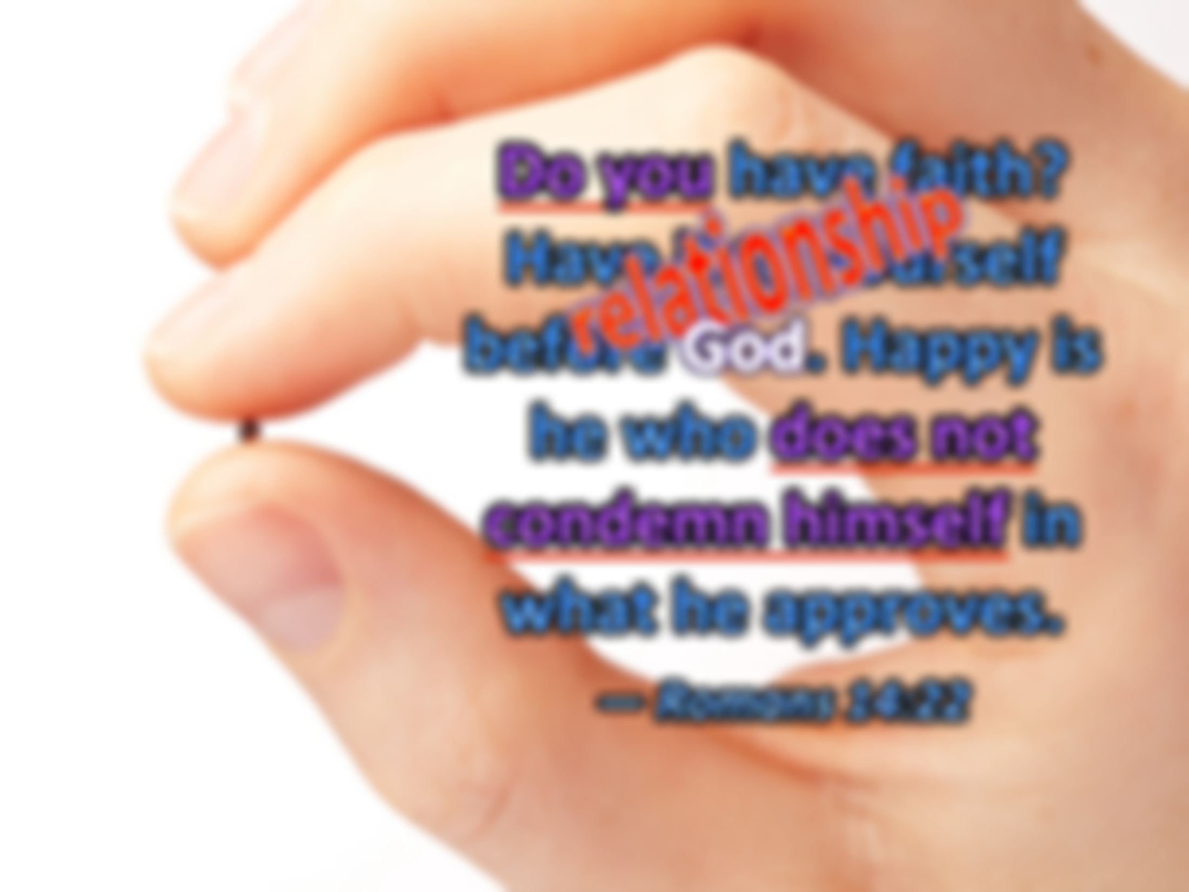


Do you have faith? Have it to yourself before God. Happy is he who does not condemn himself in what he approves. — Romans 14:22
faith
Do you
Do you
relationship
God
Happy
doer
does not
does not
conscience
condemn himself
condemn himself
Notes:
Each of is a seed waiting to either blossom or wither as eternity unveils itself. Confidence in faith comes through a pure uncondemning heart.

Slide 8
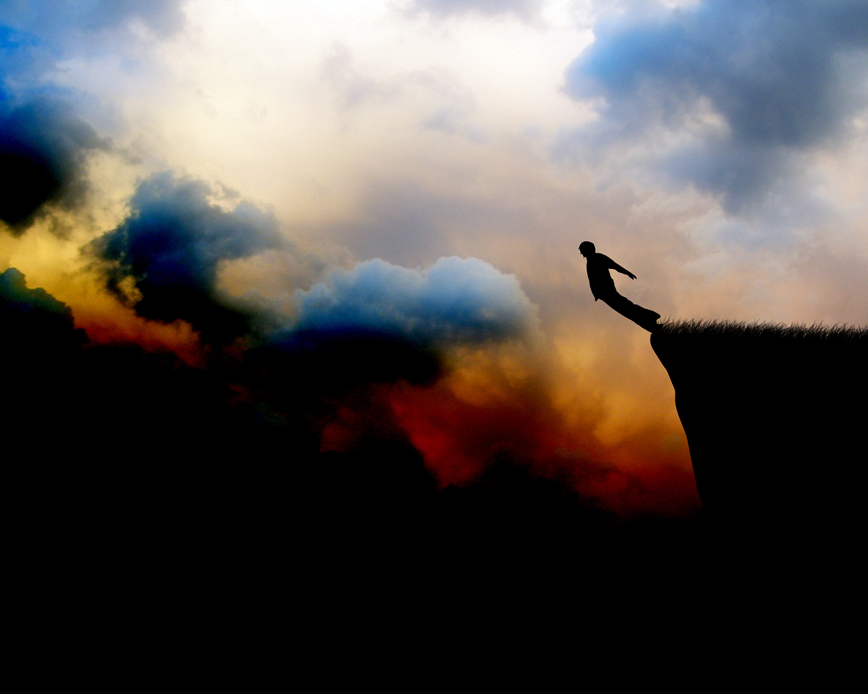
What does it profit, my brethren, if someone says he has faith but does not have works? Can faith save him? — James 2:14
faith
Notes:
Faith alone does not have the depth of a mature spiritual life. Even the demons believe and tremble. By works character of commitment to goodness is exposed. Yes, we can not be saved by works as salvation is a gift of His grace, however, ungodly works will most definitely deny access to His grace without a sincere repenting heart intimately searching out for His will; while obediently striving for love of in Him. Faith alone leans to an edge of nowhere. Boldly, it takes a lot of illusionary faith to have brazen faith without good works. The daredevil believes he will survive without all the precautions to ensure safety. He goes over Niagara falls and wonders why he left the oxygen tank and fins behind as the swirling currents consumes him. Death not only comes by ignorance, but by lack of action.

Slide 9

Thus also faith by itself, if it does not have works, is dead. But someone will say, "You have faith, and I have works." Show me your faith without your works, and I will show you my faith by my works. — James 2:17-18
I
al
faith
faith by itself
th
faith
I
I
dea
dea
I
I
I
faith by itself = death
works without faith = death
faith + works = salvation
faith
faith
v
faith
I
I
I
I
I
I
I
I
faith
i
without
t
I
faith
works
n
s
a
o
I
th
works
faith
I
faith
Notes:
I am defines the soul and by its’ works comes either brilliance or dimness of character. Walk the talk is a spiritual must if salvation is to be had. The biggest regret when we meet God is that we did not do enough to honor Him. Faith is not an act of isolation. Many intellectuals delve into the intellectualism of argument and in their self-absorption, they miss the act of simply doing for others.

Slide 10
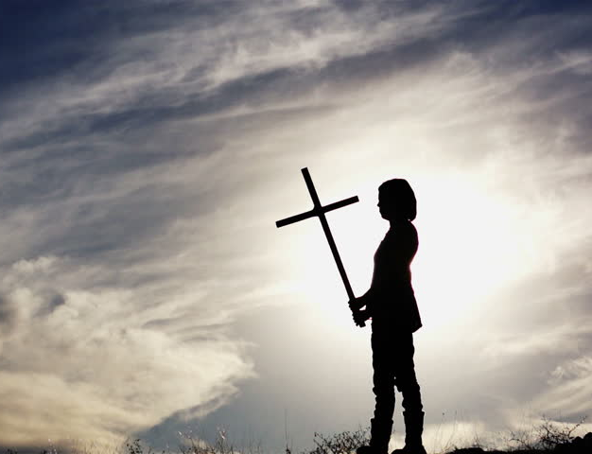
You see then that a man is justified by works, and not by faith only. — James 2:24
justified
not by faith only
not by faith only
Once saved always saved?
Notes:
Contrary to popular belief, faith alone will not justify one in the face of His coming judgment. Each of us needs justification through the sacrifice of the cross. We each need to diligently carry that cross to the doorstep of eternity.

Slide 11


(for not the hearers of the law are just in the sight of God, but the doers of the law will be justified; for when Gentiles, who do not have the law, by nature do the things in the law, these, although not having the law, are a law to themselves, who show the work of the law written in their hearts, their conscience also bearing witness, and between themselves their thoughts accusing or else excusing them) — Romans 2:13-15
in
doers
sight of God
doers
justified
law
show the work
of
in
show the work
conscience
thoughts
approval
thoughts
excusing them
excusing them
Notes:
Truth of heart has weight. Conscience is vital in developing spiritual strength.

Slide 12

But I discipline my body and bring it into subjection, lest, when I have preached to others, I myself should become disqualified. — 1st Corinthians 9:27
Submission
Obedience
Accountability
Humility
subjection
in
subjection
Restraint
Captivity
disqualified
Control
disqualified
Bondage
subjection
hypocrite
Confinement
Containment
Notes:
God’s will for each of us is to have control over impulsive desires that oppress others. He has no desire for hypocrites and only considers sincere hearts. Not just does He ask that we bring our bodies into subjection to His ways, but to remain overall in subjection to Him seeking Him diligently.

Slide 13


Examine yourselves as to whether you are in the faith. Test yourselves. Do you not know yourselves, that Jesus Christ is in you? -- unless indeed you are disqualified. — 2nd Corinthians 13:5
in
the faith
the faith
Test yourselves
Jesus Christ
in
Jesus Christ
you
you
disqualified
subjection
Notes:
Either one hits the mark or not. To miss this spiritual bullseye is to throw out the entire game. Christianity is all about soul searching. Again, faith is not an act of isolation. Faith is not a casual event.

Slide 14
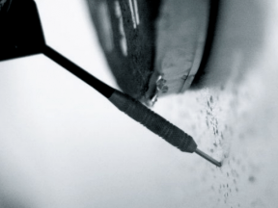
They profess to know God, but in works they deny Him, being abominable, disobedient, and disqualified for every good work. — Titus 1:16
work
in
deny Him
works
Him
works
deny Him
abominable
disobedient
disqualified
work
good
good
Notes:
So many claim faith but fail to live in the good works He demands.

Slide 15
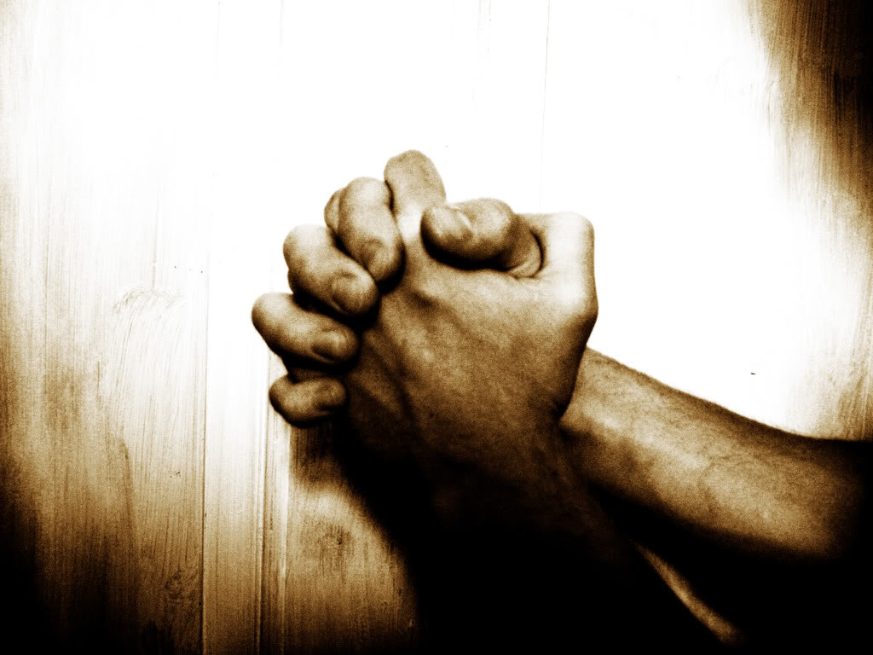
Then they said to Him, "What shall we do, that we may work the works of God?" Jesus answered and said to them, "This is the work of God, that you believe in Him whom He sent." — John 6:28-29
work
work
Jesus
work
is
work
work
believe in
Him
Notes:
His word clearly states that belief itself is a work not to be ignore as casual. Faith can only be established in knowing Him and applying His will. To deny works are required is the lunacy of those that would remain arrogant disapproving in submitting to His declarations of truth.

Slide 16
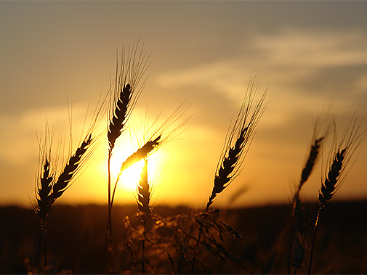
"And behold, I am coming quickly, and My reward is with Me, to give to every one according to his work." — Revelation 22:12
to give
to give
work
according to his work
according to his work
Notes:
Without doubt, we will be judged according to our works in life.

Slide 17

For in Christ Jesus neither circumcision nor uncircumcision avails anything, but faith working through love. — Galatians 5:6
in
Christ Jesus
work
faith working
faith working
through
love
love
Notes:
And it will be love that lifts us to the gates of bliss. Love has to rise for the moment to be conquered.

Slide 18

My little children, let us not love in word or in tongue, but in deed and in truth. And by this we know that we are of the truth, and shall assure our hearts before Him. For if our heart condemns us, God is greater than our heart, and knows all things. Beloved, if our heart does not condemn us, we have confidence toward God. — 1st John 3:18-21
love
us
not
love
My little children, let us not love in word or in tongue, but in deed and in truth. And by this we know that we are of the truth, and shall assure our hearts before Him. For if our heart condemns us, God is greater than our heart, and knows all things. Beloved, if our heart does not condemn us, we have confidence toward God. — 1st John 3:18-21
not just in word
in
in deed and in
word
in
in
in
in
truth
t
j
in
in
guilt
condemns us
condemns us
accept forgiveness
does not condemn us
does not condemn us
Notes:
Words can be shallow without the depth of action. As we search to know our hearts, guilt can be condemning in the face of His forgiveness. In deed and truth we must humbly travel this journey into His Kingdom climbing out from our sinful past.

Slide 19
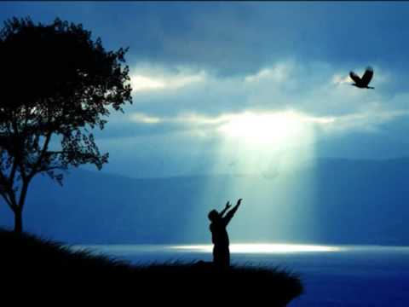
And whatever you do in word or deed, do all in the name of the Lord Jesus, giving thanks to God the Father through Him. — Colossians 3:17
word
in
giving thanks
to God
deed
Jesus
deed
. .
Notes:
Thankfulness is the measure of peace one’s heart holds.

Slide 20

And whatever you do in word or deed, do all in the name of the Lord Jesus, giving thanks to God the Father through Him. — Colossians 3:17
do all
in
giving thanks
to God
. .
through
Him
Notes:
Thankfulness is the measure of peace one’s heart holds.

Slide 21


For we are His workmanship, created in Christ Jesus for good works, which God prepared beforehand that we should walk in them. — Ephesians 2:10
we
prepared beforehand = good works
we = created in Christ Jesus
good works = should walk in them
good
created in Christ Jesus
good
created
in
for good
Christ Jesus
for good
works
God
prepared
works
works
works
beforehand
should walk
walk
walk
in them
in
God
Notes:
How can anyone think God will not judge us in the light of His goodness? Jesus Christ is the standard by which we were all created through, whether we admit it or not. God originally created goodness for us to walk (live) in, and yet, it is a choice pursued, or not, by free spirits. Fading darkness is not hidden in our eventual return to His pure light, as His love has freely released us to ourselves. Will we rise to His light or fall into the darkness?

Slide 22

So then each of us shall give account of himself to God. — Romans 14:12
God
Notes:
Each of us shall face God alone as it is His gift to us, ourselves.

Slide 23


… who "will render to each one according to his deeds": eternal life to those who by patient continuance in doing good seek for glory, honor, and immortality; but to those who are self-seeking and do not obey the truth, but obey unrighteousness -- indignation and wrath, … — Romans 2:6-8
according to deeds
↙ ↘
eternal life indignation
↓ and wrath
↓
. .
according to
deeds
eternal life
eternal life
patient
in
doing good
seek for
continuance
in doing good
patient continuance
in doing good
seek for
● glory
● honor
● immortality
glory
honor
immortality
but to those
self-seeking
do not obey
the truth
↓
unrighteousness
self-seeking
self-seeking
do not obey
the truth
indignation
unrighteousness
indignation
and
wrath
wrath
Notes:
Sermons never end, they only take pause. One man departs while another arrives. Generous spirits endure the test of time while self-seeking achievers are quickly forgotten.

Slide 24



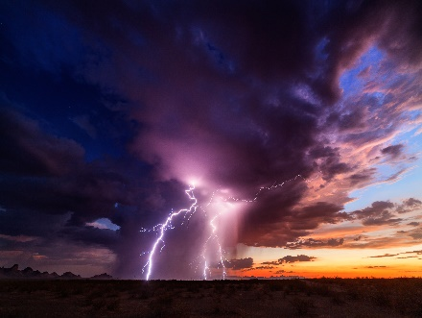








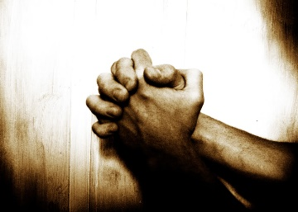


Slide 25
→ Salvation is for those doing the will of God
→ Beware of being led away in errors of the wicked
→ It is not ‘once saved always saved’ when falling away
→ One must turn to the word & respond for salvation
→ We were created for good works in Christ Jesus
→ Without good works - faith alone will not save you
→ Conscience is vital in writing His word on the heart
→ Without self-control = spiritually disqualified
→ Works counter to His will ban one from salvation
→ To believe in God requires action upon His calls
→ Faith working through love is our key
→ God is greater than our guilt as we heal to Him
→ God will render judgment based on our deeds
A working faith inherits
His promise
Notes:
A working faith inherits His promise.

Slide 26
Notes:
Darkness endlessly falls into nowhere.

Slide 27

Please visit http://www.LoveFromGod.com to explore further
Ronald Bert Channel on
Notes:
Eternity never ends.

