Slide 1
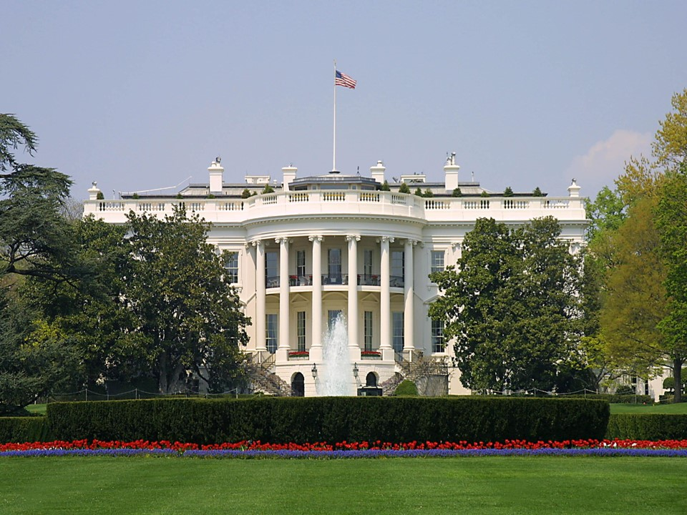
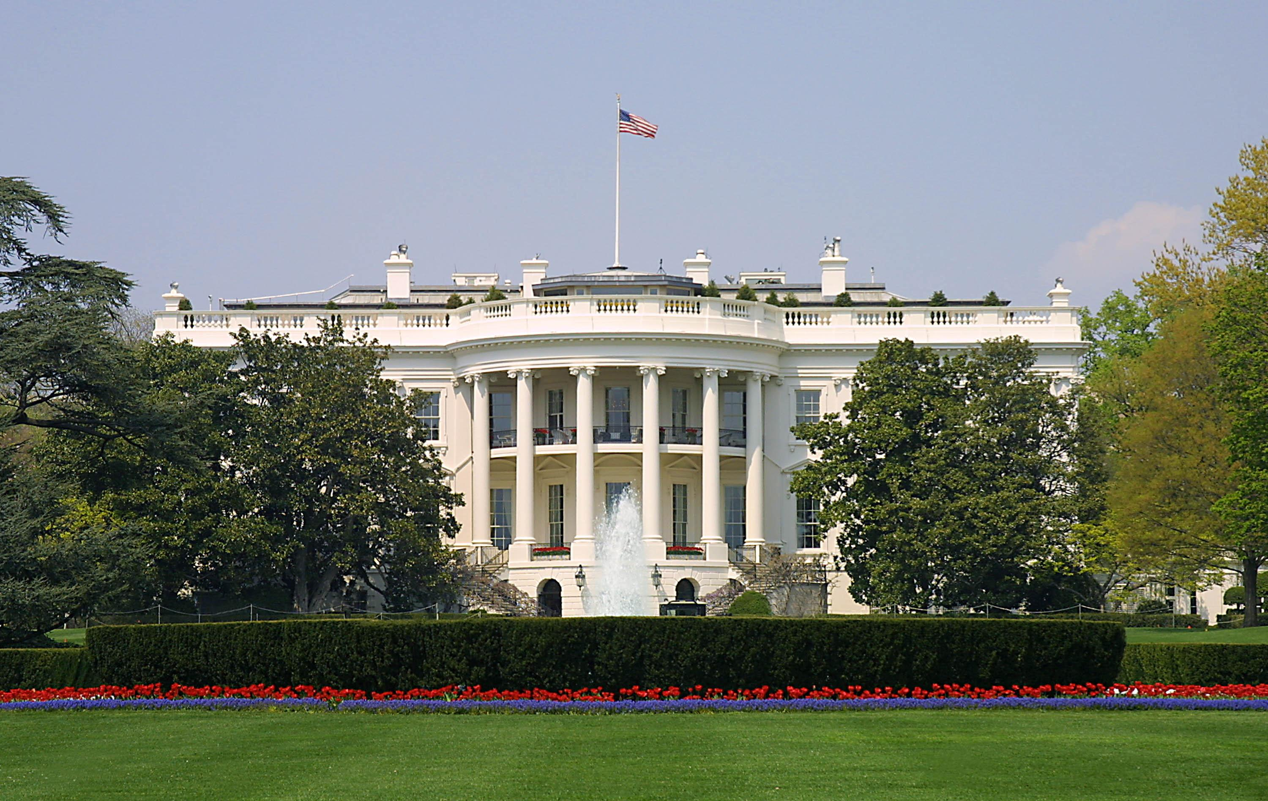


Origins of Our Nation
Ron Bert
1
Any Date in Time

Slide 2

This nation was founded to protect the free to worship with a clear conscience

Slide 3


Built from the ashes of tyranny, the sacrifices of all that was righteous brought the truths of God to light
of
God
light
light of God

Slide 4

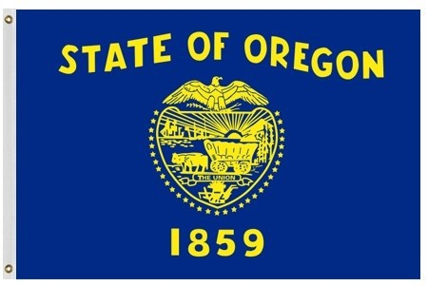
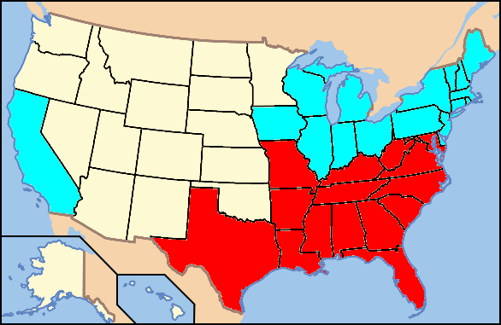

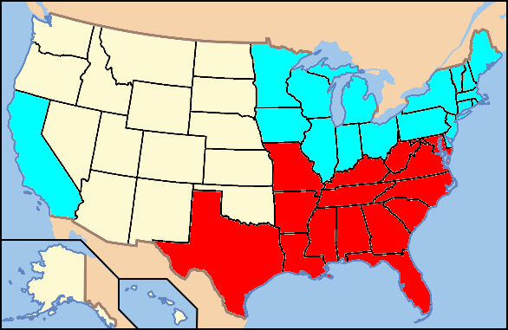
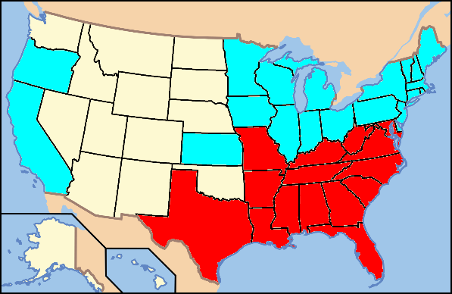
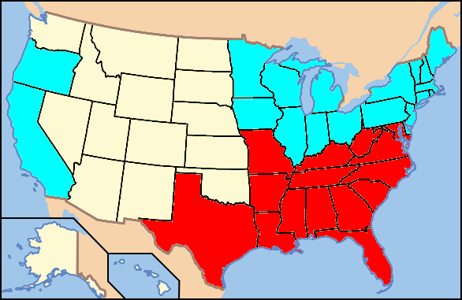
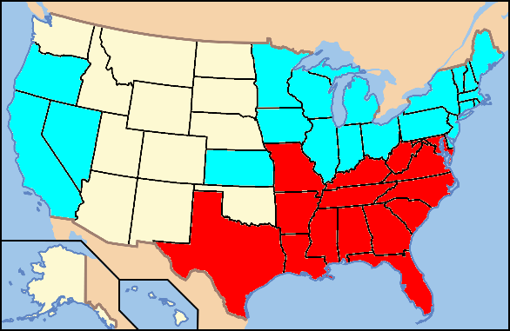

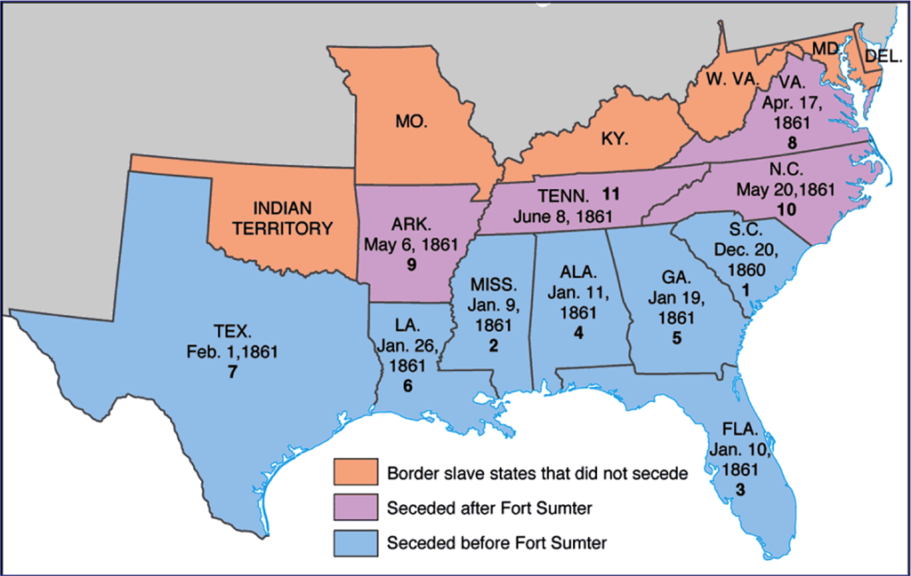
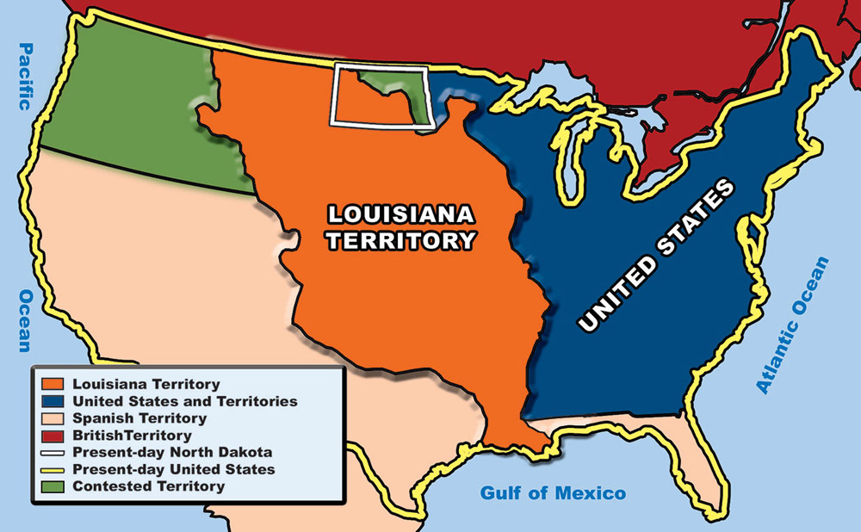
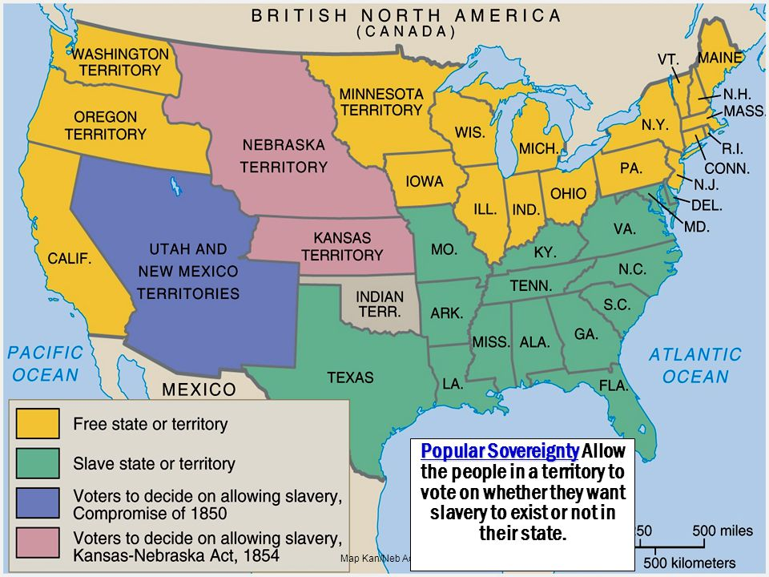
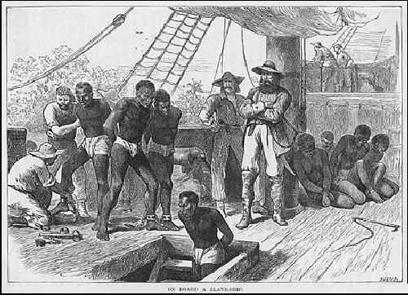
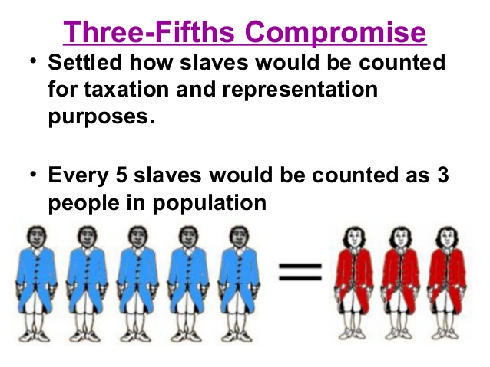
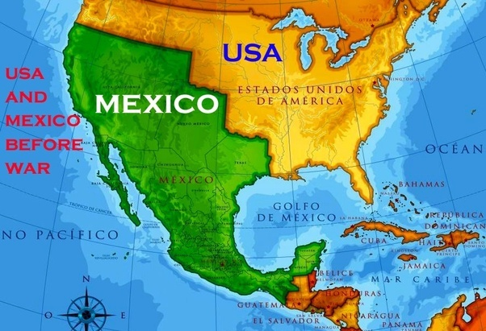
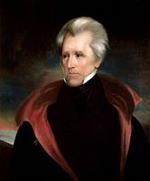
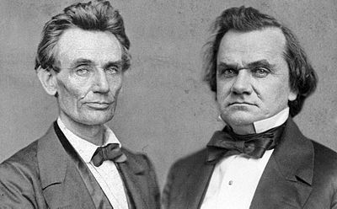
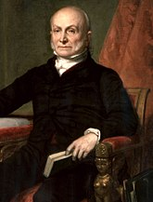
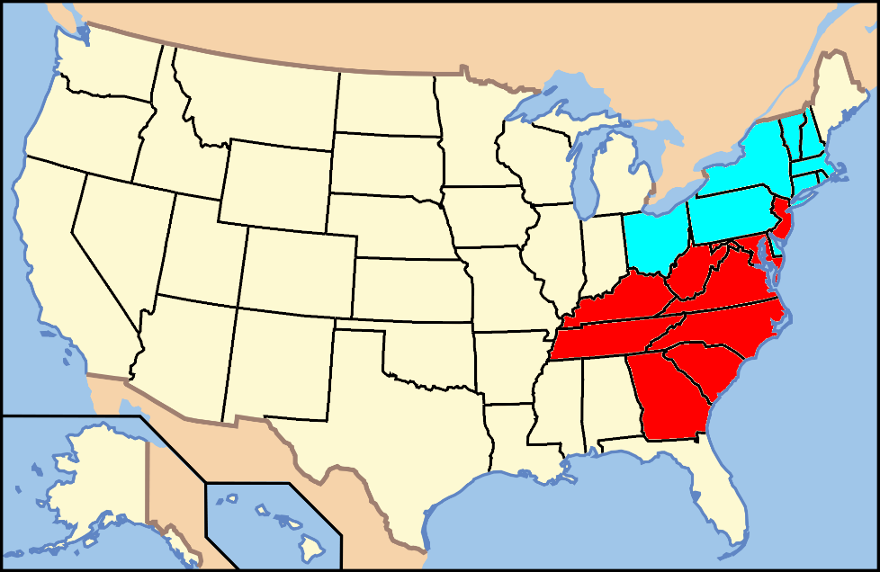
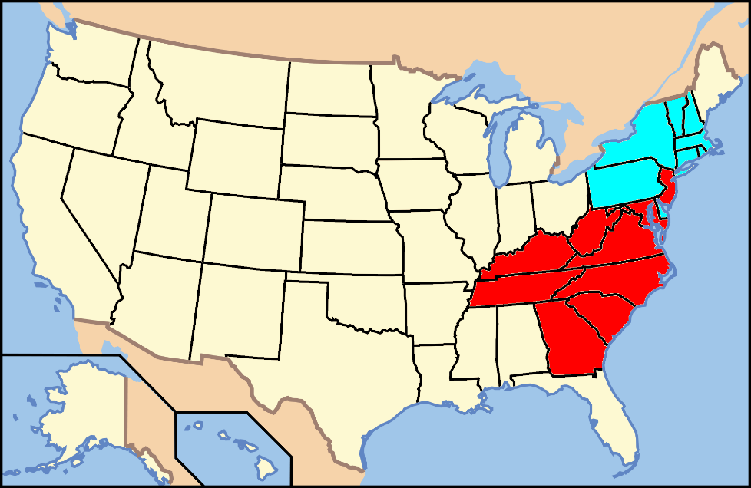
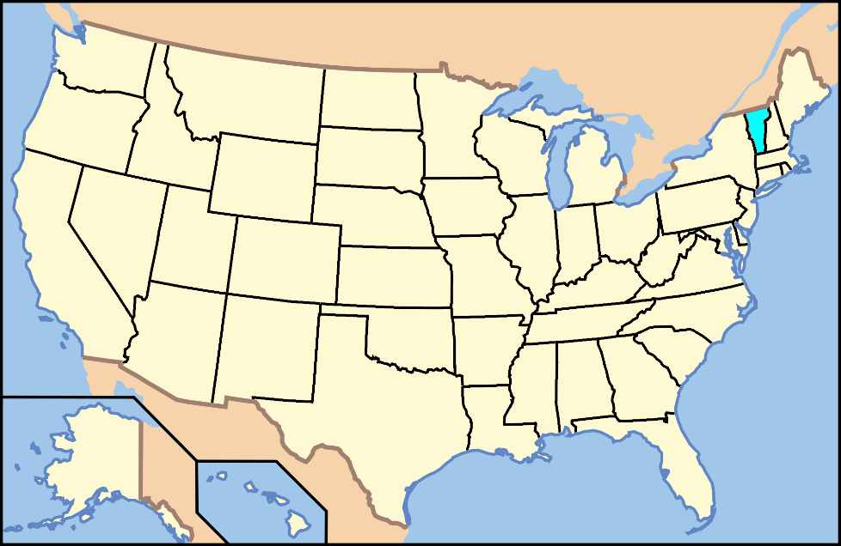
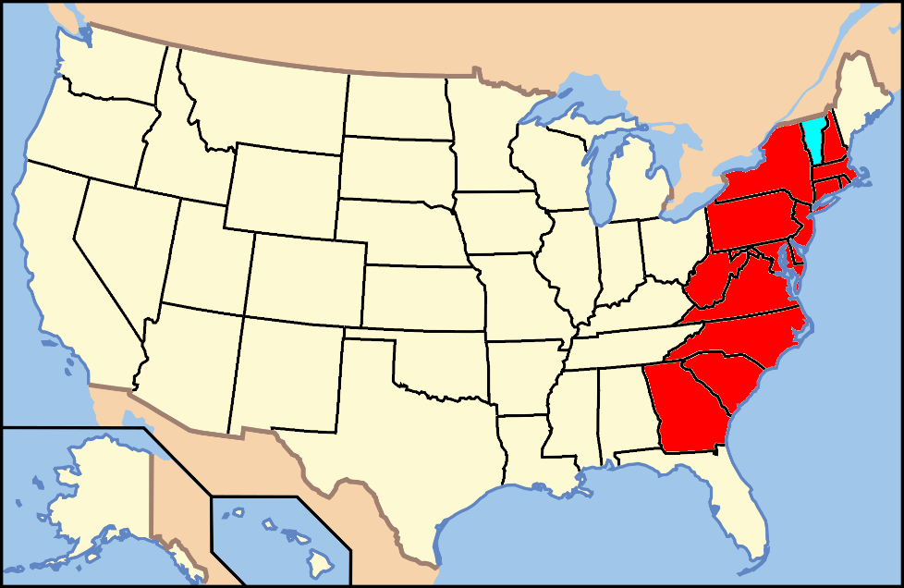
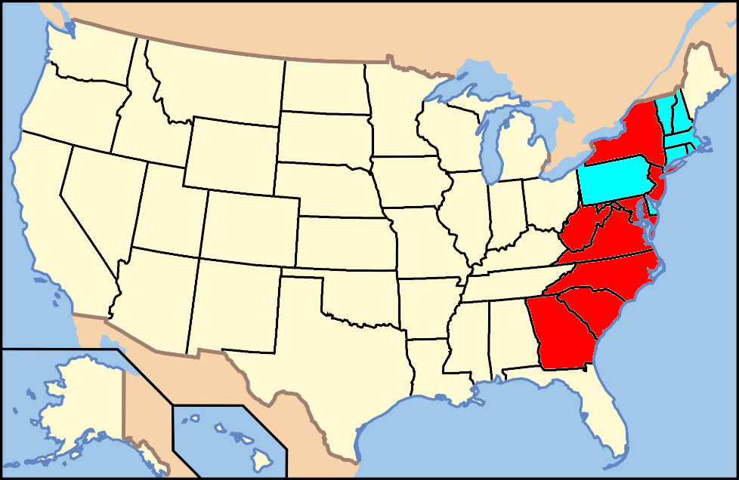
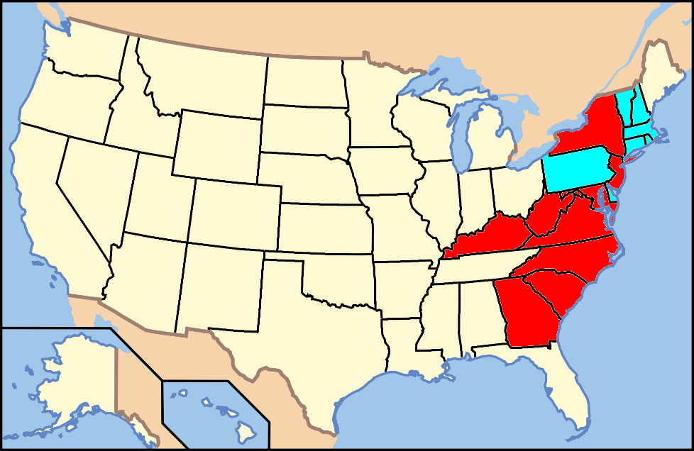
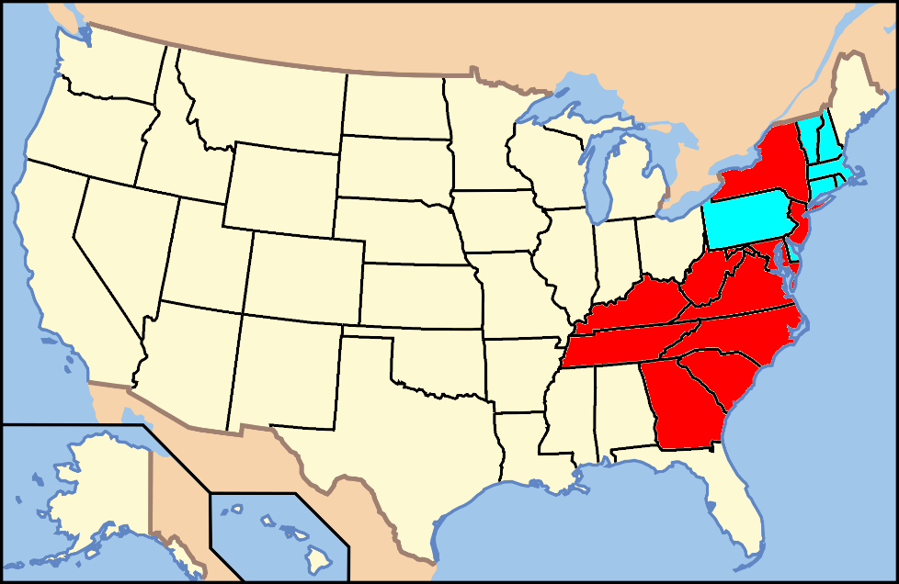
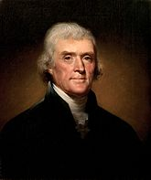
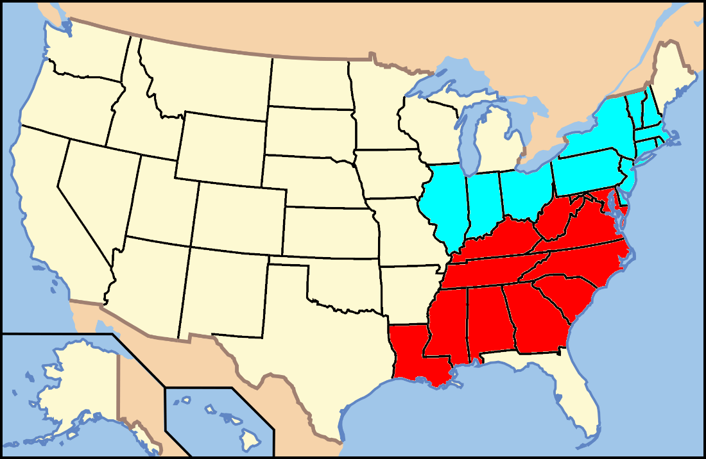
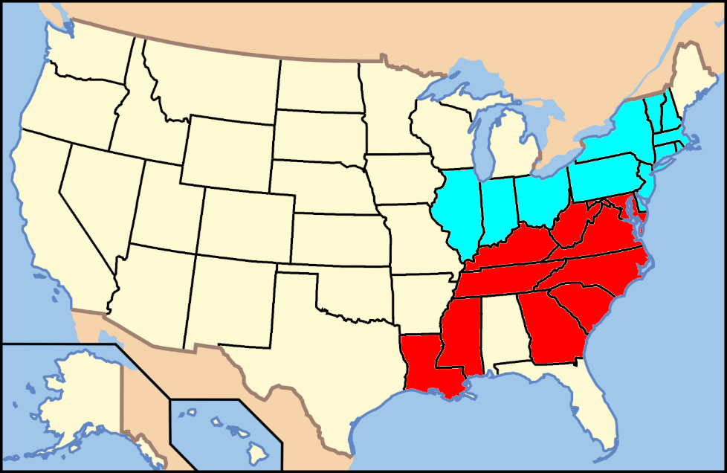
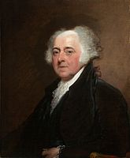
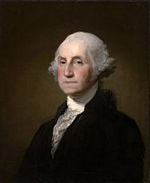
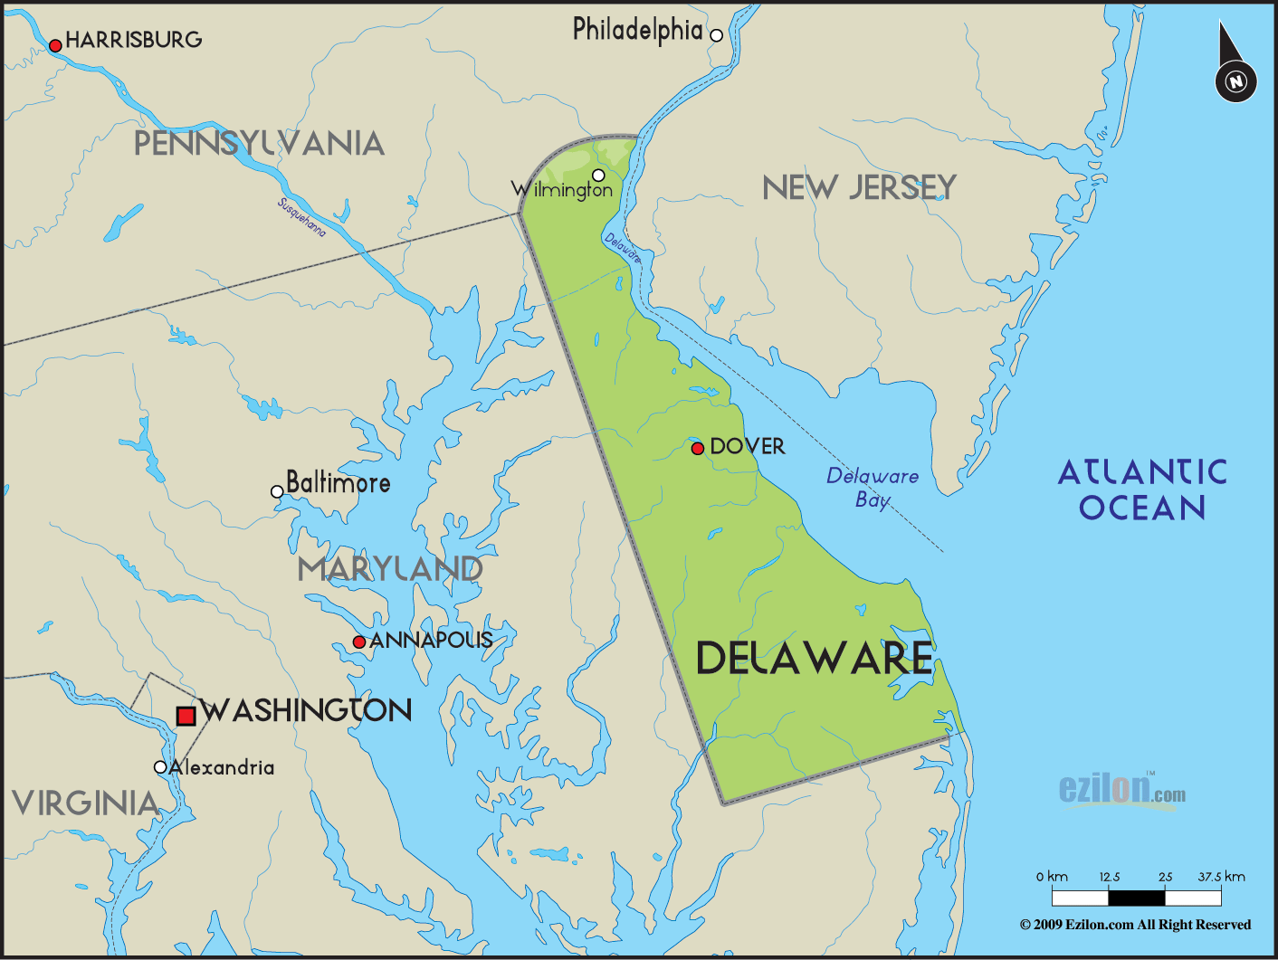
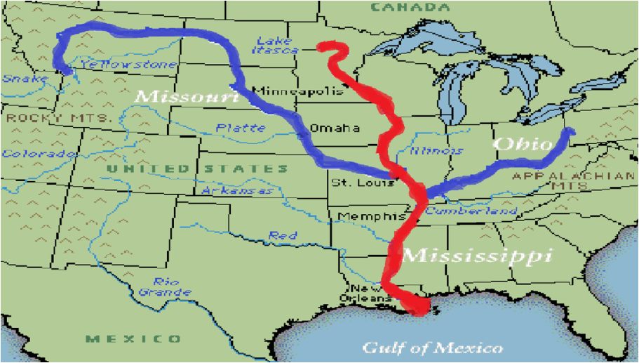
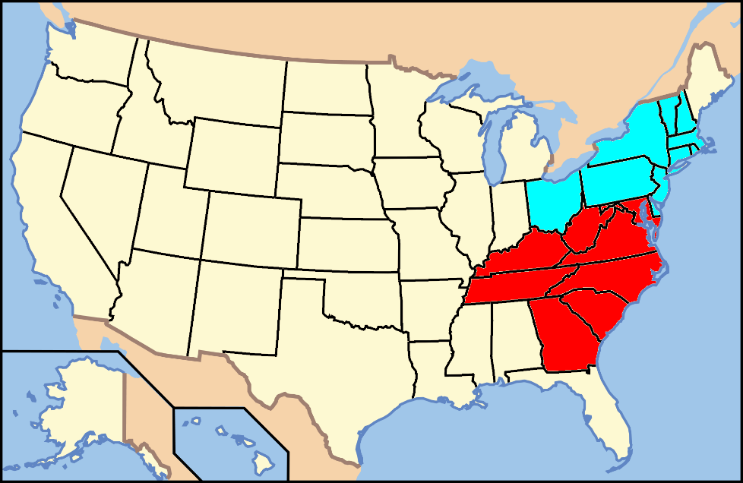
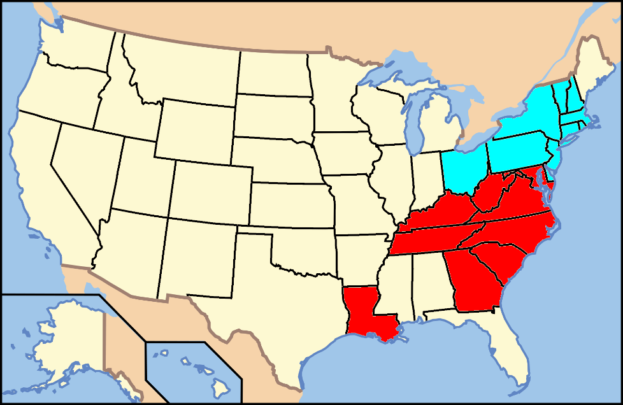
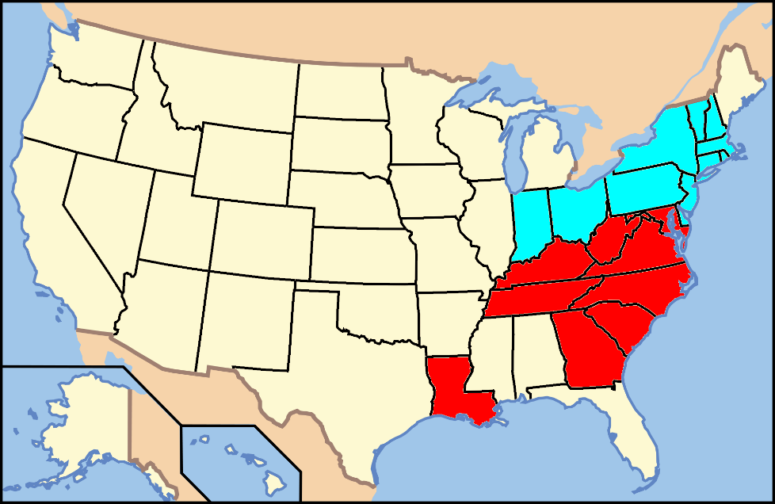
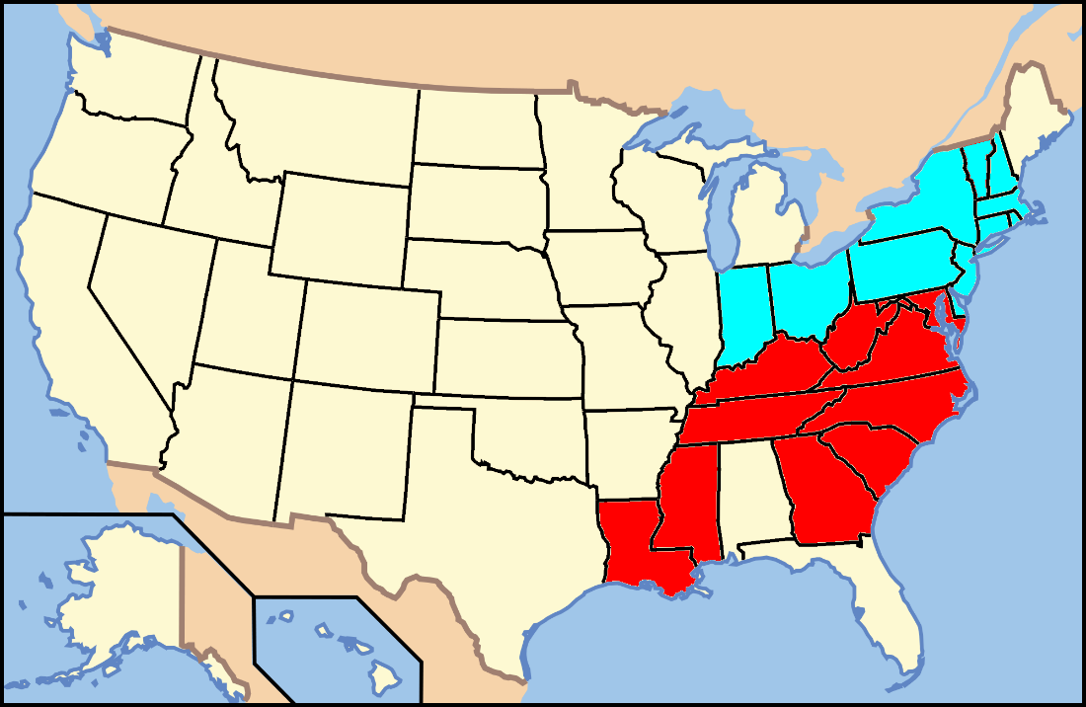
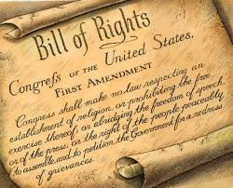
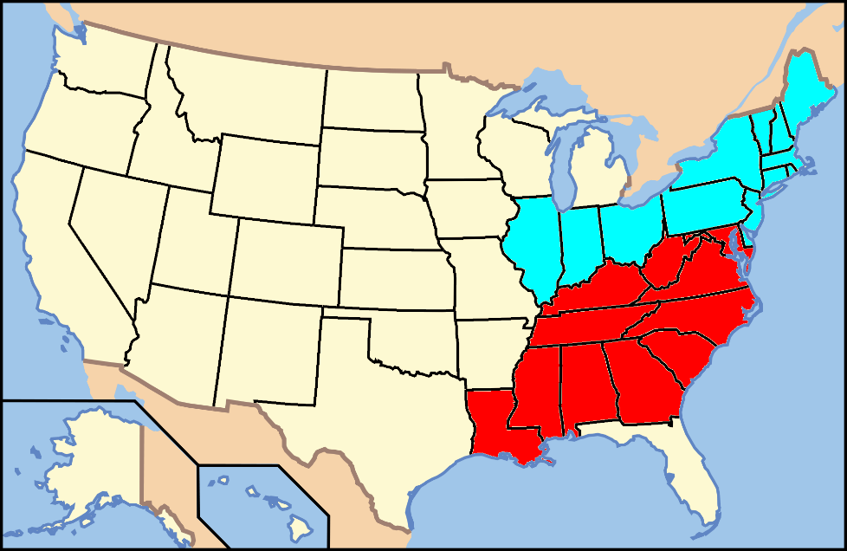
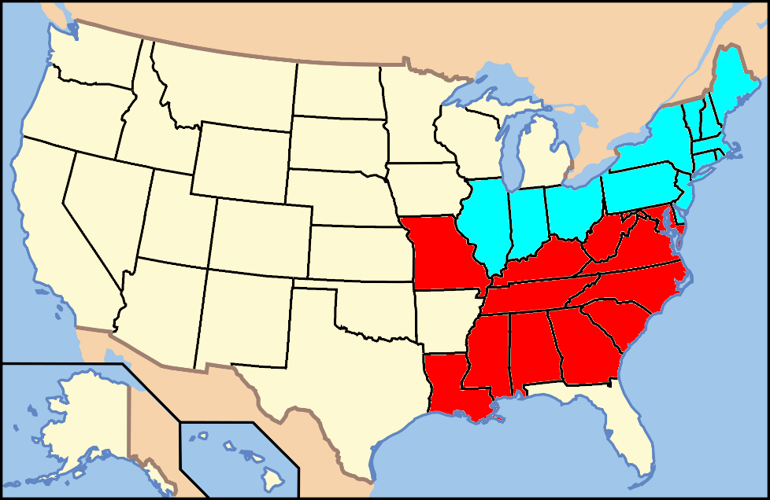
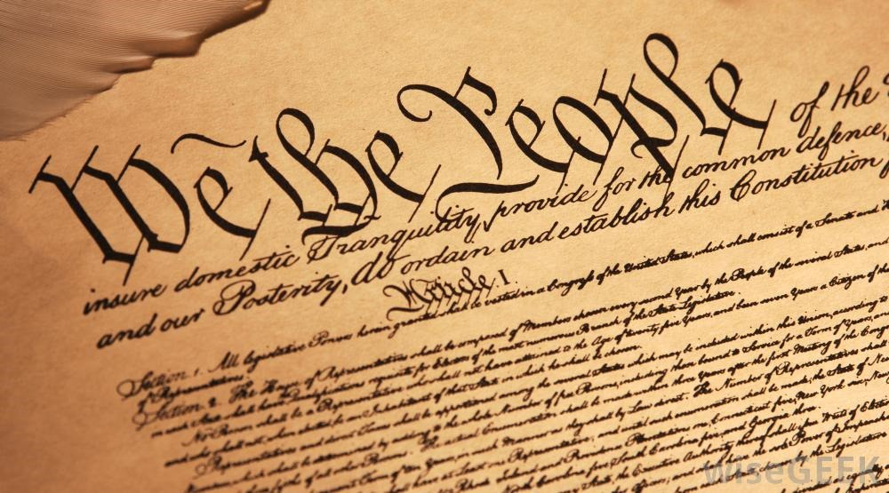
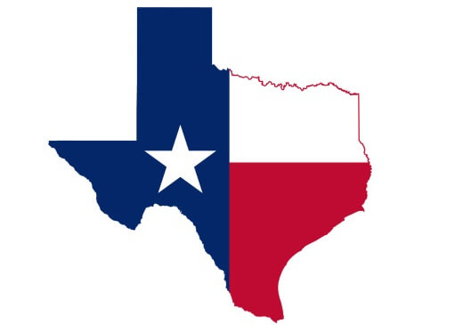
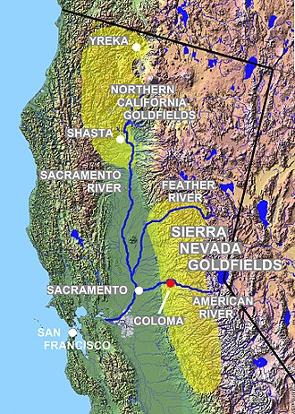
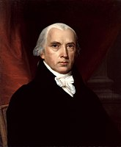
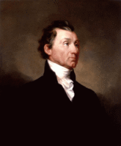
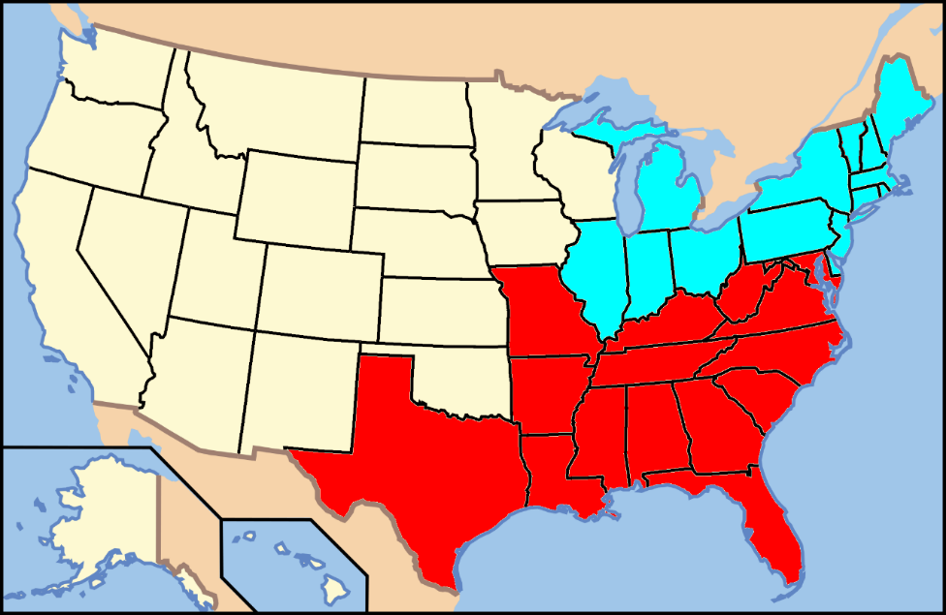
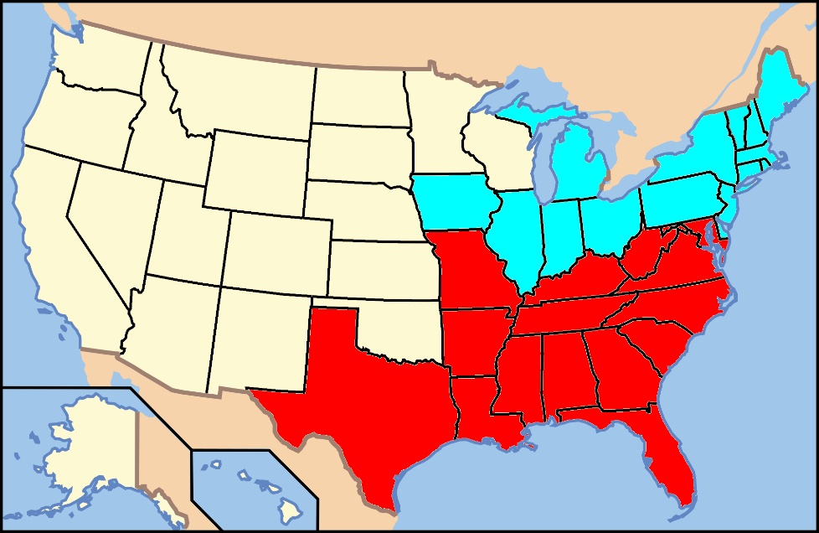
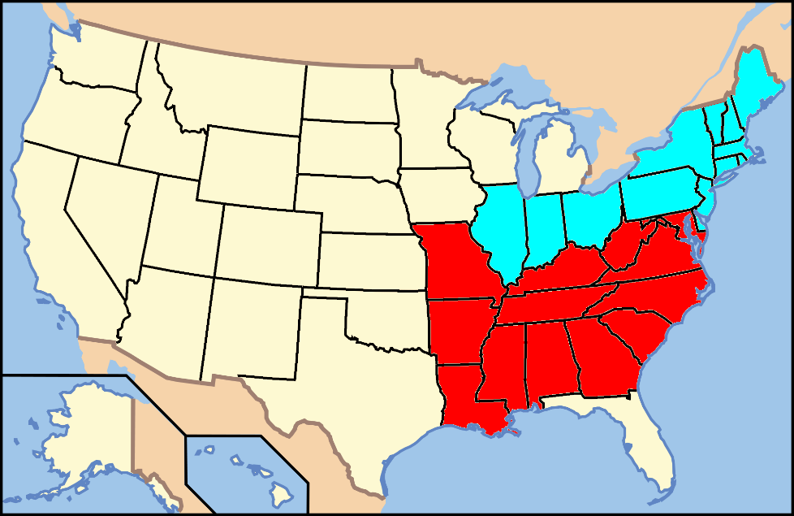
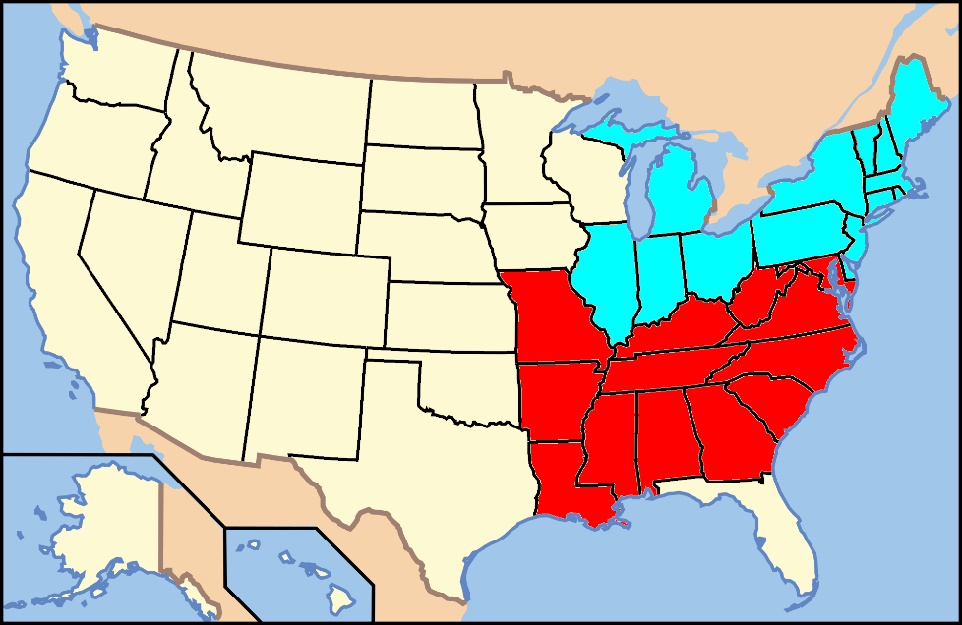
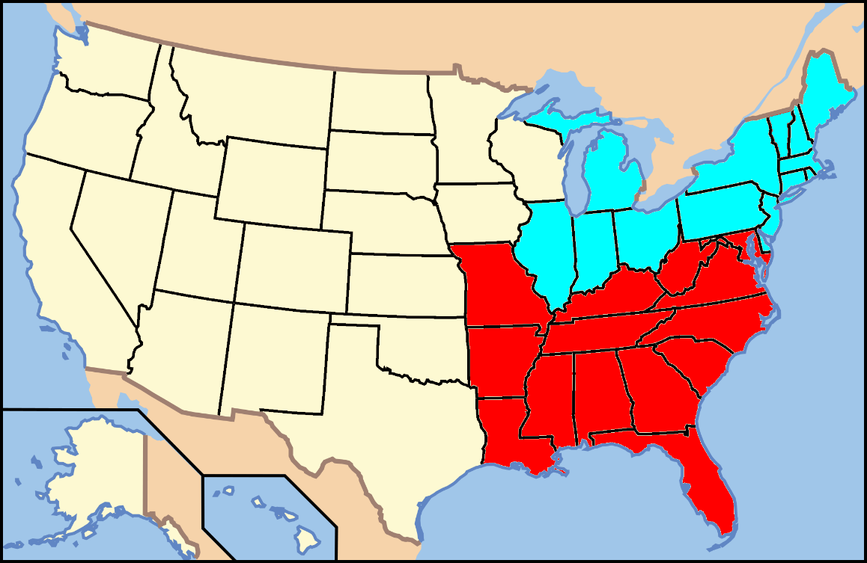

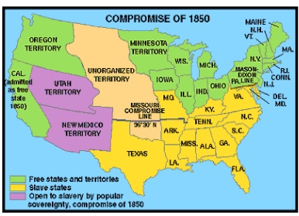
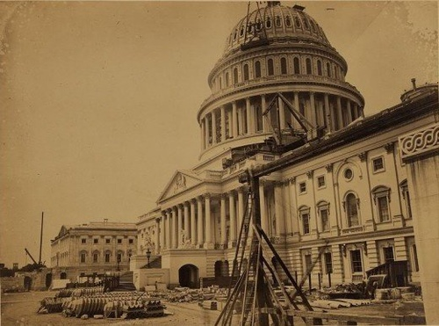







































July 4,1776
Quick Summary
At great cost freedom has been fought for. Let not prejudice and bigotry return us to a time dreaded by all.
April 12,1861
Light of God
1799
1865
1857
1861
1866
1864
God
1863
1860
1850
1858
1856
1846
1854
1841
1852
1844
1845
of
1840
1859
Light
1848
1796
1836
1808
1792
1812
1837
1819
1818
1817
1816
1803
1820
1804
July 13,1787
1828
1788
1824
1800
1821
1791
1827
1784 - Connecticut and Rhode Island for gradual abolition
1783 - New Hampshire announces gradual abolition
Thomas Jefferson elected 3rd President
Vermont joins the Union as a free state. First state admitted after the 13 original states signed Constitution; #14
First to ratify U.S. Constitution; 1788-89 Abolition societies established in Dover and Wilmington
Vermont joins the Union as a free state. First state admitted after the 13 original states signed Constitution; #14
John Quincy Adams elected 6th President
Emancipation Proclamation Pres. Abraham Lincoln decrees that all slaves in Rebel territory are free on January 1, 1863
Louisiana Purchase starts slave state debates
Purchased from France (Napoleon) for 15 million
23,054,152 people including 3,200,600 slaves or 14%. Slaves not so much in north, but 58% in S.C. & 51% in Mississippi
Republican Party (Whigs) forms on anti-slavery platform opposing Democratic Party policies
Abraham Lincoln elected 16th President – 1st Republican to win the US Presidency.
Jefferson Davis elected Confederate President February 18, 1861
James Monroe elected 5th President
Northwest Ordinance No slaves north of Ohio River - east of Mississippi; outlawed slavery in the new territories
Franklin Pierce elected 14th President
1783 - Massachusetts abolishes slavery and grants voting rights to blacks and Natives
Andrew Jackson elected 7th President
1780 - Pennsylvania 1st state to abolish slavery / gradual abolition
Kentucky joins as slave state; #15
Fugitive Slave Act of 1793 – is modified and strengthened; makes Fed. Gov. responsible for returning fugitive slaves
Federalist Papers 54 - James Madison questions morality of slaves as property
Southern states start seceding December 1860 – February 1861
August 20, 1866 President Johnson formally declared the end of the war
United States Bans Slave Trade. Importing African slaves is outlawed, but smuggling continues
The 2nd Continental Congress resolves "that NO slaves be imported into any of the thirteen United Colonies."
Zachary Taylor elected 12th President
Many National Leaders are slave owners
California becomes a free state; #31
New Jersey's state legislature announces a gradual emancipation act
Three-Fifths Compromise – Representation in Congress due to uncounted non-voting slaves and taxation purposes
Iowa enters as free state – Dec 28th, 1846; # 29
December 6, Slavery Abolished The 13th Amendment to the United States Constitution outlaws slavery
April 14, 1865 Abraham Lincoln assassinated
April 9, 1865 American Civil War Ends at Appomattox Courthouse where General Robert E. Lee surrenders his army to General Ulysses S. Grant
Lincoln Douglas Debates
November 6, 1865 The last Confederate surrender when the warship CSS Shenandoah surrendered at Liverpool, England
April 15, 1865 Democrat Andrew Johnson is sworn in. Does not give protection to former slaves and later acquitted from impeachment by one vote
Mississippi joins as slave state, #20
Alabama joins as slave state, #22
Illinois joins as free state, #21
Mexican-American War ends – Feb 2nd
Kansas-Nebraska Act – Stephen Douglas repeals the Missouri Compromise
James Polk elected 11th President
Wisconsin joins as free state, #30
Supreme Court rules in Scott v. Sandford that blacks are not U.S. citizens
U.S. Declares war on Mexico
John Tyler sworn in as 10th President
President Buchannan fails to admit Kansas a slave state
Last Compromise of 1850 – Allows voters in New Mexico and Utah to decide on slavery
Millard Fillmore assumes presidency as 13th President – July 9
Lincoln declares Federal Gov. has the power to halt the spread of slavery Feb 27, 1860
Texas Declares Independence from Mexico
Martin Van Buren elected 8th President
Gradual slavery emancipation
in New York
William Henry Harrison elected 9th President
Know Nothings – Anti Catholics and Immigrants
Tennessee joins as slave state; #16
James Madison elected 4th President
California Gold discovered – Jan. 24
The state of New York abolishes slavery
Indiana joins as free state, #19
James Buchanan elected 15th President
Minnesota joins as free state, #32
Missouri Compromise Line drawn on Slavery
Congress defines the slave trade as piracy
Missouri joins as slave state, #24
Texas enters U.S. as slave state; #28
Florida joins as slave state
Arkansas joins as slave state, #25
Maine joins as free state, #23
Louisiana joins as slave state, #18
Lincoln inaugurated – March 4, 1861
John Adams elected 2nd President
Ohio joins as free state; # 17
Lincoln reelected as President
Oregon joins as free state, #33
Nevada joins as a free state October 31, 1864
Michigan joins as free state, #26
Kansas joins as free state - January 29th, #34
Declaration of Independence
Northwest Ordinance No Slaves N. Ohio
Congress Ends Slave Trade
Importing slaves/outlawed
Missouri Compromise
Louisiana Purchase
Slave Trade as Piracy
Fugitive Slave Act
Last Compromise
War with Mexico
MO Comp. repealed
Blacks not U.S. citizens
Fort Sumter

Slide 5


Slide 6

Please visit http://www.RonBert.com to explore further
Ronald Bert Channel on
Notes:
Eternity never ends.

