Slide 2


Value
Ron Bert
March 22, 2020
Notes:
Value is gauged by the price we pay to obtain.

Slide 3

Behold, the nations are as a drop in a bucket, And are counted as the small dust on the scales; Look, He lifts up the isles as a very little thing. — Isaiah 40:15
nations
nations
drop in a bucket
drop in a bucket
small dust on the scales
small dust on the scales
United Nations:
195 members
Notes:
In the greater scheme of things God has a plan much higher than the triviality of earthlings desiring satisfaction. He offers the window to eternity.

Slide 4

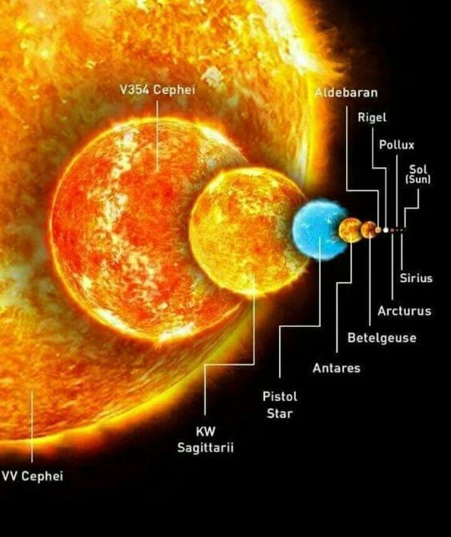

All nations before Him are as nothing, And they are counted by Him less than nothing and worthless. To whom then will you liken God? Or what likeness will you compare to Him? — Isaiah 40:17-18
nations
nothing
nothing
less than nothing
less than nothing
worthless
worthless
Notes:
Specks in time have little consequence in the eternal scheme. Of His call, for creatures given by His will to love, He commands service to one another. 195 United Nation members.

Slide 5
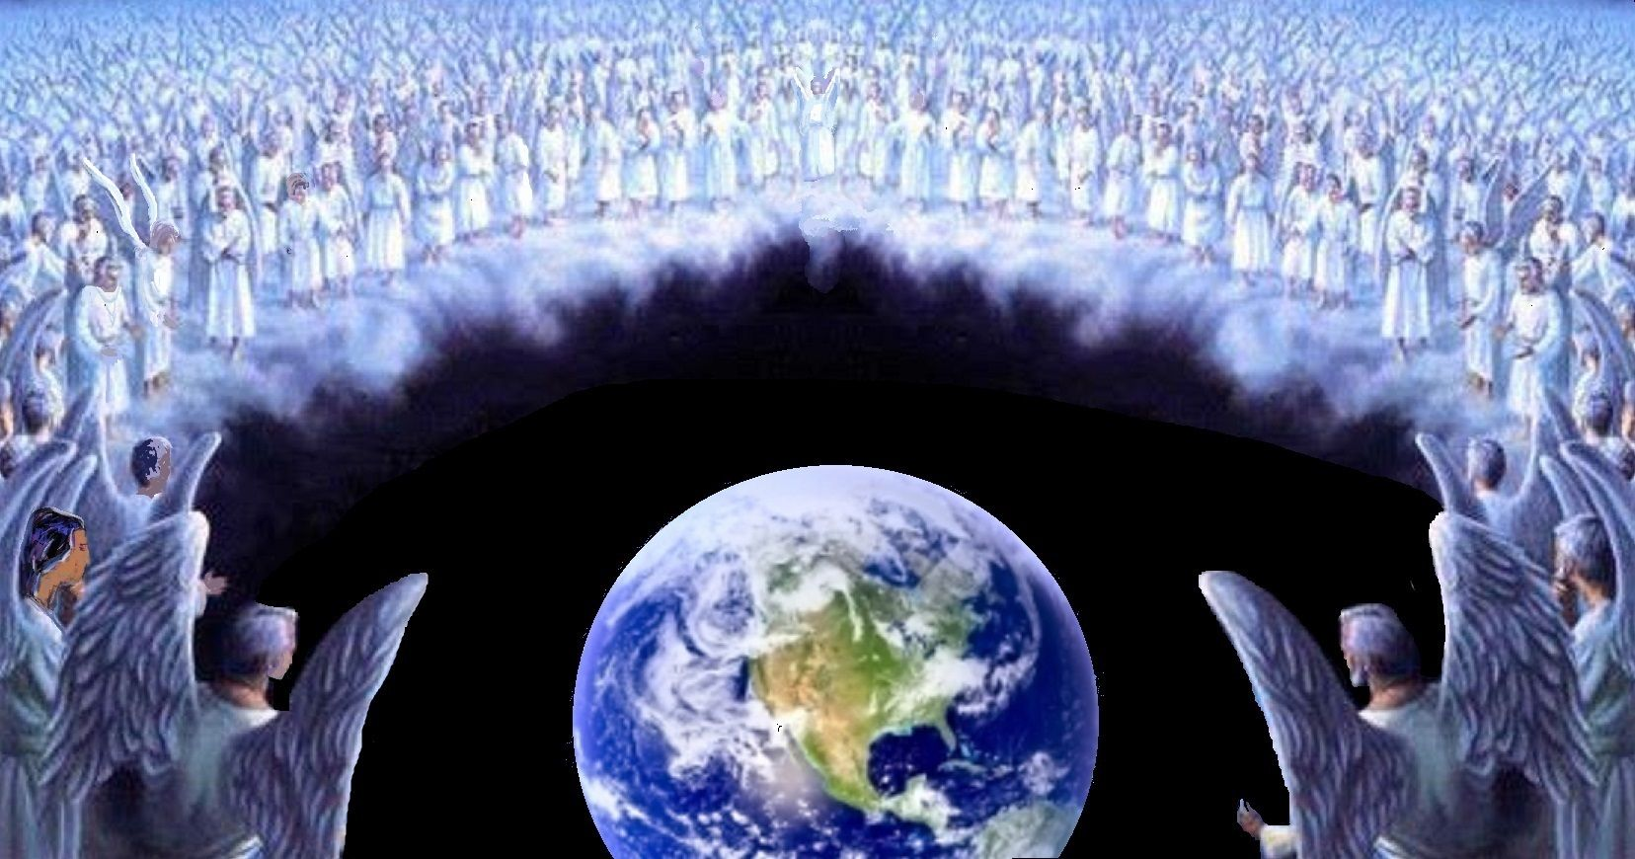
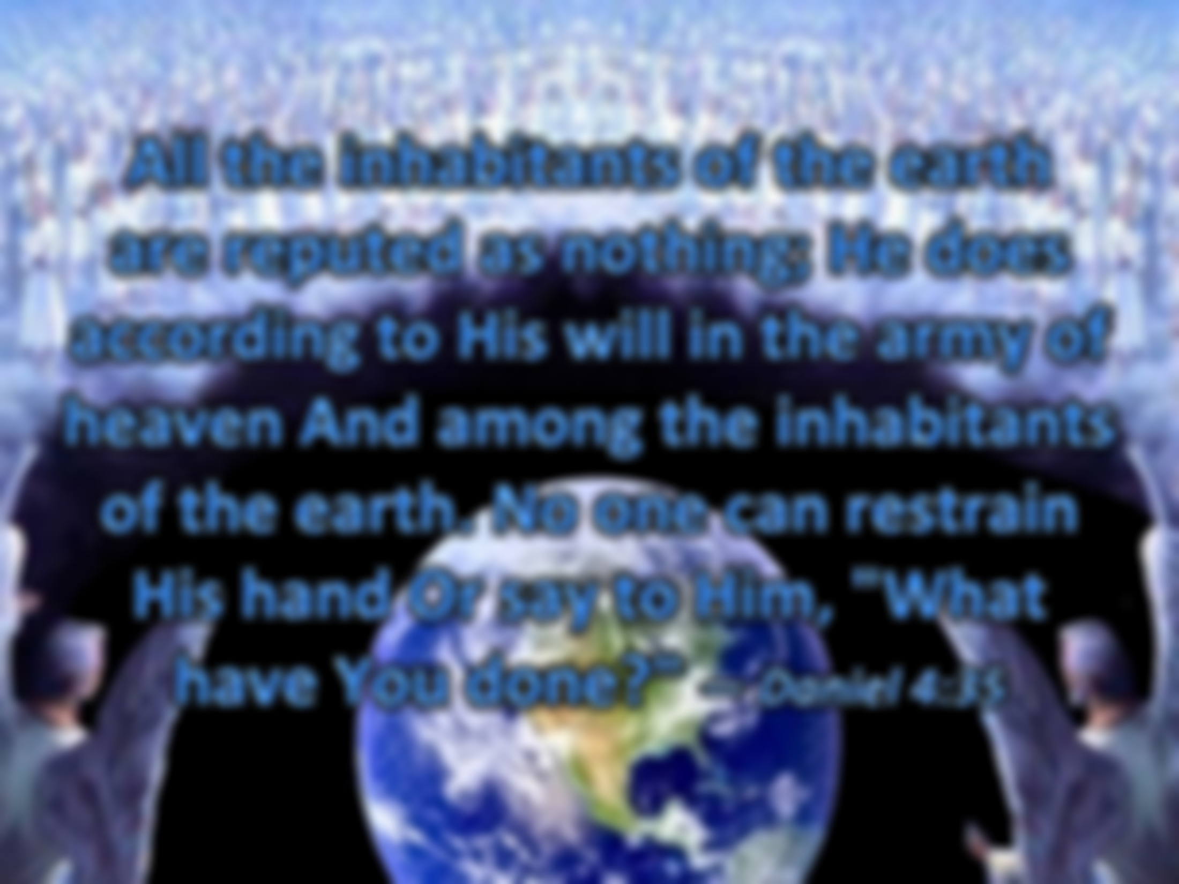


All the inhabitants of the earth are reputed as nothing; He does according to His will in the army of heaven And among the inhabitants of the earth. No one can restrain His hand Or say to Him, "What have You done?" — Daniel 4:35
heaven
nothing
according to His will
according to His will
heaven
Notes:
God has created a realm of redemption for those that have fallen away. Ask not what God can do for us, but what we can do for God.

Slide 6
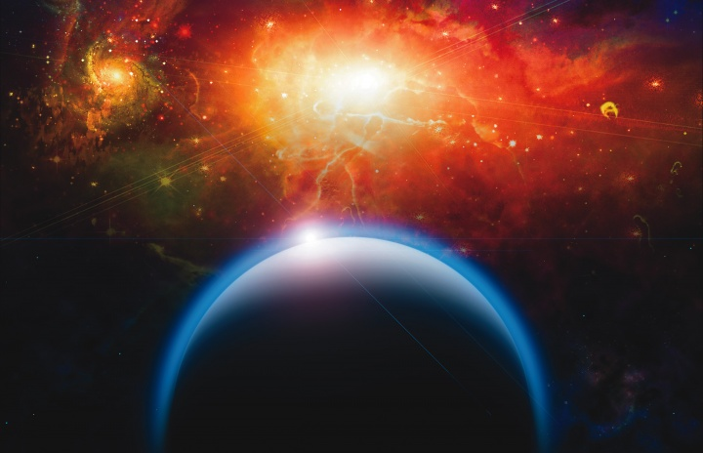
But our God is in heaven; He does whatever He pleases. — Psalms 115:3
heaven
heaven
Notes:
God needs no excuse for the good that He is.

Slide 7
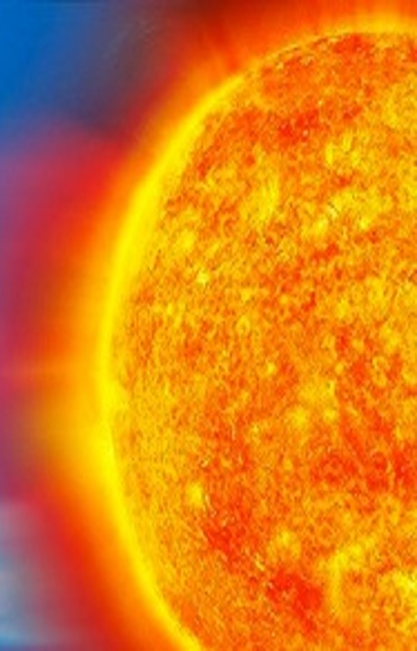
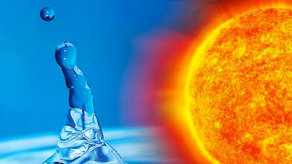


Surely men of low degree are a vapor, Men of high degree are a lie; If they are weighed on the scales, They are altogether lighter than vapor. — Psalms 62:9
high
vapor Men of
degree vapor
low
low
vapor
Men of
high
degree
lie
vapor
lie
Notes:
Loneliness is a touch upon the heart of isolation, depending on time, to reveal those questions of not knowing.

Slide 8
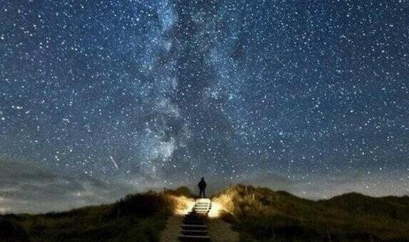
For if anyone thinks himself to be something, when he is nothing, he deceives himself. But let each one examine his own work, and then he will have rejoicing in himself alone, and not in another. For each one shall bear his own load. — Galatians 6:3-5
each one
examine
. .
examine
own work
in
. .
rejoicing in
. .
bear his own load
lie
Notes:
If God reveres those upon the earth as quintessentially honest and obedient, rather than radical, liberal, criminal, to His cause, He surely will reward those who believe over deceptions given by man.

Slide 9
soul
Notes:
If God reveres those upon the earth as quintessentially honest and obedient, rather than radical, liberal, criminal, to His cause, He surely will reward those who believe over deceptions given by man.

Slide 10

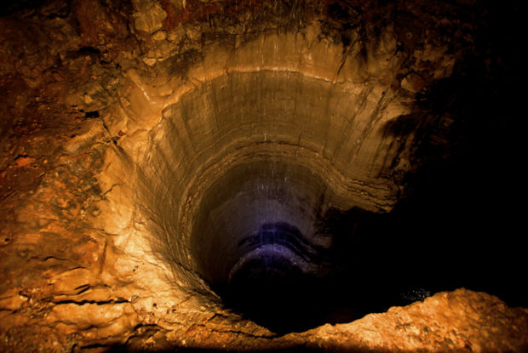
Those who trust in their wealth And boast in the multitude of their riches, None of them can by any means redeem his brother, Nor give to God a ransom for him - For the redemption of their souls is costly, And it shall cease forever - That he should continue to live eternally, And not see the Pit. — Psalms 49:6-9
redemption
soul
costly
redemption
soul
costly
soul
soul
Hell
not see the Pit
not see the Pit
Notes:
How one sees wealth reveals the cost of what no one can pay for. The whole earth cannot award one breath. No sister or brother can redeem what God alone looks for, a sole contrite heart that yearns for His forgiveness, thankfully pressed upon His love.

Slide 11
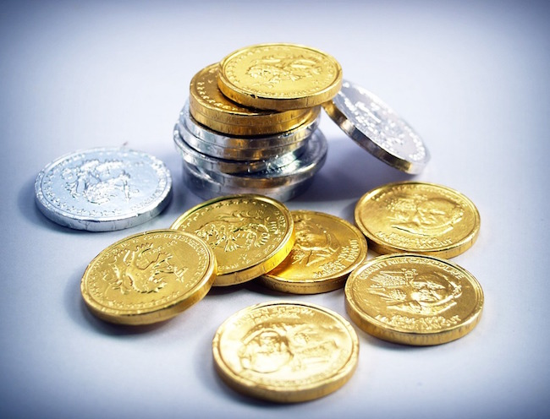
How much better to get wisdom than gold! And to get understanding is to be chosen rather than silver. The highway of the upright is to depart from evil; He who keeps his way preserves his soul. Pride goes before destruction, And a haughty spirit before a fall. — Proverbs 16:16-18
wisdom
ing
understanding
l
v
i
highway
highway
living
depart from evil
depart from evil
keeps his way
keeps his way
soul
Pride
Notes:
To travel the higher roads where truth shines without measure, one must surrender all before the One that saves and gives life.

Slide 12
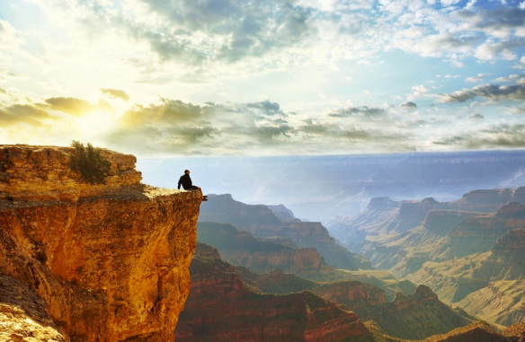
"But where can wisdom be found? And where is the place of understanding? Man does not know its value, Nor is it found in the land of the living. The deep says, 'It is not in me'; And the sea says, 'It is not with me.' It cannot be purchased for gold, Nor can silver be weighed for its price." — Job 28:12-15
understand
understand
living
cannot be purchased
cannot be purchased
Notes:
The value of life embraces the gift of God to humbly acknowledge He is supreme above all. Earth’s possessions are valued as last in comparison to eternal life where music never ends.

Slide 13
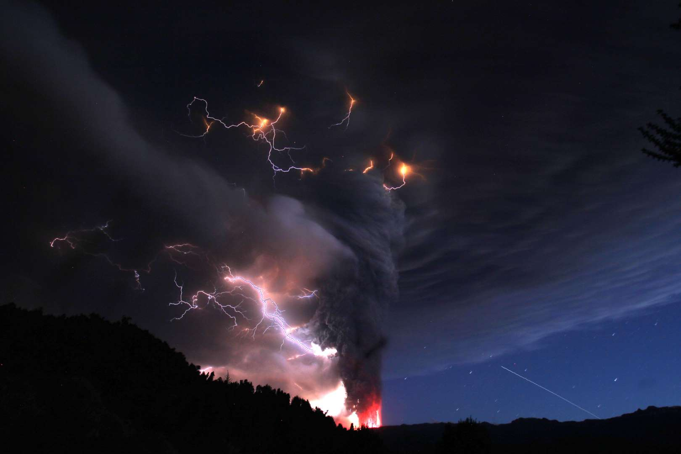
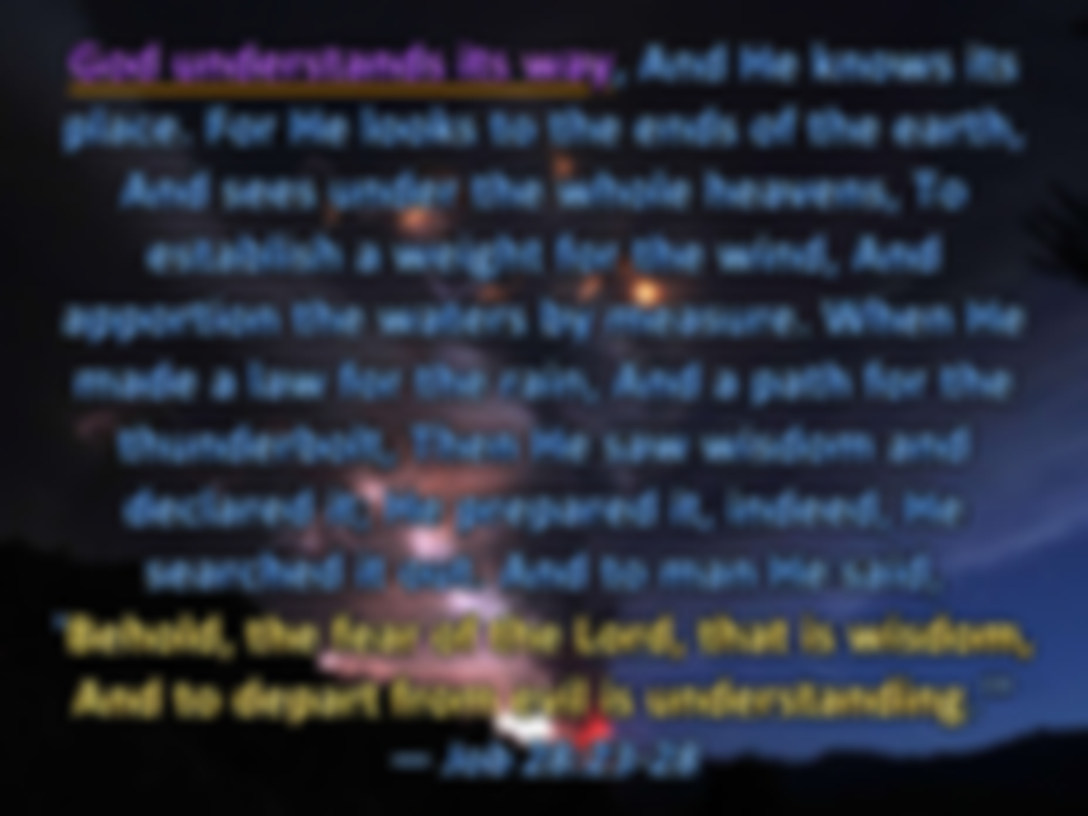
God understands its way, And He knows its place. For He looks to the ends of the earth, And sees under the whole heavens, To establish a weight for the wind, And apportion the waters by measure. When He made a law for the rain, And a path for the thunderbolt, Then He saw wisdom and declared it; He prepared it, indeed, He searched it out. And to man He said, 'Behold, the fear of the Lord, that is wisdom, And to depart from evil is understanding.'" — Job 28:23-28
God understands its way
understand
God understands its way
wisdom
wisdom
wisdom
Notes:
Facts will never change where truth tells wisdom. God declares understanding will come to those who have awe under His creation.

Slide 14
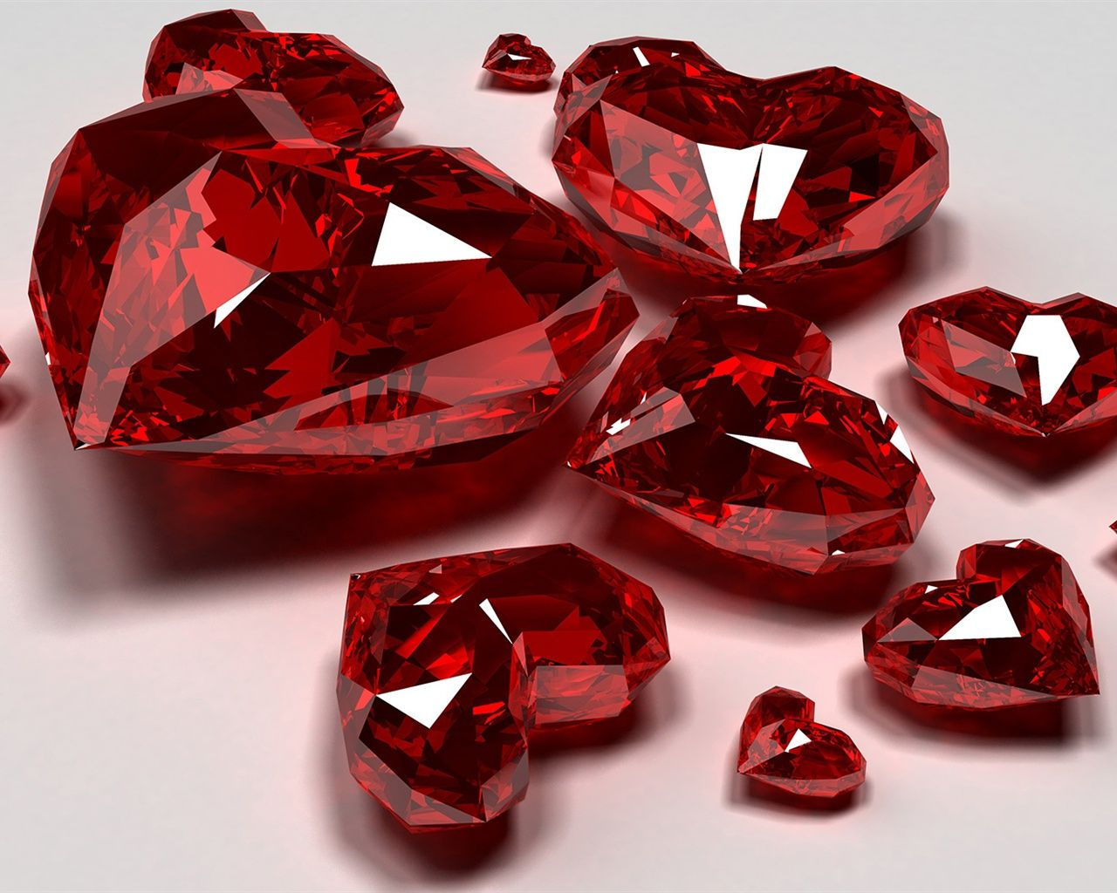
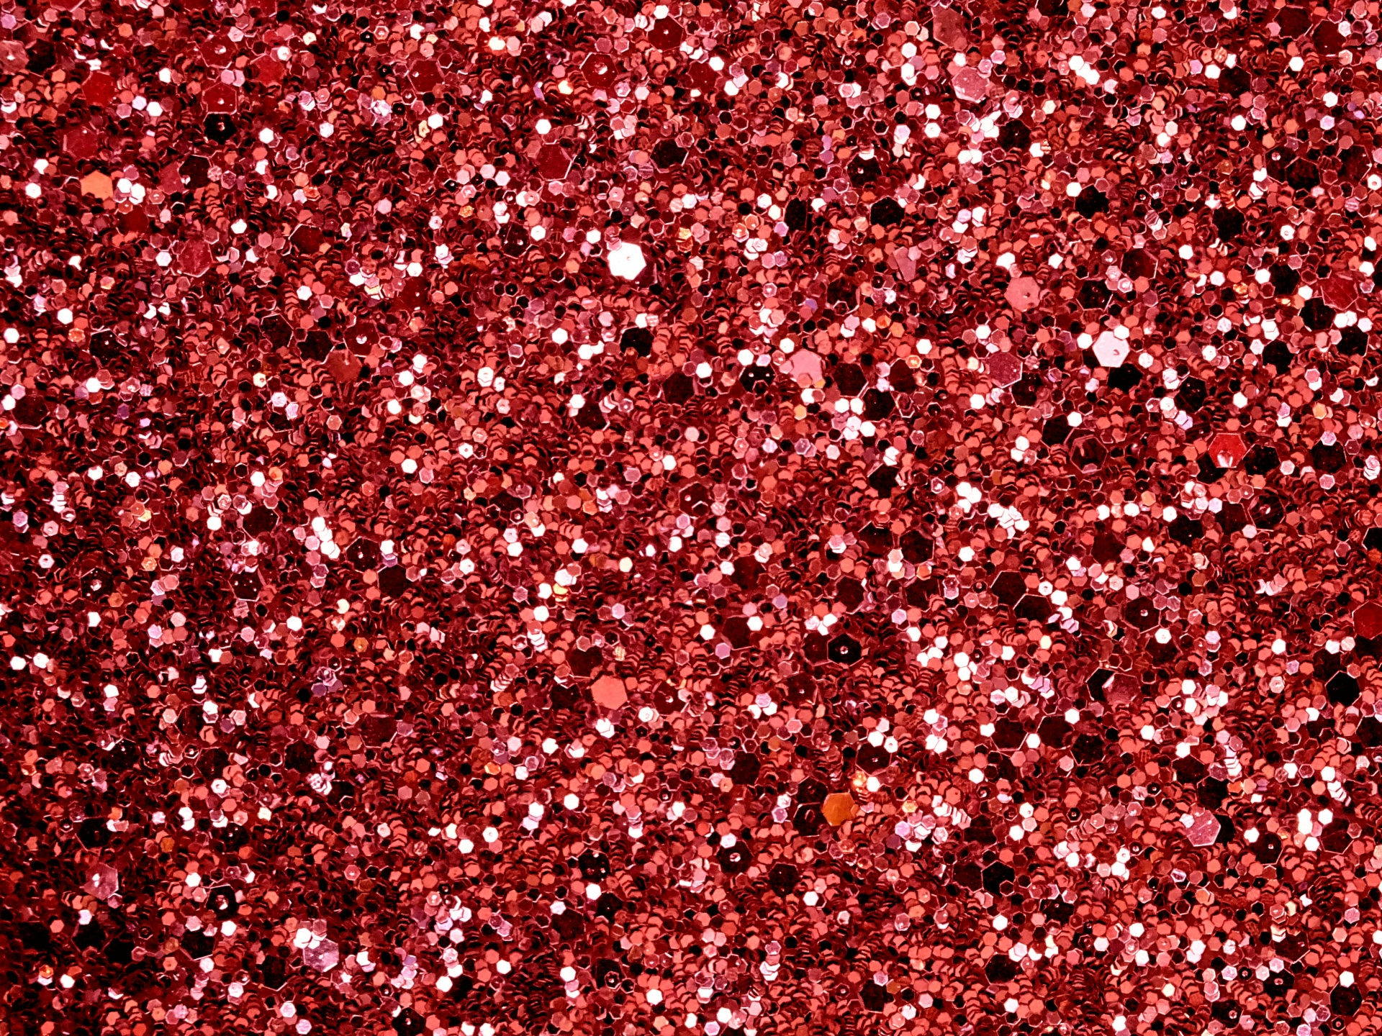
Receive my instruction, and not silver, And knowledge rather than choice gold; For wisdom is better than rubies, And all the things one may desire cannot be compared with her. — Proverbs 8:10-11
silver
choice
wisdom is better
gold
wisdom is better
choice
wisdom
rubies
Notes:
Who can say the calm of understanding does not enrich the soul?

Slide 15

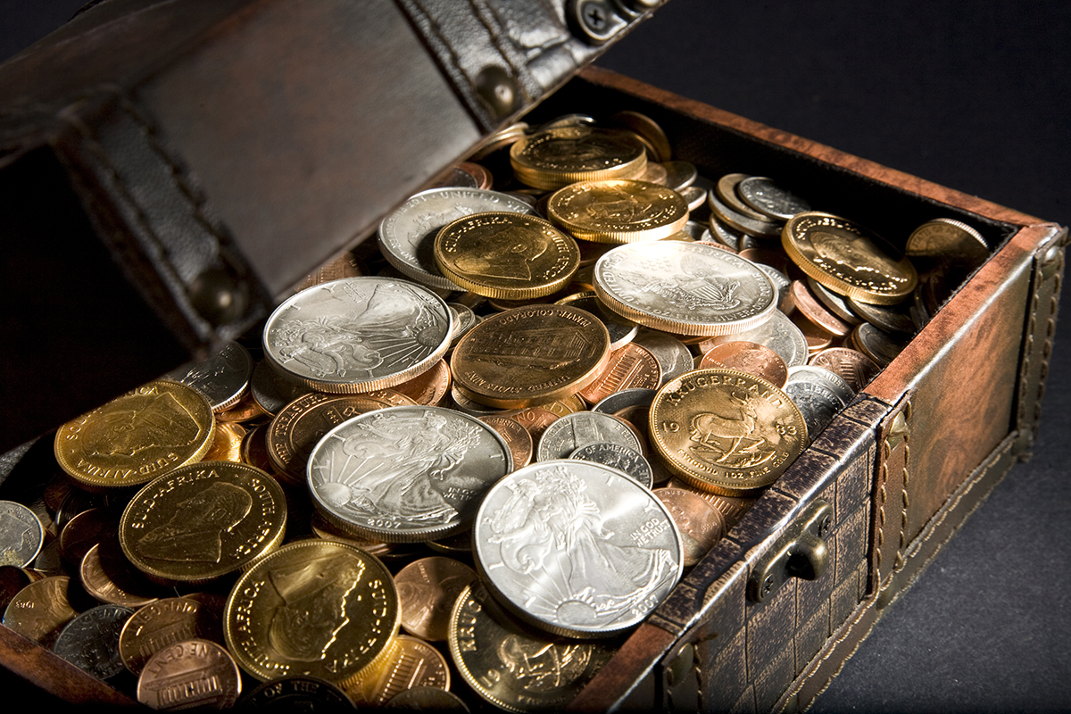
"Riches and honor are with me, Enduring riches and righteousness. My fruit is better than gold, yes, than fine gold, And my revenue than choice silver. I traverse the way of righteousness, In the midst of the paths of justice, That I may cause those who love me to inherit wealth, That I may fill their treasuries. The LORD possessed me at the beginning of His way, Before His works of old." — Proverbs 8:18-22
Riches and honor
Riches and honor
choice
righteousness
righteousness
righteousness
His way
justice
justice
justice
love
love
love
His way
Notes:
The value of truth rises above the stars where God Himself knows.

Slide 16
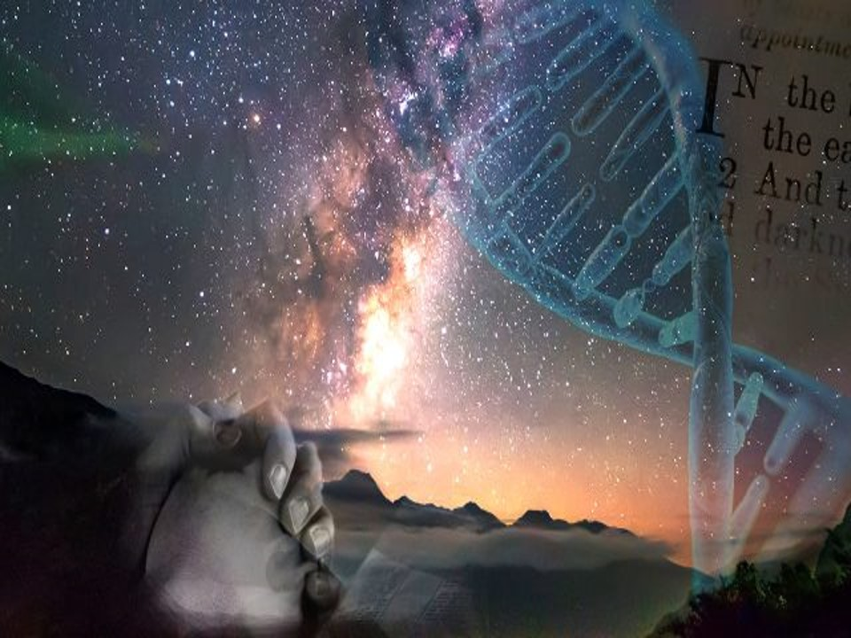

"God, who made the world and everything in it, since He is Lord of heaven and earth, does not dwell in temples made with hands. Nor is He worshiped with men's hands, as though He needed anything, since He gives to all life, breath, and all things." — Acts 17:24-25
He has made
h
made
His way
He
as
He gives to all life
He gives to all life
Notes:
God does not need temples or amusement parks built by man over true hearts in the vault of His service.

Slide 17


"And He has made from one blood every nation of men to dwell on all the face of the earth, and has determined their preappointed times and the boundaries of their dwellings, so that they should seek the Lord, in the hope that they might grope for Him and find Him, though He is not far from each one of us;" — Acts 17:26-27
He has made
to
hope to seek and find Him
seek
seek
seek
hope
hope
hope
. .
and find Him
find Him
Notes:
Senses make clear our existence. Creation exists so we may know the plan of God to love Him as He loves us.

Slide 18
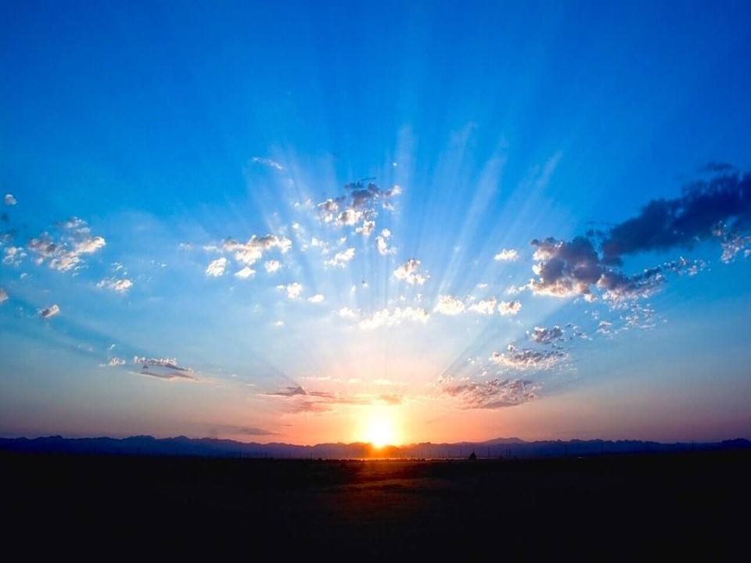

"… for in Him we live and move and have our being, as also some of your own poets have said, 'For we are also His offspring.' "Therefore, since we are the offspring of God, we ought not to think that the Divine Nature is like gold or silver or stone, something shaped by art and man's devising. — Acts 17:28-29
in
. .
in Him we live
God
we are the offspring
. .
God
of God
. .
Divine Nature
Divine Nature
Notes:
Life is not a material expression of an exact place, but now in the presence of God.

Slide 19
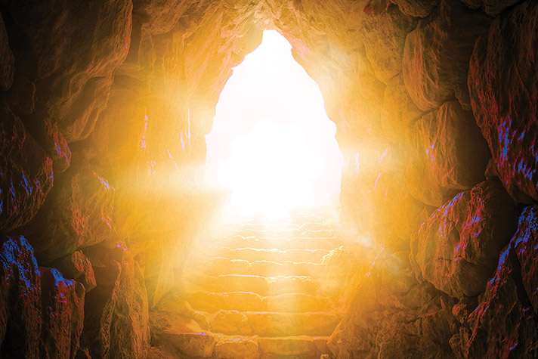
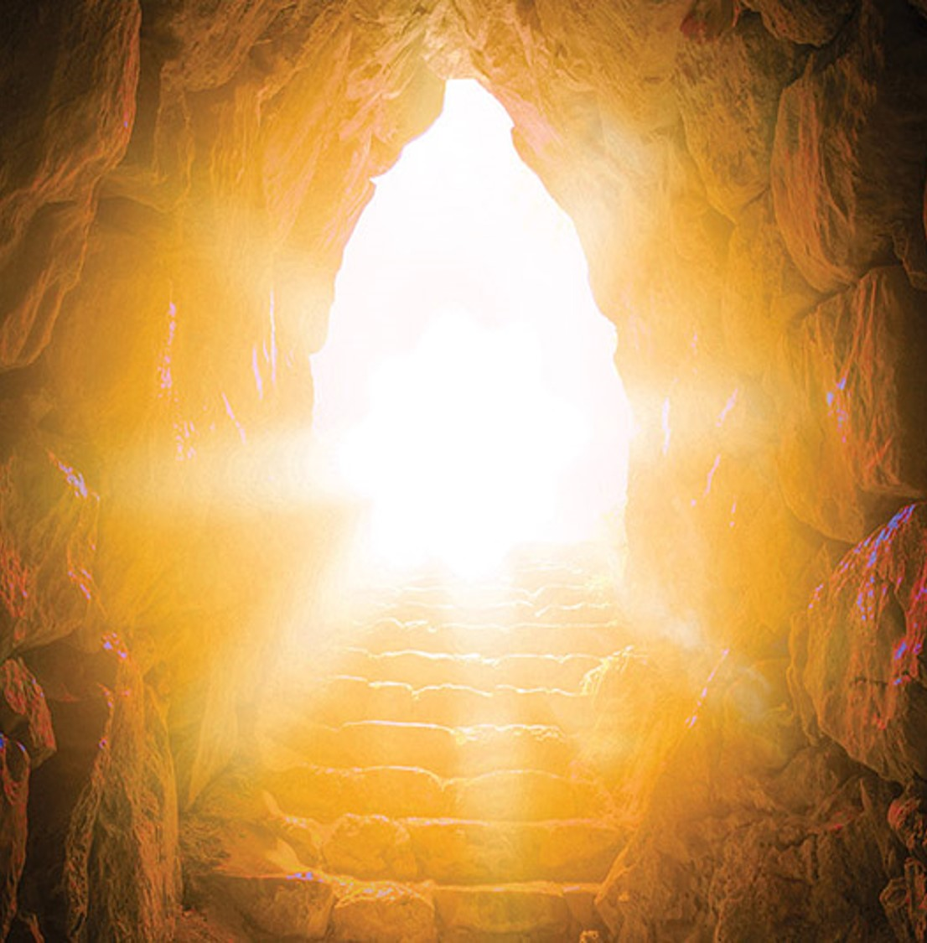
"Truly, these times of ignorance God overlooked, but now commands all men everywhere to repent, because He has appointed a day on which He will judge the world in righteousness by the Man whom He has ordained. He has given assurance of this to all by raising Him from the dead." — Acts 17:30-31
to repent
. .
God
in
the world
. .
in righteousness
all the world
all
Notes:
Judgment involves the character, and the ability, to become better than who we once were in those sins of selfish desire.

Slide 20
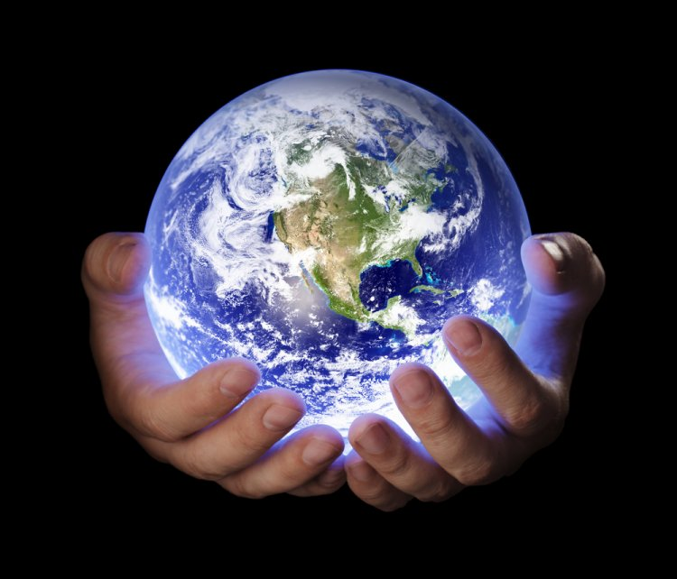
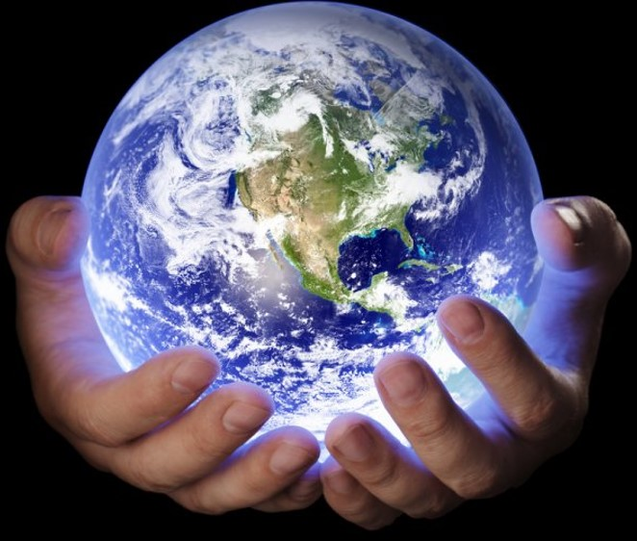
"'Now therefore, if you will indeed obey My voice and keep My covenant, then you shall be a special treasure to Me above all people; for all the earth is Mine.'" — Exodus 19:5
obey
keep
obey
keep
treasure to Me
. .
all the earth is Mine
all the world
Notes:
Treasures of God illuminate the strings of heart enhancing the aromas of heaven. God is the ultimate miner, searching the depths of life with heart.

Slide 21
God

Slide 22
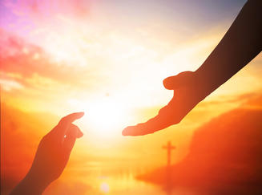
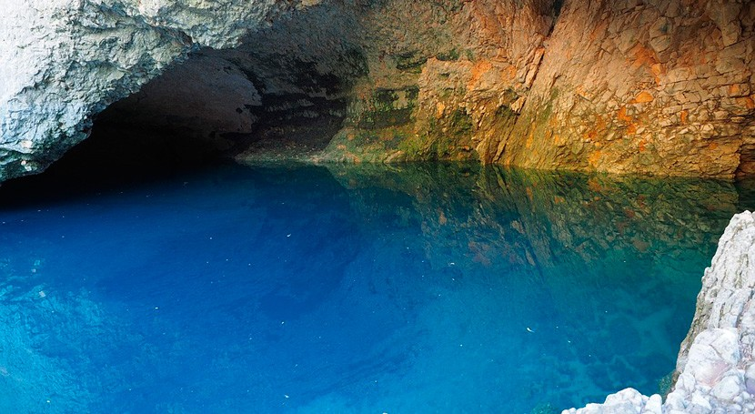
Yes, the Almighty will be your gold And your precious silver; For then you will have your delight in the Almighty, And lift up your face to God. — Job 22:25-26
have
delight
have
delight
God
God
Notes:
No spin has greater value than to look up and see more than we are. God has given us the silver and gold of life itself.

Slide 23


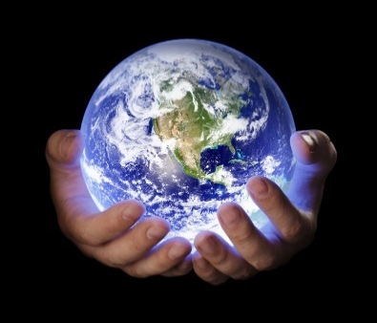


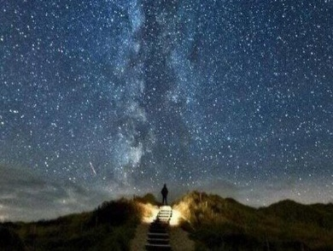
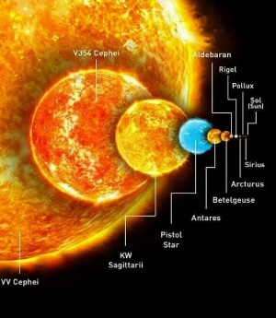
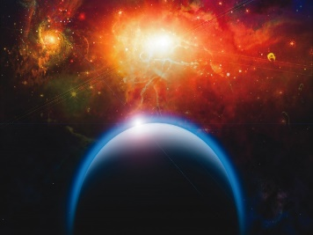
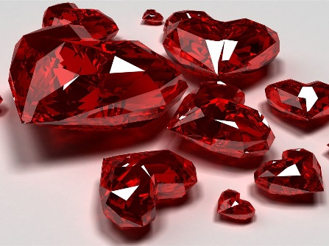





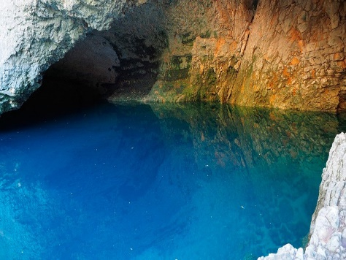

Slide 24

→ God counts the nations as small on the scales
→ God is in heaven and does as He pleases
→ Thinking one is greater can be deceptive
→ Trusting in material wealth is worthless
→ Pride and a haughty spirit causes a soul to fall
→ True value rises past mere substance
→ The wise depart from evil in fear of God
→ Wisdom and understanding is incomparable
→ The richest among us fully embrace wisdom
→ The divine nature is about life over material wealth
→ Our righteous value will be found at His judgment
→ Those who hear & obey His word are special to Him
→ It is God Himself that holds the greatest value
No faithful heart has the absence of His grace
Notes:
No faithful heart has the absence of His grace.

Slide 26
Value
2
Ron Bert
March 29, 2020

Slide 27

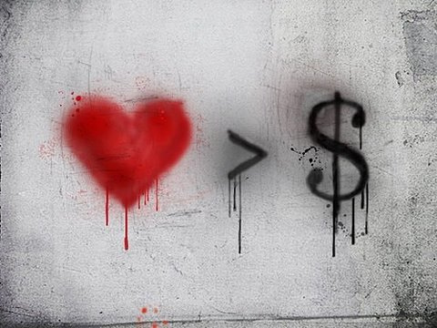
"For what profit is it to a man if he gains the whole world, and loses his own soul? Or what will a man give in exchange for his soul?" — Matthew 16:26
soul
exchange
Notes:
In the case of value, is not life itself of the highest of all known?

Slide 28
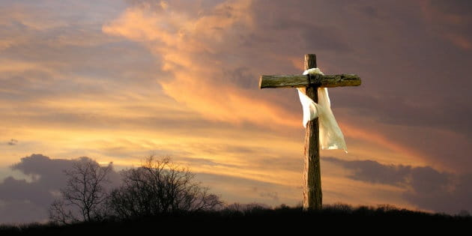
But what things were gain to me, these I have counted loss for Christ. Yet indeed I also count all things loss for the excellence of the knowledge of Christ Jesus my Lord, for whom I have suffered the loss of all things, and count them as rubbish, that I may gain Christ … — Philippians 3:7-8
Christ
Christ
excellence
excellence
Christ
Christ Jesus
count
count
gain
gain
Christ
Notes:
Knowledge of life and why we are is a quality of importance.

Slide 29
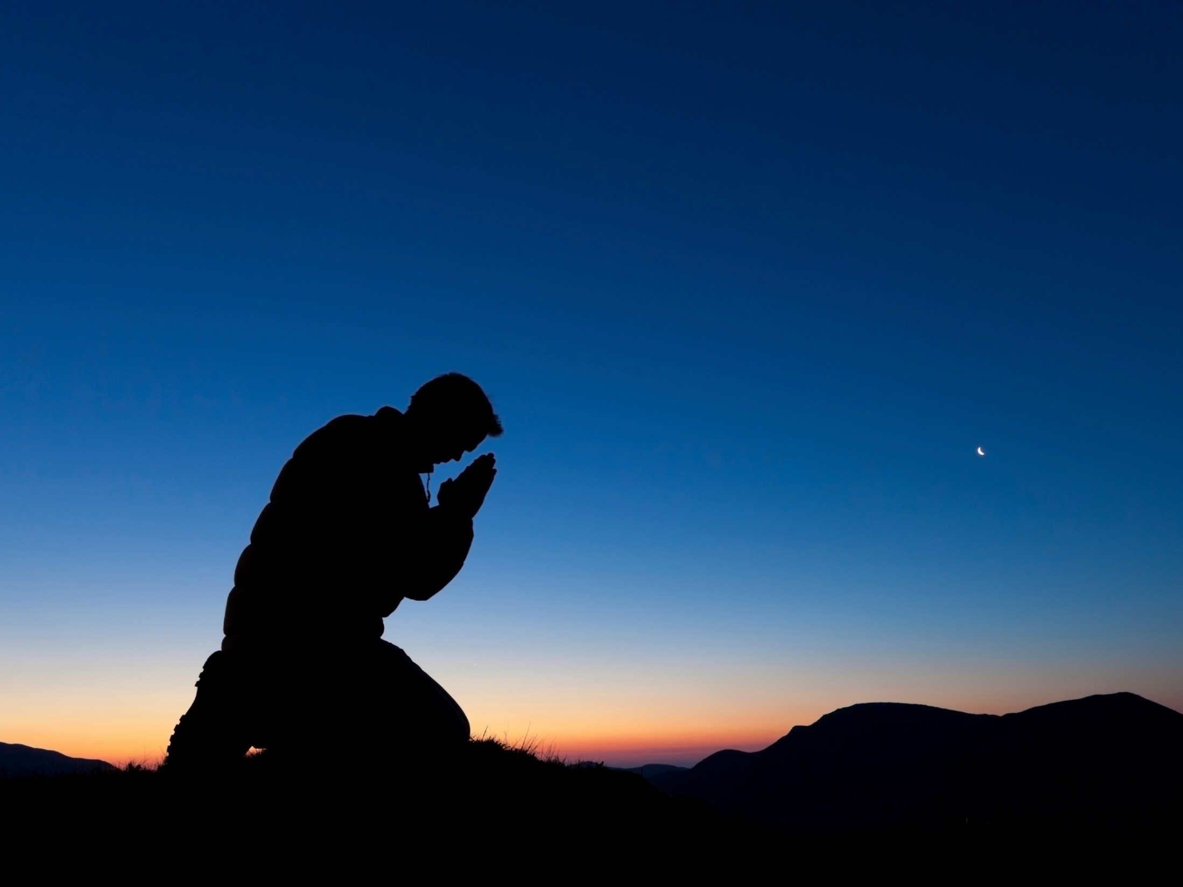
… and be found in Him, not having my own righteousness, which is from the law, but that which is through faith in Christ, the righteousness which is from God by faith; that I may know Him and the power of His resurrection, and the fellowship of His sufferings, being conformed to His death, if, by any means, I may attain to the resurrection from the dead. — Philippians 3:9-11
in
found in Him
found
found in Him
righteousness
righteousness
in
faith in
faith in
Christ
Christ
righteousness
Christ
God
faith
by any
by any
means
attain
means
God
attain
faith
Notes:
A rose is given its’ beauty because it is. A man becomes a king when belief extends beyond self and faith lifts life.

Slide 30
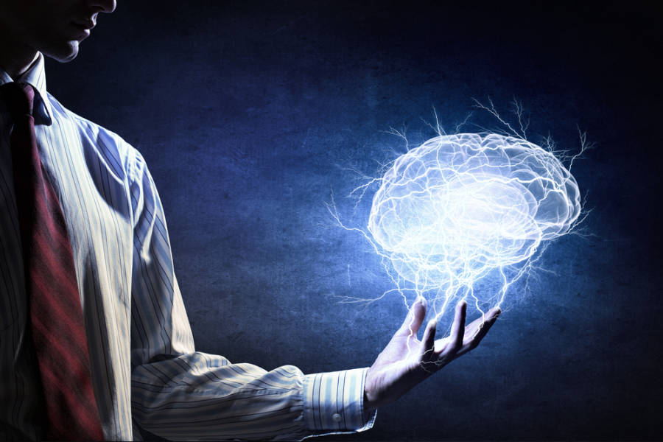

And do not be conformed to this world, but be transformed by the renewing of your mind, that you may prove what is that good and acceptable and perfect will of God. For I say, through the grace given to me, to everyone who is among you, not to think of himself more highly than he ought to think, but to think soberly, as God has dealt to each one a measure of faith. — Romans 12:2-3
be transformed
renewing
be transformed
renewing
mind
mind
prove what is
prove what is the will of God
will of God
Seek
the
God
faith
Notes:
The end of this world is dust; as such we must rise to that which is greater than the earth.

Slide 31
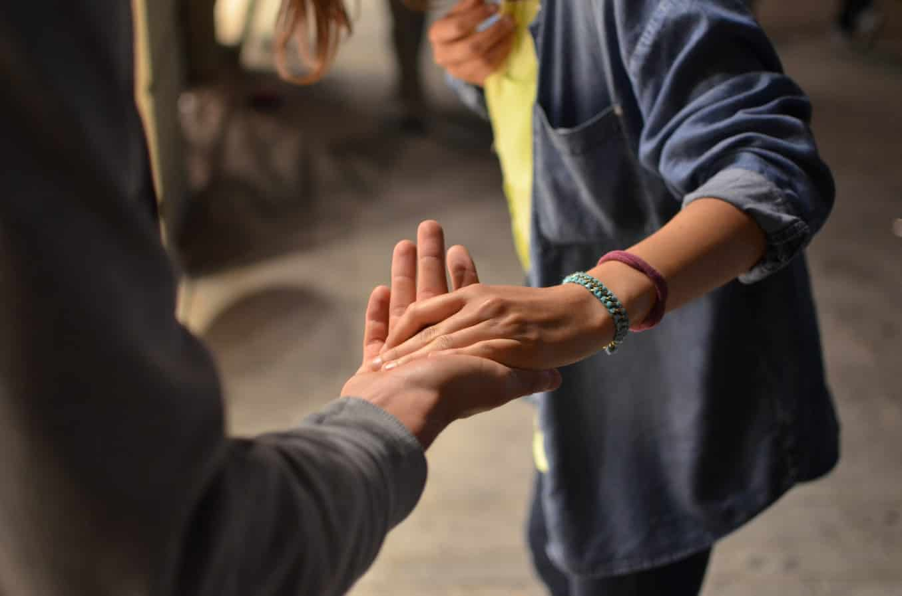
Let nothing be done through selfish ambition or conceit, but in lowliness of mind let each esteem others better than himself. Let each of you look out not only for his own interests, but also for the interests of others. Let this mind be in you which was also in Christ Jesus, … — Philippians 2:3-5
mind
esteem
mind
esteem
. .
others better than himself
. .
look out
. .
own interests
. .
interests of others
in
. .
be in you
. .
Christ Jesus
Christ Jesus
Notes:
So few are able to find the perfection He calls out for in us all. True hearts care for the simplest of concerns opening doors for strangers and tolerating the selfish among us. Nobility of heart shines as a jewel in His sight. Shame comes upon all, when He is revealed, as we fall before Him.

Slide 32
God
Notes:
So few are able to find the perfection He calls out for in us all. True hearts care for the simplest of concerns opening doors for strangers and tolerating the selfish among us. Nobility of heart shines as a jewel in His sight. Shame comes upon all, when He is revealed, as we fall before Him.

Slide 33
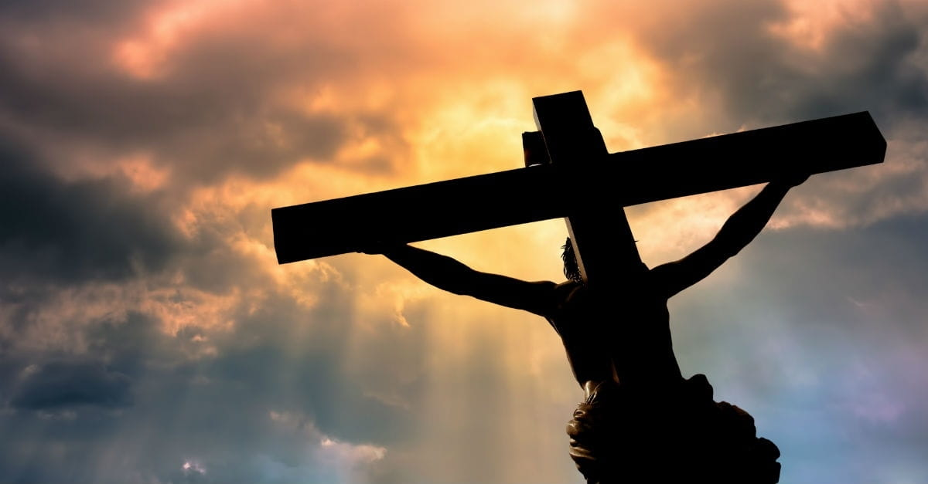
For scarcely for a righteous man will one die; yet perhaps for a good man someone would even dare to die. But God demonstrates His own love toward us, in that while we were still sinners, Christ died for us. — Romans 5:7-8
God
God demonstrates
God
God demonstrates
love
love toward us
love toward us
Christ died for us
Christ
Christ died for us
Notes:
Sacrifice has no comprehensive expression for the love it gives.

Slide 34
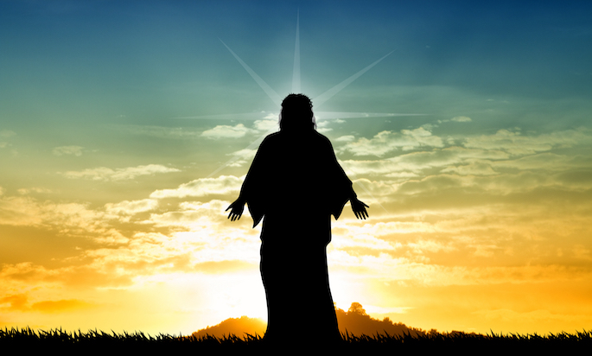
… who desires all men to be saved and to come to the knowledge of the truth. — 1st Timothy 2:4
God
come to
come to
the truth
the truth
Notes:
God has no desire to see souls deceived without hope through knowledge. This is why He came to sacrifice His own life, so we can know how to come to Him, in spirit and truth.

Slide 35
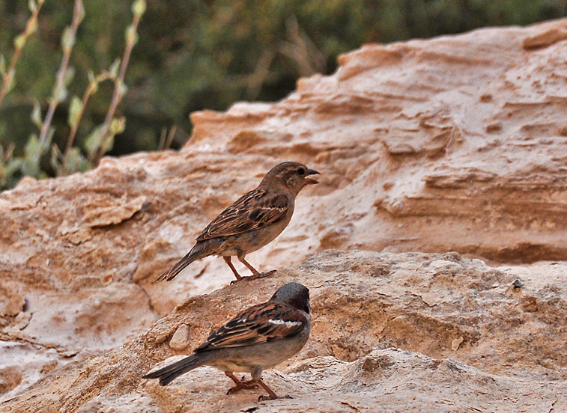
"Are not two sparrows sold for a copper coin? And not one of them falls to the ground apart from your Father's will. But the very hairs of your head are all numbered. Do not fear therefore; you are of more value than many sparrows." — Matthew 10:29-31
value
Do not fear
Do not fear
are more
are
more
value
of more value
of more value
Notes:
God created dust, and all that forms around it, to test the desires of life freely given. Too often people are mired in self-pity, despising existence, on the cough of disgust. Laughing love is thin for those wingless thoughts of blue. He waits for each returning soul He holds.

Slide 36
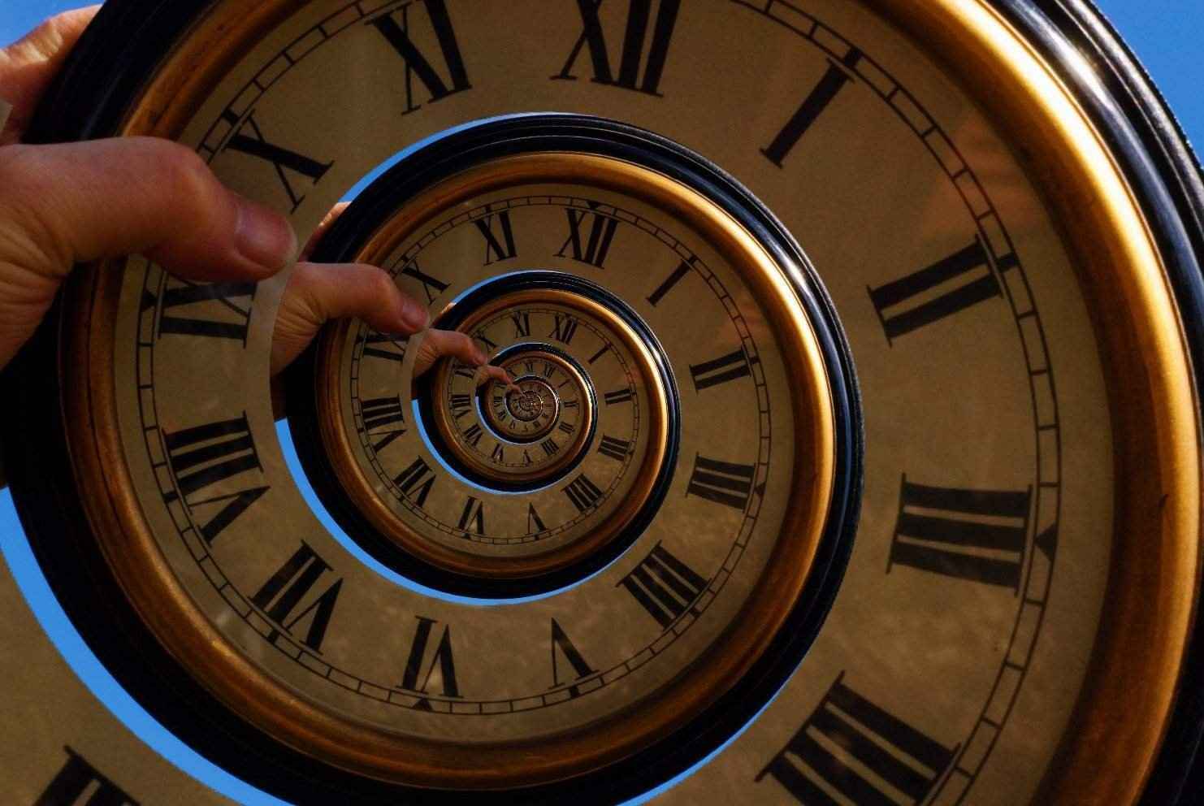
Many, O LORD my God, are Your wonderful works Which You have done; And Your thoughts toward us Cannot be recounted to You in order; If I would declare and speak of them, They are more than can be numbered. — Psalms 40:5
LORD
L
LORD
wonderful works
k
wonderful works
o
Cannot
value
Cannot
Look
o
are more
be numbered
be numbered
Notes:
Time is a spiral that wells up from deep inside memories coming from the outside. No number can express His timelessness where His sense for each of us embraces all moments.

Slide 37
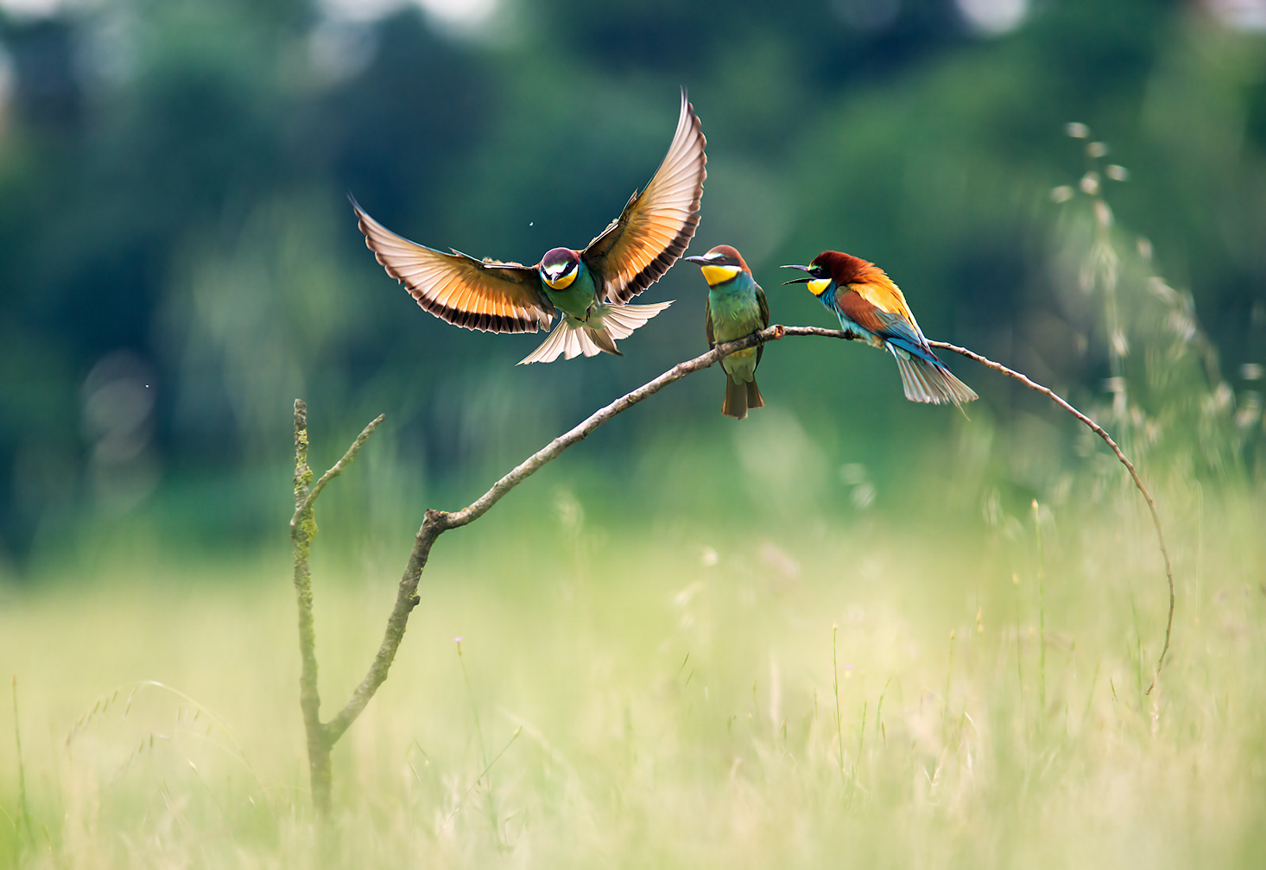
"Therefore I say to you, do not worry about your life, what you will eat or what you will drink; nor about your body, what you will put on. Is not life more than food and the body more than clothing? Look at the birds of the air, for they neither sow nor reap nor gather into barns; yet your heavenly Father feeds them. Are you not of more value than they?" — Matthew 6:25-26
life
food and
clothing
Look
food and clothing
value
value
Notes:
Worry is a lack of trust that weighs on broken hearts. Valleys always have mountains above as we all endure the shadows that etch the silence of hope’s enchantment.

Slide 38
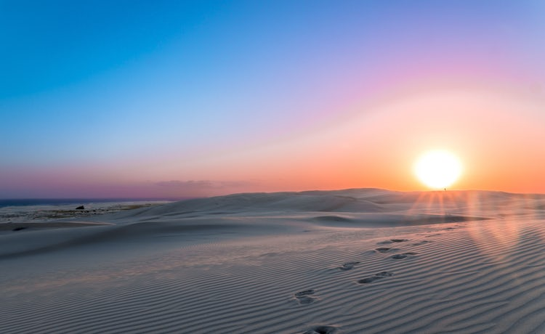
Now godliness with contentment is great gain. For we brought nothing into this world, and it is certain we can carry nothing out. And having food and clothing, with these we shall be content. — 1st Timothy 6:6-8
godliness with contentment
godliness
godliness with contentment
is great gain
is great gain
godliness
food and clothing
Notes:
To feast on heaven itself clears the senses to love. What would we do if the sun was not there; how important would those things we place the greatest importance on? We often dismiss those things of a higher nature where life itself has the greatest value.

Slide 39

For bodily exercise profits a little, but godliness is profitable for all things, having promise of the life that now is and of that which is to come. — 1st Timothy 4:8
godliness
life
life
eternity
Notes:
Nothing done by the self can lift a soul to heavens door; it is His heart that offers the hand to pull us through.

Slide 40
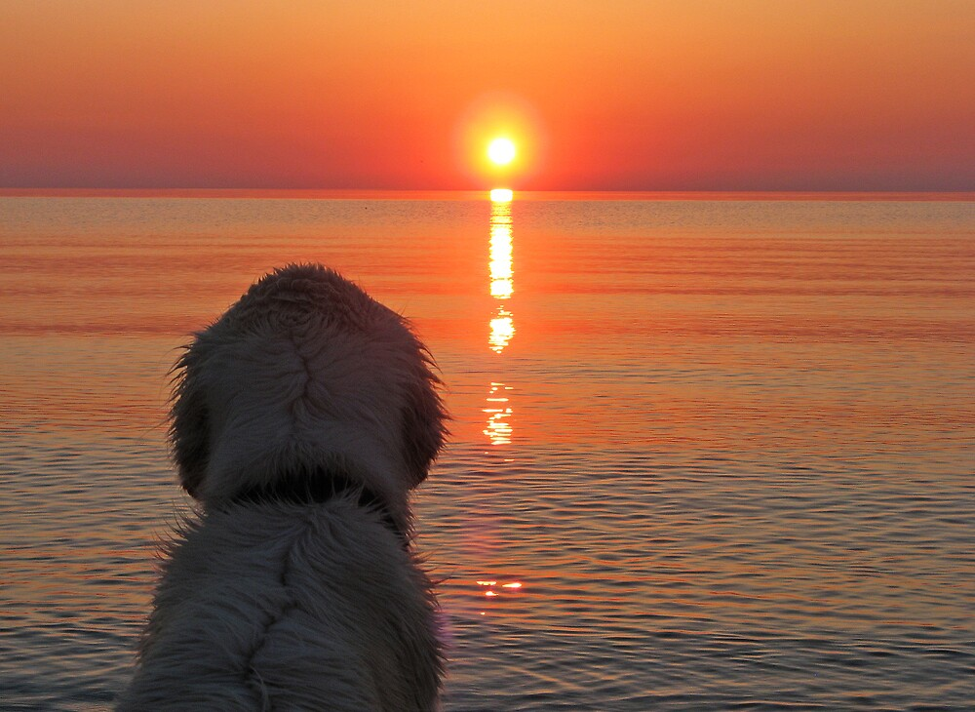
Let your conduct be without covetousness; be content with such things as you have. For He Himself has said, "I will never leave you nor forsake you." So we may boldly say: "The LORD is my helper; I will not fear. What can man do to me?" — Hebrews 13:5-6
conduct
be without
covetousness
be content with
as you have
life
conduct:
● be without covetousness
● be content with as you have
Notes:
A friend cuts to the bottom of a heart, open to all that comes forth.

Slide 41
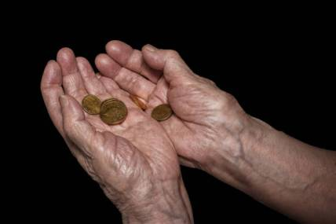
Now Jesus sat opposite the treasury and saw how the people put money into the treasury. And many who were rich put in much. Then one poor widow came and threw in two mites, which make a quadrans. So He called His disciples to Himself and said to them, "Assuredly, I say to you that this poor widow has put in more than all those who have given to the treasury; for they all put in out of their abundance, but she out of her poverty put in all that she had, her whole livelihood." — Mark 12:41-44
t
r
h
r
w
i
t
with all your heart
you
h
ea
all that she had
all
all that she had
her whole
her whole
Notes:
Each of us needs to empty our desires in acceptance of His love. Acceptance brings contentment, by which only heaven can offer. It is about surrendering all of our life, to that which gives all. Bliss is an absolute unequalled.

Slide 42

"'And you shall love the LORD your God with all your heart, with all your soul, with all your mind, and with all your strength.' This is the first commandment." — Mark 12:30
with all your heart
with all
with all
with all
with all
found
with all
ou
nd
with all
with all
with all
f
Notes:
Where should our greatest love be? Should it not be with that which gives life itself to the sweet chords of knowing?

Slide 43
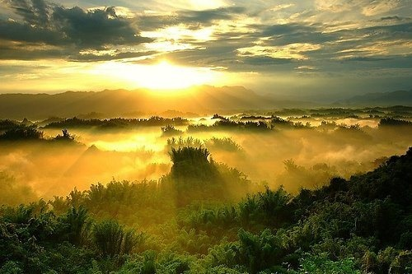
"Again, the kingdom of heaven is like treasure hidden in a field, which a man found and hid; and for joy over it he goes and sells all that he has and buys that field. — Matthew 13:44
all
treasure
treasure
found
found
found
found
all
Notes:
True treasure can never be stolen.

Slide 44

"Again, the kingdom of heaven is like a merchant seeking beautiful pearls, who, when he had found one pearl of great price, went and sold all that he had and bought it." — Matthew 13:45-46
ea
all
r
t
s
found
r
u
great
e
great treasure
all that he had
all that he had
Notes:
Genuine value is what we find the most uplifting. A prize awarded is sweetest when given in the open. He has given all in the open. Will we close the door or see the gift?

Slide 45
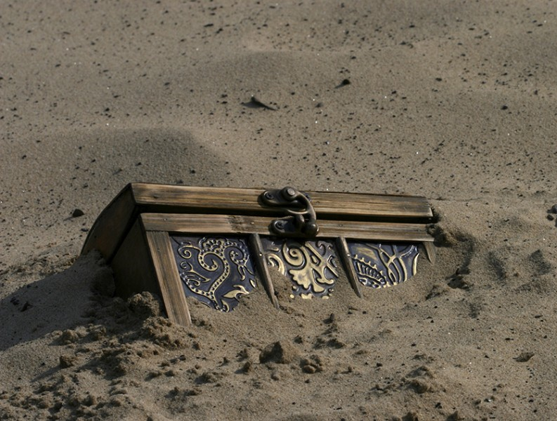
I rejoice at Your word As one who finds great treasure. — Psalms 119:162
treasure
great treasure
treasure
Notes:
What wells up from a heart’s bottom lasts longest for the depth of true desire.

Slide 46
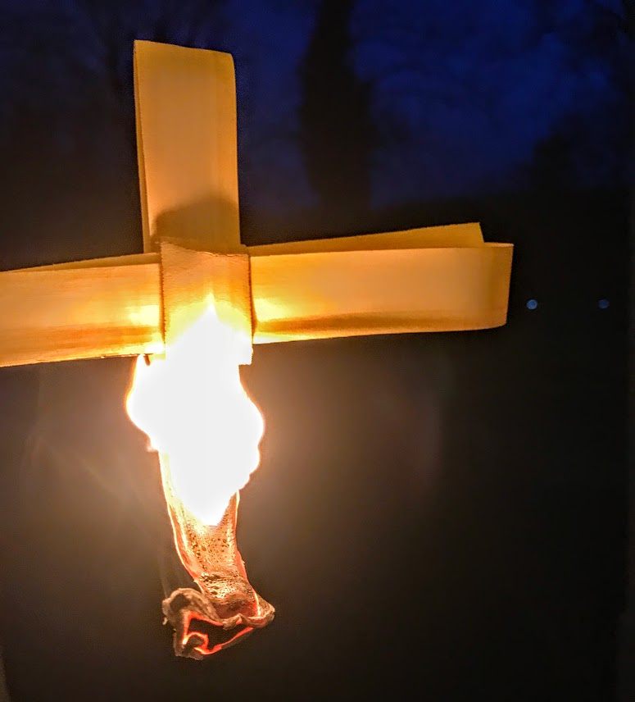
"Do not lay up for yourselves treasures on earth, where moth and rust destroy and where thieves break in and steal; but lay up for yourselves treasures in heaven, where neither moth nor rust destroys and where thieves do not break in and steal. For where your treasure is, there your heart will be also." — Matthew 6:19-21
heart for heaven
moth rust
thieves
destroy
for
in
heaven
. .
treasures in heaven
moth
rust
destroy
thieves
treasure
heart
Notes:
The agony of a soul is found in unobtainable desires to possess. Freedom is detachment from desire with happy thankful content hearts. It is the moment that has the greatest value.

Slide 47


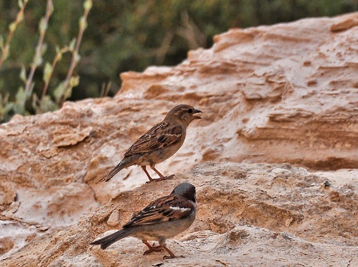




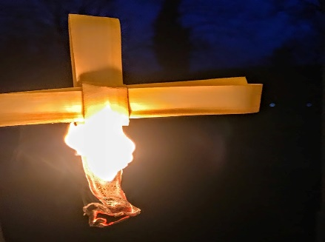
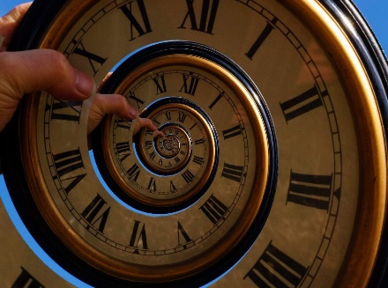






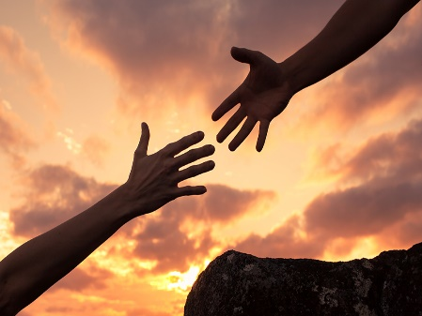


Slide 48

→ No worldly item can pay for the life of a soul
→ The excellence of knowledge of Christ has no equal
→ It's not about us but God’s power over death
→ Think soberly transformed by the renewing of mind
→ Compassionate hearts for others is a mind of Christ
→ God desires our salvation & knowledge of the truth
→ The thoughts of God for each cannot be numbered
→ Godliness with contentment is great gain
→ The promise of life to come lights real value
→ Be content with such things as you have
→ Giving your all is where one places greatest value
→ Worship is unyielding love for God’s wealth of Spirit
→ Rejoice in the great treasure of His word
In His light we find the treasure of Spirit
Notes:
In His light we find the treasure of Spirit

Slide 50
Value
3
Ron Bert
May 17, 2020

Slide 51
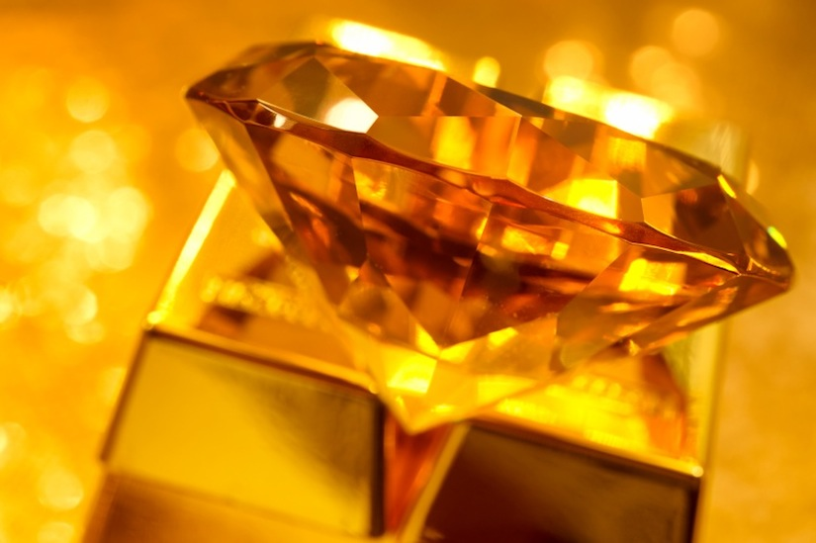

Slide 52


There is gold and a multitude of rubies, But the lips of knowledge are a precious jewel. — Proverbs 20:15
rubies
rubies
knowledge
knowledge
knowledge
. .
precious jewel
Notes:
Knowledge is priceless treasure.

Slide 53

For wisdom is better than rubies, And all the things one may desire cannot be compared with her. — Proverbs 8:11
wisdom
wisdom is better
wisdom
rubies
wisdom is better
Notes:
To understand is the blessing given to those employing wisdom.

Slide 54

If any of you lacks wisdom, let him ask of God, who gives to all liberally and without reproach, and it will be given to him. — James 1:5
wisdom
ask of God
all
God
ask of God
with
with all
will be given
will be given
Notes:
Only humble hearts can reach what cannot be bought.

Slide 55

And you will seek Me and find Me, when you search for Me with all your heart. — Jeremiah 29:13
seek
Trust
with all
Notes:
Seeking often brings epiphanies without notice.

Slide 56
call
Notes:
Seeking often brings epiphanies without notice.

Slide 57

And if you call on the Father, who without partiality judges according to each one's work, conduct yourselves throughout the time of your stay here in fear; knowing that you were not redeemed with corruptible things, like silver or gold, from your aimless conduct received by tradition from your fathers, but with the precious blood of Christ, as of a lamb without blemish and without spot. — 1st Peter 1:17-19
p
r
es
call
m
redeemed
redeemed
silver or gold
precious promises
with the
with the
precious
blood
Christ
precious blood of Christ
precious blood of Christ
is
o
Notes:
For heaven to welcome a soul, a heart must do what God calls out for, putting value on His commands.

Slide 58

… as His divine power has given to us all things that pertain to life and godliness, through the knowledge of Him who called us by glory and virtue, by which have been given to us exceedingly great and precious promises, that through these you may be partakers of the divine nature, having escaped the corruption that is in the world through lust. — 2nd Peter 1:3-4
given to us all:
→ things that pertain to life
godliness → through the knowledge of Him
↓
called us by glory and virtue
given great and precious promises
↑
may be partakers of the divine nature escaped corruption that is through lust
given to us all
His divine power has given to us all
His divine power has given to us all
things that pertain to life
godliness
through the knowledge of Him
called us by glory and virtue
given
great
and precious promises
precious promises
may be partakers of the
divine nature
escaped
corruption that is
may be
may be
through lust
Notes:
What is most lovely is not hidden for those that know.

Slide 59

Therefore, having these promises, beloved, let us cleanse ourselves from all filthiness of the flesh and spirit, perfecting holiness in the fear of God. — 2nd Corinthians 7:1
cleanse ourselves
cleanse ourselves
God
X
in
perfecting holiness in
perfecting holiness in
God
God
God
Notes:
Value has limits rising from what is despicable. True value resides where noble values take precedence.

Slide 60

Or do you not know that your body is the temple of the Holy Spirit who is in you, whom you have from God, and you are not your own? For you were bought at a price; therefore glorify God in your body and in your spirit, which are God's. — 1st Cor. 6:19-20
in
Spirit who is in you
Spirit who is in you
God
from God
from God
glorify God
glorify God
in
in
in your body and in your spirit
actions
thoughts
in your body and in your spirit
Notes:
No greater value is found than coming to God’s nurturing light in prayer.

Slide 61

You were bought at a price; do not become slaves of men. — 1st Corinthians 7:23
Worship
Submit
do not become slaves of men
men
do not become slaves of men
slaves
men
Notes:
As possessions of His eternal love, let us not return to the lonely emptiness of man’s domination and petty desires.

Slide 62


But Peter and the other apostles answered and said: "We ought to obey God rather than men." — Acts 5:29
. .
God
men
God
obey God rather than men
Notes:
God’s truth can never be replaced or substituted through the angers of man.

Slide 63


Stand fast therefore in the liberty by which Christ has made us free, and do not be entangled again with a yoke of bondage. — Galatians 5:1
. .
in
. .
Stand fast
in the liberty
Christ
free
Christ
bondage
free
Notes:
Freedom is where bondage has no effect.

Slide 64

"And you shall know the truth, and the truth shall make you free." They answered Him, "We are Abraham's descendants, and have never been in bondage to anyone. How can you say, 'You will be made free'?" — John 8:32-33
the truth shall make you
truth
the truth shall make you
free
free
free
free
free
Notes:
Arrogance has one overriding quality, denial.

Slide 65

Jesus answered them, "Most assuredly, I say to you, whoever commits sin is a slave of sin. And a slave does not abide in the house forever, but a son abides forever. Therefore if the Son makes you free, you shall be free indeed." — John 8:34-36
Jesus answered them, "Most assuredly, I say to you, whoever commits sin is a slave of sin. And a slave does not abide in the house forever, but a son abides forever. Therefore if the Son makes you free, you shall be free indeed." — John 8:34-36
free
Notes:
Chains bind all who cannot find the freedom He offers.

Slide 66
blind
Notes:
Chains bind all who cannot find the freedom He offers.

Slide 67

But their minds were blinded. For until this day the same veil remains unlifted in the reading of the Old Testament, because the veil is taken away in Christ. But even to this day, when Moses is read, a veil lies on their heart. — 2nd Corinthians 3:14-15
blind
in
. .
Christ
veil is taken away in Christ
to this day
Notes:
One must tear back the lies of man to be set free to see what all long for; truth.s

Slide 68


"A good man out of the good treasure of his heart brings forth good; and an evil man out of the evil treasure of his heart brings forth evil. For out of the abundance of the heart his mouth speaks." — Luke 6:45
treasure
treasure
Lord is
Lord is
heart brings forth
. .
abundance of the heart
Notes:
Sharp slicing's of the mouth destroy the front of all that could be good. Searching for the best orders the soul.

Slide 69

Nevertheless when one turns to the Lord, the veil is taken away. Now the Lord is the Spirit; and where the Spirit of the Lord is, there is liberty. But we all, with unveiled face, beholding as in a mirror the glory of the Lord, are being transformed into the same image from glory to glory, just as by the Spirit of the Lord. — 2nd Corinthians 3:16-18
Lord
Lord
Spirit
Spirit
Lord is
Lord
Christ
Lord
Spirit
Lord
transformed
transformed
same image
same image
by the Spirit of the Lord
Spirit
Lord
by the Spirit of the Lord
Notes:
Created in the image of God, we hold the power of destiny when we choose to pursue what has been given from above.

Slide 70

To me, who am less than the least of all the saints, this grace was given, that I should preach among the Gentiles the unsearchable riches of Christ, and to make all see what is the fellowship of the mystery, which from the beginning of the ages has been hidden in God who created all things through Jesus Christ; — Ephesians 3:8-9
riches of Christ
Christ
Christ
riches of Christ
fellowship
fellowship
Christ Jesus
Jesus
Christ
Notes:
To value the least is to find the greatest value.

Slide 71

… to the intent that now the manifold wisdom of God might be made known by the church to the principalities and powers in the heavenly places, according to the eternal purpose which He accomplished in Christ Jesus our Lord, in whom we have boldness and access with confidence through faith in Him. — Ephesians 3:10-12
… to the intent that now the manifold wisdom of God might be made known by the church to the principalities and powers in the heavenly places, according to the eternal purpose which He accomplished in Christ Jesus our Lord, in whom we have boldness and access with confidence through faith in Him. — Ephesians 3:10-12
manifold wisdom
God
manifold wisdom
made known
made known
God
eternal purpose
Christ Jesus
access with
access with
in
faith in Him
faith in Him
Notes:
Confidence is of a high prize when united in the faith of His promise. Christ Jesus came to be with those that would want salvation from the oppression of wicked men. He is here with us through His life, death, and resurrection; first born from the dead to show us the way.

Slide 72

… and having a High Priest over the house of God, let us draw near with a true heart in full assurance of faith, having our hearts sprinkled from an evil conscience and our bodies washed with pure water. Let us hold fast the confession of our hope without wavering, for He who promised is faithful. — Hebrews 10:21-23
God
a true heart
a true heart
God
God
God
hold fast
hold fast
our hope
our hope
Notes:
The astonishment of forgiveness by God Himself has an unutterable value.

Slide 73

And let us consider one another in order to stir up love and good works, not forsaking the assembling of ourselves together, as is the manner of some, but exhorting one another, and so much the more as you see the Day approaching. — Hebrews 10:24-25
God
. .
exhorting one another
Notes:
For us to hold the same faith given by His truth adds value to the whole.

Slide 74















Slide 75

→ Knowledge above all is a precious jewel
→ All the things one has cannot compare to wisdom
→ Wisdom is found when you seek her with your all
→ We are redeemed by the precious blood of Christ
→ Call to escape lust through His precious promise
→ Each needs to put off the flesh perfecting holiness
→ Obeying God is care over following man’s sinfulness
→ Jesus sets us free when we allow Him to carry us
→ Treasure is found in what comes out of one’s heart
→ When we turn to the Lord His freedom brings clarity
→ Fellowship with God in Christ comes to the humble
→ His eternal purpose gives us access by faith in Him
→ Assemble and consider with care for one another
Bearing with one another is a privilege of joining together
Notes:
Bearing with one another is a privilege of joining together.

Slide 77

Please visit http://www.RonBert.com to explore further
Ronald Bert Channel on
Notes:
Eternity never ends.

