Slide 2
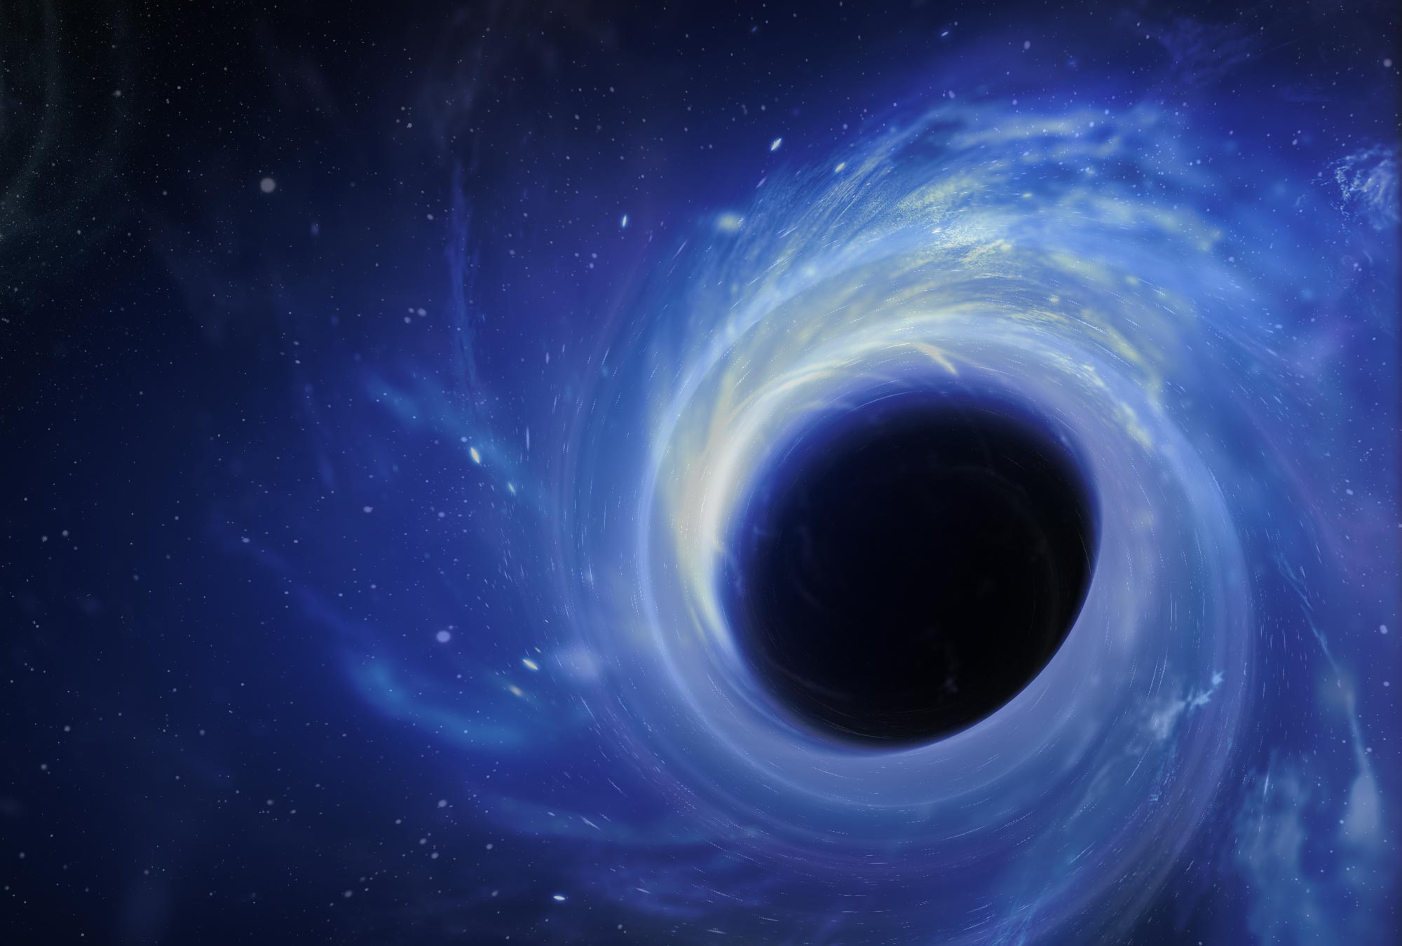
Understanding SIN
1
Ron Bert
April 7, 2013
Notes:
At once life becomes a shadow of emotions untold.

Slide 3
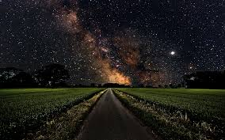
Therefore, to him who knows to do good and does not do it, to him it is sin. — James 4:17

Slide 4
Not Pursuing Good Works = Sin
Notes:
Righteousness is found in acts of pursuing goodness and general improvement.

Slide 5

In the multitude of words sin is not lacking, But he who restrains his lips is wise. — Proverbs 10:19
sin
he who restrains
he who restrains
=
=
is wise
is wise
sin

Slide 6

A haughty look, a proud heart, And the plowing of the wicked are sin. — Proverbs 21:4
A haughty look
a proud heart
plowing wicked
sin
=
A haughty look
a proud heart
sin
plowing
wicked
=
sin

Slide 7
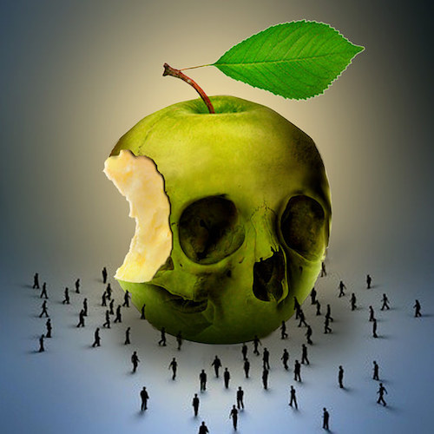
Whoever commits sin also commits lawlessness, and sin is lawlessness. — 1st John 3:4
sin
sin
sin
sin
lawlessness
lawlessness
sin

Slide 8
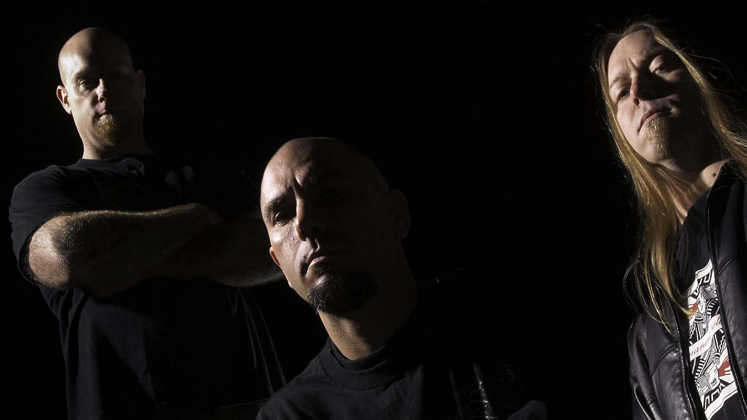
Therefore by the deeds of the law no flesh will be justified in His sight, for by the law is the knowledge of sin. — Romans 3:20
by deeds
↘
no flesh justified
↘
law is the knowledge of sin
by
deeds
deeds
deeds
no flesh
justified
sin
law is the
knowledge of sin
sin
sin

Slide 9
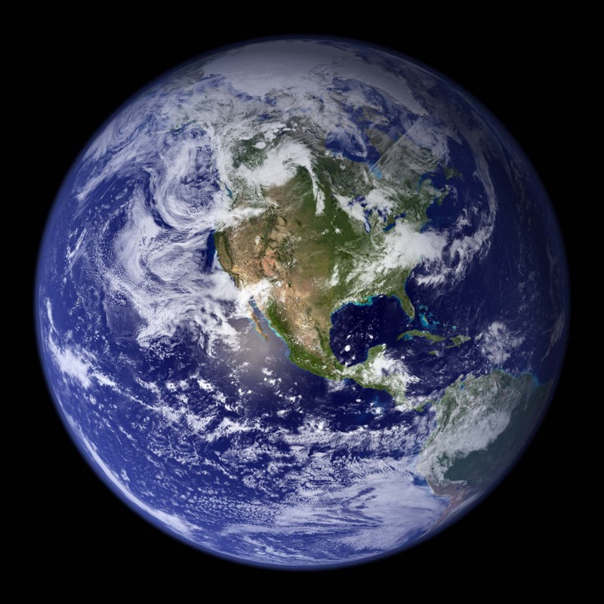
For there is not a just man on earth who does good And does not sin. — Ecclesiastes 7:20
not a just man
not a just man
sin
sin

Slide 10
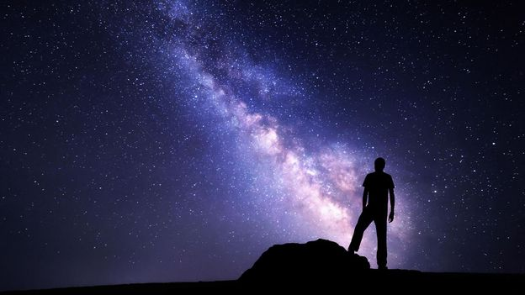
If we say that we have no sin, we deceive ourselves, and the truth is not in us. — 1st John 1:8
sin
deceive ourselves
sin
deceive ourselves
truth is not in us
in
truth is not in us

Slide 11


For I acknowledge my transgressions, And my sin is always before me. — Psalms 51:3
acknowledge
transgression
sin
always before me
transgression
always before me
Notes:
The problem arises when we do not acknowledge the sins we bear. Knowledge involves self awareness to the truth of who we are and how we treat others.

Slide 12
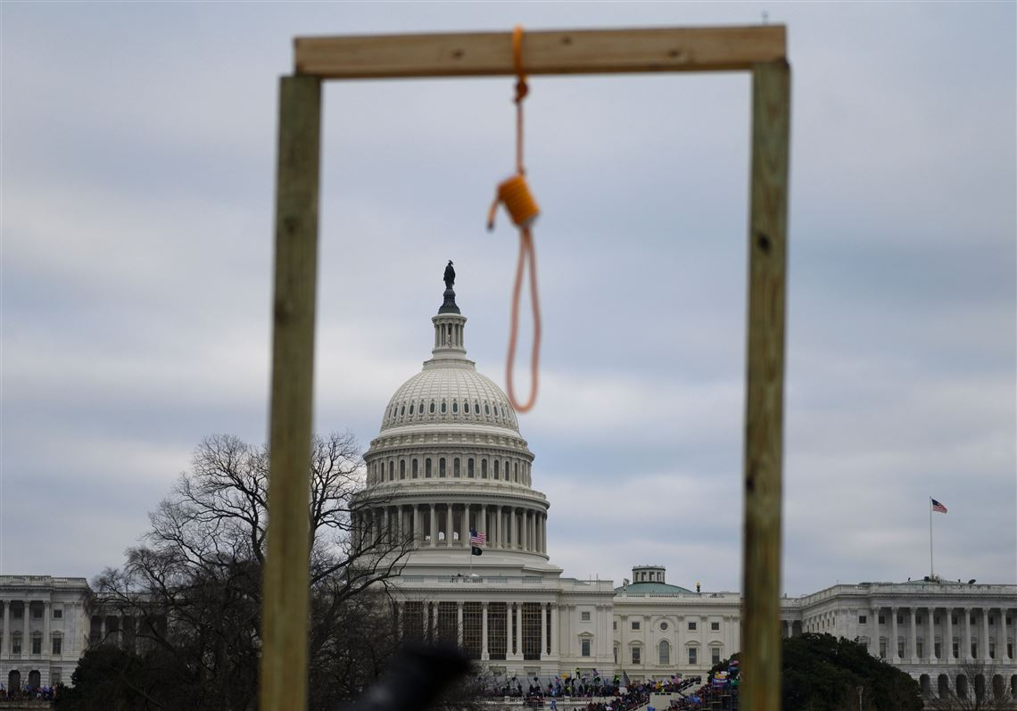
… because the law brings about wrath; for where there is no law there is no transgression. — Romans 4:15
law brings about
. .
no law
no transgression
wrath
no law
wrath
no transgression
transgression

Slide 13
death

Slide 14
sin

Slide 15

Therefore, just as through one man sin entered the world, and death through sin, and thus death spread to all men, because all sinned -- (For until the law sin was in the world, but sin is not imputed when there is no law. …). — Romans 5:12-13
sin
death
sin
death
through sin
sin
through sin
sin
sin
sin
sin

Slide 16
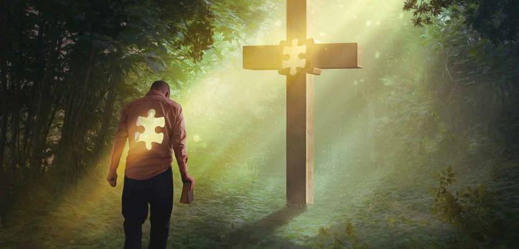
He who sins is of the devil, for the devil has sinned from the beginning. For this purpose the Son of God was manifested, that He might destroy the works of the devil. — 1st John 3:8
who sins is of the devil
who sins is of the devil
sin

Slide 17
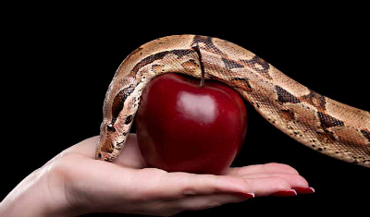
"You are of your father the devil, and the desires of your father you want to do. He was a murderer from the beginning, and does not stand in the truth, because there is no truth in him. When he speaks a lie, he speaks from his own resources, for he is a liar and the father of it." — John 8:44
crook
of
the devil
of
the devil
hypocrite
sin
deceiver
truth
imposter
cheat
sin
no truth in him
in
no truth in him
liar
dishonesty
con
Notes:
People hide behind the guilt of their lies. The stem of sin is the lies one perpetuates upon deceiving others. Honesty is where love begins.

Slide 18
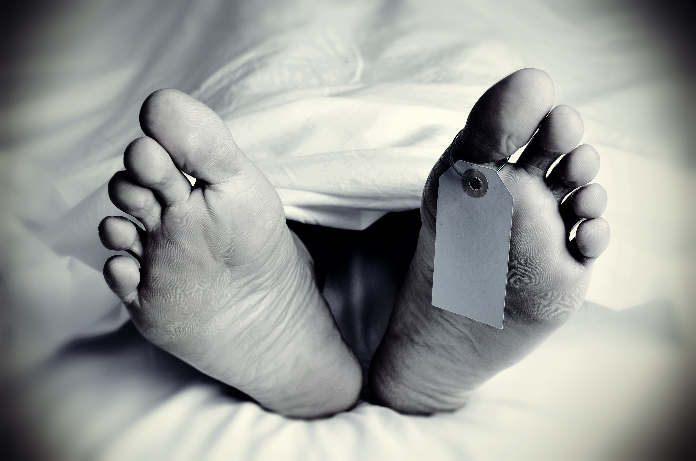
"The soul who sins shall die. The son shall not bear the guilt of the father, nor the father bear the guilt of the son. The righteousness of the righteous shall be upon himself, and the wickedness of the wicked shall be upon himself." — Ezekiel 18:20
soul
sin
soul
who sins shall die
who sins shall die
bear the guilt
bear the guilt
righteousness
righteousness
sin
wickedness
wickedness
upon himself
upon himself
Notes:
Sin is on all of our body tags. Without Christ to bear our guilt, salvation melts to the darkness of death.

Slide 19
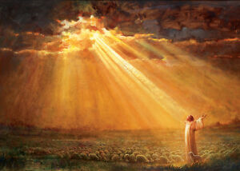
Therefore, as through one man's offense judgment came to all men, resulting in condemnation, even so through one Man's righteous act the free gift came to all men, resulting in justification of life. For as by one man's disobedience many were made sinners, so also by one Man's obedience many will be made righteous. Moreover the law entered that the offense might abound. But where sin abounded, grace abounded much more, so that as sin reigned in death, even so grace might reign through righteousness to eternal life through Jesus Christ our Lord. — Romans 5:18-21
through
offense
through offense
judgment came to all → many made sinners
◊ resulting in condemnation
through one Man's obedience
free gift came to all → many made righteous
◊ resulting in justification of life
sin = death
grace = righteousness to eternal life in Christ
judgment came to all
resulting in
condemnation
through
in
gift came to all
resulting in justification of life
sin
many
made sinners
one Man's obedience
many
made
in
righteous
sin
sin
death
grace
in
in
righteousness to eternal life
Christ

Slide 20

For the wages of sin is death, but the gift of God is eternal life in Christ Jesus our Lord. — Romans 6:23
sin
death
sin
eternal life
in
Christ Jesus our Lord

Slide 21
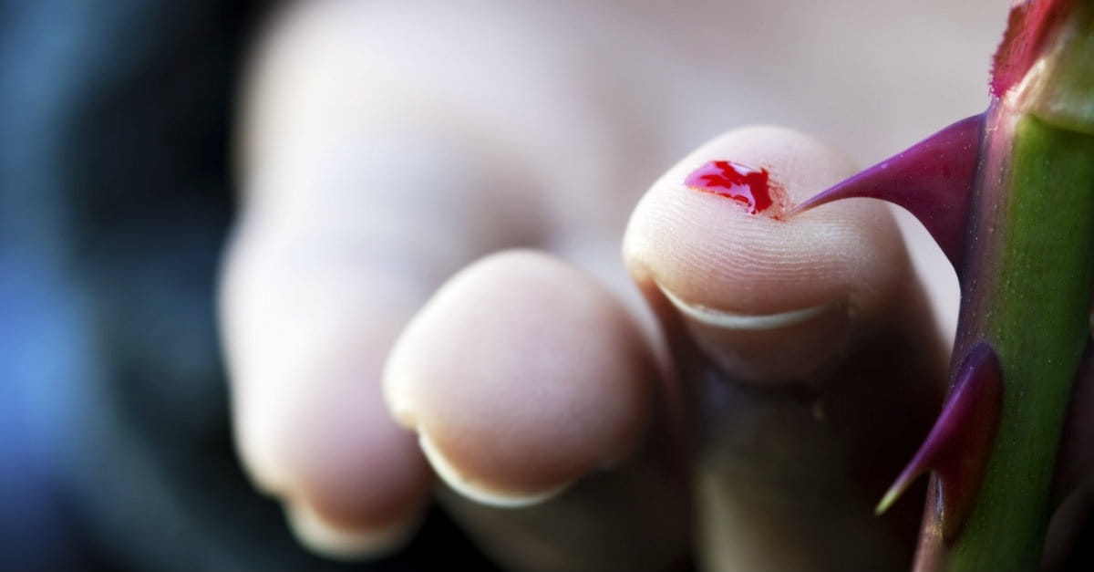
The sting of death is sin, and the strength of sin is the law. — 1st Corinthians 15:56
sting of death = sin
sting of death
sin
strength of sin
the law
strength of sin = the law
evil law
Notes:
Death is always a shock that stings all caring hearts involved. Sin’s most atrocious acts are actually condoned by mankind’s legal follies to pursue his desires over God’s. Having laws supporting sin bolsters it’s lawlessness as acceptable. Legalizing abortion gives strength to sin through the weakness of man. The injustice man inflicts will be sheared away by God’s light.

Slide 22

Therefore let him who thinks he stands take heed lest he fall. No temptation has overtaken you except such as is common to man; but God is faithful, who will not allow you to be tempted beyond what you are able, but with the temptation will also make the way of escape, that you may be able to bear it. — 1st Corinthians 10:12-13
take heed
take heed
God is faithful
temptation
temptation
temptation
escape
escape
endure
bear it
bear it

Slide 23

"And forgive us our sins, For we also forgive everyone who is indebted to us. And do not lead us into temptation, But deliver us from the evil one." — Luke 11:4
temptation
deliver us
. .

Slide 24
temptation

Slide 25
Blessed is the man who endures temptation; for when he has been approved, he will receive the crown of life which the Lord has promised to those who love Him. Let no one say when he is tempted, "I am tempted by God"; for God cannot be tempted by evil, nor does He Himself tempt anyone. But each one is tempted when he is drawn away by his own desires and enticed. Then, when desire has conceived, it gives birth to sin; and sin, when it is full-grown, brings forth death. — James 1:12-15
temptation
temptation
↘
sinful desires
↘
habit conceived
↘
full-grown sin
↘
death
f
b
desires
ha
conceived
sin
sin
it
ul
full-grown
death

Slide 26
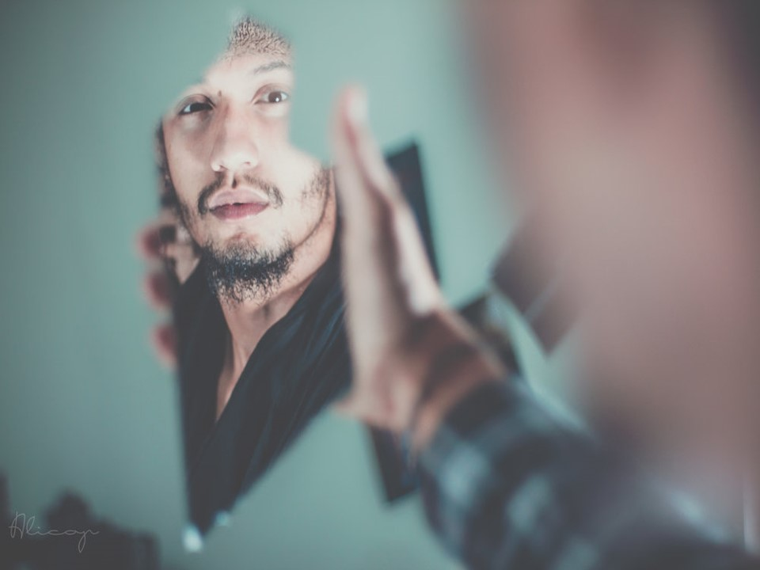



Bear one another's burdens, and so fulfill the law of Christ. For if anyone thinks himself to be something, when he is nothing, he deceives himself. But let each one examine his own work, and then he will have rejoicing in himself alone, and not in another. For each one shall bear his own load.— Galatians 6:2-5
fulfill the law of Christ
let each one
examine his own work
each one
shall bear his own load

Slide 27
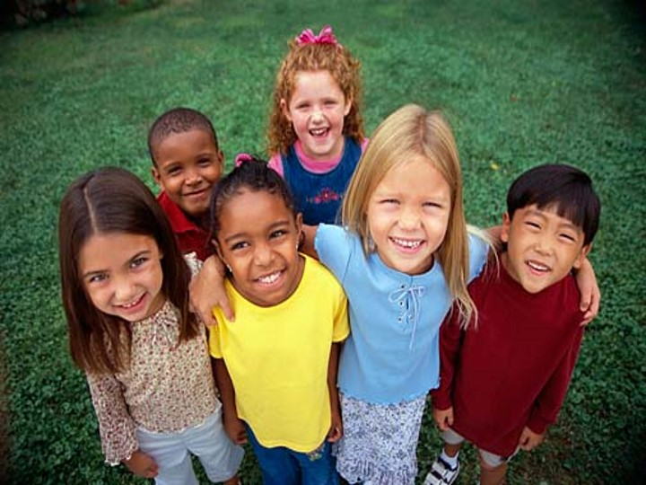

If you really fulfill the royal law according to the Scripture, "You shall love your neighbor as yourself," you do well; but if you show partiality, you commit sin, and are convicted by the law as transgressors. — James 2:8-9
fulfill the royal law
if you
. .
sin
show partiality, you commit sin
sin
. .
Notes:
Prejudice has no walls to stop the focus of its’ hate, other than God’s word declaring it as a sin of choice. Prejudice is an act that violates the word of God. Who would hate a child of any race or color but the most despicable of humans. Hate’s upward escalation, including all the other advancing carnal sins, is the root of all divisions among souls.

Slide 28

"If you do well, will you not be accepted? And if you do not do well, sin lies at the door. And its desire is for you, but you should rule over it." — Genesis 4:7
sin
sin
sin lies at the door
sin lies at the door
rule over it
rule over it
Notes:
No one has not struggles or battles in finding the spirit of truth. To get back to the sanctuary of true peace, it has to be made through God in His vision of faith.

Slide 29
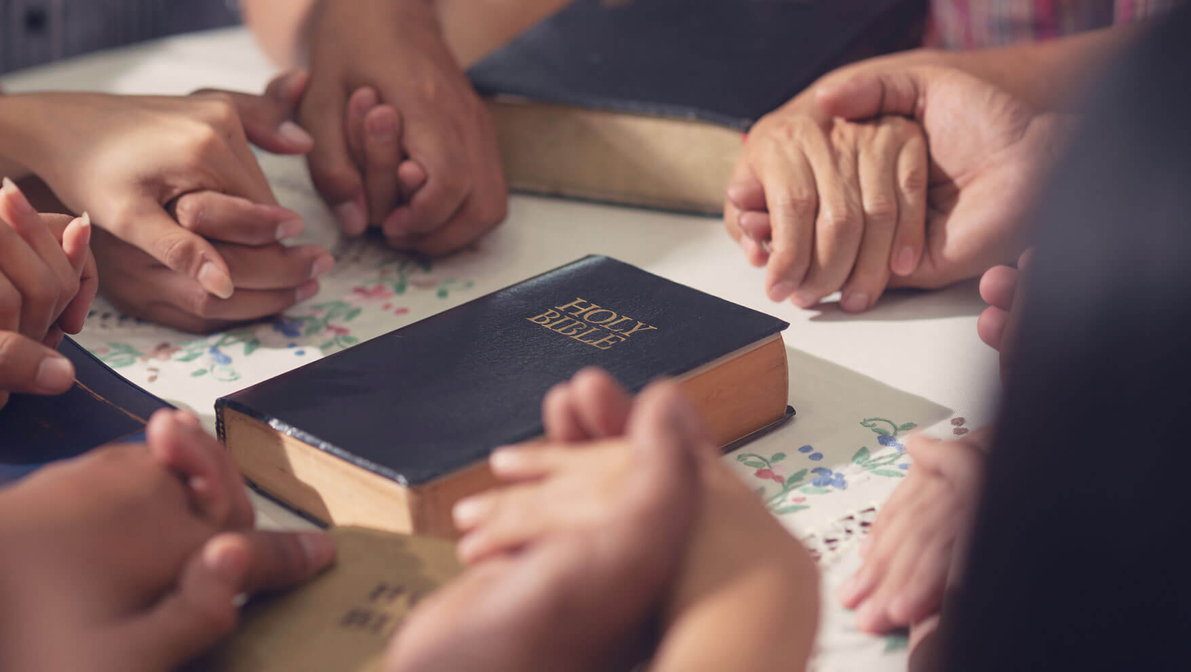
But the Scripture has confined all under sin, that the promise by faith in Jesus Christ might be given to those who believe. But before faith came, we were kept under guard by the law, kept for the faith which would afterward be revealed. Therefore the law was our tutor to bring us to Christ, that we might be justified by faith. But after faith has come, we are no longer under a tutor. — Galatians 3:22-25
before faith came
↘
kept under guard by the law (tutor)
↓
all under sin
promise by faith in Jesus Christ
given to those who believe
↕
might be justified by faith
all under
sin
promise by faith in Jesus
sin
Christ
given to those who
believe
before faith came
kept under guard by the law
might be justified by
faith
tutor

Slide 30





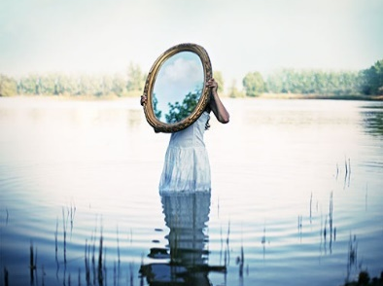

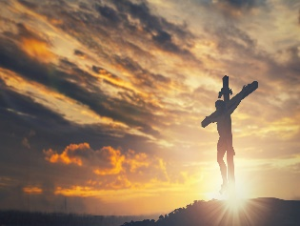

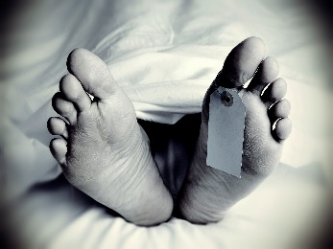






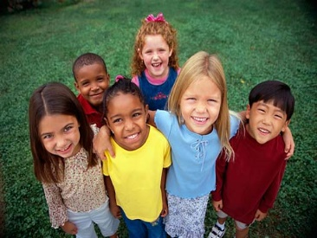

Slide 31

→ Knowing to do good and not doing it is sin
→ A haughty look, proud heart, evil pursuits, - are sin
→ Sin is lawlessness without regard for goodness
→ It is untruthful to deny that one has sinned
→ Sin enters a life through acts of disobedience
→ The root of sin is held in the heart of a liar
→ Faith in Jesus results in the justification of life
→ Knowing right from wrong is strength we all seek
→ A shallow character holds unforgiveness close
→ Desire gives sin’s unrestrained rise leading to death
→ Judging one’s self as superior is a sin of prejudice
→ His word calls for us to rule over our temptations
→ Forgiveness through Christ heals us from sin
It is God who loves us beyond the measure of our sin
Notes:
It is God who loves us beyond the measure of our sin

Slide 33
Understanding SIN
2
Ron Bert
April 7, 2013

Slide 34
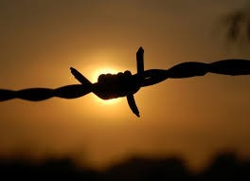
For the law of the Spirit of life in Christ Jesus has made me free from the law of sin and death. — Romans 8:2
law of the Spirit of life
law of the Spirit of life
in
Christ Jesus
sin
free
sin
law of sin and death
law of sin and death

Slide 35
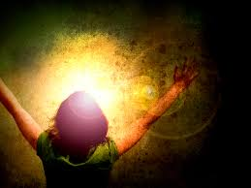
And if Christ is in you, the body is dead because of sin, but the Spirit is life because of righteousness. — Romans 8:10
Christ in you
body = dead because of sin
Spirit = life because of righteousness
in
in you
body
Christ
in
in you
dead because of sin
sin
Spirit
life because of righteousness
sin
sin
Notes:
To make Christ our divine savior from the heart, He recognizes this worship and extends the promise of His protective powers in to eternal life. God puts value on hearts that hold external love for Him, rather than exclusively self-centered focus on the self. It regards thankfulness over selfishness.

Slide 36


And as it is appointed for men to die once, but after this the judgment, so Christ was offered once to bear the sins of many. To those who eagerly wait for Him He will appear a second time, apart from sin, for salvation. — Hebrews 9:27-28
sin
apart from sin for salvation
appear a second time
judgment
↑
who eagerly wait for Him
↑
appointed for men to die once
Christ was offered once
to bear the sins of many
appointed for men
to die once
judgment
Christ was offered
sin
once
to bear the sins of many
who eagerly wait for Him
appear a second time
apart from sin
for salvation
sin
sin
Notes:
The explanation of God’s promise and plan are clear for all to understand.

Slide 37


For Christ also suffered once for sins, the just for the unjust, that He might bring us to God, being put to death in the flesh but made alive by the Spirit, … — 1st Peter 3:18
Christ
sin
the just for the unjust
the just for the unjust
He might bring us to God
death in the flesh
in
iniquity
sin
alive by the Spirit
Notes:
It is the Spirit that instructs us to become larger than just ourselves. To embrace the Creator who offers Grace, in a miraculous immeasurable way, delivers a higher peace that cannot be found alone.

Slide 38
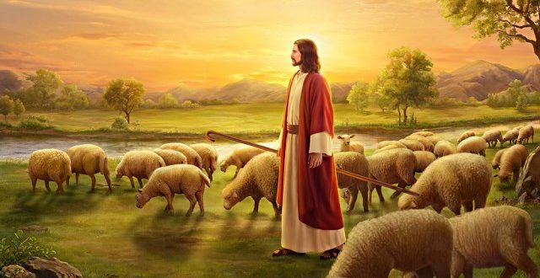
All we like sheep have gone astray; We have turned, every one, to his own way; And the LORD has laid on Him the iniquity of us all. — Isaiah 53:6
All
All
turned
turned
to his own way
to his own way
on Him
Him
on Him
iniquity of us all
in
iniquity of us all
Notes:
Jesus allows our sins to be expunged by bearing them upon His forgiving heart.

Slide 39
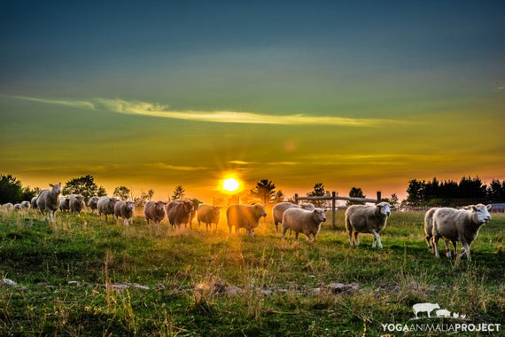
But if we walk in the light as He is in the light, we have fellowship with one another, and the blood of Jesus Christ His Son cleanses us from all sin. — 1st John 1:7
walk in the light
in
walk in the light
blood of Jesus Christ
Jesus Christ
blood of Jesus Christ
cleanses us from all sin
all
cleanses us from all sin

Slide 40
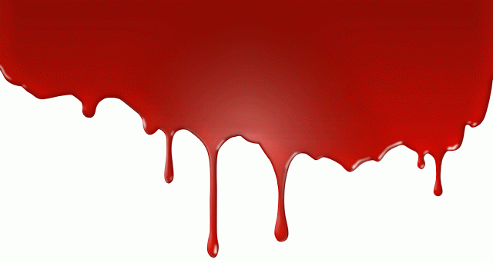

And according to the law almost all things are purified with blood, and without shedding of blood there is no remission. — Hebrews 9:22
in His own blood
without shedding of blood
without shedding of blood
sacrifice
no remission
no remission
giving of life

Slide 41
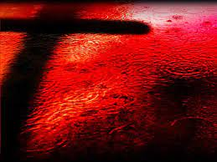
… and from Jesus Christ, the faithful witness, the firstborn from the dead, and the ruler over the kings of the earth. To Him who loved us and washed us from our sins in His own blood, … — Revelation 1:5
in His own blood
sins
washed us from our
washed us from our
sins
sins in His own blood
in
His
sins in His own blood
Notes:
As Christ gave His life for ours, in turn, we must turn to love Him as He loved us with no end. Eternity is truly an expression of His absolute love.

Slide 42
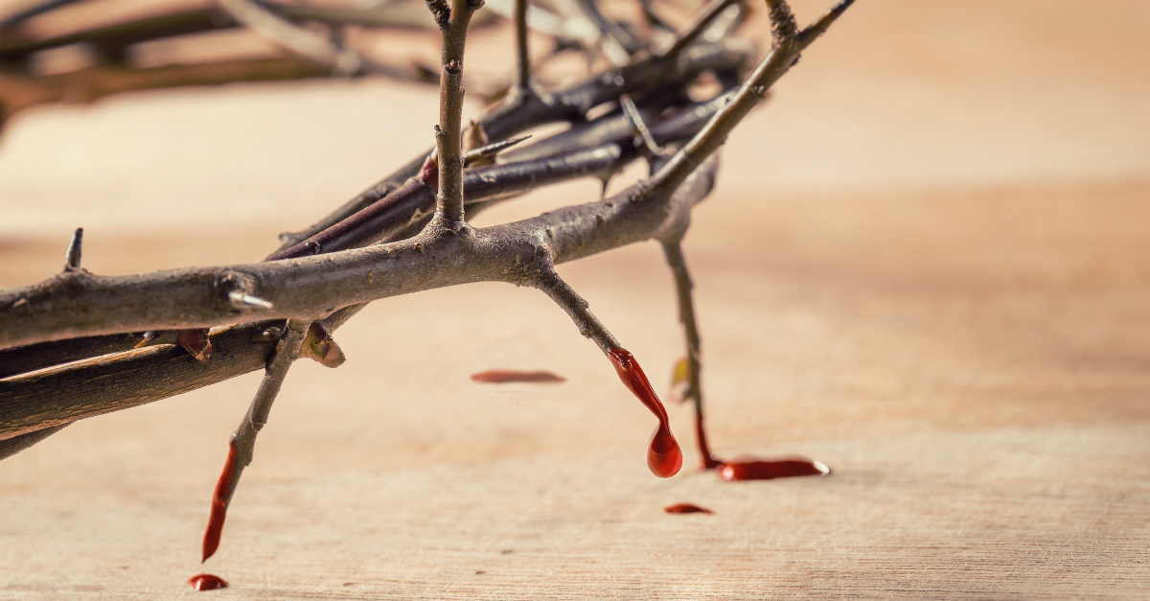
"For this is My blood of the new covenant, which is shed for many for the remission of sins." — Matthew 26:28
My
My blood
My blood
shed for
shed for
remission of sins
sins
sins
remission of sins
sins

Slide 43
"To Him all the Prophets witness that, through His name, whoever believes in Him will receive remission of sins." — Acts 10:43
Prophets
Prophets
believes in Him
in
Him
believes in Him
receive remission of sins
sins
receive remission of sins

Slide 44
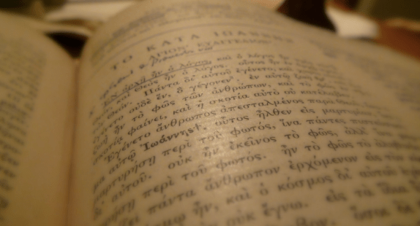
Then He said to them, "These are the words which I spoke to you while I was still with you, that all things must be fulfilled which were written in the Law of Moses and the Prophets and the Psalms concerning Me." And He opened their understanding, that they might comprehend the Scriptures. — Luke 24:44-45
fulfilled
fulfilled
Old Testament
Promise
Prophets
Law of Moses and the Prophets
Law of Moses and the Prophets
Psalms concerning Me
Me
Psalms concerning Me
TRUTH
Notes:
Scripture has been given that we may know His word transcends time, where He tests our character as to if we care to know and practice truth.

Slide 45
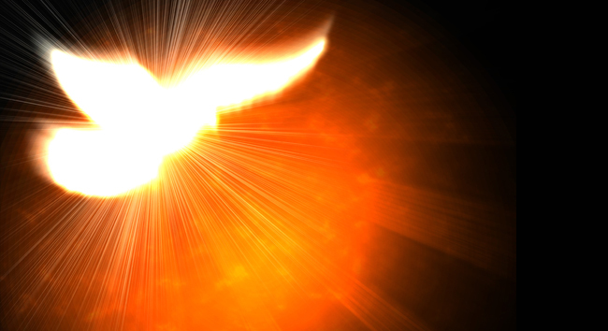
Then He said to them, "Thus it is written, and thus it was necessary for the Christ to suffer and to rise from the dead the third day, and that repentance and remission of sins should be preached in His name to all nations, beginning at Jerusalem. And you are witnesses of these things. Behold, I send the Promise of My Father upon you; but tarry in the city of Jerusalem until you are endued with power from on high." — Luke 46-49
repentance
remission
repentance
of sins
Promise
remission of sins
Promise of My Father
Promise of My Father
Notes:
To receive the blessings of the Holy Spirit, the truth of His promise must be accepted.

Slide 46

Then Peter said to them, "Repent, and let every one of you be baptized in the name of Jesus Christ for the remission of sins; and you shall receive the gift of the Holy Spirit." — Acts 2:38
sins
in
Repent + baptized in Christ
remission of sins + Holy Spirit gift
Repent
Christ
=
baptized in
Christ
remission of sins
sins
gift
Holy Spirit
Notes:
To rise to the promise of salvation, we have to respond to the call of Jesus.

Slide 47

"Repent therefore and be converted, that your sins may be blotted out, so that times of refreshing may come from the presence of the Lord, and that He may send Jesus Christ, who was preached to you before, whom heaven must receive until the times of restoration of all things, which God has spoken by the mouth of all His holy prophets since the world began." — Acts 3:19-21
sins
sins may be blotted out
sins may be blotted out
sins

Slide 48
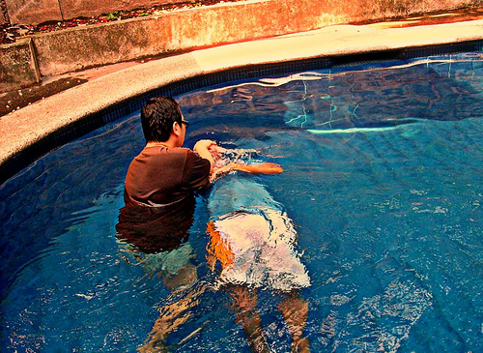
'And now why are you waiting? Arise and be baptized, and wash away your sins, calling on the name of the Lord.' — Acts 22:16
wash away your sins
sins
wash away your sins
sins

Slide 49
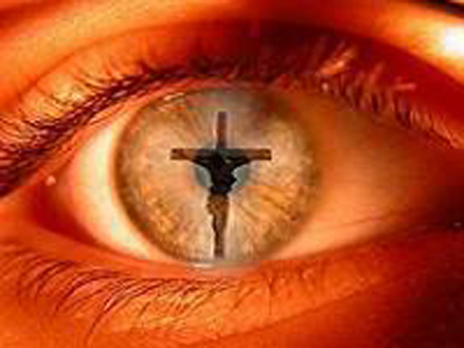
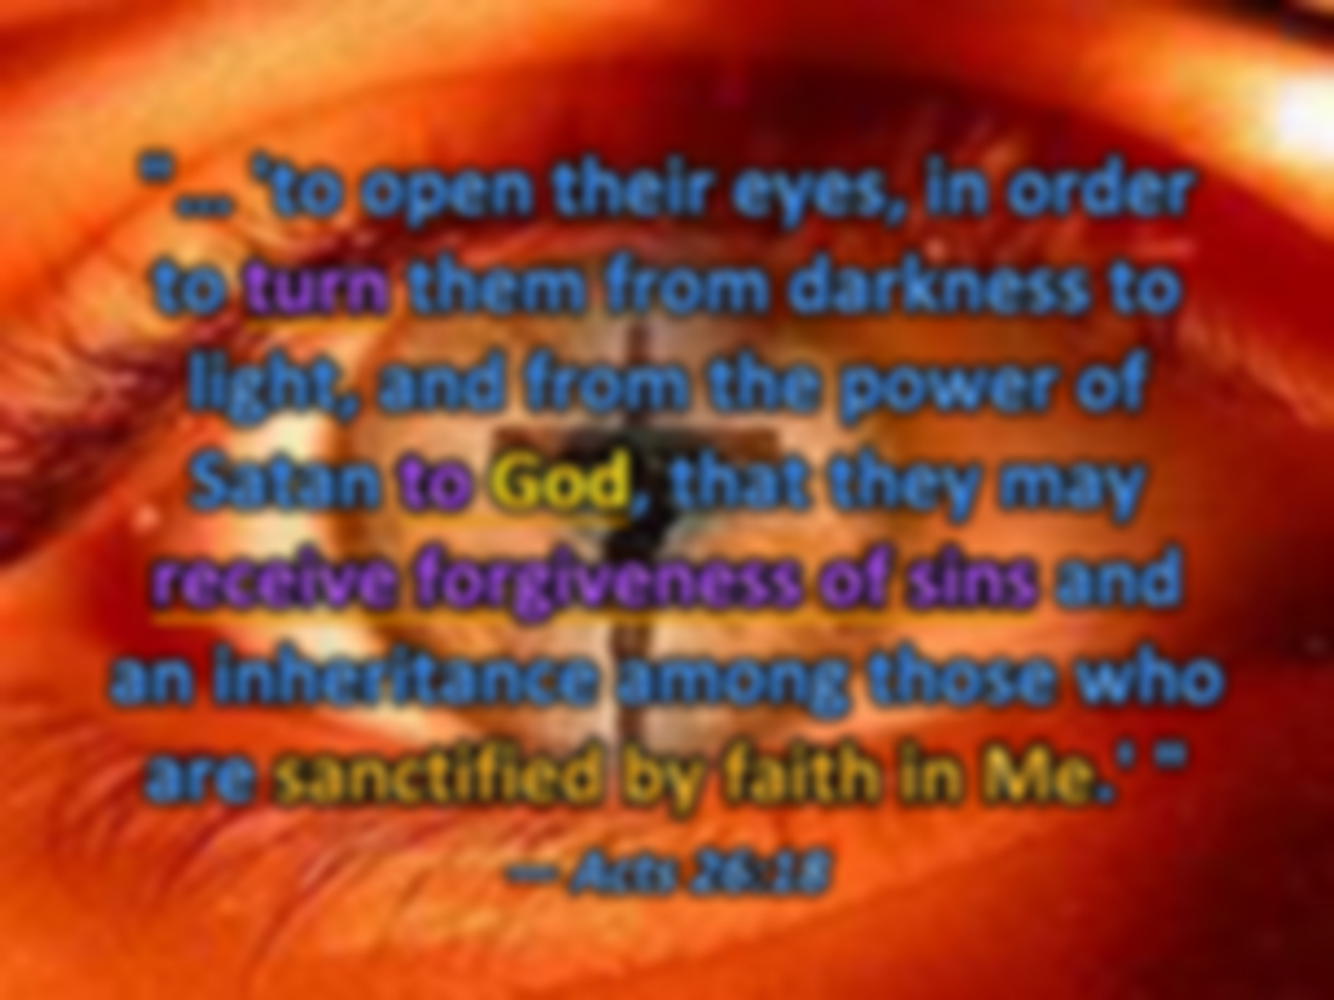

"… 'to open their eyes, in order to turn them from darkness to light, and from the power of Satan to God, that they may receive forgiveness of sins and an inheritance among those who are sanctified by faith in Me.' " — Acts 26:18
turn
turn
to God
God
to God
sins
receive forgiveness of sins
receive forgiveness of sins
sanctified by faith in Me
faith
in
Me

Slide 50

There is also an antitype which now saves us -- baptism (not the removal of the filth of the flesh, but the answer of a good conscience toward God), through the resurrection of Jesus Christ, who has gone into heaven and is at the right hand of God, angels and authorities and powers having been made subject to Him. — 1st Peter 3:21-22
baptism
baptism
answer of a good conscience
answer of a good conscience
through
Jesus Christ
Notes:
There is only one plan of God presented to man for the salvation of the soul. As many will argue to multiple co-existing avenues, His declaration and answer calls to One Way. We should not remain in the convolutions of man where fantasy and tolerance embrace the sinfulness that follows all false doctrines.

Slide 51
If we confess our sins, He is faithful and just to forgive us our sins and to cleanse us from all unrighteousness. — 1st John 1:9
● He is faithful
● to forgive us our sins
● to cleanse us from
all unrighteousness
→ confess our sins
confess our sins
He is
confess our sins
confess our sins
faithful
to forgive us our
sins
to cleanse us from
all
unrighteousness

Slide 52
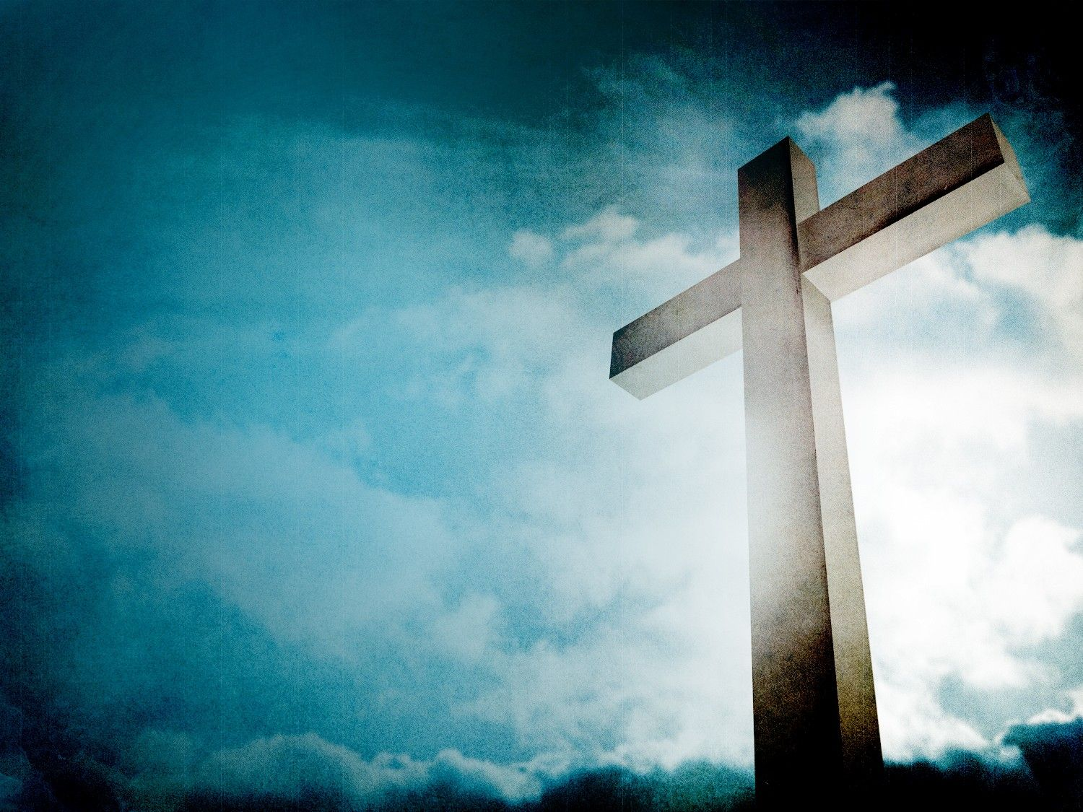
Whoever transgresses and does not abide in the doctrine of Christ does not have God. He who abides in the doctrine of Christ has both the Father and the Son. — 2nd John 1:9
transgresses
break the rules
misbehaves
do wrong
disobeys
sins
sin
transgresses
in
not abide in the doctrine of Christ
Christ
not abide in the doctrine of Christ
does not have God
God
does not have God
sin

Slide 53
[A Psalm of David. A Contemplation.] Blessed is he whose transgression is forgiven, Whose sin is covered. — Psalms 32:1
Blessed is
. .
Whose sin is covered
sin is covered
sin
. .
Notes:
There is only one way to cover the sins of a soul, and that is to give them to Christ so He may carry them over to forgotten.

Slide 54
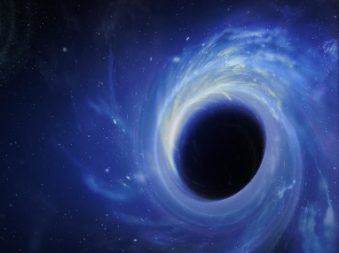



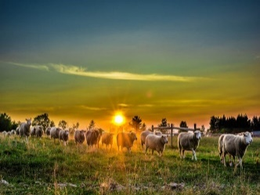


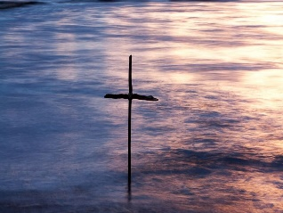







Slide 55
→ Belief in Christ frees us from the bondage of flesh
→ Righteousness of belief in Christ overwhelms sin
→ It is Christ who bears the sins of all true believers
→ God wills for us to be alive in His Spirit
→ Christ’s sacrifice in blood cleanses us from sin
→ Christ had to sacrifice His life that we might find life
→ God now employs Christ for our remission of sins
→ God’s promise is forgiveness to who act on belief
→ Regret is the healing key as God forgets prior sins
→ God came in Christ to free us from the lies of Satan
→ Faith in obedience to His baptismal call saves a soul
→ Without honest confession no forgiveness is given
→ God’s truth in Christ has to be acknowledged
Good love is defined by honesty
Notes:
Good love is defined by honesty

Slide 57
Understanding SIN
3
Ron Bert
April 14, 2013

Slide 58
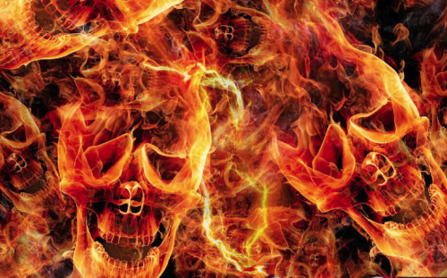
"Therefore I said to you that you will die in your sins; for if you do not believe that I am He, you will die in your sins." — John 8:24
not believe
I am He
not believe
sins
die in your sins
in
die in your sins
sins

Slide 59
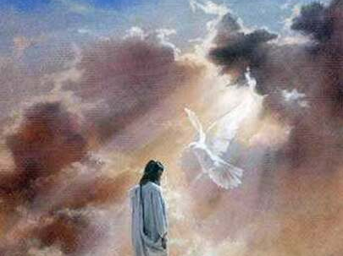

So Jesus said to them again, "Peace to you! As the Father has sent Me, I also send you. And when He had said this, He breathed on them, and said to them, "Receive the Holy Spirit. If you forgive the sins of any, they are forgiven them; if you retain the sins of any, they are retained." — John 20:21-23
sin
Receive
Receive
sin
Baptism
Forgiveness
Forgive them they know not
hold
sins
recall
recollect
remember
retain
retain
Notes:
To have the Spirit of God, and establishing the church with believing seeking holy members, is to find that forgiveness from the thorns of sin. For those that do not comply with the will of God will keep to the sin they are mired in. Denial will not excuse God’s convictions.
Luke 23:34 Then Jesus said, "Father, forgive them, for they do not know what they do." And they divided His garments and cast lots.

Slide 60

"But if, while we seek to be justified by Christ, we ourselves also are found sinners, is Christ therefore a minister of sin? Certainly not! For if I build again those things which I destroyed, I make myself a transgressor. For I through the law died to the law that I might live to God." — Galatians 2:17-19
seek to be
seek to be
justified by Christ
Christ
justified by Christ
sin
sin
live to God
God
live to God

Slide 61
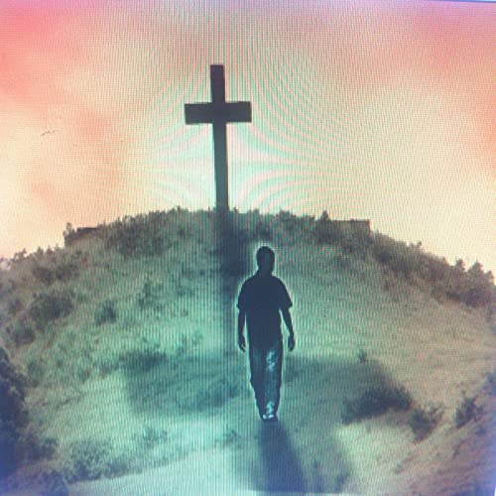
"I have been crucified with Christ; it is no longer I who live, but Christ lives in me; and the life which I now live in the flesh I live by faith in the Son of God, who loved me and gave Himself for me. I do not set aside the grace of God; for if righteousness comes through the law, then Christ died in vain." — Galatians 2:20-21
I have
I have
I who live
sin
I who live
I do
I now
I now
I live by faith
I live by faith
I do
I do
grace
Faith
grace of God
righteousness
God
righteousness
grace of God

Slide 62
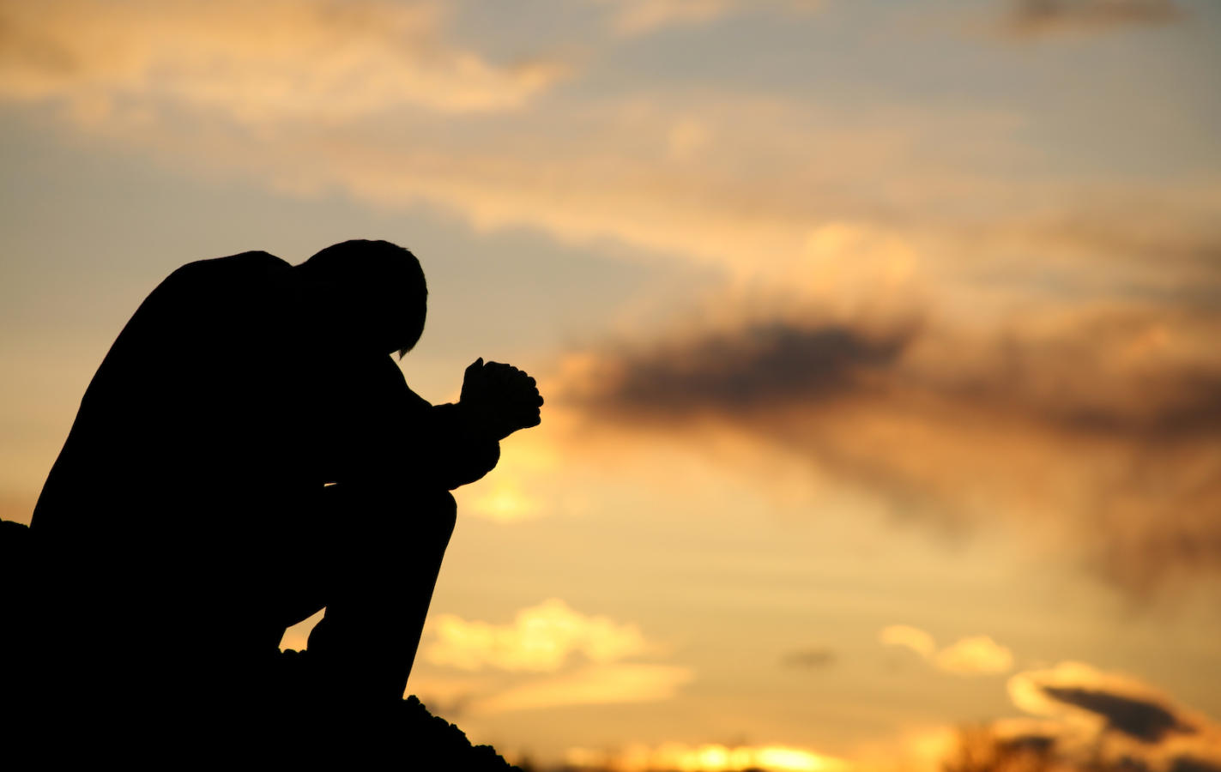
For we know that the law is spiritual, but I am carnal, sold under sin. For what I am doing, I do not understand. For what I will to do, that I do not practice; but what I hate, that I do. If, then, I do what I will not to do, I agree with the law that it is good. But now, it is no longer I who do it, but sin that dwells in me. — Romans 7:14-17
I am carnal
sin
I am carnal
I do
I do
I do
I do
to do
to do
what I hate
what I hate
sin
sin that dwells in me
sin
in
sin that dwells in me

Slide 63

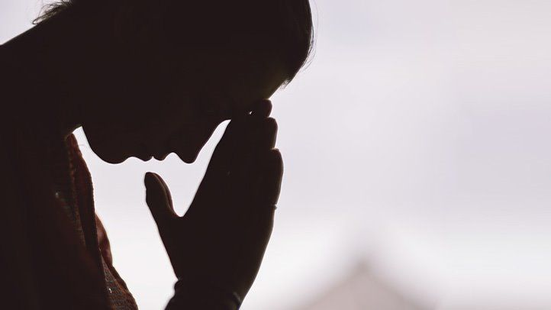
For I know that in me (that is, in my flesh) nothing good dwells; for to will is present with me, but how to perform what is good I do not find. For the good that I will to do, I do not do; but the evil I will not to do, that I practice. Now if I do what I will not to do, it is no longer I who do it, but sin that dwells in me. I find then a law, that evil is present with me, the one who wills to do good. — Romans 7:18-21
sin
practice
I do what I will not to do
I do what I will not to do
sin
in
sin
sin that dwells in me
I find then a law
I find then a law
one who wills to do good
one who wills to do good
sin

Slide 64

For I delight in the law of God according to the inward man. But I see another law in my members, warring against the law of my mind, and bringing me into captivity to the law of sin which is in my members. O wretched man that I am! Who will deliver me from this body of death? I thank God -- through Jesus Christ our Lord! So then, with the mind I myself serve the law of God, but with the flesh the law of sin — Romans 7:22-25
law of God
law of God
inward man
inward man
q
law in my members
law in my members
flesh
with the mind → serve the law of God
with the flesh → the law of sin
law of my mind
spirit
law of my mind
law of sin
sin
law of sin
Who will deliver me
Who will deliver me
God
through
Jesus Christ
with the mind
serve the law of God
with the flesh
the law of sin
sin

Slide 65
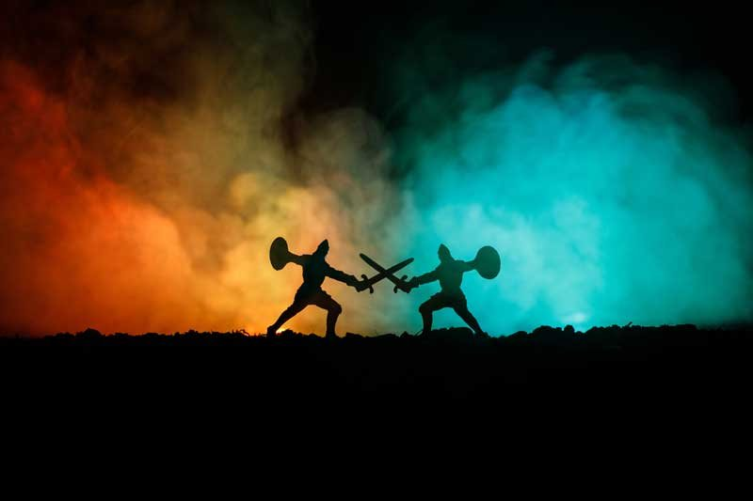
For the flesh lusts against the Spirit, and the Spirit against the flesh; and these are contrary to one another, so that you do not do the things that you wish. — Galatians 5:17

Slide 66

Whoever has been born of God does not sin, for His seed remains in him; and he cannot sin, because he has been born of God. — 1st John 3:9
sin
sin
Grace
Forgiveness
Notes:
Restraint against previous habitual sin is the battle for each true believer. To be born of God is to live under His Grace where Jesus bears the load of unforgivable sins. Through faith in Jesus we are made clean, as one chases after Him turning crimson into white as snow.

Slide 67

For sin shall not have dominion over you, for you are not under law but under grace. — Romans 6:14
sin
not under
sin
not under
law but under grace
law but under grace

Slide 68

"For I will be merciful to their unrighteousness, and their sins and their lawless deeds I will remember no more." — Hebrews 8:12
sins
sin
sins
remember no more
remember no more
sin

Slide 69


But he who doubts is condemned if he eats, because he does not eat from faith; for whatever is not from faith is sin. — Romans 14:23
whatever is not
from faith is sin
sin
sin
Believing Trust
Notes:
A believing trust aids the soul in overcoming previous and current sins; accepting the Grace of God.

Slide 70
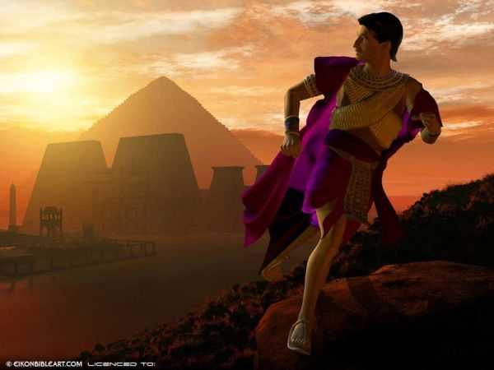
By faith Moses, when he became of age, refused to be called the son of Pharaoh's daughter, choosing rather to suffer affliction with the people of God than to enjoy the passing pleasures of sin, … — Hebrews 11:24-25
sin
choosing
choosing
passing pleasures of sin
sin
passing pleasures of sin
Empty

Slide 71
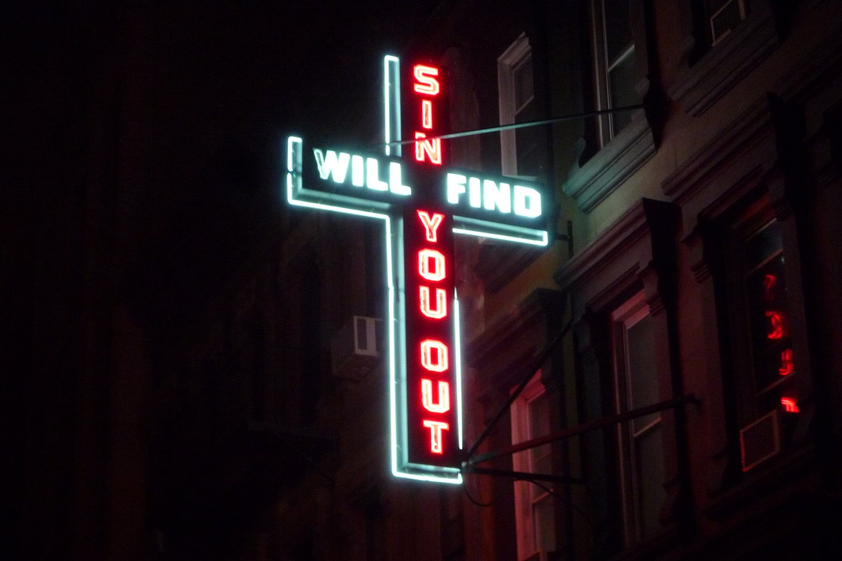
If we say that we have not sinned, we make Him a liar, and His word is not in us. — 1st John 1:10
Arrogance
not sinned
sin
sin
sin
sin
q
His word
in us
in
in us
Practice
Receive the implanted word
Notes:
Only an honest heart can find the humble truth of falling short. We all reach forward hoping for better conditions, and those in denial exemplify arrogance. To receive the implanted word benefits all who are able to find these God given truths.

Slide 72
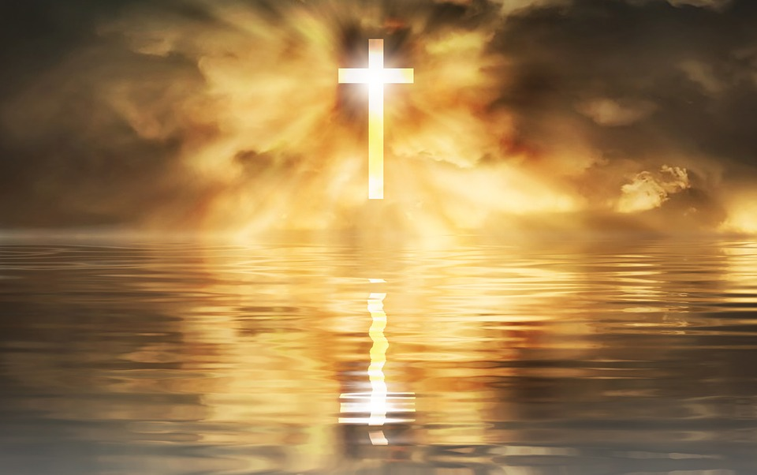
My little children, these things I write to you, so that you may not sin. And if anyone sins, we have an Advocate with the Father, Jesus Christ the righteous. — 1st John 2:1
things written
↓
that you may not sin
↕
if anyone sins
we have an Advocate
Jesus Christ
tt
en
things
wri
that you may not
sin
sin
we have
if anyone sins
an Advocate
sin
Jesus Christ
Jesus Christ

Slide 73
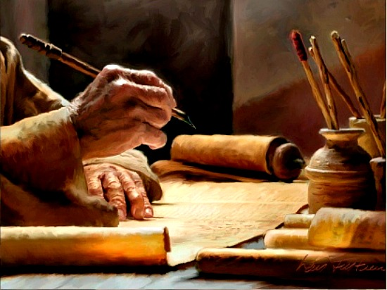
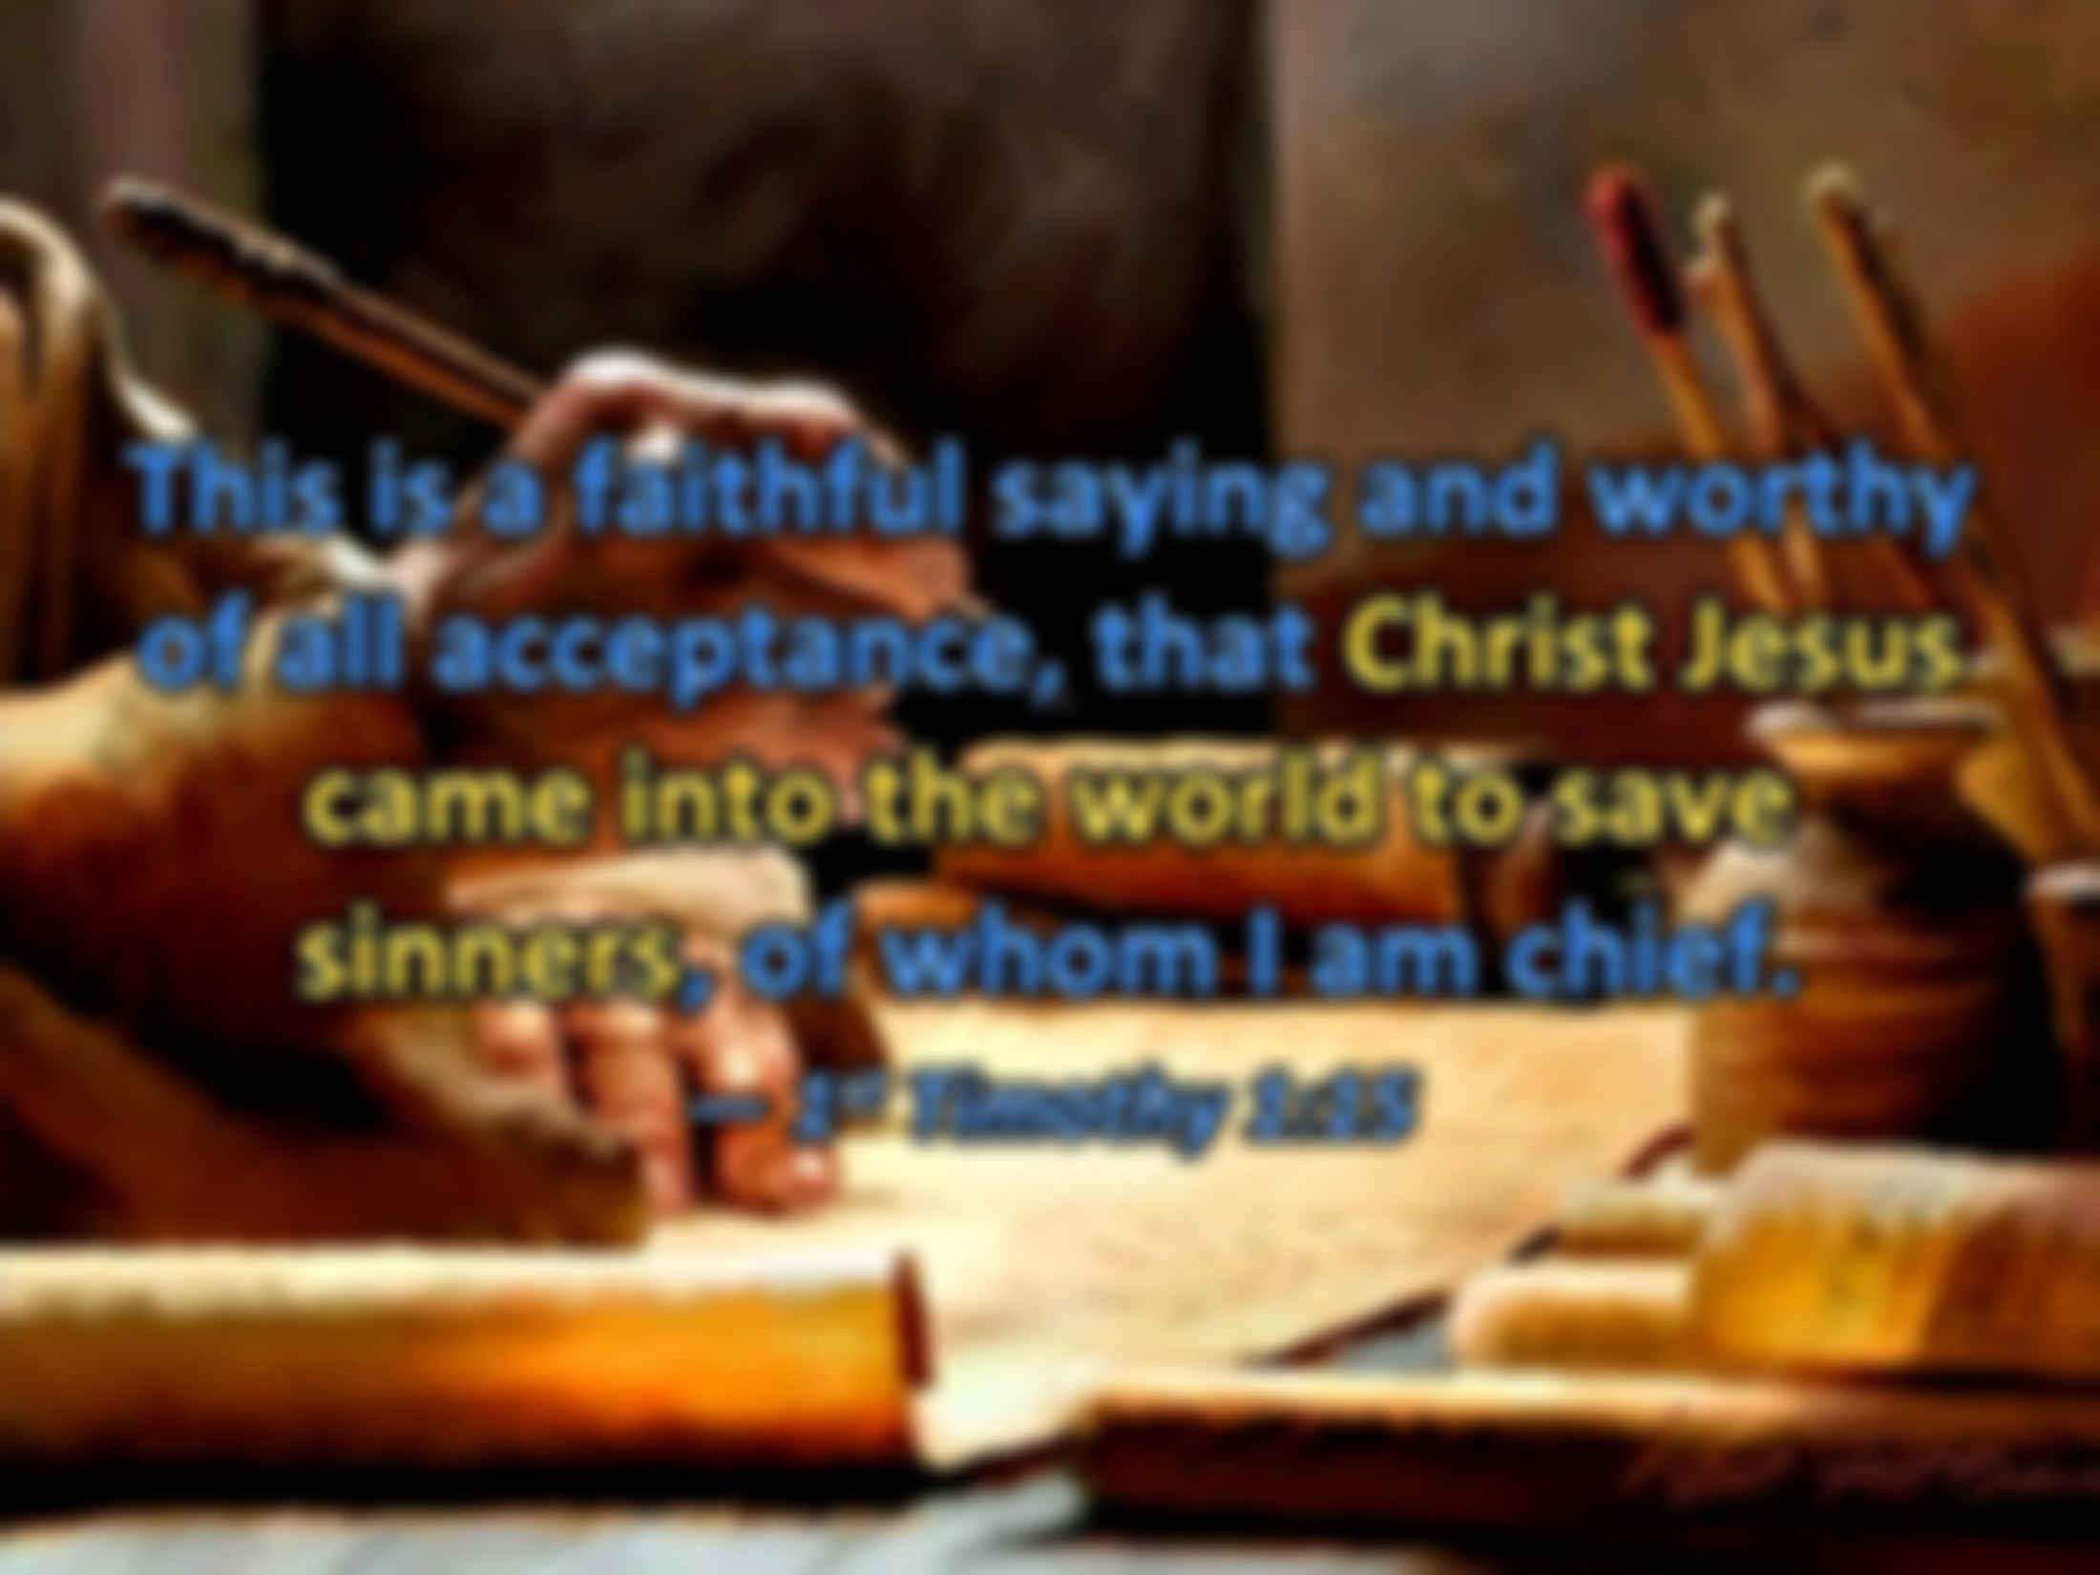



This is a faithful saying and worthy of all acceptance, that Christ Jesus came into the world to save sinners, of whom I am chief. — 1st Timothy 1:15
Christ Jesus
sinners
sin
sinners

Slide 74
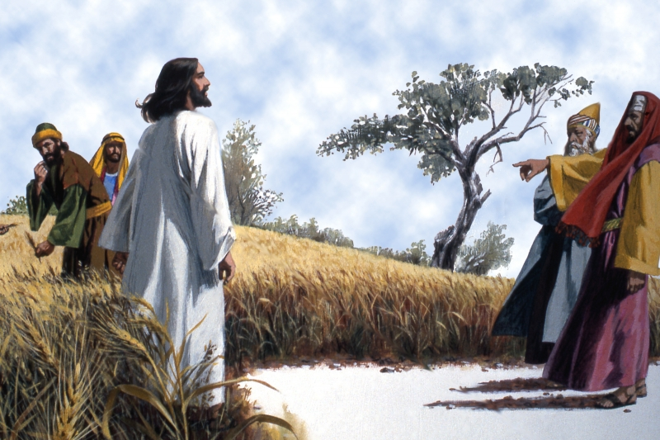
"But go and learn what this means: 'I desire mercy and not sacrifice.' For I did not come to call the righteous, but sinners, to repentance." — Matthew 9:13
mercy
caring for others
mercy
acts for self
sinners
Notes:
God desires we care for others more than just exclusively seeking those things for the self.

Slide 75

For judgment is without mercy to the one who has shown no mercy. Mercy triumphs over judgment. — James 2:13
mercy
mercy
mercy
Mercy triumphs over judgment
Love
contempt
Mercy triumphs over judgment
Notes:
To love sets the heart free from unjustified opinions that fog the mind.

Slide 76

And do not present your members as instruments of unrighteousness to sin, but present yourselves to God as being alive from the dead, and your members as instruments of righteousness to God. — Romans 6:13
do not present your members as instruments of unrighteousness
but
present yourselves to God
alive from the dead
as instruments of righteousness
→
do not present your members
members
flesh
members
as instruments of unrighteousness
actions
instruments
instruments
but
present yourselves to
God
alive from the dead
as instruments
→
of righteousness

Slide 77



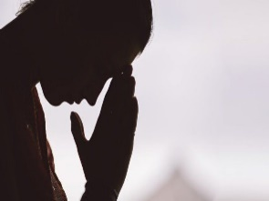

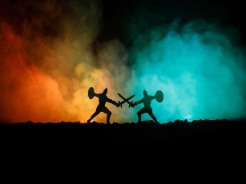





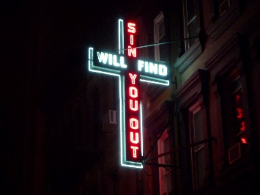






Slide 78
→ Death in sins comes by disbelief in Christ’s message
→ To live to God knows His sacrifice for our life
→ While we sin our advocacy is through Christ
→ A spirit of good wars against the desires of flesh
→ Grace supersedes the law no one can achieve
→ God declares He will dismiss the sins of the faithful
→ Whatever is not from faith is sin
→ Denying sin, and needing Him, makes God a liar
→ It is the word of God that assists us in not sinning
→ God came in Christ to deliver truth and save sinners
→ God desires mercy over excuses of sacrifice
→ Mercy triumphs over judgment
→ God looks for us to present ourselves as righteous
To have God one must submit to His will
Notes:
To have God one must submit to His will

Slide 80
Understanding SIN
4
Ron Bert
April 14, 2013

Slide 81

… that you put off, concerning your former conduct, the old man which grows corrupt according to the deceitful lusts, and be renewed in the spirit of your mind, and that you put on the new man which was created according to God, in true righteousness and holiness. — Ephesians 4:22-24
● old man
former corrupt conduct
        deceitful lusts
● renewed in the spirit
created according to God
righteousness and holiness
new man
former
conduct
old man
corrupt
deceitful lusts
renewed in
the spirit
new man
created according to God
righteousness and holiness

Slide 82
Therefore, putting away lying, "Let each one of you speak truth with his neighbor, for we are members of one another. Be angry, and do not sin": do not let the sun go down on your wrath, nor give place to the devil. — Ephesians 4:25-27
speak truth
speak truth
Be angry, and do not sin
Be angry, and do not sin
fester
wrath
wrath
Notes:
God does not want wrath to overtake our lives where festering brings only the hollow darkness sin delivers. Our anger should be for the sin that divides us.

Slide 83

I speak in human terms because of the weakness of your flesh. For just as you presented your members as slaves of uncleanness, and of lawlessness leading to more lawlessness, so now present your members as slaves of righteousness for holiness. — Romans 6:19
human terms
human terms
slaves
slaves
now present
now present
righteousness for holiness
righteousness for holiness

Slide 84

For if our heart condemns us, God is greater than our heart, and knows all things. Beloved, if our heart does not condemn us, we have confidence toward God. And whatever we ask we receive from Him, because we keep His commandments and do those things that are pleasing in His sight. — 1st John 3:20-22
guilt
condemns
God
condemns
Notes:
Guilt is the voice of conscience, and if responded to with a heart of regret, one may lift in spirit to find the free confidence found in the forgiveness of God’s own promise.

Slide 85
For if our heart condemns us, God is greater than our heart, and knows all things. Beloved, if our heart does not condemn us, we have confidence toward God. And whatever we ask we receive from Him, because we keep His commandments and do those things that are pleasing in His sight. — 1st John 3:20-22
Trust
confidence
confidence
commandments
receive
forgiveness
peace
receive
love
keep
commandments
do
keep
do
in
Notes:
Knowing God forgives us delivers blessings for the mature Christian when responded to by actions of spirit; to do His will. This comes by receiving that most simplest of all possession’s, one above all value; peace. God wills we live lives of decency, and this is the action He calls for, that sets a soul free. Peace comes by the love we give, and are able to receive.

Slide 86

And this is His commandment: that we should believe on the name of His Son Jesus Christ and love one another, as He gave us commandment. Now he who keeps His commandments abides in Him, and He in him. And by this we know that He abides in us, by the Spirit whom He has given us. — 1st John 3:23-24
should believe
should believe
love one another
love one another
commandments
keeps His commandments
keeps His commandments
in
in
in
Spirit
He has given us
Spirit
He
Spirit
He has given us

Slide 87

For if we sin willfully after we have received the knowledge of the truth, there no longer remains a sacrifice for sins, but a certain fearful expectation of judgment, and fiery indignation which will devour the adversaries. — Hebrews 10:26-27
sin willfully
sin
seared conscience
sin willfully
the truth
sin
sin
the truth
sin
sacrifice for sins
sacrifice for sins

Slide 88

Jesus answered them, "Most assuredly, I say to you, whoever commits sin is a slave of sin. And a slave does not abide in the house forever, but a son abides forever. Therefore if the Son makes you free, you shall be free indeed." — John 8:34-36
sin
commits sin is a slave of sin
sin
commits sin is a slave of sin
sin
the Son makes you
Son
the Son makes you
free
free

Slide 89

Flee sexual immorality. Every sin that a man does is outside the body, but he who commits sexual immorality sins against his own body. — 1st Corinthians 6:18
outside
sins
outside
sin
sins
inside
sin
inside
Notes:
Adultery or sexual immorality is of the most heinous of sins. It is an act of betrayal and sheer lack of any kind of honest loyalty. Does one just live to lust or love?

Slide 90

The devising of foolishness is sin, And the scoffer is an abomination to men. — Proverbs 24:9
devising of foolishness
sin
devising of foolishness
sin
sin
sin

Slide 91

If anyone sees his brother sinning a sin which does not lead to death, he will ask, and He will give him life for those who commit sin not leading to death. There is sin leading to death. I do not say that he should pray about that. All unrighteousness is sin, and there is sin not leading to death. — 1st John 5:16-17
Intercessionary sympathy
sin not leading to
sin not leading to
sin
sin
sin
sin
sin
sin
death
sin leading to death
death
sin leading to death
sin
do not
just punishment
pray
Satan?
All unrighteousness
sin
All unrighteousness
sin
Saving Grace
Notes:
God has an outstanding call for sympathy; an intercessionary force of understanding and forgiveness for ignorance or mild stumbling’s; accidents, vs. heinous acts of incest, greed, or murder --- pardon to those who regret vs. no pardon to the unrepentful. Praying for a reversal of a just conviction is useless and goes against righteous judgment. One does not pray for Satan to be forgiven. Let justice be served. God will choose penitent repenters over the unremorseful. One should not argue over what is obvious, and due punishment. To be or not to be is a question of having an accountable conscience over not having one riddled in excuses or just oblivious.

Slide 92

Now "If the righteous one is scarcely saved, Where will the ungodly and the sinner appear?" — 1st Peter 4:18
sin
ungodly
sin
ungodly
Notes:
The ungodly have no sympathy in their selfish scheming. Righteousness begins by believing God has brought salvation upon us through faith in His Son, Jesus the Christ. It is a delicate path as each of us battle those individual sins of the flesh. God devised mortal life to see how we respond to the absolute power He has handed over to us; as He stands aside waiting. Do we choose kind hearts over vicious ones? Drinking sin wholeheartedly holds no repentance.

Slide 93

His own iniquities entrap the wicked man, And he is caught in the cords of his sin. He shall die for lack of instruction, And in the greatness of his folly he shall go astray. — Proverbs 5:22-23
"When I say to the wicked, 'O wicked man, you shall surely die!' and you do not speak to warn the wicked from his way, that wicked man shall die in his iniquity; but his blood I will require at your hand. Nevertheless if you warn the wicked to turn from his way, and he does not turn from his way, he shall die in his iniquity; but you have delivered your soul." — Ezekiel 33:8-9
wicked man
wicked man shall die
sin
shall
in the cords of his sin
in
in the cords of his sin
die
lack of instruction
die
die
lack of instruction
greatness
Pride
greatness

Slide 94
if you do not warn the wicked he shall die in his iniquity but his blood I require at your hand if you warn the wicked to turn he does not turn from his way he shall die in his iniquity but you have delivered your soul
"When I say to the wicked, 'O wicked man, you shall surely die!' and you do not speak to warn the wicked from his way, that wicked man shall die in his iniquity; but his blood I will require at your hand. Nevertheless if you warn the wicked to turn from his way, and he does not turn from his way, he shall die in his iniquity; but you have delivered your soul." — Ezekiel 33:8-9
not warn
you do
not
warn the wicked
shall die in his
iniquity
but his blood I
require at
your hand
if you warn
warn
if
the wicked to turn
he does not turn from his way
he
he
shall die in his iniquity
but you have
delivered your soul

Slide 95

For if God did not spare the angels who sinned, but cast them down to hell and delivered them into chains of darkness, to be reserved for judgment; — 2nd Peter 2:4
sin
sin
chains of darkness
chains of darkness
for judgment
for judgment

Slide 96

"For whoever is ashamed of Me and My words in this adulterous and sinful generation, of him the Son of Man also will be ashamed when He comes in the glory of His Father with the holy angels." — Mark 8:38
whoever
ashamed of Me
whoever
Me
ashamed of Me
My words
My words
sin
sin
comes in the glory
in
comes in the glory
Notes:
The words of God will become extremely important when each of us comes to His presence. The preacher will not save you, and no note from mommy will excuse the consequences of who each of us has chosen to be.

Slide 97

Righteousness exalts a nation, But sin is a reproach to any people. — Proverbs 14:34
sin
sin
Notes:
Sin is the curse that has brought empires to more than their knees, and destroyed many a peoples’ livelihoods. When sin becomes the banner of a people, the substance of honor and truth is abandoned.

Slide 98

"Son of man, when a land sins against Me by persistent unfaithfulness, I will stretch out My hand against it; I will cut off its supply of bread, send famine on it, and cut off man and beast from it. Even if these three men, Noah, Daniel, and Job, were in it, they would deliver only themselves by their righteousness," says the Lord GOD. — Ezekiel 14:13-14
when a land sins against
sin
when a land sins against
Me by persistent unfaithfulness
Me
Me by persistent unfaithfulness
Hardships - not Blessings
sin
Notes:
A small handful of righteous will not halt the avalanche of overwhelming wickedness from collapsing decency for all.

Slide 99

"… if My people who are called by My name will humble themselves, and pray and seek My face, and turn from their wicked ways, then I will hear from heaven, and will forgive their sin and heal their land. Now My eyes will be open and My ears attentive to prayer made in this place." — 2nd Chronicles 7:14-15
called
called
My name
humble
humble
seek
My face
seek
turn
turn
I will hear
I
. .
forgive their sin
sin
. .
My eyes
My ears
in
Notes:
Many only return to the wicked fruits of their disgust. Without turning back to pursuing God’s will, His help will be futile. Vomit can only be made clean by responding to His word.

Slide 100
God
God
God
God

Slide 101

"Truly, these times of ignorance God overlooked, but now commands all men everywhere to repent, …" — Acts 17:30
God
commands all
commands all
to repent
to repent
God
God
God
God
God
God
God
God
God
God
Notes:
God looks to all the corners of the earth to find the upright.

Slide 102

My people are destroyed for lack of knowledge. Because you have rejected knowledge, I also will reject you from being priest for Me; Because you have forgotten the law of your God, I also will forget your children. — Hosea 4:6
people are destroyed
for lack of knowledge
Because of rejected knowledge
forgotten the law of God
↕
children will forget
people are destroyed
for lack
of knowledge
rejected knowledge
Because
forgotten
the law of
God
will
of
forget
children
Notes:
People and civilizations are destroyed for the lack of honest compassion for one another. The disregard in contempt divides all sensibility to understand peace and love, for the furtherment of truth, for the sake of truth, peace, and love. Forgetting is the excuse of fools who decide not to feel. If the keys to the truth are abandoned, only the lies that deceive will remain.

Slide 103


God thunders marvelously with His voice; He does great things which we cannot comprehend. — Job 37:5
He does great things
. .
Notes:
How can the expression of reality be explained? From all the waterfalls to pastures of every element, in the sight of the infinite void of stars and countless ongoings, how is a gift of inspiration, and why is the presence of being. God is the Awe in front of us all.

Slide 104



















Slide 105
→ God wills our knowledge in Him over man’s deceit
→ God calls for honesty without anger
→ God knowing all things will render justice
→ Slavery to sin is set free by Christ’s favor
→ Sexual immorality sins against one’s own body
→ God calls for sympathetic intervention for mild sins
→ We should not pray for those guilty of heinous acts
→ Habitual sin traps a soul to falling away from God
→ Sinners are reserved in darkness for judgment
→ The darkness of sin is repulsive to all decent
→ A land that blatantly sins denying Him will suffer
→ Ignorance is unacceptable as God calls for control
→ It is knowledge of God that emancipates the soul
True awareness is to not miss out on God’s blessings
Notes:
True awareness is to not miss out on God’s blessings

Slide 107

Please visit http://www.RonBert.com to explore further
Ronald Bert Channel on
Notes:
Eternity never ends.

