Slide 1
Notes:
Darkness has no belonging.

Slide 2

TRUST
Ron Bert
April 23, 2017
Notes:
In the light of God each one must answer to the trust buried deep in our hearts.

Slide 3
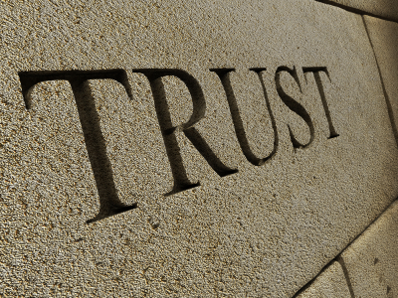
Notes:
Trust is what builds a soul. Is the choice that gives joy one of temporary carnal pleasures or spiritually more edifying and endlessly enduring?

Slide 4
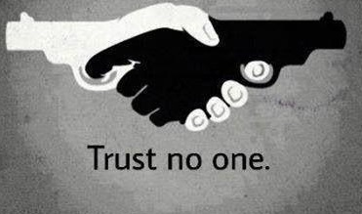

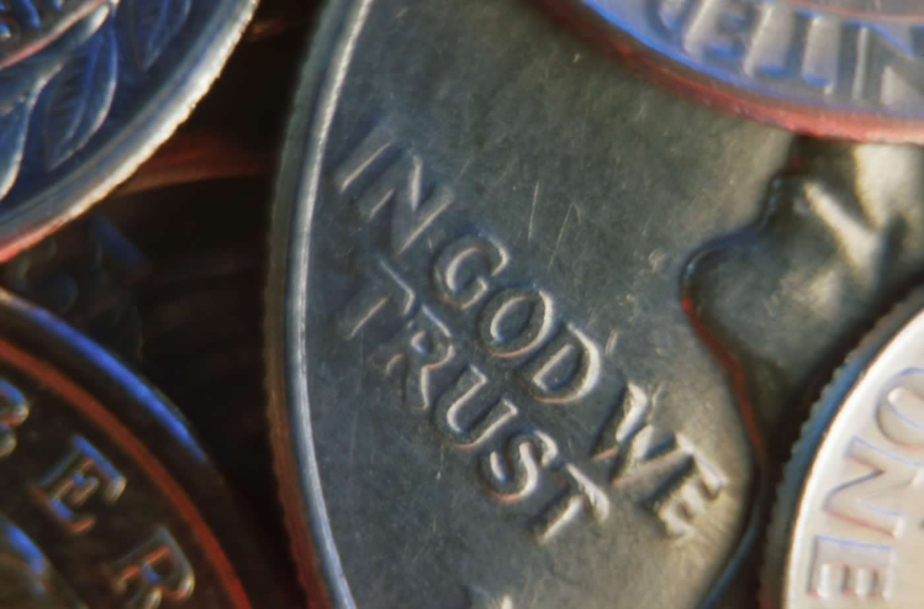
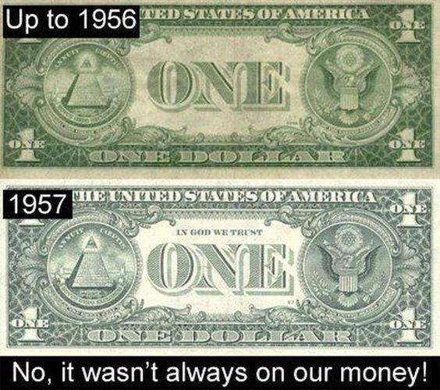
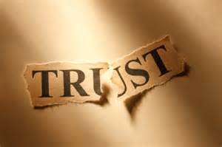
Notes:
Broken trust is why we have become the abomination that we are. If we honor the lie we miss the truth.

Slide 5
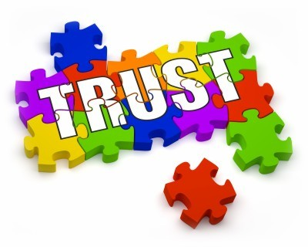
governments
education
401k
money
medicine
relationships
Notes:
Trust is like a puzzle and it involves our deepest desires. Many men crawl on their bellies searching for sustenance as they slither through their almost unconscious desperate life. Once they obtain their possession, they hide among associates unaware of the damaged goods or wounded souls left behind. The only salvation for such is to stand and listen. If fortunate enough to be humble without violence, and prodding from others not to take it, realization may come; realization that anger cannot cover misery but only increase it. As such, truth becomes one’s greatest weapon and fear the worst enemy. Trust outside self rises to a higher level allowing true liberty to arrive while in mortal bondage.

Slide 6
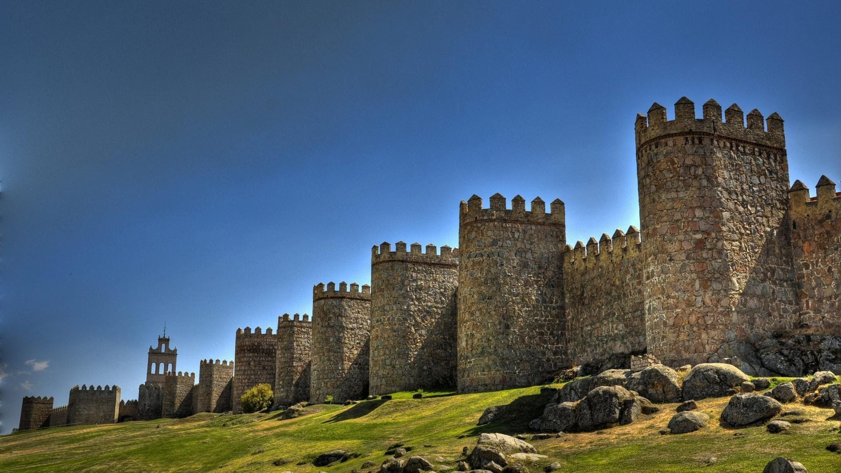
The LORD is good, A stronghold in the day of trouble; And He knows those who trust in Him. — Nahum 1:7
in
in
in
the day of trouble
the day of trouble
trust
in
in Him
in Him
Notes:
The greatest trust one can have is in God Himself. How can one find trust in what decays? Many abandon God in troubled times giving up where it should be, during these times, our faith increases not decreases.

Slide 7
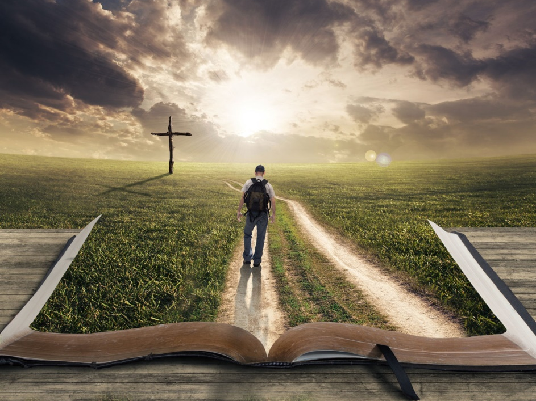
And those who know Your name will put their trust in You; For You, LORD, have not forsaken those who seek You. — Psalms 9:10
And those who know Your name will put their trust in You; For You, LORD, have not forsaken those who seek You. — Psalms 9:10
And those who know Your name will put their trust in You; For You, LORD, have not forsaken those who seek You. — Psalms 9:10
name
trust
in
Therefore God also has highly exalted Him and given Him the name which is above every name, that at the name of Jesus every knee should bow, of those in heaven, and of those on earth, and of those under the earth, and that every tongue should confess that Jesus Christ is Lord, to the glory of God the Father. — Philippians 2:9-11
trust in You
trust in You
seek
Jesus Christ
Jesus Christ is Lord, to the glory of God
Jesus Christ
Jesus Christ is Lord, to the glory of God
Notes:
Knowing the name of God is knowing who He is and what He desires has surly been revealed in Christ. By seeking Him is to know Him.

Slide 8
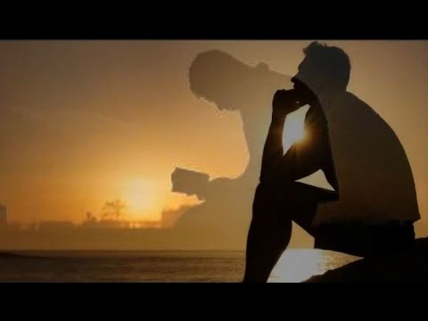
Blessed is that man who makes the LORD his trust, And does not respect the proud, nor such as turn aside to lies. — Psalms 40:4
Blessed
trust
the LORD his trust
arrogant
turn aside
to lies
turn aside
Notes:
When God becomes greater than all material and submission is above all persons, trust is rightfully placed. The brazen have always tried to steal the means of the meek.

Slide 9
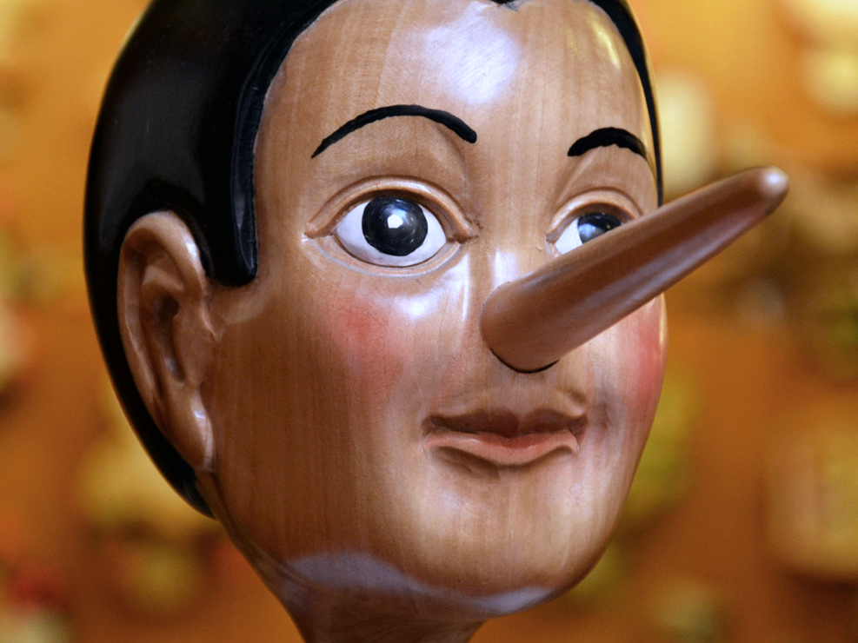
"Behold, you trust in lying words that cannot profit." — Jeremiah 7:8
trust
lying words
Notes:
How can one obtain peace if the lie becomes greater than then the truth?

Slide 10
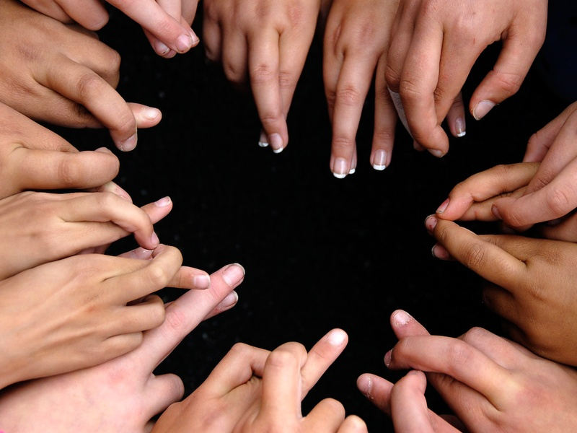
No one calls for justice, Nor does any plead for truth. They trust in empty words and speak lies; They conceive evil and bring forth iniquity. — Isaiah 59:4
?
justice
They trust in
empty words and speak lies
. .
plead for truth
truth
trust
trust
Notes:
Spinning in a vacuum of deception, the self-proclaimed have no eternal foundation. Where truth is absent there is no justice.

Slide 11
HOPE
trust
Notes:
Spinning in a vacuum of deception, the self-proclaimed have no eternal foundation. Where truth is absent there is no justice.

Slide 12
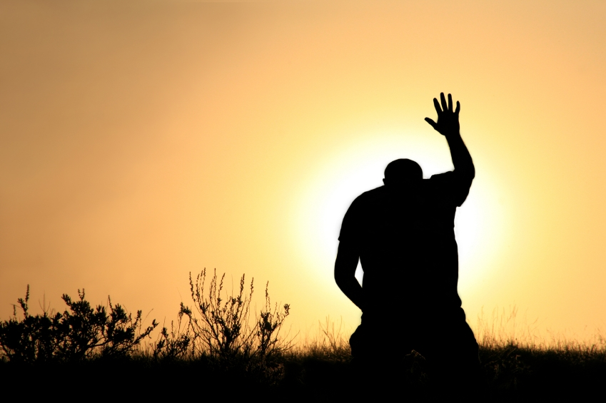
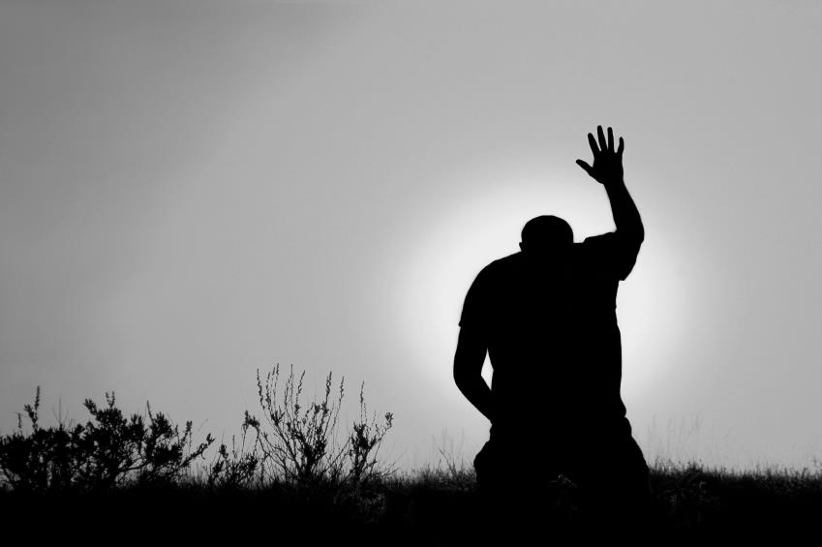
While I live I will praise the LORD; I will sing praises to my God while I have my being. Do not put your trust in princes, Nor in a son of man, in whom there is no help. — Psalms 146:2-3
?
Thus says the LORD: "Cursed is the man who trusts in man And makes flesh his strength, Whose heart departs from the LORD. — Jeremiah 17:5
I live
LORD
While I live I will praise the LORD; I will sing praises to my God while I have my being. Do not put your trust in princes, Nor in a son of man, in whom there is no help. — Psalms 146:2-3
While I live I will praise the LORD; I will sing praises to my God while I have my being. Do not put your trust in princes, Nor in a son of man, in whom there is no help. — Psalms 146:2-3
I live
praise
HOPE
trust
LORD
heart departs
Notes:
No man is higher than what God Himself can do for each one of us in His promise of salvation, when one turns to Him. Much of what we trust in is what we hope for. Does one hope for those carnal things that displease God, ignoring or abandoning His clearly defined goodness, that is found in Him and His word?

Slide 13

Trust in the LORD, and do good; Dwell in the land, and feed on His faithfulness. Delight yourself also in the LORD, And He shall give you the desires of your heart. Commit your way to the LORD, Trust also in Him, And He shall bring it to pass. — Psalms 37:3-5
Trust in the LORD
do good
trust
LORD
LORD
LORD
do
do good
Delight yourself
Delight yourself
in
the LORD
Commit your way
Commit your way
Trust also in Him
in
Trust also in Him
Him
Notes:
Trusting in the Lord is also rejoicing in Him.

Slide 14
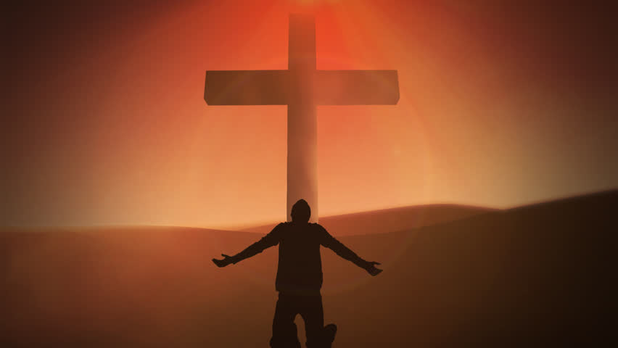
Trust in the LORD with all your heart, And lean not on your own understanding; In all your ways acknowledge Him, And He shall direct your paths. — Proverbs 3:5 - 6
LORD
Trust in the LORD
all your
heart
all your ways
all your heart
all your ways
Notes:
That elusive peace beyond understanding is an anchor one holds to as God’s gift to true believers.

Slide 15

Therefore humble yourselves under the mighty hand of God, that He may exalt you in due time, casting all your care upon Him, for He cares for you. — 1st Peter 5:6-7
humble
under the mighty hand of God
God
LORD
under the mighty hand of God
casting all
trust
Notes:
Trust in God believes He lifts us in tests that bring us to be who He wants us to be.

Slide 16
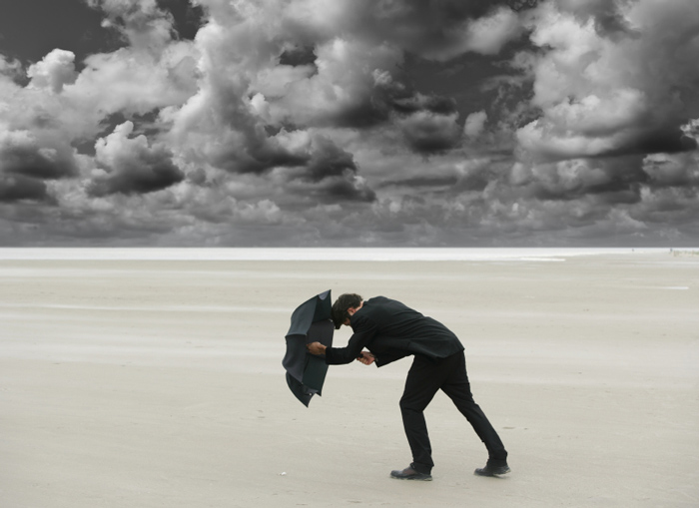
Be sober, be vigilant; because your adversary the devil walks about like a roaring lion, seeking whom he may devour. Resist him, steadfast in the faith, knowing that the same sufferings are experienced by your brotherhood in the world. — 1st Peter 5:8-9
Be sober
be vigilant
Aware
Alert
● Be sober
● be vigilant
● Resist the devil
t
the devil
vigilant
trust
Attentive
t
Heedful
Resist
steadfast in the faith
steadfast in the faith, knowing that the same sufferings are experienced by your brotherhood in the world. — 1st Peter 5:8-9
steadfast in the faith
trust
Observant
r
Cautious
s
u
Watchful
Notes:
While watchful the storm rages chasing the righteous across the sea of sin. Success is not a measure of earthly quantifications. Success is a spirit of joy’s peace for love’s emancipation. Success is the bond to give one’s heart away out of any stingy center. Dreams may never come true where many battle the loss of all those most extraordinary hopes. To stand on the bottom is to reach the top. Success is leaving a piece of yourself for the enrichment of others.

Slide 17

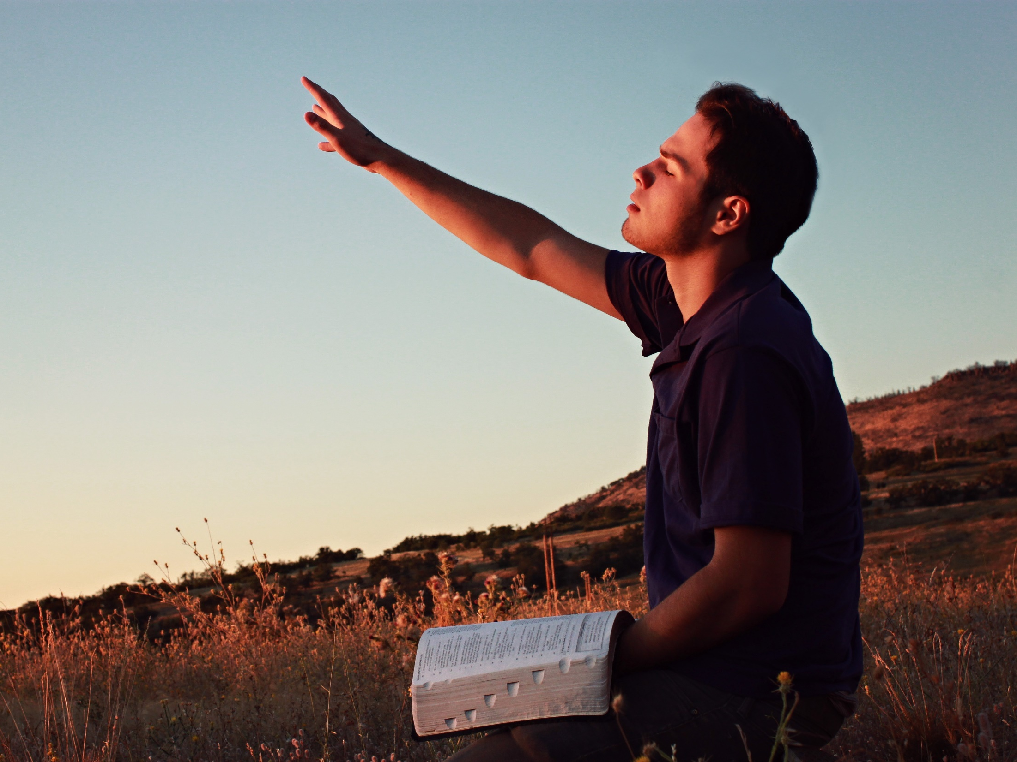
Whenever I am afraid, I will trust in You. In God (I will praise His word), In God I have put my trust; I will not fear. What can flesh do to me? — Psalms 56:3-4
trust
trust
trust
answer
So shall I have an answer for him who reproaches me, For I trust in Your word. — Psalms 119:42
His word
praise
His word
my trust
trust
my trust
Your word
Notes:
Trusting the Lord should be on all of our horizons. He rises above all that is despicable. His word gives us the wisdom of protection.

Slide 18
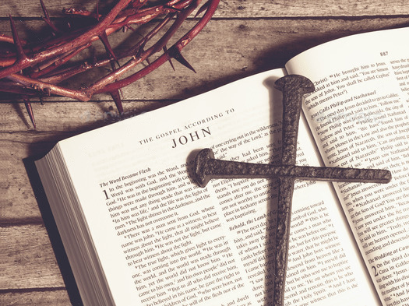
Surely he will never be shaken; The righteous will be in everlasting remembrance. He will not be afraid of evil tidings; His heart is steadfast, trusting in the LORD. — Psalms 112:6-7
The righteous
will never be shaken
in:
● lasting remembrance
● not afraid of evil
● heart is steadfast
● trusting in the LORD
will never be shaken
righteous
The righteous
in
in
trust
everlasting remembrance
never forget
lasting remembrance
everlasting remembrance
LORD
not
afraid of evil
heart is steadfast
trust
trusting in the LORD
LORD
trust
Notes:
It is love for God that unites us in the eternal rewards that He offers.

Slide 19

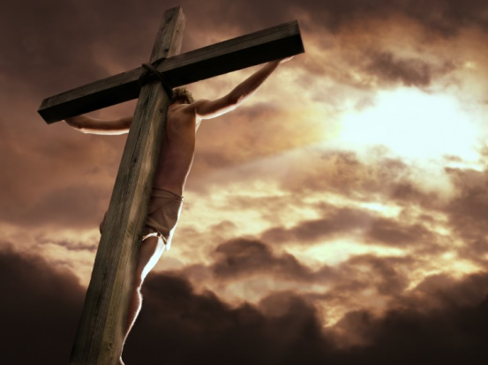
"Behold, God is my salvation, I will trust and not be afraid; 'For YAH, the LORD, is my strength and song; He also has become my salvation.'" — Isaiah 12:2
my salvation
trust
LORD
my strength
trust
LORD
Notes:
God and regarding His personal sacrifice is synonymous with salvation and the strength it brings.

Slide 20
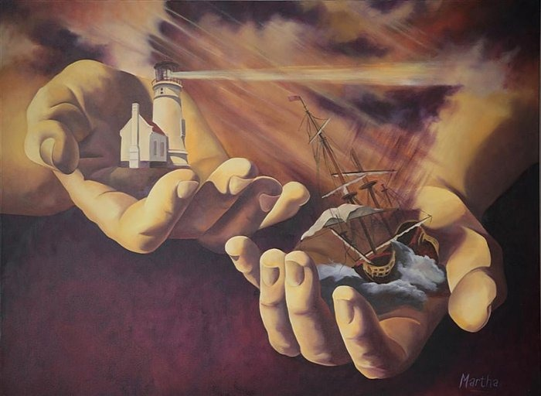
The fear of man brings a snare, But whoever trusts in the LORD shall be safe. — Proverbs 29:25
trust
in
LORD
trusts in the LORD
trusts in the LORD
safe
Notes:
Man has traps around every corner that steal joy and happiness. Mankind is but of a shipwreck lost in the fog without a rudder; keeless. Only in a true steadfast faith is the sanctuary of a heart’s security and safety.

Slide 21

It is better to trust in the LORD Than to put confidence in man. It is better to trust in the LORD Than to put confidence in princes. — Psalms 118:8-9
trust
in
LORD
in
in
LORD
better to trust in the LORD
LORD
better to trust in the LORD
LORD
Notes:
No man has the power of God nor the mercy He extends.

Slide 22
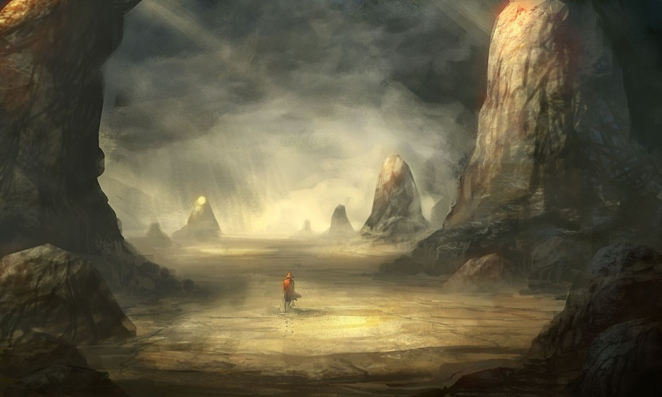
Though the fig tree may not blossom, Nor fruit be on the vines; Though the labor of the olive may fail, And the fields yield no food; Though the flock may be cut off from the fold, And there be no herd in the stalls - Yet I will rejoice in the LORD, I will joy in the God of my salvation. — Habakkuk 3:17-18
no blossom
No fruit
labor fail
no food
flock cut off
no herd
no
LORD
blossom
No
fruit
labor
fail
no food
flock
cut off
no
herd
LORD
salvation
Notes:
As Job lost all, though hardships loom, His love remains.

Slide 23

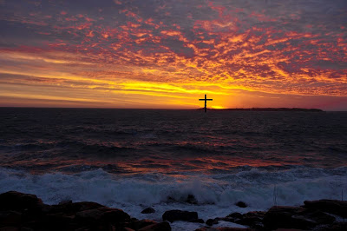
Therefore submit to God. Resist the devil and he will flee from you. — James 4:7
But as for me, I trust in You, O LORD; I say, "You are my God."
— Psalms 31:14
LORD
You are my God
my God
. .
salvation
God
Notes:
It is each souls quest to honor the Lord and His spoken word is where spiritual protection arises.

Slide 24


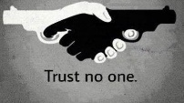



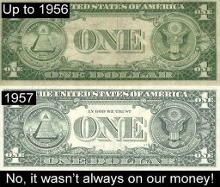
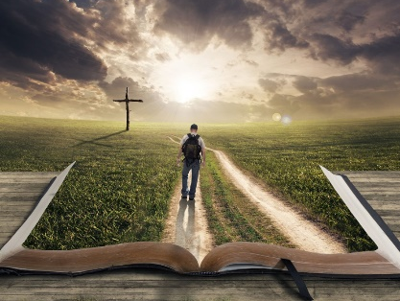







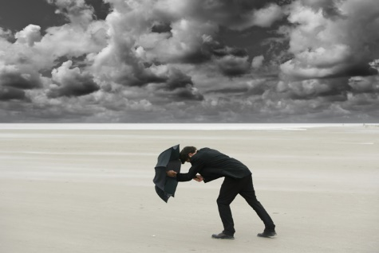
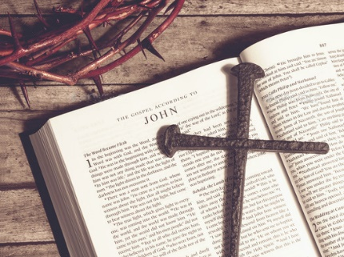
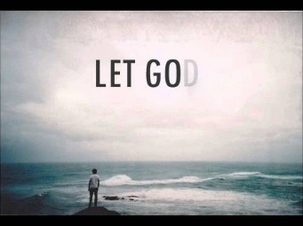


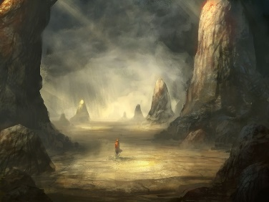
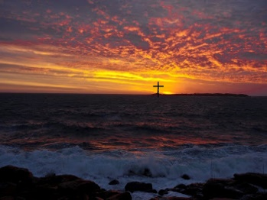

Slide 25
→ The LORD knows those who trust in Him
→ The LORD does not forsake those who seek Him
→ Blessings come upon those who trust in the LORD
→ Do not put your trust in princes or in a son of man
→ Feed on His faithfulness & commit your way to Him
→ Humble yourselves and cast all your cares upon Him
→ Be sober, vigilant; Resist the devil, steadfast in faith
→ The righteous’ heart is steadfast trusting in God
→ Trust in God’s salvation removes fear
→ Praise His word and trust in God
→ Trust in the LORD more than yourself
→ Trust in the LORD over putting confidence in man
→ Submit to God; Resist the devil and he will flee
Trust has no doubt
Notes:
Trust has no doubt.

Slide 26
Notes:
Darkness has nowhere to believe.

Slide 27
TRUST
salvation
2
Ron Bert
April 23, 2017
Notes:
God’s truth has risen to the brightest mountaintop. It is man’s attempts to distort His given truths that buries the people in the valleys of despair.

Slide 28
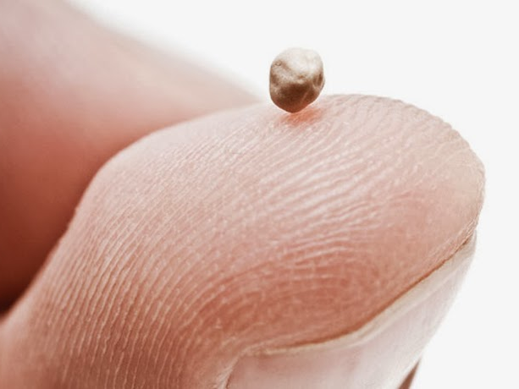
So Jesus answered and said to them, "Have faith in God." — Mark 11:22
salvation
faith
in
Have faith in God
Have faith in God
Notes:
As soul spirits we need to take heart in what reality shows us in that seeds grow and so each one’s spiritual growth is nurtured by belief.

Slide 29
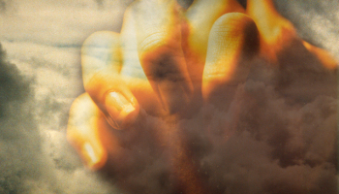
Now faith is the substance of things hoped for, the evidence of things not seen. — Hebrews 11:1
faith
hope
hope
not seen
not seen
Notes:
True faith reaches out beyond us in a presence we hope for where love is greater than any can know as it gives life itself to all.

Slide 30

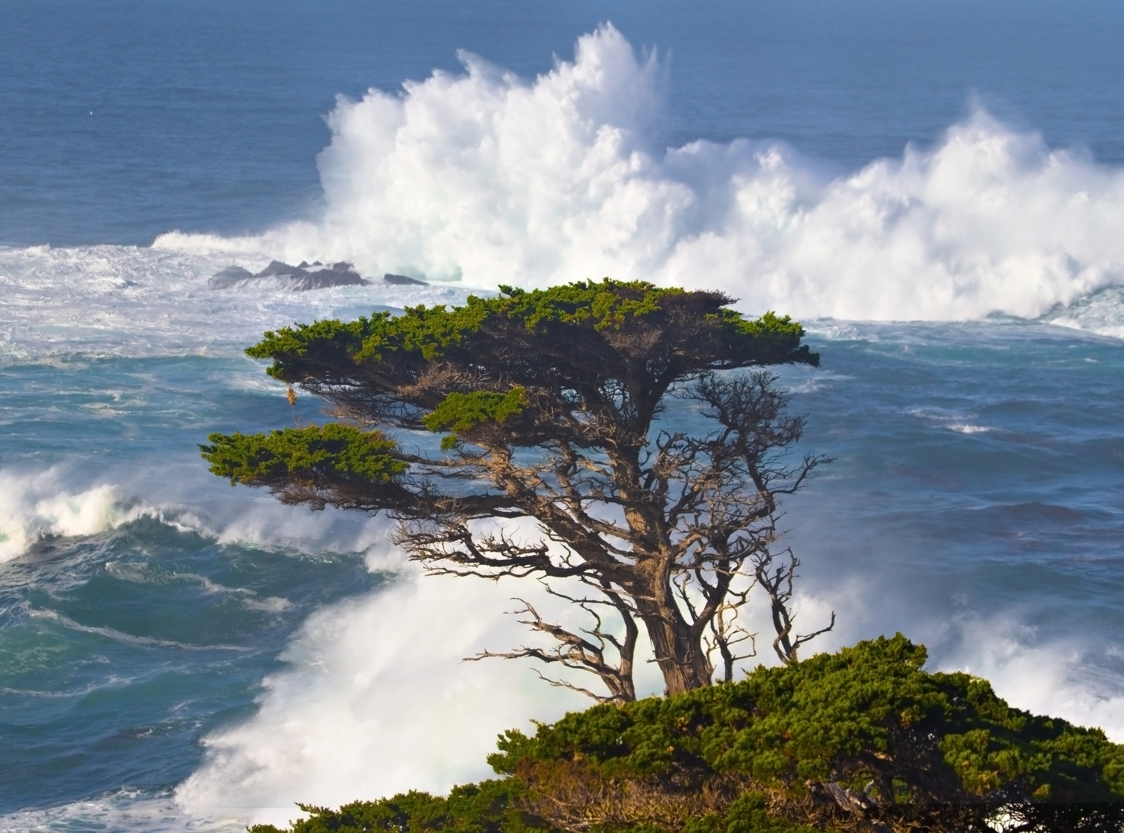
But He said to them, "Why are you so fearful? How is it that you have no faith?" — Mark 4:40
Why
fearful
faith
no faith
Notes:
Do we hang on the edge to where our faith is challenged by fear over security in Him?

Slide 31
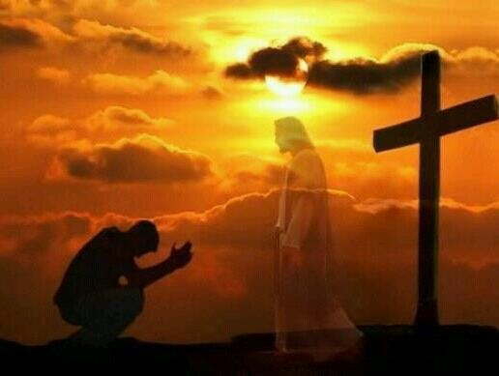
Be anxious for nothing, but in everything by prayer and supplication, with thanksgiving, let your requests be made known to God; and the peace of God, which surpasses all understanding, will guard your hearts and minds through Christ Jesus. — Philippians 4:6 -7
in
peace of God
God
peace of God
guard your hearts
guard your hearts
faith
Jesus
Notes:
Faith can sometimes be challenged by those things that weigh down and beat upon our hearts.

Slide 32
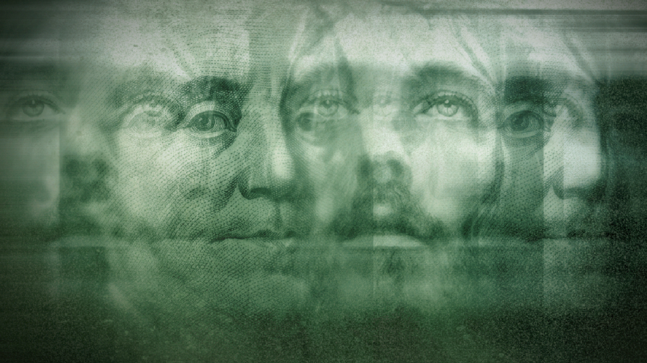
And the disciples were astonished at His words. But Jesus answered again and said to them, "Children, how hard it is for those who trust in riches to enter the kingdom of God!" — Mark 10:24
Jesus
trust
?
Notes:
Clinging to the material can be an anchor trapping a soul from truly being free.

Slide 33
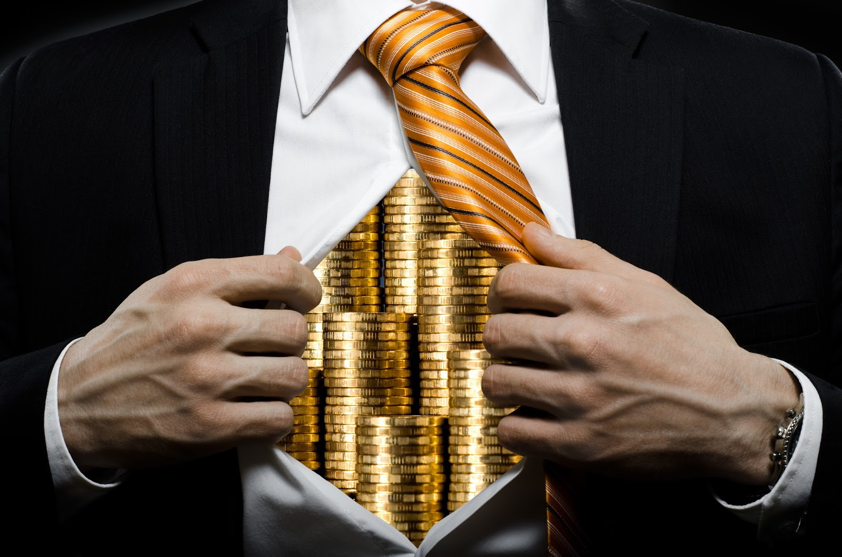

Those who trust in their wealth And boast in the multitude of their riches, None of them can by any means redeem his brother, Nor give to God a ransom for him - — Psalms 49:6-7
trust
Notes:
All men live in mortal poverty.

Slide 34
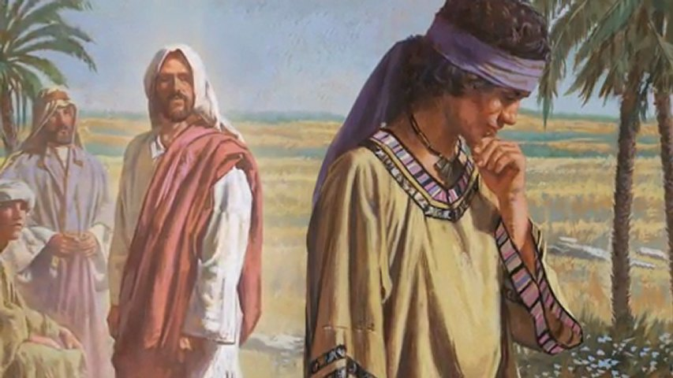
Command those who are rich in this present age not to be haughty, nor to trust in uncertain riches but in the living God, who gives us richly all things to enjoy. — 1st Timothy 6:17
haughty
trust
uncertain riches
in
in the living God
in the living God
Notes:
Rich can be a relative term. Rich in knowledge may not necessarily mean rich in truth if not in accord with what God has declared over what man has devised. Truth is written on the hearts, from the Holy Spirit, where conscious reveals genuineness over callous rejection of what is found in His goodness and delivery of universal truth.

Slide 35
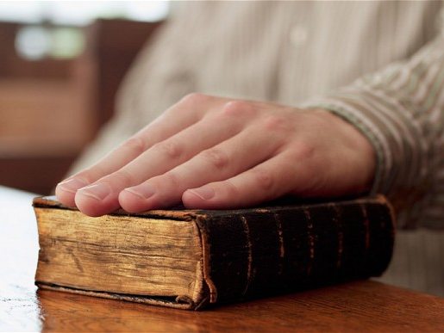
O Timothy! Guard what was committed to your trust, avoiding the profane and idle babblings and contradictions of what is falsely called knowledge -- by professing it some have strayed concerning the faith. Grace be with you. Amen. — 1st Timothy 6:20-21
Guard
O Timothy! Guard what was committed to your trust, avoiding the profane and idle babblings and contradictions of what is falsely called knowledge -- by professing it some have strayed concerning the faith. Grace be with you. Amen. — 1st Timothy 6:20-21
Guard
trust
avoid
avoid
idle babblings
false
knowledge
idle babblings
false
knowledge
Notes:
We should see God’s established truth as precious not to be discarded for popular whims as this does not honor Him.

Slide 36
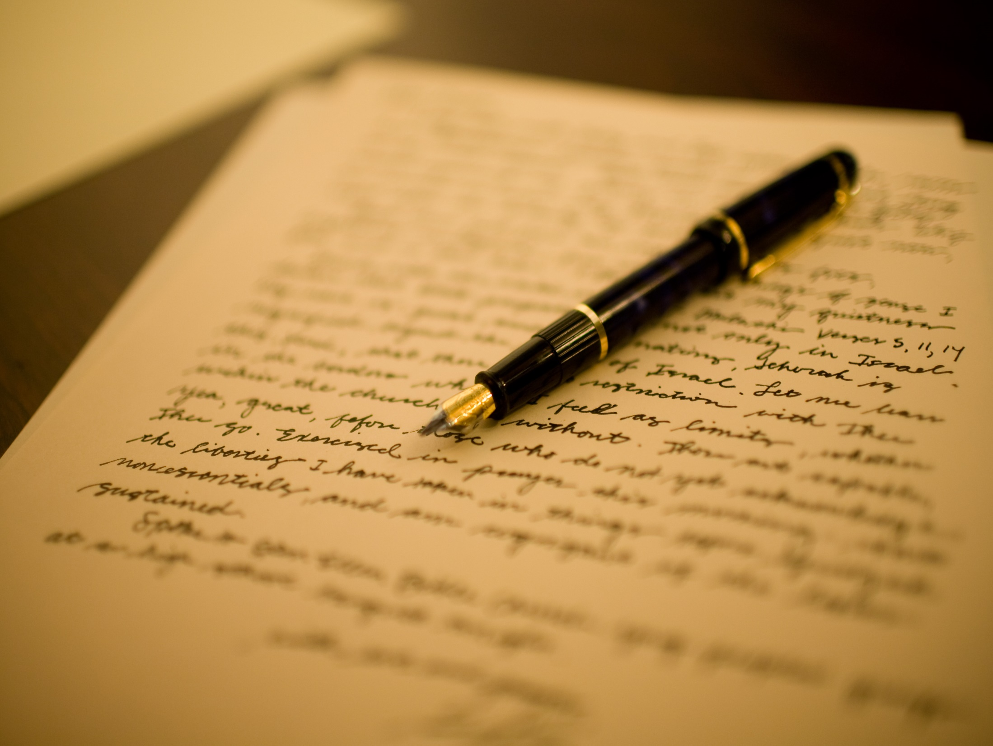
Do we begin again to commend ourselves? Or do we need, as some others, epistles of commendation to you or letters of commendation from you? — 2 ^{nd} Corinthians 3:1
Communications
Dispatches
Applaud
epistles
Truth
Messages
idle babblings
Words
Letters
Correspondences
Notes:
Is it to elevate man by man or is it to glorify God in the highest? Do we look to our own interests or strive at our best to keep the integrity of His word?

Slide 37
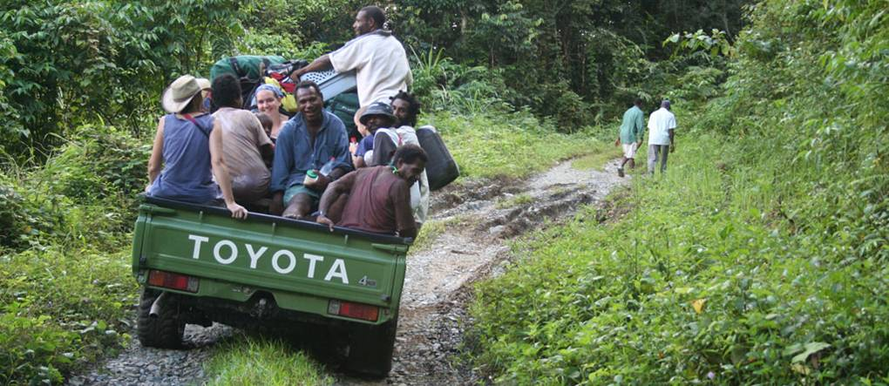

For not he who commends himself is approved, but whom the Lord commends. — 2 nd Corinthians 10:18
not
Pompous
not
whom the Lord
but
whom the Lord
Respects
Notes:
It is God that approves the actions of man and in fact He condemns man’s actions bent to glorify man over God. The letter of a man declares his character written on his heart.

Slide 38
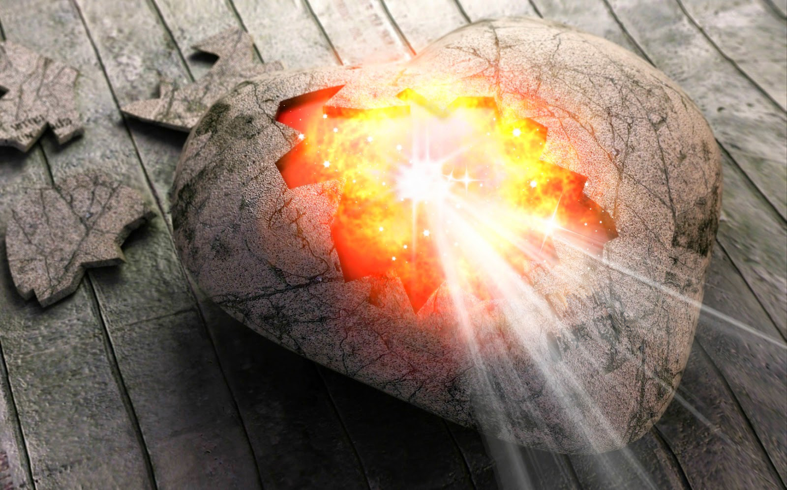
You are our epistle written in our hearts, known and read by all men; clearly you are an epistle of Christ, ministered by us, written not with ink but by the Spirit of the living God, not on tablets of stone but on tablets of flesh, that is, of the heart. — 2 nd Corinthians 3:2-3
epistle
in
epistle
TRUTH
God
Spirit of
Spirit of
God
the living God
God
the living God
the heart
Notes:
It is the fire of each heart that shines unto the Lord. He awakens us to His living way where death no longer has dominion over us.

Slide 39
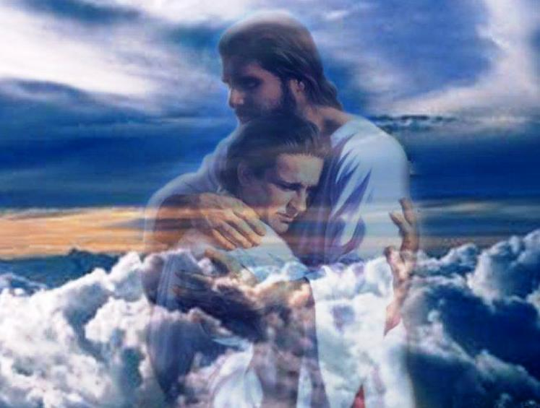
And we have such trust through Christ toward God. — 2 nd Corinthians 3:4
God
God
Notes:
No embrace is tighter than His love for us, and so we love Him. It is not by an act of insecurity that we come to God, but for the promise of eternal life for those that overcome desires that defeat a compassionate heart.

Slide 40
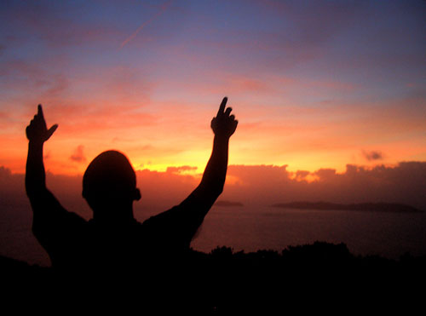
Not that we are sufficient of ourselves to think of anything as being from ourselves, but our sufficiency is from God, who also made us sufficient as ministers of the new covenant, not of the letter but of the Spirit; for the letter kills, but the Spirit gives life. — 2 nd Corinthians 3: 5 - 6
sufficiency is from God
God
sufficiency is from God
Spirit
of the Spirit
of the Spirit
Spirit
Spirit
the Spirit gives life
the Spirit gives life
Notes:
One humble heart has more value than all the dead books that blow across the ages of time.

Slide 41
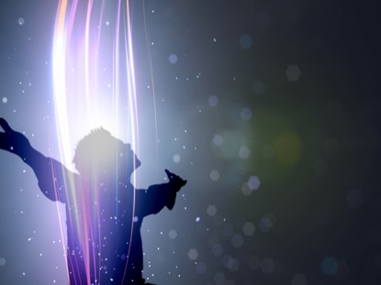
But if the ministry of death, written and engraved on stones, was glorious, so that the children of Israel could not look steadily at the face of Moses because of the glory of his countenance, which glory was passing away, how will the ministry of the Spirit not be more glorious? — 2 nd Corinthians 3:7 - 8
glory
glory
glory
Spirit
ministry of the Spirit
ministry of the Spirit
Notes:
The Holy Spirit touches us all and can only be noticed by those humble in the air of His greatness.

Slide 42
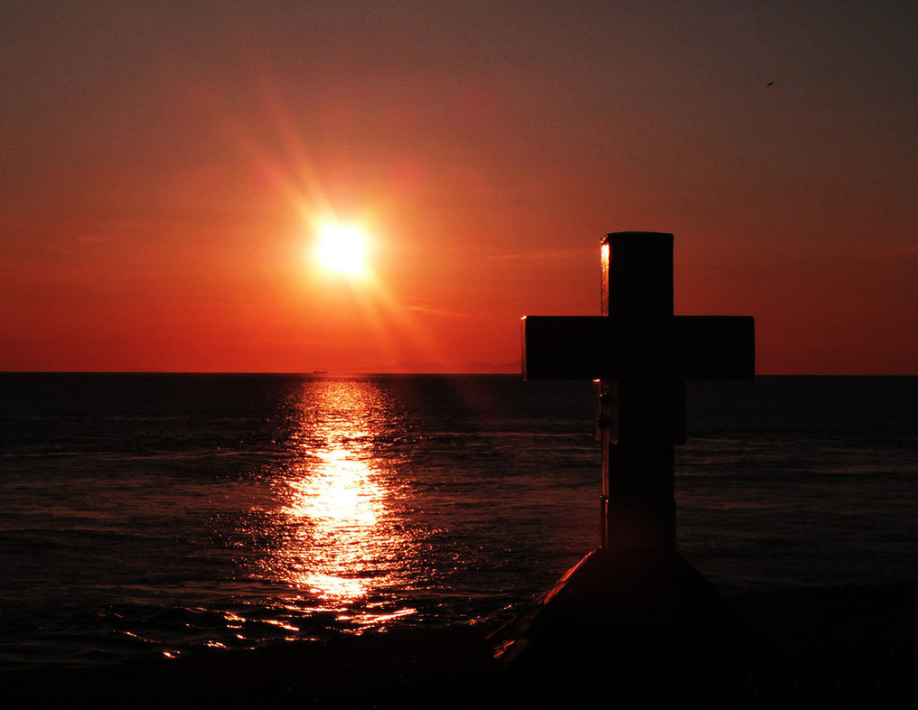
For if the ministry of condemnation had glory, the ministry of righteousness exceeds much more in glory. — 2 nd Corinthians 3:9
The LORD redeems the soul of His servants, And none of those who trust in Him shall be condemned. — Psalms 34:22
tr
trust
guilt
glory
t
us
love’s truth
glory
glory
Notes:
No glory is greater than His sacrifice bringing souls to the threshold of eternal presence. Our faith is trust in Him. There is light at the end of the tunnel for all who believe.

Slide 43

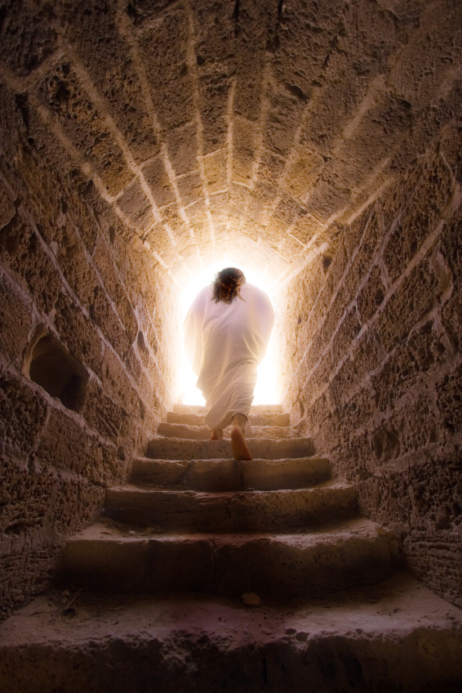
Yes, we had the sentence of death in ourselves, that we should not trust in ourselves but in God who raises the dead, who delivered us from so great a death, and does deliver us; in whom we trust that He will still deliver us, … — 2nd Corinthians 1:9-10
Yes, we had the sentence of death in ourselves, that we should not trust in ourselves but in God who raises the dead, who delivered us from so great a death, and does deliver us; in whom we trust that He will still deliver us, … — 2nd Corinthians 1:9-10
Yes, we had the sentence of death in ourselves, that we should not trust in ourselves but in God who raises the dead, who delivered us from so great a death, and does deliver us; in whom we trust that He will still deliver us, … — 2nd Corinthians 1:9-10
And the LORD shall help them and deliver them; He shall deliver them from the wicked, And save them, Because they trust in Him. — Psalms 37:40
in
in God
God
in God
deliver them
deliver them
in
trust in Him
trust in Him
trust
Notes:
Only God has the power to save souls. Our choices in life will come to His judgment as we rise from the earth to face His light. Our faith is in this resurrection to eternal life.

Slide 44

The righteous shall be glad in the LORD, and trust in Him. And all the upright in heart shall glory. — Psalms 64:10
Every word of God is pure; He is a shield to those who put their trust in Him. — Proverbs 30:5
in the
in
LORD
trust in Him
trust
in
in heart
in
Notes:
The shield of the Lord protects our hearts.

Slide 45



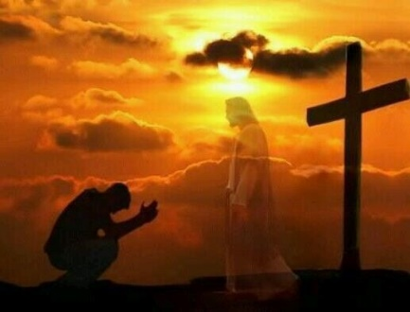

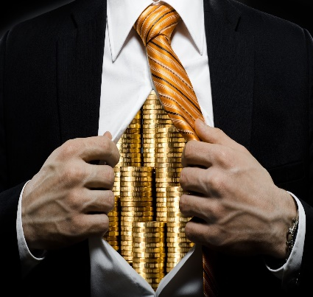







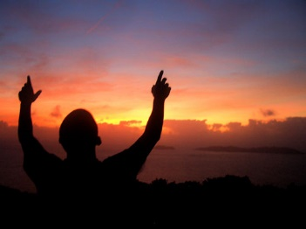
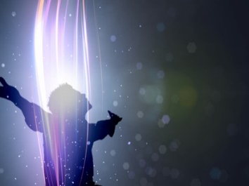

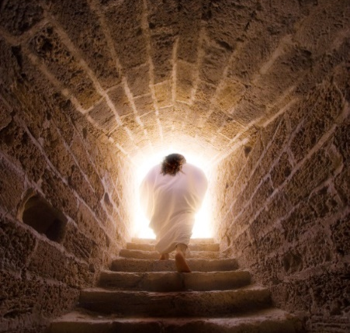


Slide 46
→ Jesus tells us to have faith in God
→ Faith is trust in God to come
→ Trust in Him guards the heart from anxiety
→ Trusting in riches blocks entrance to His kingdom
→ Money cannot redeem a life
→ Trust in God who gives all wealth
→ We need to guard the precious truth given of God
→ One cannot commend oneself; God gives approval
→ The word strengthens the spirit of one’s heart
→ Faith establishes trust through Christ toward God
→ Our sufficiency comes by the Spirit of God
→ Ministry of righteousness exceeds condemnation
→ Do not trust oneself but in God who raises the dead
Trust lifts the spirit
Notes:
Trust lifts the spirit.

Slide 47
Notes:
Darkness remains the same with no corner to turn.

Slide 48

Please visit http://www.RonBert.com to explore further
Ronald Bert Channel on
Notes:
Eternity never ends.

