Slide 1
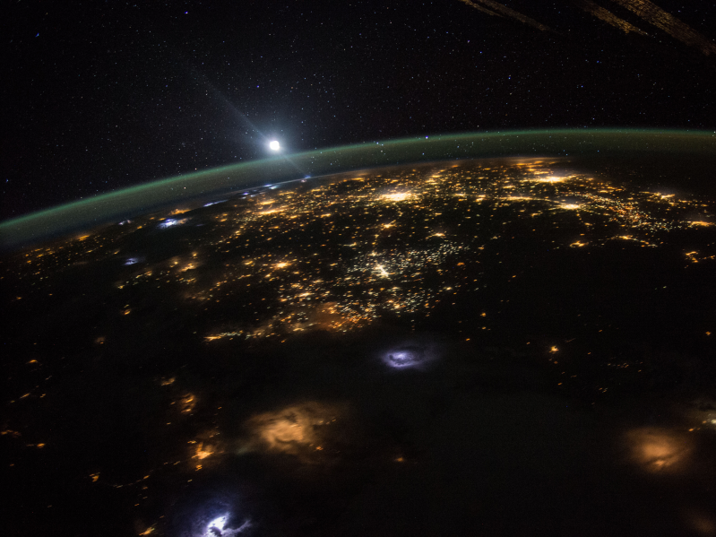

Slide 2
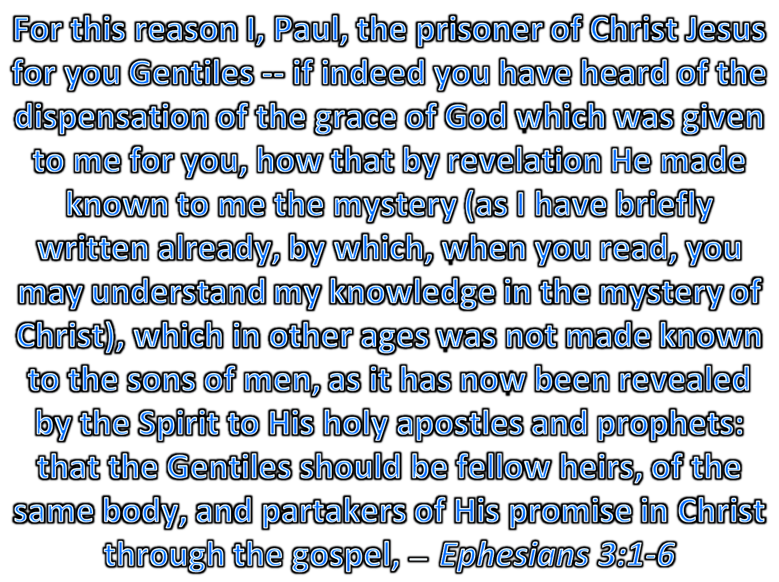
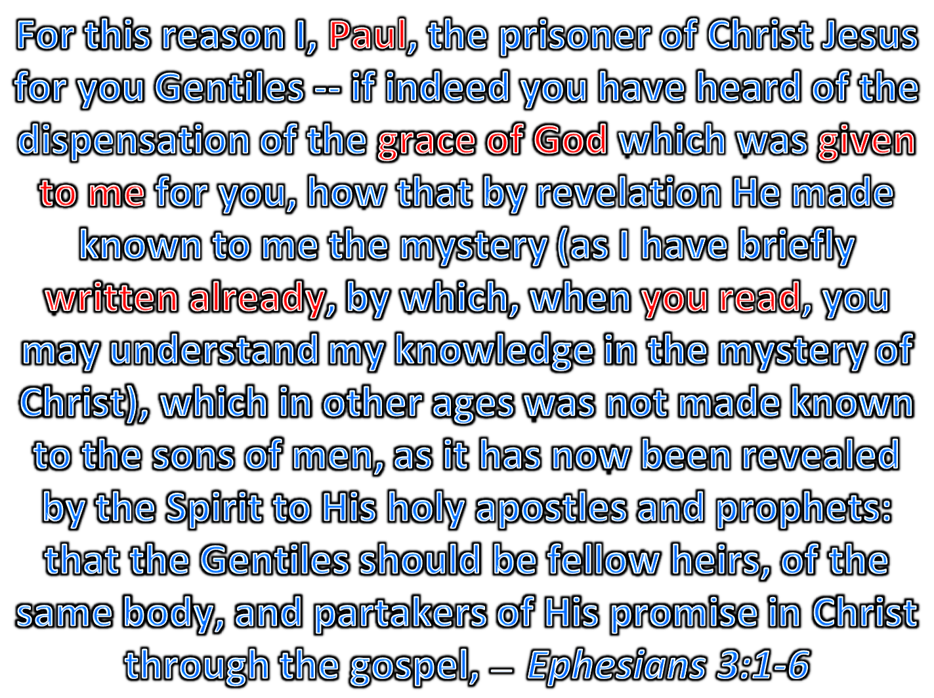
Paul
Paul
Christ Jesus
grace of God
. .
grace of God
God
. .
by revelation
. .
. .
written already
you
read
revealed
read
revealed
revealed
Paul
written already
you

Slide 3
LORD
grace of God
revealed
read
Click here for triangle html scripture links
Ephesians 3:1-6
Paul
written already
you
wrote
we

Slide 4
