Slide 1
Notes:
Darkness haunts an empty heart

Slide 2
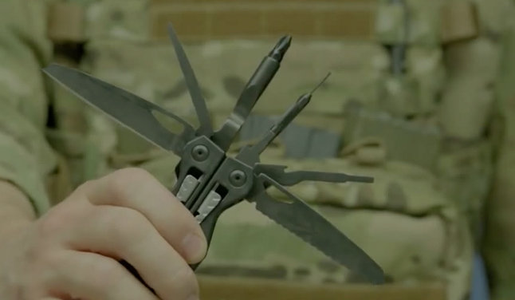

Tool or Weapon?
Ron Bert
September 29, 2019

Slide 3

“The pen is mightier than the sword” — Edward Bulwer-Lytton
“Whoever said the pen is mightier than the sword obviously never encountered automatic weapons.” – Douglas MacArthur
sword
sword
WHAM = Win Hearts and Minds
Notes:
The ages have revealed that ideals of truth have taken precedence over domination and oppression. In the individual image of God we were created to know.

Slide 4
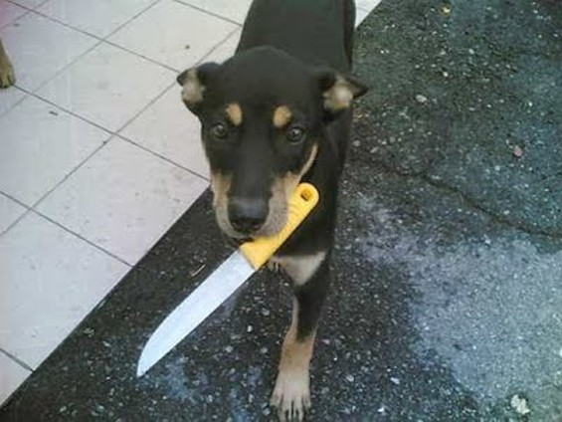
Deliver Me from the sword, My precious life from the power of the dog. — Psalms 22:20
sword
word
word
Notes:
One must ask for salvation for it to well up from within.

Slide 5
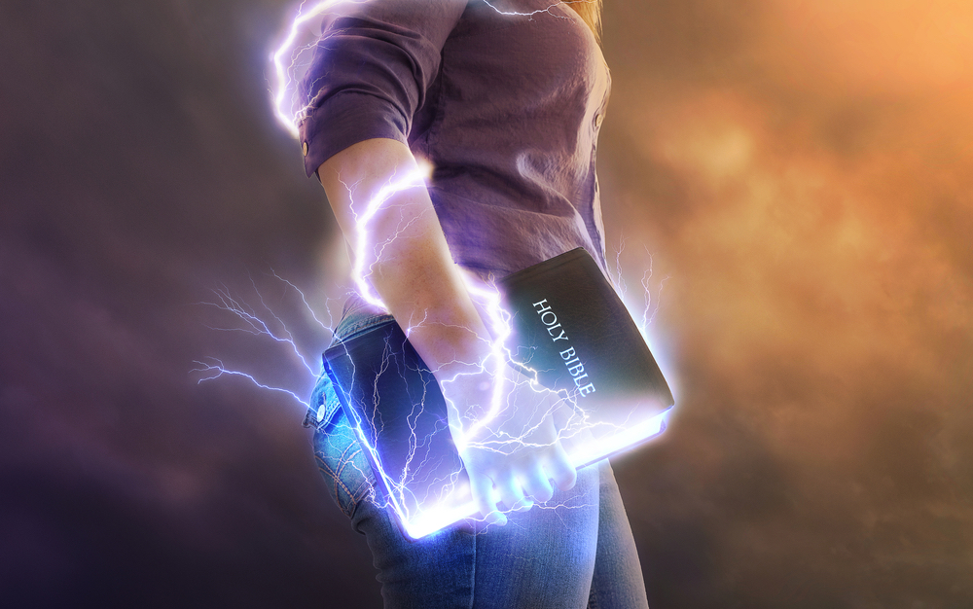
How can a young man cleanse his way? By taking heed according to Your word. With my whole heart I have sought You; Oh, let me not wander from Your commandments! — Psalms 119:9-10
Your word
taking heed
word
Your word
Notes:
Clean hearts turn to His ways praying to remain steadfast.

Slide 6
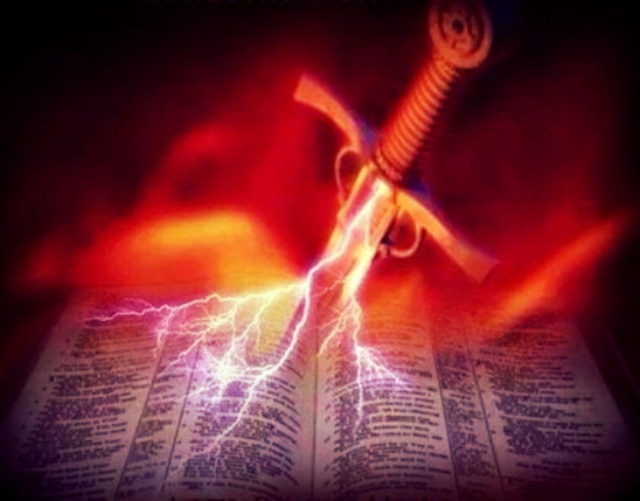
The entrance of Your words gives light; It gives understanding to the simple. I opened my mouth and panted, For I longed for Your commandments. — Psalms 119:130-131
Your word
word
word
longed for
Notes:
It is the word of God that give fire to our lives.

Slide 7
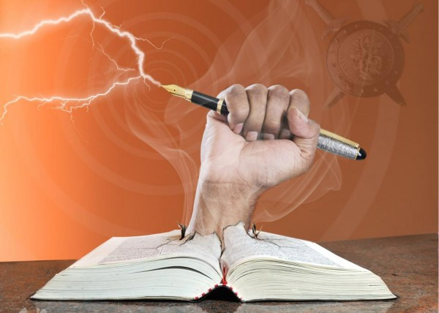
"Is not My word like a fire?" says the LORD, "And like a hammer that breaks the rock in pieces?" — Jeremiah 23:29
My word
word
breaks the rock
Notes:
No mere sword can shatter all falsehoods as God’s word does.

Slide 8
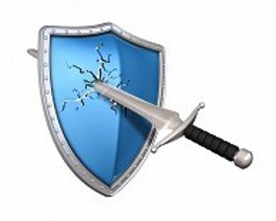
He who speaks truth declares righteousness, But a false witness, deceit. There is one who speaks like the piercings of a sword, But the tongue of the wise promotes health. — Proverbs 12:17-18
Good judgment
comes from
experience but
most experience
comes from bad
judgment
wise
Bad
wise
Notes:
Bad words spoil life where righteous ones deliver health.

Slide 9
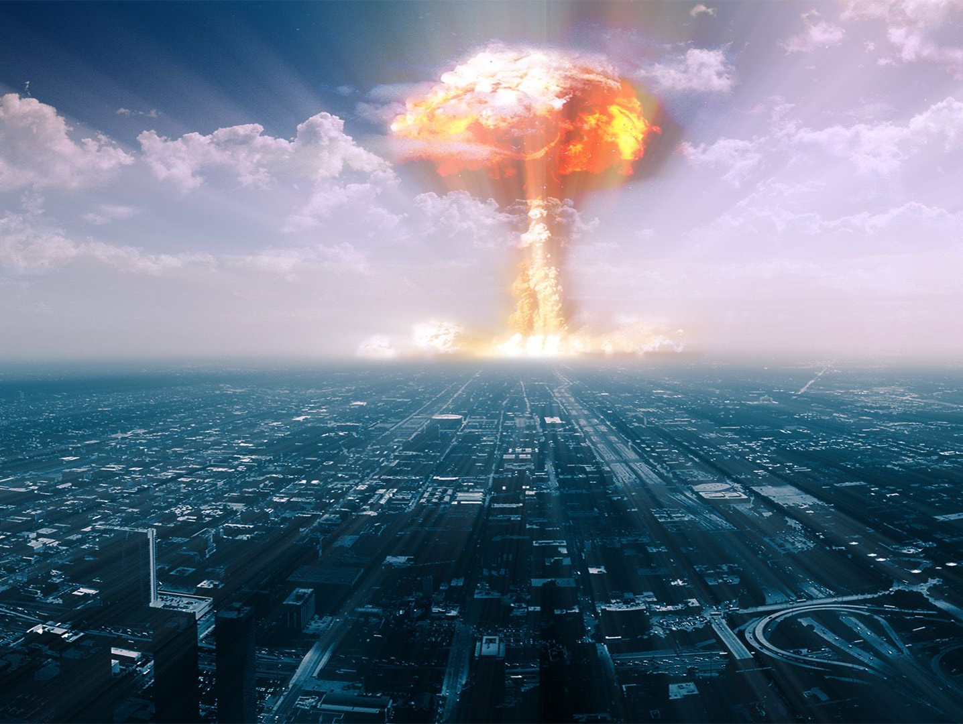
"Wisdom is better than weapons of war; But one sinner destroys much good." — Ecclesiastes 9:18
wise
one sinner
Notes:
Wisdom rises above all weapons that sinners would choose to use.

Slide 10
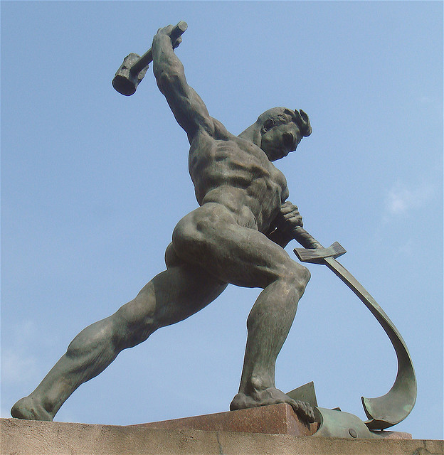

He shall judge between the nations, And rebuke many people; They shall beat their swords into plowshares, And their spears into pruning hooks; Nation shall not lift up sword against nation, Neither shall they learn war anymore. — Isaiah 2:4
PEACE
Notes:
A time will come where peace will be the joy of all.

Slide 11
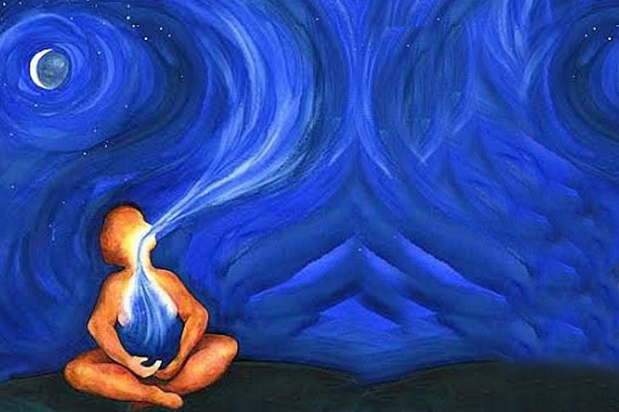
The voice said, "Cry out!" And he said, "What shall I cry?" "All flesh is grass, And all its loveliness is like the flower of the field. The grass withers, the flower fades, Because the breath of the LORD blows upon it; Surely the people are grass. The grass withers, the flower fades, But the word of our God stands forever." — Isaiah 40:6-8
God
breath of the LORD blows
Spoke
Word
Pen
God
Notes:
The breath of God cheers all times with the sweet life of His word.

Slide 12
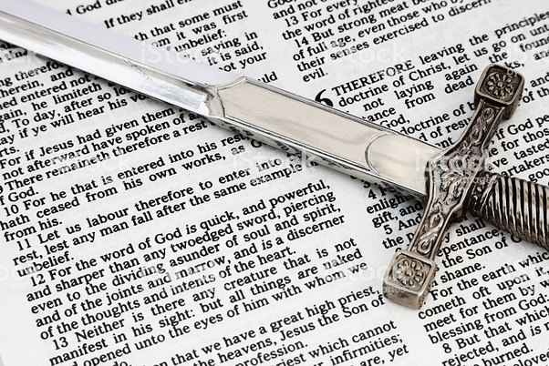
For the word of God is living and powerful, and sharper than any two-edged sword, piercing even to the division of soul and spirit, and of joints and marrow, and is a discerner of the thoughts and intents of the heart. And there is no creature hidden from His sight, but all things are naked and open to the eyes of Him to whom we must give account. — Hebrews 4:12-13
word of God
God
word of God
any two-
sharper than any
edged sword
sword
God
word of God > any two-edged sword
Notes:
No weapon devised can stand against the true word that emancipates all flesh.

Slide 13
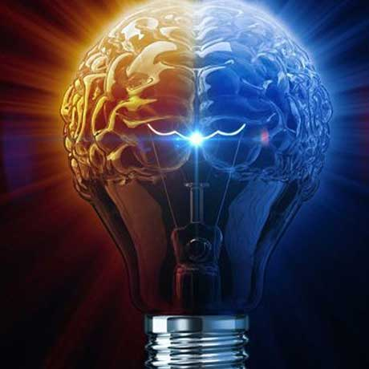
For whatever things were written before were written for our learning, that we through the patience and comfort of the Scriptures might have hope. Now may the God of patience and comfort grant you to be like-minded toward one another, according to Christ Jesus, that you may with one mind and one mouth glorify the God and Father of our Lord Jesus Christ. — Romans 15:4-6
Jesus Christ
God
like-
minded
Christ
Jesus
Jesus Christ is the same yesterday, today, and forever. — Hebrews 13:8
Jesus Christ
yesterday
one
word of God > any two-edged sword
mind
one mouth
today
forever
Jesus
Christ
Notes:
Hope is an act of patience that unites those in the faith He has authored.

Slide 14
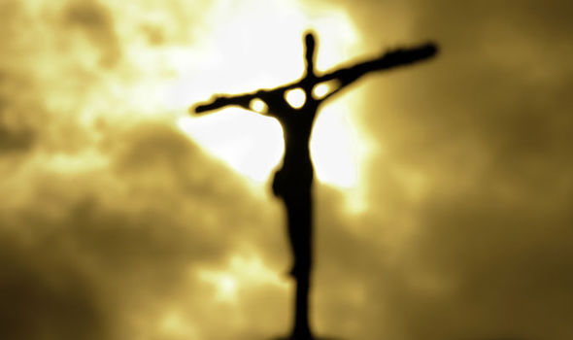
My little children, these things I write to you, so that you may not sin. And if anyone sins, we have an Advocate with the Father, Jesus Christ the righteous. And He Himself is the propitiation for our sins, and not for ours only but also for the whole world. Now by this we know that we know Him, if we keep His commandments. — 1st John 2:1-3
write
I write
so that you may not sin
propitiation for our sins
Jesus Christ
I write so that you may not sin
propitiation for our sins
propitiation for our sins
keep
keep
Notes:
To know God is to understand His word and beg He increases our will to obey.

Slide 15
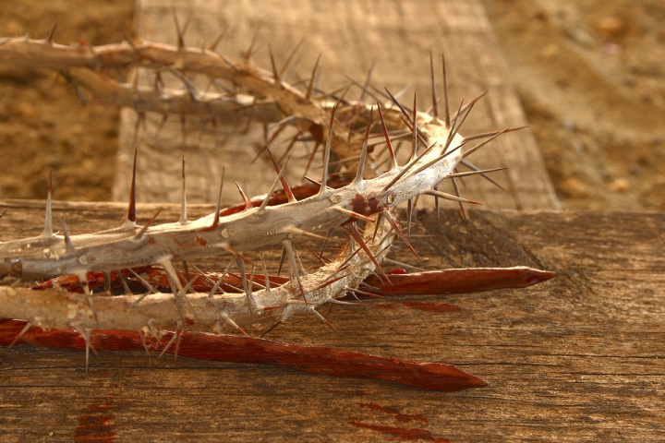
For we do not wrestle against flesh and blood, but against principalities, against powers, against the rulers of the darkness of this age, against spiritual hosts of wickedness in the heavenly places. — Ephesians 6:12
dark
wickedness
Notes:
Swords cannot battle the beasts from within that attack from without. These must be conquered by wit of heart and dedication to God. Each soul touches eternity where this fight must be won. To breathe in the light of the sky delivers the sense of life’s truth.

Slide 16
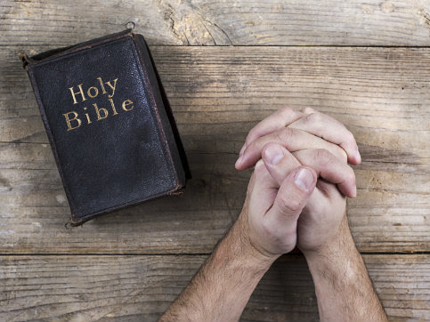
For the weapons of our warfare are not carnal but mighty in God for pulling down strongholds, casting down arguments and every high thing that exalts itself against the knowledge of God, bringing every thought into captivity to the obedience of Christ, and being ready to punish all disobedience when your obedience is fulfilled. — 2nd Corinthians 10:4-6
in
mighty in God:
• casting down arguments
  against the knowledge of God
• bringing every thought into captivity
to the obedience of Christ
• punish all disobedience
when your obedience is fulfilled
mighty in God
casting
down arguments
against the knowledge
of God
bringing every thought into
captivity
to the obedience of Christ
punish all
disobedience
when your obedience
is fulfilled
Notes:
To be a warrior of God one must exercise self-control

Slide 17
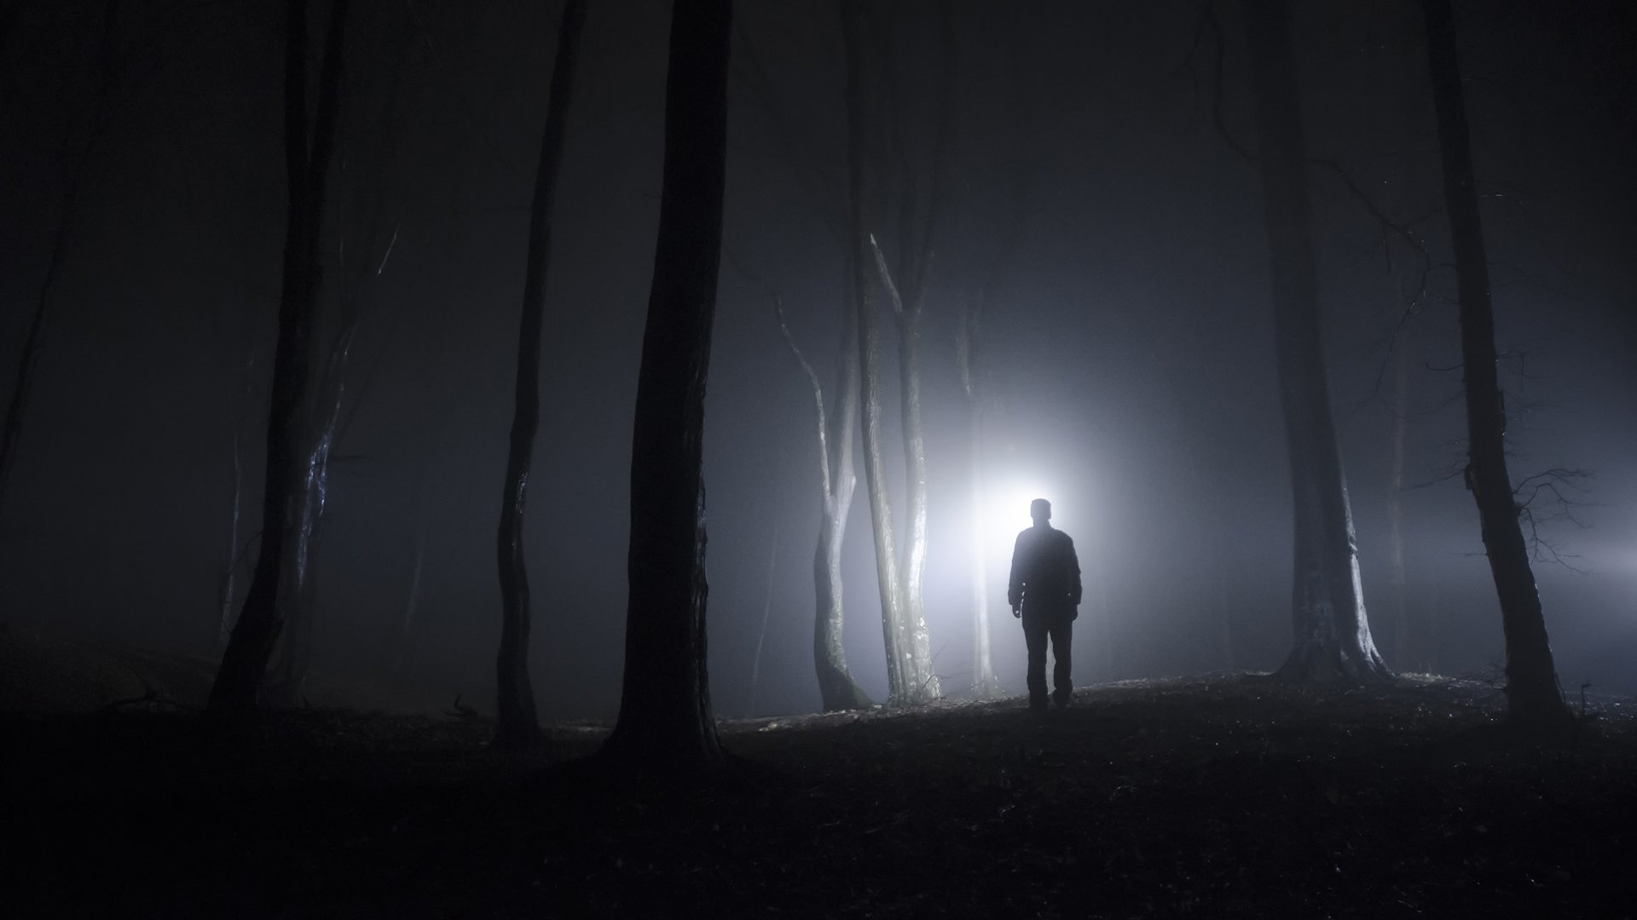
And take the helmet of salvation, and the sword of the Spirit, which is the word of God; praying always with all prayer and supplication in the Spirit, being watchful to this end with all perseverance and supplication for all the saints -- — Ephesians 6:17-18
sword
sword
word of God
sword
Notes:
The word of God is our sword allowing light to radiate forth

Slide 18
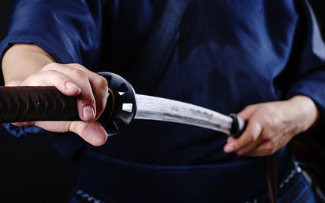
But Jesus said to him, "Put your sword in its place, for all who take the sword will perish by the sword." — Matthew 26:52
sword
sword
sword
Notes:
Violence can only return violence.

Slide 19

Let all bitterness, wrath, anger, clamor, and evil speaking be put away from you, with all malice. And be kind to one another, tenderhearted, forgiving one another, just as God in Christ forgave you. — Ephesians 4:31-32
be kind
forgiving
Notes:
All of the highest ideals reside where love dwells deepest in a soul’s heart.

Slide 20


→ Taking heed to God’s word heals the heart
→ Desire for His word renders simple understanding
→ Righteous words bring health rather a sinner’s bite
→ One sinner causes great havoc among the peaceful
→ God promises for an age where all souls do not war
→ The breath of God’s truth endures all ages
→ God’s word is greater than any mortal weapon
→ God’s word delivers hope to those that endure
→ His word helps lift us from sin to glory
→ Battles lie in each heart where soul’s breath the sky
→ God’s word is the defense which leads to salvation
→ Aggression will always be defeated by aggression
→ Qualities of kindness & forgiveness empower a soul
Without the sword of truth there is no good outcome
Notes:
Without the sword of truth there is no good outcome.

Slide 21
Notes:
Darkness has nothing to explain absent of wisdom.

Slide 22

Please visit http://www.LoveFromGod.com to explore further
Ronald Bert Channel on
Notes:
Eternity never ends.

