Slide 2

Thoughts
Ron Bert
December 30, 2018

Slide 3
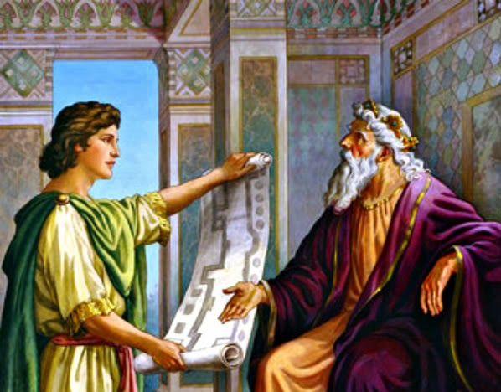
"As for you, my son Solomon, know the God of your father, and serve Him with a loyal heart and with a willing mind; for the LORD searches all hearts and understands all the intent of the thoughts. If you seek Him, He will be found by you; but if you forsake Him, He will cast you off forever." — 1st Chronicles 28:9
know
God
loyal heart
willing mind
seek
He will be found by you
forsake

Slide 4

For what man knows the things of a man except the spirit of the man which is in him? Even so no one knows the things of God except the Spirit of God. Now we have received, not the spirit of the world, but the Spirit who is from God, that we might know the things that have been freely given to us by God. — 1st Corinthians 2:11-12
God
God
God
God
God
God
we have received
God
might know
might know the things
God
freely given to us by God

Slide 5

"For My thoughts are not your thoughts, Nor are your ways My ways," says the LORD. For as the heavens are higher than the earth, So are My ways higher than your ways, And My thoughts than your thoughts." — Isaiah 55:8-9
LORD
LORD
are higher
higher
My ways

Slide 6
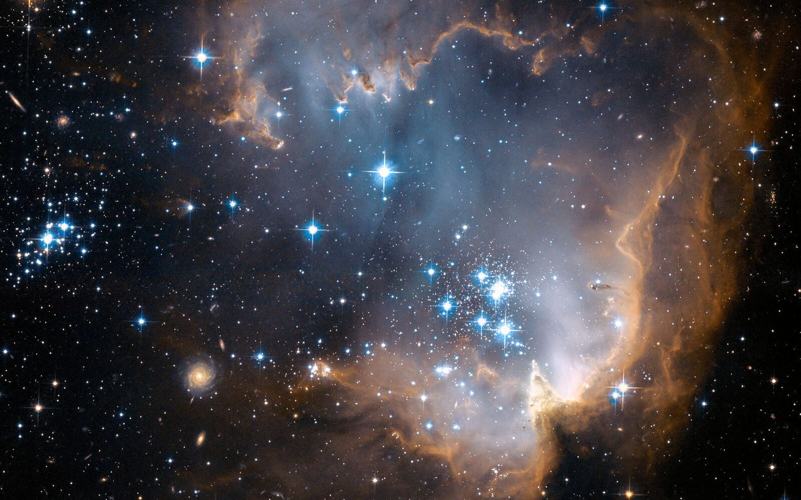
O LORD, how great are Your works! Your thoughts are very deep. — Psalms 92:5
LORD
LORD
LORD
God
How precious also are Your thoughts to me, O God! How great is the sum of them! If I should count them, they would be more in number than the sand; When I awake, I am still with You. — Psalms 139:17-18
thoughts to me
LORD
God
more
in
in number than the sand

Slide 7

Many, O LORD my God, are Your wonderful works Which You have done; And Your thoughts toward us Cannot be recounted to You in order; If I would declare and speak of them, They are more than can be numbered. — Psalms 40:5
LORD
LORD
God
wonderful works
wonderful
Your thoughts
thoughts
more
Notes:
What the Lord does for us is beyond measure.

Slide 8

Commit your works to the LORD, And your thoughts will be established. — Proverbs 16:3
LORD
LORD
Trust in the LORD with all your heart, And lean not on your own understanding; — Proverbs 3:5
LORD
heart

Slide 9
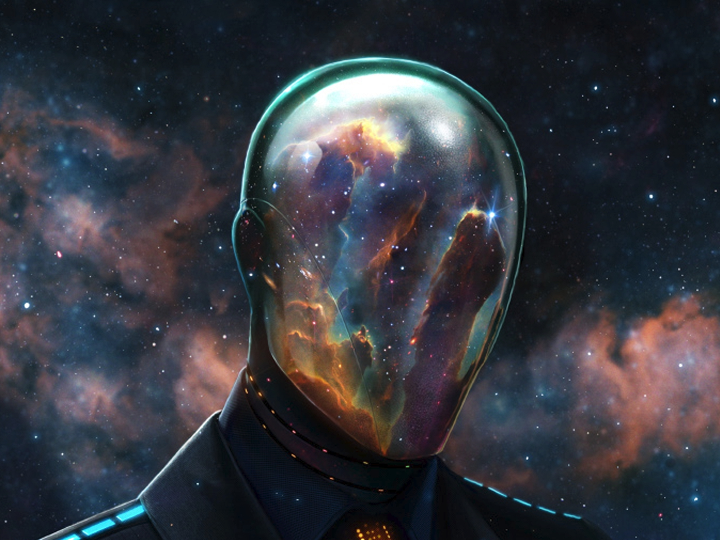
I, the LORD, search the heart, I test the mind, Even to give every man according to his ways, According to the fruit of his doings. — Jeremiah 17:10
I, the LORD
LORD
heart
I test the mind
LORD
fruit

Slide 10

For I know the thoughts that I think toward you, says the LORD, thoughts of peace and not of evil, to give you a future and a hope. — Jeremiah 29:11
LORD
peace
a hope

Slide 11
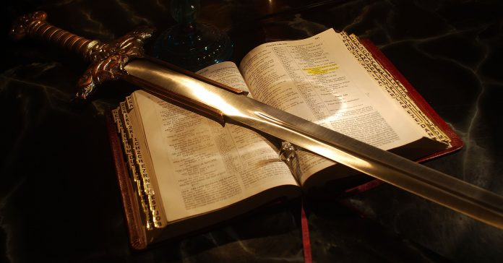
For the word of God is living and powerful, and sharper than any two-edged sword, piercing even to the division of soul and spirit, and of joints and marrow, and is a discerner of the thoughts and intents of the heart. — Hebrews 4:12
word of God
God
God
peace
soul and spirit
discerner of the thoughts

Slide 12

I beseech you therefore, brethren, by the mercies of God, that you present your bodies a living sacrifice, holy, acceptable to God, which is your reasonable service. And do not be conformed to this world, but be transformed by the renewing of your mind, that you may prove what is that good and acceptable and perfect will of God. — Romans 12:1-2
God
God
God
God
God
reasonable
renewing of your
mind
seek
God

Slide 13

The wicked in his proud countenance does not seek God; God is in none of his thoughts. — Psalms 10:4
wicked
wicked
God
God
in
is in none

Slide 14

The thoughts of the wicked are an abomination to the LORD, But the words of the pure are pleasant. — Proverbs 15:26
wicked
wicked
forsake
seek
Notes:
We mask wickedness with tolerance.

Slide 15
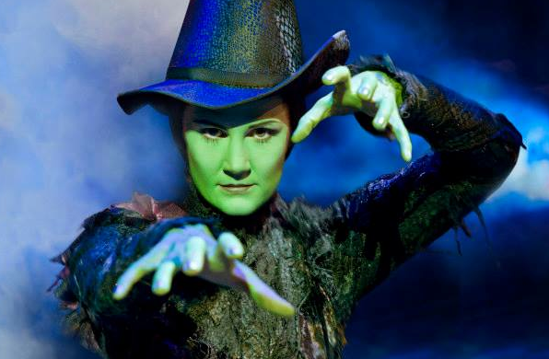
Let the wicked forsake his way, And the unrighteous man his thoughts; Let him return to the LORD, And He will have mercy on him; And to our God, For He will abundantly pardon. — Isaiah 55:7
wicked
i
n
return
mind
m
d

Slide 16

For those who live according to the flesh set their minds on the things of the flesh, but those who live according to the Spirit, the things of the Spirit. For to be carnally minded is death, but to be spiritually minded is life and peace. — Romans 8:5-6
carnally minded = death
spiritually minded = life
death
life
carnally minded
mind
death
spiritually minded is life
spiritually minded
life

Slide 17

"A good man out of the good treasure of his heart brings forth good; and an evil man out of the evil treasure of his heart brings forth evil. For out of the abundance of the heart his mouth speaks." — Luke 6:45
heart
evil
evil
heart
evil
evil
heart

Slide 18

And He said, "What comes out of a man, that defiles a man. For from within, out of the heart of men, proceed evil thoughts, adulteries, fornications, murders, thefts, covetousness, wickedness, deceit, lewdness, an evil eye, blasphemy, pride, foolishness. All these evil things come from within and defile a man." — Mark 7:20-23
• evil thoughts
• adulteries
• fornications
• murders
• thefts
• covetousness
• wickedness
• deceit
• lewdness
• an evil eye
• blasphemy
• pride
• foolishness
out of the heart
proceed evil thoughts
adulteries
evil thoughts
fornications
murders
thefts
covetousness
wickedness
deceit
lewdness
an evil eye
blasphemy
evil
evil
evil
pride
foolishness

Slide 19
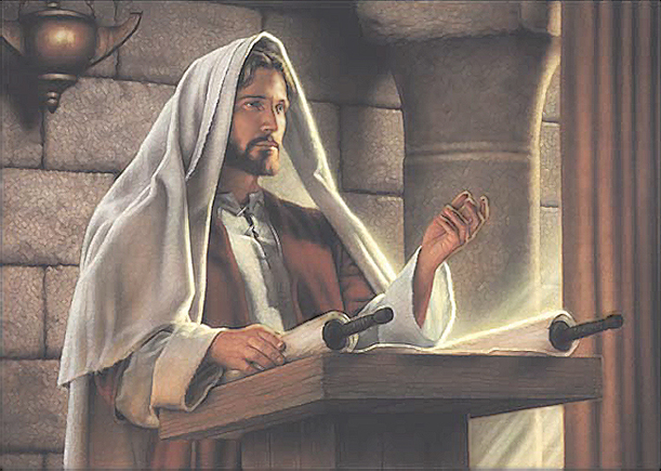
But you have not so learned Christ, if indeed you have heard Him and have been taught by Him, as the truth is in Jesus: that you put off, concerning your former conduct, the old man which grows corrupt according to the deceitful lusts, and be renewed in the spirit of your mind, and that you put on the new man which was created according to God, in true righteousness and holiness. — Ephesians 4:20-24
in
truth is in Jesus:
● put off your former conduct
the old man in deceitful lusts
● be renewed in the spirit
of your mind
● put on the new man
created according to God
in true righteousness and holiness
truth is in Jesus:
have heard
Him
truth is in
Jesus:
put off
your
in
former conduct
the old man
in
in
deceitful
lusts
be renewed in the spirit
of
your mind
put on the new
man
created according to
God
in true righteousness and holiness
in

Slide 20

(for not the hearers of the law are just in the sight of God, but the doers of the law will be justified; for when Gentiles, who do not have the law, by nature do the things in the law, these, although not having the law, are a law to themselves, who show the work of the law written in their hearts, their conscience also bearing witness, and between themselves their thoughts accusing or else excusing them) — Romans 2:13-15
God
doers
will be justified
God
in
written in
heart
their hearts

Slide 21

For God has not given us a spirit of fear, but of power and of love and of a sound mind. — 2nd Timothy 1:7
God
given us a spirit
of power
of love
God
of a sound mind

Slide 22

If then you were raised with Christ, seek those things which are above, where Christ is, sitting at the right hand of God. Set your mind on things above, not on things on the earth. — Colossians 3:1-2
in God
seek
above
God
Set your
mind on things above
in

Slide 23

For the weapons of our warfare are not carnal but mighty in God for pulling down strongholds, casting down arguments and every high thing that exalts itself against the knowledge of God, bringing every thought into captivity to the obedience of Christ, and being ready to punish all disobedience when your obedience is fulfilled. — 2nd Corinthians 10:4-6
e
God
i
in God
l
life
every thought
to the obedience of Christ
Christ
f

Slide 24

"Therefore I say to you, do not worry about your life, what you will eat or what you will drink; nor about your body, what you will put on. Is not life more than food and the body more than clothing?" — Matthew 6:25
your life
life
life
more than food
more than clothing

Slide 25

Be anxious for nothing, but in everything by prayer and supplication, with thanksgiving, let your requests be made known to God; and the peace of God, which surpasses all understanding, will guard your hearts and minds through Christ Jesus. — Philippians 4:6-7
God
peace of God
God
God
guard your hearts and minds
guard your hearts and minds
Christ Jesus

Slide 26

Therefore humble yourselves under the mighty hand of God, that He may exalt you in due time, casting all your care upon Him, for He cares for you. — 1st Peter 5:6-7
God
casting all your care upon Him

Slide 27
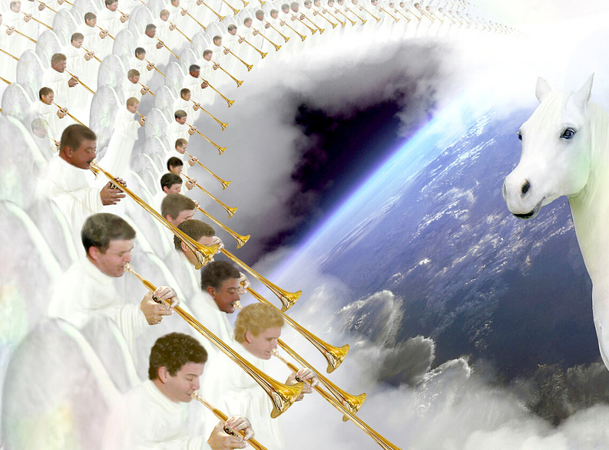
Therefore gird up the loins of your mind, be sober, and rest your hope fully upon the grace that is to be brought to you at the revelation of Jesus Christ; — 1st Peter 1:13
your mind, be sober
rest
hope
grace
Jesus Christ
Jesus Christ

Slide 28

Finally, brethren, whatever things are true, whatever things are noble, whatever things are just, whatever things are pure, whatever things are lovely, whatever things are of good report, if there is any virtue and if there is anything praiseworthy --meditate on these things. — Philippians 4:8
whatever things are
→ true
→ noble
→ just
→ pure
→ lovely
→ of good report
→ any virtue
→ anything praiseworthy
---
↙
true
whatever things are
noble
just
pure
Jesus Christ
lovely
of good
report
any virtue
anything praiseworthy
meditate on these things

Slide 29

→ God can be found if one seeks Him
→ Man is isolated by the spirit given of God
→ God’s thoughts are higher than we can know
→ Committing to God establishes one’s thoughts
→ Trust in God and not one’s own understanding
→ God tests the minds of all examining hearts
→ God’s Word discerns thoughts and intents of heart
→ If the wicked turns, He will abundantly pardon
→ The abundance of the heart speaks one’s mind
→ Truth is in Jesus to put off one’s former conduct
→ Bring every thought into captivity in Christ
→ Prayer guards one’s heart and mind through Christ
→ Cast all your cares upon God’s care – seek above
The sawing of time cuts to the core of being
Notes:
The sawing of time cuts to the core of being

Slide 31

Please visit http://www.LoveFromGod.com to explore further
Ronald Bert Channel on
Notes:
Eternity never ends.

