Slide 3
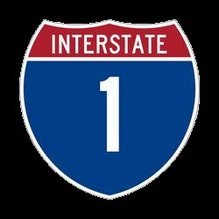
The Way
Ron Bert
June 24, 2018
Notes:
There is the way of God which calls for all sinners to return.

Slide 4
Good and upright is the LORD; Therefore He teaches sinners in the way. — Psalms 25:8
He teaches
He teaches
the way
the way
the way
Notes:
God has given His truth for us to know.

Slide 5
Thus says the LORD, your Redeemer, The Holy One of Israel: "I am the LORD your God, Who teaches you to profit, Who leads you by the way you should go. — Isaiah 48:17
Liberator ◦ Rescuer ◦ Savior
Redeemer
I am
I am
LORD
teaches you
Who leads
teaches you
the way
Notes:
The Lord has given this Holy knowledge for our spiritual recovery.

Slide 6
I have taught you in the way of wisdom; I have led you in right paths. — Proverbs 4:11
the way
taught
in
in the way
in the way
the way
led you
the way
the way
So you may walk in the way of goodness, And keep to the paths of righteousness. — Proverbs 2:20
walk
in
in the way
in the way
the way
goodness
the way
righteousness
Notes:
His knowledge remains.

Slide 7
"Now therefore, listen to me, my children, For blessed are those who keep my ways." — Proverbs 8:32
listen to me
listen to me
keep my ways
my ways
my way
keep my ways
the way
in
Blessed are the undefiled in the way, Who walk in the law of the LORD! — Psalms 119:1
in
the way
in
walk in
the way
walk in
the LORD
the LORD
Notes:
His call includes warnings not to fall away from His truth.

Slide 8
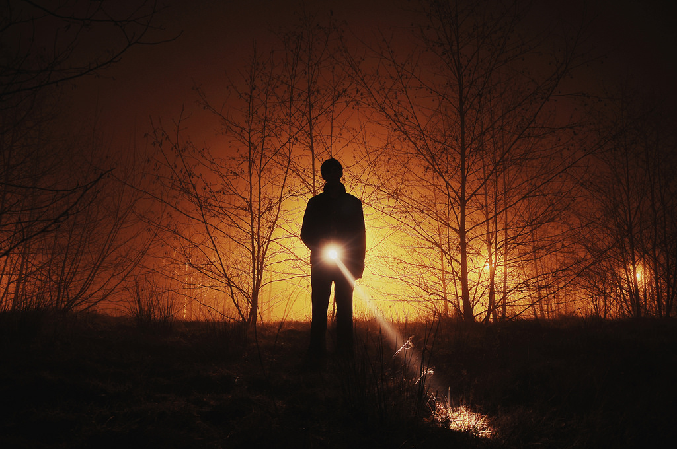
Make me understand the way of Your precepts; So shall I meditate on Your wondrous works. — Psalms 119:27
HE. Teach me, O LORD, the way of Your statutes, And I shall keep it to the end. — Psalms 119:33
Teach me
the way
. .
keep
walk
the way
the way
the way
. .
Your precepts
Guides
Notes:
To remain in His truth, it must be a soul’s desire to endure temptations and pursue Him and His ways.

Slide 9
Cause me to hear Your lovingkindness in the morning, For in You do I trust; Cause me to know the way in which I should walk, For I lift up my soul to You. — Psalms 143:8
lift up my soul
humble
Cause me to hear
Cause me to hear
Cause me
the way
in
trust
knowledge
in
know the way
the way
know the way
walk
walk
lift up
my soul
Notes:
It is a choice to hear His word.

Slide 10
Remove from me the way of lying, And grant me Your law graciously. — Psalms 119:29
sin
the way
lying
lying
plead
His way
grant me
. .
Notes:
Many lie ignoring His ways preferring the ways of man.

Slide 11
His way
Notes:
Many lie ignoring His ways preferring the ways of man.

Slide 12
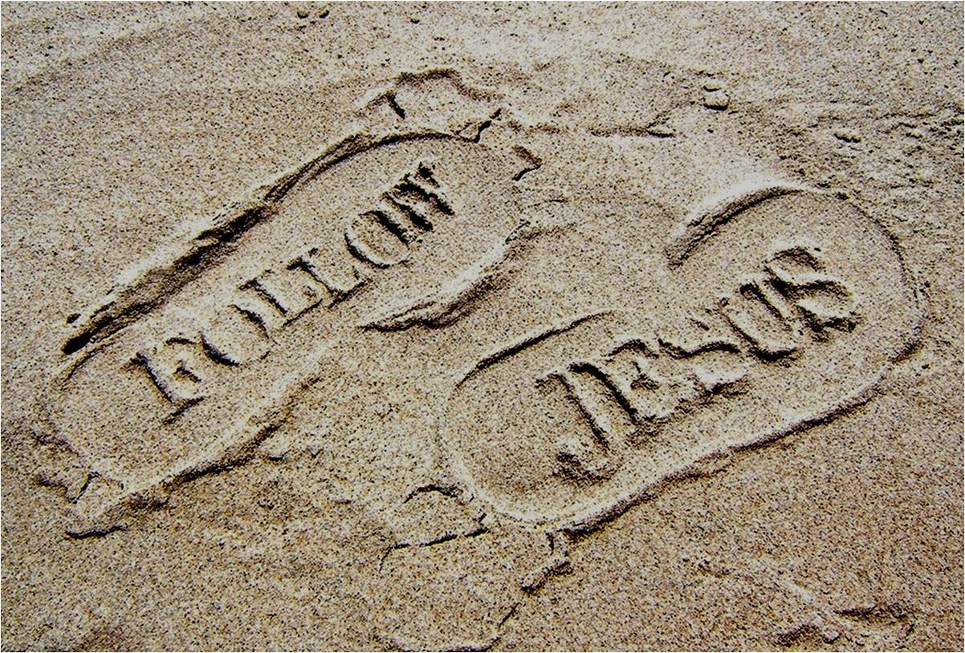
"But take careful heed to do the commandment and the law which Moses the servant of the LORD commanded you, to love the LORD your God, to walk in all His ways, to keep His commandments, to hold fast to Him, and to serve Him with all your heart and with all your soul." — Joshua 22:5
take careful heed
take careful heed
in
all
walk in all His ways
His way
walk in all His ways
all
serve Him
serve Him
Notes:
Dedication to God reveals the nature of a soul.

Slide 13
For the commandment is a lamp, And the law a light; Reproofs of instruction are the way of life, … — Proverbs 6:23
Reproofs
Reproofs
the way
the way of life
instruction
the way
Warnings
Lectures
keeps instruction
He who keeps instruction is in the way of life, But he who refuses correction goes astray. — Proverbs 10:17
keeps instruction
all
Reprimands
in
the way
Rebukes
fools
refuses correction goes astray
refuses correction goes astray
Admonitions
Chastisements
Notes:
His word can be harsh for sinners reluctant to turn to His ways.

Slide 14
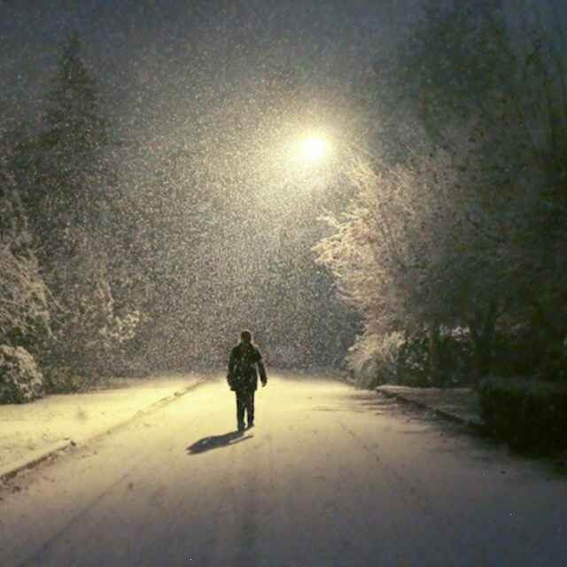
Hear, my son, and be wise; And guide your heart in the way. — Proverbs 23:19
be wise
not foolish
be wise
guide
in
guide
the way
the way
the way
the way of truth
I have chosen the way of truth; Your judgments I have laid before me. — Psalms 119:30
the way of truth
the way
the way
Notes:
Wisdom in truth brings one to the feet of God.

Slide 15
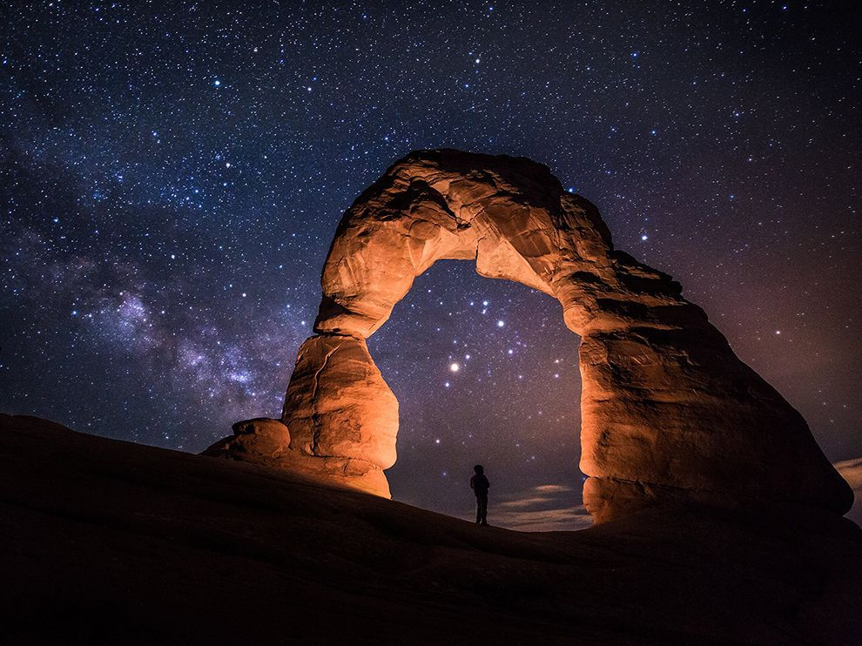
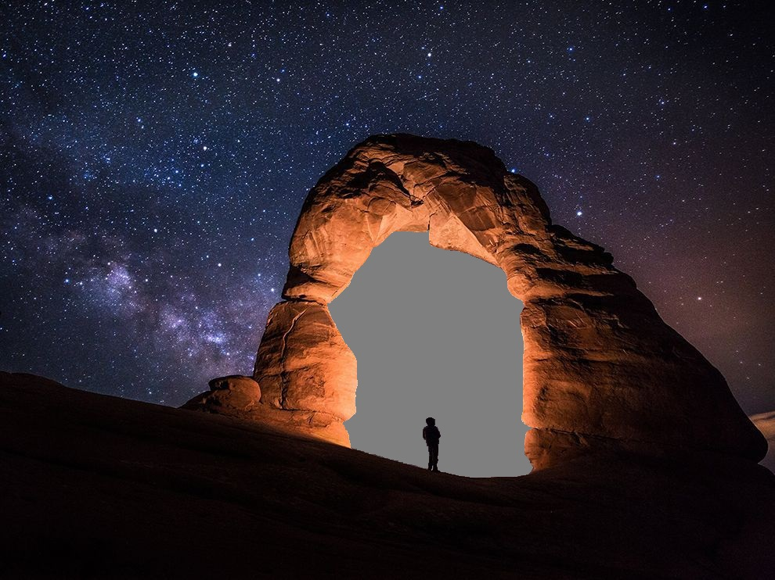
"Enter by the narrow gate; for wide is the gate and broad is the way that leads to destruction, and there are many who go in by it. Because narrow is the gate and difficult is the way which leads to life, and there are few who find it." — Matthew 7:13-14
the way
the way
=
difficult is the way
difficult is the way
the way
Notes:
One needs to remain diligent as it is a matter of life over death.

Slide 16
Thus says the LORD: "Stand in the ways and see, And ask for the old paths, where the good way is, And walk in it; Then you will find rest for your souls. But they said, 'We will not walk in it.' — Jeremiah 6:16
in
Stand in the ways
the way
Stand in the ways
not
in
the good way
walk in it
the good way
walk in it
walk in it
We will not
not
We will not
Notes:
His knowledge has endured throughout the generations relieving spiritual deprivation.

Slide 17
Yet they say to God, 'Depart from us, For we do not desire the knowledge of Your ways. — Job 21:14
the way
DARKNESS
not
not
the
way
Notes:
The stubborn of heart refuse to know of His ways. One chooses the light or remains in the darkness.

Slide 18
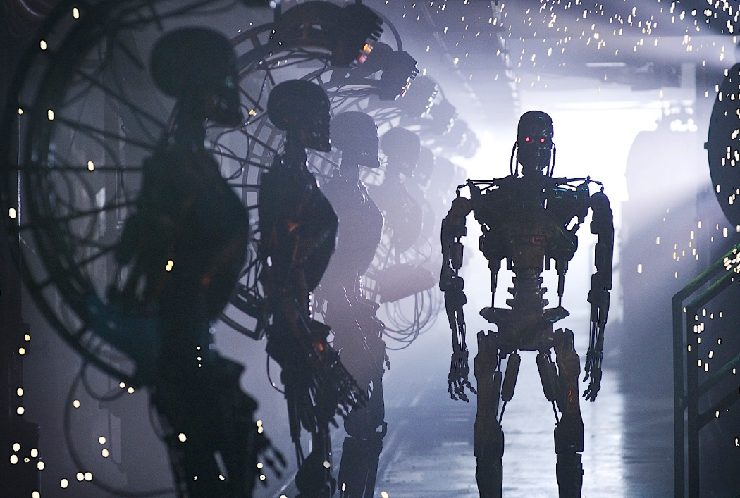
My son, do not walk in the way with them, Keep your foot from their path; For their feet run to evil, And they make haste to shed blood. — Proverbs 1:15-16
do not walk
in the way
the way
Keep
Keep
f
o
not
do not walk
in the way of evil
evil
Notes:
Warnings run all through the Bible to abstain from the ways of the wicked.

Slide 19
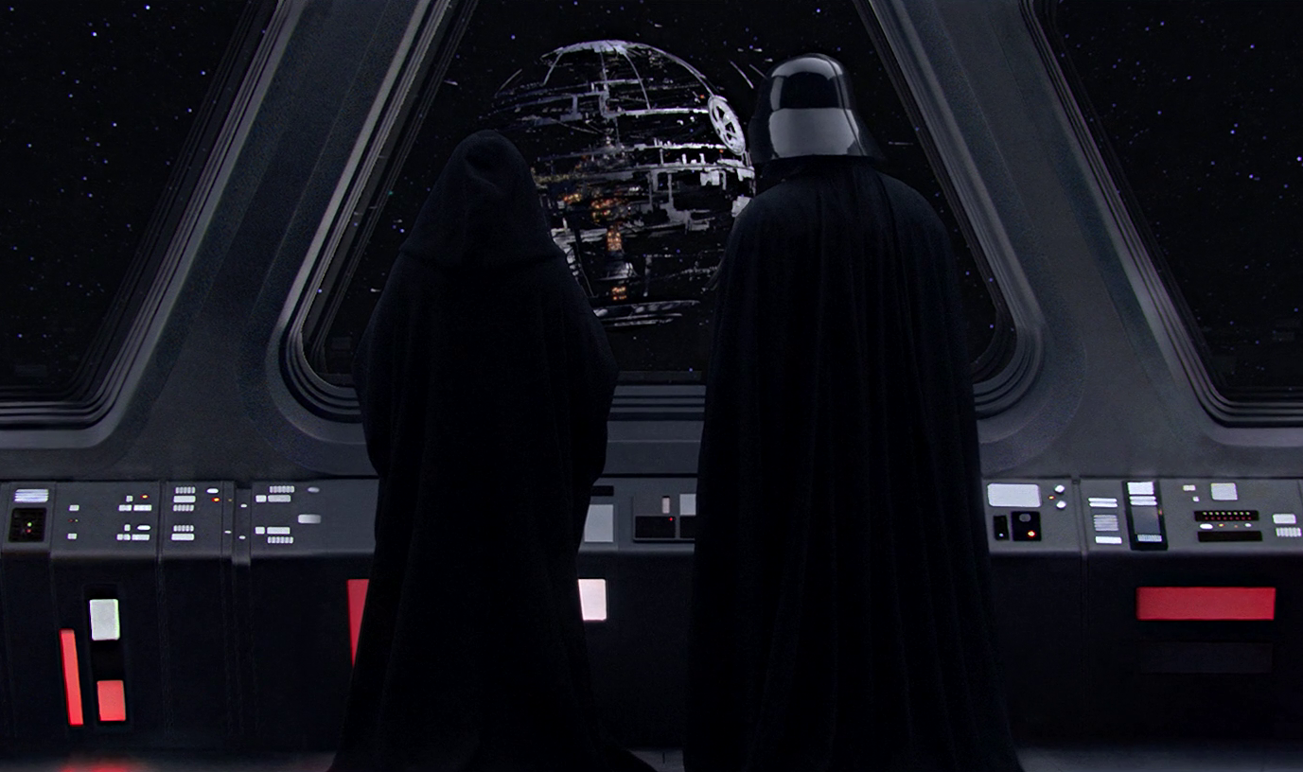
Do not enter the path of the wicked, And do not walk in the way of evil. — Proverbs 4:14
the way
Focus
do not walk
the way
in the way of evil
Force
Notes:
It is a command to stay away from the evil ways as expressed in His word.

Slide 20
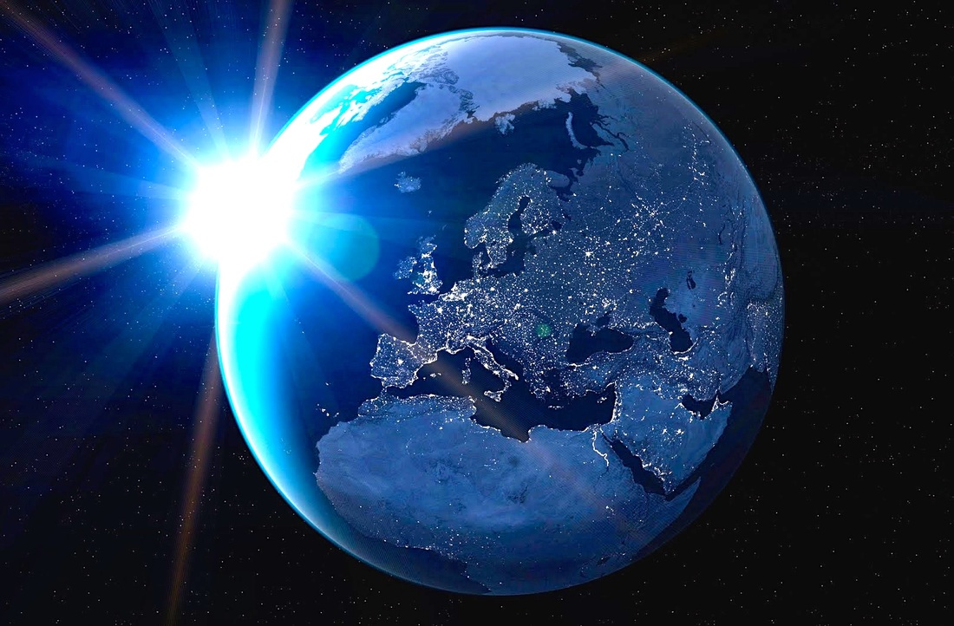
O LORD, I know the way of man is not in himself; It is not in man who walks to direct his own steps. — Jeremiah 10:23
the way
the way
the way
walk
the way
There is a way that seems right to a man, But its end is the way of death. — Proverbs 14:12
is a way
is a way
end is
end is
the way
death
Notes:
In all the expressions of God, He declares guidance over the miscalculations of man.

Slide 21
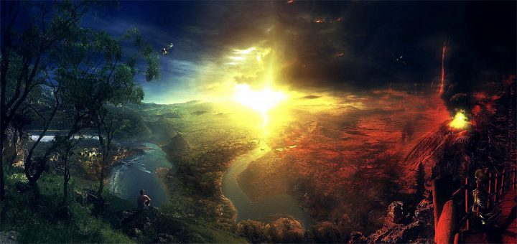
"Now you shall say to this people, 'Thus says the LORD: "Behold, I set before you the way of life and the way of death." ' " — Jeremiah 21:8
the way
death
the way
life
the way
life
life
life
death
the way
death
death
Notes:
God has given each of us the blessing of freedom and it is then up to us to choose life over death. His plan of salvation has been once delivered for those choosing life over death.

Slide 22
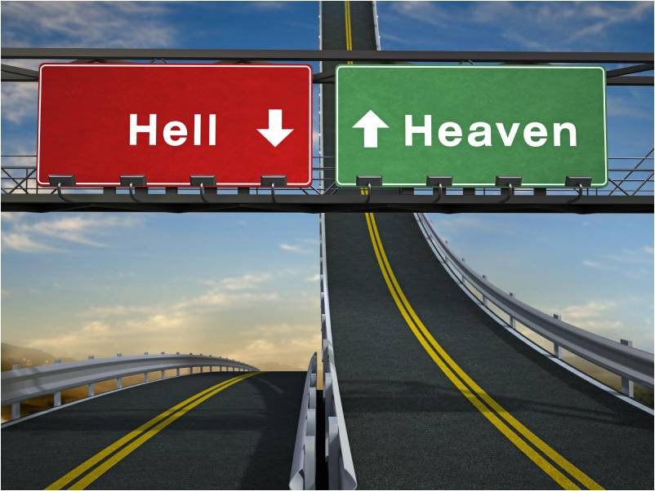
For the LORD knows the way of the righteous, But the way of the ungodly shall perish. — Psalms 1:6
the way
death
the way
life
the way
In the way of righteousness is life, And in its pathway there is no death. — Proverbs 12:28
life
pathway
the way
death
Notes:
Nothing is hidden from the Lord and judgment will be based upon the truth of His given word.

Slide 23
For when a few years are finished, I shall go the way of no return. — Job 16:22
the way
the way
And as it is appointed for men to die once, but after this the judgment, … — Hebrews 9:27
the way
judgment
Notes:
Death into life is inevitable for all mortal. Our actions and relations are what the Lord closely watches. The vapor of life approaches us all with one final call. Our response declares who we will become, in Him or not.

Slide 24
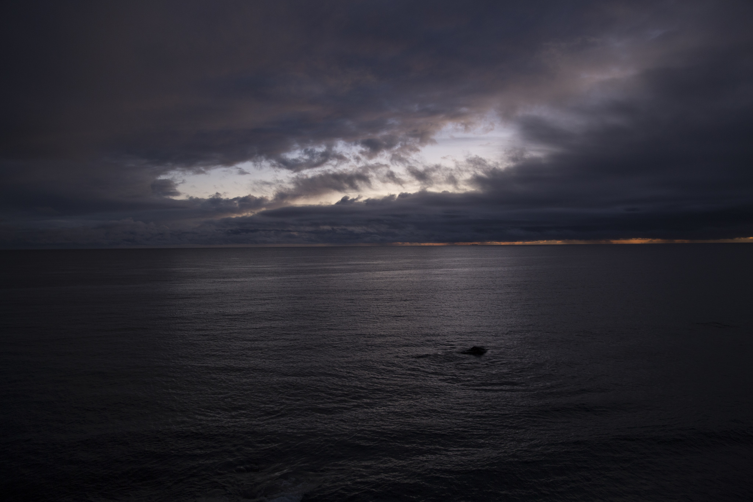
He who keeps the commandment keeps his soul, But he who is careless of his ways will die. — Proverbs 19:16
keeps the commandment
keeps the commandment
right way
way
careless of his ways will die
careless of his ways will die
Horizon
ONE
the way
Harsh discipline is for him who forsakes the way, And he who hates correction will die. — Proverbs 15:10
wrong way
way
the way
who hates correction will die
who hates correction will die
Notes:
There is consequences for those that ignore or turn from His ways and it is the way of death. Many are irritated by the mere mention they may need godly improvement. Patience is possessed by those that thirst for His ways.

Slide 25
And see if there is any wicked way in me, And lead me in the way everlasting. — Psalms 139:24
lead me
lead me
the way
the way
Notes:
Repentance is acknowledging the sin inside oneself and responding to His call.

Slide 26
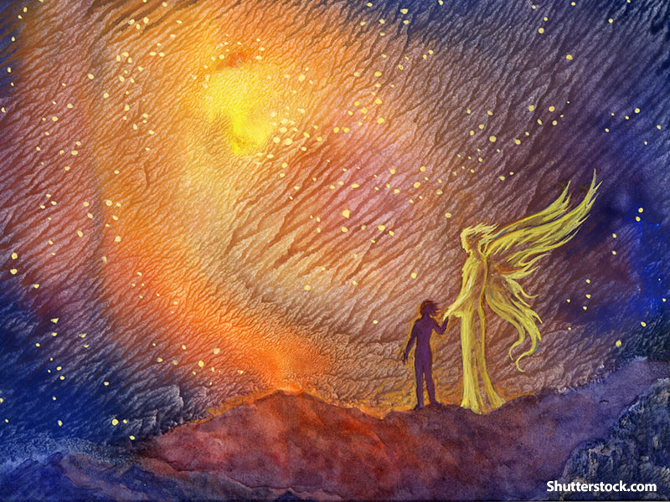
He guards the paths of justice, And preserves the way of His saints. — Proverbs 2:8
living way
... by a new and living way which He consecrated for us, through the veil, that is, His flesh, ... — Hebrews 10:20
. .
paths of justice
. .
preserves
the way
saints
Notes:
God protects those that love Him in ways not tangible but inherently internal such as peace of mind and strength of heart.

Slide 27
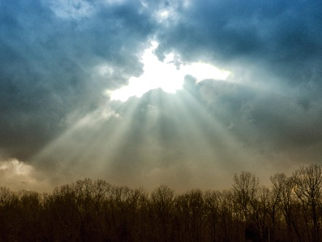
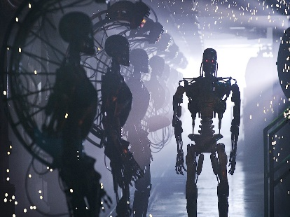
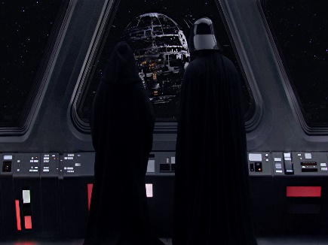
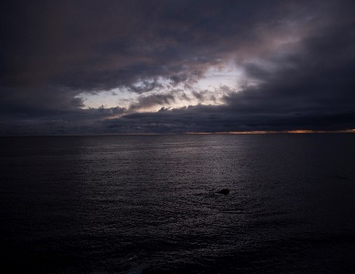
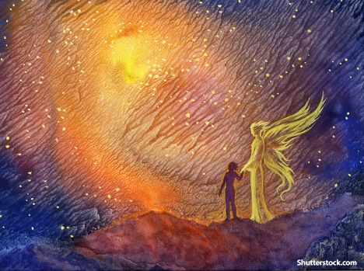

Slide 28
→ The LORD teaches sinners in the way they should go
→ Call to walk in the way of goodness in righteousness
→ Blessed are those who keep God’s ways
→ Hearing & trusting God allows one to know the way
→ God calls one in the way not to practice lying
→ Serve God with all your heart and with all your soul
→ Reproofs of instruction are the way of life
→ Keeping instruction is in the way of life
→ Narrow the gate & difficult the way leading to life
→ Wicked do not desire the knowledge of God’s ways
→ All have a choice in the way of life or way of death
→ One careless of his ways & hates correction will die
→ God preserves the way of His saints
The Way to life is in God
in
Notes:
The Way to life is in God

Slide 29
Notes:
Darkness is desperate to find anything.

Slide 31
The Way
Ron Bert
July 28, 2018
Notes:
There is the way of God which calls for all sinners to return.

Slide 32
The way of a fool is right in his own eyes, But he who heeds counsel is wise. — Proverbs 12:15
the way
The way
heeds
heeds
counsel is wise
counsel is wise
the way
The way of the wicked is like darkness; They do not know what makes them stumble. — Proverbs 4:19
the way
wicked
wicked
do not know
do not know
Notes:
Lack of understanding, or the desire for it, more often runs on impulse.

Slide 33
The righteous should choose his friends carefully, For the way of the wicked leads them astray. — Proverbs 12:26
careful
the way
careful
the way
the way
Do not be deceived: "Evil company corrupts good habits." — 1st Corinthians 15:33
Notes:
Many choose company and associations that lead them further in to sin.

Slide 34
The way of the wicked is an abomination to the LORD, But He loves him who follows righteousness. — Proverbs 15:9
the way
wicked
wicked
He loves
the way
righteousness
righteousness
Notes:
God is calling souls to be righteous and it is His test to see if one will respond to His call or fall in the rejection of His Holy ways.

Slide 35
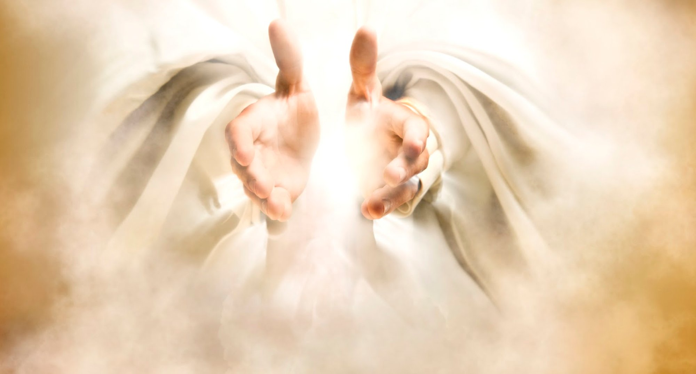
Apply your heart to instruction, And your ears to words of knowledge. — Proverbs 23:12
heart to instruction
. .
knowledge
the way
To deliver you from the way of evil, From the man who speaks perverse things, — Proverbs 2:12
Notes:
One way to insure a steadfast faith is to remain immersed in His word.

Slide 36
Apply your heart to instruction, And your ears to words of knowledge. — Proverbs 23:12
heart to instruction
. .
the way
To deliver you from the way of evil, From the man who speaks perverse things, — Proverbs 2:12
deliver you
the way

Slide 37
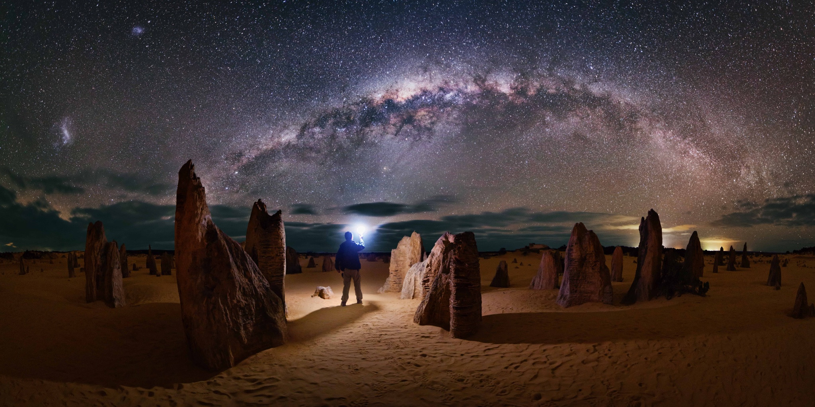
The way of the lazy man is like a hedge of thorns, But the way of the upright is a highway. — Proverbs 15:19
the way
the way
upright
upright
Notes:
It takes courage and fortitude to remain upright in His ways.

Slide 38
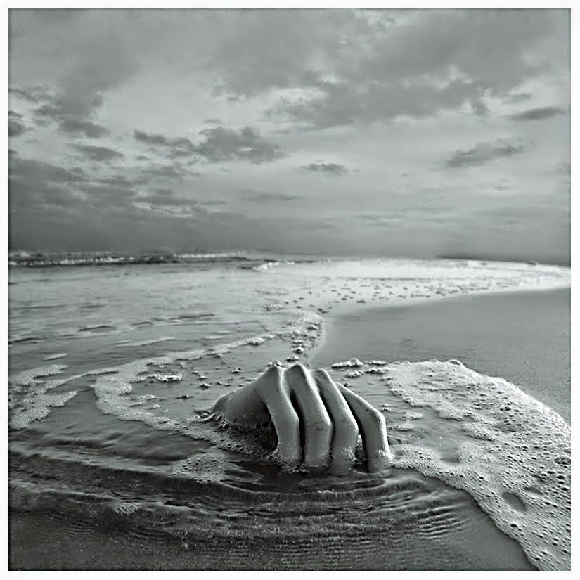
A man who wanders from the way of understanding Will rest in the assembly of the dead. — Proverbs 21:16
the way
wanders from the way
life
wanders from the way
in
Will rest in
Will rest in
the way
the dead
the dead
death
Notes:
Carelessness leads to death and for all those that choose to ignore the higher morals given by God.

Slide 39
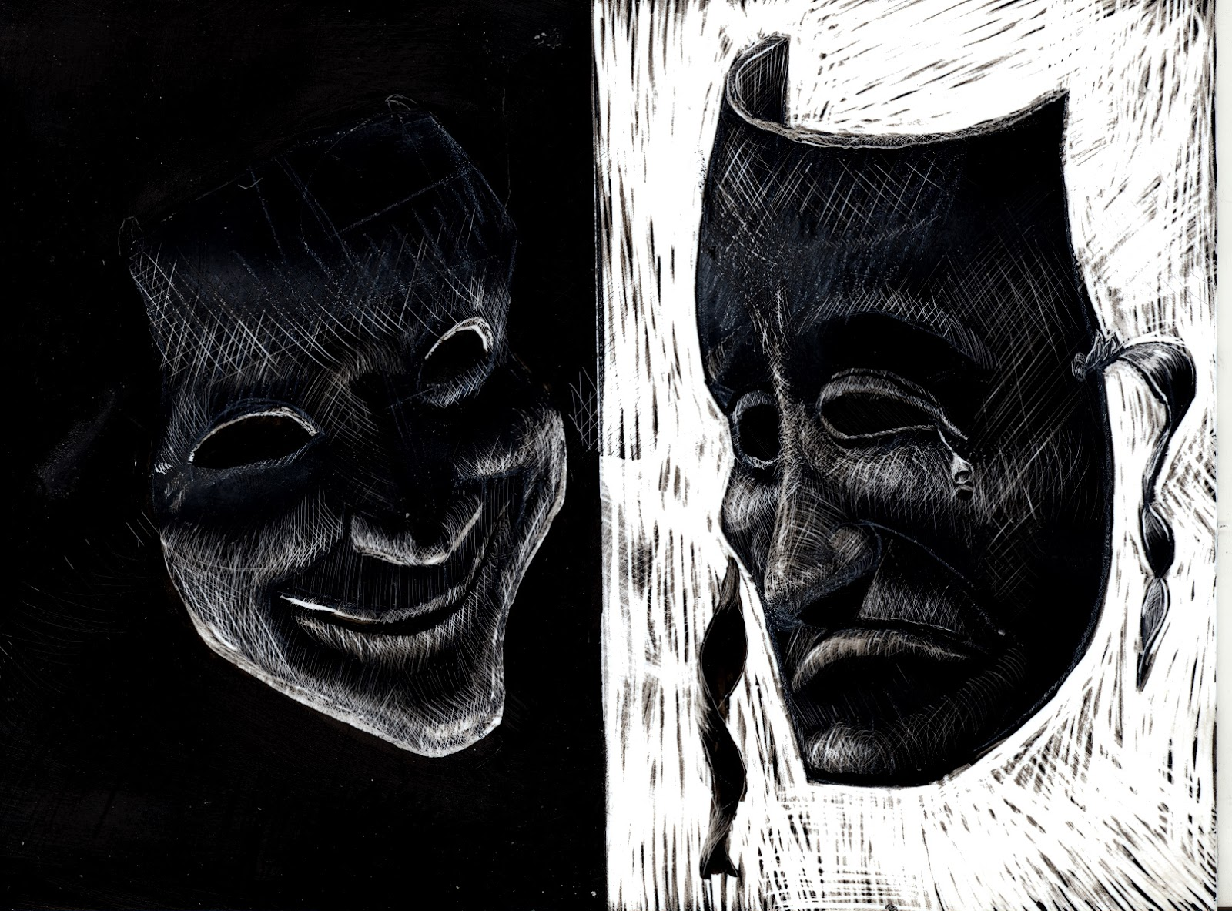
An unjust man is an abomination to the righteous, And he who is upright in the way is an abomination to the wicked. — Proverbs 29:27
evil hates good
the way
the way
good hates evil
Notes:
Evil despises good as good despises evil.

Slide 40
"Yet you say, 'The way of the Lord is not fair.' Hear now, O house of Israel, is it not My way which is fair, and your ways which are not fair?" — Ezekiel 18:25
The way of the Lord
the way
The way of the Lord = fair
our ways = not fair
fair
our ways
not
fair
Notes:
No amount of blaming God can rectify the certain atrocities of man against man.

Slide 41
"Say to them: 'As I live,' says the Lord GOD, 'I have no pleasure in the death of the wicked, but that the wicked turn from his way and live. Turn, turn from your evil ways! For why should you die, O house of Israel?'" — Ezekiel 33:11
God lives
wicked
his way
turn from your evil
turn from your evil
ways
ways
Notes:
God does not desire wickedness only that it turn back to His goodness and ways of Spirit.

Slide 42
"But you have departed from the way; You have caused many to stumble at the law. You have corrupted the covenant of Levi," Says the LORD of hosts. — Malachi 2:8
the way
the way
his way
stumble
stumble
corrupted
corrupted
Notes:
Departing from the Lord perverts justice and all that is Holy.

Slide 43
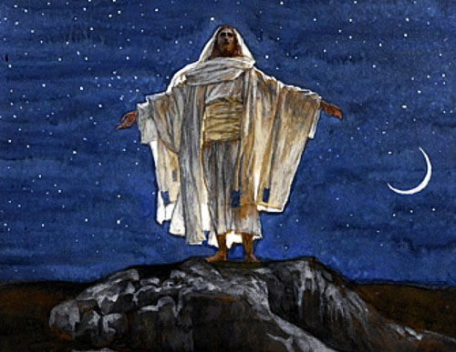
"Behold, I send My messenger, And he will prepare the way before Me. And the Lord, whom you seek, Will suddenly come to His temple, Even the Messenger of the covenant, In whom you delight. Behold, He is coming," Says the LORD of hosts. — Malachi 3:1
the way
the way
He is
He is
Notes:
God long announced He had a plan of salvation to those who would desire Him.

Slide 44
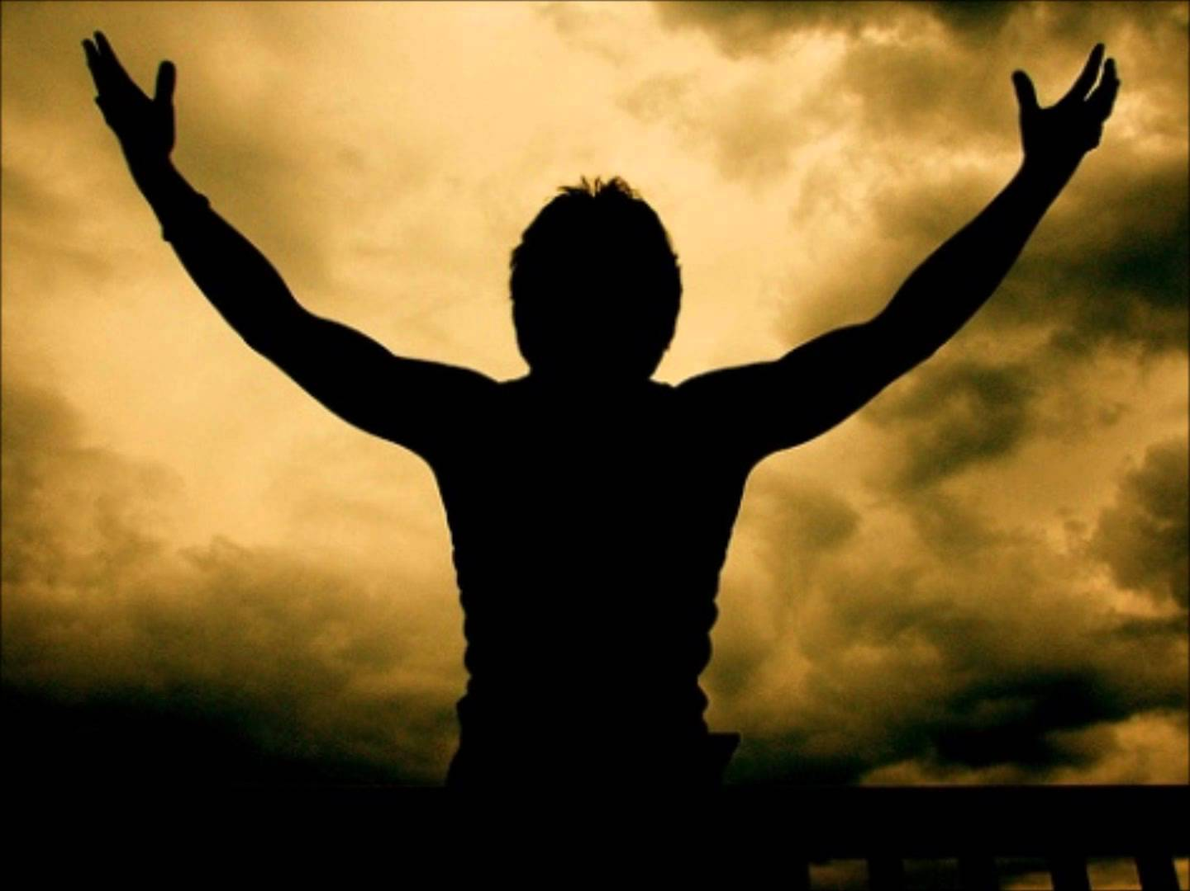
For this is he who was spoken of by the prophet Isaiah, saying: "The voice of one crying in the wilderness: 'Prepare the way of the LORD; Make His paths straight.' " — Matthew 3:3
the way
the way
the LORD
straight
Notes:
Scripture proclaims the fulfillment of the messenger proclaiming the coming of the Lord through John the Baptist.

Slide 45
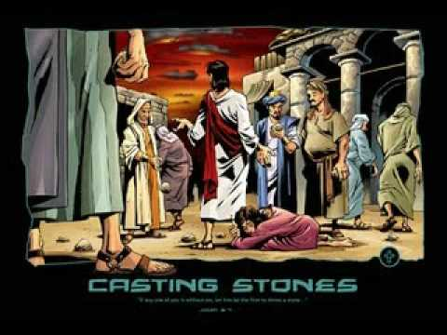
"For John came to you in the way of righteousness, and you did not believe him; but tax collectors and harlots believed him; and when you saw it, you did not afterward relent and believe him. — Matthew 21:32
in
the way
in the way
in the way
of righteousness
of righteousness
the way
Notes:
Even with the coming of Christ, still there are those in denial rejecting His coming.

Slide 46
"To give light to those who sit in darkness and the shadow of death, To guide our feet into the way of peace." — Luke 1:79
To give light
To give light
the way
the way
the way
peace
the way of peace
the way of peace
Notes:
Christ’s calling is to bring us back to God.

Slide 47
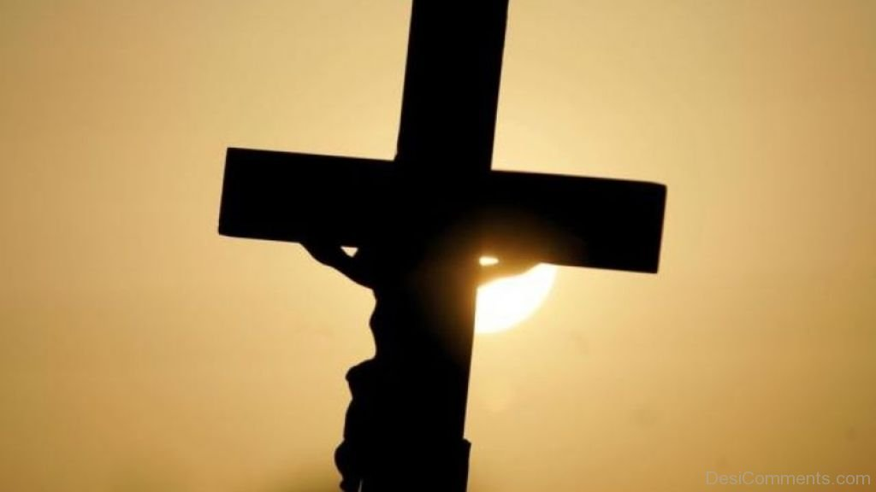
Thomas said to Him, "Lord, we do not know where You are going, and how can we know the way?" Jesus said to him, "I am the way, the truth, and the life. No one comes to the Father except through Me." — John 14:5-6
the way
the way
the way
I am the way,
the way
Notes:
It is through Jesus that we see the light of God in the ways of His truth.

Slide 48
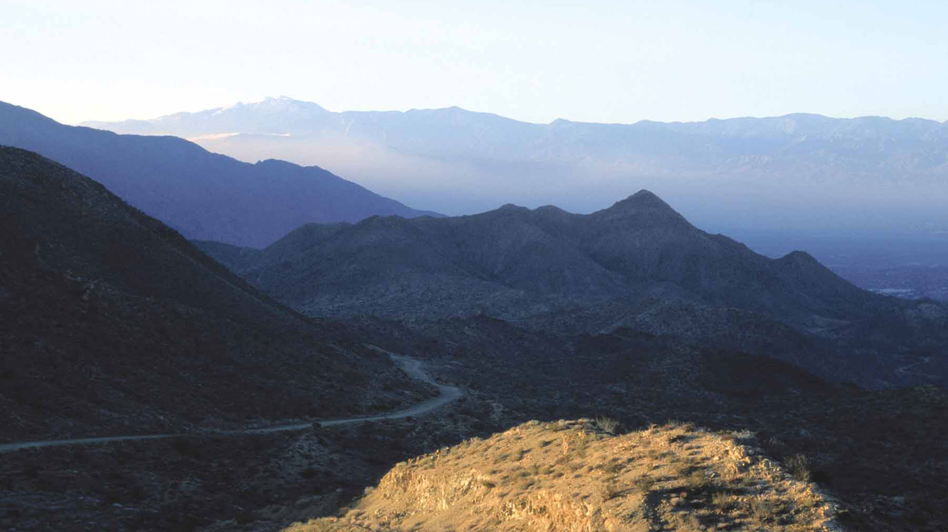
… and asked letters from him to the synagogues of Damascus, so that if he found any who were of the Way, whether men or women, he might bring them bound to Jerusalem. — Acts 9:2
the Way
the way
the Way
the way
Notes:
As the way of Jesus was known about in the first century, persecution came to those initial believers.

Slide 49
This girl followed Paul and us, and cried out, saying, "These men are the servants of the Most High God, who proclaim to us the way of salvation." — Acts 16:17
the way
the way of salvation
the way of salvation
the way
Notes:
Many original Christians were relentlessly pursued.

Slide 50
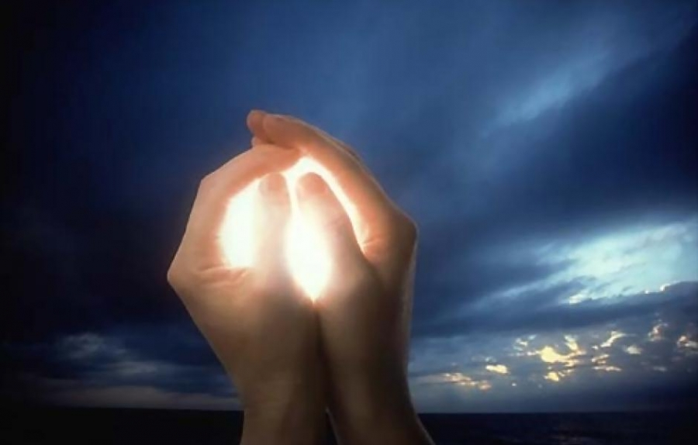
This man had been instructed in the way of the Lord; and being fervent in spirit, he spoke and taught accurately the things of the Lord, though he knew only the baptism of John. — Acts 18:25
the way
the way of the Lord
Lord
the way of the Lord
the way
Notes:
There is the way of God and in whole it is the truth. To only embrace part, or to practice that which has past, is not in the call in Christ.

Slide 51
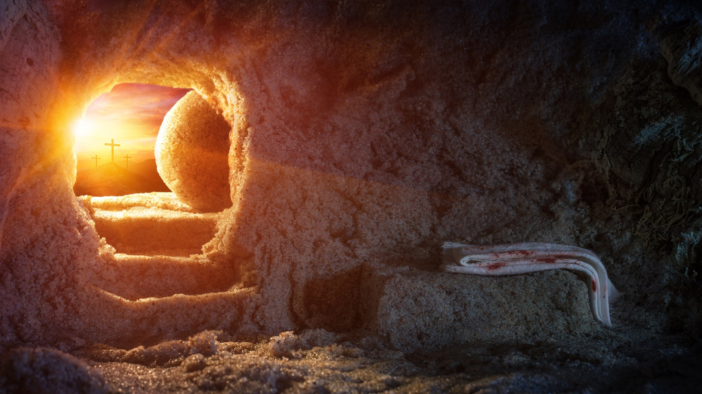
So he began to speak boldly in the synagogue. When Aquila and Priscilla heard him, they took him aside and explained to him the way of God more accurately. — Acts 18:26
the way
explained
explained
God
the way of God more accurately
the way
the way of God more accurately
Notes:
Faithful Christians are called to clarify the way of Christ as it has come to be.

Slide 52
And about that time there arose a great commotion about the Way. — Acts 19:23
uproar
the way
turmoil
disorder
disturbance
the way
the way
And the way of peace they have not known." — Romans 3:17
peace
the way of peace
the way of peace
not known
not known
Notes:
For man, his quest for power, disavows the message Christ has brought to the world. Augmentative posturing defeats His call for unity.

Slide 53
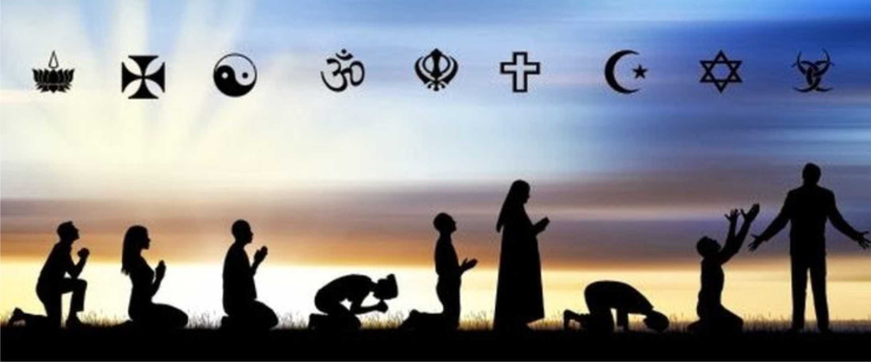
And many will follow their destructive ways, because of whom the way of truth will be blasphemed. — 2nd Peter 2:2
the
way
the way of truth
the way
the
way
the way of truth
Notes:
Many have no intension of returning to God or finding out His ways.

Slide 54
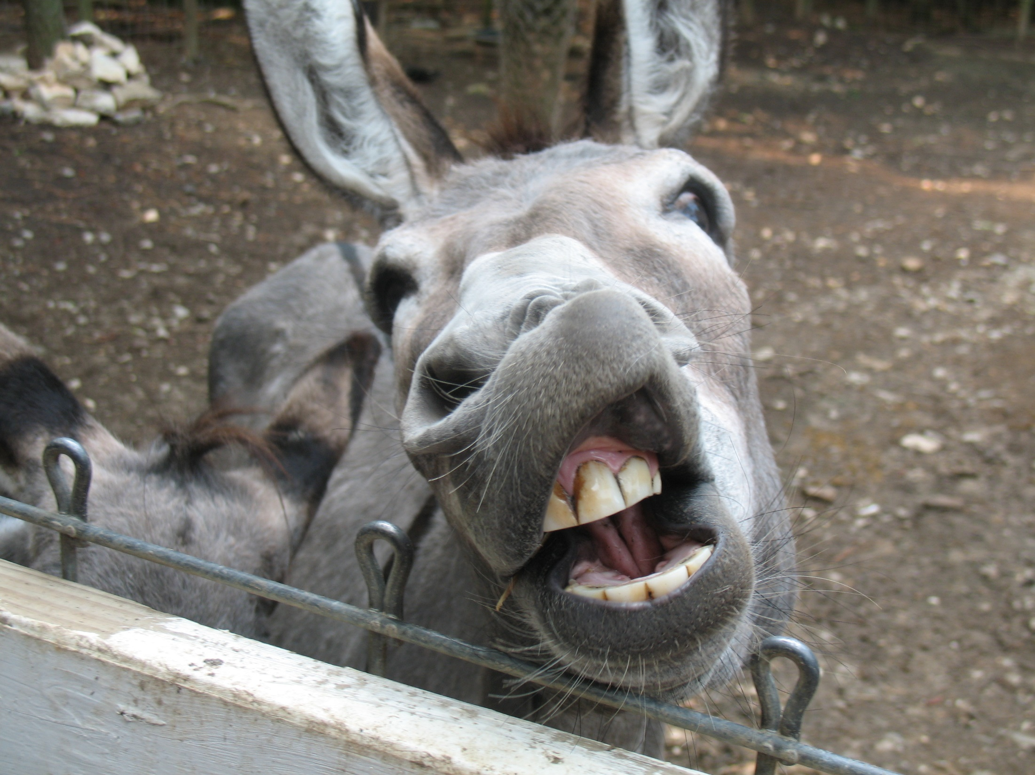
They have forsaken the right way and gone astray, following the way of Balaam the son of Beor, who loved the wages of unrighteousness; — 2nd Peter 2:15
the
right
way
the right way
the right way
the way
Notes:
There are those who would worship evil in their lust for more.

Slide 55
For it would have been better for them not to have known the way of righteousness, than having known it, to turn from the holy commandment delivered to them. — 2nd Peter 2:21
the way
the way of righteousness
the way of righteousness
holy
holy
holy
holy
holy
holy
holy
holy
Notes:
Having the knowledge of God and turning from it seeds a deeper condemnation for no excuse may be had.

Slide 56
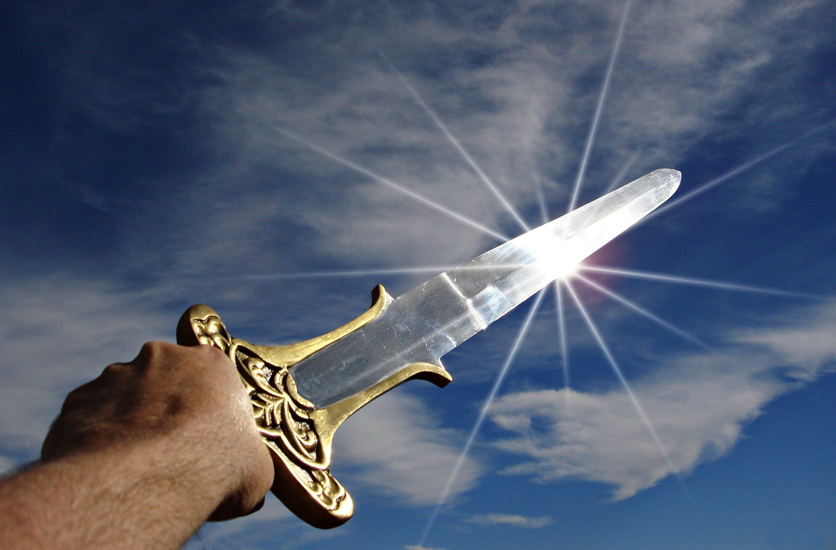
Therefore gird up the loins of your mind, be sober, and rest your hope fully upon the grace that is to be brought to you at the revelation of Jesus Christ; as obedient children, not conforming yourselves to the former lusts, as in your ignorance; but as He who called you is holy, you also be holy in all your conduct, because it is written, "Be holy, for I am holy." — 1st Peter 1:13-16
gird up
. .
mind
rest your hope
mind
. .
grace that is
. .
word
revelation
Jesus Christ
revelation
obedient children
. .
former lusts
. .
ignorance
ignorance
holy
holy
holy
holy
Notes:
To remain steadfast to the end receives the prize of eternal life. One needs to take up the sword of truth that cuts through the air.

Slide 57
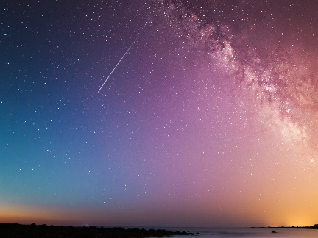
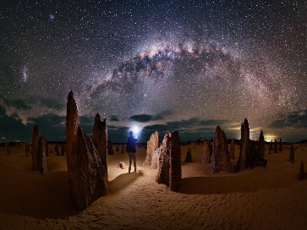
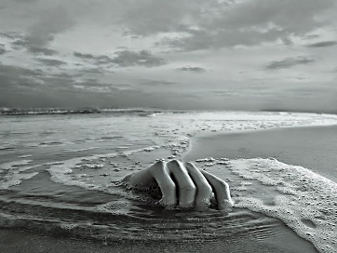
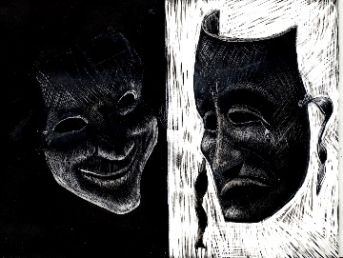
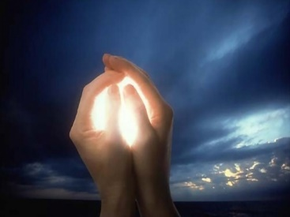
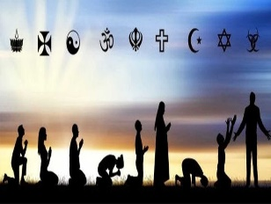
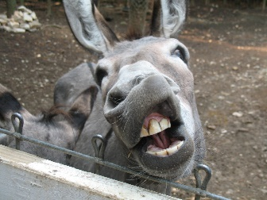

Slide 58
→ The way of the wicked is like darkness
→ The way of the wicked can lead the righteous astray
→ The way of the wicked is an abomination to God
→ Leaving the way of understanding results in death
→ Claims of God not fair/but His is the way of fairness
→ GOD/no pleasure/death of wicked / stop evil ways
→ John came/the way of righteousness-to show peace
→ Jesus is the way, the truth, and the life
→ The way of / Most High God - is the way of salvation
→ Opinions of men create commotion about the Way
→ Many follow destructive ways void of / way of truth
→ Forsaking right way for the love of unrighteousness
→ Be as obedient children holy in all your conduct
Following God
delivers a soul
Notes:
Following God delivers a soul

Slide 59
Notes:
Darkness has a sinking emptiness.

Slide 60
Please visit http://www.LoveFromGod.com to explore further
Ronald Bert Channel on
Notes:
Eternity never ends.

