Slide 2
The Walk
Ron Bert
October 4, 2020

Slide 3
Blessed is the man Who walks not in the counsel of the ungodly, Nor stands in the path of sinners, Nor sits in the seat of the scornful; But his delight is in the law of the LORD, And in His law he meditates day and night. — Psalms1:1-2
meditates in
the LORD
Blessed
w
not
the
counsel
ungodly
Blessed
path of sinners
not with:
● ungodly counsel
● path of sinners
● the scornful
the scornful
i
in
th
LORD
meditates
Notes:
Bittersweet experience touch us all. Crying beats on each genuine heart. For us to remain strong in His truths, character must turn the page on rage, for others as well as self. To the unaided and uneducated souls, humble desires of release to His love comes by diligent study of His Holy Word.

Slide 4
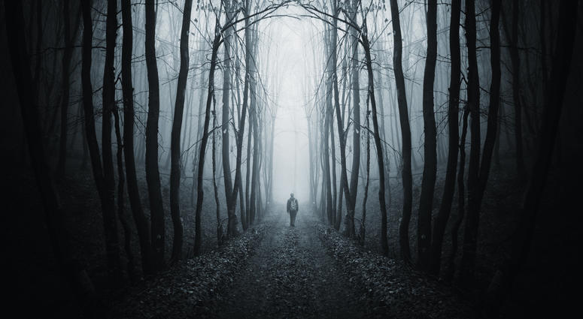
Yea, though I walk through the valley of the shadow of death, I will fear no evil; For You are with me; Your rod and Your staff, they comfort me. — Psalms 23:4
shadow of death
Your
d
a
th
comfort me
comfort me
Trust
Your path
Notes:
As we are born to die, it is a lesson in trouble and how and what we choose to depend on. Friends or God? It is a hard walk. The mettle of a soul is declared by the fearful fires one has endured in a spectrum of experiences, unique to all; and still able to stand with integrity of heart. Plain truth is not always palatable, but as a people our noble character is waning while hope stings all songs. The best taste comes by dear old friends still willing to share life. May the bonds we seek inspire a genuine touch in an insincere world.

Slide 5
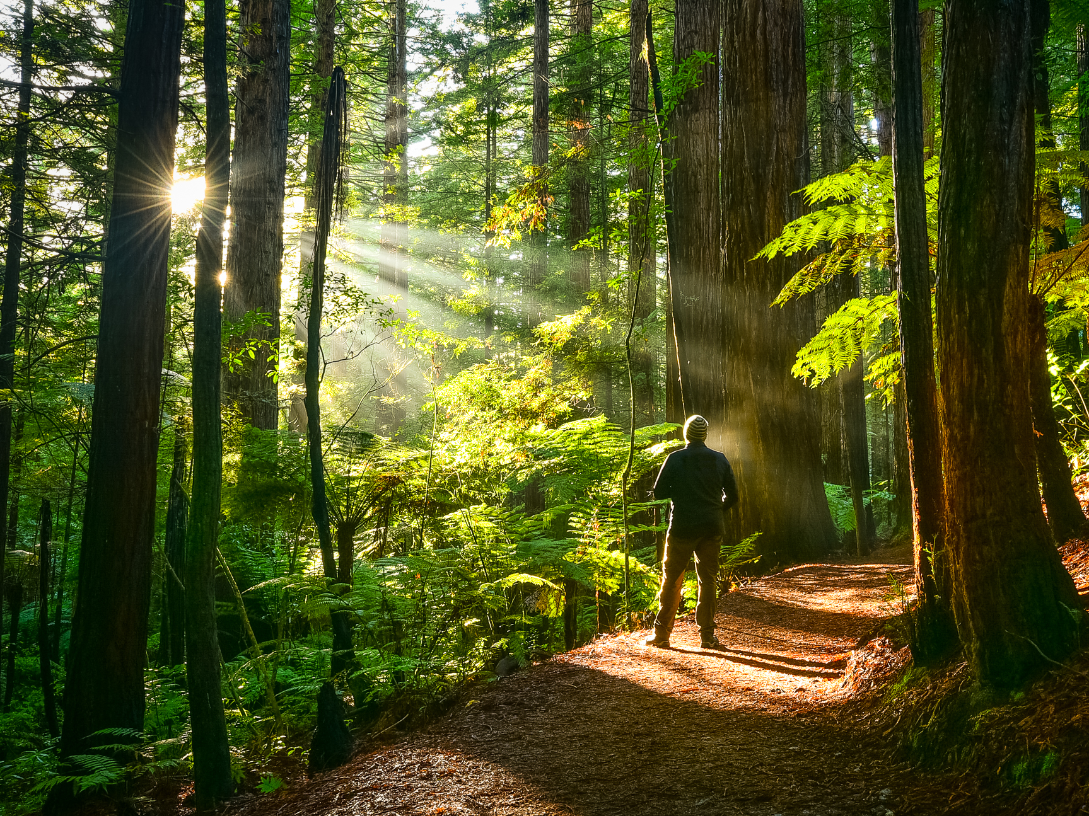
Uphold my steps in Your paths, That my footsteps may not slip. — Psalms 17:5
steps
footsteps
footsteps
steps
Your path
Notes:
Sunshine is His message of warmth in a cold distant existence.

Slide 6
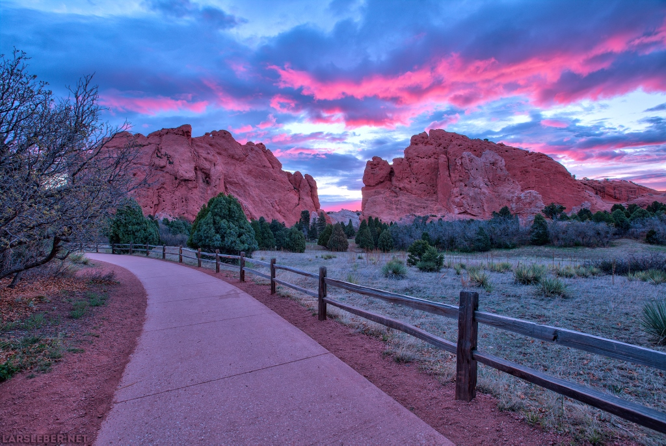
O LORD, I know the way of man is not in himself; It is not in man who walks to direct his own steps. — Jeremiah 10:23
steps
walk
steps
steps
walk
Notes:
No one can say the next step will be sure or not with so many clamorous variables. Wrong or right is presented and the masks we wear bear out in honesty or not, loving or despising, maturely adjusting or remaining desperately insecure. Strength is only found, by all hearts, in extending trust to our timeless one Almighty God.

Slide 7
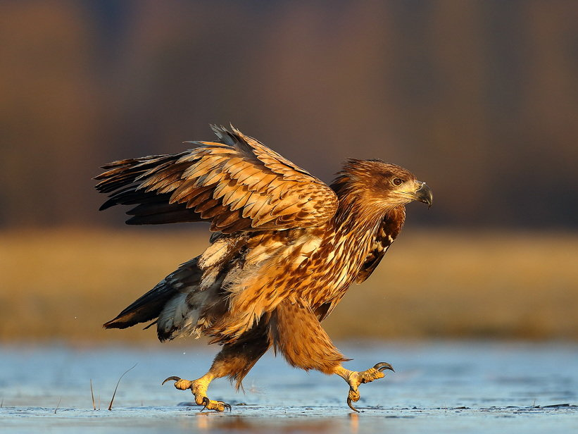
But those who wait on the LORD Shall renew their strength; They shall mount up with wings like eagles, They shall run and not be weary, They shall walk and not faint. — Isaiah 40:31
wait
wait
walk
walk
Notes:
Eagles have always expressed power of flight with sharp wisdom in all situations. In each step, we need more than less, as time ramps her avalanche upon our lives, vision is what clears the way.

Slide 8
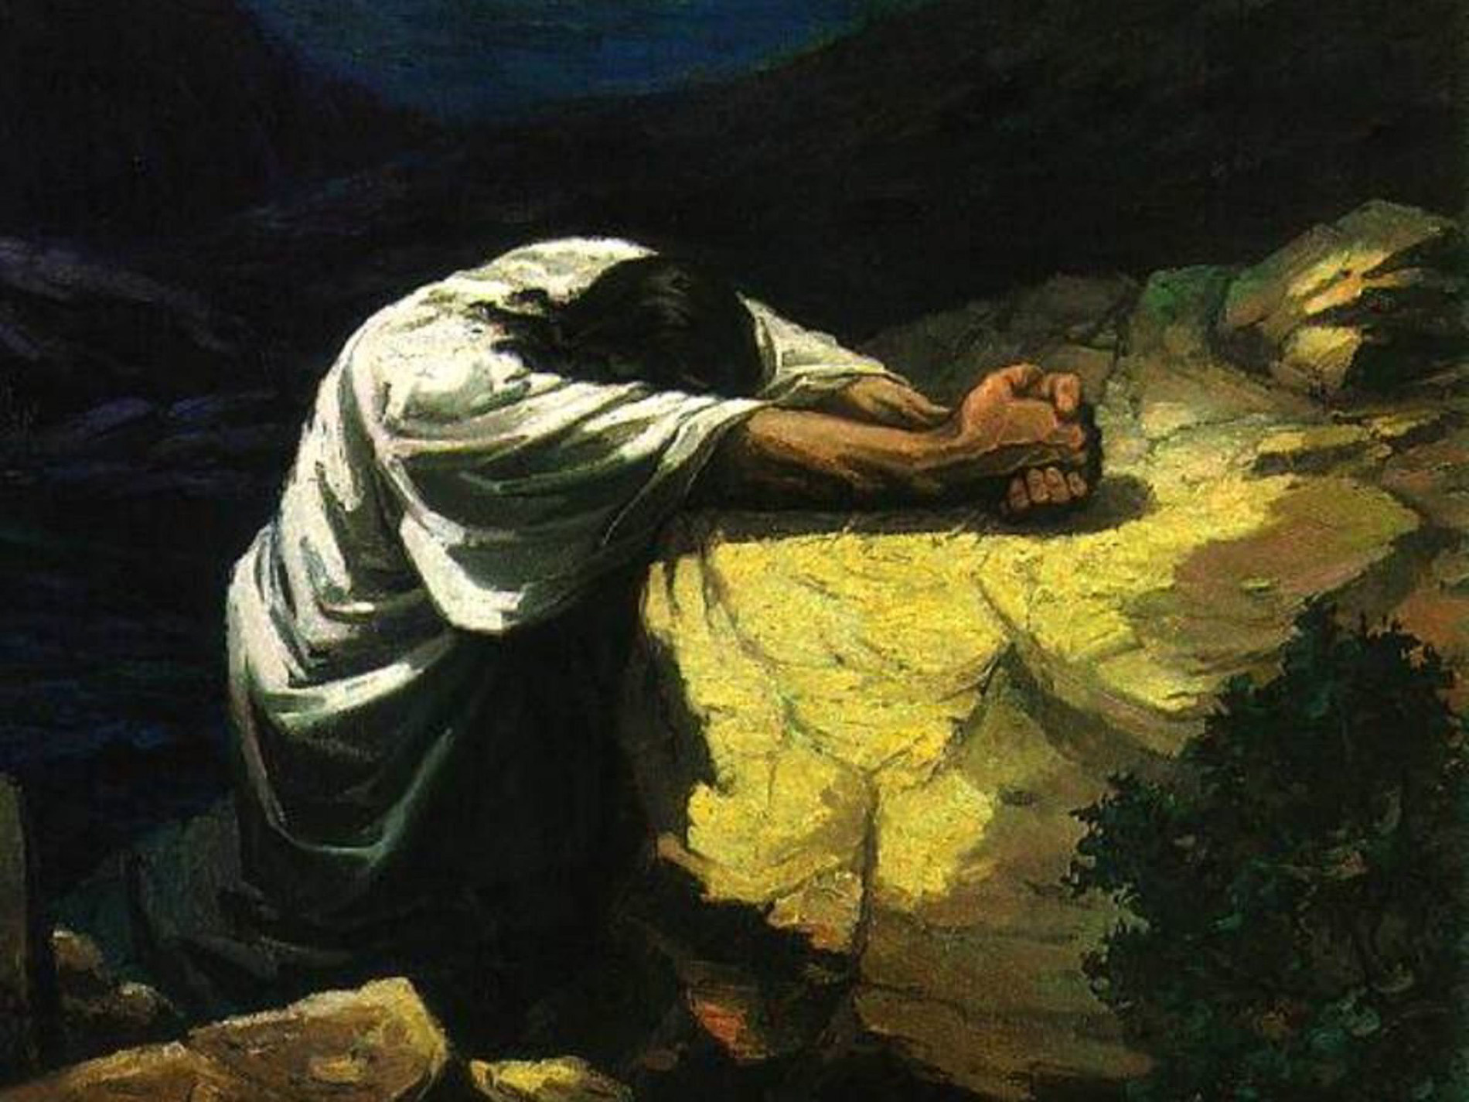
He has shown you, O man, what is good; And what does the LORD require of you But to do justly, To love mercy, And to walk humbly with your God? — Micah 6:8
Lies
walk
Truth
honesty
compassion
walk
respect
Love
Humility
Hate
Pride
Notes:
Simple truths remain whole for all the children of the earth, no matter where or who. Honesty, compassion, soft respectful hearts define the noble.

Slide 9
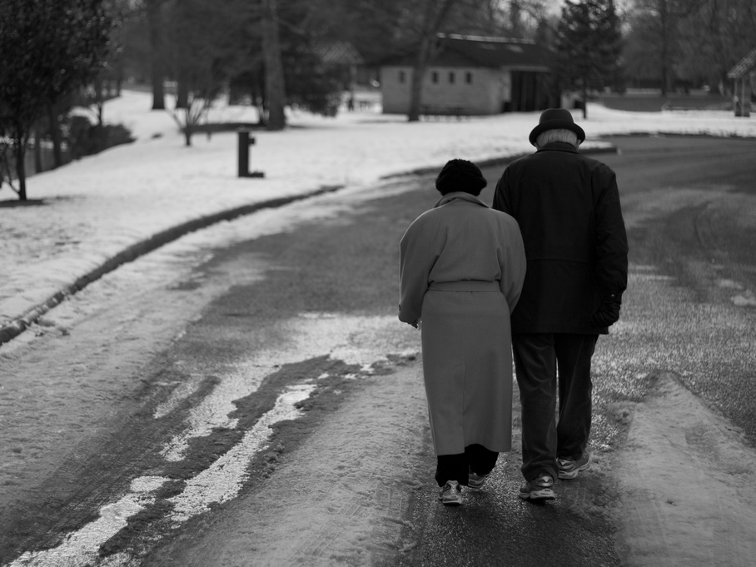
This is love, that we walk according to His commandments. This is the commandment, that as you have heard from the beginning, you should walk in it. — 2nd John 1:6
=
love
walk
love
commitment
walk
walk
Notes:
Disposable relationships and the human garbage disposal system lends to cold bitter shallow hearts. Shelter is found in our commitments, not just to God in our loneliness, but joining with others, even just one, with permanence beyond measure. Love has no boundary with the depth of forever. Without love no well can be seen. Love is commitment to a cause.

Slide 10
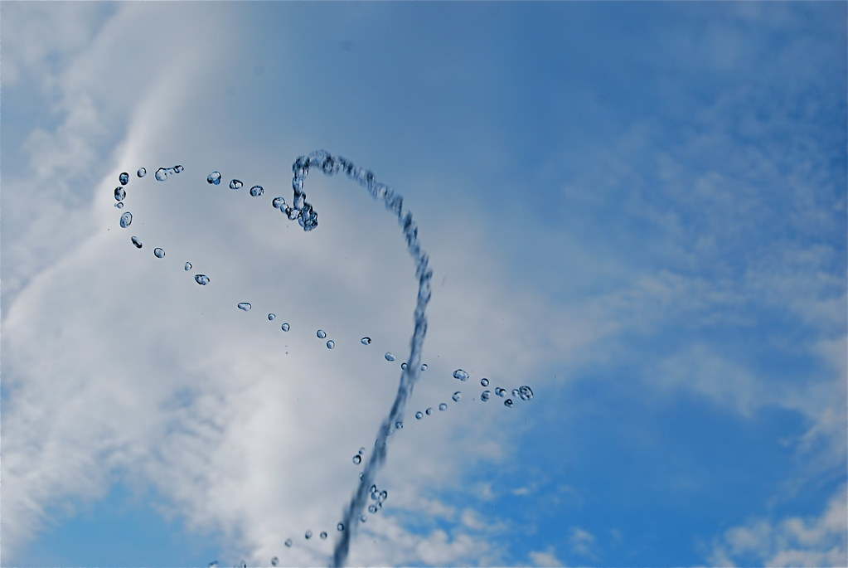
For we are His workmanship, created in Christ Jesus for good works, which God prepared beforehand that we should walk in them. — Ephesians 2:10
walk
in
Christ Jesus
goodness
should
walk
should
Notes:
Good works are so often dismissed by the callous. To achieve sure satisfied hearts, it only occurs when the best we offer is in everything we do. Quiet sleep comes to those who hold no regrets after giving it all.

Slide 11
And walk in love, as Christ also has loved us and given Himself for us, an offering and a sacrifice to God for a sweet-smelling aroma. — Ephesians 5:2
walk
in
. .
in love
walk
give
give
Notes:
Christ showed us the road to paradise in giving all for the benefit of all. That ‘I’ inside each of us must learn to give if love is to be had in its’ fullest glory.

Slide 12
For you were once darkness, but now you are light in the Lord. Walk as children of light (for the fruit of the Spirit is in all goodness, righteousness, and truth), finding out what is acceptable to the Lord. — Ephesians 5:8-10
Spirit fruit:
● in all goodness
● righteousness
● truth
● finding
what is
acceptable
to the Lord
in
walk
fruit
walk
in all goodness
Spirit
righteousness
truth
finding
what is
acceptable
to the Lord
Notes:
That epiphany that turns a heart from darkness to the light comes when one believes upon hearing the word. Seeking God is an unending task that shines unto eternity.

Slide 13
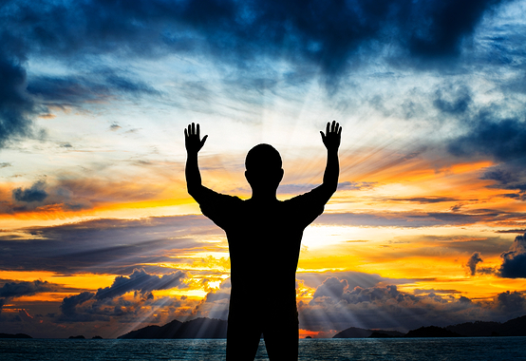
Therefore He says: "Awake, you who sleep, Arise from the dead, And Christ will give you light." See then that you walk circumspectly, not as fools but as wise, redeeming the time, because the days are evil. — Ephesians 5:14-16
walk
time
as wise
as wise
time
Notes:
Awareness rests on smiles found on deepening understandings. Jewels of knowledge that cannot be stolen possess treasure immeasurable in extent.

Slide 14
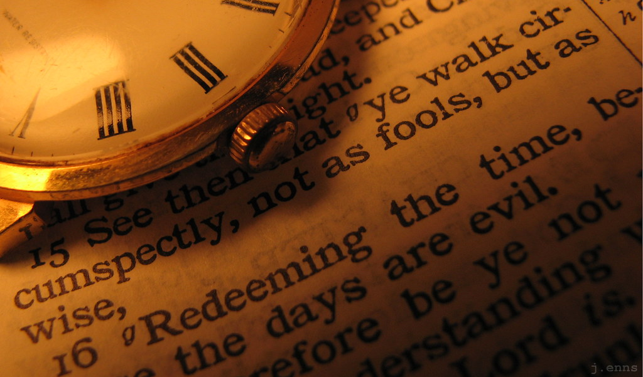
Walk in wisdom toward those who are outside, redeeming the time. — Colossians 4:5
walk
in
in wisdom
in wisdom
time
walk
Notes:
Time is the friend of no man. Timelessness is the offering of God.

Slide 15
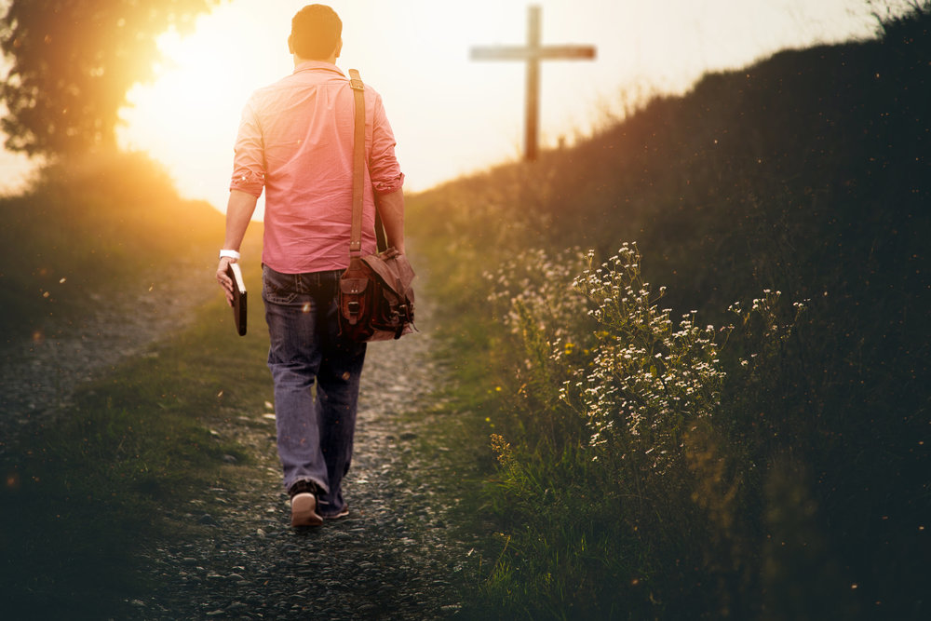
And those who are Christ’s have crucified the flesh with its passions and desires. If we live in the Spirit, let us also walk in the Spirit. — Galatians 5:24-25
crucified
desires
walk
in
walk in the
walk
walk in the
Spirit
Spirit
Notes:
In the challenges of living where there is decay, to find what remains fresh, without disguise, it is rendered by the sincerity of His eternal truth. Tides come and go but His wave rests on the calm.

Slide 16
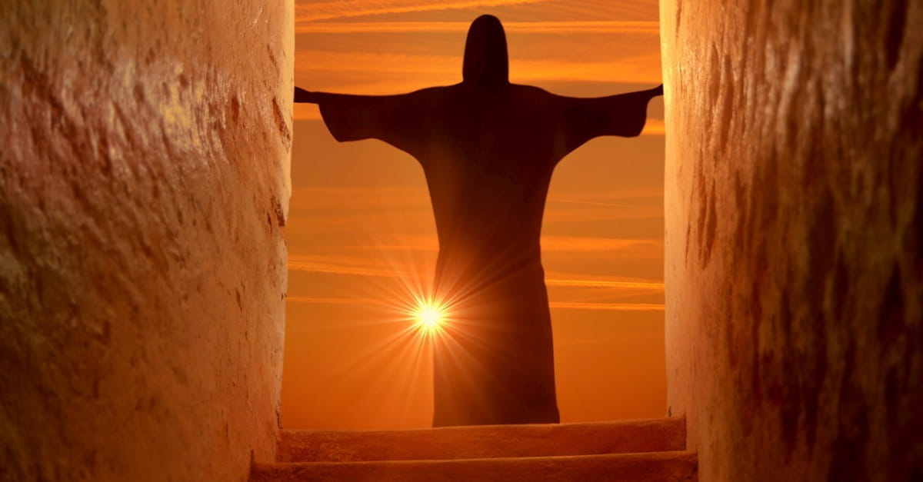
He who says he abides in Him ought himself also to walk just as He walked. — 1st John 2:6
walk
just as
just as
Notes:
Hypocrites, as lawyers, are more a penny a dozen. Victory is found in integrity without excuse. Just as Jesus walked with honesty, compassion, and respect for lives of others, so too should we.

Slide 17
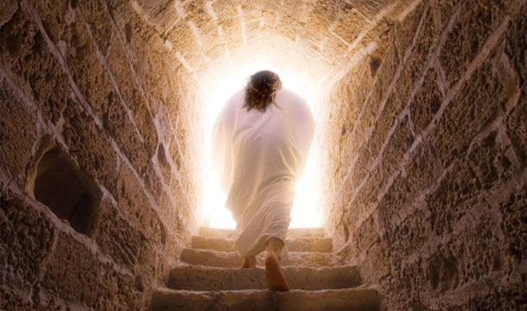
For to this you were called, because Christ also suffered for us, leaving us an example, that you should follow His steps: — 1st Peter 2:21
Know God
Live for the Spirit and will of God
Truthful
Gentle
Christ
Christ
an example
In service
Not ashamed to believe
an example
follow
follow
Endure
Christ
Forgiving
Unselfish
Notes:
As unpleasant as it is, good rises from the depths of our sufferings, when dealt in our cares for one another.

Slide 18
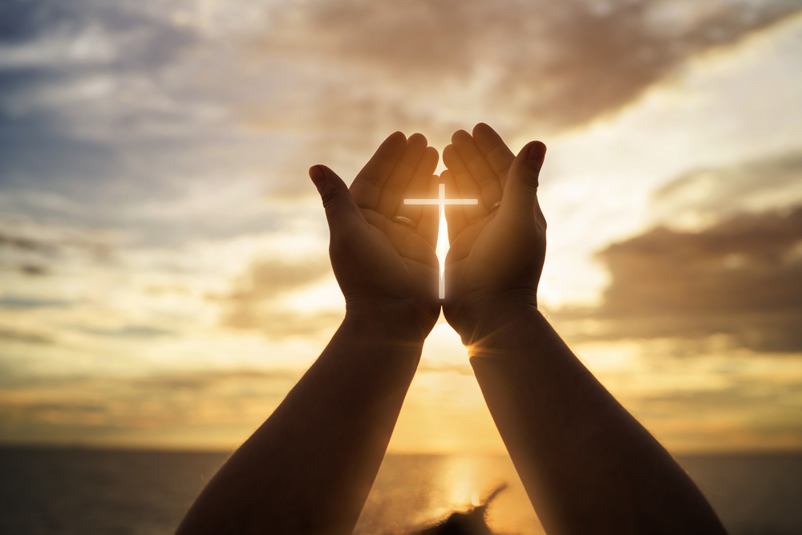
If we say that we have fellowship with Him, and walk in darkness, we lie and do not practice the truth. But if we walk in the light as He is in the light, we have fellowship with one another, and the blood of Jesus Christ His Son cleanses us from all sin. — 1st John 1:6-7
walk
practice the truth
in
. .
walk
walk in the light
then
blood
Christ
X
Notes:
The sacrifice of Christ delivers us from ourselves when we join Him and His walk to heaven.`

Slide 19
walk
Notes:
The sacrifice of Christ delivers us from ourselves when we join Him and His walk to heaven.`

Slide 20
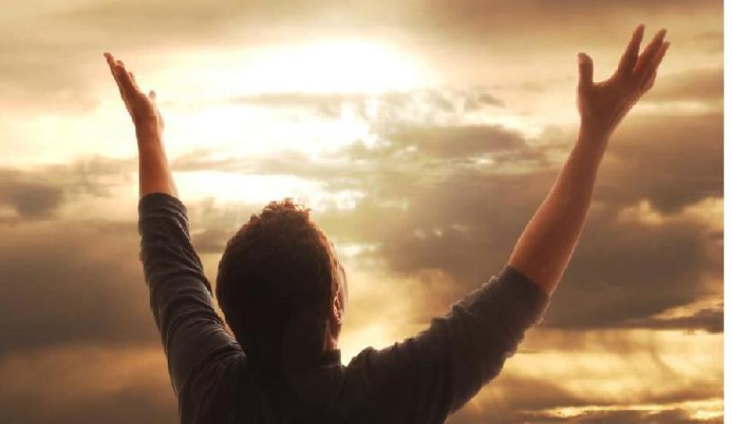
As you have therefore received Christ Jesus the Lord, so walk in Him, rooted and built up in Him and established in the faith, as you have been taught, abounding in it with thanksgiving. Beware lest anyone cheat you through philosophy and empty deceit, according to the tradition of men, according to the basic principles of the world, and not according to Christ. — Colossians 2:6-8
walk
in
walk in Him
walk in Him
walk
been taught
thanksgiving
WARNING
not according to Christ
not according to Christ
Christ
Notes:
Believing trusting thankful hearts can be innocently deceived by all the regretful countless schemers that swirl in the shark tank called earth.

Slide 21
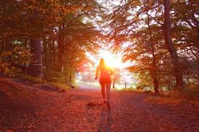
Let us walk properly, as in the day, not in revelry and drunkenness, not in lewdness and lust, not in strife and envy. — Romans 13:13
not in:
● revelry
● drunkenness
● lewdness
● lust
● strife
● envy
walk
partying
walk
not in
revelry
drunkenness
filthiness
lewdness
lust
strife
envy
fighting
Notes:
One feels light in love when accountabilities height is rendered to God. Submission is sacrifice well pleasing in His sight.

Slide 22
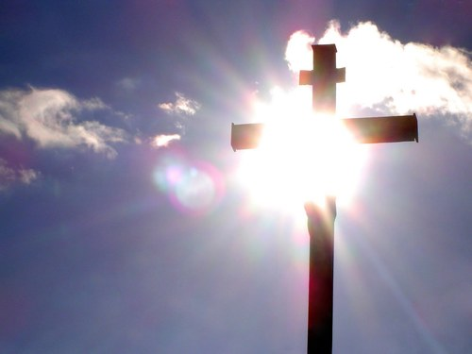
Nevertheless, to the degree that we have already attained, let us walk by the same rule, let us be of the same mind. Brethren, join in following my example, and note those who so walk, as you have us for a pattern. For many walk, of whom I have told you often, and now tell you even weeping, that they are the enemies of the cross of Christ: — Philippians 3:16-18
walk
unity
same
same
same
same
in
follow
follow
a pattern
a pattern
walk
Notes:
Experience from personal examinations, as well as those fortunate enough to witness guiding mentors, lift us closer to being and becoming the mentor we seek. Faithful help comes by those who have also been helped.

Slide 23
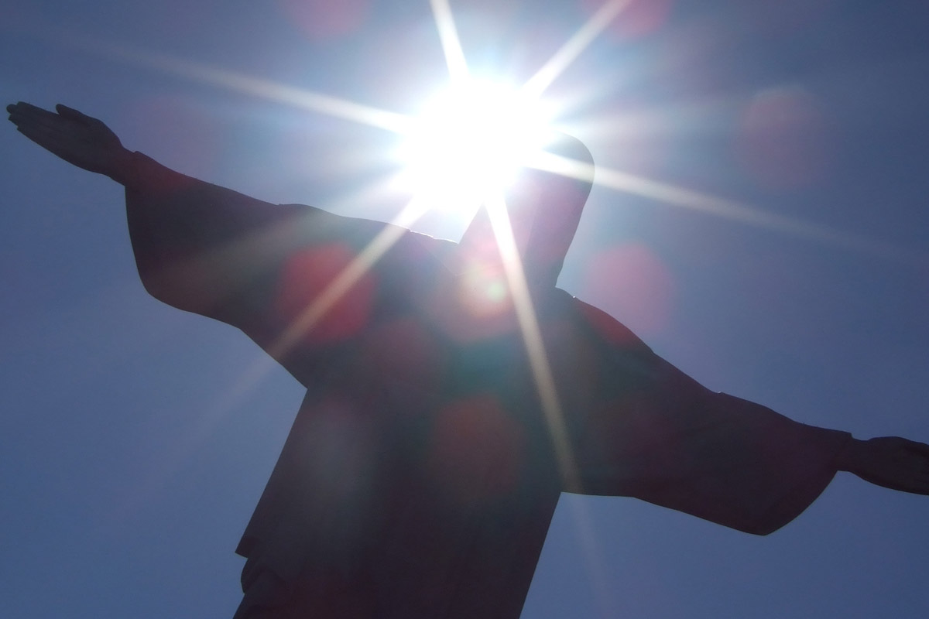
Then Jesus spoke to them again, saying, "I am the light of the world. He who follows Me shall not walk in darkness, but have the light of life." — John 8:12
follow
follow
follow
walk
light of life
light of life
walk
Notes:
Jesus is the starting and finish line.

Slide 24
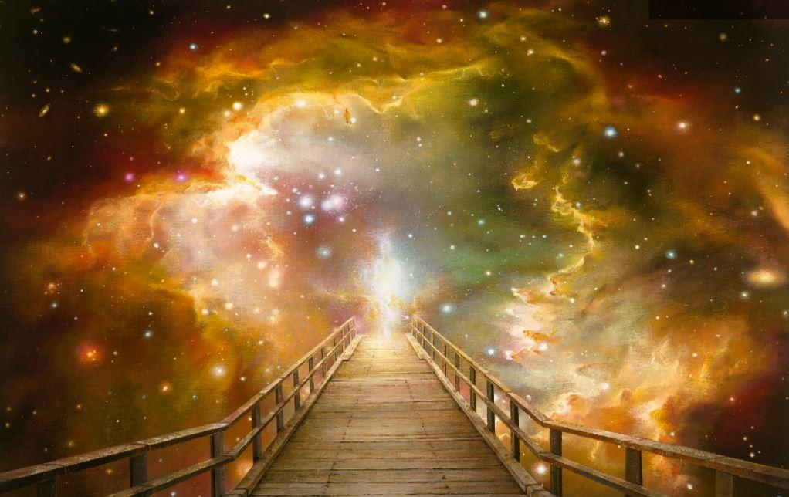
Therefore we were buried with Him through baptism into death, that just as Christ was raised from the dead by the glory of the Father, even so we also should walk in newness of life. — Romans 6:4
walk
Christ
raised
Christ
raised
in
walk in newness of life
walk
walk in newness of life
Notes:
To open the eternal door one must follow what He has given to know.

Slide 25
For we walk by faith, not by sight. — 2nd Corinthians 5:7
Inner
heart
walk
walk
walk
Outer
stuff
Notes:
Our faith is found in every sure heart knowing our Father’s intent to redeem all souls in His womb of love.

Slide 26
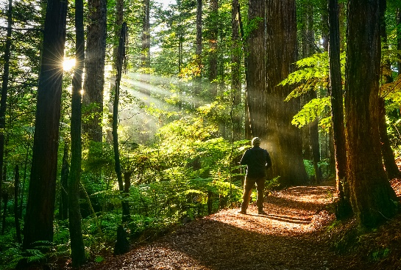
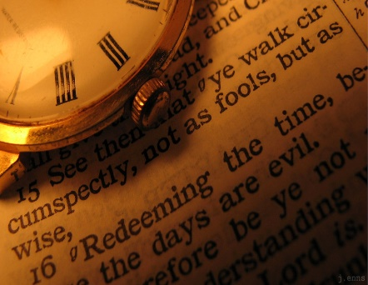

Slide 27
→ Blessed when we walk godly, not with sinners
→ As we all walk to death’s gate, He holds us
→ To honestly love and walk humbly pleases God
→ To truly love God one walks uprightly in His will
→ He created goodness to walk in all over His creation
→ Walking in His light seeks what is acceptable to Him
→ Reflectively walk learning while building wisdom
→ To walk in the Spirit is to put off the flesh
→ Christ is our example in what He endured
→ Walking in His light gains fellowship with others
→ Walk in principles of Christ over traditions of men
→ In Him we should walk in the newness of life
→ For we walk by faith, not by sight
To walk in His light lifts us to His love
Notes:
To walk in His light lifts us to His love.

Slide 29
Please visit http://www.LoveFromGod.com to explore further
Ronald Bert Channel on
Notes:
Eternity never ends.

