Slide 1
Notes:
Darkness has no corner.

Slide 2
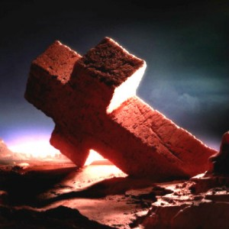
Ron Bert
THE ROCK
THE ROCK
August 21, 2016
Notes:
Rising from nothing, all substance is of God.

Slide 3
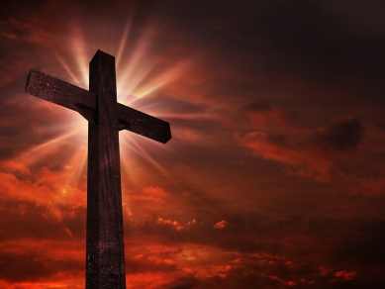
For I proclaim the name of the LORD: Ascribe greatness to our God. He is the Rock, His work is perfect; For all His ways are justice, A God of truth and without injustice; Righteous and upright is He. — Deuteronomy 32:3-4
He = the Rock
He is the Rock
His
● truth
● justice
● upright
● Righteous
work is perfect
His ways
His ways
justice
truth
Righteous
His work = perfect
upright
Notes:
We may not always be able to see what the intent of the Lord is, but we are assured that His method is sound, and sure, to accomplish His purpose of nurturing autonomous goodness inviting His creation to live eternally, in union with Him. It is God that declares righteous upright justice in truth.

Slide 4
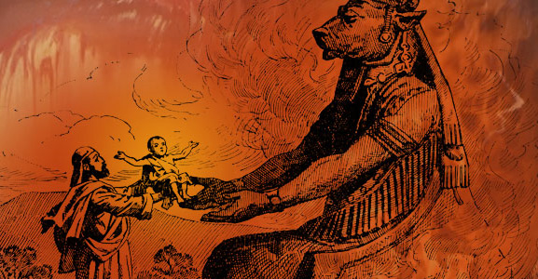
They sacrificed to demons, not to God, To gods they did not know, To new gods, new arrivals That your fathers did not fear. Of the Rock who begot you, you are unmindful, And have forgotten the God who fathered you. — Deuteronomy 32:17-18
not to
God
however
Rock who begot you
unmindful
forgotten
unmindful
forgotten
Notes:
Man too often has chosen his own rule and or immediate distorted desires, disregarding the sensible and just will of God. It was never in God’s plan to have man sacrifice his children to the carnage of human atrocities. To forget God is to forget decency.

Slide 5
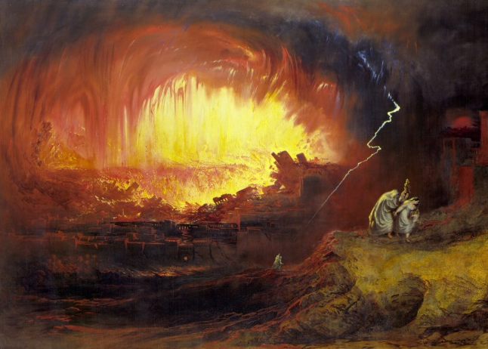
For their rock is not like our Rock, Even our enemies themselves being judges. For their vine is of the vine of Sodom And of the fields of Gomorrah; Their grapes are grapes of gall, Their clusters are bitter. Their wine is the poison of serpents, And the cruel venom of cobras. — Deuteronomy 32:31-33
their rock is not like our Rock
rock
Rock
their rock is not like out Rock
Rock of God
of
of
d
f
Go
l
e
s
rock of flesh
h
Notes:
Exalting objects over eternal purpose is what amplifies the lustful destroying the innocence of youth and all higher noble qualities.

Slide 6
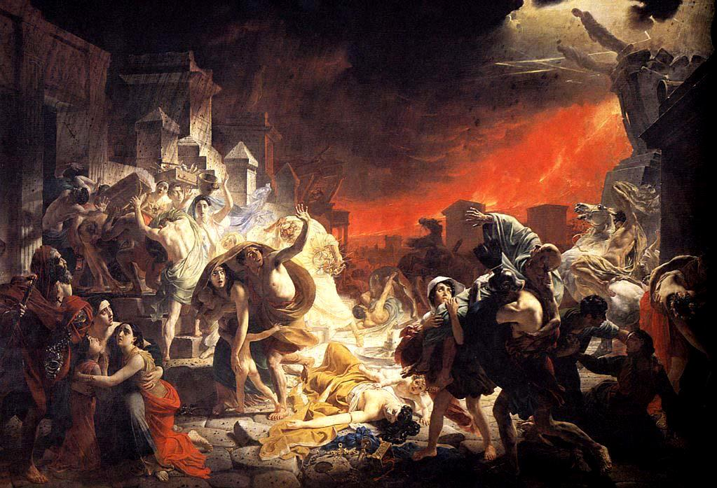
"For the LORD will judge His people And have compassion on His servants, When He sees that their power is gone, And there is no one remaining, bond or free. He will say: 'Where are their gods, The rock in which they sought refuge? Who ate the fat of their sacrifices, And drank the wine of their drink offering? Let them rise and help you, And be your refuge. '" — Deuteronomy 32:36-38
"For the LORD will judge His people And have compassion on His servants, When He sees that their power is gone, And there is no one remaining, bond or free. He will say: 'Where are their gods, The rock in which they sought refuge? Who ate the fat of their sacrifices, And drank the wine of their drink offering? Let them rise and help you, And be your refuge. '" — Deuteronomy 32:36-38
compassion on His servants
compassion on His servants
Where
refuge
Self-indulgence
Notes:
The Lord watches and waits while man argues in ways of excusing wrong for right, away from God’s truth, justifying rebellion with empty lies. God regards only those in service to His ways. There is no refuge for the fallen.

Slide 7
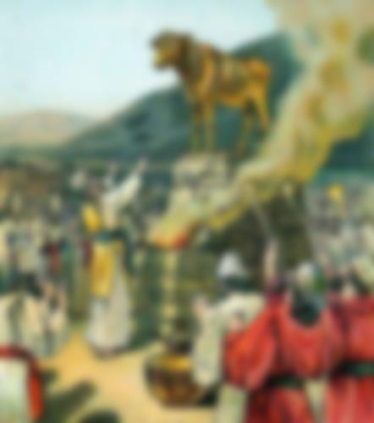
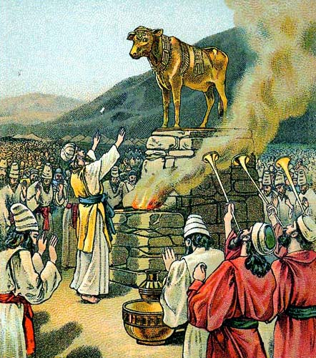
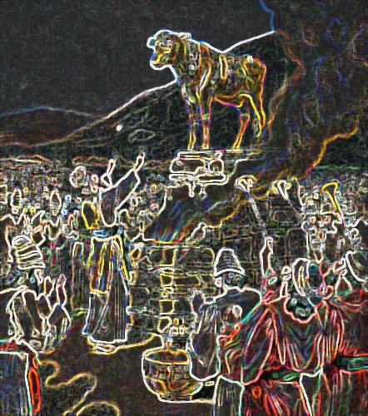
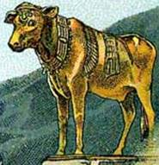
Woe to him who says to wood, 'Awake!' To silent stone, 'Arise! It shall teach!' Behold, it is overlaid with gold and silver, Yet in it there is no breath at all. — Habakkuk 2:19
Woe to him who says to wood, 'Awake!' To silent stone, 'Arise! It shall teach!' Behold, it is overlaid with gold and silver, Yet in it there is no breath at all. — Habakkuk 2:19
Notes:
For that which can never be, man cannot create life. In his faux attempt, he creates dead objects to assimilate his power over life. Pompously knowing is not the same as humbly wondering. Whatever this world may create or produce, it can never express the glory that comes from that which made it all. Earth in all its glory is just a fragile rock rolling in space. Worshipping creations of man blurs vision to the point of blindness.

Slide 8
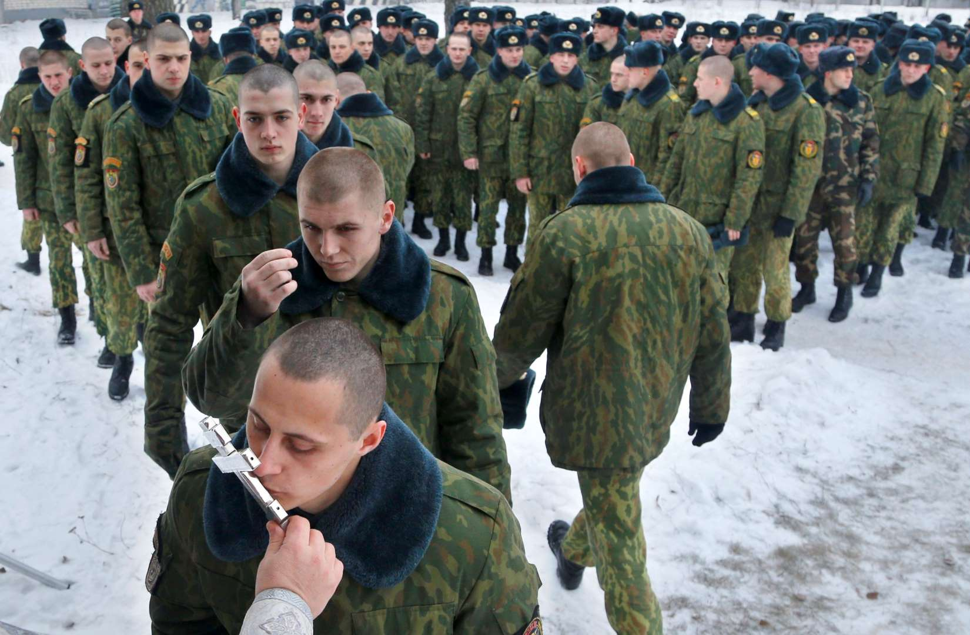
… who exchanged the truth of God for the lie, and worshiped and served the creature rather than the Creator, who is blessed forever. Amen. — Romans 1:25
creature
Creator
Notes:
False ideas infect the whole of humanity finding delusions as truth. The ignorant flock to the manipulations of man. The truth of God is a call to be upright in spirit seeking out His will, over the blind stumbling's of those that would continue to find worship in the material world, over that of the unseen where hope intersects love. God is not found in golden crosses or ornate structures that magnifying man over God. God is not an object more than an essence.

Slide 9
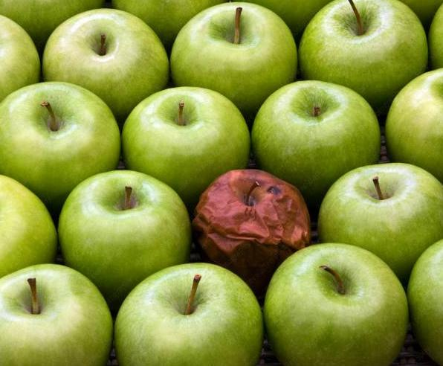
"Therefore by their fruits you will know them. — Matthew 7:20
"Therefore by their fruits you will know them. — Matthew 7:20
Creator
Spiritual
creature
fleshly
God
man
Notes:
Humanity is spoiled by those that fester in what is rotten. Holiness is lost when evil putrefies the whole.

Slide 10

And He said, "My Presence will go with you, and I will give you rest." — Exodus 33:14
And He said, "My Presence will go with you, and I will give you rest." — Exodus 33:14
H
My Presence
My Presence
will give you rest
will give you rest
In His presence = fullness of joy
In His presence = fullness of joy
In His presence = fullness of joy
In His presence = fullness of joy
In His presence = fullness of joy
In His presence = fullness of joy
In His presence = fullness of joy
You will show me the path of life; In Your presence is fullness of joy; At Your right hand are pleasures forevermore. — Psalm 16:11
You will show me the path of life; In Your presence is fullness of joy; At Your right hand are pleasures forevermore. — Psalm 16:11
In
is
presence
fullness of joy
Notes:
It is acknowledging the presence of the Lord that gives us our strength, and it settles one in to rest in Him which is peace of mind.

Slide 11
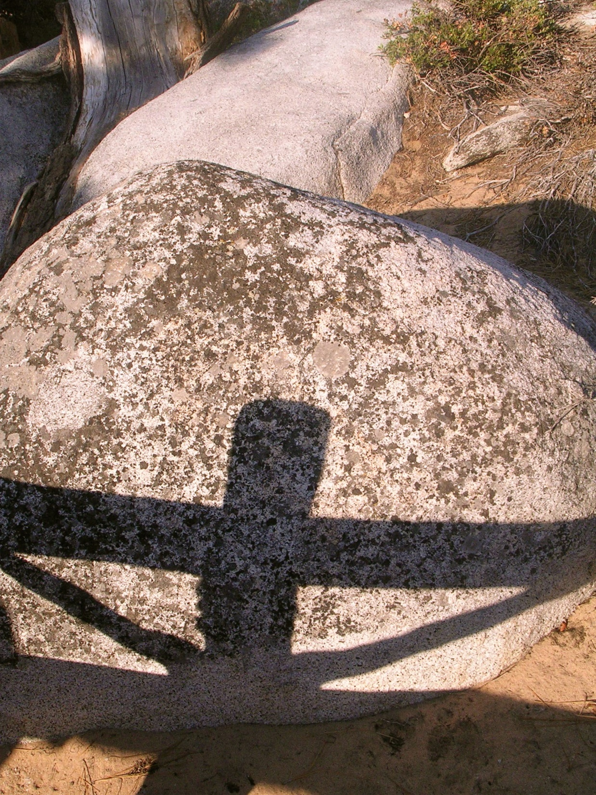
"No one is holy like the LORD, For there is none besides You, Nor is there any rock like our God." — 1st Samuel 2:2
"No one is holy like the LORD, For there is none besides You, Nor is there any rock like our God." — 1st Samuel 2:2
Jesus
Notes:
Holy is God in the pureness of His creation whereby comes the rock of His truth. We all live in the shadow of His salvation.

Slide 12
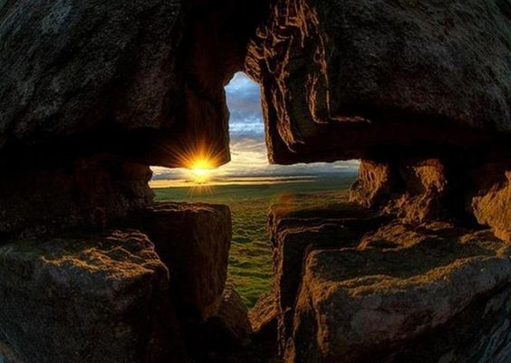
And he said: "The LORD is my rock and my fortress and my deliverer; The God of my strength, in whom I will trust; My shield and the horn of my salvation, My stronghold and my refuge; My Savior, You save me from violence." — 2nd Samuel 22:2-3
The LORD is my rock
and my fortress and my deliverer; The God of my strength, in whom I will trust; My shield and the horn
of my salvation, My stronghold.
trust
2nd Samuel 22:2-3
and my refuge; My Savior, You save me from violence."
my refuge.
My Savior
truth
,
You
trust
sanctuary
save me from violence
I will call upon the LORD, who is worthy to be praised; So shall I be saved from my enemies — Psalm 18:2-3
I will call upon the LORD,
and my refuge; My Savior, You
save me from violence
worthy to be praised
;
enemies
2nd Samuel 22:2-3 + Psalms 18:2-3
Notes:
In an anguished world living in the flesh, to find a strength of reliance within to that which is greater than self delivers the soul. Knowing He is the savior shelters the heart. Sanctuary can not be taken if trust is not the shield of salvation. A true believer of God in Christ does not act rashly on impulse, but methodically reserves thoughts carefully.

Slide 13
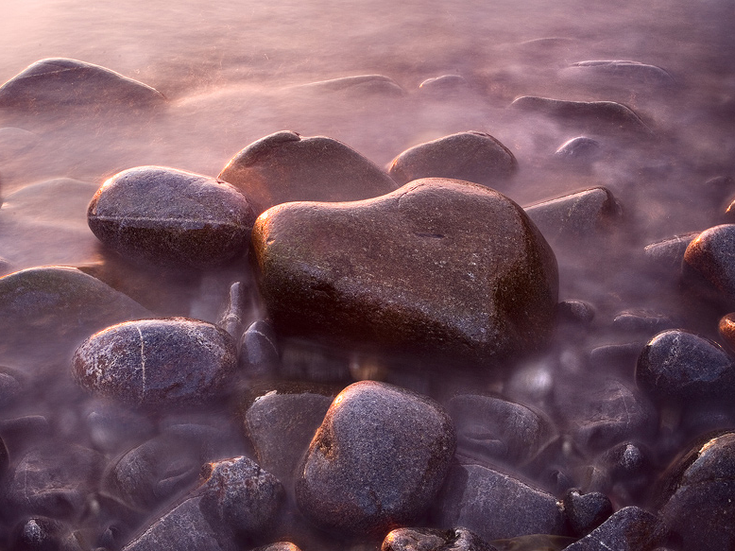
"For who is God, except the LORD? And who is a rock, except our God? God is my strength and power, And He makes my way perfect. — 2nd Samuel 22:32-33
my way
"For who is God, except the LORD? And who is a rock, except our God? God is my strength and power, And He makes my way perfect. — 2nd Samuel 22:32-33
God = my strength + my power
God
my strength
my strength
my strength
power
my
my way
my way
Notes:
Confidence in Him is where life becomes more tolerable knowing our return is to Him.

Slide 14
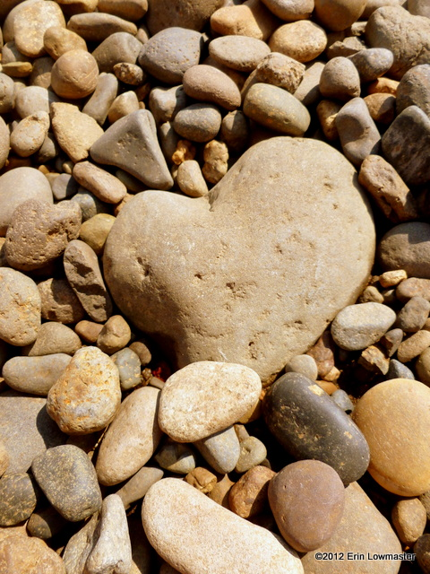
"The LORD lives! Blessed be my Rock! Let God be exalted, The Rock of my salvation! — 2nd Samuel 22:47
"The LORD lives! Blessed be my Rock! Let God be exalted, The Rock of my salvation! — 2nd Samuel 22:47
my Rock
my Rock
my salvation
my salvation
Notes:
He is the truth of eternal salvation.

Slide 15

As for God, His way is perfect; The word of the LORD is proven; He is a shield to all who trust in Him. For who is God, except the LORD? And who is a rock, except our God? — Psalms 18:30-31
s
i
As for God, His way is perfect; The word of the LORD is proven; He is a shield to all who trust in Him. For who is God, except the LORD? And who is a rock, except our God? — Psalms 18:30-31
f
word
proven
He
a shield
trust
in
a shield
who trust
a shield
who trust
Hi
Him
His word = proven
He = a shield if trust is in Him
is
if
in
if
=
Notes:
The word the Lord delivers is upon all decent and upright, wherein a call to return to original holiness shines out.

Slide 16
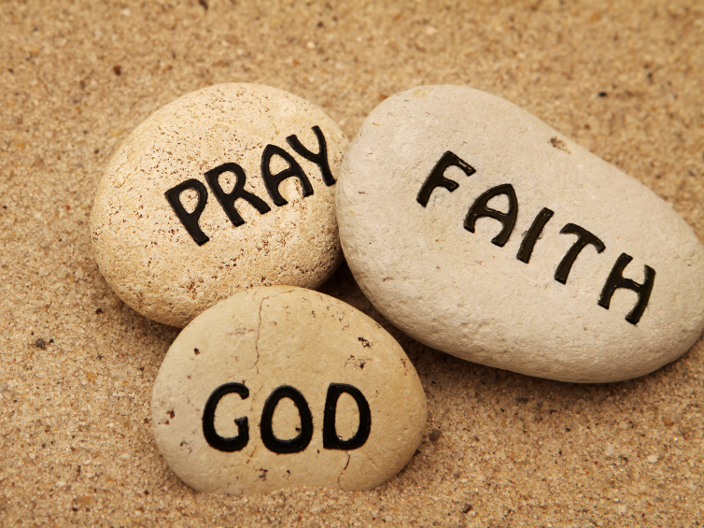
●
●
●
●
●
●
my rock
my rock
my rock
He only is my rock and my salvation; He is my defense; I shall not be moved. In God is my salvation and my glory; The rock of my strength, And my refuge, is in God — Psalms 62:6-7
He only is my rock and my salvation; He is my defense; I shall not be moved. In God is my salvation and my glory; The rock of my strength, And my refuge, is in God — Psalms 62:6-7
my
my salvation
my defense
my salvation
my defense
my salvation
my defense
my
my
my salvation
my glory
my salvation
my glory
my salvation
my glory
my
my
my strength
my strength
my strength
my
my refuge
my refuge
in
my refuge
in
my
MY
Notes:
No helper is greater than the creator of all. Where we place our confidence is what defines the rock we worship.

Slide 17
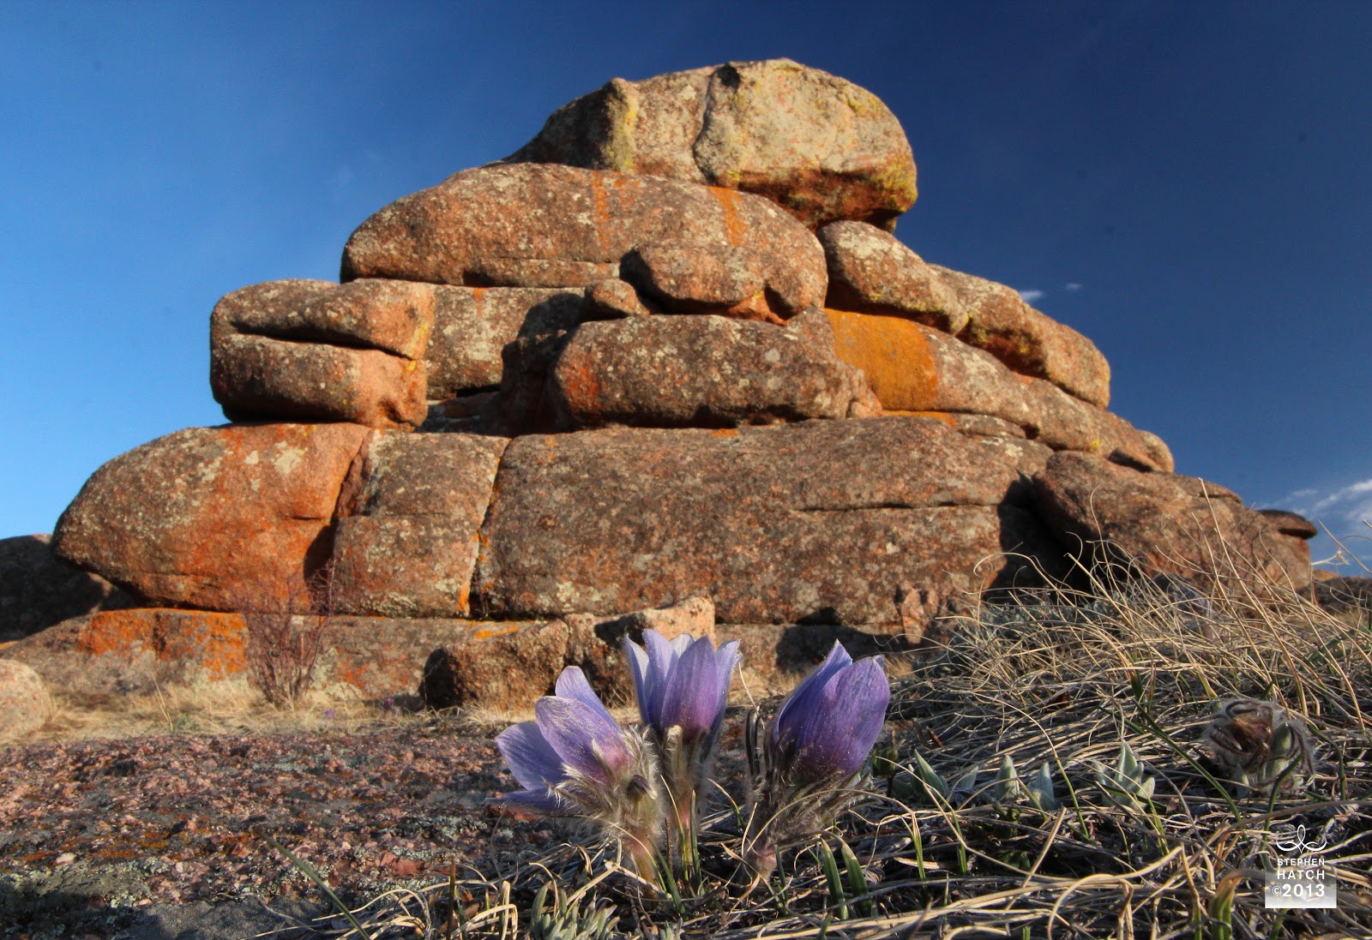
Oh come, let us sing to the LORD! Let us shout joyfully to the Rock of our salvation. — Psalm 95:1
Oh come, let us sing to the LORD! Let us shout joyfully to the Rock of our salvation. — Psalm 95:1
Rock of our salvation
Rock of our salvation
Notes:
Is not salvation where life lives? In Him we live resoundingly!

Slide 18
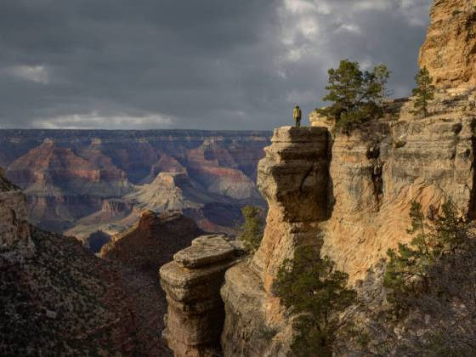
For in the time of trouble He shall hide me in His pavilion; In the secret place of His tabernacle He shall hide me; He shall set me high upon a rock. — Psalm 27:5
Psychic Protection
For in the time of trouble He shall hide me in His pavilion; In the secret place of His tabernacle He shall hide me; He shall set me high upon a rock. — Psalm 27:5
in
inside
His pavilion
His pavilion
s
His tabernacle
His tabernacle
He shall
ide
He shall
He shall
He shall
high upon a rock
Notes:
In the lowest ditch, His hill reaches out, becoming a merciful mountain comforting the meek to sit higher. Earth is but a pebble in the rock of His creation. Fluid are the brushstrokes He paints with time. What He gives us is psychic protection just by knowing He is there.

Slide 19
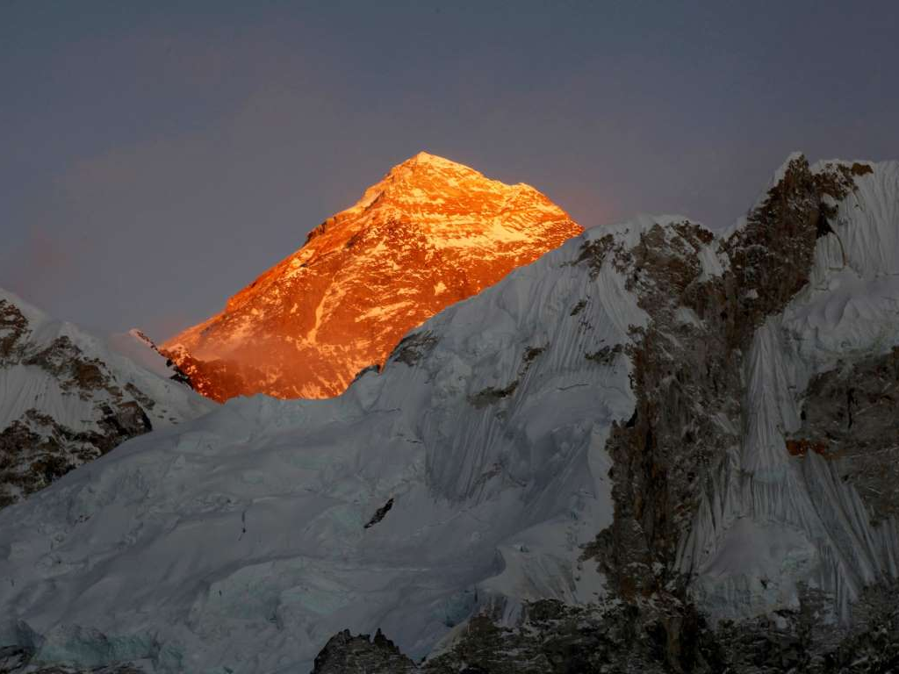
"Can you search out the deep things of God? Can you find out the limits of the Almighty? They are higher than heaven - what can you do? Deeper than Sheol - what can you know? Their measure is longer than the earth And broader than the sea."
— Job 11:7-9
God
limits
limits
higher
Deeper
Notes:
This concept of God as our rock is rhetorical. From the highest to the lowest and all that is in-between, it involves that which is greater than all known, more solidly fundamentally than the simplest of observations. One can not measure God in relation to the material. The creator of mountains, His glory screams in all that we can perceive. Credit needs to be given where it is deserved, and regarding His omnipotence brings the honor He merits. No one can see God for He is all things formed and beyond.

Slide 20
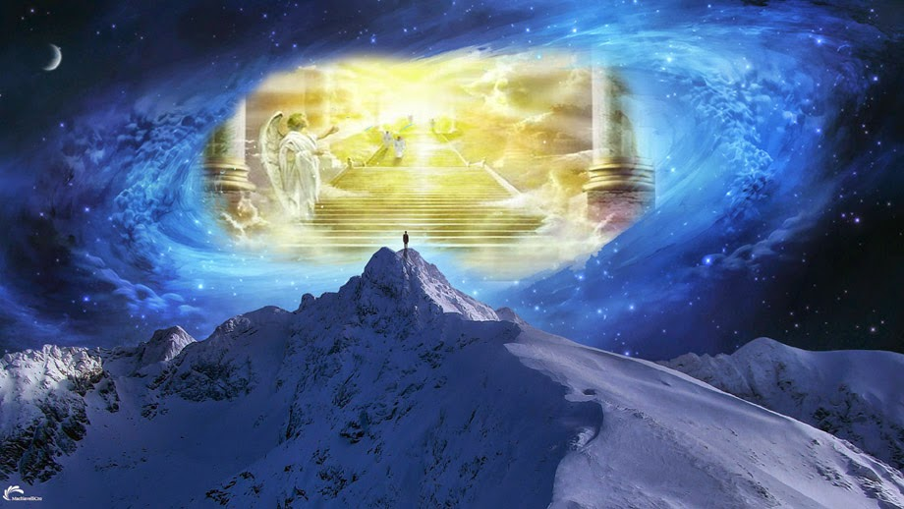
But you have come to Mount Zion and to the city of the living God, the heavenly Jerusalem, to an innumerable company of angels, — Hebrews 12:22
The heavens declare the glory of God; And the firmament shows His handiwork. — Psalm 19:1
come to
come to
God
God
Notes:
God is our destination and our home. When one sees eternal life in the offering of His Grace, no rock of truth is greater. More solid than what we temporarily see in mortal life, eternity opens realms unseen drawing us to something larger than life. Those realizing our brief exposure in His sight are surely humbled for the undeserved gift that will lift us into life in Him. He waits as much as we do and more. Even if we were to stand upon the highest peak or gaze from the utmost view, it would utterly be short of His great heavenly glory, as His staircase opens to eternity’s light.

Slide 21
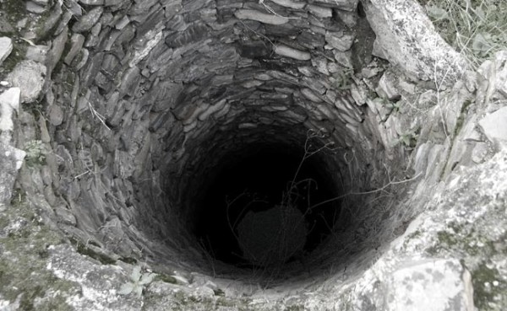
He also brought me up out of a horrible pit, Out of the miry clay, And set my feet upon a rock, And established my steps. — Psalm 40:2
He also brought me up out of a horrible pit, Out of the miry clay, And set my feet upon a rock, And established my steps. — Psalm 40:2
brought me up
brought me up
rock
rock
Notes:
To be right with self, others, and God, one must confer with the majesty of God’s own truths and allow Him to lift you. In life many pits can surround one in struggling to achieve a higher sense of sanctuary. Without God, only a grim descending abyss awaits with no saving handle holds in sight for climbing to a higher spiritual safety.

Slide 22
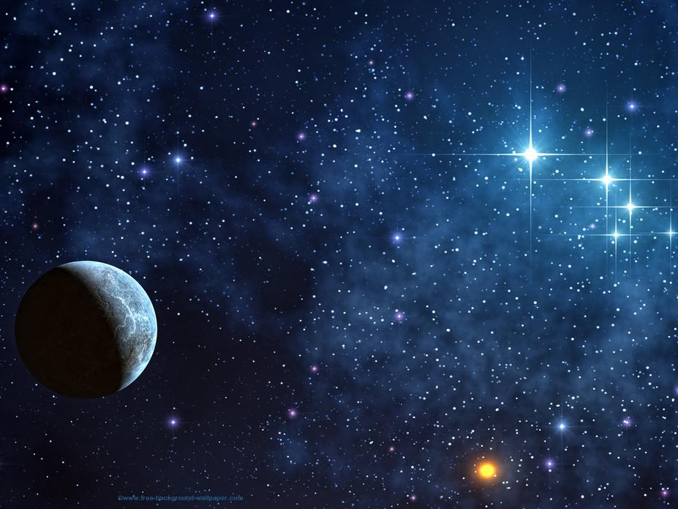
From the end of the earth I will cry to You, When my heart is overwhelmed; Lead me to the rock that is higher than I. — Psalm 61:2
From the end of the earth I will cry to You, When my heart is overwhelmed; Lead me to the rock that is higher than I. — Psalm 61:2
rock
higher than I
. .
Notes:
To reach out endlessly is to find the sure help He gives. As a part of that which is greater, solid quiescent peace connects all that would become. God is the celestial Rock of all.

Slide 23


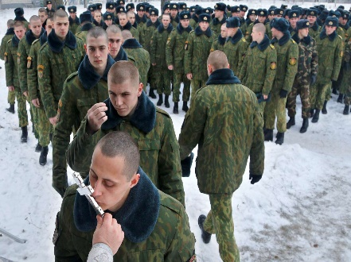



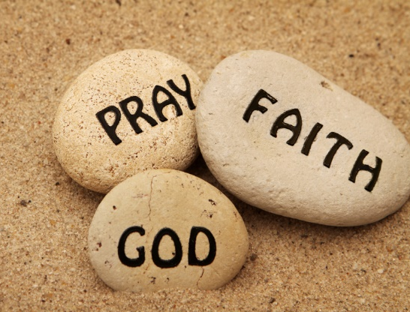



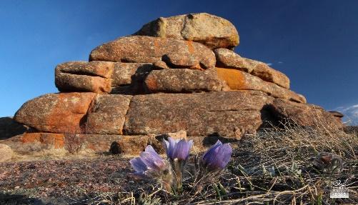



Slide 24
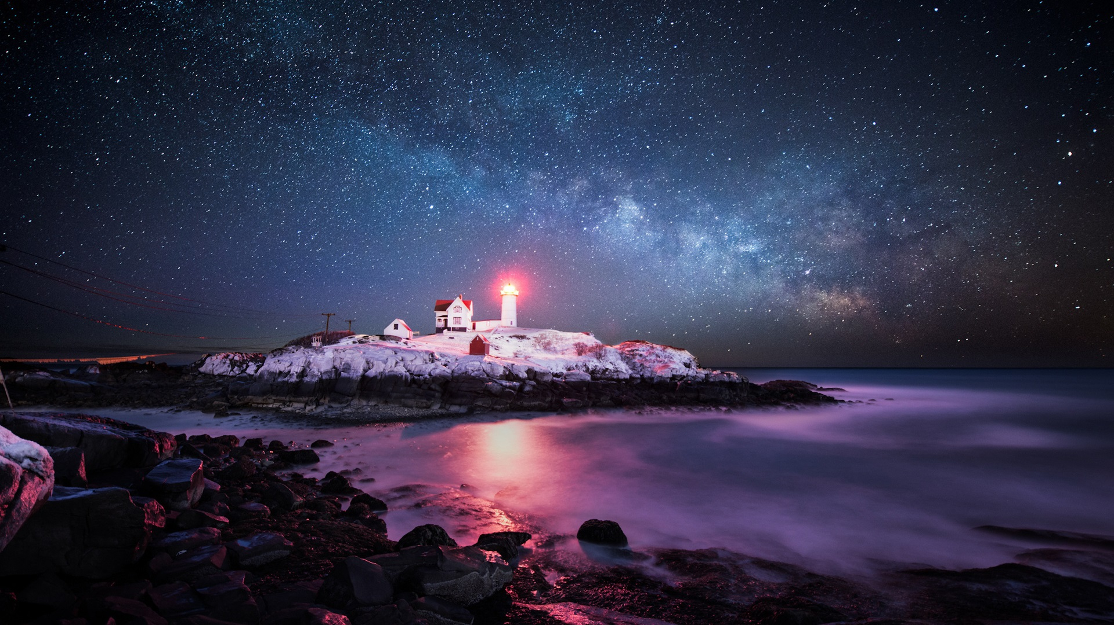
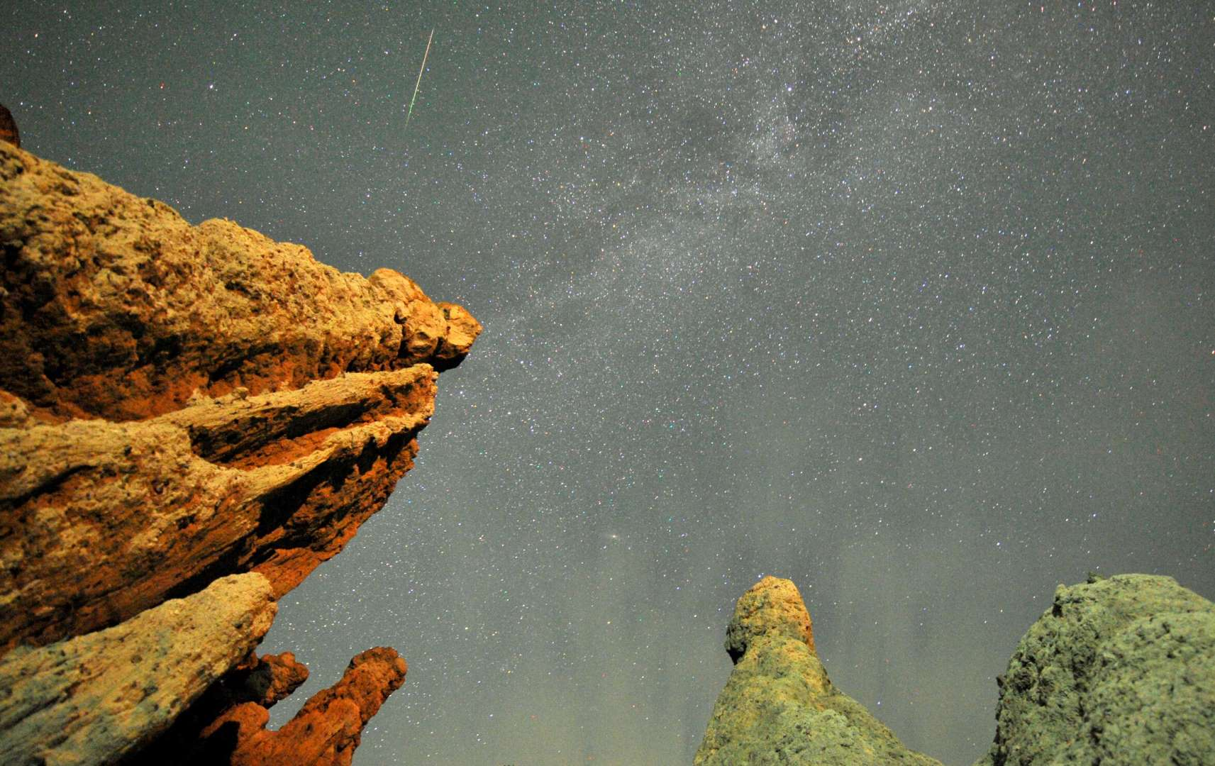
→ God is a Rock of justice, truth; righteous and upright
→ Evil god’s manifest when one forgets and ignores God
→ There is no refuge in creations of one’s own making
→ Man’s makings & lies cannot replace the truth of God
→ Trust in God delivers strength; the refuge of salvation
→ God is the Rock of our defense
→ Submitting to God allows a soul to rise
God’s Truth Rises to Touch All
Notes:
No rock on earth can match the magnitude of God’s majestic glory. God’s truth rises to touch all.
If you have not come to the Lord and His light of truth, life is at best a fading gleam. More than all the earth could ever surrender is His gift rising past all that has ever been to a heavenly realm only imagined where He is the undeniable pulse.

Slide 25
Notes:
Darkness suffers with the bottom of nothing.

Slide 26
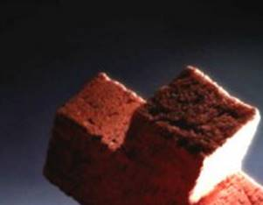
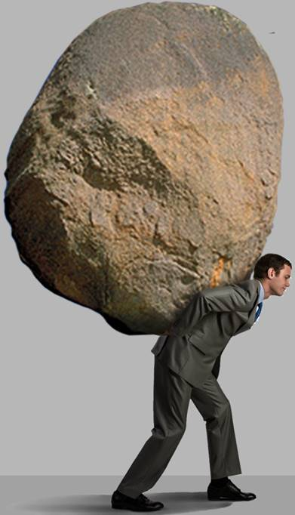
Ron Bert
THE ROCK
THE ROCK
Part 2
August 21, 2016
Notes:
As light cuts truth, appreciation is the ladder that carries a heart. Sometimes the cross we carry feels like a crushing boulder upon our backs.

Slide 27
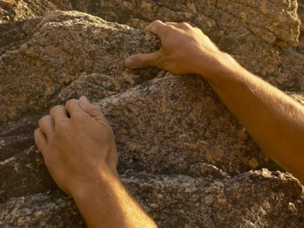
Notes:
No one can deny that mortal life is like climbing a cliff to reach a better view. The question is what is it we are climbing for?

Slide 28
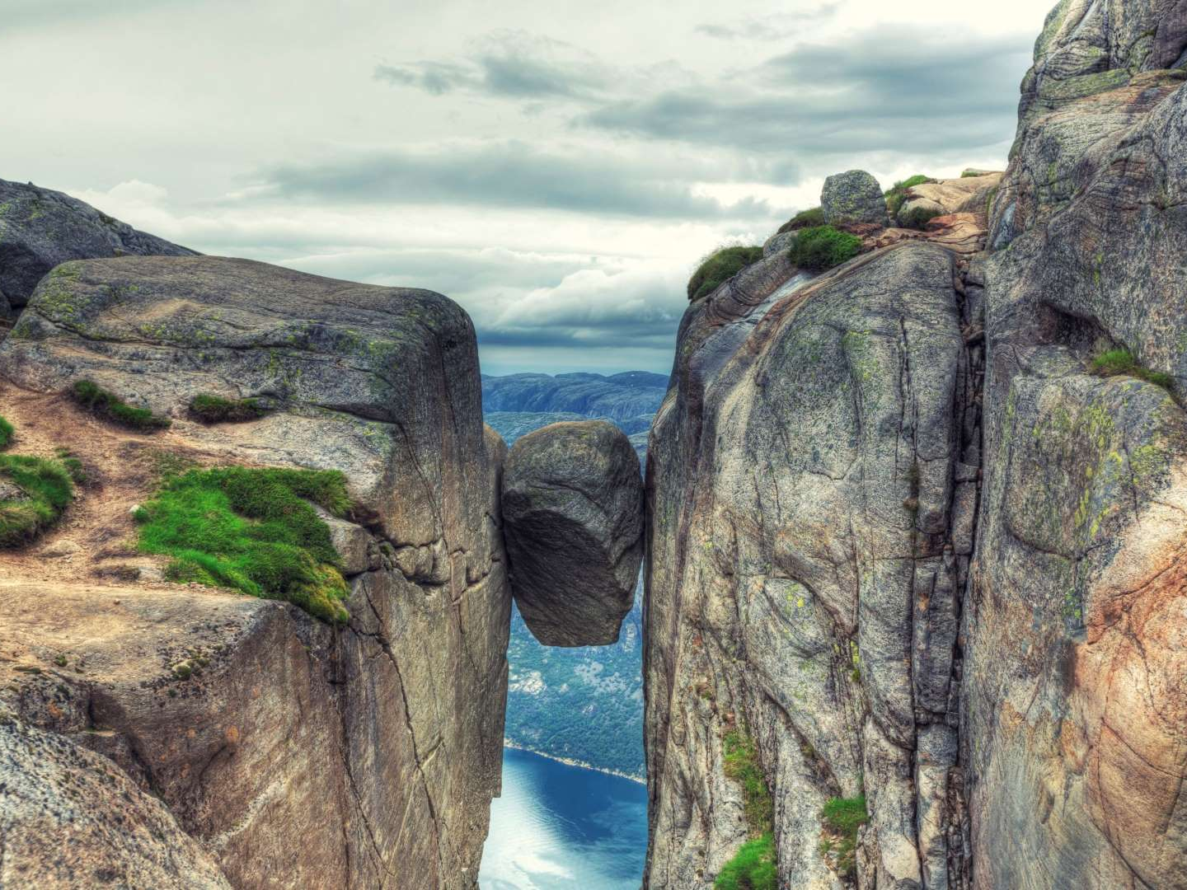
Notes:
Many become stuck for one reason or another paralyzing their ability to act. They remain stationary waiting for time to take its course with no real influence over the outcome. Stuck between mortal crushing powers greater than one is able to overcome, relying upon the Lord extracts one from this limited stifling grip of human bondage. His is a call to rise.

Slide 29
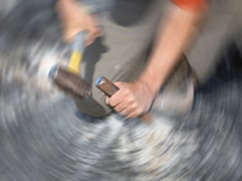
"But why do you call Me 'Lord, Lord,' and do not do the things which I say? Whoever comes to Me, and hears My sayings and does them, I will show you whom he is like: He is like a man building a house, who dug deep and laid the foundation on the rock. And when the flood arose, the stream beat vehemently against that house, and could not shake it, for it was founded on the rock." — Luke 6:46-48
Whoever comes to Me
hears
Whoever comes to Me
hears
does them
Rock
founded
founded
Sand
Notes:
It is a choice not to be left just hanging waiting for circumstance to decide one’s destiny. Only for those that chisel out a deep foundation of spirit planted in a contemplative soul endure the inevitable conflicts that invade the lives of all. The faithful have the confidence of God.

Slide 30
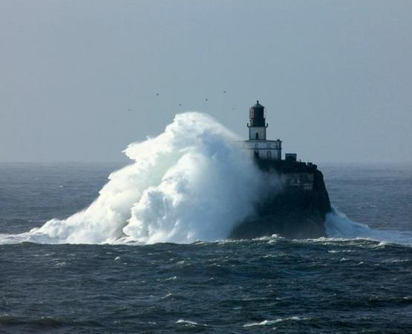
"Therefore whoever hears these sayings of Mine, and does them, I will liken him to a wise man who built his house on the rock: and the rain descended, the floods came, and the winds blew and beat on that house; and it did not fall, for it was founded on the rock." — Matthew 7:24-25
"Therefore whoever hears these sayings of Mine, and does them, I will liken him to a wise man who built his house on the rock: and the rain descended, the floods came, and the winds blew and beat on that house; and it did not fall, for it was founded on the rock." — Matthew 7:24-25
. .
wise man
rock
founded
rock
Notes:
The storms will arise and remain catastrophic for those unprepared. Without the words of God, the heart is left dry to be washed away.

Slide 31
GOD
GOD
Rock
Rock

Slide 32

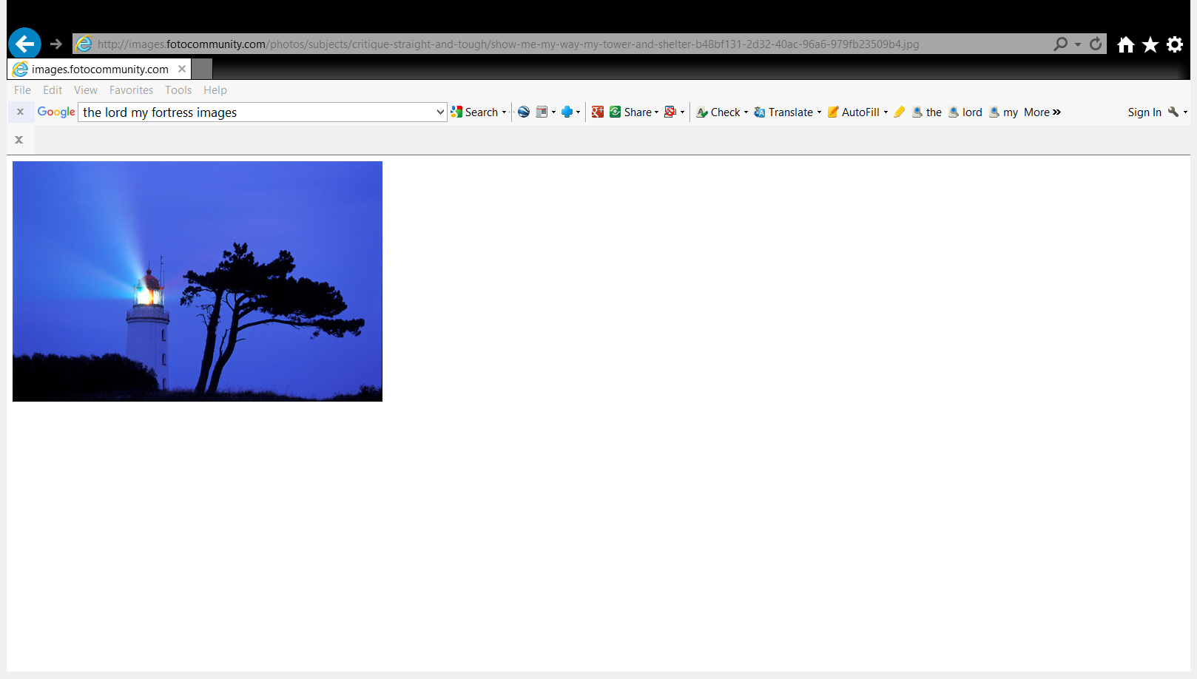
Do not fear, nor be afraid; Have I not told you from that time, and declared it? You are My witnesses. Is there a GOD besides Me? Indeed there is no other Rock; I know not one.'" — Isaiah 44:8
Do not fear, nor be afraid; Have I not told you from that time, and declared it? You are My witnesses. Is there a GOD besides Me? Indeed there is no other Rock; I know not one.'" — Isaiah 44:8
Do not fear
Do not fear
witnesses
You are My witnesses
You are My witnesses
GOD
GOD
no other Rock
Rock
Notes:
The light of God has never abandoned us in that it remains for all to see. He is and we choose to see or not to see the glory of all. There is one light that leads all.

Slide 33
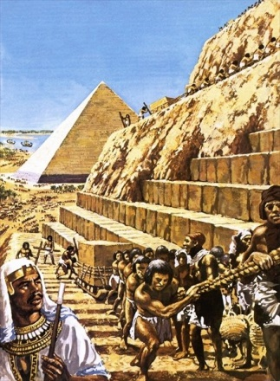
"Listen to Me, you who follow after righteousness, You who seek the LORD: Look to the rock from which you were hewn, And to the hole of the pit from which you were dug." — Isaiah 51:1
"Listen to Me, you who follow after righteousness, You who seek the LORD: Look to the rock from which you were hewn, And to the hole of the pit from which you were dug." — Isaiah 51:1
Listen to Me
Listen to Me
Listen to Me
Look to the rock from
Look to the rock from
Remember
which you were hewn
which you were hewn
Suffering
Notes:
Suffering unjust lies is the root of all of our becoming's. As we rise to know awareness, He asks we consider the source of life, and from there we can realize all that is higher than self. It is when His ways are dismissed that oppression by the few reduces life to that of hardship without mercy.
What God is telling us is to listen and remember that suffering is what He is saving us from.

Slide 34

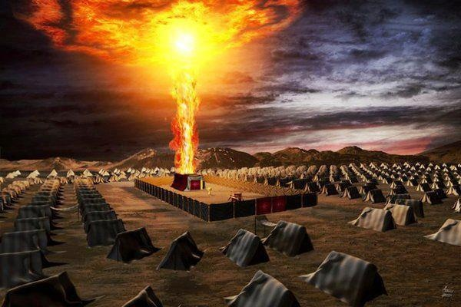
"And You divided the sea before them, So that they went through the midst of the sea on the dry land; And their persecutors You threw into the deep, As a stone into the mighty waters. Moreover You led them by day with a cloudy pillar, And by night with a pillar of fire, To give them light on the road Which they should travel. You came down also on Mount Sinai, And spoke with them from heaven, And gave them just ordinances and true laws, Good statutes and commandments." — Nehemiah 9:11-13
"And You divided the sea before them, So that they went through the midst of the sea on the dry land; And their persecutors You threw into the deep, As a stone into the mighty waters. Moreover You led them by day with a cloudy pillar, And by night with a pillar of fire, To give them light on the road Which they should travel. You came down also on Mount Sinai, And spoke with them from heaven, And gave them just ordinances and true laws, Good statutes and commandments." — Nehemiah 9:11-13
You led them
You led them
Rock
light on the road
just ordinances and true laws
just ordinances and true laws
Notes:
God has spoken timeless times to multitudes of people. His ark is the tabernacle of life in the light. His knowledge is abundantly sufficient to decide, either for His ways, or the dead end terminal ways of man’s despicable decadent constructions. Turning blue is the color of death. So easy is the forgetfulness of man to disregard the rock solid virtues given by God.

Slide 35
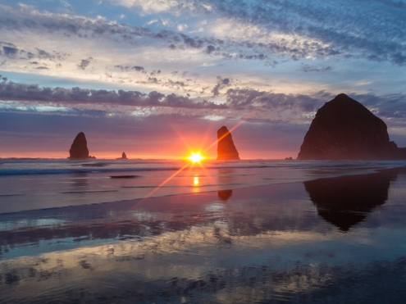
… and all drank the same spiritual drink. For they drank of that spiritual Rock that followed them, and that Rock was Christ. — 1st Corinthians 10:4
… and all drank the same spiritual drink. For they drank of that spiritual Rock that followed them, and that Rock was Christ. — 1st Corinthians 10:4
Rock
Rock
spiritual Rock
spiritual Rock
Rock
Christ
Notes:
The presence of God has never left us. Goodness has been established to be known. It is man that chooses to forget. Christ is God’s flame of spirit.

Slide 36
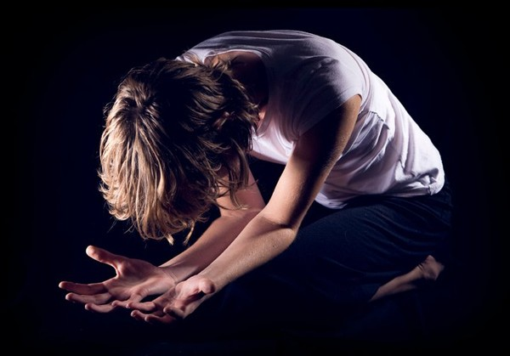
What shall we say then? That Gentiles, who did not pursue righteousness, have attained to righteousness, even the righteousness of faith; but Israel, pursuing the law of righteousness, has not attained to the law of righteousness. — Romans 9:30-31
h
G
le
o
d
u
humble
faith in God
m
faith
b
righteousness of faith
righteousness of faith
in
God
in
Notes:
Anyone can submit to God as He is the only true God. God is that He is. In pursuit of His Spirit of goodness, righteousness is obtained. It is not earned, it is lived.

Slide 37
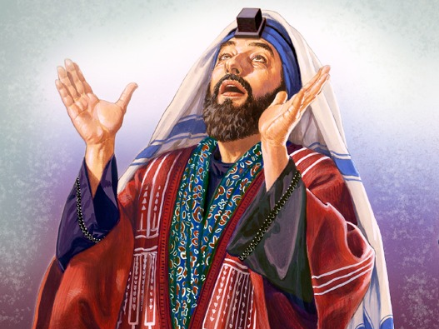
Why? Because they did not seek it by faith, but as it were, by the works of the law. For they stumbled at that stumbling stone. As it is written: "Behold, I lay in Zion a stumbling stone and rock of offense, And whoever believes on Him will not be put to shame." — Romans 9:32-33
d
Why? Because they did not seek it by faith, but as it were, by the works of the law. For they stumbled at that stumbling stone. As it is written: "Behold, I lay in Zion a stumbling stone and rock of offense, And whoever believes on Him will not be put to shame." — Romans 9:32-33
f
u
seek it by faith
seek it by faith
proud
believes in self
proud
believes in self
r
o
l
by the works
by the works
in
As it is written: "Behold, I lay in Zion a stumbling stone and rock of offense, And whoever believes on Him will not be put to shame." — Romans 9:32-33
As it is written: "Behold, I lay in Zion a stumbling stone and rock of offense, And whoever believes on Him will not be put to shame." — Romans 9:32-33
se
believes
believes
believes
p
not be put to shame
Christ
not be put to shame
Notes:
For all that see themselves only as great and accomplished fail to see the need for redemption from the darkness, from the corridors of all of our shameful hearts. Many claim to have no sin while basking in their perceived splendor discounting His mightier glory. It is not man that approves man, but that honor is reserved for God’s discretion.

Slide 38
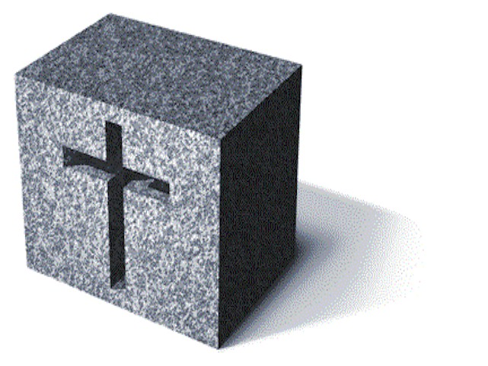
Therefore thus says the Lord GOD: "Behold, I lay in Zion a stone for a foundation, A tried stone, a precious cornerstone, a sure foundation; Whoever believes will not act hastily. — Isaiah 28:16
Therefore thus says the Lord GOD: "Behold, I lay in Zion a stone for a foundation, A tried stone, a precious cornerstone, a sure foundation; Whoever believes will not act hastily. — Isaiah 28:16
Whoever believes
Whoever believes
not act hastily
not be put to shame
Christ
Notes:
For this reason Jesus came to call all to be humble in heart to know self through Him and God in life. It is a call to be thoughtful.

Slide 39
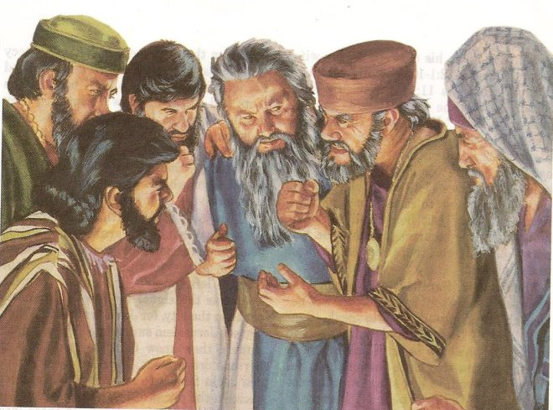
Therefore, to you who believe, He is precious; but to those who are disobedient, "The stone which the builders rejected Has become the chief cornerstone," and "A stone of stumbling And a rock of offense." They stumble, being disobedient to the word, to which they also were appointed. — 1st Peter 2:7-8
Therefore, to you who believe, He is precious; but to those who are disobedient, "The stone which the builders rejected Has become the chief cornerstone," and "A stone of stumbling And a rock of offense." They stumble, being disobedient to the word, to which they also were appointed. — 1st Peter 2:7-8
Therefore, to you who believe, He is precious; but to those who are disobedient, "The stone which the builders rejected Has become the chief cornerstone," and "A stone of stumbling And a rock of offense." They stumble, being disobedient to the word, to which they also were appointed. — 1st Peter 2:7-8
Therefore, to you who believe, He is precious; but to those who are disobedient, "The stone which the builders rejected Has become the chief cornerstone," and "A stone of stumbling And a rock of offense." They stumble, being disobedient to the word, to which they also were appointed. — 1st Peter 2:7-8
precious
Psalm 118:2
precious
Isaiah 8:14
Notes:
For the conniving and schemers, true God is more than an inconvenience, He is an active annoyance to consider in any purposed thoughts, especially concerning accountability. The conscience of the wicked has no mercy, which is one of God’s greatest wills, for man to man, to show compassion for one another.

Slide 40
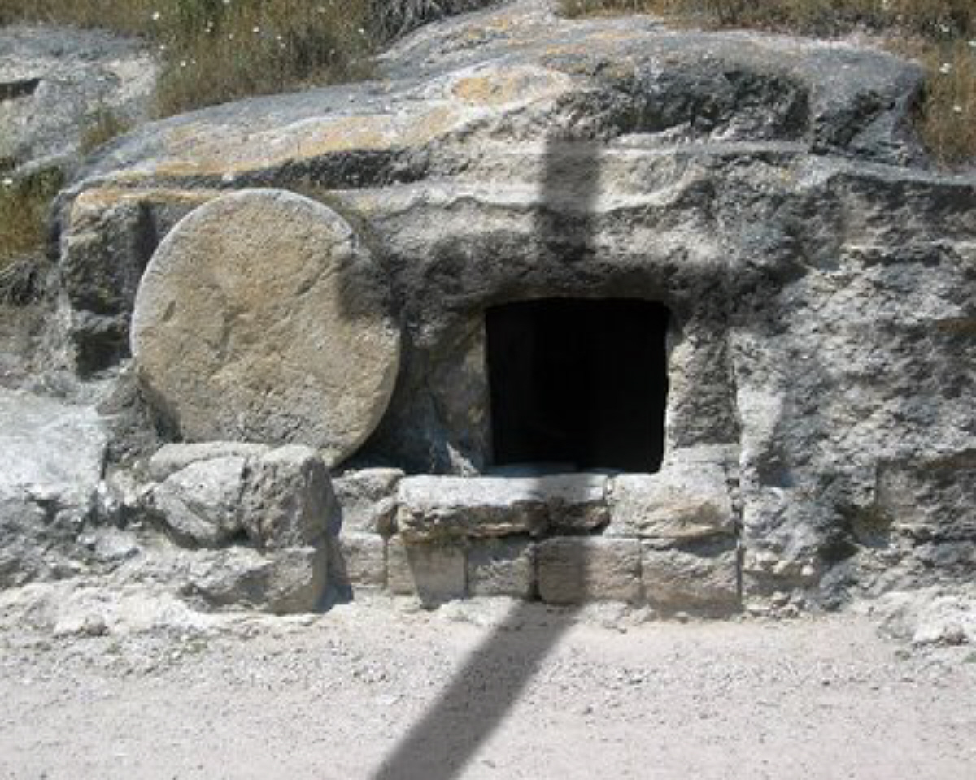
Simon Peter answered and said, "You are the Christ, the Son of the living God." Jesus answered and said to him, "Blessed are you, Simon Bar-Jonah, for flesh and blood has not revealed this to you, but My Father who is in heaven. And I also say to you that you are Peter, and on this rock I will build My church, and the gates of Hades shall not prevail against it." — Matthew 16:16-18
Simon Peter answered and said, "You are the Christ, the Son of the living God." Jesus answered and said to him, "Blessed are you, Simon Bar-Jonah, for flesh and blood has not revealed this to you, but My Father who is in heaven. And I also say to you that you are Peter, and on this rock I will build My church, and the gates of Hades shall not prevail against it." — Matthew 16:16-18
confession
You
are the Christ, the Son of the living God
Jesus
precious
on this rock I will build My church
rock
faith
Notes:
The life of Christ, His crucifixion, and then resurrection, is the rock of truth that shall not go away. It is the expression of God to sacrifice on our behalf, releasing each of us to our own lives, rising to be that we are. Christ builds His church upon Himself calling to individuals over manipulative conglomerates of man that blur His purpose for a relationship with Him over man.

Slide 41
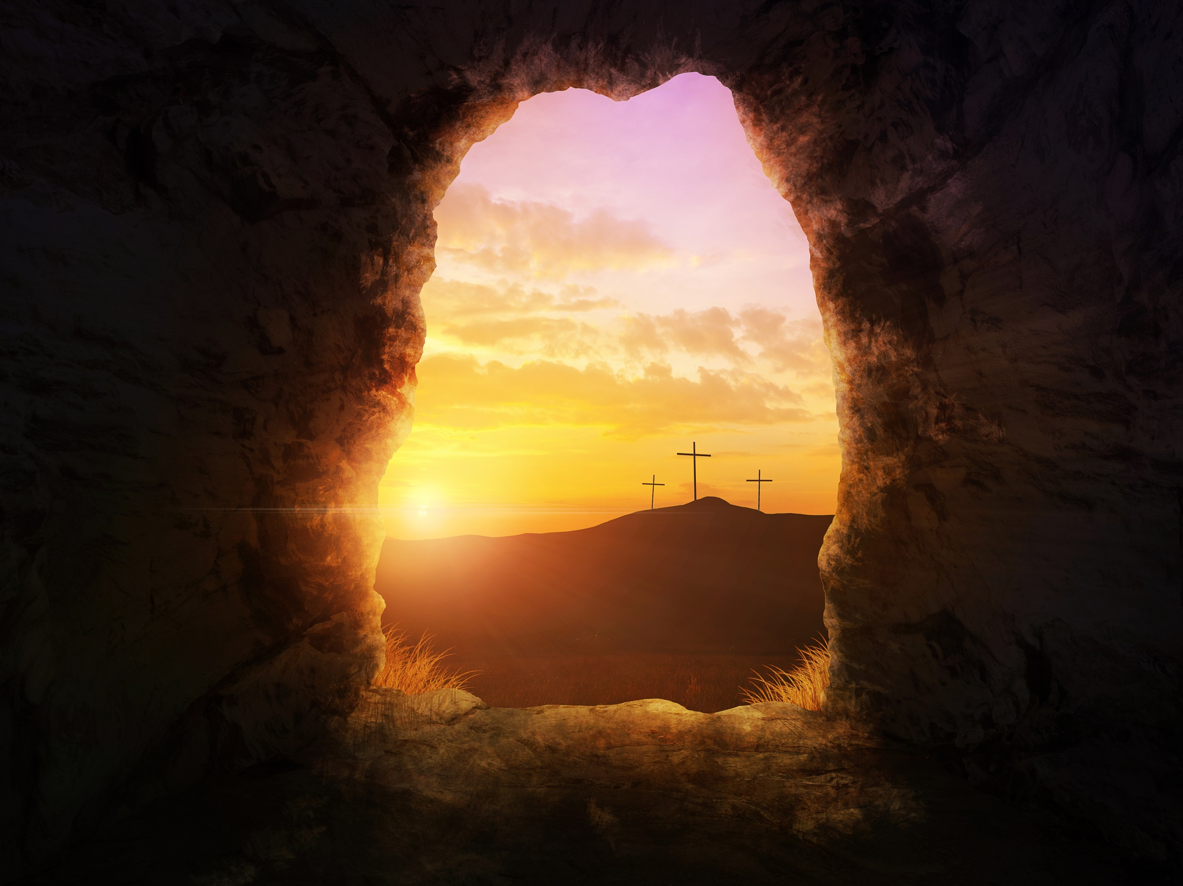
For no other foundation can anyone lay than that which is laid, which is Jesus Christ. — 1st Corinthians 3:11
For no other foundation can anyone lay than that which is laid, which is Jesus Christ. — 1st Corinthians 3:11
Jesus
Notes:
It is in truth the resonance of Jesus Christ that sets the air of life in God. It is not Buddha. It is not Muhammad. It is not Joseph Smith. It is not John Calvin. It is not Pope Doe. It is not called deities of any other exalted colorful names or falsely appointed mavericks. No substitution can replace that which is declared by God Himself, Jesus Christ, in fact, the truth stops here. Each of us will be judged according to how we build our life upon Him and no other comparison has as much value. It has come to be through Him, and not by others, and this is the test of honest godly relationship. Man does not supersede God.

Slide 42
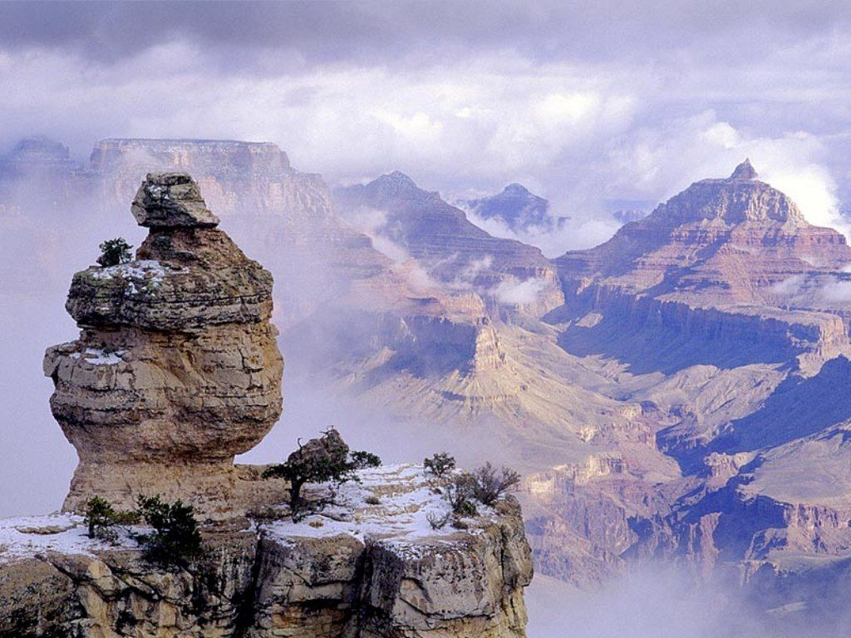
Jesus said to them, "Have you never read in the Scriptures: 'The stone which the builders rejected Has become the chief cornerstone. This was the LORD'S doing, And it is marvelous in our eyes'? Therefore I say to you, the kingdom of God will be taken from you and given to a nation bearing the fruits of it. And whoever falls on this stone will be broken; but on whomever it falls, it will grind him to powder." — Matthew 21:42-44
Jesus
the LORD'S doing
the LORD’S doing
humbled
will be broken
come
whomever it falls
judgment
reject
Notes:
To find God in truth humbles the soul in it’s exaltation of Him. Rising in His light of truth, over those that would prefer other made-up exits leading to the dust of destruction, proclaims the destiny of a soul.

Slide 43
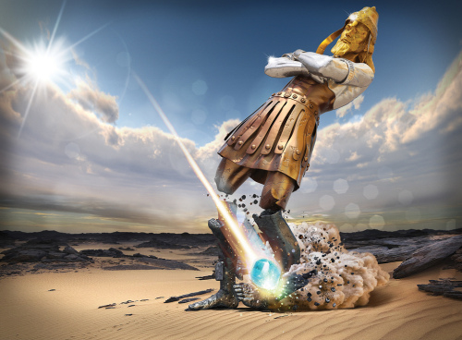
"You watched while a stone was cut out without hands, which struck the image on its feet of iron and clay, and broke them in pieces. "Then the iron, the clay, the bronze, the silver, and the gold were crushed together, and became like chaff from the summer threshing floors; the wind carried them away so that no trace of them was found. And the stone that struck the image became a great mountain and filled the whole earth. — Daniel 2:34-35
the stone
the stone
filled the whole earth
filled the whole earth
Notes:
It was foretold that God’s own kingdom, overtaking men and their ways, would be established, remaining supreme to the ends of the ages. He is the Rock of our salvation. All paths lead to God.

Slide 44
"And in the days of these kings the God of heaven will set up a kingdom which shall never be destroyed; and the kingdom shall not be left to other people; it shall break in pieces and consume all these kingdoms, and it shall stand forever." — Daniel 2:44
God
set up a
kingdom
to
God
set up a kingdom
to stand forever
stand
forever
Notes:
It was foretold that God’s own kingdom, overtaking men and their ways, would be established, remaining supreme to the ends of the ages. He is the Rock of our salvation. All paths lead to God.

Slide 45
"Inasmuch as you saw that the stone was cut out of the mountain without hands, and that it broke in pieces the iron, the bronze, the clay, the silver, and the gold-the great God has made known to the king what will come to pass after this. The dream is certain, and its interpretation is sure." — Daniel 2:45
God has made known
what will come to pass
Notes:
It was foretold that God’s own kingdom, overtaking men and their ways, would be established, remaining supreme to the ends of the ages. He is the Rock of our salvation. All paths lead to God.

Slide 46

O LORD, are not Your eyes on the truth? You have stricken them, But they have not grieved; You have consumed them, But they have refused to receive correction. They have made their faces harder than rock; They have refused to return. — Jeremiah 5:3
O LORD, are not Your eyes on the truth? You have stricken them, But they have not grieved; You have consumed them, But they have refused to receive correction. They have made their faces harder than rock; They have refused to return. — Jeremiah 5:3
ea
d
stone
not grieved
repentance
His heart is as hard as stone, Even as hard as the lower millstone. — Job 41:24
His heart is as hard as stone, Even as hard as the lower millstone. — Job 41:24
dead stone
d
refused
to receive
refused
hard
refused
refused
to return
Notes:
Many have fallen bitter hearted with an angry fist raised against God. More than a cold stone, God asks us to become softly alive in Him. If one only becomes dead to feeling love, choosing rage for others, their death walks with them.

Slide 47
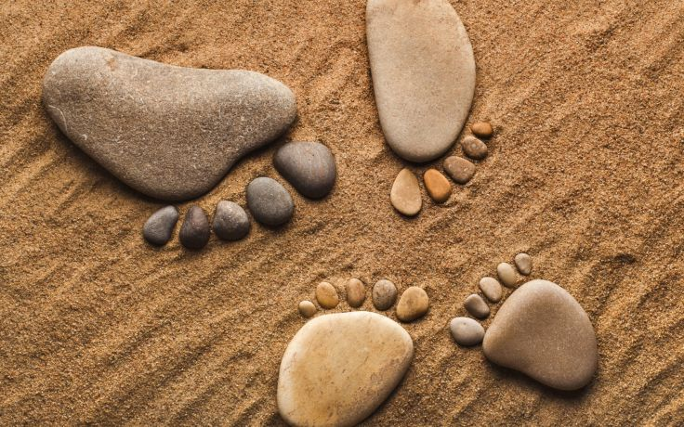
Coming to Him as to a living stone, rejected indeed by men, but chosen by God and precious, you also, as living stones, are being built up a spiritual house, a holy priesthood, to offer up spiritual sacrifices acceptable to God through Jesus Christ. — 1st Peter 2:4-5
stone
Coming to Him as to a living stone, rejected indeed by men, but chosen by God and precious, you also, as living stones, are being built up a spiritual house, a holy priesthood, to offer up spiritual sacrifices acceptable to God through Jesus Christ. — 1st Peter 2:4-5
Coming to Him
Him
Coming to Him
living stone
stone
spiritual sacrifices
spiritual sacrifices
Notes:
His Rock is our rock. What declares our rock is the walk we choose in life. To refuse the light He offers dulls the spirit and turns the heart dark.

Slide 48

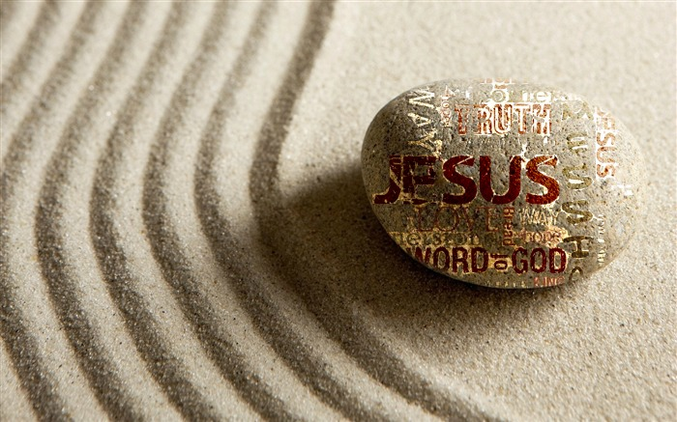

"He who has an ear, let him hear what the Spirit says to the churches. To him who overcomes I will give some of the hidden manna to eat. And I will give him a white stone, and on the stone a new name written which no one knows except him who receives it."' — Revelation 2:17
"He who has an ear, let him hear what the Spirit says to the churches. To him who overcomes I will give some of the hidden manna to eat. And I will give him a white stone, and on the stone a new name written which no one knows except him who receives it."' — Revelation 2:17
who overcomes
white
white
stone
stone
stone
a
a
new
new
name
name
identity
Notes:
To be chosen exposes strength of character in Him over hostile creations of man. We wait for His revealing and our becoming. It is eternal identity that God offers each penitent soul that comes to Him.

Slide 49
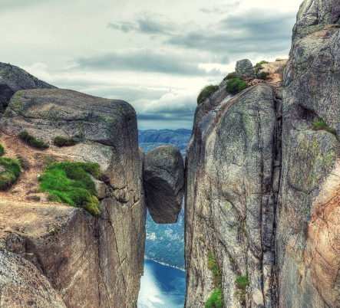


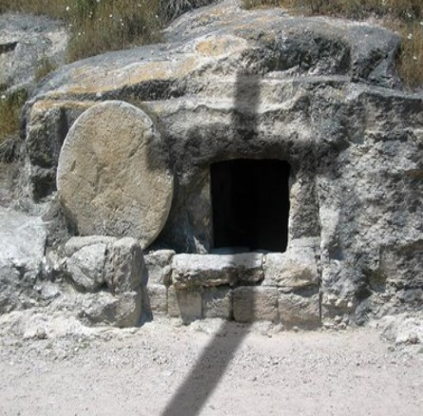



a
new
name

Slide 50
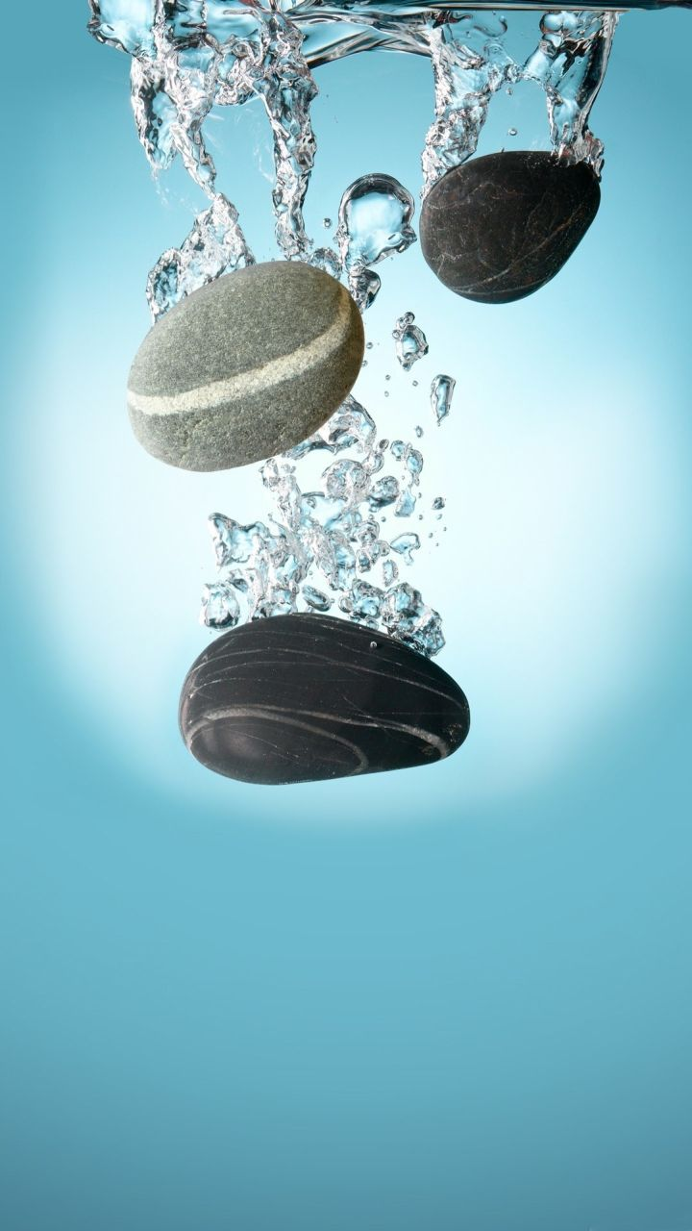

→ God is a Rock of justice, truth; righteous and upright
→ Evil god’s manifest when one forgets and ignores God
→ There is no refuge in creations of one’s own making
→ Man’s makings & lies cannot replace the truth of God
→ Trust in God delivers strength; the refuge of salvation
→ God is the Rock of our defense
→ It is a mighty spiritual Rock found in Jesus Christ
→ Faith and belief in God leads to this righteous Rock
→ The truth of Jesus Christ is the Rock of His church
→ Jesus Christ is the only foundation set by God
→ Christ is the cornerstone of God’s church on earth
→ No society of man is greater than the Rock of God
→ As living stones we offer holy sacrifice in His image
Our Rock is a True Relationship in God
a
new
name
Notes:
No religion can replace true relationship in God.
It is a call to the soul for the spirit to come.
It is a call to the soul for the spirit to come.

Slide 51
Notes:
Darkness has no visible path.

Slide 52

Please visit http://www.RonBert.com to explore further
Ronald Bert Channel on
Notes:
Eternity never ends.

Slide 53

















Slide 54




