Slide 1
Notes:
Darkness rides on the heels of nowhere.

Slide 2
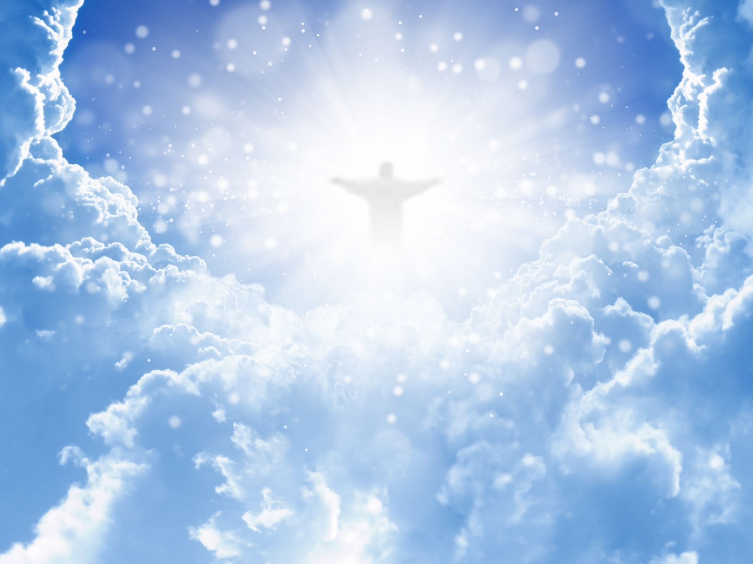
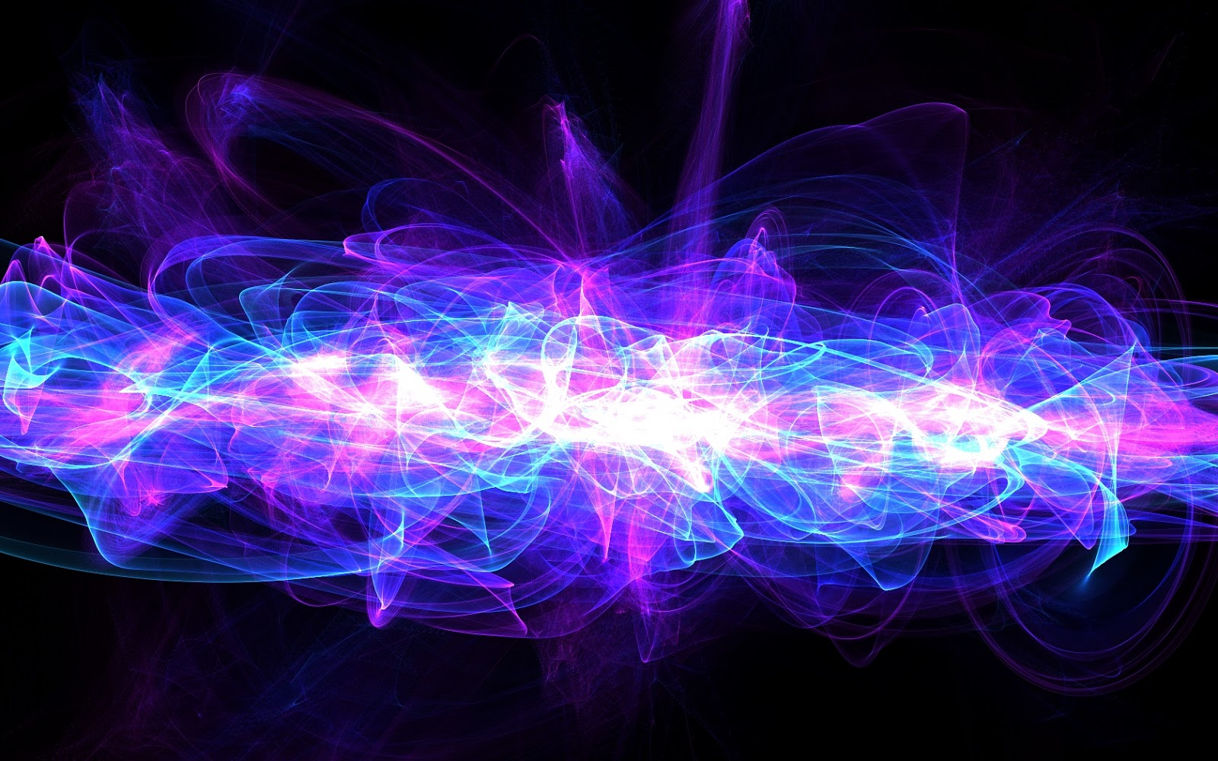
THE FAITH
Ron Bert
May 21, 2017
Notes:
Faith is the essence of what one believes.

Slide 3


There is one body and one Spirit, just as you were called in one hope of your calling; one Lord, one faith, one baptism; one God and Father of all, who is above all, and through all, and in you all. — Ephesians 4:4-6
one
● one body
● one Spirit
● one hope of your calling
● one Lord
● one faith
● one baptism
● one God and Father of all
→ above all
→ through all
→ in you all
one
one body
one Spirit
one body
church
one body
one
God’s
Declaration
in
one
one
one
hope of your calling
one Lord
hope
one
one faith
one faith
one baptism
one God
one faith
one
and Father of all
above all
one
all
through all
in
in you all
you all
all
all
all
Notes:
It is God that declares what is and what He has devised as His saving Grace. Man cannot change what God has ordained.

Slide 4
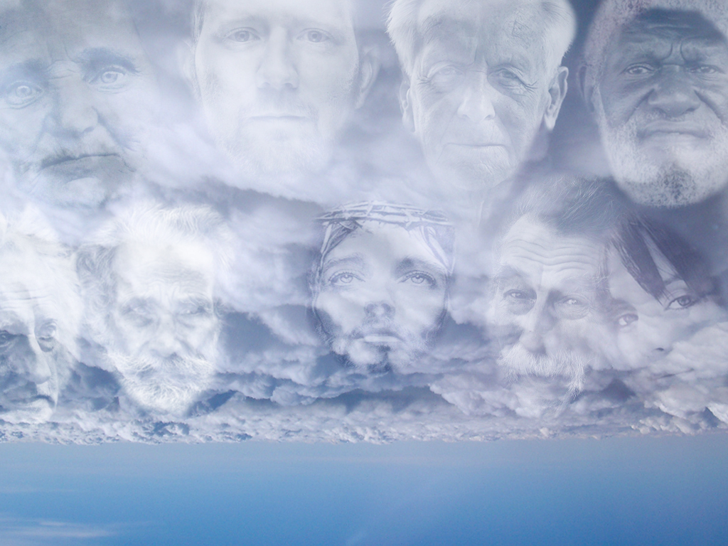
Therefore we also, since we are surrounded by so great a cloud of witnesses, let us lay aside every weight, and the sin which so easily ensnares us, and let us run with endurance the race that is set before us, … — Hebrews 12:1
Notes:
God calls all to cease from sin and lead a life in His ways of righteousness. This is not condemning arrogance rather a humble noticing. Too many claim to know more than God has proclaimed. They refuse to look to Him more interested in their own.

Slide 5
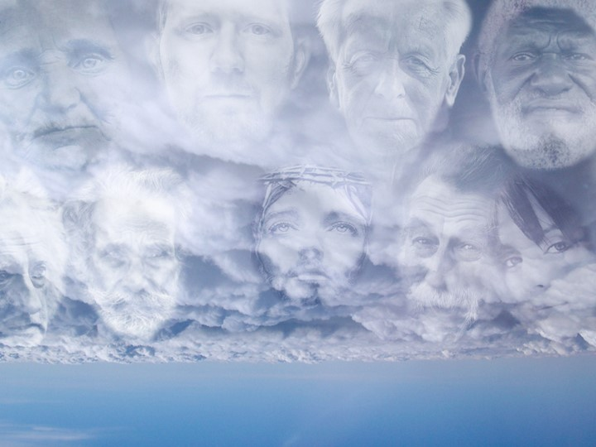
Therefore we also, since we are surrounded by so great a cloud of witnesses, let us lay aside every weight, and the sin which so easily ensnares us, and let us run with endurance the race that is set before us, … — Hebrews 12:1
control
lay aside
. .
sin
STEADFAST
race
endurance
race
endurance
faith
Notes:
God calls all to cease from sin and lead a life in His ways of righteousness. This is not condemning arrogance rather a humble noticing. Too many claim to know more than God has proclaimed. They refuse to look to Him more interested in their own.

Slide 6
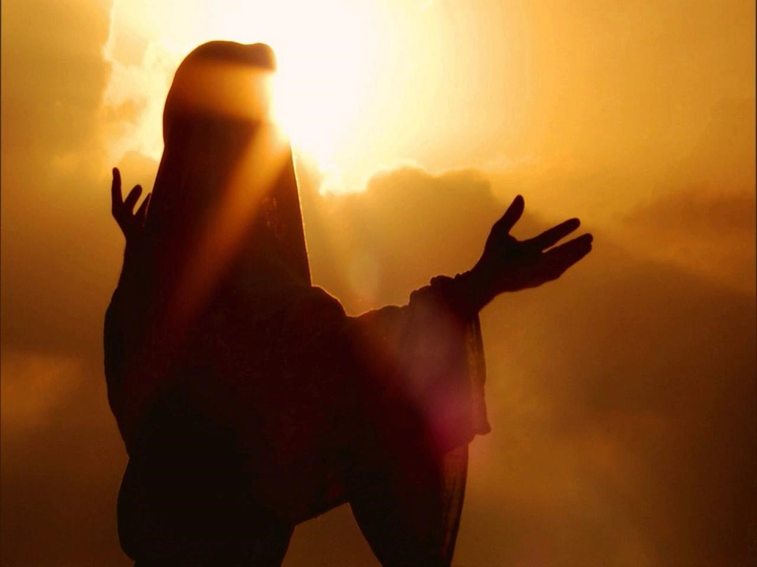

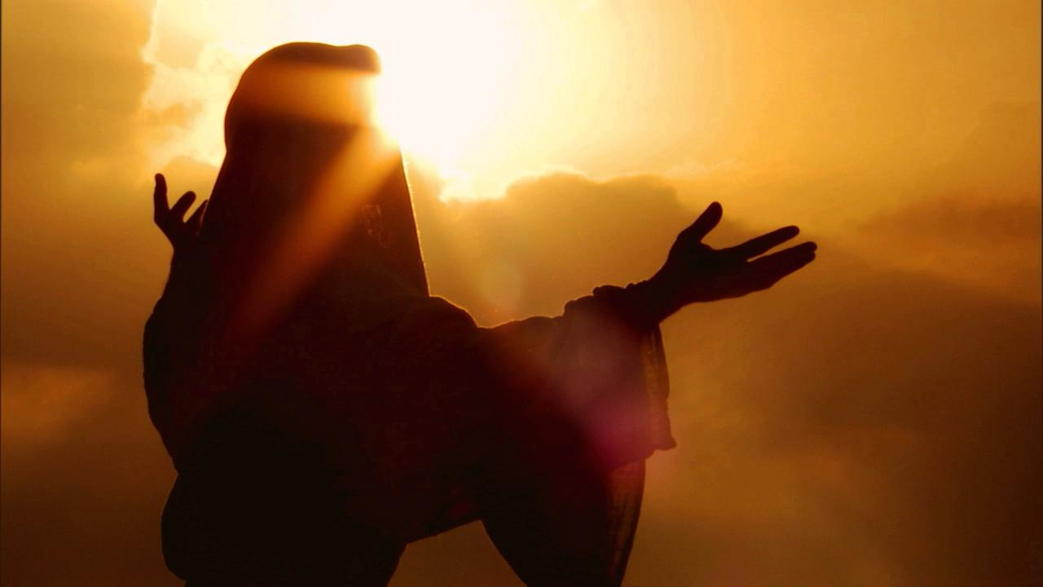
... looking unto Jesus, the author and finisher of our faith, who for the joy that was set before Him endured the cross, despising the shame, and has sat down at the right hand of the throne of God. For consider Him who endured such hostility from sinners against Himself, lest you become weary and discouraged in your souls. — Hebrews 12: 2-3
Jesus the author
. .
faith
our faith
endure
endured
shame
endured
hostility
endured
endure
endured
against Himself
Notes:
He has devised it so as to have a most personal relationship in the faith, and He has constructed it. Faith is an individual connection to what He has brought in the truth of His righteousness. This endurance comes from the gut of each who bears with it delivered from above.

Slide 7
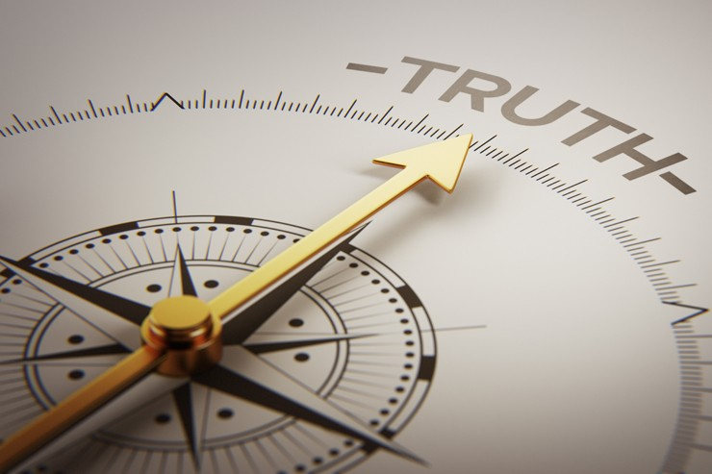
Here is the patience of the saints; here are those who keep the commandments of God and the faith of Jesus. — Revelation 14:12
patience
of the saints
keep the commandments
of God + the faith of Jesus
patience
of the
saints
=
+
keep
faith
keep
keep
the
obedient to the faith
+
the commandments
of God
the
commandments of God
commandments of God
faith
faith
faith
faith
the faith of Jesus
Notes:
The truth cannot be changed to fit the whims of man. His truth has been written for each heart to reach out in quest of Him.

Slide 8
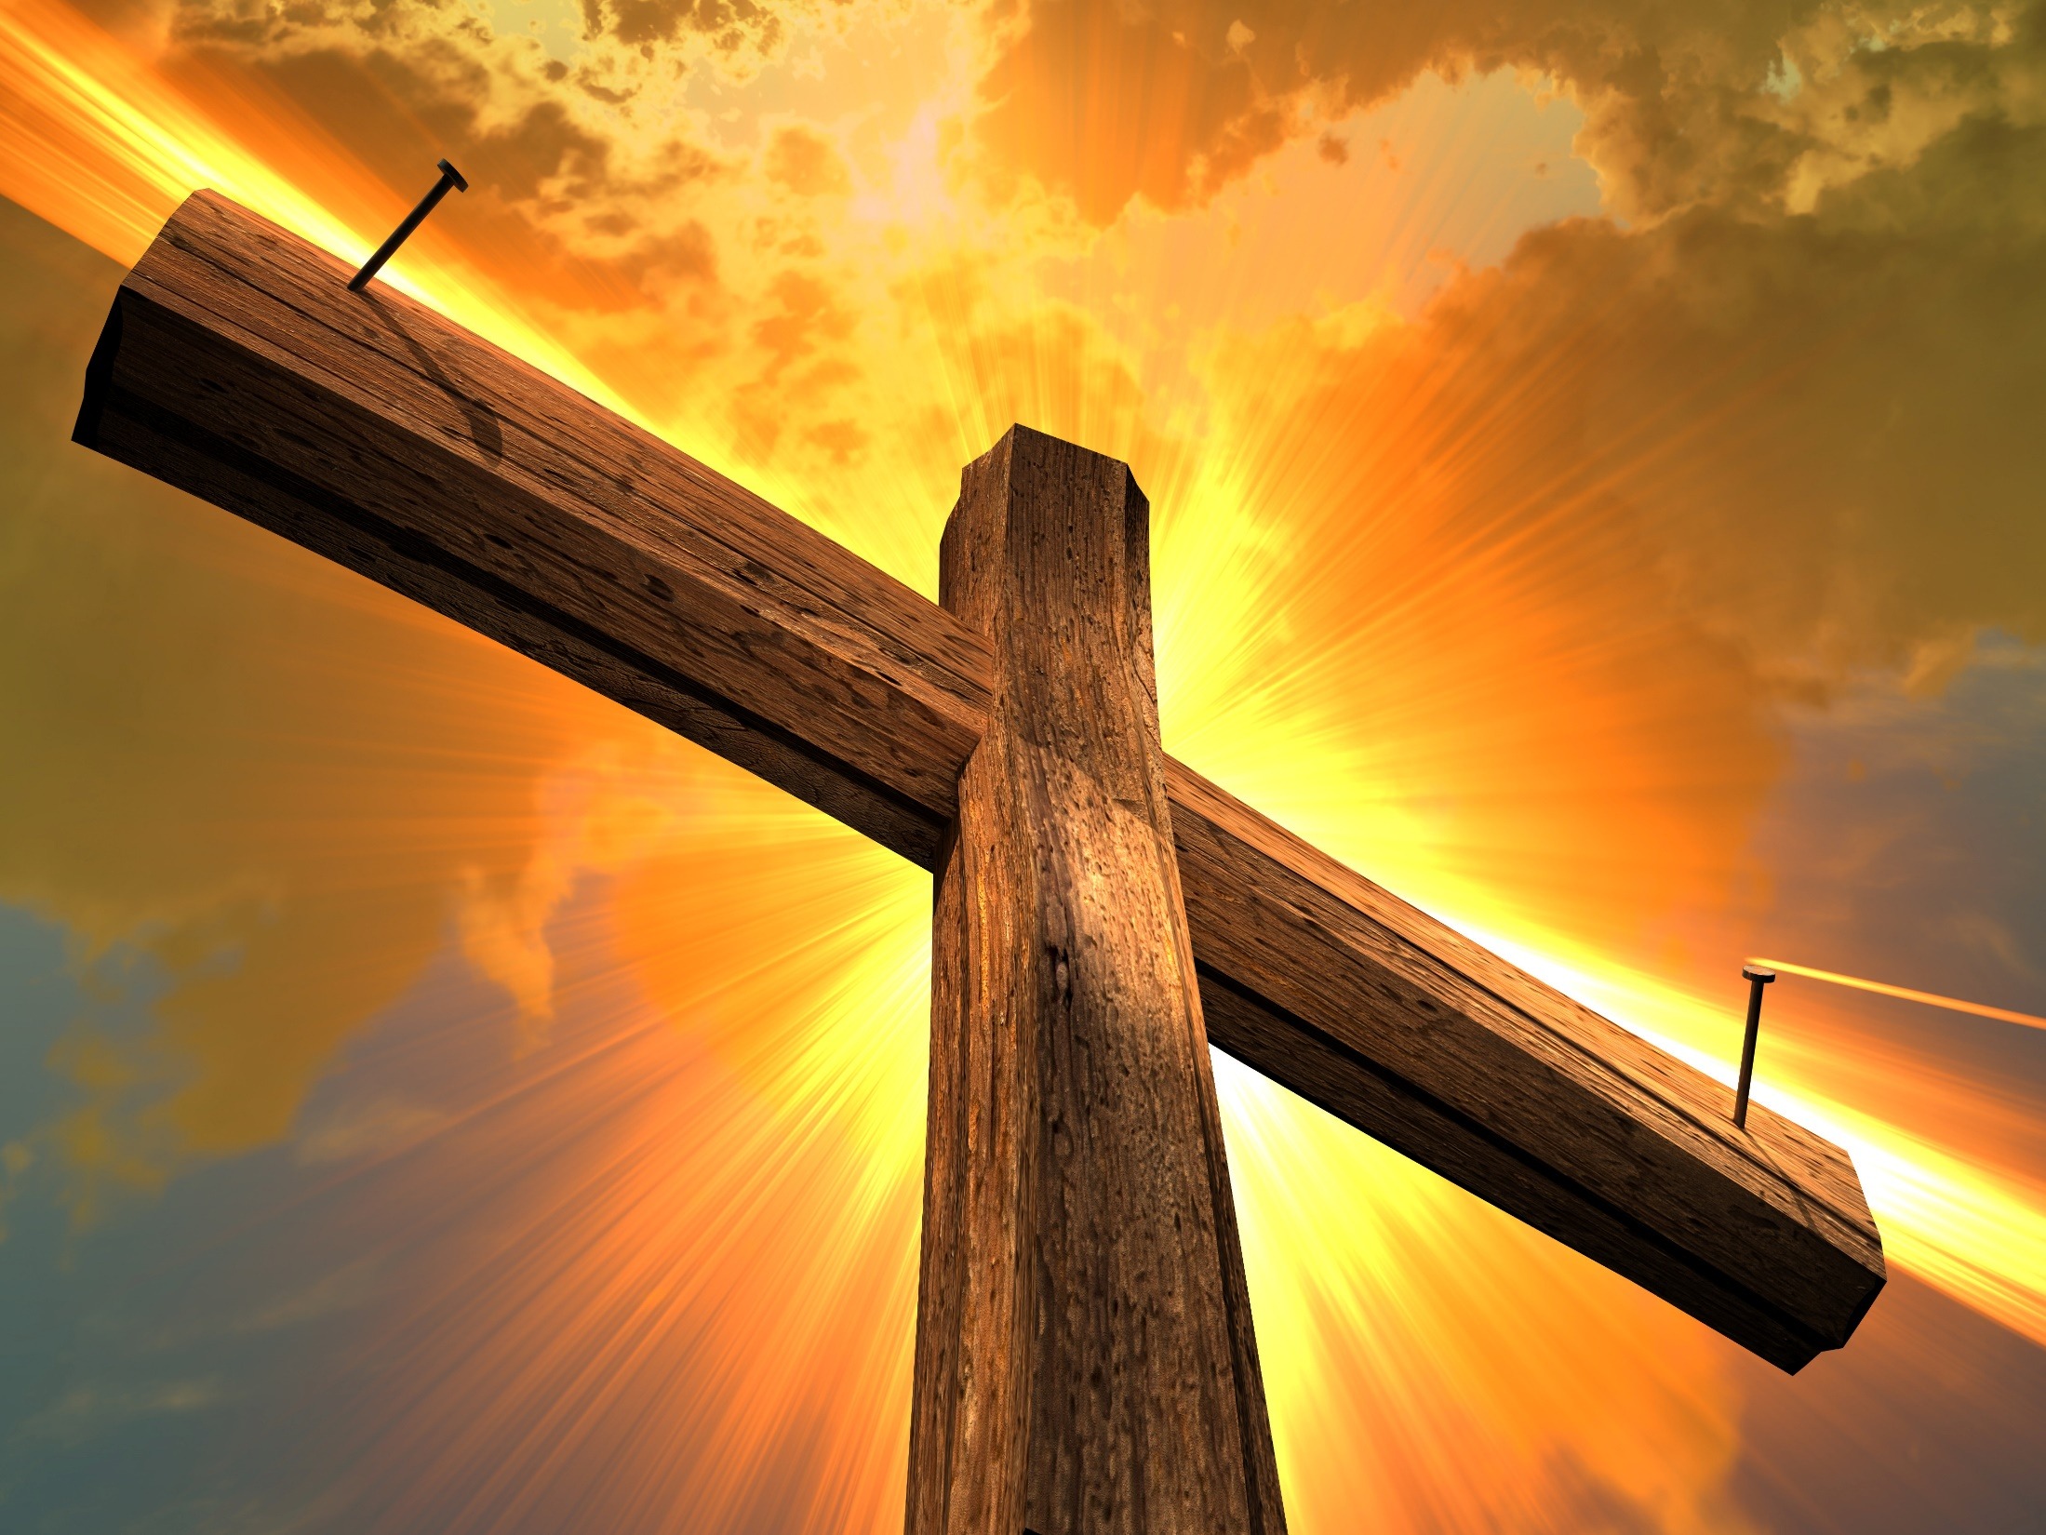
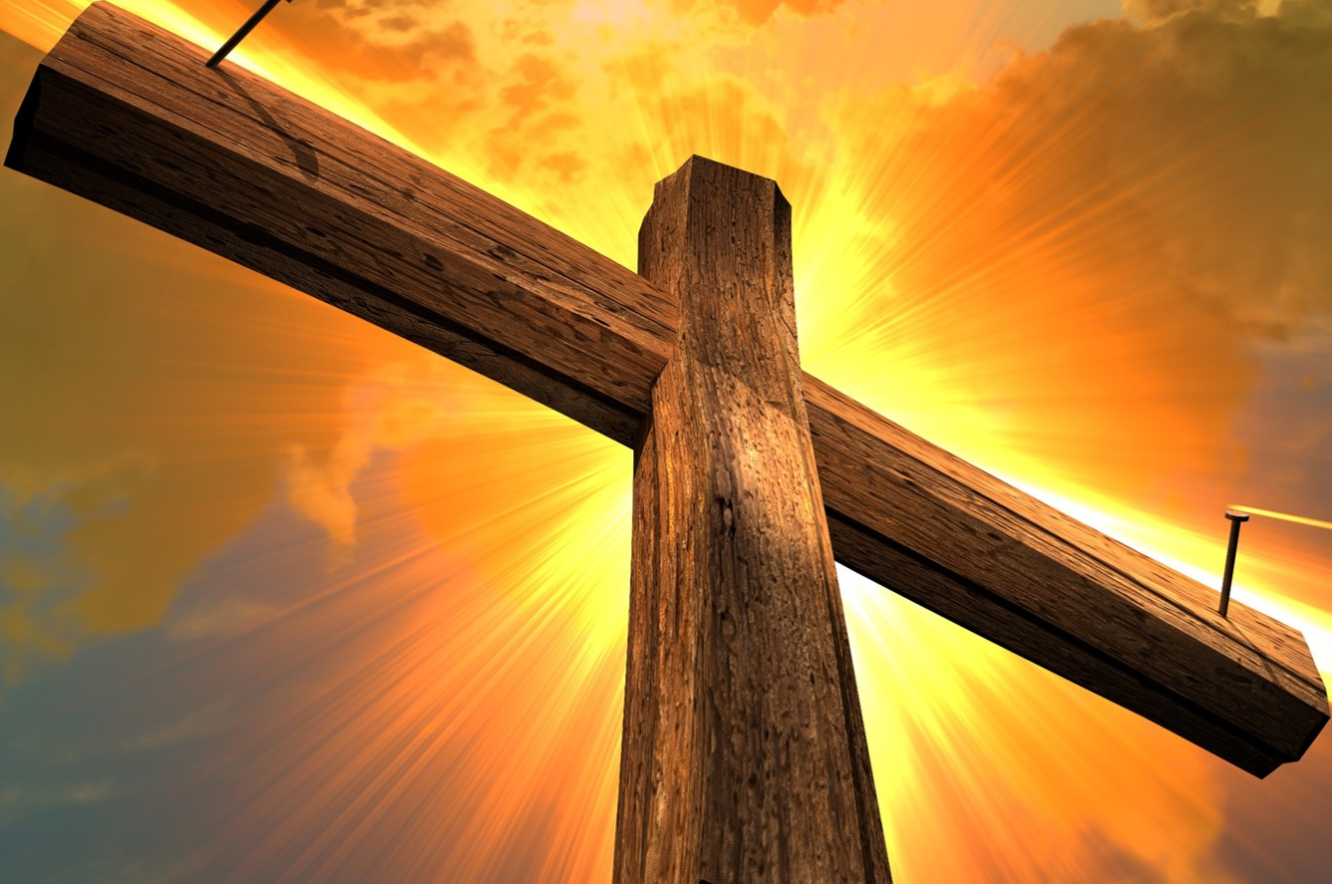

He indeed was foreordained before the foundation of the world, but was manifest in these last times for you who through Him believe in God, who raised Him from the dead and gave Him glory, so that your faith and hope are in God. — 1st Peter 1:20-21
He indeed was foreordained before the foundation of the world, but was manifest in these last times for you who through Him believe in God, who raised Him from the dead and gave Him
glory, so that your and
are in God. — 1st Peter 1:20-21
the faith
manifest in
in
manifest in
time
through
time
Him
believe
in
God
Jesus
the
endurance
your faith
your faith
your faith
your faith
your faith
your faith
your faith
your faith
your faith
your faith
faith
and
faith and hope
your
faith
hope
in
God
Notes:
To really believe in God becomes the greatest thriving force in living. Each of us carries a cross. We decide to endure or slip into the quick sands of destruction. Our faith is equally intermingled with the hope we seek. The Faith requires a belief in a resurrected Jesus and regard for the power of God to rule over the misgivings of man.

Slide 9
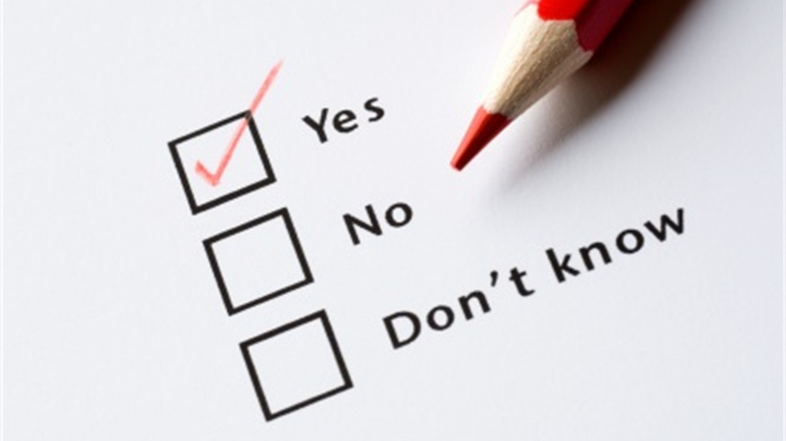
Examine yourselves as to whether you are in the faith. Test yourselves. Do you not know yourselves, that Jesus Christ is in you? -- unless indeed you are disqualified. — 2nd Corinthians 13:5
the faith
disqualified
Notes:
To be in The Faith is a question of knowing. “My people are destroyed for lack of knowledge.” A serious humble heart cannot deny the truth of a much greater reality where the earth is just a shadow in a moment left behind.

Slide 10
Examine yourselves as to whether you are in the faith. Test yourselves. Do you not know yourselves, that Jesus Christ is in you? -- unless indeed you are disqualified. — 2nd Corinthians 13:5
are you in the faith?
you
are
in the
faith
faith
Jesus Christ
is
in
you?
?
not once saved always saved
is Jesus Christ in you?

Slide 11
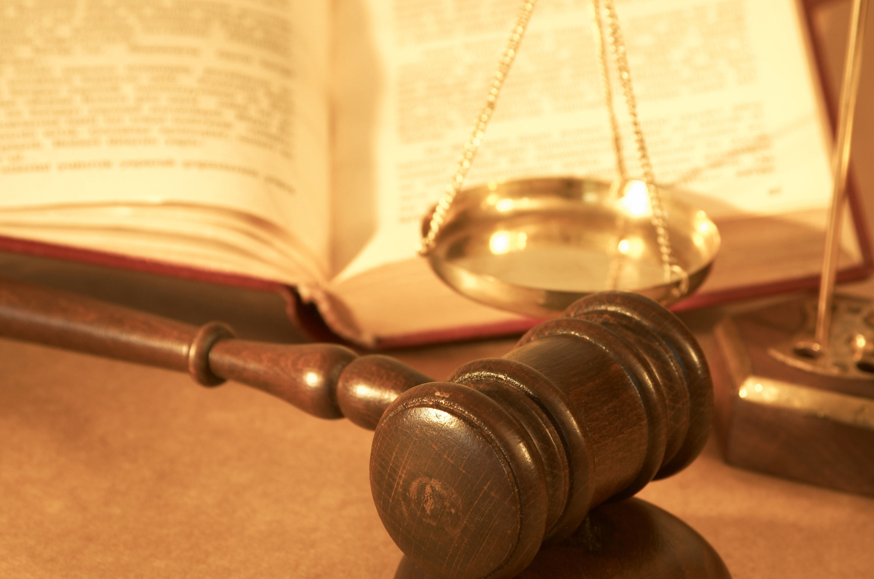
But the Scripture has confined all under sin, that the promise by faith in Jesus Christ might be given to those who believe. But before faith came, we were kept under guard by the law, kept for the faith which would afterward be revealed. — Galatians 3:22-23
the law
the promise
the promise
in
by faith
Jesus Christ
by faith
faith
faith
GIFT
who believe
before faith came
faith
before faith came
fundamental principles
under guard by the law
faith
the law
under guard by the law
the faith
faith
revealed
Notes:
The law was the prelude to the faith. Expected obedience, and punishment for subsequent sin forgiven, is in those faithful to Him and His ways.

Slide 12
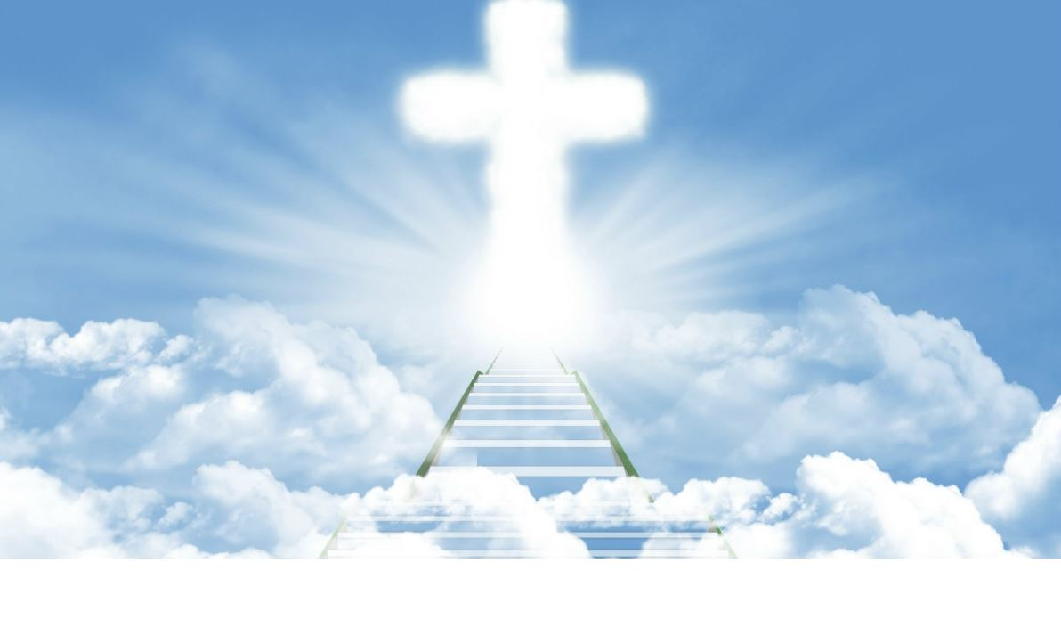
But now the righteousness of God apart from the law is revealed, being witnessed by the Law and the Prophets, even the righteousness of God, through faith in Jesus Christ, to all and on all who believe. For there is no difference; … — Romans 3:21-22
righteousness of God
apart from
the law
is revealed
apart from
Old Testament
Law
and the Prophets
through
through
through
through
in
Jesus Christ
faith
faith
Jesus
Christ
faith
Christ Jesus
believe
Notes:
It is through faith in Jesus that God has delivered His greatest righteousness revealed, in the sacrifice of His love. He welcomes those wise enough to apply the simplest of instructions to live in and under the goodness found in Him and His creation. All that rise to Him openly know the truth of this, what He has once delivered to be recognized.

Slide 13
… all have sinned and fall short of the glory of God, being justified freely by His grace through the redemption that is in Christ Jesus, … — Romans 3:23-24
through
… all have sinned and fall short of the glory of God, being justified freely by His grace through the redemption that is in Christ Jesus, … — Romans 3:23-24
His grace
His grace
through
through
redemption
redemption
recovery
in
Jesus
Jesus
Christ Jesus
Christ Jesus
Jesus
Notes:
Grace comes by God and through Jesus. It is God who has established this, and neither can it be superseded or replaced by constructions from the fantasies of man. To disregard His ways is the greatest travesty a soul will ever encounter upon that equal rejection in an air of superiority to His will. All will be humbled in that final judgment through the shame of our lacking holiness.

Slide 14
…. whom God set forth as a propitiation by His blood, through faith, to demonstrate His righteousness, because in His forbearance God had passed over the sins that were previously committed, to demonstrate at the present time His righteousness, that He might be just and the justifier of the one who has faith in Jesus. — Romans 3:25-26
by His blood
through
faith
faith
Forgiveness
one who has faith
in
one who has faith
Jesus
faith
Jesus
Notes:
Faith in the life of Jesus is what brings on eternal life in the realizations of all that is higher. He gave up His life so that we might possess our own.

Slide 15
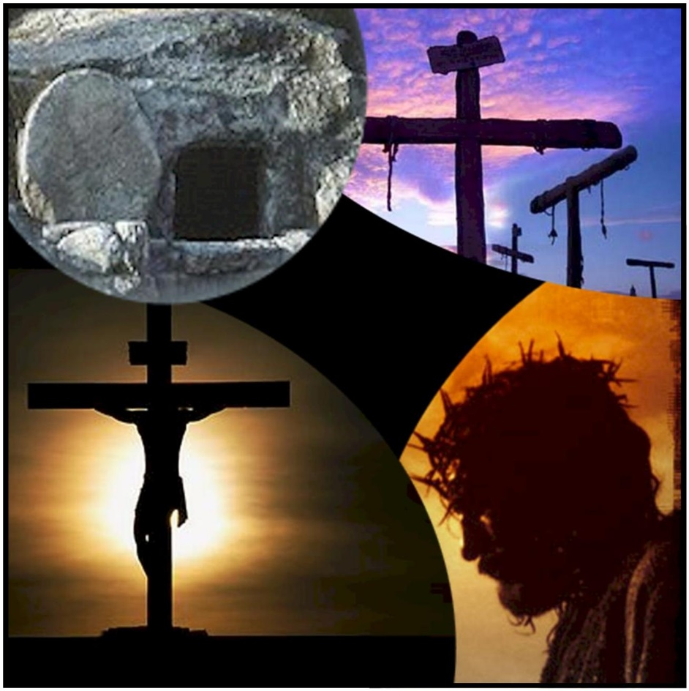
And you, who once were alienated and enemies in your mind by wicked works, yet now He has reconciled in the body of His flesh through death, to present you holy, and blameless, and above reproach in His sight -- — Colossians 1:21-22
continue in
… if indeed you continue in the faith, grounded and steadfast, and are not moved away from the hope of the gospel which you heard, which was preached to every creature under heaven, of which I, Paul, became a minister. — Colossians 1:23
in
the faith
enemies in your
alienated
the faith
enemies in your
the faith
mind by wicked works
mind by wicked works
in
faith
hope of the gospel
reconciled in the body
hope
reconciled in the body
hope of the gospel
the faith
in
above reproach in His sight
above reproach in His sight
Notes:
Many people despise God and fail to consider why He is and what He has done. He created us, for good works in Him, Christ, and that makes one accountable to Him. We did not create ourselves. Sinners with no regard, other than self, live in a cloud of isolated condemnation, generally angry and or bitter. To acquire saving grace one must remain in Him and loyal to achieving a greater stance in obedience to His called for ways. This does not leave excuse open for discussion as no is no and yes is yes. The truth of The Faith is unlocked in the gospel (Bible) given to all mankind. As He is the author of our Faith, He is supremely over all, and His guiding force Has delivered what is sufficient, not being a God of confusion, truth has been given to us all. To be unsure or doubt His will requires a greater humbling in beseeching requests to know His wisdom.

Slide 16
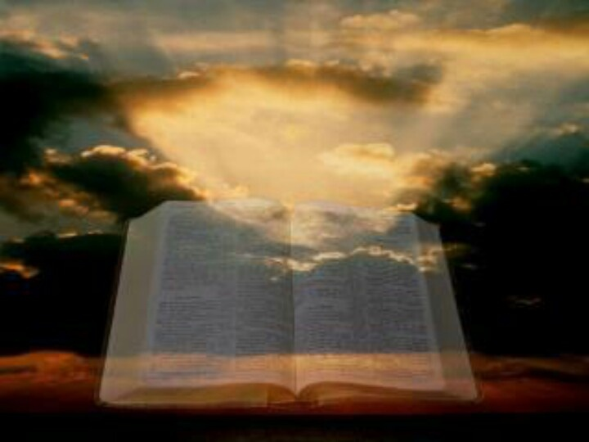
Beloved, while I was very diligent to write to you concerning our common salvation, I found it necessary to write to you exhorting you to contend earnestly for the faith which was once for all delivered to the saints. — Jude 1:3
focus wholeheartedly
contend earnestly
. .
. .
the faith
once
the faith
delivered to the saints
. .
Notes:
God wants us to focus wholeheartedly, and most importantly, to what He is asking of us to remain in His creation. Time is inconsequential in the higher nature of what He is seeking from the hearts of the souls that return to Him.

Slide 17
Beloved, while I was very diligent to write to you concerning our common salvation, I found it necessary to write to you exhorting you to contend earnestly for the faith which was once for all delivered to the saints. — Jude 1:3
common salvation
writ
the faith
focus wholeheartedly
ten
written
. .
the faith
the faith
delivered to the saints
. .
Notes:
God wants us to focus wholeheartedly, and most importantly, to what He is asking of us to remain in His creation. Time is inconsequential in the higher nature of what He is seeking from the hearts of the souls that return to Him.

Slide 18

As you have therefore received Christ Jesus the Lord, so walk in Him, rooted and built up in Him and established in the faith, as you have been taught, abounding in it with thanksgiving. — Colossians 2:6-7
received
walk
in
Jesus
ord
walk
living
word
Him
rooted
rooted
established
in
the faith
established
the faith
l
the faith
learned
been taught
been taught
w
iving
the faith
Notes:
The classroom is the heart of all men. The heart is like a spider web that catches flies putrefying the nobility of a pure conscience. No one can know the heart of another and it is by the spirit one answers to being. In the tree of life Jesus supports all truth. Receiving Him is mandatory, granting entrance to the grace offered by Him, in His Faith. God will only accept the genuine as He casts off the superficial. Get real is the call of God.

Slide 19
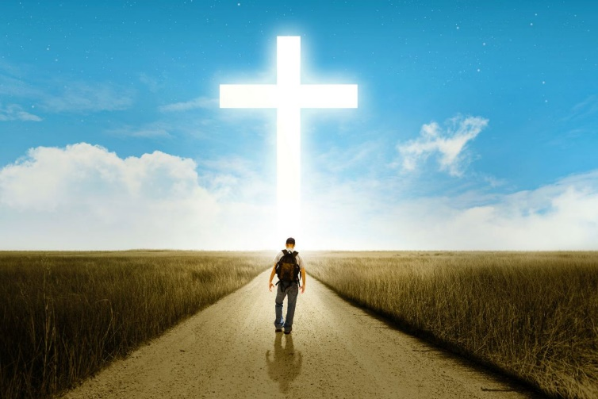
Only let your conduct be worthy of the gospel of Christ, so that whether I come and see you or am absent, I may hear of your affairs, that you stand fast in one spirit, with one mind striving together for the faith of the gospel, … — Philippians 1:27
conduct
conduct be worthy
gospel of Christ
Christ
of the gospel of Christ
in
one
spirit
one
mind
striving
the faith
the faith
of the gospel
the faith
of the gospel
the faith
Notes:
It is our conduct that God closely watches, even closer than we see ourselves. To remain casual about God is to live as a recluse as His call is for unity in the truth of one way, in the spirit of truth He has delivered.

Slide 20
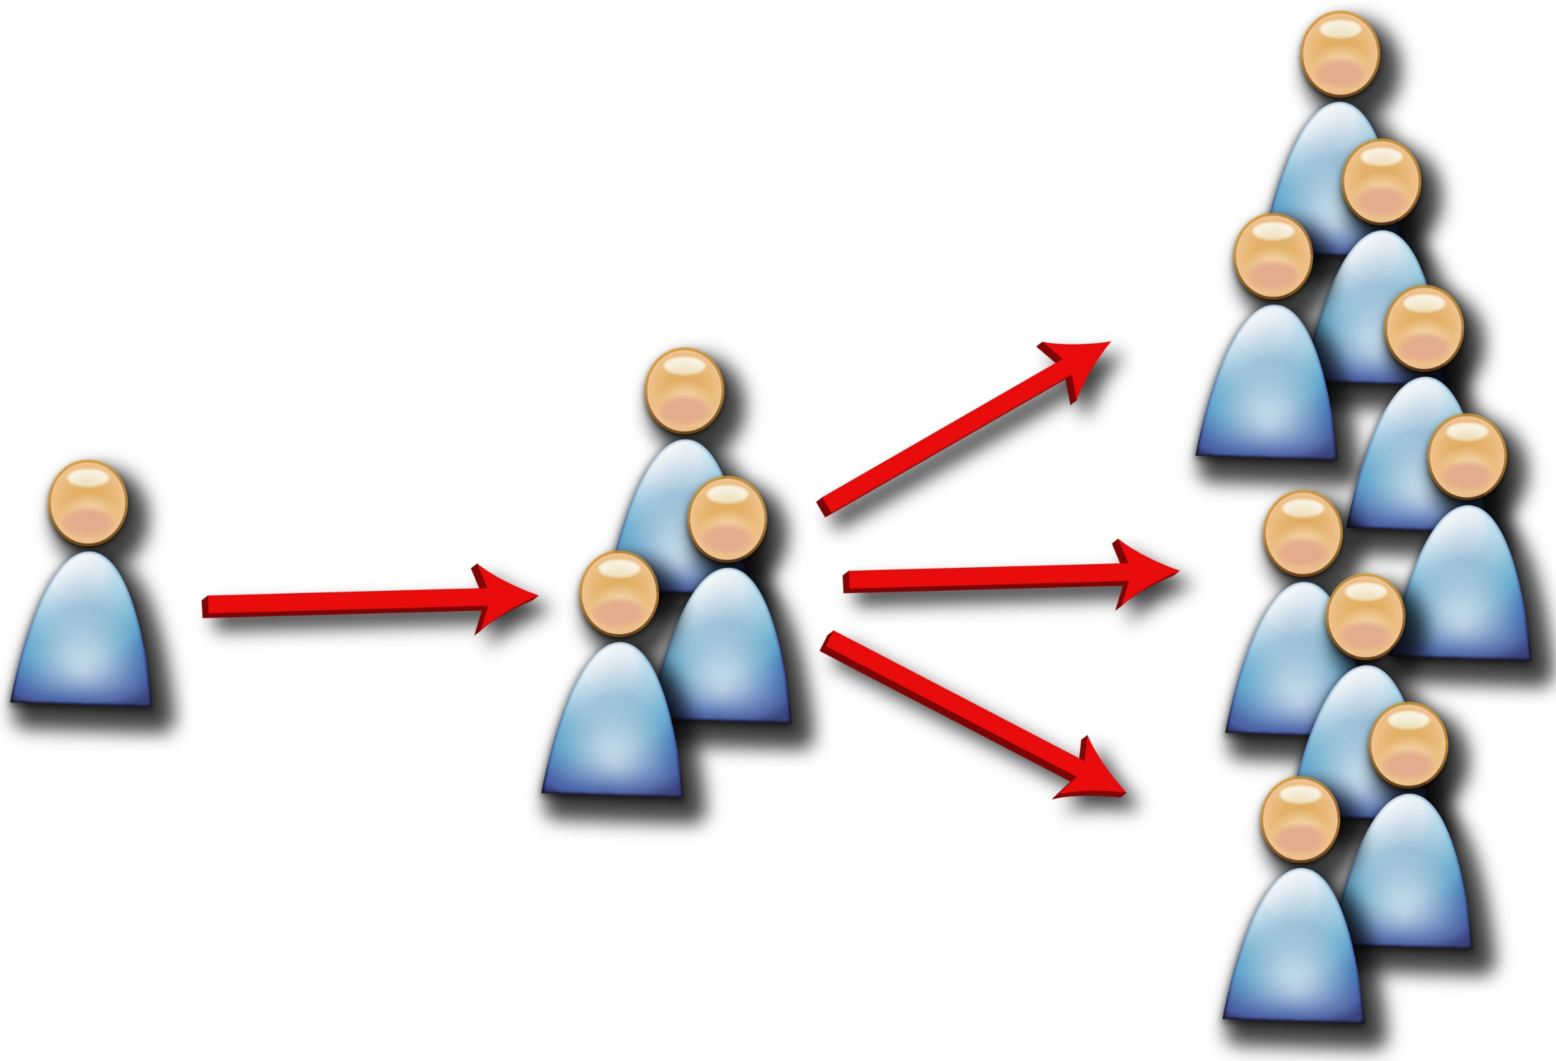
Then the word of God spread, and the number of the disciples multiplied greatly in Jerusalem, and a great many of the priests were obedient to the faith. — Acts 6:7
faith
word of God spread
word of God spread
faith
faith
faith
faith
faith
faith
obedient to the faith
the faith
the faith
faith
Notes:
As from faith to faith, we edify each other when we adhere to His ways. His plan of faith comforts all who enter.

Slide 21
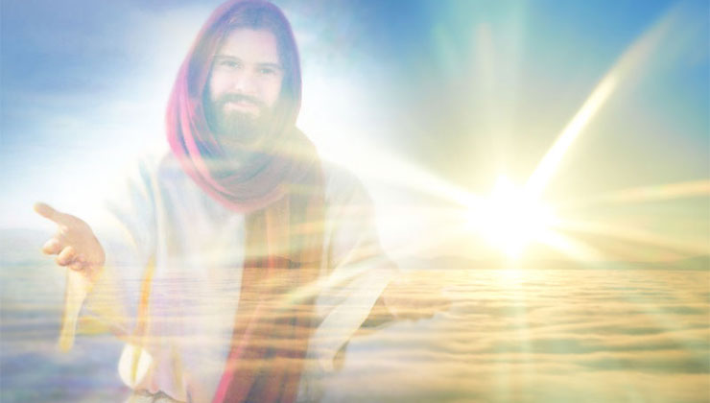
"I know your works, and where you dwell, where Satan's throne is. And you hold fast to My name, and did not deny My faith even in the days in which Antipas was My faithful martyr, who was killed among you, where Satan dwells." — Revelation 2:13
faith
faith
Hate
Satan
faith
Satan
you hold fast
author
Jesus
My faith
faith
My faith
My faith
My faith
My faith
faith
faith
Satan
Hate
Satan
faith
faith
Notes:
Jesus specifically proclaims that it is His faith that He calls us out to be in. He asks us to remain faithful until that parting moment comes, from the mortal flesh that confines us. The test is will we come to God or leave under the duress of living without Him? His design of faith is one of purpose. Our life is our choice to rise in His light or fall back in loneliness enhanced by self inflicted darkness, succumbing to the evils of Satan’s temptations, for material gratification, over thankfulness for what simply is.

Slide 22

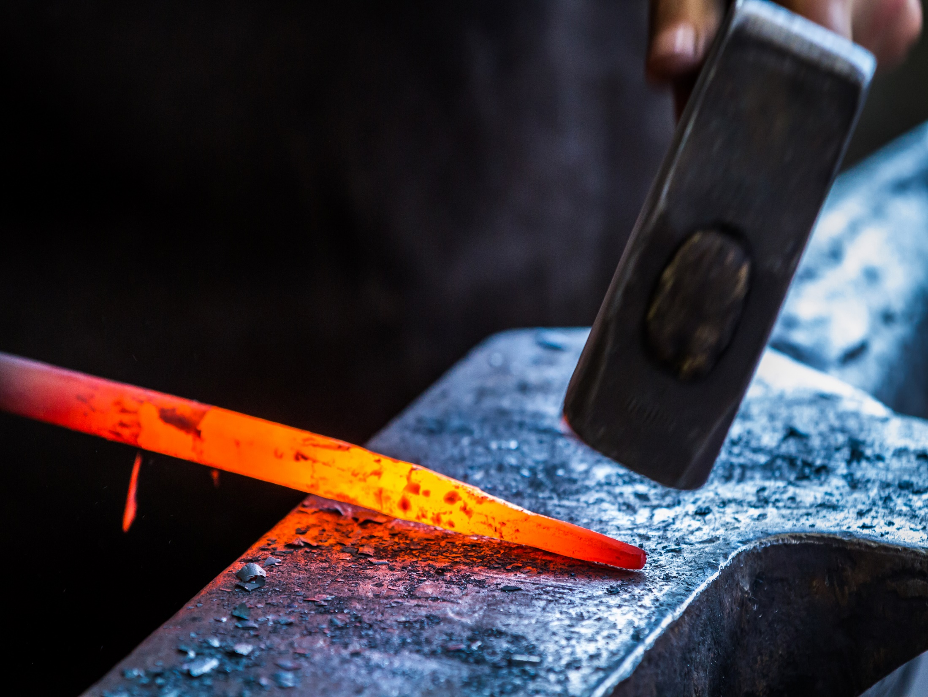
Now the Spirit expressly says that in latter times some will depart from the faith, giving heed to deceiving spirits and doctrines of demons, speaking lies in hypocrisy, having their own conscience seared with a hot iron, forbidding to marry, and commanding to abstain from foods which God created to be received with thanksgiving by those who believe and know the truth. — 1st Timothy 4:1-3
some will depart
some will depart
the faith
faith
the faith
the faith
seared with a hot iron
the faith
God created to be received
received
received
received
those who believe
thanksgiving
believe
those who believe
and know the truth
and know the truth
Notes:
To be removed from conscience is the dreadfulness of humanity, or the lack of it. Stubborn hearts only see self over the greater truth in Him. There is no disguise to protect the insincere from His coming wrath. The Faith has been delivered to those that believe in His given truths.

Slide 23
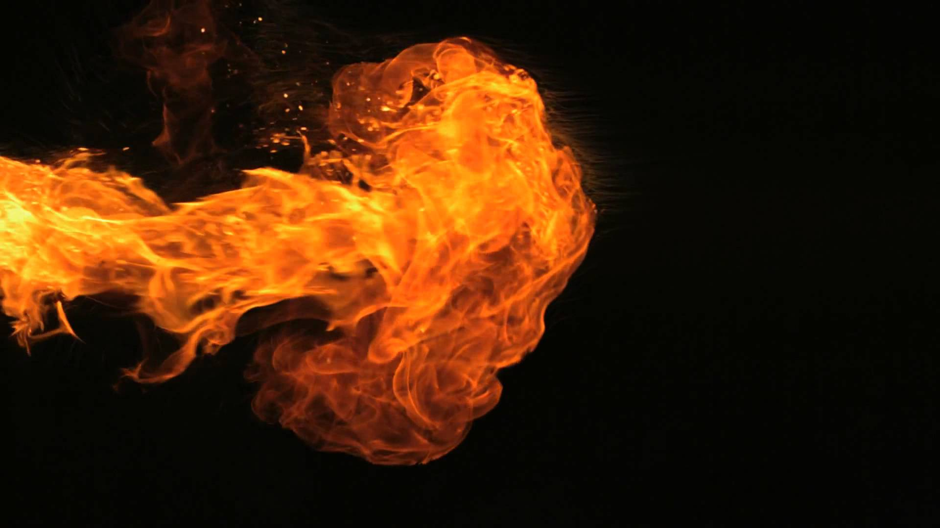
Now as Jannes and Jambres resisted Moses, so do these also resist the truth: men of corrupt minds, disapproved concerning the faith; — 2nd Timothy 3:8
the faith
resist the truth
men of corrupt
resist the truth
the truth
minds
Self - seeking
X
the faith
Notes:
For those that resist the truth create the corruption by which their own destruction will come.

Slide 24
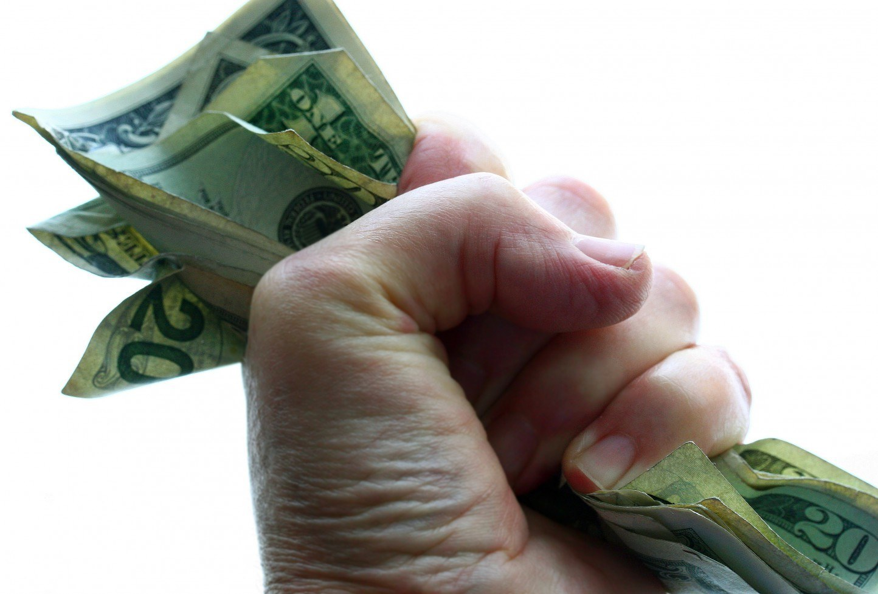
For the love of money is a root of all kinds of evil, for which some have strayed from the faith in their greediness, and pierced themselves through with many sorrows. — 1st Timothy 6:10
love of
evil
stray
from the faith
the faith
stray
from the faith
the faith
Notes:
Love of anything less than God seeks death over life. God has made a temporary universe to test His infinite creatures, be they loyal or rebellious. It is our desires and the direction they take us that defines each of our destinations, heaven or hell. Greedy hearts are not contrite hearts. To know The Faith is to repent of that which takes us away from it, the goodness intended in the freedom of living. No blessing is greater than God given life.

Slide 25
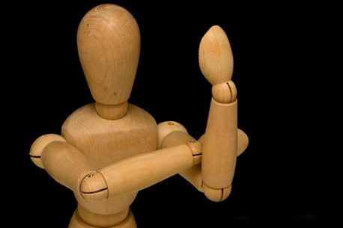
But if anyone does not provide for his own, and especially for those of his household, he has denied the faith and is worse than an unbeliever. — 1st Timothy 5:8
local
denied
denied
the faith
the faith
the faith
the faith
Notes:
Many thumb their fist at creation mired in disgust missing thankfulness in the love of the Creator.

Slide 26

O Timothy! Guard what was committed to your trust, avoiding the profane and idle babblings and contradictions of what is falsely called knowledge -- by professing it some have strayed concerning the faith. Grace be with you. Amen. — 1st Timothy 6:20-21
contradictions
contradictions
believe the lie
false
false
knowledge
knowledge
stray
the
the
faith
faith
Notes:
Without regarding His word as precious, it reduces to insignificant as man and his ways take precedence.

Slide 27

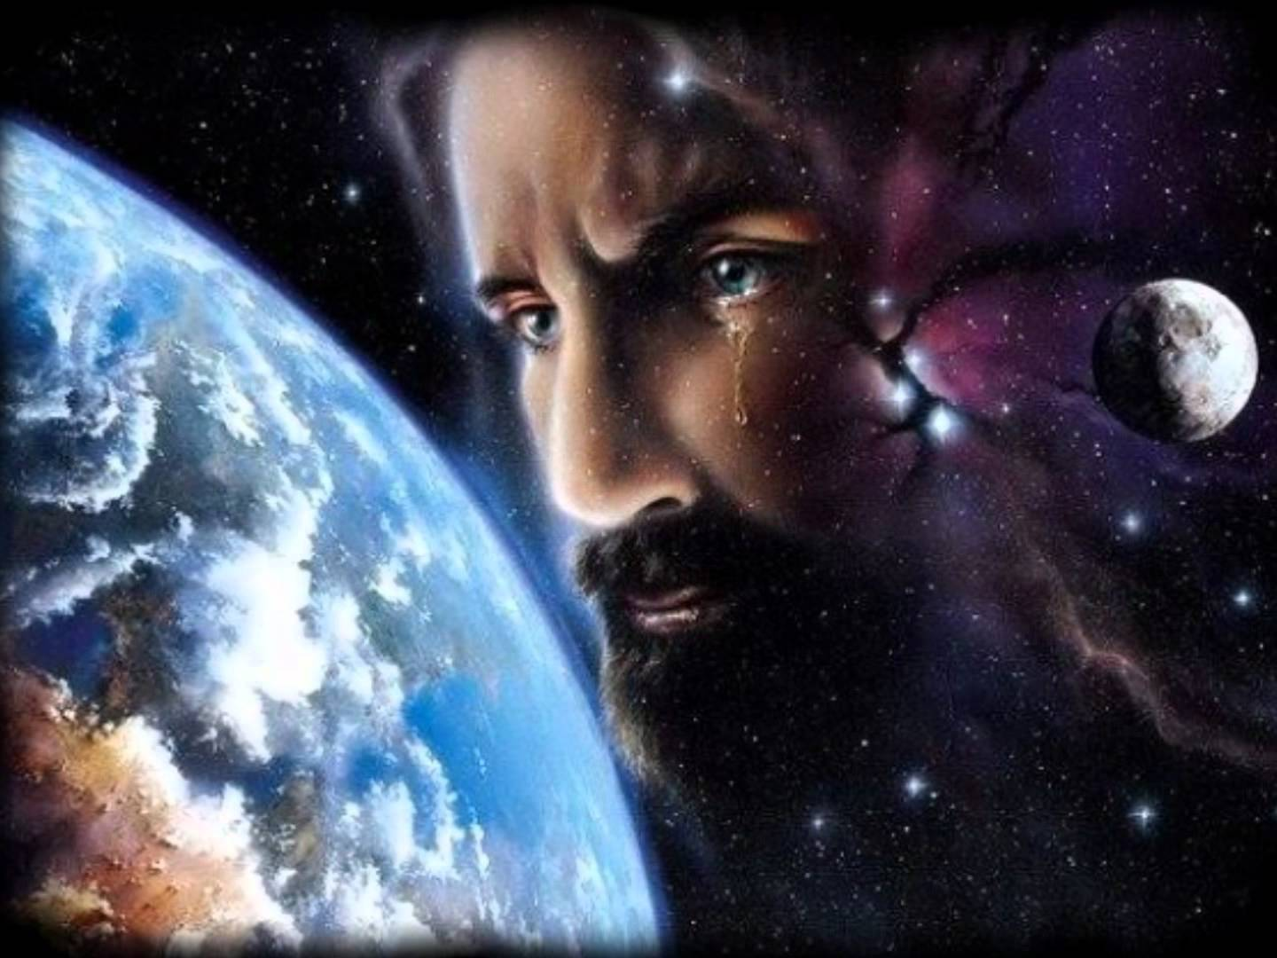
"I tell you that He will avenge them speedily. Nevertheless, when the Son of Man comes, will He really find faith on the earth?" — Luke 18:8
the faith
the
find faith on the earth?
faith
Notes:
A crying shame that the Bible even asks if the faith will be upon the earth, as Jesus gazes, near to His coming. God’s return is certain when man discards all thoughts of Him and His declared ways of decency.

Slide 28

Watch, stand fast in the faith, be brave, be strong. — 1st Corinthians 16:13
the faith
the faith
the faith
the faith
I have fought the good fight, I have finished the race, I have kept the faith. — 2nd Timothy 4:7
race
kept the faith
kept the faith
Notes:
Great satisfaction comes by keeping the faith and overcoming those temptations that weaken the heart.

Slide 29

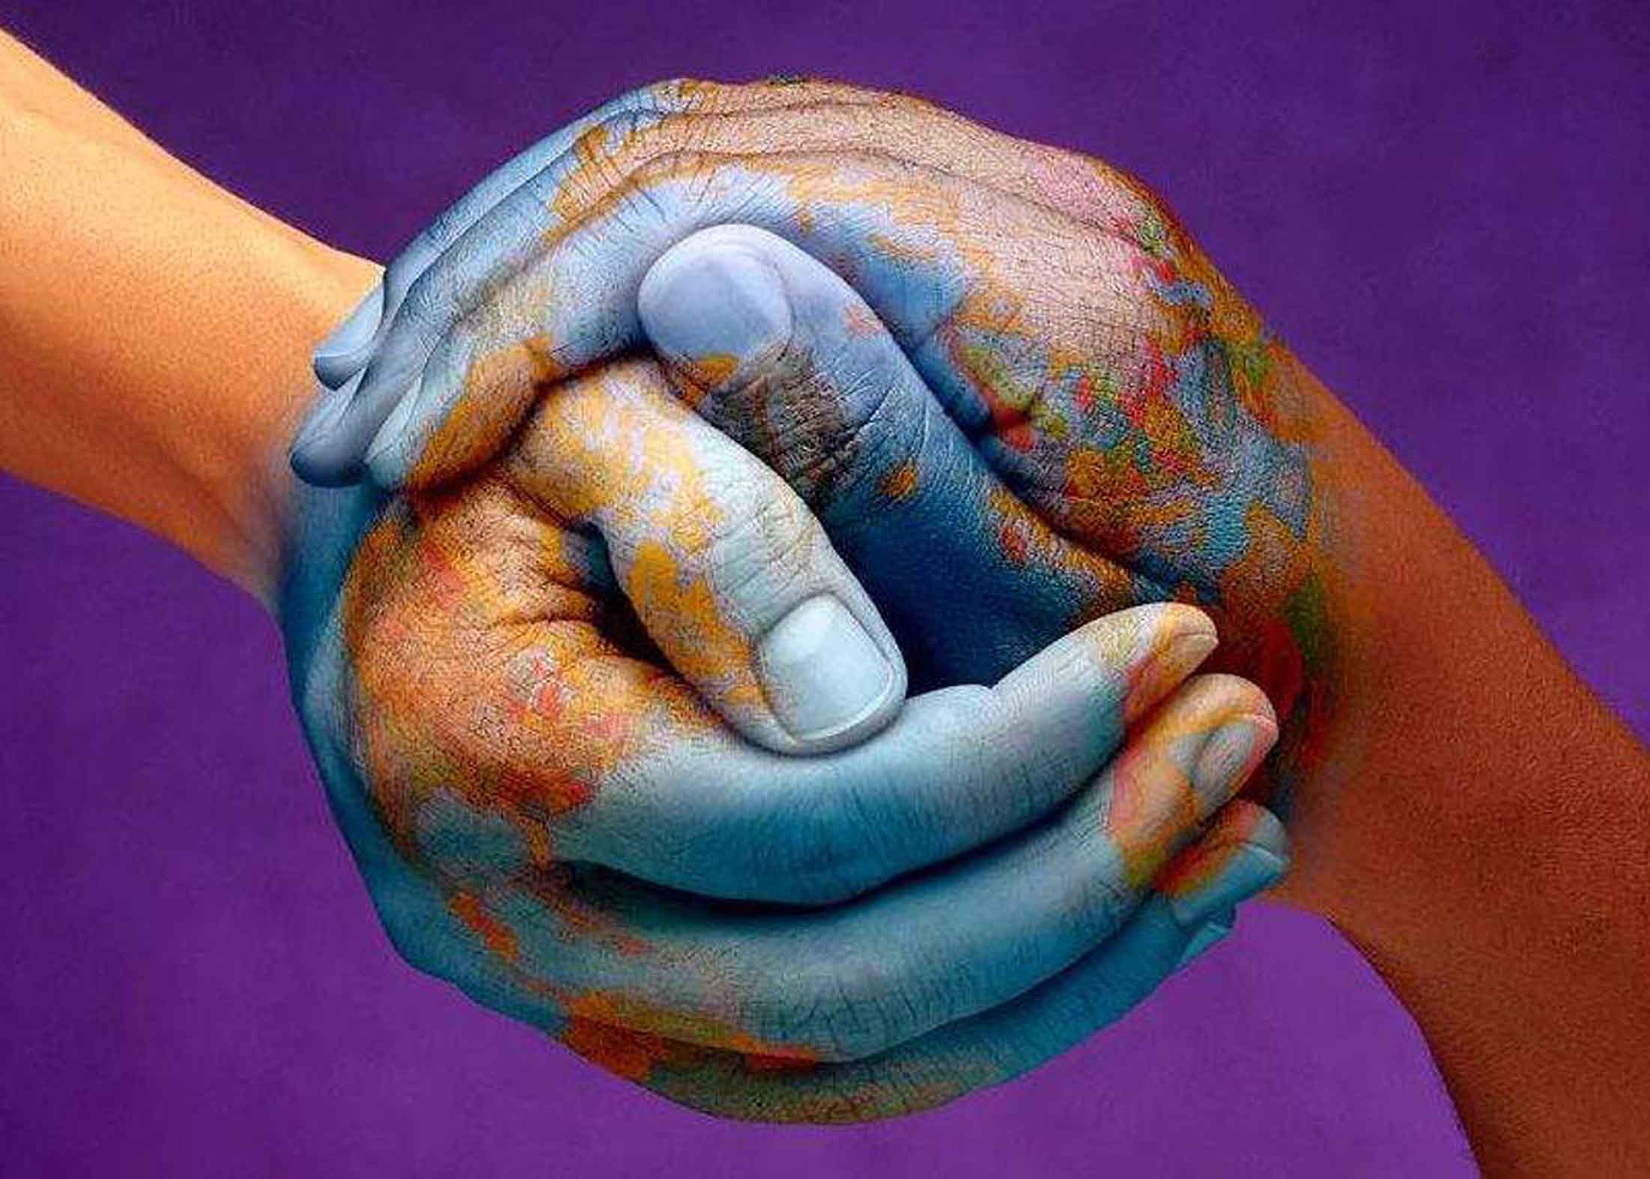
All who are with me greet you. Greet those who love us in the faith. Grace be with you all. Amen. — Titus 3:15
in
. .
those who love
the faith
the faith
in Him
Notes:
All who love in pureness cannot deny grace comes by being in Him.

Slide 30


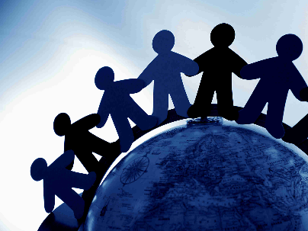

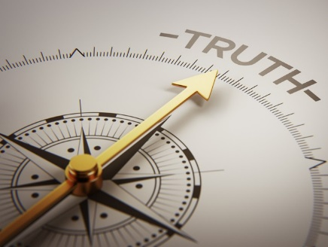









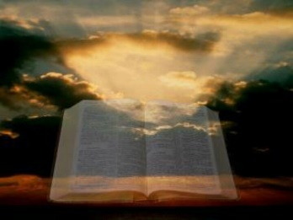






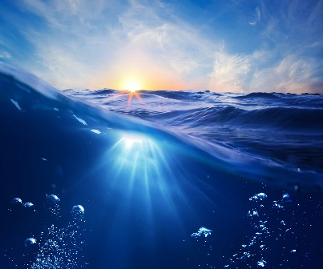

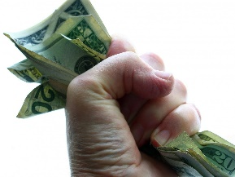

Slide 31
→ There is one faith
→ Jesus is the author and finisher of our faith
→ Saints keep the ways of God and the faith of Jesus
→ Christ’s rising is so that your faith & hope are in God
→ Examine yourself as to whether you are in the faith
→ Before faith came we were under guard by the law
→ God’s righteousness is shown through faith in Christ
→ Continue in the faith firm in the hope of the gospel
→ The faith was once for all delivered to the saints
→ Be established in the faith, as taught, thankfully
→ Be in one mind striving for the faith of the gospel
→ Do not deny My faith as some will depart the faith
→ By resisting the truth one strays from the faith
The Faith
comes by the Word of God
Notes:
The Faith comes by the Word of God

Slide 32
Notes:
Darkness seals the trap removing all light.

Slide 33

Please visit http://www.LoveFromGod.com to explore further
Ronald Bert Channel on
Notes:
Eternity never ends.

