Slide 1
Notes:
In the absence of light, darkness has no smell.

Slide 2
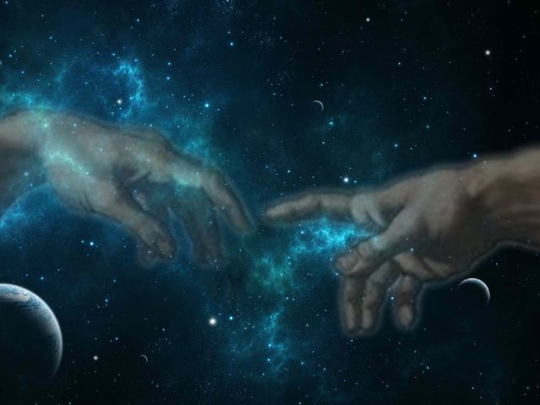

Sons of God
Ron Bert
August 28, 2022

Slide 3
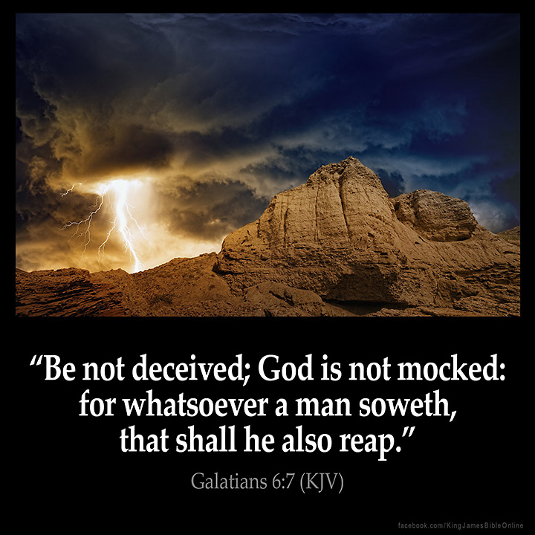

"God is not a man, that He should lie, Nor a son of man, that He should repent. Has He said, and will He not do? Or has He spoken, and will He not make it good? — Numbers 23:19
God is not a man
will He not do?
. .
will He not make it good?
. .
Notes:
It may take more than a human lifetime, but God delivers on His word in His time of patience. The Lord cannot be quantified in all His glory as men quibble over their petty beliefs. God is God who created man, not that man created God.

Slide 4
He is the Rock,
His work is perfect; For all His ways are justice, A God of truth and without injustice; Righteous and upright is He.
— Deuteronomy 32:4
LORD
CREATOR
A God of truth
God
. .

Slide 5
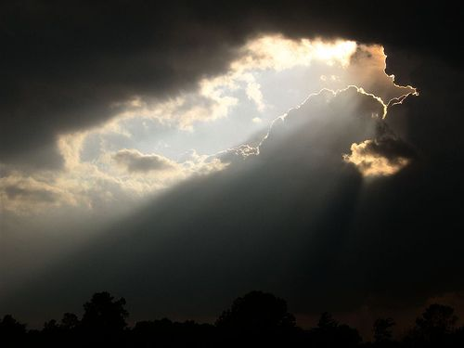
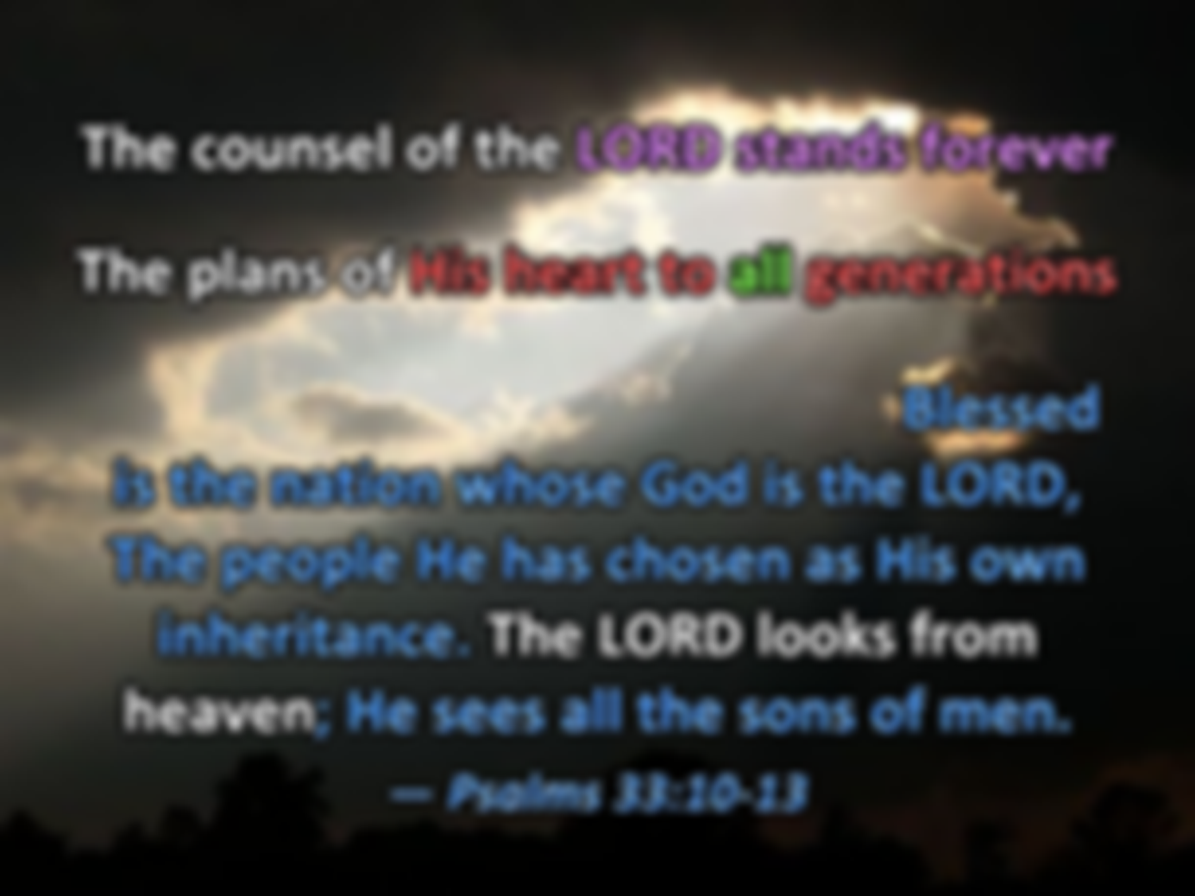
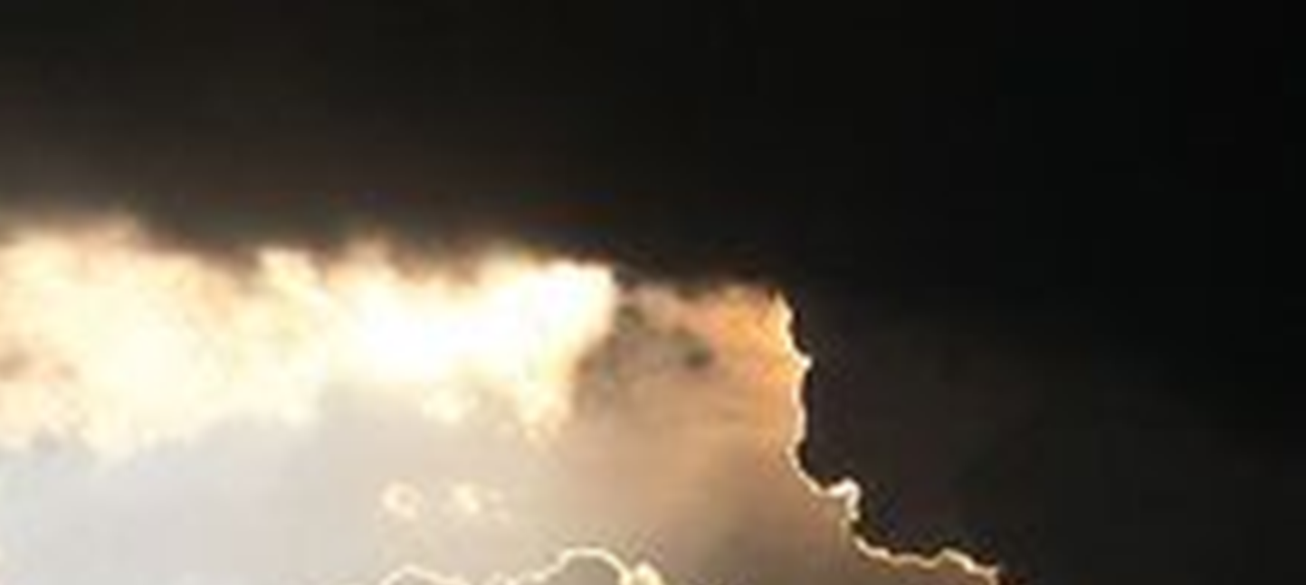
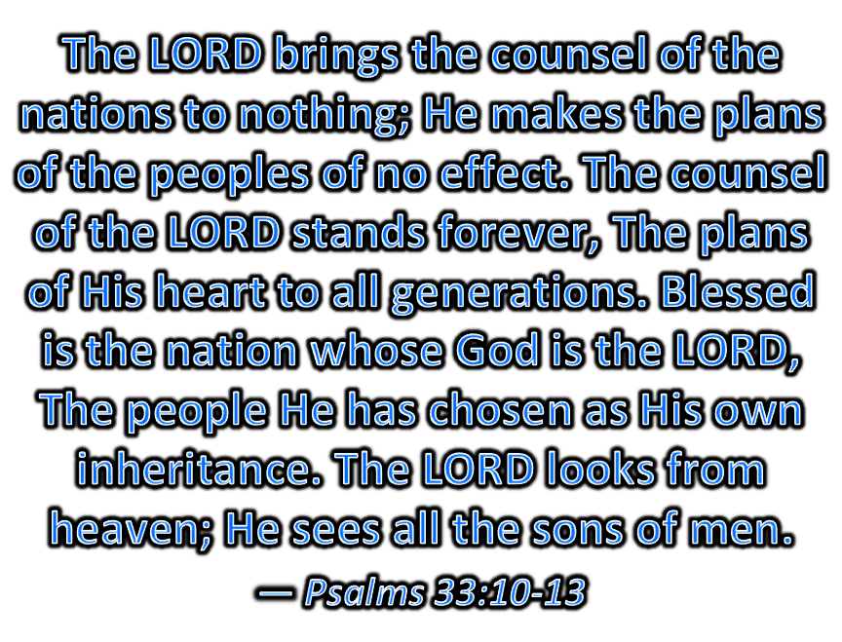

The LORD brings the counsel of the nations to nothing; He makes the plans of the peoples of no effect. The counsel of the LORD stands forever, The plans of His heart to all generations. Blessed is the nation whose God is the LORD, The people He has chosen as His own inheritance. The LORD looks from heaven; He sees all the sons of men. — Psalms 33:10-13
LORD
counsel of the
The counsel of the LORD stands forever
The plans of His heart to all generations
The counsel of the LORD stands forever
The plans of His heart to all generations
The counsel of the LORD stands forever
The plans of His heart to all generations
The counsel of the LORD stands forever
The plans of His heart to all generations
nations to nothing
the plans
of the peoples of no effect
The counsel
all
of the LORD stands forever
The plans
LORD
,
Blessed is the nation whose God is the LORD, The people He has chosen as His own inheritance. The LORD looks from heaven; He sees all the sons of men. — Psalms 33:10-13
of His heart to all generations
Blessed
LORD
whose God is the LORD
. .
He has chosen as His own
. .
The LORD looks from
heaven
The LORD looks from
heaven
inheritance
LORD
Notes:
The LORD cannot be replaced or substituted. To find God is to find one’s own heart.

Slide 6
The LORD looks down from heaven upon the children of men, To see if there are any who understand, who seek God. — Psalms 14:2
The fear of the LORD is the beginning of wisdom, And the knowledge of the Holy One is understanding. — Proverbs 9:10
LORD looks down from heaven
LORD looks
beginning of wisdom
. .
children of men
. .
knowledge of the Holy One
=
if
understand
understanding
infinite
His
understand
ing
rules
Test
unsearchable
God looks down from heaven upon the children of men, To see if there are any who understand, who seek God. — Psalms 53:2
God looks down from heaven
God looks
The fear of the LORD is the beginning of knowledge, But fools despise wisdom and instruction. — Proverbs 1:7
children of men
if
beginning of knowledge
. .
. .
understand
correction
truth
Notes:
There is 1,451 “ifs” in the Bible.

Slide 7
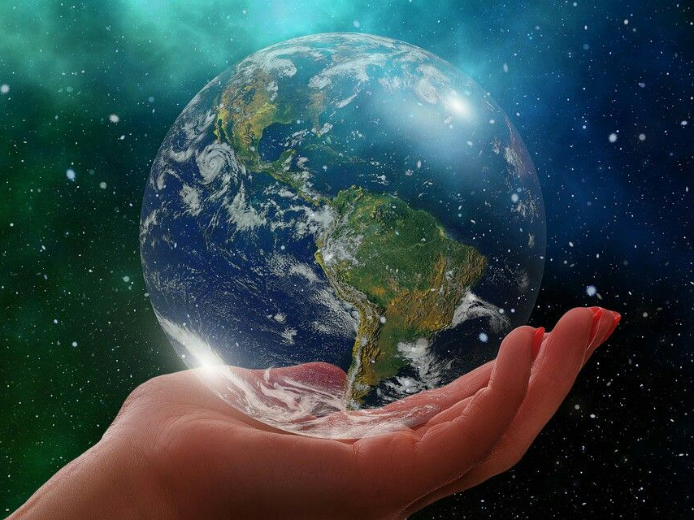
Be exalted, O God, above the heavens; Let Your glory be above all the earth. — Psalms 57:11
All nations
All nations before Him are as nothing, And they are counted by Him less than nothing and worthless. — Isaiah 40:17
All nations before Him are as nothing, And they are counted by Him less than nothing and worthless. — Isaiah 40:17
All nations before Him are as nothing, And they are counted by Him less than nothing and worthless. — Isaiah 40:17
All nations
All the inhabitants
All the inhabitants of the earth are reputed as nothing; He does according to His will in the army of heaven And among the inhabitants of the earth. No one can restrain His hand Or say to Him, "What have You done?" — Daniel 4:35
All the inhabitants of the earth are reputed as nothing; He does according to His will in the army of heaven And among the inhabitants of the earth. No one can restrain His hand Or say to Him, "What have You done?" — Daniel 4:35
All the inhabitants of the earth are reputed as nothing; He does according to His will in the army of heaven And among the inhabitants of the earth. No one can restrain His hand Or say to Him, "What have You done?" — Daniel 4:35
All the inhabitants
as nothing
as nothing
God
reputed as nothing
reputed as nothing
above
understand
all
God above all
Notes:
For all that believe in human importance, the Lord God clears the confusion, it is a quagmire of insignificance if not considering His glory of creation. Mankind's demise is his inability to join across the spectrum of all conditions. Greed, corruption, and the such, steal decency and respect for all. God remains sure.

Slide 8
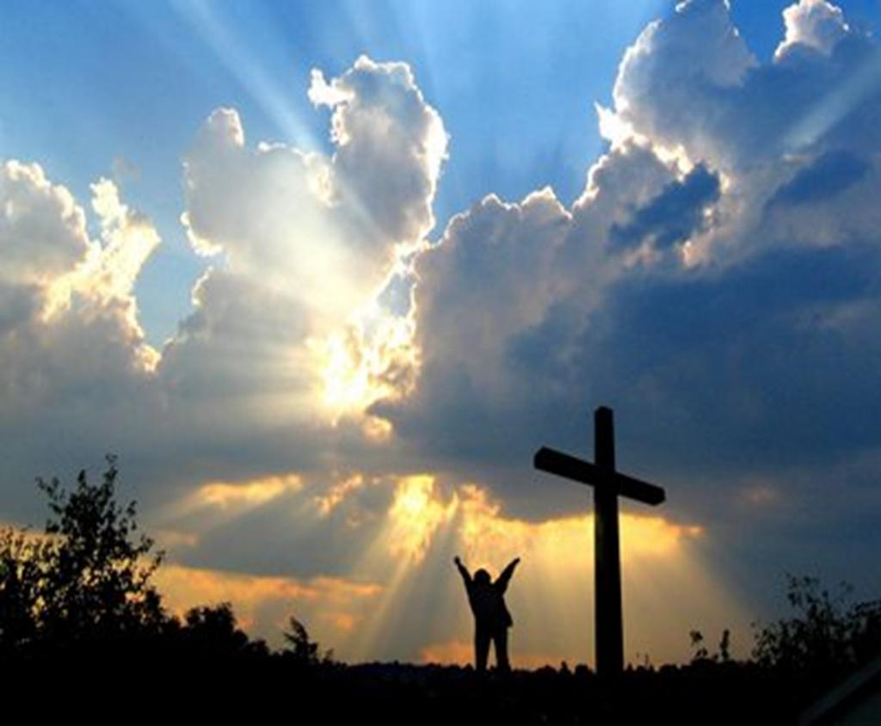
For you are all sons of God through faith in Christ Jesus.
— Galatians 3:26
the inheritance
↑
you will receive the reward
knowing from the Lord
↑
do it to the Lord, not as to men
↑
whatever you do
for you serve the Lord Christ
And whatever you do, do it heartily, as to the Lord and not to men, knowing that from the Lord you will receive the reward of the inheritance; for you serve the Lord Christ. — Colossians 3:23-24
whatever you do
do it
sons of God
By this we know that we love the children of God, when we love God and keep His commandments.
— 1st John 5:2
as
to the Lord
not
sons of God
when we love God
God
when we love God
to men
knowing
from the
,
through faith
in Christ Jesus
God above all
Lord
you will receive the reward
the inheritance
for you serve
in Christ Jesus
in
Christ Jesus
the Lord Christ
do
through faith
Notes:
Inheritance is a result of actions in life. Full or empty expresses a soul’s quantifiable spirit accumulations; good with bad. To be in God’s service is to extend gracious behavior to those in our lives. Faith in Jesus puts one a step ahead of the human condition, where death divides lies from truth. Holy bound heaven is the sight ahead.

Slide 9







And I set my heart to seek and search out by wisdom concerning all that is done under heaven; this burdensome task God has given to the sons of man, by which they may be exercised.
— Ecclesiastes 1:13
given to the sons of man
↑
burdensome task
↑
search out by wisdom
↑
heart to seek
And I set my heart to seek and search out by wisdom concerning all that is done under heaven; this burdensome task God has given to the sons of man, by which they may be exercised.
— Ecclesiastes 1:13
LIFE
heart to seek
LIFE
sons of man
search out by wisdom
burdensome task
given
Humanity
to the sons of man
sons of man
laborious
laborious
Notes:
It is a laborious effort to achieve wisdom in the truth of God’s own excellence. Upon the endless spirals of time it can be a trial of hardship as experience can be a unkind razor. God speaks to us all with the gift of life. What we seek, either below or above, defines our spirit and soul destination.

Slide 10
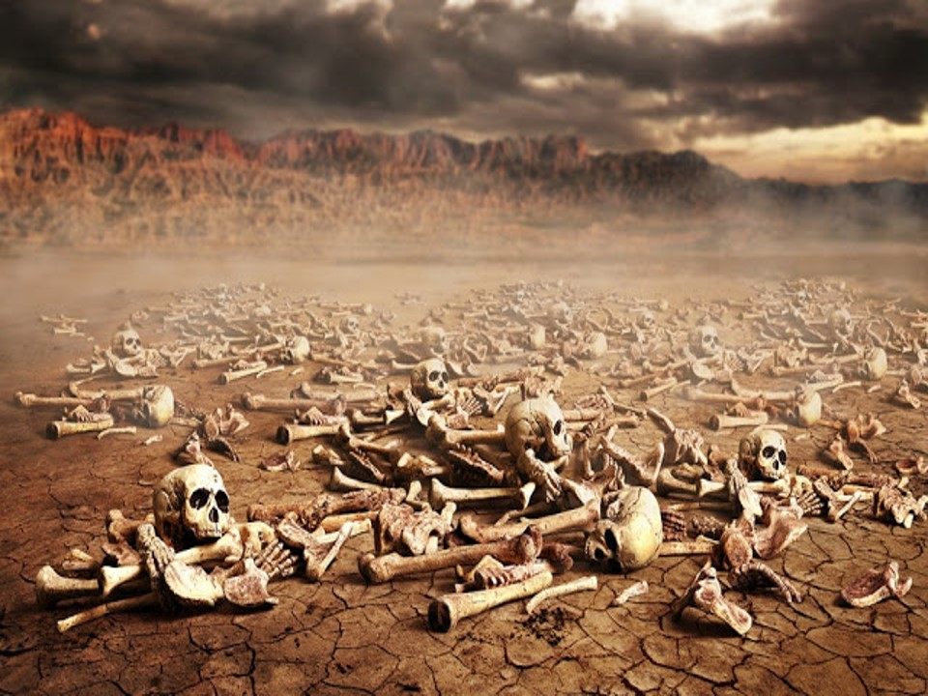

And He said to me,
"Son of man, can these bones live?"
So I answered,
"O Lord GOD, You know."
— Ezekiel 37:3
Unity under
One God
Higher Calling
Freedom
Hear
N.T. = 84 times
Mortal
Son of man
Son of man
. .
O.T. = 106 times
Divided worship
Lower calling
Captivity
Deaf
Notes:
Unity under One God verses divided worship is what God sees. “Son of man” occurs 106 times In the Old Testament, and 84 times in the New Testament. He wants humans to come to Him, not to a man or woman. God wills we hear over remaining deaf. Our captivity from true freedom is where the lower callings of flesh hinder those higher calls from God’s own nobility above.

Slide 11
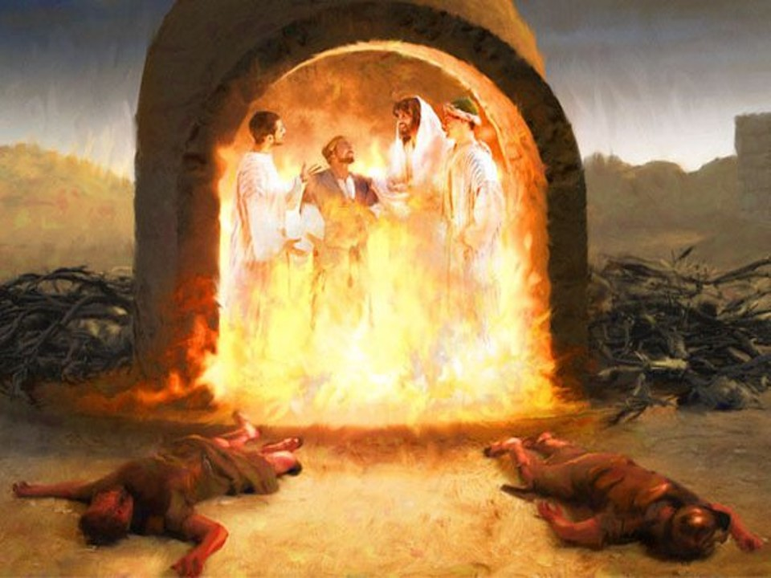
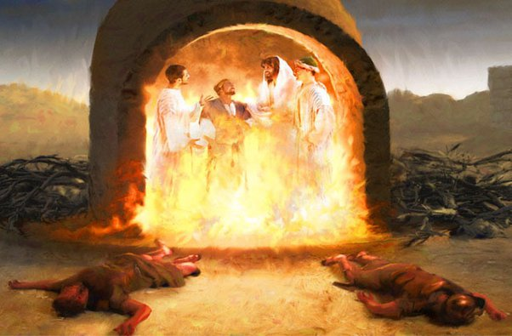




"Look!" he answered, "I see four men loose, walking in the midst of the fire; and they are not hurt, and the form of the fourth is like the Son of God."
— Daniel 3:25
Nebuchadnezzar - Shadrach, Meshach, and Abed-Nego
①
②
③
Son of God
④
Son of God
. .
N.T. = 46 times
O.T. = 1 time
Notes:
1 in old Testament, -46 in New Testament. King Nebuchadnezzar - Shadrach, Meshach, and Abed-Nego

Slide 12
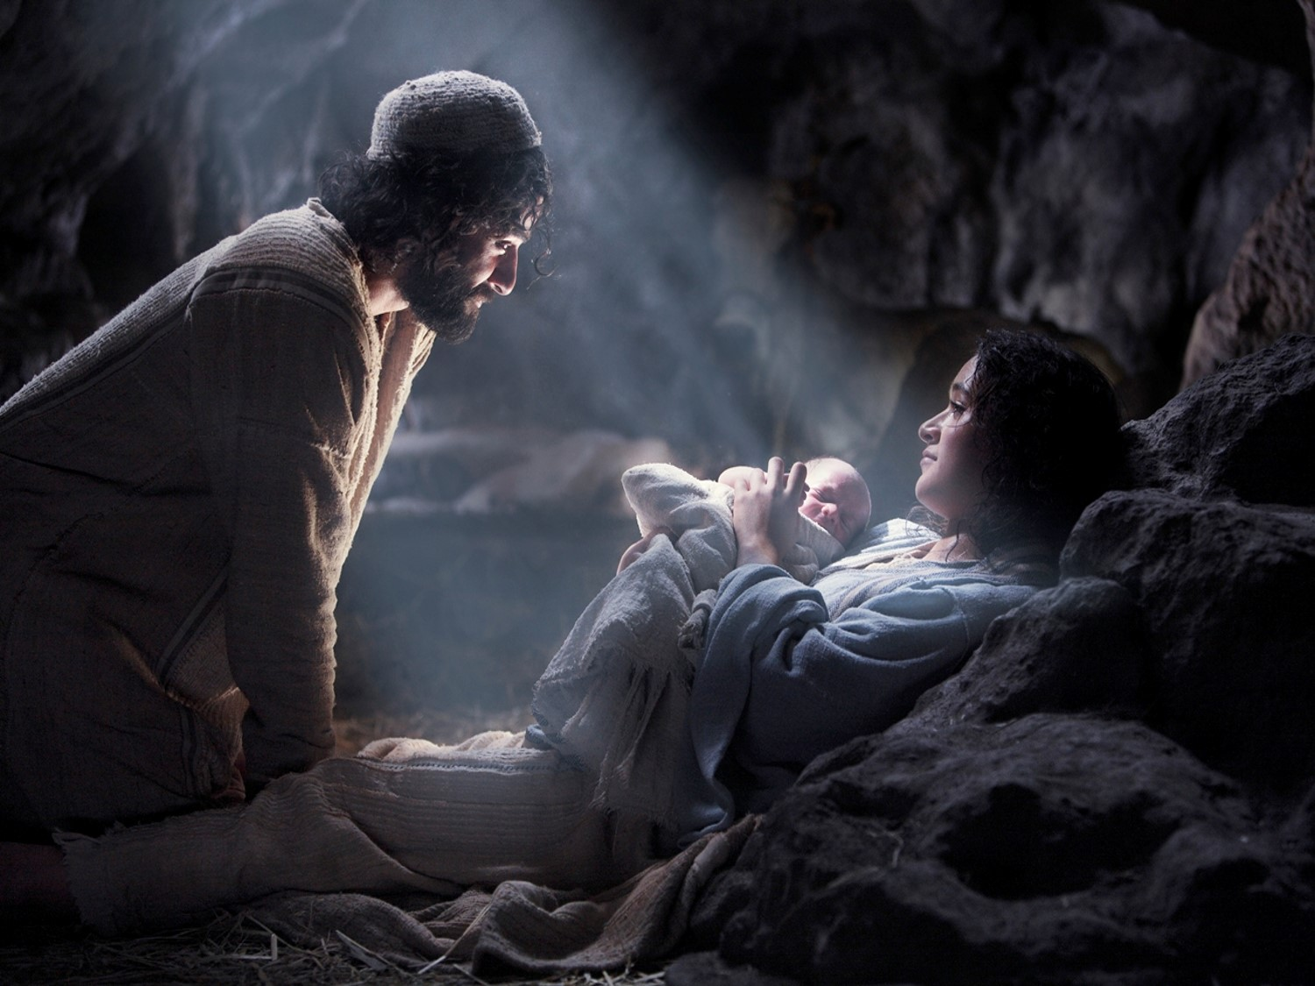
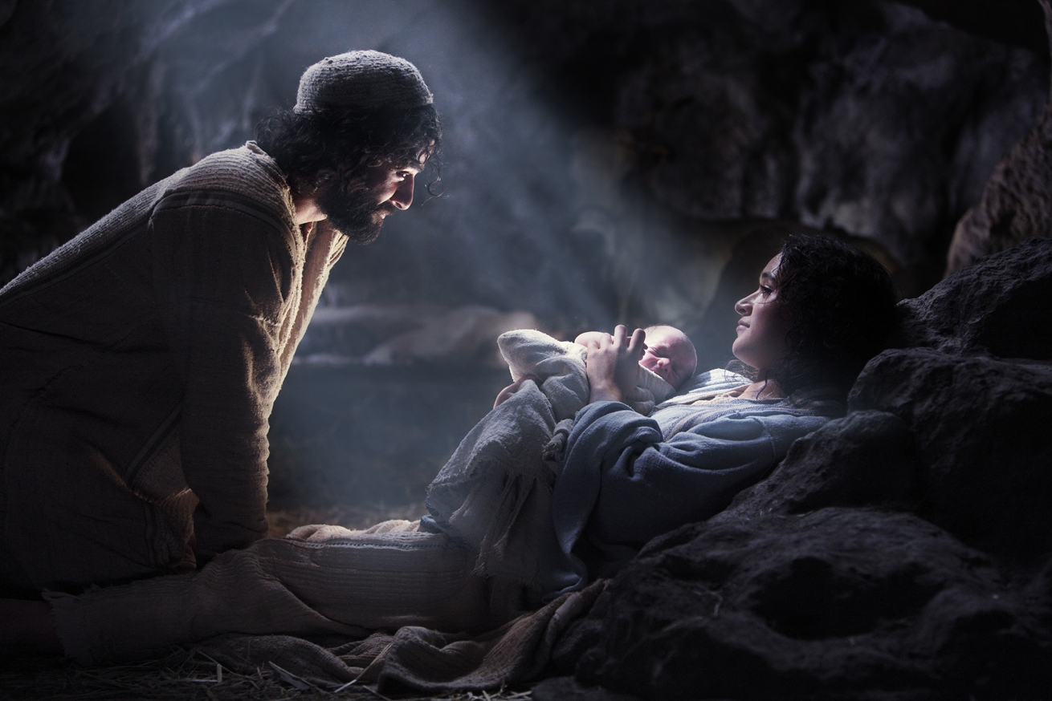
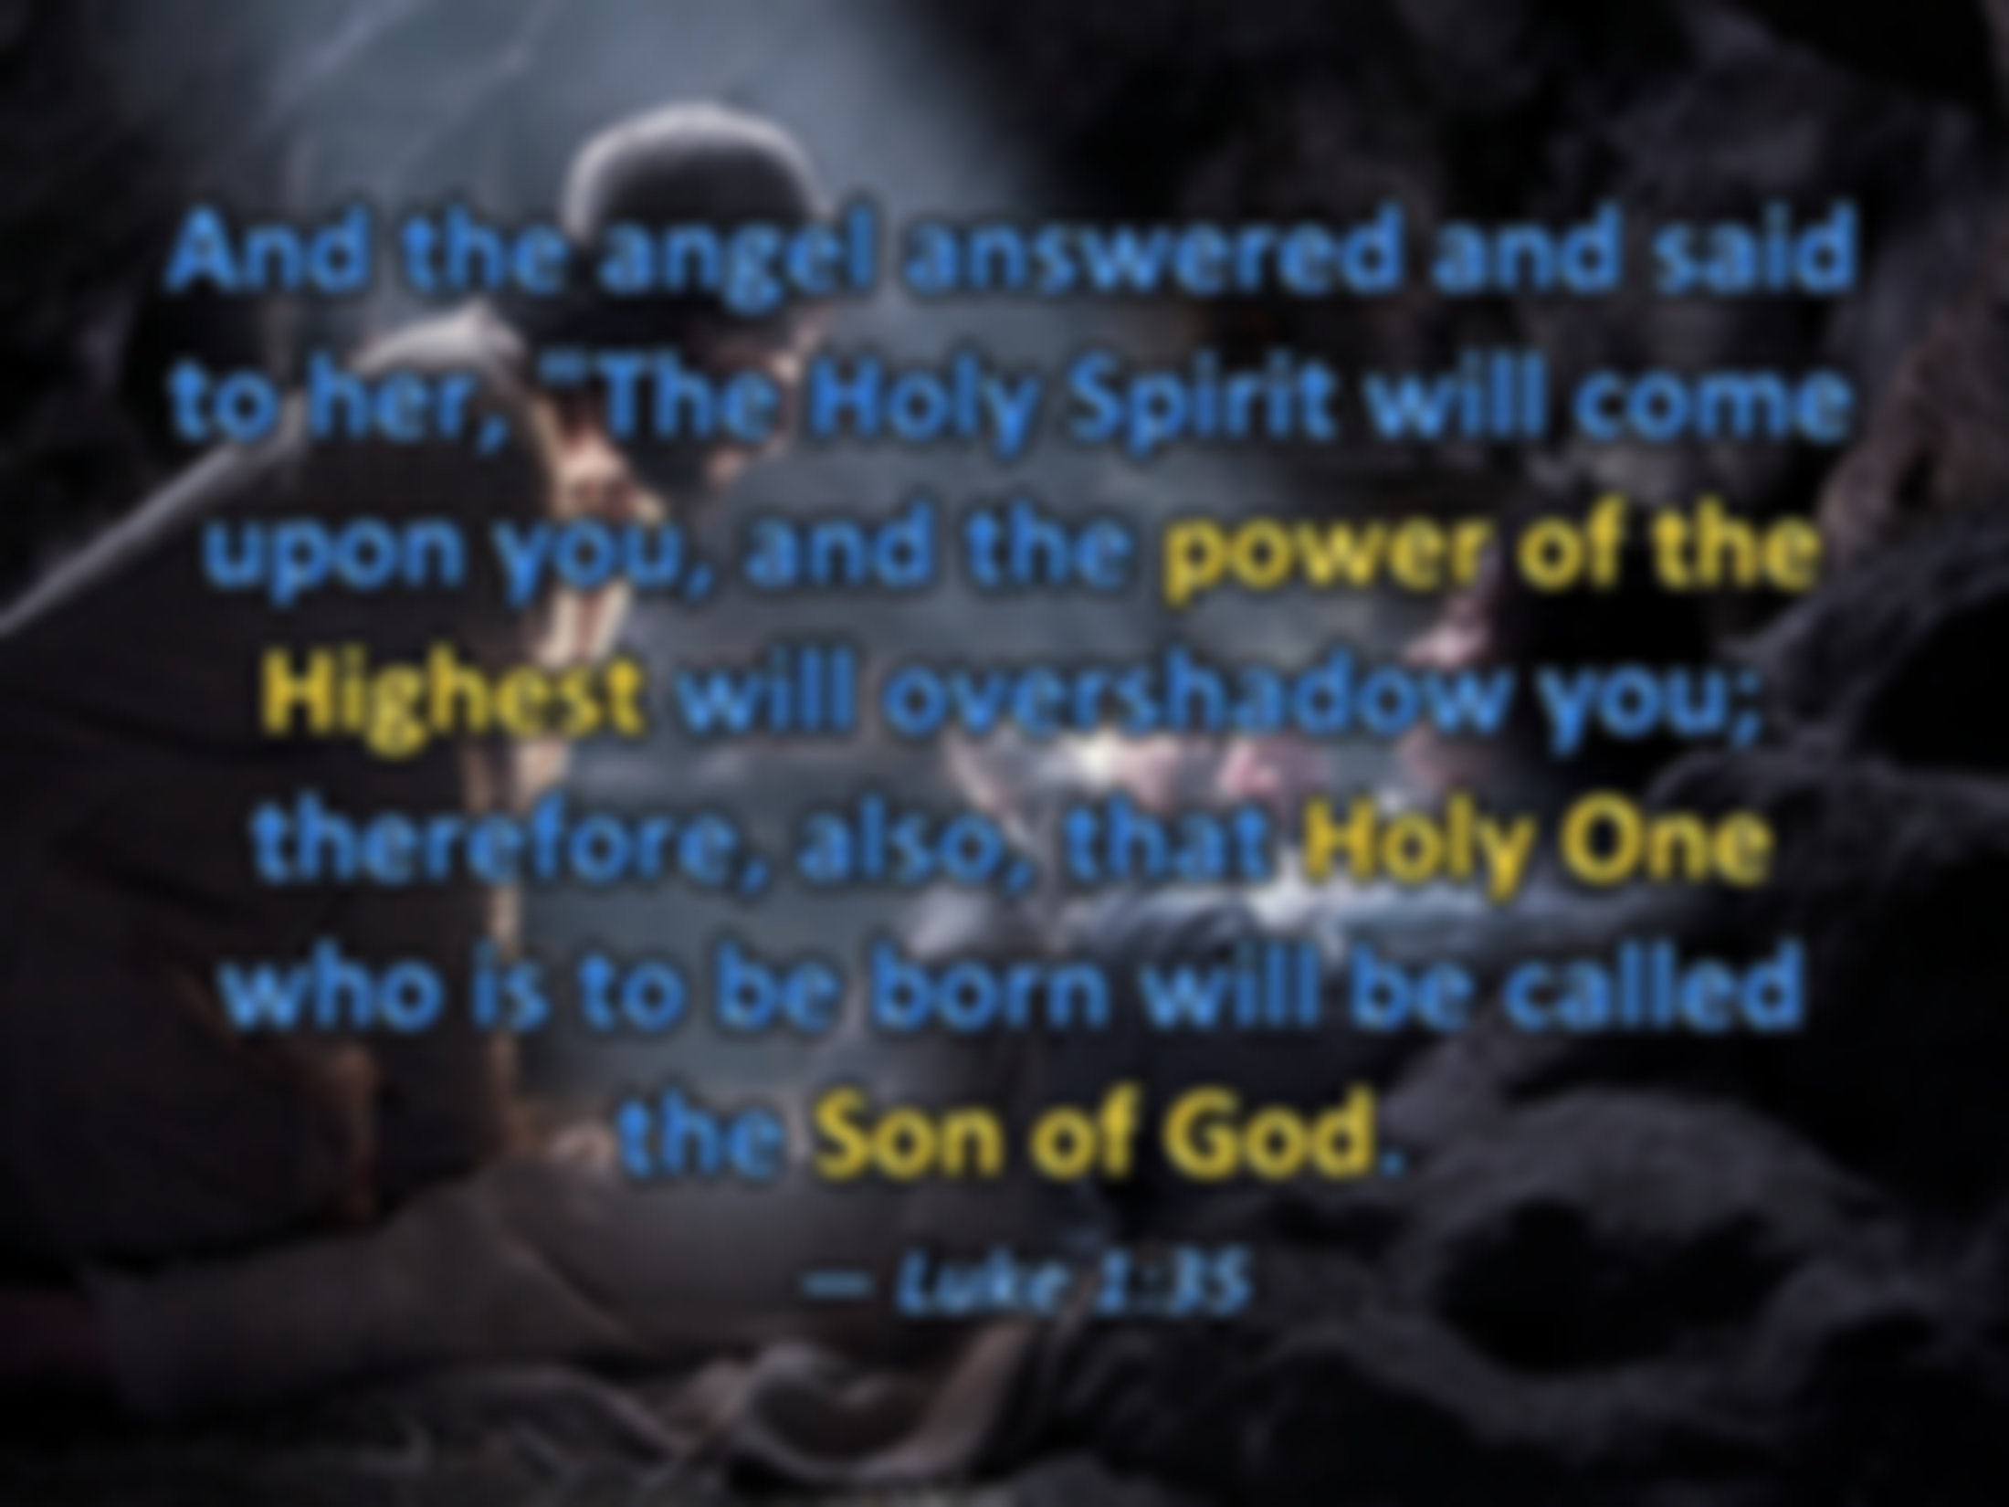




And the angel answered and said to her, "The Holy Spirit will come upon you, and the power of the Highest will overshadow you; therefore, also, that Holy One who is to be born will be called the Son of God.
— Luke 1:35
Holy Spirit
Son of God
of God

Slide 13
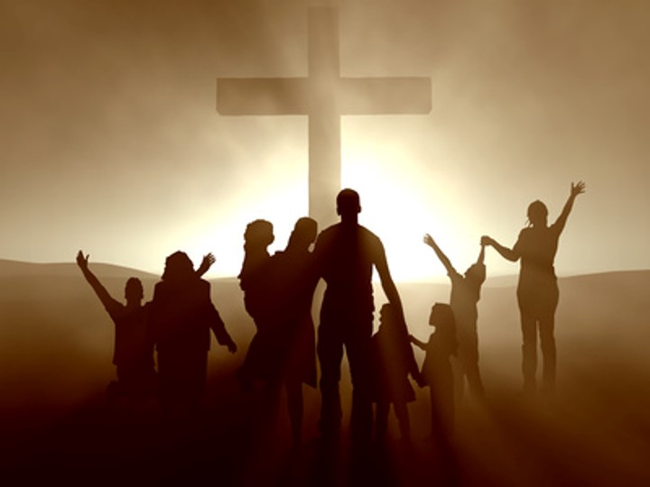
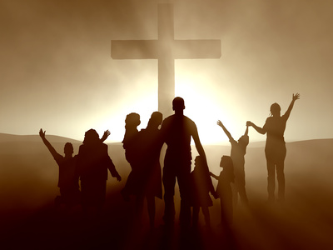
And Jesus answered and said to them, "The sons of this age marry and are given in marriage. "But those who are counted worthy to attain that age, and the resurrection from the dead, neither marry nor are given in marriage; "nor can they die anymore, for they are equal to the angels and are sons of God, being sons of the resurrection.
— Luke 20:34-36
equal to the angels
neither die nor given in marriage
↑
sons of God
sons of the resurrection from the dead
↑
counted worthy to attain that age
↑
sons of this age marry
Jesus
Jesus
sons of this age marry
But as many as received Him, to them He gave the right to become children of God, to those who believe in His name: who were born, not of blood, nor of the will of the flesh, nor of the will of man, but of God. — John 1:12-13
That is, those who are the children of the flesh, these are not the children of God; but the children of the promise are counted as the seed. — Romans 9:8
become children of God
O.T. = 5 times
N.T. = 5 times
counted worthy to attain that age
children of the promise
. .
neither
born
from the dead
born
sons of God
s
. .
counted as the seed
. .
nor
given in marriage
of God
. .
seed
die
Believers
sons of God
equal to the angels
sons of God
. .
=
Born Again
sons of the resurrection
being
sons of the resurrection
. .
Notes:
Sons of God – Old Testament, Genesis 2 times, Job 3 times. New Testament 5 times. God’s power comes to us by His Holy Spirit displayed through Christ. Sons of God, also called sons of the resurrection, find life through God’s own womb of truth. His promise comes to those born in Him who call on His name, believe in His Word. Belief is key to unlocking the door to eternity. God wills that we find peace under His cover of truth in Grace.

Slide 14
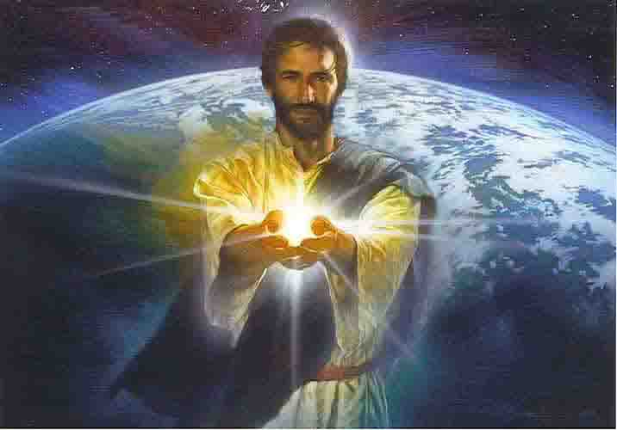
The Jews answered Him, saying, "For a good work we do not stone You, but for blasphemy, and because You, being a Man, make Yourself God." Jesus answered them, "Is it not written in your law, 'I said, "You are gods"'? If He called them gods, to whom the word of God came (and the Scripture cannot be broken), do you say of Him whom the Father sanctified and sent into the world, 'You are blaspheming,' because I said, 'I am the Son of God'? If I do not do the works of My Father, do not believe Me; but if I do, though you do not believe Me, believe the works, that you may know and believe that the Father is in Me, and I in Him." — John 10:33-38
called them gods
God
God called them gods
I am the Son of God
the Father is in Me, and I in Him
in
in
I am the Son of God
Unity
the Father is in Me, and I in Him
Notes:
Myhlak keelohim, "like God."

Slide 15
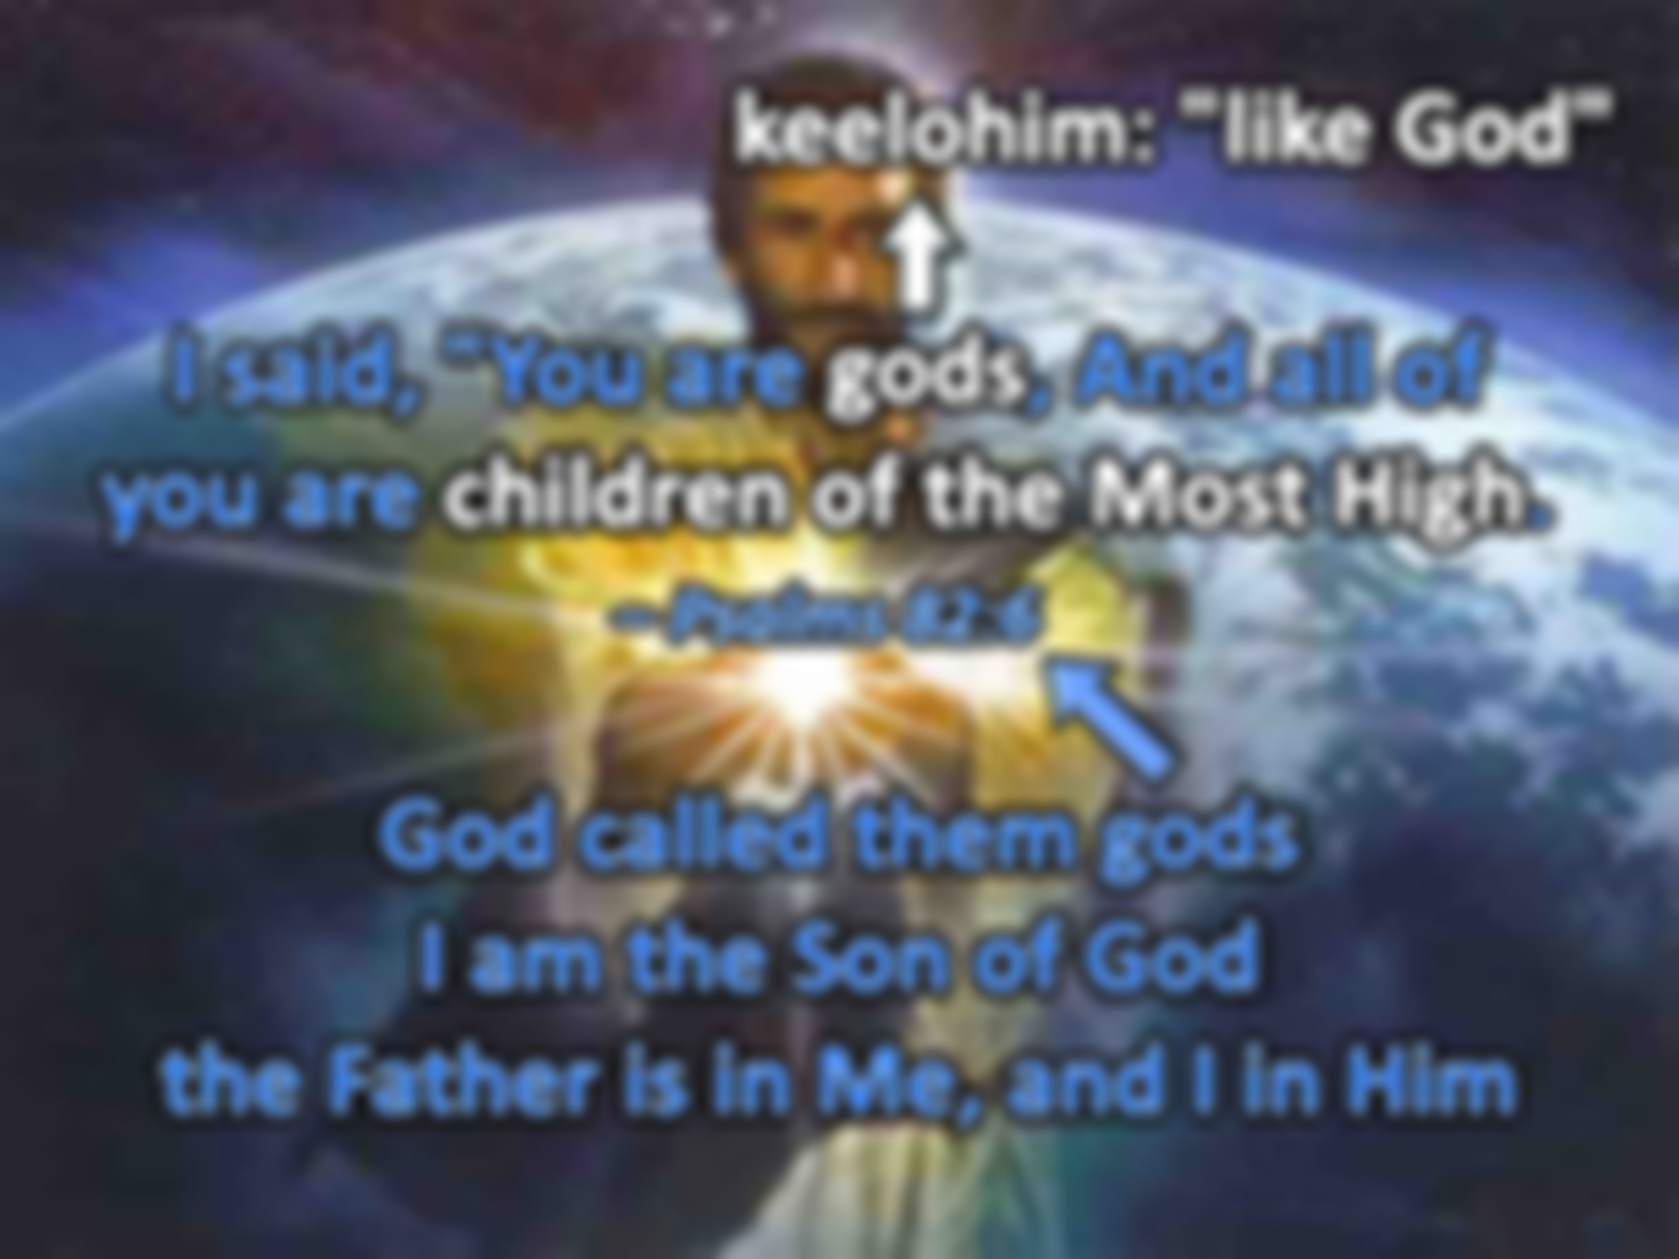



Beloved, now we are children of God; and it has not yet been revealed what we shall be, but we know that when He is revealed, we shall be like Him, for we shall see Him as He is. — 1st John 3:2
For you were once darkness, but now you are light in the Lord. Walk as children of light — Ephesians 5:8
keelohim: "like God"
In Him was life, and the life was the light of men. — John 1:4
light in the Lord
light in the Lord
in
in
. .
children of light
gods
I said, "You are gods, And all of you are children of the Most High. – Psalms 82:6
children of the Most High
N.T. = 10 times
children of God
God called them gods
I am the Son of God
the Father is in Me, and I in Him
God called them gods
I am the Son of God
the Father is in Me, and I in Him
Notes:
keelohim, "like God" . As God proclaims “You are gods,” it is for our power to judge and execute punishment. Created in His image we have these absolute characteristics of the Almighty. To find the highest quality of self, one must see God in self, both inward and outward. God wants us to see the light of life is given by His love for us to become on our own. We bear witness of ourselves and what leads us will judge us in His presence. Without practicing righteousness with a loving heart will condemn all those who fall away from this call. To be of God or not of God.

Slide 16
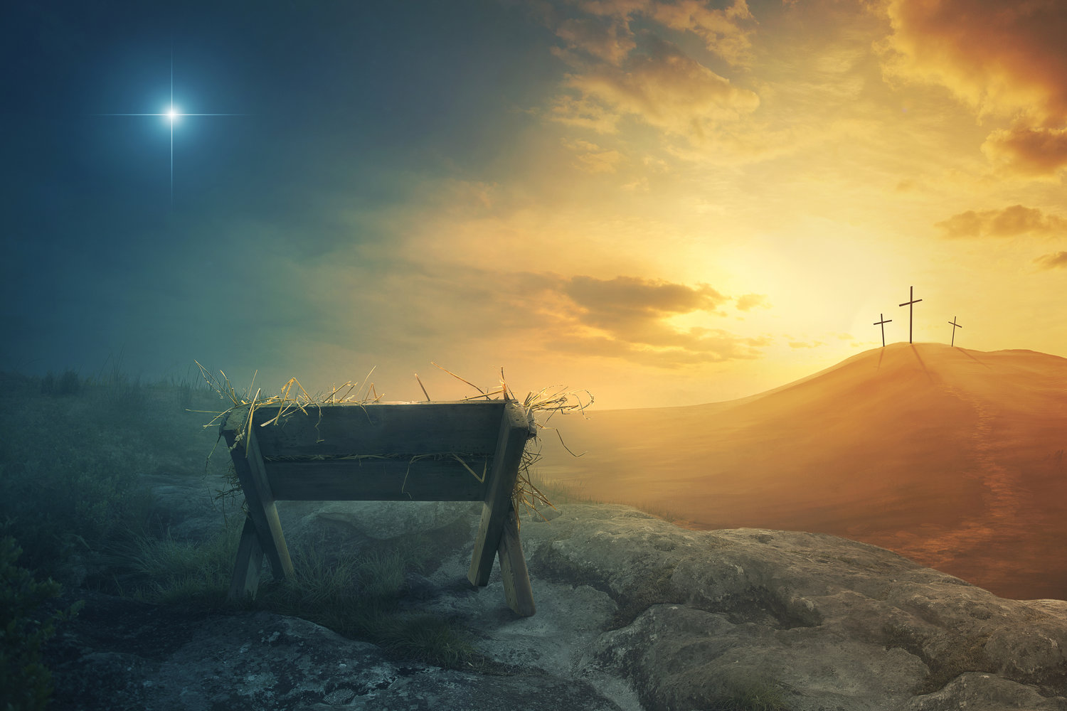
children of God

Slide 17
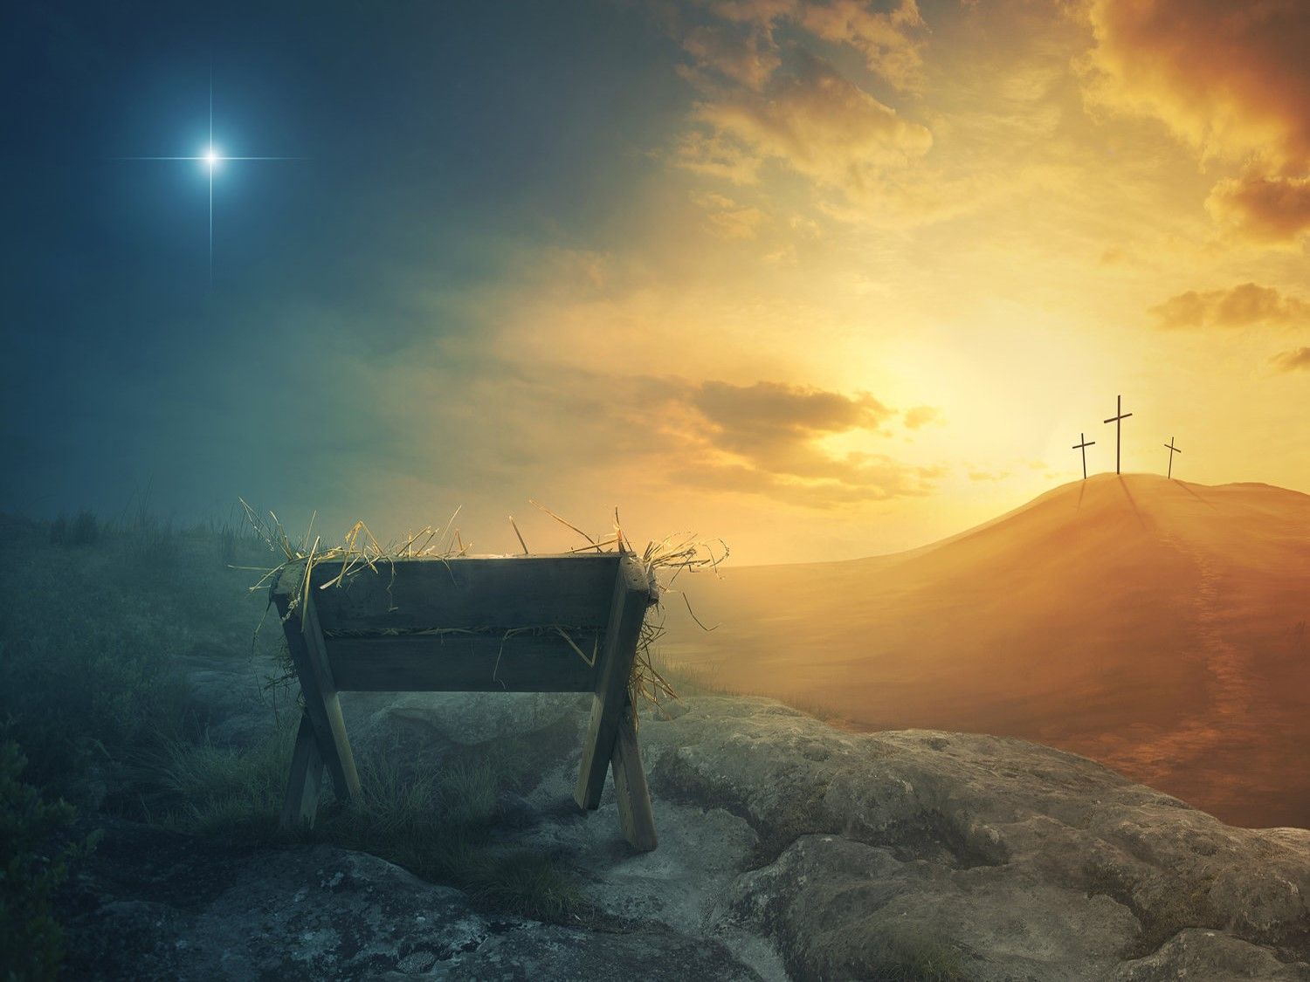
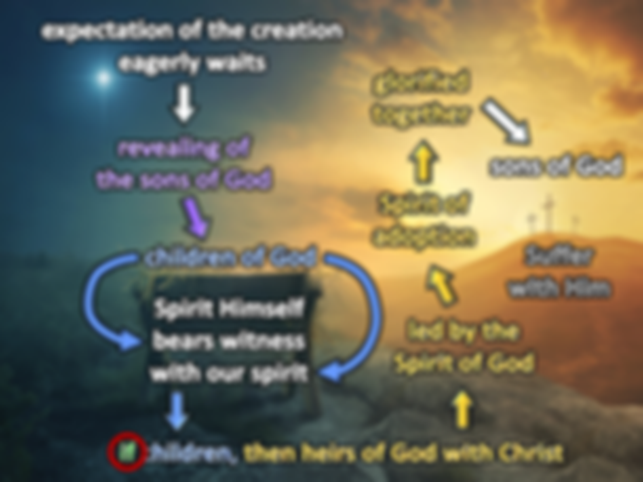
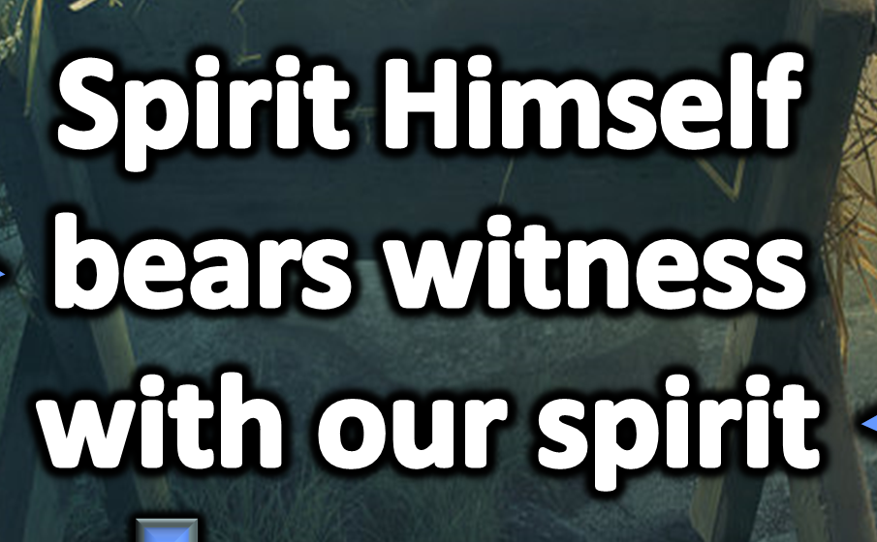
expectation of the creation eagerly waits
led by the
Spirit of God
In this the children of God and the children of the devil are manifest: Whoever does not practice righteousness is not of God, nor is he who does not love his brother. — 1st John 3:1
For as many as are led by the Spirit of God, these are sons of God. For you did not receive the spirit of bondage again to fear, but you received the Spirit of adoption by whom we cry out, "Abba, Father." The Spirit Himself bears witness with our spirit that we are children of God, and if children, then heirs - heirs of God and joint heirs with Christ, if indeed we suffer with Him, that we may also be glorified together. For I consider that the sufferings of this present time are not worthy to be compared with the glory which shall be revealed in us. For the earnest expectation of the creation eagerly waits for the revealing of the sons of God. — Romans 8:14-19
sons of God
glorified together
God
children of God
. .
children of the devil
Spirit of
. .
adoption
practice
revealing of the sons of God
righteousness
not of God
sons of God
Spirit Himself
bears witness
with our spirit
love his brother
Spirit of adoption
children of God
if children, then heirs
children of God
of God
with Christ
Suffer with Him
children of God
glorified
together
Spirit Himself bears witness with our spirit
led by the Spirit of God
expectation
of the creation
eagerly waits
revealing of
the sons of God
God
God
God
God
God
God
God
God
if
if children, then heirs of God with Christ
of God

Slide 18
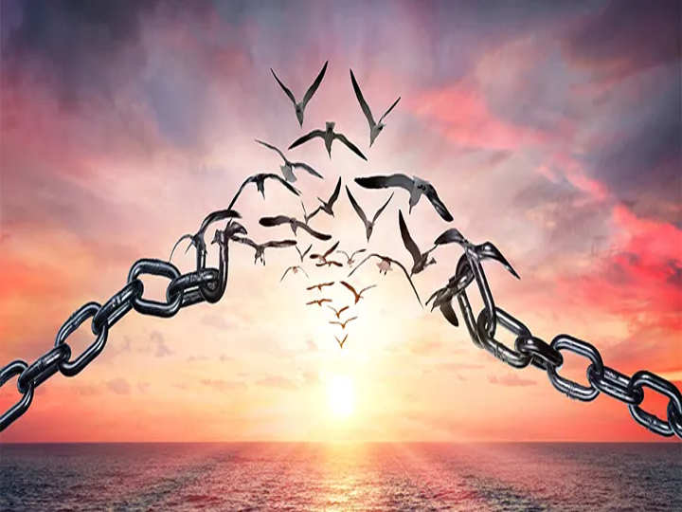
Blessed are the peacemakers, For they shall be called sons of God.
— Matthew 5:9
sons of God
Notes:
God wills that we find peace under His cover of truth in Grace.

Slide 19



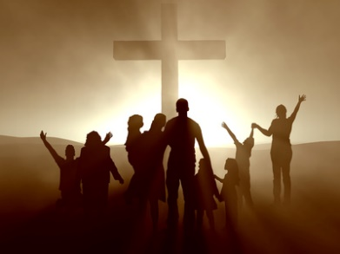



Slide 20

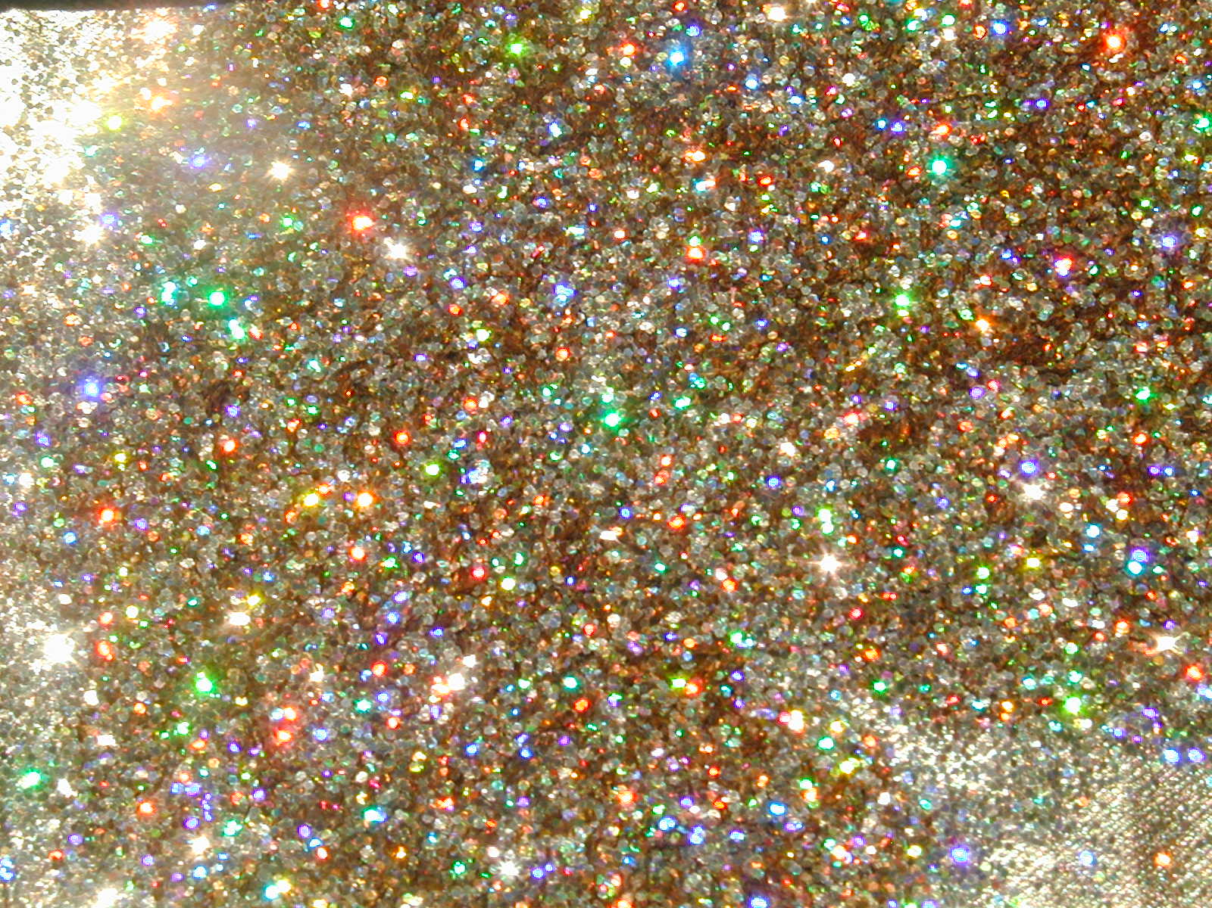
→ God, not a man, is of truth, justice, & righteousness
→ God’s plans remain sure viewing all the sons of men
→ Knowledge of the Holy One is understanding
→ Do all one does heartily as to the Lord & not to men
→ Sons of God are called to have faith in Christ Jesus
→ God wills dead spiritual bones to rise in life to Him
→ Sons of God distinctly receive eternal life as angles
→ Children of God trust receiving God, born in Him
→ Given freedom’s power, virtues prevail or not
→ God calls us to walk as children of light in His light
→ To be led by the Spirit of God proclaims sons of God
→ The creation waits for the revealing of sons of God
→ God wills we find peace as sons of God
In His light we find love
Notes:
In His light we find love.

Slide 22

Please visit http://www.RonBert.com to explore further
Ronald Bert Channel on
Notes:
Eternity never ends.

