Slide 2


Skilled Servants
Skilled
Servants
Ron Bert
January 24, 2021

Slide 3

There are diversities of gifts, but the same Spirit. — 1st Corinthians 12:4
ONE
Notes:
People and religions like to declare the God of their choice, one that fits for their convenience of tolerance. COEXIST is a religion of religions. One thing cannot be changed in that God is God, and there is no other. Many would prefer a God of love, but not a God of judgment. As God is God, His ways can not be ignored with clauses written by mere men. God looks for genuine hearts that seek Him, and climb the ladder of truth’s righteousness.

Slide 4
one

Slide 5


As each one has received a gift, minister it to one another, as good stewards of the manifold grace of God. — 1st Peter 4:10
each one has received a gift
each one has received a gift
share
one
God
God
God
God
God
God
God
God
God
diverse
God
grace of God
Notes:
We do not have a God of bigotry but fairness. Each has a given gift to be found.

Slide 6

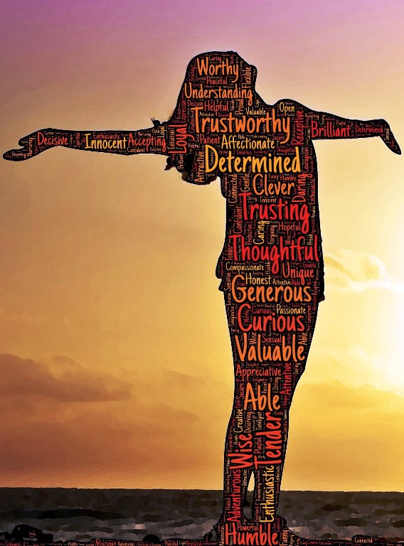
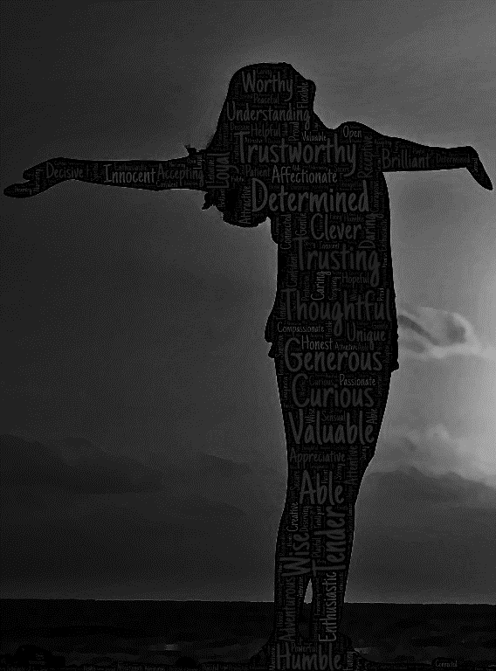
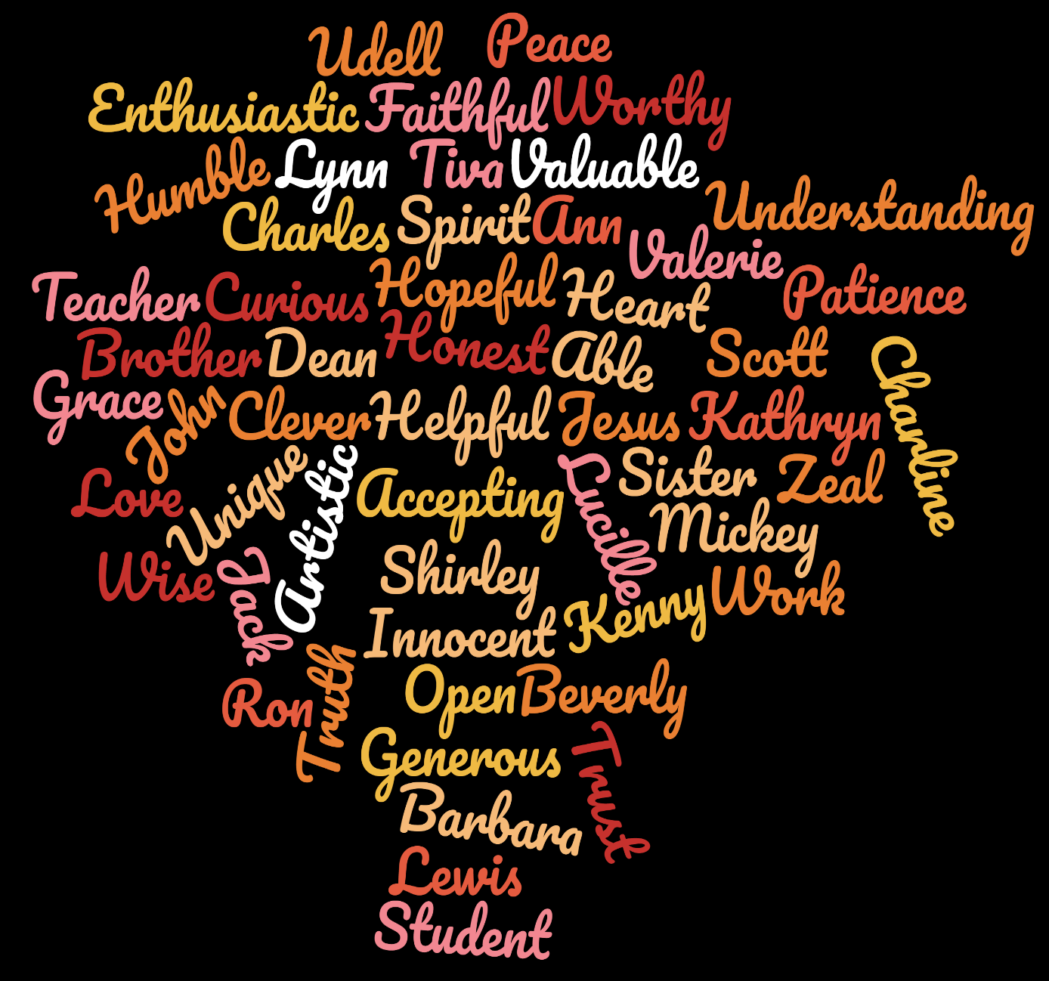
I beseech you therefore, brethren, by the mercies of God, that you present your bodies a living sacrifice, holy, acceptable to God, which is your reasonable service. — Romans 12:1
present your bodies:
→ a living sacrifice
holy, acceptable to God
reasonable service
present your bodies
a living
God
God
a living sacrifice
sacrifice
holy, acceptable to God
holy
reasonable service
Notes:
So many qualities exemplify a soul of high quality. Determined qualities of valuable humble honesty; tender and appreciative. Thoughtful caring souls are not so apt to apply cunning arrogance stealing innocence.
Human life is a gift and a test of commitment

Slide 7
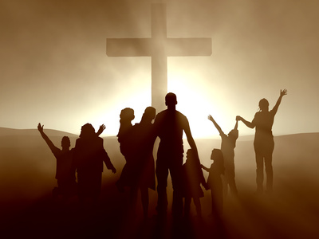
For as we have many members in one body, but all the members do not have the same function, so we, being many, are one body in Christ, and individually members of one another. — Romans 12:4-5
members
members
members
in
being many, are one body in Christ
being many, are one body in Christ
holy
Christ
holy
members

Slide 8

Having then gifts differing according to the grace that is given to us, let us use them: if prophecy, let us prophesy in proportion to our faith; or ministry, let us use it in our ministering; he who teaches, in teaching; he who exhorts, in exhortation; he who gives, with liberality; he who leads, with diligence; he who shows mercy, with cheerfulness. — Romans 12:6-7
Having then gifts differing according to the grace that is given to us, let us use them: if prophecy, let us prophesy in proportion to our faith; or ministry, let us use it in our ministering; he who teaches, in teaching; he who exhorts, in exhortation; he who gives, with liberality; he who leads, with diligence; he who shows mercy, with cheerfulness. — Romans 12:6-7
Having
Having
given to us
given to us
use them
use them
our faith
ministering
members
teaching
exhortation
gives
leads
mercy

Slide 9

And He Himself gave some to be apostles, some prophets, some evangelists, and some pastors and teachers, for the equipping of the saints for the work of ministry, for the edifying of the body of Christ, … — Ephesians 4:11-12
to be
to be
for the equipping
for the work
for the edifying
Christ
for the equipping
saints
for the work
for the edifying
Christ

Slide 10

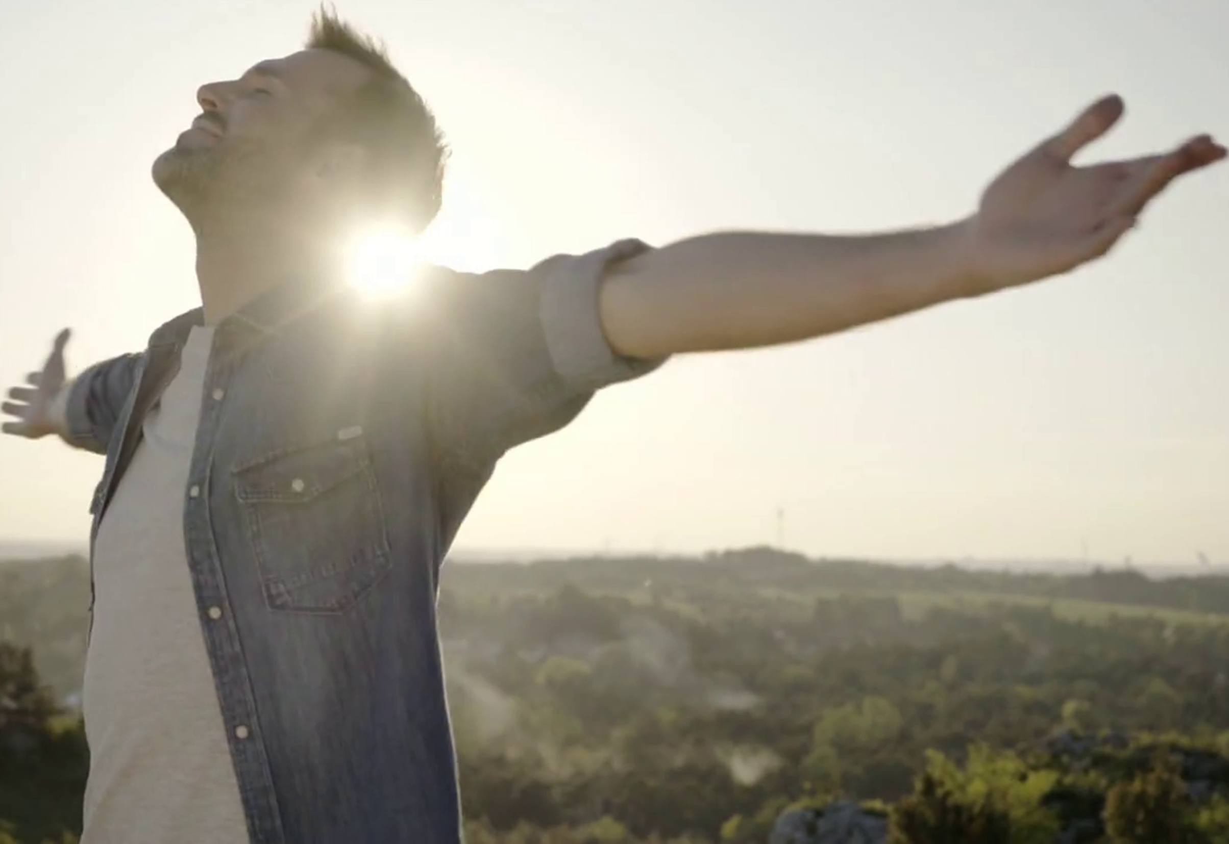
… till we all come to the unity of the faith and of the knowledge of the Son of God, to a perfect man, to the measure of the stature of the fullness of Christ; that we should no longer be children, tossed to and fro and carried about with every wind of doctrine, by the trickery of men, in the cunning craftiness of deceitful plotting, … — Ephesians 4:13-14
the unity of
the unity of the faith:
knowledge of the Son of God
fullness of Christ
should no longer be children:
tossed with every wind of doctrine
trickery of men
cunning craftiness
deceitful plotting
the faith
knowledge of the
Son of God
Christ
fullness
Christ
of
Christ
should no longer
be children
tossed
with every wind of
doctrine
trickery of men
cunning craftiness
deceitful
plotting

Slide 11
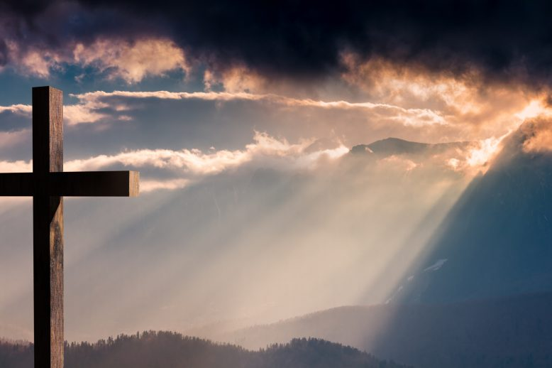

… but, speaking the truth in love, may grow up in all things into Him who is the head -- Christ -- from whom the whole body, joined and knit together by what every joint supplies, according to the effective working by which every part does its share, causes growth of the body for the edifying of itself in love. — Ephesians 4:15-16
in
. .
truth in love
. .
grow up
Christ
Christ
. .
effective working
. .
every part does its share
CHURCH
enriching
in
love
Notes:
Overall it is God accomplishing His plan to retrieve the greatest number of souls without browbeating anyone into submission. Choices in life are given to the freedom He bestows upon all of us. Those who unite in building character worthy of all they encounter is His will for the love He hopes all to share.

Slide 12

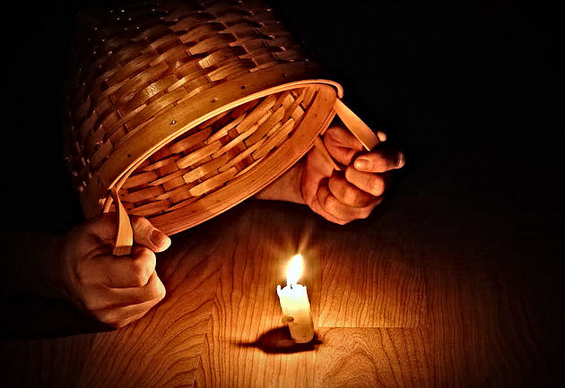
"You are the light of the world. A city that is set on a hill cannot be hidden. Nor do they light a lamp and put it under a basket, but on a lampstand, and it gives light to all who are in the house. Let your light so shine before men, that they may see your good works and glorify your Father in heaven." — Matthew 5:14-16
You are
light
You are
light
light
light
light
so shine
may see your good
glorify your Father
Notes:
When people hide paranoia fills the void where honesty has evaporated.

Slide 13

"You are the salt of the earth; but if the salt loses its flavor, how shall it be seasoned? It is then good for nothing but to be thrown out and trampled underfoot by men." — Matthew 5:13
Genuine
You are
Positive
o
f
from
Negative
r
m
Ingenuine
Notes:
Salt has presence when it is able to perform the work appropriate to the task. If is inactive it lacks the quality to enhance what it interacts with.

Slide 14
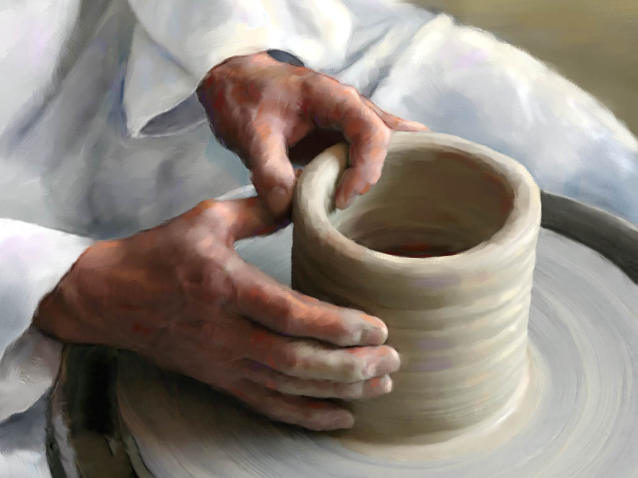
Does not the potter have power over the clay, from the same lump to make one vessel for honor and another for dishonor? — Romans 9:21
honor
dishonor
from
honor
dishonor

Slide 15

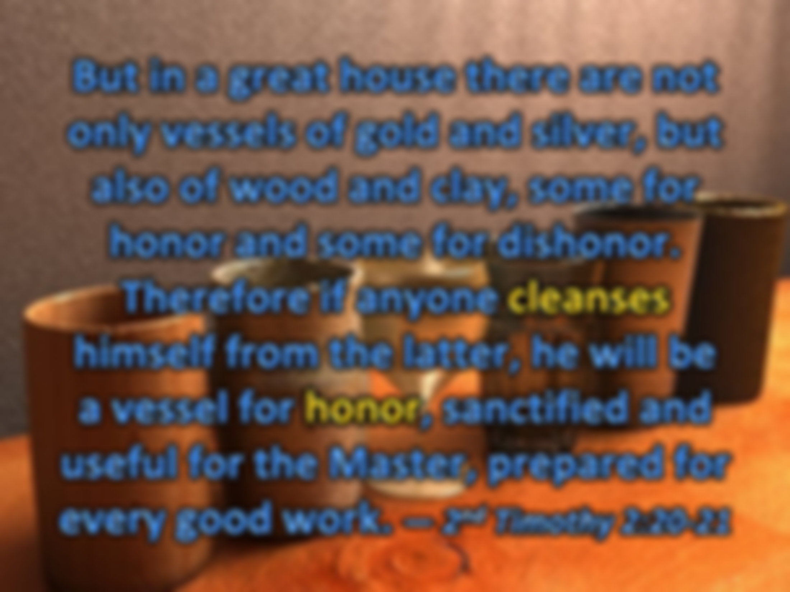


But in a great house there are not only vessels of gold and silver, but also of wood and clay, some for honor and some for dishonor. Therefore if anyone cleanses himself from the latter, he will be a vessel for honor, sanctified and useful for the Master, prepared for every good work. — 2nd Timothy 2:20-21
honor
dishonor
useful for
. .
good work
. .
Notes:
Each honest heart understands there are unholy things in life. To purge one’s environment of these either despicable objects or filth producing products ensures a better quality of living decently.

Slide 16
God
Death
Life
Notes:
Each honest heart understands there are unholy things in life. To purge one’s environment of these either despicable objects or filth producing products ensures a better quality of living decently.

Slide 17

Be diligent to present yourself approved to God, a worker who does not need to be ashamed, rightly dividing the word of truth. — 2nd Timothy 2:15
present yourself to God
an approved diligent worker
not ashamed
↓
rightly dividing
↓
the word of truth
God
diligent
present yourself
to
approved to God
God
approved
to God
a
worker
approved to God
not
n
ashamed
rightly dividing
the word of truth
Actions
Notes:
Light will judge our actions be they as they are

Slide 18
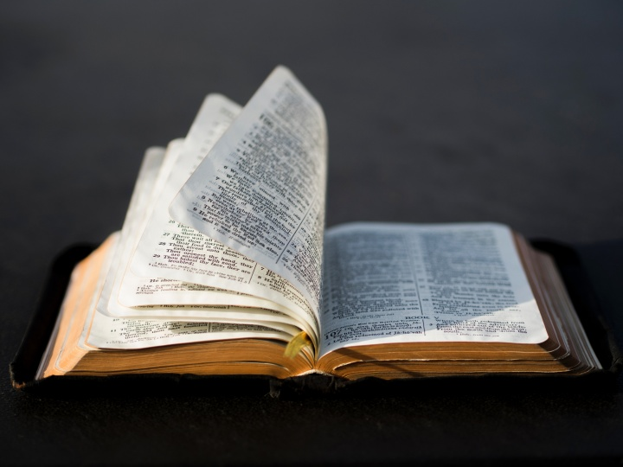
Till I come, give attention to reading, to exhortation, to doctrine. Do not neglect the gift that is in you, which was given to you by prophecy with the laying on of the hands of the eldership. Meditate on these things; give yourself entirely to them, that your progress may be evident to all. Take heed to yourself and to the doctrine. Continue in them, for in doing this you will save both yourself and those who hear you. — 1st Timothy 4:13-16
Till I come, give attention to reading, to exhortation, to doctrine. Do not neglect the gift that is in you, which was given to you by prophecy with the laying on of the hands of the eldership. Meditate on these things; give yourself entirely to them, that your progress may be evident to all. Take heed to yourself and to the doctrine. Continue in them, for in doing this you will save both yourself and those who hear you. — 1st Timothy 4:13-16
Do not neglect
Do not neglect
the gift
in
in you
the gift
in you
Meditate on
Meditate on
give yourself entirely to them
give yourself entirely to them
progress
progress
in
Continue in them
Continue in them
Notes:
Continuing in His word is what allows us to approach heaven while still in the flesh. One must desire salvation to acquire it.

Slide 19

Therefore, laying aside all malice, all deceit, hypocrisy, envy, and all evil speaking, as newborn babes, desire the pure milk of the word, that you may grow thereby, if indeed you have tasted that the Lord is gracious. — 1st Peter 2:1-3
X
laying aside
malice
laying aside
milk
envy
malice
all deceit
hypocrisy
evil speaking
all deceit
hypocrisy
envy
Basic
Truths
evil speaking
desire the pure milk of the word
milk
desire the pure milk of the word

Slide 20
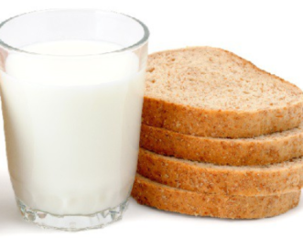
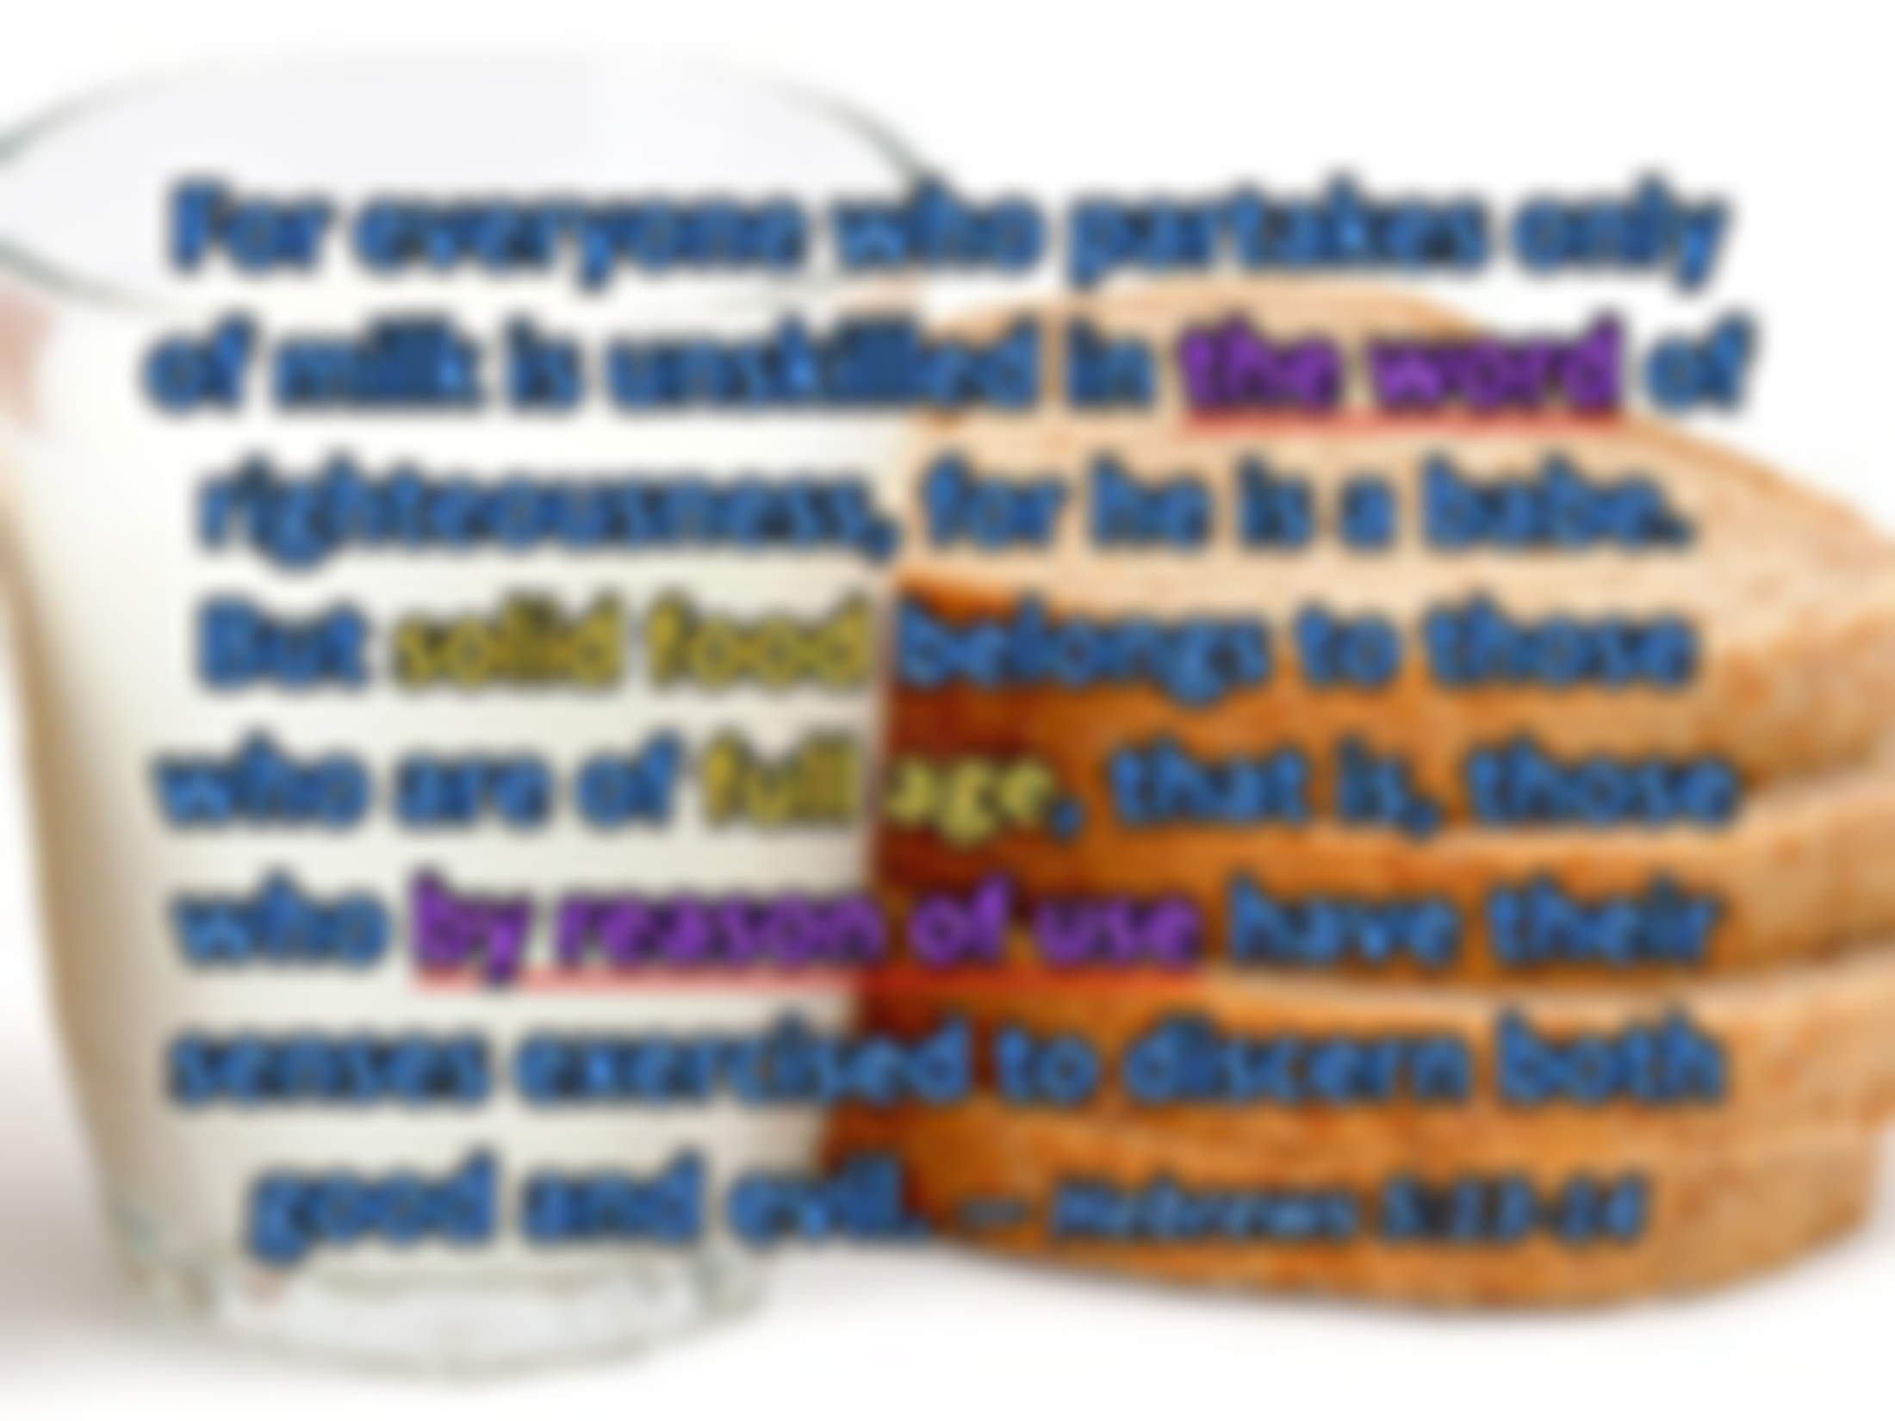



For everyone who partakes only of milk is unskilled in the word of righteousness, for he is a babe. But solid food belongs to those who are of full age, that is, those who by reason of use have their senses exercised to discern both good and evil. — Hebrews 5:13-14
Goodness
Blameless
Decency
only
only
Virtuous
milk
the word
of milk is unskilled
. .
. .
Integrity
righteousness
righteousness
Faith
Love
Trust in God
in
discern by reason good and evil
Obedience
. .
Bold
by reason of use
by reason
Honesty
Honorable
discern
Morality
good and evil
Justice
Uprightness
Notes:
The old adage “Use it or loose it” certainly applies when concerning God’s word. It is a continual practice to improve that which aligns with His word. Worthy is defined by our actions regarding His call to be in truth.

Slide 21


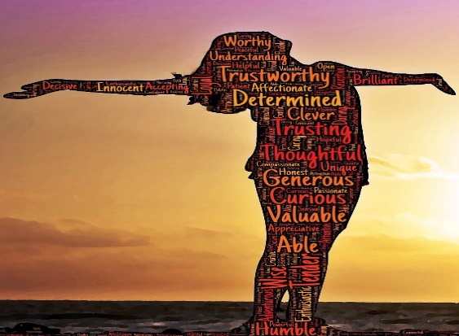


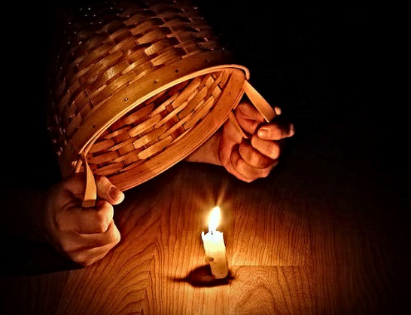
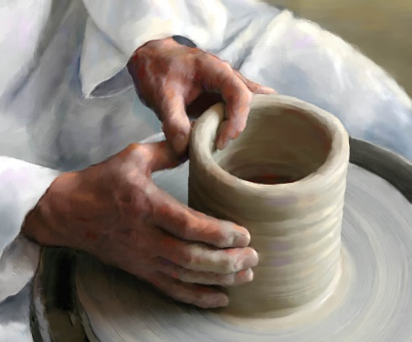




Slide 22


→ God shares talents among the many for the whole
→ As stewards we have received gifts to be shared
→ Individualism is the staple call of God’s own image
→ Thus by God’s grace we were created to perform
→ One’s gifts in life are to assist for the good of all
→ Speaking truth in love propels spiritual growth
→ All are called to shine forth in a working faith
→ Without presence of character we fade in isolation
→ Purging moral filth cleanses the spirit in His light
→ Truth allows one to stand in the light unashamed
→ Each has been given not to neglect using said gift
→ We should always have a desire to grow in His word
→ Spiritual maturity’s key is knowledge with wisdom
Truth often is a razor that cuts honest hearts
Notes:
Truth often is a razor that cuts honest hearts

Slide 24

Please visit http://www.LoveFromGod.com to explore further
Ronald Bert Channel on
Notes:
Eternity never ends.

