Slide 1
`
Notes:
Darkness hides no truth but holds all lies.

Slide 2
Signs
Ron Bert
August 4, 2017

Slide 3
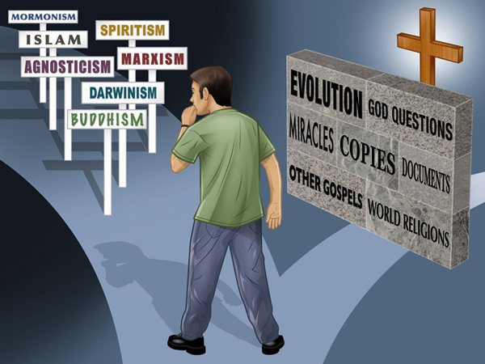
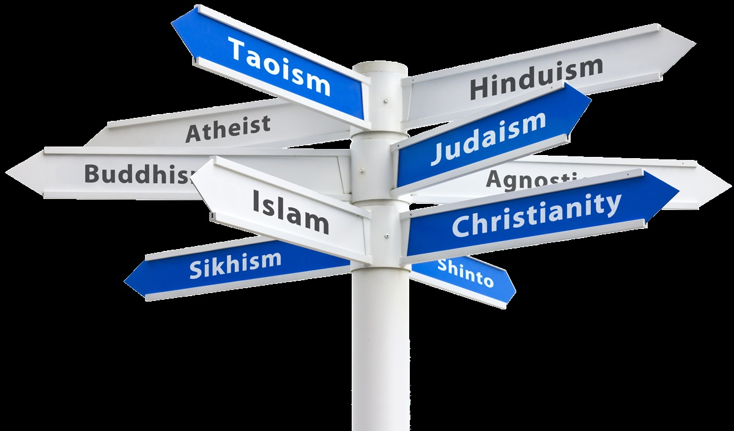

Slide 4
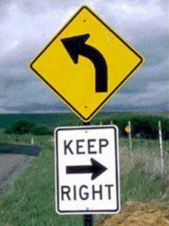
Darkness
Light

Slide 5
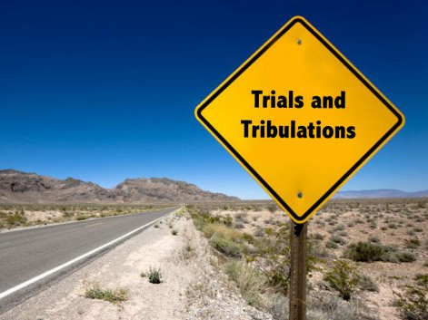
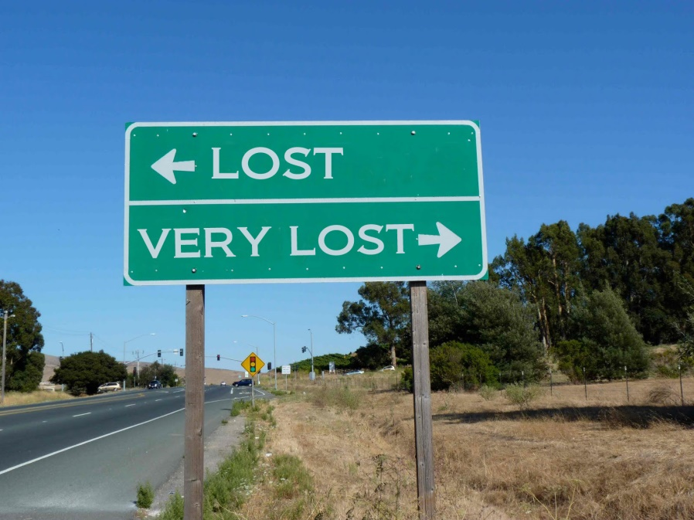
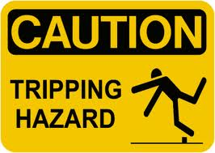
For man also does not know his time: Like fish taken in a cruel net, Like birds caught in a snare, So the sons of men are snared in an evil time, When it falls suddenly upon them. — Ecclesiastes 9:12
"Tell us, when will these things be? And what will be the sign when all these things will be fulfilled?" — Mark 13:4
The backslider in heart will be filled with his own ways, But a good man will be satisfied from above. — Proverbs 14:14
For a righteous man may fall seven times And rise again, But the wicked shall fall by calamity. — Proverbs 24:16
what will be the sign
what will be the sign
Dishonest
Honest

Slide 6
"And there will be signs in the sun, in the moon, and in the stars; and on the earth distress of nations, with perplexity, the sea and the waves roaring; men's hearts failing them from fear and the expectation of those things which are coming on the earth, for the powers of heaven will be shaken. Then they will see the Son of Man coming in a cloud with power and great glory." — Luke 21:25-27
Now the Spirit expressly says that in latter times some will depart from the faith, giving heed to deceiving spirits and doctrines of demons, speaking lies in hypocrisy, having their own conscience seared with a hot iron, forbidding to marry, and commanding to abstain from foods which God created to be received with thanksgiving by those who believe and know the truth. — 1st Timothy 4:1-3
in
in latter times
deceiving spirits and
◦ deceiving spirits and doctrines
◦ speaking lies in hypocrisy
◦ having conscience seared
◦ forbidding to marry
◦ commanding to abstain from foods
doctrines
speaking lies in
hearts failing them from fear
conscience
hypocrisy
having
seared
forbidding to marry
commanding to abstain from foods

Slide 7
And have no fellowship with the unfruitful works of darkness, but rather expose them. — Ephesians 5:11
'They shall be My people, and I will be their God; then I will give them one heart and one way, that they may fear Me forever, for the good of them and their children after them.' — Jeremiah 32:38-39
Coexis
one way
one way
one heart and one way
Respect

Slide 8
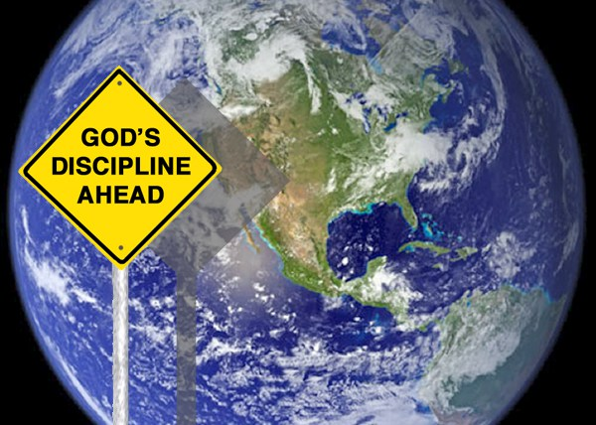
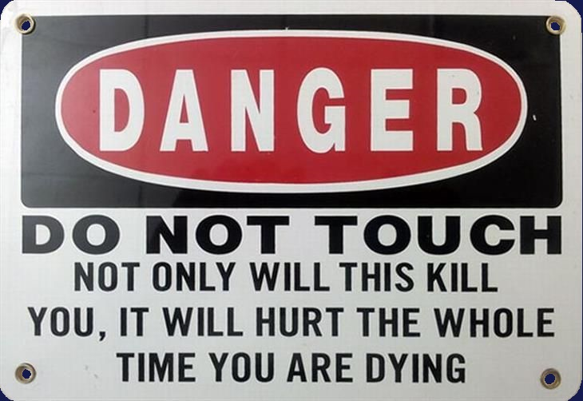
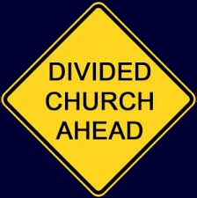
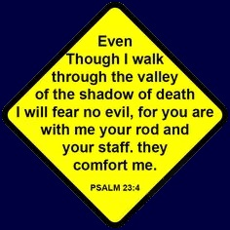
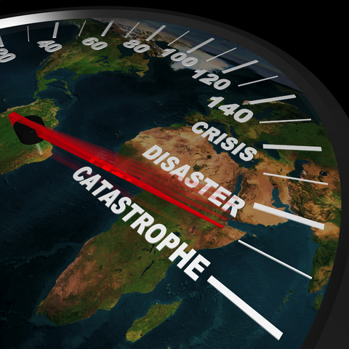
A good name is better than precious ointment, And the day of death than the day of one's birth; — Ecclesiastes 7:1
The way of life winds upward for the wise, That he may turn away from hell below. — Proverbs 15:24
The way of life
turn

Slide 9
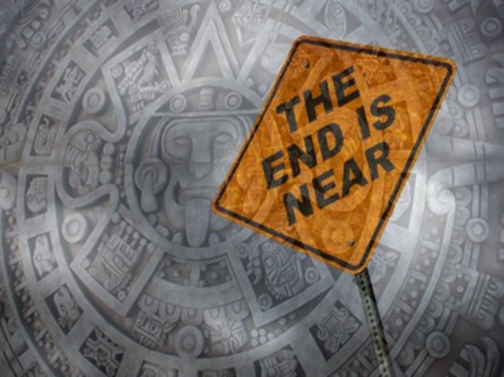
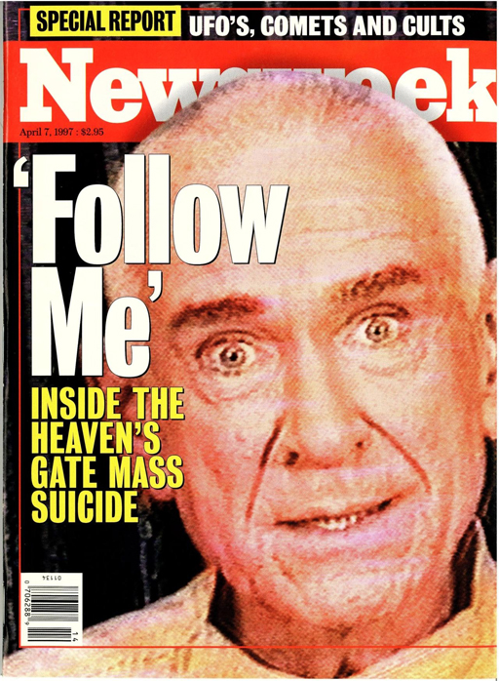
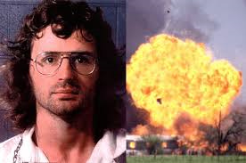
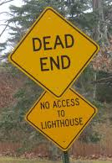
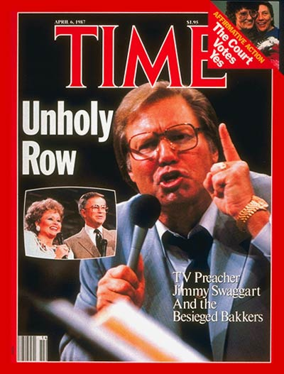
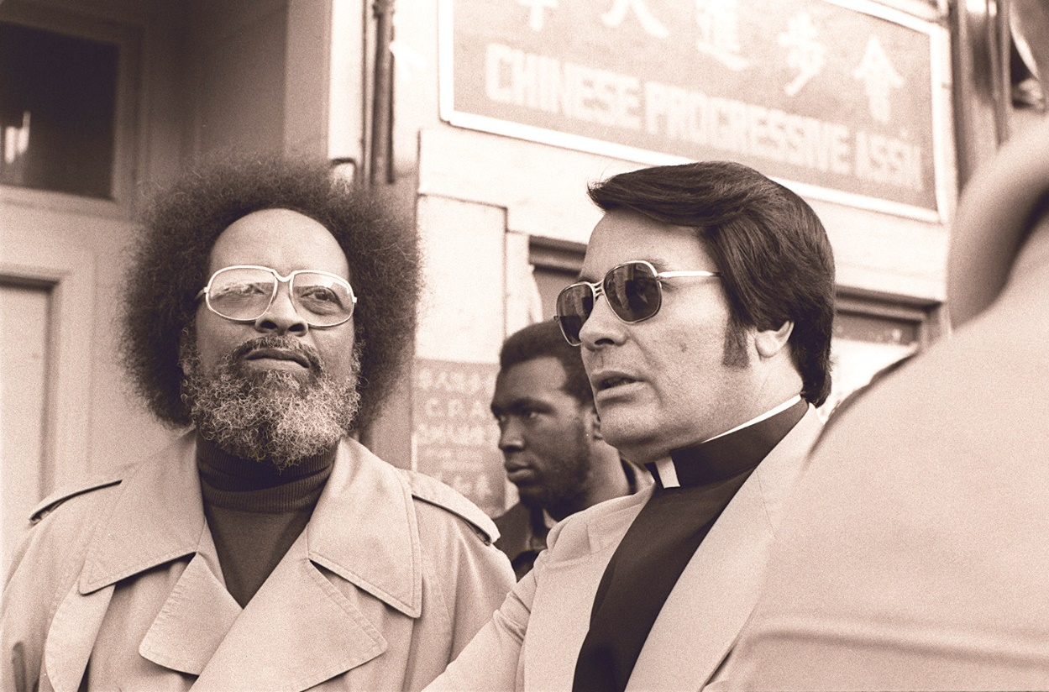
"But when you hear of wars and rumors of wars, do not be troubled; for such things must happen, but the end is not yet." — Mark 13:7
Waco
"But when you hear of wars and rumors of wars, do not be troubled; for such things must happen, but the end is not yet." — Mark 13:7
Beloved, do not believe every spirit, but test the spirits, whether they are of God; because many false prophets have gone out into the world. — 1st John 4:1
Beloved, do not believe every spirit, but test the spirits, whether they are of God; because many false prophets have gone out into the world. — 1st John 4:1
"Then many false prophets will rise up and deceive many." — Matthew 24:11
"But he who endures to the end shall be saved." — Matthew 24:13
"But he who endures to the end shall be saved." — Matthew 24:13
Jonestown
Notes:
Jonestown = 918 deaths - November 18, 1978
Heaven’s Gate = 39 deaths - Feb 09, 2010
Davidians = 74 deaths - April 19, 1993

Slide 10
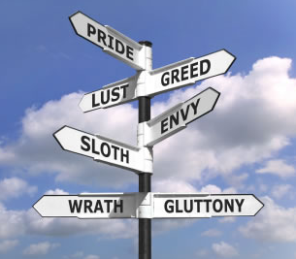
There is no fear in love; but perfect love casts out fear, because fear involves torment. But he who fears has not been made perfect in love. — 1st John 4:18
Therefore put to death your members which are on the earth: fornication, uncleanness, passion, evil desire, and covetousness, which is idolatry. — Colossians 3:5
put to death
And Moses said to the people, "Do not fear; for God has come to test you, and that His fear may be before you, so that you may not sin." — Exodus 20:20
perfect love casts out fear
torment
God has come to test you
SAVED

Slide 11
And you will seek Me and find Me, when you search for Me with all your heart.
— Jeremiah 29:13
"For where your treasure is, there your heart will be also."
— Luke 12:34
heart
heart

Slide 12
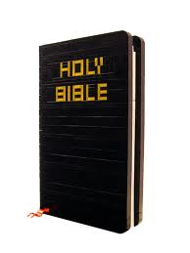
Do you not know that to whom you present yourselves slaves to obey, you are that one's slaves whom you obey, whether of sin leading to death, or of obedience leading to righteousness? — Romans 6:16
Trust in the LORD with all your heart, And lean not on your own understanding; In all your ways acknowledge Him, And He shall direct your paths. — Proverbs 3:5-6
in
Trust
Do not be wise in your own eyes; Fear the LORD and depart from evil. It will be health to your flesh, And strength to your bones. — Proverbs 3:7-8
sin leading to death
sin
depart from
heart
obedience leading to righteousness
obedience
evil

Slide 13
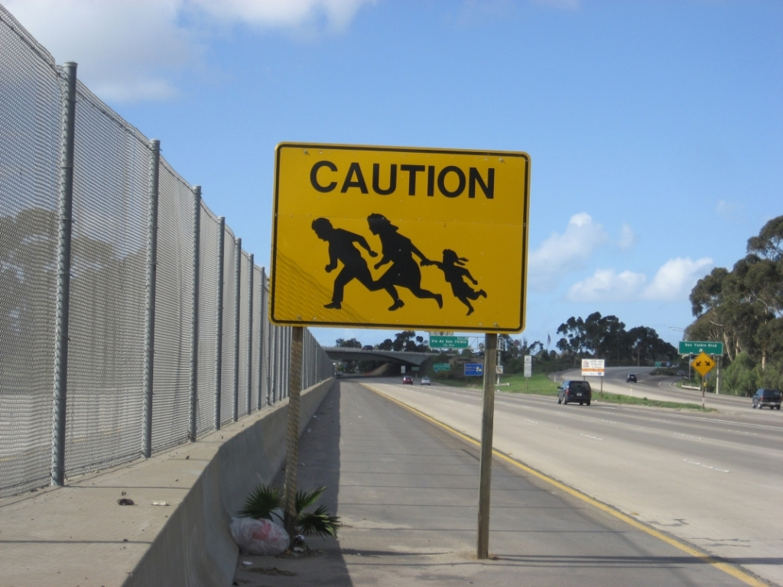
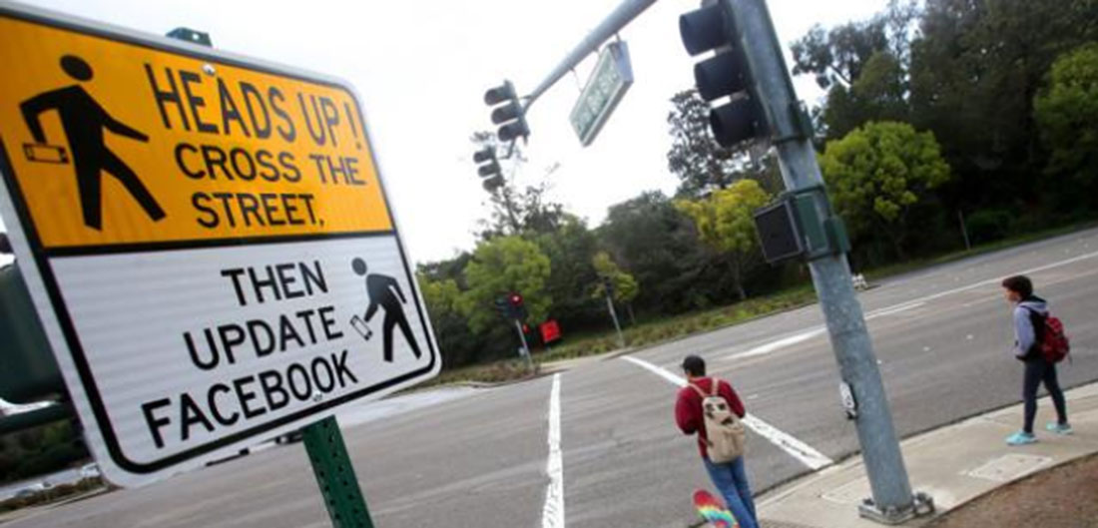
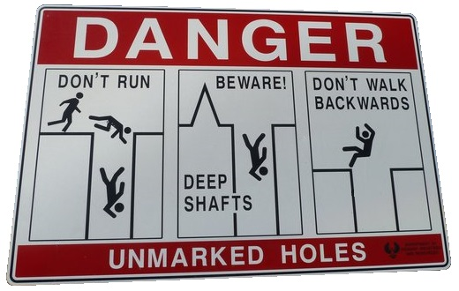
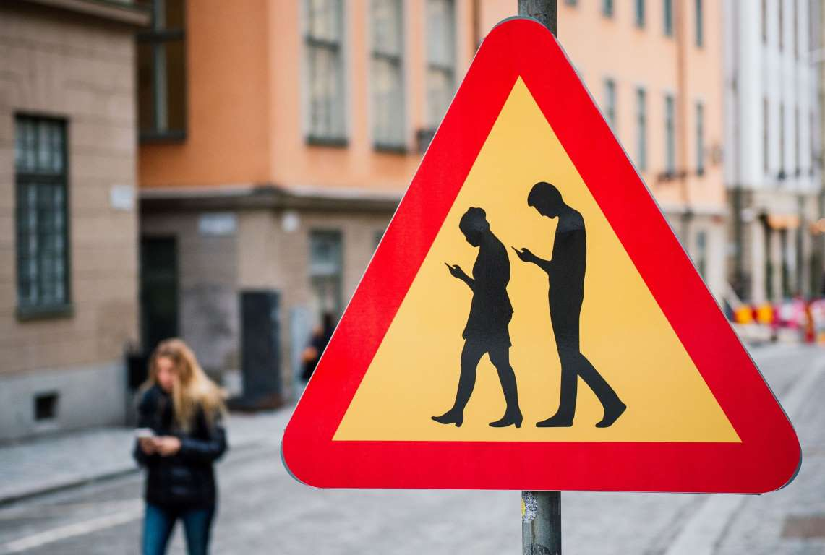
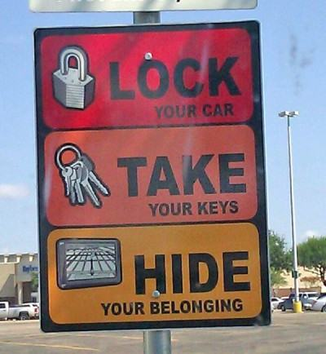
"And because lawlessness will abound, the love of many will grow cold." — Matthew 24:12

Slide 14
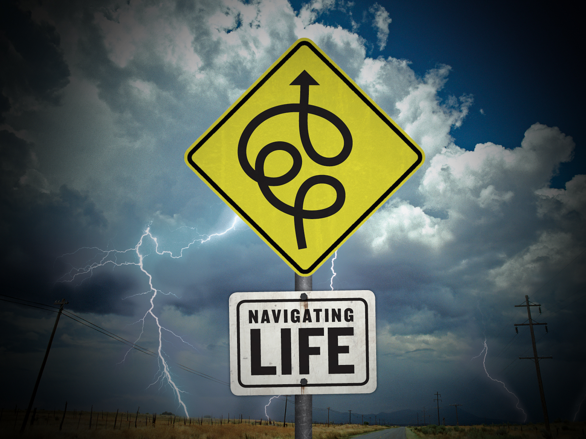
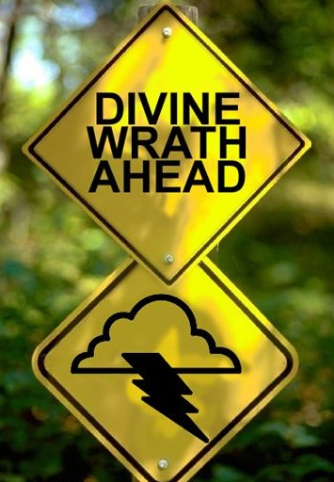
"Strive to enter through the narrow gate, for many, I say to you, will seek to enter and will not be able." — Luke 13:24
For if we sin willfully after we have received the knowledge of the truth, there no longer remains a sacrifice for sins, but a certain fearful expectation of judgment, and fiery indignation which will devour the adversaries. — Hebrews 10:26-27
"Therefore thus will I do to you, O Israel; Because I will do this to you, Prepare to meet your God, O Israel!" — Amos 4:12
The lazy man says, "There is a lion outside! I shall be slain in the streets!" — Proverbs 22:13
seek to enter
Prepare to meet your God

Slide 15
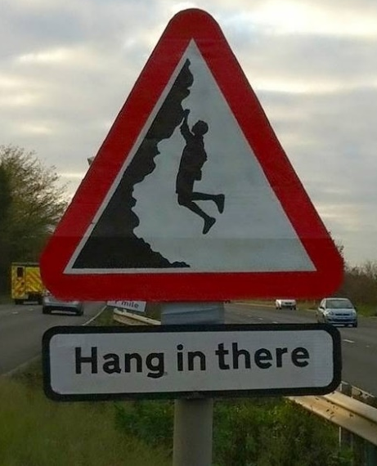
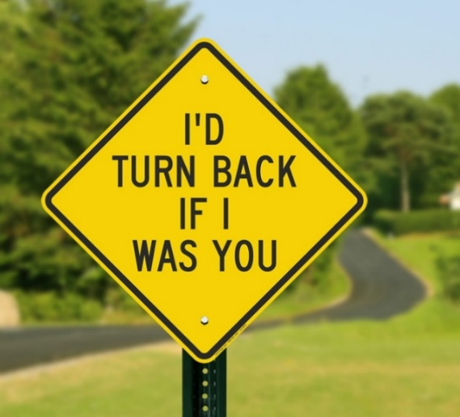
Then Jesus said to him, "Unless you people see signs and wonders, you will by no means believe." — John 4:48
For Jews request a sign, and Greeks seek after wisdom; — 1st Corinthians 1:22
a sign
wisdom
a sign
wisdom

Slide 16
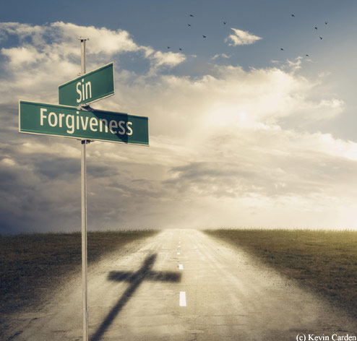
Then some of the scribes and Pharisees answered, saying, "Teacher, we want to see a sign from You." But He answered and said to them, "An evil and adulterous generation seeks after a sign, and no sign will be given to it except the sign of the prophet Jonah. — Matthew 12:38-39
doubt
faith
want to see a sign
Jesus said to him, "Thomas, because you have seen Me, you have believed. Blessed are those who have not seen and yet have believed." — John 20:29

Slide 17
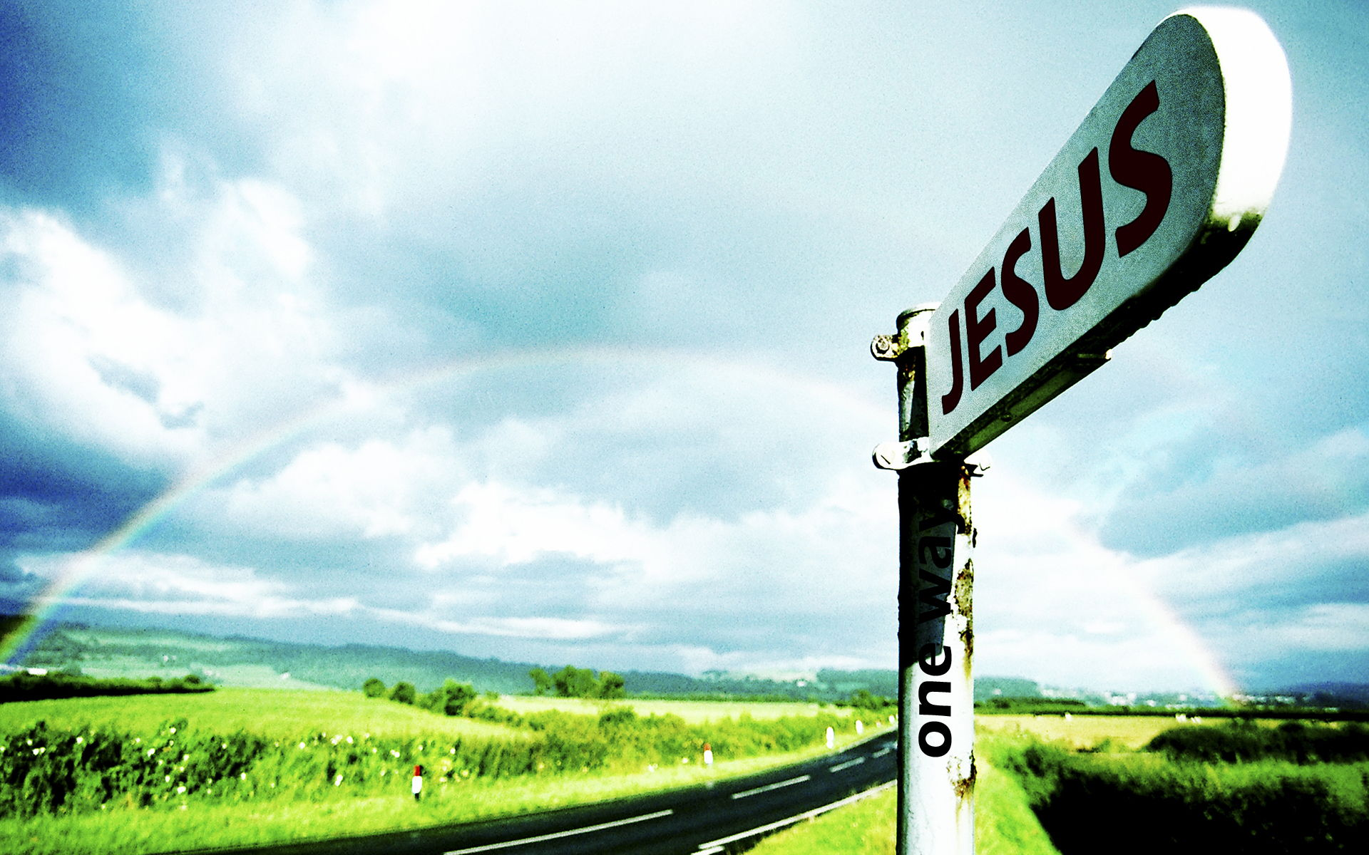
"I set My rainbow in the cloud, and it shall be for the sign of the covenant between Me and the earth." — Genesis 9:13
"... and in the morning, 'It will be foul weather today, for the sky is red and threatening.' Hypocrites! You know how to discern the face of the sky, but you cannot discern the signs of the times." — Matthew 16:3
one way
signs of the times

Slide 18
"And as it was in the days of Noah, so it will be also in the days of the Son of Man: They ate, they drank, they married wives, they were given in marriage, until the day that Noah entered the ark, and the flood came and destroyed them all. Likewise as it was also in the days of Lot: They ate, they drank, they bought, they sold, they planted, they built; but on the day that Lot went out of Sodom it rained fire and brimstone from heaven and destroyed them all. Even so will it be in the day when the Son of Man is revealed." — Luke 17:26-30
They ate
in the day when the Son of Man is revealed:
• They ate
• they drank
• they married wives
• they were given in marriage
• they bought
• they sold
• they planted
• they built
they drank
they married wives
they were
given in marriage
they
bought
they sold
they planted
they built
in the day when the
Son of Man is revealed

Slide 19
"Then the sign of the Son of Man will appear in heaven, and then all the tribes of the earth will mourn, and they will see the Son of Man coming on the clouds of heaven with power and great glory. And He will send His angels with a great sound of a trumpet, and they will gather together His elect from the four winds, from one end of heaven to the other." — Matthew 24:30-31
gather together His elect

Slide 20
Seek the LORD while He may be found, Call upon Him while He is near. — Isaiah 55:6
genuine
… that the genuineness of your faith, being much more precious than gold that perishes, though it is tested by fire, may be found to praise, honor, and glory at the revelation of Jesus Christ, …. — 1st Peter 1:7
Sincere
Insincere

Slide 21
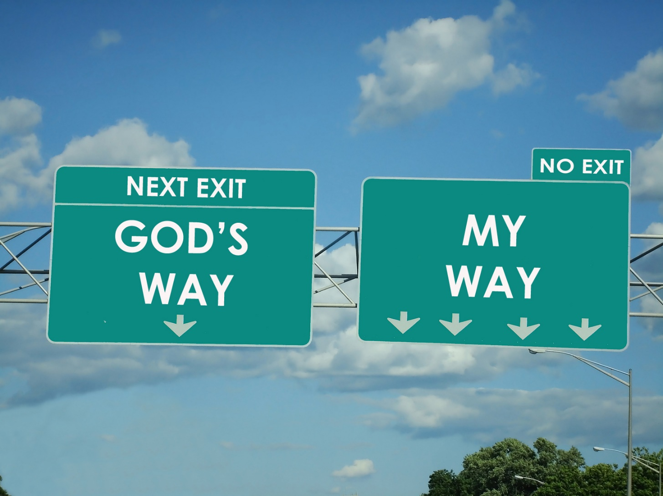
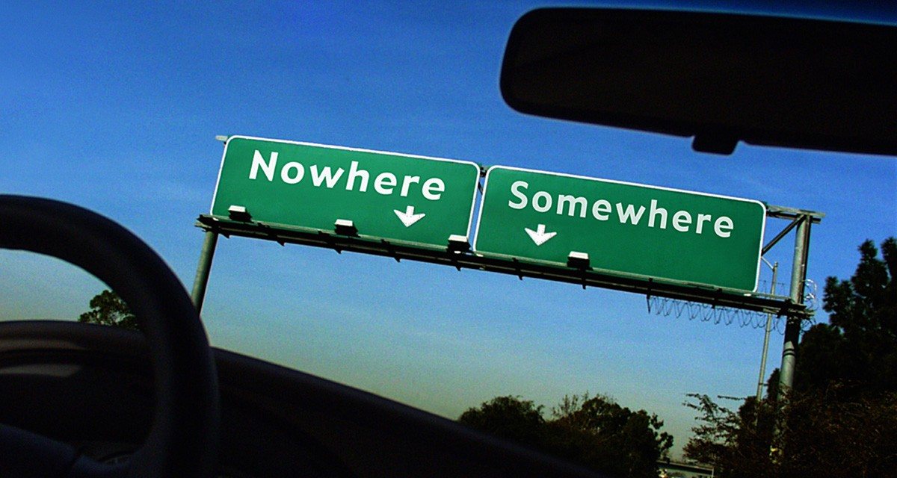
Jesus said to him, "I am the way, the truth, and the life. No one comes to the Father except through Me." — John 14:6

Slide 22
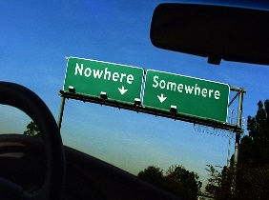
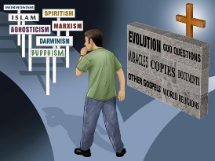
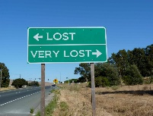
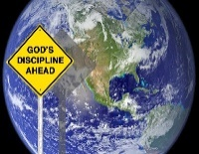

Slide 23
→ Evil times are a snare for all
→ The righteous rise with hope from above
→ Men’s hearts will fail with fearful expectations
→ God calls for souls to expose works of darkness
→ The day of mortal death is more than one’s birth
→ Many spirits will rise to deceive many
→ God tests our character as we deal with sin
→ Treasure is found in what the heart desires
→ Departing evil in fear of the Lord is supernal
→ For lawlessness the love of many will grow cold
→ Excuses fail in pursuit of knowing God’s true will
→ Faith is built on belief beyond wisdom or signs
→ God seeks genuine hearts as He waits nearby
The signs of our heart can not hide from God
Notes:
The signs of our heart cannot hide from God

Slide 25
Please visit http://www.LoveFromGod.com to explore further
Ronald Bert Channel on
Notes:
Eternity never ends.

