Slide 2
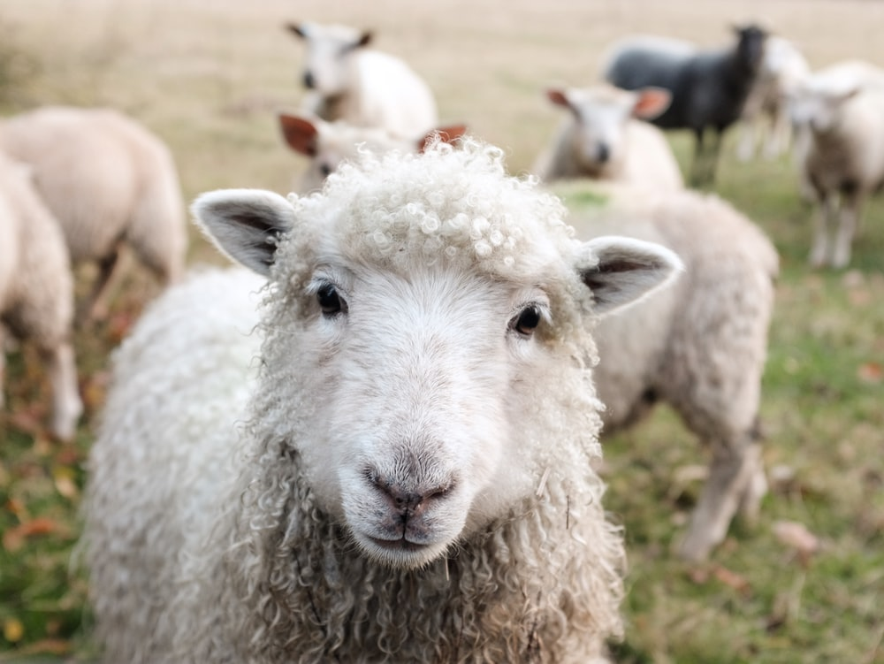
Sheep
Ron Bert
May 31, 2020

Slide 3
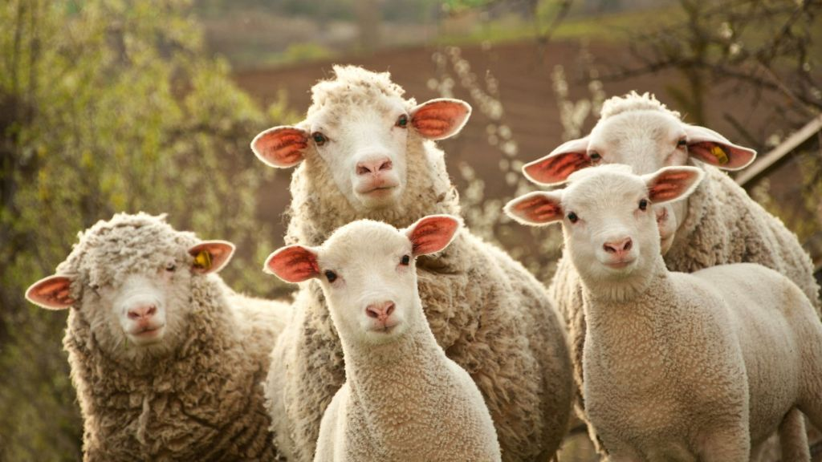
Know that the LORD, He is God; It is He who has made us, and not we ourselves; We are His people and the sheep of His pasture. — Psalms 100:3
sheep
He
made us
He
made us
We are
We are
the sheep of His pasture
the sheep of His pasture
sheep

Slide 4
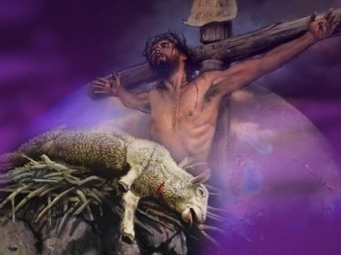
All we like sheep have gone astray; We have turned, every one, to his own way; And the LORD has laid on Him the iniquity of us all. — Isaiah 53:6
All
All
sheep
Lamb of God
astray
astray
sheep
own way
own way
SIN

Slide 5
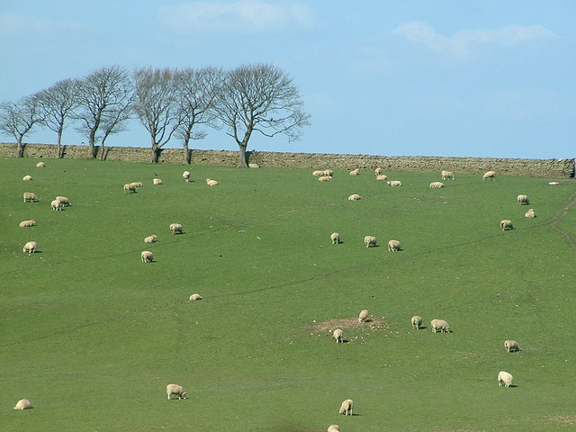
'"So they were scattered because there was no shepherd; and they became food for all the beasts of the field when they were scattered. My sheep wandered through all the mountains, and on every high hill; yes, My flock was scattered over the whole face of the earth, and no one was seeking or searching for them."' — Ezekiel 34:5-6
no shepherd
no shepherd
no shepherd
sheep
no shepherd

Slide 6
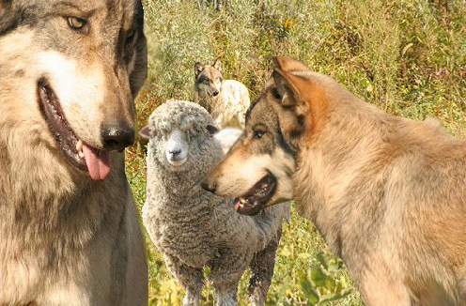
'Therefore, you shepherds, hear the word of the LORD: "as I live," says the Lord GOD, "surely because My flock became a prey, and My flock became food for every beast of the field, because there was no shepherd, nor did My shepherds search for My flock, but the shepherds fed themselves and did not feed My flock"' — Ezekiel 34:7-8
hear the word of the LORD
hear the word of the LORD
My flock became a prey
My flock became a prey
no shepherd
Truth

Slide 7
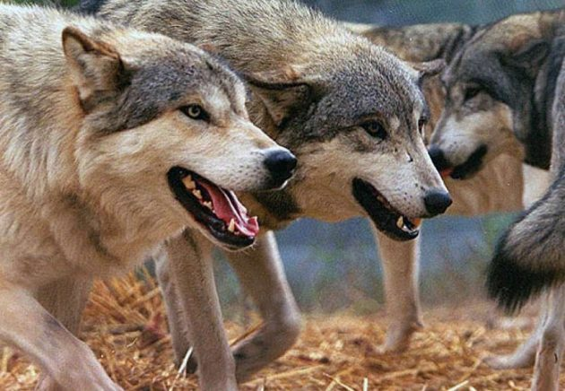
'… therefore, O shepherds, hear the word of the LORD! Thus says the Lord GOD: "Behold, I am against the shepherds, and I will require My flock at their hand; I will cause them to cease feeding the sheep, and the shepherds shall feed themselves no more; for I will deliver My flock from their mouths, that they may no longer be food for them."' — Ezekiel 34:9-10
hear the word of the LORD
GOD
sheep
sheep
I will deliver My flock
I will deliver My flock

Slide 8
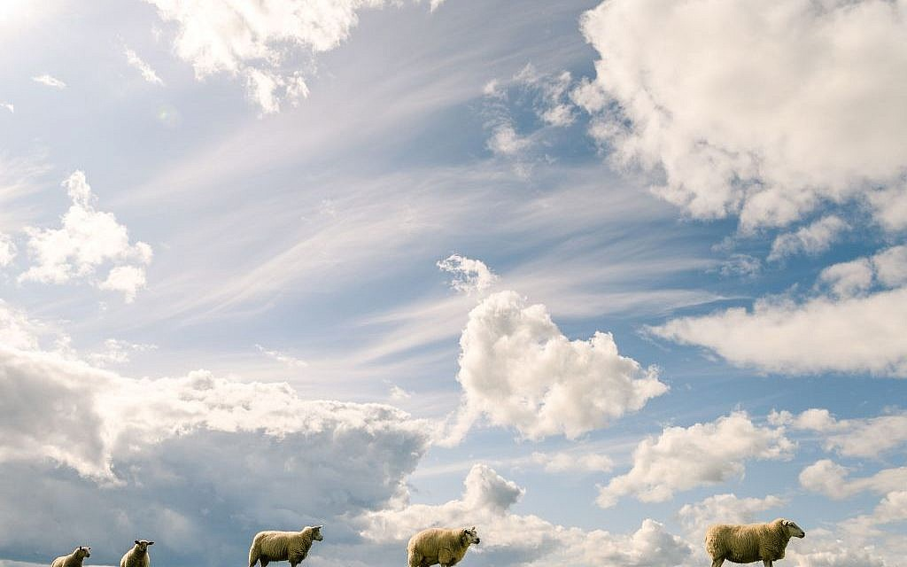
'For thus says the Lord GOD: "Indeed I Myself will search for My sheep and seek them out. As a shepherd seeks out his flock on the day he is among his scattered sheep, so will I seek out My sheep and deliver them from all the places where they were scattered on a cloudy and dark day."' — Ezekiel 34:11-12
GOD
I Myself will
I Myself will
sheep
sheep
deliver them
sheep
sheep
deliver them

Slide 9
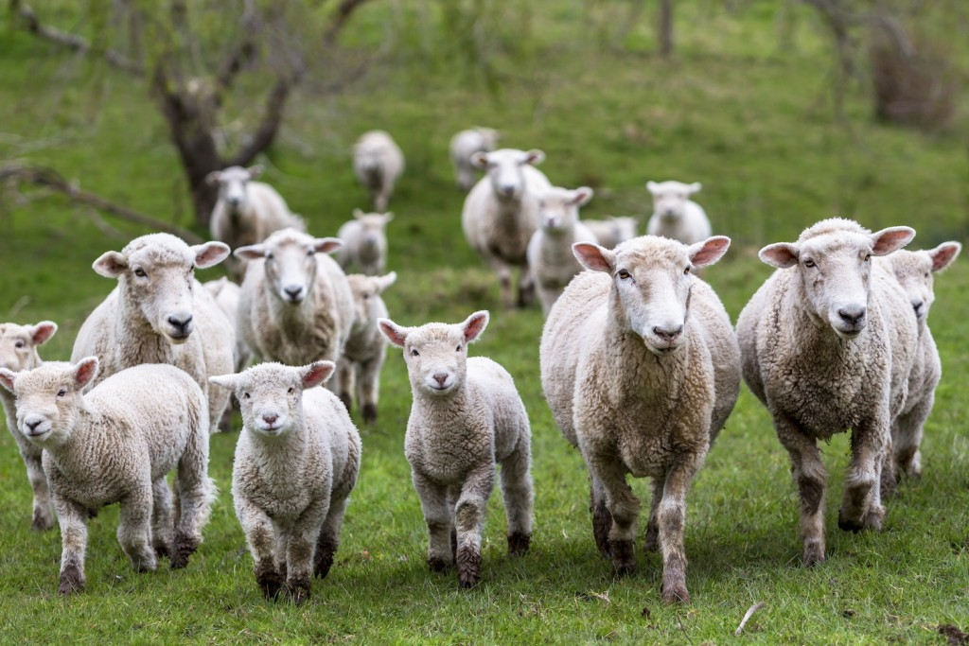
But when He saw the multitudes, He was moved with compassion for them, because they were weary and scattered, like sheep having no shepherd. — Matthew 9:36
Jesus
t
l
o
s
sheep
lost
no shepherd
no shepherd
Notes:
Jesus is observing that no one is elevating the weary as they are trampled upon.

Slide 10
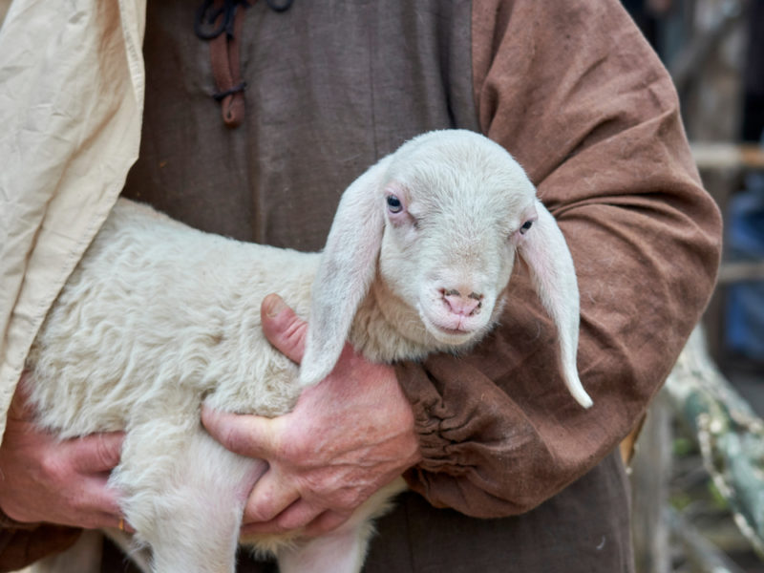
"... for the Son of Man has come to seek and to save that which was lost." — Luke 19:10
. .
. .
to save
come to seek
to save
come to seek
lost

Slide 11
"... for the Son of Man has come to seek and to save that which was lost." — Luke 19:10
Found
. .
. .
come to seek
to save
lost
Find

Slide 12
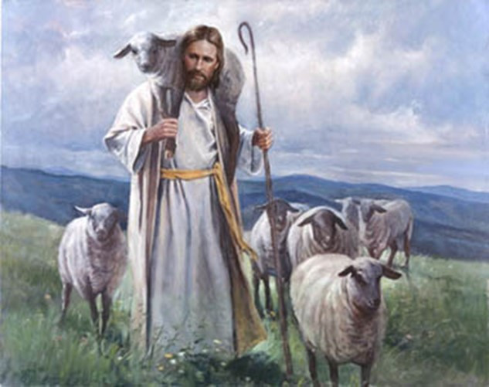
"I am the good shepherd. The good shepherd gives His life for the sheep." — John 10:11
door
oo
r
gives His life
d
gives His life

Slide 13
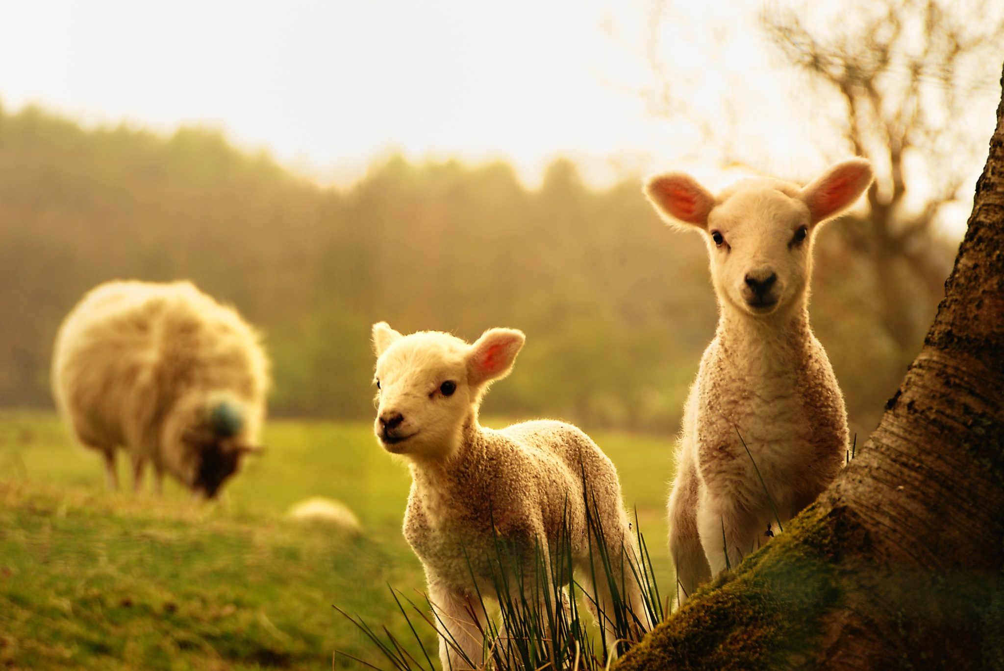
"I am the door. If anyone enters by Me, he will be saved, and will go in and out and find pasture." — John 10:9
door
saved

Slide 14
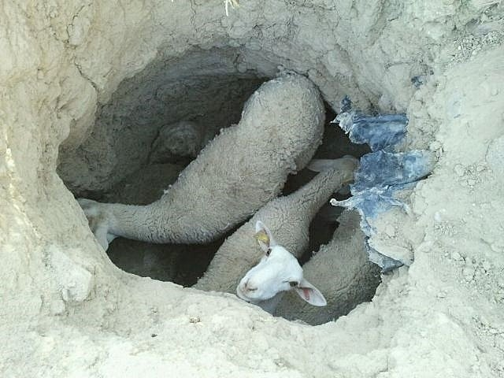
Then He said to them, "What man is there among you who has one sheep, and if it falls into a pit on the Sabbath, will not lay hold of it and lift it out? Of how much more value then is a man than a sheep? Therefore it is lawful to do good on the Sabbath." — Matthew 12:11-12
sheep
sheep
saved
sheep
lawful to do good
lawful to do good

Slide 15
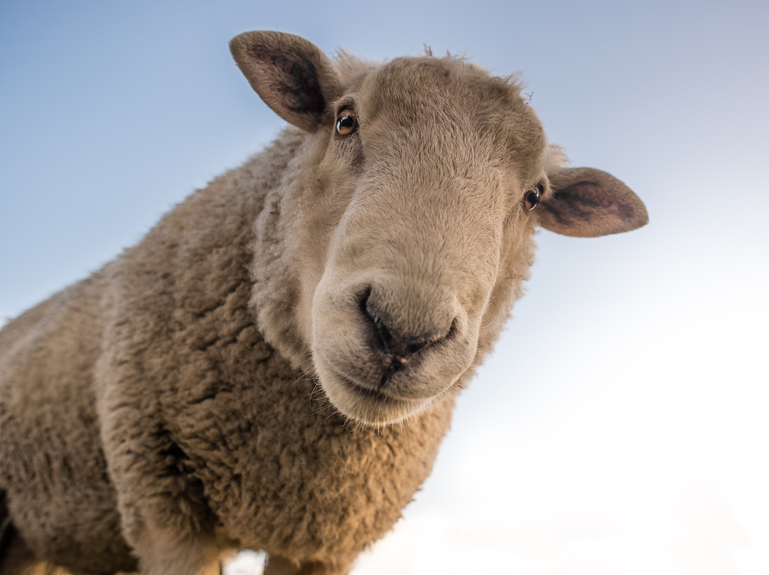
"What man of you, having a hundred sheep, if he loses one of them, does not leave the ninety-nine in the wilderness, and go after the one which is lost until he finds it? And when he has found it, he lays it on his shoulders, rejoicing." — Luke 15:4-5
sheep
sheep
found
found
rejoicing
rejoicing
Notes:
Would you turn someone looking for help, and a word of compassion, away? Revenge is the Lord’s, and He asks of us to gain souls bound for heaven. Love is the light no matter how dark the sinner.

Slide 16
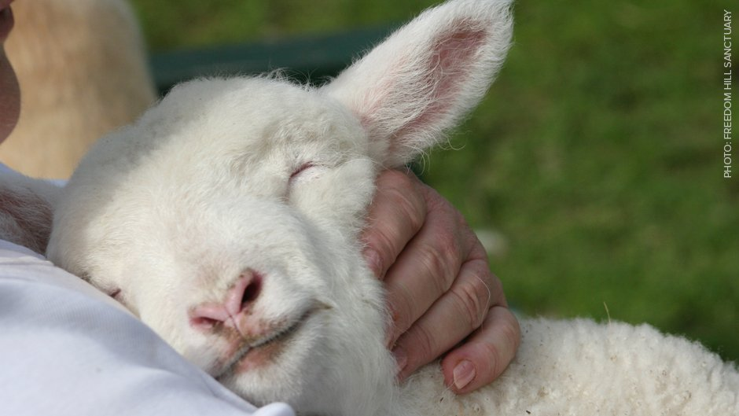
"And when he comes home, he calls together his friends and neighbors, saying to them, 'Rejoice with me, for I have found my sheep which was lost!' I say to you that likewise there will be more joy in heaven over one sinner who repents than over ninety-nine just persons who need no repentance." — Luke 15:6-7
sheep
sheep
joy
joy
over one sinner
over one sinner

Slide 17
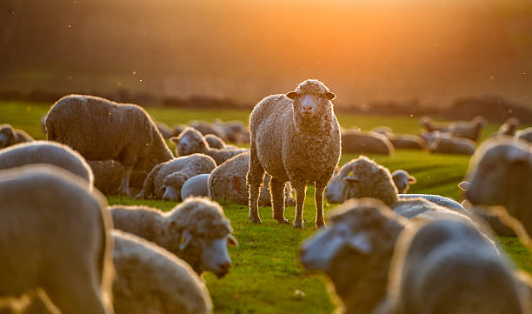
So when they had eaten breakfast, Jesus said to Simon Peter, "Simon, son of Jonah, do you love Me more than these?" He said to Him, "Yes, Lord; You know that I love You." He said to him, "Feed My lambs." He said to him again a second time, "Simon, son of Jonah, do you love Me?" He said to Him, "Yes, Lord; You know that I love You." He said to him, "Tend My sheep." He said to him the third time, "Simon, son of Jonah, do you love Me?" Peter was grieved because He said to him the third time, "Do you love Me?" And he said to Him, "Lord, You know all things; You know that I love You." Jesus said to him, "Feed My sheep. — John 21:15-17
Feed
My lambs
Feed My lambs
Tend My sheep
Feed My sheep
Tend My sheep
sheep
Feed My sheep

Slide 18
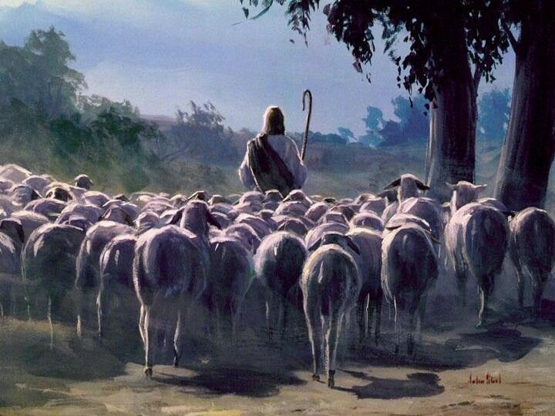
"My sheep hear My voice, and I know them, and they follow Me. And I give them eternal life, and they shall never perish; neither shall anyone snatch them out of My hand." — John 10:27-28
hear
hear
follow
follow
eternal life
never perish

Slide 19
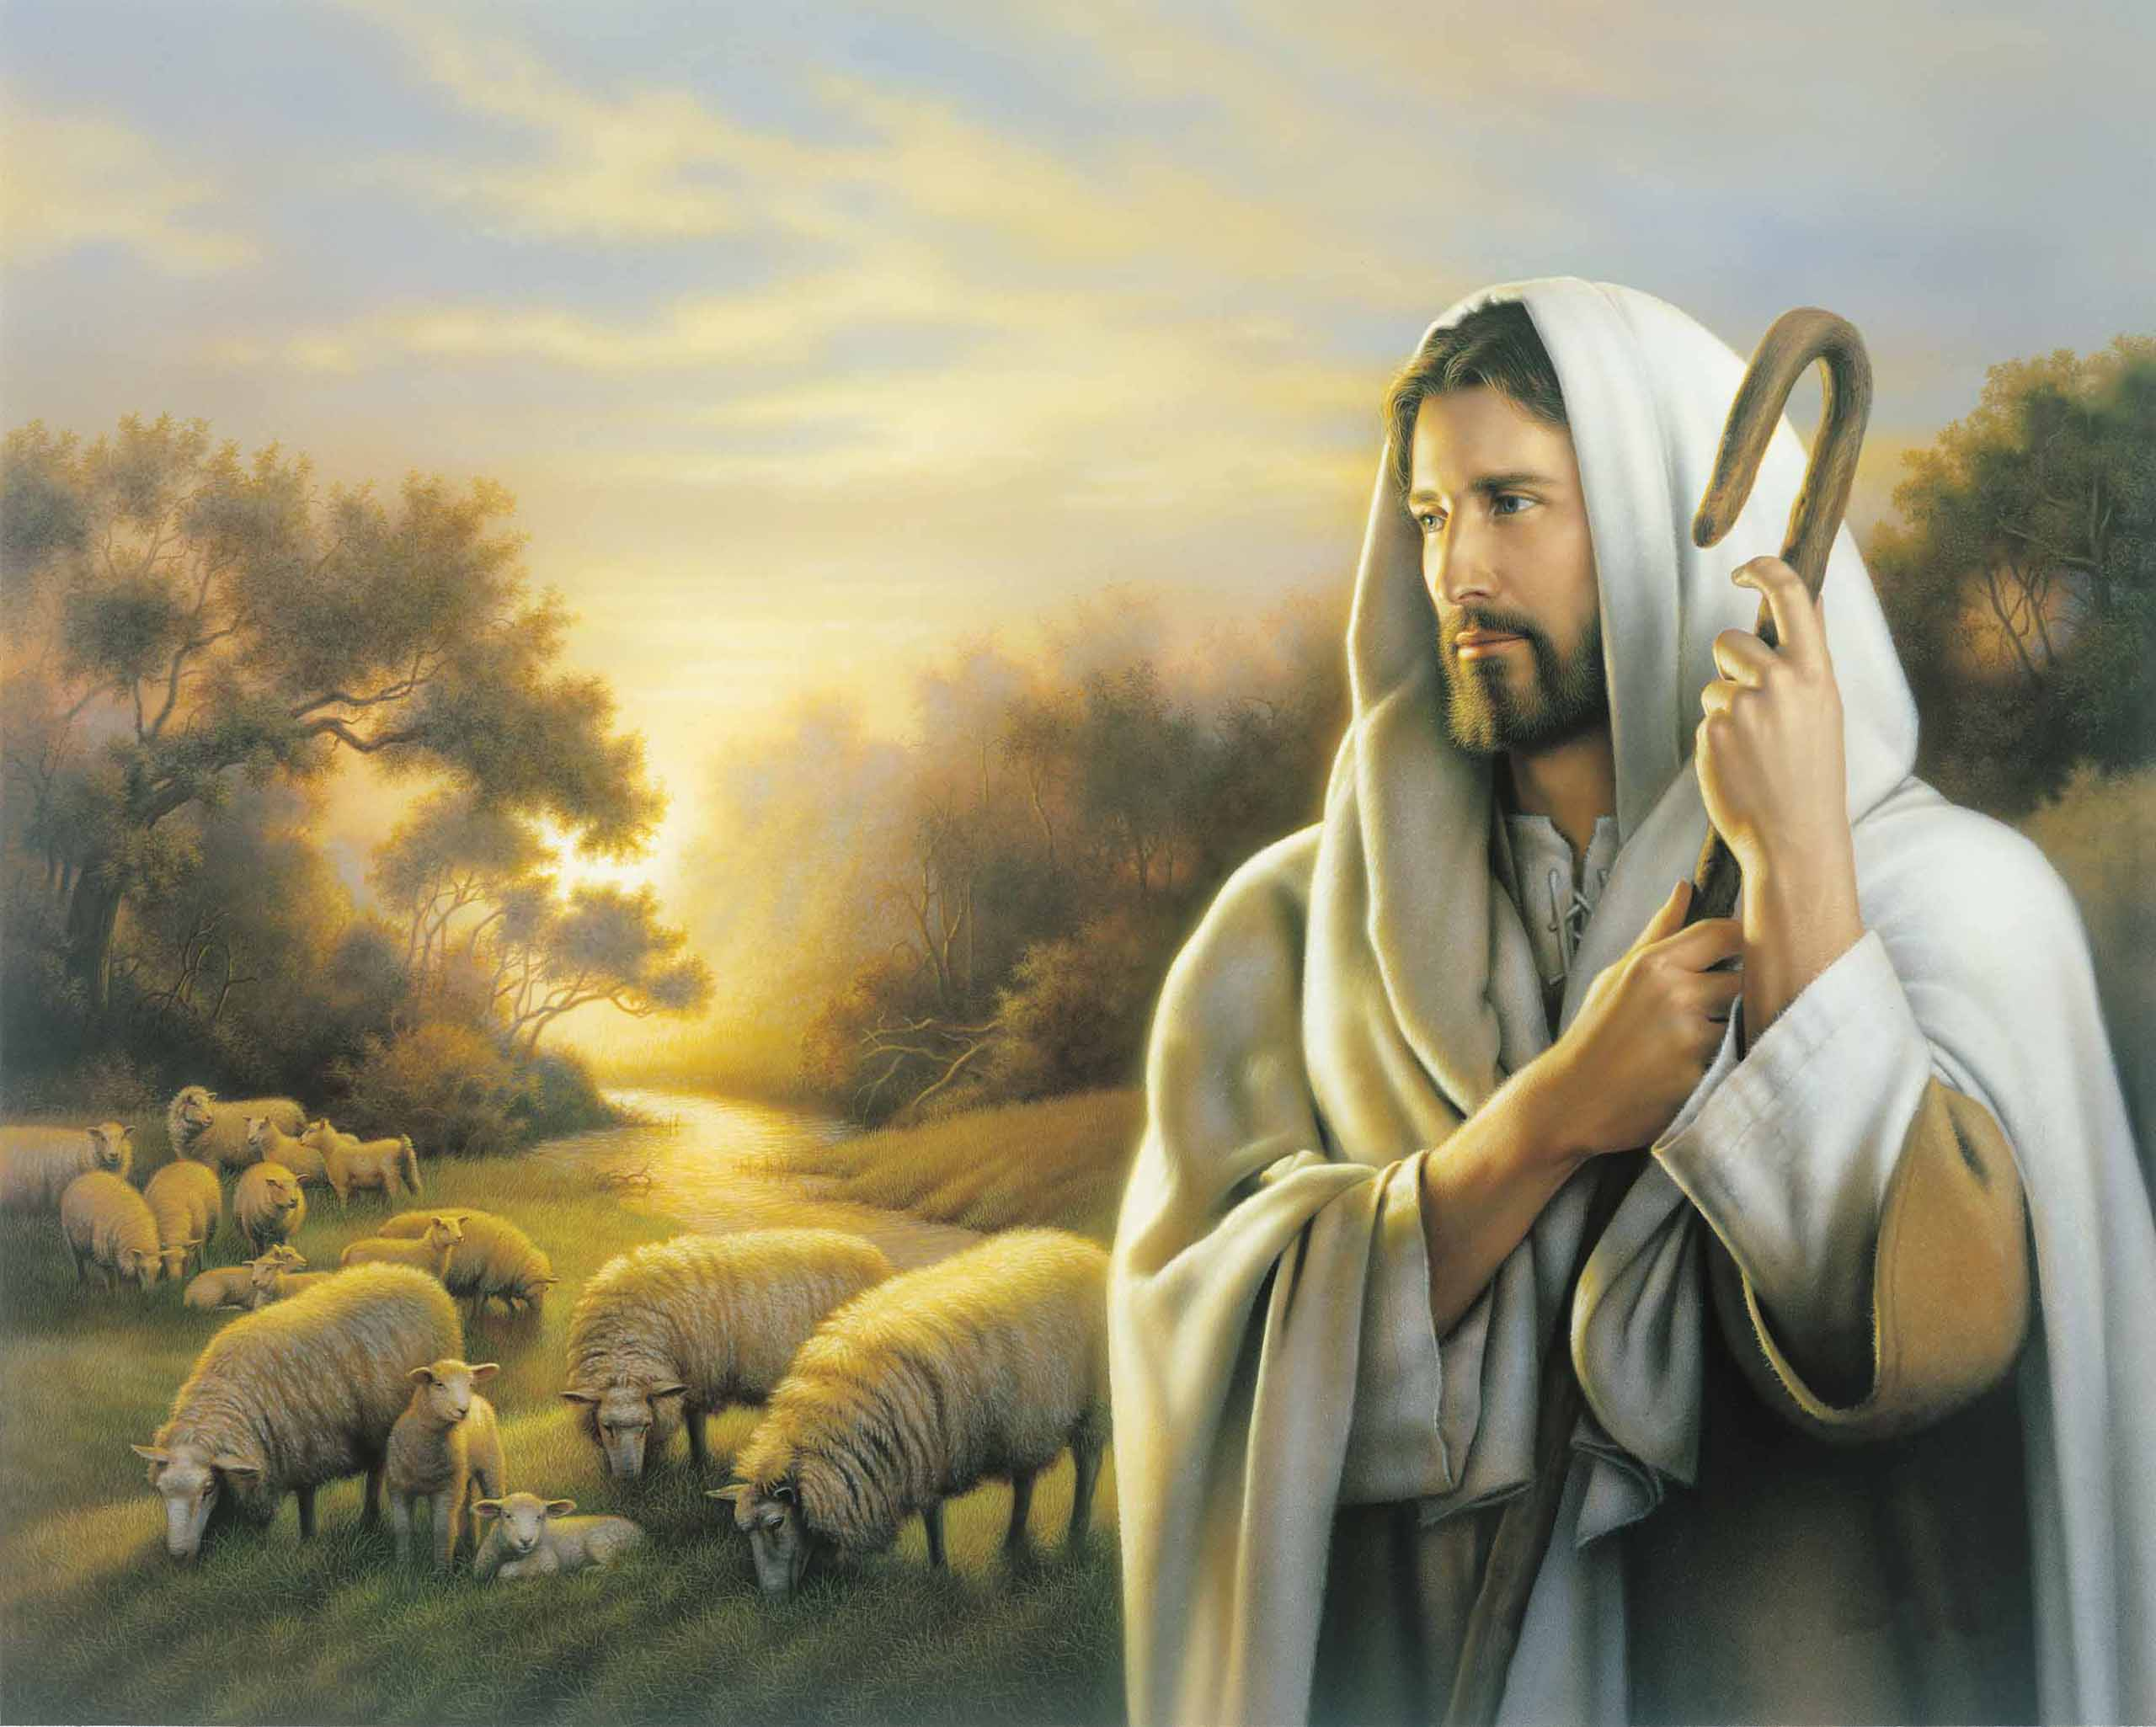
… who desires all men to be saved and to come to the knowledge of the truth. — 1st Timothy 2:4
desires
desires
come to
come to
the truth
the truth

Slide 20
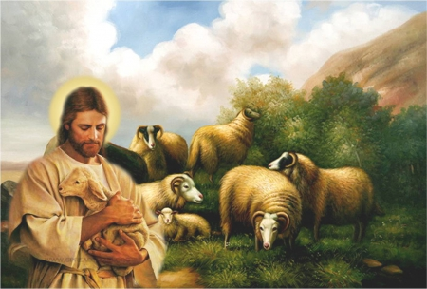
Now may the God of peace who brought up our Lord Jesus from the dead, that great Shepherd of the sheep, through the blood of the everlasting covenant, make you complete in every good work to do His will, working in you what is well pleasing in His sight, through Jesus Christ, to whom be glory forever and ever. Amen. — Hebrews 13:20-21
Now may the God of peace
Now may the God of peace make you
complete in every good work
to do His will
working in you
what is well pleasing in His sight
through Jesus Christ
in
make you
complete in every good work
to do
in
His will
working in you
what is well
in
pleasing in His sight
through Jesus
Christ

Slide 21
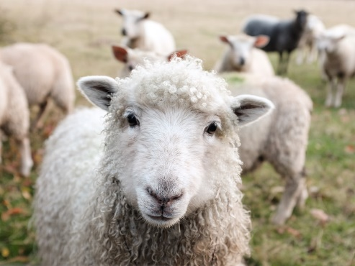
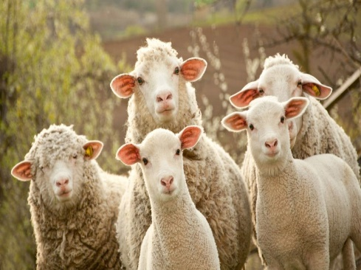
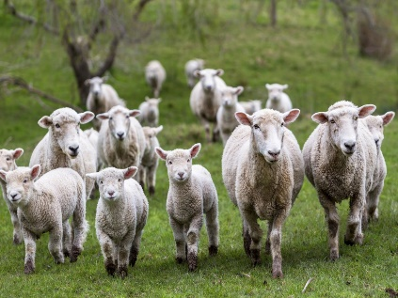
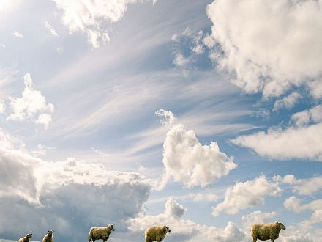
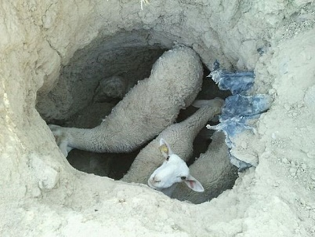
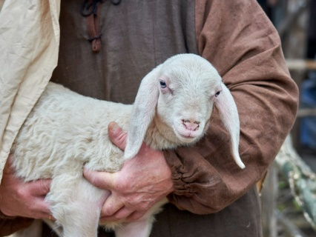
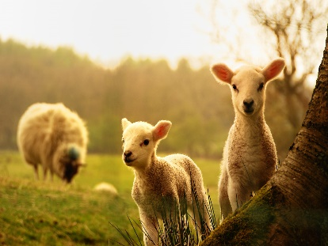

Slide 22
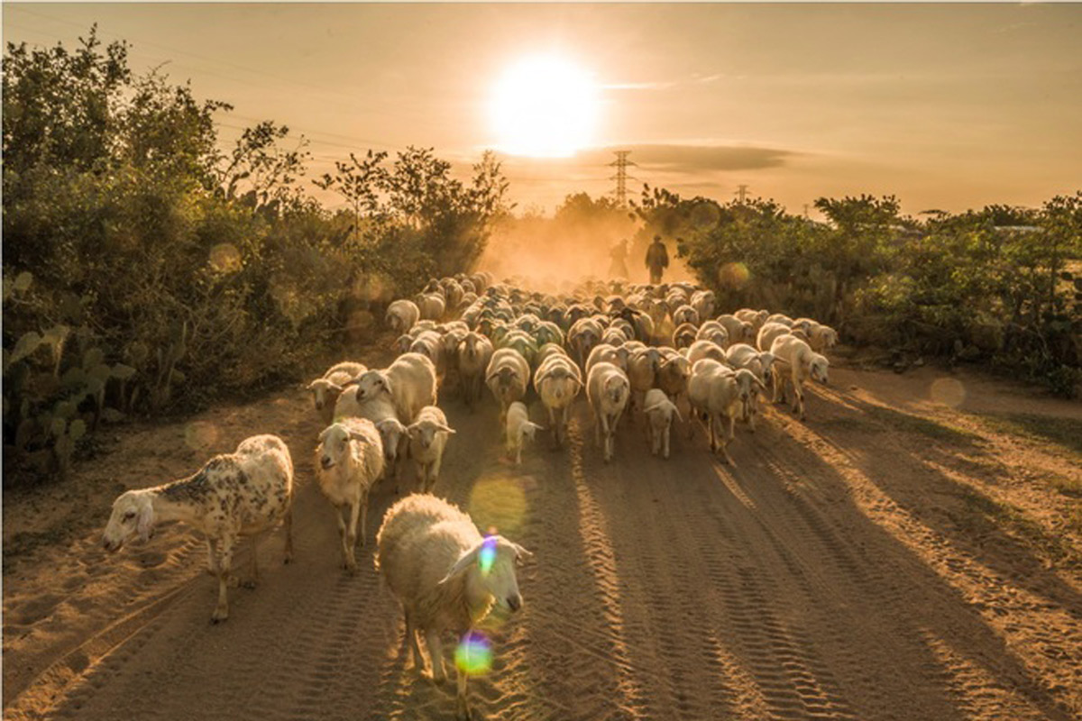
→ God has made us, and not we ourselves
→ Like sheep we have all gone astray in self pursuits
→ All shepherds greedily turned feeding themselves
→ God himself would shepherd where none were
→ Jesus painfully saw no shepherds among the people
→ Jesus came to seek and save all the lost
→ It is through Jesus’ door, entrance to truth is had
→ Without continuous good conduct, truth is lost
→ God declares value in the whole of it all
→ Angles rejoice over one sinner who repents
→ Jesus wants us to feed each other in love
→ God desires all to be saved in knowledge of truth
→ Christ is the great shepherd who completes us
The song is lost if all hear not, the cry to help one another
Notes:
The song is lost if all hear not, the cry to help one another

Slide 24
Please visit http://www.LoveFromGod.com to explore further
Ronald Bert Channel on
Notes:
Eternity never ends.

