Slide 2
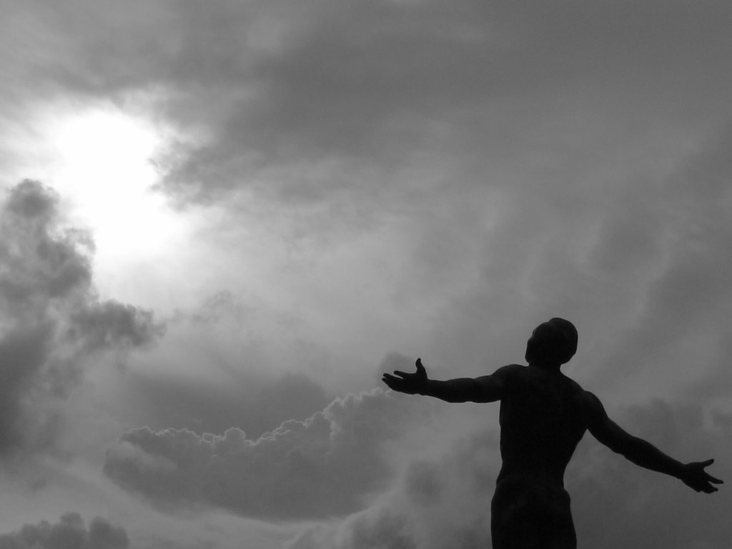
Sacrifice
Ron Bert
August 26, 2019

Slide 3

Give to the LORD the glory due His name; Bring an offering, and come into His courts. Oh, worship the LORD in the beauty of holiness! Tremble before Him, all the earth. — Psalms 96:8-9
LORD
Bring an offering
LORD

Slide 4
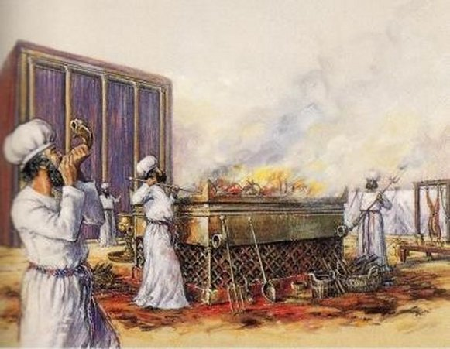
Then Samuel said: "Has the LORD as great delight in burnt offerings and sacrifices, As in obeying the voice of the LORD? Behold, to obey is better than sacrifice, And to heed than the fat of rams. — 1st Samuel 15:22
LORD
LORD
obey

Slide 5
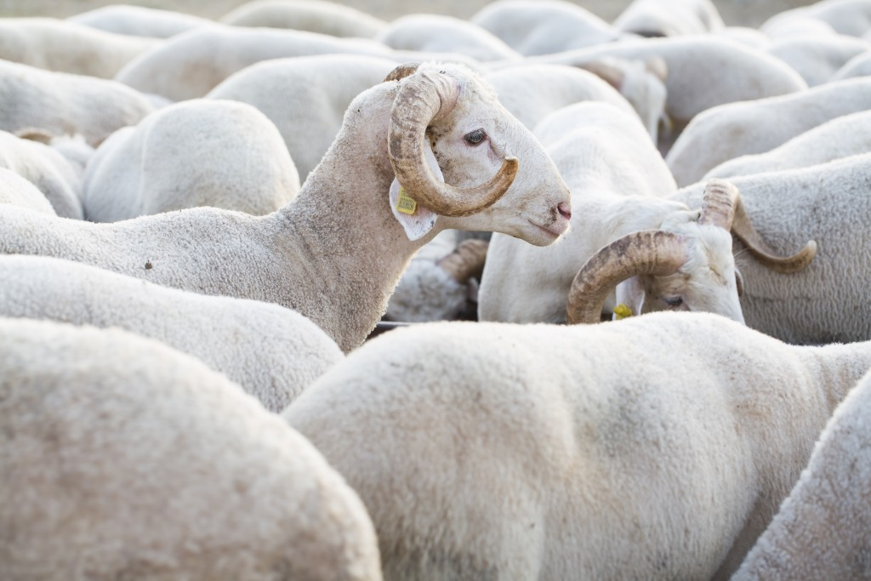
"To what purpose is the multitude of your sacrifices to Me?" Says the LORD. "I have had enough of burnt offerings of rams And the fat of fed cattle. I do not delight in the blood of bulls, Or of lambs or goats." — Isaiah 1:11
LORD
burnt offerings
burnt offerings
delight

Slide 6

For I desire mercy and not sacrifice, And the knowledge of God more than burnt offerings. — Hosea 6:6
love
knowledge
burnt offerings

Slide 7

To do righteousness and justice Is more acceptable to the LORD than sacrifice. — Proverbs 21:3
truth
goodness
acceptable to the LORD
sacrifice
sacrifice
Offer the sacrifices of righteousness, And put your trust in the LORD. — Psalms 4:5
sacrifice

Slide 8
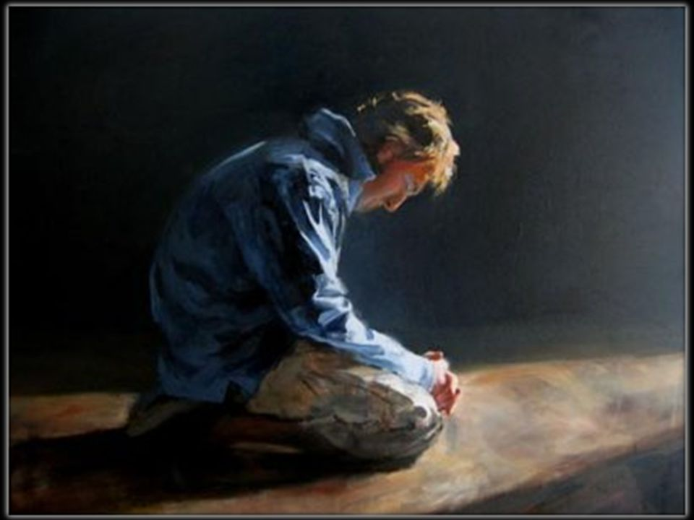
For You do not desire sacrifice, or else I would give it; You do not delight in burnt offering. The sacrifices of God are a broken spirit, A broken and a contrite heart - These, O God, You will not despise. — Psalms 51:16-17
sacrifice
submissive
repentful

Slide 9

He has shown you, O man, what is good; And what does the LORD require of you But to do justly, To love mercy, And to walk humbly with your God? — Micah 6:8
honesty
kindhearted
gentle

Slide 10
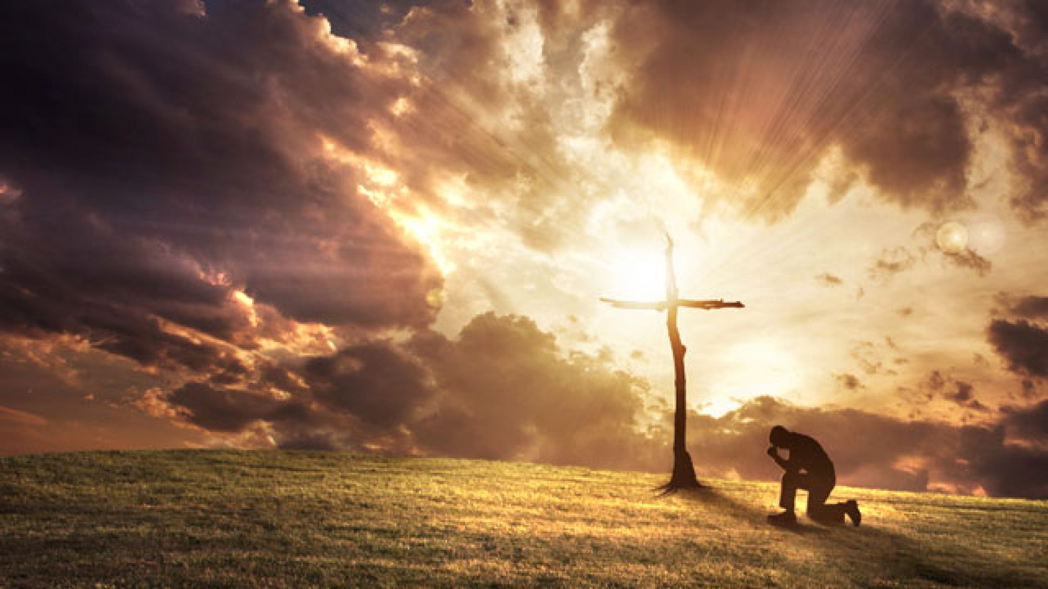
"But go and learn what this means: 'I desire mercy and not sacrifice.' For I did not come to call the righteous, but sinners, to repentance." — Matthew 9:13
desire
desire
repentance

Slide 11
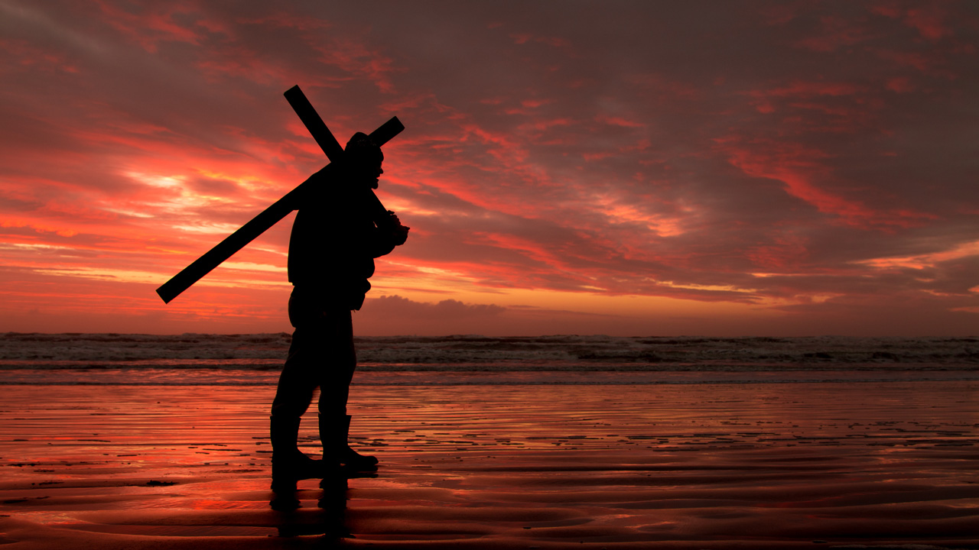
When He had called the people to Himself, with His disciples also, He said to them, "Whoever desires to come after Me, let him deny himself, and take up his cross, and follow Me. — Mark 8:34
desires
desire
desires

Slide 12
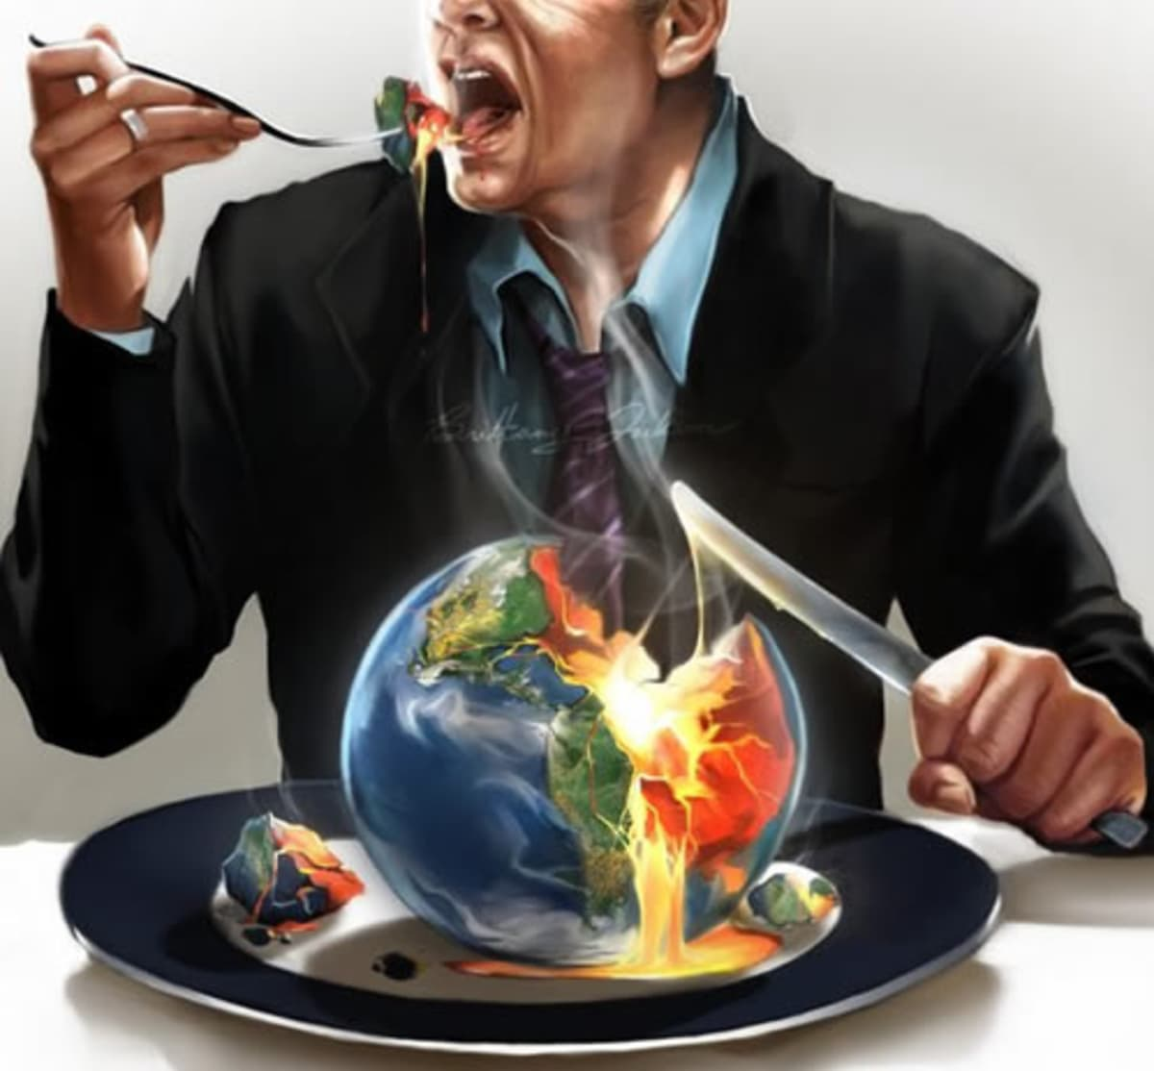
"For whoever desires to save his life will lose it, but whoever loses his life for My sake and the gospel's will save it. For what will it profit a man if he gains the whole world, and loses his own soul? Or what will a man give in exchange for his soul?" — Mark 8:35-37
r
desires
f
s
fruits
t
Greed & Envy
i
u

Slide 13
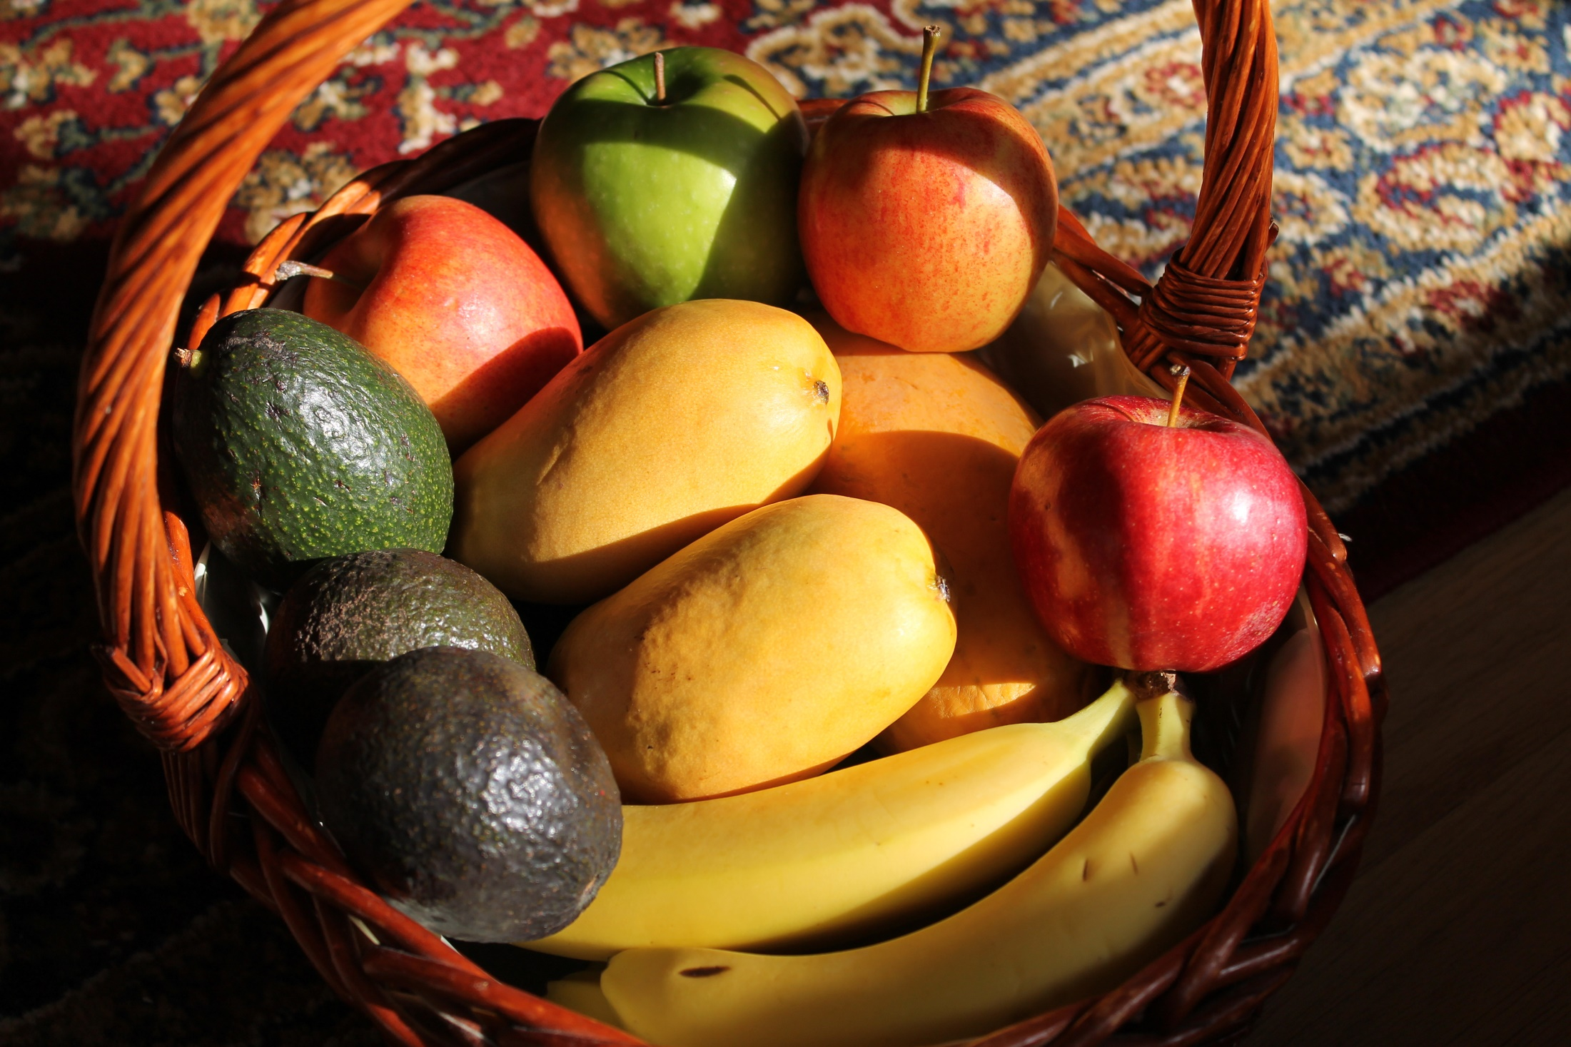
"Therefore bear fruits worthy of repentance, …" — Matthew 3:8
fruits

Slide 14

"And to love Him with all the heart, with all the understanding, with all the soul, and with all the strength, and to love one's neighbor as oneself, is more than all the whole burnt offerings and sacrifices." — Mark 12:33
love
love
love
love

Slide 15
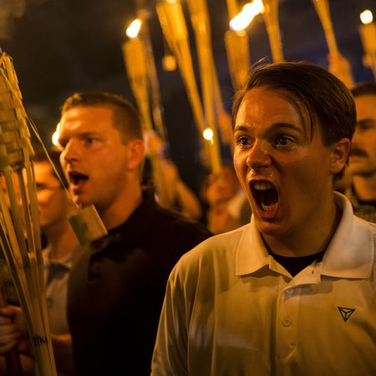
And though I bestow all my goods to feed the poor, and though I give my body to be burned, but have not love, it profits me nothing. — 1st Corinthians 13:3
love
love

Slide 16
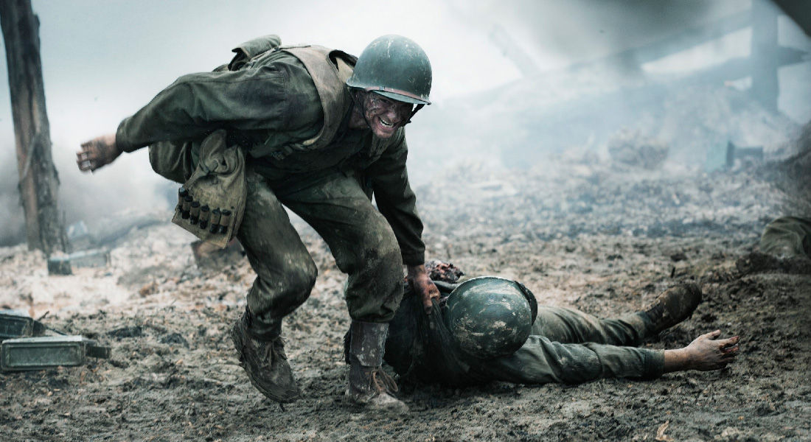
"Greater love has no one than this, than to lay down one's life for his friends. You are My friends if you do whatever I command you. No longer do I call you servants, for a servant does not know what his master is doing; but I have called you friends, for all things that I heard from My Father I have made known to you." — John 15:13-15
love
friend

Slide 17

I beseech you therefore, brethren, by the mercies of God, that you present your bodies a living sacrifice, holy, acceptable to God, which is your reasonable service. And do not be conformed to this world, but be transformed by the renewing of your mind, that you may prove what is that good and acceptable and perfect will of God. — Romans 12:1-2
in
in

Slide 18
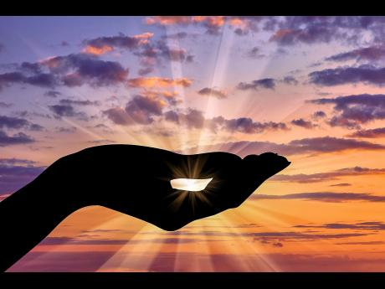
And those who are Christ's have crucified the flesh with its passions and desires. If we live in the Spirit, let us also walk in the Spirit. Let us not become conceited, provoking one another, envying one another. — Galatians 5:24-26
walk in the Spirit:
● not become conceited
● not provoking one another
● not envying one another
in
walk in the Spirit
not
provoking
not become conceited
not
one another
envying one another

Slide 19
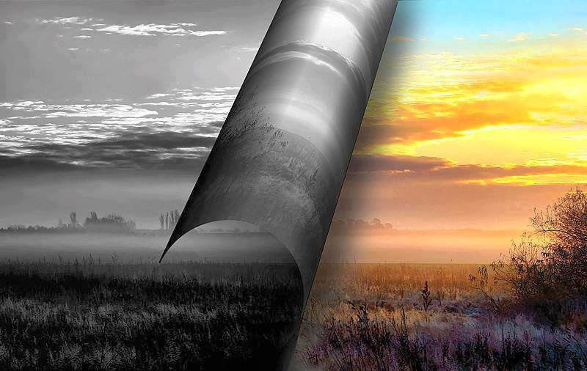
For the law, having a shadow of the good things to come, and not the very image of the things, can never with these same sacrifices, which they offer continually year by year, make those who approach perfect. — Hebrews 10:1
shadow
sacrifices
sacrifices
sacrifices

Slide 20
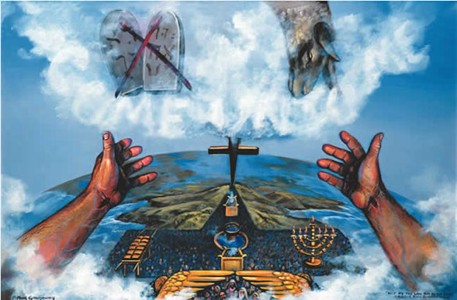
For then would they not have ceased to be offered? For the worshipers, once purified, would have had no more consciousness of sins. But in those sacrifices there is a reminder of sins every year. For it is not possible that the blood of bulls and goats could take away sins. — Hebrews 10:2-4
sacrifices
sacrifices

Slide 21
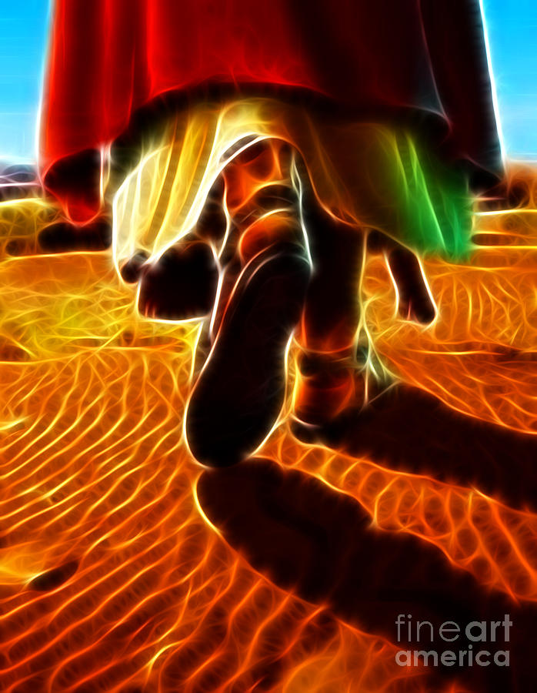
Therefore, when He came into the world, He said: "Sacrifice and offering You did not desire, But a body You have prepared for Me. In burnt offerings and sacrifices for sin You had no pleasure. Then I said, 'Behold, I have come--In the volume of the book it is written of Me--To do Your will, O God.'" — Hebrews 10:5-7
sacrifices
Your will, O God
Your will, O God

Slide 22
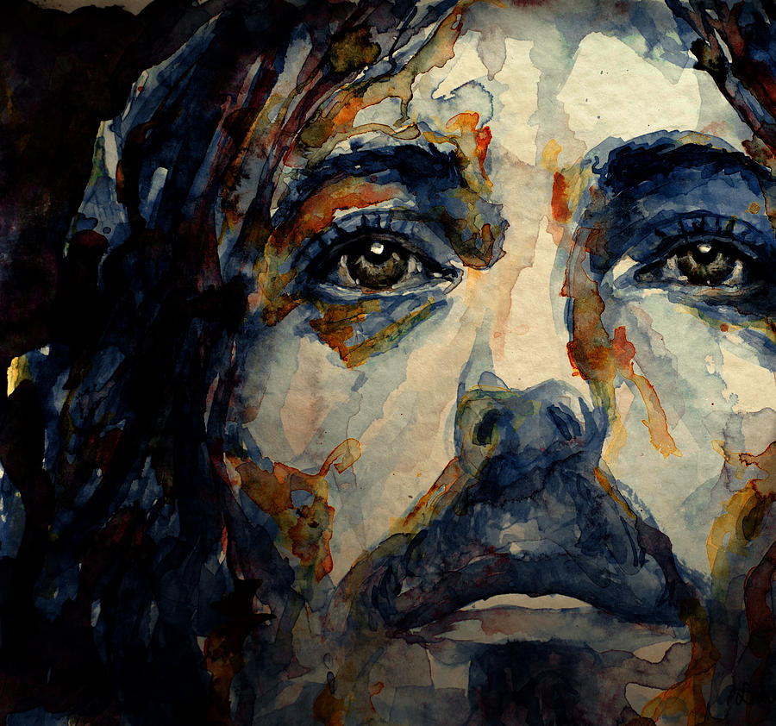
Previously saying, "Sacrifice and offering, burnt offerings, and offerings for sin You did not desire, nor had pleasure in them" (which are offered according to the law), then He said, "Behold, I have come to do Your will, O God." He takes away the first that He may establish the second. — Hebrews 10:8-9
Your will, O God

Slide 23
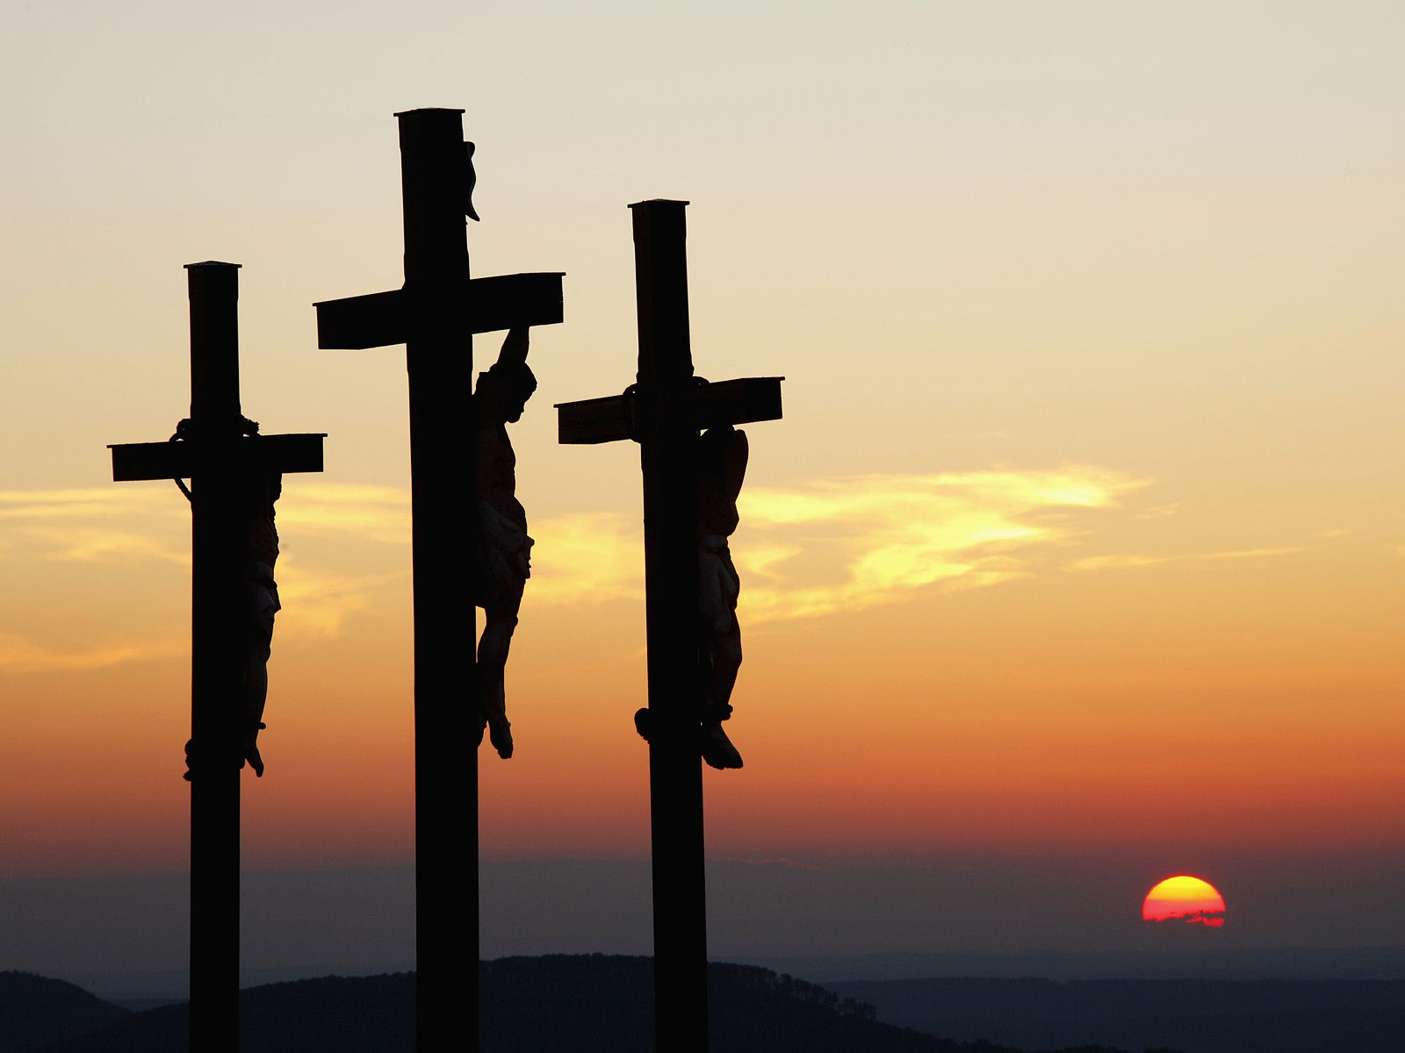
By that will we have been sanctified through the offering of the body of Jesus Christ once for all. And every priest stands ministering daily and offering repeatedly the same sacrifices, which can never take away sins. — Hebrews 10:10-11
sanctified through
the body of Jesus
once

Slide 24

But this Man, after He had offered one sacrifice for sins forever, sat down at the right hand of God, from that time waiting till His enemies are made His footstool. For by one offering He has perfected forever those who are being sanctified. — Hebrews 10:12-14
But this Man, after He had offered one sacrifice for sins forever, sat down at the right hand of God, from that time waiting till His enemies are made His footstool. For by one offering He has perfected forever those who are being sanctified. — Hebrews 10:12-14
one sacrifice for sins
one offering

Slide 25
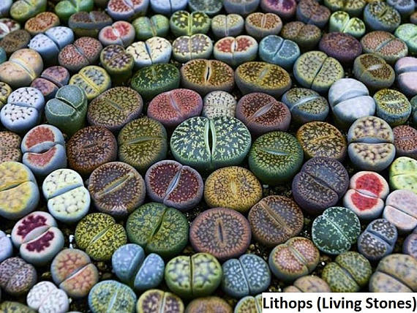
… you also, as living stones, are being built up a spiritual house, a holy priesthood, to offer up spiritual sacrifices acceptable to God through Jesus Christ. — 1st Peter 2:5
sacrifice
spiritual sacrifices
sacrifice

Slide 26

Therefore by Him let us continually offer the sacrifice of praise to God, that is, the fruit of our lips, giving thanks to His name. But do not forget to do good and to share, for with such sacrifices God is well pleased. — Hebrews 13:15-16
sacrifices:
● praise to God of our lips
● giving thanks to His name
● do good and share
sacrifice
praise to God
of our lips
giving thanks to His
name
do
good and
share
sacrifices

Slide 27

And walk in love, as Christ also has loved us and given Himself for us, an offering and a sacrifice to God for a sweet-smelling aroma. — Ephesians 5:2

Slide 28

→ One needs to make offerings in worship of the Lord
→ The Lord has no pleasure in insincere sacrifices
→ The Lord looks for mercy, righteousness, and justice
→ The Lord accepts a broken and contrite heart
→ God expects - do justly, love mercy, & walk humbly
→ All called to follow in pursuit of the ways of Jesus
→ Destiny is declared by desire for God or the world
→ A life without love leaves no sacrifice
→ Reasonable service is to our life as a living sacrifice
→ Control passions & desires free of conceit & envy
→ Sacrifice of Jesus sanctifies all who believe & obey
→ God wants spiritual sacrifices through Jesus Christ
→ Vocally praising God & doing good pleases God
God has sacrificed that we might have eternal salvation

Slide 30

Please visit http://www.LoveFromGod.com to explore further
Ronald Bert Channel on
Notes:
Eternity never ends.

