Slide 2
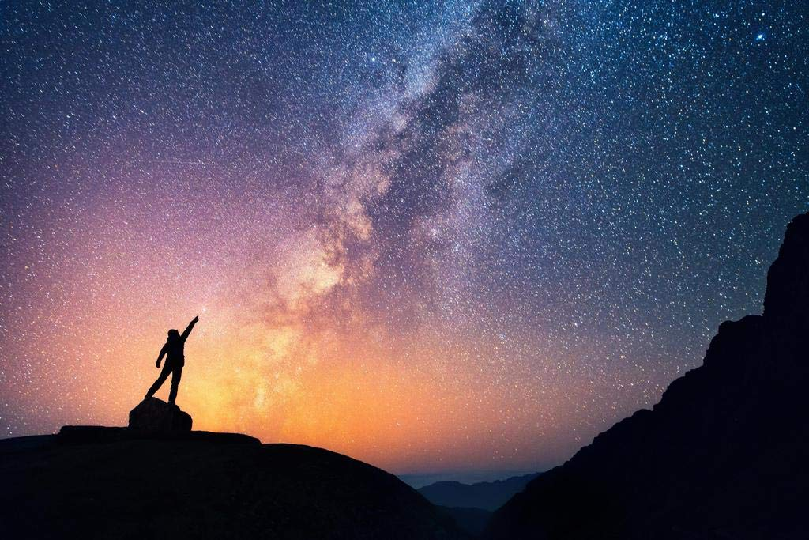
Raised Up
Ron Bert
April 25, 2021
Notes:
To gaze upon the heavens touches a call to come home.

Slide 3
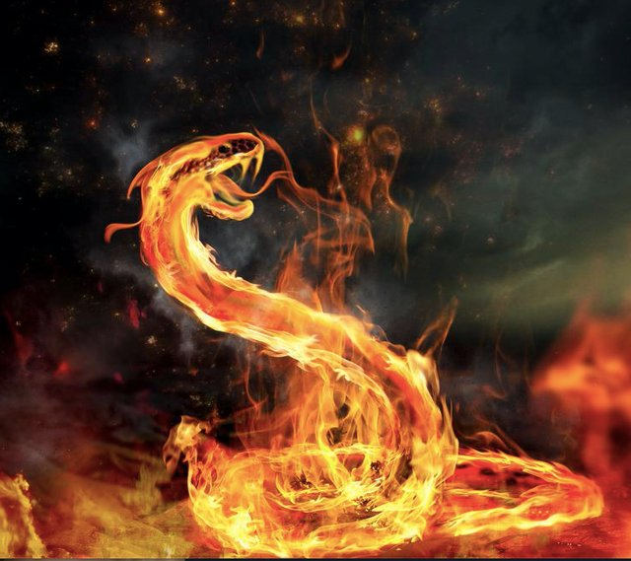
And the people spoke against God and against Moses: "Why have you brought us up out of Egypt to die in the wilderness? For there is no food and no water, and our soul loathes this worthless bread." So the LORD sent fiery serpents among the people, and they bit the people; and many of the people of Israel died. — Numbers 21:5-6
spoke against God
spoke against God
LORD
LORD
LORD
LORD
many
died
many
died
Notes:
The fire of sin bites all that sink to its’ darkness.

Slide 4
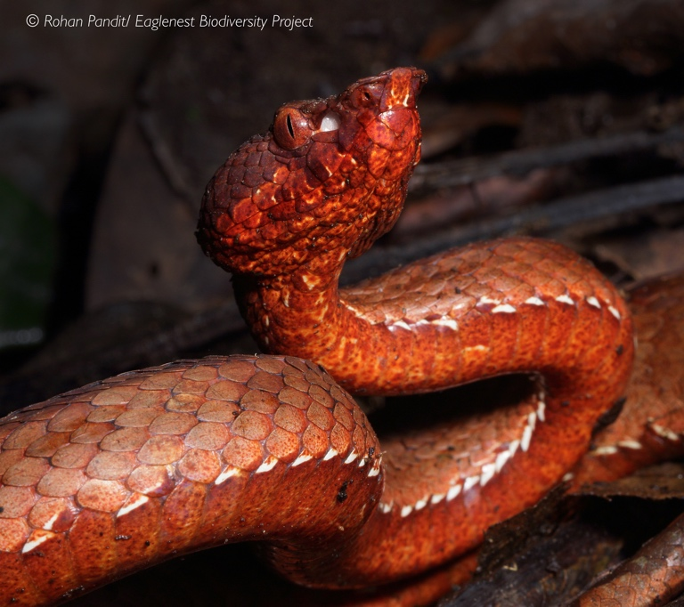
Therefore the people came to Moses, and said, "We have sinned, for we have spoken against the LORD and against you; pray to the LORD that He take away the serpents from us." So Moses prayed for the people. — Numbers 21:7
LORD
We have sinned
We have sinned
LORD
pray
pray
Requests
LORD
pray
pray
Action
Notes:
Tragedies onslaught often reveals the fear of evils done.

Slide 5
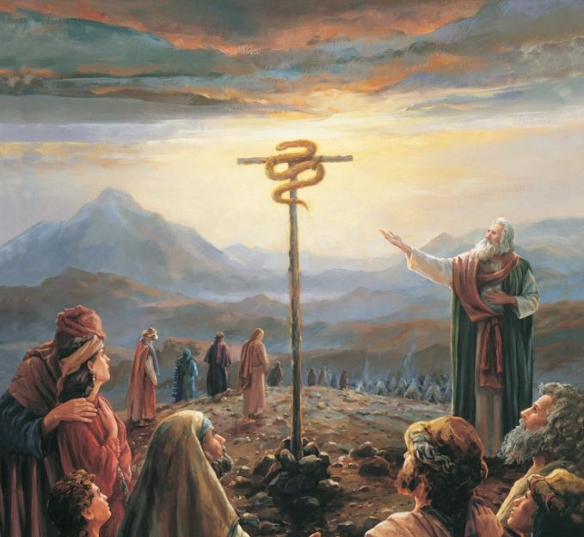
Then the LORD said to Moses, "Make a fiery serpent, and set it on a pole; and it shall be that everyone who is bitten, when he looks at it, shall live." So Moses made a bronze serpent, and put it on a pole; and so it was, if a serpent had bitten anyone, when he looked at the bronze serpent, he lived. — Numbers 21:8-9
LORD
look up to live
set it on a pole
set it on a pole
everyone who
everyone who
looks at it, shall live
look
live
looks at it, shall live
u
t
o
p
look
live
Notes:
To live, one must look up to God and what He has begun in Christ, our once eternal propitiation.

Slide 6
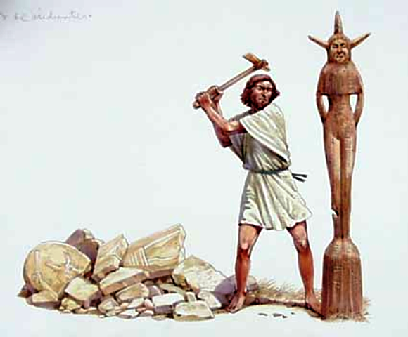
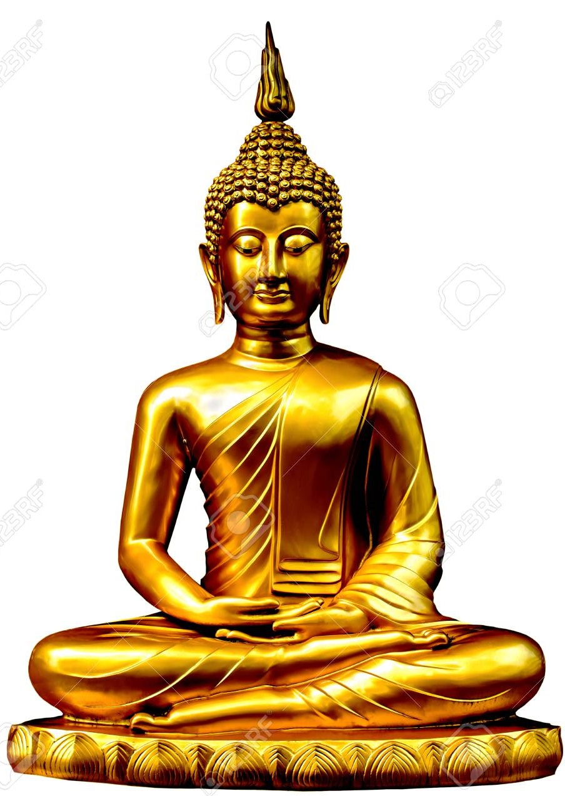
He (Hezekiah) removed the high places and broke the sacred pillars, cut down the wooden image and broke in pieces the bronze serpent that Moses had made; for until those days the children of Israel burned incense to it, and called it Nehushtan. — 2nd Kings 18:4
broke
broke
bronze serpent
bronze serpent
burned incense
Notes:
Physical desires can blur the truth of what is not seen.

Slide 7
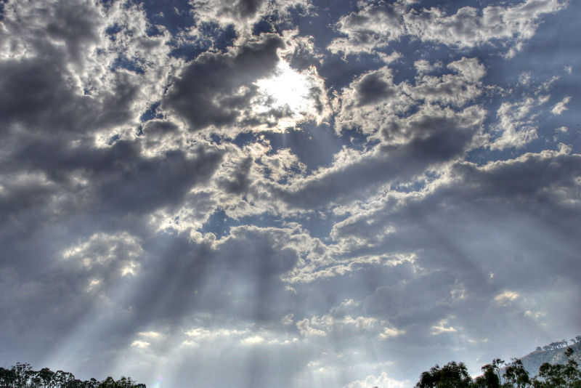
"No one has ascended to heaven but He who came down from heaven, that is, the Son of Man who is in heaven. And as Moses lifted up the serpent in the wilderness, even so must the Son of Man be lifted up, that whoever believes in Him should not perish but have eternal life. For God so loved the world that He gave His only begotten Son, that whoever believes in Him should not perish but have everlasting life." — John 3:13-16
heaven
heaven
heaven
"No one has ascended to heaven but He who came down from heaven, that is, the Son of Man who is in heaven. And as Moses lifted up the serpent in the wilderness, even so must the Son of Man be lifted up, that whoever believes in Him should not perish but have eternal life. For God so loved the world that He gave His only begotten Son, that whoever believes in Him should not perish but have everlasting life." — John 3:13-16
down from heaven
heaven
heaven
heaven
Son of Man who is in heaven
Son of Man
in
Son of Man who is in heaven
as Moses lifted up the serpent
. .
Son of Man
so must the Son of Man
. .
be lifted up
in
. .
Notes:
Eternal love calls for our return to the heights of forever.

Slide 8
heaven
heaven
heaven
heaven
heaven
heaven
from above

Slide 9
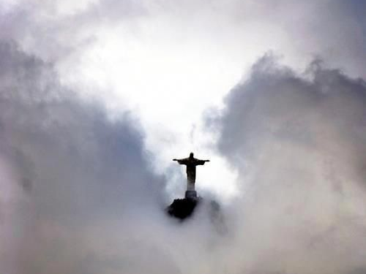
"He who comes from above is above all; he who is of the earth is earthly and speaks of the earth. He who comes from heaven is above all." — John 3:31
He
He
from above
He
He
is above all
. .
heaven
heaven
heaven
Notes:
God has spoken to the entire world of what is from above.

Slide 10
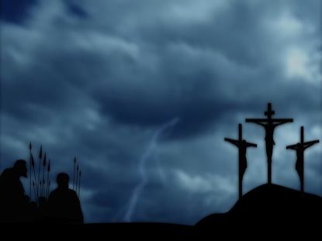
Then Jesus said to them, "When you lift up the Son of Man, then you will know that I am He, and that I do nothing of Myself; but as My Father taught Me, I speak these things." — John 8:28
lift up the Son of Man
. .
you will know that I am He
He
. .
Notes:
No doubt is left for those that believe in what God no longer needs to do; a call to come.

Slide 11
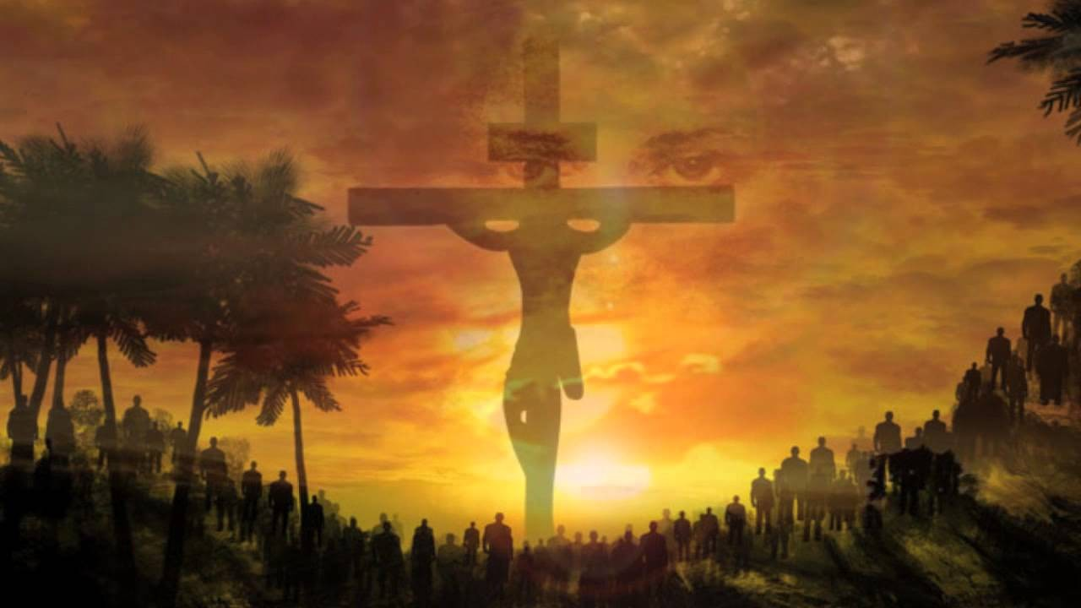
"And I, if I am lifted up from the earth, will draw all peoples to Myself." This He said, signifying by what death He would die. — John 12:32-33
I am lifted up
I am lifted up
earth
will draw
will draw
all peoples to Myself
to Myself
all peoples to Myself
to Myself
earth
Notes:
The proof is in the sacrifice and the truth it delivered. People of the earth need to be lifted up to find salvation.

Slide 12
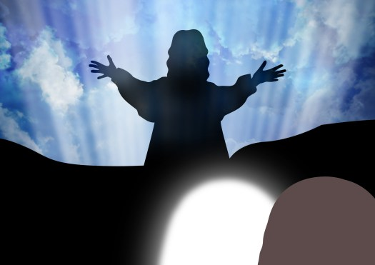
"The blind see and the lame walk; the lepers are cleansed and the deaf hear; the dead are raised up and the poor have the gospel preached to them. And blessed is he who is not offended because of Me." — Matthew 11:5-6
● blind see
● lame walk
● lepers are cleansed
● deaf hear
● dead are raised up
● poor have the gospel
"The blind see and the lame walk; the lepers are cleansed and the deaf hear; the dead are raised up and the poor have the gospel preached to them. And blessed is he who is not offended because of Me." — Matthew 11:5-6
The
blind see
lame walk
lepers are cleansed
deaf hear
dead are raised up
poor have the gospel
offended
to Myself
offended?
Notes:
Miraculous wonderments followed truths announcement by God Himself.

Slide 13
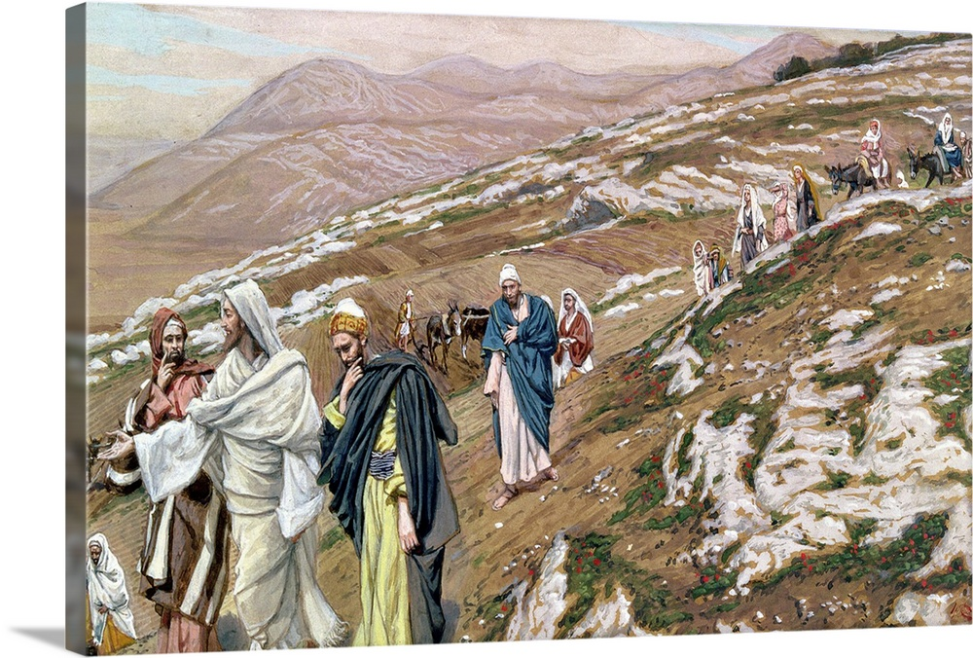
Now while they were staying in Galilee, Jesus said to them, "The Son of Man is about to be betrayed into the hands of men, and they will kill Him, and the third day He will be raised up." And they were exceedingly sorrowful. — Matthew 17:22-23
raised
kill Him
kill Him
He will be raised up
He will be raised up
raised
Notes:
It is natural to have sorrow in our separation from God’s immediate personal presence.

Slide 14
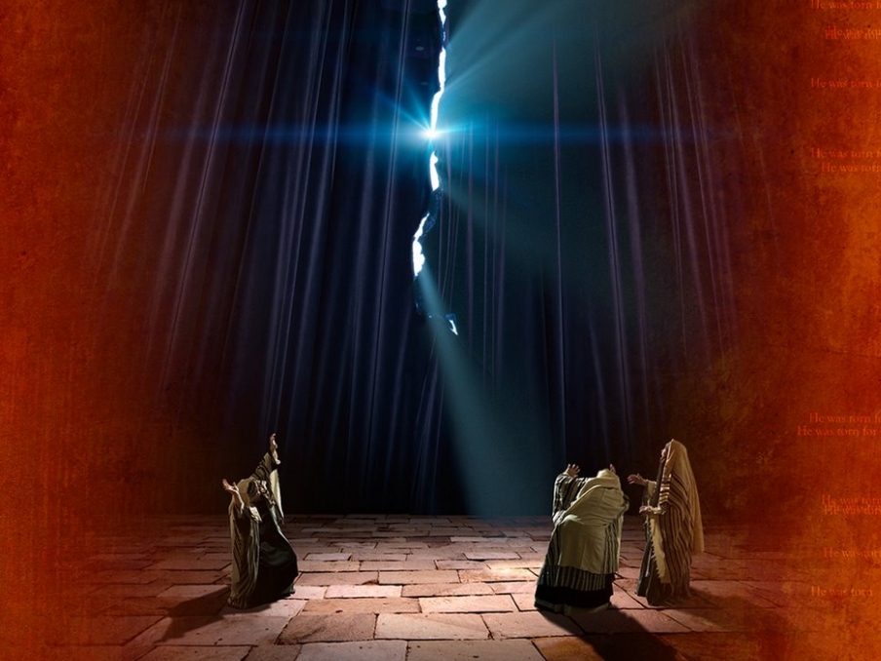
Then, behold, the veil of the temple was torn in two from top to bottom; and the earth quaked, and the rocks were split, and the graves were opened; and many bodies of the saints who had fallen asleep were raised; and coming out of the graves after His resurrection, they went into the holy city and appeared to many. So when the centurion and those with him, who were guarding Jesus, saw the earthquake and the things that had happened, they feared greatly, saying, "Truly this was the Son of God!" — Matthew 27:51-54
many bodies
many bodies
raised
were raised
were raised
resurrection
coming out of the graves
coming out of the graves
resurrection
resurrection
"Truly
this was the Son of God!"
Notes:
Witnesses aboundingly sail the echoes of time that heal as many souls who hear.

Slide 15
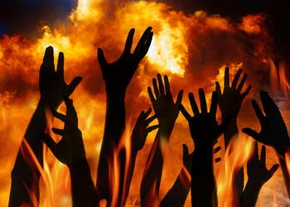
For Sadducees say that there is no resurrection -- and no angel or spirit; but the Pharisees confess both. — Acts 23:8
resurrection
no resurrection
no resurrection
Notes:
Confusion has no shortage when men are involved in explaining what they do not know. In the light of Jesus Christ, His truth of resurrection now remains.

Slide 16
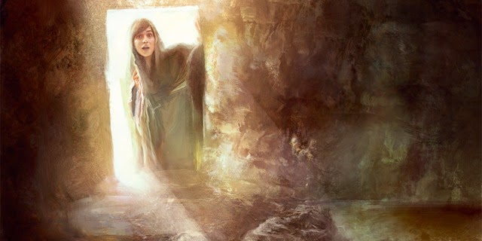
"He is not here; for He is risen, as He said. Come, see the place where the Lord lay." — Matthew 28:6
Lord
Lord
Lord
Lord
He is risen
He is risen
Come
Lord
Notes:
Truth cannot be covered by lies of what God has commanded.

Slide 17
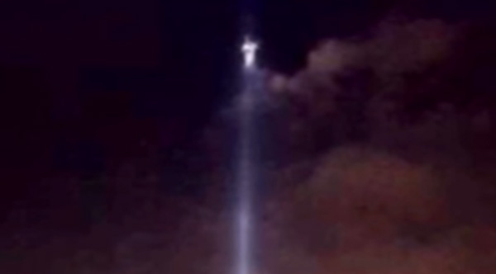
After that He was seen by over five hundred brethren at once, of whom the greater part remain to the present, but some have fallen asleep. — 1st Corinthians 15:6
Lord
seen by over
. .
. .
five hundred brethren at once
five hundred brethren
Notes:
God’s reassurance through resurrection gave an undeniable eternal foundation for all to see and remember.

Slide 18
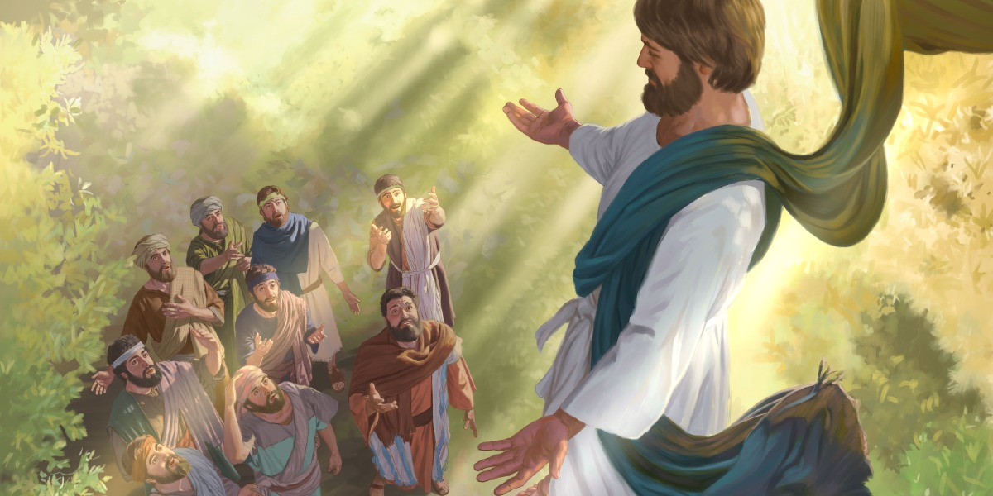
"This Jesus God has raised up, of which we are all witnesses." — Acts 2:32
God
. .
Jesus
God
Jesus God has raised up
Jesus
we are all witnesses
Notes:
What a wonder to see God ascend before mere mortals.

Slide 19
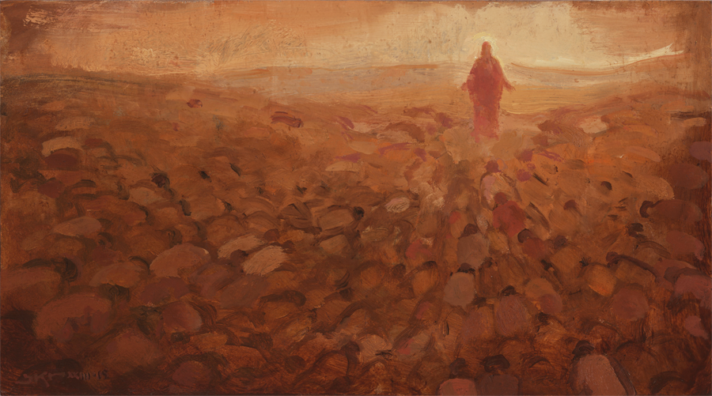
And being found in appearance as a man, He humbled Himself and became obedient to the point of death, even the death of the cross. Therefore God also has highly exalted Him and given Him the name which is above every name, that at the name of Jesus every knee should bow, of those in heaven, and of those on earth, and of those under the earth, and that every tongue should confess that Jesus Christ is Lord, to the glory of God the Father. — Philippians 2:8-11
God
is above
. .
Jesus
Jesus Christ is Lord, to the glory of God
Jesus Christ
. .
Notes:
How can anyone of true enlightenment not bow in worship for what God has done for all to know.
Romans 14:11 For it is written: "As I live, says the LORD, Every knee shall bow to Me, And every tongue shall confess to God."

Slide 20
"Nor is there salvation in any other, for there is no other name under heaven given among men by which we must be saved." — Acts 4:12
. .
no other name
. .
must be saved
must
Notes:
From days of old, His call is to come near, away from leaving His heart, of life’s truth.

Slide 21
… looking unto Jesus, the author and finisher of our faith, who for the joy that was set before Him endured the cross, despising the shame, and has sat down at the right hand of the throne of God. — Hebrews 12:2
looking unto Jesus
. .
our faith
God
Risen
. .
right hand of the throne of God
God
Notes:
To look to God through Jesus Christ saves the soul and inspires the beginning of life forever. To see Him one has to rise through the heart.

Slide 22
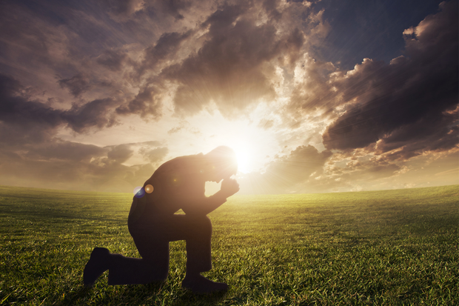
… knowing that Christ, having been raised from the dead, dies no more. Death no longer has dominion over Him. For the death that He died, He died to sin once for all; but the life that He lives, He lives to God. Likewise you also, reckon yourselves to be dead indeed to sin, but alive to God in Christ Jesus our Lord. Therefore do not let sin reign in your mortal body, that you should obey it in its lusts. — Romans 6:9-12
Christ
Christ
raised
raised from the dead, dies no more
raised from the dead, dies no more
raised
God
God
be
be
in
alive to God in Christ Jesus
alive to God in Christ Jesus
Christ Jesus
Notes:
To be free of death, one has to realize He died for all, conditionally upon all who would believe, and obey.

Slide 23
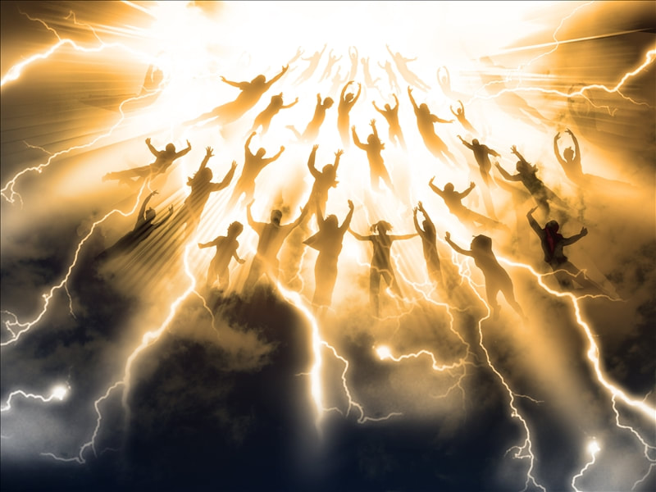
If then you were raised with Christ, seek those things which are above, where Christ is, sitting at the right hand of God. Set your mind on things above, not on things on the earth. For you died, and your life is hidden with Christ in God. — Colossians 3:1-3
Christ
raised
Christ
Christ
where Christ is
where Christ is
mind on things above
brain
watch
care
psyche
thinking
attention
spirit
mind on things above
life is
life is
Christ
in God
in
God
in God
Notes:
No one in mortal flesh can see into the bottom of another's heart; each of us is hidden in the confines of our own being. Life is either plain and honest or deceptive and corrupt. To seek things above clears a heart to know what is of all higher truths. Focused on earth below involves material self-seeking, frozen away from any true empathy. Selfish hearts are wells of darkness. Unambiguously, love renders life where hate delivers death. We must die to our hate, for self and others, to see God’s mercy under His grace. Alone, all come to judgment.
Hebrews 11:6 But without faith it is impossible to please Him, for he who comes to God must believe that He is, and that He is a rewarder of those who diligently seek Him.
5487 = “is”
9395 = “in”

Slide 24
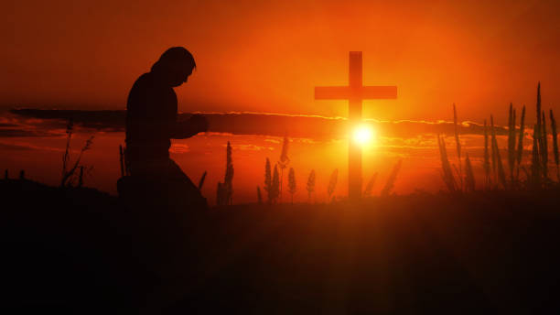
When Christ who is our life appears, then you also will appear with Him in glory. Therefore put to death your members which are on the earth: fornication, uncleanness, passion, evil desire, and covetousness, which is idolatry. — Colossians 3:4-5
Christ
our life
in glory
in
in glory
Christ our life
Notes:
An event comes to all oceans in life’s game, a rendering of truth upon His judgment of light.

Slide 25
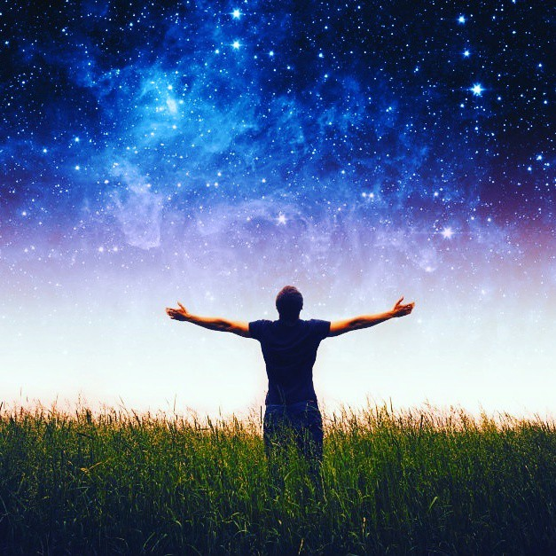
[A Song of Ascents.] Unto You I lift up my eyes, O You who dwell in the heavens. — Psalms 123:1
in glory
Christ our life
lift up
my eyes

Slide 26
lift up
my eyes
Notes:
When our longing hearts call as equally for His return, we have arrived.

Slide 27
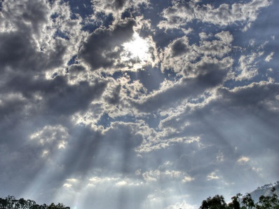
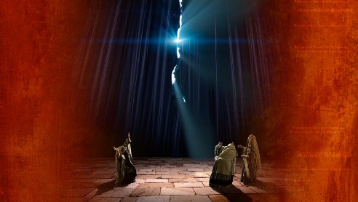
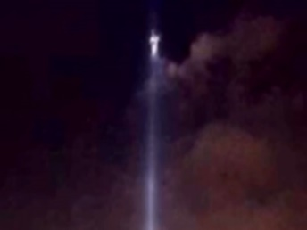
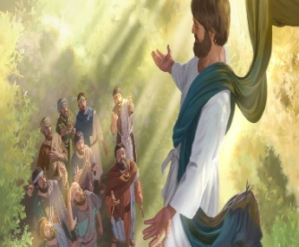
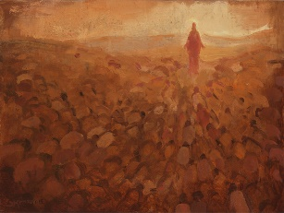

Slide 28
→ People complain even when God supplies
→ Moses made a bronze serpent for healing the bitten
→ The people turned the bronze serpent into an idol
→ We must look up to the truth of Jesus to be saved
→ From heaven, Jesus is above all
→ Jesus offends many for His miraculous powers
→ Many dead came forth after Christ’s crucifixion
→ Jesus humbled Himself in the face of evil
→ There is no other salvation than through Jesus
→ Jesus is the author and finisher of our faith
→ Exercise self-control over lusts of the flesh
→ Seek those spiritual things from above
→ The faithful will appear with Christ in glory
To each soul’s hope for love’s return cannot be hushed
Notes:
To each soul’s hope for love’s return cannot be hushed.

Slide 30
Please visit http://www.LoveFromGod.com to explore further
Ronald Bert Channel on
Notes:
Eternity never ends.

