Slide 2


Pursue
Ron Bert
June 7, 2020

Slide 3


Depart from evil and do good; Seek peace and pursue it. — Psalms 34:14
pursue
do good
do good
Seek peace
pursue
Seek peace
Notes:
Do we pursue those things called out for, for the best in our spiritual evolvement? The pools of peace are in the depths of heaven’s truth.

Slide 4

Therefore let us pursue the things which make for peace and the things by which one may edify another — Romans 14:19
pursue
pursue
make for peace
make for peace
edify another
edify another
Notes:
It is a challenge with all the adversities in this world to follow the advice of the Bible. However, it instructs us all with a baseline of conduct in appreciative qualities to pursue. Genuinely caring for others has always been paramount for anything really successful. When we help others is where our true strength is found.

Slide 5


Pursue love, and desire spiritual gifts, but especially that you may prophesy. — 1st Corinthians 14:1
pursue
have insight
telling the truth
pursue
Notes:
As a rose’s fragrance, love must rise in sweet tender tranquility, for it to be real.

Slide 6

For "He who would love life And see good days, Let him refrain his tongue from evil, And his lips from speaking deceit. Let him turn away from evil and do good; Let him seek peace and pursue it. — 1st Peter 3:10-11
good
good
do good
do good
seek peace
pursue
seek peace
Notes:
There is no misery like the misery of one unable to find love, breaking over filthy language. It is a conscious event to remain more decent than despicable. Doing good and pursuing peace brings the treasures of heaven to heart. To find the definition of good, one has to look to the word of God.

Slide 7

Remind them to be subject to rulers and authorities, to obey, to be ready for every good work, to speak evil of no one, to be peaceable, gentle, showing all humility to all men. — Titus 3:1-2
be subject to
● be subject to authorities
● to obey
● to be ready for every good work
● to speak evil of no one
● to be peaceable, gentle
● showing humility to all
authorities
to obey
to be ready for every good work
good
to speak evil of no one
to be
peaceable, gentle
showing
humility to all
Notes:
Pondering on the qualities called out for radiate the greatest smiles in the midst of laughter. God sings to us with every breath.

Slide 8

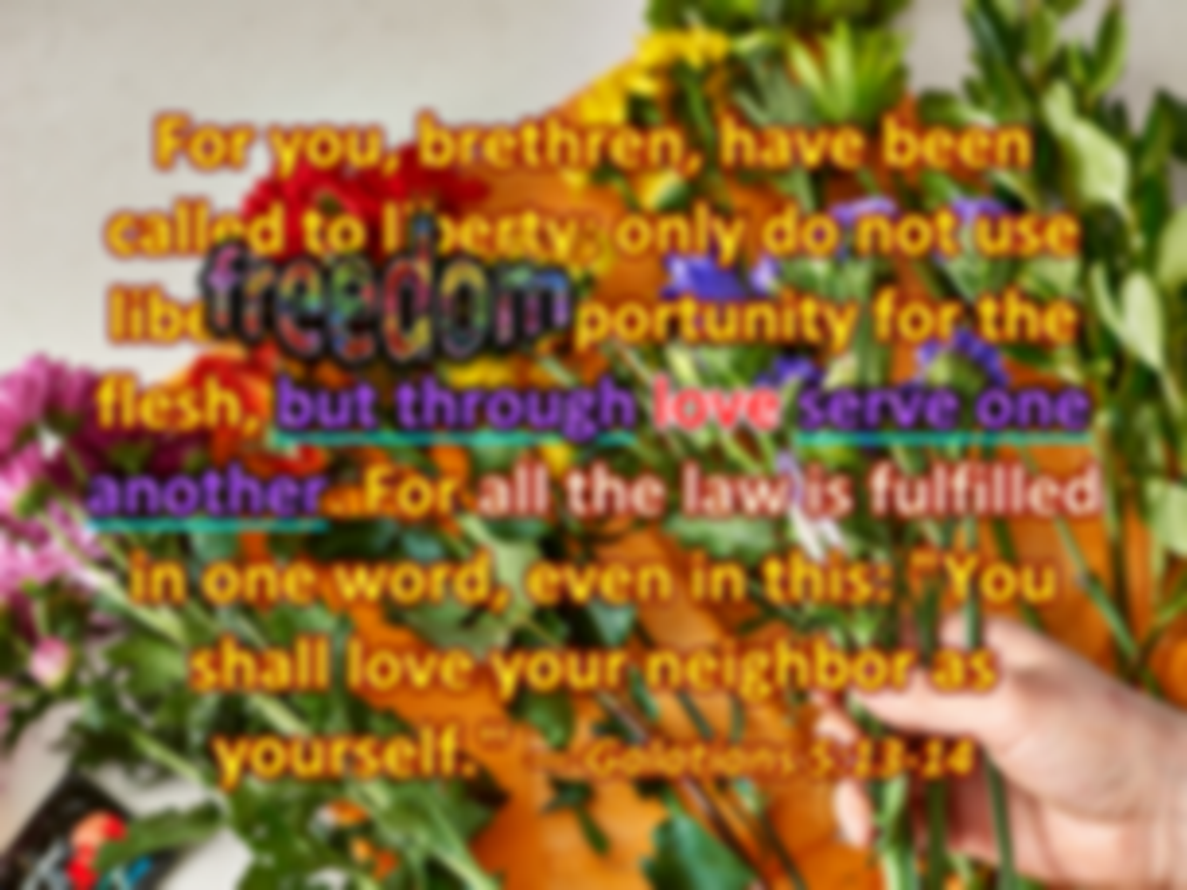


For you, brethren, have been called to liberty; only do not use liberty as an opportunity for the flesh, but through love serve one another. For all the law is fulfilled in one word, even in this: "You shall love your neighbor as yourself." — Galatians 5:13-14
freedom
but through love serve one
but through love serve one
another
another
Notes:
As flowers sway in the wind, our love should reflect His gifts of beauty, and respect and or regard for this freedom to be. It does not say to use freedom of spirit to pursue evil intentions skewing away from God’s purposed word. God’s truth cannot be replaced by the oblivious whims of man.

Slide 9

Flee also youthful lusts; but pursue righteousness, faith, love, peace with those who call on the Lord out of a pure heart. — 2nd Timothy 2:22
a pure heart
↑
peace who call on the Lord
love
faith
righteousness
pursue
↗
Flee youthful lusts
prayer
→
youthful lusts
Flee
→
righteousness
faith
pursue
love
→
who call on
peace
→
the Lord
a pure heart
Notes:
Age delivers wisdom for those of careful thoughtfulness. A raving maniac is easily exposed. Many diseases of spirit confront the soul. Arrogance, superiority over others, lauding self, has the value of all that is empty. Weakness in pride holds the unsettling resentments of others, and sears the heart from true peace. Some are never able to recover, mired in the battles of self, and it can take a lifetime to overcome lust, and turn it to unutterable sincerest of deepest love, over its shallow predecessor of youthful reckless wild passions. Instant gratification endures little if not held with pure unconditional commitment of heart. Endless desire spirals a hole with peace so far out of reach. Contentment is closely associated with pure love. Gladness is deeper than the flesh can deliver. What is divine is to be supremely valued where thankfulness lifts us past troubles caused by grief and not having. Prayer is what establishes a clean heart.

Slide 10


Beloved, I beg you as sojourners and pilgrims, abstain from fleshly lusts which war against the soul, having your conduct honorable among the Gentiles, that when they speak against you as evildoers, they may, by your good works which they observe, glorify God in the day of visitation. — 1st Peter 2:11-12
abstain from fleshly lusts
abstain from fleshly lusts
war against the soul
war against the soul
Notes:
If one merely dwells on the lusts of the flesh, all spiritual gifts will be at best, elusive. The soul is a gift of God and it should be everyone's ambition, and need, to follow where God leads us.

Slide 11
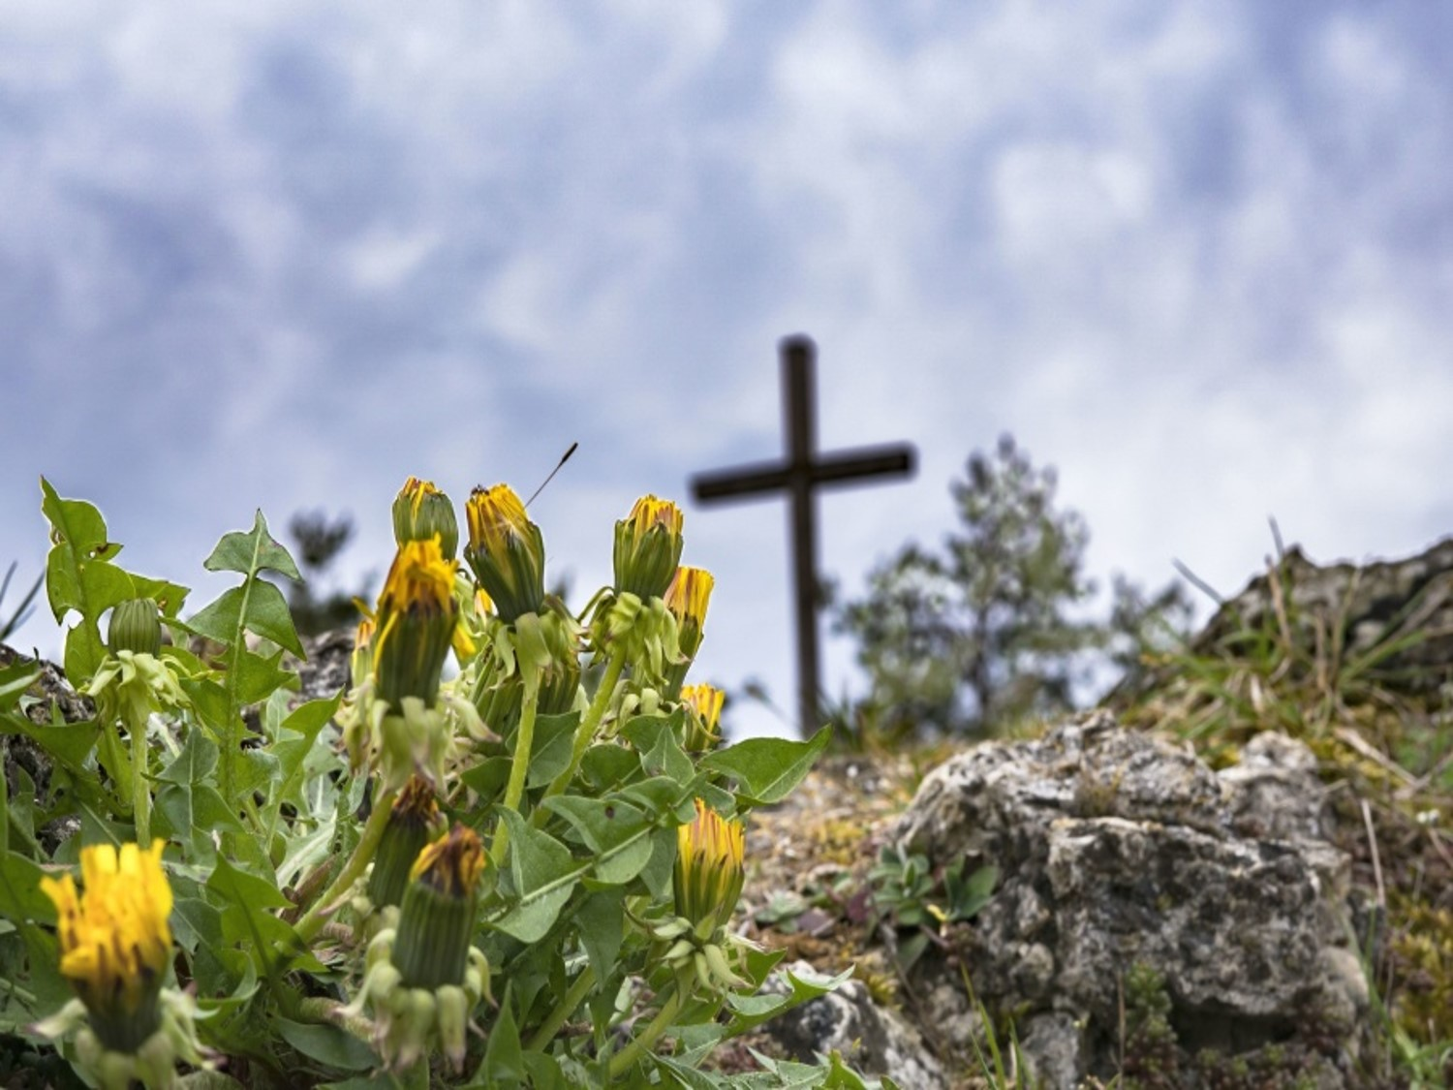


Then Jesus said to His disciples, "If anyone desires to come after Me, let him deny himself, and take up his cross, and follow Me. — Matthew 16:24
Jesus said
Jesus
. .
self-control
deny himself
. .
follow Me
follow
. .
Notes:
The message from Jesus is to exercise self-control and to laboriously pursue good works.

Slide 12



"And he who does not take his cross and follow after Me is not worthy of Me." — Matthew 10:38
follow
worthy of Me
. .
follow
Notes:
In all the purity that God is, and in delivering His word for man to know, no one should be lost to His true intentions; salvation of His children in the light. While none of us may be worthy, it must be a desire to be more acceptable in His sight, and in service to be true for all. This is accomplished by adhering to, and studying, the word of God.

Slide 13

For to this you were called, because Christ also suffered for us, leaving us an example, that you should follow His steps: — 1st Peter 2:21
Christ
Christ
Christ
leaving us an example
leaving us an example
follow
follow
Notes:
To step into the life Jesus walked is to know the love that surpasses all understanding.

Slide 14

Now it happened as they journeyed on the road, that someone said to Him, "Lord, I will follow You wherever You go." — Luke 9:57
follow
submission
follow
wherever You go
wherever You go
Notes:
One is lucky if the winds of heart lead to feathers of golden truths.

Slide 15
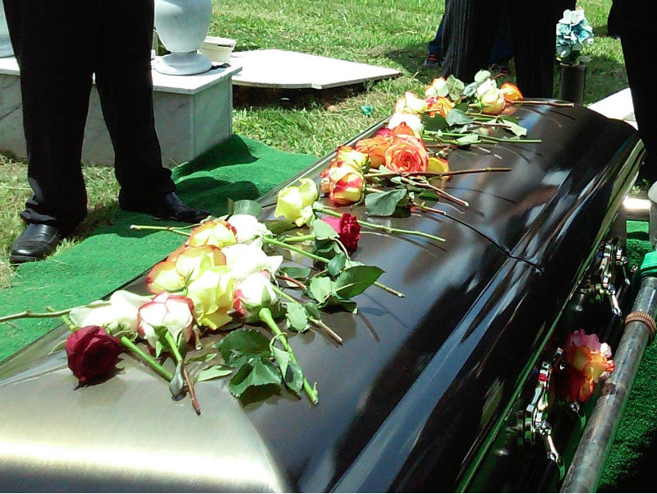
Then He said to another, "Follow Me." But he said, "Lord, let me first go and bury my father." — Luke 9:59
follow
follow
let me first
let me first
Notes:
Family is precious when joy of love is shared. When love is so prevalent, it can be obscure to find yet a higher love, for God, but it must take precedence. Thankfulness for His gift to love itself should easily lift our hearts closer to Him.

Slide 16


And another also said, "Lord, I will follow You, but let me first go and bid them farewell who are at my house." — Luke 9:61
follow
let me first
let me first
my house
Family
Notes:
The meal we eat is not just to satisfy cravings of the flesh. If desire for God and His salvation is less than anything else, priorities are misaligned from that sparkle that rises to touch eternity itself.

Slide 17
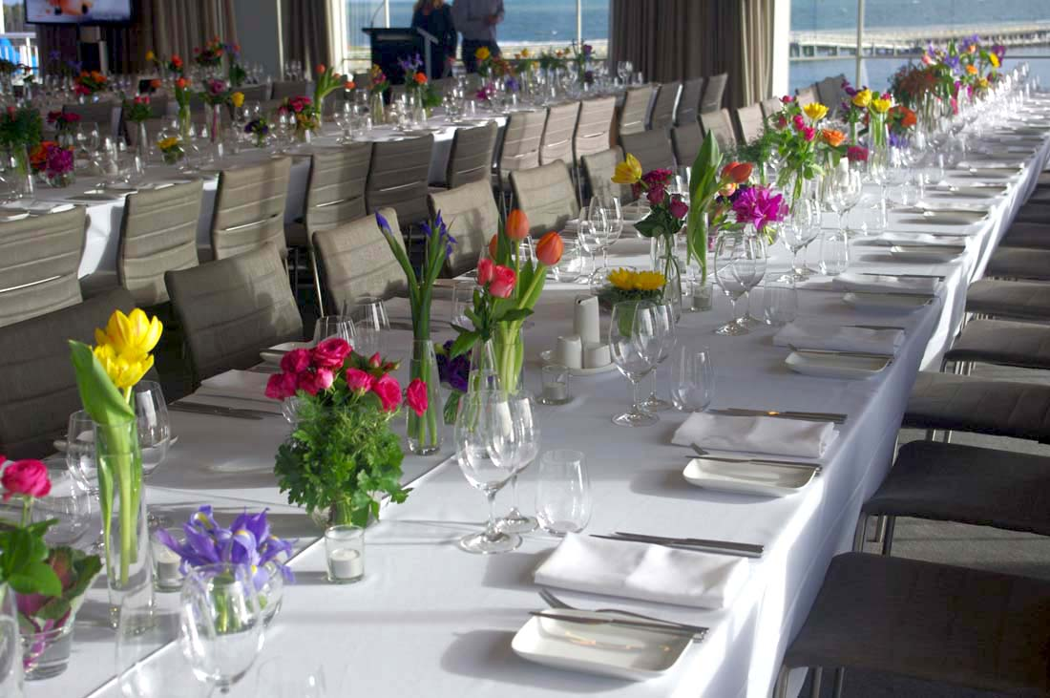
Then He said to him, "A certain man gave a great supper and invited many, and sent his servant at supper time to say to those who were invited, 'Come, for all things are now ready.'" — Luke 14:16-17
Come
Come
now
now
Notes:
The call from God has always been now, as His presence has never left us, as of yet.

Slide 18


"But they all with one accord began to make excuses. The first said to him, 'I have bought a piece of ground, and I must go and see it. I ask you to have me excused.' And another said, 'I have bought five yoke of oxen, and I am going to test them. I ask you to have me excused.' Still another said, 'I have married a wife, and therefore I cannot come.' — Luke 14:18-20
excuses
excuses
Property (possessions)
bought
bought
Business (livelihood)
bought
bought
Family (relationships)
married
married
Notes:
People have lives, and they should be valued accordingly. However, when one puts any of the activities of life above that which gave life, for it to be, true worship is neglected, and even dismissed, when property, business, and or family is the only focus. One either comes to God or not.

Slide 19


I cannot
come
Notes:
Hypocrites are the snakes in all of our lives. They plot and manipulate to achieve power over others, and take little stock in accountability. Truth is possessing a clear conscience with God as our guide. Selfish people have a perverted inward desire, lacking outward expressions of mercy and truth, welded in patience.

Slide 20
"So they come to you as people do, they sit before you as My people, and they hear your words, but they do not do them; for with their mouth they show much love, but their hearts pursue their own gain." — Ezekiel 33:31
hear
word
hear
word
word
do not do them
pursue their
pursue their
. .
own gain
own gain
. .
Notes:
Hypocrites are the snakes in all of our lives. They plot and manipulate to achieve power over others, and take little stock in accountability. Truth is possessing a clear conscience with God as our guide. Selfish people have a perverted inward desire, lacking outward expressions of mercy and truth, welded in patience.

Slide 21


"But as for those whose hearts follow the desire for their detestable things and their abominations, I will recompense their deeds on their own heads," says the Lord GOD. — Ezekiel 11:21
follow
follow
hearts follow
. .
detestable things
detestable things
. .
Notes:
There will always be, as long as God is disregarded, people that prey upon all others with cold detestable qualities. It is a choice for darkness over the light. These mongers highest achievement is satisfying their own lusts, regardless of consequences to others. Unfortunately, evil often devours what could be good. In dismissing God, one generally dismisses all respect for others as well. What could be beautiful is smothered by the web of misery. God will judge all cold hearts accordingly.

Slide 22
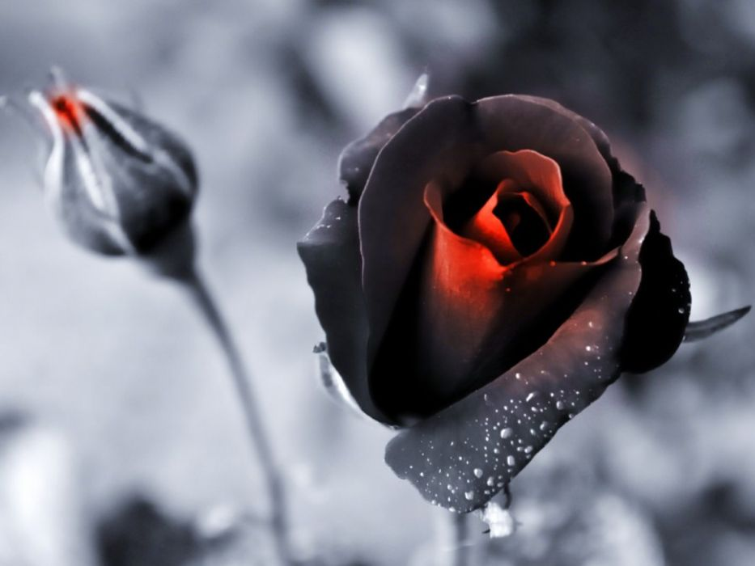
And many will follow their destructive ways, because of whom the way of truth will be blasphemed. — 2nd Peter 2:2
follow
the way of truth
the way of truth
Notes:
The Bible speaks of the way of truth, and so there is a way of truth. To find truth it can only be done when the truth of God is acknowledged.

Slide 23

But you, O man of God, flee these things and pursue righteousness, godliness, faith, love, patience, gentleness. — 1st Timothy 6:11
O man of God pursue:
● righteousness
● godliness
● faith
● love
● patience
● gentleness
→
O man of God
→
pursue
righteousness
→
pursue
godliness
faith
love
patience
→
gentleness
→
→
Notes:
God is clear for souls to pursue those things He declares as good, and flee what is defined as evil. Plenty of warnings have been given not to change His word, and deceive the ignorant by calling evil good, and good evil. Hypocrites are not able to hide from the truth God has delivered. All the lot of us fools will be shot down when we bow before His Majesty of grace.

Slide 24
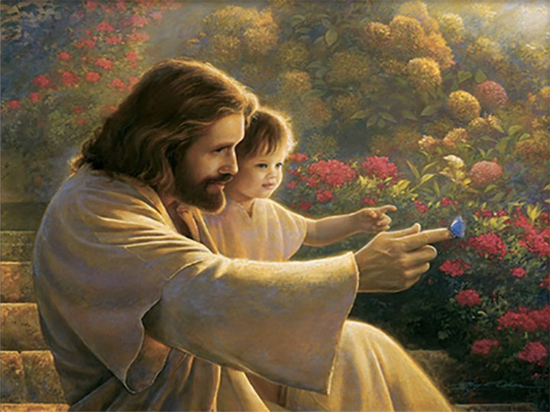

See that no one renders evil for evil to anyone, but always pursue what is good both for yourselves and for all. — 1st Thessalonians 5:15
evil for evil
pursue
pursue what is good
. .
all
for all
. .
Notes:
What we pursue is who we are; this is life.

Slide 25


Draw near to God and He will draw near to you. Cleanse your hands, you sinners; and purify your hearts, you double-minded. — James 4:8
God
Draw near to God
. .
heart
hypocrites
self-seekers
phonies
schemers
heart
back-stabbers
double-minded
Notes:
Drawing near to God helps our climb away from those evil practices of the past, or even those that remain in the present. One can never be close enough to God for all He has done for us. God does not seek souls who hide behind walls of deception. Truth is transparent where it forever resides as obvious.

Slide 26

Trust in the LORD with all your heart, And lean not on your own understanding; In all your ways acknowledge Him, And He shall direct your paths. — Proverbs 3:5-6
Trust in the LORD
all
Trust in the LORD
heart
all
Notes:
Trust in anything is what we put faith in. Trust in God frees a soul to find contentment above all that is the material realm.

Slide 27


Brethren, I do not count myself to have apprehended; but one thing I do, forgetting those things which are behind and reaching forward to those things which are ahead, I press toward the goal for the prize of the upward call of God in Christ Jesus. — Philippians 3:13-14
forgetting
behind
reaching forward
. .
in
God in Christ Jesus
forgetting behind
toward the goal
. .
the upward call
God in
. .
Christ Jesus
Notes:
None of has attained perfection as we struggle to become better than before, for those with conscience. Regrets are part of that repentance to turn back to God, and regard His ways of being. The fires of truth help understanding as we travel through this wicked world. Let us dream of better days where we lift each other to be more for our children. Assholes die in the piles they create. We must find a way to fertilize the future, and the truth of God has no greater value in this pursuit.

Slide 28















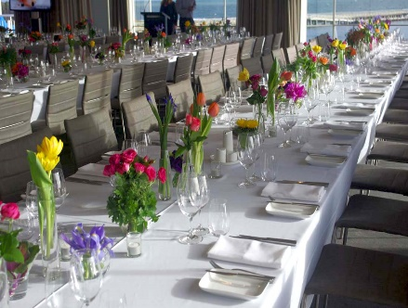





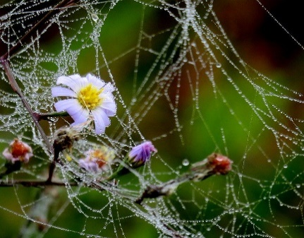

Notes:
It can be hard to choose life over death, optimism verses pessimism, as honest hearts can find it difficult to not look back upon the sins we all bear. It is not original sin, but those actions of selfishness we have all individually pursued. In an ever flowing kaleidoscope of stop and go, what cripples us is lack of belief, in God, and in one another.

Slide 29


→ Seek peace and pursue it
→ Pursue those things that edify each other
→ Pursue love & that one may give proper instruction
→ Be ready to do good works in subject to authority
→ Love is the one word that fulfills all the law
→ Pursue righteousness/faith/ love/peace/calling God
→ Abstain from fleshly lusts which war against souls
→ To be worthy one must bear loads & follow Christ
→ Excuses keep one from following God
→ Hypocrites lie in pursuit of their own gain
→ Pursue what is good both for yourselves and for all
→ He directs the path when one trusts God / one’s all
→ Pursue the eternal prize found in the upward call
The greatest pursuit for all is seeking love’s peace
Notes:
The greatest pursuit for all is seeking love’s peace

Slide 31

Please visit http://www.RonBert.com to explore further
Ronald Bert Channel on
Notes:
Eternity never ends.

