Slide 2
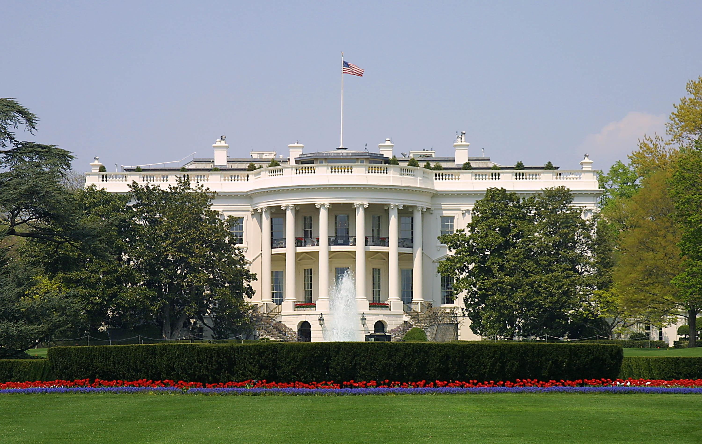
Presidential Quotes
Ron Bert
28
December 1, 2019

Slide 3
Part 2
35. John F. Kennedy (1961-1963)

Slide 4
“This nation was founded by men of many nations and backgrounds. It was founded on the principle that all men are created equal, and that the rights of every man are diminished when the rights of one man are threatened ... It ought to be possible, in short, for every American to enjoy the privileges of being American without regard to his race or his color.”
rights of every man

Slide 5
Therefore I exhort first of all that supplications, prayers, intercessions, and giving of thanks be made for all men, for kings and all who are in authority, that we may lead a quiet and peaceable life in all godliness and reverence. For this is good and acceptable in the sight of God our Savior, who desires all men to be saved and to come to the knowledge of the truth. — 1st Timothy 2:1-4
quiet and peaceable
godliness and reverence
God
desires all men
truth

Slide 6
“I'm 43 years old and I'm the healthiest candidate for the Presidency of the United States. You've travelled with me enough to know that I'm not going to die in office.”

Slide 7
“To exclude from positions of trust and command all those below the age of 44 would have kept Jefferson from writing the Declaration of Independence, Washington from commanding the Continental Army, Madison from fathering the Constitution, Hamilton from serving as secretary of the treasury, Clay from being elected speaker of the House and Christopher Columbus from discovering America.”

Slide 8
“The Jewish people, ever since David slew Goliath, have never considered youth as a barrier to leadership.”

Slide 9
“I think it is appropriate that we pay tribute to this great constitutional principle which is enshrined in the First Amendment of the Constitution: the principle of religious independence, of religious liberty, of religious freedom.”
religious independence
freedom
religious liberty
freedom
religious freedom

Slide 10
“But I think it is also important that we pay tribute and acknowledge another great principle, and that is the principle of religious conviction. Religious freedom has no significance unless it is accompanied by conviction.”
religious conviction
freedom
belief
view
principle
faith
devotion

Slide 11
Now faith is the substance of things hoped for, the evidence of things not seen. For by it the elders obtained a good testimony. By faith we understand that the worlds were framed by the word of God, so that the things which are seen were not made of things which are visible. — Hebrews 11:1-3
faith
hope

Slide 12
“I believe the American people are more concerned with a man’s views and abilities than with the church to which he belongs. I believe the founding fathers meant it when they provided in Article VI of the Constitution that there should be no religious test for public office. And I believe that the American people mean to adhere to those principles today.”
views and abilities
public office

Slide 13
“Whatever one's religion in his private life may be, for the officeholder, nothing takes precedence over his oath to uphold the Constitution and all its parts - including the First Amendment and the strict separation of church and state.”

Slide 14
“I believe in an America where the separation of church and state is absolute - where no Catholic prelate would tell the president (should he be Catholic) how to act. I do not speak for my church on public matters - and the church does not speak for me.”

Slide 15
“We do not want an official state church. If ninety-nine percent of the population were Catholics, I would still be opposed to it. I do not want civil power combined with religious power. I want to make it clear that I am committed as a matter of deep personal conviction to separation.”

Slide 16
“I believe in an America that is officially neither Catholic, Protestant nor Jewish; where no public official either requests or accepts instructions on public policy from the Pope, the National Council of Churches or any other ecclesiastical source; where no religious body seeks to impose its will directly or indirectly upon the general populace or the public acts of its officials; and where religious liberty is so indivisible that an act against one church is treated as an act against all.”

Slide 17
[A Song of Ascents. Of David.] Behold, how good and how pleasant it is For brethren to dwell together in unity! — Psalms 133:1

Slide 18
"Therefore, whatever you want men to do to you, do also to them, for this is the Law and the Prophets." — Matthew 7:12

Slide 19
He who is devoid of wisdom despises his neighbor, But a man of understanding holds his peace. — Proverbs 11:12

Slide 20
For this is the will of God, that by doing good you may put to silence the ignorance of foolish men -- as free, yet not using liberty as a cloak for vice, but as bondservants of God. Honor all people. Love the brotherhood. Fear God. Honor the king. — 1st Peter 2:15-17
bondservants of God:
• Honor all people
• Love the brotherhood
• Fear God
• Honor the king
→
bondservants
of God
Honor all people
Love the
→
brotherhood
Fear God
Honor
the king

Slide 21
Finally, all of you be of one mind, having compassion for one another; love as brothers, be tenderhearted, be courteous; not returning evil for evil or reviling for reviling, but on the contrary blessing, knowing that you were called to this, that you may inherit a blessing. — 1st Peter 3:8-9
be of one mind
be of one mind ↓
• having compassion
• love as brothers
• be tenderhearted
• be courteous
• not returning evil for evil
or reviling for reviling
→ but on the contrary blessing
having compassion
love as brothers
be
tenderhearted
be courteous
not
returning evil for evil
or reviling
for reviling
but on the contrary
blessing
called to this

Slide 22
“Finally, I believe in an America where religious intolerance will someday end; where all men and all churches are treated as equal; where every man has the same right to attend or not attend the church of his choice; where there is no Catholic vote, no anti-Catholic vote, no bloc voting of any kind; and where Catholics, Protestants and Jews, at both the lay and pastoral level, will refrain from those attitudes of disdain and division which have so often marred their works in the past, and promote instead the American ideal of brotherhood.”

Slide 23
Whoever hates his brother is a murderer, and you know that no murderer has eternal life abiding in him. — 1st John 3:15

Slide 24
And this commandment we have from Him: that he who loves God must love his brother also. — 1st John 4:21

Slide 25
A friend loves at all times, And a brother is born for adversity. — Proverbs 17:17

Slide 26
A man who has friends must himself be friendly, But there is a friend who sticks closer than a brother. — Proverbs 18:24

Slide 27
“Tolerance implies no lack of commitment to one's own beliefs. Rather it condemns the oppression or persecution of others.”
Love your neighbor
faith
Religious domination
Notes:
Many religious zealots hate other religious doctrines contrary to one’s own personal beliefs. Condemning others is contrary to the instructions of God. It is God alone who reserves the right of final judgment.

Slide 28
Beloved, I beg you as sojourners and pilgrims, abstain from fleshly lusts which war against the soul, having your conduct honorable among the Gentiles, that when they speak against you as evildoers, they may, by your good works which they observe, glorify God in the day of visitation. — 1st Peter 2:11-12
speak against you as evildoers
by your good works
glorify God

Slide 29
“The greater our knowledge increases the more our ignorance unfolds.”

Slide 30
"To you, O men, I call, And my voice is to the sons of men. O you simple ones, understand prudence, And you fools, be of an understanding heart. Listen, for I will speak of excellent things, And from the opening of my lips will come right things;" — Proverbs 8:4-6
carefulness
understanding heart
Listen

Slide 31
“War and hunger and ignorance and despair know no religious barriers.”

Slide 32
… having their understanding darkened, being alienated from the life of God, because of the ignorance that is in them, because of the blindness of their heart; who, being past feeling, have given themselves over to lewdness, to work all uncleanness with greediness. — Ephesians 4:18-19
understanding
darkened
alienated from
● understanding darkened
● alienated from the life of God
● ignorance that is in them
● blindness of their heart
● past feeling
● given to lewdness
uncleanness with greediness
the life of God
ignorance that is in them
blindness of their heart
Godless
past feeling
given
lewdness
to
uncleanness
with greediness
Notes:
It is the godless that plague all mankind past true sense of eternal caring. Above all the Bible is a book and expression of truth for souls to know.

Slide 33
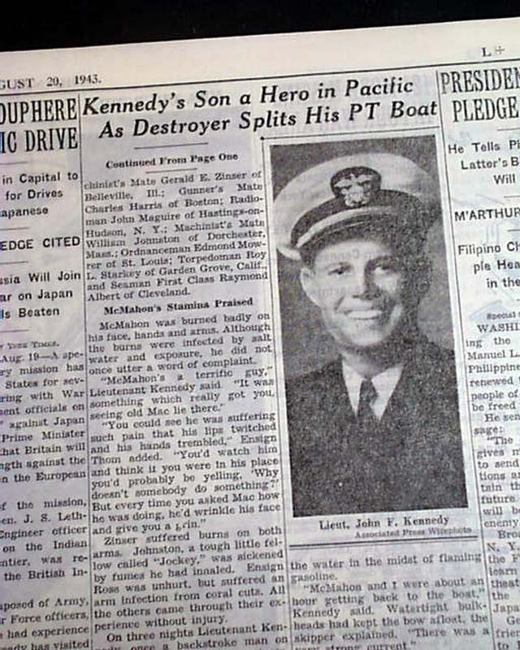
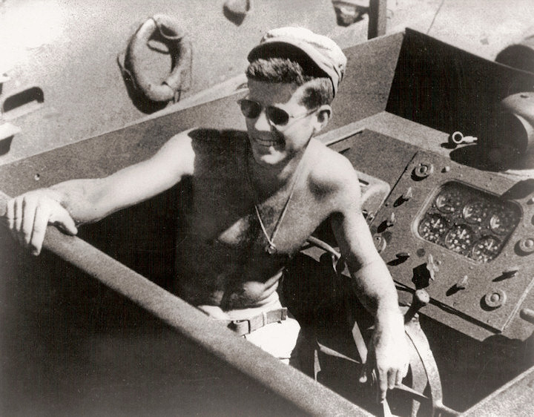
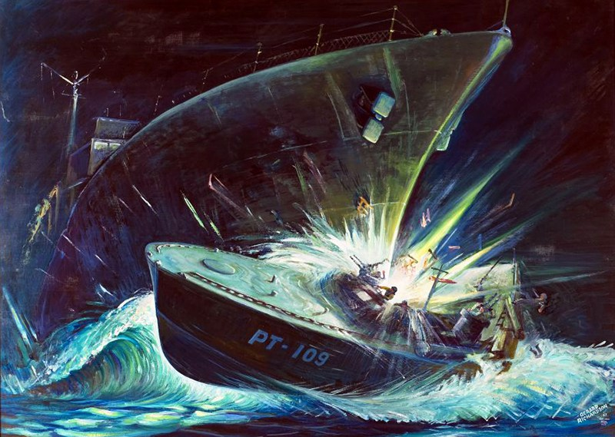
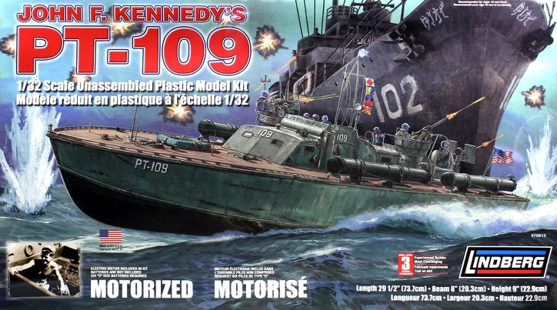
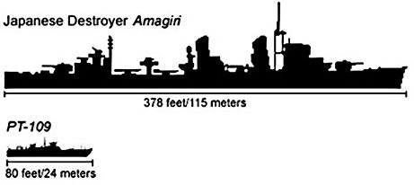
Notes:
a Japanese destroyer rams an American PT (patrol torpedo) boat, No. 109, slicing it in two. The destruction is so massive other American PT boats in the area assume the crew is dead. Two crewmen were, in fact, killed, but 11 survived, including Lt. John F. Kennedy

Slide 34
Notes:
last conventionally powered carrier built for the United States Navy

Slide 35
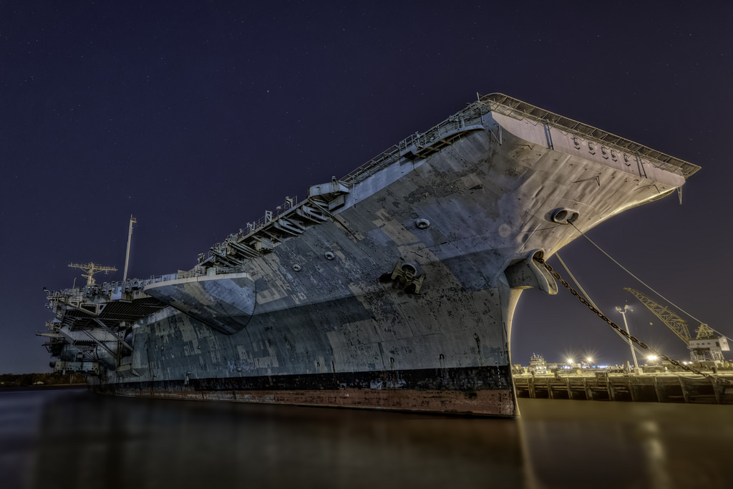
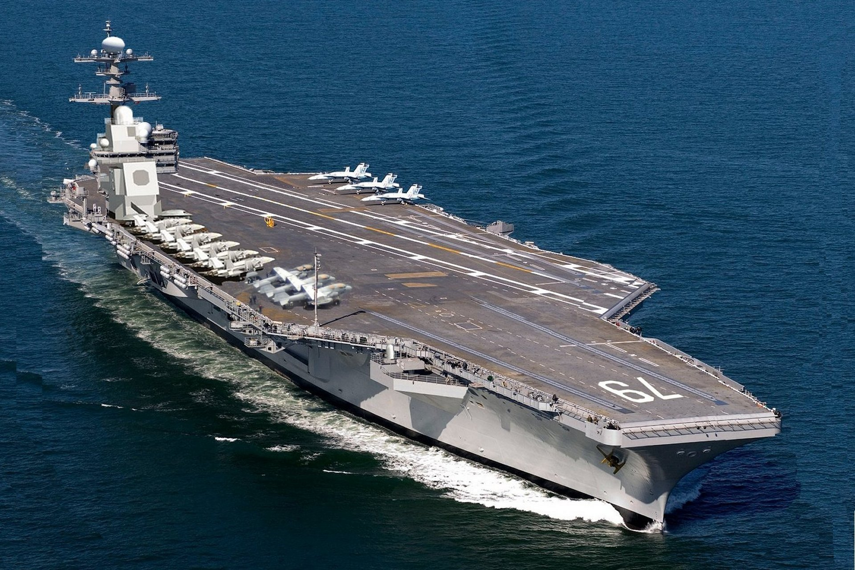
Decommissioned‎: ‎23 March 2007
Aircraft carried‎: ‎80+
Commissioned‎: ‎7 September 1968
Notes:
Philli ship yard

Slide 36
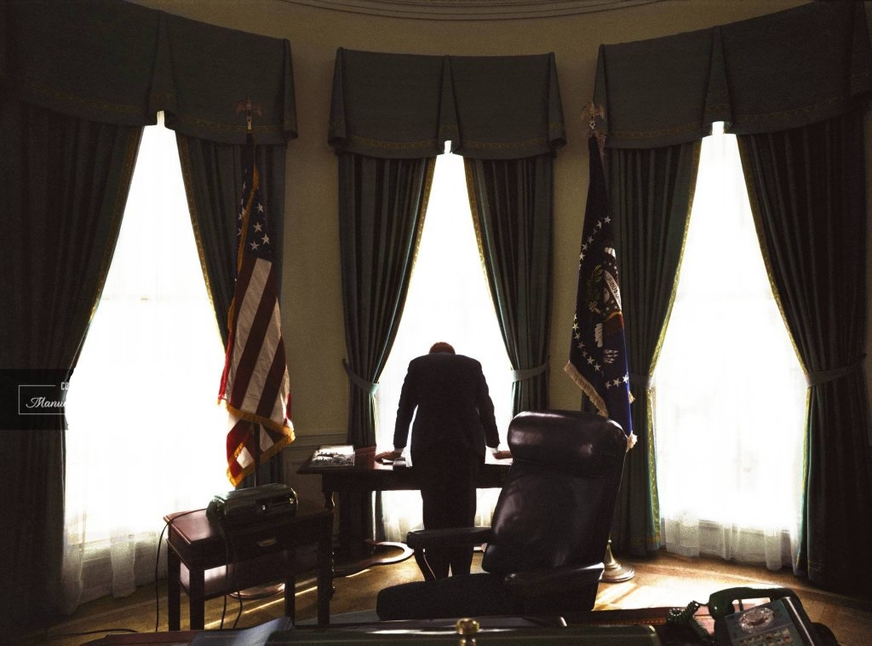

Slide 37
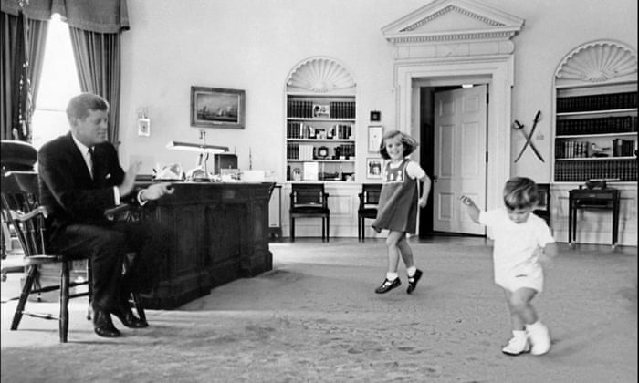
Caroline Kennedy
John F. Kennedy Jr.

Slide 38
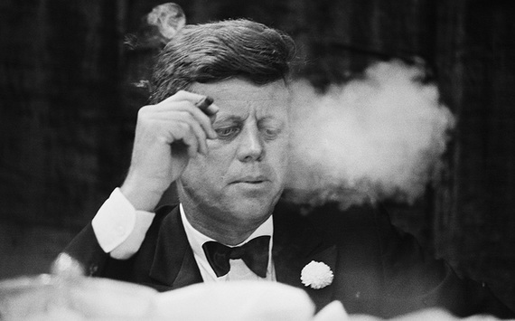

Slide 39
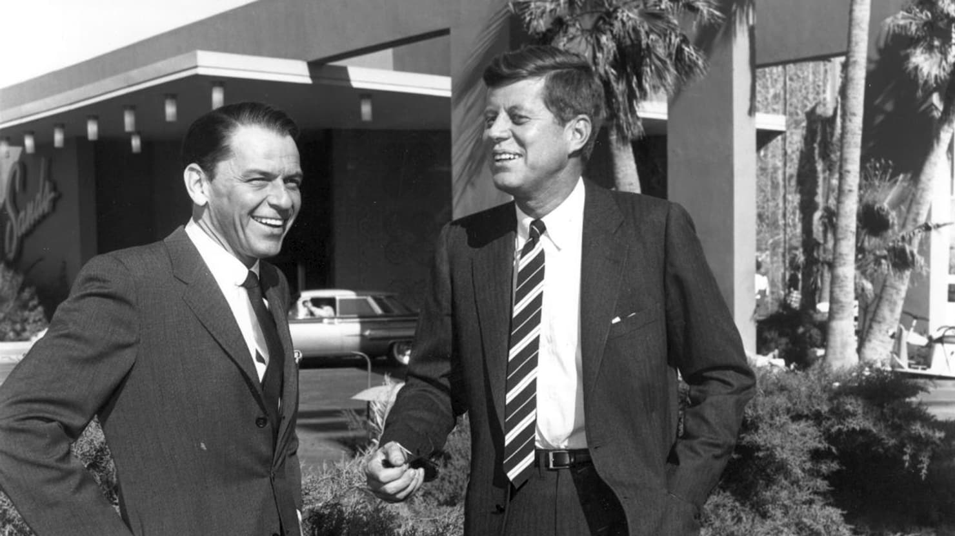
Frank Sinatra

Slide 40
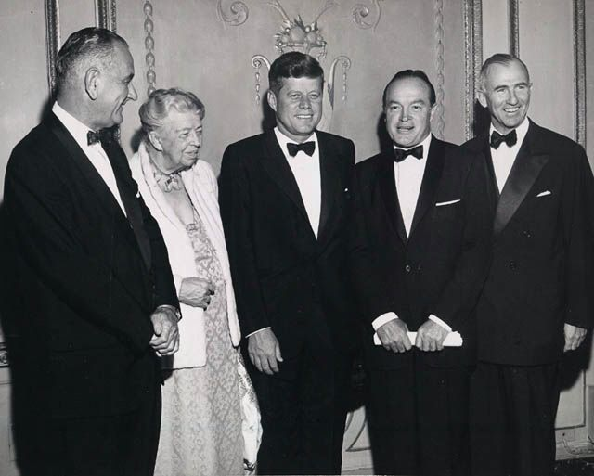
Stuart Symington
Eleanor Roosevelt
Lyndon Johnson
Bob Hope
Notes:
dinner held in honor of Eleanor Roosevelt in 1960

Slide 41
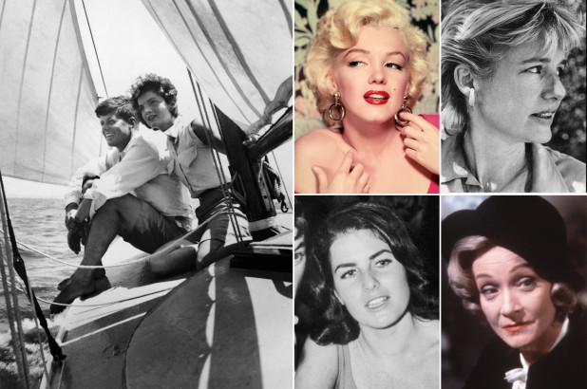
Marilyn
Monroe
Mary Meyer
Judith Exner
Marlene Dietrich
Notes:
Alleged affairs of JFK

Slide 42
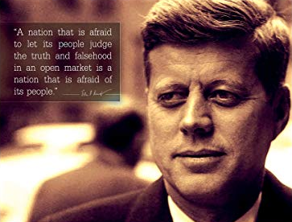
“A nation that is afraid to let its people judge truth and falsehood in an open market is a nation that is afraid of its people.”

Slide 43
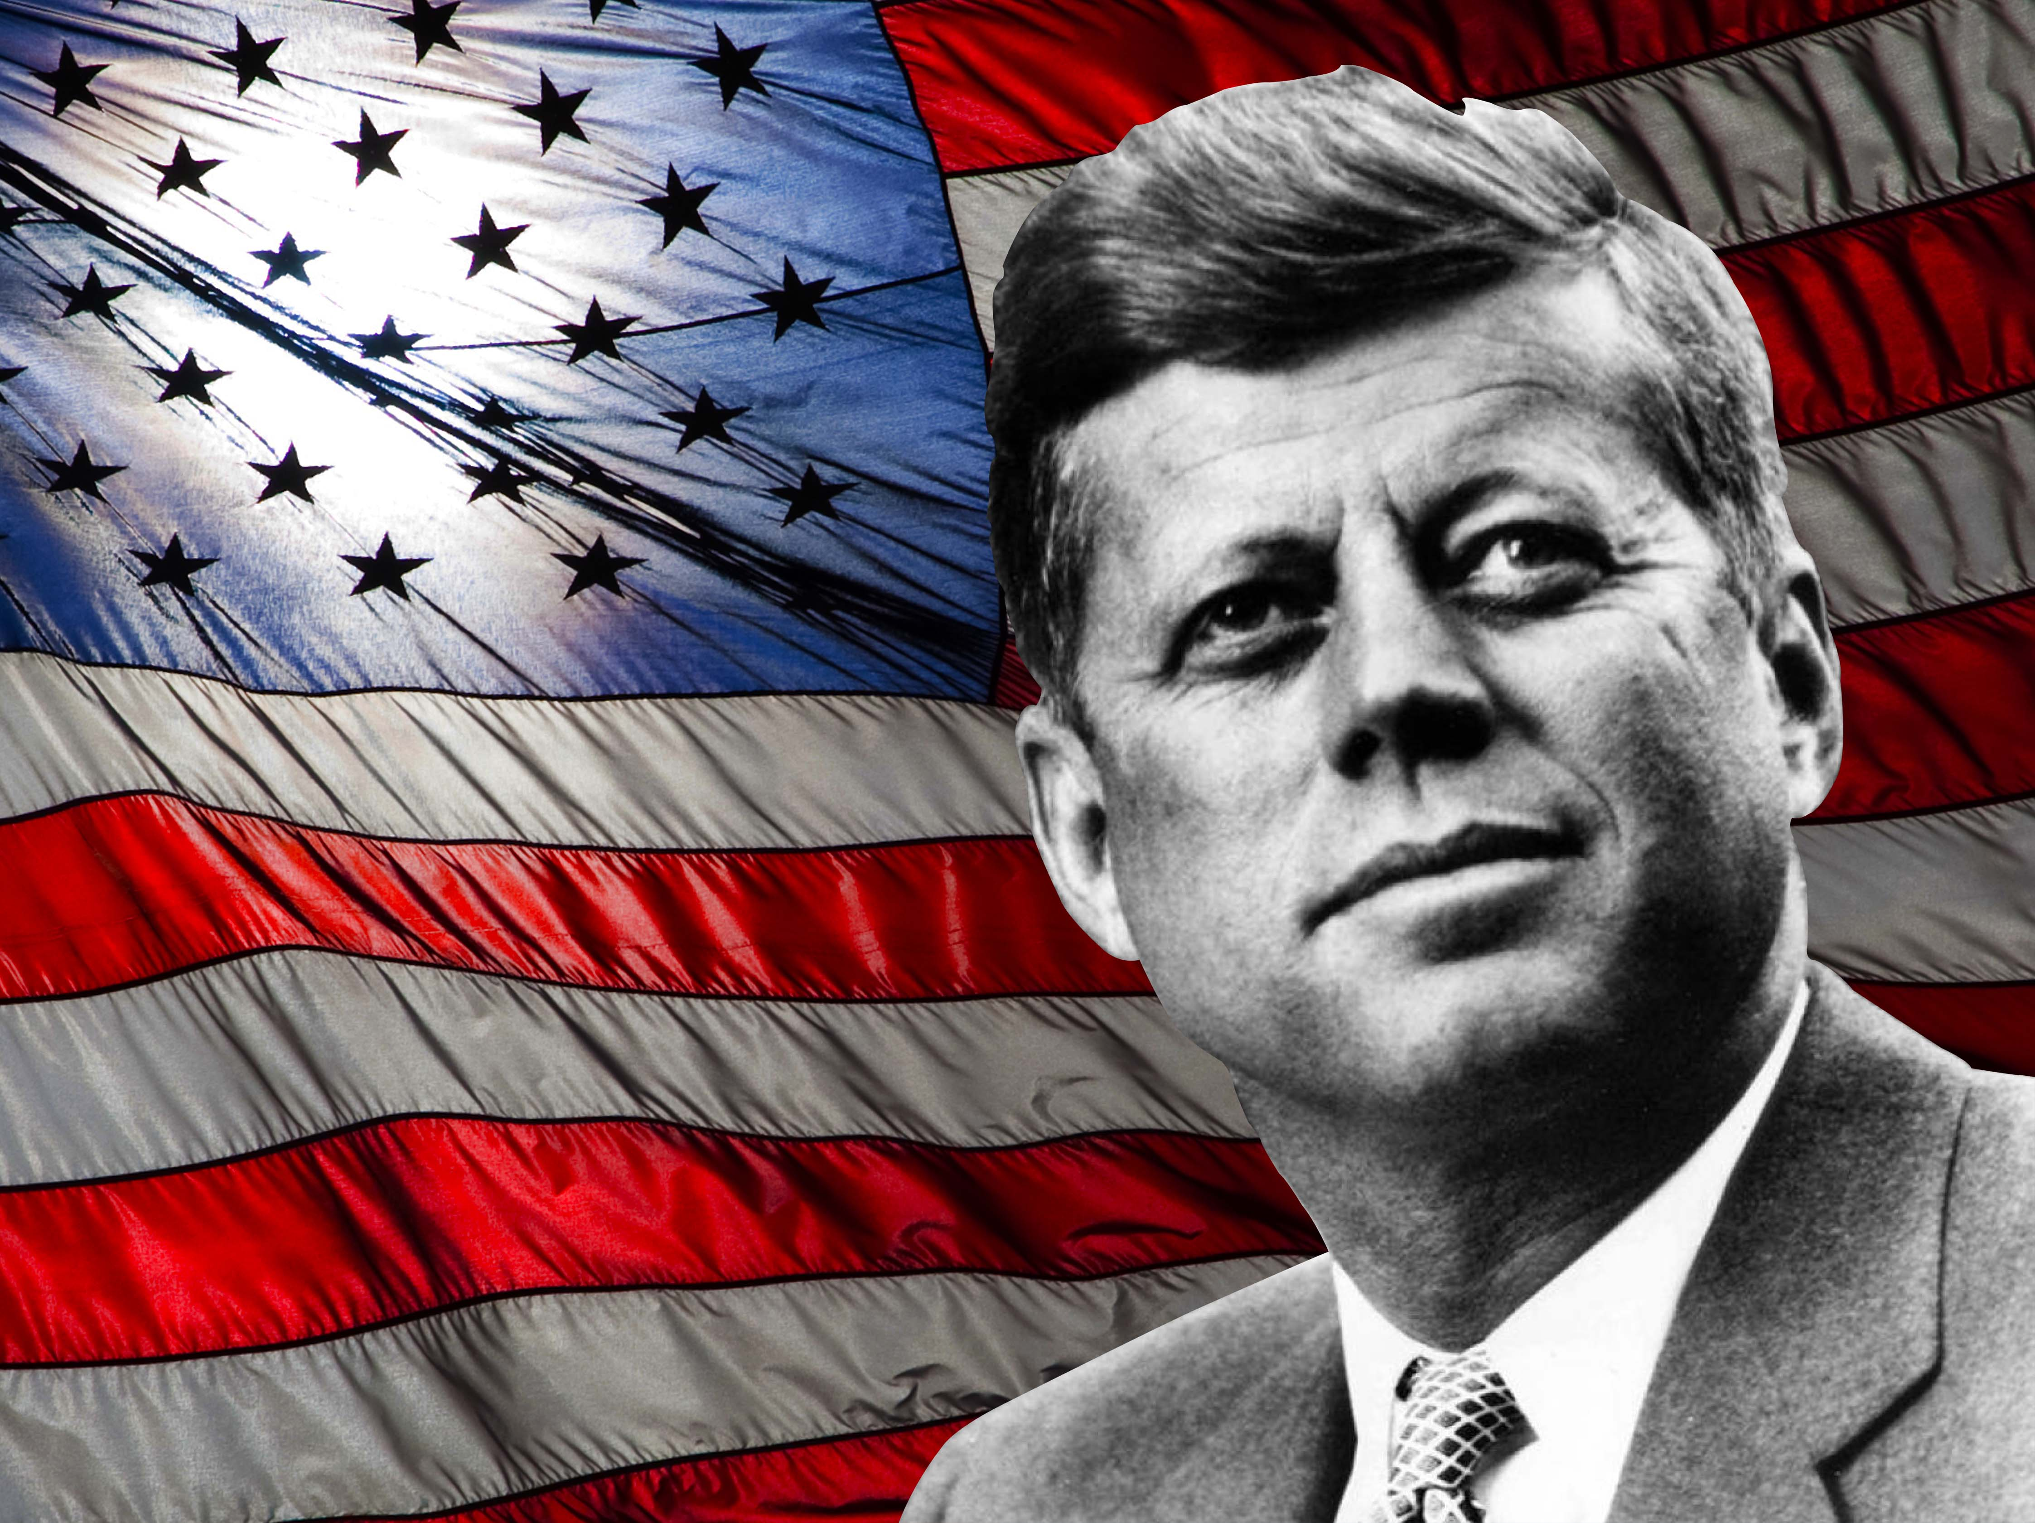

Slide 44
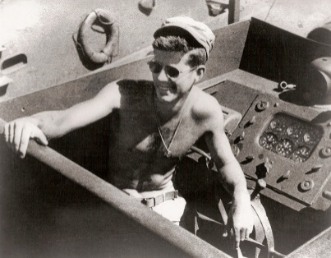
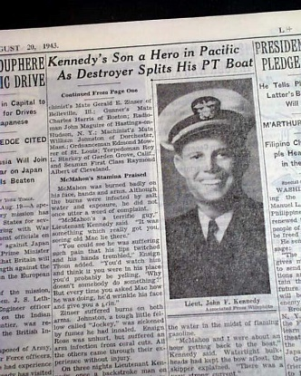
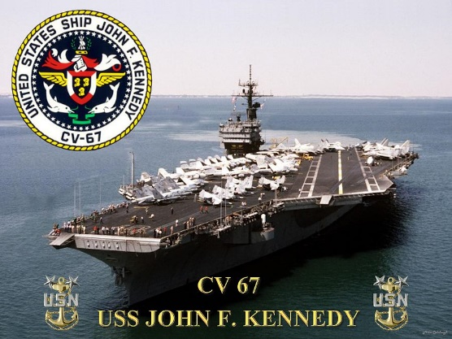
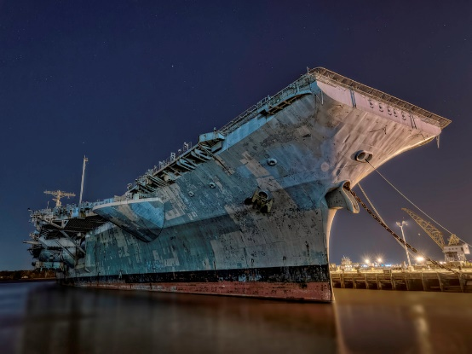

Slide 45
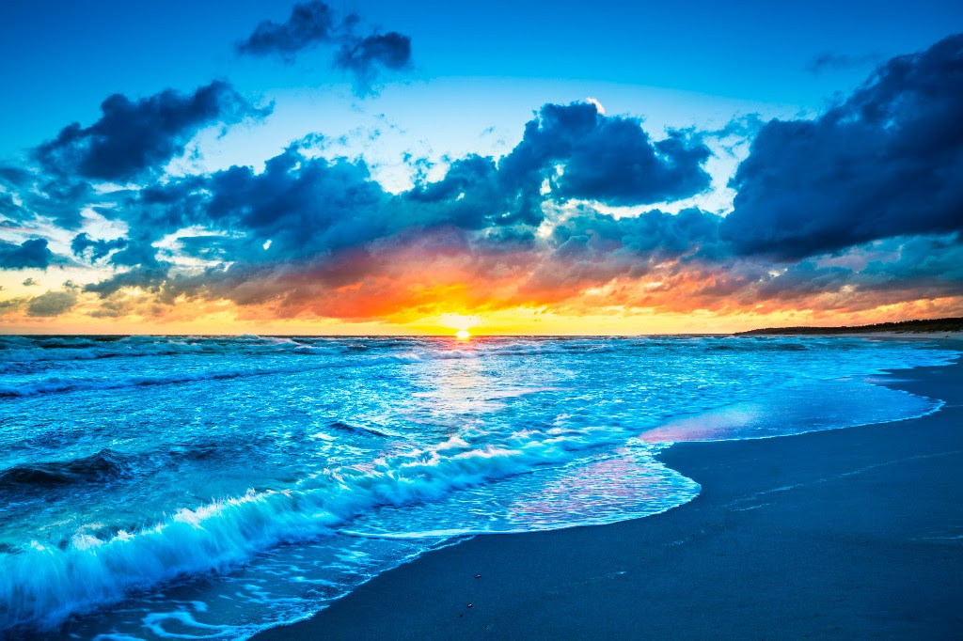

Slide 47
Presidential Quotes
Ron Bert
28½
December 22, 2019

Slide 48
Part 3
35. John F. Kennedy (1961-1963)

Slide 49
“Don’t pray for an easy life, pray to be a stronger man.”

Slide 50
And the apostles said to the Lord, "Increase our faith." — Luke 17:5

Slide 51
But may the God of all grace, who called us to His eternal glory by Christ Jesus, after you have suffered a while, perfect, establish, strengthen, and settle you. — 1st Peter 5:10
after you have suffered a while:
• perfect
• establish
• strengthen
• settle you
called us
→ Submission
after you have
→ Steadfast
suffered a while
perfect
establish
strengthen
→ Knowledge
settle you
→ Wisdom

Slide 52
“Conformity is the jailer of freedom and the enemy of growth.”
complacency
submission
traditionalism
stagnation
habitually
customs

Slide 53
Therefore gird up the loins of your mind, be sober, and rest your hope fully upon the grace that is to be brought to you at the revelation of Jesus Christ; as obedient children, not conforming yourselves to the former lusts, as in your ignorance; but as He who called you is holy, you also be holy in all your conduct, because it is written, "Be holy, for I am holy." — 1st Peter 1:13-16
Therefore gird up the loins of your mind, be sober, and rest your hope fully upon the grace that is to be brought to you at the revelation of Jesus Christ; as obedient children, not conforming yourselves to the former lusts, as in your ignorance; but as He who called you is holy, you also be holy in all your conduct, because it is written, "Be holy, for I am holy." — 1st Peter 1:13-16
hope
hope
GRACE
to
promise
Jesus Christ
Jesus Christ
as obedient children
not conforming
yourselves to the former lusts
call

Slide 54
“With a good conscience our only sure reward, with history the final judge of our deeds, let us go forth to lead the land we love, asking His blessing and His help, but knowing that here on earth God's work must truly be our own.”
good conscience
deeds

Slide 55
“I know there is a God - I see the storm coming and I see His hand in it - if He has a place then I am ready - we see the hand.”

Slide 56
“We in this country, in this generation, are by destiny rather than choice the watchmen on the walls of world freedom. We ask, therefore, that we may be worthy of our power and responsibility, that we may exercise our strength with wisdom and restraint, and that we may achieve in our time and for all time the ancient vision of peace on earth, good will toward men. That must always be our goal, and the righteousness of our cause must always underlie our strength. For as was written long ago: except the Lord keep the city, the watchman waketh but in vain.”
righteousness
underlie our strength

Slide 57
[A Song of Ascents. Of Solomon.] Unless the LORD builds the house, They labor in vain who build it; Unless the LORD guards the city, The watchman stays awake in vain. — Psalms 127:1

Slide 58
“Let every nation know, whether it wishes us well or ill, that we shall pay any price, bear any burden, meet any hardship, support any friend, oppose any foe to assure the survival and the success of liberty.”

Slide 59
“It is an unfortunate fact that we can secure peace only by preparing for war.”

Slide 60
“Our most basic common link is that we all inhabit this small planet. We all breathe the same air. We all cherish our children's future. And we are all mortal.”
Our
basic common link is
Our basic common link is we:
• all inhabit this small planet
• all breathe the same air
• all cherish our children’s future
• are all mortal
we
we
all inhabit this small
planet
We
all breathe the same
air
We
all cherish our children's
future
we
are all mortal

Slide 61
“As we express our gratitude, we must never forget that the highest appreciation is not to utter words, but to live by them.”
live by

Slide 62
But he who looks into the perfect law of liberty and continues in it, and is not a forgetful hearer but a doer of the work, this one will be blessed in what he does. If anyone among you thinks he is religious, and does not bridle his tongue but deceives his own heart, this one's religion is useless. — James 1:25-26
doer

Slide 63
“The guiding principle of this Nation has been, is now, and ever shall be IN GOD WE TRUST.”
IN GOD WE TRUST

Slide 64
Therefore humble yourselves under the mighty hand of God, that He may exalt you in due time, casting all your care upon Him, for He cares for you. Be sober, be vigilant; because your adversary the devil walks about like a roaring lion, seeking whom he may devour. Resist him, steadfast in the faith, knowing that the same sufferings are experienced by your brotherhood in the world. — 1st Peter 5:6-9
in
steadfast in the faith
same boat

Slide 65
“Children are the world's most valuable resource and its best hope for the future.”

Slide 66
“We can say with some assurance that, although children may be the victims of fate, they will not be the victims of our neglect.”

Slide 67
“I think when we talk about corporal punishment, and we have to think about our own children, and we are rather reluctant, it seems to me, to have other people administering punishment to our own children, because we are reluctant, it puts a special obligation on us to maintain order and to send children out from our homes who accept the idea of discipline. So I would not be for corporal punishment in the school, but I would be for very strong discipline at home so we don't place an unfair burden on our teachers.”
strong discipline at home
unfair burden on our teachers

Slide 68
Do not withhold correction from a child, For if you beat him with a rod, he will not die. You shall beat him with a rod, And deliver his soul from hell. — Proverbs 23:13-14

Slide 69
The rod and rebuke give wisdom, But a child left to himself brings shame to his mother. — Proverbs 29:15

Slide 70
“A revolution is coming – a revolution which will be peaceful if we are wise enough; compassionate if we care enough; successful if we are fortunate enough – but a revolution which is coming whether we will it or not. We can affect its character; we cannot alter its inevitability.”

Slide 71
“Those who make peaceful revolution impossible will make violent revolution inevitable.”

Slide 72
“The world was not meant to be a prison in which man awaits his execution.”

Slide 73
Be kindly affectionate to one another with brotherly love, in honor giving preference to one another; not lagging in diligence, fervent in spirit, serving the Lord; rejoicing in hope, patient in tribulation, continuing steadfastly in prayer; — Romans 12:10-12
serving the Lord Be:
• kindly affectionate, brotherly love
• in honor giving preference
to one another
• not lagging in diligence
• fervent in spirit
• rejoicing in hope
• patient in tribulation
• continuing steadfastly in prayer
Be
kindly affectionate
a
i
th
brotherly love
in
,
honor giving preference
to one
another
not lagging in diligence
in
faith in
serving the Lord
fervent in spirit
f
in
rejoicing in hope
patient in
in
tribulation
continuing steadfastly
in
in prayer
in

Slide 74
“There can be no progress if people have no faith in tomorrow.”
faith in
faith in
faith in
faith in

Slide 75
“We can have faith in the future only if we have faith in ourselves.”
faith in
faith in

Slide 76
Where there is no revelation, the people cast off restraint; But happy is he who keeps the law. — Proverbs 29:18
vision
belief
Godly regard
divination
foresight
truth
perish

Slide 77
“Forbidden fruit tastes sweet, but its aftertaste is bitter.”

Slide 78
Bread gained by deceit is sweet to a man, But afterward his mouth will be filled with gravel. — Proverbs 20:17

Slide 79
“A nation reveals itself not only by the men it produces but also by the men it honors, the men it remembers.”

Slide 80
And He took bread, gave thanks and broke it, and gave it to them, saying, "This is My body which is given for you; do this in remembrance of Me." — Luke 22:19
remembrance of Me

Slide 81
“If anyone is crazy enough to want to kill a president of the United States, he can do it. All he must be prepared to do is give his life for the president's.”

Slide 82
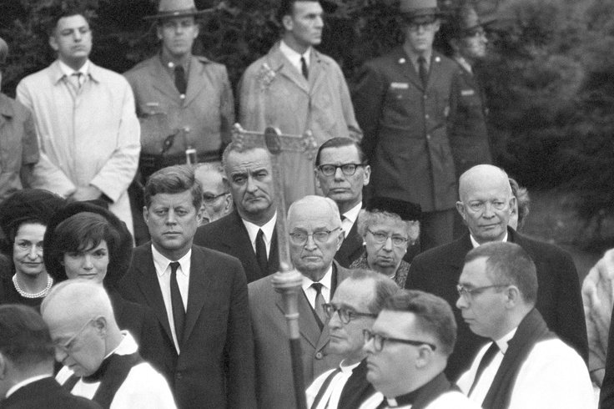
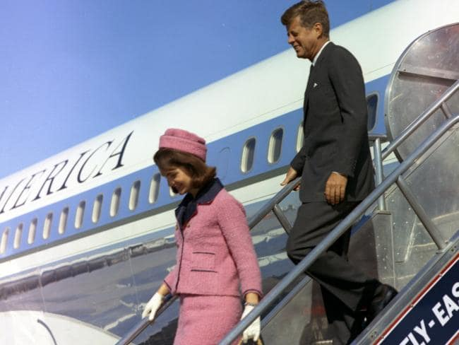
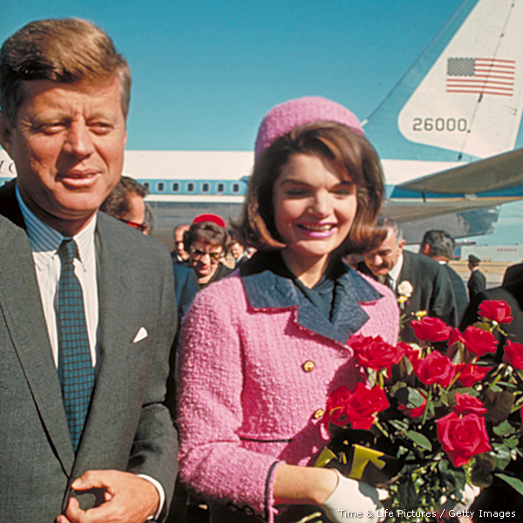
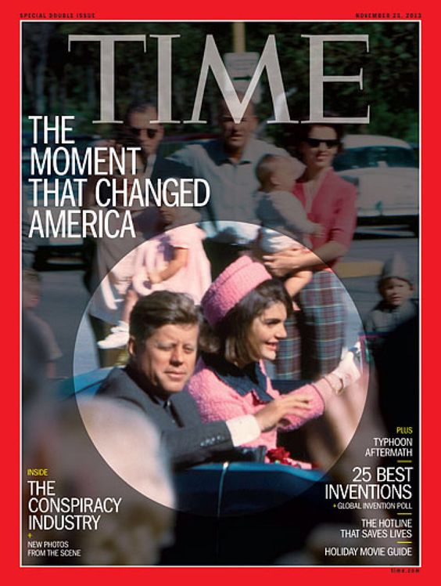
Notes:
Eleanor Roosevelt funeral 1962 –Milton Berle but not Robert McNamara?

Slide 83
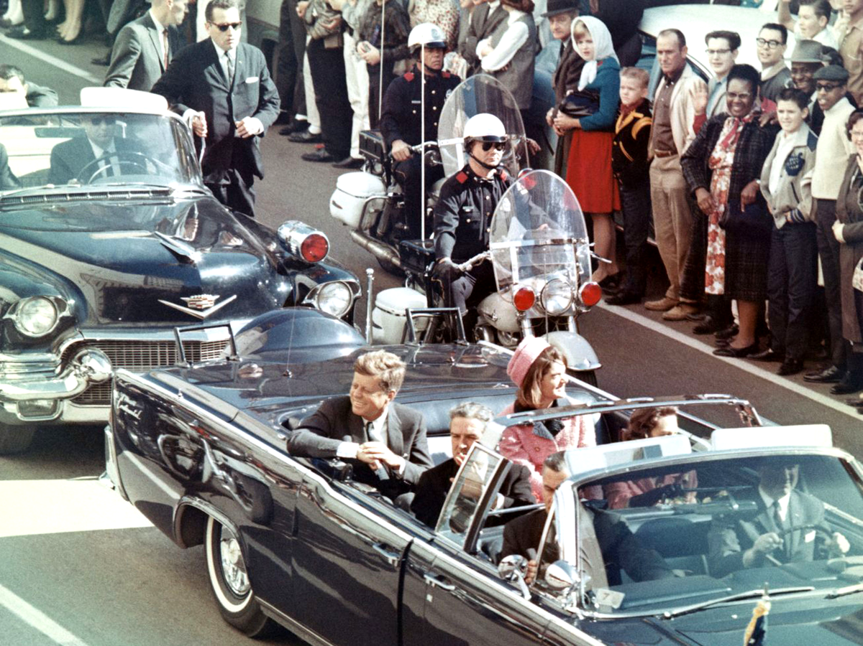

Slide 84
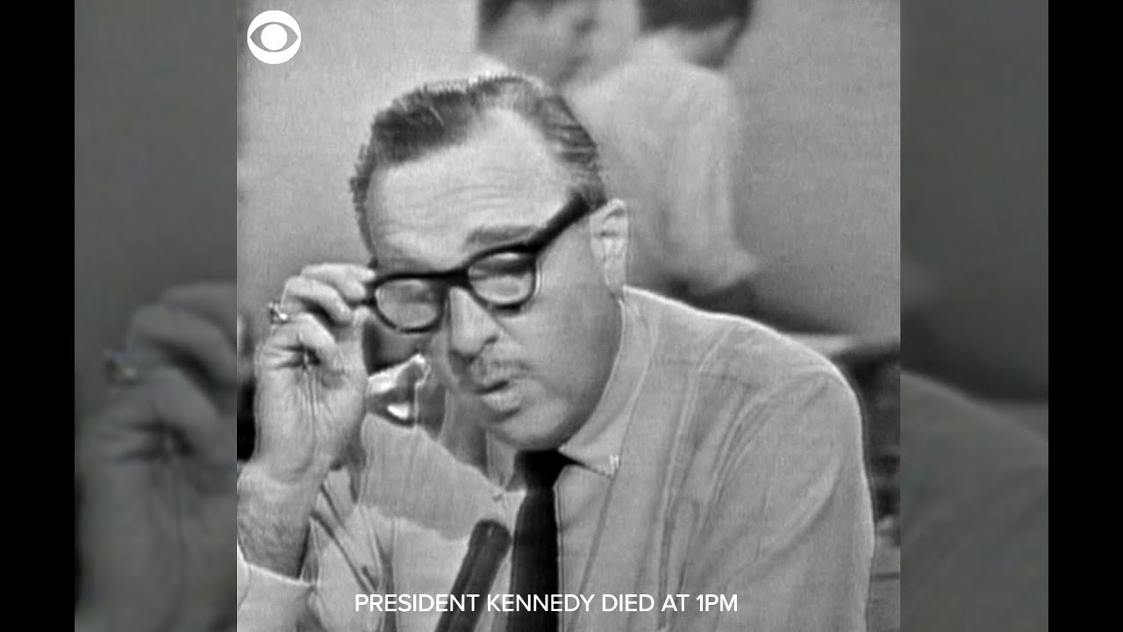

Slide 85
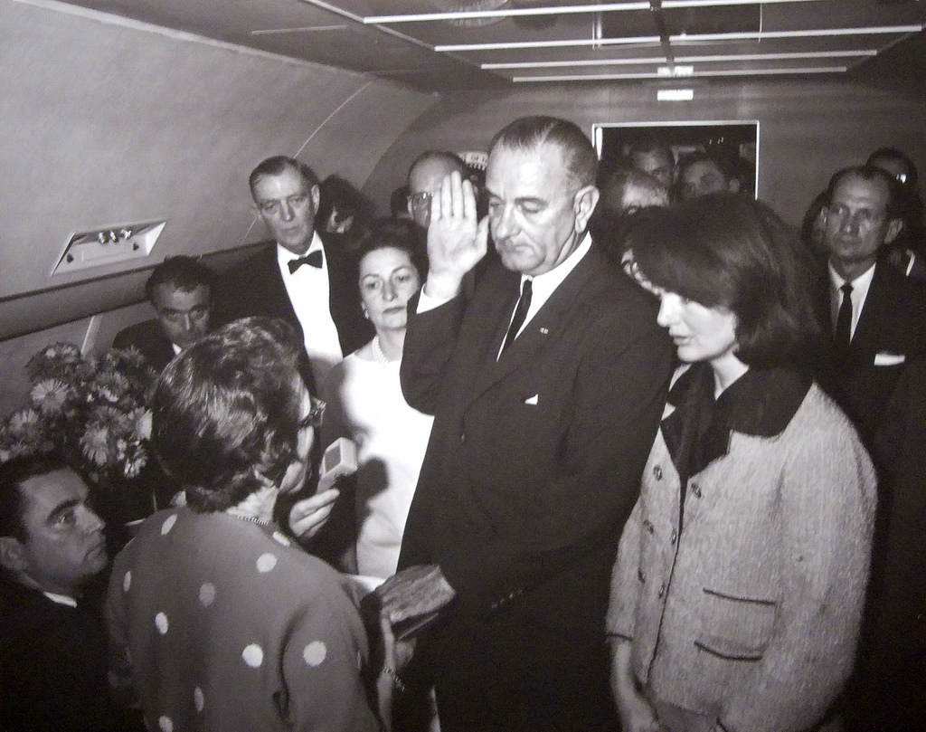

Slide 86
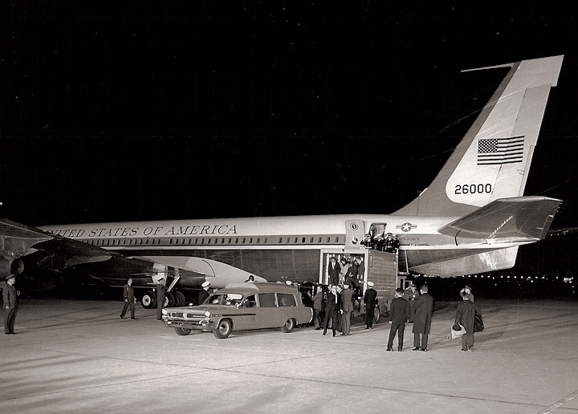

Slide 87
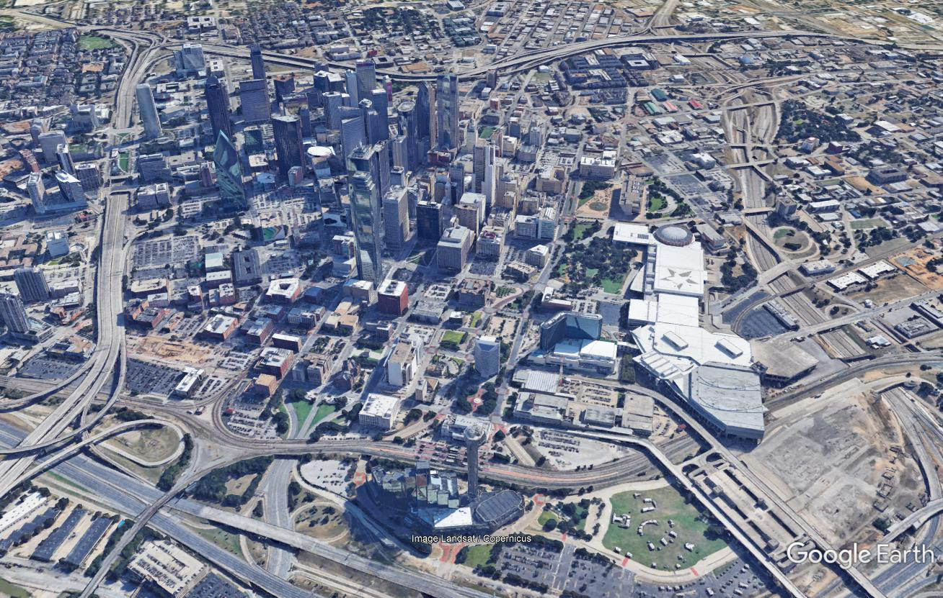

Slide 88
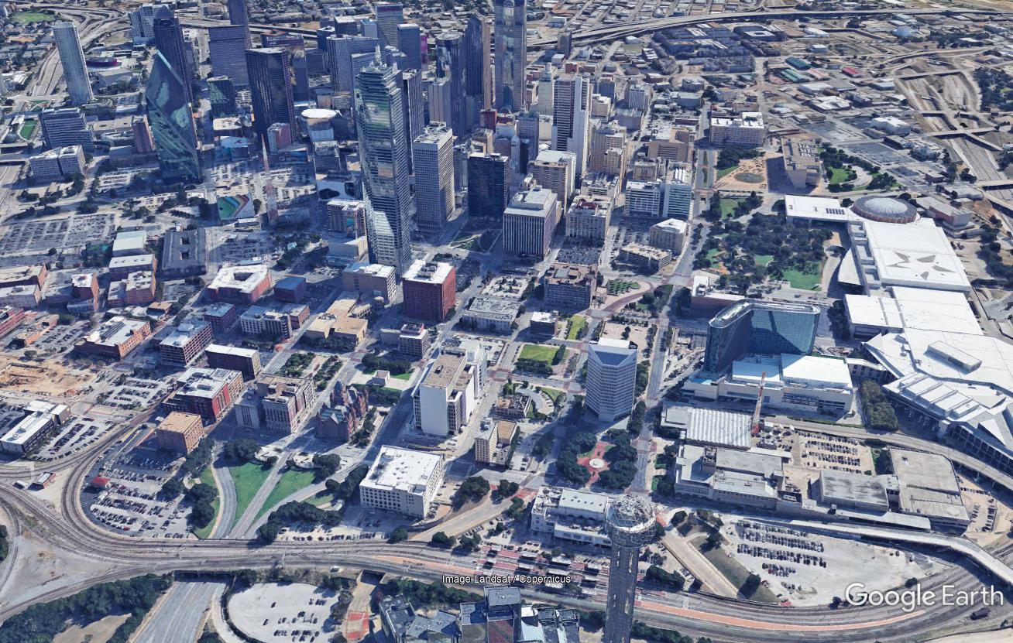

Slide 89
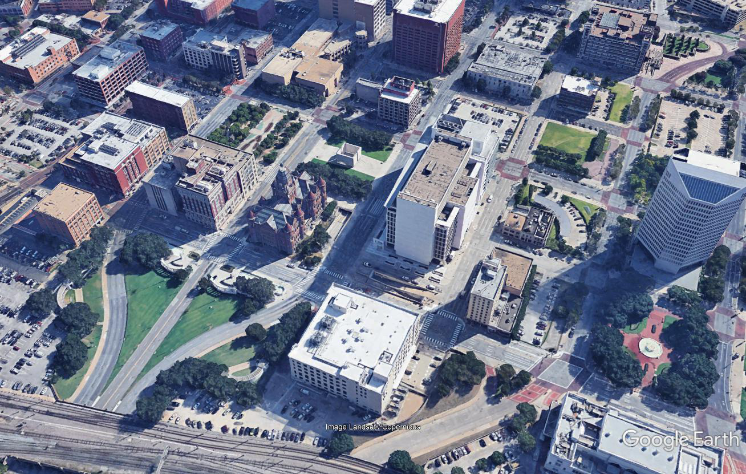

Slide 90
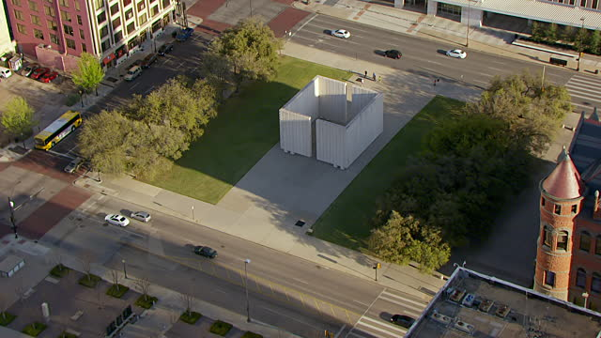

Slide 91
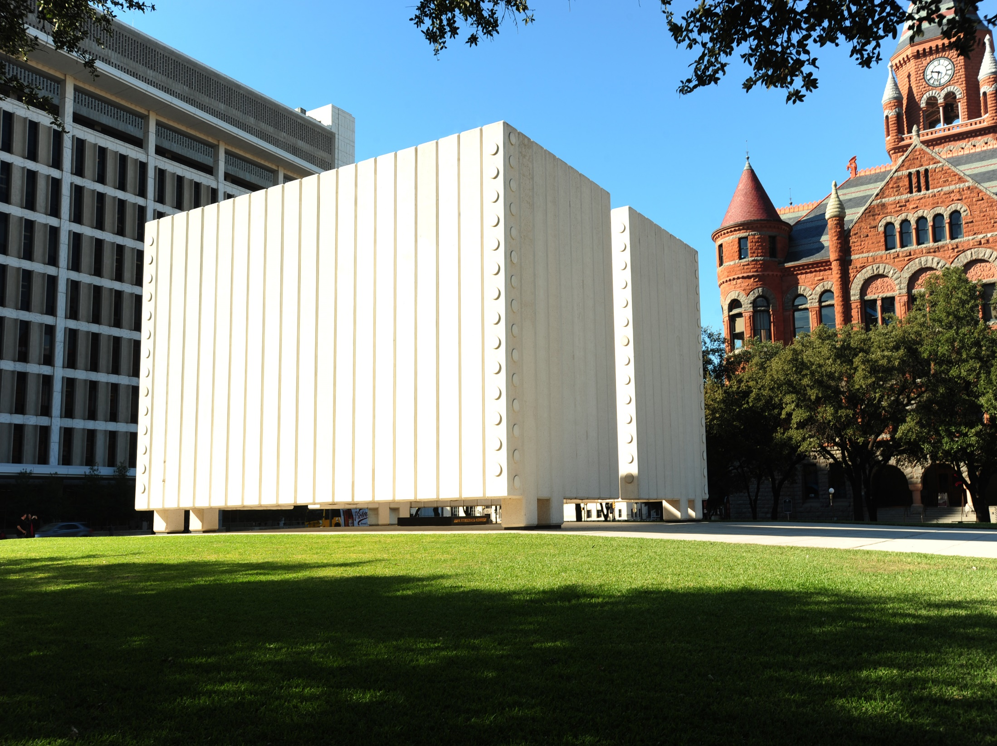

Slide 92
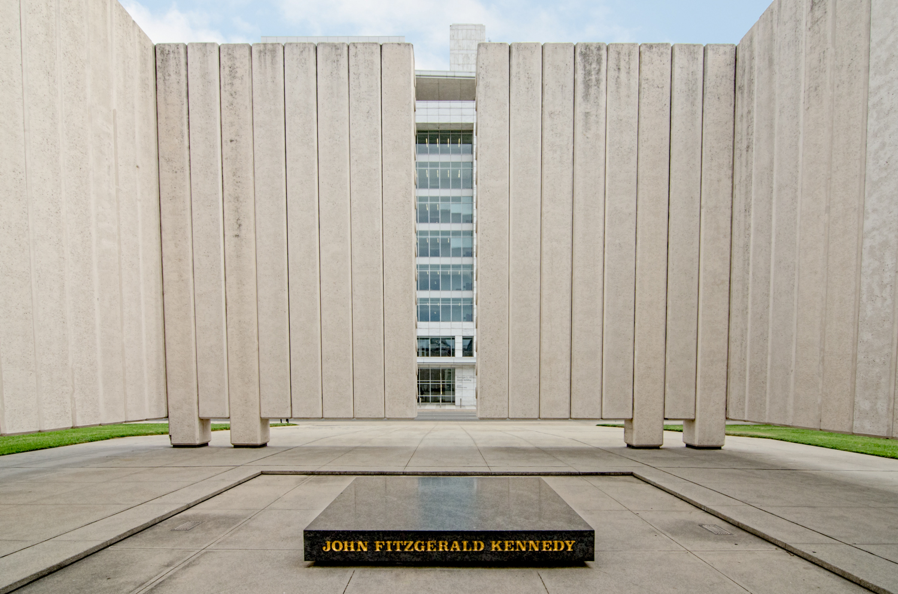
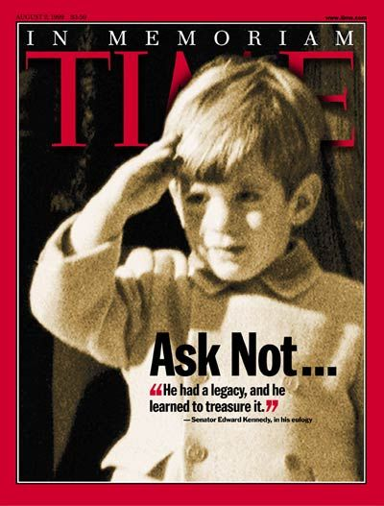

Slide 93
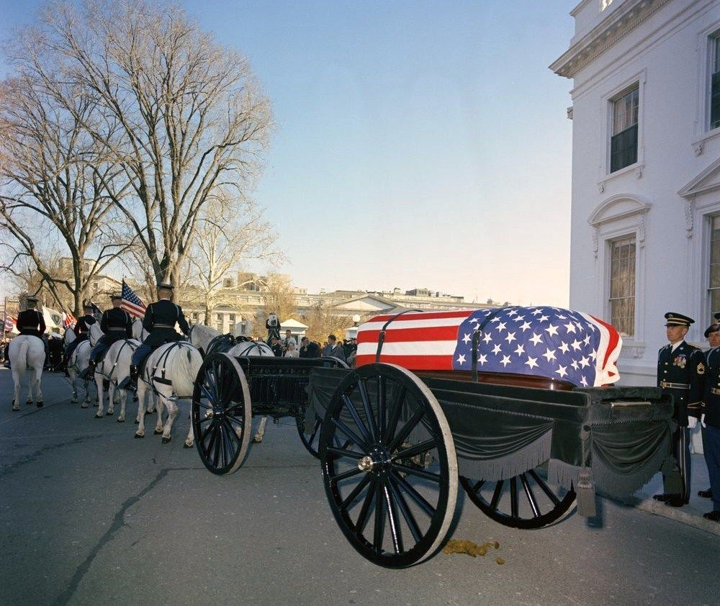
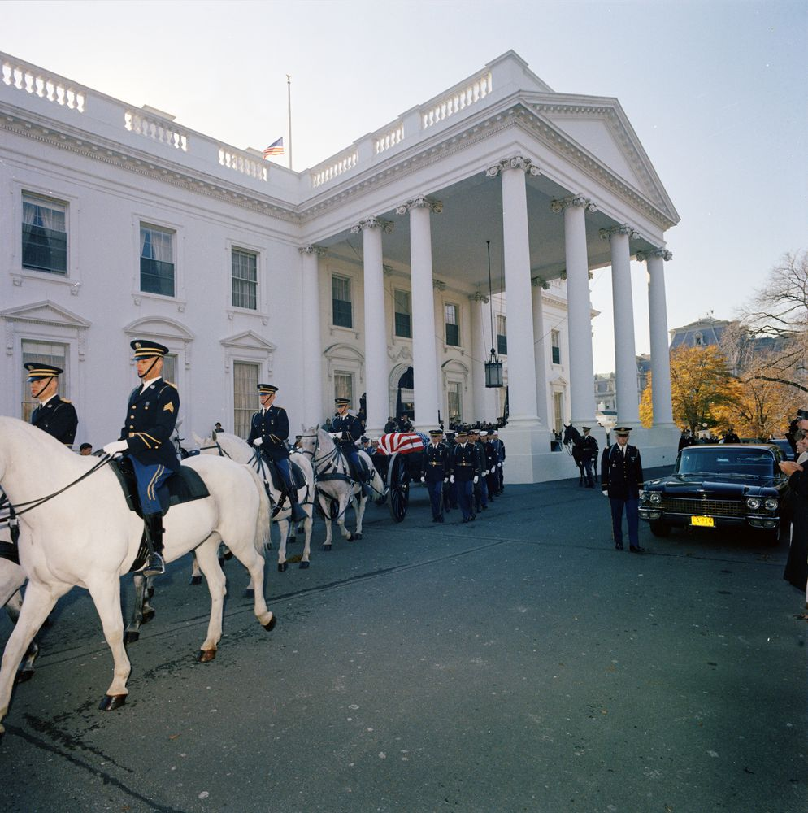

Slide 94
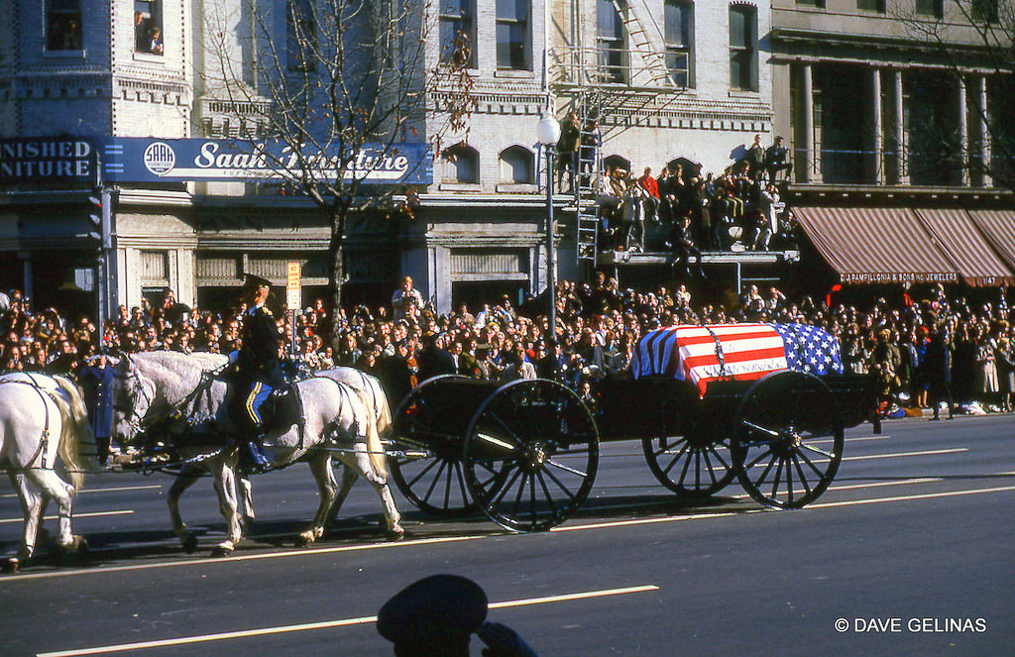

Slide 95
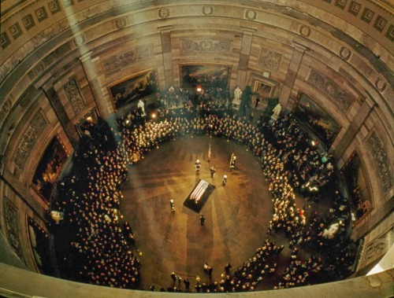

Slide 97
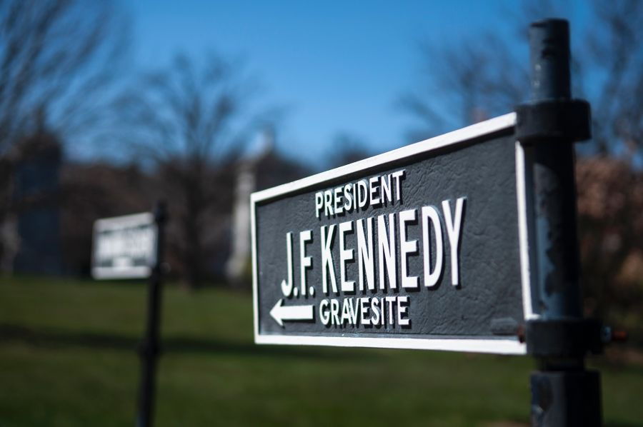

Slide 98
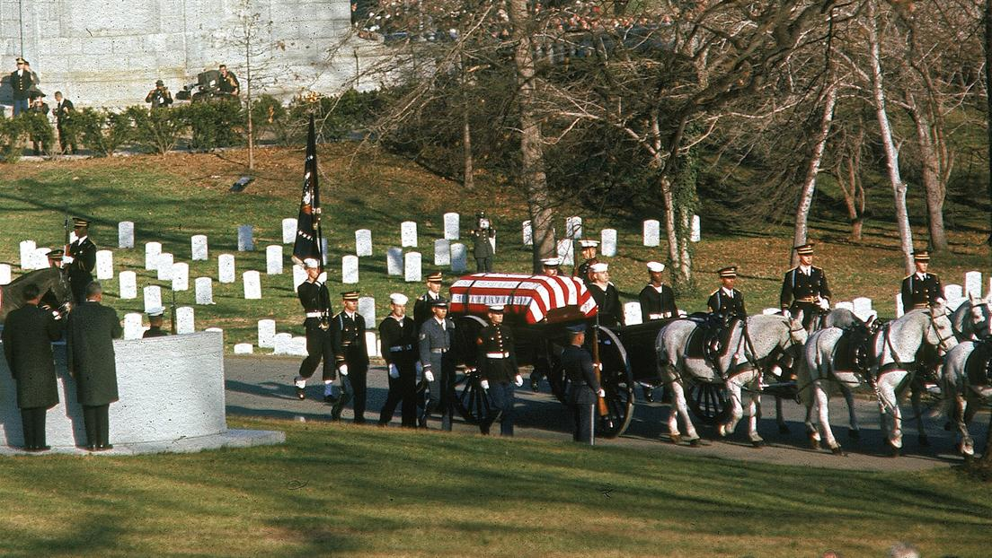

Slide 99
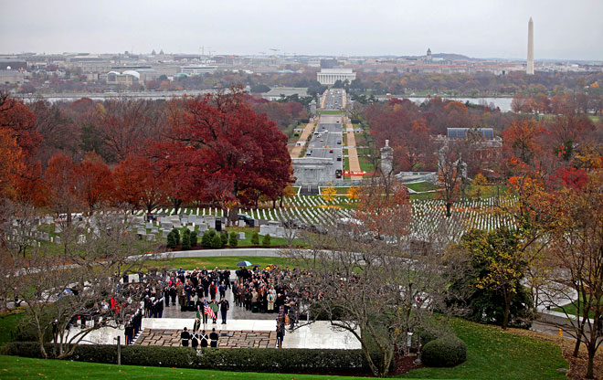
Notes:
Body moved 1967

Slide 100
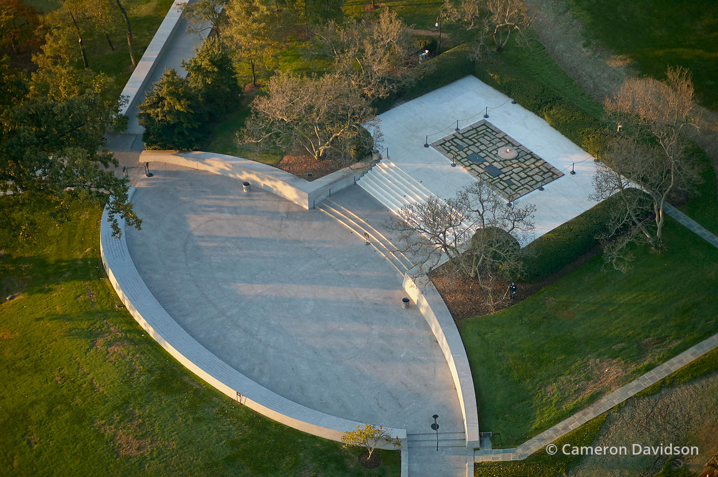

Slide 101
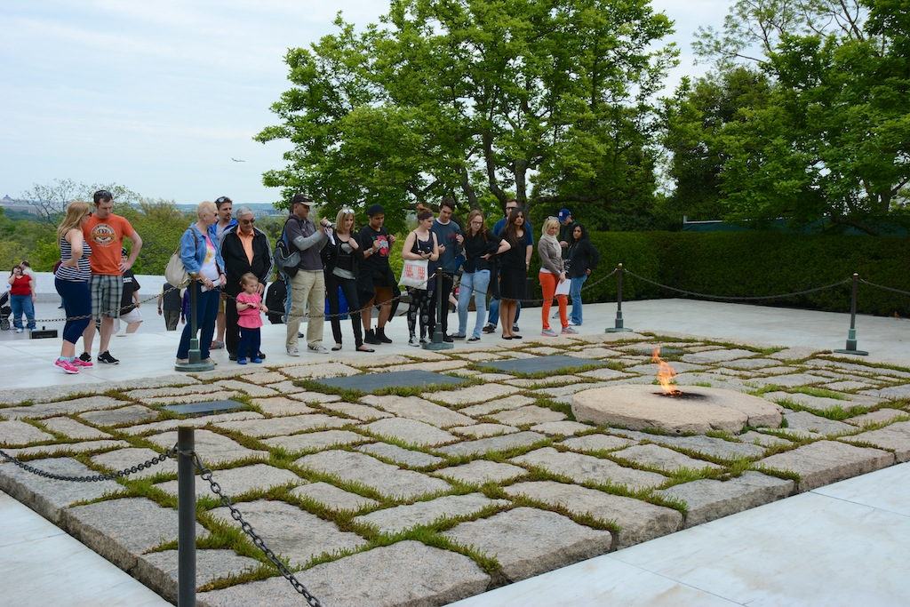

Slide 102
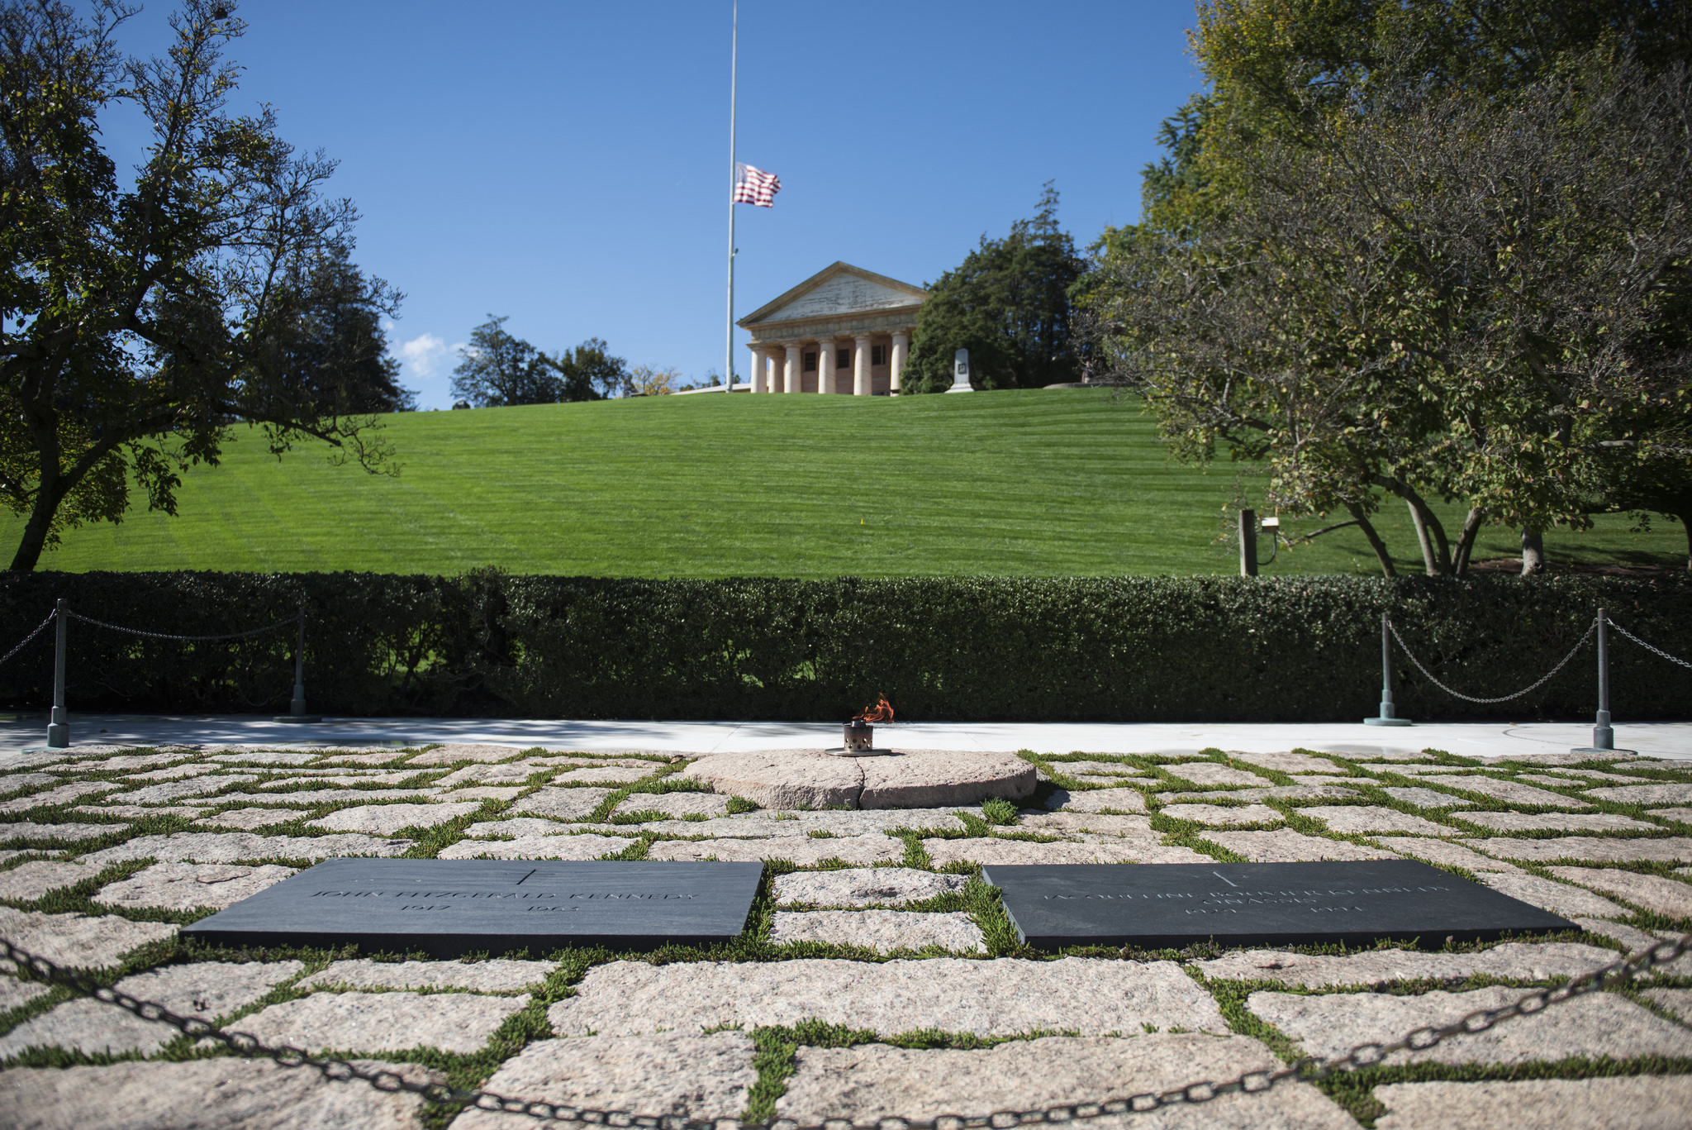
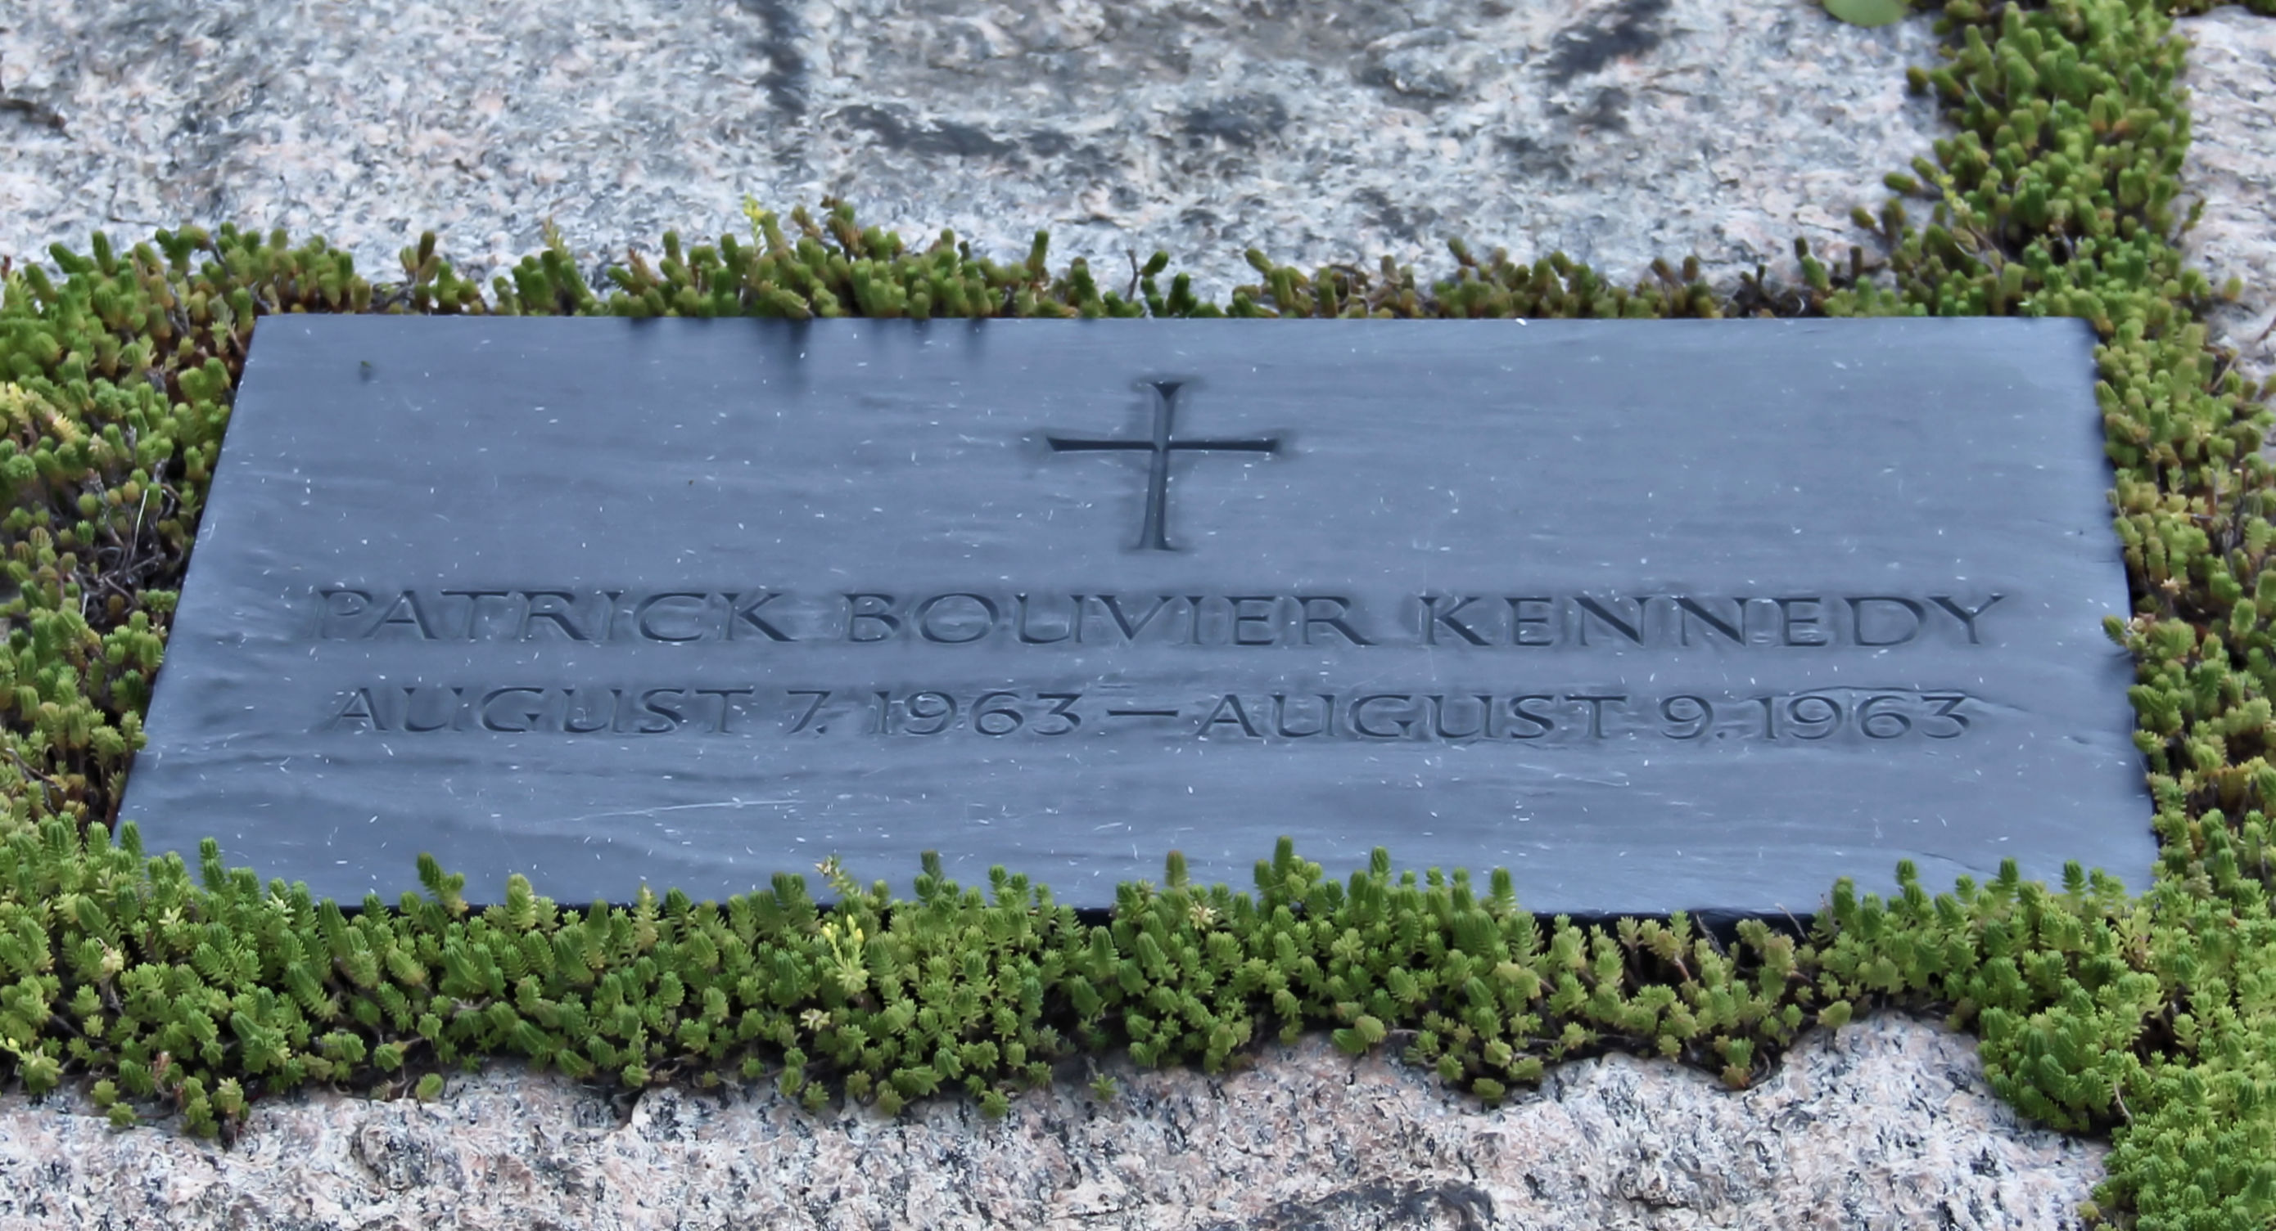
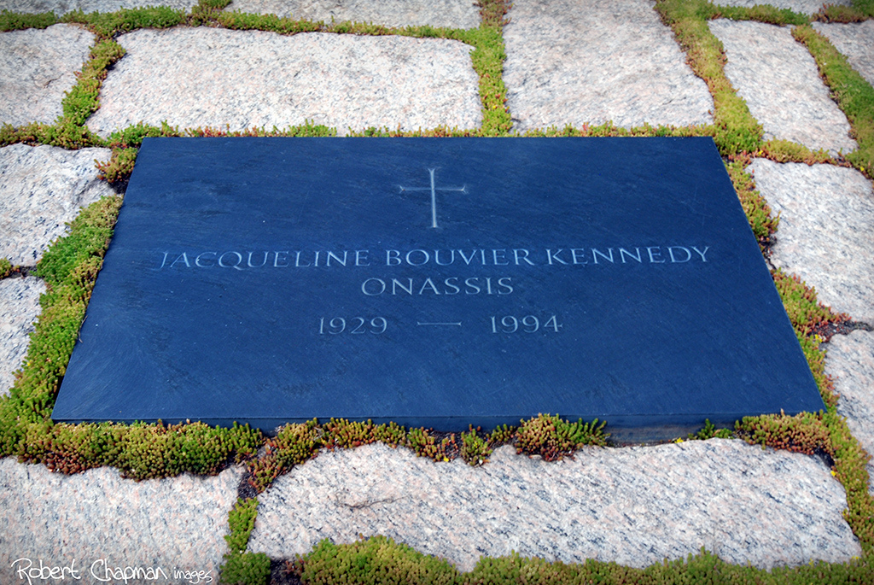

Slide 103
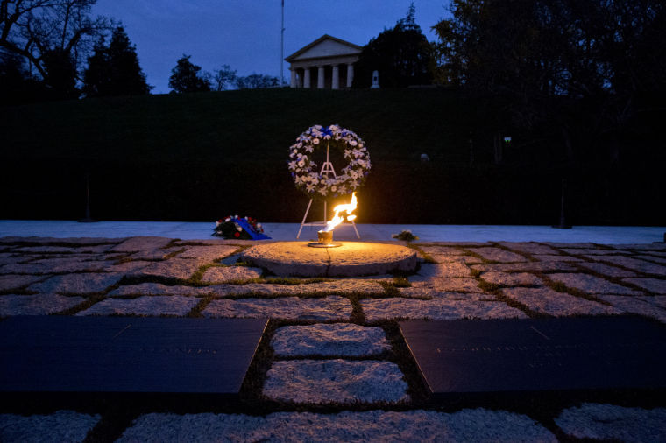

Slide 104
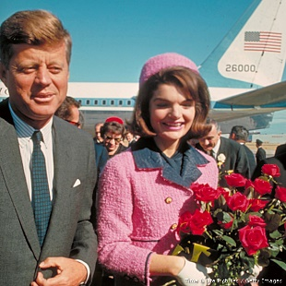

Slide 105
→ God created all the colors of His creation
→ Noble achievements of man serve timelessly
→ Constitutional freedoms do not include morality
→ No moral test is required to achieve public office
→ Separation of brothers is to the grief of God
→ A friend can weigh in better than a brother
→ Tolerating evil has always defeated greater glory
→ Forced beliefs plague all that is heartfully clear
→ Life has commonalities in cherishing family & friends
→ Life is meant to be lived, not regretted or despised
→ Where there is no faith only futility lingers
→ All thieves eventually carry piercing anchors
→ Murder is the core of hate
Life carries hearts viewed by His patience
Notes:
Life carries hearts viewed by His patience

Slide 107
Please visit http://www.LoveFromGod.com to explore further
Ronald Bert Channel on
Notes:
Eternity never ends.

