Slide 2
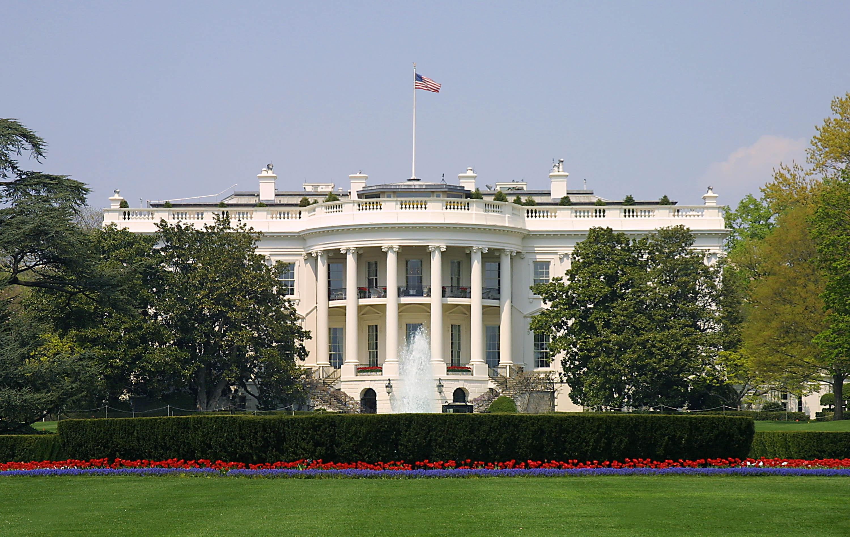
Presidential Quotes
Ron Bert
27
November 3, 2019

Slide 3
Part 3
34. Dwight D. Eisenhower (1953-1961)

Slide 4
“We have the disgrace of racial discrimination, or we have prejudice against people because of their religion. We have not had the courage to uproot these things, although we know they are wrong.”
prejudice
intolerance
intolerance
courage to uproot

Slide 5
“The final battle against intolerance is to be fought - not in the chambers of any legislature - but in the hearts of men.”
intolerance
Senate
Congress

Slide 6
But the path of the just is like the shining sun, That shines ever brighter unto the perfect day. The way of the wicked is like darkness; They do not know what makes them stumble. My son, give attention to my words; Incline your ear to my sayings. — Proverbs 4:18-20
shining
shining
LOVE
darkness
HATE
my words
darkness
my words
my words

Slide 7
Do not let them depart from your eyes; Keep them in the midst of your heart; For they are life to those who find them, And health to all their flesh. Keep your heart with all diligence, For out of it spring the issues of life. — Proverbs 4:21-23
are life
my words
Keep your heart
Keep
diligence
diligence
carefulness
persistence
industrious
meticulousness
thoroughness
attentiveness

Slide 8
“… make it a practice to avoid hating anyone. If someone's been guilty of despicable actions, especially toward me, I try to forget him. I used to follow a practice - somewhat contrived, I admit - to write the man's name on a piece of scrap paper, drop it into the lowest drawer of my desk, and say to myself: "That finishes the incident, and so far as I'm concerned, that fellow." The drawer became over the years a sort of private wastebasket for crumbled-up spite and discarded personalities.”
practice to avoid hating

Slide 9
But he who hates his brother is in darkness and walks in darkness, and does not know where he is going, because the darkness has blinded his eyes. — 1st John 2:11

Slide 10
Whoever hates his brother is a murderer, and you know that no murderer has eternal life abiding in him. — 1st John 3:15

Slide 11
If someone says, "I love God," and hates his brother, he is a liar; for he who does not love his brother whom he has seen, how can he love God whom he has not seen? — 1st John 4:20

Slide 12
"For if you forgive men their trespasses, your heavenly Father will also forgive you. But if you do not forgive men their trespasses, neither will your Father forgive your trespasses." — Matthew 6:14-15
not forgive men

Slide 13
“Civilization owes to the Islamic world some of its most important tools and achievements ... the Muslim genius has added much to the culture of all peoples.”
Asian
African
Foreigner
Indian
American
people

Slide 14
“And I should like to assure you, my Islamic friends, that under the American Constitution, under American tradition, and in American hearts, this Center, this place of worship, is just as welcome as could be a similar edifice of any other religion. Indeed, America would fight with her whole strength for your right to have here your own church and worship according to your own conscience. This concept is indeed a part of America, and without that concept we would be something else than what we are.”
worship according to your own
conscience

Slide 15
“No people on earth can be held, as a people, to be an enemy, for all humanity shares the common hunger for peace and fellowship and justice.”
all
all humanity shares
hunger for peace

Slide 16
There is neither Jew nor Greek, there is neither slave nor free, there is neither male nor female; for you are all one in Christ Jesus. — Galatians 3:28
in
Christ Jesus
all one in Christ Jesus
Christ
Christ

Slide 17
For none of us lives to himself, and no one dies to himself. For if we live, we live to the Lord; and if we die, we die to the Lord. Therefore, whether we live or die, we are the Lord’s. For to this end Christ died and rose and lived again, that He might be Lord of both the dead and the living. — Romans 14:7-9
live or die
LORD
LORD
LOVE
HATE
Christ

Slide 18
"But I say to you, love your enemies, bless those who curse you, do good to those who hate you, and pray for those who spitefully use you and persecute you, …" — Matthew 5:44
love
hate

Slide 19
“A people that values its privileges above its principles soon loses both.”

Slide 20
“Peace and justice are two sides of the same coin.”

Slide 21
For unto us a Child is born, Unto us a Son is given; And the government will be upon His shoulder. And His name will be called Wonderful, Counselor, Mighty God, Everlasting Father, Prince of Peace. Of the increase of His government and peace There will be no end, Upon the throne of David and over His kingdom, To order it and establish it with judgment and justice From that time forward, even forever. The zeal of the LORD of hosts will perform this. — Isaiah 9:6-7
Prince of Peace
His government and peace
establish it
with judgment and justice
justice

Slide 22
“We are particularly thankful to you for your part in the movement to have the words under God added to our Pledge of Allegiance. These words will remind Americans that despite our great physical strength we must remain humble. They will help us keep constantly in our minds and hearts the spiritual and moral principles which alone give dignity to man.”
words under God
Pledge of Allegiance

Slide 23
“In this way we are reaffirming the transcendence of religious faith in America's heritage and future. From this day forward, the millions of our schoolchildren will daily proclaim in every city and town, every village and every rural schoolhouse, the dedication of our nation and our people to the Almighty. In this way we shall constantly strengthen those spiritual weapons which forever will be our country's most powerful resource in peace and war.”
dedication
to the Almighty

Slide 24
“The Founding Father expressed in words for all to read the ideal of Government based upon the dignity of the individual. That ideal previously had existed only in the hearts and minds of men. They produced the timeless documents upon which the Nation is rounded and has grown great. They, recognizing God as the author of individual fights, declared that the purpose of Government is to secure those rights.”
dignity
recognizing God as
the author
purpose of Government is
to secure those rights

Slide 25
Therefore we also, since we are surrounded by so great a cloud of witnesses, let us lay aside every weight, and the sin which so easily ensnares us, and let us run with endurance the race that is set before us, looking unto Jesus, the author and finisher of our faith, who for the joy that was set before Him endured the cross, despising the shame, and has sat down at the right hand of the throne of God. — Hebrews 12:1-2
Jesus
Jesus
author and finisher of our faith

Slide 26
“Every step we take towards making the State our Caretaker of our lives, by that much we move toward making the State our Master.”

Slide 27
“If our founding fathers were alive today, they'd roll over in their graves.”

Slide 28
“America is best described by one word, freedom.”

Slide 29
“Speeches are for the younger men who are going places. And I'm not going anyplace except six feet under the floor of that little chapel adjoining the museum and library at Abilene.”

Slide 30
“There’s no tragedy in life like the death of a child. Things never get back to the way they were.”

Slide 31
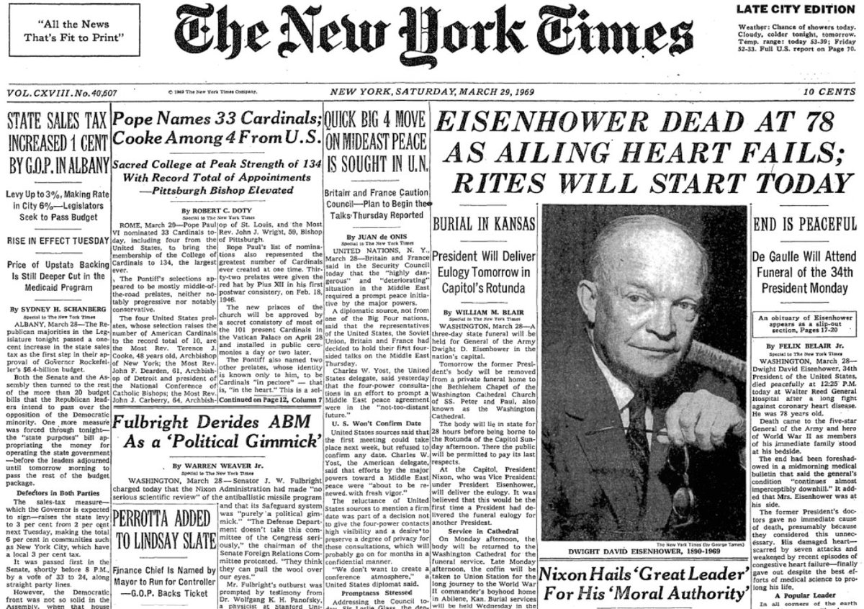

Slide 32
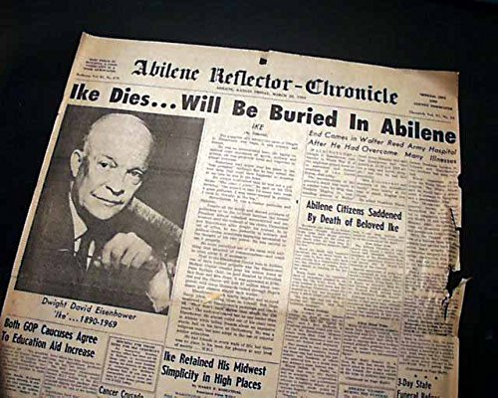

Slide 33
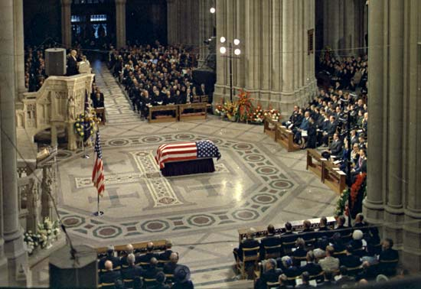

Slide 34
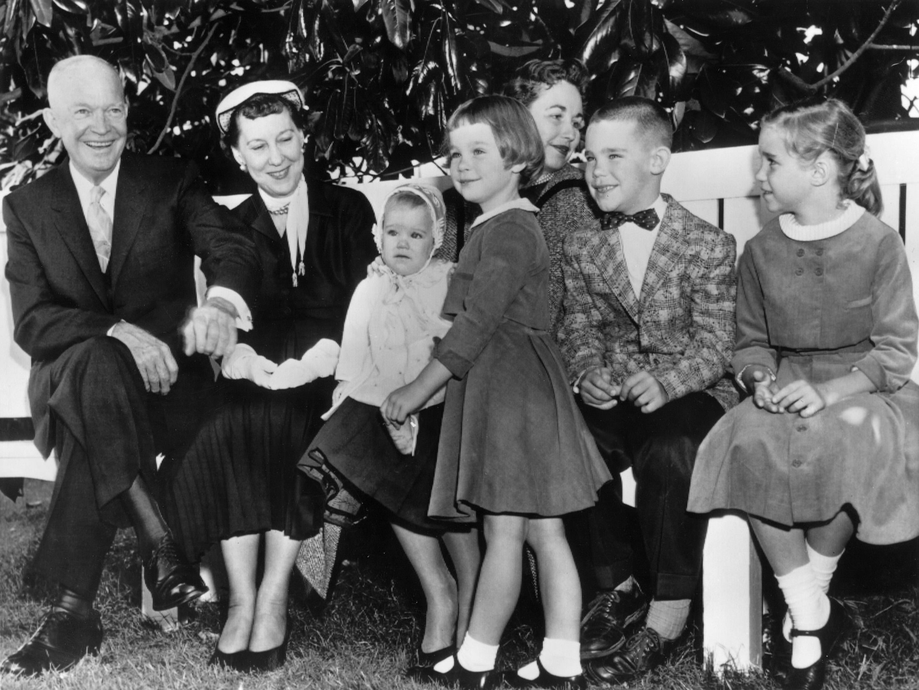
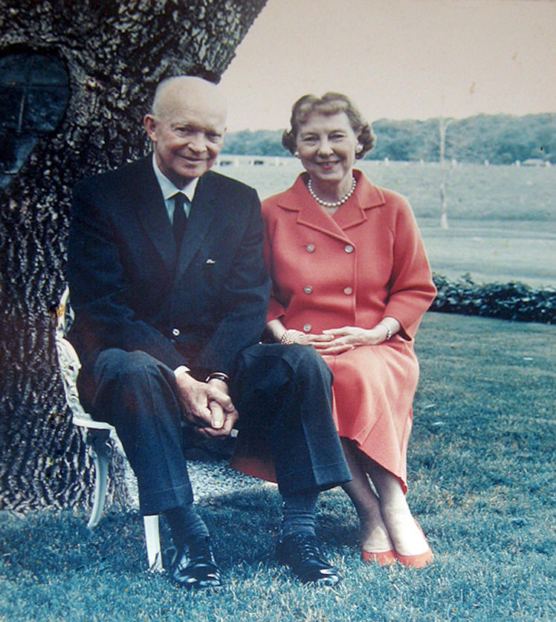
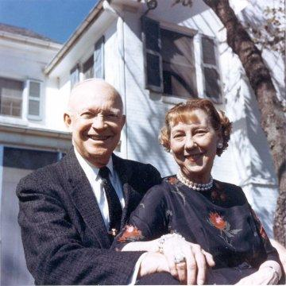
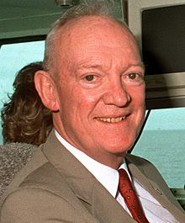
John Eisenhower
1922-2013

Slide 35
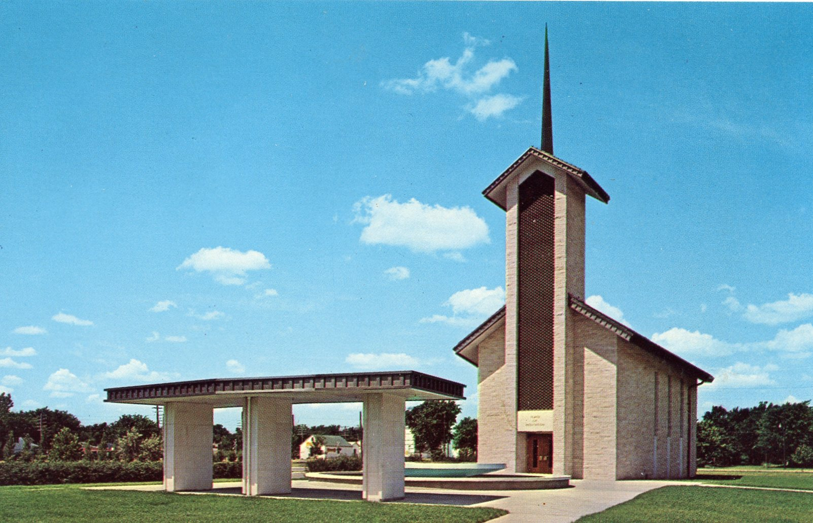

Slide 36
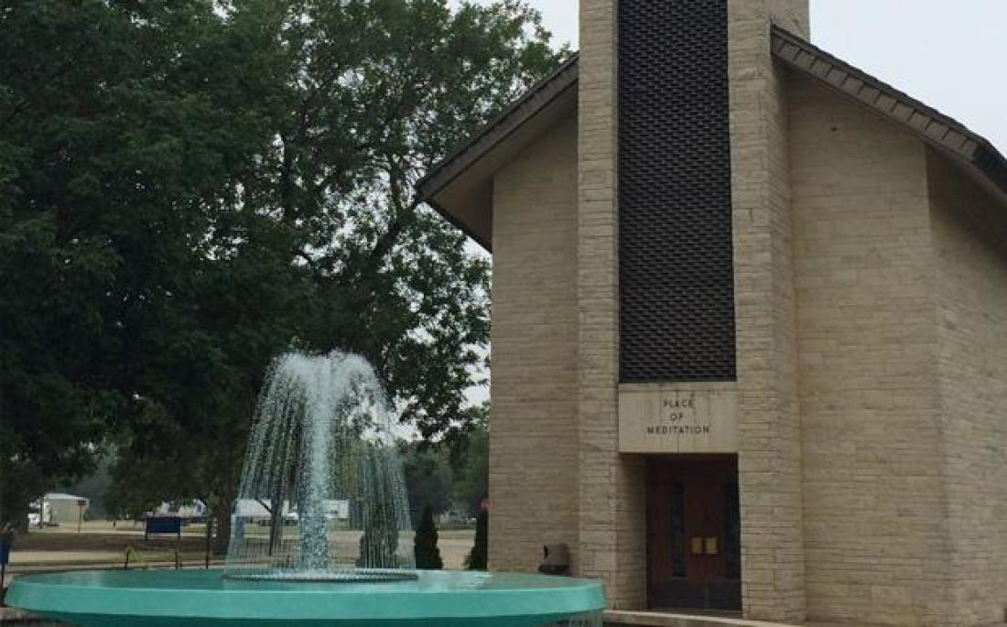

Slide 37
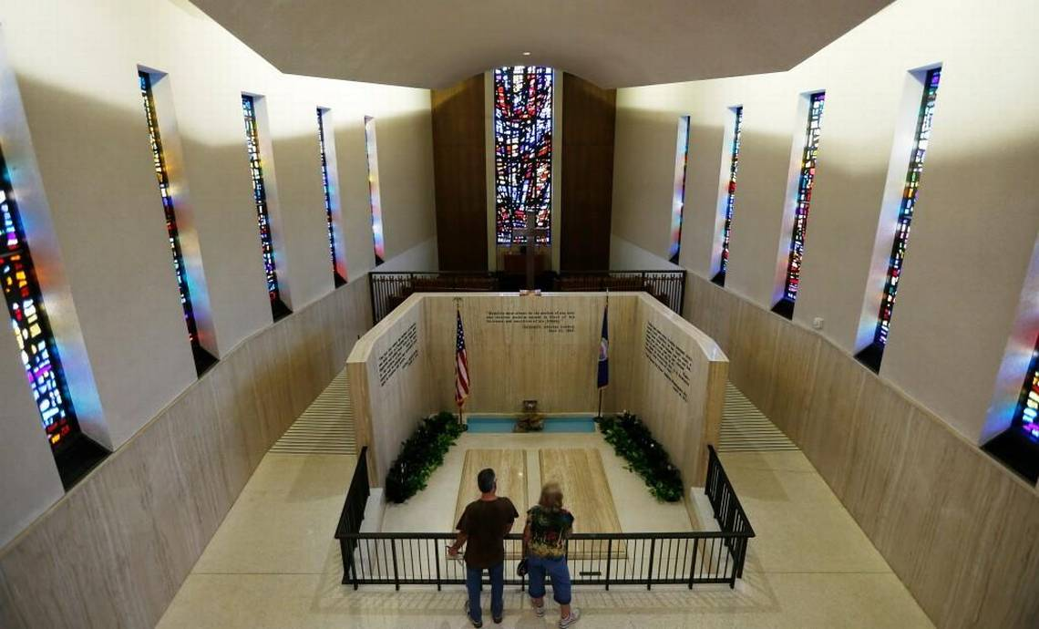

Slide 38
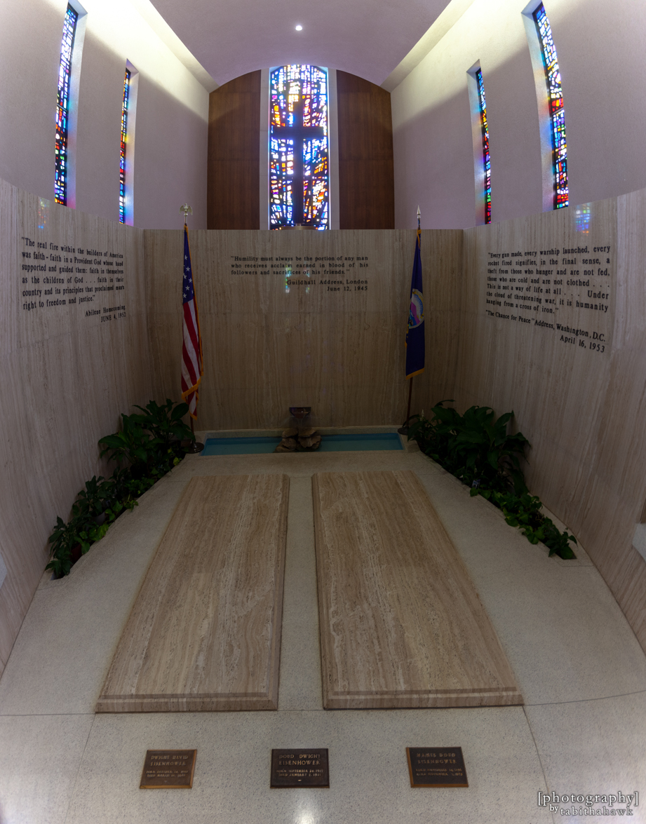
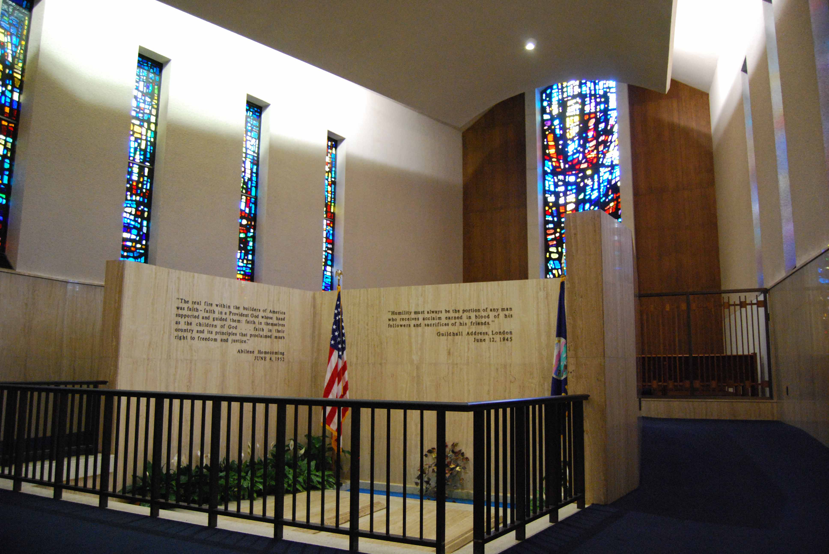

Slide 39
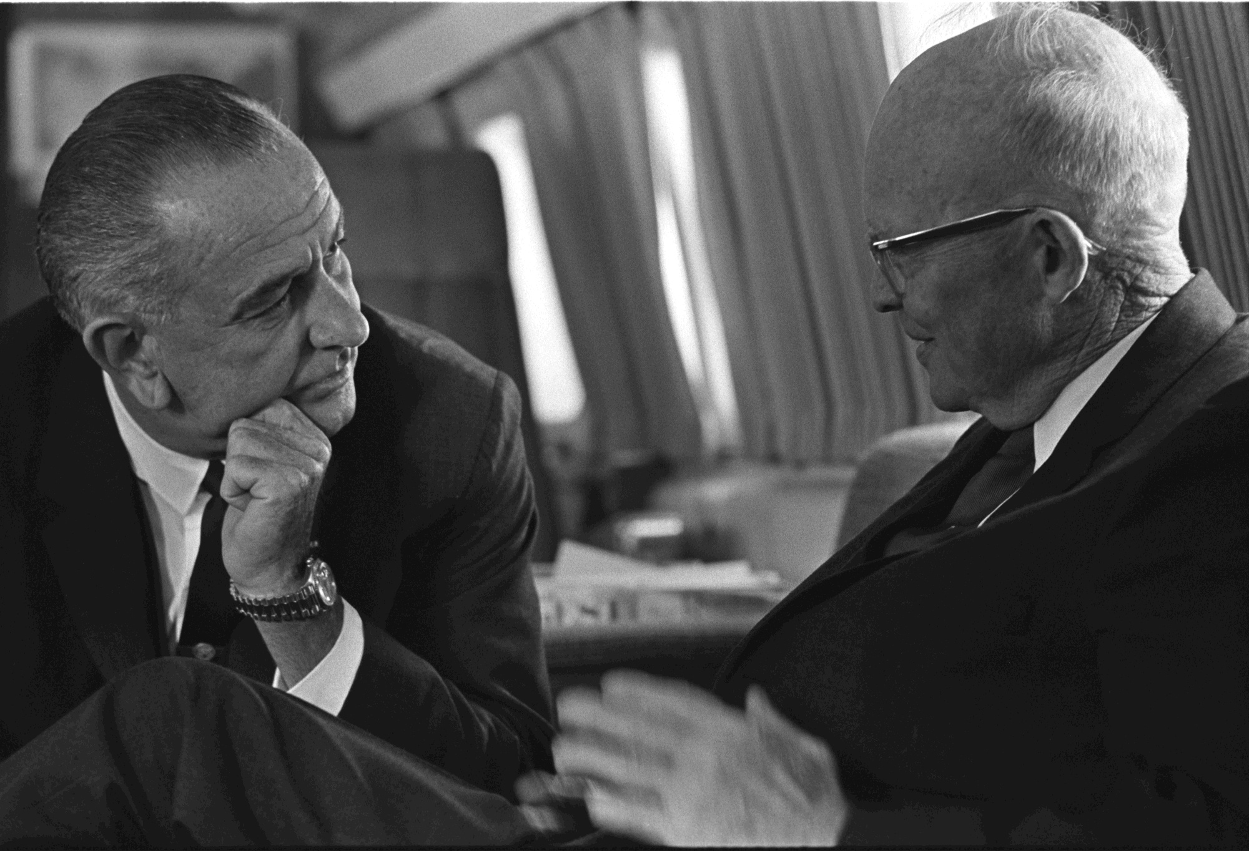
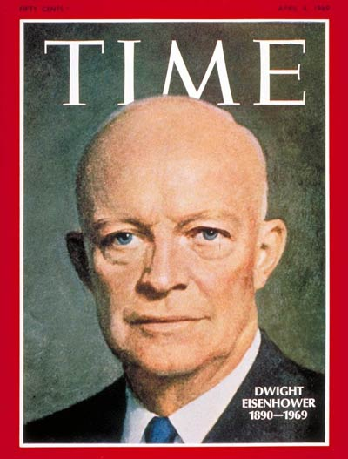
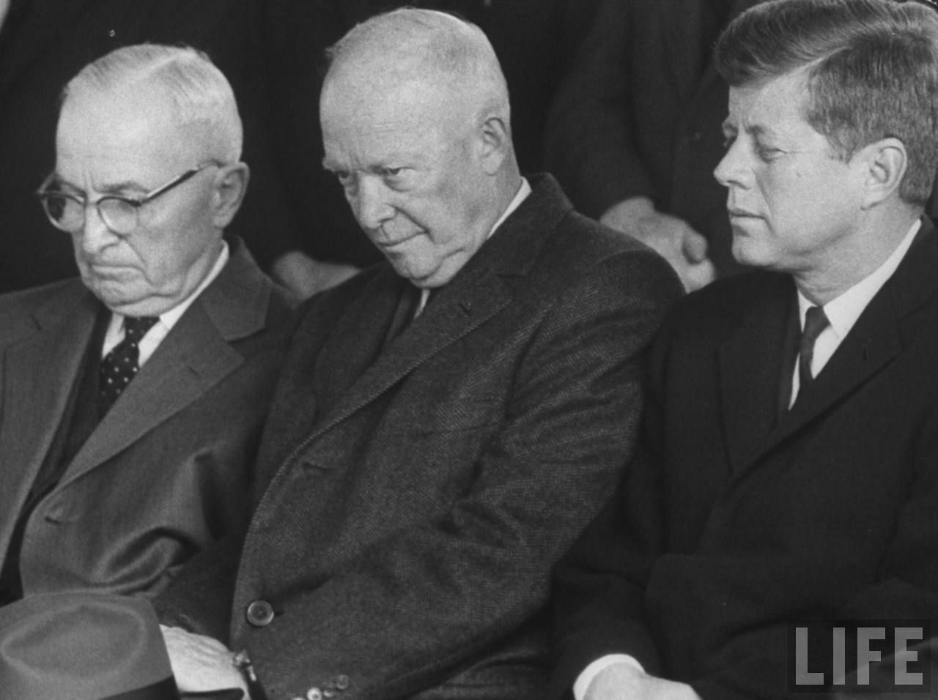
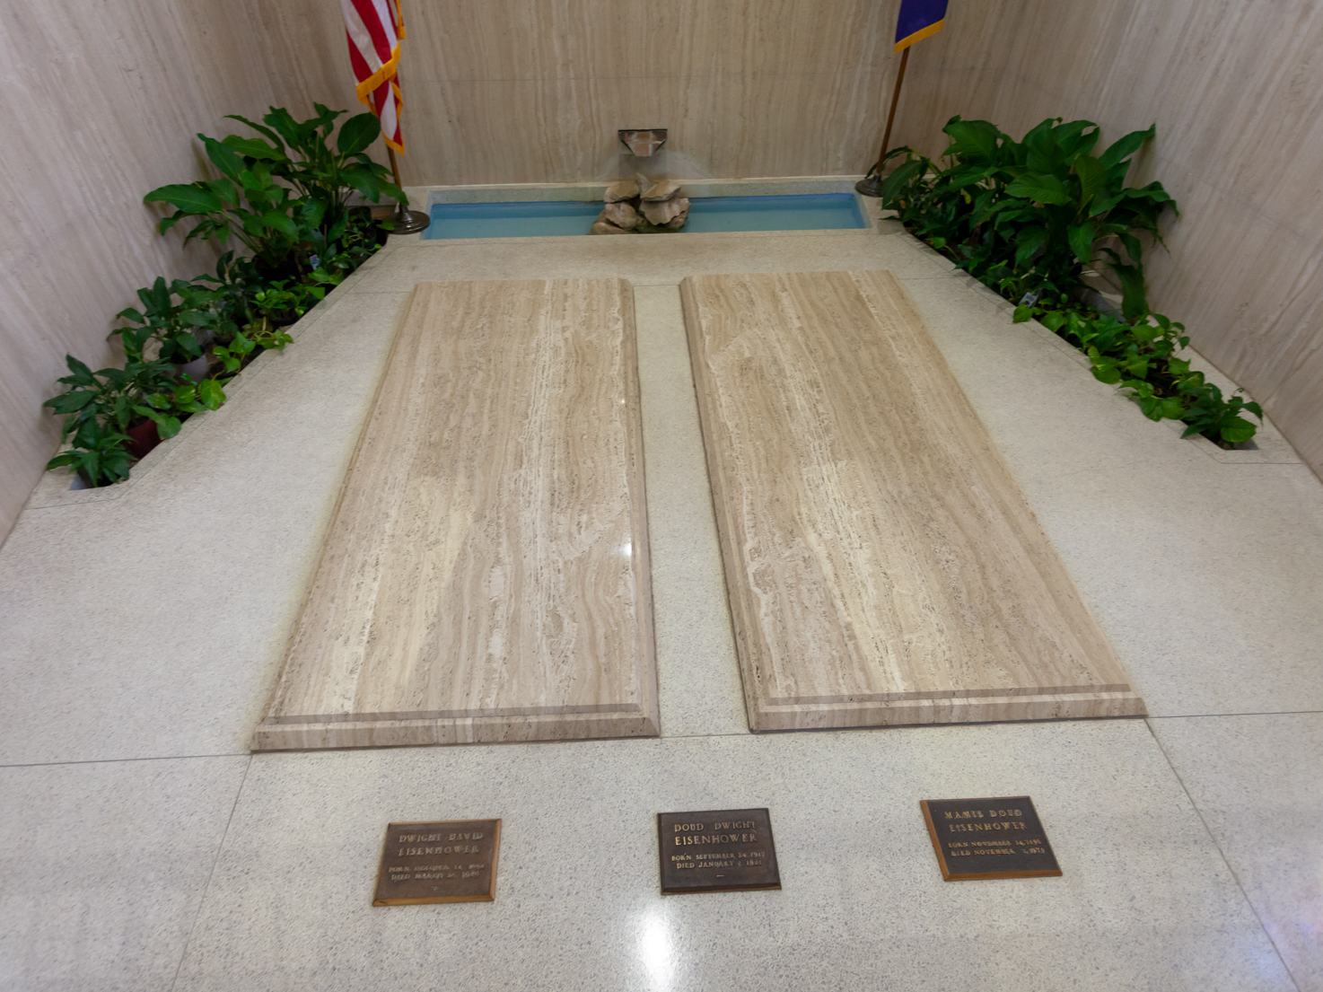
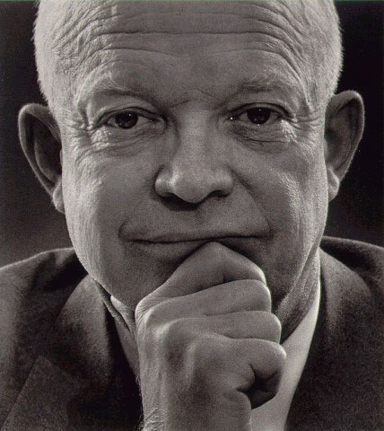
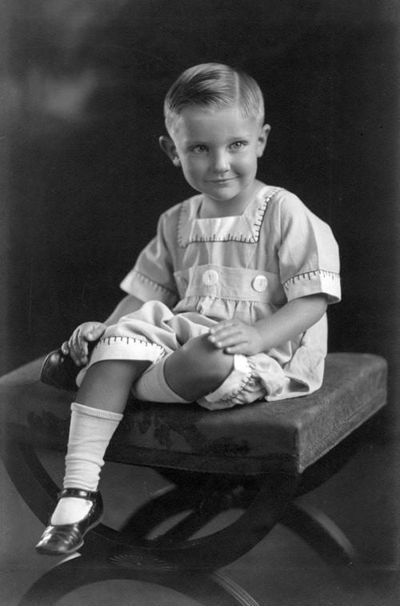
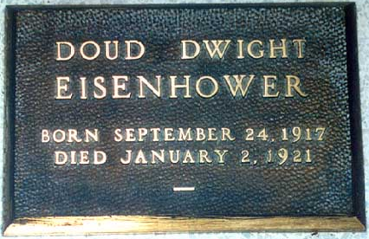
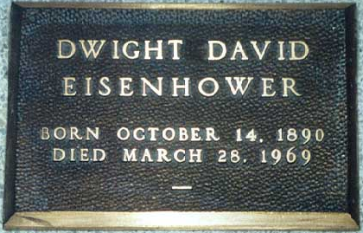
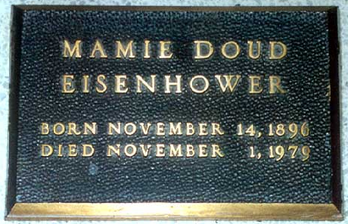
John Eisenhower
1922-2013

Slide 40
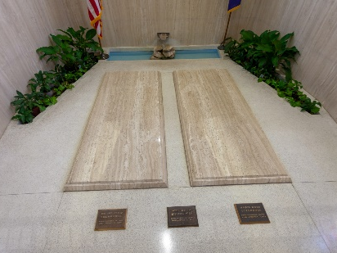

Slide 41
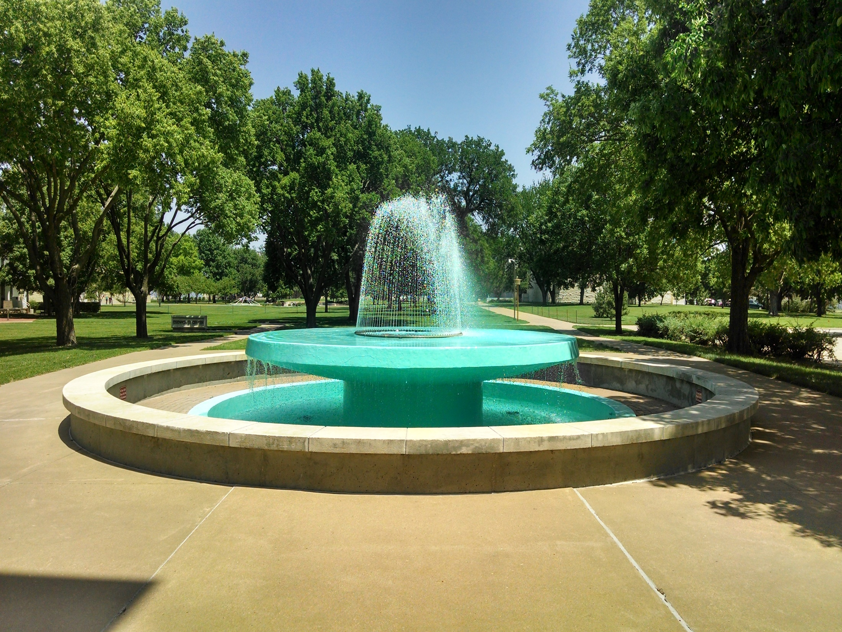

Slide 43
Presidential Quotes
Ron Bert
27½
November 24, 2019

Slide 44
Part 1
35. John F. Kennedy (1961-1963)

Slide 45
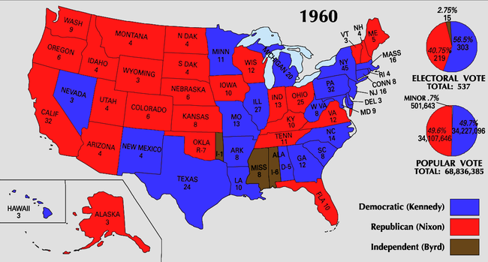

Slide 46
“The rights of man come not from the generosity of the state but from the hand of God.”
. .
. .

Slide 47
But there is a spirit in man, And the breath of the Almighty gives him understanding. — Job 32:8
spirit in man
spirit in man
breath of the Almighty
gives him understanding
breath of the Almighty
gives
consciousness
him understanding

Slide 48
The burden of the word of the LORD against Israel. Thus says the LORD, who stretches out the heavens, lays the foundation of the earth, and forms the spirit of man within him: — Zechariah 12:1
lays the foundation
LIFE
forms the spirit

Slide 49
But even to this day, when Moses is read, a veil lies on their heart. Nevertheless when one turns to the Lord, the veil is taken away. Now the Lord is the Spirit; and where the Spirit of the Lord is, there is liberty. But we all, with unveiled face, beholding as in a mirror the glory of the Lord, are being transformed into the same image from glory to glory, just as by the Spirit of the Lord. — 2nd Corinthians 3:15-18
turns
when one turns to the
Lord
Lord
liberty
transformed into
image

Slide 50
“This country cannot afford to be materially rich and spiritually poor.”

Slide 51
“To those whom much is given, much is expected.”

Slide 52
My brethren, let not many of you become teachers, knowing that we shall receive a stricter judgment. — James 3:1

Slide 53
“The day before my inauguration President Eisenhower told me, You'll find that no easy problems ever come to the President of the United States. If they are easy to solve, somebody else has solved them. I found that hard to believe, but now I know it is true.”

Slide 54
“No man who enters upon the office to which I have succeeded can fail to recognize how every president of the United States has placed special reliance upon his faith in God. Every president has taken comfort and courage when told that the Lord 'will be with thee. He will not fail thee nor forsake thee. Fear not-neither be thou dismayed.' Each of our presidents in his own way has placed a special trust in God. Those who were strongest intellectually were also strongest spiritually.”
“No man who enters upon the office to which I have succeeded can fail to recognize how every president of the United States has placed special reliance upon his faith in God. Every president has taken comfort and courage when told that the Lord 'will be with thee. He will not fail thee nor forsake thee. Fear not-neither be thou dismayed.' Each of our presidents in his own way has placed a special trust in God. Those who were strongest intellectually were also strongest spiritually.”
faith in God
in
comfort and courage
in
trust in God

Slide 55
‘Fear not, for I am with you; Be not dismayed, for I am your God. I will strengthen you, Yes, I will help you, I will uphold you with My righteous right hand.’ — Isaiah 41:10
I will help you

Slide 56
“We have become more and more not a nation of athletes but a nation of spectators.”
participants
contestants
not
insiders
onlookers
outsiders
bystanders

Slide 57
“We shall be judged more by what we do at home than what we preach abroad.”
what we do
do
do

Slide 58
“My fellow Americans, ask not what your country can do for you, ask what you can do for your country.”
service
what you can do
do

Slide 59
“My fellow citizens of the world: ask not what America will do for you, but what together we can do for the freedom of man.”
freedom of man

Slide 60
“Let the word go forth from this time and place, to friend and foe alike, that the torch has been passed to a new generation of Americans - born in this century, tempered by war, disciplined by a hard and bitter peace.”

Slide 61
“A nation which has forgotten the quality of courage which in the past has been brought to public life is not as likely to insist upon or regard that quality in its chosen leaders today - and in fact we have forgotten.”
forgotten
courage
courage
courage
quality

Slide 62
“Effort and courage are not enough without purpose and direction.”
courage
purpose
purpose

Slide 63
Now He who searches the hearts knows what the mind of the Spirit is, because He makes intercession for the saints according to the will of God. And we know that all things work together for good to those who love God, to those who are the called according to His purpose. — Romans 8:27-28
God
direction
purpose
purpose
Notes:
-

Slide 64
“Never let your fears hold you back from pursuing your hopes.”
hope
hope

Slide 65
“The stories of past courage ... can offer hope, they can provide inspiration. But they cannot supply courage itself. For this each man must look into his own soul.”
hope
hope
Zeal
must look into
hope
own soul

Slide 66
For whatever things were written before were written for our learning, that we through the patience and comfort of the Scriptures might have hope. — Romans 15:4
hope

Slide 67
“The highest duty of the writer, the composer, the artist, is to remain true to himself and to let the chips fall where they may.”
integrity
true to himself

Slide 68
“We are not here to curse the darkness, but to light the candle that can guide us through that darkness to a safe and sane future.”
light the candle

Slide 69
For You will light my lamp; The LORD my God will enlighten my darkness. — Psalms 18:28
"Nor do they light a lamp and put it under a basket, but on a lampstand, and it gives light to all who are in the house. Let your light so shine before men, that they may see your good works and glorify your Father in heaven." — Matthew 5:15-16
good works and glorify your Father

Slide 70
“But however close we sometimes seem to that dark and final abyss, let no man of peace and freedom despair. For he does not stand alone.”
stand alone

Slide 71
Let your conduct be without covetousness; be content with such things as you have. For He Himself has said, "I will never leave you nor forsake you." — Hebrews 13:5
I will never leave you

Slide 72
“Persons are judged to be great because of the positive qualities they possess, not because of the absence of faults.”
righteousness
sin

Slide 73
If we say that we have not sinned, we make Him a liar, and His word is not in us. — 1st John 1:10

Slide 74
“The great enemy of truth is very often not the lie -- deliberate, contrived and dishonest -- but the myth -- persistent, persuasive and unrealistic. Too often we hold fast to the clichés of our forebears. We subject all facts to a prefabricated set of interpretations. We enjoy the comfort of opinion without the discomfort of thought.”
traditions
cliches
prejudices
interpretations
lies
opinion
truth
thought

Slide 75
"… 'These people draw near to Me with their mouth, And honor Me with their lips, But their heart is far from Me. And in vain they worship Me, Teaching as doctrines the commandments of men.'" — Matthew 15:8-9
hypocrites

Slide 76
“The most powerful single force in the world today is neither Communism nor Capitalism, neither the H-bomb nor the guided missile -- it is man’s eternal desire to be free and independent.”
eternal desire to be free

Slide 77
“If men and women are in chains anywhere in the world, then freedom is endangered everywhere.”

Slide 78
Now the Lord is the Spirit; and where the Spirit of the Lord is, there is liberty. — 2nd Corinthians 3:17

Slide 79
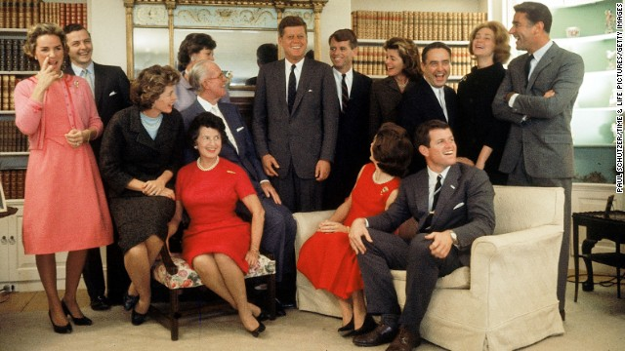
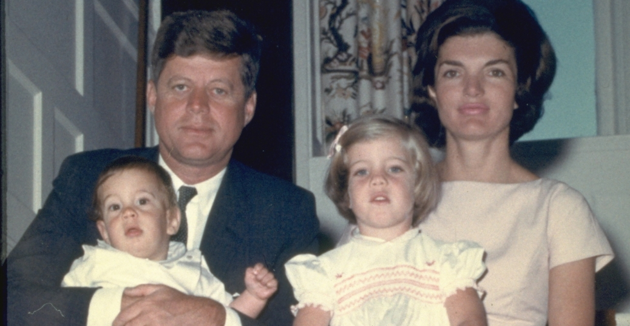
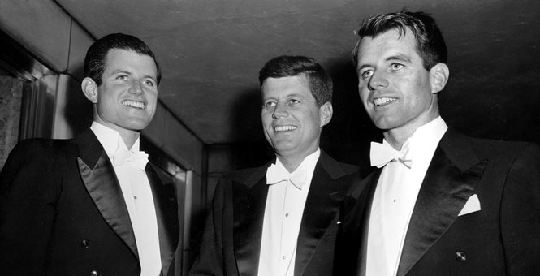

Slide 80
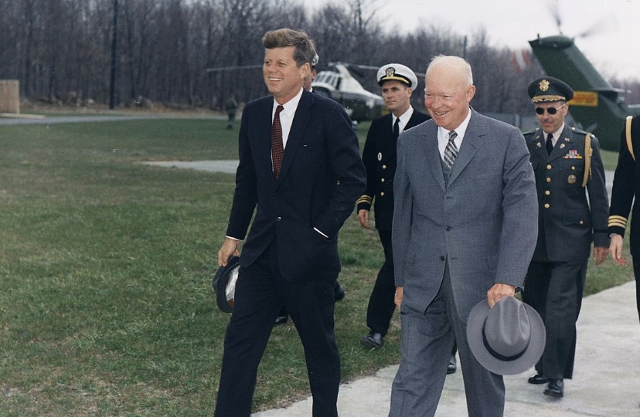

Slide 81
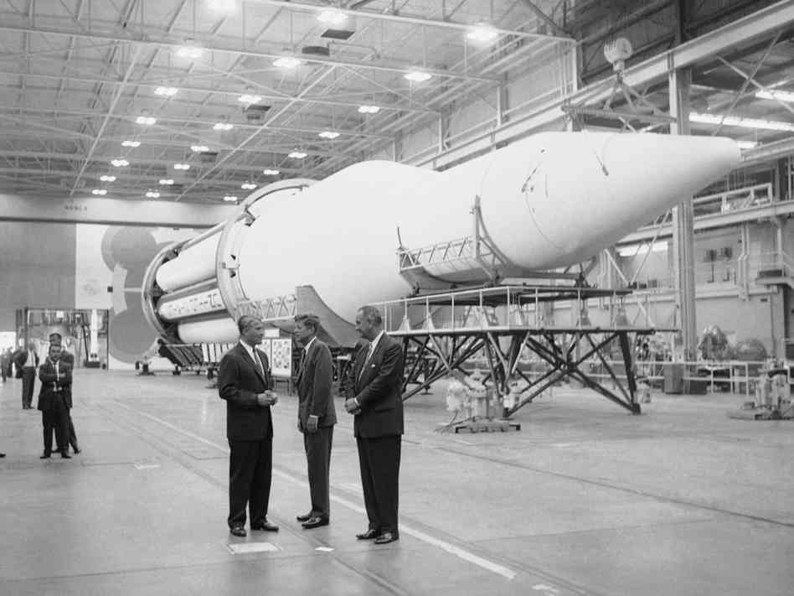
Wernher von Braun

Slide 82
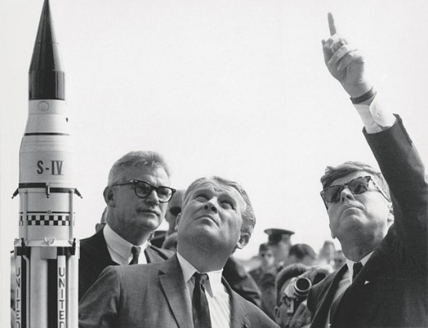

Slide 83
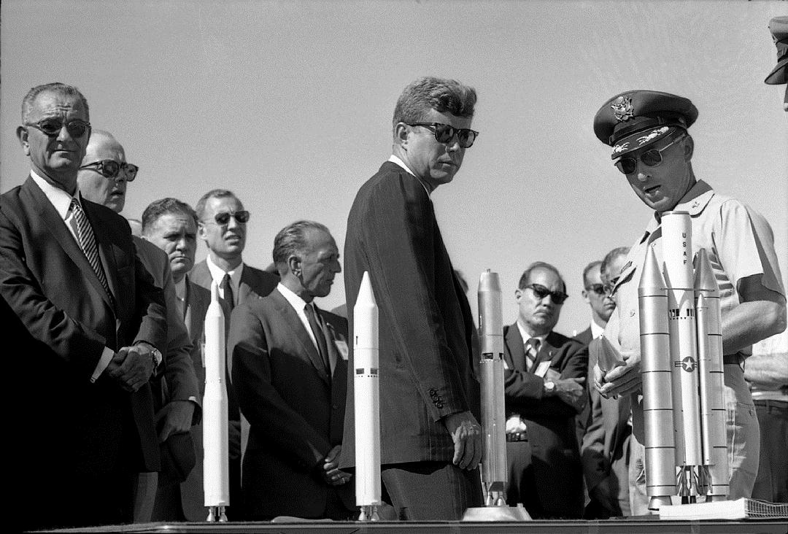

Slide 84
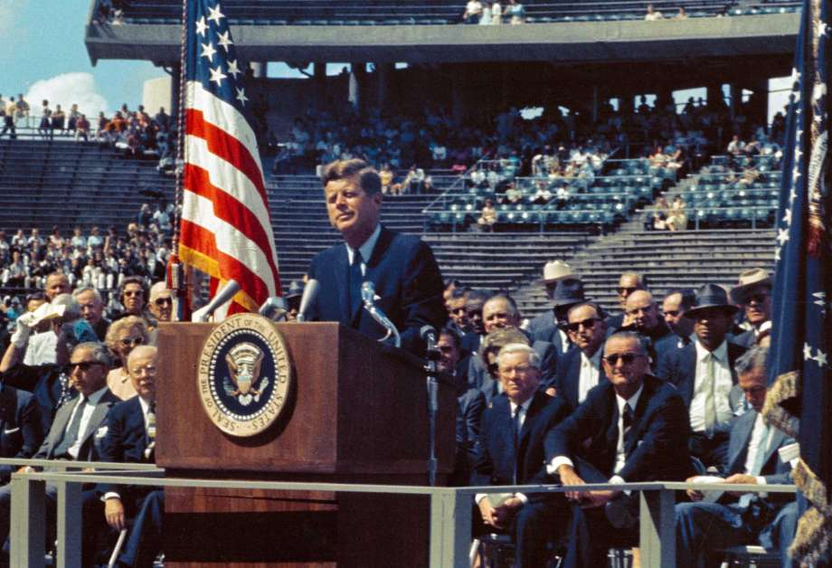
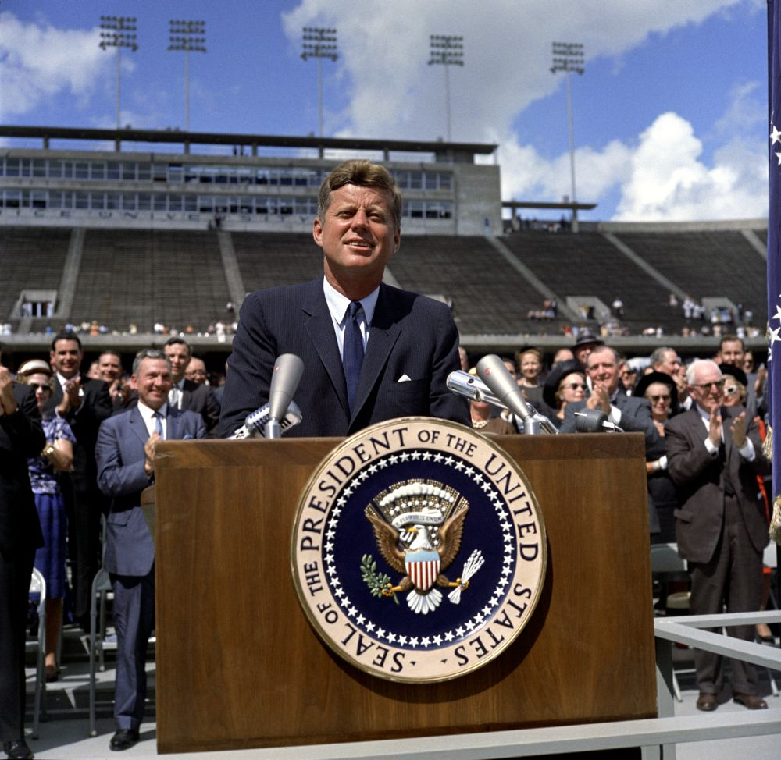

Slide 85
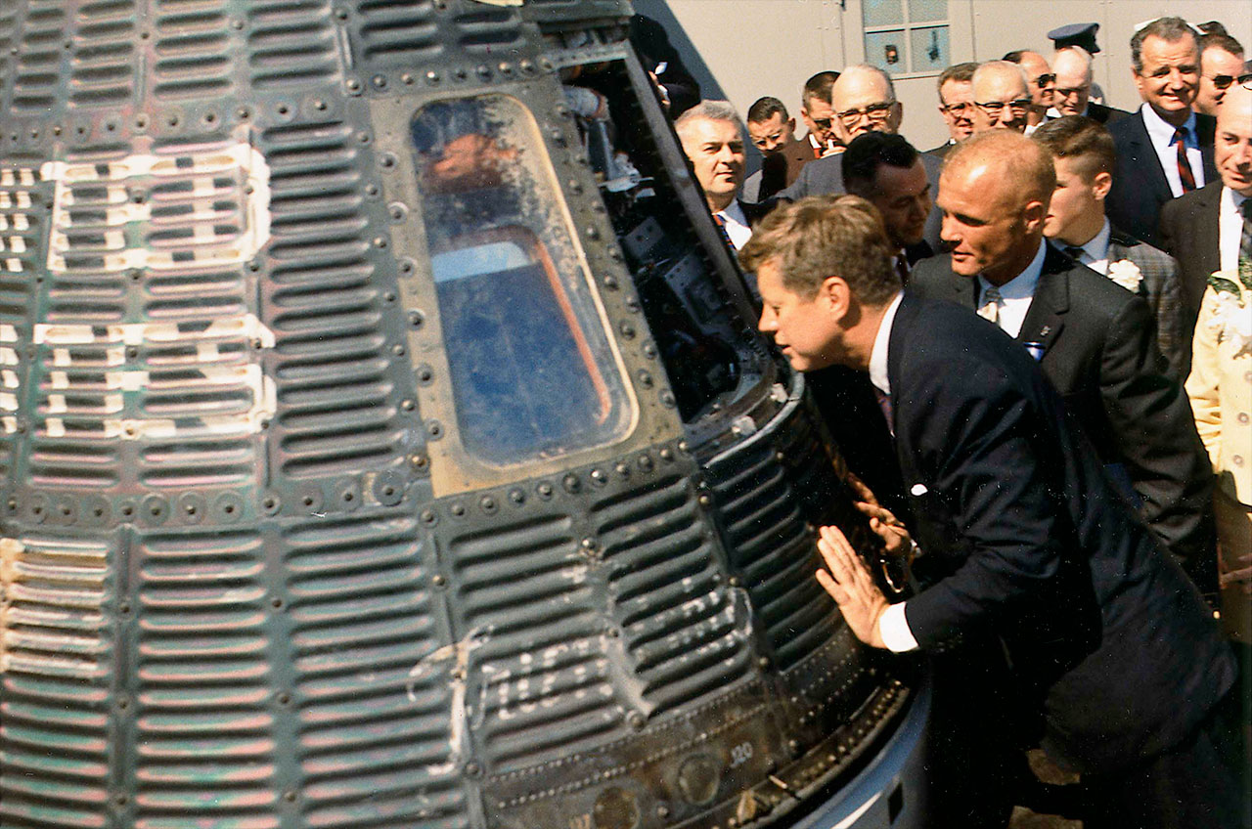
Gemini “Freedom” capsule with John Glenn

Slide 86
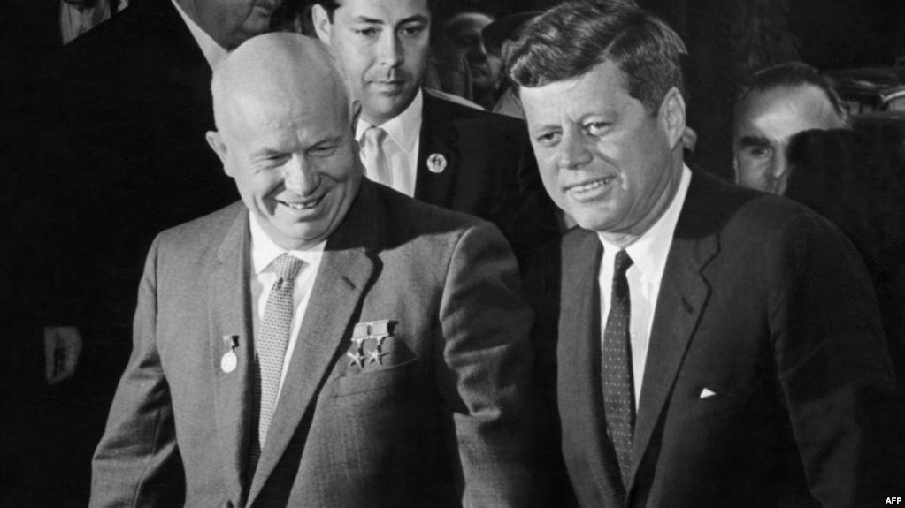
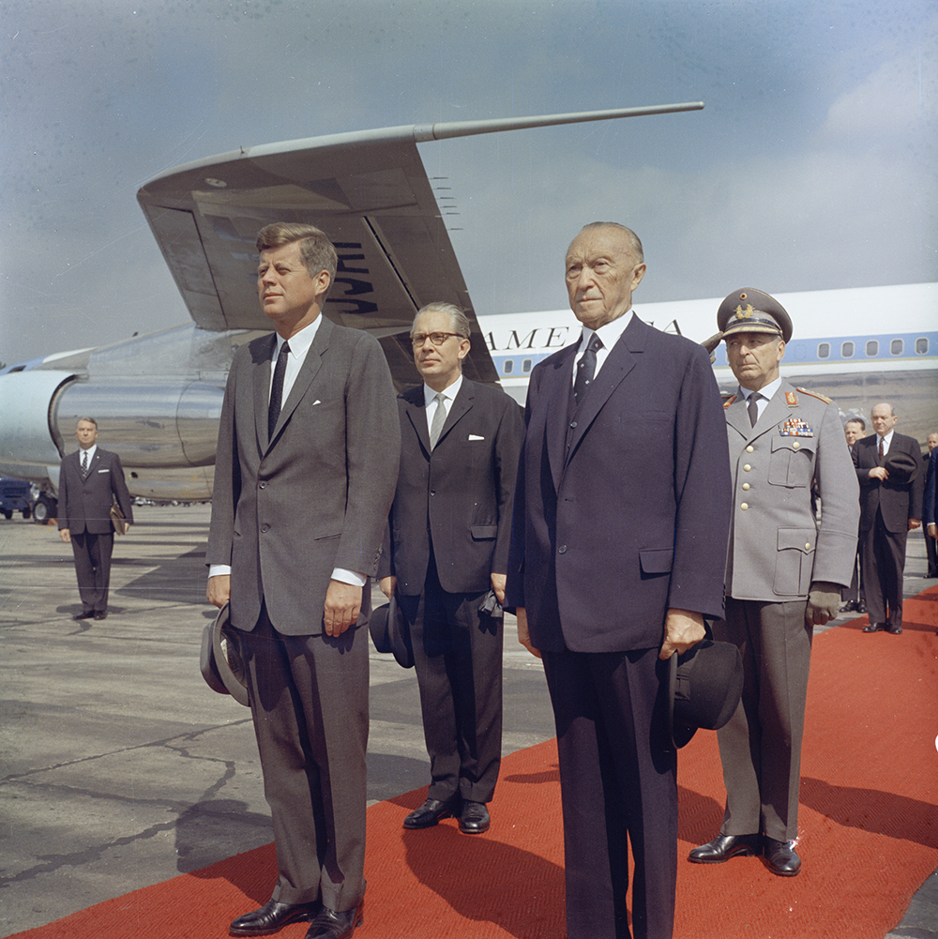
Nikita Khrushchev
Chancellor of West Germany, Konrad Adenauer
Notes:
Chancellor of West Germany, Konrad Adenauer

Slide 87
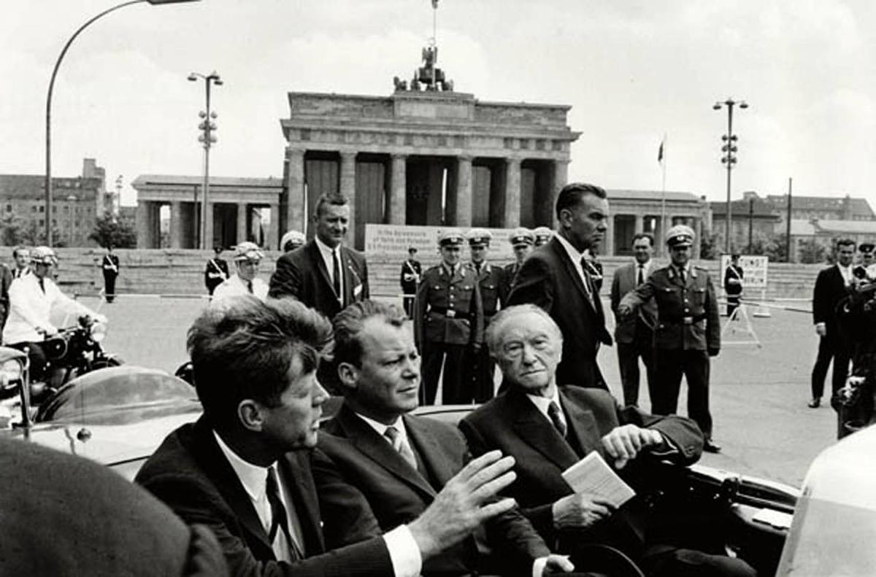

Slide 88
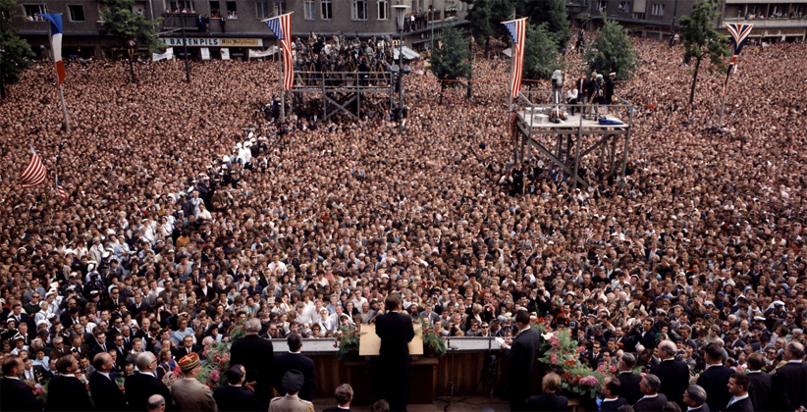
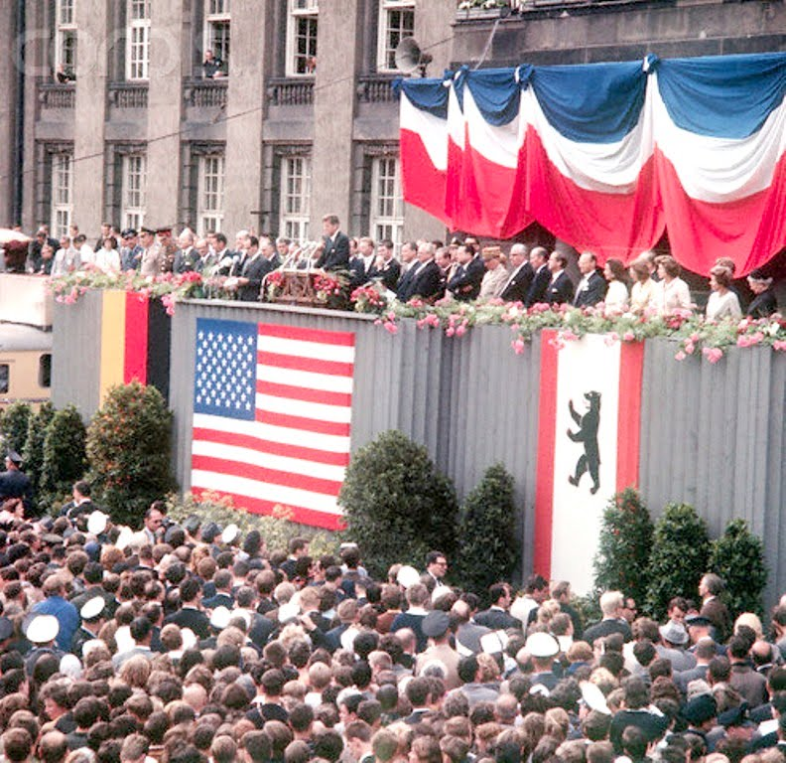

Slide 89
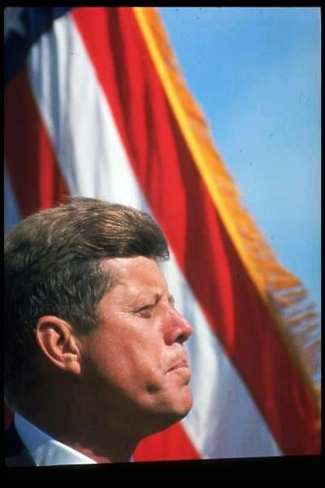
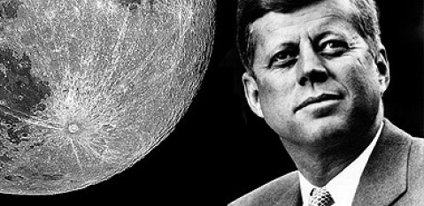
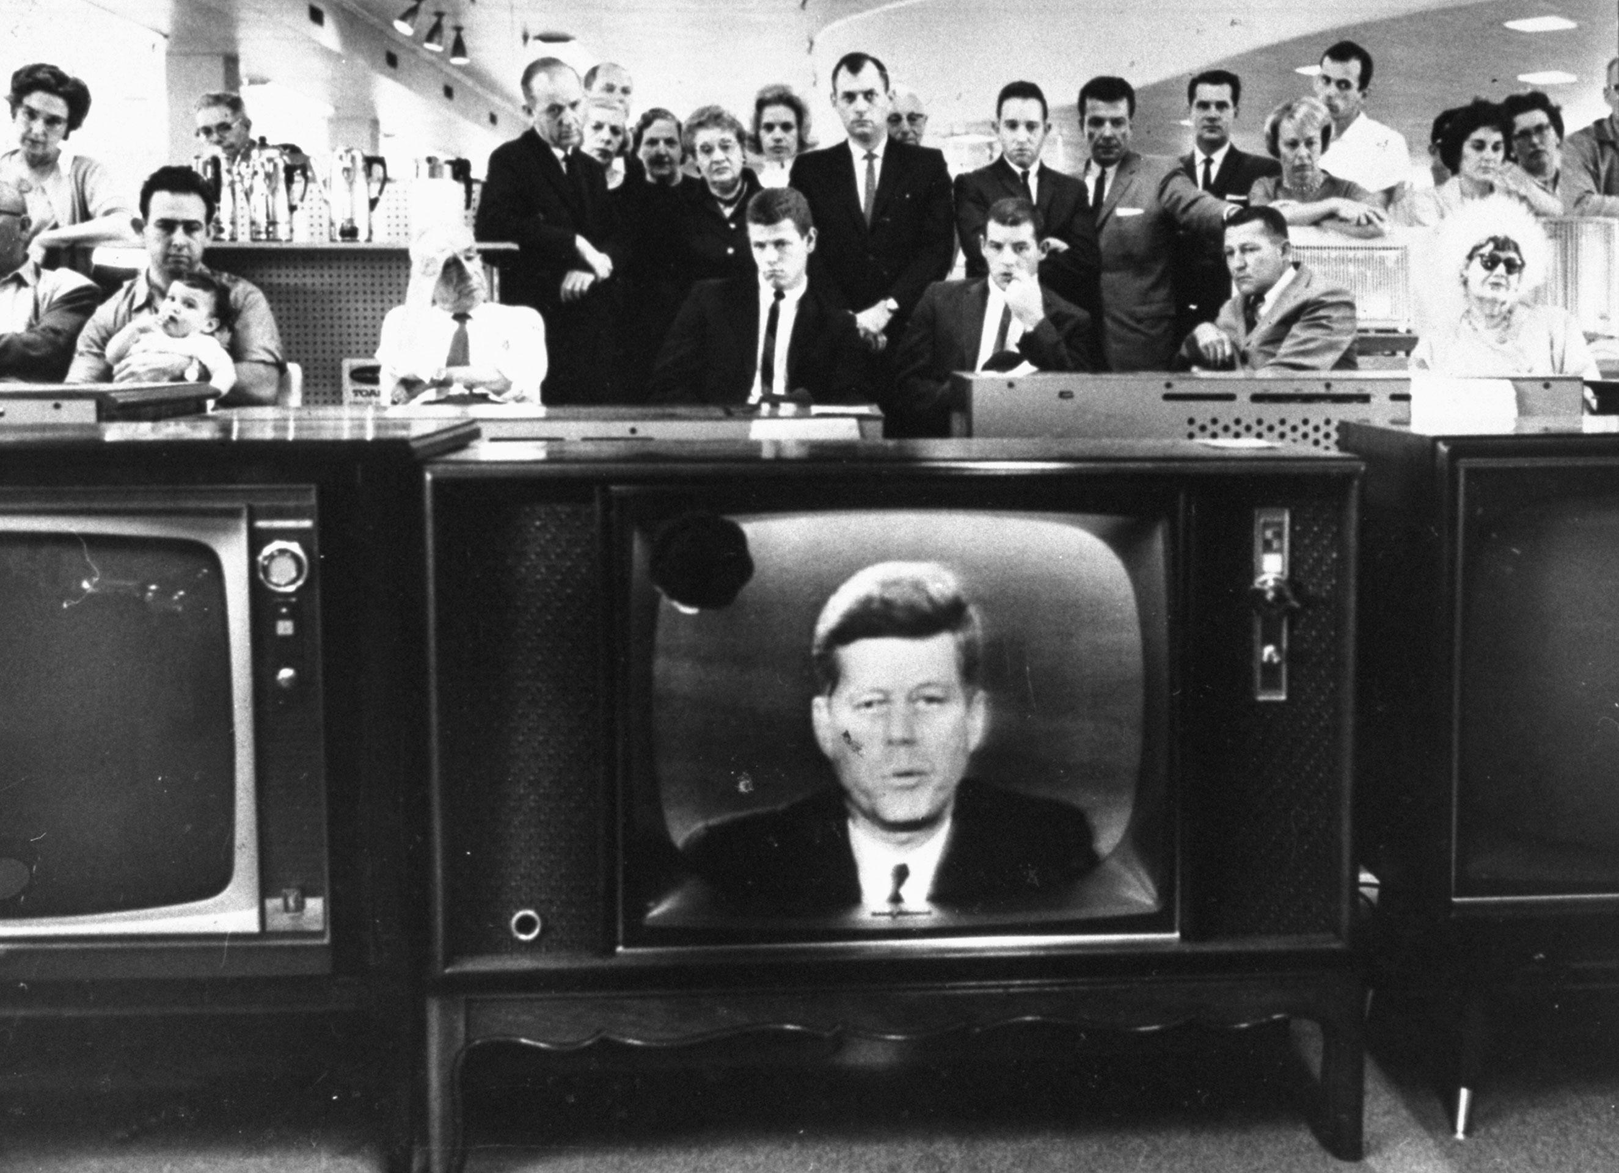
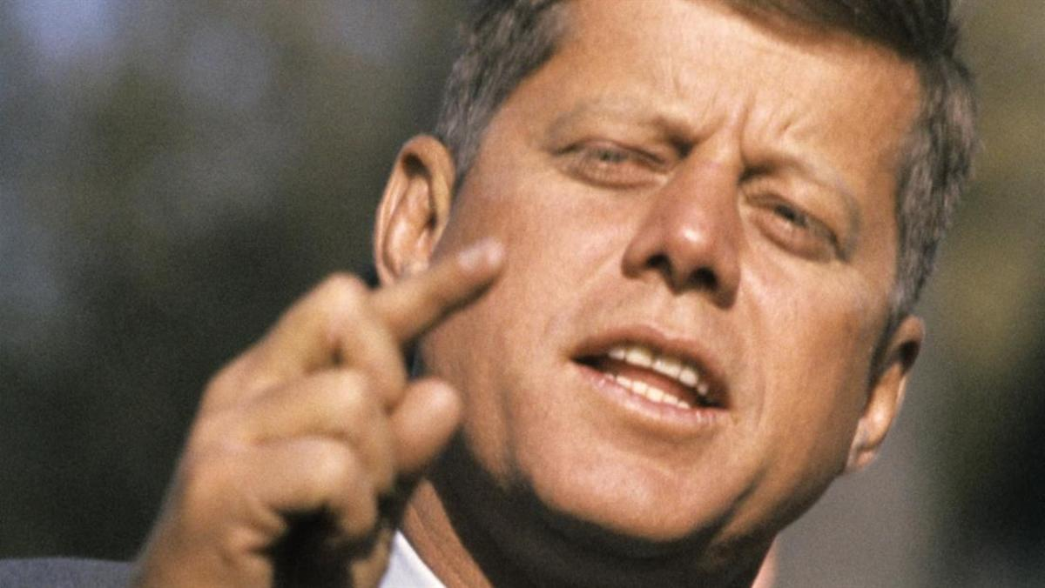
Notes:
In Kennedy’s death, the nation found purpose in the vision he put forth. Without purpose the children suffer in the oblivion left with no way out.

Slide 90
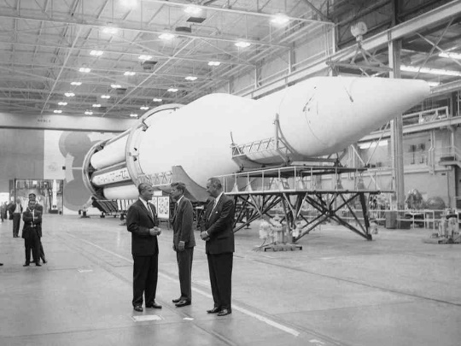
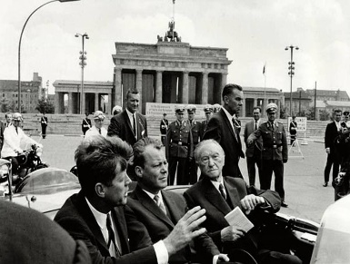
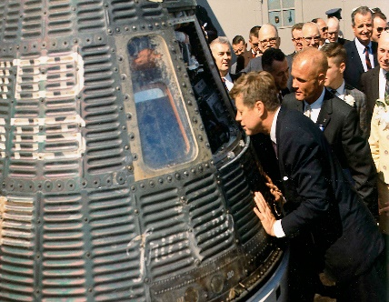

Slide 91
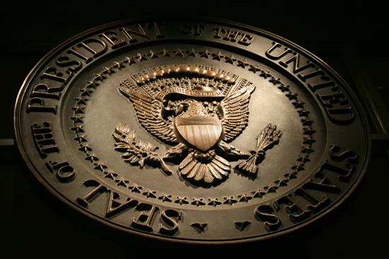
→ Prejudice and intolerance has always been with us
→ Hatefulness puts one’s eternal life in jeopardy
→ Freedom of conscience holds high, an American ideal
→ Reckless demands for freedom diminish principles
→ Humble loyalty for one another is godly cement
→ Socialism destroys freedoms of noblier character
→ It is God who gifts life to living beings
→ Without spiritual knowledge our morals are ruined
→ Much is expected from those who are ably blessed
→ A torch without truth has little light
→ Each soul must delve to find an honest heart
→ Climbing to a good life admits faults from behind
→ Traditions can blind one to underlying real truth
Tears shed call out to our Maker
Notes:
Tears shed call out to our Maker

Slide 93
Please visit http://www.LoveFromGod.com to explore further
Ronald Bert Channel on
Notes:
Eternity never ends.

