Slide 2
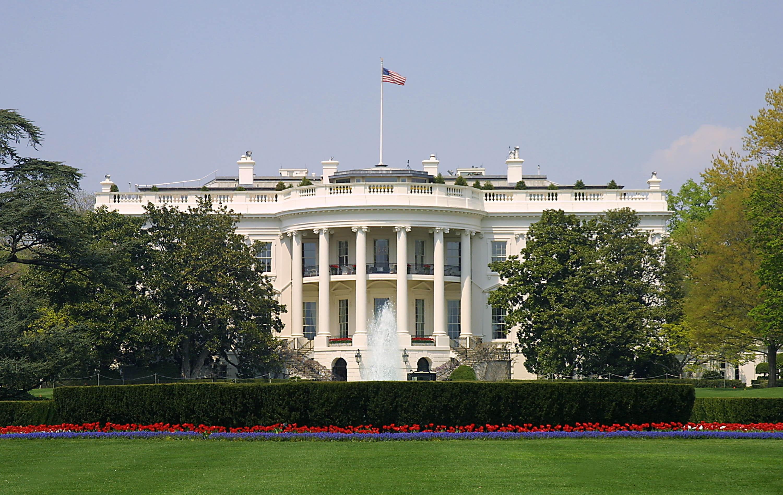
Presidential Quotes
Ron Bert
24
August 4, 2019

Slide 3
Part 1
32. Franklin D. Roosevelt (1933-1945)

Slide 4
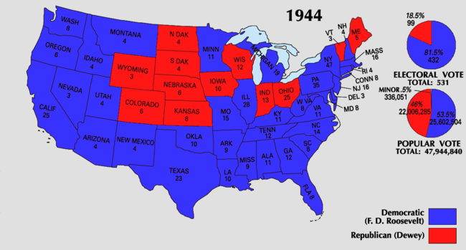
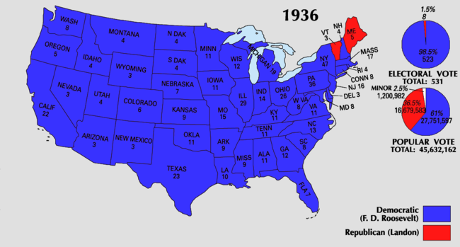
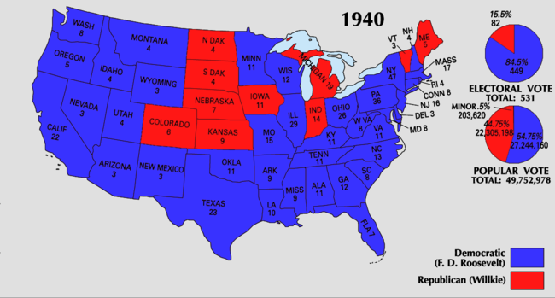
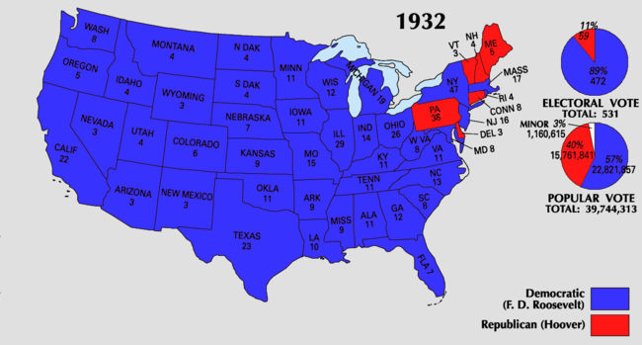

Slide 5
“[The United States is] founded on the principles of Christianity.”
“I am a Christian and a Democrat, that's all.”
“Lord, reform Thy world, beginning with me.”

Slide 6
“Let us move forward with strong and active faith.”
active faith

Slide 7
“We cannot read the history of our rise and development as a nation without reckoning with the place the Bible has occupied in shaping the advances of the Republic. Where we have been the truest and most consistent in obeying its precepts, we have attained the greatest measure of contentment and prosperity.”
Bible
obeying its precepts
greatest measure
contentment and prosperity

Slide 8
“In the formative days of the Republic, the directing influence the Bible exercised upon the fathers of the Nation is conspicuously evident.”
directing influence
Bible

Slide 9
For in it the righteousness of God is revealed from faith to faith; as it is written, "The just shall live by faith." — Romans 1:17

Slide 10
“Almighty God, who hast given us this good land for our heritage; We humbly beseech Thee that we may always prove ourselves a people mindful of Thy favor and glad to do Thy will.”
prove ourselves
mindful

Slide 11
“As Commander-in-Chief, I take pleasure in commending the reading of the Bible to all who serve in the Armed Forces of the United States. Throughout the centuries, men of many faiths and diverse origins have found in the Sacred Book words of wisdom, counsel, and inspiration. It is a fountain of strength ... an aid in attaining the highest aspiration of the human soul.”
Bible
found in the Sacred Book:
words of wisdom
• counsel
• inspiration
• fountain of strength
found in the Sacred
Book
words of wisdom
counsel
inspiration
fountain of
strength
highest aspiration of the human soul

Slide 12
A wise man is strong, Yes, a man of knowledge increases strength; — Proverbs 24:5

Slide 13
The way of the LORD is strength for the upright, But destruction will come to the workers of iniquity. — Proverbs 10:29

Slide 14
“I hope that you have re-read the Constitution of the United States in these past few weeks. Like the Bible, it ought to be read again and again.”
read again and again

Slide 15
“The traditional Jeffersonian principle of religious freedom was so broadly democratic that it included the right to have no religion at all - it gave to the individual the right to worship any God he chose or no god.”
religious freedom
democratic
included the right
no religion at all
choice
God
or no god

Slide 16
“Where freedom of religion has been attacked, the attack has come from sources opposed to democracy. Where democracy has been overthrown, the spirit of free worship has disappeared. And where religion and democracy have vanished, good faith and reason in international affairs have given way to strident ambition and brute force.”
zeal for God
spirit of free worship
Greed and oppression

Slide 17
"The thief does not come except to steal, and to kill, and to destroy. I have come that they may have life, and that they may have it more abundantly. — John 10:10

Slide 18
“Freedom of speech is of no use to a man who has nothing to say and freedom of worship is of no use to a man who has lost his God.”
awareness
Freedom of speech
uneducated
nothing to say
faith
freedom of worship
petty complainer
lost his God

Slide 19
“Religion, by teaching man his relationship to God, gives the individual a sense of his own dignity and teaches him to respect himself by respecting his neighbors.”
teaches
respect

Slide 20
If you really fulfill the royal law according to the Scripture, "You shall love your neighbor as yourself," you do well; but if you show partiality, you commit sin, and are convicted by the law as transgressors. — James 2:8-9

Slide 21
“The whole world is one neighborhood.”

Slide 22
“No greater blessing could come to our land today than a revival of the spirit of religion. I doubt if there is any problem in the world today -- social, political, or economic -- that would not find happy solution if approached in the spirit of the Sermon on the Mount.”
Seek God’s Kingdom / His righteousness Recognize your sin and repent Hunger for God and be kind Find happiness in a peaceful nature Obedience from the heart Shine a godly light before all
Seek God’s Kingdom / His righteousness
Recognize your sin and repent
Hunger for God and be kind
Find happiness in a peaceful nature
Obedience from the heart
Shine a godly light before all
how to live a life that pleases God
shows a way to happiness
exposes our sin
points us to Jesus
Sermon on the Mount
Sermon on the Mount

Slide 23
And the apostles said to the Lord, "Increase our faith." — Luke 17:5

Slide 24
“There comes a time in the affairs of men when they must prepare to defend not their homes alone but the tenets of faith and humanity on which their churches, their governments and their very foundations are set. The defense of religion, of democracy and of good faith among nations is all the same fight. To save one, we must now make up our minds to save all.”
must prepare to defend
The defense of religion and democracy:
is all the same fight
faith and humanity
churches and governments
very foundations
The defense of religion and democracy:
is all the same fight
faith and humanity
churches and governments
very foundations
and
faith and humanity
churches
governments
and
very foundations
The defense
of religion
democracy
is all the same
fight

Slide 25
“But the challenge is always the same - whether each generation facing its own circumstances can summon the practical devotion to attain and retain that greatest good for the greatest number which this government of the people was created to ensure.”
practical devotion
good
people

Slide 26
“Whoever seeks to set one religion against another seeks to destroy all religion.”

Slide 27
“I am perhaps being a bit facetious but if some of my good Baptist brethren in Georgia had done a little preaching from the pulpit against the K.K.K. in the '20s, I would have a little more genuine American respect for their Christianity!”
hypocrisy

Slide 28
"Therefore, whatever you want men to do to you, do also to them, for this is the Law and the Prophets." — Matthew 7:12

Slide 29
“We must remember that any oppression, any injustice, any hatred, is a wedge designed to attack our civilization.”
must remember

Slide 30
Self-interest is the enemy of all true affection.

Slide 31
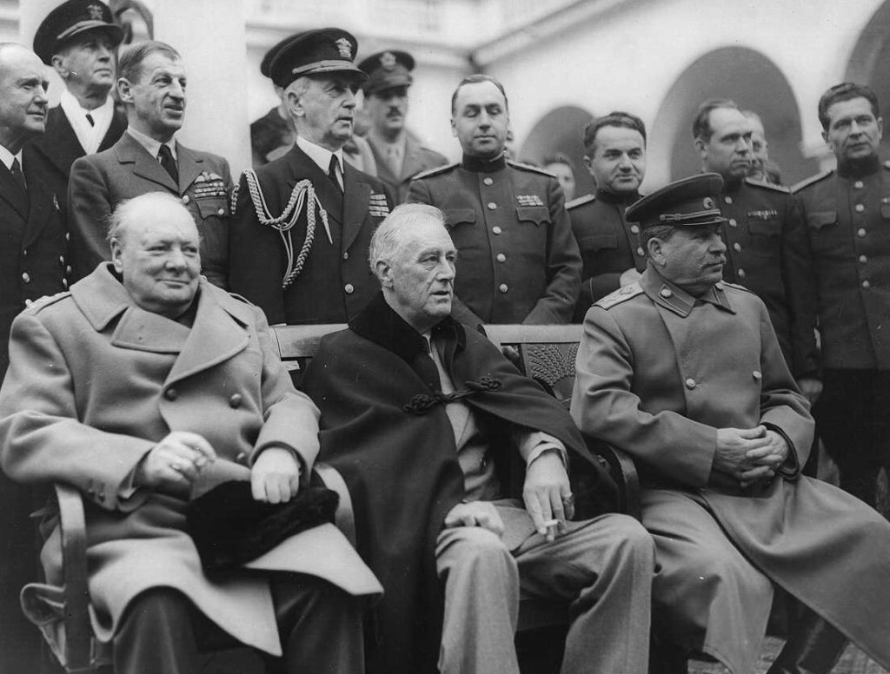

Slide 32
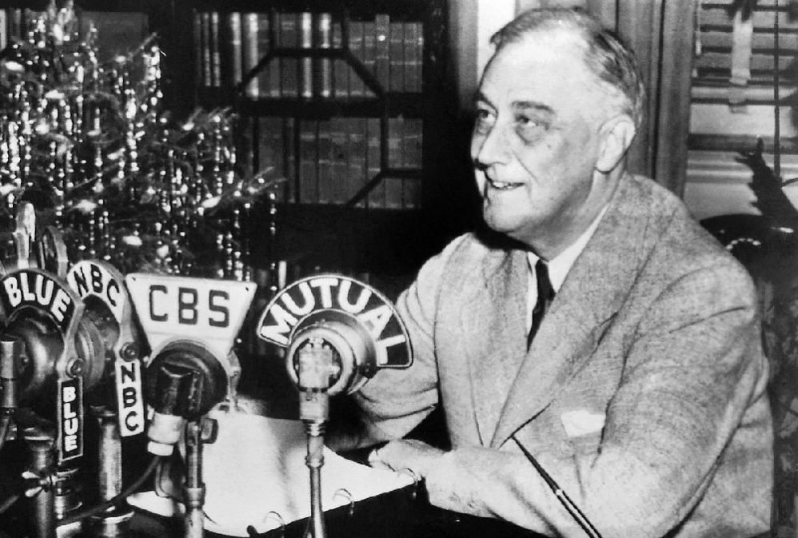

Slide 33
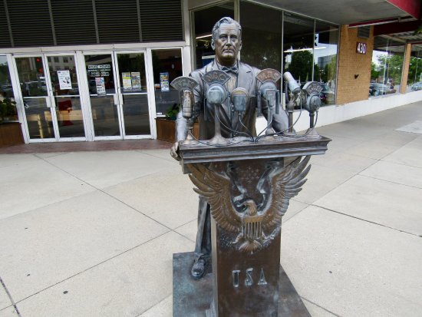

Slide 35
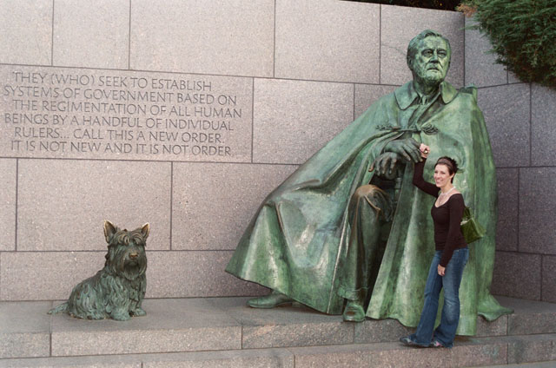

Slide 36
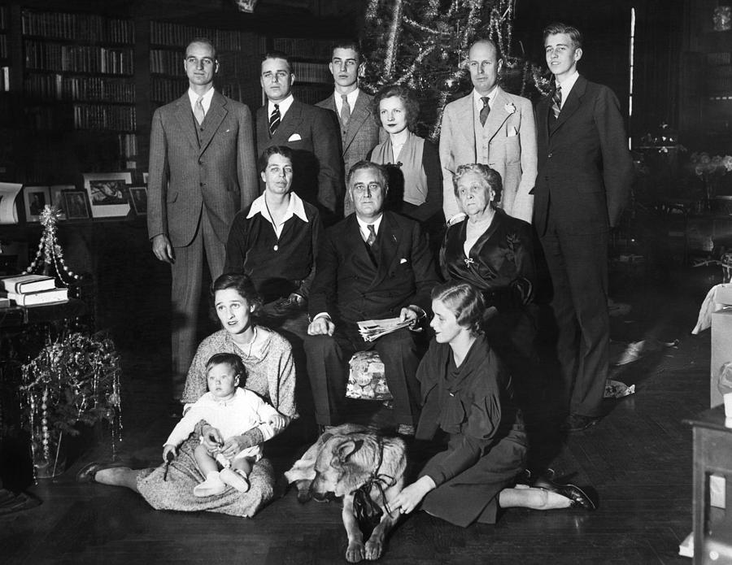

Slide 37
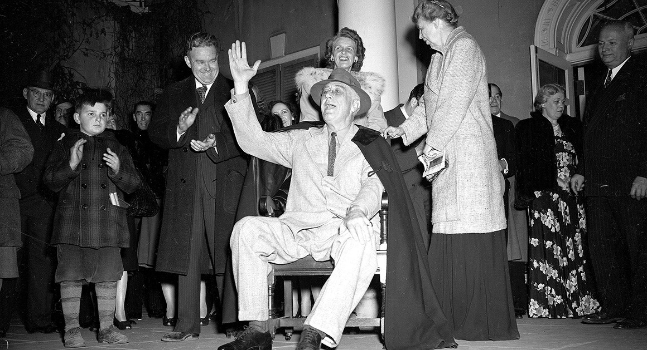
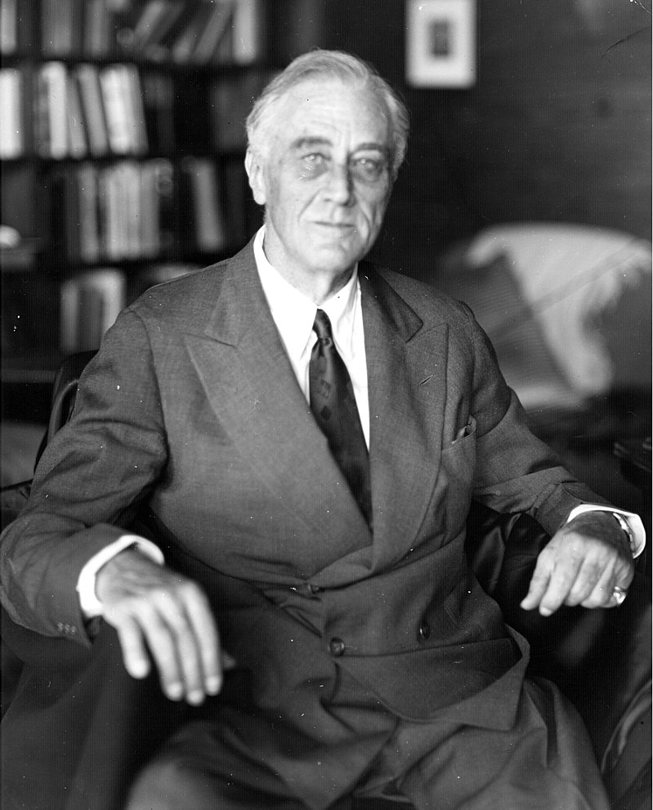
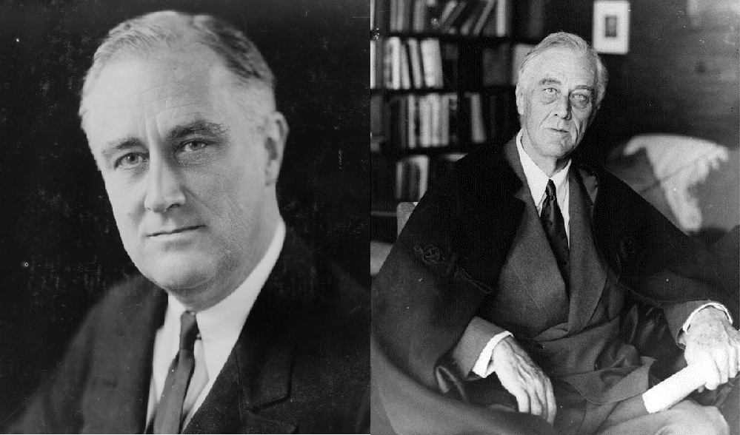

Slide 38
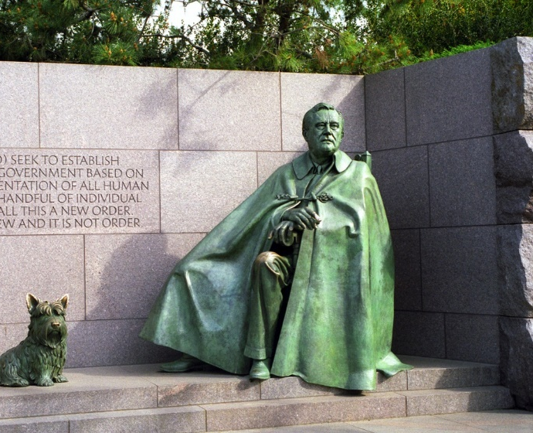

Slide 39
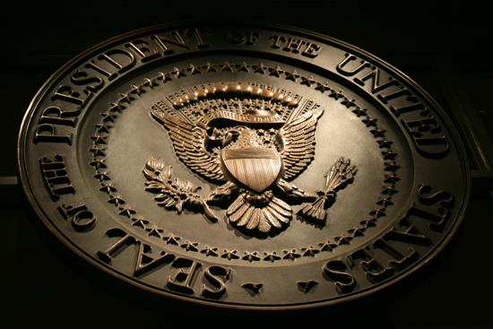
→ The USA is founded on the principles of Christianity
→ Bible awe achieves supreme comfort and fortune
→ Humble hearts mindful of His will build a heritage
→ Bible study attains the highest aspiration of the soul
→ True freedom of conscience allows for belief or not
→ Ignorance and ungodliness do not establish freedom
→ Respecting others is God’s own true nature
→ The Sermon on the Mount guides all who are blind
→ No one finds salvation if the whole boat sinks
→ Each generation is challenged to maintain goodness
→ True Christians purge prejudice and bigotry
→ Self-interest, oppression, injustice, and any hatred
are the wedges that destroy civilization
Hearing the truth has little meaning unless remembered
Notes:
Hearing the truth has little meaning unless remembered

Slide 41
Presidential Quotes
Ron Bert
24½
August 25, 2019

Slide 42
Part 2
32. Franklin D. Roosevelt (1933-1945)

Slide 43
Notes:
Hoover went to the GOP conventions in 1936 and 1940, hoping to sway enough delegate support to get nominated. He was unsuccessful. So while he was never a nominee again after 1932, he did attempt to win the nomination twice.

Slide 44
“The lessons of religious toleration - a toleration which recognizes complete liberty of human thought, liberty of conscience - is one which, by precept and example, must be inculcated in the hearts and minds of all Americans if the institutions of our democracy are to be maintained and perpetuated. We must recognize the fundamental rights of man. There can be no true national life in our democracy unless we give unqualified recognition to freedom of religious worship and freedom of education.”
liberty of conscience
impressed upon

Slide 45
“The school is the last expenditure upon which America should be willing to economize.”

Slide 46
For wisdom is a defense as money is a defense, But the excellence of knowledge is that wisdom gives life to those who have it. — Ecclesiastes 7:12

Slide 47
“The public schools shall be free from sectarian influences and, above all, free from any attitude of hostility to the adherents of any particular creed.”

Slide 48
“Repetition does not transform a lie into a truth.”
“If you tell a big enough lie and tell it frequently enough, it will be believed.” – Adolf Hitler

Slide 49
“First of all, let me assert my firm belief that the only thing we have to fear is fear itself - nameless, unreasoning, unjustified terror which paralyzes needed efforts to convert retreat into advance.”

Slide 50
Yea, though I walk through the valley of the shadow of death, I will fear no evil; For You are with me; Your rod and Your staff, they comfort me. — Psalms 23:4

Slide 51
“Courage is not the absence of fear, but rather the assessment that something else is more important than fear.”

Slide 52
“We, and all others who believe in freedom as deeply as we do, would rather die on our feet than live on our knees.”

Slide 53
“We look forward to a world founded upon four essential human freedoms. The first is freedom of speech and expression. The second is freedom of every person to worship God in his own way. The third is freedom from want. The fourth is freedom from fear.”
essential human
essential human freedoms:
1) of speech and expression
2) worship God in own way
3) freedom from want
4) freedom from fear
freedoms
of
speech and expression
worship God in
own way
freedom from want
freedom from fear

Slide 54
Nevertheless we, according to His promise, look for new heavens and a new earth in which righteousness dwells. — 2nd Peter 3:13

Slide 55
“We have always held to the hope, the belief, the conviction that there is a better life, a better world, beyond the horizon.”
hope
a better life

Slide 56
“Sometimes the best way to keep peace in the family is to keep the members of the family apart for awhile.

Slide 57
“The value of love will always be stronger than the value of hate. Any nation or group of nations which employs hatred eventually is torn to pieces by hatred.”

Slide 58
Do not be overcome by evil, but overcome evil with good. — Romans 12:21

Slide 59
“The truth is found when men are free to pursue it.”
truth
truth

Slide 60
“The real truth of the matter is, as you and I know, that a financial element in the larger centers has owned the Government ever since the days of Andrew Jackson ...”
truth

Slide 61
“Governments can err, Presidents do make mistakes, but the immortal Dante tells us that divine justice weighs the sins of the cold-blooded and the sins of the warm-hearted in different scales. Better the occasional faults of a Government that lives in a spirit of charity than the constant omission of a Government frozen in the ice of its own indifference.”
cold-blooded
cold-blooded
love
warm-hearted
warm-hearted
in
charity
spirit of charity

Slide 62
The motto of war is: "Let the strong survive; let the weak die.“ The motto of peace is: "Let the strong help the weak to survive."
bigotry
war
benevolence
peace

Slide 63
“I have seen war. I have seen war on land and sea. I have seen blood running from the wounded. I have seen men coughing out their gassed lungs. I have seen the dead in the mud. I have seen cities destroyed. I have seen 200 limping, exhausted men come out of line—the survivors of a regiment of 1,000 that went forward 48 hours before. I have seen children starving. I have seen the agony of mothers and wives. I hate war.”
I hate war

Slide 64
“No country, however rich, can afford the waste of its human resources. Demoralization caused by vast unemployment is our greatest extravagance. Morally, it is the greatest menace to our social order.”
unemployment
Morally
greatest menace
social order

Slide 65
“The virtues are lost in self-interest as rivers are lost in the sea.”

Slide 66
Let nothing be done through selfish ambition or conceit, but in lowliness of mind let each esteem others better than himself. — Philippians 2:3

Slide 67
But if you have bitter envy and self-seeking in your hearts, do not boast and lie against the truth. This wisdom does not descend from above, but is earthly, sensual, demonic. For where envy and self-seeking exist, confusion and every evil thing are there. — James 3:14-16

Slide 68
“Men are not prisoners of fate, but only prisoners of their own minds.”

Slide 69
“Happiness lies not in the mere possession of money; it lies in the joy of achievement, in the thrill of creative effort. The joy and moral stimulation of work no longer must be forgotten in the mad chase of evanescent profits. These dark days will be worth all they cost us if they teach us that our true destiny is not to be ministered unto but to minister to ourselves and to our fellow men.”
teach us
to minister
to ourselves and to our fellow men

Slide 70
For if we would judge ourselves, we would not be judged. — 1st Corinthians 11:31

Slide 71
And He said to them, "Take heed and beware of covetousness, for one's life does not consist in the abundance of the things he possesses." — Luke 12:15

Slide 72
“I suggest a nationwide reading of the Holy Scriptures during the period from Thanksgiving Day to Christmas.”

Slide 73
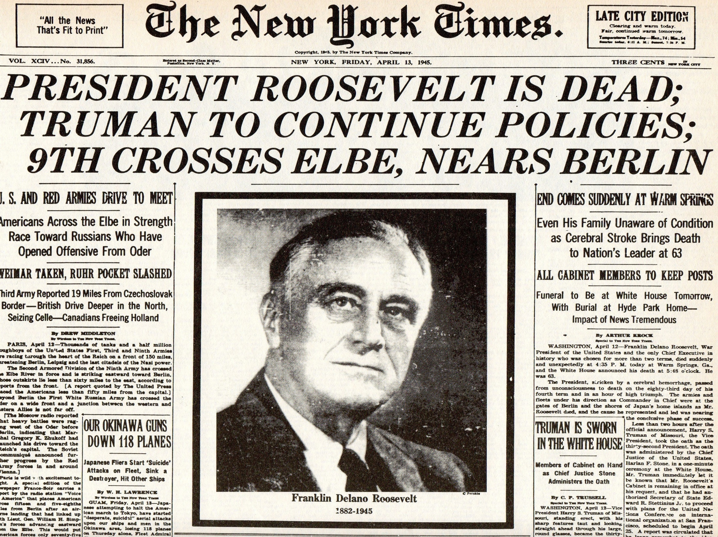

Slide 74
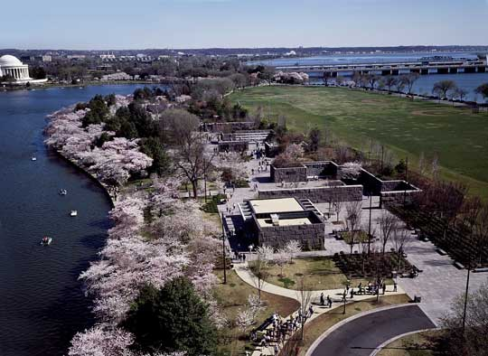
Jefferson Memorial
Potomac River

Slide 75
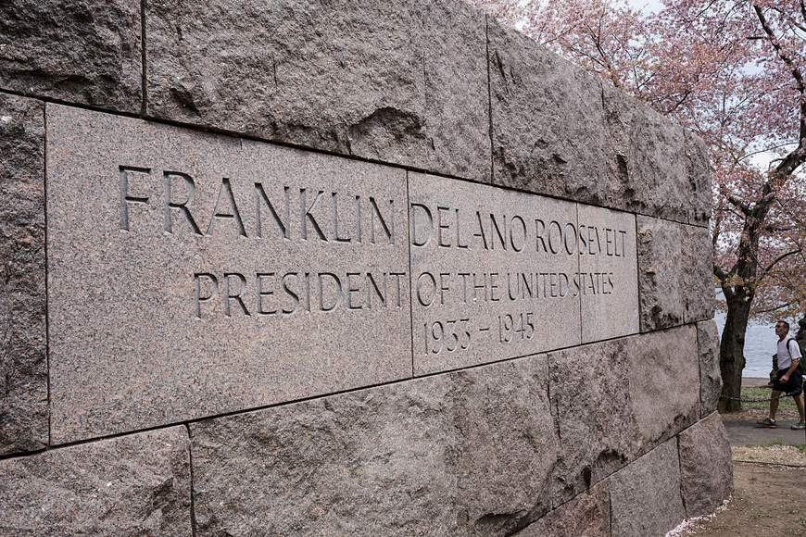

Slide 76
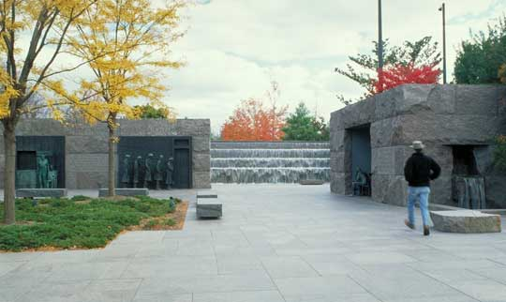

Slide 77
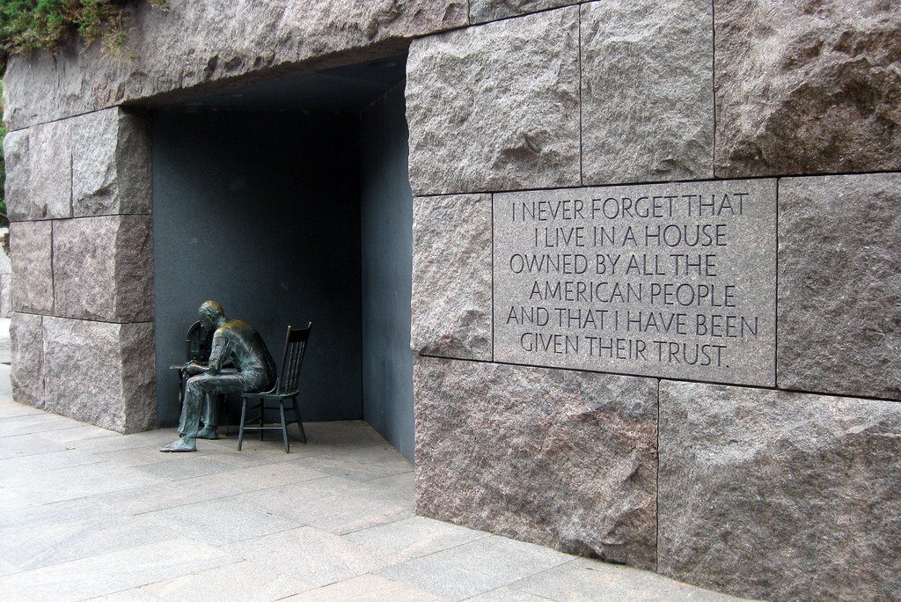

Slide 78
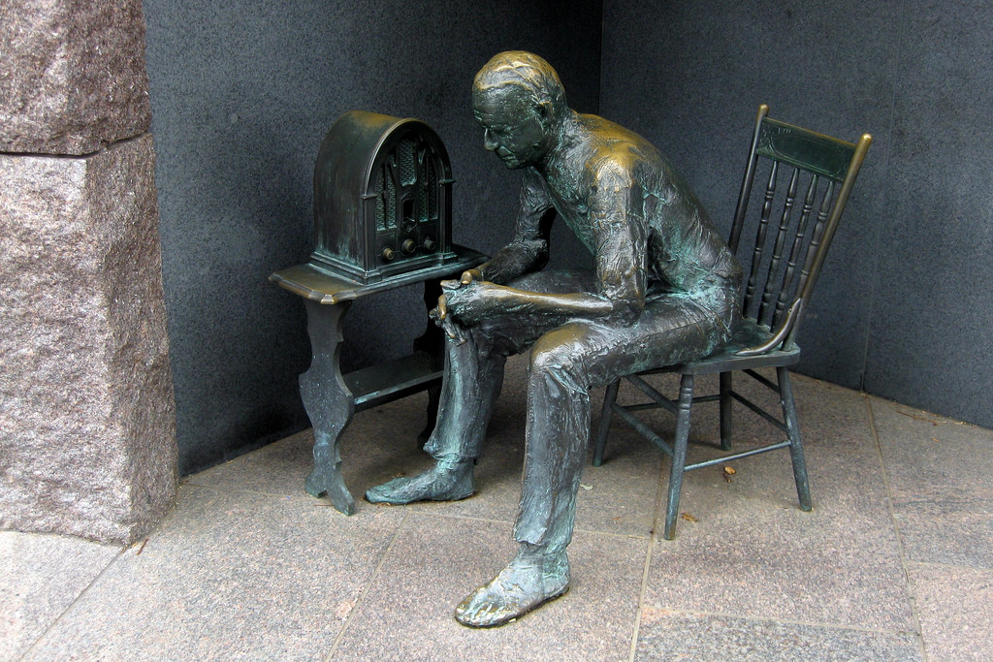
Notes:
1909 Marconi won the Nobel prize in physics for the wireless telegraph

Slide 79
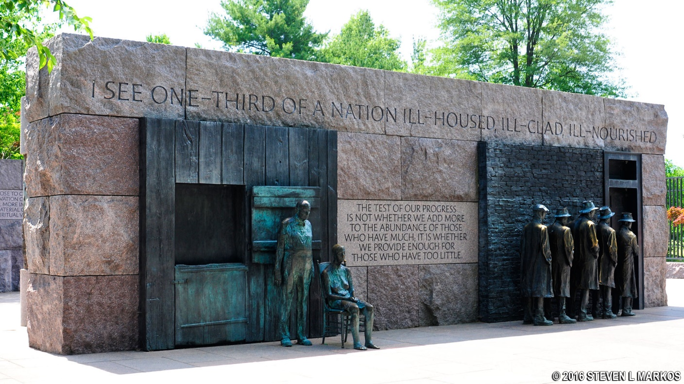

Slide 80
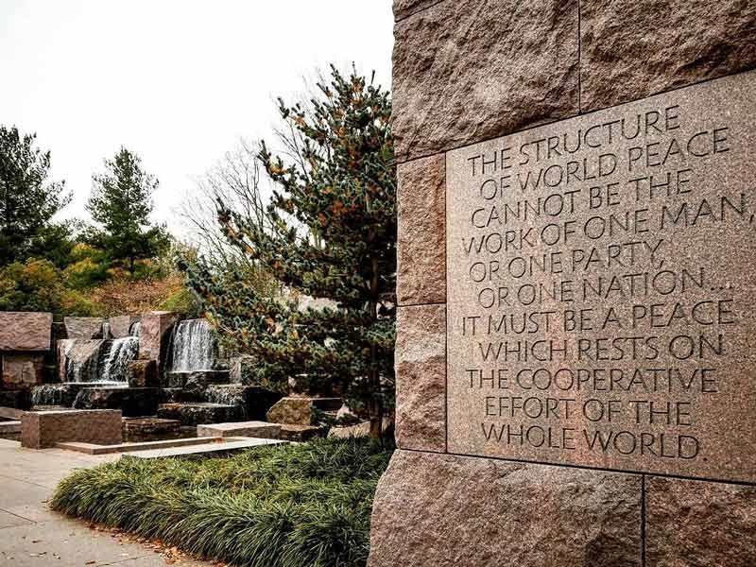

Slide 82
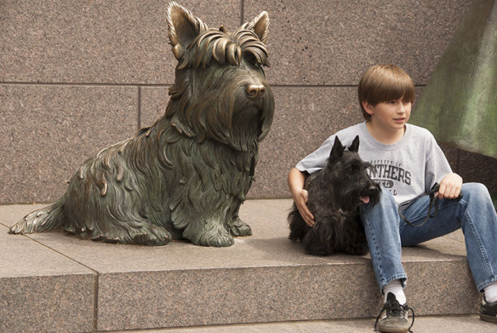

Slide 83
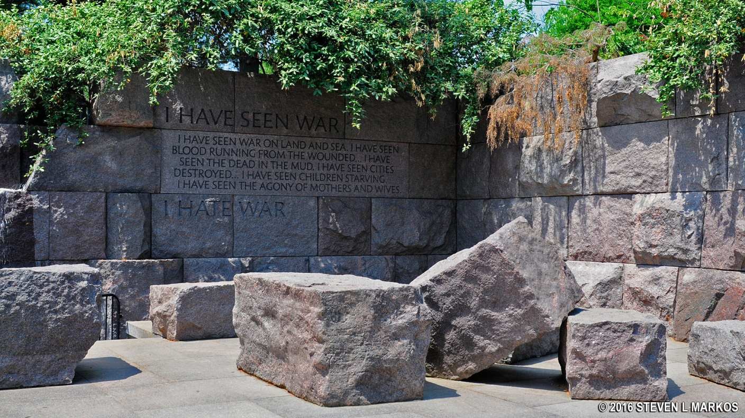

Slide 84
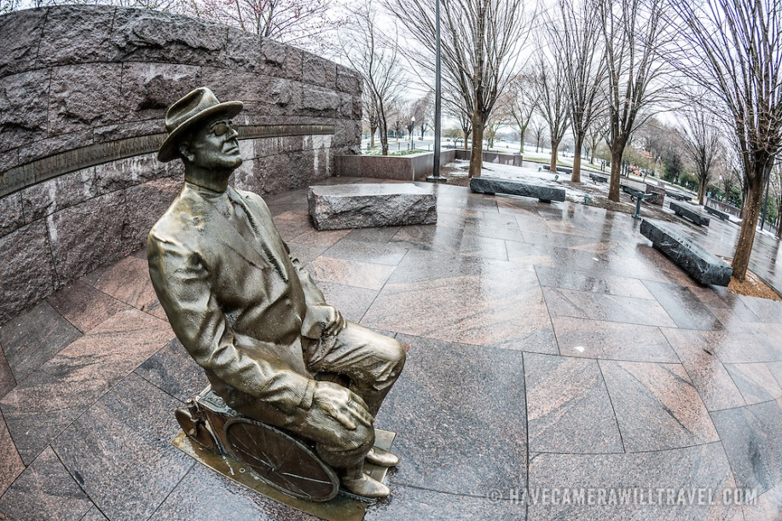

Slide 85
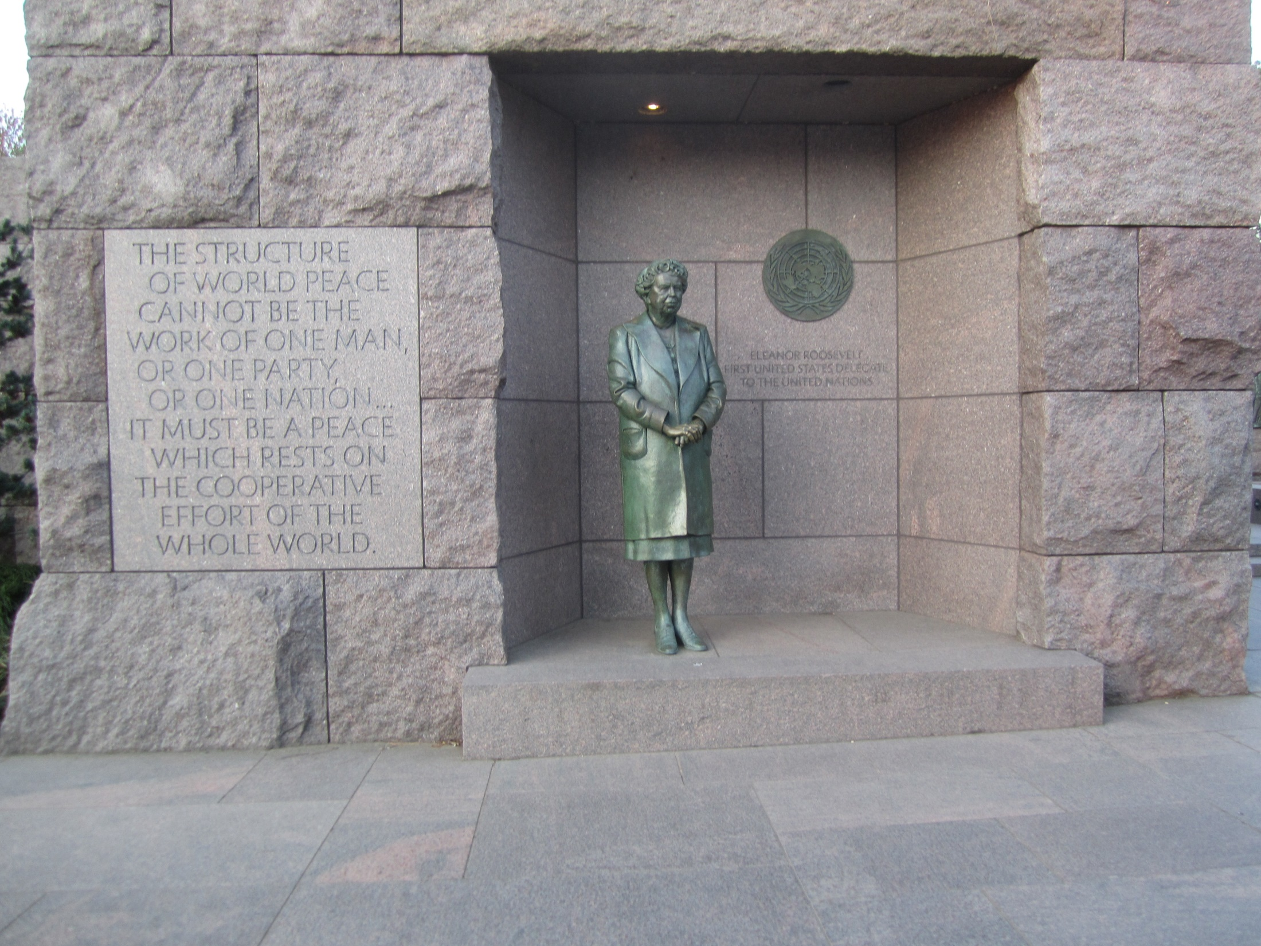

Slide 86
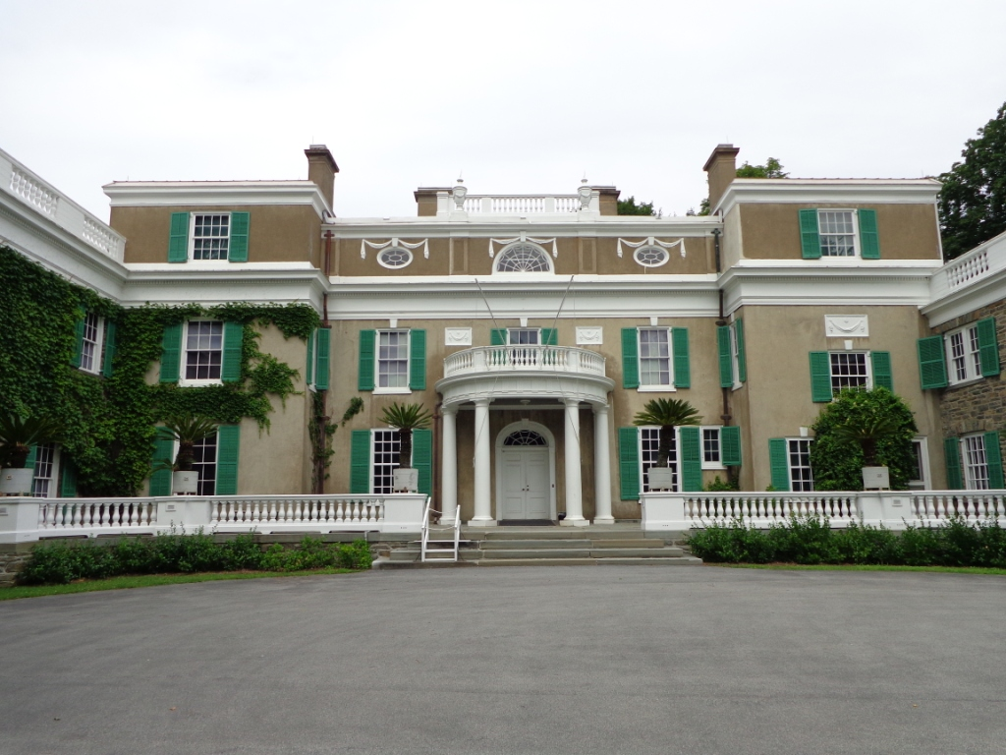
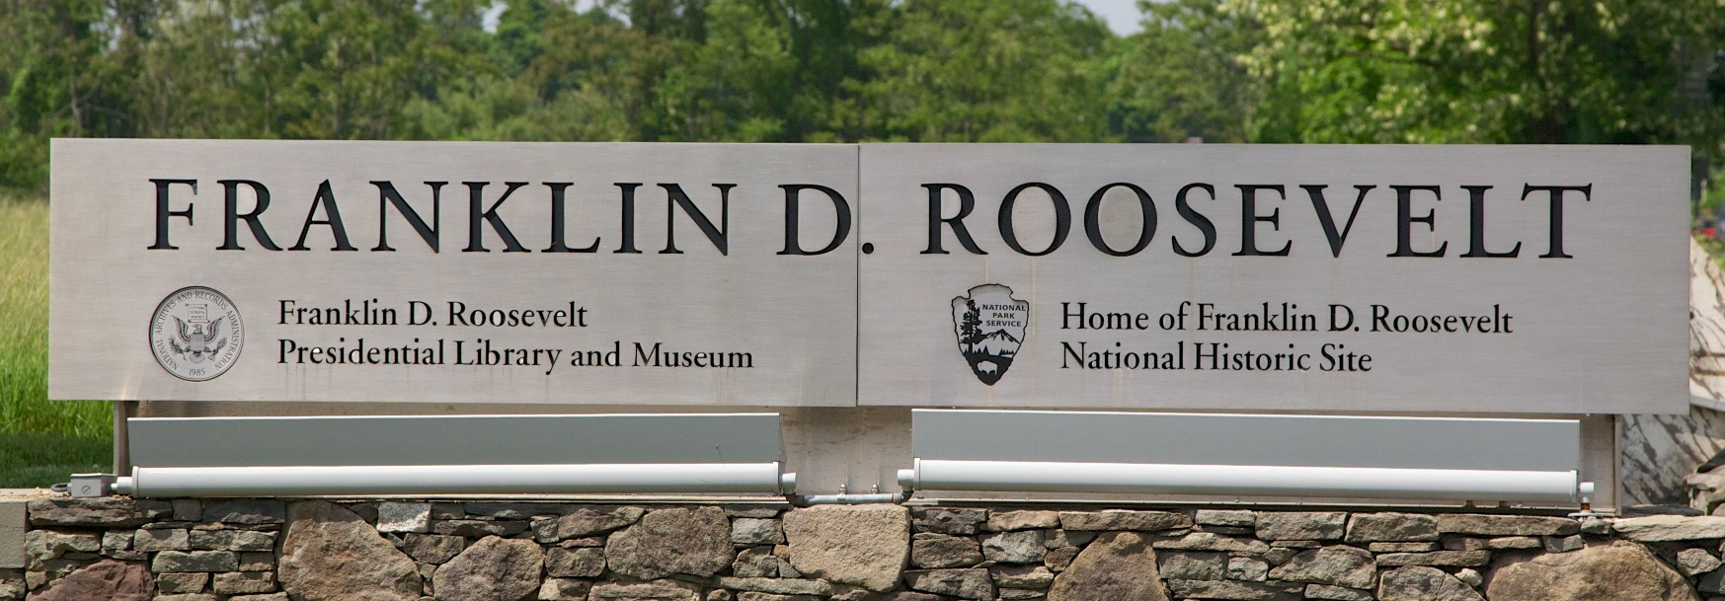

Slide 87
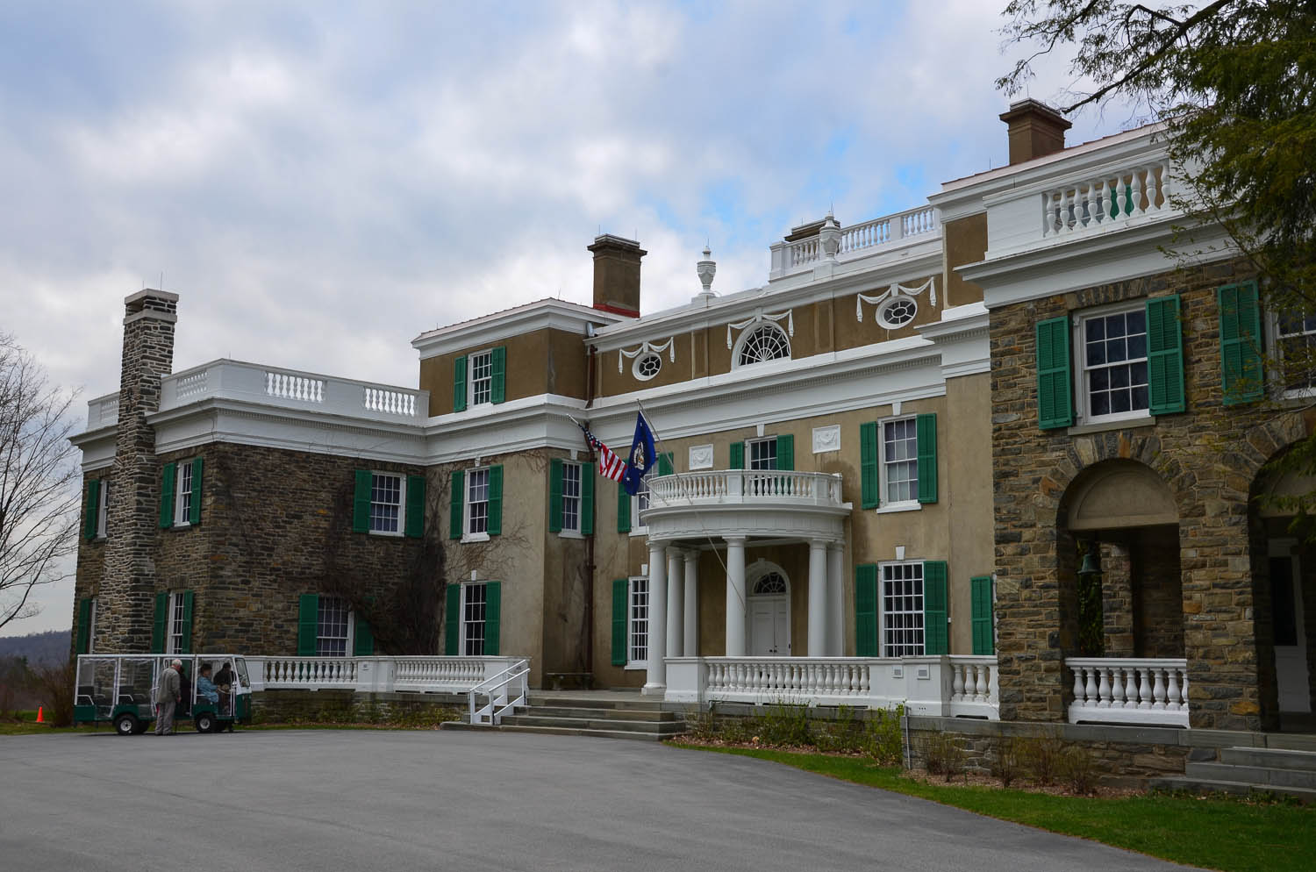

Slide 88
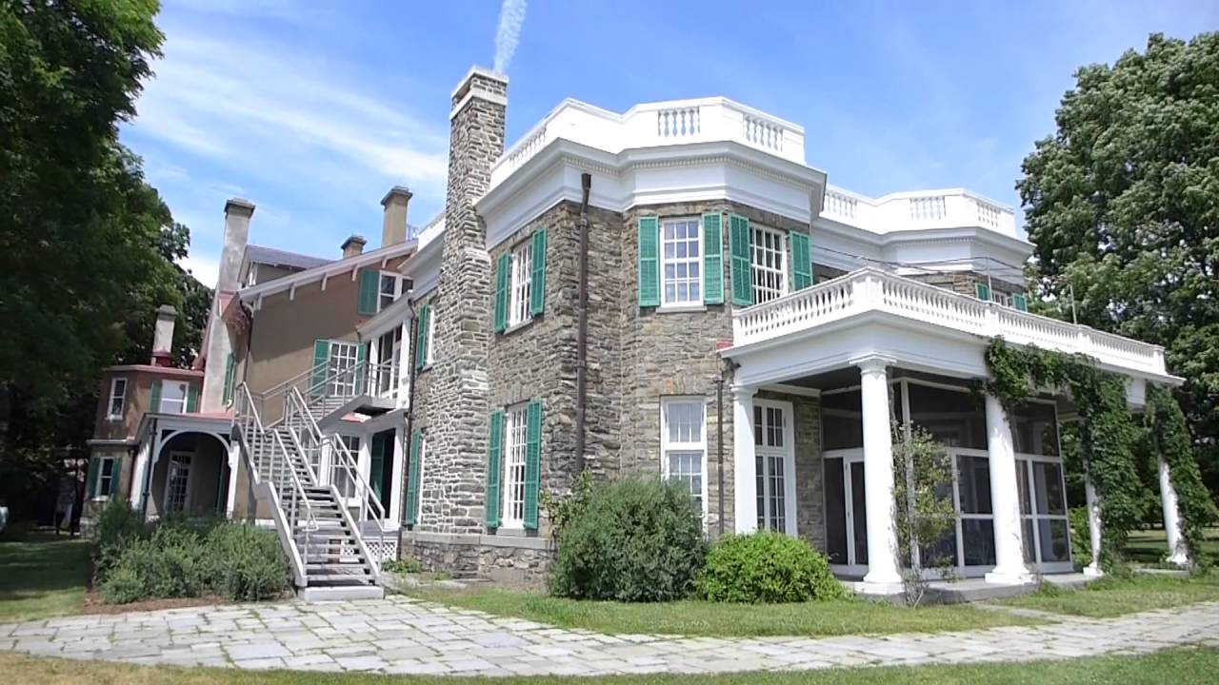

Slide 89
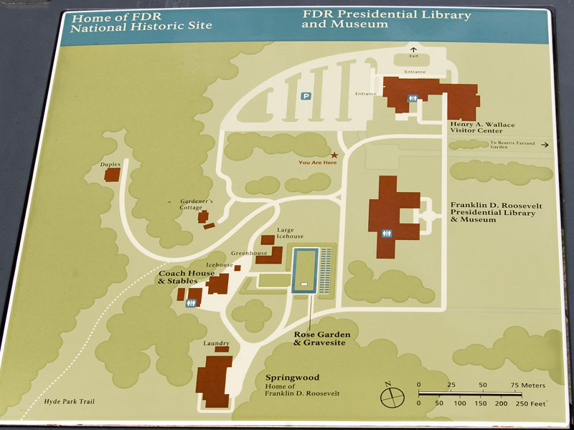
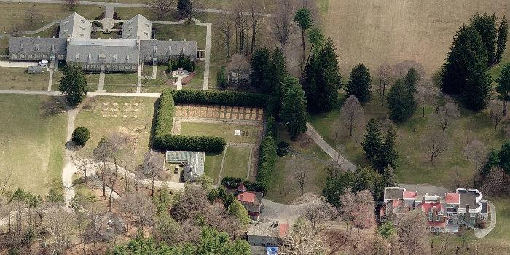

Slide 90
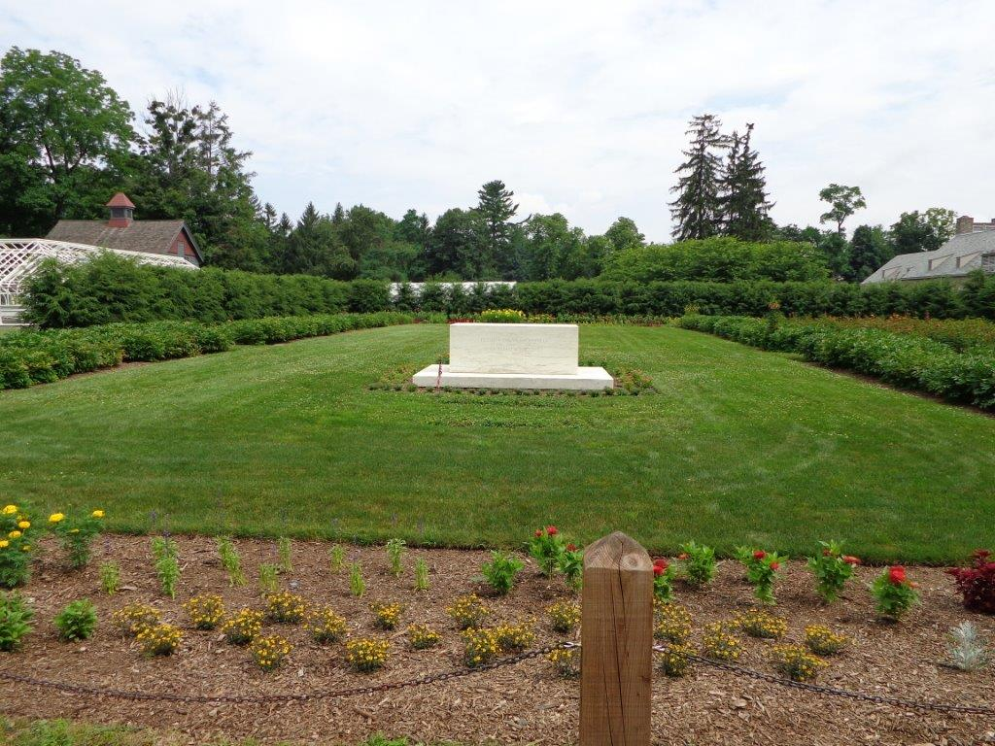
Notes:
Franklin D. Roosevelt's gravesite and burial location at his Springwood estate in Hyde Park, New York

Slide 91
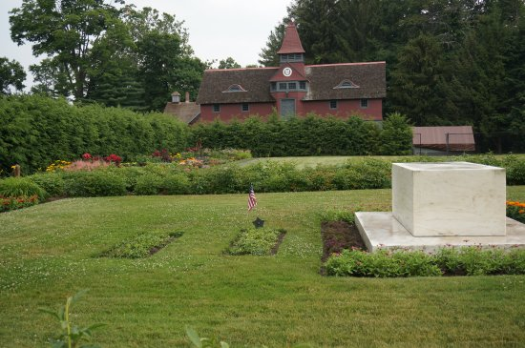

Slide 92
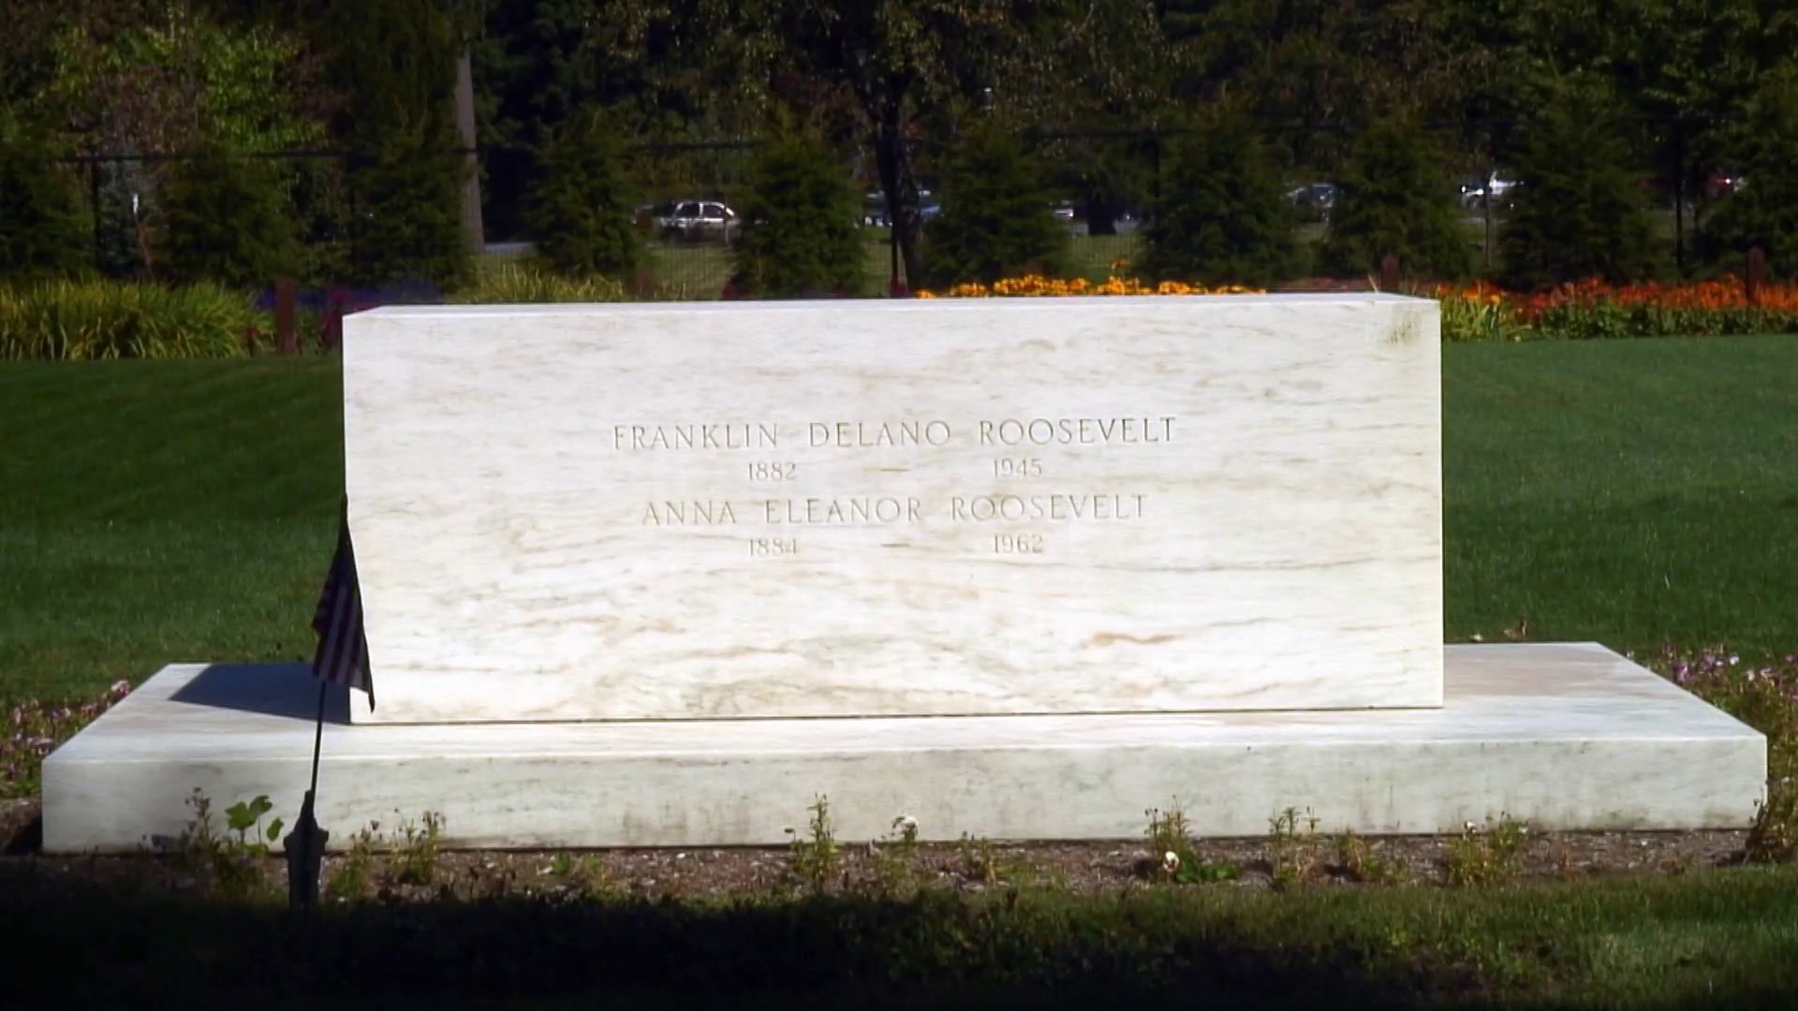

Slide 93
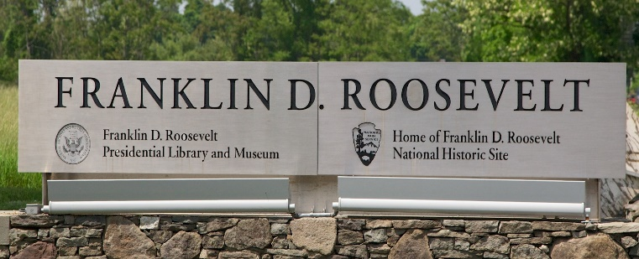
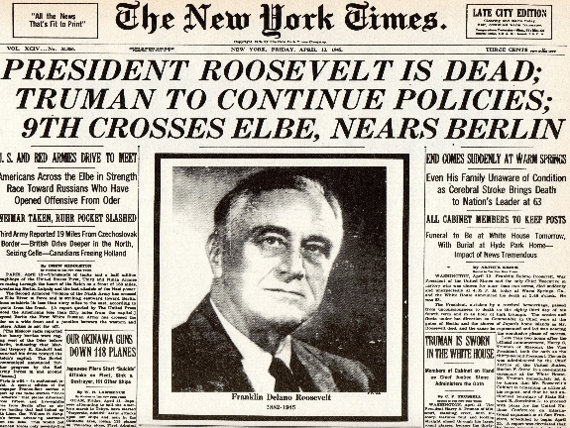
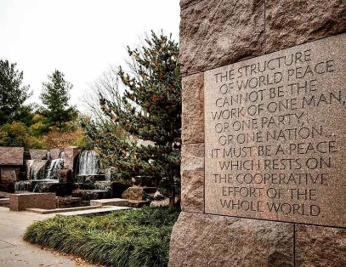
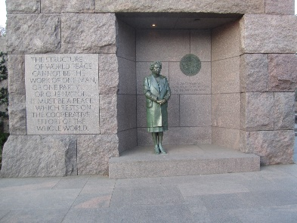
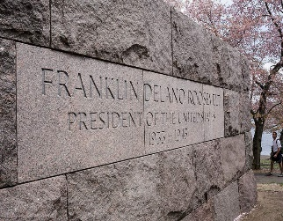
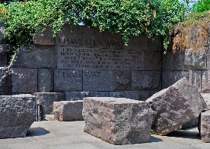
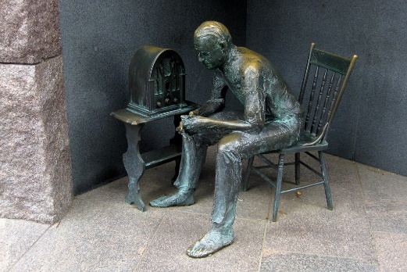
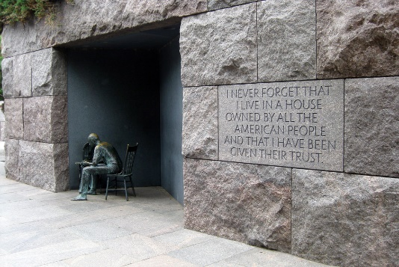
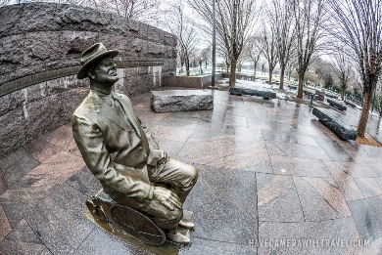
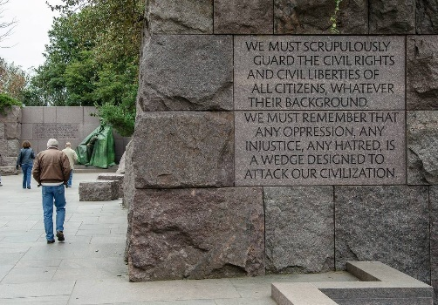
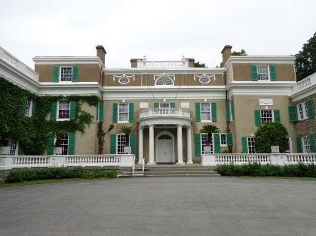

Slide 94
→ Without education no free nation can survive
→ Basic to freedom is individual speech & expression,
free to choose worship, and free of want and fear
→ Hope has always established a brighter horizon
→ Love and understanding is key to any success
→ Truth is found only when freedom’s door is open
→ Indifference is the thick cold ice of frozen empathy
→ Joining together involves helping all to climb
→ Unemployment is the greatest threat to morality
→ Self-interest plagues affection in the vacuum of hate
→ Prisoners of fate in the world lack freedom of mind
→ Thrill of living stands upon individual creative effort
→ Only by fruits of labor is true joy achieved
Troubled times arrive yet faith’s anchor moors upon eternity
Notes:
Troubled times arrive yet faith’s anchor moors upon eternity

Slide 96
Please visit http://www.LoveFromGod.com to explore further
Ronald Bert Channel on
Notes:
Eternity never ends.

