Slide 2
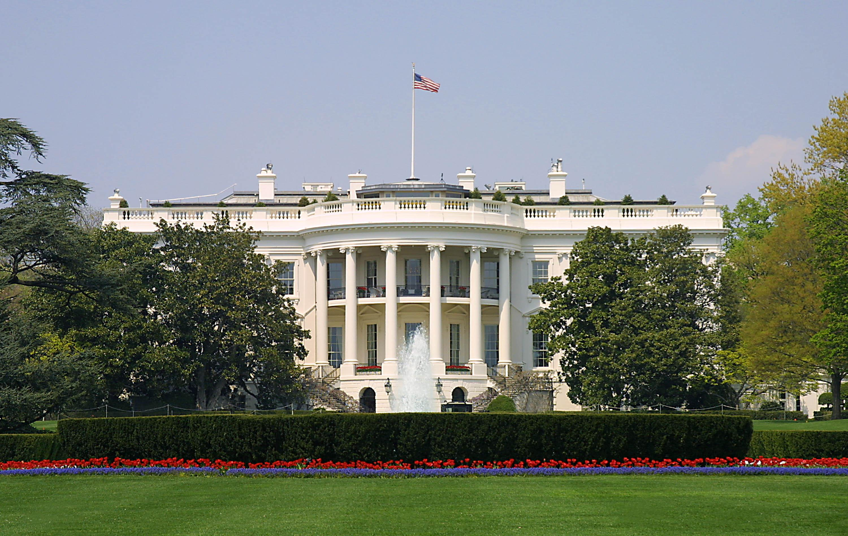

Presidential Quotes
Ron Bert
2
January 28, 2018

Slide 3
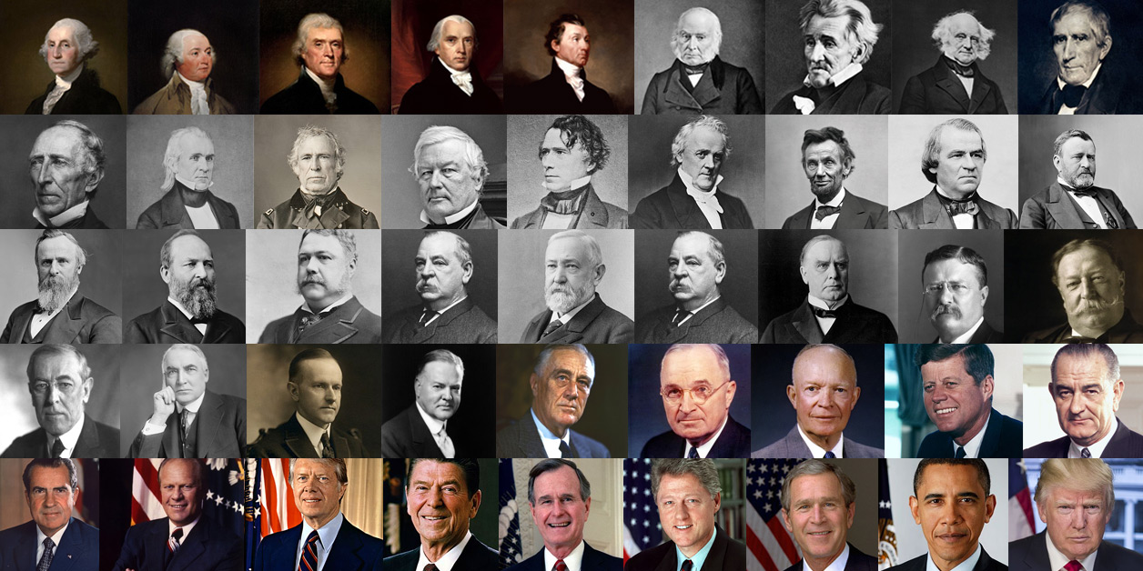

Slide 4
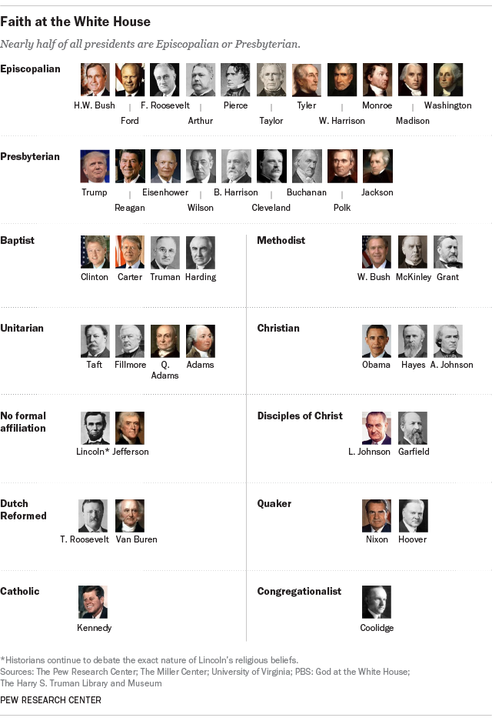
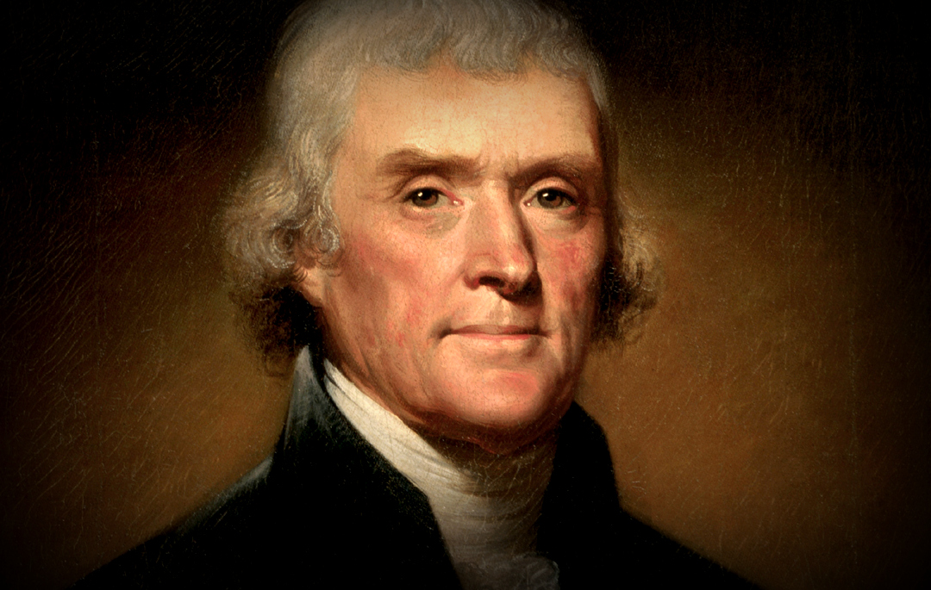
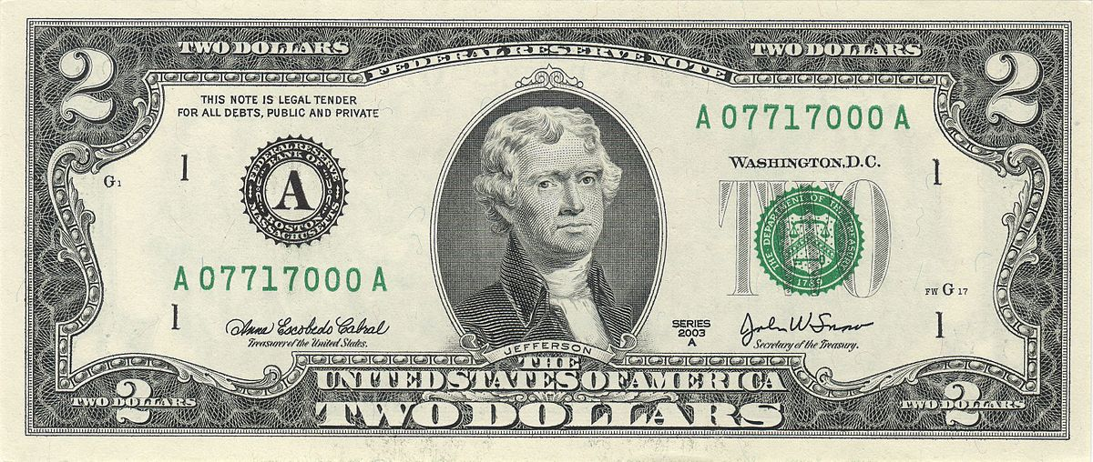
3. Thomas Jefferson (1801-1809)

Slide 5
“The God who gave us life, gave us liberty at the same time. And can the liberties of a nation be thought secure when we have removed their only firm basis, a conviction in the minds of a people that these liberties are of the Gift of God? Indeed I tremble for my country when I reflect that God is just, that His justice cannot sleep forever.”
removed
belief
Freedom
Gift of God
I tremble for my country

Slide 6
“When the government fears the people, there is liberty. When the people fear the government, there is tyranny.”

Slide 7
“That government is best which governs the least, because its people discipline themselves.”
people discipline themselves

Slide 8
“Because religious belief, or non-belief, is such an important part of every person’s life, freedom of religion affects every individual. Religious institutions that use government power in support of themselves and force their views on persons of other faiths, or of no faith, undermine all our civil rights. Moreover, state support of an established religion tends to make the clergy unresponsive to their own people, and leads to corruption within religion itself. Erecting the “wall of separation between church and state,” therefore, is absolutely essential in a free society.”
wall of separation between
church and state

Slide 9
“Believing with you that religion is a matter which lies solely between man and his God, that he owes account to none other for his faith or his worship, that the legislative powers of government reach actions only, and not opinions, I contemplate with sovereign reverence that act of the whole American people which declared that their legislature should "make no law respecting an establishment of religion, or prohibiting the free exercise thereof," thus building a wall of separation between Church and State.”
between man and his God
he owes account
for his
faith or his worship

Slide 10
“I am for freedom of religion, & against all maneuvers to bring about a legal ascendancy of one sect over another.”

Slide 11
“Christianity neither is, nor ever was, a part of the common law.”

Slide 12
“The clergy converted the simple teachings of Jesus into an engine for enslaving mankind and adulterated by artificial constructions into a contrivance to filch wealth and power themselves … these clergy, in fact, constitute the real Anti-Christ.”
clergy converted the simple
teachings of Jesus
into
an engine
into:
● an engine for enslaving mankind
● adulterated/artificial constructions
● a contrivance to filch wealth/power
clergy = the real Anti-Christ
for enslaving mankind
adulterated
artificial
constructions
a contrivance
to filch wealth
power
clergy
the real Anti-Christ

Slide 13
"...those who live by mystery & charlatanerie, fearing you would render them useless by simplifying the Christian philosophy, the most sublime & benevolent, but most perverted system that ever shone on man, endeavored to crush your well earnt, & well deserved fame."
schemers
But I fear, lest somehow, as the serpent deceived Eve by his craftiness, so your minds may be corrupted from the simplicity that is in Christ. — 2nd Corinthians 11:3
honest believers

Slide 14
“Fix reason firmly in her seat, and call to her tribunal every fact, every opinion. Question with boldness even the existence of a god; because, if there be one, he must more approve the homage of reason, than that of blindfolded fear."
Do not quench the Spirit.
Do not despise prophecies. Test all things; hold fast what is good. Abstain from every form of evil. — 1st Thessalonians 5:19-22
Respect for Truth
Understanding through knowledge
intellectual maturity
Fanatical anxiety
Notes:
Without intellectual maturity, within the common knowledge of God, enabling wisdom to flourish, society reduces to a chasm of swelling paranoias.

Slide 15
“Sir, no nation has ever yet existed or been governed without religion. Nor can be. The Christian religion is the best religion that has been given to man, and I as chief magistrate of this nation am bound to give it the sanction of my example.”
The Christian
religion is the best religion

Slide 16
“Honesty is the first chapter in the book of wisdom.”

Slide 17
“It is in our lives and not our words that our religion must be read.”
“Tranquility is the old man's milk.”
Tranquility
Be anxious for nothing, but in everything by prayer and supplication, with thanksgiving, let your requests be made known to God; and the peace of God, which surpasses all understanding, will guard your hearts and minds through Christ Jesus. — Philippians 4:6-7
The silver-haired head is a crown of glory, If it is found in the way of righteousness. — Proverbs 16:31
The silver-haired head is a crown of glory, If it is found in the way of righteousness. — Proverbs 16:31
The silver-haired head is a crown of glory, If it is found in the way of righteousness. — Proverbs 16:31
in
If
found in
relationship
spiritual blessings

Slide 18
"If a nation expects to be ignorant and free in a state of civilization, it expects what never was and never will be. If we are to guard against ignorance and remain free, it is the responsibility of every American to be informed."
responsibility
to be informed

Slide 19
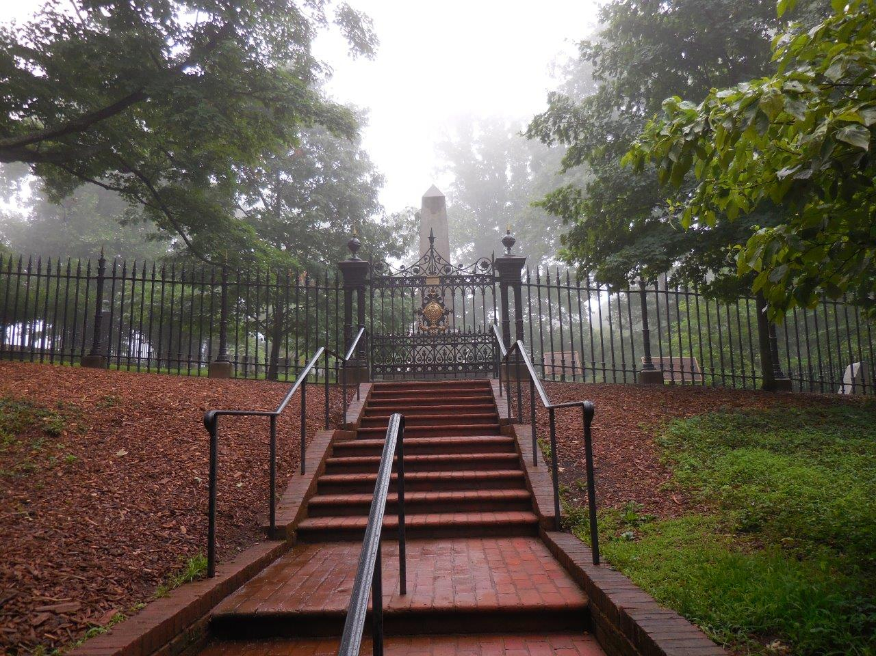

Slide 20
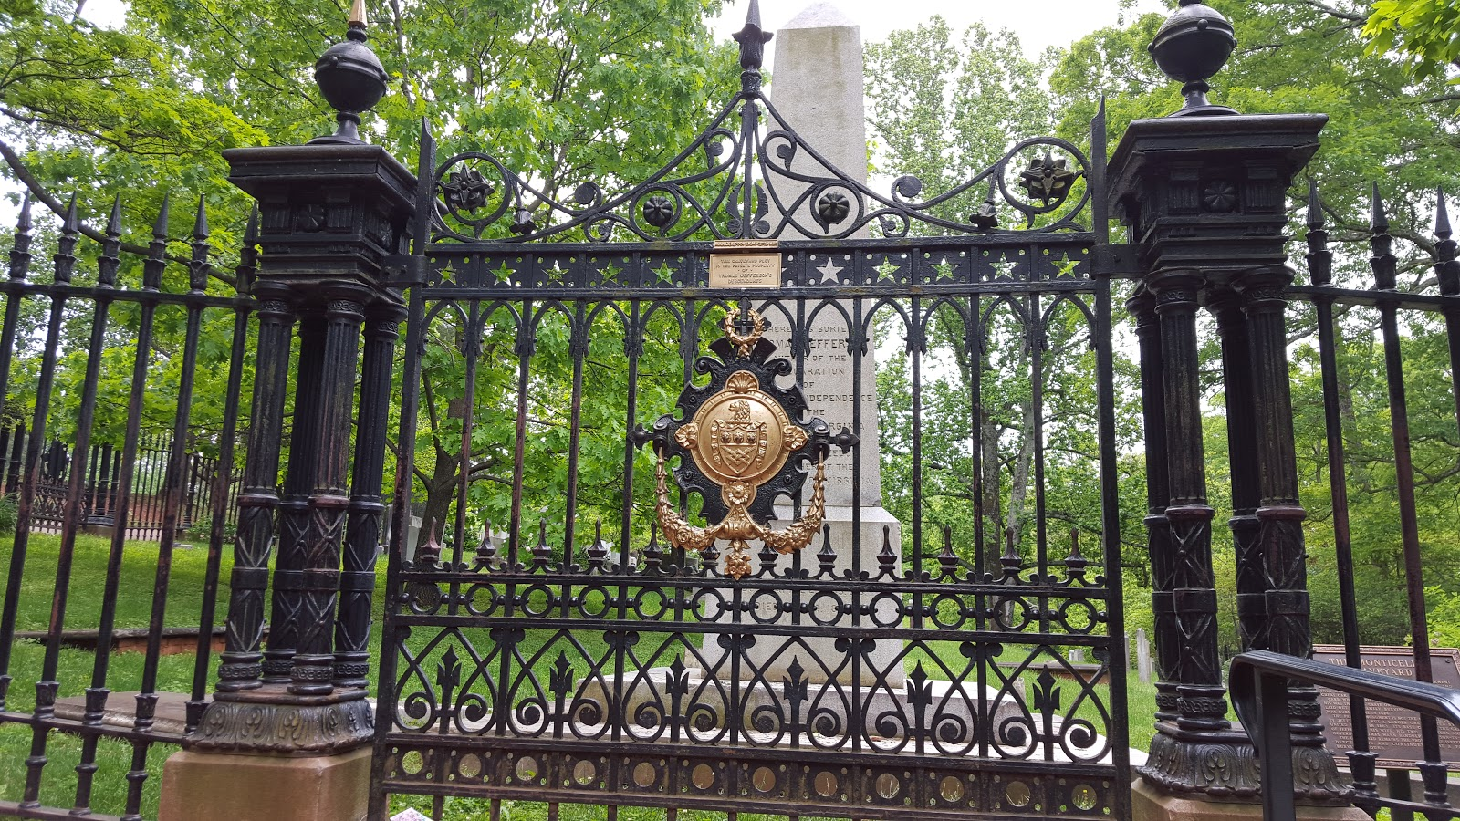
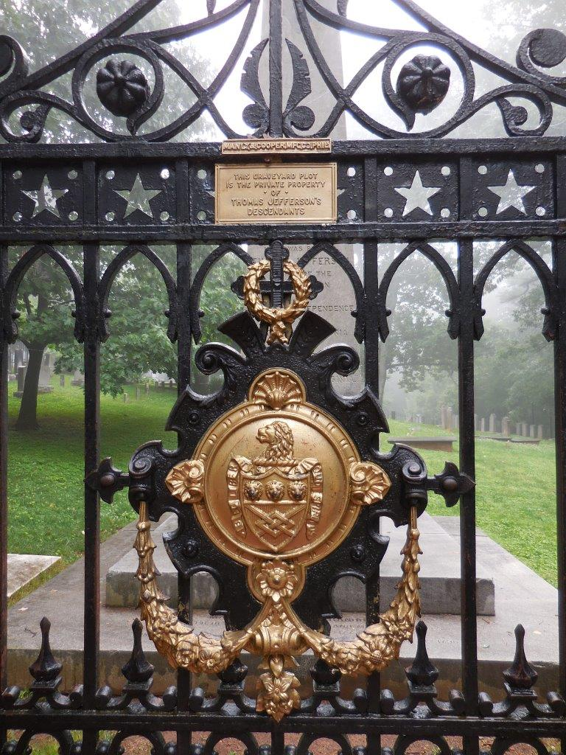

Slide 21
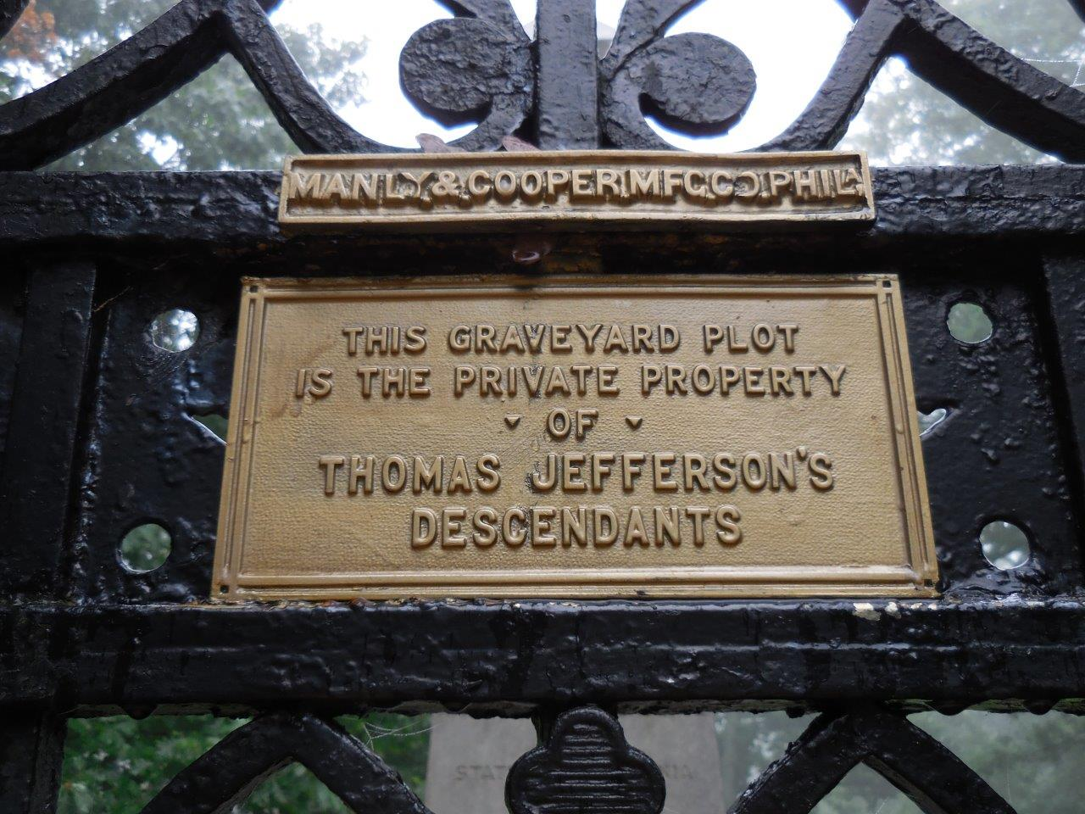

Slide 22
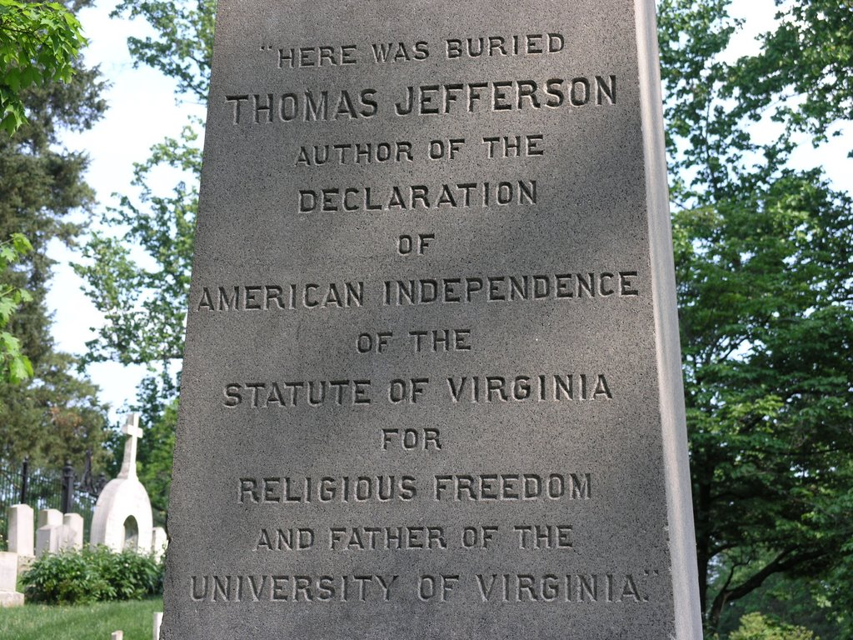

Slide 23


Slide 24
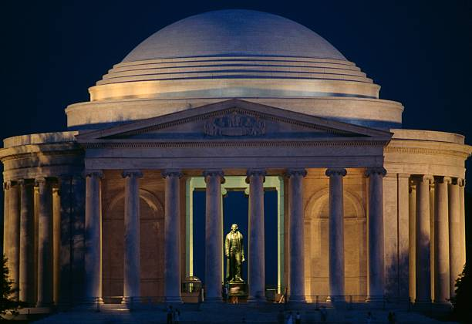

Slide 25
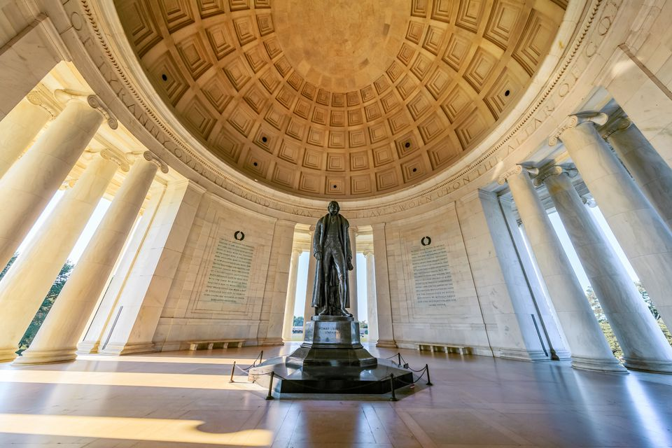
When the righteous are in authority, the people rejoice; But when a wicked man rules, the people groan. — Proverbs 29:2
Notes:
Tall men are often envied by men of shorter stature.

Slide 26
Behold, a king will reign in righteousness, And princes will rule with justice. A man will be as a hiding place from the wind, And a cover from the tempest, As rivers of water in a dry place, As the shadow of a great rock in a weary land. The eyes of those who see will not be dim, And the ears of those who hear will listen. Also the heart of the rash will understand knowledge, And the tongue of the stammerers will be ready to speak plainly. — Isaiah 32:1-4
a king will reign in righteousness
h
And princes will rule with justice
L
r
i
a
s
d
e
Leadership
e
p
Notes:
Surely, spiritual nobility touches even the least of all faithful bringing wisdoms’ clarity of thought.

Slide 27
To know wisdom and instruction, To perceive the words of understanding, To receive the instruction of wisdom, Justice, judgment, and equity; To give prudence to the simple, To the young man knowledge and discretion - A wise man will hear and increase learning, And a man of understanding will attain wise counsel, To understand a proverb and an enigma, The words of the wise and their riddles. The fear of the LORD is the beginning of knowledge, But fools despise wisdom and instruction. My son, hear the instruction of your father, And do not forsake the law of your mother; — Proverbs 1:2-8
hear
Notes:
Leadership is a responsibility to hold respect for all.

Slide 28
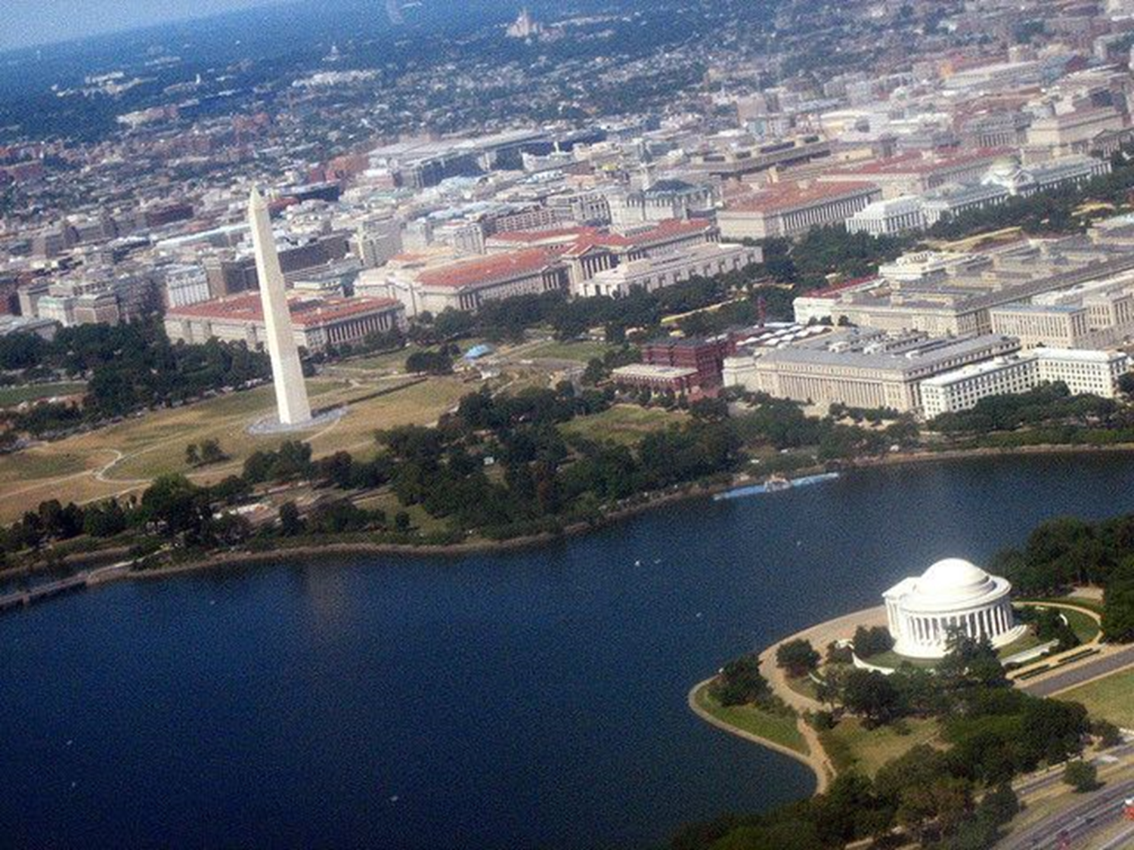
Show us Your mercy, LORD, And grant us Your salvation. I will hear what God the LORD will speak, For He will speak peace To His people and to His saints; But let them not turn back to folly. Surely His salvation is near to those who fear Him, That glory may dwell in our land. — Psalms 85:7-9
hear
Notes:
The Glory of a people is found in their respect for God. Working together for the better brings the fruit of our children’s blessings. Arrogance destroys al that is civil.

Slide 29
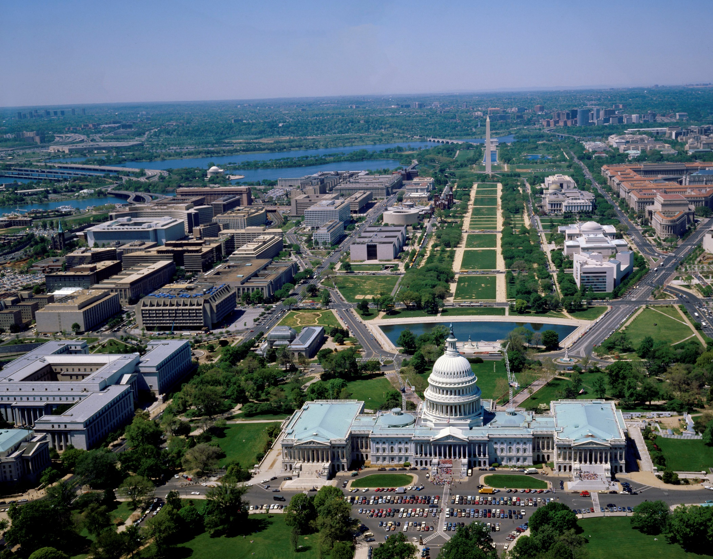
Remember those who rule over you, who have spoken the word of God to you, whose faith follow, considering the outcome of their conduct. — Hebrews 13:7
Notes:
Ignorance is an infection of the immoral where deception is desired over enlightenment. Society is best served when citizens are courageous enough to be watchful rather than complacent.

Slide 30
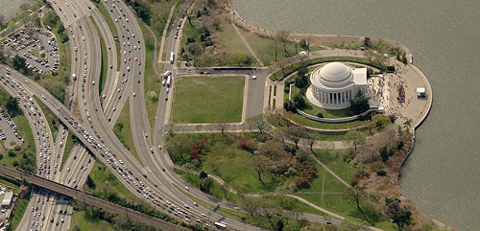
For men will be lovers of themselves, lovers of money, boasters, proud, blasphemers, disobedient to parents, unthankful, unholy, unloving, unforgiving, slanderers, without self-control, brutal, despisers of good, traitors, headstrong, haughty, lovers of pleasure rather than lovers of God, having a form of godliness but denying its power. And from such people turn away! — 2nd Timothy 3:2-5
Why do You stand afar off, O LORD? Why do You hide in times of trouble? The wicked in his pride persecutes the poor; Let them be caught in the plots which they have devised. For the wicked boasts of his heart's desire; He blesses the greedy and renounces the LORD. The wicked in his proud countenance does not seek God; God is in none of his thoughts. — Psalms 10:1-4
Notes:
God watches as man chooses more folly in his escape from a life of reverent homage to Him.

Slide 31
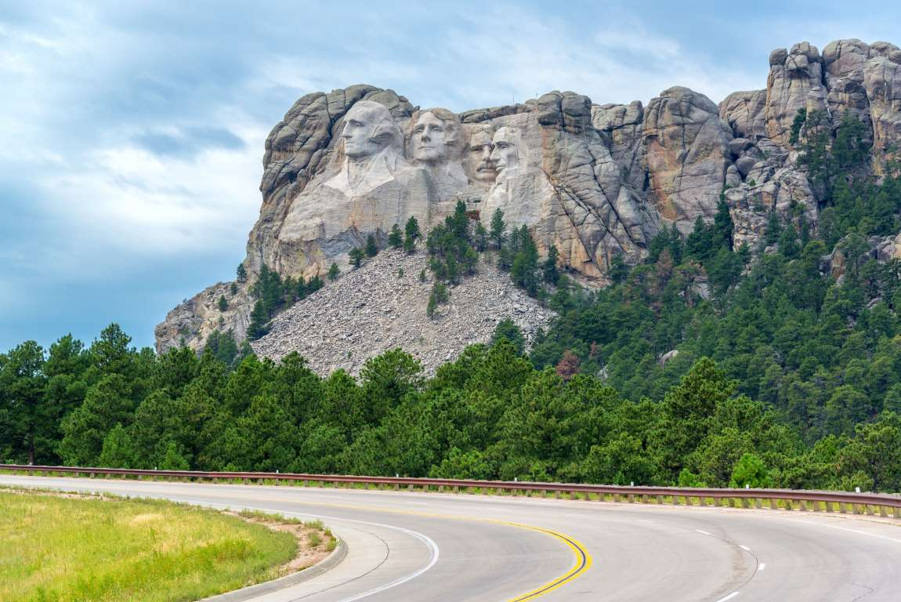
Praise the LORD! Praise God in His sanctuary; Praise Him in His mighty firmament! Praise Him for His mighty acts; Praise Him according to His excellent greatness! Praise Him with the sound of the trumpet; Praise Him with the lute and harp! Praise Him with the timbrel and dance; Praise Him with stringed instruments and flutes! Praise Him with loud cymbals; Praise Him with clashing cymbals! Let everything that has breath praise the LORD. Praise the LORD! — Psalms 150:1-6
Notes:
Praising the Lord acknowledges the Lord.

Slide 32

→ All liberties are of the Gift of God
→ When the people fear government, there is tyranny
→ Best governing least / people discipline themselves
→ Civil rights involve freedom of religious choice
→ Religion is a matter between man and his God
→ No one religion should rule over another
→ Clergy is used more as deceptive business of thieves
→ False pious leaders favor your belief in lies over truth
→ God expects careful reason over impulsive fear
→ The Christian religion = best religion given to man
→ Wisdom cannot be had without honesty
→ The actions of our lives reflect our religious values
→ Knowledge/key to a soul’s freedom & such, societies
Belief in God is the only sure safe way

Slide 34

Please visit http://www.LoveFromGod.com to explore further
Ronald Bert Channel on
Notes:
Eternity never ends.

