Slide 1
Notes:
Darkness has no praise.

Slide 2



Acquiring the
'Presence of the LORD'
Ron Bert
March 19, 2017
Notes:
When we embrace the Lord we seize life. It is the ability to see through the veil.

Slide 3
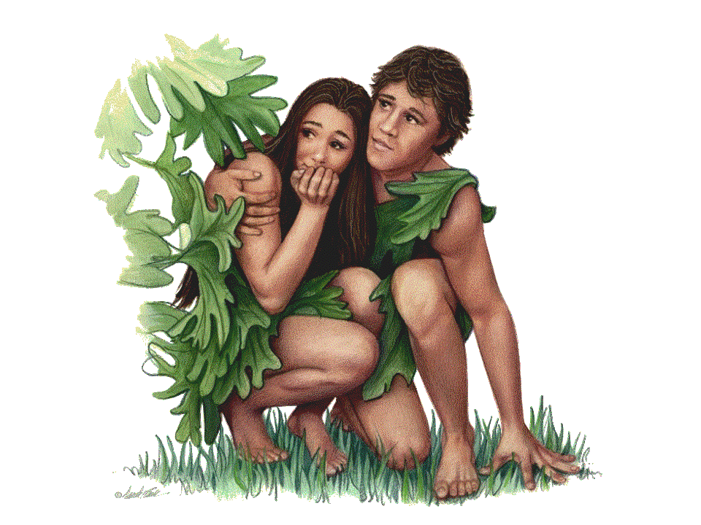
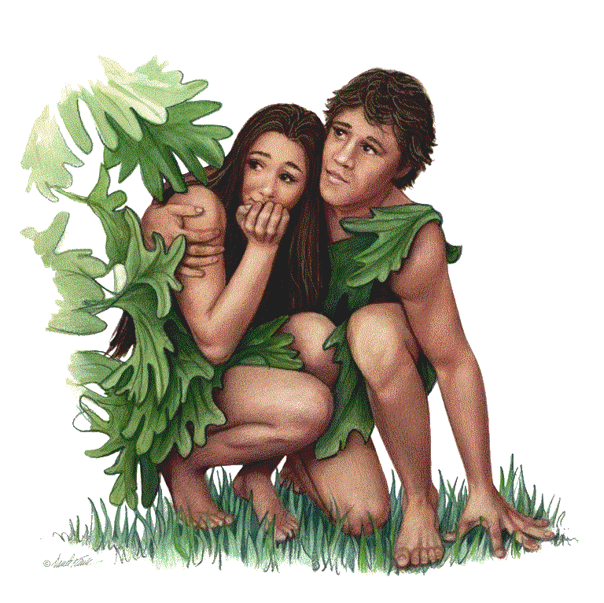
And they heard the sound of the LORD God walking in the garden in the cool of the day, and Adam and his wife hid themselves from the presence of the LORD God among the trees of the garden. — Genesis 3:8
LORD
hid
dishonesty
hid
. .
hideous
. .
LORD
presence of the LORD
Notes:
Some believe God is distant, if existent, and that deeds may be done in secret, foreign from His view.

Slide 4
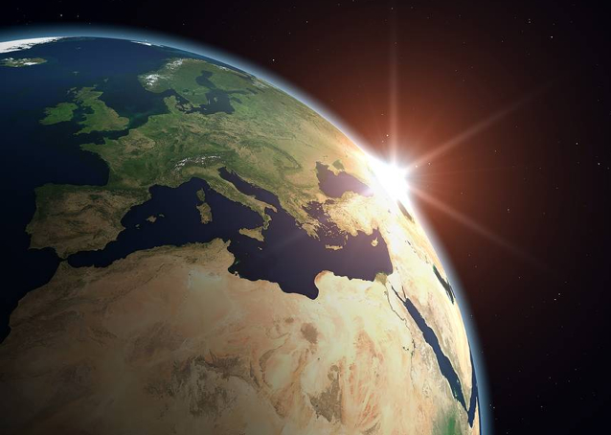
"Can anyone hide himself in secret places, So I shall not see him?" says the LORD; "Do I not fill heaven and earth?" says the LORD. — Jeremiah 23:24
LORD
LORD
Notes:
Contrary to any human doctrine, God perceives all in the presence of His creation.

Slide 5
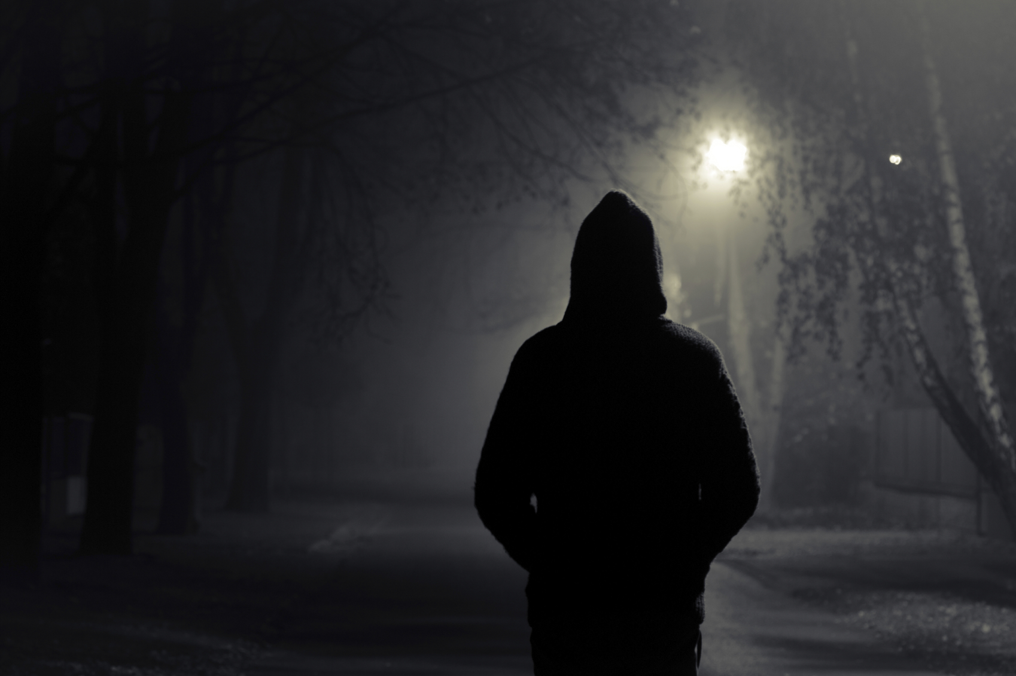
Woe
Woe to those who seek deep to hide their counsel far from the LORD, And their works are in the dark; They say, "Who sees us?" and, "Who knows us?" — Isaiah 29:15
who
hide
from the
Woe who hide from the LORD works in the dark;
"Who sees us?"
"Who knows us?"
LORD
who hide
LORD
who hide
works
in the
dark;
"Who sees us?"
→
"Who knows us?"
→
Notes:
Repeated warnings go forth cautioning not to ignore His vision.

Slide 6
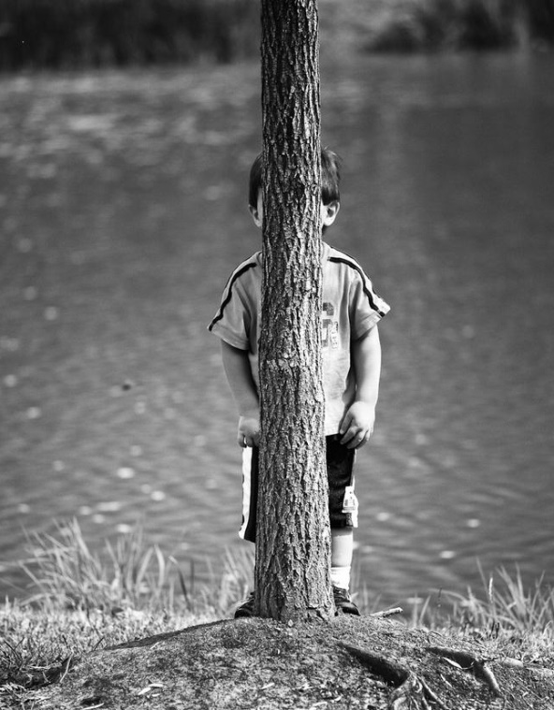
There is no darkness nor shadow of death Where the workers of iniquity may hide themselves. — Job 34:22
re
no
ignore
ig
hide
hide
Notes:
The farthest corners of darkness are not hidden from the sight of God.

Slide 7
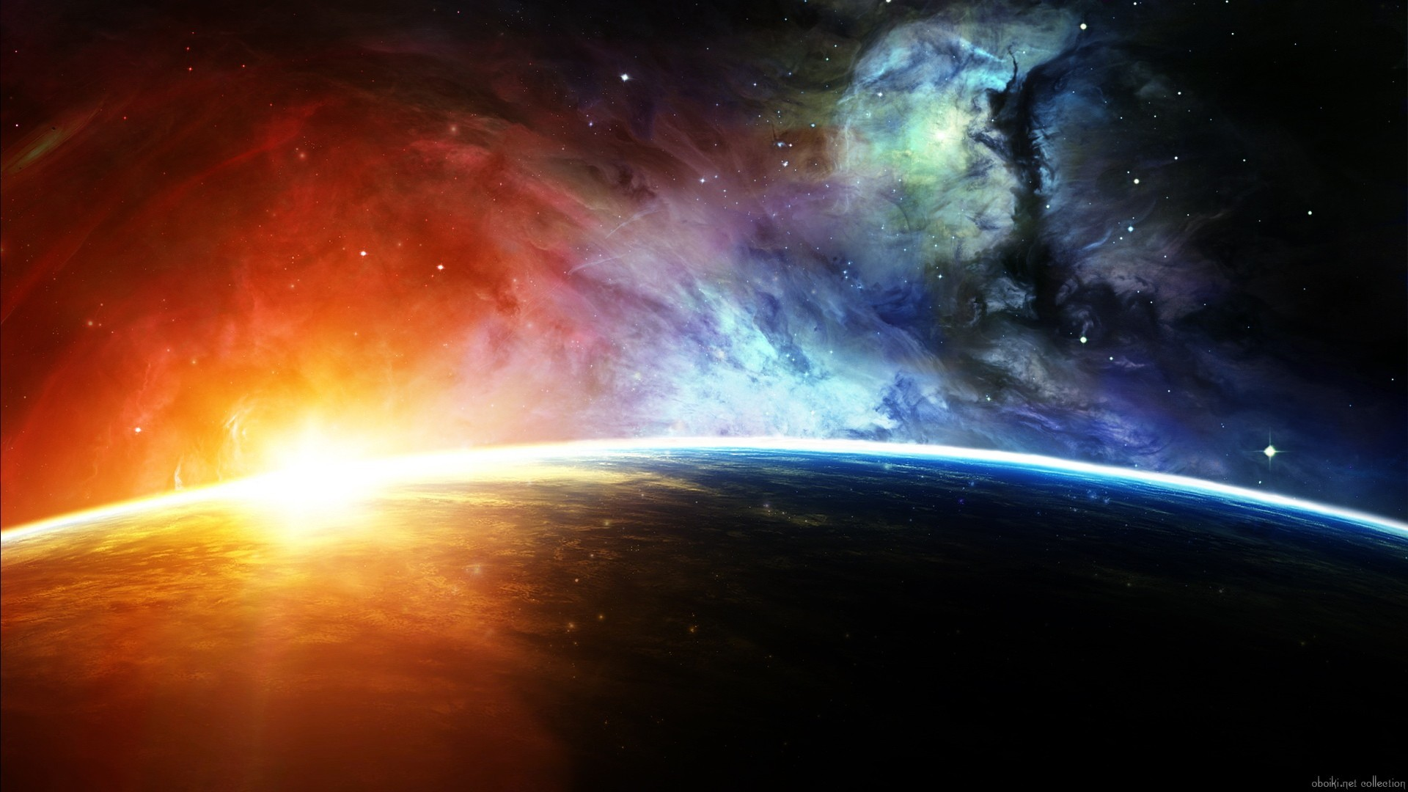
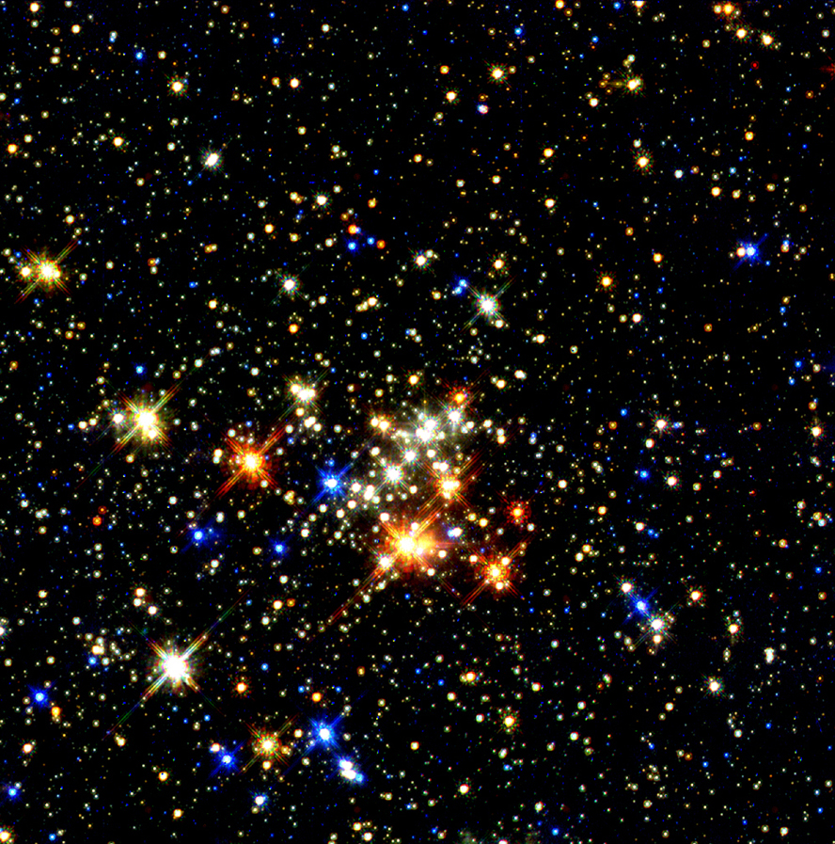

Where can I go from Your Spirit? Or where can I flee from Your presence? If I ascend into heaven, You are there; If I make my bed in hell, behold, You are there. If I take the wings of the morning, And dwell in the uttermost parts of the sea, Even there Your hand shall lead me, And Your right hand shall hold me. — Psalms 139:7-10
Spirit
Spirit
presence
presence
Space
lead
lead
hold
hold
Time
Notes:
For those seeking to escape Him there is no refuge. It is God that leads all of us as He waits holding time in space.

Slide 8
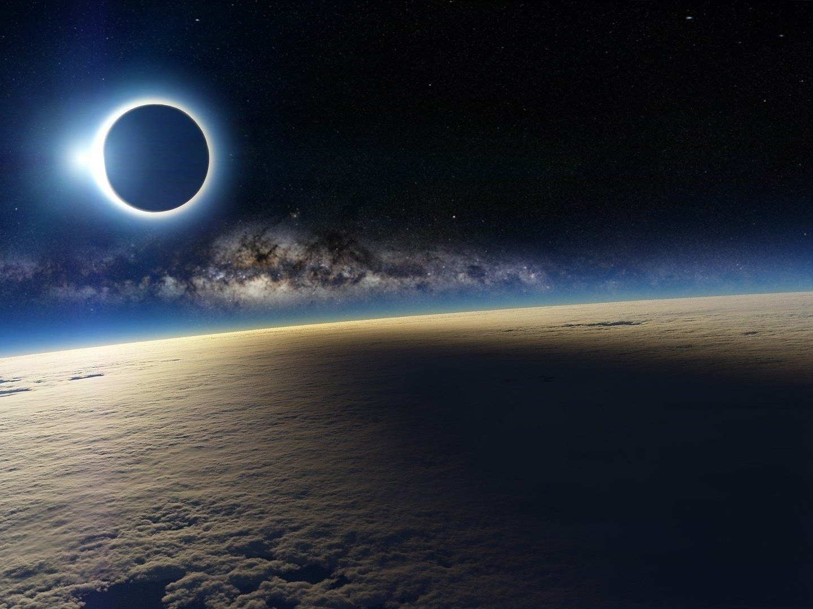
If I say, "Surely the darkness shall fall on me," Even the night shall be light about me; Indeed, the darkness shall not hide from You, But the night shines as the day; The darkness and the light are both alike to You. — Psalms 139:11-12
evil
darkness
ignorance
faith
knowledge
. .
darkness
darkness shall not hide from You
darkness
Notes:
In the timelessness of God, He waits for what He has openly given in light to freely return to Him. The faith of a true believer turns the darkest of all situations into the light He commands, for one’s inner brilliance is to shine in the midst of affliction. No matter how dark it gets, His light shines forth. Belief in God is a shield of light. God sees all with no place hidden beyond His view. Earth is His womb unto eternity where He patiently watches.

Slide 9
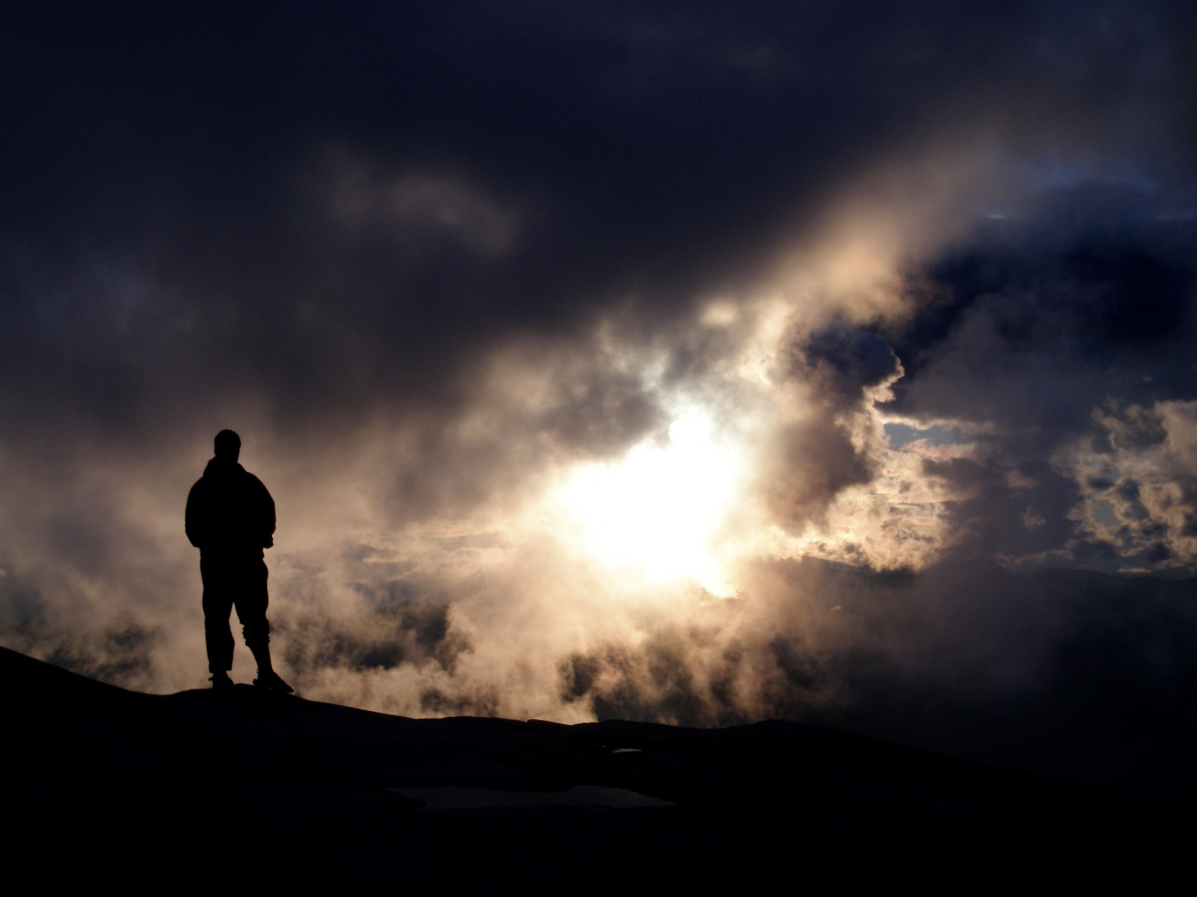
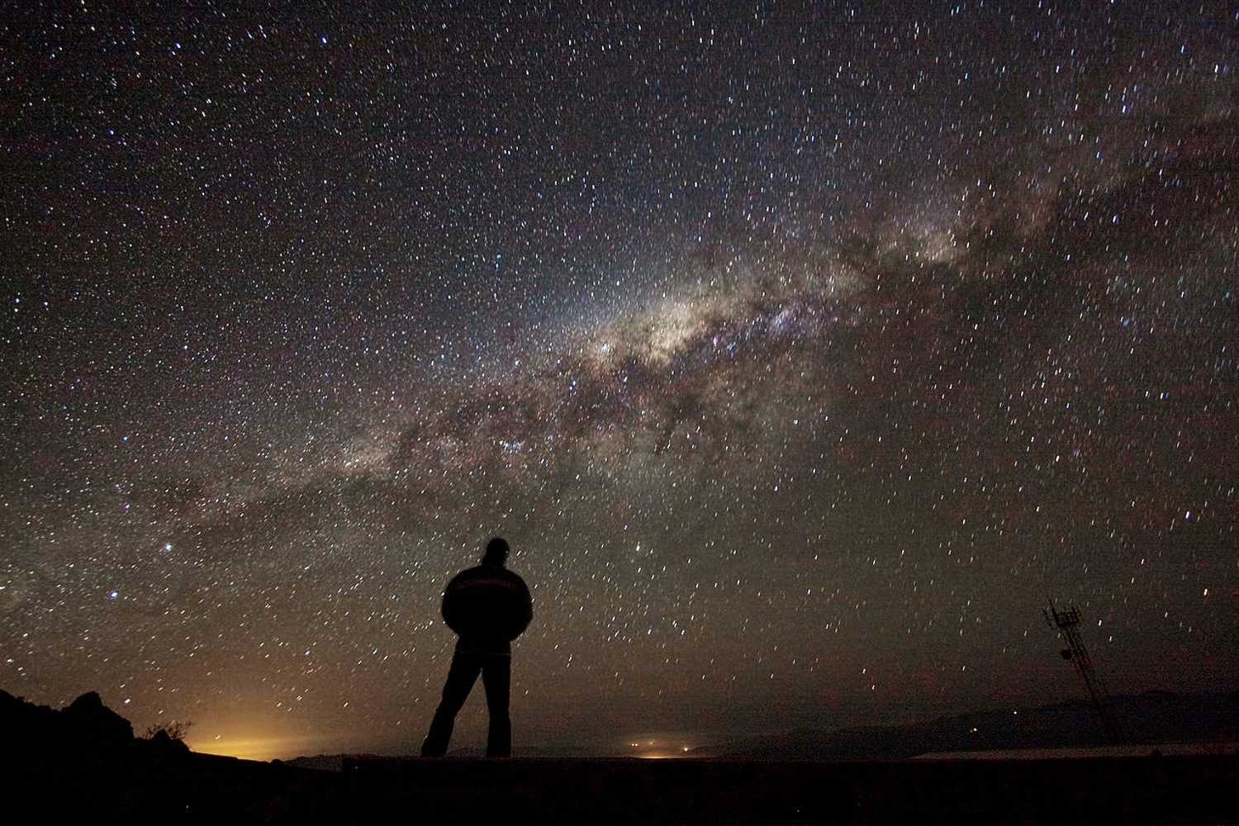

For He performs what is appointed for me, And many such things are with Him. Therefore I am terrified at His presence; When I consider this, I am afraid of Him. For God made my heart weak, And the Almighty terrifies me; Because I was not cut off from the presence of darkness, And He did not hide deep darkness from my face. — Job 23:14-17
what is
It is that it is
fearful power
afraid of Him
not cut off
not cut off
presence of
presence of
presence of
witnesses of evil
deep darkness
deep darkness
darkness
deep darkness
Notes:
As God sees darkness, so do we witness it, as hard and cold as it is. Evil can be blatant unafraid to hide. The stars upon the heavens fade into darkness. In witnessing darkness we see what is to come for those that reject His pure light; death.

Slide 10
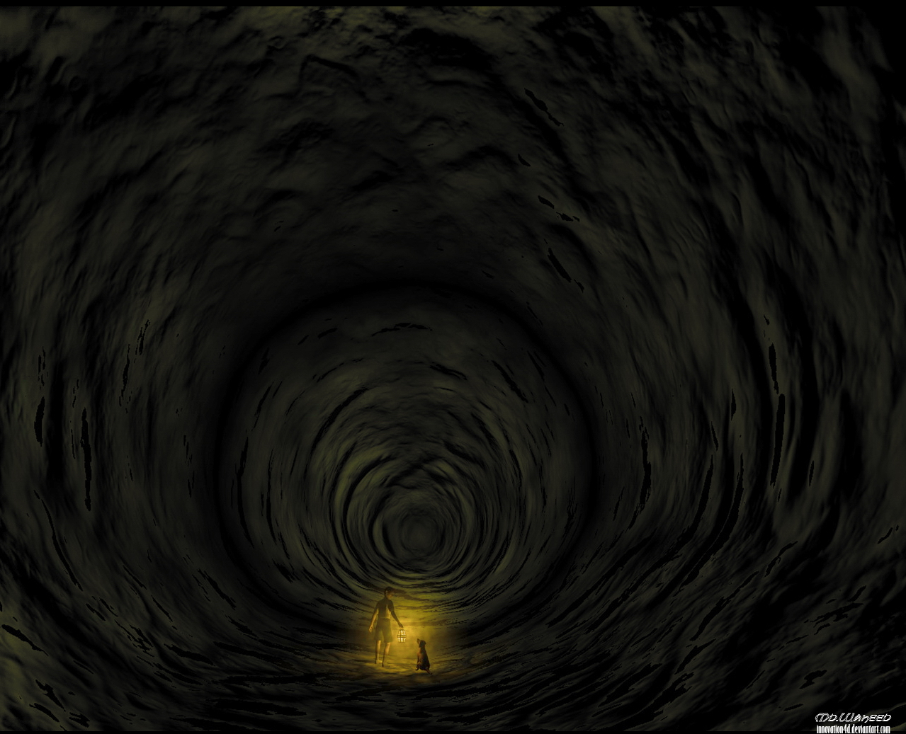
Yea, though I walk through the valley of the shadow of death, I will fear no evil; For You are with me; Your rod and Your staff, they comfort me. — Psalm 23:4
I will fear no evil
darkness
I will fear no evil
with me
truth
presence of
deep darkness
Notes:
He is the protection in the face of overwhelming evil. Are we able to endure the fires of pain to stand in His light? He is the rewarding strength when we are too weak to hold ourselves up. It is God that brings fearlessness to the heart.

Slide 11
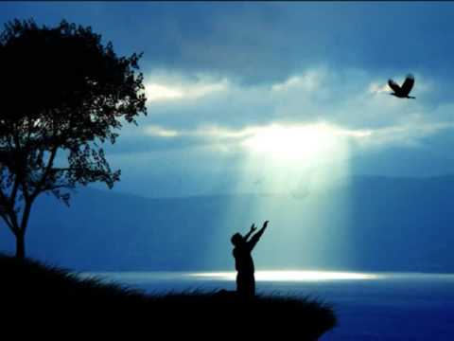
The LORD is near to all who call upon Him, To all who call upon Him in truth. He will fulfill the desire of those who fear Him; He also will hear their cry and save them. The LORD preserves all who love Him, But all the wicked He will destroy. — Psalm 145:18-20
LORD
in
truth
fear Him
fear Him
will hear their cry
will hear their cry
LORD
love Him
love Him
Notes:
An honest heart cries out and He lifts all that is genuine. To know He hears us is to trustingly love Him even though we must at times endure tribulations.

Slide 12
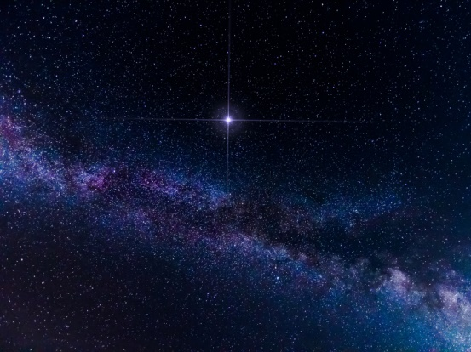
The LORD has made all for Himself, Yes, even the wicked for the day of doom. — Proverbs 16:4
LORD
Notes:
By the hand of God blessings unfold in the presence of all. He will retrieve all who genuinely attempt the best they can to seek Him out. A destination is coming for all. On the one hand, eternal life in His light for the faithful, while eternal darkness absent from His power awaits the wicked. It is pride that fearlessly exalts oneself above God Almighty.

Slide 13
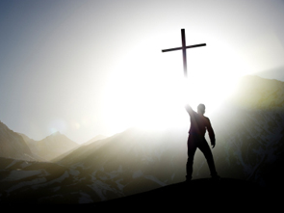
Seek the LORD while He may be found, Call upon Him while He is near. — Isaiah 55:6
Seek
LORD
Call
He is near
Notes:
While in the light opportunity is offered to all. God is offering each of us something greater than ourselves, His love in the light.

Slide 14

Do not harden your hearts as in the rebellion, In the day of trial in the wilderness, … — Hebrews 3:8
despise
harden your heart
harden your heart
Notes:
Bitter of heart blocks the love in accepting the sacrifice He has given for all to autonomously know.

Slide 15
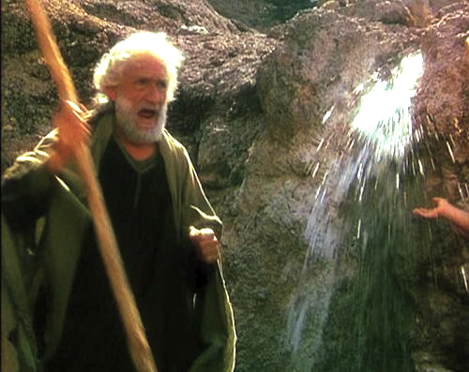
So he called the name of the place Massah and Meribah, because of the contention of the children of Israel, and because they tempted the LORD, saying, "Is the LORD among us or not?" — Exodus 17:7
Resentment
Conflict
Uprising
Bitterness
contention
Quarrel
Unrest
Clash
Dispute
among us or not
doubt
among us or not
Argument
Disagreement
Notes:
To hold contempt for God exposes a selfish over thankful heart.

Slide 16
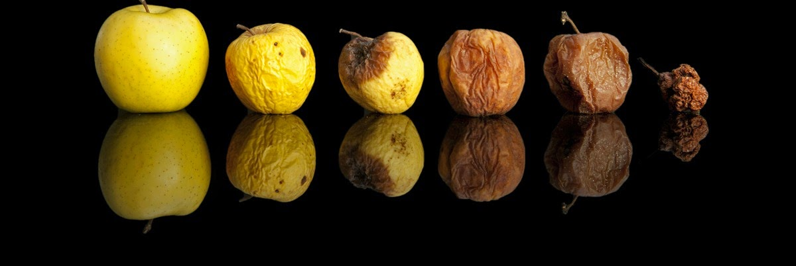
Beware, brethren, lest there be in any of you an evil heart of unbelief in departing from the living God; — Hebrews 3:12
evil heart
darkness
evil heart
unbelief in departing
unbelief in departing
in
Notes:
Unbelief and doubt destroy an honest open relationship with God. He seeks life in His creation to return on its’ own accord. Doubt shrivels the spirit.

Slide 17
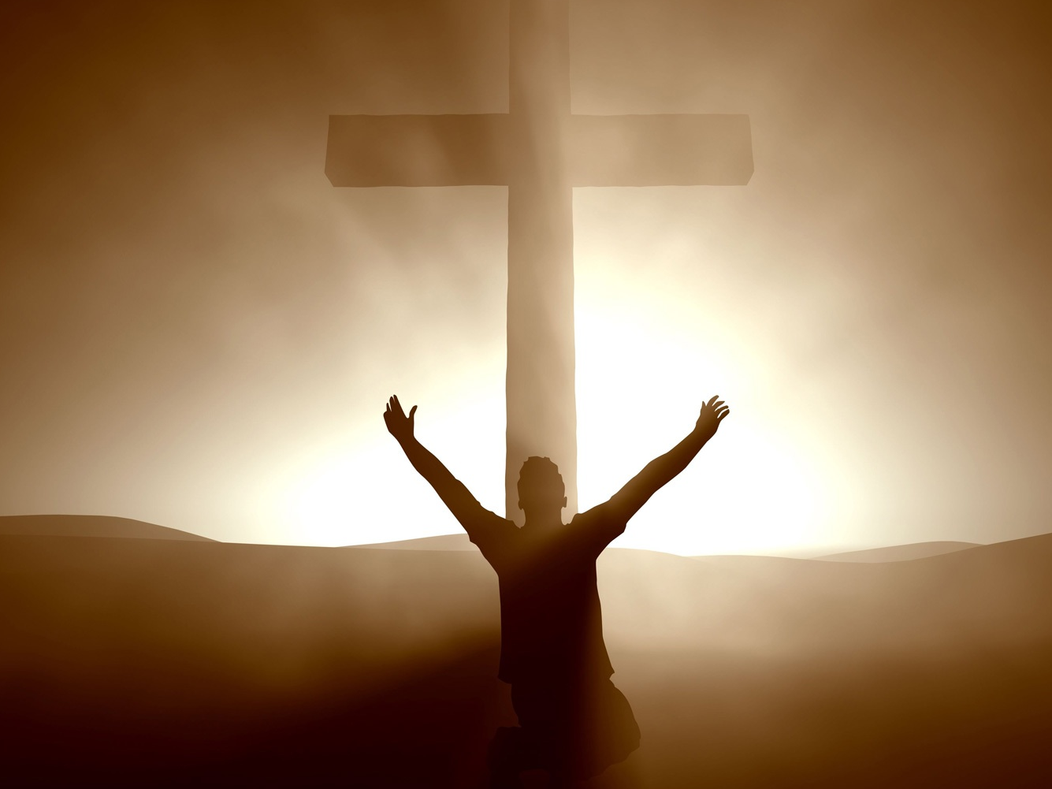
"Repent therefore and be converted, that your sins may be blotted out, so that times of refreshing may come from the presence of the Lord, …" — Acts 3:19
Repent
refreshing
from
refreshing
from
presence of the Lord
Notes:
Repentance is a change of heart to pursue that which is good in Him. To repent is to turn from the desires that are contrary to His commands.

Slide 18
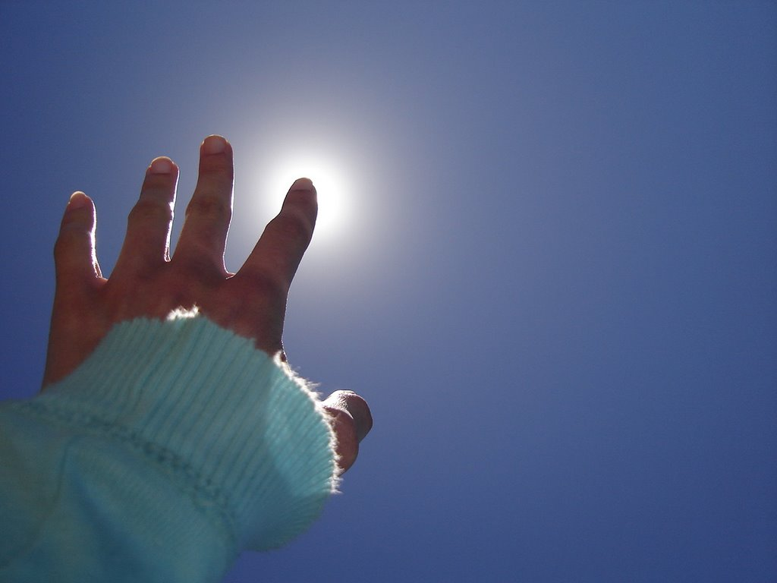
" … so that they should seek the Lord, in the hope that they might grope for Him and find Him, though He is not far from each one of us;" — Acts 17:27
hope
He is not far
He is not far
Notes:
To notice the Lord one has to accept that He is. This is when He becomes closer than we are even to ourselves. If the Lord seems far away, one has either a weak faith, … even to the point of unbelief, its roots are in a selfish and or unthankful based faith. The Lord is far from those with doubt in their hearts. The Lord rests not just upon the surface of our flesh, right next too, but all while in the depths of our deepest parts. He looks for what we come to love.

Slide 19

Commit your way to the LORD, Trust also in Him, And He shall bring it to pass. He shall bring forth your righteousness as the light, And your justice as the noonday. — Psalms 37:5-6
Commit
Commit
Commit
Trust
in
Trust
Trust
Him
bring it to pass
Commit + Trust = bring it to pass
righteousness
justice
Notes:
Just committing is not enough in establishing a true unbreakable relationship. Trust is essential and is what a surrendering heart does. With trust His will comes to be as the spirit is illuminated in His truths. It is trust that solves all problems.

Slide 20
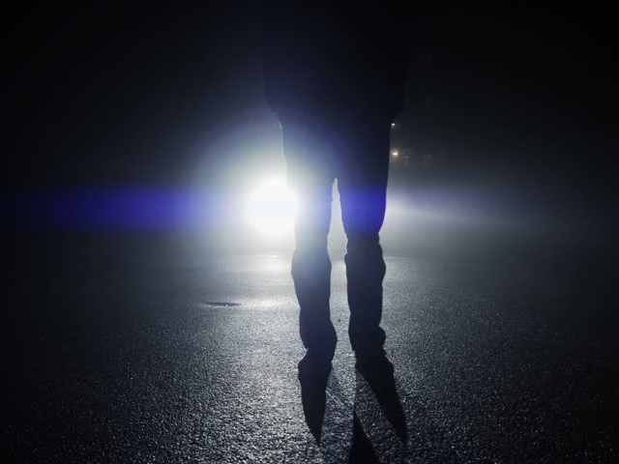
Arise, shine; For your light has come! And the glory of the LORD is risen upon you. For behold, the darkness shall cover the earth, And deep darkness the people; But the LORD will arise over you, And His glory will be seen upon you. — Isaiah 60:1-2
shine
Christ
LORD
LORD
is risen upon you
is risen upon you
ignorance
LORD
believers
His glory will be seen
His glory will be seen
Notes:
Christ has risen upon us all. To see Him is to know what He did that we may live. Faith is allowing one’s self to be drawn back into His light of all truth. The sight of the Lord radiates from within.

Slide 21
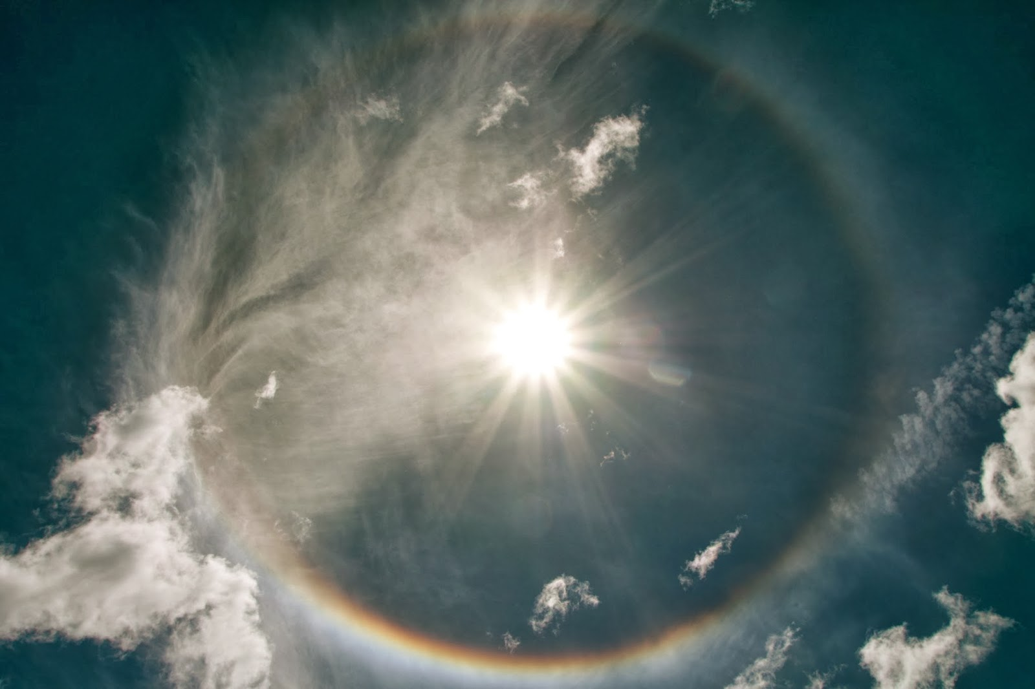
The LORD your God in your midst, The Mighty One, will save; He will rejoice over you with gladness, He will quiet you with His love, He will rejoice over you with singing." — Zephaniah 3:17
He will:
● rejoice over you with gladness
● quiet you with His love
● rejoice over you with singing
LORD
in
in your midst
in your midst
He will
rejoice over you with gladness
quiet you with His love
quiet you with His love
rejoice over you with
singing
Notes:
It is easy to forget those things the Lord does for us. Accepting His love opens that eternal door where truth resides.

Slide 22
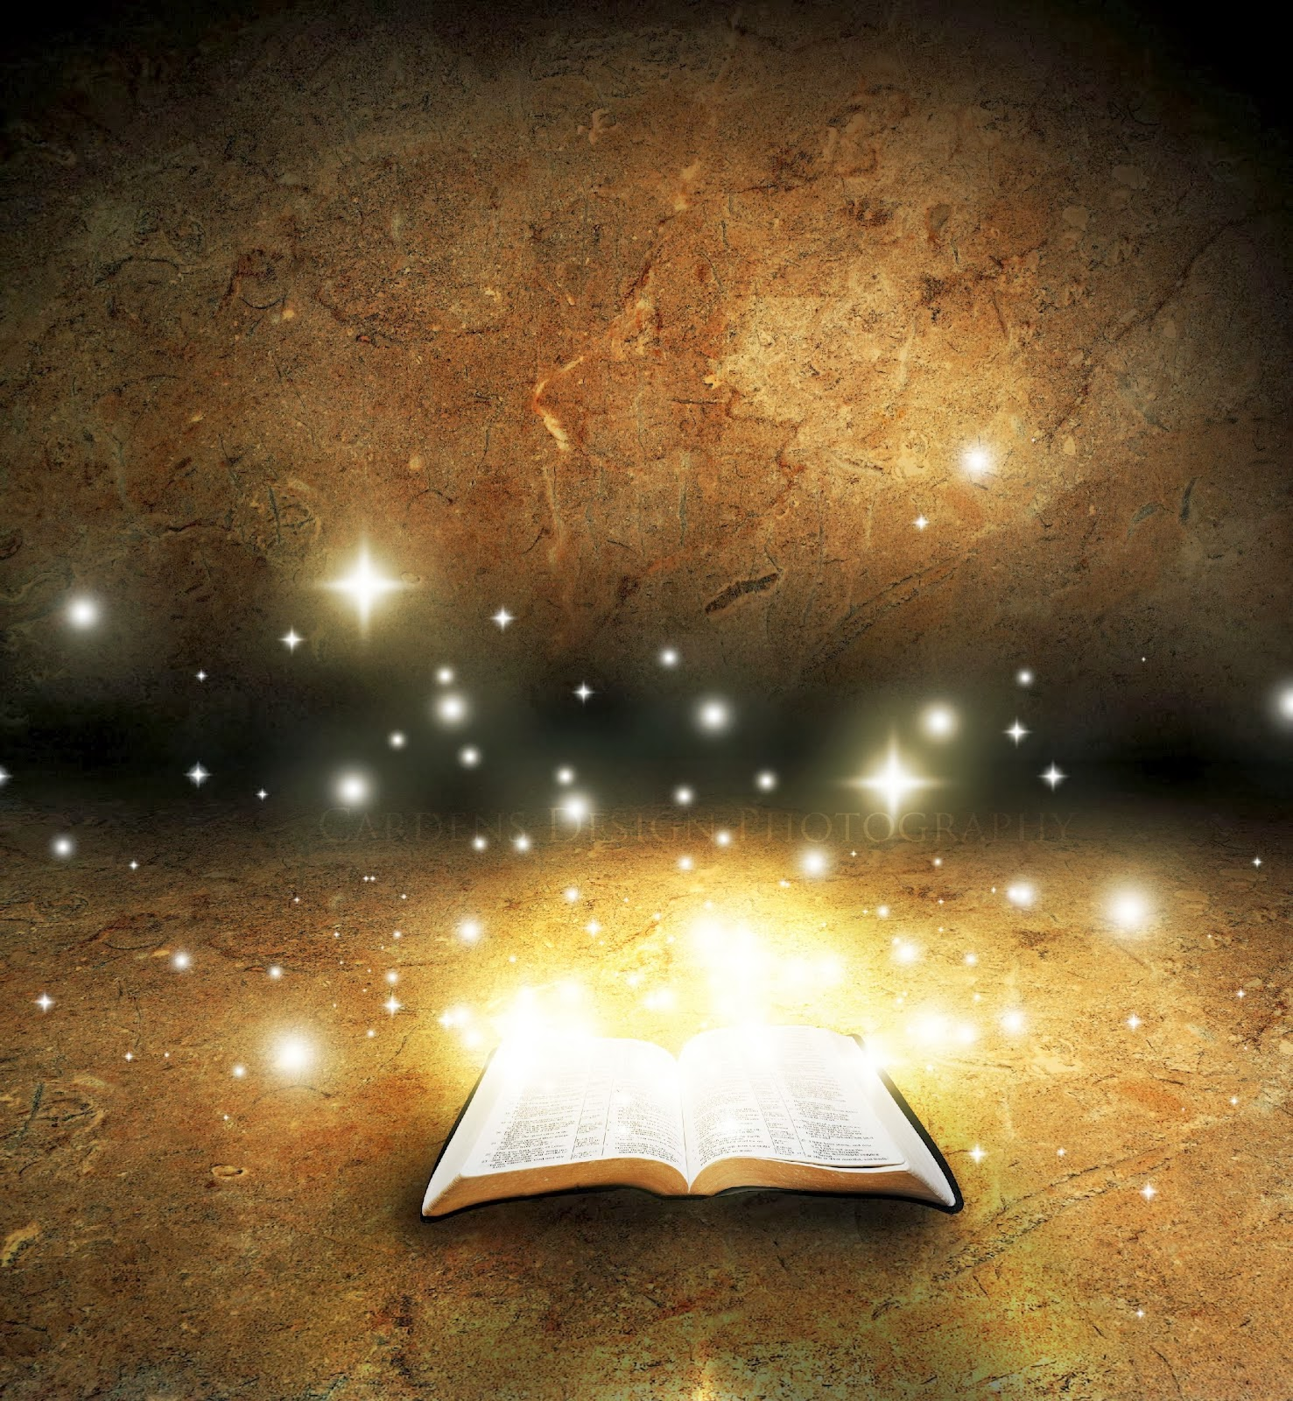
"Most assuredly, I say to you, he who hears My word and believes in Him who sent Me has everlasting life, and shall not come into judgment, but has passed from death into life." — John 5:24
in
believes in
believes in
Him
death into life
death into life
Notes:
To find God is to believe in Him which brings His eternal presence to light in one’s life. If one still believes in death, one has yet to fully realize life in Him.

Slide 23
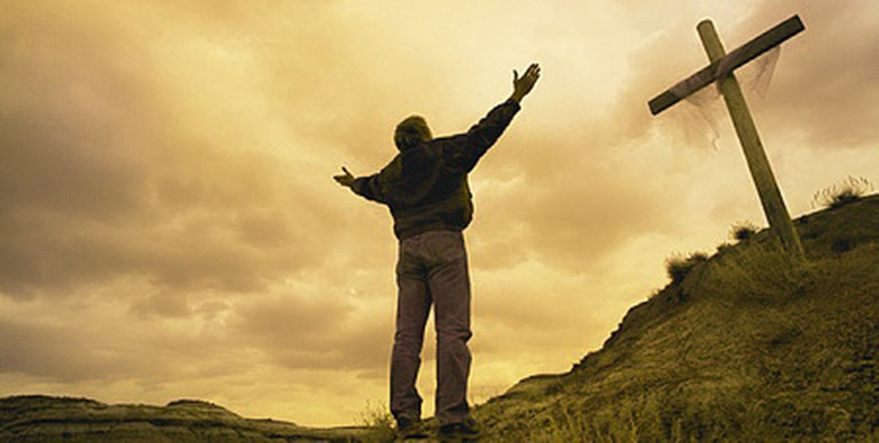
"I have been crucified with Christ; it is no longer I who live, but Christ lives in me; and the life which I now live in the flesh I live by faith in the Son of God, who loved me and gave Himself for me." — Galatians 2:20
Christ
But if the Spirit of Him who raised Jesus from the dead dwells in you, He who raised Christ from the dead will also give life to your mortal bodies through His Spirit who dwells in you. — Romans 8:11
in
Christ
Christ
. .
in
by faith
in the Son of God
His Spirit
in
Notes:
Once one fully appreciates what He did for us, in all of its facets, how awesome does His sacrifice become as one bows before His brilliance of grace.

Slide 24

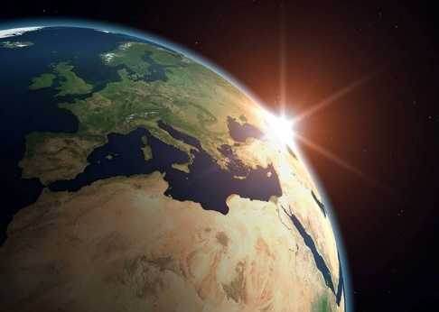
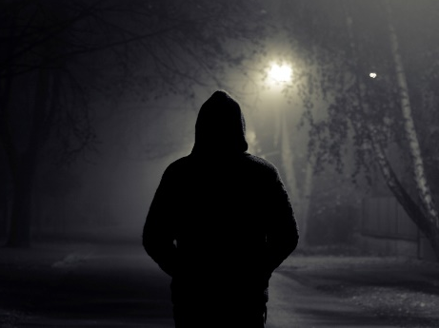

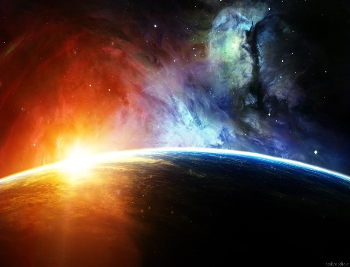
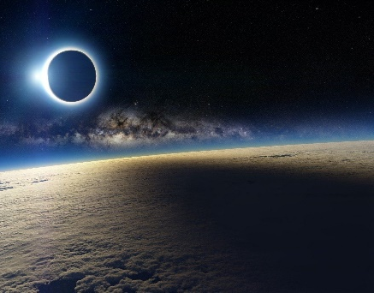

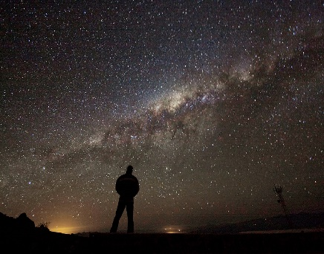


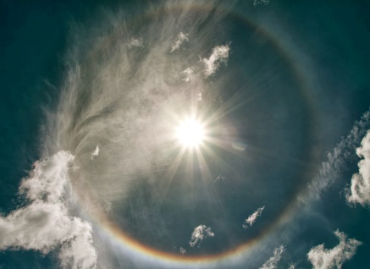
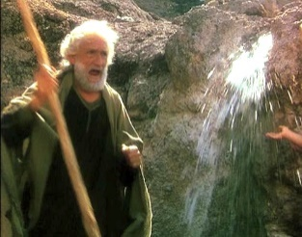







Slide 25
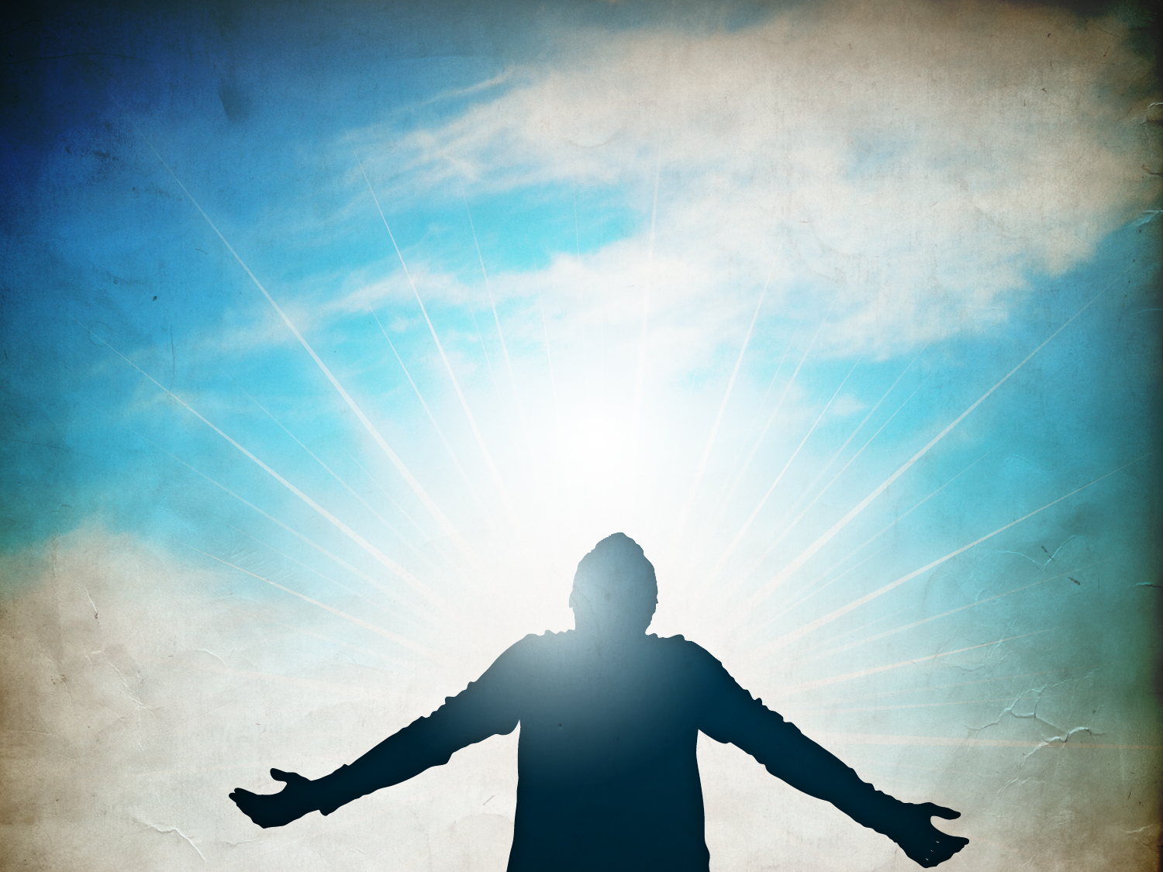
→ People think they can hide from God
→ The Lord sees all that happens
→ Dark works cannot hide from His view
→ None can escape from the presence of the Lord
→ He crosses all as light expose all that is
→ God does not hide darkness from us
→ God protects us in all we do
→ The LORD is near all who are in truth and love Him
→ All is made for and by the Lord
→ He calls for all to return in Him
→ Don’t harden your hearts questioning His presence
→ An evil heart of unbelief departs from God
→ His presence refreshes the spirit
In His light we see Him for He is
Notes:
In His light we see Him for He is. Broken dreams do not defeat the faithful. True belief rises past all tribulation in view of that which is greater, the love of God.

Slide 26
Notes:
Silence is part of the deep hole of darkness.

Slide 27

Acquiring the 'Presence of the LORD'
Part 2
Ron Bert
March 19, 2017
Notes:
To be with the Lord has no greater value.

Slide 28
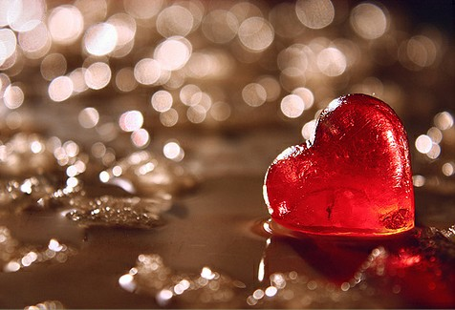
Create in me a clean heart, O God, And renew a steadfast spirit within me. Do not cast me away from Your presence, And do not take Your Holy Spirit from me. Restore to me the joy of Your salvation, And uphold me by Your generous Spirit. — Psalms 51:10-12
in
clean
Create in me
a clean heart
me
clean
renew
a steadfast
renew
spirit
spirit
spirit
presence
● Create in me
● a clean heart
● a steadfast spirit
● joy of Your salvation
Restore
joy of Y our
Restore
salvation
Notes:
We need to ask for His help in opening our understanding, to be better established in His will. Without a clean conscious and zeal of spirit pursuing His truths, His presence is all but elusive. Carl Marx said that religion was the opium of the masses, but in actuality, it is the identity of a true soul returning to the source of all life, love. It is an upward call from God Himself for us to remember Him of our own accord.

Slide 29

And He said, "My Presence will go with you, and I will give you rest." — Exodus 33:14
presence
I will give you rest
I will give you rest
Notes:
And in Him we find our eternal spiritual rest. There is no greater love than knowing the Lord waits to give each of us rest upon His originating Spirit.

Slide 30

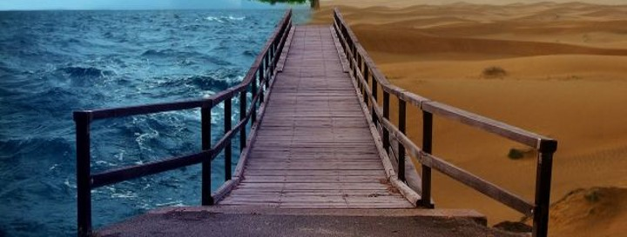
You will show me the path of life; In Your presence is fullness of joy; At Your right hand are pleasures forevermore. — Psalm 16:11
spirit
despair
presence
=
joy
. .
fullness of joy
is
In Your presence
fullness of joy
Notes:
Choices confront each of us and we can only pray sin passes us by as we approach His presence. Life is either full or empty and it is in this choice that our character is revealed. Do you live in a reservoir or a desert? Part of the presence of God is accepting the presence of God.

Slide 31
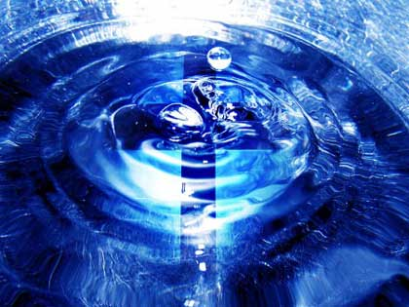
And in that day you will say: "O LORD, I will praise You; Though You were angry with me, Your anger is turned away, and You comfort me. Behold, God is my salvation, I will trust and not be afraid; 'For YAH, the LORD, is my strength and song; He also has become my salvation.'" Therefore with joy you will draw water From the wells of salvation. — Isaiah 12:1-3
● I will praise You
● You were angry with me
● Your anger is turned away
● You comfort me
● God is my salvation
● I will trust & not be afraid
WORSHIP
I will praise
SIN
I will praise Y ou
Y ou were
I will praise
MERCY
angry with me
Y our anger is turned
TRUTH
away
Y ou comfort me
CHRIST
I will trust
God is my salvation
I will trust
&
I will trust
not be afraid
LOVE
not be afraid
not be afraid
water
joy
water
wells of salvation
belief
Notes:
God’s willingness to forgive falls upon those that trust in Him and follow after Him.

Slide 32
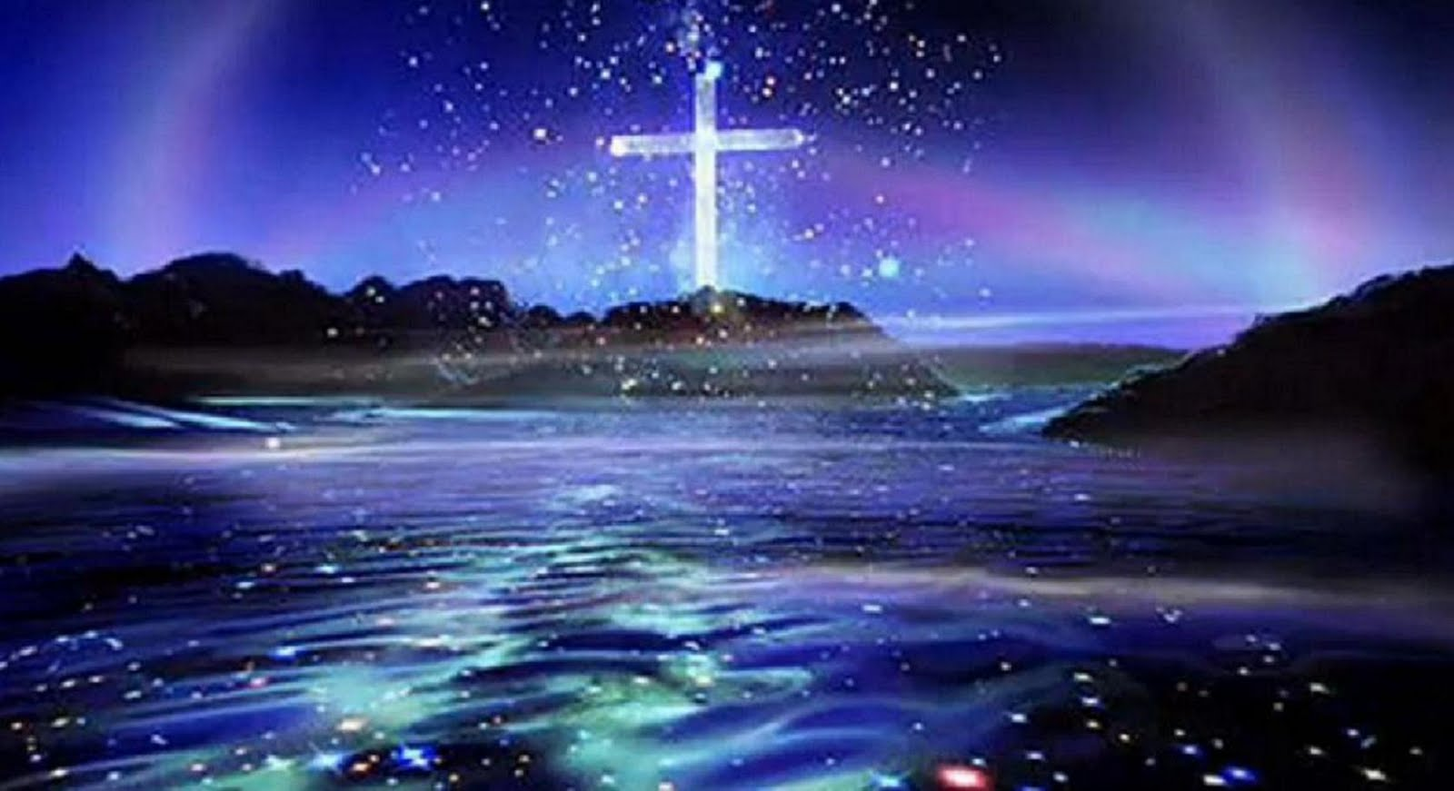
"He who believes in Me, as the Scripture has said, out of his heart will flow rivers of living water." — John 7:38
said
water
faith
Notes:
A rising spirt comes to those that achieve a loving dedication to Him in all that they are. It is our faith that pours out of us.

Slide 33

Let your conduct be without covetousness; be content with such things as you have. For He Himself has said, "I will never leave you nor forsake you." So we may boldly say: "The LORD is my helper; I will not fear. What can man do to me?" — Hebrews 13:5-6
said
I will never
I will never
leave you
leave you
LORD
Notes:
With what has been said one must act on scripture to reap those benefits the inspired word speaks of. The concepts given of His word deliver the peace the world does not know. It is the blessing of His eternalness that gives more than takes. Man has no power over God.

Slide 34
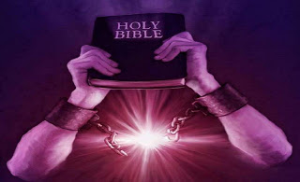

For You will light my lamp; The LORD my God will enlighten my darkness. — Psalm 18:28
You will
You will
LORD
God
enlighten
enlighten
ignorance
you will
find Me
And you will seek Me and find Me, when you search for Me with all your heart. — Jeremiah 29:13
you will
find Me
heart
Notes:
God is found by all who desire Him with all of their being. To have faith in the Lord is greater than what can be seen, and it is larger than all that is.

Slide 35

But I am poor and sorrowful; Let Your salvation, O God, set me up on high. I will praise the name of God with a song, And will magnify Him with thanksgiving. This also shall please the LORD better than an ox or bull, Which has horns and hooves. The humble shall see this and be glad; And you who seek God, your hearts shall live. — Psalms 69:29-32
But I am poor and sorrowful
But I am poor and sorrowful
God
I will praise
God
I will praise
God
magnify Him
God
magnify Him
God
God
thanksgiving
thanksgiving
humble
shall see
humble
who seek
God
who seek
shall live
shall live
Notes:
Though miseries are persistent, His peace in love shine forth through all gloom. It is when your heart lives in Him that He is present.

Slide 36
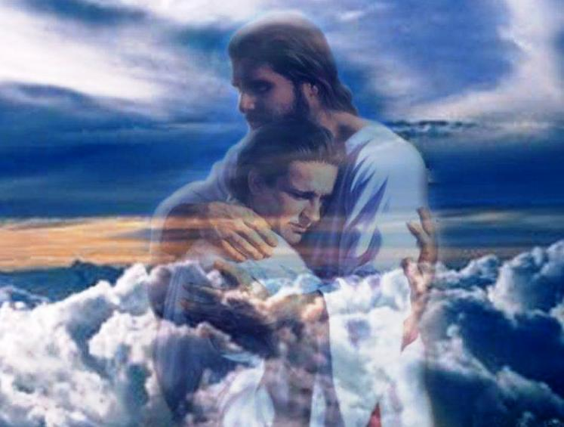
Draw near to God and He will draw near to you. Cleanse your hands, you sinners; and purify your hearts, you double-minded. — James 4:8
God
near to you
near to you
sinners
Shifty
Fickle
Deceitful
Dishonest
Two-faced
Inconsistent
Hypocritical
Double-dealing
Notes:
The closer to God the more one can identify with His presence and notice His will at play.
Shifty
Fickle
Deceitful
Dishonest
Two-faced
Inconsistent
Hypocritical
Double-dealing

Slide 37
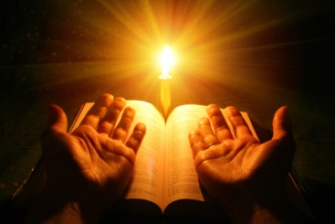
Therefore lay aside all filthiness and overflow of wickedness, and receive with meekness the implanted word, which is able to save your souls. — James 1:21
sinners
implanted word
=
word
is
implanted word
is
salvation
Notes:
To shed past mistakes and evil influences, seeking His word, empowers the salvation He offers. The more one knows and accepts of His truth brings about the closeness greater than any human bond. We find God through the light of the word.

Slide 38
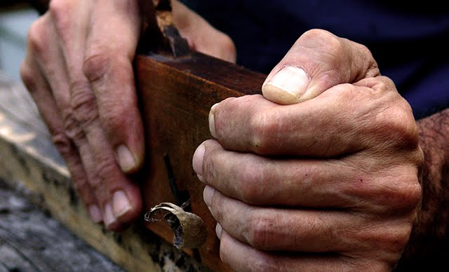
But be doers of the word, and not hearers only, deceiving yourselves. For if anyone is a hearer of the word and not a doer, he is like a man observing his natural face in a mirror; for he observes himself, goes away, and immediately forgets what kind of man he was. — James 1:22-24
G
doers
doers
word
o
d
word
not a doer
not a doer = forgets God
forgets
Notes:
If one does not apply the word of God, one should not expect to feel His presence. Submission to a higher love in trust, one cannot know God if not applying His will in one’s life. Be Holy for I am Holy is where goodness comes to goodness. To not see God in self is to deny His presence.

Slide 39
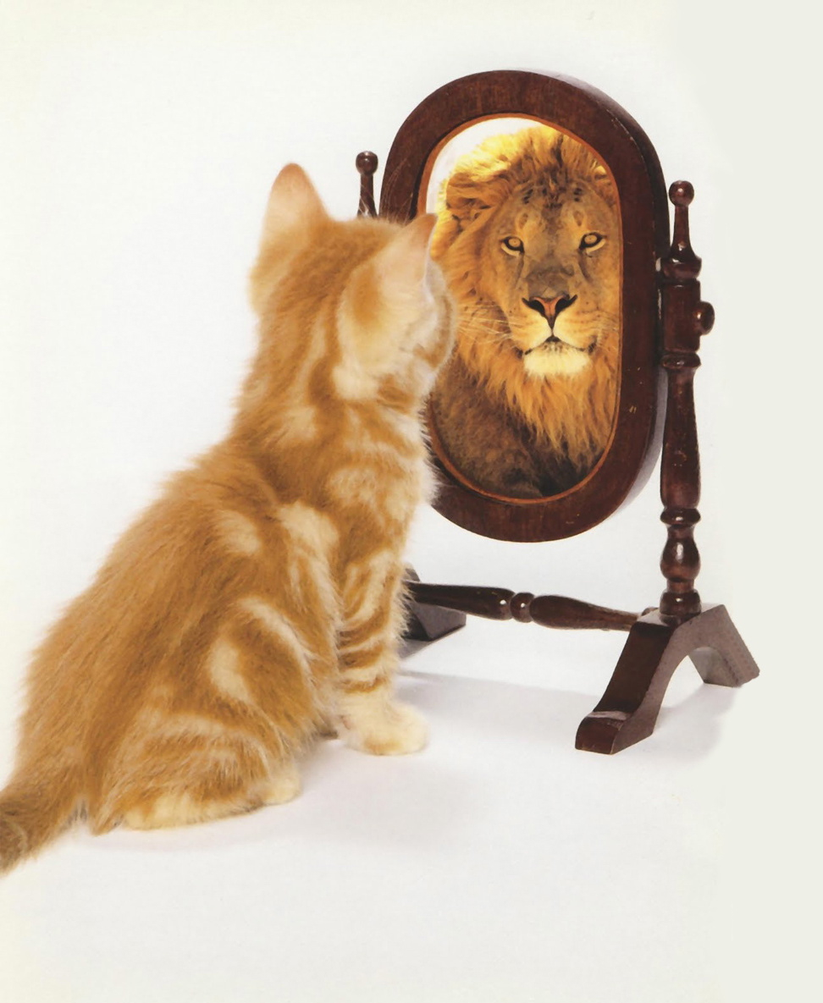
When I was a child, I spoke as a child, I understood as a child, I thought as a child; but when I became a man, I put away childish things. For now we see in a mirror, dimly, but then face to face. Now I know in part, but then I shall know just as I also am known. — 1st Corinthians 13:11-12
s
r
d
an
transformed
transformed
t
or
f
e
I shall know
m
I shall know
Notes:
To know God is to know self. Maturity of spirit is required to enjoy the blessings He bestows. Strength of spirit is the brilliance He imparts on the humble. There is no question for those that believe in Him as He is here.

Slide 40
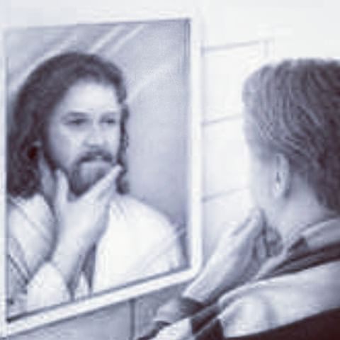
But we all, with unveiled face, beholding as in a mirror the glory of the Lord, are being transformed into the same image from glory to glory, just as by the Spirit of the Lord. — 2nd Corinthians 3:18
transformed
Lord
transformed
transformed
into the same image
into the same image
If we are faithless, He remains faithful; He cannot deny Himself. — 2nd Timothy 2:13
He remains
He remains
Notes:
To acquire a true sense of His presence, we are transformed into His image as spirits of His creation.

Slide 41

"Behold, I stand at the door and knock. If anyone hears My voice and opens the door, I will come in to him and dine with him, and he with Me." — Revelation 3:20
I stand at the door
I will come
in
in to him
in to him
he with Me
he with Me
Notes:
To enter His door is to be eternally immersed in His light. Doubt and earthly desires deny a true relationship with God in the freedom He offers.

Slide 42
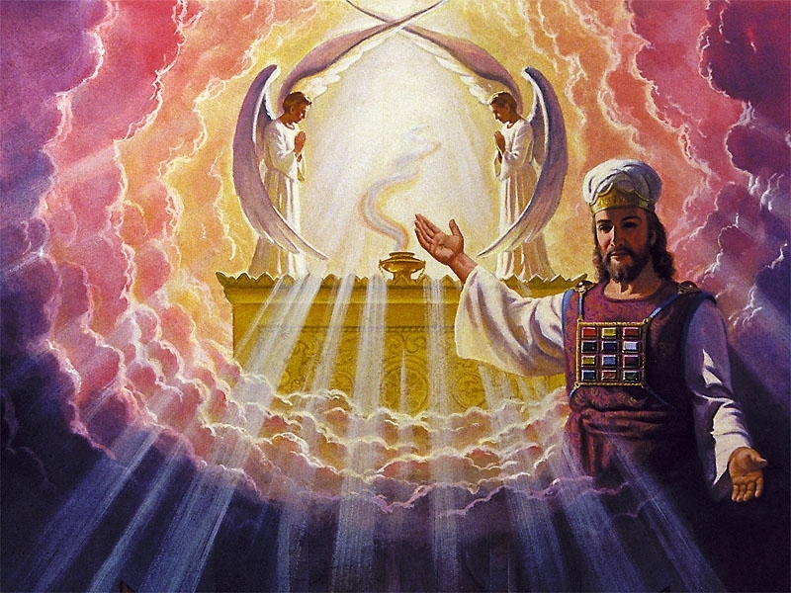
For Christ has not entered the holy places made with hands, which are copies of the true, but into heaven itself, now to appear in the presence of God for us; — Hebrews 9:24
Christ
Christ
in
the presence of God
for us
the presence of God
Notes:
Christ Himself is our arbitrator in our own eternal creation. As we are witnesses of ourselves to Him, and if aware of this exposure, it draws us closer to Him. Christ is everyone's portal to eternity.

Slide 43
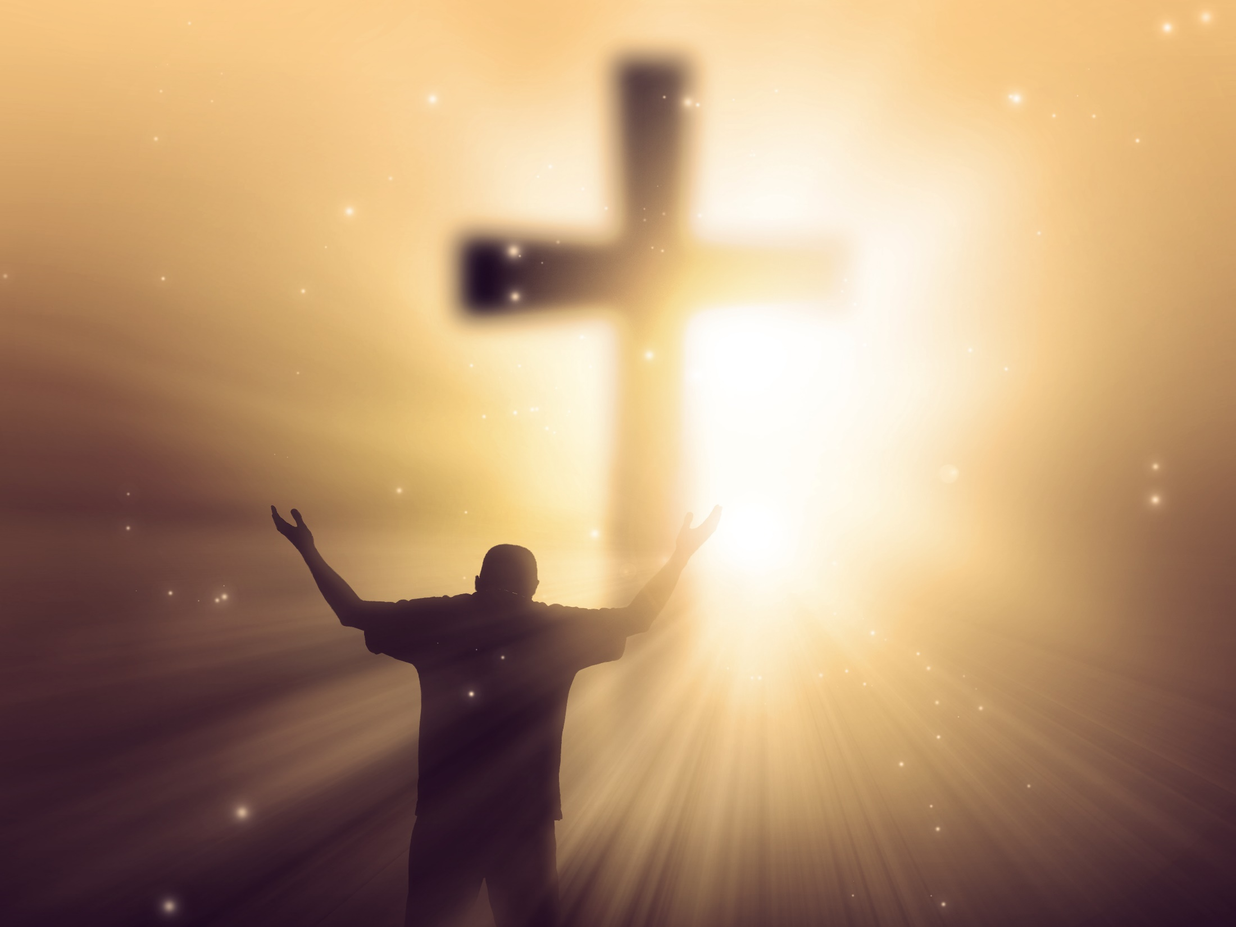
For Christ also suffered once for sins, the just for the unjust, that He might bring us to God, being put to death in the flesh but made alive by the Spirit, — 1st Peter 3:18
Christ
Christ
Christ
He might bring us to God
He might bring us to God
alive by the Spirit
Notes:
Christ came to earth specifically so that we could be drawn into the true and only living God. Christ is God calling us to come to Him.

Slide 44
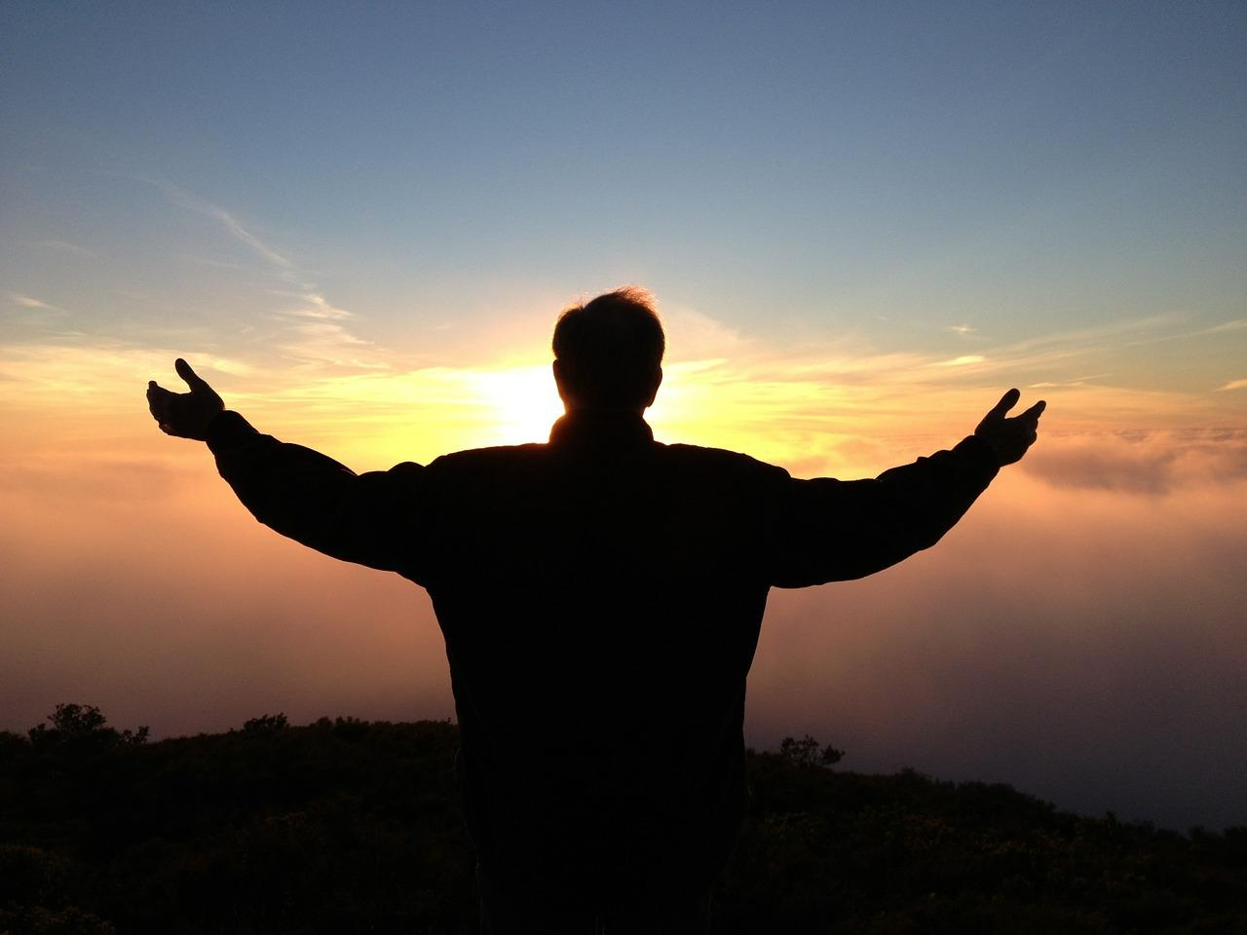
Let us therefore come boldly to the throne of grace, that we may obtain mercy and find grace to help in time of need. — Hebrews 4:16
Christ
come boldly to
come boldly to
find
Notes:
To believe in God is to come directly to Him and in this His presence is.

Slide 45

For through Him we both have access by one Spirit to the Father. — Ephesians 2:18
through
access
to
access
Spirit
to
access
faith
… in whom we have boldness and access with confidence through faith in Him. — Ephesians 3:12
in
Him
Notes:
Confidence is a natural effect of our bond in His eternal grace. We take our direct access to God for granted as it has been long fought for and hard won.

Slide 46
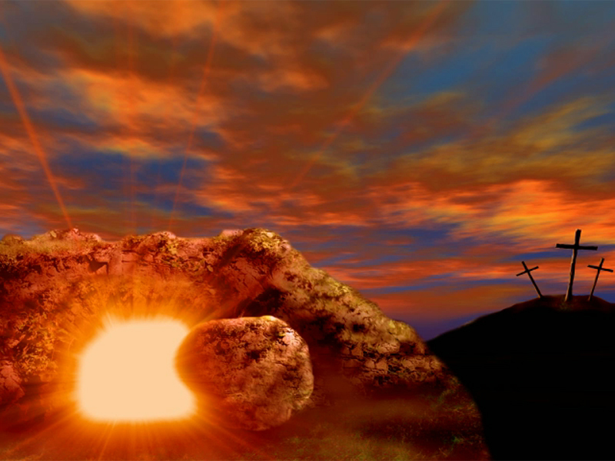
in Him
Notes:
He is with us always as He waits for our awakening.

Slide 47
" … teaching them to observe all things that I have commanded you; and lo, I am with you always, even to the end of the age." Amen. — Matthew 28:20
. .
I am with you
Notes:
He is with us always as He waits for our awakening.

Slide 48

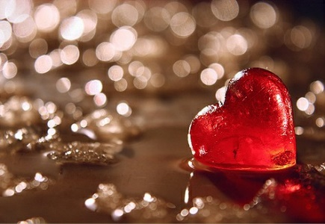



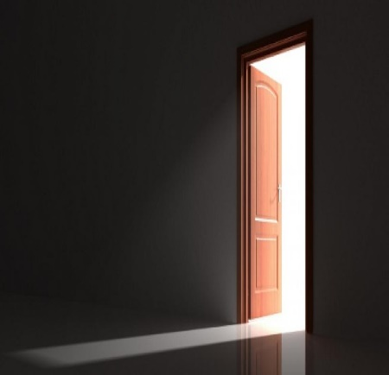
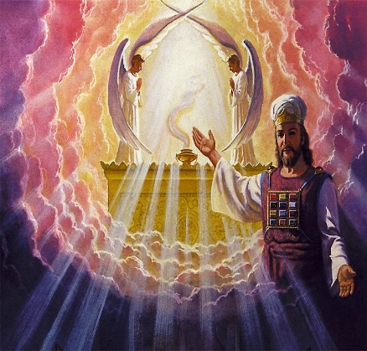

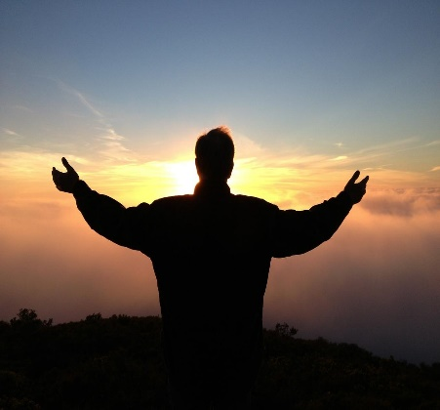



Slide 49
→ In a clean heart pray His presence is not taken away
→ His presence gives one rest
→ In His presence is fullness of joy
→ Belief in Him brings wells of salvation
→ Be content with such things as you have
→ He is the light of our lives
→ One finds God with all of one’s heart
→ One’s heart shall live who seeks God
→ God comes near to those near to Him
→ Receiving His word is what saves one’s soul
→ Only the genuine find His presence
→ Depth of character reveals His presence
→ We are transformed closer to Him in His presence
His Presence is what gives us life
Notes:
His Presence is what gives us life.

Slide 50
Notes:
There is no where to move in darkness.

Slide 51

Please visit http://www.RonBert.com to explore further
Ronald Bert Channel on
Notes:
Eternity never ends.

