Slide 2
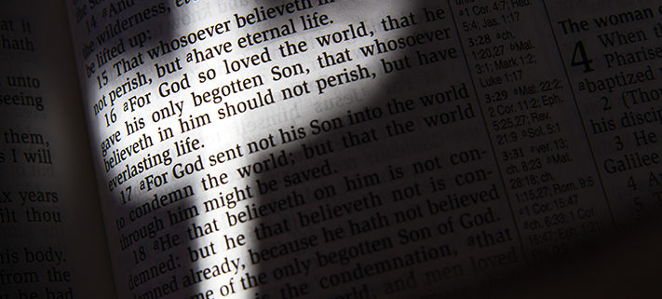
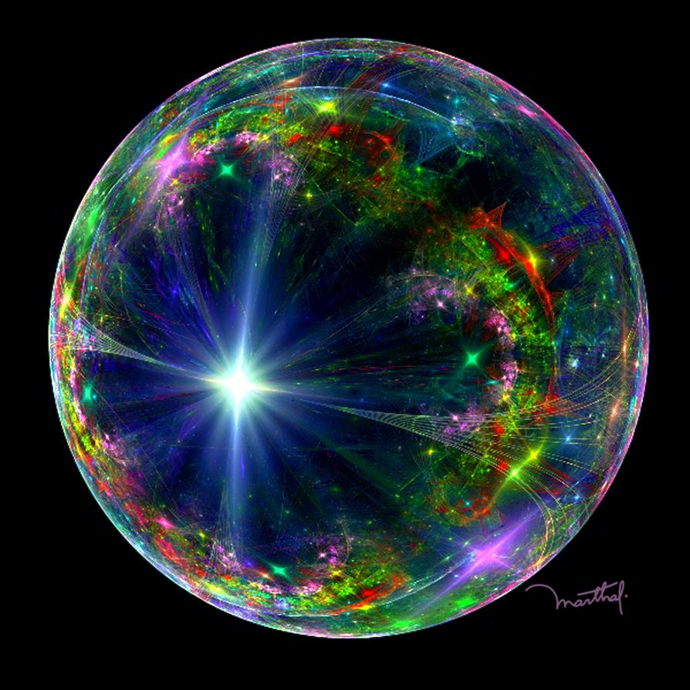
Preach the Word
Ron Bert
September 27, 2020

Slide 3
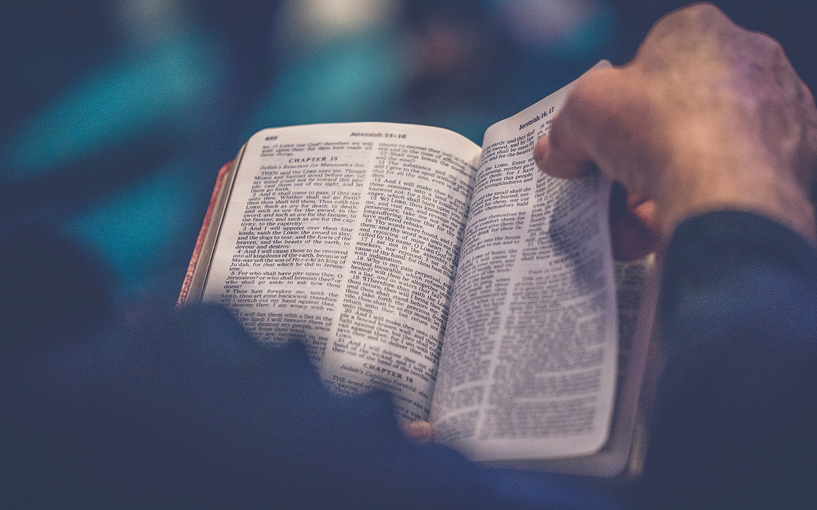
Till I come, give attention to reading, to exhortation, to doctrine. — 1st Timothy 4:13
to
to
exhort
exhort
motivation
guidance
advising
encouragement
advocating
to
Notes:
Conditions of wealth are relative. Does one seek inner or outer satisfactions for the soul to digest?

Slide 4
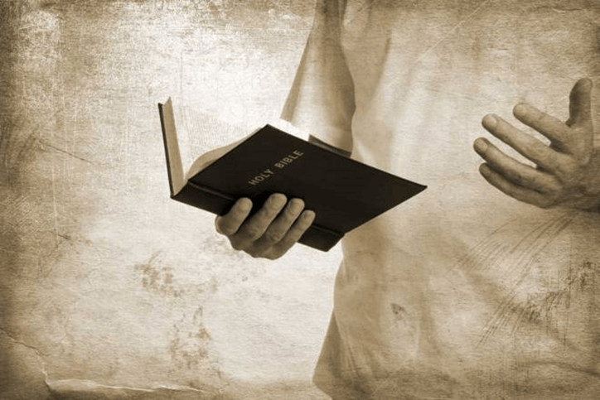
Preach the word! Be ready in season and out of season. Convince, rebuke, exhort, with all longsuffering and teaching. — 2nd Timothy 4:2
Preach the word! Be ready in season and out of season.
Convince
rebuke
exhort
longsuffering
teaching
Notes:
Instructions are clear. Without the Word of God we are crippled in attempting to become better as a whole.

Slide 5

Preach the word! Be ready in season and out of season.
→
Convince
→
rebuke
→
exhort
↙
↘
longsuffering
teaching

Slide 6


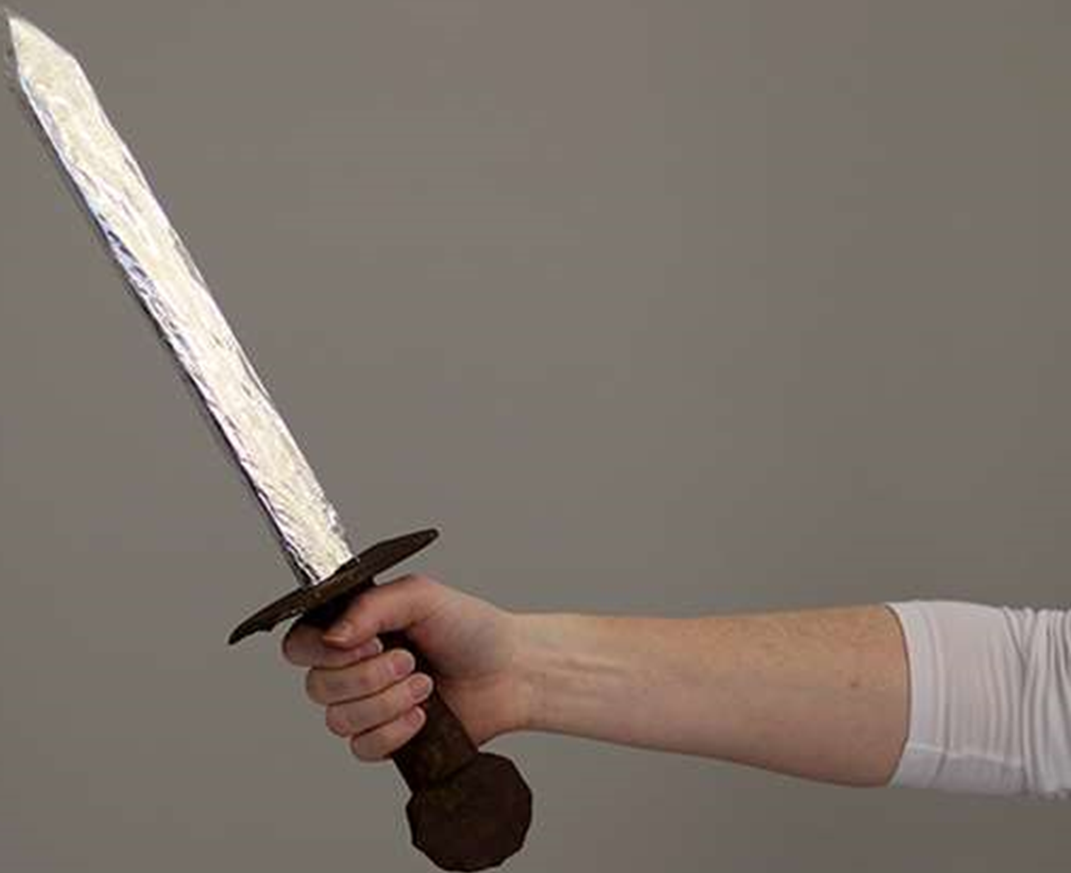
Speak these things, exhort, and rebuke with all authority. Let no one despise you. — Titus 2:15
exhort
rebuke
Notes:
The sword of truth cuts between love and correction.

Slide 7



"And He commanded us to preach to the people, and to testify that it is He who was ordained by God to be Judge of the living and the dead." — Acts 10:42
"And He commanded us to preach to the people, and to testify that it is He who was ordained by God to be Judge of the living and the dead." — Acts 10:42
commanded us to preach
. .
Jesus
Notes:
The Word announces Jesus will judge all, at the appointed time, of both living and dead as this age comes to an end.

Slide 8

Those who are sinning rebuke in the presence of all, that the rest also may fear. — 1st Timothy 5:20
rebuke
who are sinning
rebuke
in
who are sinning
presence of all
presence of all
Notes:
Courage is always lacking in confronting sin. Heinous acts of injustice should not be excused or rewarded, but terminated for the better of the whole. To maintain growing violators only defeats all that could be greater among us.

Slide 9

This testimony is true. Therefore rebuke them sharply, that they may be sound in the faith, not giving heed to Jewish fables and commandments of men who turn from the truth. — Titus 1:13-14
rebuke
in
sound in the faith
sound in the faith
rebuke
men who turn
truth
truth
Notes:
Correction is a guide to the truth. To never overcome fantasies, built on the sands of desire, causes one to neglect to see the truth of faith.

Slide 10

"Take heed to yourselves. If your brother sins against you, rebuke him; and if he repents, forgive him." — Luke 17:3
Watchful
rebuke
rebuke
repent
repent
Notes:
Many will never apologize expecting that everyone else should. An unapologetic heart is the demise of all who encounter it.

Slide 11

"'You shall not hate your brother in your heart. You shall surely rebuke your neighbor, and not bear sin because of him.'" — Leviticus 19:17
rebuke
not bear sin because of
not bear sin because of
Notes:
Love is the pinnacle of human advancement to the spiritual realm, of joy, peace and harmony.

Slide 12
"Nevertheless if you warn the wicked to turn from his way, and he does not turn from his way, he shall die in his iniquity; but you have delivered your soul." — Ezekiel 33:9
warn the wicked to turn
↘
does not turn
↘
shall die
you have delivered your soul
warn the
wicked to turn
does not turn
shall die
you have delivered your soul
Notes:
There is no looking back if forward is not seen.

Slide 13

Rebuke is more effective for a wise man Than a hundred blows on a fool. — Proverbs 17:10
wise
wise
fool
Notes:
Wisdom is the principle thing, and if we abandon the truth of this, our children are already destroyed.

Slide 14

It is better to hear the rebuke of the wise Than for a man to hear the song of fools. — Ecclesiastes 7:5
rebuke
rebuke
wise
wise
fool
Notes:
Without strong characteristics of moral obligations, the fan of delusions take over.

Slide 15
Turn at my rebuke; Surely I will pour out my spirit on you; I will make my words known to you. — Proverbs 1:23
rebuke
spirit
LIFE
my spirit on you
my spirit on you
words known
words known
Notes:
God’s own Spirit calls for us to return to His upright nature of harmony between souls. The instructions to regain sense is found in His divine Word, delivered once for all to know, not to be adjusted, added to, or deleted when inconvenient.

Slide 16
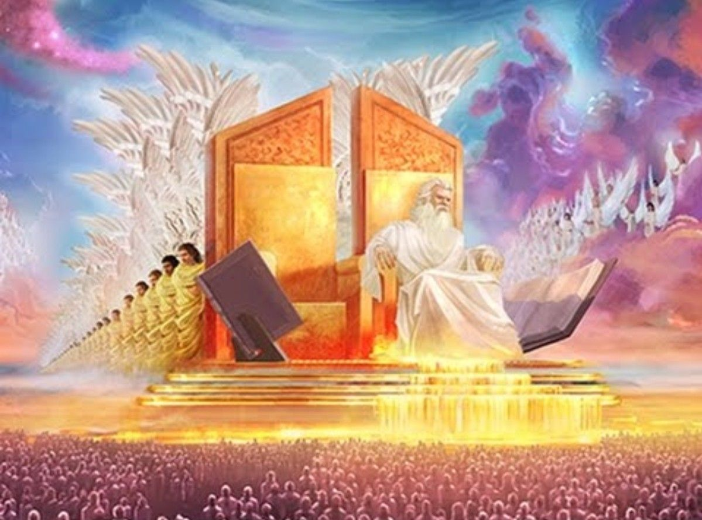
"And when He has come, He will convict the world of sin, and of righteousness, and of judgment:" — John 16:8
convict the world of
● sin
● righteousness
● judgment
convict the world of
sin
righteousness
−−−−−−−−−−→ evil
judgment
→ goodness
−−−−→ decision
Notes:
Judgment is as certain as the death of the flesh.

Slide 17
Beware, brethren, lest there be in any of you an evil heart of unbelief in departing from the living God; but exhort one another daily, while it is called "Today," lest any of you be hardened through the deceitfulness of sin. For we have become partakers of Christ if we hold the beginning of our confidence steadfast to the end, while it is said: "Today, if you will hear His voice, Do not harden your hearts as in the rebellion." — Hebrews 3:12-15
Beware:
of an evil heart of unbelief
in departing from the living God
↑ but exhort one another daily
↓
lest you be hardened
through the deceitfulness of sin
partakers of Christ
hold confidence steadfast to the end
hear His voice Today
Beware
of
an evil heart of unbelief
in departing
from the living God
but exhort one
another daily
lest
you be hardened
through the
deceitfulness of sin
partakers of Christ
hold
confidence steadfast to the end
Today
hear His
voice
Notes:
The horizon has always come with warnings. Without knowledge of His ways to guide us, snare lines surround the borders.

Slide 18

And let us consider one another in order to stir up love and good works, not forsaking the assembling of ourselves together, as is the manner of some, but exhorting one another, and so much the more as you see the Day approaching. — Hebrew 10:24-25
consider one another
consider one another
to stir up love and good works
↓
not forsaking assembling
of ourselves together
↕
but exhorting one another
consider
consider
to stir up love and
good works
not forsaking
assembling
of ourselves together
not forsaking
not forsaking
but
exhorting one another
but exhorting
but exhorting
Notes:
No one can do what must be done by the one who is you.

Slide 19


Now I myself am confident concerning you, my brethren, that you also are full of goodness, filled with all knowledge, able also to admonish one another. — Romans 15:14
① full of goodness
② filled with all knowledge
able also to admonish one another
goodness
goodness
knowledge
knowledge
full of goodness
filled with all knowledge
able also
to admonish one another
reprimand
caution
able
warn
able
rebuke
Notes:
Goodness and knowledge are prerequisites to being able to correct ourselves and those we care for.

Slide 20


… strengthening the souls of the disciples, exhorting them to continue in the faith, and saying, "We must through many tribulations enter the kingdom of God." — Acts 14:22
exhort
exhorting
exhort
endurance
Notes:
The climb through life has never been easy for any of us. It is a quest to obtain peace of heart and love of mind. Many fall to the quandaries of self criticism and disgust of living.

Slide 21
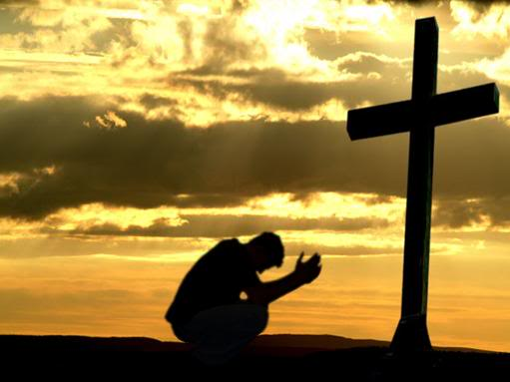
And you have forgotten the exhortation which speaks to you as to sons: "My son, do not despise the chastening of the LORD, Nor be discouraged when you are rebuked by Him; For whom the LORD loves He chastens, And scourges every son whom He receives." — Hebrews 12:5-6
exhort
correct
discipline
reprimand
rebuke
chasten
chasten
Notes:
Only humble hearts filled with the desire of becoming wiser have the ability to lift their souls.

Slide 22
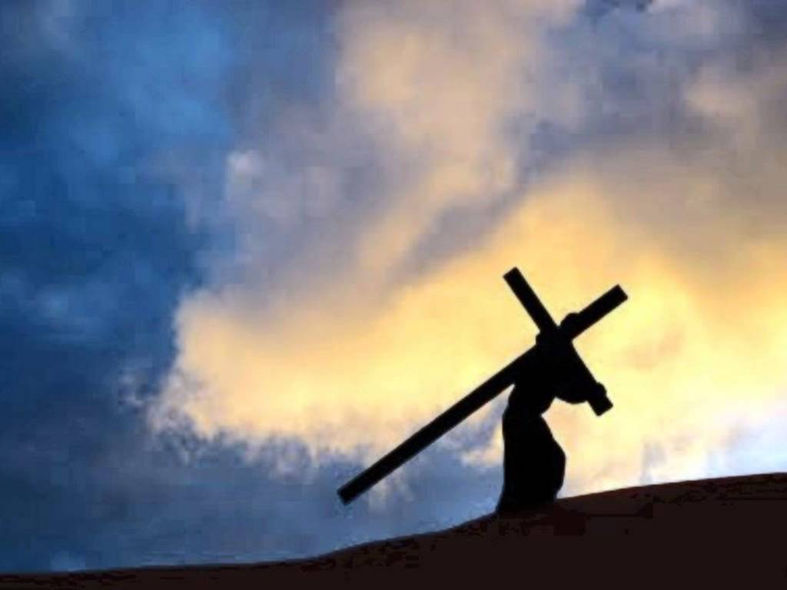
If you endure chastening, God deals with you as with sons; for what son is there whom a father does not chasten? But if you are without chastening, of which all have become partakers, then you are illegitimate and not sons. — Hebrews 12:7-8
endure
endure
chasten
chastening
chastening
Notes:
Bumps and cliffs will appear on the path to enlightenment. No one achieves a plateau without a great deal of climbing.

Slide 23


For you have need of endurance, so that after you have done the will of God, you may receive the promise: — Hebrews 10:36
endure
done the
do
do
endure
will of God
receive
the promise
receive
the promise
Notes:
It is important for all to realize doing is part of the larger picture. To get it done, is for those that do. In a society that relinquishes its’ excellence, and caters to burdens of despair, filtered down from disgruntled leaders, produces challenges for all who endure under the affiliations, either real of imagined. Tyrannies of man stir unrest. Convolution has no foundation.

Slide 24
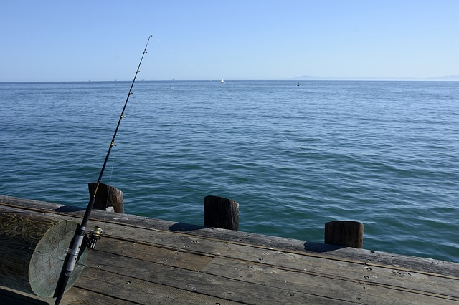
And so, after he had patiently endured, he obtained the promise — Hebrews 6:15
endure
the promise
the promise
Notes:
If we wait at the dock of life the reward will come.

Slide 25

But the fruit of the Spirit is love, joy, peace, longsuffering, kindness, goodness, faithfulness, gentleness, self-control. Against such there is no law. — Galatians 5:22-23
Spoils:
fruit of the Spirit is:
● love
● joy
● peace
● longsuffering
● kindness
● goodness
● faithfulness
● gentleness
● self-control
xxxxxxxxx
contempt
unhappy
turmoil
impatience
meanness
evil
unbelief
harshness
impulsive
fruit of the Spirit is
love
joy
peace
longsuffering
kindness
goodness
faithfulness
gentleness
self-control
the promise
Against such there is no law
→
Freedom
Bondage
Notes:
The Bible is clear on those qualities God looks for in a soul. If it is one’s goal to get caught up in to eternal life, attention to His desires must take precedence.

Slide 26
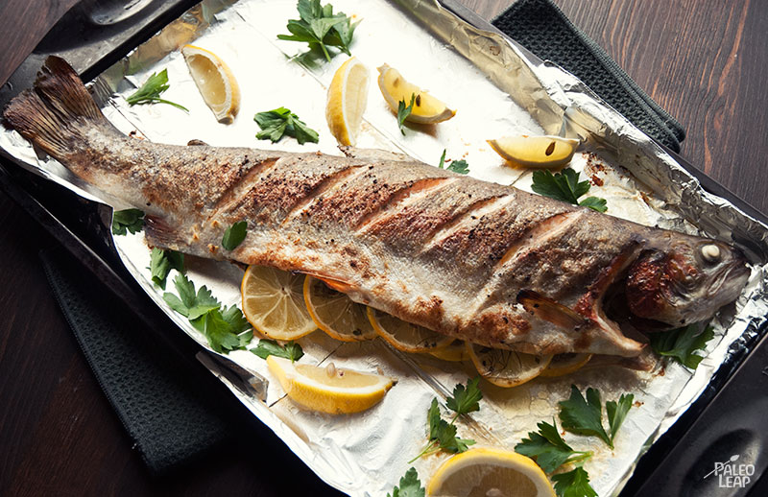
And let us not grow weary while doing good, for in due season we shall reap if we do not lose heart. Therefore, as we have opportunity, let us do good to all, especially to those who are of the household of faith. — Galatians 6:9-10
not grow weary while
doing good
not grow weary
. .
do
do
reap if we do not lose heart
not lose heart
. .
do
do good to all
especially
of faith
Notes:
No fish to fry leaves the pan empty. To fill the self with His food is to become nourished in the truth.

Slide 27
not grow weary while doing good
reap if we do not lose heart
do good to all, especially of the faith

Slide 28

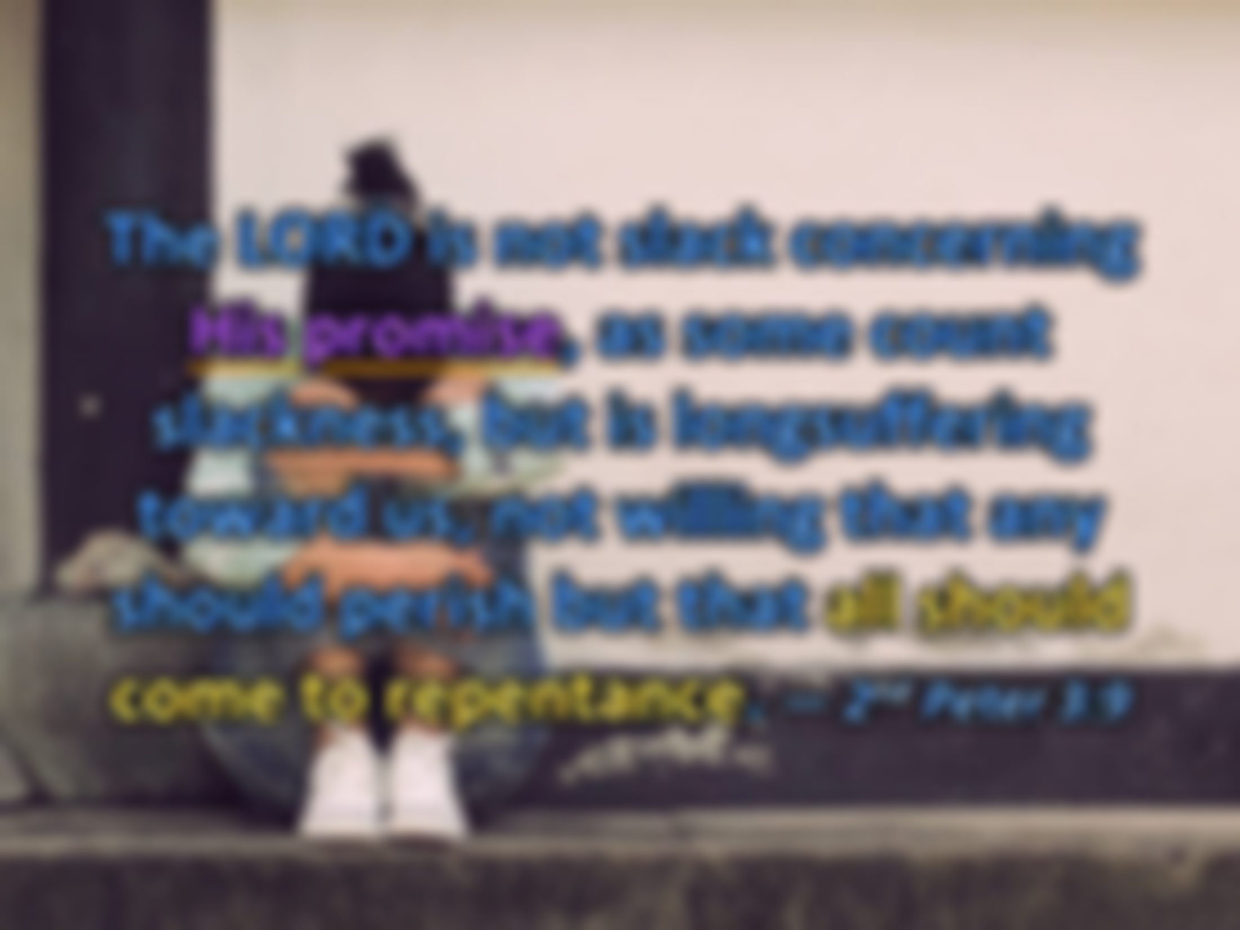


The LORD is not slack concerning His promise, as some count slackness, but is longsuffering toward us, not willing that any should perish but that all should come to repentance. — 2nd Peter 3:9
LORD
His promise
His promise
LORD
Notes:
For the person expecting everyone to apologize, this is not the call of God. Even though the Lord cannot be visibly seen in His entirety, one must see Him near to have any useful effect.

Slide 29
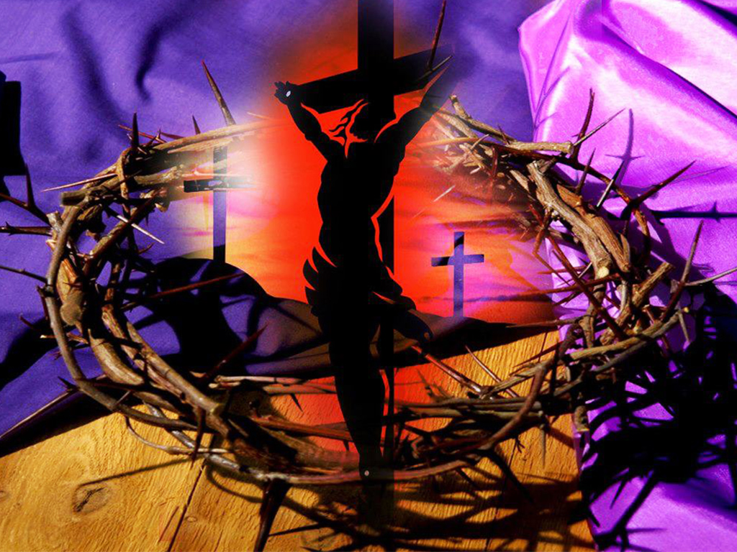
Therefore, beloved, looking forward to these things, be diligent to be found by Him in peace, without spot and blameless; and consider that the longsuffering of our LORD is salvation -- as also our beloved brother Paul, according to the wisdom given to him, has written to you, … — 2nd Peter 3:14-15
Therefore, beloved, looking forward to these things, be diligent to be found by Him in peace, without spot and blameless; and consider that the longsuffering of our LORD is salvation -- as also our beloved brother Paul, according to the wisdom given to him, has written to you, … — 2nd Peter 3:14-15
be
be diligent
be diligent
found by Him
in
in peace
in peace
blameless
blameless
LORD
=
Notes:
Only Jesus can save us from judgment that all deserve.

Slide 30
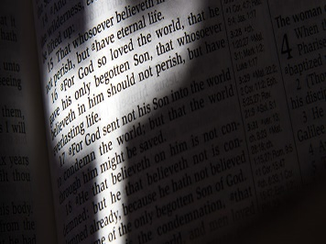




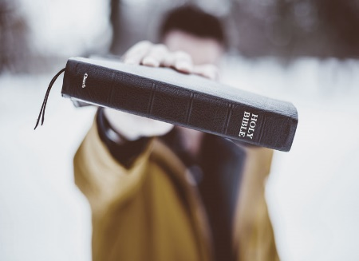

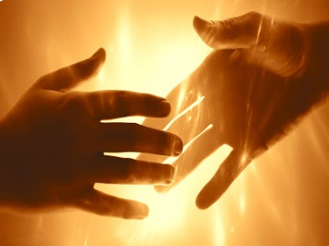

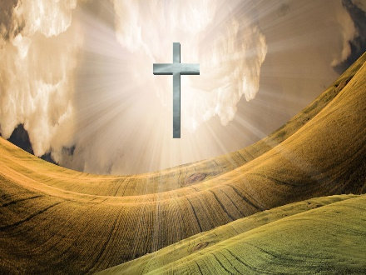



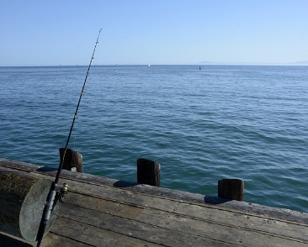
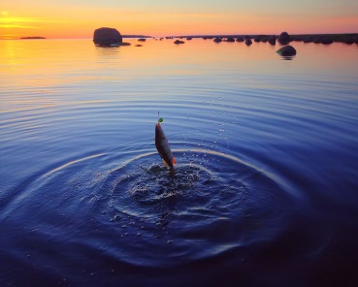
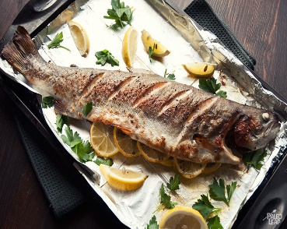


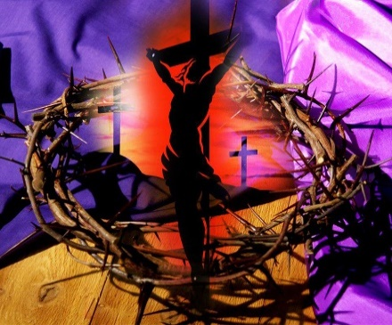



Slide 31


→ Convince, rebuke, exhort / longsuffering & teaching
→ Jesus will judge the living and the dead
→ Forgiveness is part of faith for those receptive
→ One must warn those sinning to be free of the same
→ Rebukes build the strength of the wise
→ He will convict sinners in righteousness & judgment
→ Confident steadfastness in faith wins the prize
→ It is good as we are able to correct one another
→ Endurance will involve many afflictions on His path
→ The Lord chastens all in order to refine character
→ Those patient in the faith receive the promise
→ Lose not heart doing good especially for the faithful
→ Pray God finds us at peace hoping in His salvation
The wind cannot change the direction God calls us to go
Notes:
The wind cannot change the direction God calls us to go

Slide 33

Please visit http://www.RonBert.com to explore further
Ronald Bert Channel on
Notes:
Eternity never ends.

