Slide 2
ONE
Ron Bert
June 6, 2021

Slide 3
"Hear, O Israel: The LORD our God, the LORD is one! "You shall love the LORD your God with all your heart, with all your soul, and with all your strength. — Deuteronomy 6:4-5
LORD is one
love the LORD
love the LORD
LORD
①
all
heart
②
all
LORD is one
strength
soul
③
all

Slide 4
Jesus answered him, "The first of all the commandments is: 'Hear, O Israel, the LORD our God, the LORD is one. — Mark 12:29
LORD
LORD
LORD
LORD is one
LORD is one
LORD
LORD is one
Notes:
Above all Jesus instructs us to know in God there is no division. In God is the whole of all truth.

Slide 5
'And you shall love the LORD your God with all your heart, with all your soul, with all your mind, and with all your strength.' This is the first commandment.' — Mark 12:30
LORD
all
heart
all
all
all
ONE
soul
all
mind
all
all
strength
all
first commandment
Notes:
There is no schism in our love for God. No division in devotion. Humbled under His gift of life, how can one not love that which created all for our experience to wonder independently; exclusively to possess the power of thought unique to each identity.

Slide 6
For there are three that bear witness in heaven: the Father, the Word, and the Holy Spirit; and these three are one. And there are three that bear witness on earth: the Spirit, the water, and the blood; and these three agree as one. — 1st John 5:7-8
witness in heaven:
1) the Father
2) the Word
3) Holy Spirit
witness on earth:
1) the Spirit
2) the water
3) the blood
witness in heaven:
the Father
= one
SON
the Word
Holy Spirit
one
witness
on earth:
the Spirit
the water
Eye of God
the blood
= one
Baptism
one
Sacrifice of life
Notes:
As the stars are of heights above earth’s ground, so does God’s presence permeate beyond all that is, from top to bottom at all there's to here’s. As God identifies with Himself, He looks to see the construct of each soul’s presence as well. What declares the whole truth of one is purpose of devotion. God watches as He asks we develop a character of service in observance of His ways.
Genesis 1:26 Then God said, "Let Us make man in Our image, according to Our likeness; let them have dominion over the fish of the sea, over the birds of the air, and over the cattle, over all the earth and over every creeping thing that creeps on the earth."
John 1:17 For the law was given through Moses, but grace and truth came through Jesus Christ.

Slide 7
There is one body and one Spirit, just as you were called in one hope of your calling; one Lord, one faith, one baptism; one God and Father of all, who is above all, and through all, and in you all. But to each one of us grace was given according to the measure of Christ's gift. — Ephesians 4:4-7
There is one body and one Spirit, just as you were called in one hope of your calling; one Lord, one faith, one baptism; one God and Father of all, who is above all, and through all, and in you all. But to each one of us grace was given according to the measure of Christ's gift. — Ephesians 4:4-7
one body
one Spirit
one body
one Spirit
one hope
one Lord
one faith
one baptism
one God
one
hope
one Lord
one faith
one baptism
one God
God
one
to each one of us
to each one of us
one
God
Notes:
As fingerprints offer tiny infinite diversity, the face of truth spreads her gifts endlessly most prolifically.

Slide 8
For I wish that all men were even as I myself. But each one has his own gift from God, one in this manner and another in that. — 1st Corinthians 7:7
each one
each one
own gift from God
one
God
own gift from God
gift
Notes:
Talent is something given to be discovered in the depths of each one’s character. Too often destructive vices or woes of living blur purpose, with the all to common breaths of despair, causing the detrimentals of death, instead of the invigorations of life.

Slide 9
One thing I have desired of the LORD, That will I seek: That I may dwell in the house of the LORD All the days of my life, To behold the beauty of the LORD, And to inquire in His temple. — Psalms 27:4
desire
desire
LORD
dwell
dwell
LORD
LORD
life
life
LORD
behold the beauty of the LORD
LORD
behold the beauty of the LORD
in
each one
inquire
His temple
His temple
Notes:
Situational specific, it is what one desires or chooses that life dwells upon. God again watches to see if we consider Him in the heart of our thoughts. His truth is so available if one desires. His promise holds a reality far beyond what ever could be supplied through the complexly simple which displays before our limited senses.

Slide 10
Also to You, O LORD, belongs mercy; For You render to each one according to his work. — Psalms 62:12
LORD
render to each one
render to each one
according to his work
according to his work
Notes:
None can work their way into heaven, however, one can work their way out of heaven by not heeding to His words of truth. Without effort to know God, how can we be deemed His friend, accepting, fearfully begging, His consideration?

Slide 11
… who "will render to each one according to his deeds": … — Romans 2:6
one
one
render to each one
deeds
deeds
Notes:
Each of us will be weighed on the balance of character in the brilliance of His unadulterated love.

Slide 12
It is good that one should hope and wait quietly For the salvation of the LORD. — Lamentations 3:26
one
one
wait
wait
Notes:
Salvation is a test of patience and inner self-control to the cause He has put forth.

Slide 13
As it is written: "There is none righteous, no, not one; — Romans 3:10
not
one
one
Notes:
Not one of us has not miserably failed. Failure is a condition of continually coping. Not giving up is our success as we all ride failures.

Slide 14
?
one
Notes:
Not one of us has not miserably failed. Failure is a condition of continually coping. Not giving up is our success as we all ride failures.

Slide 15
Let no one say when he is tempted, "I am tempted by God"; for God cannot be tempted by evil, nor does He Himself tempt anyone. But each one is tempted when he is drawn away by his own desires and enticed. Then, when desire has conceived, it gives birth to sin; and sin, when it is full-grown, brings forth death. — James 1:13-15
one thing
one
by his own desire
by his own desire
th
ing
Notes:
The gift of life is such that no one can blame God for the internalizations we all develop. Love of what we have, or disgust of what we don’t have, causes a soul to either be thankful or just fester.

Slide 16
Brethren, I do not count myself to have apprehended; but one thing I do, forgetting those things which are behind and reaching forward to those things which are ahead, I press toward the goal for the prize of the upward call of God in Christ Jesus. — Philippians 3:13-14
Therefore if there is any consolation in Christ, if any comfort of love, if any fellowship of the Spirit, if any affection and mercy, fulfill my joy by being like-minded, having the same love, being of one accord, of one mind. Let nothing be done through selfish ambition or conceit, but in lowliness of mind let each esteem others better than himself. Let each of you look out not only for his own interests, but also for the interests of others. Let this mind be in you which was also in Christ Jesus, … — Philippians 2:1-5
Therefore if there is any consolation in Christ, if any comfort of love, if any fellowship of the Spirit, if any affection and mercy, fulfill my joy by being like-minded, having the same love, being of one accord, of one mind. Let nothing be done through selfish ambition or conceit, but in lowliness of mind let each esteem others better than himself. Let each of you look out not only for his own interests, but also for the interests of others. Let this mind be in you which was also in Christ Jesus, … — Philippians 2:1-5
one thing
m
of God
upward call
in Christ Jesus
one accord
one accord
one mind
reaching
one mind
reaching
in
I in them
I
goal
goal
prize
upward call
of God
prize
the
in Christ Jesus
in
Notes:
Sanity can only be found by marching ahead leaving mistakes gone past as to lessons learned. Regret is the conscience of repentance. Hope is the inspiration of faith.

Slide 17
"… that they all may be one, as You, Father, are in Me, and I in You; that they also may be one in Us, that the world may believe that You sent Me. And the glory which You gave Me I have given them, that they may be one just as We are one: I in them, and You in Me; that they may be made perfect in one, and that the world may know that You have sent Me, and have loved them as You have loved Me." — John 17:21-23
may be one in Us
I in You
be made perfect in one
believe that You sent Me
I in them, and You in Me
be one just as We are one
I in You
may be one in Us
believe that You sent Me
in
one
one
be one just
I in them, and You in
as We are one
I in them
Me
be made perfect in
one
Notes:
God in us is what Jesus proclaimed as our creator savior. To stand on His strength delivers a transcendence wisdom.

Slide 18
So when they heard that, they raised their voice to God with one accord and said: "Lord, You are God, who made heaven and earth and the sea, and all that is in them, who by the mouth of Your servant David have said: 'Why did the nations rage, And the people plot vain things?'" — Acts 4:24-25
God
God
common
understanding
one accord
one accord
God
Why
Why
the nations rage
people
the nations rage
people
plot vain things
plot vain things
Notes:
What divides a people is by not having a common understanding. It is said common sense is social wisdom. Humble questions of why there is evil instead of embracing evil defines a people, and whether a culture is noble or wicked.

Slide 19
God
God
For I wish that all men were even as I myself. But each one has his own gift from God, one in this manner and another in that. — 1st Corinthians 7:7

Slide 20
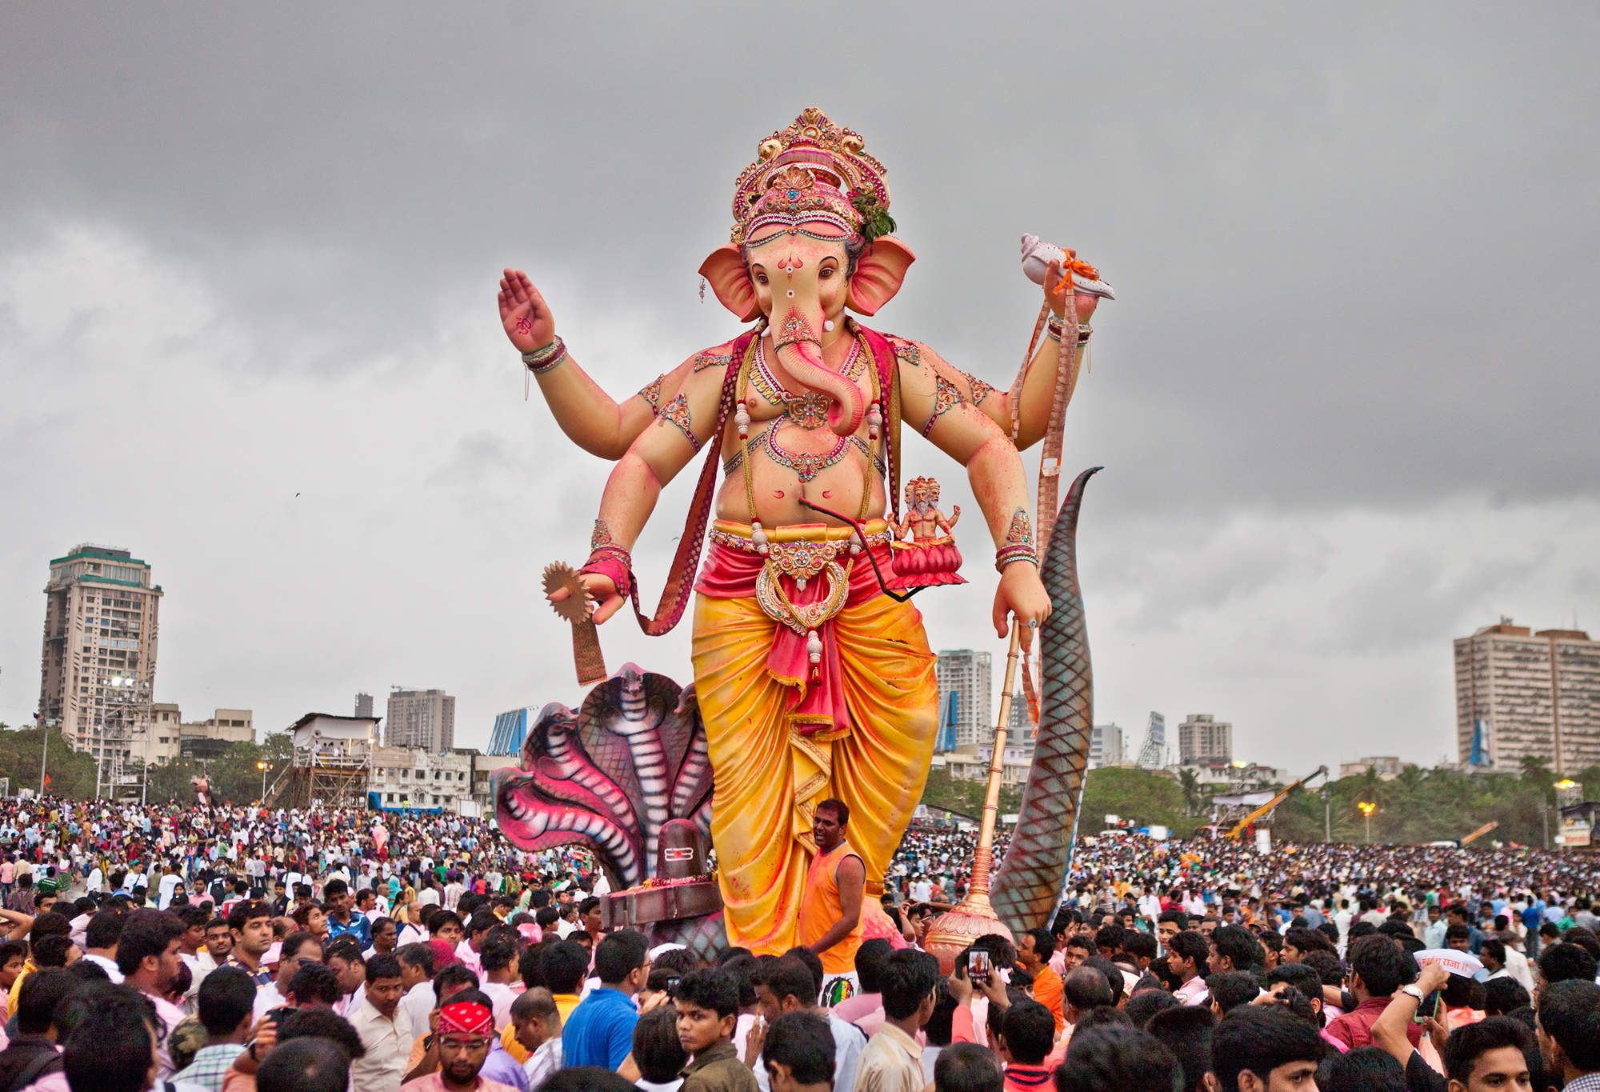
… yet for us there is one God, the Father, of whom are all things, and we for Him; and one Lord Jesus Christ, through whom are all things, and through whom we live. However, there is not in everyone that knowledge; for some, with consciousness of the idol, until now eat it as a thing offered to an idol; and their conscience, being weak, is defiled. — 1st Corinthians 8:6-7
one God, the Father
whom are all things
we for Him
God
God
one God, the Father
we for Him
one Lord
Jesus Christ
whom are all things
t
r
u
whom
one Lord
Jesus Christ
whom we live
we live
not in
God
everyone
knowledge
e
true
knowledge
not in everyone
Notes:
God reigns over all false religions, no matter how bizarre or twisted the creations man chooses to worship. Artistic creations allure man’s outward senses where God looks to the desires of heart, to assess a soul. God is worshipped from the inside, not the outside.

Slide 21
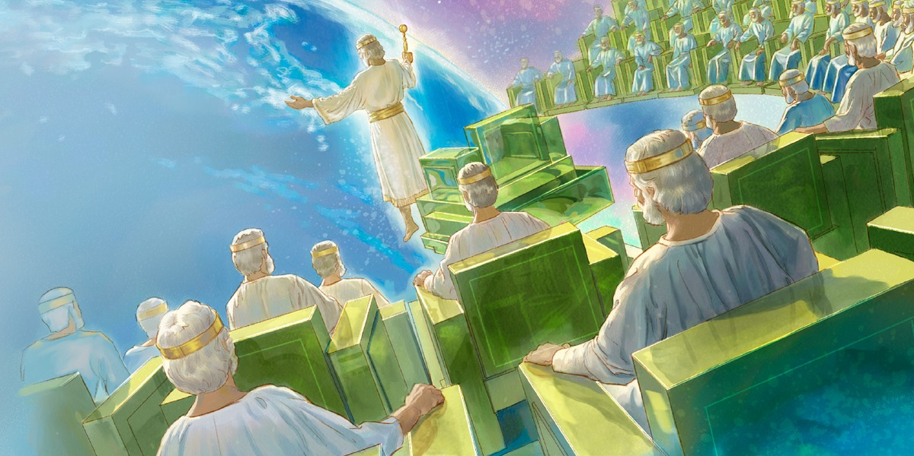
Therefore concerning the eating of things offered to idols, we know that an idol is nothing in the world, and that there is no other God but one. For even if there are so-called gods, whether in heaven or on earth (as there are many gods and many lords), … — 1st Corinthians 8:4-5
idol is nothing
idol is nothing
one
God
God
one
Notes:
Material edifices pale in the glory of His majesty where earth is but dust passing in time.

Slide 22
For there is one God and one Mediator between God and men, the Man Christ Jesus, — 1st Timothy 2:5
one
God
one God
one
Mediator
Notes:
Jesus Christ will find each of us before the door to eternity. To not call upon Him reduces a soul to not having an advocate as evil is expelled.
The only way to achieve success is to never give up on attempting to further clarity of thought. Drowning occurs when laziness passes the gumption to pursue what one can be sure of no matter the cost. Security is when insecurity is not an option. As Apollo 13 exposed the best of us, this quality to get it done shines on all that is great.

Slide 23
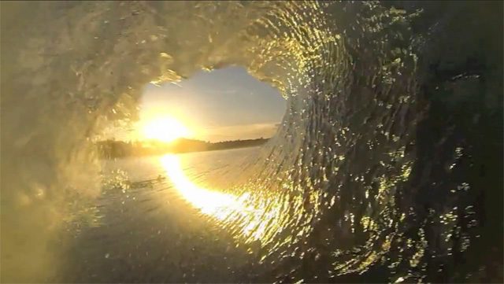
O
n
e
one God
M
e
d
i
a
t
o
r

Slide 24
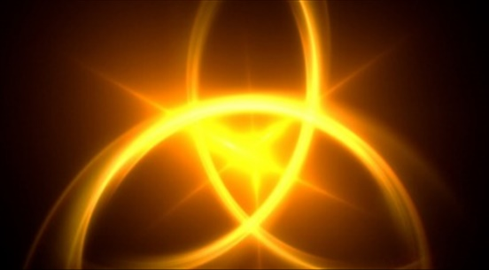
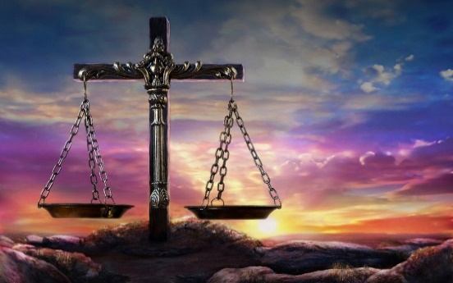

Slide 25
→ The Lord God is One
→ One must love God with one’s all
→ God is multifaceted in the oneness that He is
→ One body & Spirit, one hope, one faith, one God
→ Each one has his own gift from God
→ According to one’s deeds determines judgment
→ Patient hope is the good path to salvation
→ All have fallen short of the righteousness of God
→ Each person is tempted by their own desires
→ One thing to do is to let the past go reaching ahead
→ To find God sees Him in the life that we are
→ A common cry goes forth why mankind rages/plots
→ All live through one God, and one Lord Jesus Christ
In His Oneness all is, and we in Him
Notes:
In His Oneness all is, and we in Him

Slide 27
Please visit http://www.LoveFromGod.com to explore further
Ronald Bert Channel on
Notes:
Eternity never ends.

