Slide 2

Once For All
Ron Bert
September 9, 2018

Slide 3

… for all have sinned and fall short of the glory of God, … — Romans 3:23
sins
sins
sin
s
Christ
"Why does this Man speak blasphemies like this? Who can forgive sins but God alone?" — Mark 2:7
And He Himself is the propitiation for our sins, and not for ours only but also for the whole world. — 1st John 2:2
sins
forgive sins but God alone
God
Notes:
If your trying to get to God through a mere exalted man or woman, one is gravely mistaken.
Isa 1:18 "Come now, and let us reason together," Says the LORD, "Though your sins are like scarlet, They shall be as white as snow; Though they are red like crimson, They shall be as wool.

Slide 4

If we confess our sins, He is faithful and just to forgive us our sins and to cleanse us from all unrighteousness. — 1st John 1:9
sins
confess
sins
He
sins
sins
cleanse us
Notes:
Most religions on earth are religions of guilt. The religion of Jesus is redemption.

Slide 5
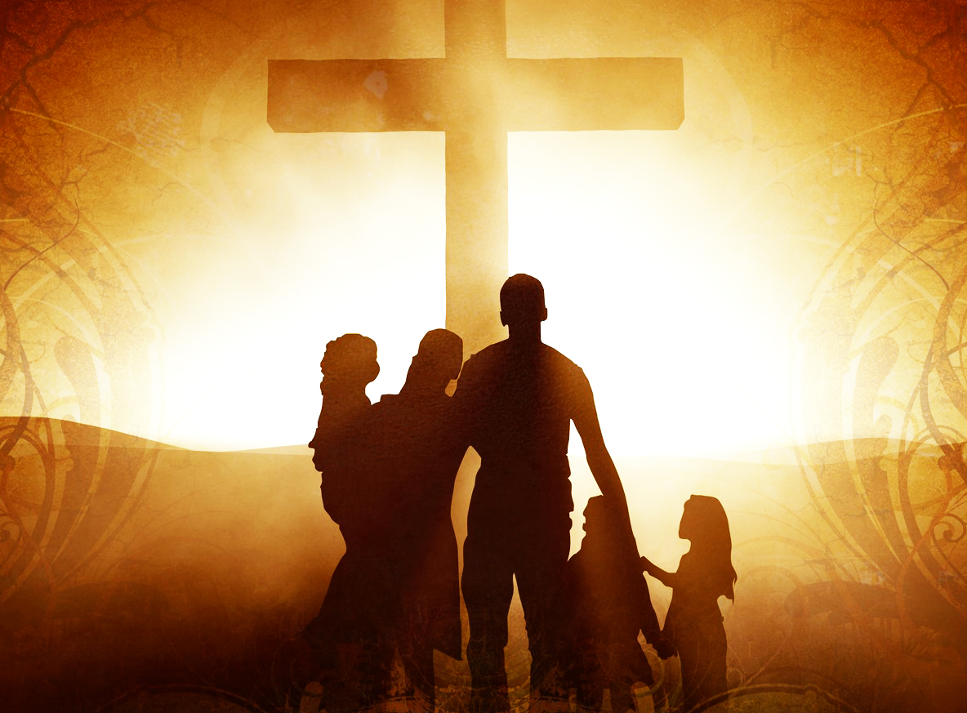
And you He made alive, who were dead in trespasses and sins, in which you once walked according to the course of this world, according to the prince of the power of the air, the spirit who now works in the sons of disobedience, among whom also we all once conducted ourselves in the lusts of our flesh, fulfilling the desires of the flesh and of the mind, and were by nature children of wrath, just as the others. — Ephesians 2:1-3
He made alive
sins
spirit
spirit
once conducted
desires
children of wrath

Slide 6
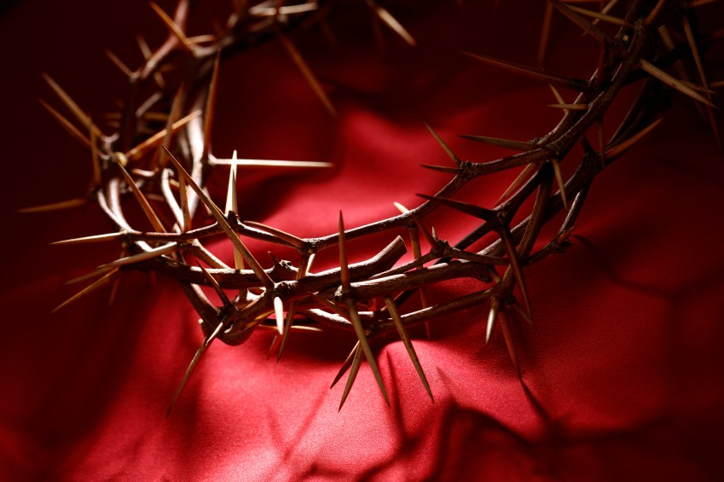
But now in Christ Jesus you who once were far off have been brought near by the blood of Christ. — Ephesians 2:13
in
Christ
Spirit
Spirit
by the blood
Christ

Slide 7
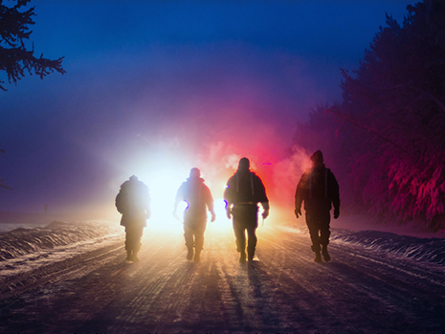
Let no one deceive you with empty words, for because of these things the wrath of God comes upon the sons of disobedience. Therefore do not be partakers with them. For you were once darkness, but now you are light in the Lord. Walk as children of light (for the fruit of the Spirit is in all goodness, righteousness, and truth), finding out what is acceptable to the Lord. And have no fellowship with the unfruitful works of darkness, but rather expose them. — Ephesians 5:6-11
iv
empty words
Let no one deceive you with empty words, for because of these things the wrath of God comes upon the sons of disobedience. Therefore do not be partakers with them. For you were once darkness, but now you are light in the Lord. Walk as children of light (for the fruit of the Spirit is in all goodness, righteousness, and truth), finding out what is acceptable to the Lord. And have no fellowship with the unfruitful works of darkness, but rather expose them. — Ephesians 5:6-11
wrath of God
sons of disobedience
sons of disobedience
in
return
Walk
children of light
children of light
Spirit
in
living in
Spirit
in
. .
finding
truth
ing
l
unfruitful works
expose them

Slide 8

For we ourselves were also once foolish, disobedient, deceived, serving various lusts and pleasures, living in malice and envy, hateful and hating one another. — Titus 3:3
Wickedness
● foolish
● deceived
● disobedient
● serving various lusts
● living in malice and envy
● hateful and hating
Meanness
Nastiness
foolish
disobedient
deceived
serving various lusts
Spite
Evil
living in
living in malice and
malice
envy
hateful and hating
Hatred
Cruelty

Slide 9
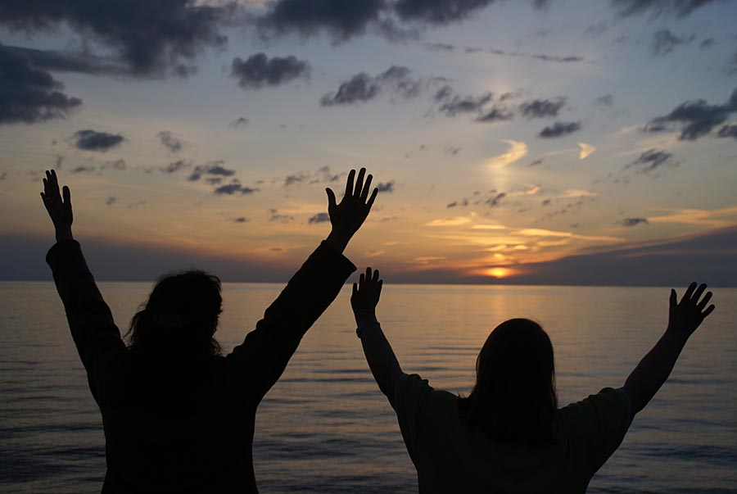
And you, who once were alienated and enemies in your mind by wicked works, yet now He has reconciled in the body of His flesh through death, to present you holy, and blameless, and above reproach in His sight -- if indeed you continue in the faith, grounded and steadfast, and are not moved away from the hope of the gospel which you heard, which was preached to every creature under heaven, of which I, Paul, became a minister. — Colossians 1:21-23
once were alienated
continue in the faith:
└ grounded and steadfast
● not moved away from hope
of the gospel ┘
in
Love
gospel
continue in the faith
if
faith
grounded and steadfast
not moved
away from
hope
of the gospel
hope

Slide 10

For the death that He died, He died to sin once for all; but the life that He lives, He lives to God. — Romans 6:10
sin
once for all
God
live
God
live
Notes:
Ro 14:8 For if we live, we live to the Lord; and if we die, we die to the Lord. Therefore, whether we live or die, we are the Lord's.

Slide 11

For Christ also suffered once for sins, the just for the unjust, that He might bring us to God, being put to death in the flesh but made alive by the Spirit, … — 1st Peter 3:18
Christ
suffered once
just for the unjust
He might bring us to God
God
Christ
live

Slide 12
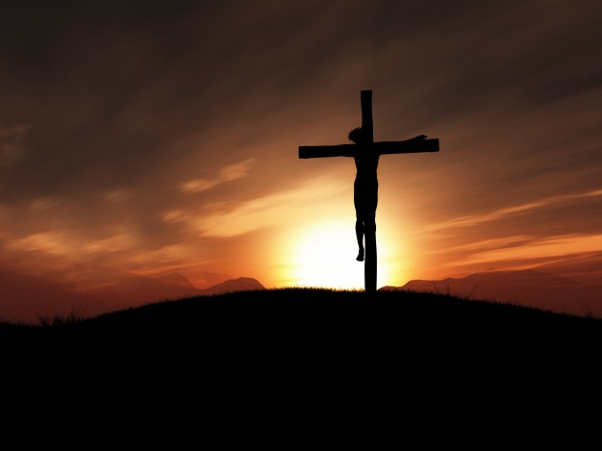
By that will we have been sanctified through the offering of the body of Jesus Christ once for all. — Hebrews 10:10
sanctified
Christ
once for
all

Slide 13

And every priest stands ministering daily and offering repeatedly the same sacrifices, which can never take away sins. But this Man, after He had offered one sacrifice for sins forever, sat down at the right hand of God, from that time waiting till His enemies are made His footstool. For by one offering He has perfected forever those who are being sanctified. — Hebrews 10:11-14
every priest
repeatedly
offering repeatedly
never take away
sins
one sacrifice for sins forever
forever
one offering
repeatedly
perfected forever
forever

Slide 14
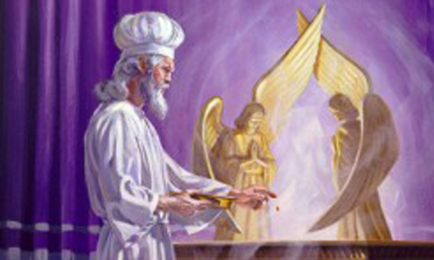
But into the second part the high priest went alone once a year, not without blood, which he offered for himself and for the people's sins committed in ignorance; — Hebrews 9:7
"Truly, these times of ignorance God overlooked, but now commands all men everywhere to repent, …" — Acts 17:30
"Truly, these times of ignorance God overlooked, but now commands all men everywhere to repent, …" — Acts 17:30
blood
in
ignorance
blood
repeatedly

Slide 15
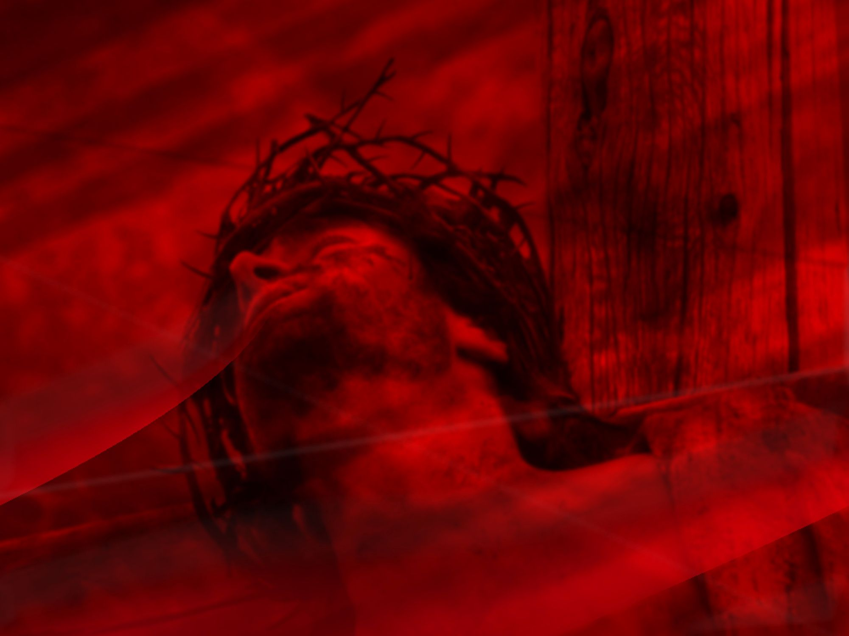
But Christ came as High Priest of the good things to come, with the greater and more perfect tabernacle not made with hands, that is, not of this creation. Not with the blood of goats and calves, but with His own blood He entered the Most Holy Place once for all, having obtained eternal redemption. — Hebrews 9:11-12
Christ
Christ
blood
blood
once for all
blood

Slide 16

For Christ has not entered the holy places made with hands, which are copies of the true, but into heaven itself, now to appear in the presence of God for us; not that He should offer Himself often, as the high priest enters the Most Holy Place every year with blood of another — Hebrews 9:24-25
often
Christ
in the presence of God for us
not
offer Himself
often
often
blood
Notes:
Acts 5:29 But Peter and the other apostles answered and said: "We ought to obey God rather than men.

Slide 17

He then would have had to suffer often since the foundation of the world; but now, once at the end of the ages, He has appeared to put away sin by the sacrifice of Himself. And as it is appointed for men to die once, but after this the judgment, so Christ was offered once to bear the sins of many. To those who eagerly wait for Him He will appear a second time, apart from sin, for salvation. — Hebrews 9:26-28
often
Christ
offered once
offered once to bear the sins of many

Slide 18
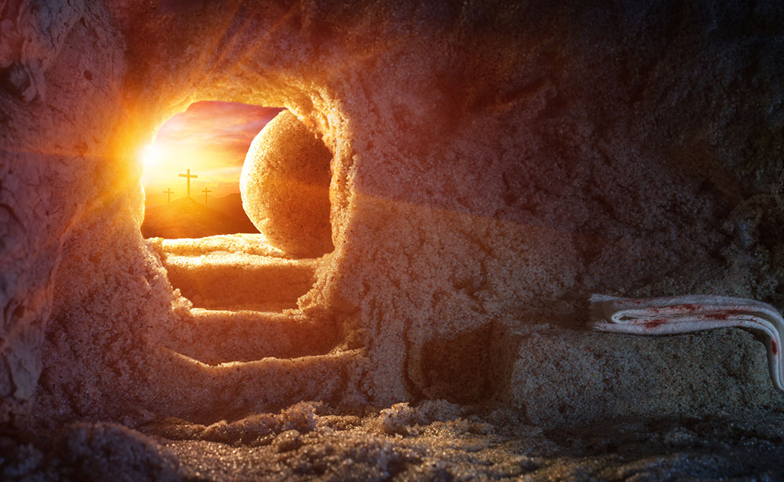
For such a High Priest was fitting for us, who is holy, harmless, undefiled, separate from sinners, and has become higher than the heavens; who does not need daily, as those high priests, to offer up sacrifices, first for His own sins and then for the people's, for this He did once for all when He offered up Himself. — Hebrews 7:26-27
higher than the heavens
once for all
He did once for all
once for all
up

Slide 19
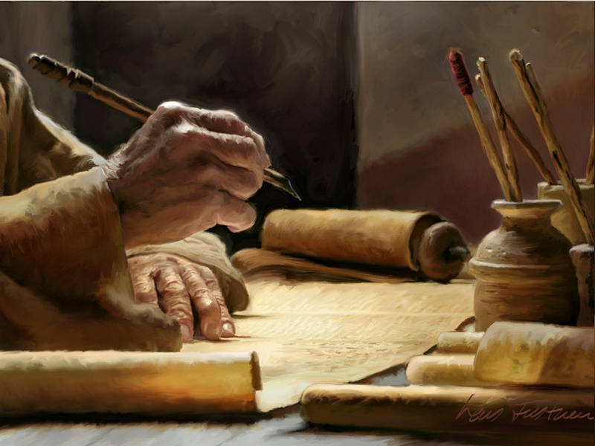
Beloved, while I was very diligent to write to you concerning our common salvation, I found it necessary to write to you exhorting you to contend earnestly for the faith which was once for all delivered to the saints. — Jude 1:3
common salvation
the faith
once for all
once for all

Slide 20

For it is impossible for those who were once enlightened, and have tasted the heavenly gift, and have become partakers of the Holy Spirit, and have tasted the good word of God and the powers of the age to come, if they fall away, to renew them again to repentance, since they crucify again for themselves the Son of God, and put Him to an open shame. — Hebrews 6:4-6
enlightened
God
heavenly gift
Holy Spirit
good word of God
God
fall away
God
crucify again
God

Slide 21

Now may the God of patience and comfort grant you to be like -minded toward one another, according to Christ Jesus, that you may with one mind and one mouth glorify the God and Father of our Lord Jesus Christ. — Romans 15:5-6
God
like -
minded toward one another
one
one
one
one mind
one mouth
one
glorify
God
Notes:
Eph 4:4 -6There is one body and one Spirit, just as you were called in one hope of your calling; 5 one Lord, one faith, one baptism; 6 one God and Father of all, who is above all, and through all, and in you all.

Slide 22
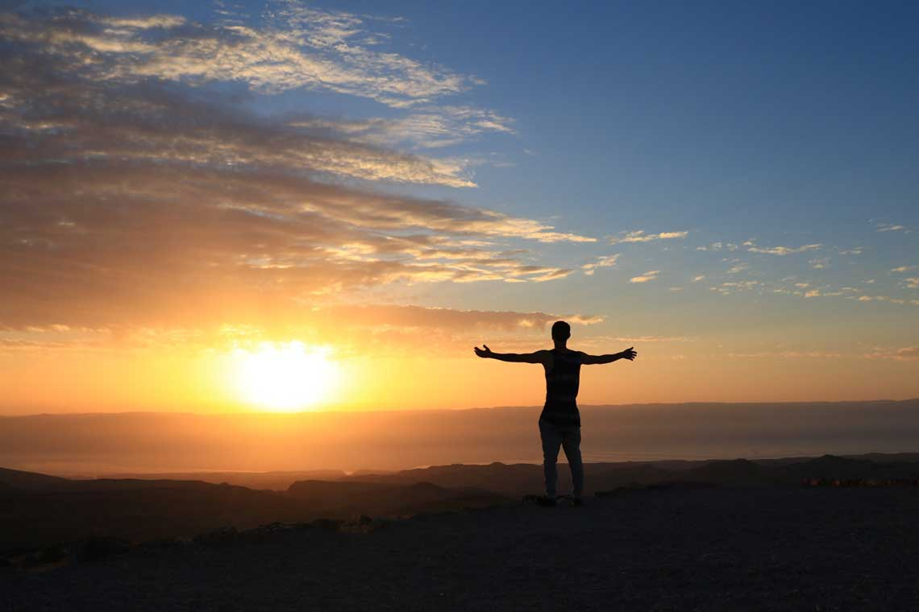
I have fought the good fight, I have finished the race, I have kept the faith. — 2nd Timothy 4:7
kept the faith
one

Slide 23

→ All have sinned and fall short
→ Confession purges sins in pursuit of righteousness
→ Once far off we are now close through Christ
→ Do not be deceived with empty words of darkness
→ One is reconciled if remaining in the faith
→ Jesus died once for all and now lives to God
→ We are sanctified once for all by Christ’s sacrifice
→ Priests sacrificed once/year for sins of ignorance
→ Christ has risen once for all for eternal redemption
→ Christ does not have to re-offer Himself for sins
→ It is appointed for men to die once
→ Christ offered Himself once for the sins of many
→ Faith was once for all delivered to the saints
We have what God wants us to know

Slide 25

Please visit http://www.LoveFromGod.com to explore further
Ronald Bert Channel on
Notes:
Eternity never ends.

