Slide 2



MUST
Ron Bert
January 31, 2021

Slide 3
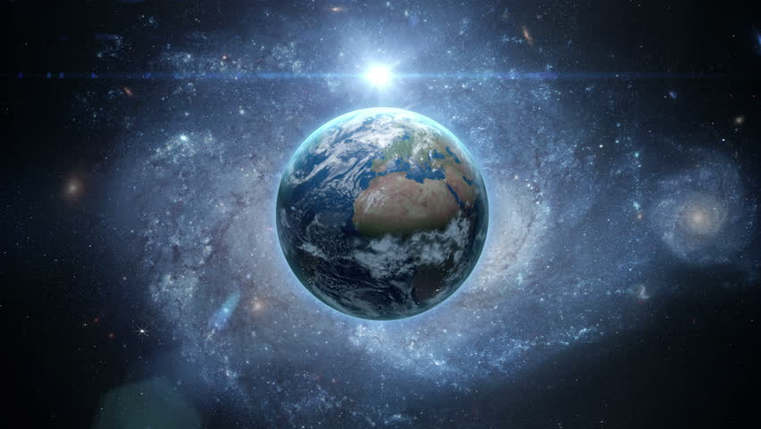
And there is no creature hidden from His sight, but all things are naked and open to the eyes of Him to whom we must give account. — Hebrews 4:13
must
must give account
must
must give account
Notes:
The source of all life in light will gauge each heart by how it loved or not.

Slide 4

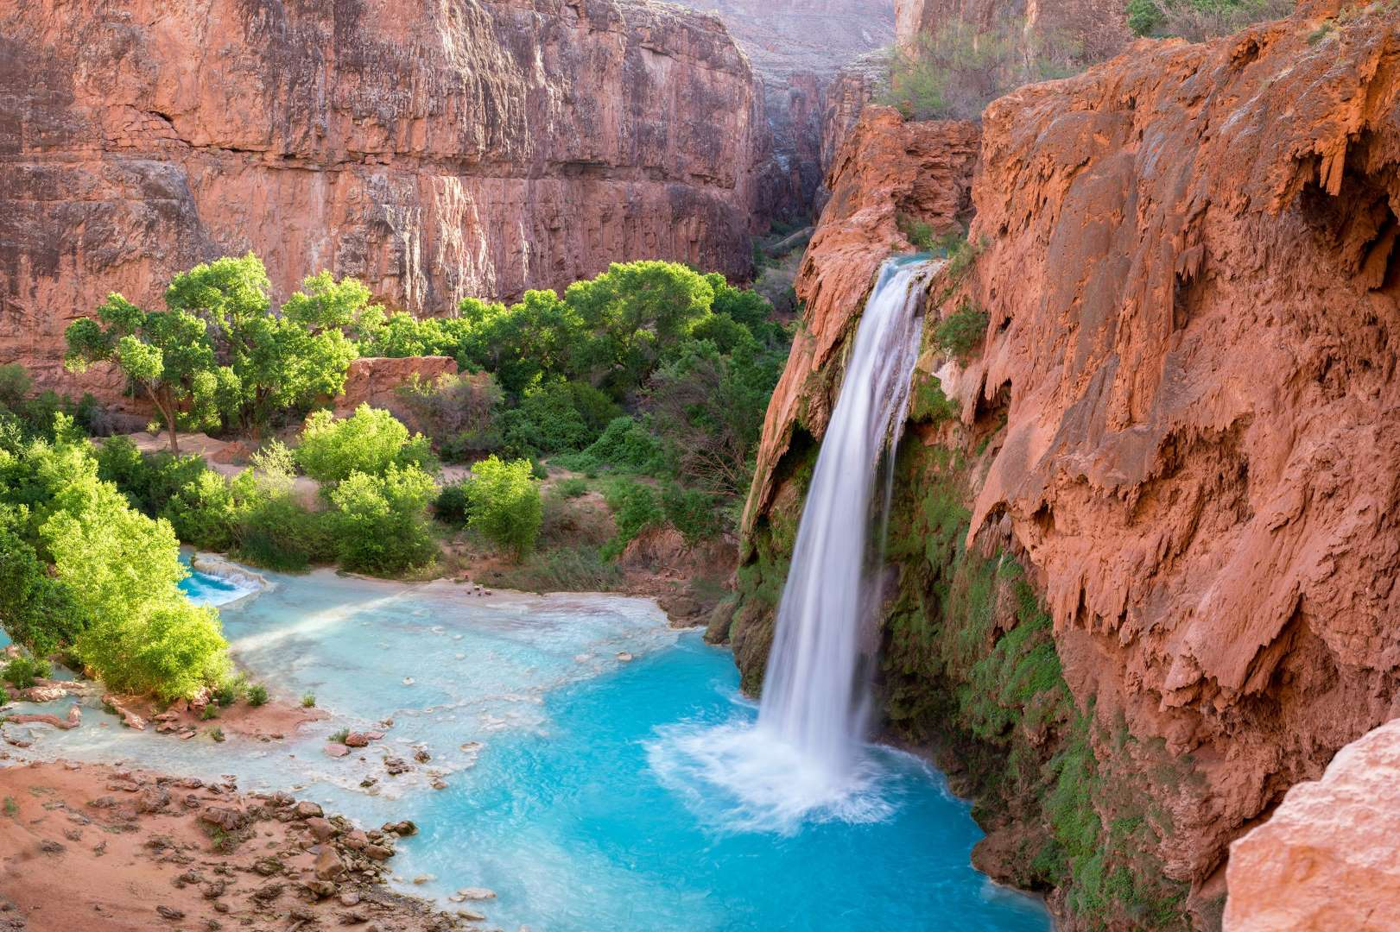
Therefore we must give the more earnest heed to the things we have heard, lest we drift away. For if the word spoken through angels proved steadfast, and every transgression and disobedience received a just reward, how shall we escape if we neglect so great a salvation, which at the first began to be spoken by the Lord, and was confirmed to us by those who heard Him, … — Hebrews 2:1-3
must
must give
must give
heed to the things we have heard
warning
heed to the things we have heard
must
drift away
receive
receive
justice
just reward
just reward
if we neglect
Him
Notes:
In the most sincere terms God calls to all in hope for the genuine.

Slide 5
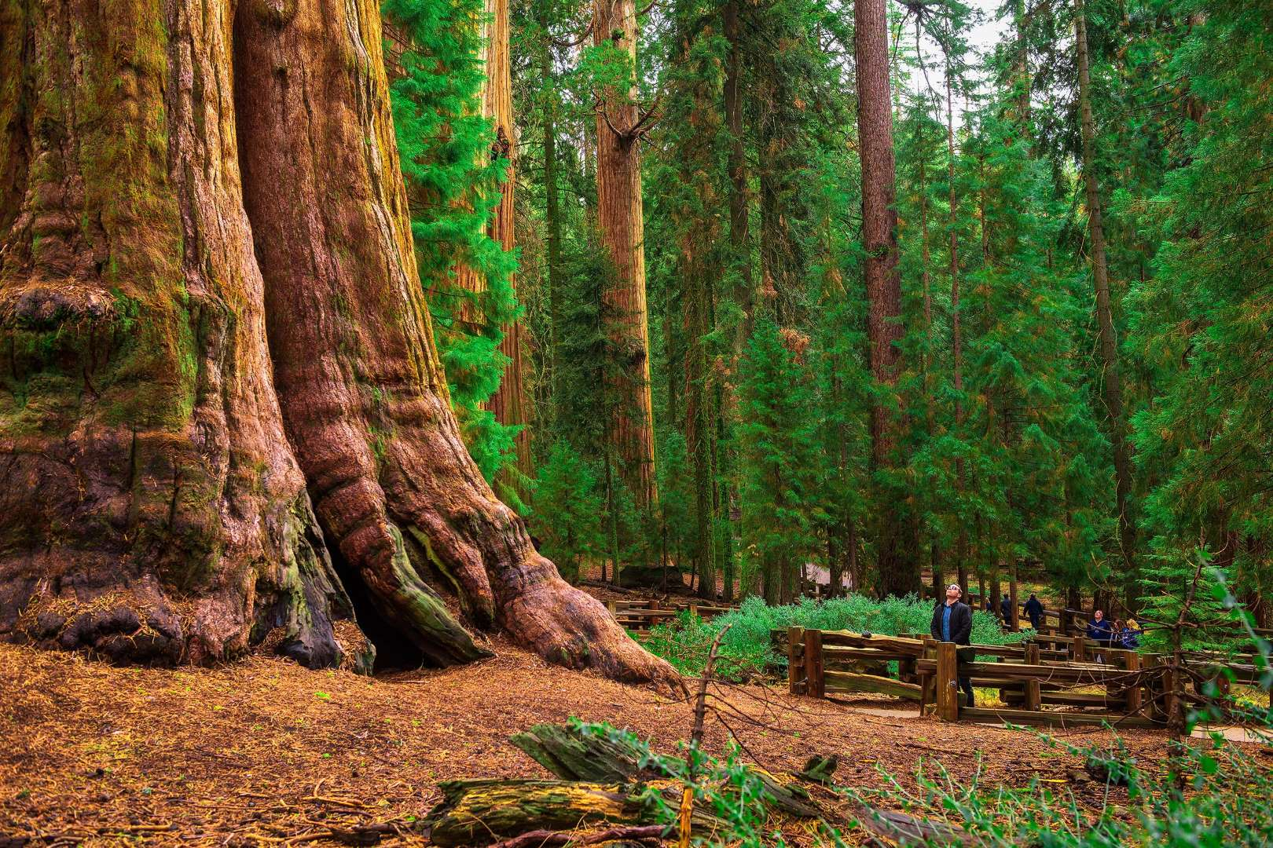
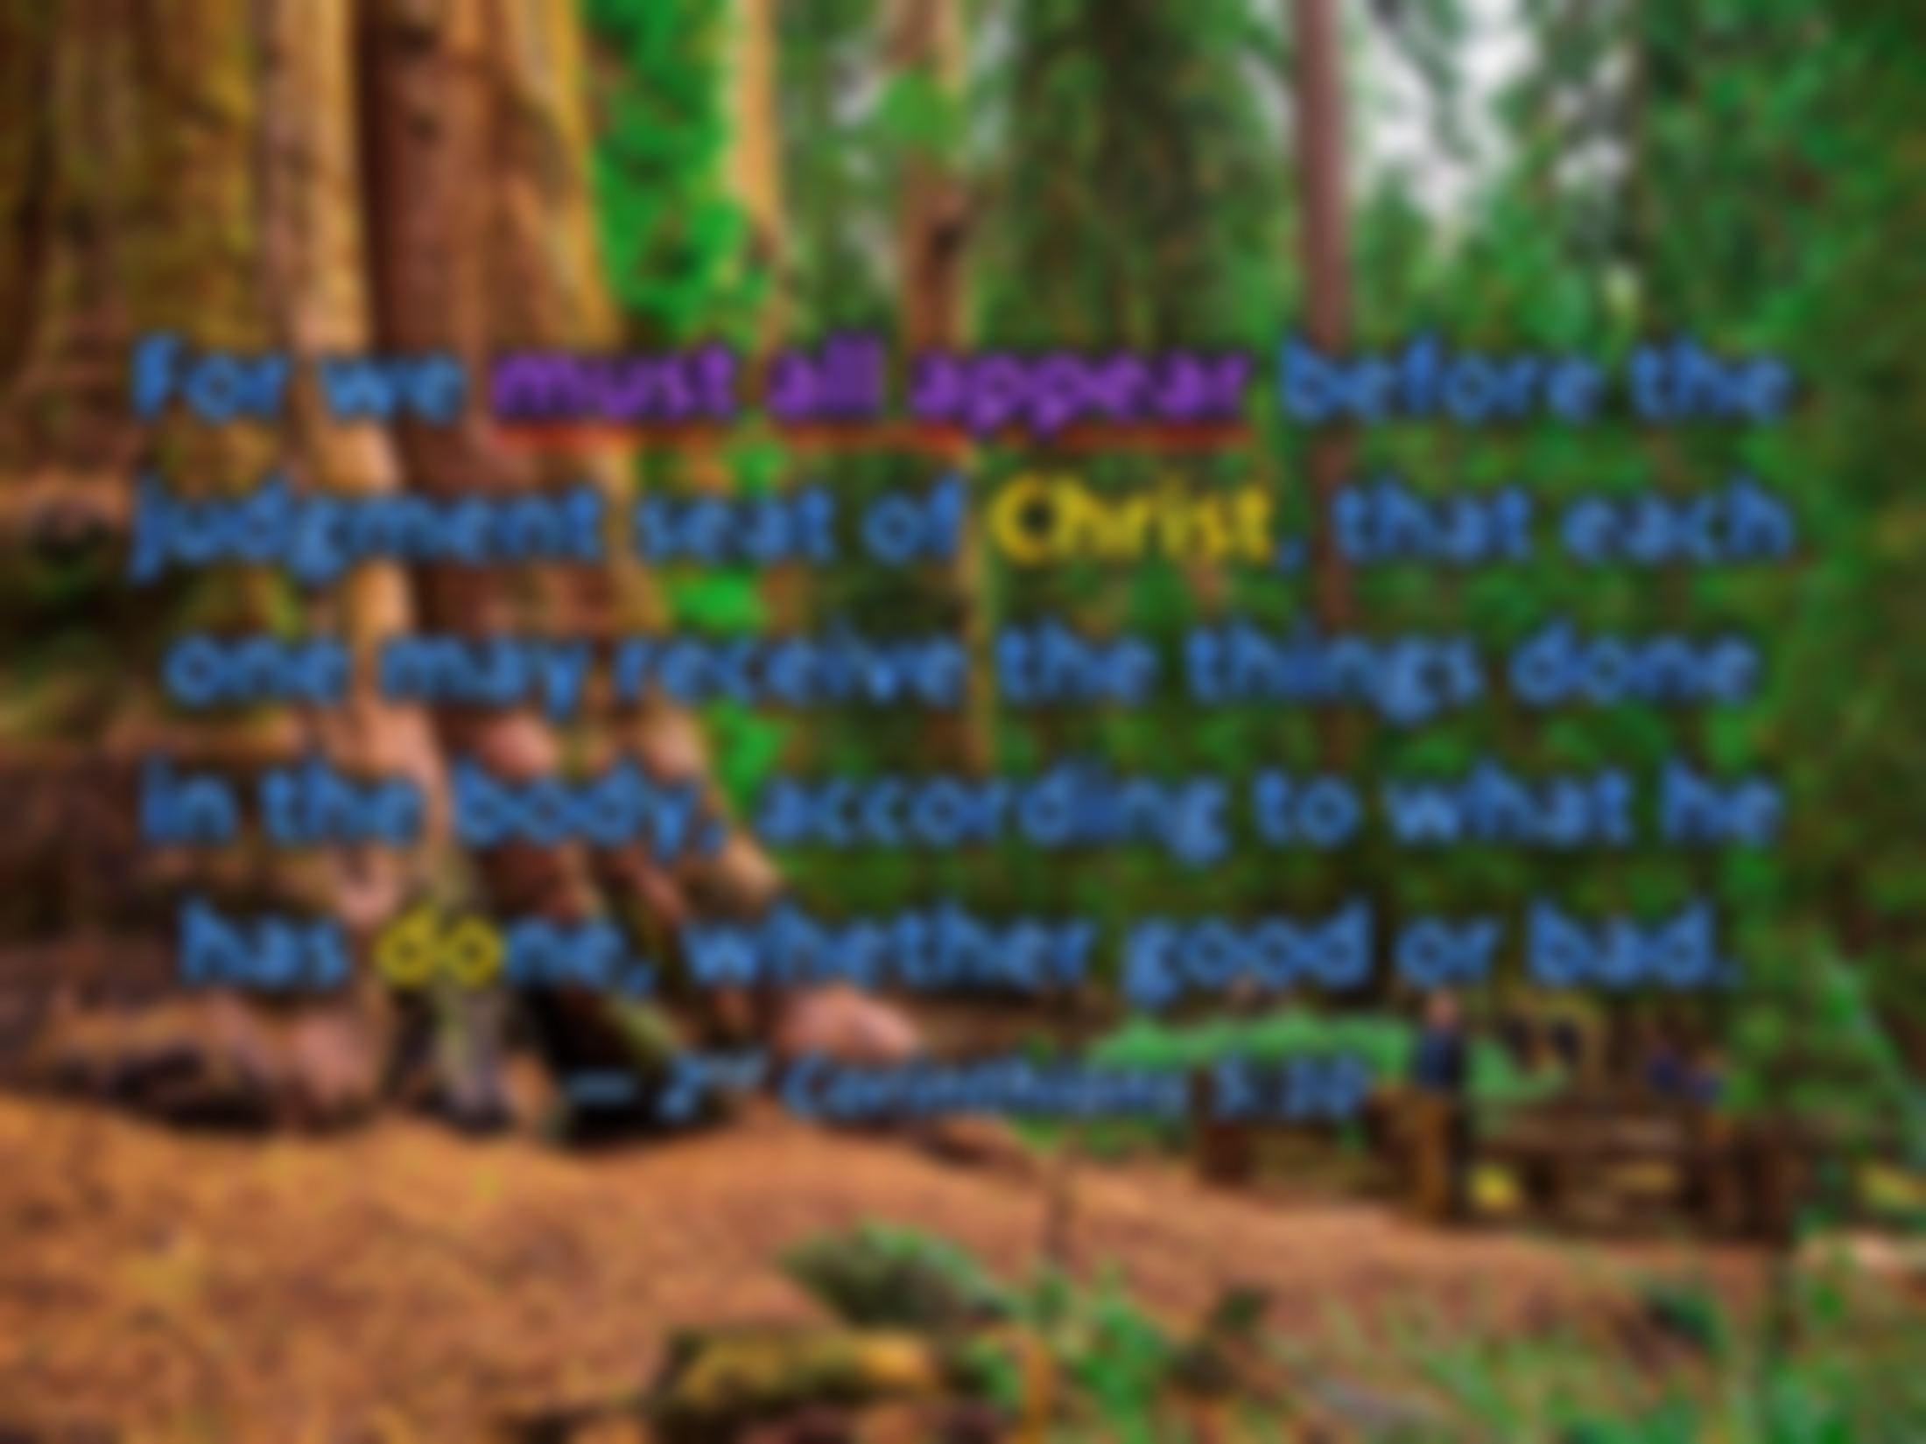

For we must all appear before the judgment seat of Christ, that each one may receive the things done in the body, according to what he has done, whether good or bad. — 2nd Corinthians 5:10
must all appear
must
must all appear
Christ
must
receive
good
bad
Notes:
Courage of spirit is lacking when cowards lie as their last front of protection. To not be humbled by the bottom of the sky is to exalt oneself over the dust below.

Slide 6
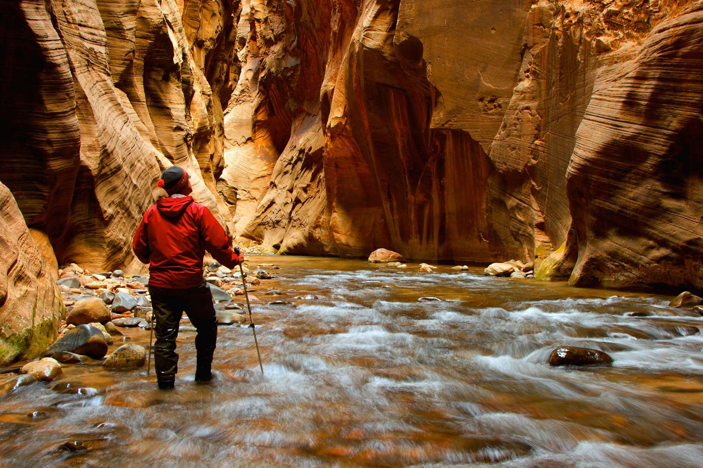
You therefore must endure hardship as a good soldier of Jesus Christ. — 2nd Timothy 2:3
must endure
must
must endure
good soldier
of
Jesus Christ
must
good soldier
of Jesus Christ
Jesus Christ
Notes:
In the canyons of life, cliffs arise meant to inspire heights yet unknown.

Slide 7
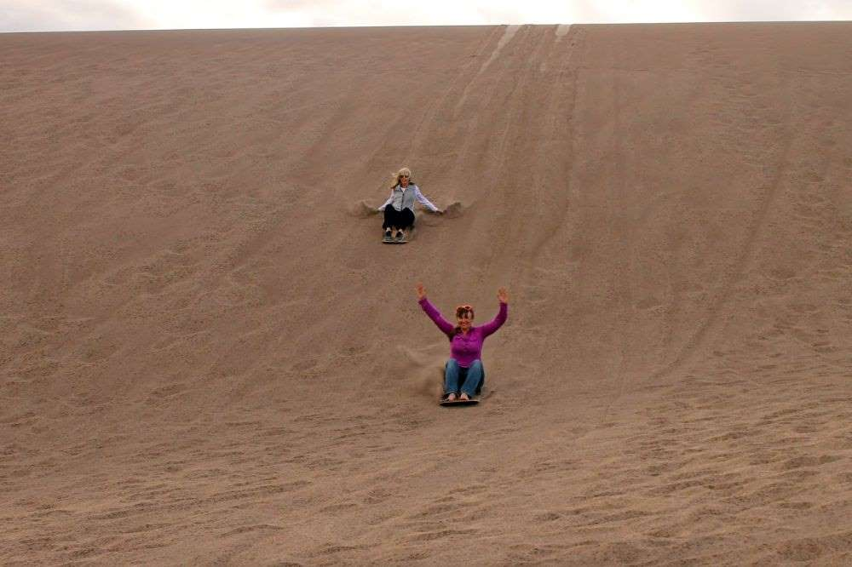
Therefore, as the elect of God, holy and beloved, put on tender mercies, kindness, humility, meekness, longsuffering; bearing with one another, and forgiving one another, if anyone has a complaint against another; even as Christ forgave you, so you also must do. But above all these things put on love, which is the bond of perfection. — Colossians 3:12-14
put on:
• tender mercies
• kindness
• humility
• meekness
• longsuffering
• bearing with one another
• forgiving one another
• love
put on
tender
mercies
kindness
humility
meekness
longsuffering
bearing with one another
forgiving one another
forgiving one another
forgiving one another
must
do
you also must do
must
you also must do
love
Notes:
God knows one of our weaknesses is being unable to have forgiving hearts. We more often judge one another, and so condemn those we know, to the detriment of our greater joy in the freedom found in simple love.

Slide 8
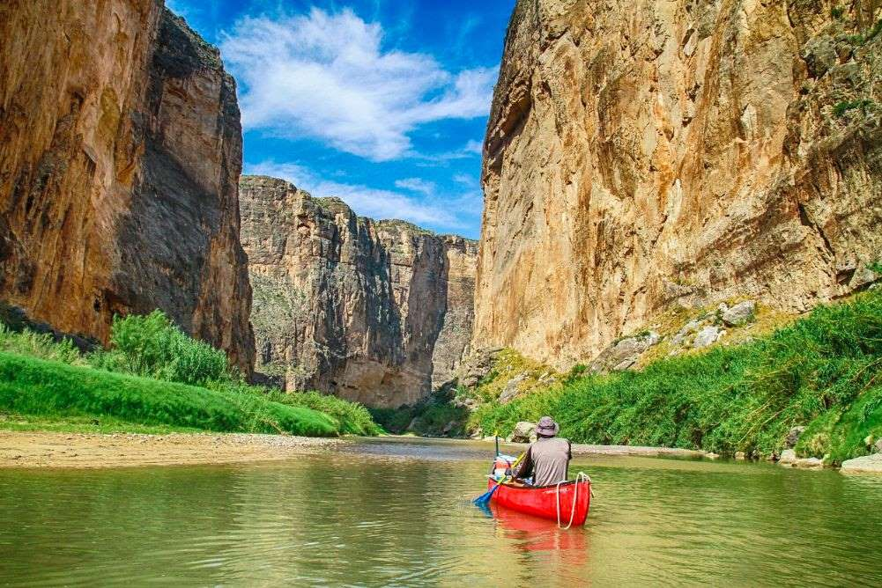
And this commandment we have from Him: that he who loves God must love his brother also. — 1st John 4:21
must
must love his brother
must
must love his brother

Slide 9

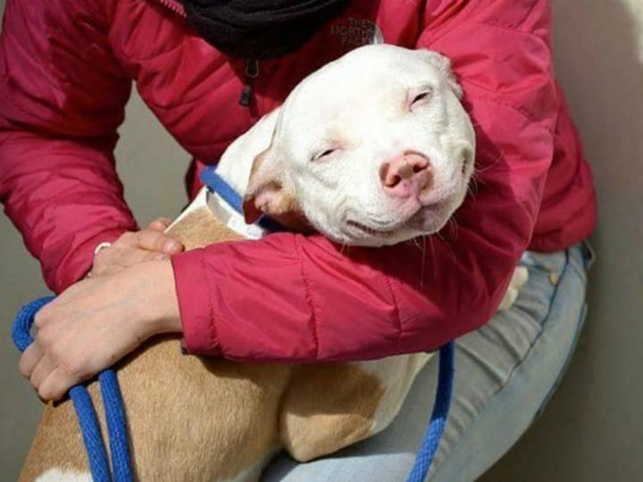
A man who has friends must himself be friendly, But there is a friend who sticks closer than a brother. — Proverbs 18:24
must
must
must
must
be friendly
be friendly
Notes:
Unconditional love is a truly rare event in all the twistings this conscious life presents. As animals commit in subservience, its’ lesson shows us the reflection of true love beyond measure. Life can not live without the simplest of ingredients, love.

Slide 10
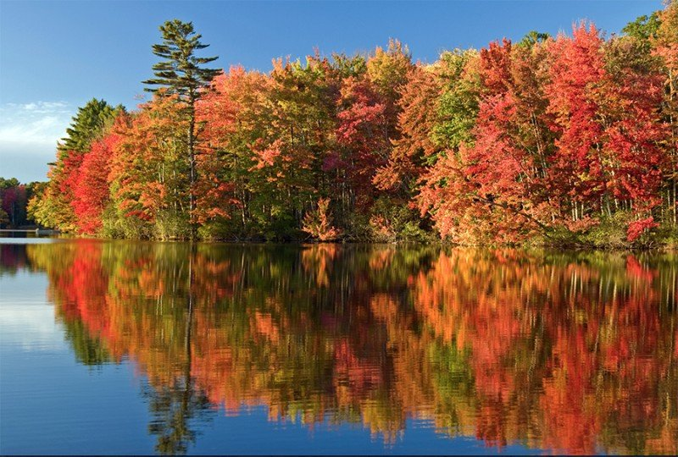
And a servant of the Lord must not quarrel but be gentle to all, able to teach, patient, in humility correcting those who are in opposition, if God perhaps will grant them repentance, so that they may know the truth, and that they may come to their senses and escape the snare of the devil, having been taken captive by him to do his will. — 2nd Timothy 2:24-26
servant of the Lord
must
must not
quarrel
but
be gentle to all
able to
teach
patient
in humility correcting
servant of the Lord:
must not quarrel
but
be gentle to all
able to teach
patient
in humility correcting
servant of the Lord:
must not quarrel
but
be gentle to all
able to teach
patient
in humility correcting
know the truth
know the truth
come to their senses
come to their senses
escape the snare of the devil
escape the snare of the devil
must
do
Notes:
If truth is one’s quest, the senses reveal evils cleavage, on God’s call to return in wholesome awareness.

Slide 11

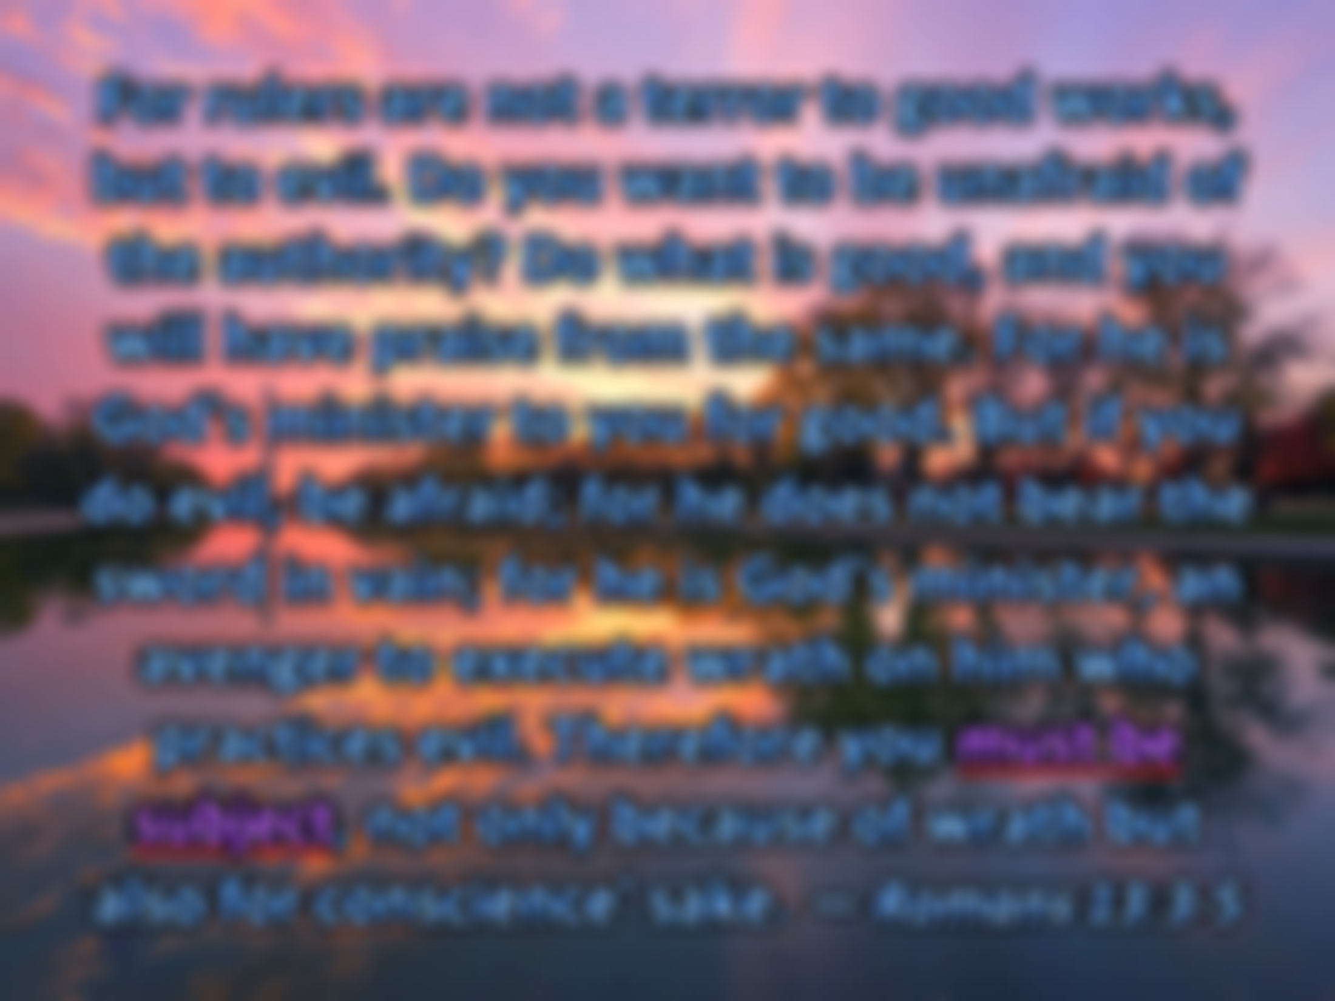

For rulers are not a terror to good works, but to evil. Do you want to be unafraid of the authority? Do what is good, and you will have praise from the same. For he is God's minister to you for good. But if you do evil, be afraid; for he does not bear the sword in vain; for he is God's minister, an avenger to execute wrath on him who practices evil. Therefore you must be subject, not only because of wrath but also for conscience' sake. — Romans 13:3-5
Do what is good
Do what is good
must
must be
must be
subject
must
subject
for conscience' sake

Slide 12

Jesus answered, "Most assuredly, I say to you, unless one is born of water and the Spirit, he cannot enter the kingdom of God. That which is born of the flesh is flesh, and that which is born of the Spirit is spirit. Do not marvel that I said to you, 'You must be born again.'" — John 3:5-7
must
must be born again
must
must be born again
awake to truth
Notes:
To have a higher state of consciousness, one must see through the lens of an omnipotent creator, father of all. As such, birth into eternity is something unnatural to where all flesh dies.

Slide 13
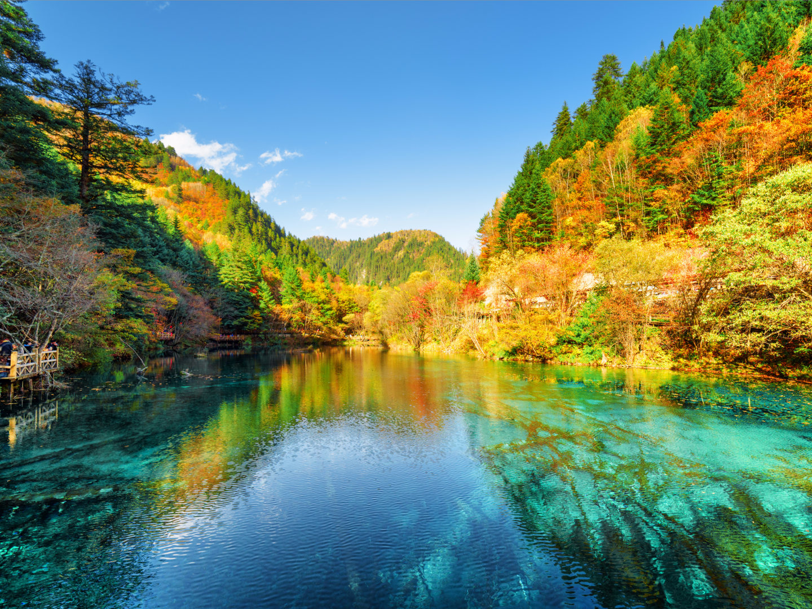
"God is Spirit, and those who worship Him must worship in spirit and truth." — John 4:24
must
must
in
must worship
spirit and truth
spirit and truth
Notes:
In the pool of truth it is shared across all ages no matter what levels of knowledge are to be had. Fundamentals do not change in God’s call for righteousness and adherence to His given words.

Slide 14
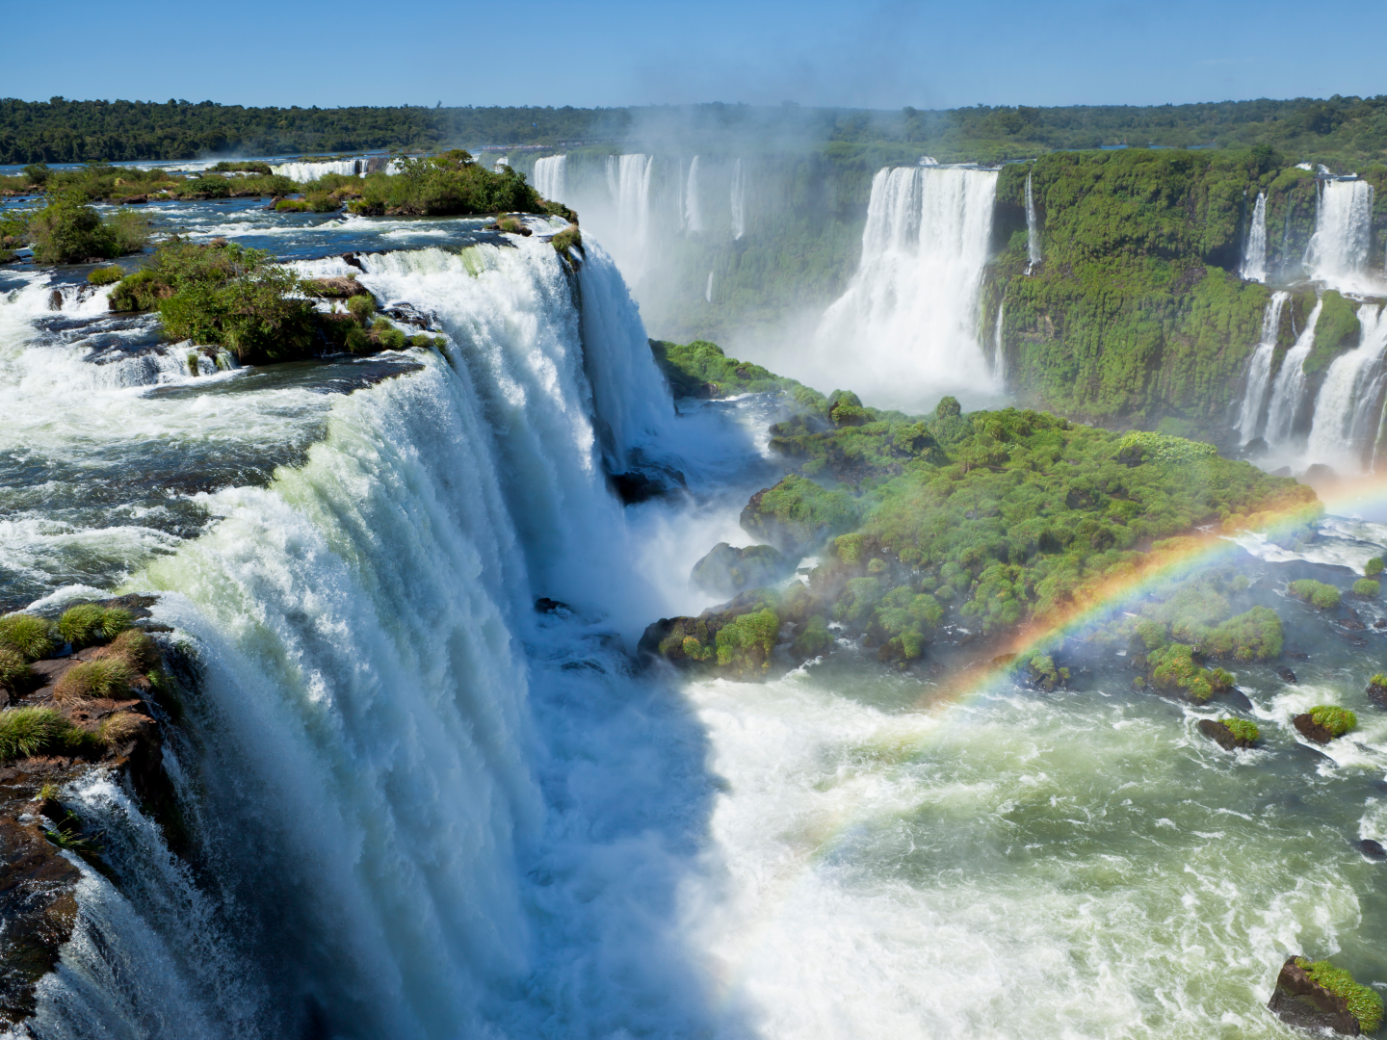
But without faith it is impossible to please Him, for he who comes to God must believe that He is, and that He is a rewarder of those who diligently seek Him. — Hebrews 11:6
must
must believe
must
must believe

Slide 15
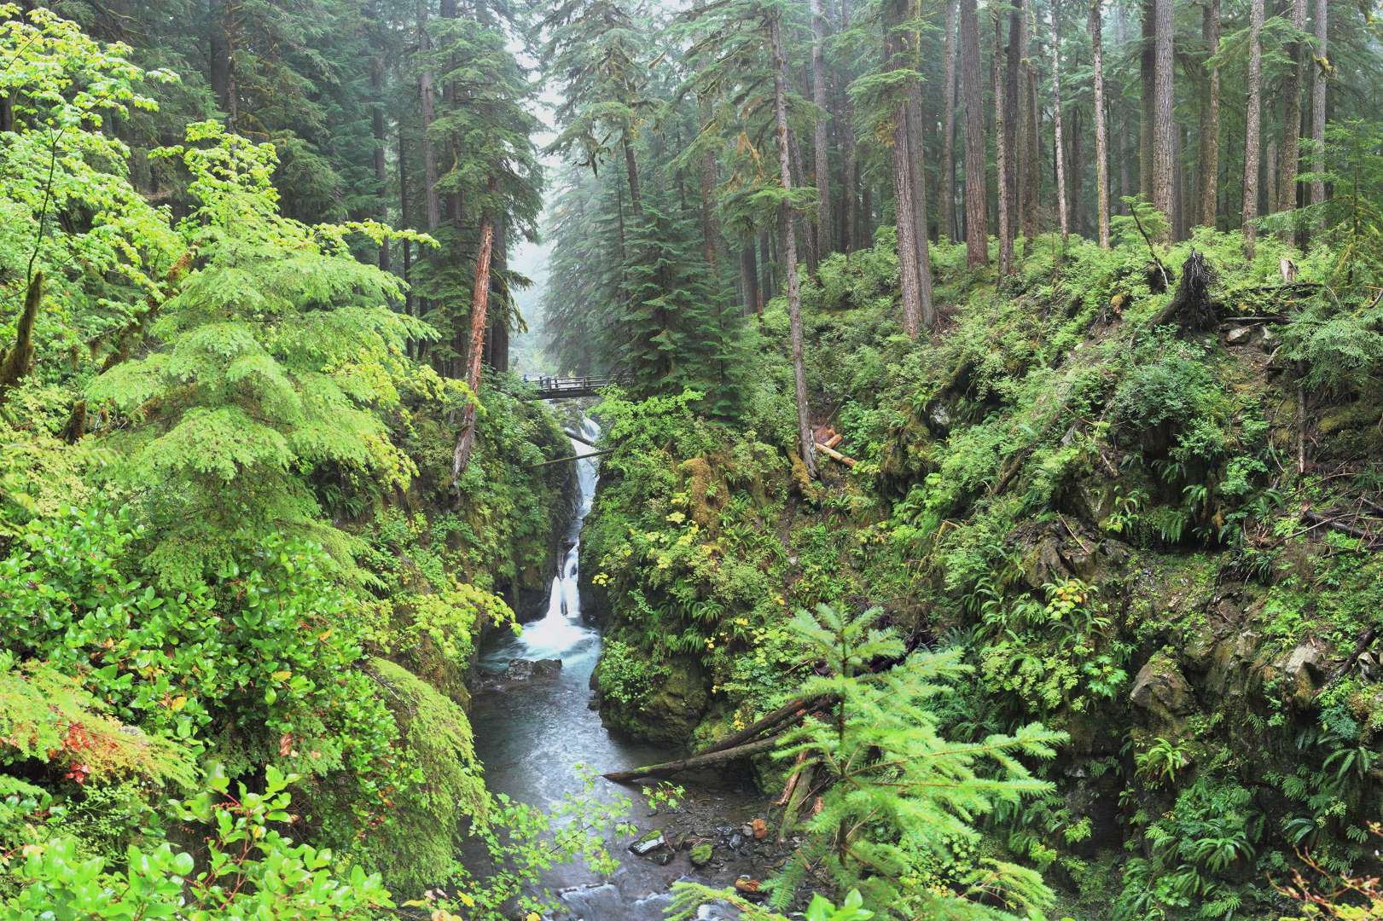
And he brought them out and said, "Sirs, what must I do to be saved?" So they said, "Believe on the Lord Jesus Christ, and you will be saved, you and your household." Then they spoke the word of the Lord to him and to all who were in his house. And he took them the same hour of the night and washed their stripes. And immediately he and all his family were baptized. — Acts 16:30-33
what must I do to be saved
must
what must I do to be saved
Believe on the Lord Jesus Christ
Believe on the Lord Jesus Christ
Jesus Christ
the word
the word
must
baptized
baptized
baptized
Notes:
Salvation is a matter of action on our part, and not just listening, but striving to improve in all the facets of a good heart.

Slide 16

"Nor is there salvation in any other, for there is no other name under heaven given among men by which we must be saved." — Acts 4:12
salvation
salvation
r
i
s
Christ
C
h
t
given
given
we must be saved
must
must be saved
we must be saved
Notes:
Salvation is a make it or break it deal as announced by God Almighty Himself

Slide 17
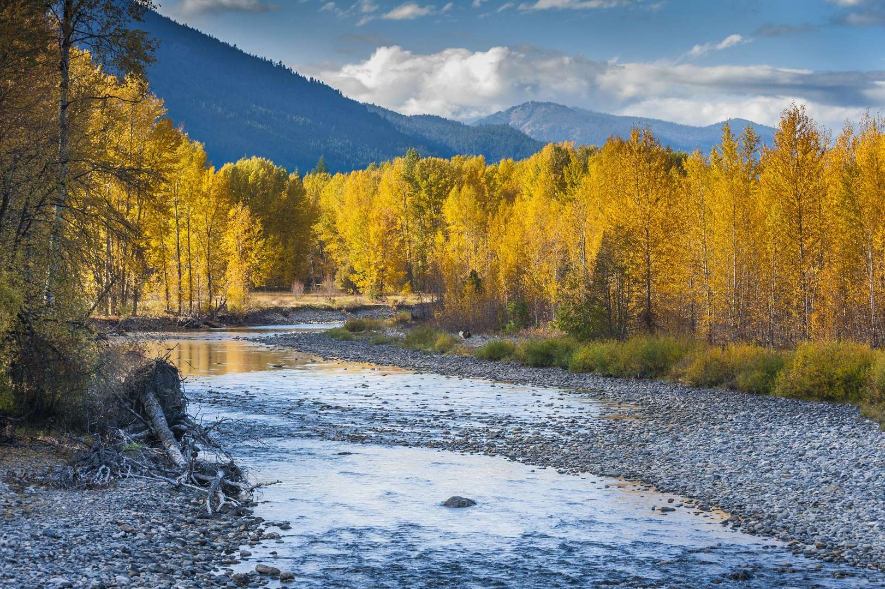
Behold, I tell you a mystery: We shall not all sleep, but we shall all be changed -- in a moment, in the twinkling of an eye, at the last trumpet. For the trumpet will sound, and the dead will be raised incorruptible, and we shall be changed. — 1st Corinthians 15:51-52
o
put on incorruption
n
p
ut
o
n
raised incorruptible
incorrupti
raised incorruptible

Slide 18
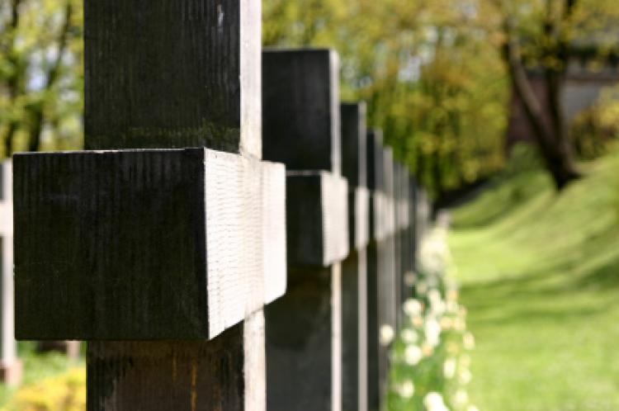
For this corruptible must put on incorruption, and this mortal must put on immortality. So when this corruptible has put on incorruption, and this mortal has put on immortality, then shall be brought to pass the saying that is written: "Death is swallowed up in victory." — 1st Corinthians 15:53-54
put on incorruption
. .
must put on immortality
victory
victory
Notes:
Just to live in the past or future is to miss the moment, and its’ significance. Corruption surrounds all who live upon the earth, however, to inherit the blessing, eternal life's recognition leads to an incorruptible rise back to Him. Nothing compares to the eternal moment where all love lives.

Slide 19
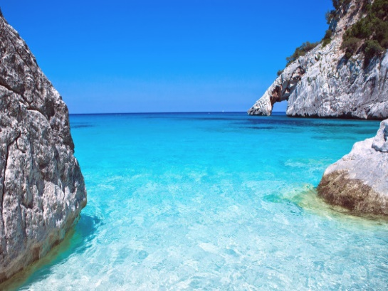

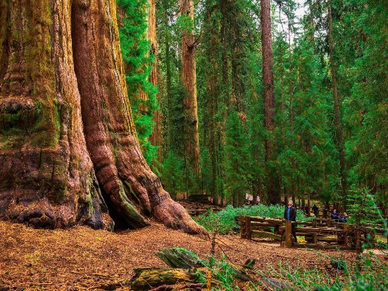



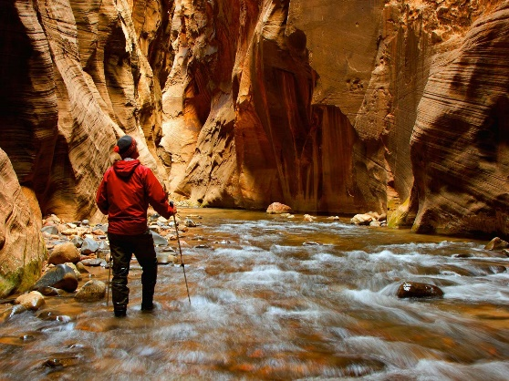







Slide 20
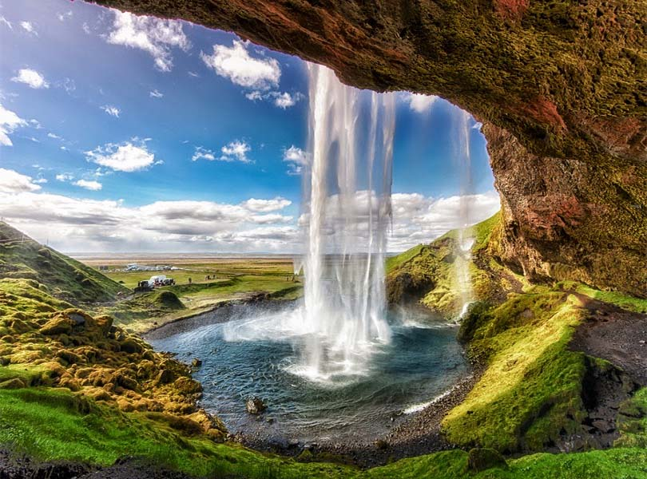

‘What is’ will not change for His Glory Remains
→ All must give an account of actions to God
→ We must give earnest heed to His words of truth
→ We must endure hardships in light of Jesus Christ
→ We must hold forgiving hearts or risk damnation
→ If we love God we must love others too
→ For one to have friends, one must be friendly
→ God’s servants must not quarrel but inspire truth
→ Must be subject to governments for peace’s sake
→ One must be born again to see spiritual truths
→ One must worship God in spirit and truth
→ One must believe God is to find His rewards
→ To be eternally saved, one must believe in Christ
→ We must cleave to the divine hope of immortality
Notes:
‘What is’ will not change for His Glory Remains

Slide 22

Please visit http://www.LoveFromGod.com to explore further
Ronald Bert Channel on
Notes:
Eternity never ends.

