Slide 2
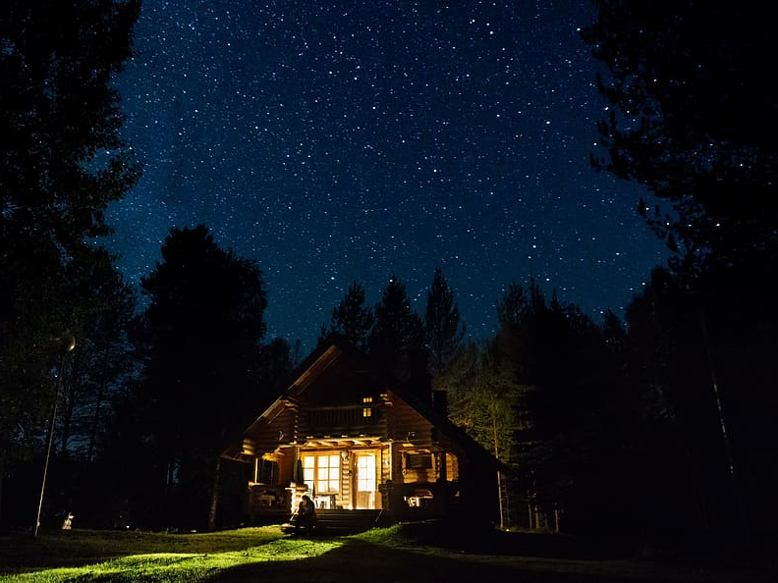
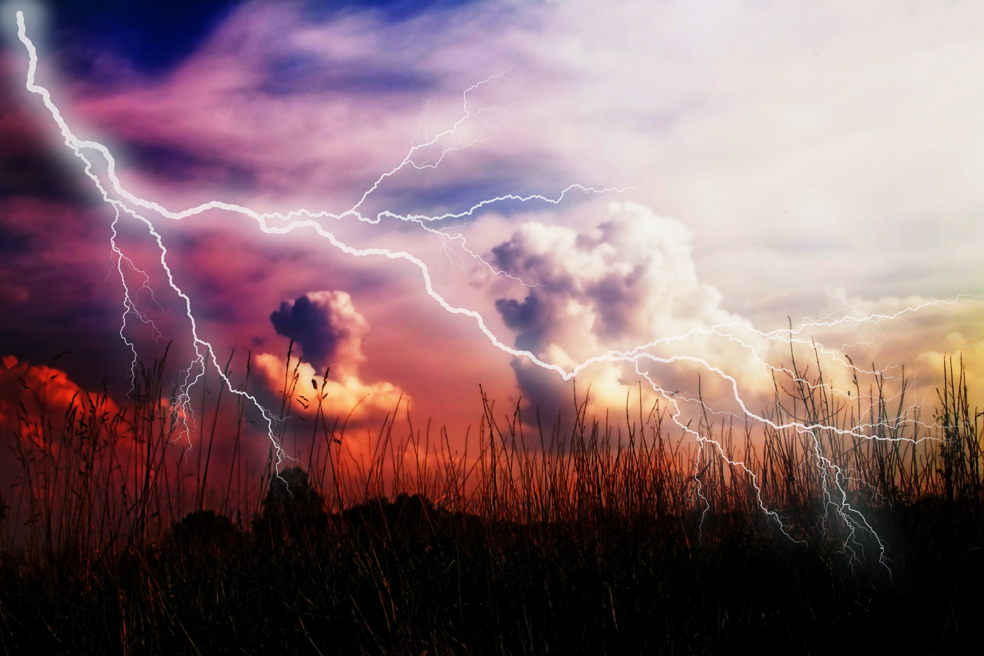
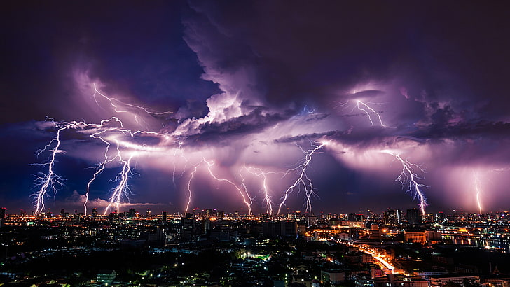
Light in the House
Ron Bert
September 25, 2022

Slide 3

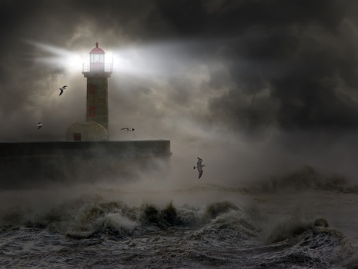
But God, who is rich in mercy, because of His great love with which He loved us, even when we were dead in trespasses, made us alive together with Christ (by grace you have been saved), and raised us up together, and made us sit together in the heavenly places in Christ Jesus, that in the ages to come He might show the exceeding riches of His grace in His kindness toward us in Christ Jesus. – Ephesians 2:4-7
But God, who is rich in mercy, because of His great love with which He loved us, even when we were dead in trespasses, made us alive together with Christ (by grace you have been saved), and raised us up together, and made us sit together in the heavenly places in Christ Jesus, that in the ages to come He might show the exceeding riches of His grace in His kindness toward us in Christ Jesus. – Ephesians 2:4-7
God
God rich in mercy
in the heavenly places in Christ Jesus
raised us up by grace
↑
His great love with which He loved us
made us alive together with Christ
↑
His kindness
His great love
by grace
Christ
Christ
raised us up
Christ
in
together in the
Christ
in
heavenly places in Christ Jesus
Christ Jesus
"Behold, I stand at the door and knock. If anyone hears My voice and opens the door, I will come in to him and dine with him, and he with Me." — Revelation 3:20
hears My voice
Author and finisher of our faith
. .
Christ
in
Eternal salvation
Notes:
In the storm of life, is our foundation of heart Christ? In God’s great love He sent forth His own Son so that we may have the salvation of our souls. He knocks and the door to His house is the light home.
Heb 5:9 And having been perfected, He became the author of eternal salvation to all who obey Him,
Heb 12:2 looking unto Jesus, the author and finisher of our faith, who for the joy that was set before Him endured the cross, despising the shame, and has sat down at the right hand of the throne of God.

Slide 4
WORD
life
life
life
life
life

Slide 5


Then Jesus spoke to them again, saying, "I am the light of the world. He who follows Me shall not walk in darkness, but have the light of life." — John 8:12
Jesus
have the light of life
light of the world
follow Jesus
not walk in darkness
light of the
↑
world
follow
not walk in darkness
have
life
the light of life
↑

Slide 6
great light

Slide 7
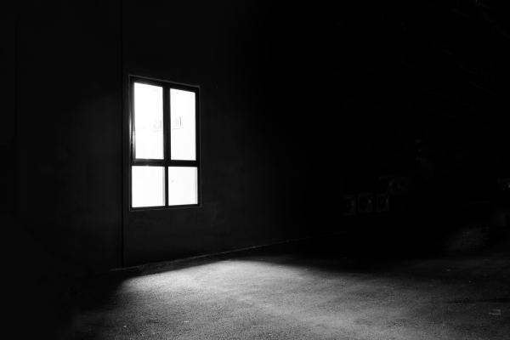
The people who sat in darkness have seen a great light, And upon those who sat in the region and shadow of death Light has dawned." — Matthew 4:16
implanted
sat
in darkness
great light
seen
Almighty God
seen
shadow
of death
dawned
decay
Grace and Truth – John 1:17
The Way, Truth, Life – John 14:6
Peace – John 14:27
Reconciliation – 2nd Cor. 5:18
Christ
Truth
Notes:
John 1:17 For the law was given through Moses, but grace and truth came through Jesus Christ.
John 14:6 Jesus said to him, "I am the way, the truth, and the life. No one comes to the Father except through Me.
John 14:27 "Peace I leave with you, My peace I give to you; not as the world gives do I give to you. Let not your heart be troubled, neither let it be afraid.
2nd Corinthians 5:18 Now all things are of God, who has reconciled us to Himself through Jesus Christ, and has given us the ministry of reconciliation,

Slide 8

For it is the God who commanded light to shine out of darkness, who has shone in our hearts to give the light of the knowledge of the glory of God in the face of Jesus Christ. — 2nd Corinthians 4:6
God commanded
light to shine out of darkness
shone in our hearts
to give the light of the knowledge
of the glory of God
in the face of Jesus Christ
God
commanded
Creator
light to shine out of darkness
↑
in
shone in our hearts
to give the
knowledge
light of the knowledge
of the glory
. .
of God
in the face of Jesus Christ
↙ ↘
in
Jesus Christ

Slide 9
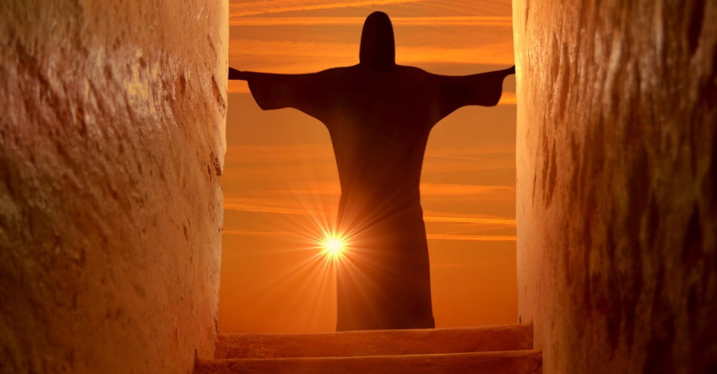
Then Jesus cried out and said, "He who believes in Me, believes not in Me but in Him who sent Me. And he who sees Me sees Him who sent Me. I have come as a light into the world, that whoever believes in Me should not abide in darkness." — John 12:44-46
Jesus
who sees Me sees Him
believe in Him who sent Me
Jesus, light into the world
whoever believes in Me
should not abide in darkness
God
believe
,
↑
in Him who sent Me
God
who sees Me sees Him
↑
light into
the world
whoever believes
↑
in Me
should not abide in
darkness

Slide 10
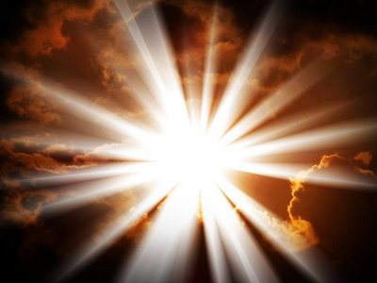
That was the true Light which gives light to every man coming into the world. — John 1:9
Savior
Deliverer
Messiah
true Light
. .
Notes:
Anointed One
Messiah
Deliverer
True light gives while darkness takes

Slide 11

That was the true Light which gives light to every man coming into the world. — John 1:9
GOD
GOD
GOD
Thus says God the LORD, Who created the heavens and stretched them out, Who spread forth the earth and that which comes from it, Who gives breath to the people on it, And spirit to those who walk on it: — Isaiah 42:5
"I, the LORD, have called You in righteousness, And will hold Your hand; I will keep You and give You as a covenant to the people, As a light to the Gentiles, To open blind eyes, To bring out prisoners from the prison, Those who sit in darkness from the prison house." — Isaiah 42:6-7
called
called
true Light
. .
created
created
a light
. .
earth
earth
To open blind eyes
. .
gives breath
. .
And spirit
who sit in
. .
. .
prison house
. .
Notes:
Anointed One
Messiah
Deliverer

Slide 12
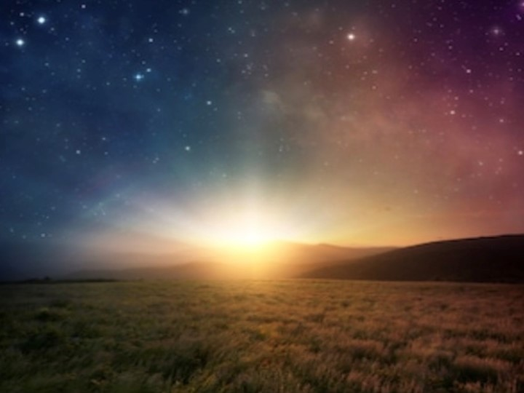
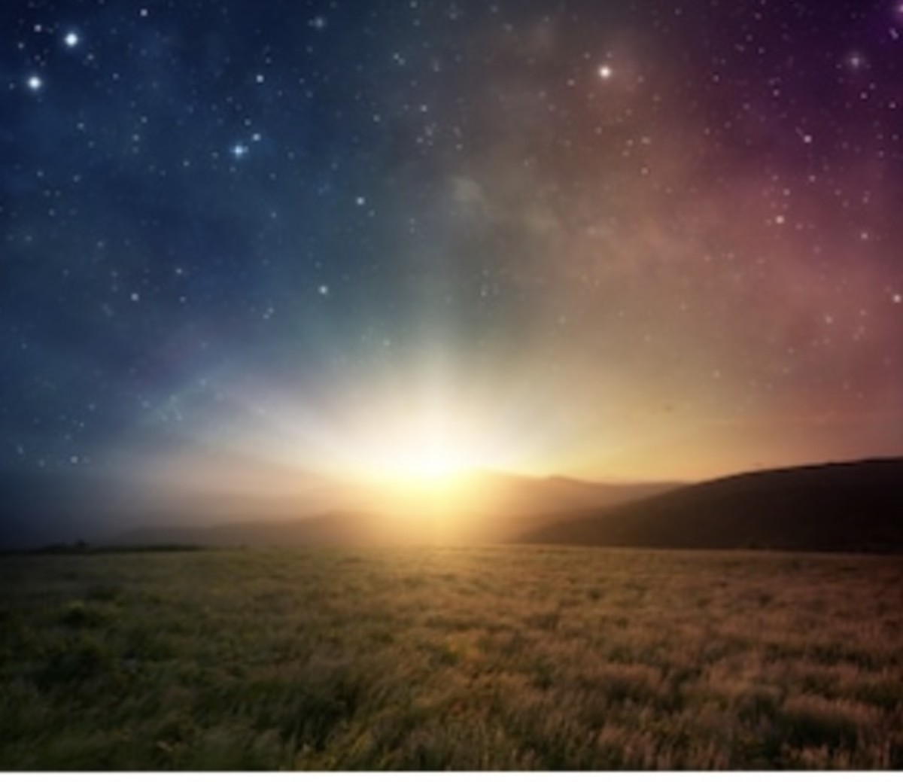
And the light shines in the darkness, and the darkness did not comprehend it. — John 1:5
light shines
light
light
light
light
light
darkness

Slide 13
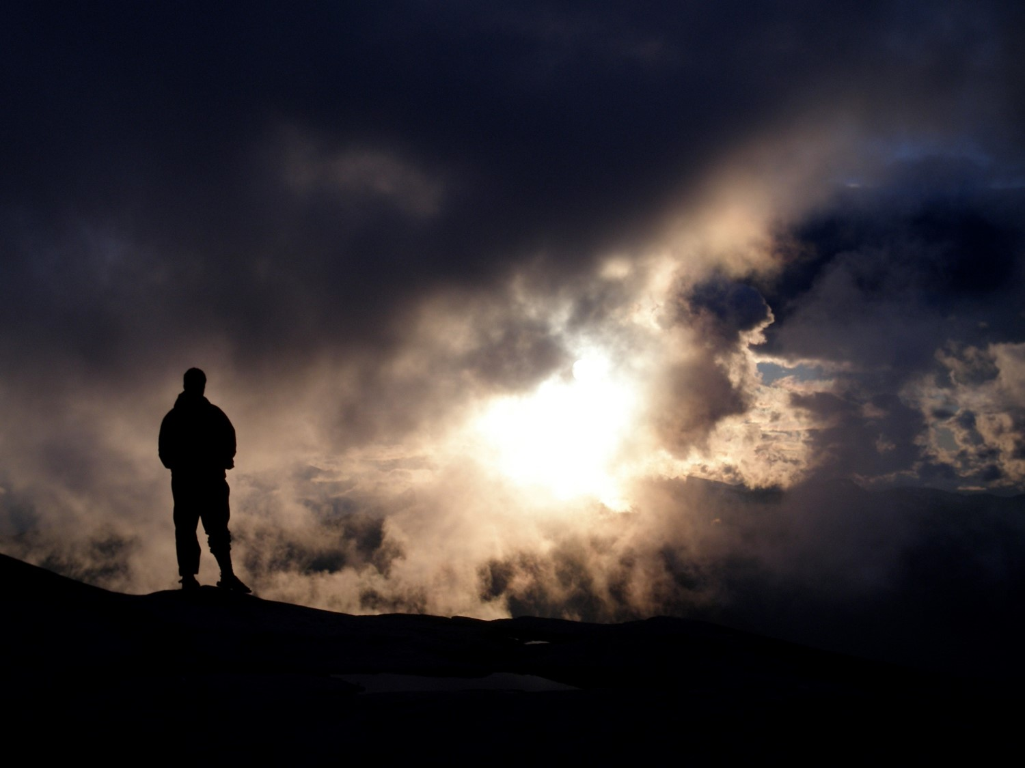

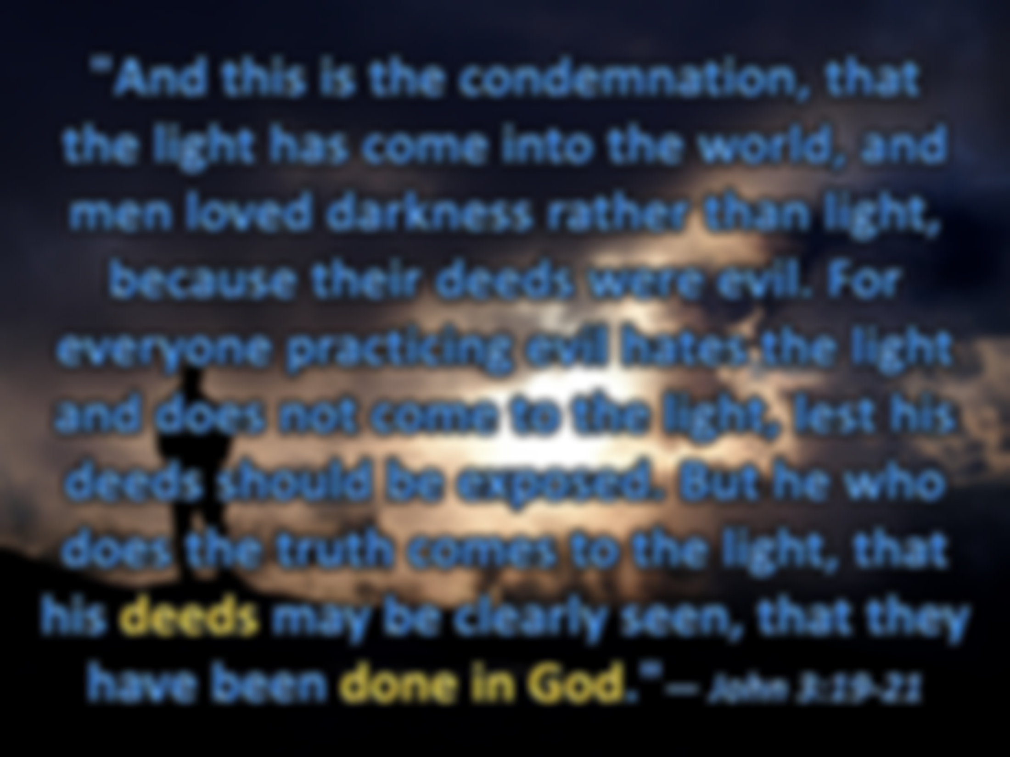



"And this is the condemnation, that the light has come into the world, and men loved darkness rather than light, because their deeds were evil. For everyone practicing evil hates the light and does not come to the light, lest his deeds should be exposed. But he who does the truth comes to the light, that his deeds may be clearly seen, that they have been done in God."— John 3:19-21
light has come into the world
light has come into the world
light
darkness
light
evil hates the light
who does the truth
comes to the light
light
truth
and
does not come to the light
light
who
does the truth
light
comes to the light
evil hates the light and
does not come to the light
evil hates
. .
in
God

Slide 14
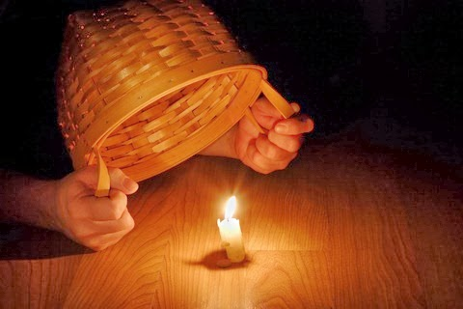
"No one, when he has lit a lamp, puts it in a secret place or under a basket, but on a lampstand, that those who come in may see the light." — Luke 11:33
"Let your light so shine before men, that they may see your good works and glorify your Father in heaven." — Matthew 5:16
see your good works
see your good works
glorify your Father
witnesses
in
see
see the light
see the light
Deut 30:19 - Heaven and earth
Notes:
Deuteronomy 30:19 "I call heaven and earth as witnesses today against you, that I have set before you life and death, blessing and cursing; therefore choose life, that both you and your descendants may live;

Slide 15
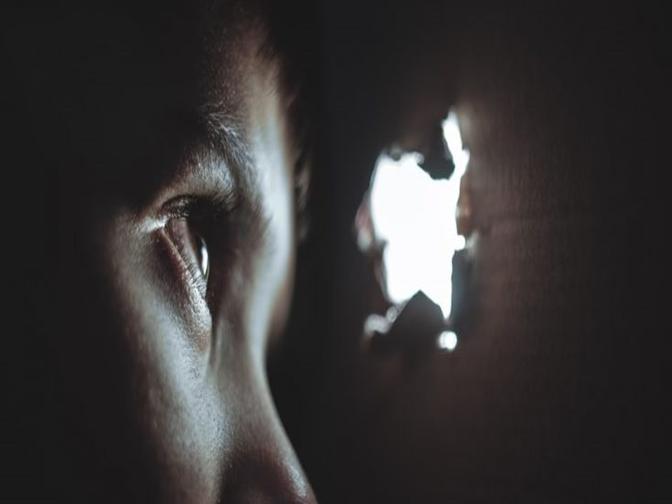

"The lamp of the body is the eye. If therefore your eye is good, your whole body will be full of light.
But if your eye is bad, your whole body will be full of darkness. If therefore the light that is in you is darkness, how great is that darkness!" — Matthew 6:22-23
The lamp of the body is the eye
The lamp of the body is the eye
darkness light
eye is bad eye is good
body full body full
of darkness of light
eye is good
body
light
full
of light
eye is bad
body
full
of darkness
light
darkness

Slide 16
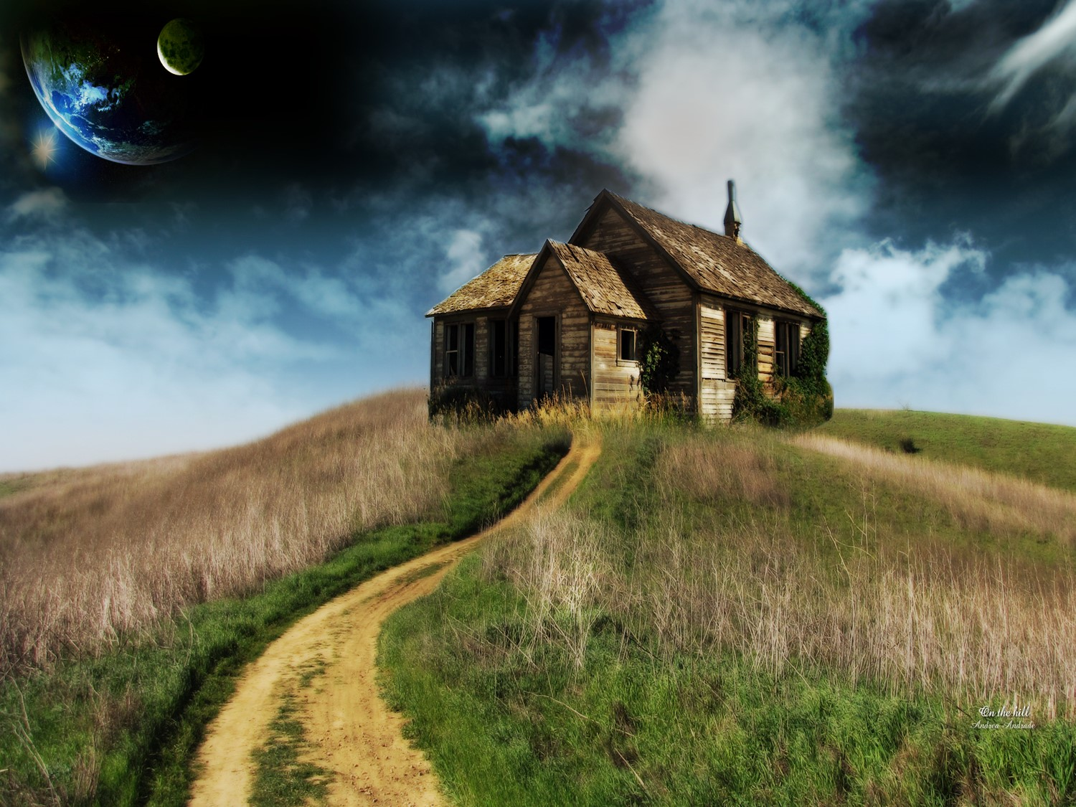
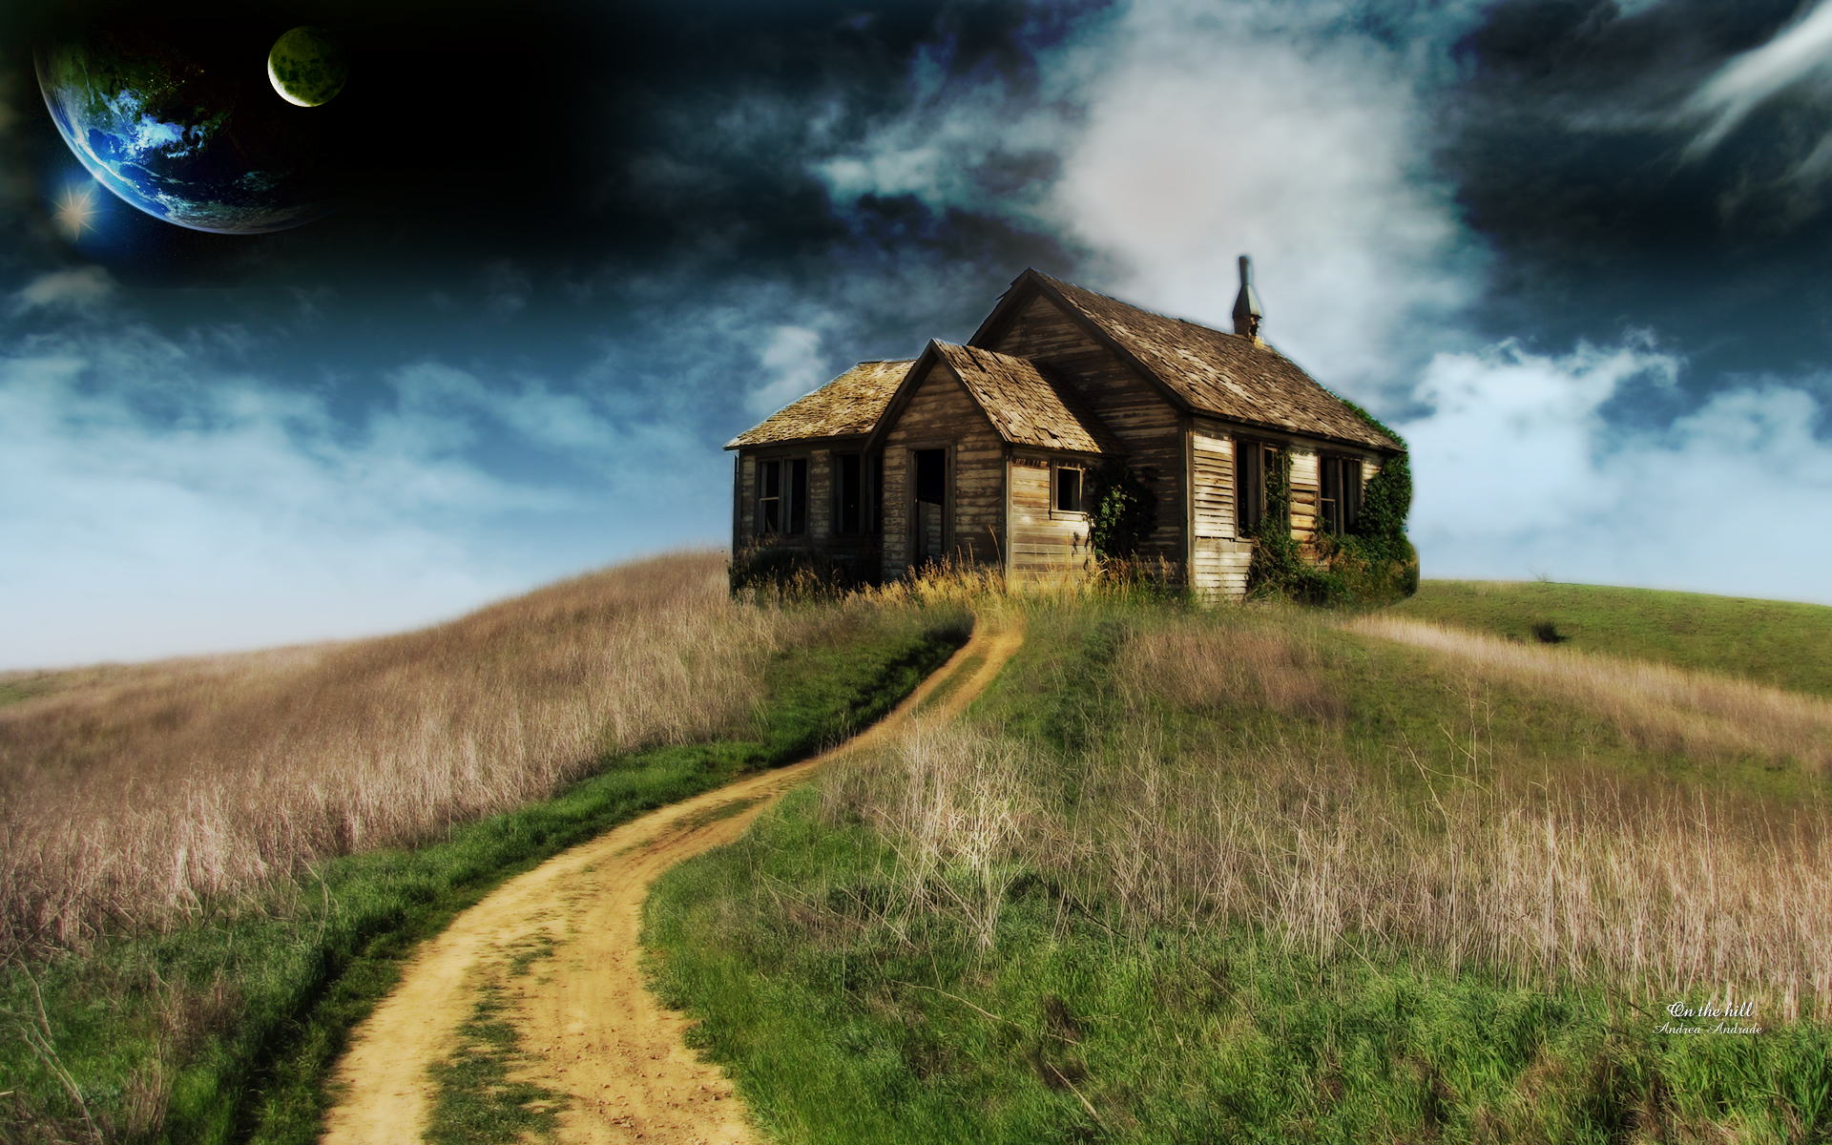
The God of Israel said, The Rock of Israel spoke to me: 'He who rules over men must be just, Ruling in the fear of God. And he shall be like the light of the morning when the sun rises, A morning without clouds, Like the tender grass springing out of the earth, By clear shining after rain.' Although my house is not so with God, Yet He has made with me an everlasting covenant, Ordered in all things and secure. For this is all my salvation and all my desire; Will He not make it increase?" — 2nd Samuel 23:3-5
Truth
who rules over men:
● must be just
● Ruling in the fear of God
● be like the light of the morning
● A morning without clouds
● Like the tender grass
● By clear shining after rain
↘
Although my house is not so with God
↓
Yet He has made an everlasting covenant Ordered in all things and secure
For this is my salvation and desire
Rock of Israel
. .
:
who rules over men
must be just
Ruling in the fear of God
be like
light
the light of the morning
A
light
light
morning without clouds
Like the tender grass
By clear shining
after rain
Although my house is not so with
my house is not so
. .
God
Yet He has made
an everlasting
covenant
Ordered in all things and secure
For
this is
my salvation and
desire

Slide 17
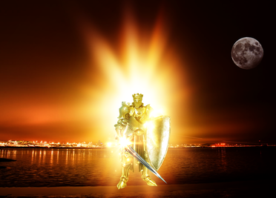
The night is far spent, the day is at hand. Therefore let us cast off the works of darkness, and let us put on the armor of light. Let us walk properly, as in the day, not in revelry and drunkenness, not in lewdness and lust, not in strife and envy. But put on the Lord Jesus Christ, and make no provision for the flesh, to fulfill its lusts.— Romans 13:12-14
night
night day
↓ ↑
in revelry cast off works
drunkenness of darkness
lewdness put on the
in lust armor of light
in strife walk properly
and envy put on the Lord
Jesus Christ
day
cast off
works
of darkness
put on
the
armor of light
light
walk
properly
in revelry
drunkenness
in
lewdness
lust
in strife
and envy
put on the Lord
Jesus Christ
Jesus Christ

Slide 18
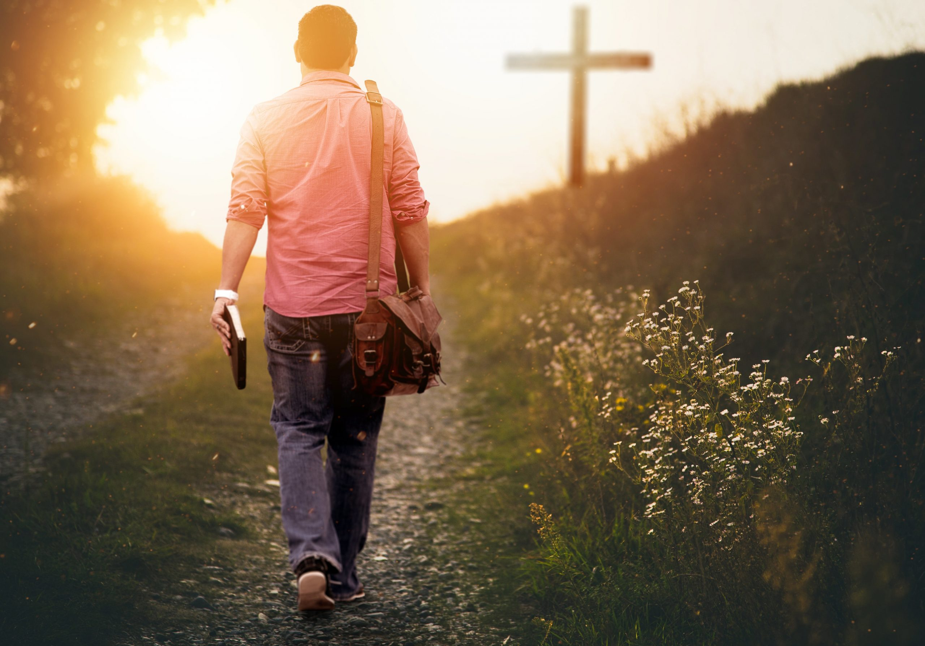
If we say that we have fellowship with Him, and walk in darkness, we lie and do not practice the truth. But if we walk in the light as He is in the light, we have fellowship with one another, and the blood of Jesus Christ His Son cleanses us from all sin. — 1st John 1:6-7
say
we have
fellowship
walk in the light
say we have as He is in
fellowship with Him the light
walk in darkness fellowship
we lie and do not with one
practice the truth another
blood of Jesus Christ
cleanses us from all sin
with Him
walk in darkness
we lie and do not
practice the
truth
walk in the light
as He is in
the light
fellowship
with one
another
blood of Jesus Christ
↓
cleanses us from all sin

Slide 19
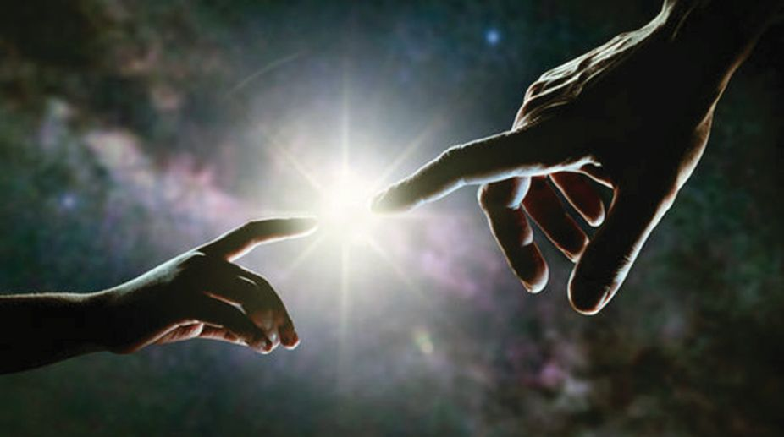
This is the message which we have heard from Him and declare to you, that God is light and in Him is no darkness at all. — 1st John 1:5
God is light
God is light
in Him
is no darkness
in Him is no darkness

Slide 20
God = light
in Him = no darkness

Slide 21
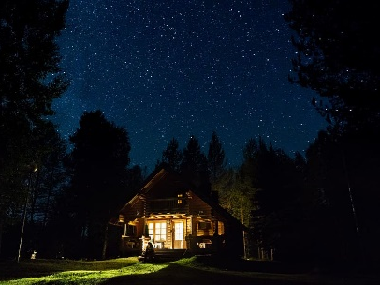
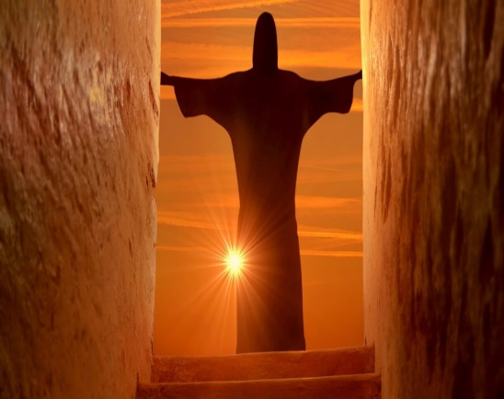




Slide 22
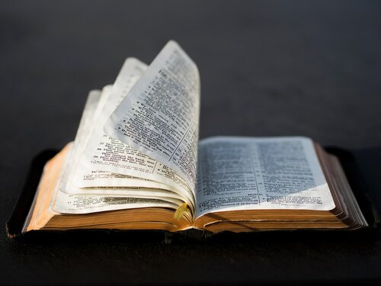
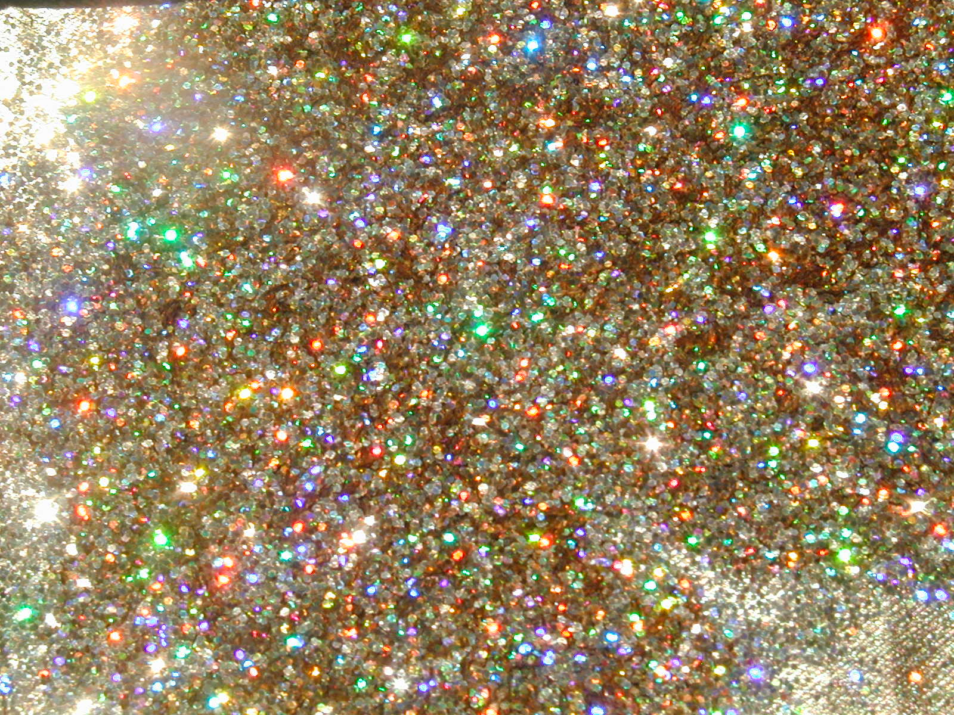
→ God’s rich love has made us alive together in Christ
→ In Christ we are raised to sit with Him in heaven
→ Jesus stands at the door inviting us to live with Him
→ Past death’s darkness God’s light of truth has come
→ Grace, the way, truth, life, & peace come by Christ
→ God’s Christ knowledge shines truth in our hearts
→ Belief in Christ’s life is directed to believe in God
→ God gives light to each mortal coming to the world
→ God calls for us see becoming free of dark prisons
→ God wills our deeds be clearly seen and not hidden
→ Strength comes by casting off dark works & in Christ
→ Christ’s sacrificial blood cleanses us from all sin
→ God is light and in Him is no darkness at all
God dines with those who love Him

Slide 24
Light in the House
2
Ron Bert
October 23, 2022

Slide 25
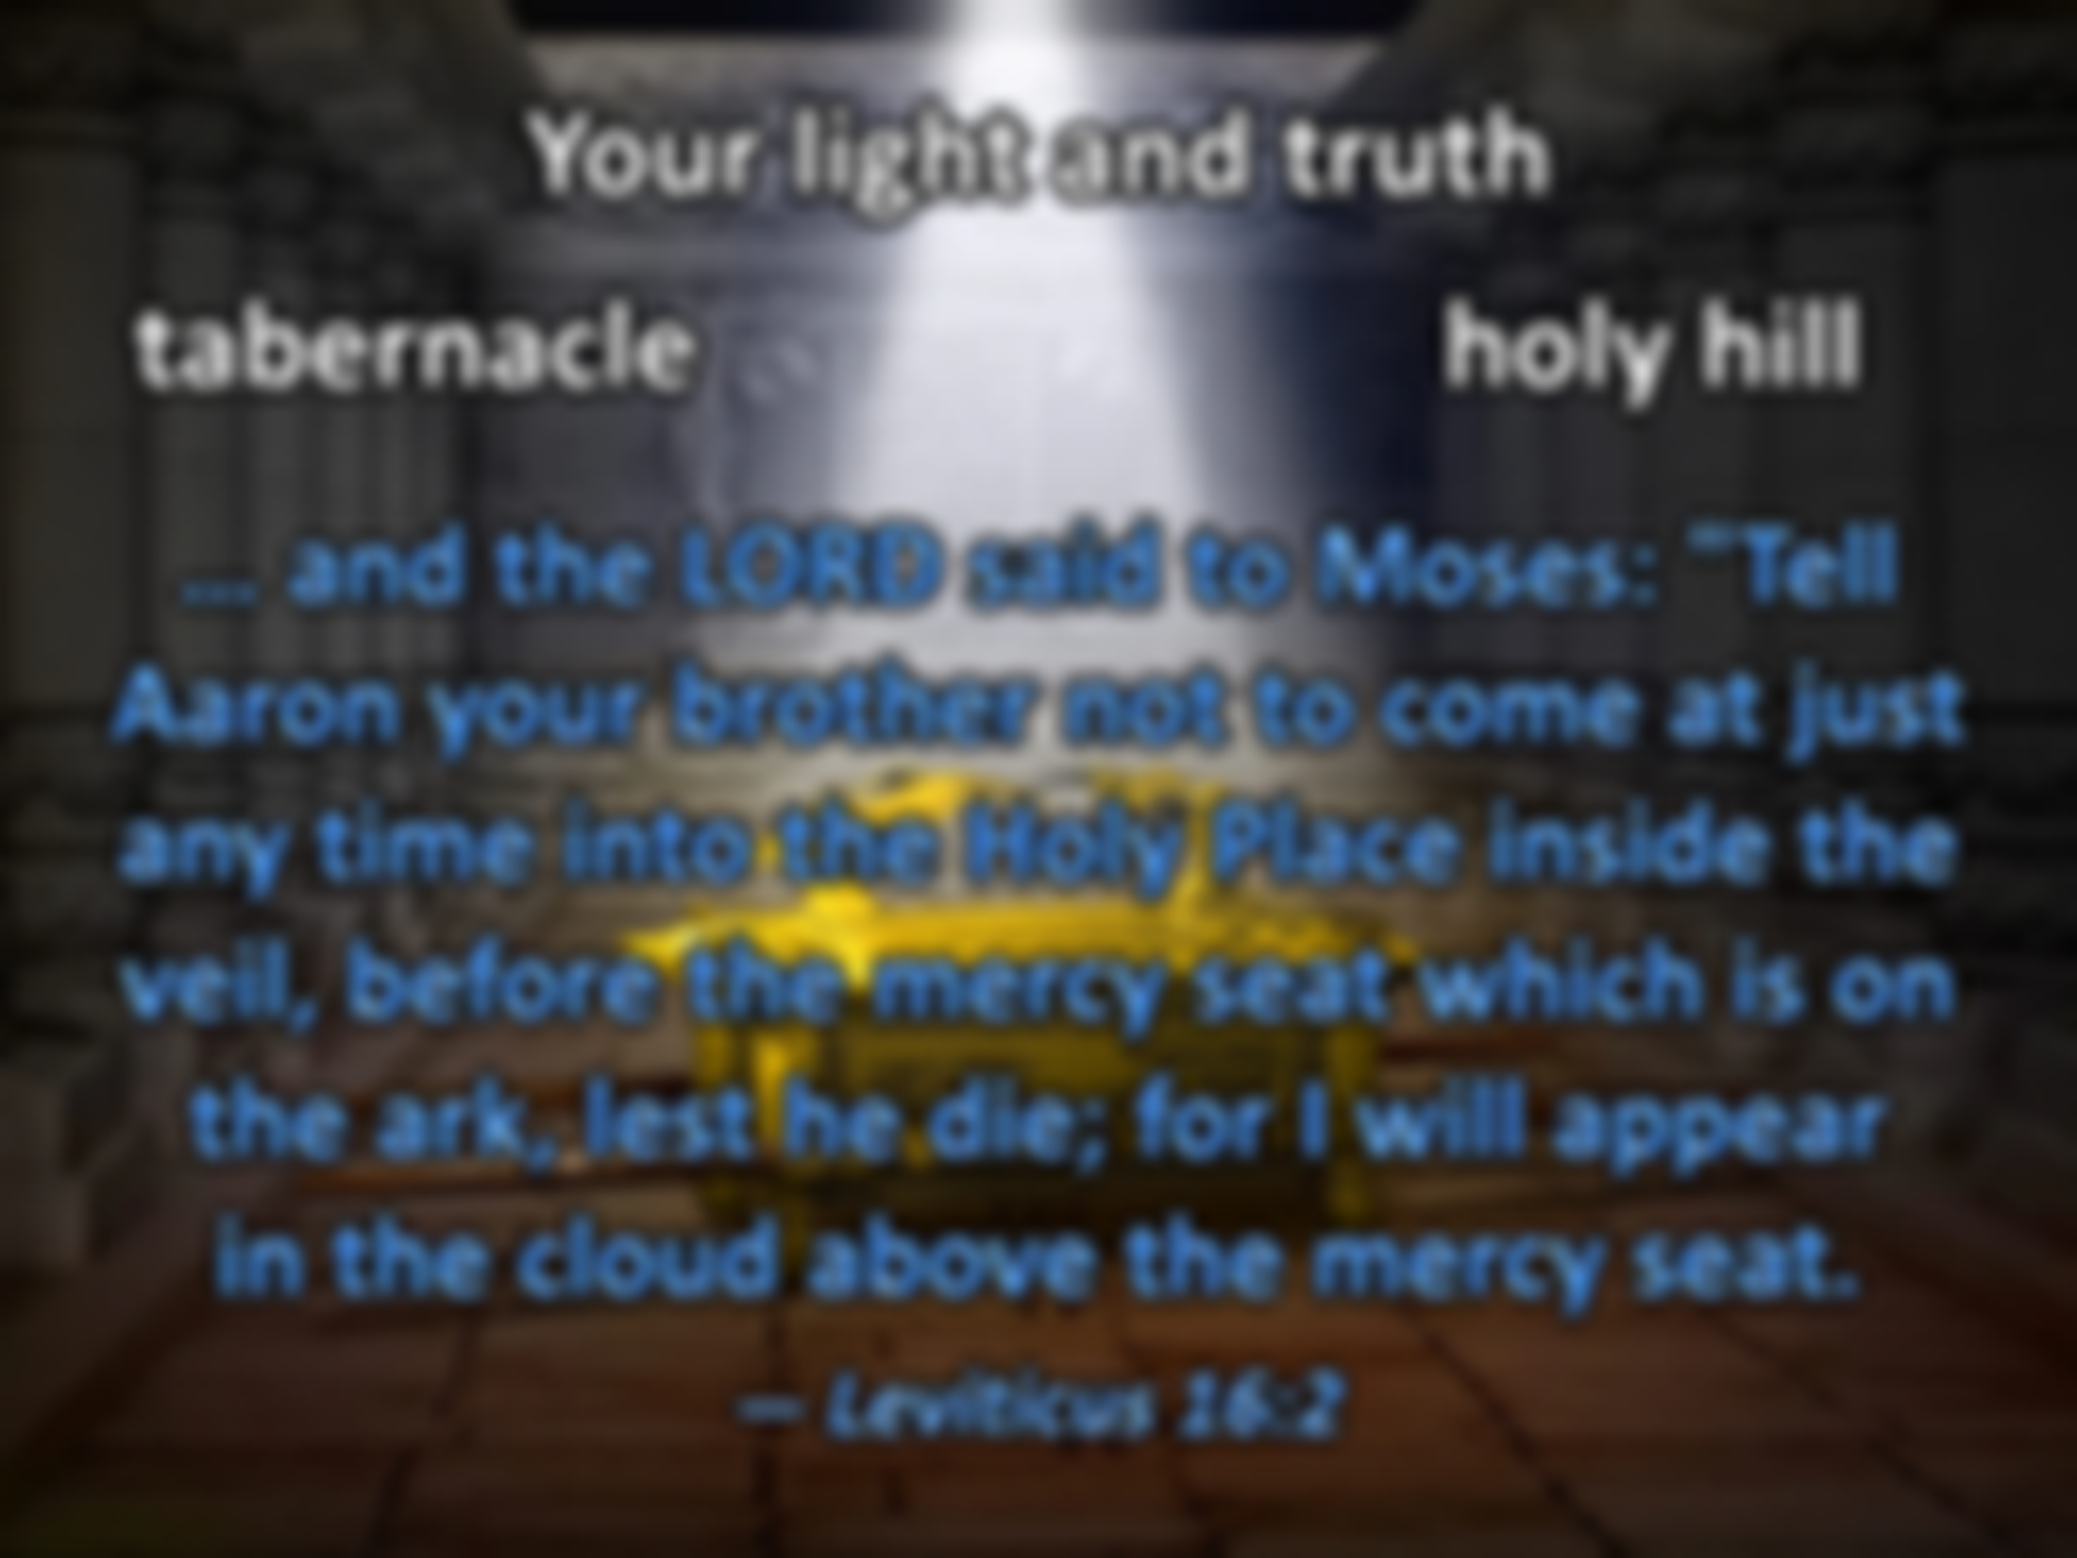



Oh, send out Your light and Your truth! Let them lead me; Let them bring me to Your holy hill And to Your tabernacle. — Psalms 43:3
Your light and truth
Your light and
Your
… and the LORD said to Moses: "Tell Aaron your brother not to come at just any time into the Holy Place inside the veil, before the mercy seat which is on the ark, lest he die; for I will appear in the cloud above the mercy seat. — Leviticus 16:2
truth
Holy Place inside
Your
holy hill
. .
Your
tabernacle
the ark
. .
Notes:
Le 16:1 Now the LORD spoke to Moses after the death of the two sons of Aaron, when they offered profane fire before the LORD, and died;
Leviticus 16:2 and the LORD said to Moses: "Tell Aaron your brother not to come at just any time into the Holy Place inside the veil, before the mercy seat which is on the ark, lest he die; for I will appear in the cloud above the mercy seat.
2Samuel 6:2 And David arose and went with all the people who were with him from Baale Judah to bring up from there the ark of God, whose name is called by the Name, the LORD of Hosts, who dwells between the cherubim.
2Kings 19:15 Then Hezekiah prayed before the LORD, and said: "O LORD God of Israel, the One who dwells between the cherubim, You are God, You alone, of all the kingdoms of the earth. You have made heaven and earth.
Isaiah 8:18 Here am I and the children whom the LORD has given me! We are for signs and wonders in Israel From the LORD of hosts, Who dwells in Mount Zion.
Isaiah 2:3 Many people shall come and say, "Come, and let us go up to the mountain of the LORD, To the house of the God of Jacob; He will teach us His ways, And we shall walk in His paths." For out of Zion shall go forth the law, And the word of the LORD from Jerusalem.
Psalms 135:21 Blessed be the LORD out of Zion, Who dwells in Jerusalem! Praise the LORD!
Isaiah 5:13 Therefore my people have gone into captivity, Because they have no knowledge; Their honorable men are famished, And their multitude dried up with thirst.
Lamentations 5:18 Because of Mount Zion which is desolate, With foxes walking about on it.
King Cyrus of Babylon
Ezra 5:15 "And he said to him, 'Take these articles; go, carry them to the temple site that is in Jerusalem, and let the house of God be rebuilt on its former site.'
Zechariah 8:3 "Thus says the LORD: 'I will return to Zion, And dwell in the midst of Jerusalem. Jerusalem shall be called the City of Truth, The Mountain of the LORD of hosts, The Holy Mountain.’
Joel 2:32 And it shall come to pass That whoever calls on the name of the LORD Shall be saved. For in Mount Zion and in Jerusalem there shall be deliverance, As the LORD has said, Among the remnant whom the LORD calls.
Micah 4:2 Many nations shall come and say, "Come, and let us go up to the mountain of the LORD, To the house of the God of Jacob; He will teach us His ways, And we shall walk in His paths." For out of Zion the law shall go forth, And the word of the LORD from Jerusalem.
Joel 3:17 "So you shall know that I am the LORD your God, Dwelling in Zion My holy mountain. Then Jerusalem shall be holy, And no aliens shall ever pass through her again.“
Micah 4:7 I will make the lame a remnant, And the outcast a strong nation; So the LORD will reign over them in Mount Zion From now on, even forever.
Isa 31:9 He shall cross over to his stronghold for fear, And his princes shall be afraid of the banner," Says the LORD, Whose fire is in Zion And whose furnace is in Jerusalem.
Joel 3:21 "For I will acquit them of the guilt of bloodshed, whom I had not acquitted; For the LORD dwells in Zion."
Ro 8:9 But you are not in the flesh but in the Spirit, if indeed the Spirit of God dwells in you. Now if anyone does not have the Spirit of Christ, he is not His.
1Co 3:16 Do you not know that you are the temple of God and that the Spirit of God dwells in you?
Psalms 125:1 <<A Song of Ascents.>> Those who trust in the LORD Are like Mount Zion, Which cannot be moved, but abides forever.

Slide 26
And David arose and went with all the people who were with him from Baale Judah to bring up from there the ark of God, whose name is called by the Name, the LORD of Hosts, who dwells between the cherubim. — 2nd Samuel 6:2
Your light and truth
tabernacle
holy hill
…. and behind the second veil, the part of the tabernacle which is called the Holiest of All, which had the golden censer and the ark of the covenant overlaid on all sides with gold, in which were the golden pot that had the manna, Aaron's rod that budded, and the tablets of the covenant; — Hebrews 9:3-4
Then Hezekiah prayed before the LORD, and said: "O LORD God of Israel, the One who dwells between the cherubim, You are God, You alone, of all the kingdoms of the earth. You have made heaven and earth. — 2nd Kings 19:15
dwells
who dwells between the cherubim
the LORD of Hosts
the ark of God
Holiest of All
dwells
the ark
Giver
the ark
Presenter
Commander
Anchor
Announcer
Hosts
the ark
Ringmaster
You are God
of God
①
golden
…. and above it were the cherubim of glory overshadowing the mercy seat. Of these things we cannot now speak in detail. — Hebrews 9:5
name is
pot
manna
②
rod
the LORD of Hosts
who dwells
You have made heaven and earth
budded
③
tablets
cannot now speak in detail
. .
between the cherubim
Notes:
Hebrews 9:5 and above it were the cherubim of glory overshadowing the mercy seat. Of these things we cannot now speak in detail.
Commander
Ringmaster
Announcer
Presenter
Anchor
Giver

Slide 27
Here am I and the children whom the LORD has given me! We are for signs and wonders in Israel From the LORD of hosts, Who dwells in Mount Zion. — Isaiah 8:18
Your light and truth
tabernacle
holy hill
LORD of hosts
Who dwells in Mount Zion
LORD of hosts
Who dwells
in Mount Zion
in
. .
in Mount Zion

Slide 28
Many people shall come and say, "Come, and let us go up to the mountain of the LORD, To the house of the God of Jacob; He will teach us His ways, And we shall walk in His paths." For out of Zion shall go forth the law, And the word of the LORD from Jerusalem. — Isaiah 2:3
Your light and truth
tabernacle
holy hill
Blessed be the LORD out of Zion, Who dwells in Jerusalem! Praise the LORD!
— Psalms 135:21
mountain of the
LORD
the house of the God of Jacob
mountain of the LORD
the house of the God of Jacob
out of Zion from Jerusalem
the house of
out of Zion
. .
law
word
from Jerusalem
law word
Truth

Slide 29
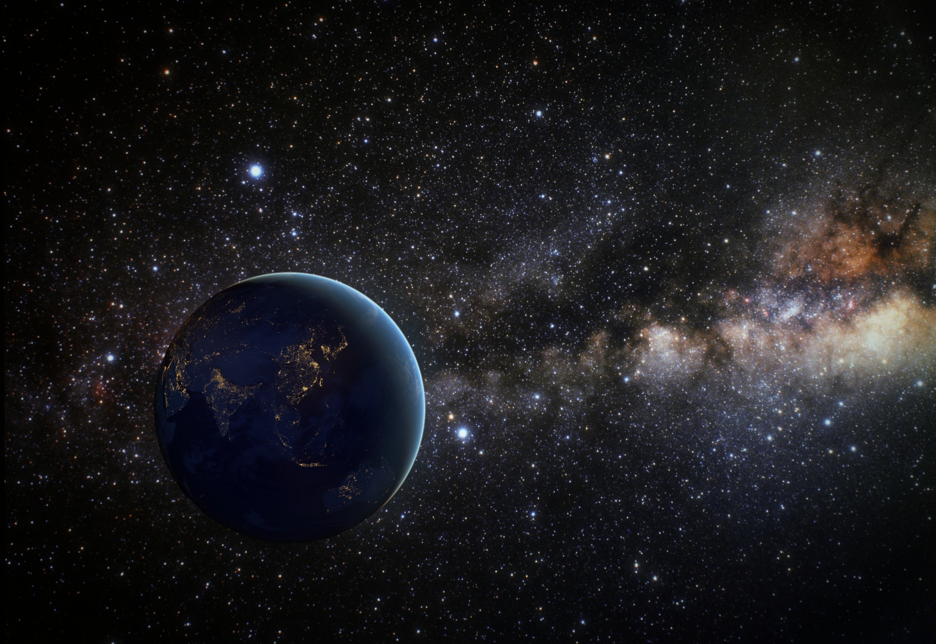
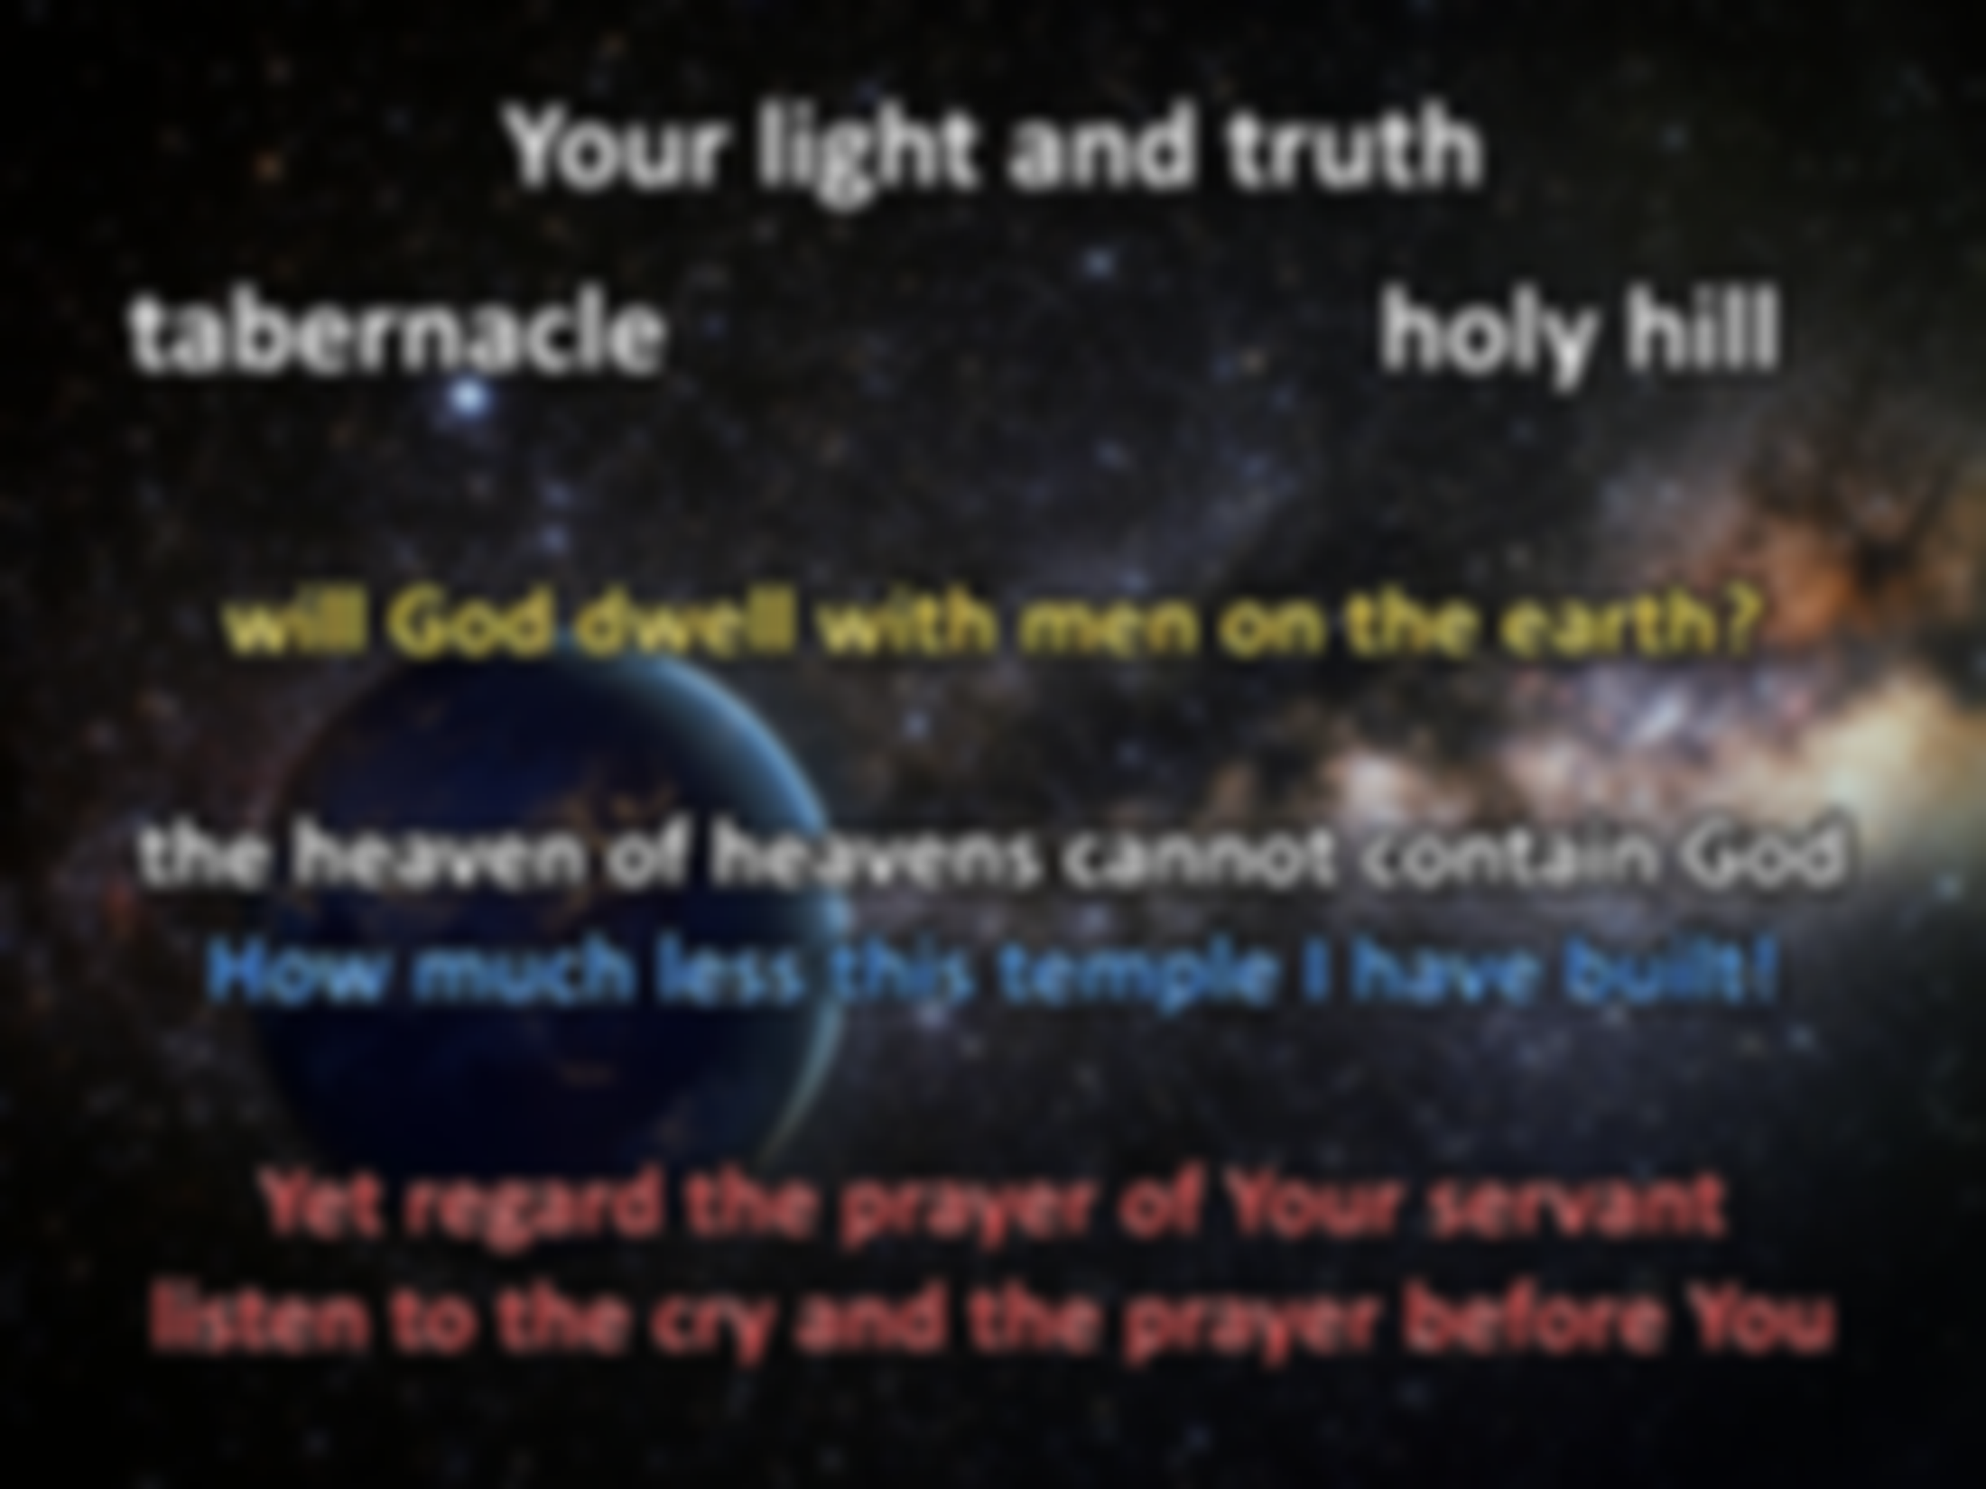
"But will God indeed dwell with men on the earth? Behold, heaven and the heaven of heavens cannot contain You. How much less this temple which I have built! Yet regard the prayer of Your servant and his supplication, O LORD my God, and listen to the cry and the prayer which Your servant is praying before You:" — 2nd Chronicles 6:18-19
Your light and truth
tabernacle
holy hill
will God
dwell with men on
will God dwell with men on the earth?
the heaven of heavens cannot contain God
How much less this temple I have built!
Yet regard the prayer of Your servant
listen to the cry and the prayer before You
God
the earth?
the heaven
of heavens cannot contain
How much
less this temple
I have built!
God
Yet
regard the prayer of Your servant
God
listen to
the cry and the prayer
before You

Slide 30
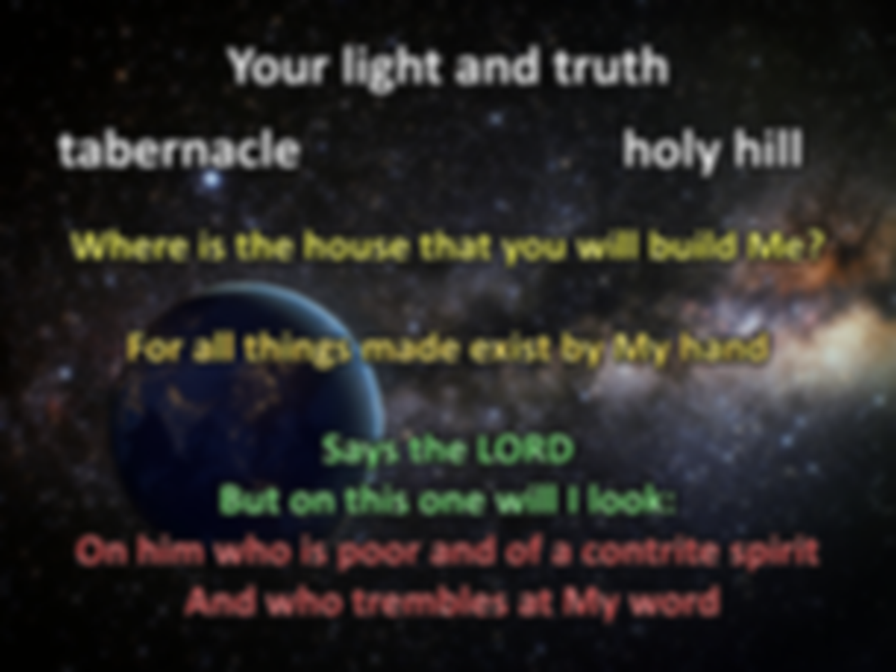
Thus says the LORD: "Heaven is My throne, And earth is My footstool. Where is the house that you will build Me? And where is the place of My rest? For all those things My hand has made, And all those things exist," Says the LORD. "But on this one will I look: On him who is poor and of a contrite spirit, And who trembles at My word."
— Isaiah 66:1-2
Your light and truth
tabernacle
holy hill
LORD
y
Where is the house that you will build Me?
For all things made exist by My hand
Says the LORD
But on this one will I look:
On him who is poor and of a contrite spirit
And who trembles at My word
Where is the
house that you will build Me?
b
For all
My
hand
made
things
exist
Says the LORD
But on this one will I look:
LORD
On him who is poor and of a contrite spirit
apologetic
remorseful
sorry
regretful
contrite
And who trembles at My word

Slide 31
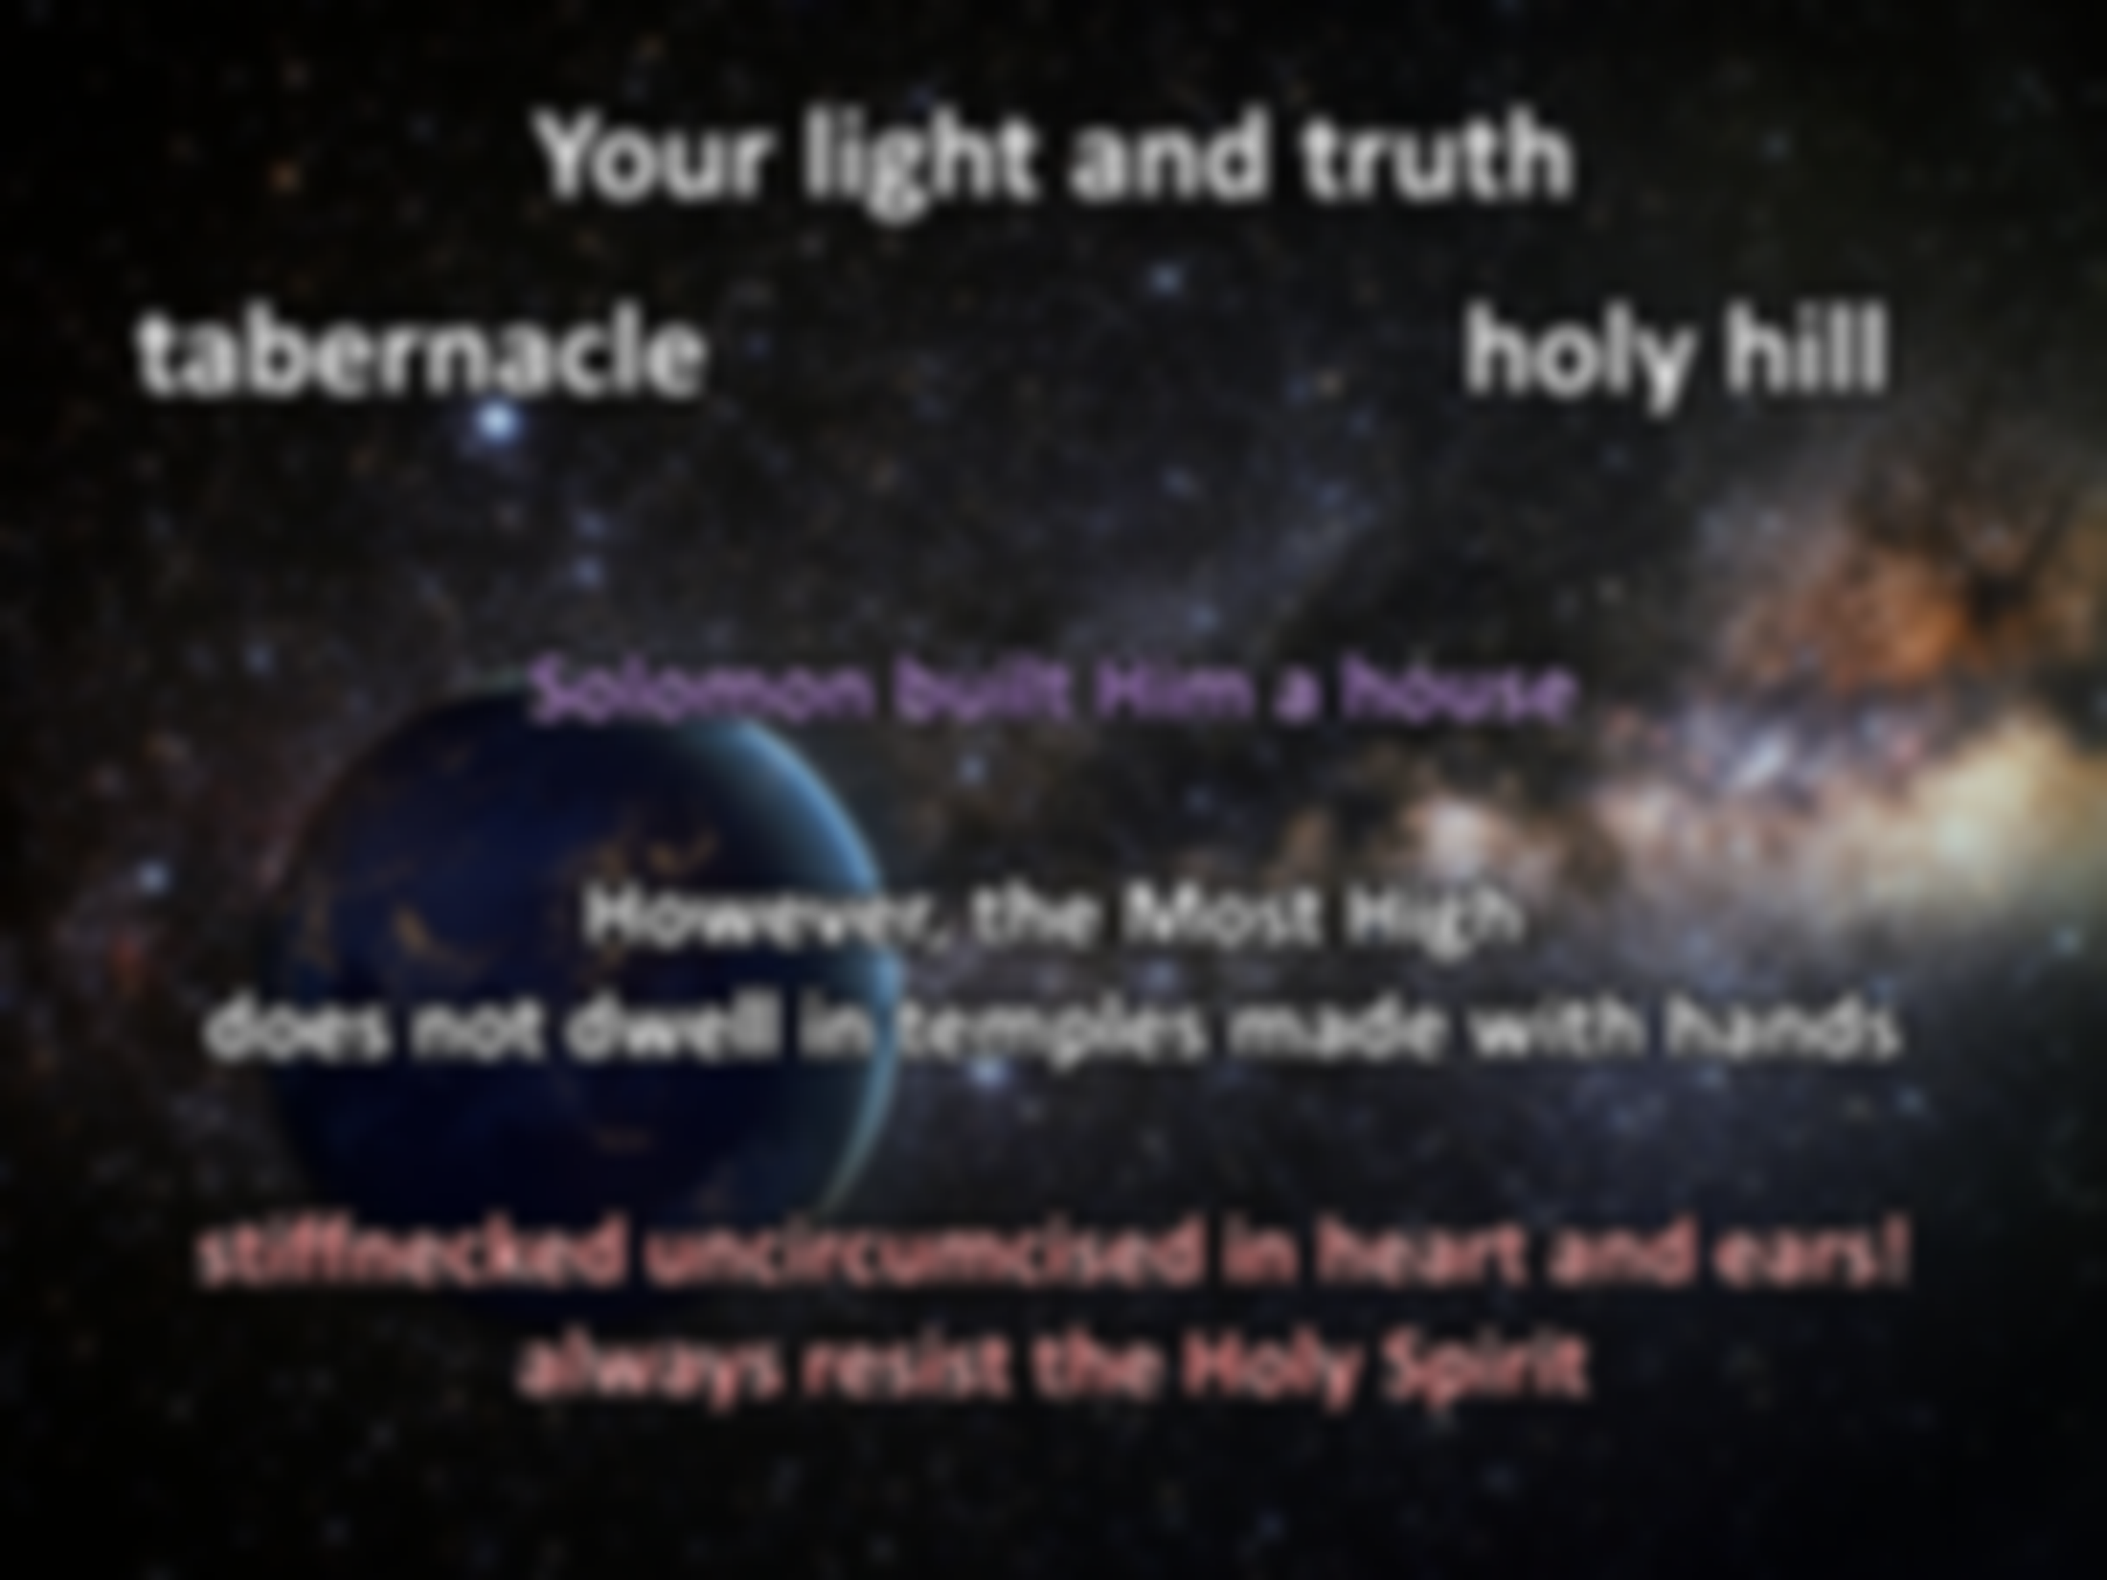

"But Solomon built Him a house. However, the Most High does not dwell in temples made with hands, as the prophet says: 'Heaven is My throne, And earth is My footstool. What house will you build for Me? says the LORD, Or what is the place of My rest? Has My hand not made all these things?' You stiffnecked and uncircumcised in heart and ears! You always resist the Holy Spirit; as your fathers did, so do you." — Acts 7:47-51
Your light and truth
tabernacle
holy hill
Solomon built Him a house
However, the
Most High
does not dwell in temples made with
Solomon built Him a house
However, the Most High
does not dwell in temples made with hands
stiffnecked uncircumcised in heart and ears! always resist the Holy Spirit
hands
stiffnecked
in
uncircumcised
stiffnecked uncircumcised in heart and ears! always resist the Holy Spirit
in
heart and ears!
always resist the Holy Spirit
resist the Holy Spirit
. .

Slide 32
"... who have received the law by the direction of angels and have not kept it." — Acts 7:53
Your light and truth
tabernacle
holy hill
received the law
. .
not kept it
. .

Slide 33
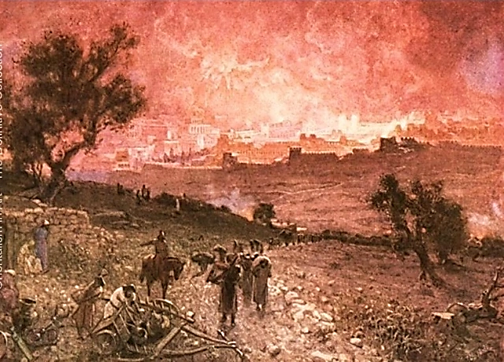
And in the fifth month, on the seventh day of the month (which was the nineteenth year of King Nebuchadnezzar king of Babylon), Nebuzaradan the captain of the guard, a servant of the king of Babylon, came to Jerusalem. He burned the house of the LORD and the king's house; all the houses of Jerusalem, that is, all the houses of the great, he burned with fire. — 2nd Kings 25:8-9
Your light and truth
tabernacle
holy hill
589–586 BC
took away
They also took away the pots, the shovels, the trimmers, the spoons, and all the bronze utensils with which the priests ministered. The firepans and the basins, the things of solid gold and solid silver, the captain of the guard took away. — 2nd Kings 25:14-15
They also took away the pots, the shovels, the trimmers, the spoons, and all the bronze utensils with which the priests ministered. The firepans and the basins, the things of solid gold and solid silver, the captain of the guard took away. — 2nd Kings 25:14-15
took away
Because of Mount Zion which is desolate, With foxes walking about on it. — Lamentations 5:18
bronze
burned the house of the LORD
burned the house of the LORD
gold
silver
Notes:
589–587 BC
2nd Kings 25:8-9 And in the fifth month, on the seventh day of the month (which was the nineteenth year of King Nebuchadnezzar king of Babylon), Nebuzaradan the captain of the guard, a servant of the king of Babylon, came to Jerusalem.
9 He burned the house of the LORD and the king's house; all the houses of Jerusalem, that is, all the houses of the great, he burned with fire.
2nd Kings 25:14-15 They also took away the pots, the shovels, the trimmers, the spoons, and all the bronze utensils with which the priests ministered. 15 The firepans and the basins, the things of solid gold and solid silver, the captain of the guard took away.

Slide 34
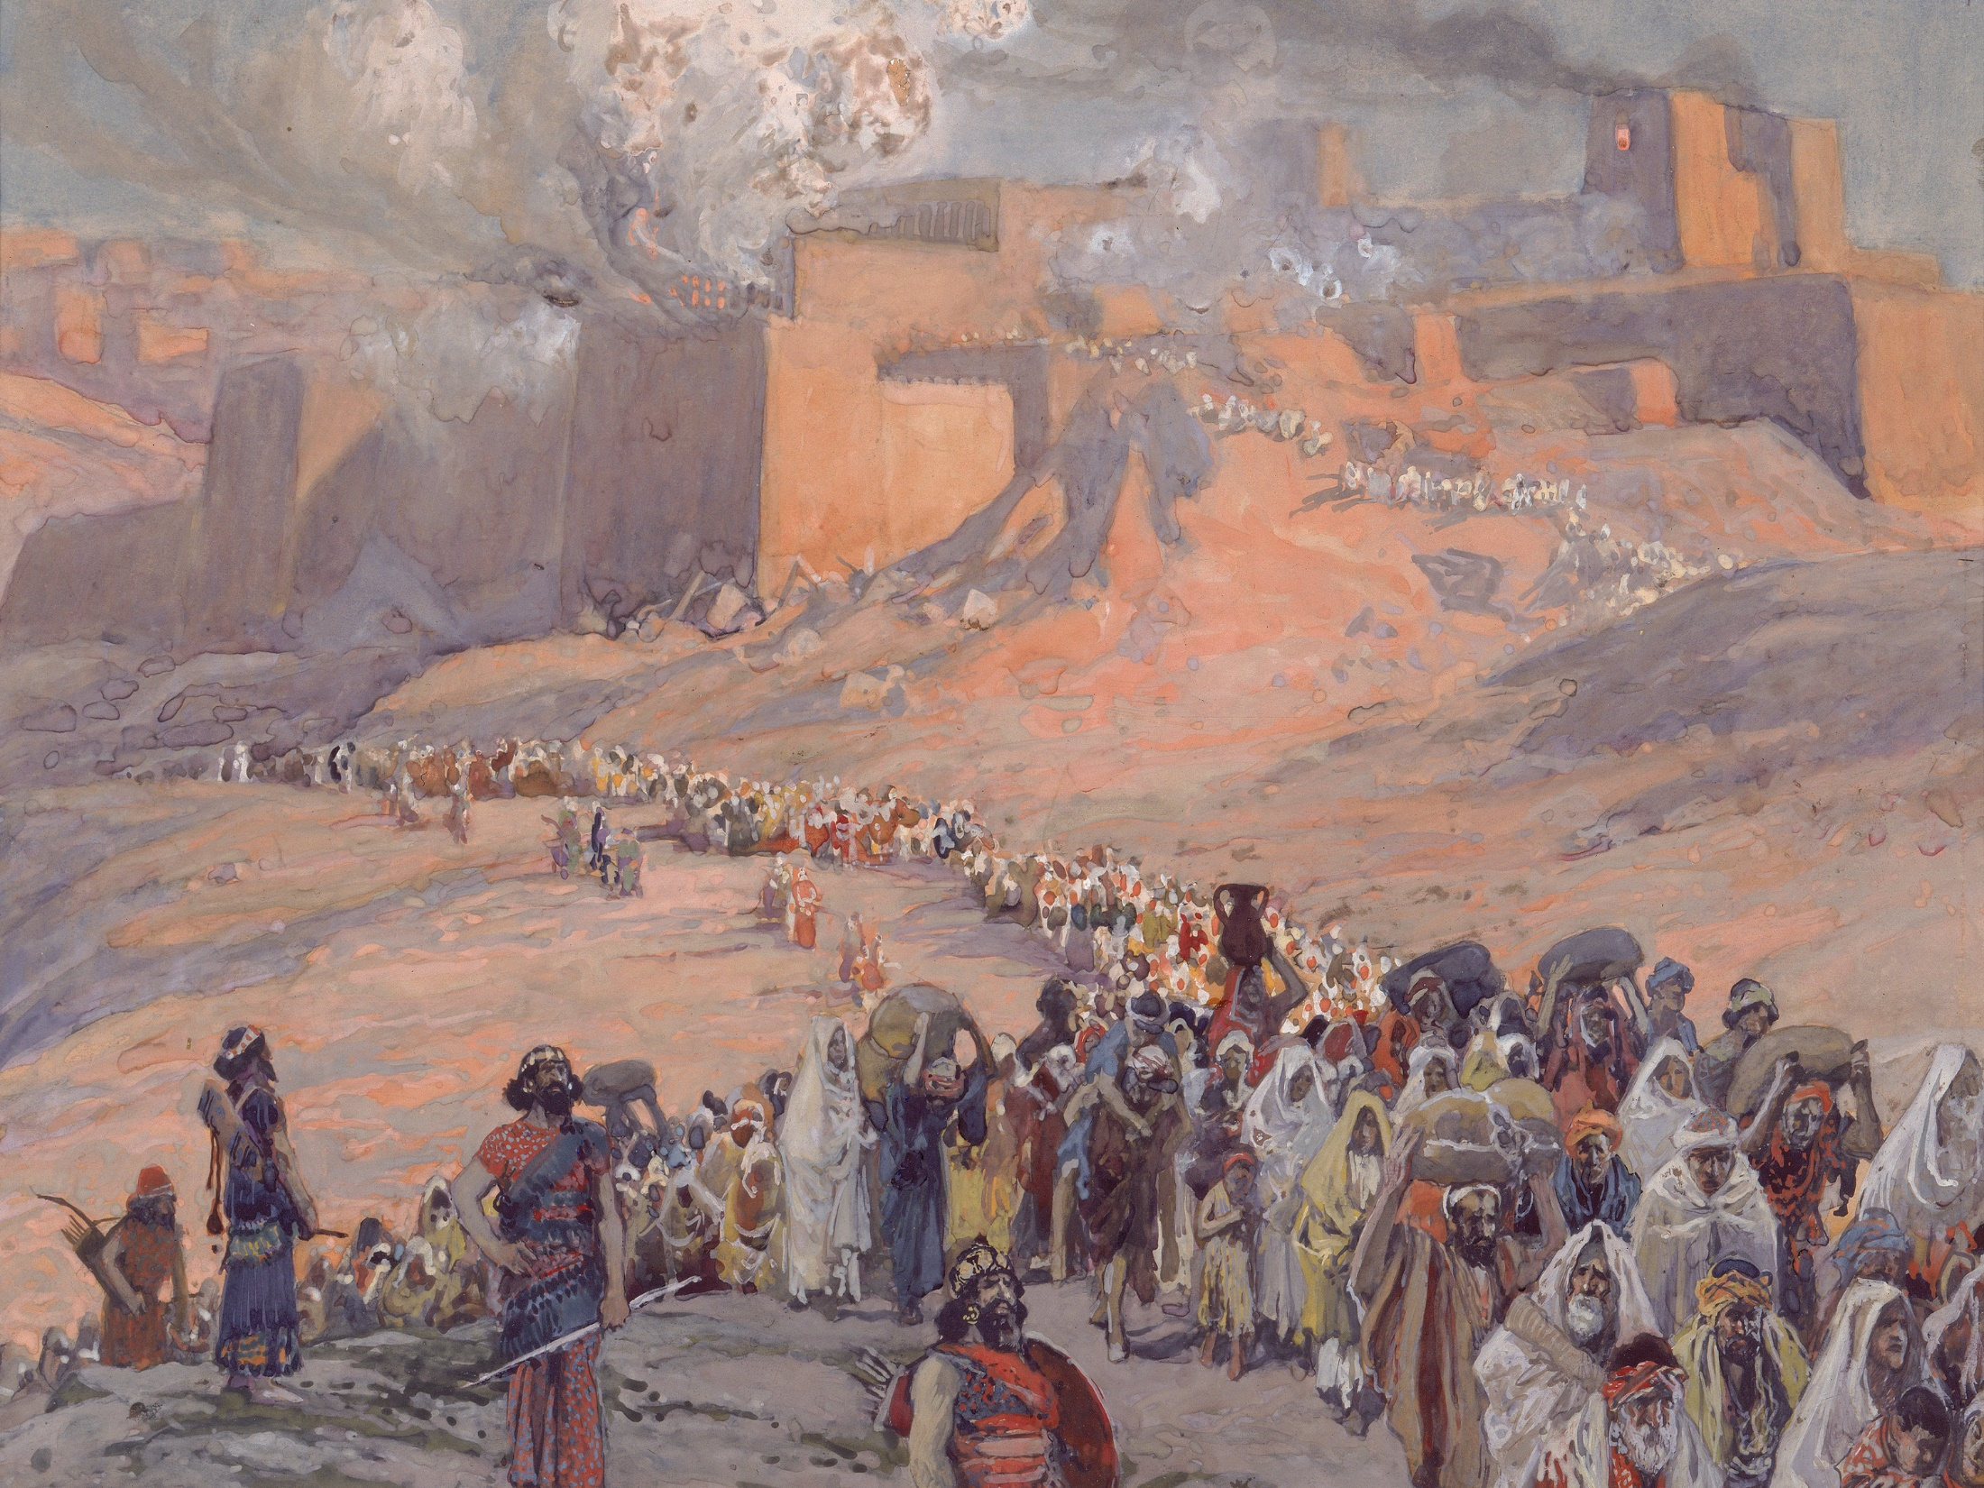
Therefore my people have gone into captivity, Because they have no knowledge; Their honorable men are famished, And their multitude dried up with thirst.
— Isaiah 5:13
Your light and truth
tabernacle
holy hill
no knowledge
self-seeking
destroyed
Hosea 4:6
Jeremiah 8:6
Notes:
Hosea 4:6 My people are destroyed for lack of knowledge. Because you have rejected knowledge, I also will reject you from being priest for Me; Because you have forgotten the law of your God, I also will forget your children.
Jeremiah 8:6 I listened and heard, But they do not speak aright. No man repented of his wickedness, Saying, 'What have I done?' Everyone turned to his own course, As the horse rushes into the battle.

Slide 35
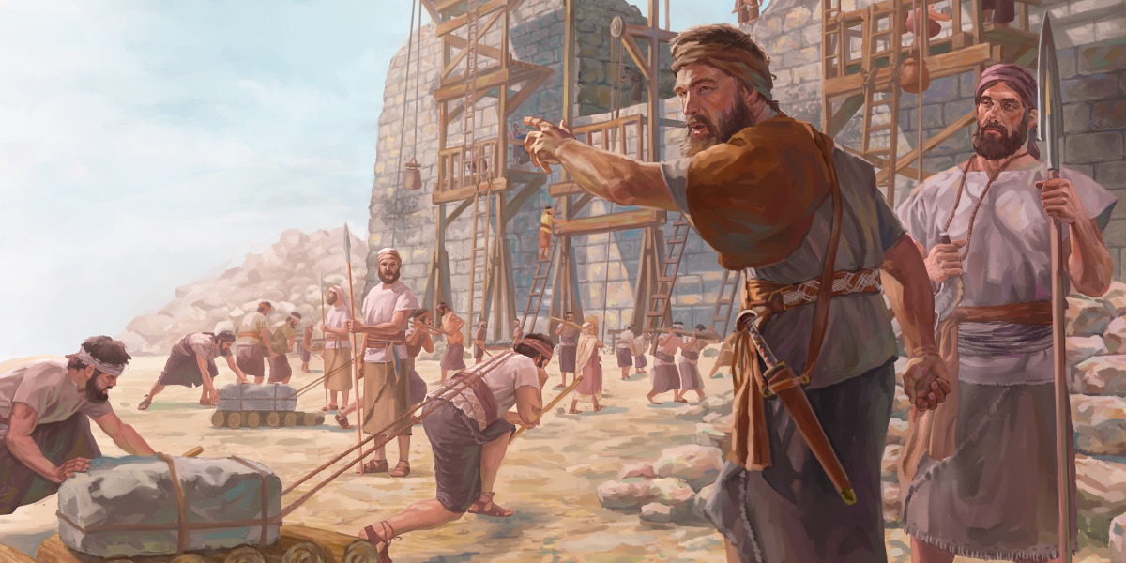
"And he said to him, 'Take these articles; go, carry them to the temple site that is in Jerusalem, and let the house of God be rebuilt on its former site.' " — Ezra 5:15
Your light and truth
tabernacle
holy hill
538 BC
King Cyrus of Babylon
Sheshbazzar
he
bronze
silver
gold
house of God be rebuilt
God
house of God be rebuilt
Notes:
Sheshbazzar

Slide 36
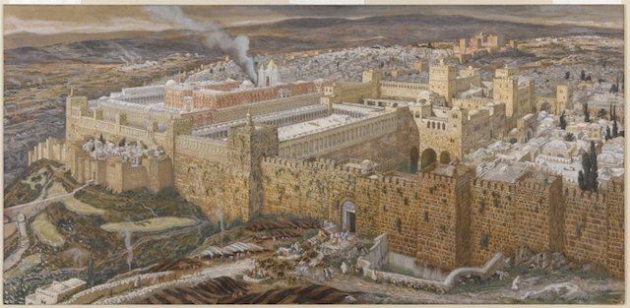
"Thus says the LORD: 'I will return to Zion, And dwell in the midst of Jerusalem. Jerusalem shall be called the City of Truth, The Mountain of the LORD of hosts, The Holy Mountain.' " — Zechariah 8:3
Your light and truth
tabernacle
holy hill
says the LORD
I will return to Zion
dwell in the midst of Jerusalem
called:
● the City of Truth
● Mountain of the LORD of hosts
● The Holy Mountain
→
←
says the LORD
:
I will return
to Zion
dwell in the midst of
Jerusalem
called
the City of Truth
Mountain of the LORD of hosts
The Holy Mountain

Slide 37
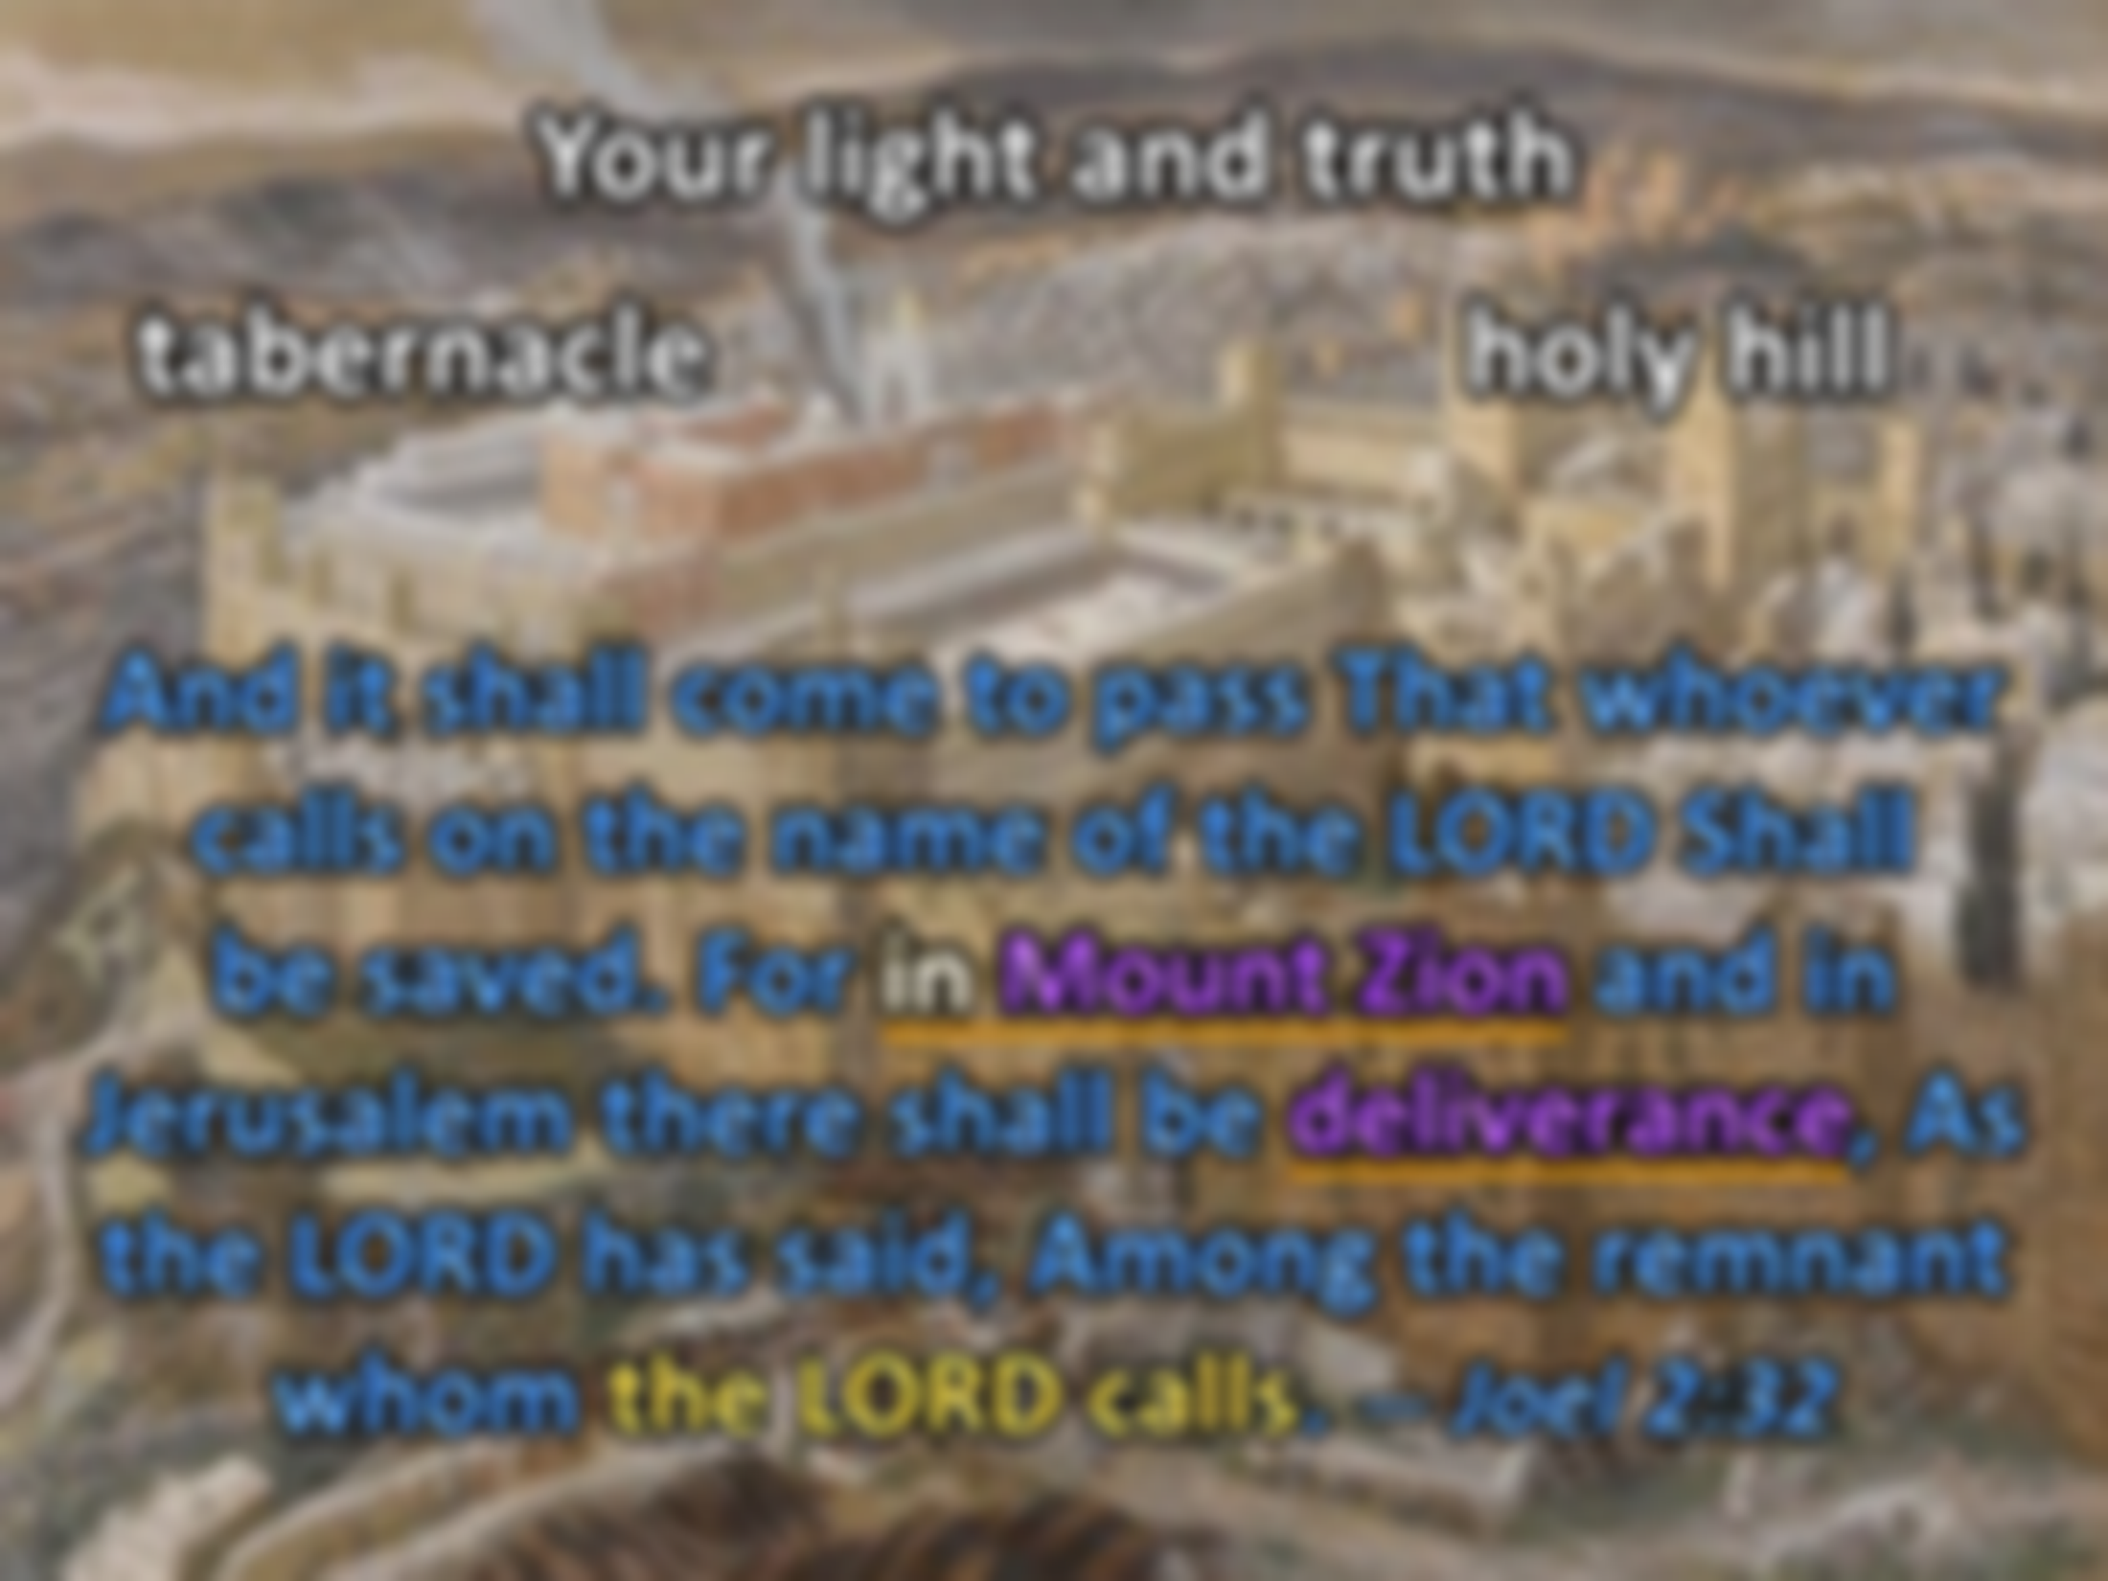

And it shall come to pass That whoever calls on the name of the LORD Shall be saved. For in Mount Zion and in Jerusalem there shall be deliverance, As the LORD has said, Among the remnant whom the LORD calls. — Joel 2:32
Your light and truth
tabernacle
holy hill
says the LORD
I will return to Zion
dwell in the midst of Jerusalem
called:
● the City of Truth
● Mountain of the LORD of hosts
● The Holy Mountain
NUN. Your word is a lamp to my feet And a light to my path. — Psalms 119:105
the mountain of the LORD
the house of the God of Jacob
He will teach us His ways
out of Zion law shall go forth
the word of the LORD
from Jerusalem
Your word
. .
the LORD has said
↓
whoever calls on the name of the LORD Shall be saved
↑
in Mount Zion and in Jerusalem
deliverance
Many nations shall come and say, "Come, and let us go up to the mountain of the LORD, To the house of the God of Jacob; He will teach us His ways, And we shall walk in His paths." For out of Zion the law shall go forth, And the word of the LORD from Jerusalem. — Micah 4:2
→
←
"So you shall know that I am the LORD your God, Dwelling in Zion My holy mountain. Then Jerusalem shall be holy, And no aliens shall ever pass through her again."
— Joel 3:17
I am the
whoever
I am the LORD your God
Dwelling in Zion My holy mountain
Jerusalem shall be holy
no aliens shall pass again
the house
a light
the house
. .
the mountain
LORD your God
Dwelling in Zion
calls on the name of the LORD
Shall
of the LORD
the house of the God of
My holy mountain
Jerusalem
be saved
in Mount Zion and in
in Mount Zion
teach
in
in Mount Zion
1Pet 3:18 - Christ’s sacrifice once for all
Ep 3:6 - Gentiles as fellow heirs
Heb 8:10 - Covenant with all mankind
Jacob
He will teach us His ways
For the commandment is a lamp, And the law a light; Reproofs of instruction are the way of life, …. — Proverbs 6:23
shall be holy
no aliens shall
Jerusalem
deliverance
deliverance
deliverance
law a light
out of
. .
the LORD has said
again
pass
the word
Zion
law shall go forth
the word
the way of life
of the LORD
deliverance
from Jerusalem
Notes:
Eph 3:6 that the Gentiles should be fellow heirs, of the same body, and partakers of His promise in Christ through the gospel,
Heb 8:10 "For this is the covenant that I will make with the house of Israel after those days, says the LORD: I will put My laws in their mind and write them on their hearts; and I will be their God, and they shall be My people.
1Pe 3:18 For Christ also suffered once for sins, the just for the unjust, that He might bring us to God, being put to death in the flesh but made alive by the Spirit,

Slide 38
I will make the lame a remnant, And the outcast a strong nation; So the LORD will reign over them in Mount Zion From now on, even forever. — Micah 4:7
Your light and truth
tabernacle
holy hill
Luke 1:33 - Christ’s kingdom with no end
lame
LORD
outcast
LORD
in Mount Zion
in
. .
forever
forever
Notes:
Lu 1:33 "And He will reign over the house of Jacob forever, and of His kingdom there will be no end."

Slide 39


{A Song of Ascents.} Those who trust in the LORD Are like Mount Zion, Which cannot be moved, but abides forever. — Psalms 125:1
● Root of the righteous cannot be moved - Prov 12:2-3
● My salvation, defense and strength - Ps 62:5-7
● Grounded and steadfast - Col 1:23
Presence
of GOD
dwells
who
who trust in the LORD
like Mount Zion
cannot be moved
abides forever
trust
Christ
LORD
LORD
trust in the LORD
like Mount
→
←
Zion
cannot be moved
abides forever
abides forever
in Him in us
1ST John 4:15-16
Notes:
Colossians 1:23 if indeed you continue in the faith, grounded and steadfast, and are not moved away from the hope of the gospel which you heard, which was preached to every creature under heaven, of which I, Paul, became a minister.
Psalms 62:5-7 My soul, wait silently for God alone, For my expectation is from Him. 6 He only is my rock and my salvation; He is my defense; I shall not be moved. 7 In God is my salvation and my glory; The rock of my strength, And my refuge, is in God.
Proverbs 12:2-3 A good man obtains favor from the LORD, But a man of wicked intentions He will condemn. 3 A man is not established by wickedness, But the root of the righteous cannot be moved.
Prov 12:2-3 root of the righteous cannot be moved
Ps 62:5-7 my salvation, defense and strength
Col 1:23 grounded and steadfast
1ST John 4:15-16

Slide 40

"You are the light of the world. A city that is set on a hill cannot be hidden.
Nor do they light a lamp and put it under a basket, but on a lampstand, and it gives light to all who are in the house. Let your light so shine before men, that they may see your good works and glorify your Father in heaven." — Matthew 5:14-16
glorify your Father in heaven
gives light to all who are in the house
Let your light so shine before men
see your good works
of God
gives light to all who are in the
in the house
house
Let your light so shine before
men
see your good
Let your light so shine
. .
works
glorify your Father in
heaven
Eph 2:10 - Created in Christ for good works

Slide 41

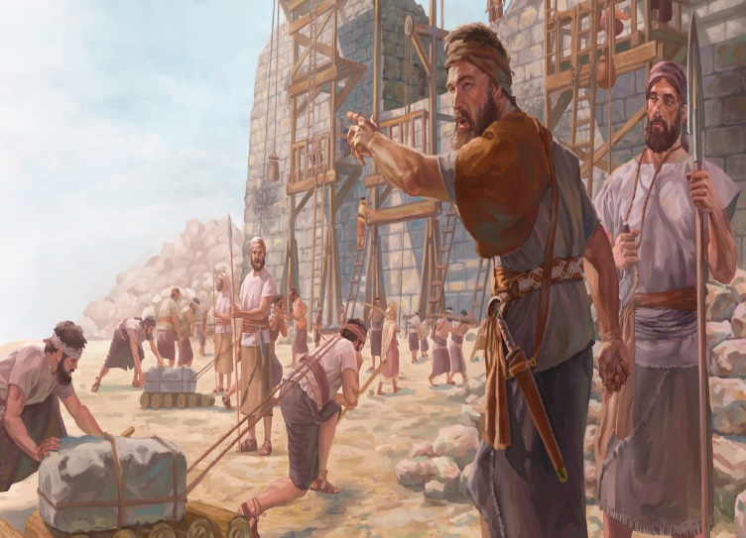


Slide 42
→ God’s holy hill, Mount Zion, held His tabernacle
→ God would appear in a cloud above the mercy seat
→ Two cherubim overshadowing mercy seat on Ark
→ The Ark has no details that can be truly given
→ God’s dwelling on earth was between the cherubim
→ Well known God dwelt in Jerusalem on Mount Zion
→ Babylon destroyed Jerusalem taking all her riches
→ Captivity came for Mount Zion was filled with foxes
→ King Cyrus ordered the temple to be rebuilt
→ So in Mount Zion and Jerusalem will be deliverance
→ Law comes from Zion & His word from Jerusalem
→ Upon the return from captivity, Zion will never fail
→ God declares faith should be seen and not hidden
God’s word holds timeless truths

Slide 44
Light in the House
3
Ron Bert
November 6, 2022

Slide 45
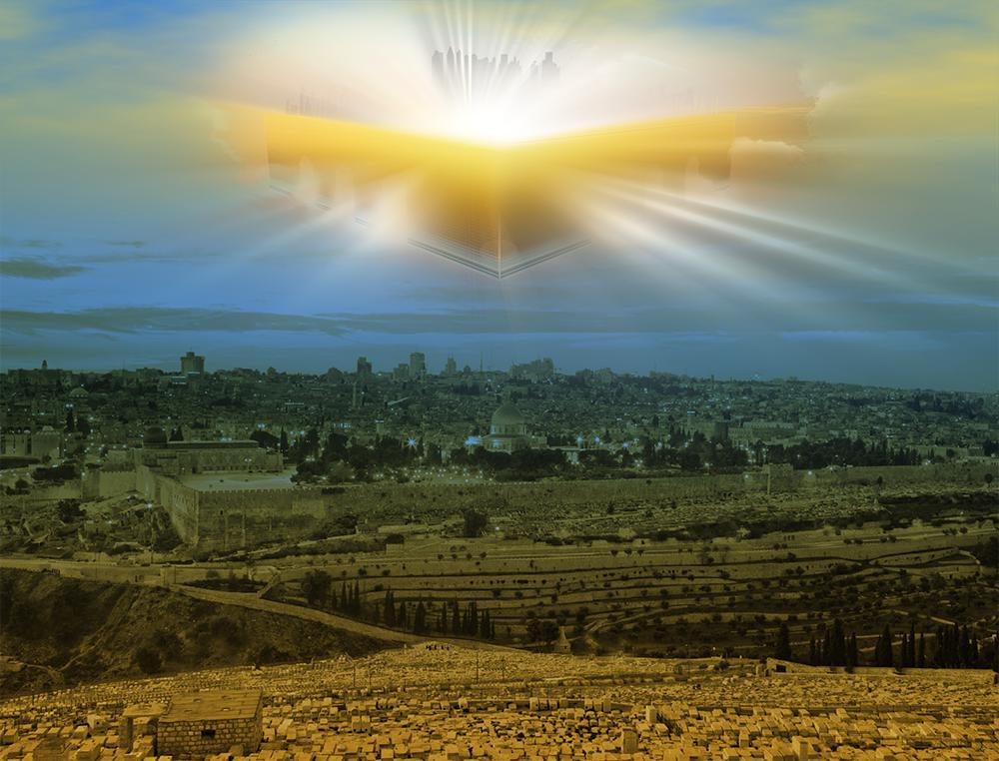
Abraham
… for he waited for the city which has foundations, whose builder and maker is God. — Hebrews 11:10
he
But now they desire a better, that is, a heavenly country. Therefore God is not ashamed to be called their God, for He has prepared a city for them. — Hebrews 11:16
Creator
a heavenly country
a heavenly country
is
God
God
prepared
For here we have no continuing city, but we seek the one to come. — Hebrews 13:14
prepared
a city for them
a city for them
Heb 11:6 - Rewards diligent seeking
Notes:
Hebrews 11:6 But without faith it is impossible to please Him, for he who comes to God must believe that He is, and that He is a rewarder of those who diligently seek Him.

Slide 46
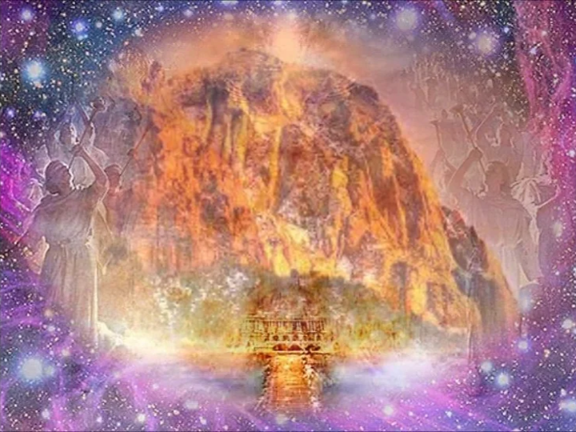
But you have come to Mount Zion and to the city of the living God, the heavenly Jerusalem, to an innumerable company of angels, to the general assembly and church of the firstborn who are registered in heaven, to God the Judge of all, to the spirits of just men made perfect, to Jesus the Mediator of the new covenant, and to the blood of sprinkling that speaks better things than that of Abel. — Hebrews 12:22-24
God the Judge of all
↓
to an innumerable company of angels
Mount Zion the city of the living God
the heavenly Jerusalem
the general assembly church of the firstborn who are registered in heaven
↑
to Jesus the Mediator of the new covenant
↑
spirits of just men made perfect
Mount Zion
the city of the living God
the heavenly
Jerusalem
to an innumerable company
of angels
the general assembly
church of the
firstborn who are
the heavenly Jerusalem
registered in heaven
God the Judge
the city of the living God
of all
spirits of just men made
perfect
to Jesus the Mediator of the new
covenant

Slide 47
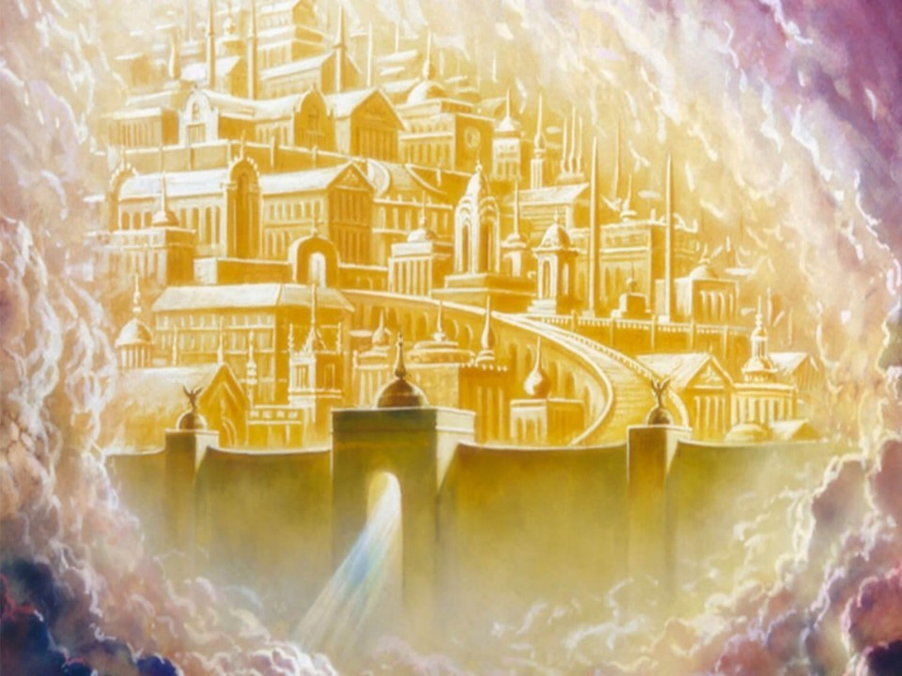


Then I, John, saw the holy city, New Jerusalem, coming down out of heaven from God, prepared as a bride adorned for her husband. And I heard a loud voice from heaven saying, "Behold, the tabernacle of God is with men, and He will dwell with them, and they shall be His people. God Himself will be with them and be their God. — Revelation 21:2-3
Entrance
into
Heaven
holy city
New Jerusalem
out of heaven from God
prepared as a bride for her husband
↓
the tabernacle of God is with men
He will dwell with His people
↑
God Himself will be
with them and be their God
visible
out of
prepared
heaven from God
prepared as a bride
GOD
for her husband
GOD
glorious
holy city
faithful submission
protector
New Jerusalem
Creation
shelter
preserve
sanctuary
temple
the tabernacle of God is
tabernacle of God is
shrine
God
. .
with men
dwell
He will dwell with
with men
. .
sight
His people
sight
2Co 5:7
God Himself will be
with them and
be their God
Notes:
2Co 5:7 For we walk by faith, not by sight.

Slide 48
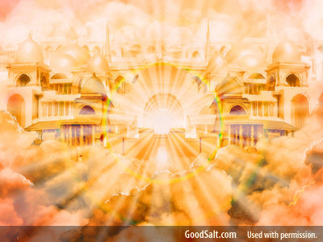
"In My Father's house are many mansions; if it were not so, I would have told you. I go to prepare a place for you. And if I go and prepare a place for you, I will come again and receive you to Myself; that where I am, there you may be also." — John 14:2-3
My Father's house
many
My Father's house
many mansions
I go to prepare a place for you
I will come again
and receive you to Myself
where I am, there you may be also
mansions
→
I go to
←
prepare a place for you
I will
come again
and receive you to
Myself
where I am, there
where I am
you may be also
you may be also

Slide 49
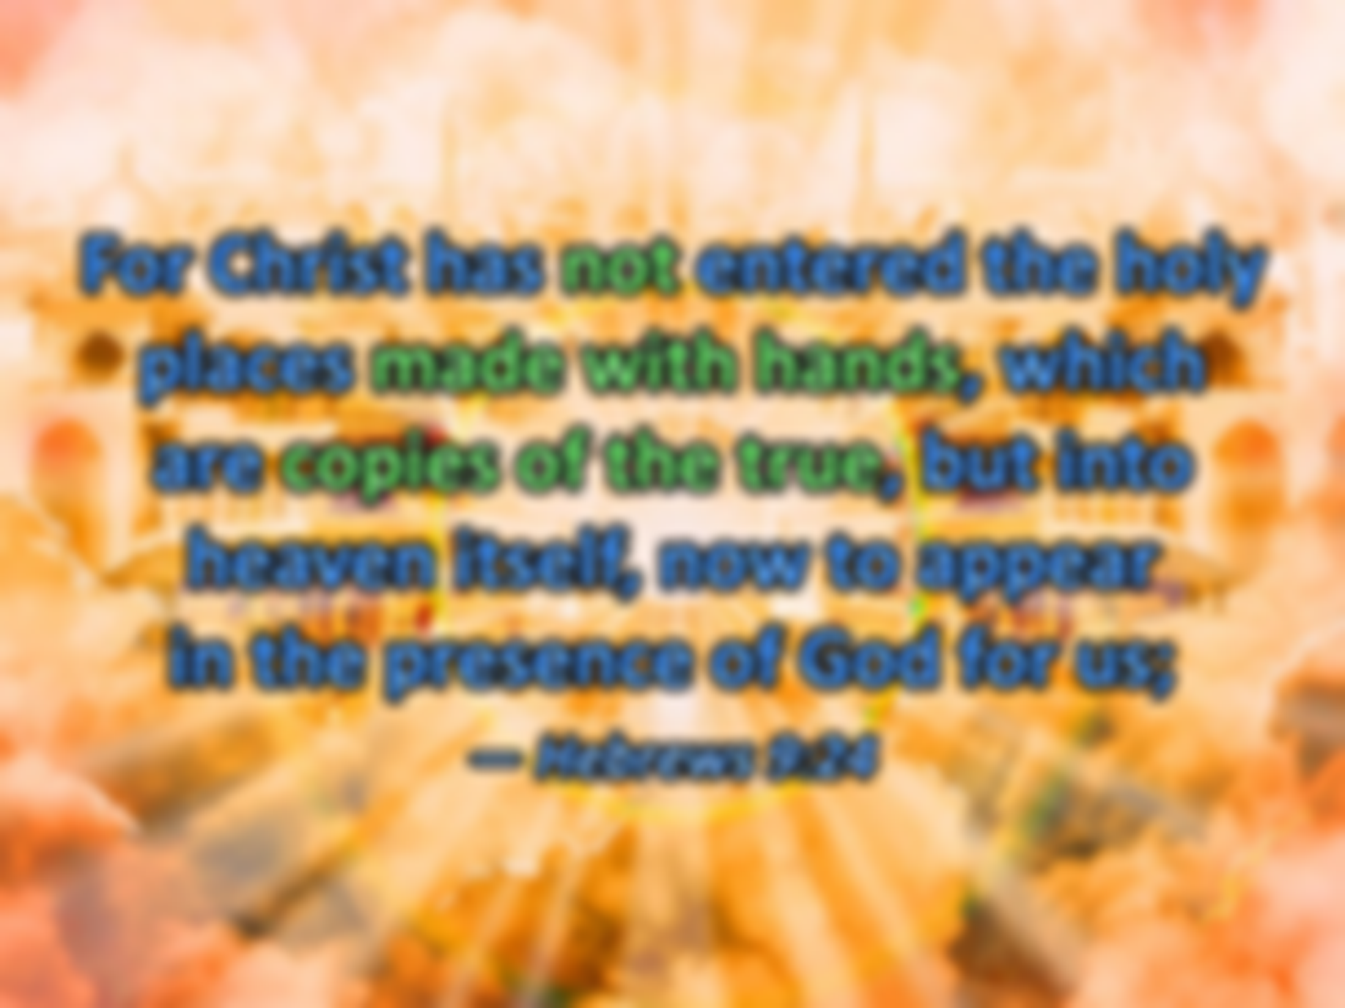
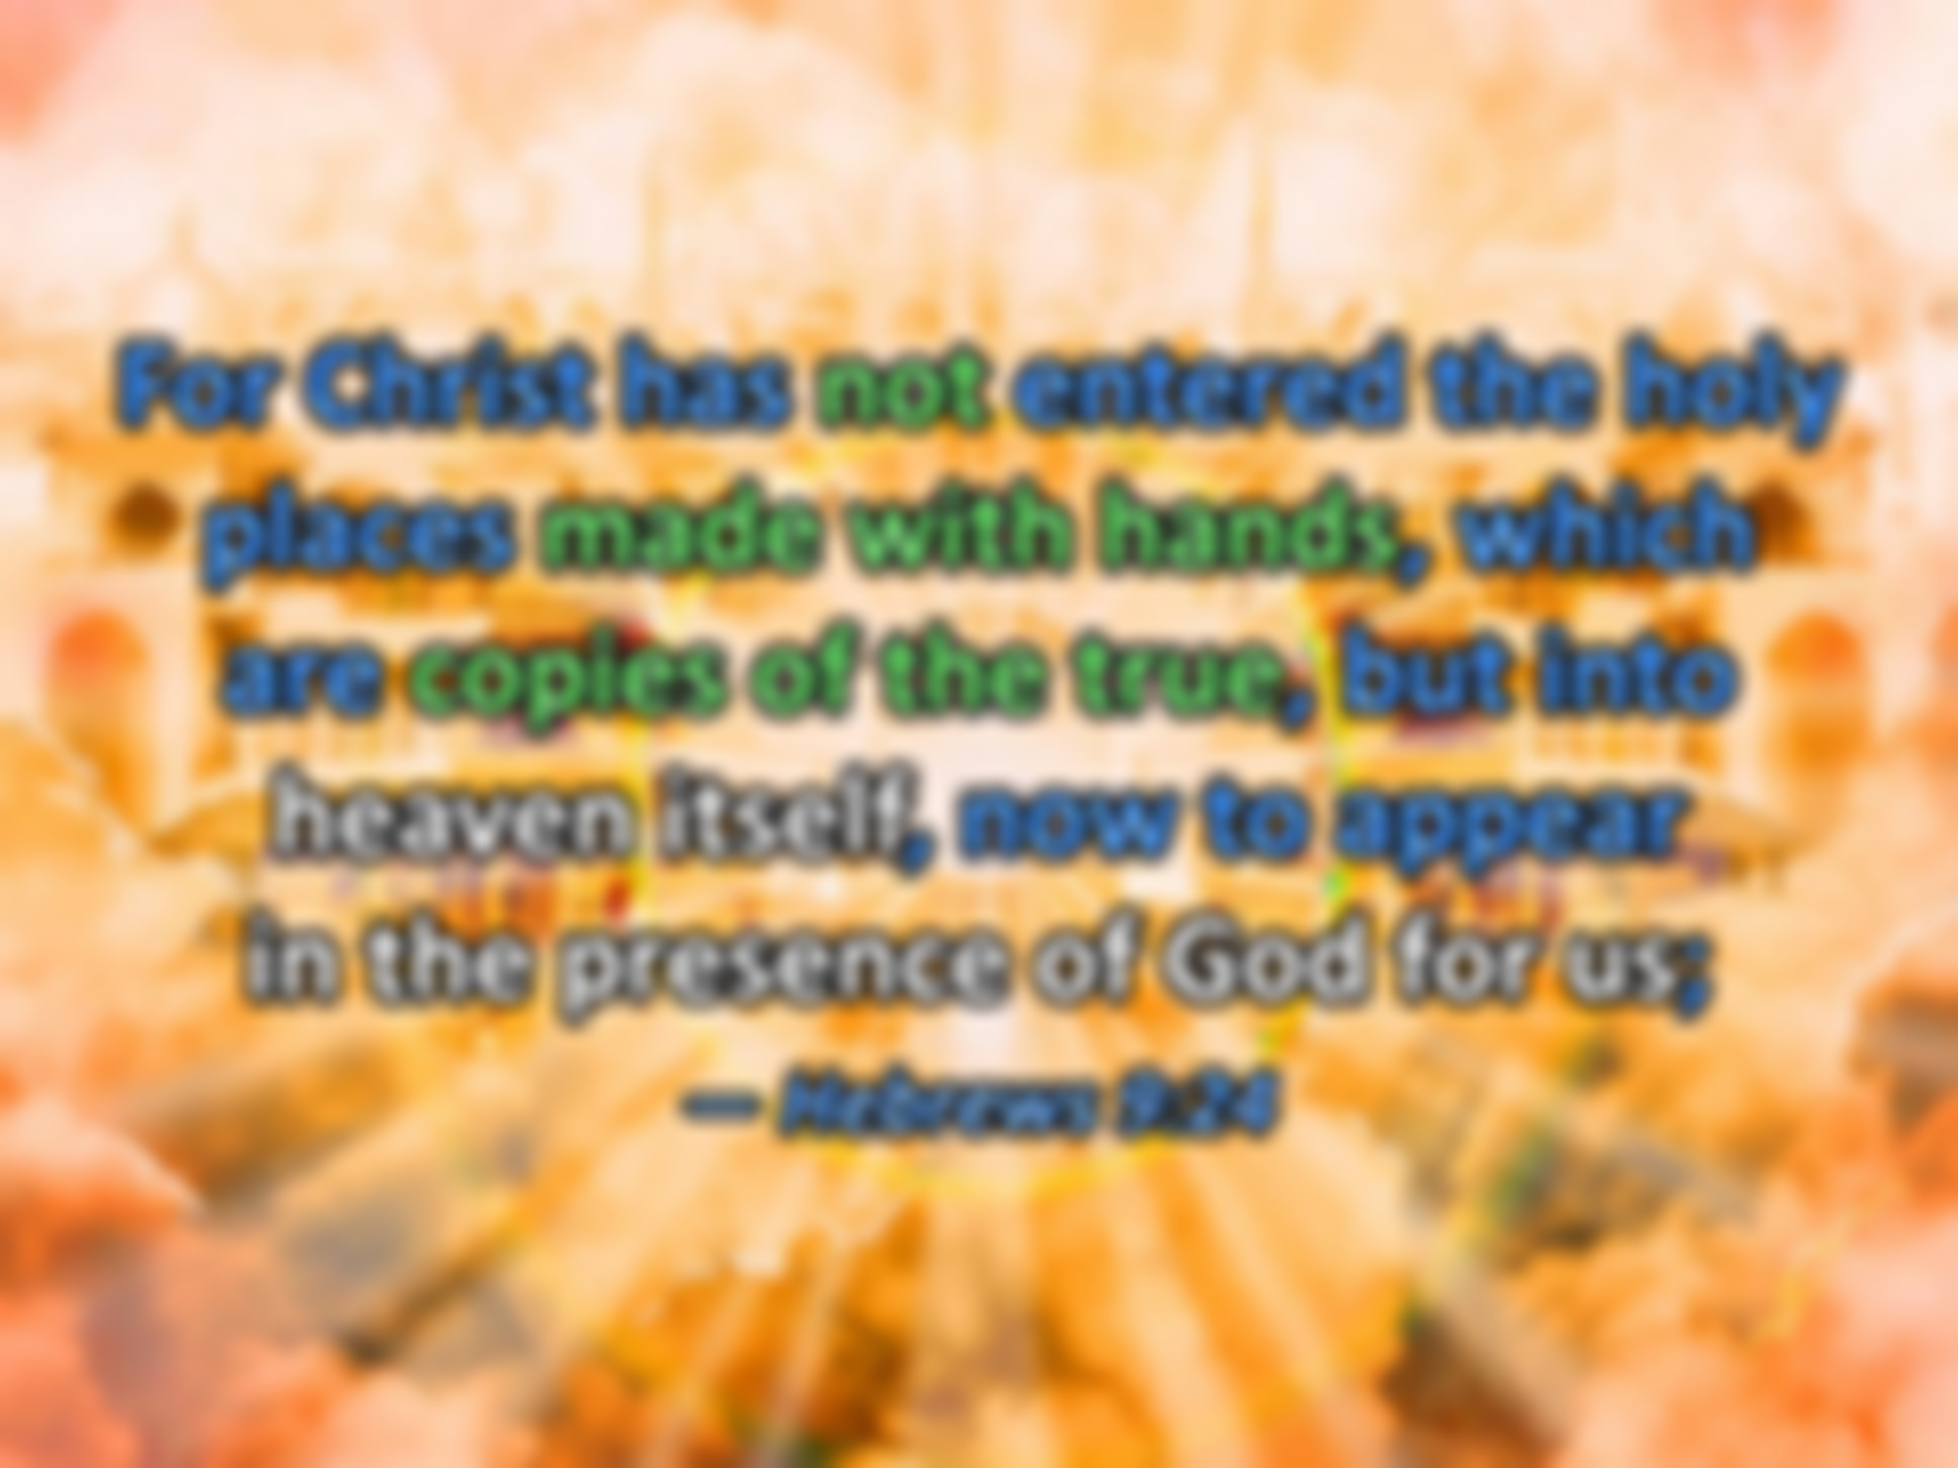





presence of God
heaven itself
Christ
copies of the true
not made with hands
For Christ has not entered the holy places made with hands, which are copies of the true, but into heaven itself, now to appear in the presence of God for us; — Hebrews 9:24
Christ
not
made with hands
copies of the true
Christ
heaven itself
in
presence of God

Slide 50
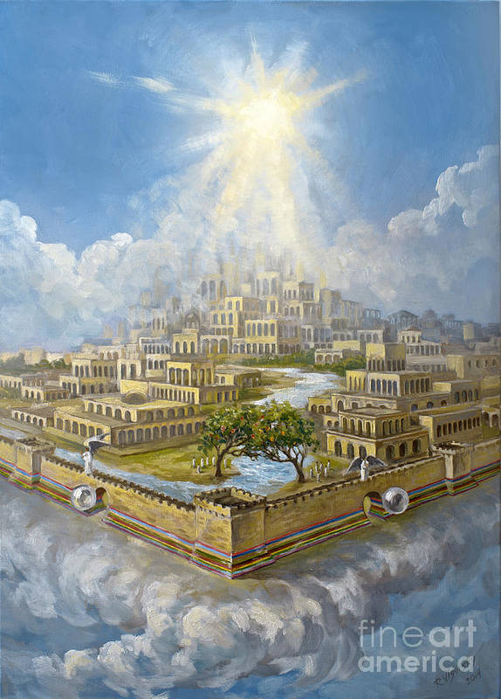
"And God will wipe away every tear from their eyes; there shall be no more death, nor sorrow, nor crying. There shall be no more pain, for the former things have passed away." — Revelation 21:4
And God will
the former things have passed away
And God will
wipe away every
wipe away every tear
no more death
nor sorrow
nor crying
no more pain
tear
no more death
nor sorrow
nor
crying
no more
pain
the former things have
passed away

Slide 51
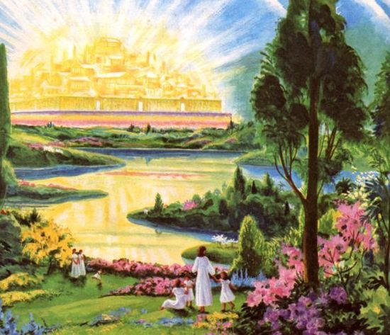
Do all things without complaining and disputing, that you may become blameless and harmless, children of God without fault in the midst of a crooked and perverse generation, among whom you shine as lights in the world, holding fast the word of life, so that I may rejoice in the day of Christ that I have not run in vain or labored in vain. — Philippians 2:14-16
holding fast the word
of life
Do all things
without complaining and
disputing
become
the day of Christ
↘
shine as lights in the world
Do all things
without complaining and disputing
become blameless and harmless
↓
children of God without fault
in a crooked and perverse generation
Christ
blameless and harmless
children of
in
a
God without fault
crooked and perverse generation
shine as lights in
the world
holding fast
the word
of
life
the day of
Christ

Slide 52
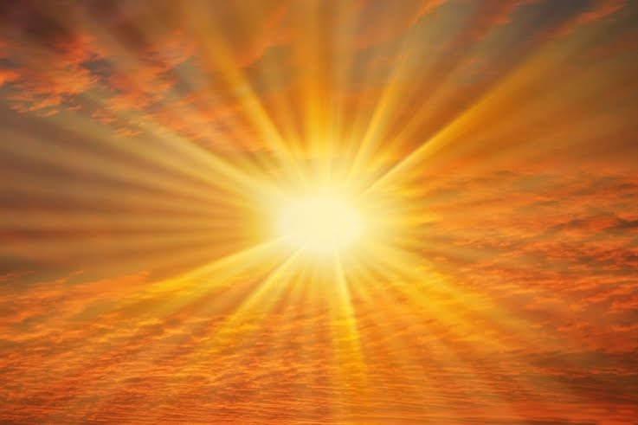
But you are a chosen generation, a royal priesthood, a holy nation, His own special people, that you may proclaim the praises of Him who called you out of darkness into His marvelous light; — 1st Peter 2:9
Heb 11:16 – Heavenly country
Acts 26:18 – Forgiveness of sins
Titus 2:14 – Zealous for good works
made us honored – Rev 1:5
2Co 13:5 - Believers in Christ
chosen generation
. .
priesthood
holy nation
royal priesthood
. .
. .
special people
. .
out of darkness
. .
Notes:
2nd Corinthians 13:5 Examine yourselves as to whether you are in the faith. Test yourselves. Do you not know yourselves, that Jesus Christ is in you? --unless indeed you are disqualified.
Revelation 1:5 and from Jesus Christ, the faithful witness, the firstborn from the dead, and the ruler over the kings of the earth. To Him who loved us and washed us from our sins in His own blood, 6 and has made us kings and priests to His God and Father, to Him be glory and dominion forever and ever. Amen.
Hebrews11:16 But now they desire a better, that is, a heavenly country. Therefore God is not ashamed to be called their God, for He has prepared a city for them.
Titus 2:14 who gave Himself for us, that He might redeem us from every lawless deed and purify for Himself His own special people, zealous for good works.
Acts 26:18 To open their eyes, and to turn them from darkness to light, and from the power of Satan unto God, that they may receive forgiveness of sins, and inheritance among them which are sanctified by faith that is in me.

Slide 53
priesthood

Slide 54

… you also, as living stones, are being built up a spiritual house, a holy priesthood, to offer up spiritual sacrifices acceptable to God through Jesus Christ. — 1st Peter 2:5
to offer up spiritual sacrifices acceptable to God through Christ
spiritual sacrifices
Christ
a spiritual house
a spiritual house
→ Righteousness – Heb 11:4
priesthood
to offer up
→ Praise to God – Heb 13:15
spiritual sacrifices
acceptable to
→ Do good & share – Heb 13:16
God through
Christ
→ Mercy – Matthew 9:13
→ Love – Ephesians 5:2
Notes:
Hebrews 11:4 By faith Abel offered to God a more excellent sacrifice than Cain, through which he obtained witness that he was righteous, God testifying of his gifts; and through it he being dead still speaks.
Hebrews 13:15 Therefore by Him let us continually offer the sacrifice of praise to God, that is, the fruit of our lips, giving thanks to His name.
Hebrews 13:16 But do not forget to do good and to share, for with such sacrifices God is well pleased.
Mathew 9:13 "But go and learn what this means: 'I desire mercy and not sacrifice.' For I did not come to call the righteous, but sinners, to repentance.“
Ephesians 5:2 And walk in love, as Christ also has loved us and given Himself for us, an offering and a sacrifice to God for a sweet-smelling aroma.

Slide 55
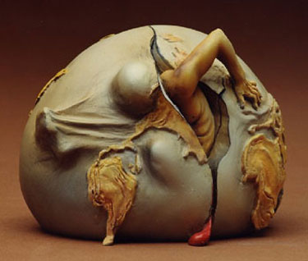
For we know that if our earthly house, this tent, is destroyed, we have a building from God, a house not made with hands, eternal in the heavens. For in this we groan, earnestly desiring to be clothed with our habitation which is from heaven, — 2nd Corinthians 5:1-2
eternal in the heavens
we have a building from God
a house not made with hands
↓
we desire habitation in heaven
↑
if our earthly house is destroyed
this tent
this tent
if our earthly
house
this tent
is destroyed
we
have a building from God
a house
not made with hands
e
eternal in
the heavens
in
we
desir
habitation
heaven

Slide 56
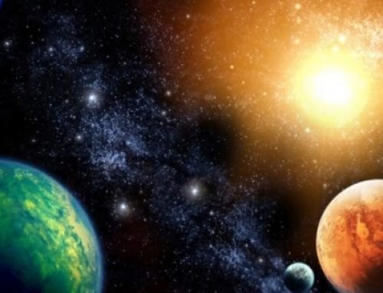
For we who are in this tent groan, being burdened, not because we want to be unclothed, but further clothed, that mortality may be swallowed up by life. Now He who has prepared us for this very thing is God, who also has given us the Spirit as a guarantee. — 2nd Corinthians 5:4-5
God who is has prepared
us for this very thing
↓
who has given us the
Spirit as a guarantee
↑
that mortality may be
swallowed up by life
↑
burdened we groan
we
this tent
groan
God
Believe
Know
burdened
that mortality may be
Trust
swallowed up by life
who
has prepared
us for this very
thing
God
who
Hope
is
has given
us the
Spirit as a guarantee
Flesh
in Time

Slide 57
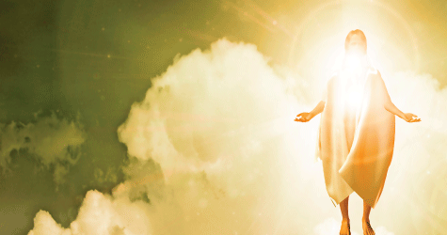
But you are not in the flesh but in the Spirit, if indeed the Spirit of God dwells in you. Now if anyone does not have the Spirit of Christ, he is not His. — Romans 8:9
if the Spirit of God dwells in you
not in the flesh but in the Spirit
if anyone does not have
the Spirit of Christ
he is not His
dwells
not in the flesh but in
dwells
the Spirit
if
the Spirit of
God dwells in you
if anyone
does not have
the Spirit of Christ
he is not His

Slide 58

Do you not know that you are the temple of God and that the Spirit of God dwells in you? If anyone defiles the temple of God, God will destroy him. For the temple of God is holy, which temple you are. — 1st Corinthians 3:16 -17
True Light
you are the temple of God
the Spirit of God dwells in you
the temple of God is holy
which temple you are
God will destroy him
anyone defiles the temple of God
you are the
dwell
dwell
Spirit of God dwells in you
Spirit of God
in
Spirit of God dwells in you
temple of God
the Spirit
of God dwells in you
anyone
dwells
defiles the temple of God
God
2Co 6:16
1Pe 1:16
will destroy him
the temple of
Temple
Holy
God is holy
which temple you are
Darkness
Notes:
1Pe 1:16 because it is written, "Be holy, for I am holy.“
2Co 6:16 And what agreement has the temple of God with idols? For you are the temple of the living God. As God has said: "I will dwell in them And walk among them. I will be their God, And they shall be My people."

Slide 59
LORD, who may abide in Your tabernacle? Who may dwell in Your holy hill? He who walks uprightly, And works righteousness, And speaks the truth in his heart; He who does not backbite with his tongue, Nor does evil to his neighbor, Nor does he take up a reproach against his friend; — Psalms 15:1-3
who may abide in Your tabernacle? Who may dwell in Your holy hill?
● He who walks uprightly
● works righteousness
● speaks the truth in his heart
● does not backbite with his tongue
● Nor does evil to his neighbor
● Nor does he take up a reproach
against his friend
who may abide in Your
tabernacle?
dwell
Who may dwell in Your
holy hill?
He who walks uprightly
works righteousness
speaks the truth in his heart
does not backbite with his tongue
Nor does evil to his neighbor
Nor does he take up a reproach
against his friend

Slide 60
But the path of the just is like the shining sun, That shines ever brighter unto the perfect day. — Proverbs 4:18
Notes:
Direction
Righteous
Optimistic
God’s coming

Slide 61
Beloved, now we are children of God; and it has not yet been revealed what we shall be, but we know that when He is revealed, we shall be like Him, for we shall see Him as He is. — 1st John 3:2
we shall see Him as He is
↑
we shall be like Him
when He is revealed
↑
revealed what we shall be
↑
children of God
children of God
revealed what
we shall be
when
He is revealed
we shall be like Him
we shall see Him as He is

Slide 62
Walk as children of light

Slide 63
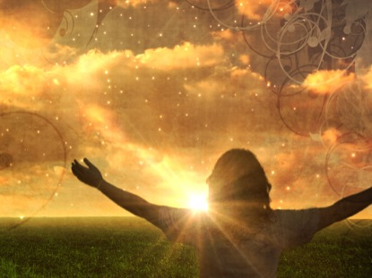
Therefore He says: "Awake, you who sleep, Arise from the dead, And Christ will give you light." — Ephesians 5:14
For you were once darkness, but now you are light in the Lord. Walk as children of light. — Ephesians 5:8
light
Walk as children of light
Christ will give you light
Christ
. .

Slide 64





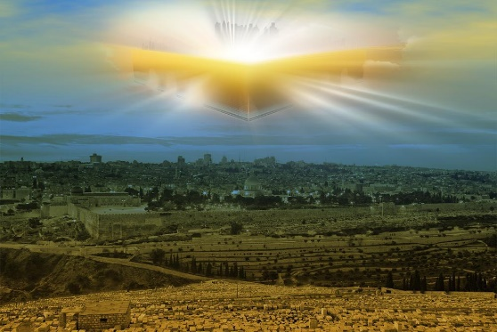




Slide 65
→ Abraham waited for a city built and made by God
→ We seek a city of God to come - in heavenly country
→ God dwells in divine Mt. Zion; heavenly Jerusalem
→ New Jerusalem is where God welcomes His own
→ Jesus prepares a place for us where He now is
→ Heaven has no tears, no death, no sorrow, nor pain
→ As mortals shine as lights not complaining / arguing
→ God calls us to praise Him zealous for good works
→ Our earthly house, this tent is temporary
→ Though all groan, the Spirit is our guarantee of life
→ As living stones/temples of God, He dwells with us
→ Qualities of just righteous honest works lead to God
→ God says wake from death & come to Christ’s light
His light of truth draws us Home

Slide 67

Please visit http://www.RonBert.com to explore further
Ronald Bert Channel on
Notes:
Eternity never ends.

