Slide 1
Notes:
Where there is no freedom, only darkness remains.

Slide 2
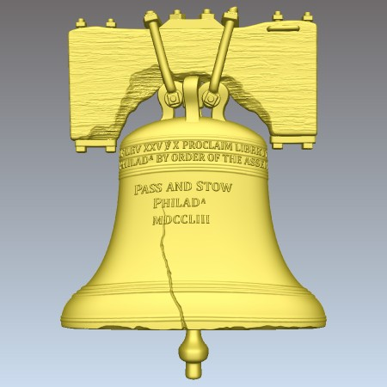
Freedom
Liberty’s Cloak
Liberation
liberty
Deliverance
Free
Will
Privilege
Releasing
Ron Bert
June 19, 2016
Independence
Notes:
Liberty is contained in all that maintains light in His presence.

Slide 3
Now the Lord is the Spirit; and where the Spirit of the Lord is, there is liberty. — 2nd Corinthians 3:17
Lord = Spirit = liberty
Lord
Spirit
Spirit of the Lord
liberty
liberty
Notes:
It is by the Spirit of God that life is freely given. Time is free to blow in space. Grass grows as rivers flow. The moment is given to unfurl as it becomes, free as it is. Many ask where this Spirit of God is, and it is for the pure in heart to know as they know He is here omnipresently.

Slide 4
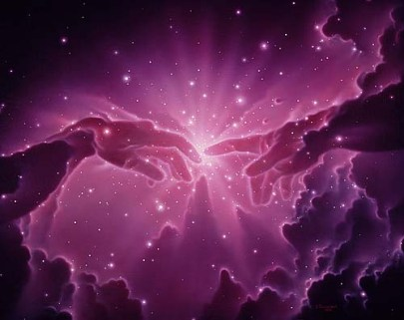
So God created man in His own image; in the image of God He created him; male and female He created them. — Genesis 1:27
God created man
image of God
Spirit of the Lord
Notes:
Hearts hang on the edge of eternity. It is a choice to see creation and whence we came if life is to be grasped in the fullest. We came of God. It was God who chose to make both men and women to expose the deeper points of a soul’s commitment in giving over taking. We were created to reflect His image in life.

Slide 5
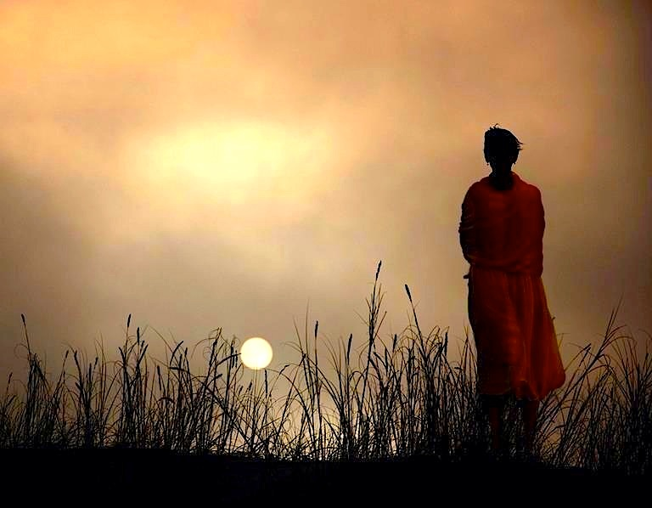
And I will walk at liberty, For I seek Your precepts. — Psalm 119:45
Rules
Laws
Principles
image of God
Commands
walk
For with You is the fountain of life; In Your light we see light. — Psalm 36:9
light
light
light
precepts
Instructions
Teachings
Guidelines
Notes:
What does it mean to be created in the image of God? We can experience. Feel the light. Smell the grass. Sense the wind of time. In His image we are free to be who we are. Precepts have been given in His light for us to know what God expects, if eternity is to be had by those that yearn for it. Death mongers and delusionists will inherit what they darkly desire in a single coughing gasp as their teeth gnash upon the decaying dust, and all too sadly alone absent from His eternal presence. His call is from the light of life.

Slide 6
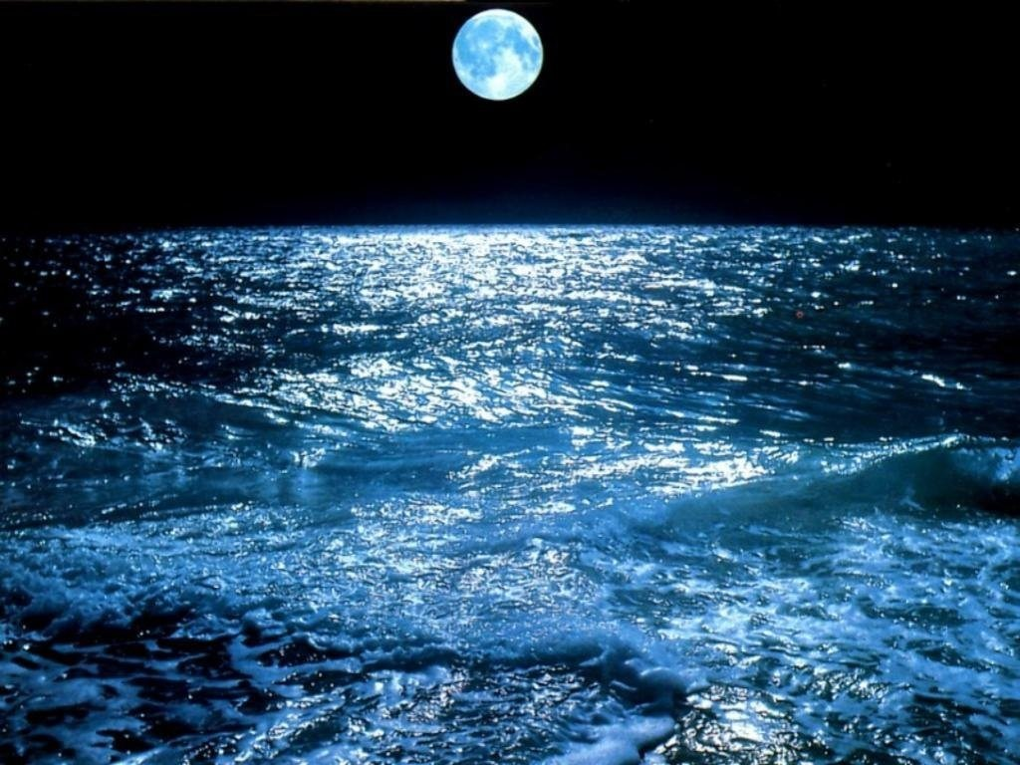
And the LORD said to Samuel, "Heed the voice of the people in all that they say to you; for they have not rejected you, but they have rejected Me, that I should not reign over them." — 1st Samuel 8:7
. .
they have rejected Me
Notes:
Souls have fallen from appreciating that which is freely given by God. The simple minded desire direction from the tangible lacking faith in the eternal. Darkness is immersed in an ocean that cannot see the sky.

Slide 7
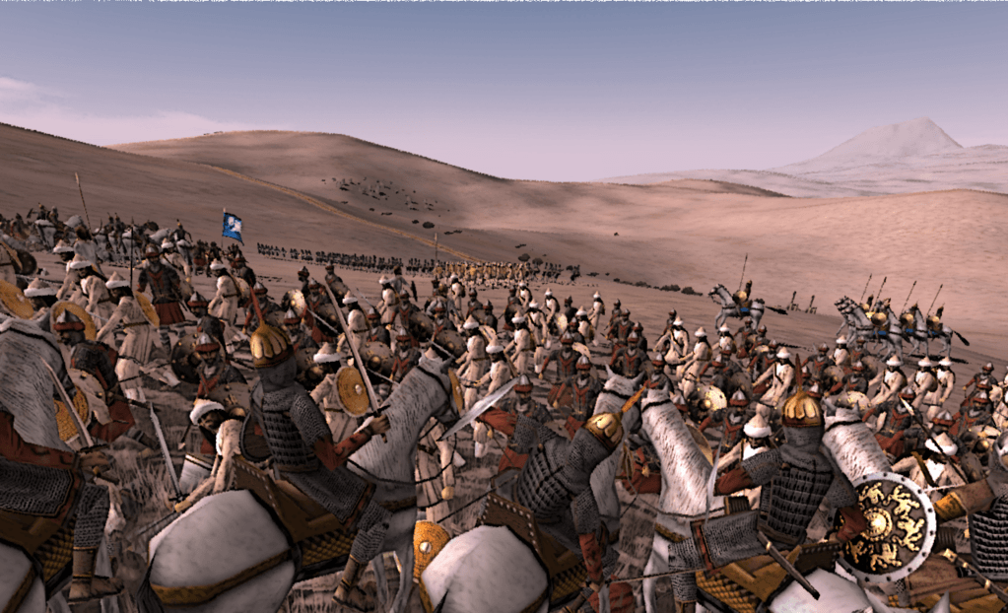
So Samuel told all the words of the LORD to the people who asked him for a king. And he said, "This will be the behavior of the king who will reign over you: He will take your sons and appoint them for his own chariots and to be his horsemen, and some will run before his chariots." — 1st Samuel 8:10-11
the king
the king
. .
He will take
Notes:
Men of stature and influence more often take than give.

Slide 8
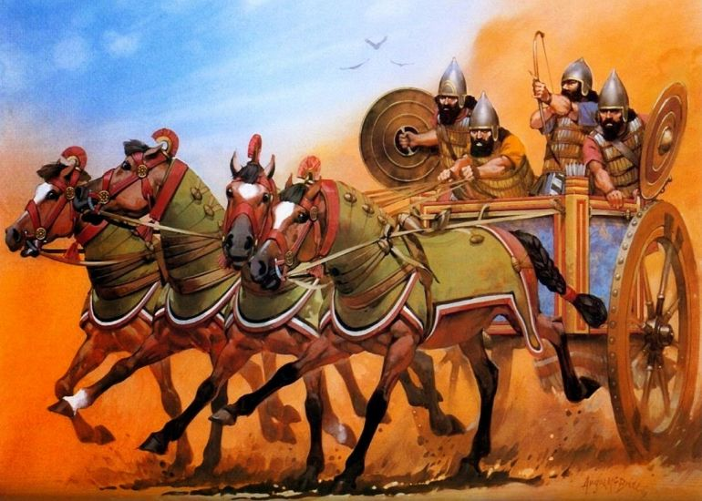
"He will appoint captains over his thousands and captains over his fifties, will set some to plow his ground and reap his harvest, and some to make his weapons of war and equipment for his chariots." — 1st Samuel 8: 12
. .
He will appoint
Notes:
It is the nature of leadership to direct those under their command.

Slide 9
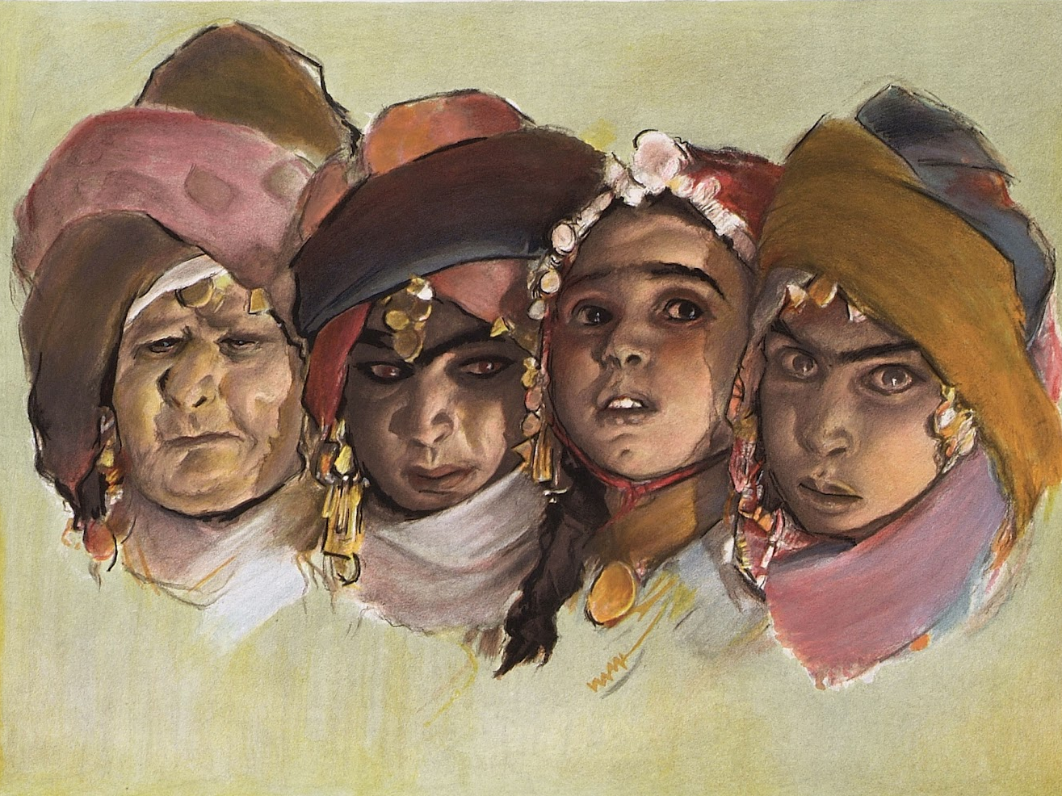
"He will take your daughters to be perfumers, cooks, and bakers." — 1st Samuel 8:13
. .
He will take
Notes:
Often indulgence overwhelms those whose greed supersedes a heart of generosity.

Slide 10
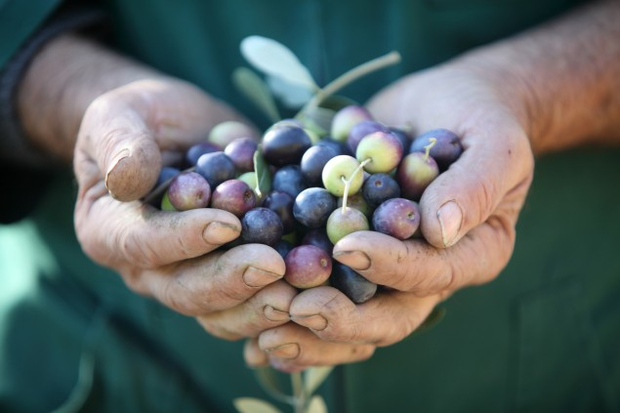
"And he will take the best of your fields, your vineyards, and your olive groves, and give them to his servants. He will take a tenth of your grain and your vintage, and give it to his officers and servants." — 1st Samuel 8: 14-15
. .
he will take
. .
He will take
Notes:
The spoils of greatness are hoarded by the elite few over the many poor.

Slide 11
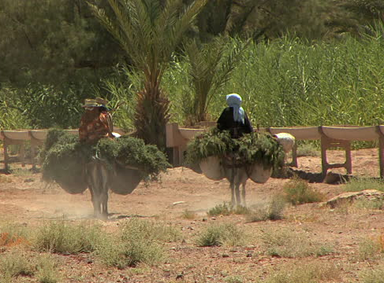
"And he will take your male servants, your female servants, your finest young men, and your donkeys, and put them to his work." — 1st Samuel 8: 16
. .
he will take
Notes:
Those in power take the best for themselves.

Slide 12
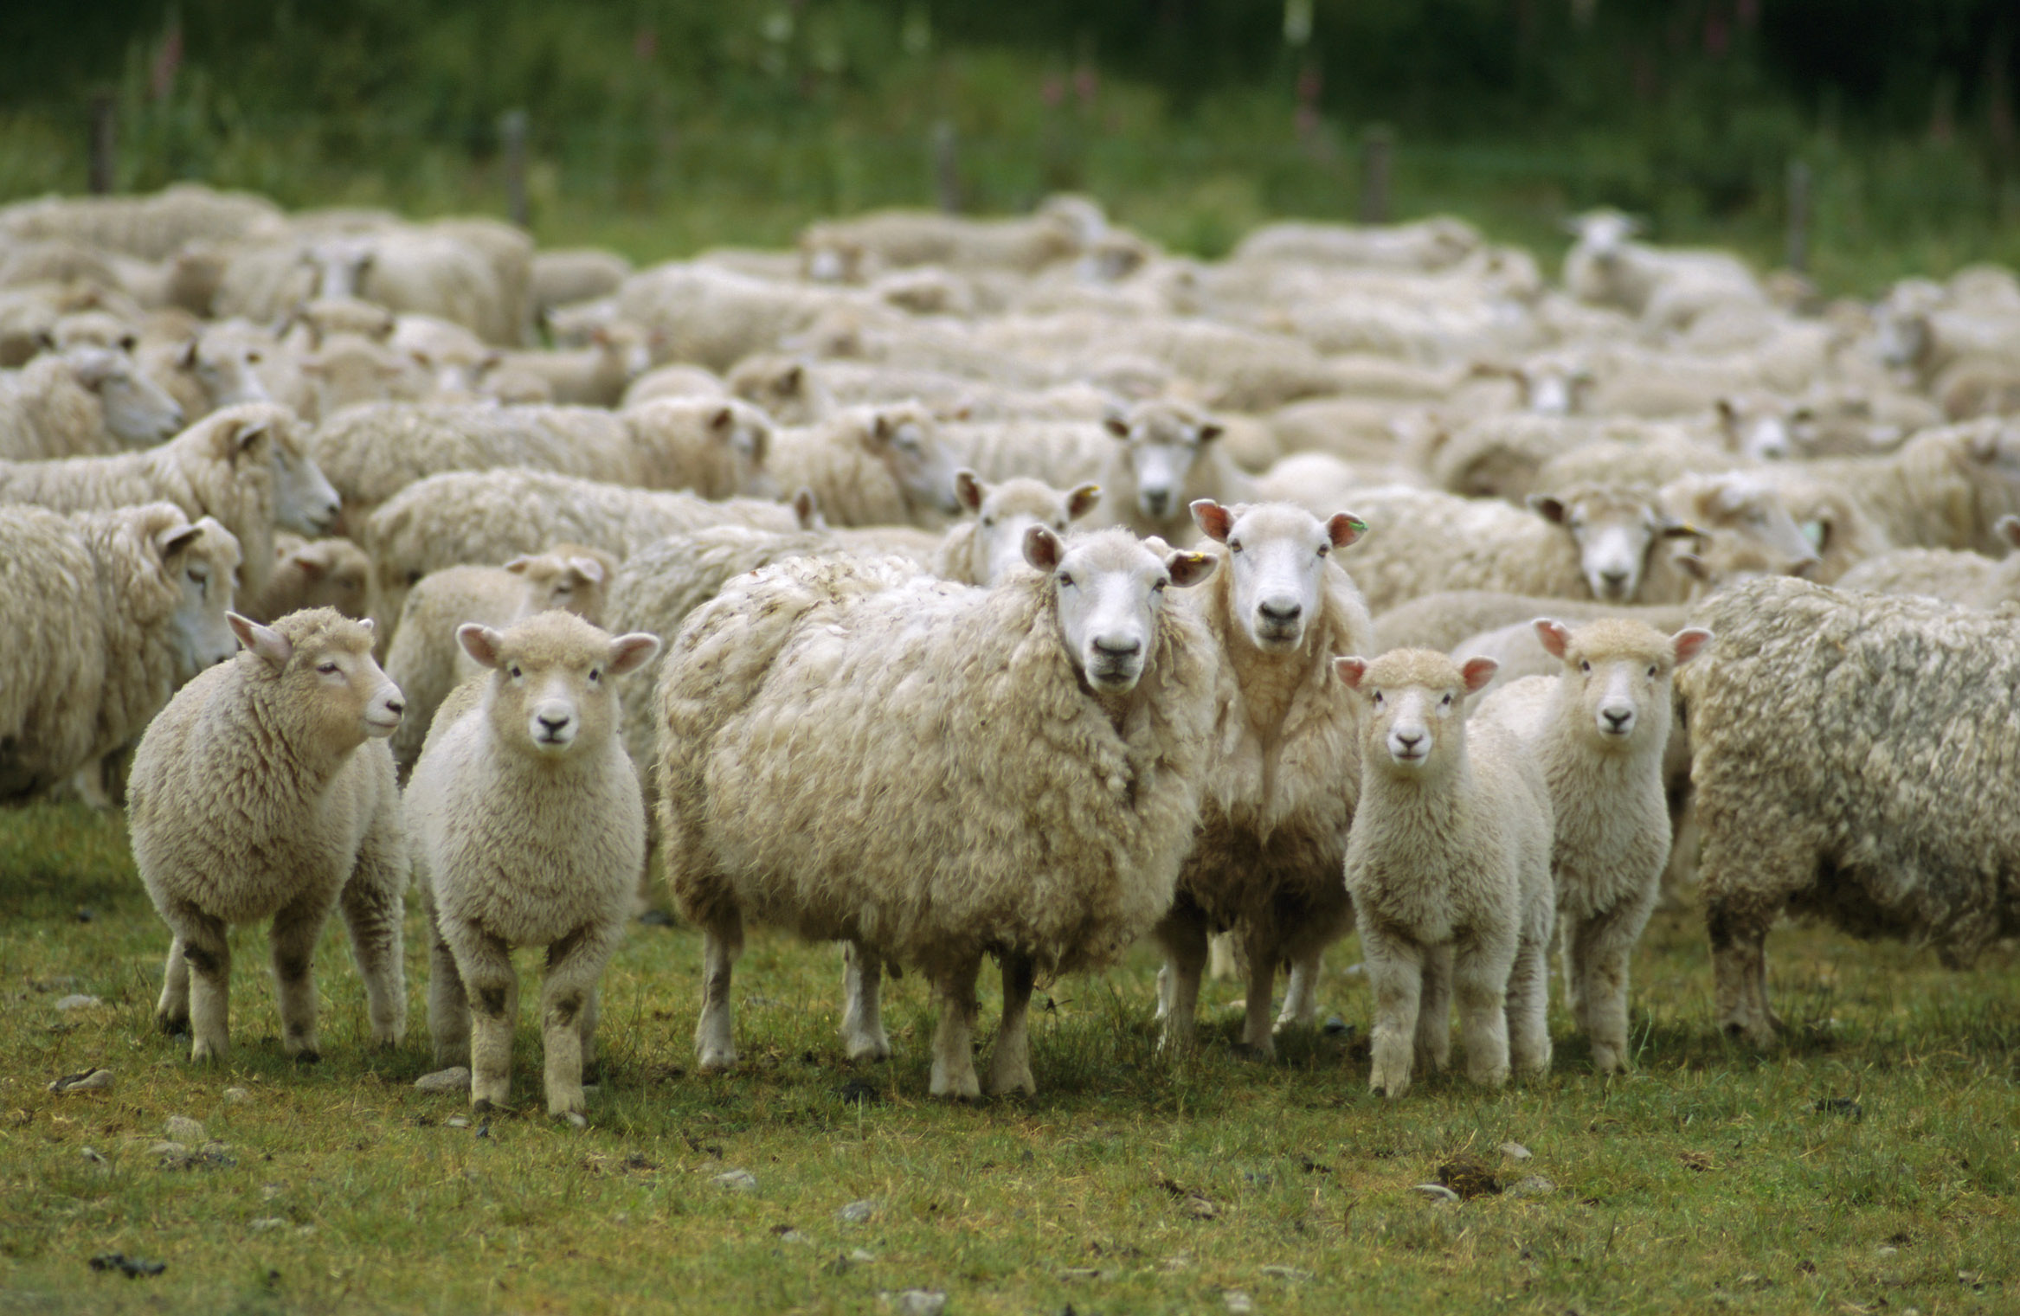
"He will take a tenth of your sheep. And you will be his servants. And you will cry out in that day because of your king whom you have chosen for yourselves, and the LORD will not hear you in that day." — 1st Samuel 8: 17-18
. .
He will take
Notes:
The compounding burden of successive leaders deepens the oppression of the meek without God.

Slide 13
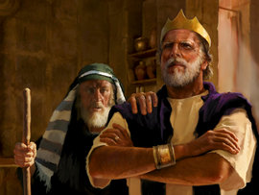
Nevertheless the people refused to obey the voice of Samuel; and they said, "No, but we will have a king over us, …" — 1st Samuel 8: 19
refused
refused
to obey
to obey
king
Notes:
Man regularly chooses man over God. People unwisely choose personal liberties away from God.

Slide 14
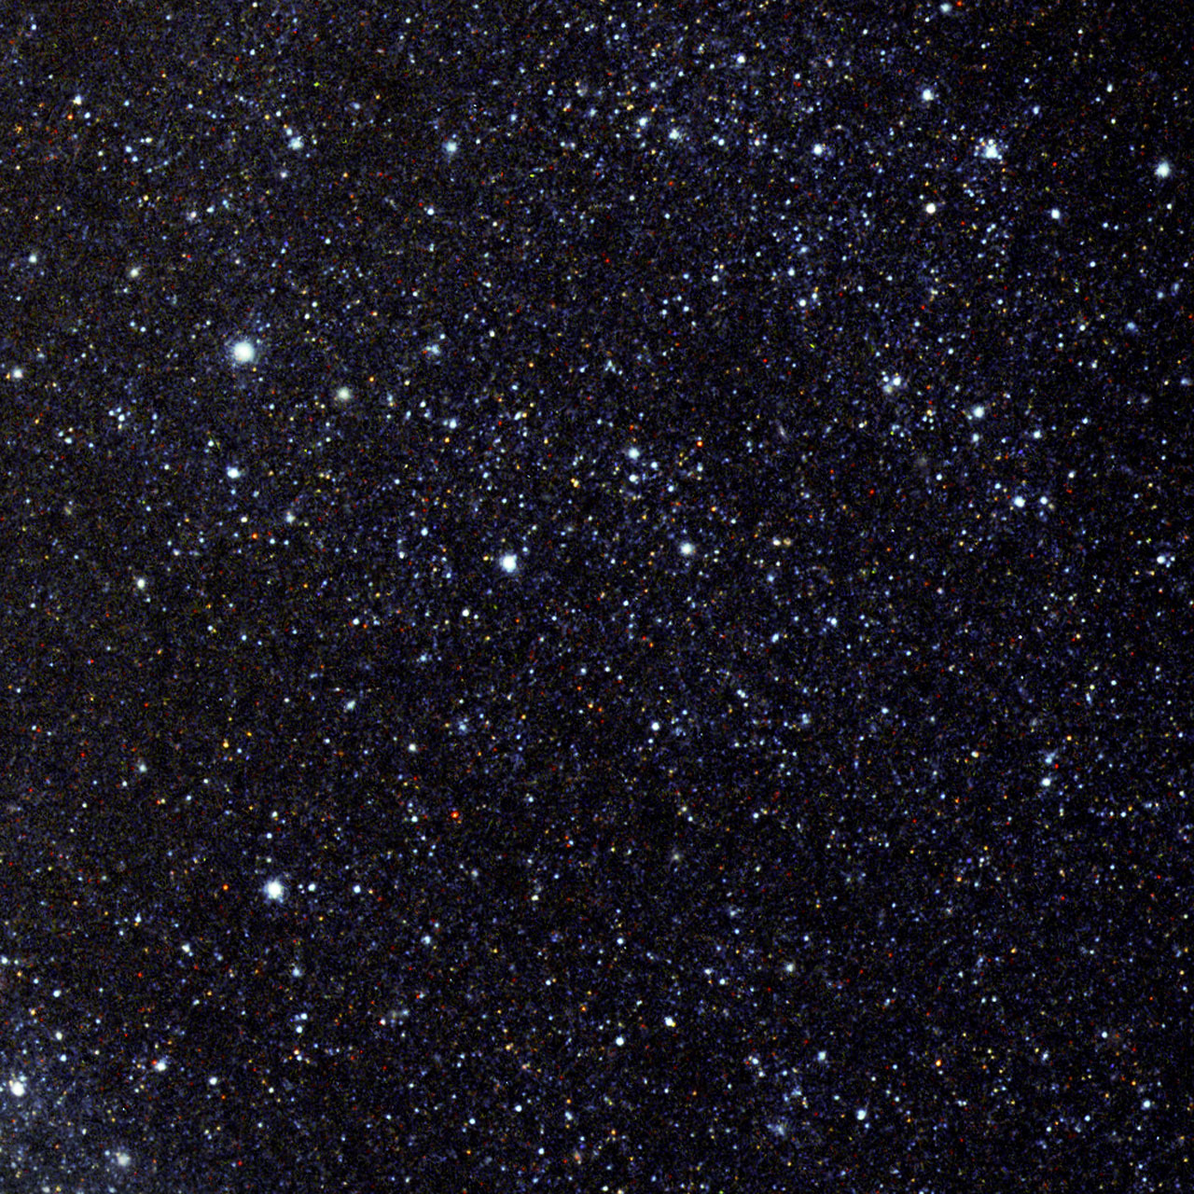
The LORD is King forever and ever; The nations have perished out of His land. — Psalm 10:16
"Nor is He worshiped with men's hands, as though He needed anything, since He gives to all life, breath, and all things." — Acts 17:25
. .
He gives to all
. .
King
king
LORD is King forever
perished
Notes:
His hand is upon the whole of the heavens rising in the midst of all. God gives without ceasing bestowing life upon all under His care. Truth cannot be changed, for He is, no matter how high men exalt lies of convenience.

Slide 15
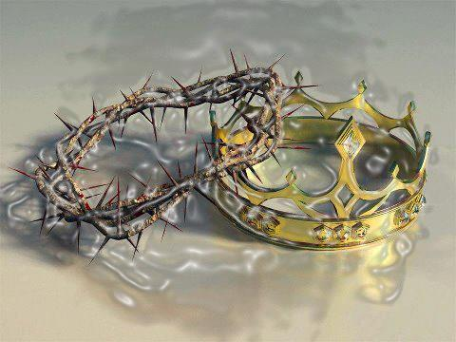
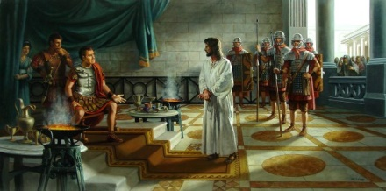
Pilate therefore said to Him, "Are You a king then?" Jesus answered, "You say rightly that I am a king. For this cause I was born, and for this cause I have come into the world, that I should bear witness to the truth. Everyone who is of the truth hears My voice." — John 18:37
king
Jesus
ou
king
. .
r
king
to
Jesus is our king
is
. .
of the truth
Notes:
Jesus suffered with us so that we could know the extent of God’s most Holy Love for us. God himself has sacrificed His life, so that we can have life, as equals in His image of autonomy. Liberty is given to life of God. Who makes a better king, one that would take, or one that would give? He eternally gives where no other could. His crown of suffering offers each of us an eternal crown of life in His light of truth.

Slide 16
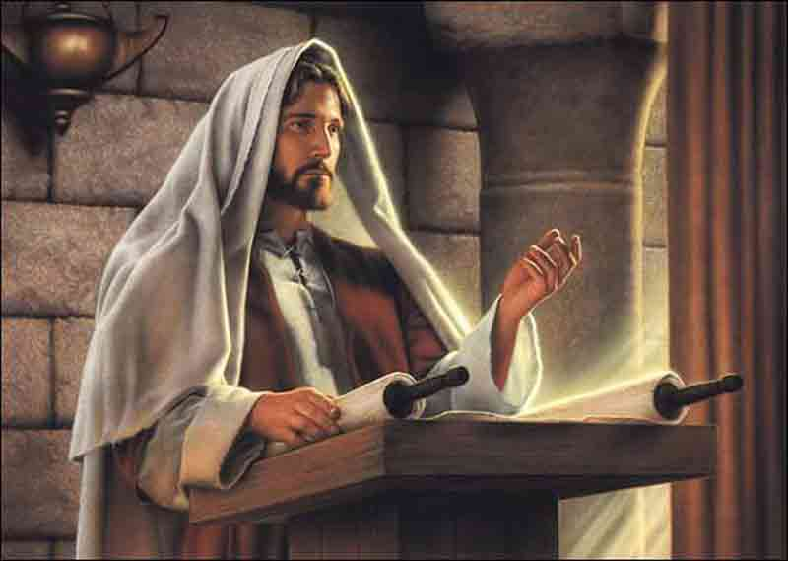
"The Spirit of the LORD is upon Me, Because He has anointed Me To preach the gospel to the poor; He has sent Me to heal the brokenhearted, To proclaim liberty to the captives And recovery of sight to the blind, To set at liberty those who are oppressed;" — Luke 4:18
The Spirit of the LORD
To
To preach the gospel
to the poor
to heal the brokenhearted
To proclaim liberty
to the captives
to the blind
To set at liberty
He has
He has
To
to
to
He has
to
to
To
To
to
to
to
to
To
To
Jesus is our king
Notes:
Jesus came of God to produce the true force of His truth.

Slide 17
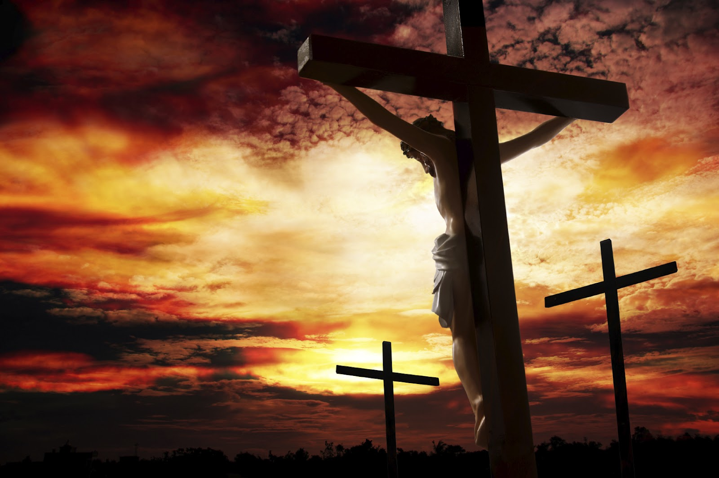
He has delivered us from the power of darkness and conveyed us into the kingdom of the Son of His love, in whom we have redemption through His blood, the forgiveness of sins. — Colossians 1:13-14
He has
. .
He has delivered us
forgiveness of sins
forgiveness of sins
Notes:
The kingdom He rules waits for us, in what we will decide. God has given all freedom in life. Will we choose to live in Him is the call from eternities portal. His love is ready to redeem all those who come to His call to return embracing roots from the Father.

Slide 18
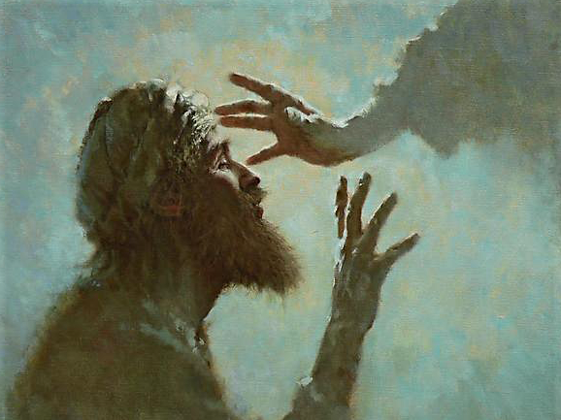
"Therefore if the Son makes you free, you shall be free indeed." — John 8:36
Son
free
Notes:
We live in a limited realm of temporalities where fleshly bondage holds us captive. To be free one must reach beyond self to His touch of Grace. Eternity is offered freely to all alive.

Slide 19
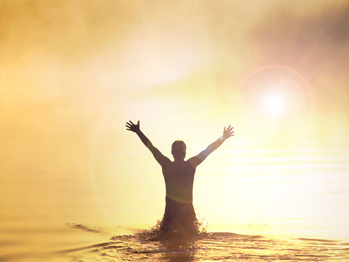
… because the creation itself also will be delivered from the bondage of corruption into the glorious liberty of the children of God. — Romans 8:21
delivered
bondage
liberty
glorious liberty
children of God
Notes:
Freedom is the nature of all things. By the hand of God a greater liberty awaits.

Slide 20
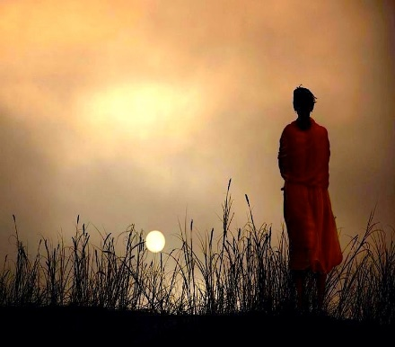
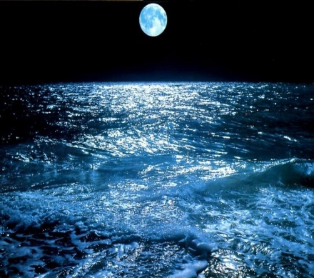
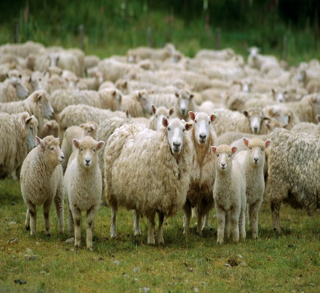
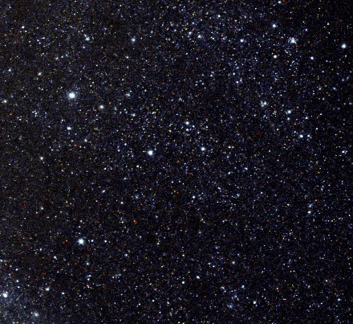
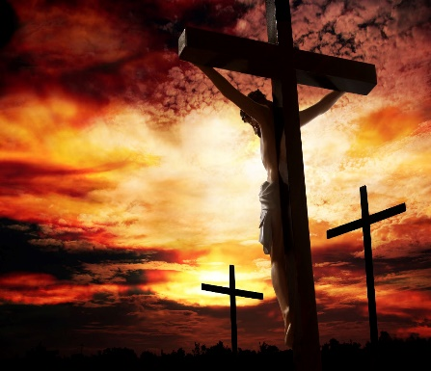
liberty

Slide 21
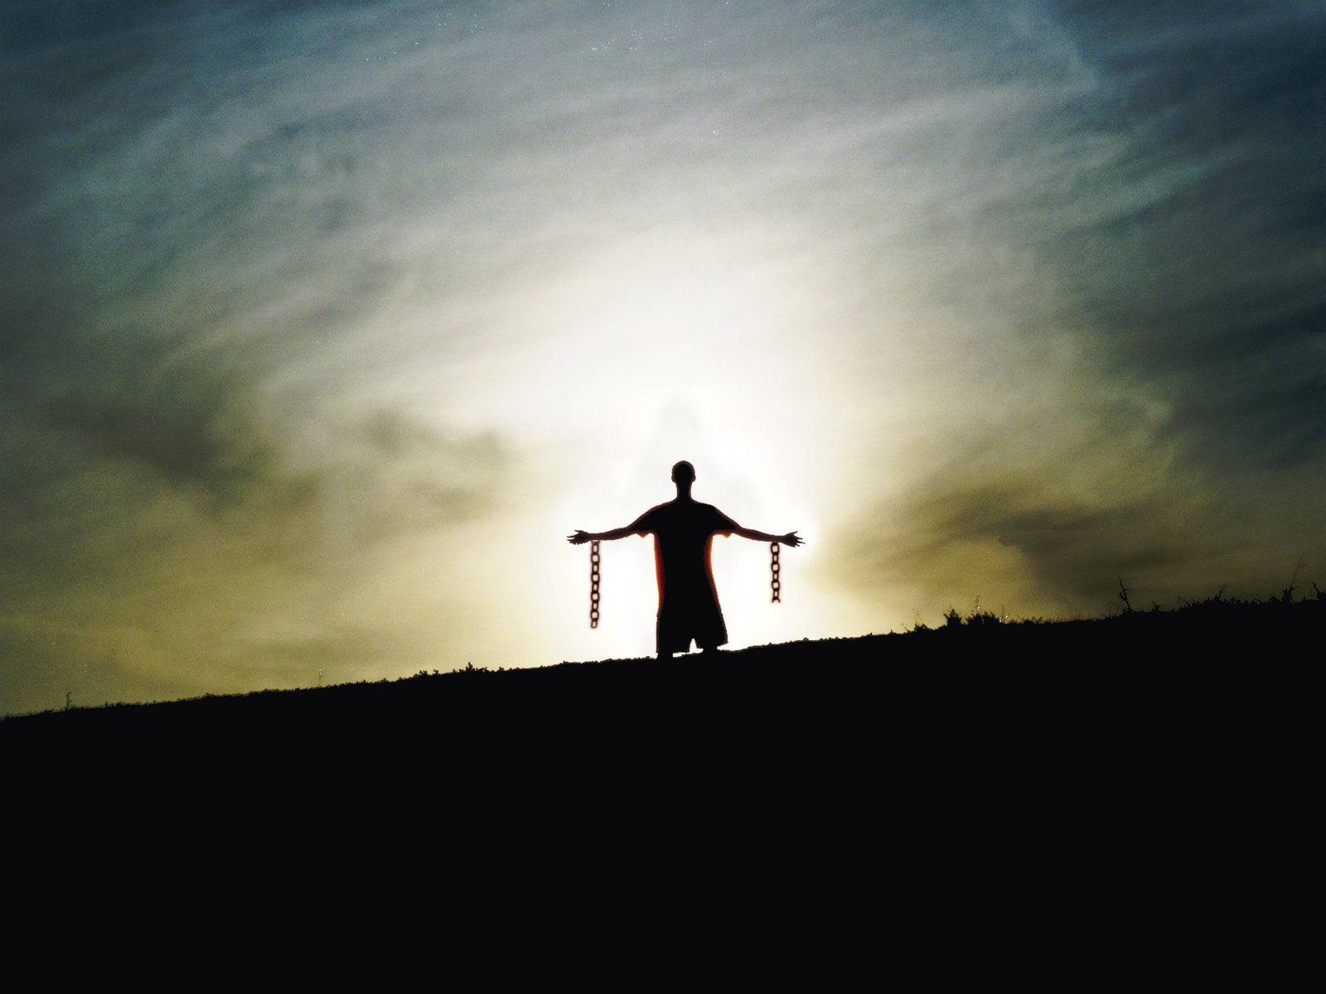
Liberty is a call from His Spirit
→ The Spirit of the Lord maintains Liberty
→ In God’s light, we are
→ Liberty is a lesson in finding His word
→ Man’s mistake is a call to man over God
→ Heavenly freedom comes by the Son of God
→ Remain in His liberty over in bondage by man
→ In liberty serve one another in love
liberty
Notes:
Liberty is God’s blessing for life.

Slide 22
Notes:
In darkness there is no sense.

Slide 23
Liberty’s Cloak
Part
II
Ron Bert
June 19, 2016
Notes:
To be free, only in the light can we see.

Slide 24
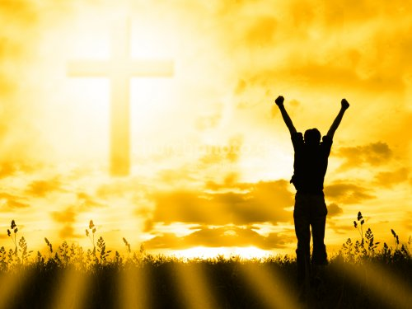
Stand fast therefore in the liberty by which Christ has made us free, and do not be entangled again with a yoke of bondage. — Galatians 5:1
Stand
liberty
by
Christ
bondage
Notes:
Rising in the truth of God Himself, we must remain in Him over the confabulations of man’s devising. In the bondage of flesh, He clearly offers Liberty in His light.

Slide 25
For you, brethren, have been called to liberty; only do not use liberty as an opportunity for the flesh, but through love serve one another. — Galatians 5:13
liberty
For you, brethren, have been called to liberty; only do not use liberty as an opportunity for the flesh, but through love serve one another. — Galatians 5:13
liberty
liberty
. .
love
through love
. .
serve
Notes:
Working together, no power is greater than love. God calls for His creatures to care for one another. What one serves defines destiny. To serve only self leads to death of the spirit, whereas selfless acts glorify His intent for creation. In this image of His truth, we are alive. With concerted purpose we are called to live over random ramblings. What good is freedom if it ends up leaving you isolated all alone?

Slide 26
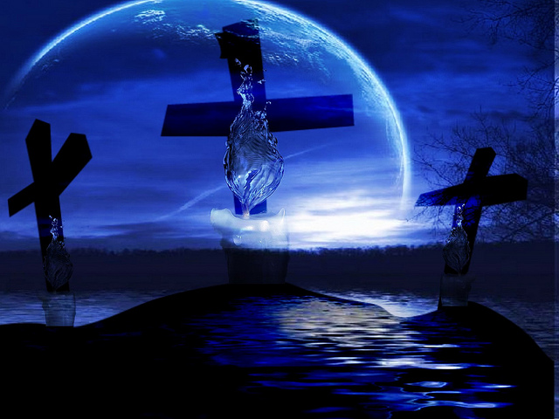
You were bought at a price; do not become slaves of men. — 1st Corinthians 7:23
FREEDOM
FR
E
ED
M
liberty
LIBERTY
LIFE
LIB RTY
GOD
. .
do not become slaves of men
Notes:
To really be free in God, one has to thirst in service to Him. To merely be in service to man, exclusively, is to be locked in the mortal confine worshipping only the tangible, and for that finite pursuit of which passes before us. More than the objects of our desire, it is about the One who formed all that is inert, from beginning to end. Past all known, God is Spirit and in truth, His unseen fruit is sweeter than the largest imaginable perceptions. His known invisible qualities are offered to each freely. The condition is to be right with God as an eager slave to His welcoming love. In check with eternity we become free.

Slide 27
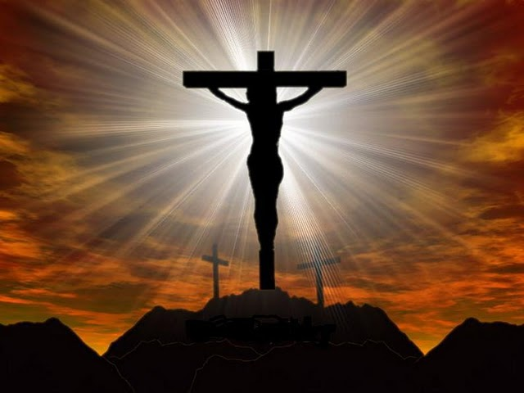
… knowing that you were not redeemed with corruptible things, like silver or gold, from your aimless conduct received by tradition from your fathers, but with the precious blood of Christ, as of a lamb without blemish and without spot. — 1st Peter 1:18-19
L
i
b
e
r
t
y
L
i
b
e
r
t
y
Saved
redeemed
Freed
redeemed
redeemed
redeemed
Liberated
Restored
Rescued
Bought Back
Delivered
Make Amends For
Notes:
He gave us His life so that we could see how to live. His blood of life truly washes away our sins; to be able to stand in His unblemished pureness. Without His guidance, what purpose do we serve? Is not saving grace greater than all than can be known? In the shadow of His death, redemption is offered to those who would obey His calling with a noble heart. Liberty in the highest is, in truth, Christ. No spin on truth is higher.

Slide 28
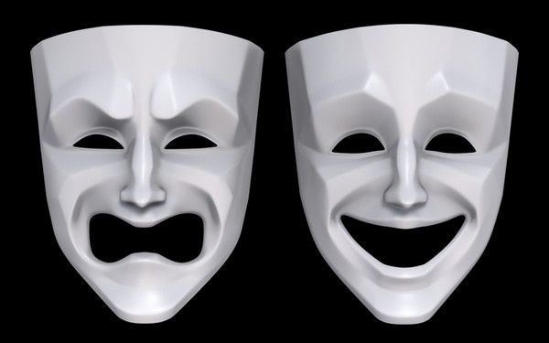
… knowing this, that our old man was crucified with Him, that the body of sin might be done away with, that we should no longer be slaves of sin. For he who has died has been freed from sin. Now if we died with Christ, we believe that we shall also live with Him, knowing that Christ, having been raised from the dead, dies no more. Death no longer has dominion over Him. — Romans 6:6-9
slaves of sin
freed
from sin
died with
bondage
died with
freedom
live with
live with
Notes:
Being a Christian is an awakening to the truth God has announced for all to know. To be free of the sinful chains that bind us in darkness allows us to rise in His light. To know of our bondage sets us on the path to freedom. Repentance and true godly sorrow pulls us to be better than we are. His accolades are that we love all that is good.

Slide 29
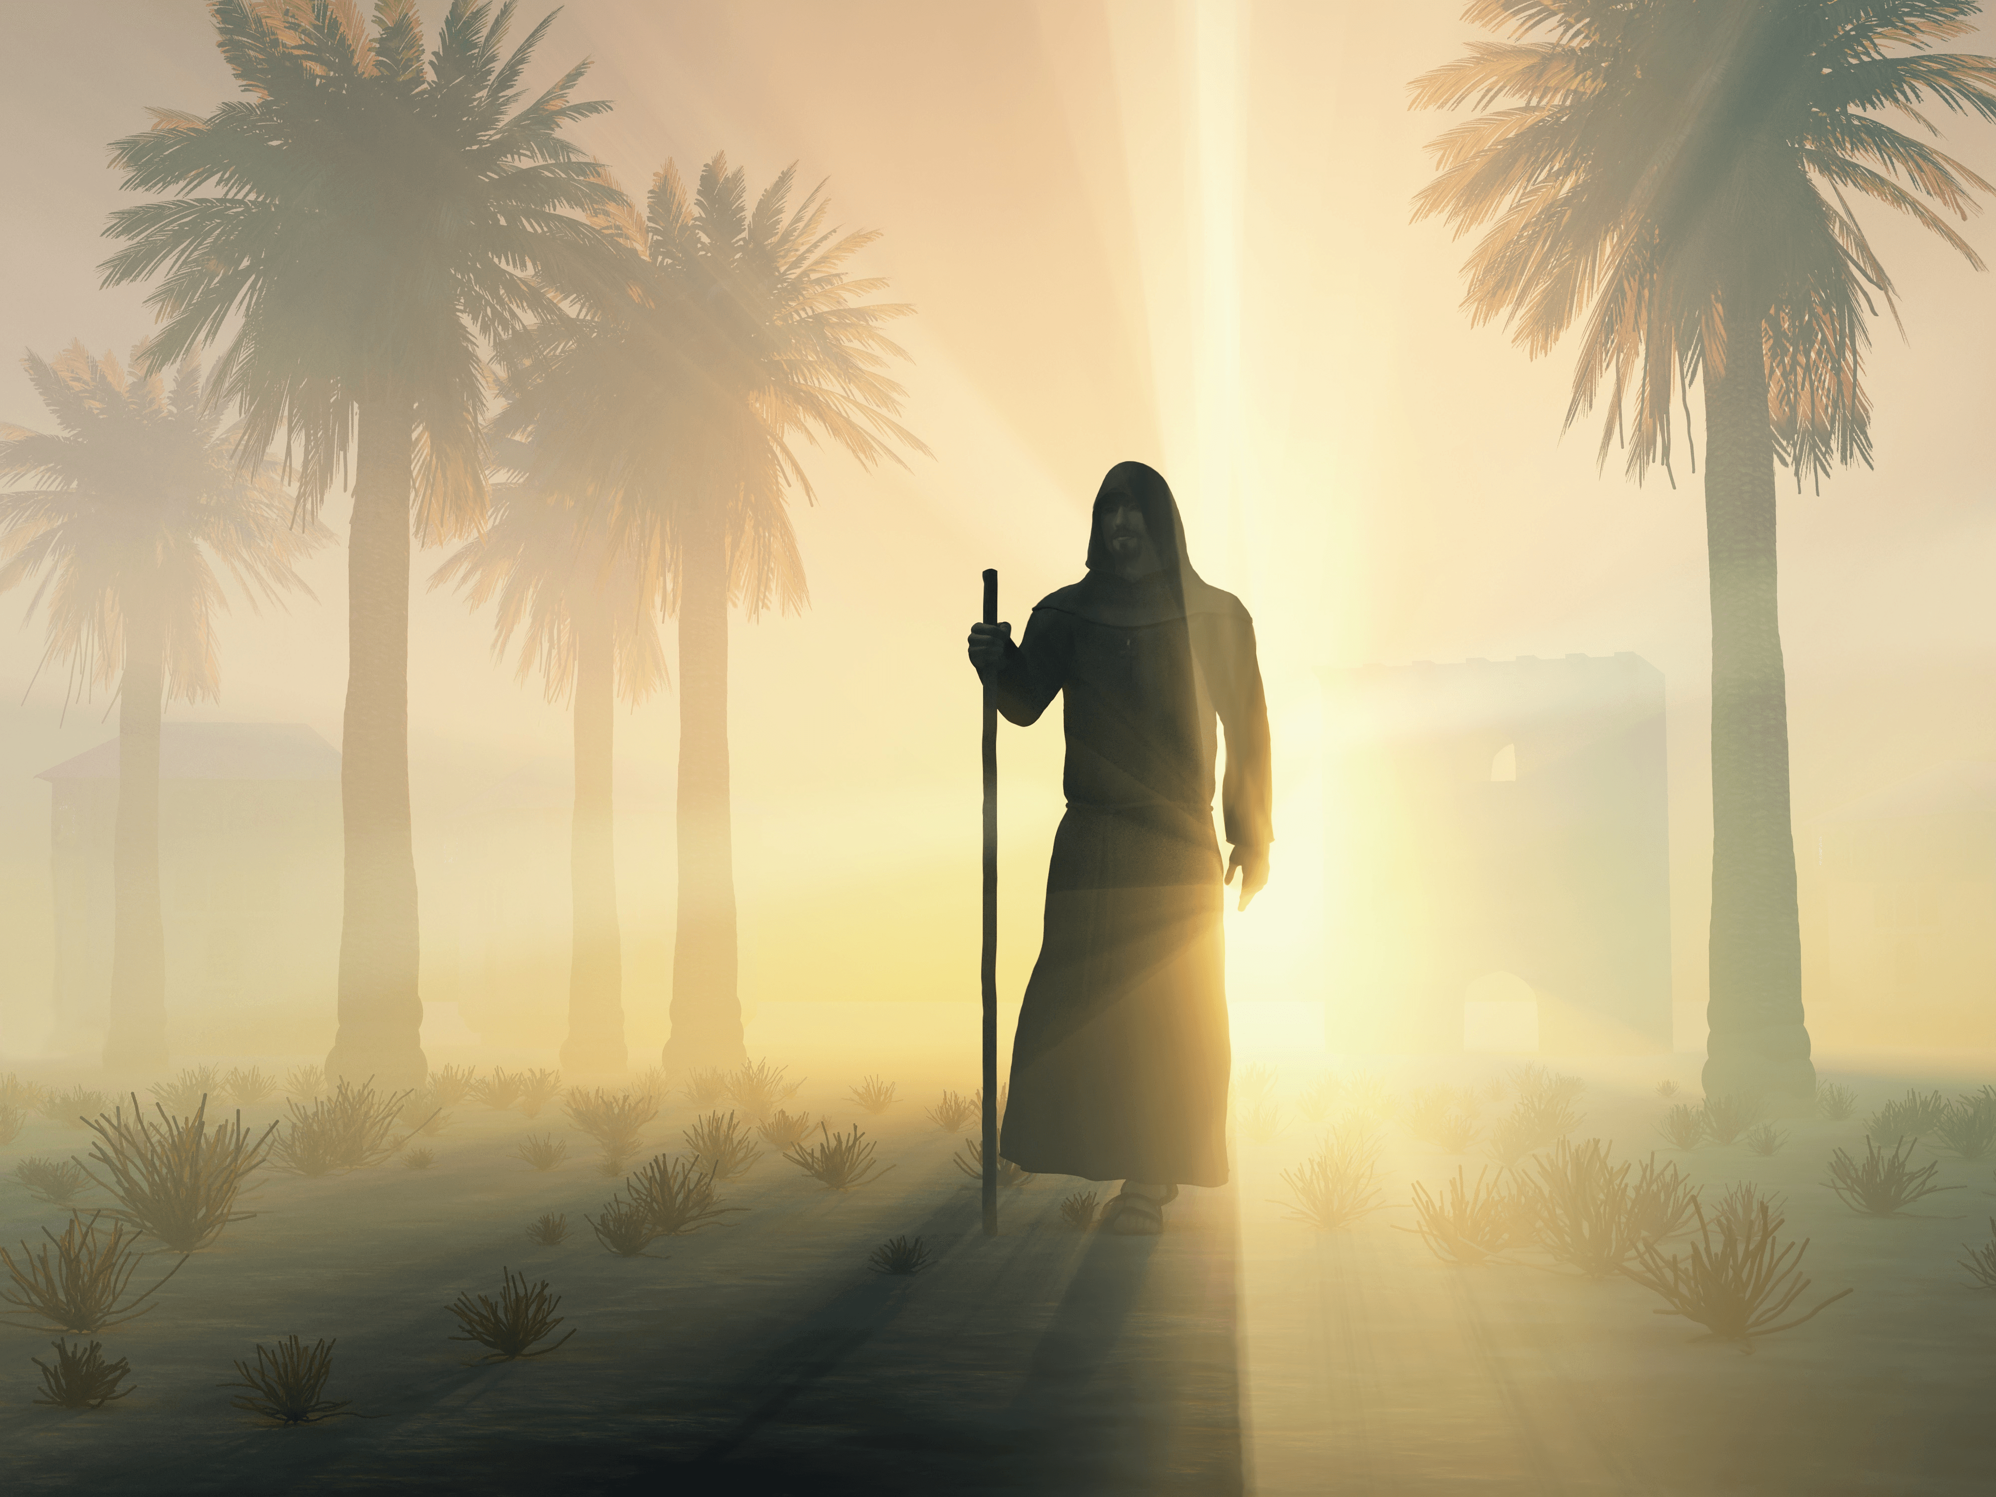
Were you called while a slave? Do not be concerned about it; but if you can be made free, rather use it. For he who is called in the LORD while a slave is the LORD's freedman. Likewise he who is called while free is Christ's slave. You were bought at a price; do not become slaves of men. — 1st Corinthians 7:21-23
use it
use it
LORD
LORD
Notes:
Yes in the Lord we are all freed, but we still hold the responsibility of the teachings of Christ. We are not at liberty to do anything we wish but must cling to the doctrine delivered to all that we might find eternal liberty. The only true liberty is found upon entrance in to heaven itself.

Slide 30
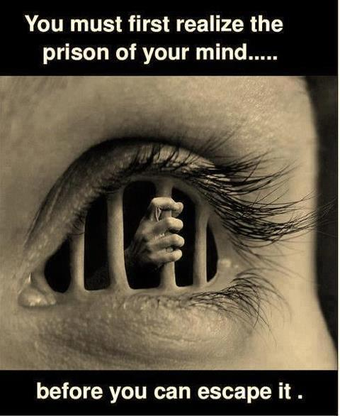
Who executes justice for the oppressed, Who gives food to the hungry. The LORD gives freedom to the prisoners. The LORD opens the eyes of the blind; The LORD raises those who are bowed down; The LORD loves the righteous. — Psalms 146:7-8
LORD
. .
LORD
The LORD gives freedom
LORD
LORD
LORD
Notes:
To take advantage of the qualities the Lord reveals leads to liberties enlightenment.

Slide 31
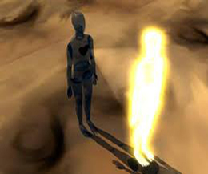
For the law of the Spirit of life in Christ Jesus has made me free from the law of sin and death. — Romans 8:2
Spirit
law of the Spirit of life
law of the Spirit of life
Spirit
in
Christ Jesus
sin and death
Notes:
Where resides the golden orb of Spirit? It is after all is said and done that the Spirit continues beyond the mere presence of the mortal. Unarguably, eternity is the gate we will all face as we rise to meet Him, each bowing before His giving life, the undeniable source of flawless love. Without Him, we become nothing.

Slide 32
But now we have been delivered from the law, having died to what we were held by, so that we should serve in the newness of the Spirit and not in the oldness of the letter. — Romans 7:6
. .
delivered
in
. .
should serve
Spirit
Spirit
Notes:
You can’t find faith in a book for it dwells in the heart. There are no walls in the truth of His light. If one is not serving in the Spirit He calls out for, blindness beats the negligent soul. Darkness cannot replace the Light.

Slide 33
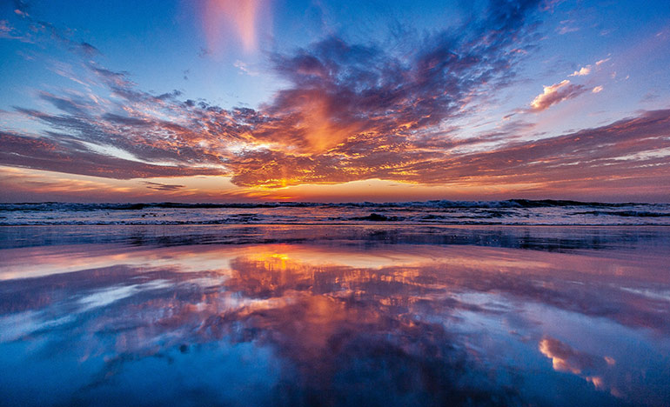
But we all, with unveiled face, beholding as in a mirror the glory of the Lord, are being transformed into the same image from glory to glory, just as by the Spirit of the Lord. — 2nd Corinthians 3:18
unveiled face
see God
beholding
in a mirror
glory of the Lord
transformed
. .
image
. .
Spirit
. .
Spirit of the Lord
Notes:
To return to the Lord is to return to the true unveiled image of our innermost identity. In goodness and truth, this is the way of His universe forever. God is not hidden as in His word He reveals Himself. To recognize His Spirit living in us is to become gloriously alive forevermore. Eternity gleams upon those worshipping in His giving truth. To see the glory of God is to see the true self.

Slide 34
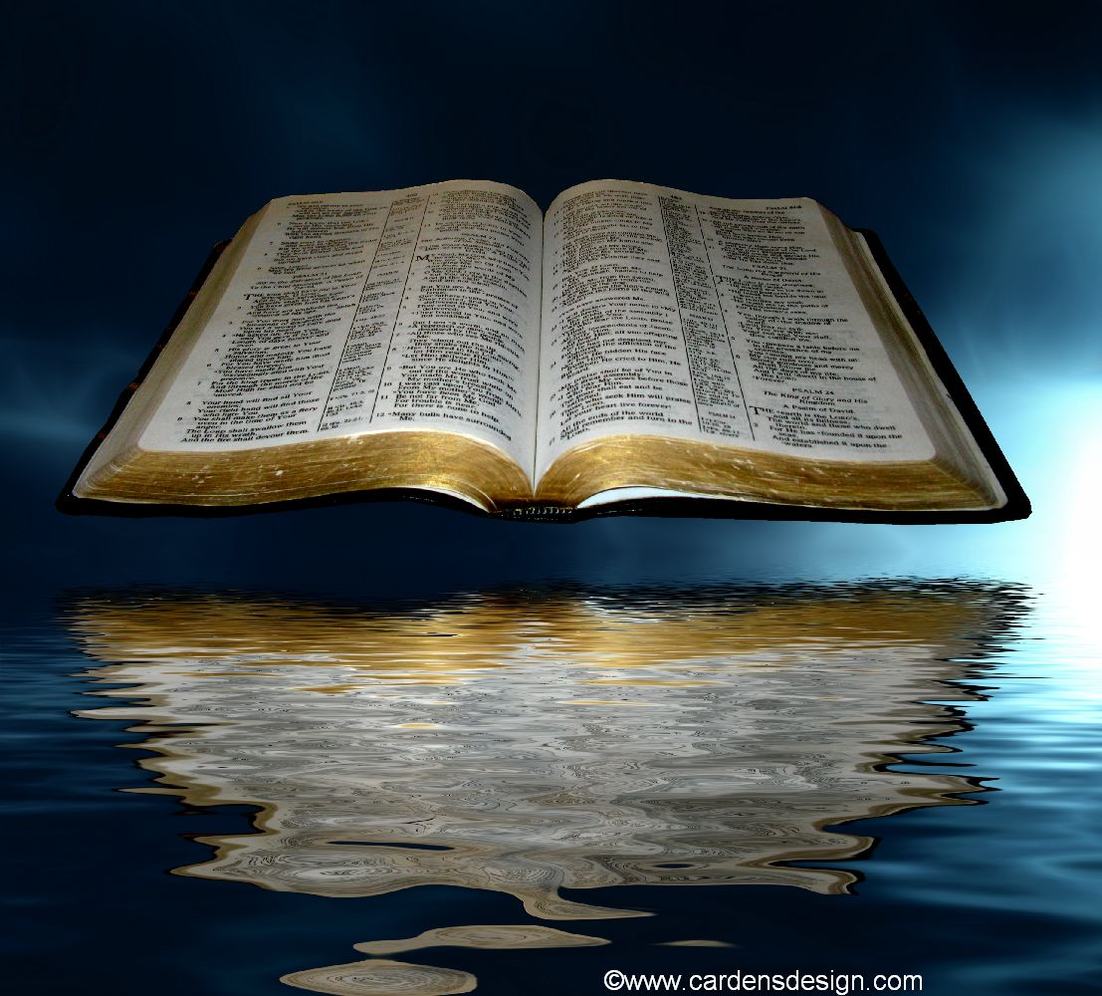
But he who looks into the perfect law of liberty and continues in it, and is not a forgetful hearer but a doer of the work, this one will be blessed in what he does. — James 1:25
. .
looks into
. .
doer of
blessed
Notes:
Without personal studies of God’s own truth, and observing His desires for what He asks of His children, and in fact commands of His children, life in Him is missed. Those lacking His noblest knowledge fail to live in the eternal light that He calls out for life to live in. We all will meet God in God’s way, and only a fool would assume otherwise. Those void of the actions He wills for in creatures destined for eternal life will suffer in bottomless emptiness without Him. Darkness can only reveal what it does not have. Blessings come to all who act on their love of God.

Slide 35
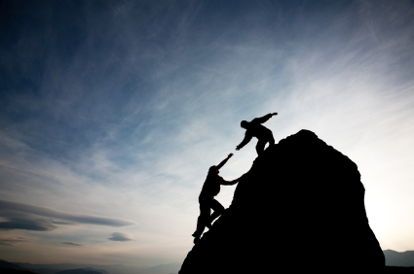
So speak and so do as those who will be judged by the law of liberty. For judgment is without mercy to the one who has shown no mercy. Mercy triumphs over judgment. — James 2:12-13
LOVE
do
do
CONTEMPT
Mercy triumphs over
judgment
Notes:
God cannot be fooled as we need honesty with self to come before Him. Double minded hypocrites have no part in the truthfulness He purely calls for. Souls in His favor know and promote His calling truths. We are all called to help one another achieve His heavenly acceptance. Surely, deep love in one’s heart triumphs over being devoured by superficial contempt for others. It is a high order to help those who would not help themselves. In climbing the mountain of life, He reflects an image of humbly giving over arrogantly taking. By His standard we will be judged.

Slide 36
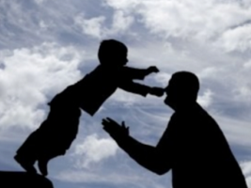
… not with eyeservice, as men-pleasers, but as bondservants of Christ, doing the will of God from the heart, with goodwill doing service, as to the Lord, and not to men, … — Ephesians 6:6-7
e
free
r
as bondservants
as bondservants
f
heart
e
Notes:
A free godly heart experiences the fullness of life giggling in the release from measly mortal bondage. To fall freely into the Father’s hands, trust is the root of this love. A passionate life with godly purpose holds freedom’s inspiration, and it is a struggle for most, if not all.

Slide 37
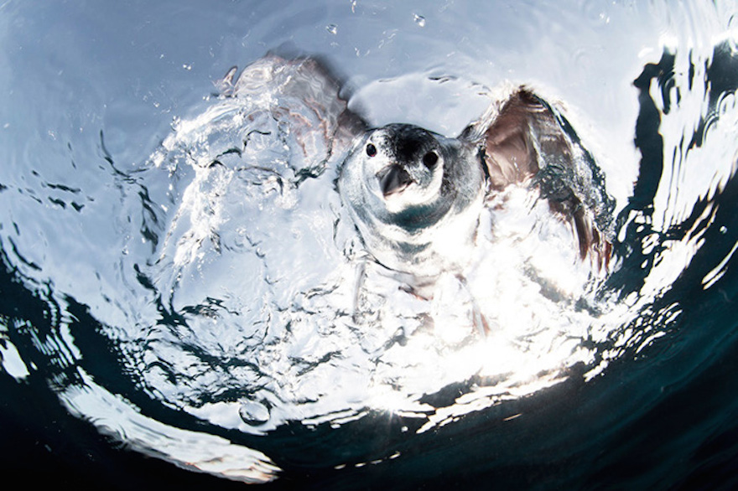
… as free, yet not using liberty as a cloak for vice, but as bondservants of God. Honor all people. Love the brotherhood. Fear God. Honor the king. — 1st Peter 2:16-17
as bondservants of God:
Honor all people
Love the brotherhood
Fear God
Honor the king
free
as
bondservants of God
Honor all
people
Love the brotherhood
Fear God
Honor the king
Notes:
To be immersed in His Holy Spirit is to find the greatest of all liberties. Part of the whole has wider value than lone focused isolation. Rebellion has always led to disunion. True unity is found in His truth over the whims of mans.

Slide 38
For by one Spirit we were all baptized into one body--whether Jews or Greeks, whether slaves or free--and have all been made to drink into one Spirit. — 1st Corinthians 12:13
one Spirit
one body
free
m
d
o
one
Notes:
There is a storm upon the waves of man. With only one true freedom, this eternal liberty is in God. To hear the call renders a soul’s free will in His service.

Slide 39
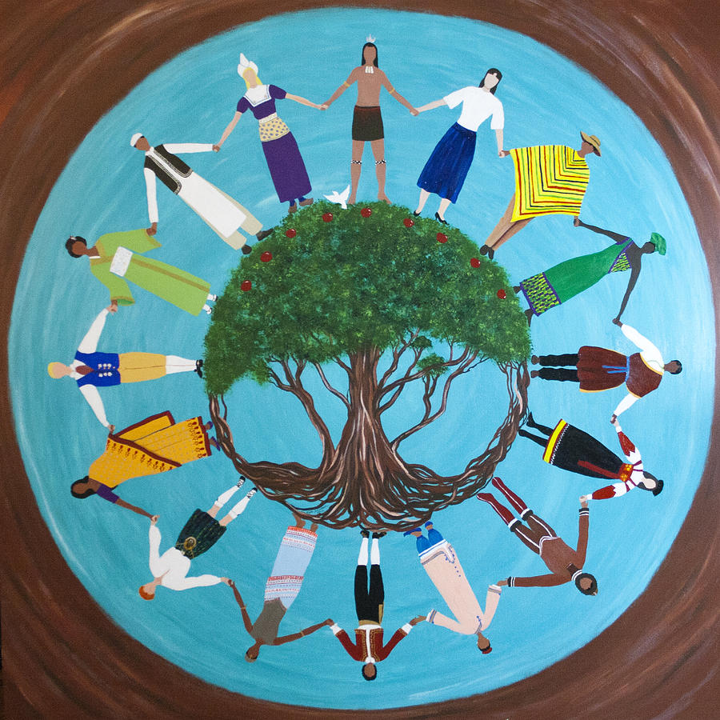
For there is no distinction between Jew and Greek, for the same Lord over all is rich to all who call upon Him. For "whoever calls on the name of the LORD shall be saved." — Romans 10:12-13
r
i
t
L
y
calls on
e
calls on
b
Notes:
Many are called to be in the eternal liberty he offers as it all souls God is calling out to.

Slide 40
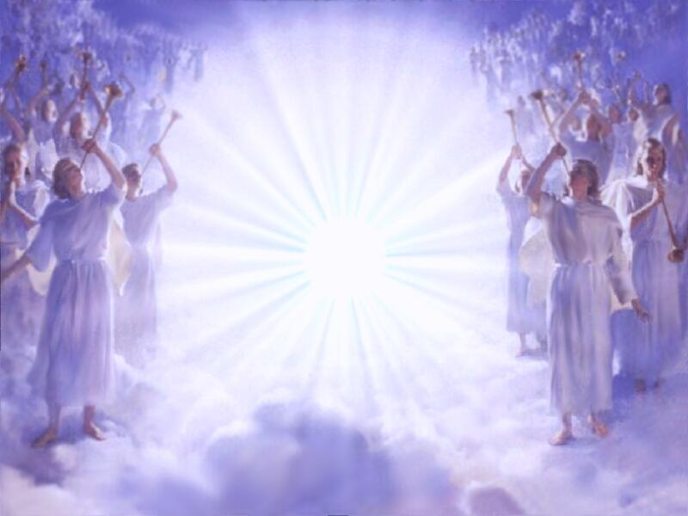
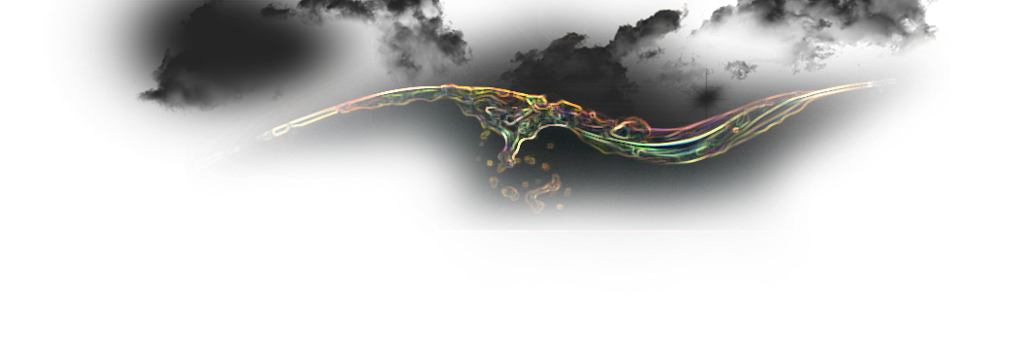
"But those who are counted worthy to attain that age, and the resurrection from the dead, neither marry nor are given in marriage; nor can they die anymore, for they are equal to the angels and are sons of God, being sons of the resurrection." — Luke 20:35-36
counted
worthy
attain
attain
. .
resurrection from the dead
counted worthy
Liberty
equal
equal
angels
sons of God
sons of the resurrection
Notes:
To attain eternal life is finally where the equality of liberty is realized for all.

Slide 41
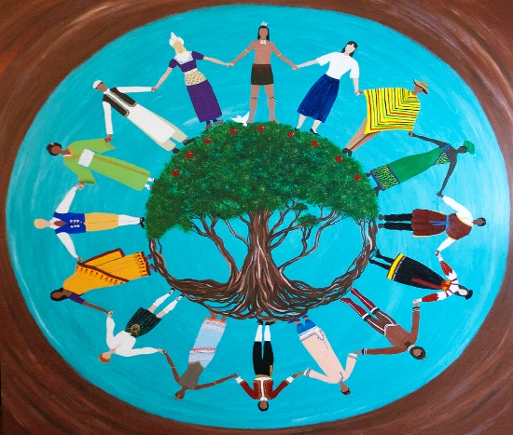
counted worthy

Slide 42
→ The Spirit of the Lord maintains Liberty
→ In God’s light, we are
→ Liberty is a lesson in finding His word
→ Man’s mistake is a call to man over God
→ Heavenly freedom comes by the Son of God
→ Remain in His liberty over in bondage by man
→ In liberty serve one another in love
→ In Him we are freed from slavery to sin
→ Redemption comes by accepting His sacrifice
→ In Christ we are free from sin and death
→ A call to perform in His workings of Liberty
→ He calls for us to freely possess loving hearts
→ Liberty is not a call to sin, but to godliness
Liberty is God’s Blessing for life
counted worthy
Notes:
Only those in God are truly free. Liberty is a call from His Spirit.

Slide 43
Notes:
Darkness opens to nothing.

Slide 44
Please visit http://www.RonBert.com to explore further
Ronald Bert Channel on
Notes:
Eternity never ends.

