Slide 2
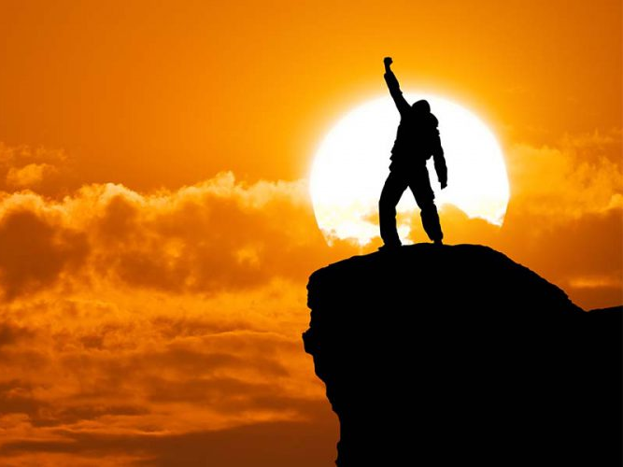
JOY
Ron Bert
December 1, 2019

Slide 3
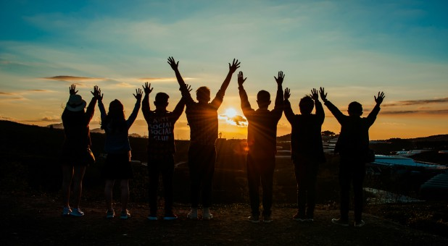
For what is our hope, or joy, or crown of rejoicing? Is it not even you in the presence of our Lord Jesus Christ at His coming? For you are our glory and joy. — 1st Thessalonians 2:19-20
hope
joy
crown
in
. .
Lord Jesus Christ
our glory
and joy
Notes:
There is joy in the quantity of numbers when hearts bear genuine faith in His ways.

Slide 5
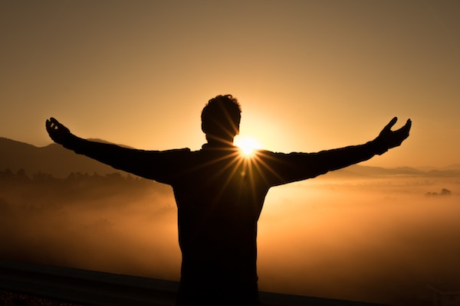
And my spirit has rejoiced in God my Savior. — Luke 1:47
rejoiced
rejoiced
rejoice
Rejoice always, … — 1st Thessalonians 5:16
Faith
Rejoice
Rejoice
Rejoice in the Lord always. Again I will say, rejoice! — Philippians 4:4
Rejoice
Rejoice
rejoice
rejoice

Slide 6
Be glad in the LORD and rejoice, you righteous; And shout for joy, all you upright in heart! — Psalms 32:11
rejoice
you righteous
in
heart
rejoice
in heart
Light is sown for the righteous, And gladness for the upright in heart. — Psalms 97:11
heart
in
in heart
heart

Slide 7
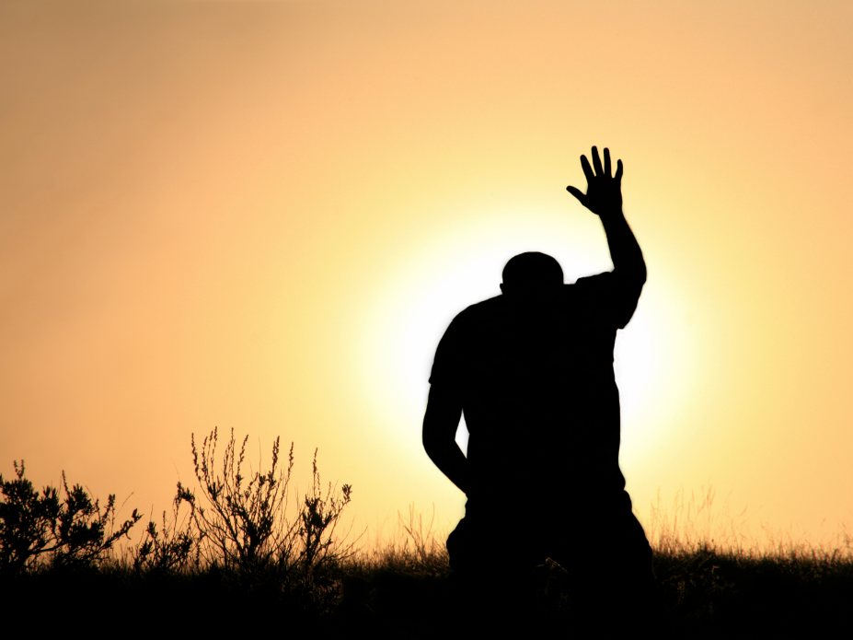
I have set the LORD always before me; Because He is at my right hand I shall not be moved. Therefore my heart is glad, and my glory rejoices; My flesh also will rest in hope. — Psalms 16:8-9
heart
heart
is glad
in
rest in hope
hope

Slide 8
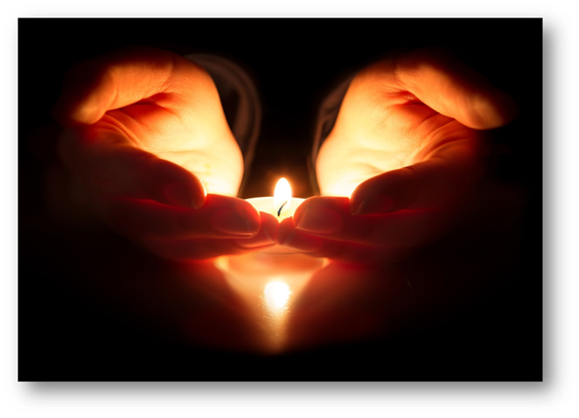
For our heart shall rejoice in Him, Because we have trusted in His holy name. Let Your mercy, O LORD, be upon us, Just as we hope in You. — Psalms 33:21-22
heart
trust
in
trusted in
heart
hope
in
hope in You

Slide 9
Your testimonies I have taken as a heritage forever, For they are the rejoicing of my heart. — Psalms 119:111
Holy Word
forever
heart
forever
Notes:
Time will run out for each of us. The greatest question is are you prepared to meet your maker? Strangers will find no sanctuary while the faithful enter His kingdom freely. Forever is a timeless event and it is the most important destination we will all face.

Slide 10
You will show me the path of life; In Your presence is fullness of joy; At Your right hand are pleasures forevermore. — Psalms 16:11
Your presence is fullness of joy
Your presence
joy
Your presence
forever

Slide 11
'You have made known to me the ways of life; You will make me full of joy in Your presence.' — Acts 2:28
ways of life
in
joy in
Your presence

Slide 12
This is the day the LORD has made; We will rejoice and be glad in it. — Psalms 118:24
LORD
LORD
in
glad in it

Slide 13
Make a joyful shout to the LORD, all you lands! Serve the LORD with gladness; Come before His presence with singing. Know that the LORD, He is God; It is He who has made us, and not we ourselves; We are His people and the sheep of His pasture. — Psalms 100:1-3
joyful
shout
Serve
LORD
LORD
LORD
gladness
Come before His presence
sing
LORD
Notes:
The Lord does not want us to remain quiet or complacent with our faith. He want to hear us shout out singing praises to His glory.

Slide 14
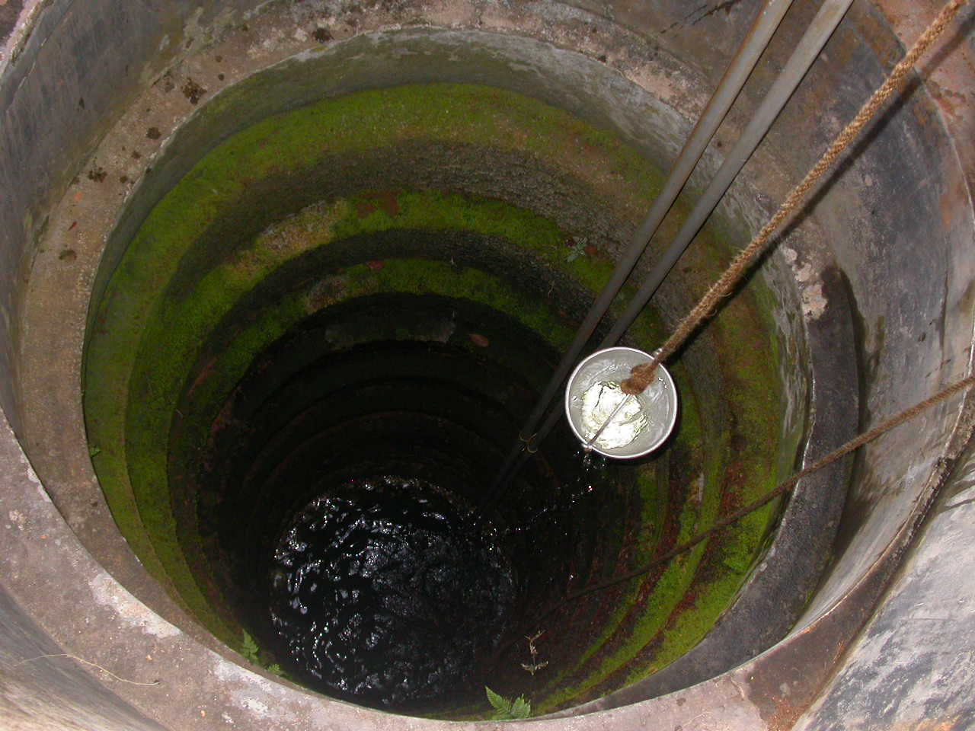
Therefore with joy you will draw water From the wells of salvation. And in that day you will say: "Praise the LORD, call upon His name; Declare His deeds among the peoples, Make mention that His name is exalted." — Isaiah 12:3-4
joy
salvation
salvation
Praise the LORD
LORD
joy

Slide 15
Restore to me the joy of Your salvation, And uphold me by Your generous Spirit. — Psalms 51:12
joy
joy
salvation

Slide 16
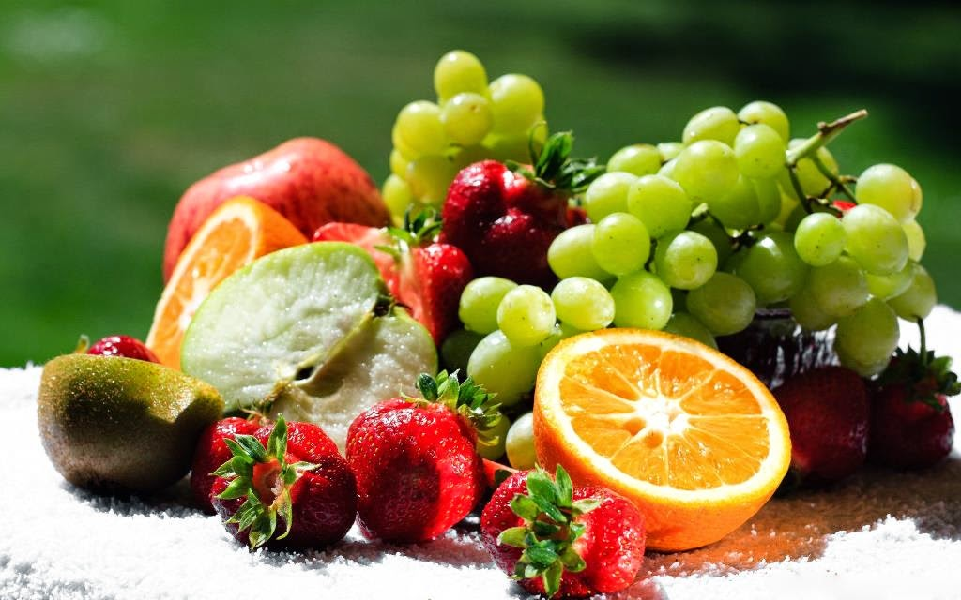
But the fruit of the Spirit is love, joy, peace, longsuffering, kindness, goodness, faithfulness, gentleness, self-control. Against such there is no law. — Galatians 5:22-23
fruit of the Spirit is:
• love
• joy
• peace
• longsuffering
• kindness
• goodness
• faithfulness
• gentleness
• self-control
fruit of the Spirit is
joy
love
joy
peace
longsuffering
. .
kindness
goodness
faithfulness
gentleness
self-control

Slide 17
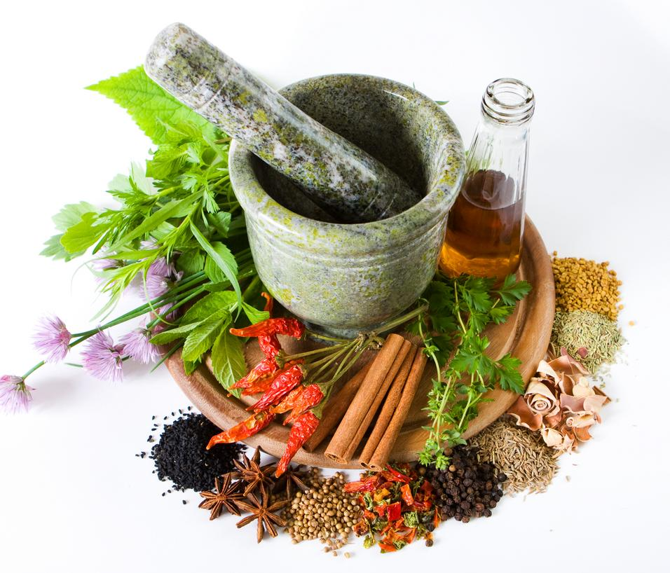
A merry heart does good, like medicine, But a broken spirit dries the bones. — Proverbs 17:22
merry heart
merry heart
Notes:
It can be a challenge to have a merry heart is such a dreadful world filled with death and destruction. Rising in Him where death has no power delivers a peace the earth cannot possess.

Slide 18
A merry heart makes a cheerful countenance, But by sorrow of the heart the spirit is broken. — Proverbs 15:13
All the days of the afflicted are evil, But he who is of a merry heart has a continual feast. — Proverbs 15:15
merry heart
continual
spirit

Slide 19
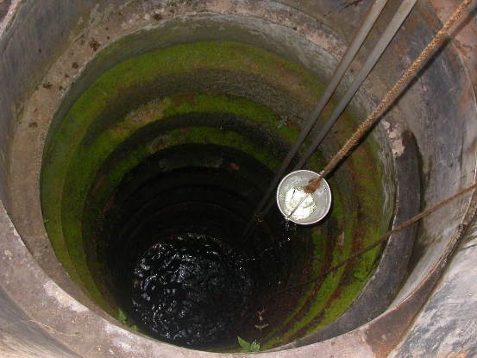

Slide 21
JOY
2
Ron Bert
December 22, 2019

Slide 22
The hope of the righteous will be gladness, But the expectation of the wicked will perish. — Proverbs 10:28
hope of the righteous
hope
gladness

Slide 23
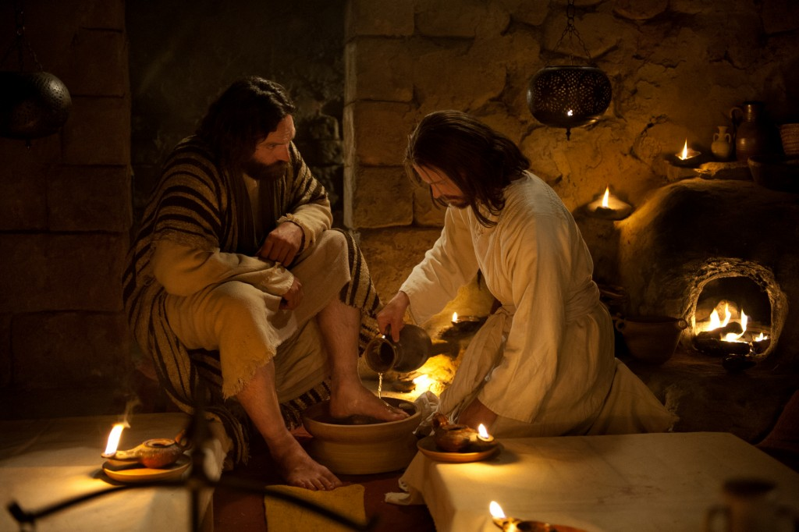
"These things I have spoken to you, that My joy may remain in you, and that your joy may be full. This is My commandment, that you love one another as I have loved you. Greater love has no one than this, than to lay down one's life for his friends. You are My friends if you do whatever I command you." — John 15:11-14
in
My joy may remain in you
My joy
love
My joy
My friends
Notes:
The joy of Jesus is to love others.

Slide 24
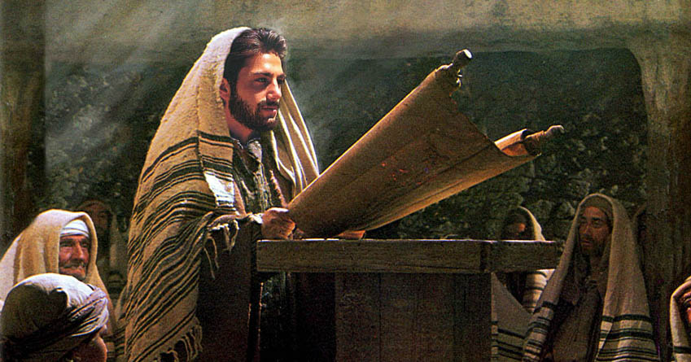
"But now I come to You, and these things I speak in the world, that they may have My joy fulfilled in themselves." — John 17:13
may have
My joy
My joy
in
in themselves

Slide 25
And these things we write to you that your joy may be full. — 1st John 1:4
write
joy
joy may be full
may
Notes:
Inner sanctuary is a precious commodity that is hard to steal where thieves cannot go.

Slide 26
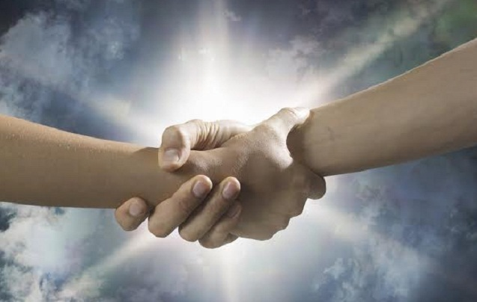
And not only that, but we also rejoice in God through our Lord Jesus Christ, through whom we have now received the reconciliation. — Romans 5:11
God
in
rejoice in God
God
Jesus Christ
Jesus Christ
settlement
agreement
understanding
resolution
reunion
reconciliation

Slide 27
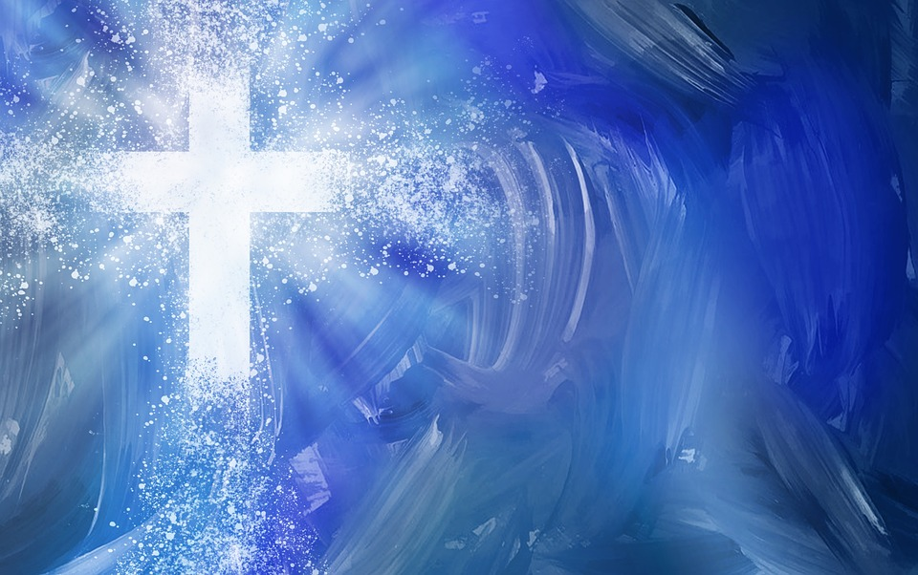
Now may the God of hope fill you with all joy and peace in believing, that you may abound in hope by the power of the Holy Spirit. Now I myself am confident concerning you, my brethren, that you also are full of goodness, filled with all knowledge, able also to admonish one another. — Romans 15:13-14
God
in
all joy and peace in believing
God
knowledge
Notes:
God puts a premium on knowledge of His will and ways.

Slide 28
… for the kingdom of God is not eating and drinking, but righteousness and peace and joy in the Holy Spirit. — Romans 14:17
God
LIFE
righteousness and peace and joy
in
Holy Spirit

Slide 29
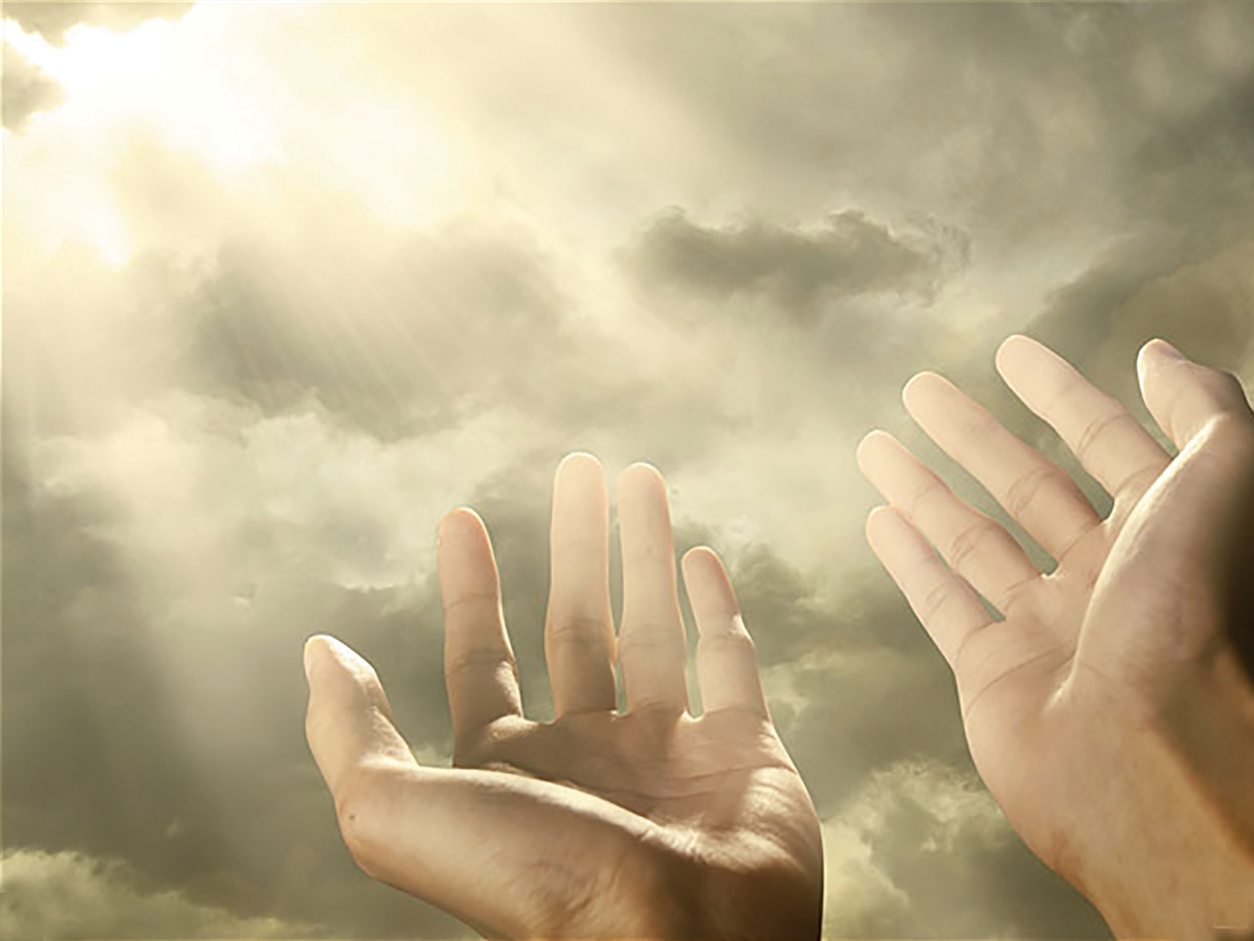
Be kindly affectionate to one another with brotherly love, in honor giving preference to one another; not lagging in diligence, fervent in spirit, serving the Lord; rejoicing in hope, patient in tribulation, continuing steadfastly in prayer; distributing to the needs of the saints, given to hospitality. — Romans 12:10-13
Be kindly affectionate
in
Be kindly affectionate:
in honor
in diligence
in spirit
rejoicing in hope
patient in tribulation
steadfastly in prayer
honor
in
in diligence
in
in
serving the Lord
fervent in spirit
in spirit
Lord
in
in
rejoicing in hope
rejoicing in hope
patient in
in
tribulation
steadfastly in
in
prayer
in

Slide 30
My brethren, count it all joy when you fall into various trials, knowing that the testing of your faith produces patience. But let patience have its perfect work, that you may be perfect and complete, lacking nothing. If any of you lacks wisdom, let him ask of God, who gives to all liberally and without reproach, and it will be given to him. — James 1:2-5
count it all joy
various trials
various trials
ask of God
. ..
. .

Slide 31
In this you greatly rejoice, though now for a little while, if need be, you have been grieved by various trials, that the genuineness of your faith, being much more precious than gold that perishes, though it is tested by fire, may be found to praise, honor, and glory at the revelation of Jesus Christ, whom having not seen you love. Though now you do not see Him, yet believing, you rejoice with joy inexpressible and full of glory, receiving the end of your faith -- the salvation of your souls. — 1st Peter 1:6-9
trial
trial
various trials
genuineness
genuineness
believing
rejoice with joy
Notes:
Though often feeling submerged under the weight of living, faith in Him lifts the heart. We are all looking for more solid ground as the waves of time continue to pound.

Slide 32
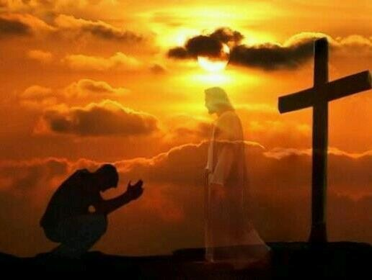
Beloved, do not think it strange concerning the fiery trial which is to try you, as though some strange thing happened to you; but rejoice to the extent that you partake of Christ's sufferings, that when His glory is revealed, you may also be glad with exceeding joy. — 1st Peter 4:12-13
trial
rejoice
joy
glad
joy
exceeding joy
Notes:
Certainly the heights of joy cannot be achieved without going through the grace of Jesus.

Slide 33
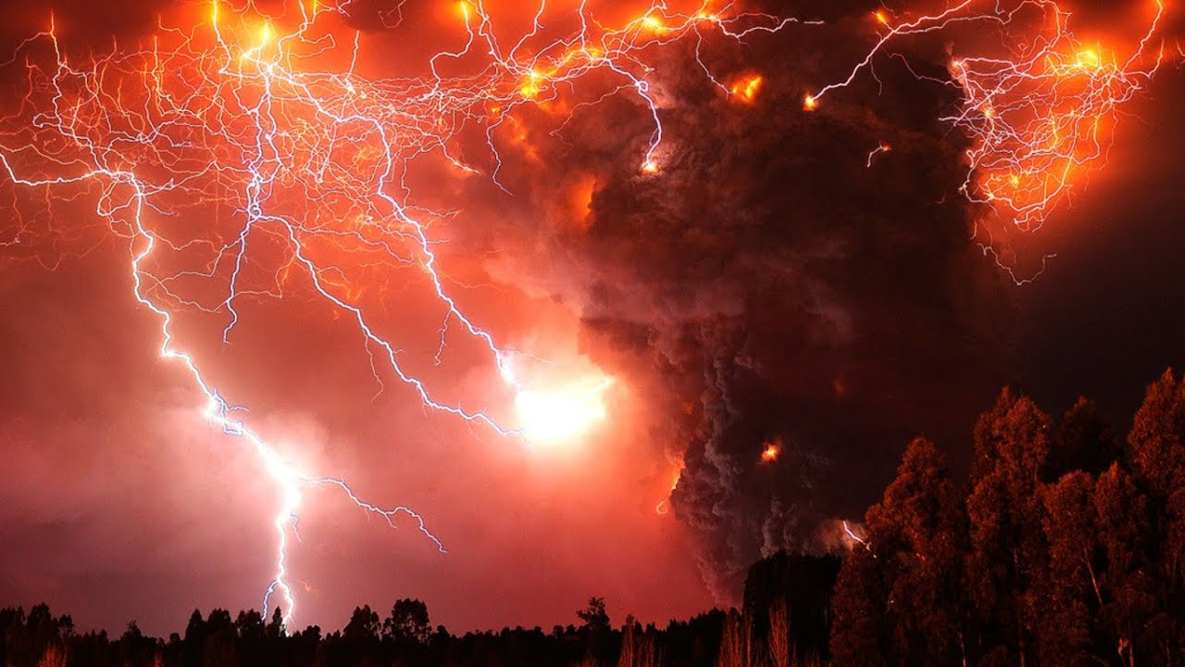
For His anger is but for a moment, His favor is for life; Weeping may endure for a night, But joy comes in the morning. — Psalms 30:5
eternity
joy
awaken
joy

Slide 34
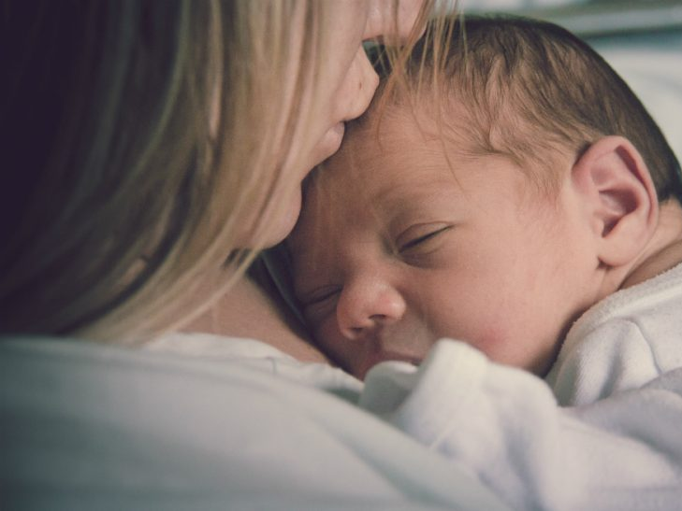
"A woman, when she is in labor, has sorrow because her hour has come; but as soon as she has given birth to the child, she no longer remembers the anguish, for joy that a human being has been born into the world. Therefore you now have sorrow; but I will see you again and your heart will rejoice, and your joy no one will take from you." — John 16:21-22
joy
joy

Slide 35
"But none of these things move me; nor do I count my life dear to myself, so that I may finish my race with joy, and the ministry which I received from the Lord Jesus, to testify to the gospel of the grace of God." — Acts 20:24
finish
my race with joy
joy
joy
joy
joy
joy

Slide 36
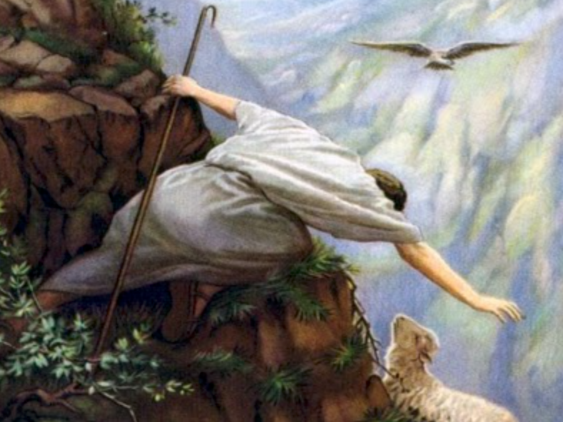
"Likewise, I say to you, there is joy in the presence of the angels of God over one sinner who repents." — Luke 15:10
feel sorrow
be remorseful
regret
ask forgiveness
joy
joy
joy
joy

Slide 37
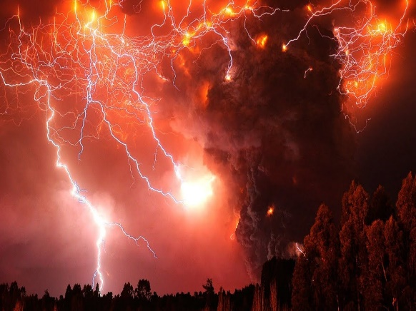
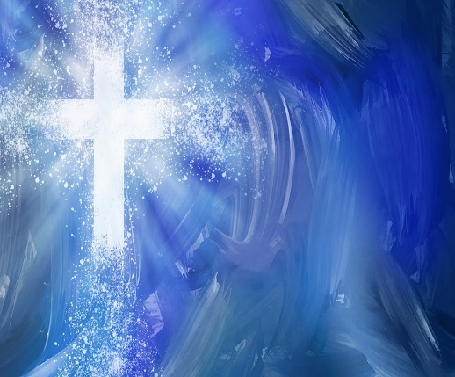
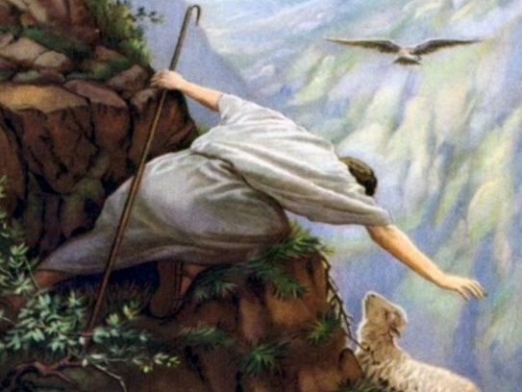

Slide 38
→ Rejoicing swells from the hearts of the righteous
→ Trust in Him rests in our hope for His mercy
→ His presence instructs in the ways of life
→ Salvation is a deep well of devotion
→ Merry hearts lift the soul and heal the body
→ Jesus spoke so we could be full of His joy in us
→ Scriptures are written that our joy may be full
→ In Jesus Christ we are receiving reconciliation
→ A believing hope in joy & peace involves knowledge
→ Rejoicing is rooted in hope with many other virtues
→ Trials build patience when yielding to God’s wisdom
→ Suffering is a moment and afterward will be joy
→ Strive to finish the race with joy of heart
Men cannot steal what God has given
Notes:
Men cannot steal what God has given
Darkness cannot consume the light as it departs.

Slide 40
Please visit http://www.LoveFromGod.com to explore further
Ronald Bert Channel on
Notes:
Eternity never ends.

