Slide 1
Notes:
Darkness is deepest in the gloom of despair.

Slide 2
JESUS CHRIST
GOD MANIFEST
IN THE FLESH
Ron Bert
PART 1
May 17, 2015
Notes:
He came so that we could know of His light.

Slide 3

In the beginning was the Word, and the Word was with God, and the Word was God. He was in the beginning with God. All things were made through Him, and without Him nothing was made that was made. In Him was life, and the life was the light of men. And the light shines in the darkness, and the darkness did not comprehend it. – John 1:1-5
light shines
life
light of men
light shines
Notes:
The creation of His love was for those of equal love. In a spirit of life, He is.

Slide 4
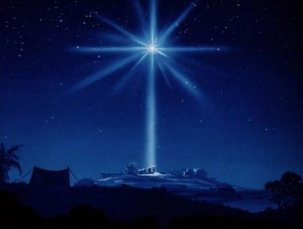
And the Word became flesh and dwelt among us, and we beheld His glory, the glory as of the only begotten of the Father, full of grace and truth. – John 1:14
light shines
glory
glory
grace and truth
Notes:
By His steadfast will, He has not abandoned that which abandons Him.

Slide 5
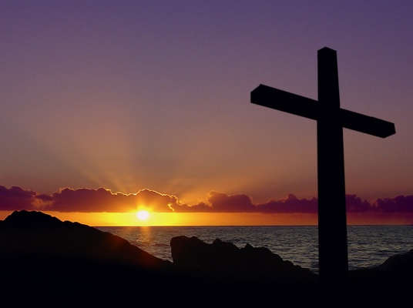
For it is the God who commanded light to shine out of darkness, who has shone in our hearts to give the light of the knowledge of the glory of God in the face of Jesus Christ. – 2nd Corinthians 4:6
light to shine
hearts
knowledge
glory
Christ
Notes:
His deepest desire is for us to know Him.

Slide 6
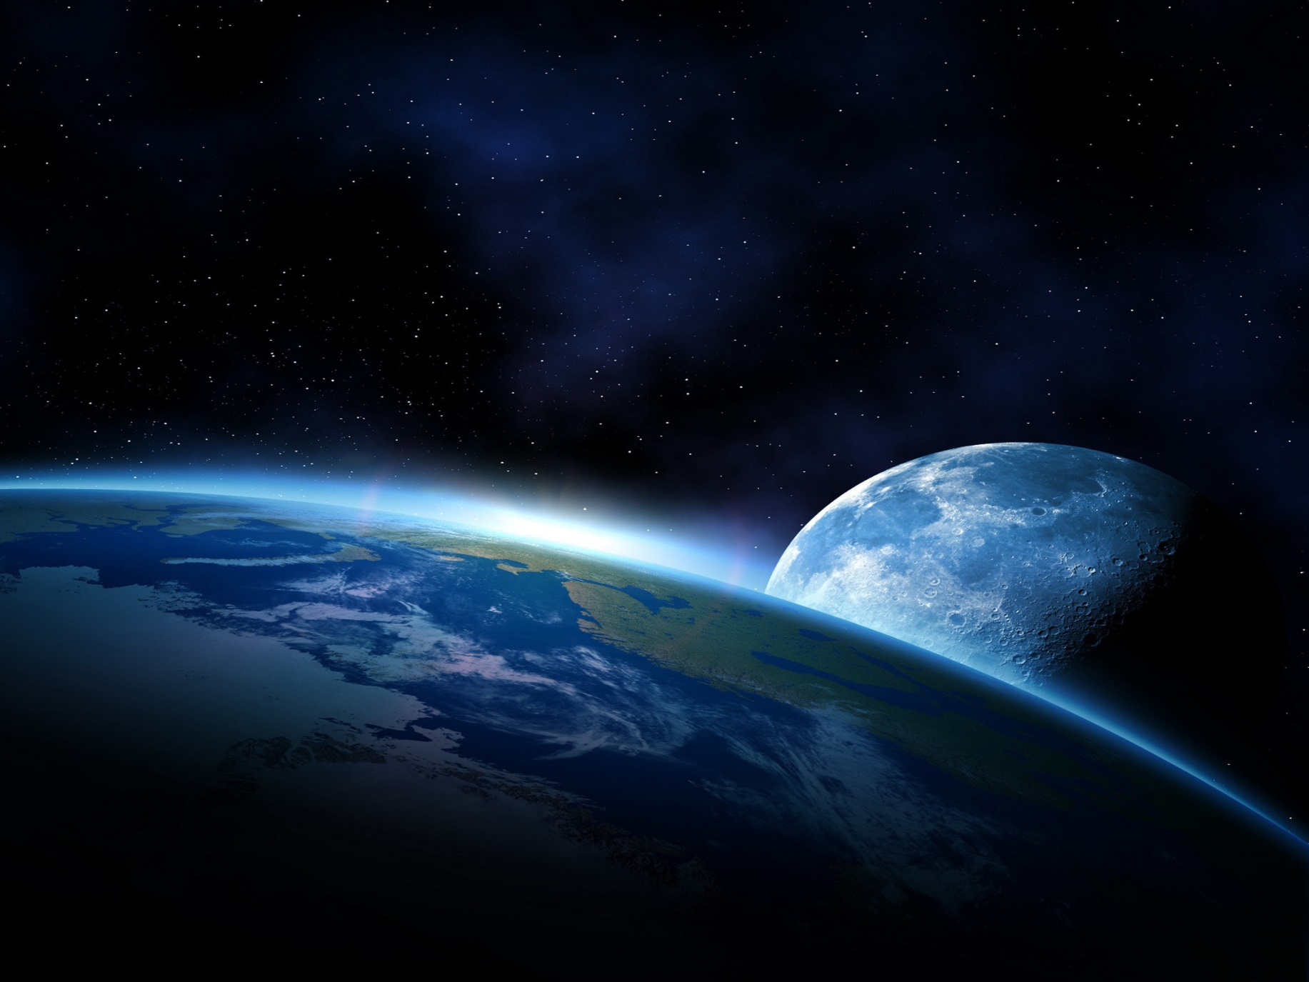
"I have come as a light into the world, that whoever believes in Me should not abide in darkness." – John 12:46
light
Notes:
Through His truth, His wish is for us to return to the presence of His Holy Light.

Slide 7
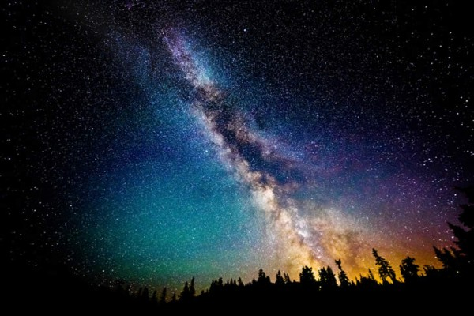
And He is before all things, and in Him all things consist. – Colossians 1:17
all things
Notes:
Eternity is but a glimpse of His great glory.

Slide 8

For of Him and through Him and to Him are all things, to whom be glory forever. Amen – Romans 11:36
all things
glory
Notes:
And it is His glory that shines through all of creation.

Slide 9
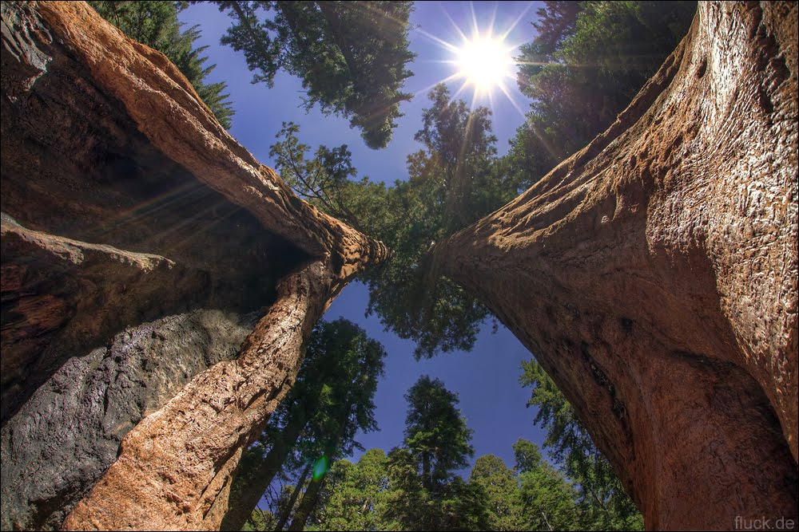
JESUS
"And in that day there shall be a Root of Jesse, Who shall stand as a banner to the people; For the Gentiles shall seek Him, And His resting place shall be glorious." - Isaiah 11:10
And again, Isaiah says: "There shall be a root of Jesse; And He who shall rise to reign over the Gentiles, In Him the Gentiles shall hope." - Romans 15:12
HOPE
glory
hope
Notes:
Jesus came so that we would know hope in Him, the true God, giver of life.

Slide 10
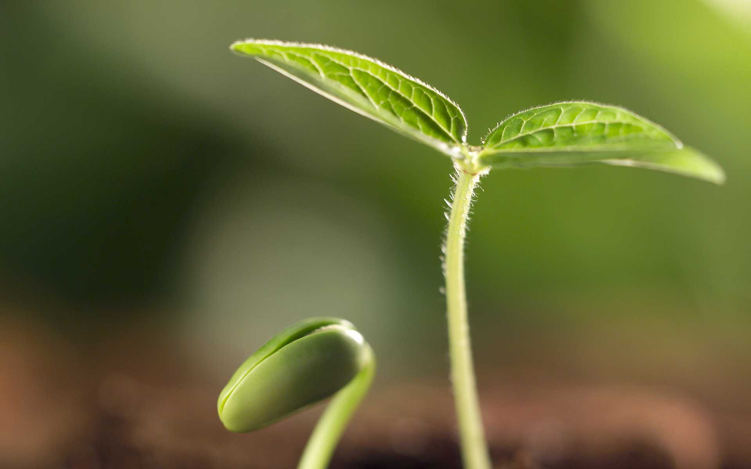
For He shall grow up before Him as a tender plant, And as a root out of dry ground. He has no form or comeliness; And when we see Him, There is no beauty that we should desire Him. - Isaiah 53:2
For He shall grow up before Him as a tender plant, And as a root out of dry ground. He has no form or comeliness; And when we see Him, There is no beauty that we should desire Him. - Isaiah 53:2
For unto us a Child is born, Unto us a Son is given; And the government will be upon His shoulder. And His name will be called Wonderful, Counselor, Mighty God, Everlasting Father, Prince of Peace. - Isaiah 9:6
For unto us a Child is born, Unto us a Son is given; And the government will be upon His shoulder. And His name will be called Wonderful, Counselor, Mighty God, Everlasting Father, Prince of Peace. - Isaiah 9:6
a Son is given
a Son is given
Son
Son
Notes:
In all ways, He knows the suffering we endure as creatures born of dust.

Slide 11
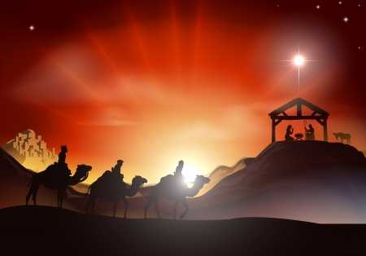
But when the fullness of the time had come, God sent forth His Son, born of a woman, born under the law,
– Galatians 4:4
Son
Notes:
God’s plan for our redemption is by His design.

Slide 12
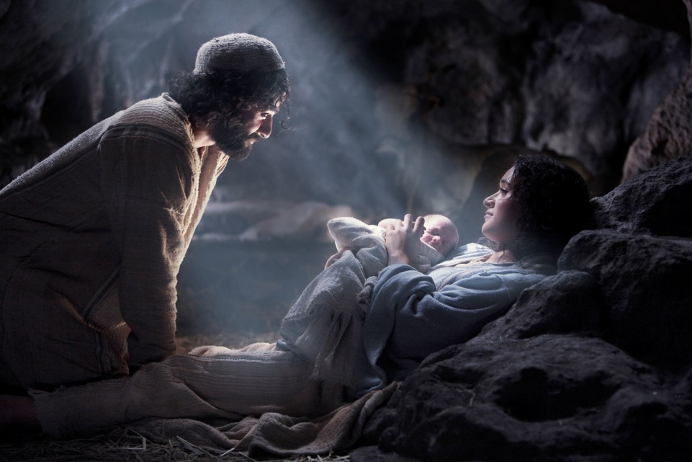
And she brought forth her firstborn Son, and wrapped Him in swaddling cloths, and laid Him in a manger, because there was no room for them in the inn. – Luke 2:7
Notes:
In truth, Jesus came forth to show all the love of God, through His own perfect sacrifice for us, of us.

Slide 13
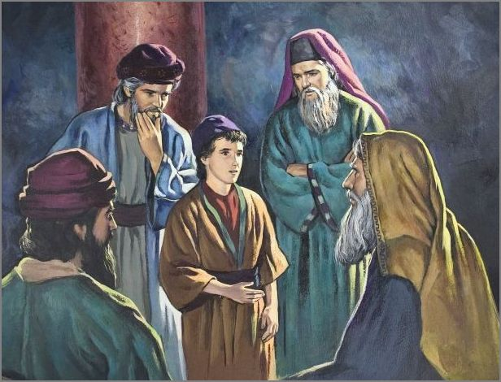
And Jesus increased in wisdom and stature, and in favor with God and men. – Luke 2:52
Jesus
Notes:
Jesus came as eternally, the greatest teacher. God desires personal relationships and not distant associations.

Slide 14
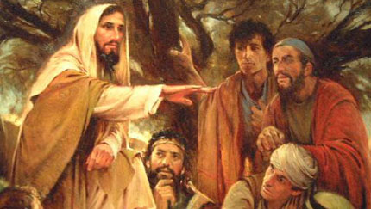
Now Jesus Himself began His ministry at about thirty years of age, being (as was supposed) the son of Joseph, the son of Heli, … – Luke 3:23
Son
Jesus
Son
Notes:
In His time, He came to be exactly who He was and is.

Slide 15
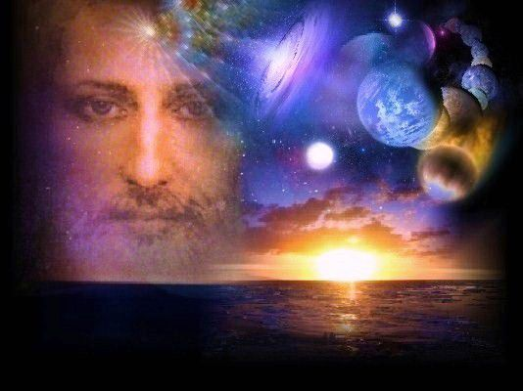
God, who at various times and in various ways spoke in time past to the fathers by the prophets, has in these last days spoken to us by His Son, whom He has appointed heir of all things, through whom also He made the worlds; who being the brightness of His glory and the express image of His person, and upholding all things by the word of His power, when He had by Himself purged our sins, sat down at the right hand of the Majesty on high, having become so much better than the angels, as He has by inheritance obtained a more excellent name than they. – Hebrews 1:1-4
Son
Notes:
There is no comparison for the coming of Jesus.

Slide 16
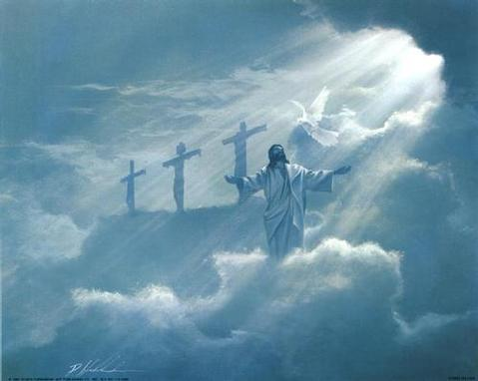
But we see Jesus, who was made a little lower than the angels, for the suffering of death crowned with glory and honor, that He, by the grace of God, might taste death for everyone. – Hebrews 2:9
Notes:
Jesus suffered in the flesh so that without excuse, God’s purpose for salvation would prevail for all creation to know.

Slide 17
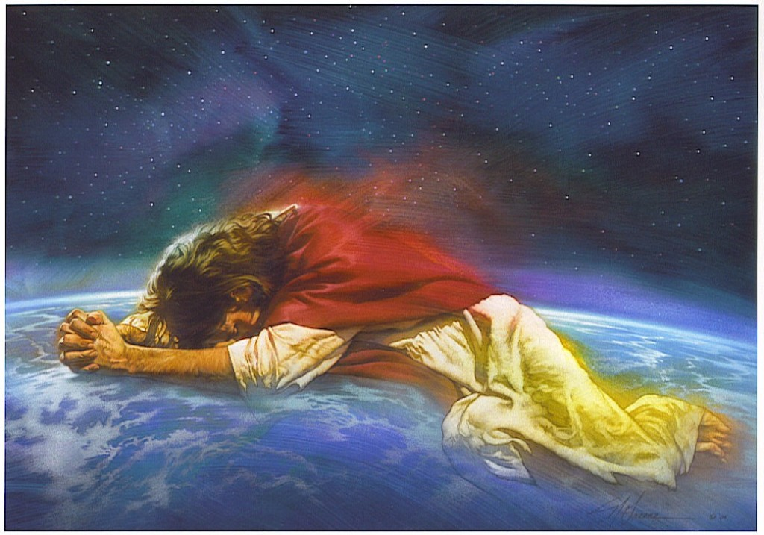
For indeed He does not give aid to angels, but He does give aid to the seed of Abraham. – Hebrews 2:16
Notes:
Jesus came and suffered for all in the flesh, that with the mercy of God’s own mortal presence, grace through His truth would be known.

Slide 18
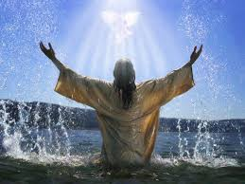
"Behold! My Servant whom I have chosen, My Beloved in whom My soul is well pleased! I will put My Spirit upon Him, And He will declare justice to the Gentiles." – Matthew 12:18
Notes:
Through Jesus, God revealed Himself.

Slide 19
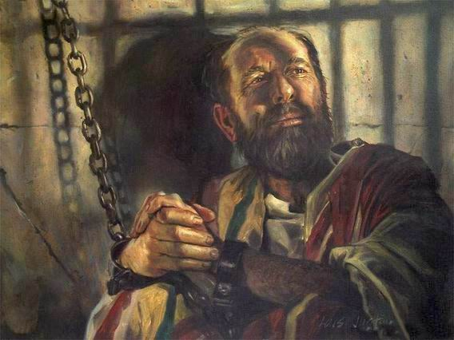
This is a faithful saying and worthy of all acceptance, that Christ Jesus came into the world to save sinners, of whom I am chief. – 1st Timothy 1:15
to save sinners
Notes:
All humble hearts know the sacrifice in love Jesus bestowed upon us all.

Slide 20
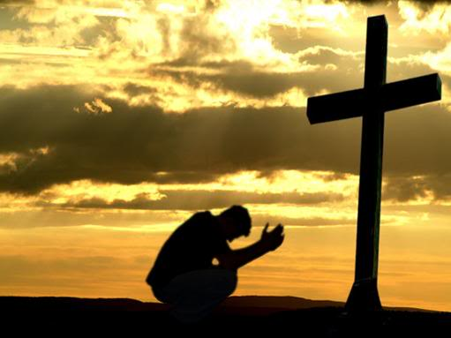
In this the love of God was manifested toward us, that God has sent His only begotten Son into the world, that we might live through Him. – 1st John 4:9
live
Notes:
The only way to find true life is to live in God as part of His creation.

Slide 21

And this is the testimony: that God has given us eternal life, and this life is in His Son. He who has the Son has life; he who does not have the Son of God does not have life. – 1st John 5:11-12
Notes:
The test of God is for those alive to come to Him.

Slide 22
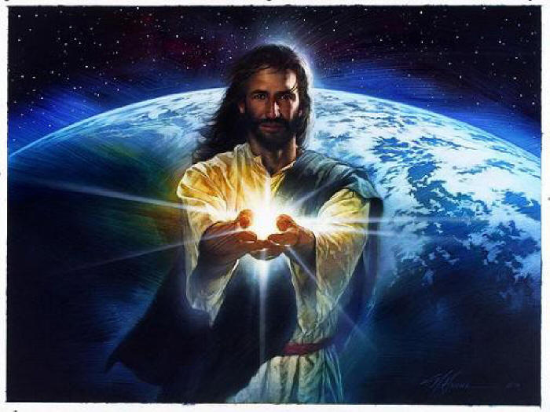
Then Jesus spoke to them again, saying, "I am the light of the world. He who follows Me shall not walk in darkness, but have the light of life." – John 8:12
light of life
Notes:
The light of Spirit from within holds brighter than the sun in all its’ brilliance.

Slide 23
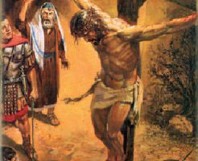
For Christ also suffered once for sins, the just for the unjust, that He might bring us to God, being put to death in the flesh but made alive by the Spirit, – 1st Peter 3:18
Notes:
God’s goal is for souls to know truth in the eternal love He offers, for those that overcome the temptation to actively pursue evil.

Slide 24
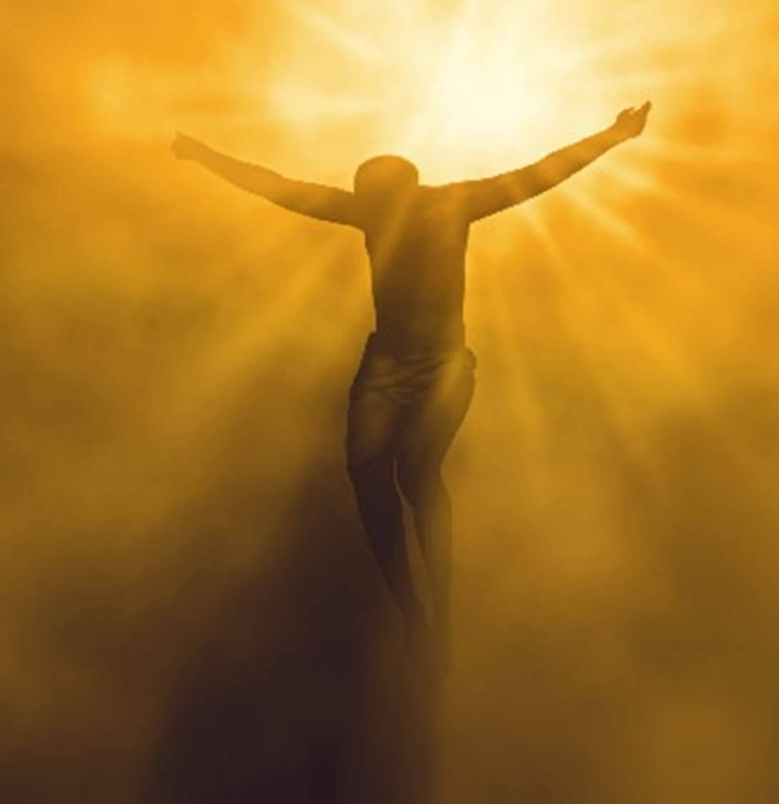
"It is the Spirit who gives life; the flesh profits nothing. The words that I speak to you are spirit, and they are life. – John 6:63
Spirit
Notes:
The Spirit is such that it asks for those contemplations that are higher than the flesh.

Slide 25
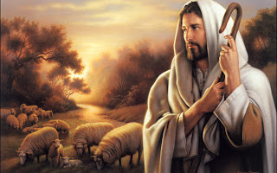
"The Spirit of the LORD is upon Me, Because He has anointed Me To preach the gospel to the poor; He has sent Me to heal the brokenhearted, To proclaim liberty to the captives And recovery of sight to the blind, To set at liberty those who are oppressed; – Luke 4:18
Spirit
Notes:
Jesus knew His purpose in every respect and He fulfilled what He came to accomplish. His is the kingdom of eternity.

Slide 26
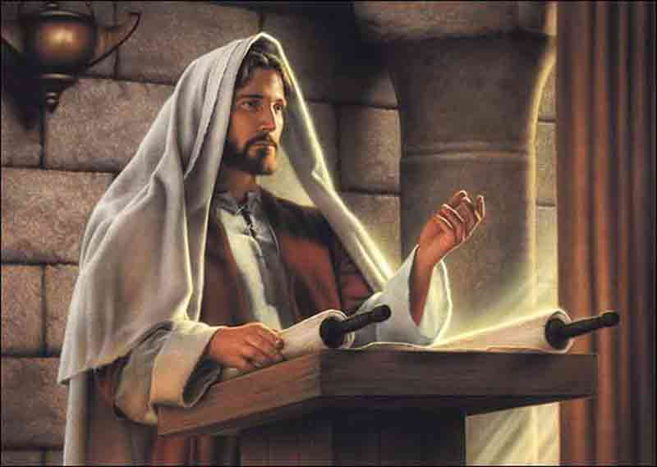
… that is, that God was in Christ reconciling the world to Himself, not imputing their trespasses to them, and has committed to us the word of reconciliation. – 2nd Corinthians 5:19
Reunion
Resolution
Settlement
Appeasement
Understanding
word of reconciliation
Notes:
His resolve was that through truth, souls could find salvation through His Spirit in the Father of all creation.

Slide 27
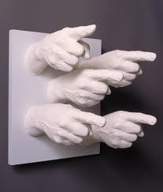
"You judge according to the flesh; I judge no one. – John 8:15
judge
Notes:
Too often the judgments of man condemn the whole. Jesus is our tangible opportunity to return to God.

Slide 28
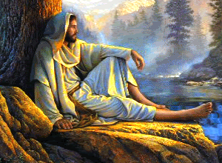
"And if anyone hears My words and does not believe, I do not judge him; for I did not come to judge the world but to save the world. – John 12:47
judge
judge
Notes:
The word of God remains in the world for all to know.

Slide 29
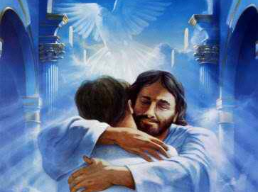
"For as the Father has life in Himself, so He has granted the Son to have life in Himself, and has given Him authority to execute judgment also, because He is the Son of Man." – John 5:26-27
judge
Notes:
It is God that wants us to live in Him. He does not want to loose the autonomous life He created to love and to know His love.

Slide 30
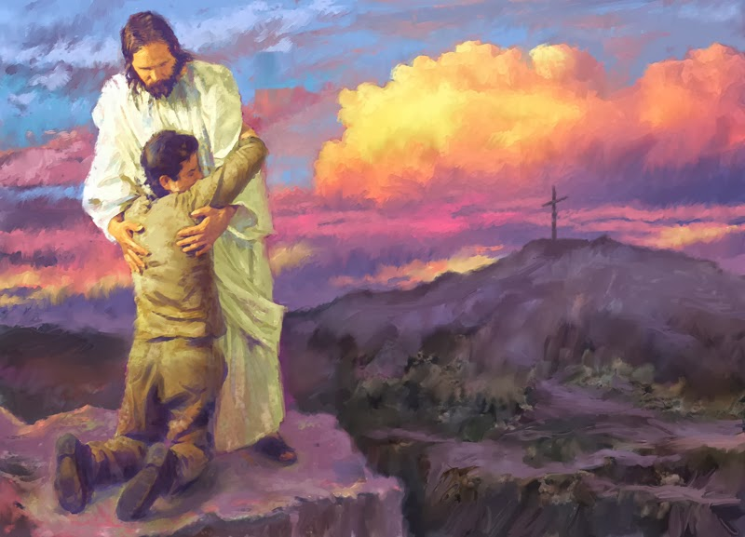
… who desires all men to be saved and to come to the knowledge of the truth. For there is one God and one Mediator between God and men, the Man Christ Jesus, who gave Himself a ransom for all, to be testified in due time, – 1st Timothy 2:4-6
knowledge of the truth
Man Christ Jesus
Notes:
God’s desire is that all would find Him. As darkness falls away, He offers a way to return to the light of His love.

Slide 31
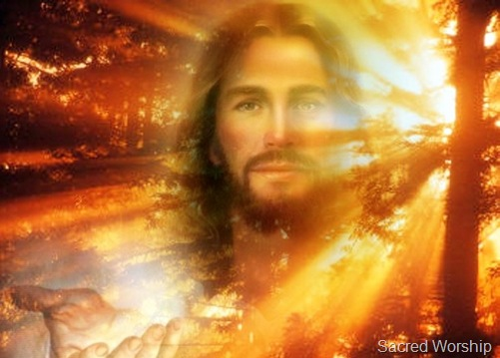
"And yet if I do judge, My judgment is true; for I am not alone, but I am with the Father who sent Me. – John 8:16
Notes:
The judgment of God is based in the goodness of His love, and truth without partiality.

Slide 32

J
→ Full of grace and truth
→ Light in darkness
→ All things are in Him
→ Hope comes through Him
→ God speaks to us through Jesus
→ He came to aid us in living
→ He declares justice
→ He came to save sinners
→ He came to bring us to God
→ He came to heal our suffering
→ He came to deliver His word
→ We all must face His judgment
J
E
S
U
S
E
JESUS
S
U
S
Notes:
Do you hear the call?

Slide 33
Notes:
Darkness remains for all those that do not hear.

Slide 34
JESUS CHRIST
GOD MANIFEST
IN THE FLESH
Ron Bert
PART 2
May 17, 2015
Notes:
Jesus exposes the nature of God, and how souls can return to abiding in His will.

Slide 35
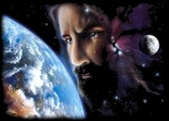
He is the image of the invisible God, the firstborn over all creation. For by Him all things were created that are in heaven and that are on earth, visible and invisible, whether thrones or dominions or principalities or powers. All things were created through Him and for Him. And He is before all things, and in Him all things consist. And He is the head of the body, the church, who is the beginning, the firstborn from the dead, that in all things He may have the preeminence. – Colossians 1:15-18
Notes:
There is no denying that Jesus is God manifest in the flesh. To deny Him is to deny God.

Slide 36
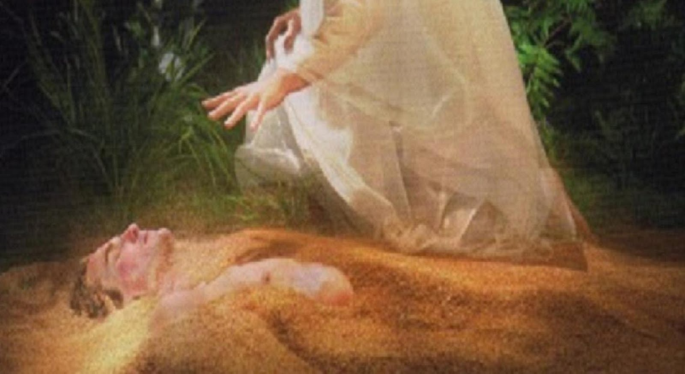
The first man was of the earth, made of dust; the second Man is the Lord from heaven. – 1st Corinthians 15:47
Notes:
God Himself came to show His creation of life how to live and to find life in Him.

Slide 37
And so it is written, "The first man Adam became a living being." The last Adam became a life-giving spirit. – 1st Corinthians 15:45
Notes:
The Spirit of God is eternal life through Him.

Slide 38
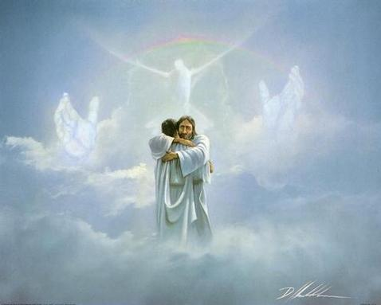
Jesus said to him, "I am the way, the truth, and the life. No one comes to the Father except through Me." – John 14:6
Notes:
It is God’s universe and His will is such that Jesus is the redeemer and no other.

Slide 39
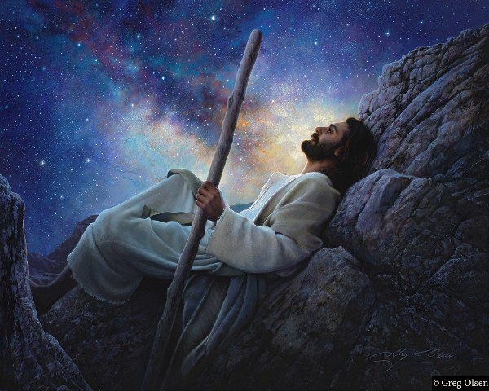
"I and My Father are one." – John 10:30
Notes:
Jesus commands the power of God as God.

Slide 40
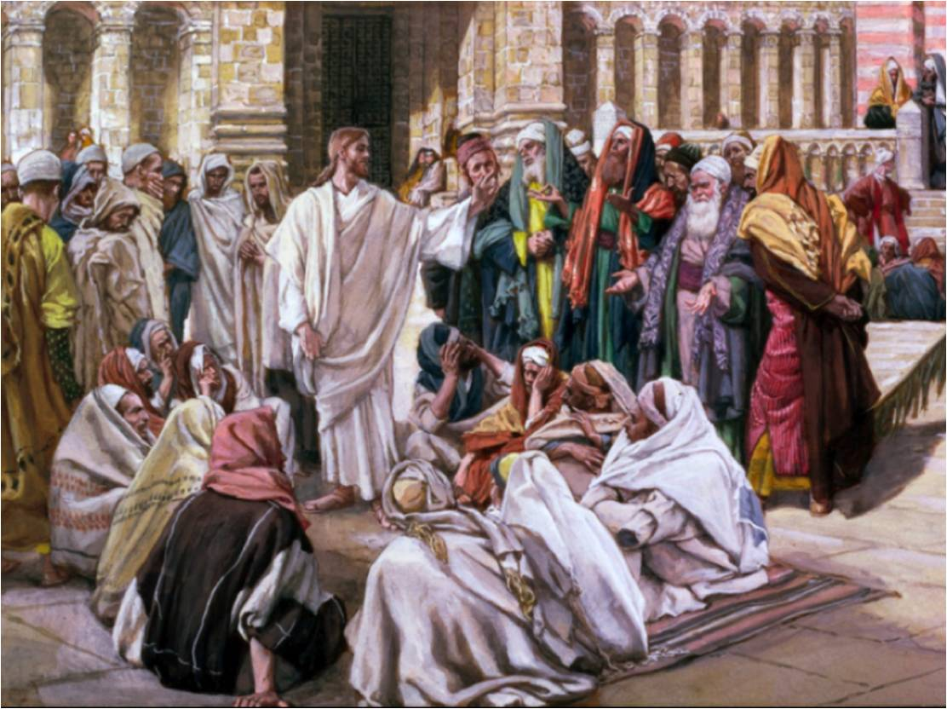
But Jesus answered them, "My Father has been working until now, and I have been working." Therefore the Jews sought all the more to kill Him, because He not only broke the Sabbath, but also said that God was His Father, making Himself equal with God. –John 5:17-18
Notes:
Jesus’ plan has always been simple, to bring souls to know God.

Slide 41
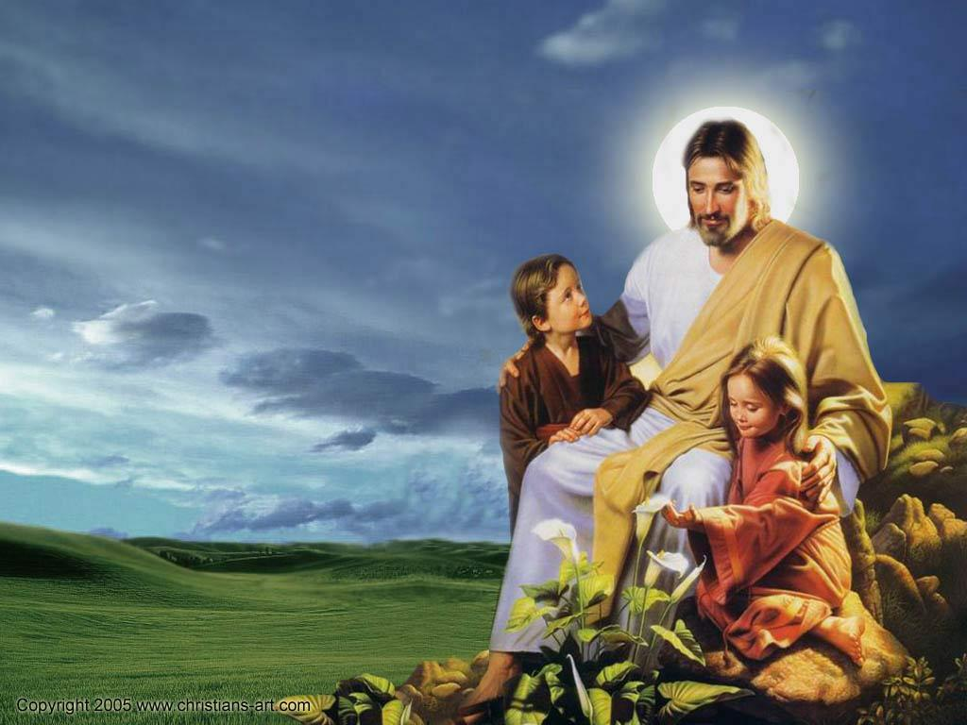
"For the Son of Man is Lord even of the Sabbath." – Matthew 12:8
Notes:
In truth, He is the rest in love that we all seek.

Slide 42
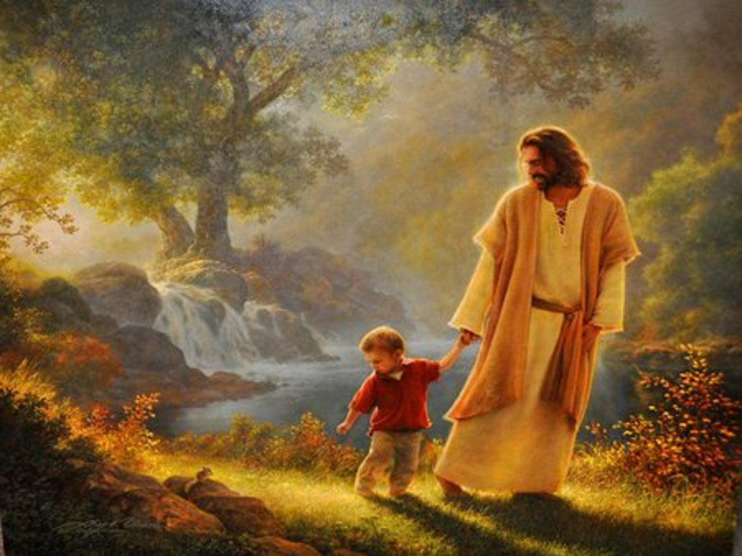
"Take My yoke upon you and learn from Me, for I am gentle and lowly in heart, and you will find rest for your souls. – Matthew 11:29
Notes:
The heart of Jesus holds mercy for all that love and obey His calling.

Slide 43
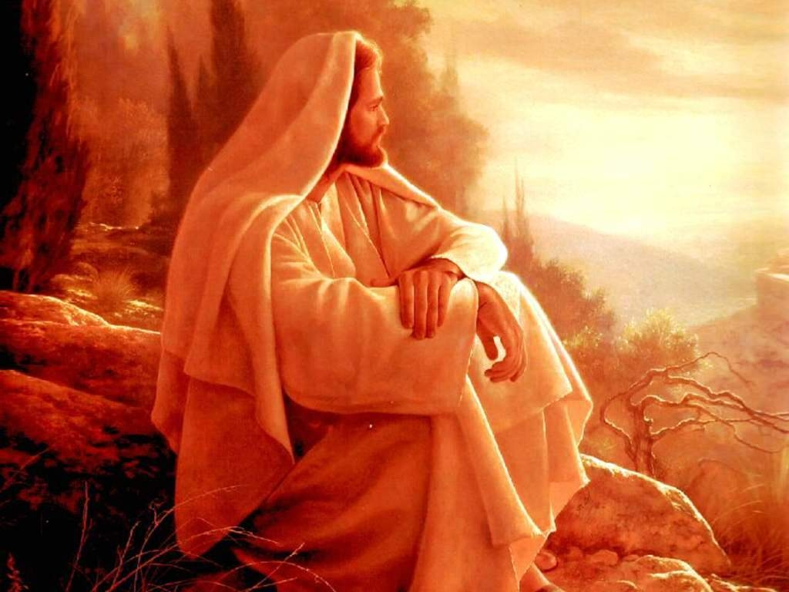
Jesus answered, "If I honor Myself, My honor is nothing. It is My Father who honors Me, of whom you say that He is your God. Yet you have not known Him, but I know Him. And if I say, 'I do not know Him,' I shall be a liar like you; but I do know Him and keep His word." –John 8:54-55
Notes:
Jesus did not come to win an argument of how good He was, He came for us to know God.

Slide 44
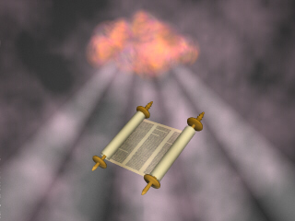
For the word of the LORD is right, And all His work is done in truth. – Psalm 33:4
Notes:
In all aspects, God sets the moral compass for us all to live or die by.

Slide 45
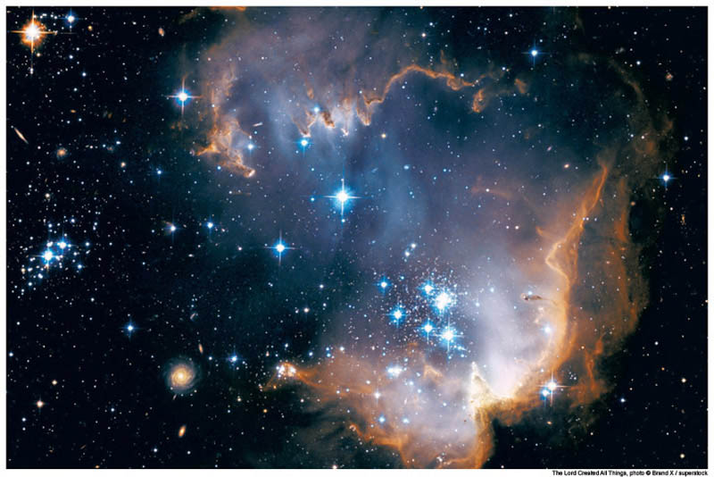
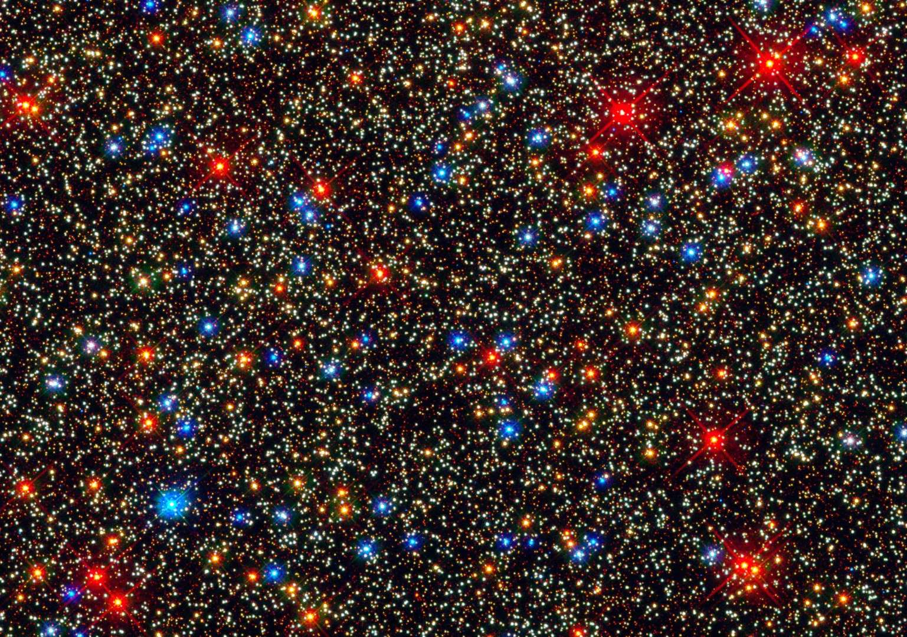
Jesus said to them, "Most assuredly, I say to you, before Abraham was, I AM." – John 8:58
Notes:
For God to walk upon the earth in the flesh, in all that He is, shows His care for even the smallest parts of His creation.

Slide 46
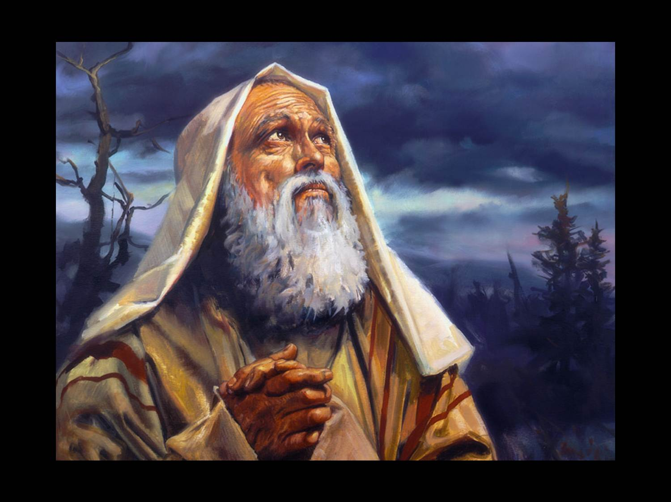
There is neither Jew nor Greek, there is neither slave nor free, there is neither male nor female; for you are all one in Christ Jesus. And if you are Christ's, then you are Abraham's seed, and heirs according to the promise. –Galatians 3:28-29
Summery of the Bible
Notes:
Mortal gender is His creation to expose creation in His image and to show and teach compassion for that which is created. No matter disposition, God looks for souls loyal to His call.

Slide 47
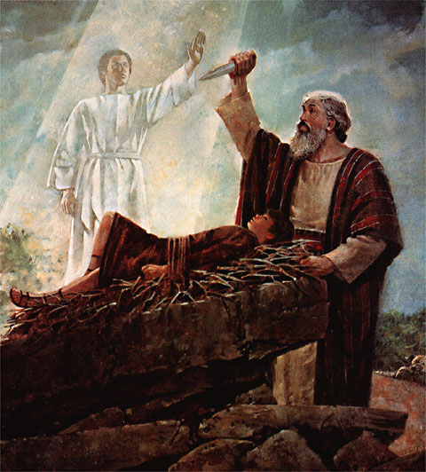
"In your seed all the nations of the earth shall be blessed, because you have obeyed My voice." – Genesis 22:18
Notes:
Obedience to His word defines righteousness and His promise is sure, that in His coming, salvation through forgiveness is God’s plan of Grace.

Slide 48
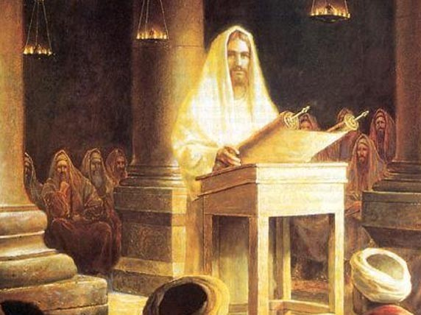
And Jesus said to him, "Today salvation has come to this house, because he also is a son of Abraham; for the Son of Man has come to seek and to save that which was lost." – Luke 19:9-10
Notes:
As all souls upon the earth come from a root of being lost, Jesus’ message is that one can find, and be sure of, salvation in Him.

Slide 49
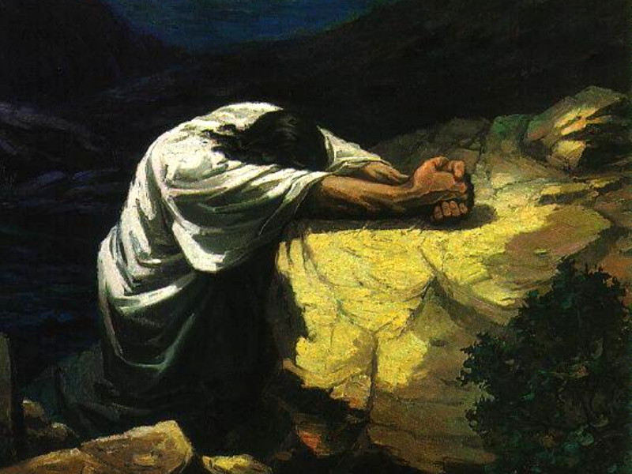
... though He was a Son, yet He learned obedience by the things which He suffered. – Hebrews 5:8
Notes:
Suffering causes a humble heart to be born in our fragility, in the face of His power, if arrogance does not rebel to the corner of anger.

Slide 50
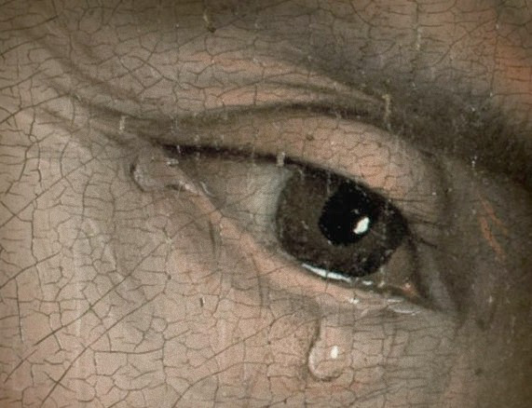
Jesus wept.
– John 11:35
Notes:
Sorrow is all suffering apart from Him.

Slide 51
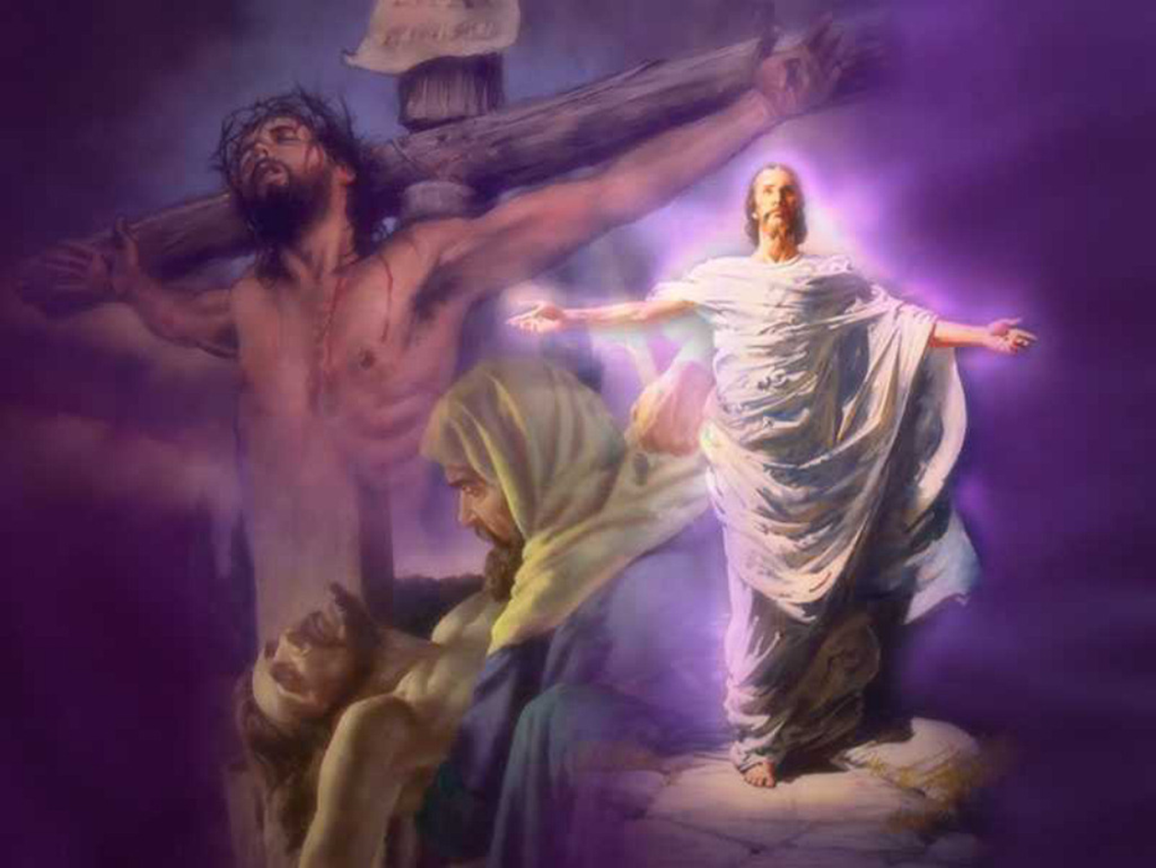
Inasmuch then as the children have partaken of flesh and blood, He Himself likewise shared in the same, that through death He might destroy him who had the power of death, that is, the devil, ... – Hebrews 2:14
Notes:
For life to be free of the curse of death, His glory showed that it can be done if a soul turns back to Him.

Slide 52
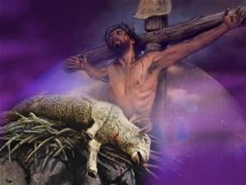
Therefore, in all things He had to be made like His brethren, that He might be a merciful and faithful High Priest in things pertaining to God, to make propitiation for the sins of the people. – Hebrews 2:17
Notes:
His unblemished sacrifice allows for salvation to come for all that believe.

Slide 53
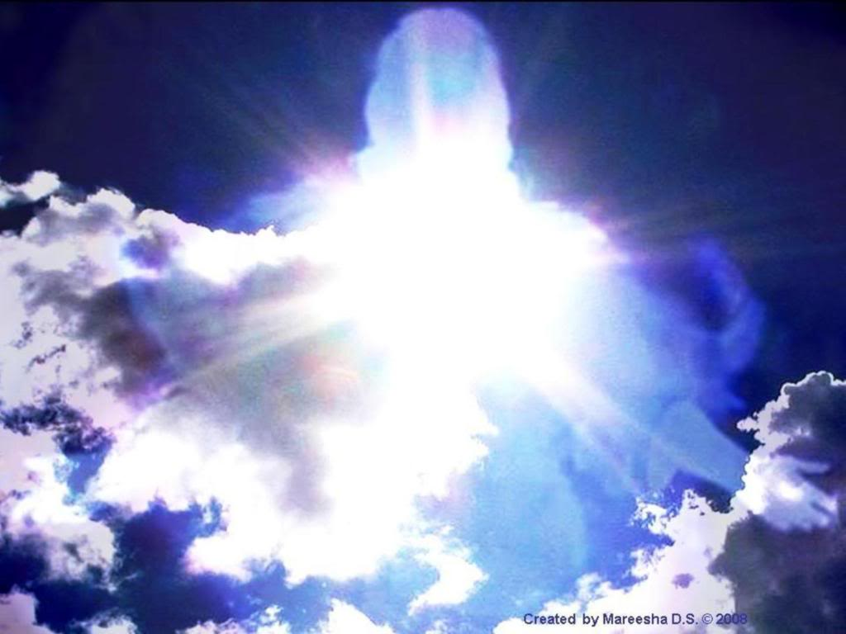
And He Himself is the propitiation for our sins, and not for ours only but also for the whole world. – 1st John 2:2
Notes:
Once for all, He is the path one must take if Holy redemption is to be had.

Slide 54
… who has come, not according to the law of a fleshly commandment, but according to the power of an endless life.
– Hebrews 7:16

Slide 55
For such a High Priest was fitting for us, who is holy, harmless, undefiled, separate from sinners, and has become higher than the heavens; – Hebrews 7:26
Notes:
Above all, a merciful God reaches down for us.

Slide 56
But He, because He continues forever, has an unchangeable priesthood. – Hebrews 7:24
Notes:
He remains that He is as He has always been.

Slide 57
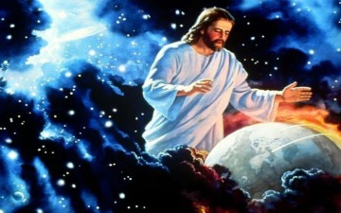
But Christ came as High Priest of the good things to come, with the greater and more perfect tabernacle not made with hands, that is, not of this creation. – Hebrews 9:11
Notes:
Rising from material substance, His glory is greater than all knowable.

Slide 58
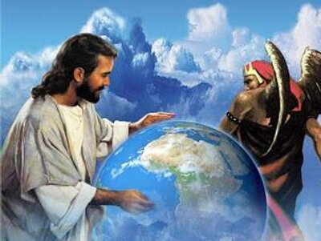
He has delivered us from the power of darkness and conveyed us into the kingdom of the Son of His love, in whom we have redemption through His blood, the forgiveness of sins. – Colossians 1:13-14
conveyed us into the kingdom
blood
Notes:
From the womb of darkness, His love and sacrifice of life brings us to the feet of His light. Conquering rebellion is the Spirit He comes in.

Slide 59

Therefore, brethren, having boldness to enter the Holiest by the blood of Jesus, by a new and living way which He consecrated for us, through the veil, that is, His flesh, and having a High Priest over the house of God, – Hebrews 10:19-21
blood
Notes:
Through Jesus, we have access directly with God Almighty.

Slide 60
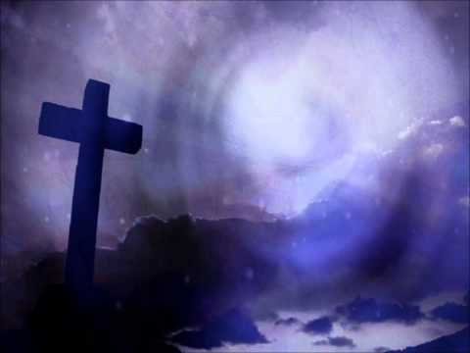
For by one offering He has perfected forever those who are being sanctified. – Hebrews 10:14
b
e
battle
t
l
a
t
Notes:
No other sacrifice is required, He is the supreme final destination.

Slide 61
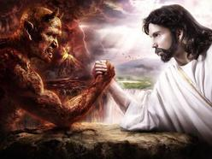
He who sins is of the devil, for the devil has sinned from the beginning. For this purpose the Son of God was manifested, that He might destroy the works of the devil. – 1st John 3:8
battle
purpose
Notes:
God came to earth to defeat rebellion once for all, retrieving those that would turn back to the light from the descending darkness.

Slide 62
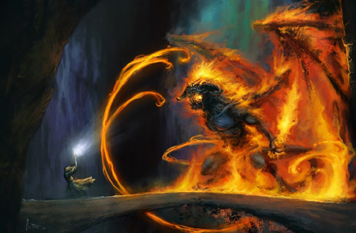
'to open their eyes, in order to turn them from darkness to light, and from the power of Satan to God, that they may receive forgiveness of sins and an inheritance among those who are sanctified by faith in Me.' –Acts 26:18
faith in Me
Notes:
The power of His life subdues all evil and extinguishes, through example, the desire for rebellion.

Slide 63
J
→ Image of the invisible God
→ Firstborn from the dead
→ Lord of heaven
→ Life-giving Spirit
→ Jesus is the way
→ Jesus is the rest souls seek
→ Jesus is timeless
→ His promise is for those in Christ
→ He came to save the lost
→ Suffering honed His obedience
→ To conquer the power of Satan
→ He is our propitiation for sin
J
E
S
U
S
E
JESUS
S
U
S
Notes:
Do you hear the call?

Slide 64
Notes:
Darkness remains for all those that do not hear.

Slide 65
JESUS CHRIST
GOD MANIFEST
IN THE FLESH
Ron Bert
PART 3
July 19, 2015
Notes:
Jesus exposes the nature of God, and how souls can return to abiding in His will.

Slide 66

Let nothing be done through selfish ambition or conceit, but in lowliness of mind let each esteem others better than himself. Let each of you look out not only for his own interests, but also for the interests of others. – Philippians 2:3-4
lowliness of mind
esteem others
look out
Notes:
Compassion and love over anger or jealousy is the sign of a soul rising in Him. To see God is to love of a genuine heart.

Slide 67

Let this mind be in you which was also in Christ Jesus, who, being in the form of God, did not consider it robbery to be equal with God, but made Himself of no reputation, taking the form of a bondservant, and coming in the likeness of men. And being found in appearance as a man, He humbled Himself and became obedient to the point of death, even the death of the cross. – Philippians 2:5 -8
mind
obedient
bondservant
bondservant
humble
obedient
Notes:
In the light of His glory, we are one in Him. Commitment has no barriers in His unending love for each of us.

Slide 68

Therefore, since Christ suffered for us in the flesh, arm yourselves also with the same mind, for he who has suffered in the flesh has ceased from sin, that he no longer should live the rest of his time in the flesh for the lusts of men, but for the will of God. – 1st Peter 4:1-2
obedient
mind
suffer
in the flesh
cease
sin
bondservant
for the lust
for the will of God
Notes:
Suffering in this life is unavoidable but with repentance climbing to do His will eases deep turmoil.

Slide 69

"These things I have spoken to you, that in Me you may have peace. In the world you will have tribulation; but be of good cheer, I have overcome the world." – John 16:33
in Me
peace
overcome
in Him
Notes:
It is an anchor beyond mortal life resting in the sanctuary of Him.

Slide 70

Beware lest anyone cheat you through philosophy and empty deceit, according to the tradition of men, according to the basic principles of the world, and not according to Christ. For in Him dwells all the fullness of the Godhead bodily; – Colossians 2:8-9
Beware
cheat
philosophy
deceit
tradition of men
principles
Christ
in Him
fullness
Notes:
God warns that man devises against himself so beware of coming to Him through the world of man.

Slide 71

… to know the love of Christ which passes knowledge; that you may be filled with all the fullness of God. – Ephesians 3:19
Christ
h
t
passes knowledge
l
g
light
i
fullness
… but we preach Christ crucified, to the Jews a stumbling block and to the Greeks foolishness, … – 1st Corinthians 1:23
stumbling block
foolishness
Notes:
To come to God is to know Him directly.

Slide 72

…and He was transfigured before them. His face shone like the sun, and His clothes became as white as the light. And behold, Moses and Elijah appeared to them, talking with Him. – Matthew 17:2-3
For we did not follow cunningly devised fables when we made known to you the power and coming of our Lord Jesus Christ, but were eyewitnesses of His majesty. For He received from God the Father honor and glory when such a voice came to Him from the Excellent Glory: "This is My beloved Son, in whom I am well pleased." And we heard this voice which came from heaven when we were with Him on the holy mountain. – 2 ^{nd} Peter 1:16 -18
eyewitnesses
light
Notes:
His fullness of Spirit is larger than all the ages of life.

Slide 73
For "who has known the mind of the LORD that he may instruct Him?" But we have the mind of Christ. – 1st Corinthians 2:16
Christ
Notes:
Christ is God’s compassion for each of us to know Him.

Slide 74
Christ
Jesus Christ is the same yesterday, today, and forever. – Hebrews 13:8
Notes:
His truth in love remains over all.

Slide 75

"You call me Teacher and Lord, and you say well, for so I am." – John 13:13
Teacher
Notes:
Forever He is Lord and teacher of all.

Slide 76

"If I then, your Lord and Teacher, have washed your feet, you also ought to wash one another's feet. For I have given you an example, that you should do as I have done to you." – John 13:14-15
Teacher
example
Notes:
He teaches us to have hearts of service.

Slide 77

And they were astonished beyond measure, saying, "He has done all things well. He makes both the deaf to hear and the mute to speak." – Mark 7:37
all things well
Notes:
While Jesus walked upon the world He commanded above all.

Slide 78

"But he said to him, 'If they do not hear Moses and the prophets, neither will they be persuaded though one rise from the dead.' " – Luke 16:31
And we know that all things work together for good to those who love God, to those who are the called according to His purpose. For whom He foreknew, He also predestined to be conformed to the image of His Son, that He might be the firstborn among many brethren. – Romans 8:28 -29
God knew there would be those wanting Him
foreknew
For those in Him must hear and obey in Spirit
predestined
conformed to
Image of His Son
Notes:
For all Jesus did, and is, choice still remains for each to follow Him or not. No other savior is forthcoming.

Slide 79

Imitate me, just as I also imitate Christ. – 1st Corinthians 11:1
imitate Christ
Christ
Notes:
For those He taught to be like Him, He asks we too follow in His dedication to goodness, for the benefit of all.

Slide 80

… that you do not become sluggish, but imitate those who through faith and patience inherit the promises. For when God made a promise to Abraham, because He could swear by no one greater, He swore by Himself, saying, "Surely blessing I will bless you, and multiplying I will multiply you." And so, after he had patiently endured, he obtained the promise. – Hebrews 6:12 -15
patiently endure
Notes:
Be assured, His promise of eternal life holds for all those pursuing His will.

Slide 81

For to this you were called, because Christ also suffered for us, leaving us an example, that you should follow His steps: "Who committed no sin, Nor was deceit found in His mouth"; who, when He was reviled, did not revile in return; when He suffered, He did not threaten, but committed Himself to Him who judges righteously; – 1st Peter 2:21-23
r
example
follow
Nor was deceit found
serve
v
e
s
committed Himself to Him
to Him
e
Notes:
His example shows mercy in the face of hostile destruction. A heart without love has no union with His Spirit.

Slide 82

"... just as the Son of Man did not come to be served, but to serve, and to give His life a ransom for many." – Matthew 20:28
serve
life
Notes:
To love or not to love is a question of God.

Slide 83

"Therefore My Father loves Me, because I lay down My life that I may take it again." – John 10:17
Father
life
Notes:
Loving God redeems a soul to live again in Him. Knowing our destination lifts a spirit to rise as Jesus died and came to live again.

Slide 84

"…for the Father Himself loves you, because you have loved Me, and have believed that I came forth from God. I came forth from the Father and have come into the world. Again, I leave the world and go to the Father." – John 16:27-28
Father
Father
Notes:
To love God is the way to return whole in soul.

Slide 85

Jesus, knowing that the Father had given all things into His hands, and that He had come from God and was going to God, – John 13:3
Father
Notes:
Jesus always knew His return would guide all else on their journey back to God.

Slide 86

"He who comes from above is above all; he who is of the earth is earthly and speaks of the earth. He who comes from heaven is above all." – John 3:31
earth is earthly
heaven is above all
Notes:
None on earth has supremacy over that which God Himself has commanded.

Slide 87
See that you do not refuse Him who speaks. For if they did not escape who refused Him who spoke on earth, much more shall we not escape if we turn away from Him who speaks from heaven, … – Hebrews 12:25
heaven
Notes:
He commands that we hear Him and warns not to turn from His word.

Slide 88
"No one has ascended to heaven but He who came down from heaven, that is, the Son of Man who is in heaven." – John 3:13
heaven
Notes:
God declares that all wait for final judgment below Christ’s pronouncements from heaven.

Slide 89

"A little while longer and the world will see Me no more, but you will see Me. Because I live, you will live also." – John 14:19
I live, you will live also
live
In Him was life, and the life was the light of men. – John 1:4
Notes:
Through the life of Jesus we find life.

Slide 90

"Do not labor for the food which perishes, but for the food which endures to everlasting life, which the Son of Man will give you, because God the Father has set His seal on Him." – John 6:27
live
seal
Notes:
It is truth of heart God renders to those that love and obey Him, upon the mercy and grace of His word.

Slide 91

And He took bread, gave thanks and broke it, and gave it to them, saying, "This is My body which is given for you; do this in remembrance of Me." Likewise He also took the cup after supper, saying, "This cup is the new covenant in My blood, which is shed for you." – Luke 22:19-20
My body
He gave of Himself
seal
seal
given for you
My blood
He sacrificed His life that we may have life
shed for you
Notes:
Our covenant with God is union with God Himself.

Slide 92

"Whoever eats My flesh and drinks My blood has eternal life, and I will raise him up at the last day. For My flesh is food indeed, and My blood is drink indeed. He who eats My flesh and drinks My blood abides in Me, and I in him. As the living Father sent Me, and I live because of the Father, so he who feeds on Me will live because of Me. This is the bread which came down from heaven -not as your fathers ate the manna, and are dead. He who eats this bread will live forever." – John 6:54-58
abides in Me
abide
feeds on Me
live
Notes:
To embrace our living Lord as real unites us in Him. The living way literally is the life Christ lived in the flesh.

Slide 93
In this the love of God was manifested toward us, that God has sent His only begotten Son into the world, that we might live through Him. – 1st John 4:9
live through Him
live
live
through Him
Notes:
Great is the love of the Lord offering life in love.

Slide 94

But God demonstrates His own love toward us, in that while we were still sinners, Christ died for us. – Romans 5:8
e
m
live through Him
redeem
e
e
r
d
Notes:
His sacrifice cleanses all those who genuinely believe in Him.

Slide 95

J
→ Let the mind of Christ be in you
→ Live for the will of God
→ Love of Christ surpasses knowledge
→ He commands the power of light
→ His is the eternal and more
→ He is the master teacher by example
→ Imitate those who patiently endure
→ Jesus is our ransom for eternal life
→ Jesus knows all above all
→ Do not refuse His words
→ Jesus is in us if we live through Him
→ Yearn for His eternal spiritual food
J
E
S
U
S
E
JESUS
S
U
S
Notes:
Join Him in His eternal call. His light washes us in the Holy sacrifice of His love.

Slide 96
Notes:
Without Him, nothing remains.

Slide 97
JESUS CHRIST
GOD MANIFEST
IN THE FLESH
Ron Bert
PART 4
July 19, 2015
Notes:
It is His coming in the flesh that cements God’s resolve, singing His call for our eternal return.

Slide 98

In Him you were also circumcised with the circumcision made without hands, by putting off the body of the sins of the flesh, by the circumcision of Christ, buried with Him in baptism, in which you also were raised with Him through faith in the working of God, who raised Him from the dead. And you, being dead in your trespasses and the uncircumcision of your flesh, He has made alive together with Him, having forgiven you all trespasses, – Colossians 2:11-13
Christ,
buried with Him in baptism
with Him
faith
raised with Him through faith
with Him
working of God
alive
with Him
with Him
Notes:
A cutting from this world unites us in His bosom of His Spirit.

Slide 99

… having wiped out the handwriting of requirements that was against us, which was contrary to us. And He has taken it out of the way, having nailed it to the cross. Having disarmed principalities and powers, He made a public spectacle of them, triumphing over them in it. So let no one judge you in food or in drink, or regarding a festival or a new moon or sabbaths, which are a shadow of things to come, but the substance is of Christ. – Colossians 2:14-17
the substance is of Christ
Christ
Notes:
Petty judgmental hearts know not of His patience. He asks us to consider others that they abide in Him too.

Slide 100

Brethren, I do not count myself to have apprehended; but one thing I do, forgetting those things which are behind and reaching forward to those things which are ahead, I press toward the goal for the prize of the upward call of God in Christ Jesus. – Philippians 3:13-14
upward call of God in Christ
Christ
Notes:
As long as we live the earth will be a struggle to survive. Hope alive survives.

Slide 101

... looking unto Jesus, the author and finisher of our faith, who for the joy that was set before Him endured the cross, despising the shame, and sat down at the right hand of the throne of God. – Hebrews 12:2
looking unto Jesus
Jesus
Jesus
Notes:
To see the life of Jesus is to see the path to God.

Slide 102

"Behold, we are going up to Jerusalem, and the Son of Man will be betrayed to the chief priests and to the scribes; and they will condemn Him to death, and deliver Him to the Gentiles to mock and to scourge and to crucify. And the third day He will rise again." – Matthew 20:18-19
Jesus
Jesus
Notes:
Jesus predicted all of the turmoils He would endure in the last days of His presence, in the flesh, on earth.

Slide 103

He went a little farther and fell on His face, and prayed, saying, "O My Father, if it is possible, let this cup pass from Me; nevertheless, not as I will, but as You will." – Matthew 26:39
not
as I will, but as You will
Notes:
Knowing of the agony ahead tortures all, but submission to God reveals a greater purpose.

Slide 104

Pilate therefore said to Him, "Are You a king then?" Jesus answered, "You say rightly that I am a king. For this cause I was born, and for this cause I have come into the world, that I should bear witness to the truth. Everyone who is of the truth hears My voice." – John 18:37
bear witness to the truth
is of the truth
of the truth
hears My voice
hears
Notes:
Jesus was the most knowing man who ever lived as God in the flesh.

Slide 105

Now Pilate wrote a title and put it on the cross. And the writing was: JESUS OF NAZARETH, THE KING OF THE JEWS. Then many of the Jews read this title, for the place where Jesus was crucified was near the city; and it was written in Hebrew, Greek, and Latin. – John 19:19-20
Jesus was crucified
Jesus
Notes:
The testament of His life declared the fulfillment of prophecy.

Slide 106
Likewise the chief priests also, mocking among themselves with the scribes, said, "He saved others; Himself He cannot save. Let the Christ, the King of Israel, descend now from the cross, that we may see and believe." Even those who were crucified with Him reviled Him. – Mark 15:31-32
spurned
scorned
unloved
rejected
insulted
hated
belittled
despised
mocked
detested
ridiculed
abused
loathed
reviled
Notes:
Tormenters show their callous cowardice in their contempt over any heart of mercy. The message God sent through Jesus is larger than any idol of man or the hate that comforts the masses in ignorance. God waits for the return of His children through faith in the knowledge of Him. His truth supersedes any construction born of man’s delusions and or lust for power. Proud men cannot save anyone and only humble patient hearts will arrive at His doorstep. Jesus came to turn our hearts back to God and not to any exalted man in the flesh.

Slide 107

Jesus spoke these words, lifted up His eyes to heaven, and said: "Father, the hour has come. Glorify Your Son, that Your Son also may glorify You, as You have given Him authority over all flesh, that He should give eternal life to as many as You have given Him. And this is eternal life, that they may know You, the only true God, and Jesus Christ whom You have sent." – John 17:1-3
glorify
glory
eternal life, that they may know You
Notes:
In Christ’s perfect sacrifice, His strength of purpose put all to shame.

Slide 108

"I have glorified You on the earth. I have finished the work which You have given Me to do. And now, O Father, glorify Me together with Yourself, with the glory which I had with You before the world was." – John 17:4-5
glory
glory
Notes:
Jesus in truth fulfilled God’s eternal plan for the righteous redemption of life in His creation.

Slide 109

"Father, I desire that they also whom You gave Me may be with Me where I am, that they may behold My glory which You have given Me; for You loved Me before the foundation of the world." – John 17:24
where I am
glory
love
before
the world
Notes:
Jesus revealed that to be eternally with Him is more glorious than any imagination imaginable. His is the ticket to the tree of life.

Slide 110

But when they came to Jesus and saw that He was already dead, they did not break His legs. But one of the soldiers pierced His side with a spear, and immediately blood and water came out. And he who has seen has testified, and his testimony is true; and he knows that he is telling the truth, so that you may believe. – John 19:33-35
Notes:
Again, His flesh was a testament in the fulfilment of prophecy.

Slide 111

Then, behold, the veil of the temple was torn in two from top to bottom; and the earth quaked, and the rocks were split, and the graves were opened; and many bodies of the saints who had fallen asleep were raised; and coming out of the graves after His resurrection, they went into the holy city and appeared to many. – Matthew 27:51-53
Notes:
No longer exclusive to the Jews, God’s truth opened for all. Signs and wonders accompanied the Great coming of the Kingdom of God.

Slide 112

… to whom He also presented Himself alive after His suffering by many infallible proofs, being seen by them during forty days and speaking of the things pertaining to the kingdom of God. – Acts 1:3
After that He was seen by over five hundred brethren at once, of whom the greater part remain to the present, but some have fallen asleep. – 1st Corinthians 15:6
Notes:
His resurrection is an infallible proof, never denied at the time, as it was that it is.

Slide 113

… that at the name of Jesus every knee should bow, of those in heaven, and of those on earth, and of those under the earth, – Philippians 2:10
Jesus
Notes:
Truth knocks at the gate of each heart that hears of the name of Jesus.

Slide 114

… and from Jesus Christ, the faithful witness, the firstborn from the dead, and the ruler over the kings of the earth. To Him who loved us and washed us from our sins in His own blood, … – Revelation 1:5
Jesus
e
k
y
keys
s
Notes:
Jesus presents us clean of our previous sins when we follow Him into eternity. The bread Jesus asks us to eat is His life, and His blood, to be part of His Spirit.

Slide 115

"I am He who lives, and was dead, and behold, I am alive forevermore. Amen. And I have the keys of Hades and of Death." – Revelation 1:18
keys
Notes:
Our key to eternal life can only be unlocked through Jesus.

Slide 116

"Why should it be thought incredible by you that God raises the dead?" – Acts 26:8
"For as the Father raises the dead and gives life to them, even so the Son gives life to whom He will." – John 5:21
Notes:
The miracle of life is a creation of God.

Slide 117

"Therefore I said to you that you will die in your sins; for if you do not believe that I am He, you will die in your sins." – John 8:24
believe
die in your sins
Notes:
Without believing in God as God calls us forth, oblivion without Him is a choice hard to die with.

Slide 118

Jesus said to him, "Thomas, because you have seen Me, you have believed. Blessed are those who have not seen and yet have believed." – John 20:29
believe
believe
Notes:
Faith is a commitment to take action on something that has not yet occurred or is yet to be seen. Faith incorporates those qualities God looks for in souls loyal to His eternal call.

Slide 119

And we know that the Son of God has come and has given us an understanding, that we may know Him who is true; and we are in Him who is true, in His Son Jesus Christ. This is the true God and eternal life. – 1st John 5:20
know
in Him
eternal
life
Notes:
The message delivered is not difficult to understand; it is difficult to apply without the resolve to choose His will.

Slide 120

"But you shall receive power when the Holy Spirit has come upon you; and you shall be witnesses to Me in Jerusalem, and in all Judea and Samaria, and to the end of the earth." Now when He had spoken these things, while they watched, He was taken up, and a cloud received Him out of their sight. – Acts 1:8-9
receive power
Holy Spirit has come upon you
Notes:
Jesus came in truth and left in power. His test is a question of belief in His awesome works.

Slide 121

… that the God of our Lord Jesus Christ, the Father of glory, may give to you the spirit of wisdom and revelation in the knowledge of Him, the eyes of your understanding being enlightened; that you may know what is the hope of His calling, what are the riches of the glory of His inheritance in the saints, and what is the exceeding greatness of His power toward us who believe, according to the working of His mighty power which He worked in Christ when He raised Him from the dead and seated Him at His right hand in the heavenly places, … – Ephesians 1:17-20
u
f
the spirit of
wisdom
revelation in the knowledge of
l
Him
know what is the
hope of His calling
s
n
fullness
He
worked in Christ when He raised Him
s
e
l

Slide 122

And He put all things under His feet, and gave Him to be head over all things to the church, which is His body, the fullness of Him who fills all in all. – Ephesians 1:22-23
His body
fullness
Notes:
There is no other Master, the God of our universe in all His wonders.

Slide 123
Christ has redeemed us from the curse of the law, having become a curse for us (for it is written, "Cursed is everyone who hangs on a tree"), that the blessing of Abraham might come upon the Gentiles in Christ Jesus, that we might receive the promise of the Spirit through faith. – Galatians 3:13-14
redeemed
blessing
Jesus
might
Notes:
As Jesus hung on the cross, each of our lawless deeds pierced His compassionate love.

Slide 124

"The God of our fathers raised up Jesus whom you murdered by hanging on a tree. Him God has exalted to His right hand to be Prince and Savior, to give repentance to Israel and forgiveness of sins" – Acts 5:30-31
Jesus
repentance
forgiveness of sins
Notes:
No torture was greater, the killing of the innocent. He waits for our arrival.

Slide 125

And without controversy great is the mystery of godliness: God was manifested in the flesh, Justified in the Spirit, Seen by angels, Preached among the Gentiles, Believed on in the world, Received up in glory – 1st Timothy 3:16
glory
Notes:
The fulfilment of Jesus gives life, from angles to man, no excuse from knowing God’s commitment to those He loves.

Slide 126

… who will transform our lowly body that it may be conformed to His glorious body, according to the working by which He is able even to subdue all things to Himself. – Philippians 3:21
conformed
glory

Slide 127


Slide 128
J
→ Buried with Him in baptism
→ Author and finisher of our faith
→ To bear witness to the truth
→ Eternal life is to know Him
→ He came to reveal His glory
→ He was crucified and died
→ Jesus arose from the dead
→ His blood washes away our sins
→ He holds the keys over death
→ Blessed are those who believe
→ True eternal life is in Him
→ Forgiveness of sins through Him
J
E
S
U
S
E
JESUS
S
U
S
Notes:
Join Him in His eternal call. His light washes us in the Holy sacrifice of His love.

Slide 129
Notes:
To deny Jesus is to embrace darkness without Him.

Slide 130
JESUS CHRIST
GOD MANIFEST
IN THE FLESH
Ron Bert
PART 5
August 2, 2015
Notes:
It is only by His appearance in the flesh that God’s own sacrifice could be demonstrated.

Slide 131
"… he, foreseeing this, spoke concerning the resurrection of the Christ, that His soul was not left in Hades, nor did His flesh see corruption." – Acts 2:31
David
resurrection

Slide 132
But now Christ is risen from the dead, and has become the firstfruits of those who have fallen asleep. For since by man came death, by Man also came the resurrection of the dead. For as in Adam all die, even so in Christ all shall be made alive. – 1st Corinthians 15:20 -22
raised
risen
fallen asleep
by man
came death
by Man
came
death
resurrection
resurrection of the dead
resurrection
Adam
in Adam
Christ
in Christ
Christ
Notes:
We look to live as death has its’ dreadful approach. To be born in Him brings the praise of God.

Slide 133

"This Jesus God has raised up, of which we are all witnesses. Therefore being exalted to the right hand of God, and having received from the Father the promise of the Holy Spirit, He poured out this which you now see and hear." – Acts 2:32 -33
raised
love
poured
Notes:
Much more than words could ever express, His drawing power, to His presence, spread truth upon the world.

Slide 134
… whom God set forth as a propitiation by His blood, through faith, to demonstrate His righteousness, because in His forbearance God had passed over the sins that were previously committed, to demonstrate at the present time His righteousness, that He might be just and the justifier of the one who has faith in Jesus. – Romans 3:25 -26
Mercy
God
Patience
Leniency
Restraint
His
Moderation
forbearance
love
love
Self-control
Tolerance
His
righteousness
Notes:
For it is that He is and through His sacrifice, in the flesh, it positions Him as a just judge over all.

Slide 135

… just as He chose us in Him before the foundation of the world, that we should be holy and without blame before Him in love, – Ephesians 1:4
love
holy
without blame
in love
Notes:
What makes a people, an individual great, is when they love over hate. Hate drives the world and if we engage in the madness, we are no better than the dust that consumes us. Love is God’s call to return to the reason for creation.

Slide 136

…who has saved us and called us with a holy calling, not according to our works, but according to His own purpose and grace which was given to us in Christ Jesus before time began, – 2nd Timothy 1:9
holy
purpose
Christ
Notes:
God calls us with a purpose to awaken in Him. Heaven is not held in the boundaries of time.

Slide 137

… that in the dispensation of the fullness of the times He might gather together in one all things in Christ, both which are in heaven and which are on earth -- in Him. – Ephesians 1:10
in one
in heaven
Christ
in Christ
Christ
in heaven
in Him
Notes:
Jesus comes for all to become as God, committed in love from the depths of our deepest parts.

Slide 138

"Also I say to you, whoever confesses Me before men, him the Son of Man also will confess before the angels of God." – Luke 12:8
Admit
Assert
Affirm
Declare
Acknowledge
in heaven
confess
Own up
Come clean
Plead guilty
Notes:
Not to acknowledge Jesus with a humble filled heart, God and all angles will not see this one.

Slide 139

"Do you suppose that I came to give peace on earth? I tell you, not at all, but rather division." – Luke 12:51
Ways of God
Ways of man
Notes:
The purpose of grief is to test our allegiance of heart be it cursing God for afflictions or obediently enduring chastisement in view of His eternal offering of life.

Slide 140

"For whoever is ashamed of Me and My words in this adulterous and sinful generation, of him the Son of Man also will be ashamed when He comes in the glory of His Father with the holy angels." – Mark 8:38
My words
Uncomfortable
adulterous and sinful
Embarrassed
FEAR
ashamed
Dissatisfied
Displeased
Hesitant
Offended
Annoyed
Notes:
God’s plan is to stop rebellion from occurring with just consequences, and to commit His truth, in and through love, enlightening angels.

Slide 141

For the love of Christ compels us, because we judge thus: that if One died for all, then all died; and He died for all, that those who live should live no longer for themselves, but for Him who died for them and rose again. – 2nd Corinthians 5:14 -15
love of Christ
Christ
live
for
Him
Notes:
To see God is to see God in us. To be part of Him with all one’s heart exposes the truth He came to reveal.

Slide 142

"I have been crucified with Christ; it is no longer I who live, but Christ lives in me; and the life which I now live in the flesh I live by faith in the Son of God, who loved me and gave Himself for me." – Galatians 2:20
Christ
I live by faith
Notes:
Maturing Christians grow in thankfulness, stilling the deepest of human turmoils. In the flesh we will suffer, but He lifts all of our sorrows with His patient love. He wants to see us as much as we want to see Him.

Slide 143

But may the God of all grace, who called us to His eternal glory by Christ Jesus, after you have suffered a while, perfect, establish, strengthen, and settle you. – 1st Peter 5:10
Christ
suffer
perfect
establish
strengthen
settle
Notes:
Settling in the Lord is a challenge with all the world throws at us. Never forgetting or taking for granted His Holiness withstands all needles.

Slide 144

There is therefore now no condemnation to those who are in Christ Jesus, who do not walk according to the flesh, but according to the Spirit. For the law of the Spirit of life in Christ Jesus has made me free from the law of sin and death. – Romans 8:1-2
Christ
in Christ Jesus
flesh
Spirit
law
of life
law of
death
death
Notes:
To succumb to the flesh in all its’ imaginary desires will not free you to be Holy with Jesus. It is the Spirit that holds truth.

Slide 145
Therefore, from now on, we regard no one according to the flesh. Even though we have known Christ according to the flesh, yet now we know Him thus no longer. – 2nd Corinthians 5:16
e
Higher
r
g
h
Christ
i
H
Notes:
Flesh is a test of whether a soul has the power of spirit over its’ sinful temptations.

Slide 146

For what the law could not do in that it was weak through the flesh, God did by sending His own Son in the likeness of sinful flesh, on account of sin: He condemned sin in the flesh, that the righteous requirement of the law might be fulfilled in us who do not walk according to the flesh but according to the Spirit. – Romans 8:3 -4
Higher
sinful flesh
in us
flesh
Spirit
Notes:
Christ came to experience all that we must endure so that our path to salvation would be open free from the bondage of sin.

Slide 147

For those who live according to the flesh set their minds on the things of the flesh, but those who live according to the Spirit, the things of the Spirit. For to be carnally minded is death, but to be spiritually minded is life and peace. Because the carnal mind is enmity against God; for it is not subject to the law of God, nor indeed can be. So then, those who are in the flesh cannot please God. – Romans 8:5-8
Christ
i
t
r
h
C
s
Notes:
Self seeking to satisfy only the self and its passions lacks godly insights to higher truths of spirit.

Slide 148

And those who are Christ's have crucified the flesh with its passions and desires. – Galatians 5:24
Christ
Christ
Notes:
For the love of God the spirit overpowers the desires of the flesh.

Slide 149

But put on the Lord Jesus Christ, and make no provision for the flesh, to fulfill its lusts. – Romans 13:14
put on
Christ
Notes:
In Him we live for a greater eternal purpose.

Slide 150

But you are not in the flesh but in the Spirit, if indeed the Spirit of God dwells in you. Now if anyone does not have the Spirit of Christ, he is not His. – Romans 8:9
in you
Spirit of Christ
Christ
Christ
Notes:
Without God, suffering in the flesh will not offer up the peace of heart souls seek.

Slide 151

And if Christ is in you, the body is dead because of sin, but the Spirit is life because of righteousness. But if the Spirit of Him who raised Jesus from the dead dwells in you, He who raised Christ from the dead will also give life to your mortal bodies through His Spirit who dwells in you. Therefore, brethren, we are debtors--not to the flesh, to live according to the flesh. For if you live according to the flesh you will die; but if by the Spirit you put to death the deeds of the body, you will live. For as many as are led by the Spirit of God, these are sons of God. – Romans 8:10 -14
Christ
Christ
live
to the flesh
led by the Spirit
Notes:
To be in Jesus is to be absent in the flesh but full in the spirit.

Slide 152
… of whom are the fathers and from whom, according to the flesh, Christ came, who is over all, the eternally blessed God. Amen. – Romans 9:5
David
Joshua
Joseph
Isaac
Samuel
Moses
Jacob
Abraham
noble genealogy
Christ
Christ
God
Notes:
In the lineage of God’s chosen people, and through the prophetic word, Jesus came in the flesh to bless us all.

Slide 153

… so we, being many, are one body in Christ, and individually members of one another. – Romans 12:5
s
e
Christ
i
c
individually
v
e
r
Notes:
To be in Jesus is the greatest unity we can find in life.

Slide 154

For we are members of His body, of His flesh and of His bones. – Ephesians 5:30
creation
bread
blood
life
Notes:
Clearly, there is no separation between us and God. A final clearing is coming and for those unbelieving, a casting off will occur.

Slide 155

He indeed was foreordained before the foundation of the world, but was manifest in these last times for you who through Him believe in God, who raised Him from the dead and gave Him glory, so that your faith and hope are in God. – 1st Peter 1:20 -21
through Him
your faith and hope are in
faith and hope
God
God
Notes:
Jesus rising from the dead assures us of life beyond the dust.

Slide 156
… and to make all see what is the fellowship of the mystery, which from the beginning of the ages has been hidden in God who created all things through Jesus Christ; to the intent that now the manifold wisdom of God might be made known by the church to the principalities and powers in the heavenly places, according to the eternal purpose which He accomplished in Christ Jesus our Lord, in whom we have boldness and access with confidence through faith in Him. – Ephesians 3:9 -12
make all see
God who created all things
might be made known
might
Christ Jesus
eternal purpose
He accomplished
in
Christ Jesus
Notes:
No mystery, God wants our love that He may fully love us in return.

Slide 157

"Go therefore and make disciples of all the nations, baptizing them in the name of the Father and of the Son and of the Holy Spirit, …" – Matthew 28:19
Notes:
He calls for us to make known our wonderful faith in Him.

Slide 158

"… teaching them to observe all things that I have commanded you; and lo, I am with you always, even to the end of the age." Amen. – Matthew 28:20
observe all things that I have
all things
commanded you
Notes:
He commands that we pay attention to the words delivered for us to know.

Slide 159

For the grace of God that brings salvation has appeared to all men, teaching us that, denying ungodliness and worldly lusts, we should live soberly, righteously, and godly in the present age, looking for the blessed hope and glorious appearing of our great God and Savior Jesus Christ who gave Himself for us, that He might redeem us from every lawless deed and purify for Himself His own special people, zealous for good works. – Titus 2:11-14
deny
live
look
hope
our
might
zealous for good works
Notes:
Meditating upon His word is the help we need in our climb back to His steadfast truths. In both sufferings and blessings, strength is retrieved in Him.

Slide 160

And truly Jesus did many other signs in the presence of His disciples, which are not written in this book; but these are written that you may believe that Jesus is the Christ, the Son of God, and that believing you may have life in His name. – John 20:30-31
of
book
life
Notes:
The rock of Jesus delivers a believing heart. Each rock in time holds the truth of Jesus.

Slide 161

"And what I say to you, I say to all: Watch!" – Mark 13:37
book
of life
Notes:
Too long has this world disposed of the goodness offered by simple genuine souls. Redemption can be a matter of waiting an entire lifetime for the promised reward. Unmitigated cruelty and blatant callousness has become a roadly habit of rage we all must endure. Today we simply delete people, unfriend them, so shallow in the depths of emotion have we become. Compassion and empathy, called for principles from God Himself, are neglected in our human garbage disposal system. God will hold the malice in each heart accountable in the honest light. A meeting with Jesus is coming. Many watch but few see.

Slide 162

Therefore, as the elect of God, holy and beloved, put on tender mercies, kindness, humility, meekness, longsuffering; bearing with one another, and forgiving one another, if anyone has a complaint against another; even as Christ forgave you, so you also must do. – Colossians 3:12-13
Christ
must
Notes:
We need to watch that we are doing His will and not our own if it fails to follow His call to good works.

Slide 163

J
→ His flesh did not see corruption
→ In Christ all will be made alive
→ Faith in Jesus conveys His justice
→ Called to be holy before Him in love
→ To confess Him responds to Him
→ He died for all to find life in Him
→ In the Spirit puts off fleshly passions
→ To be led by the Spirit, not the flesh
→ He came according to the flesh
→ We are all members in Him alive
→ His glory aids faith and hope in God
→ As He forgives, so we must also
J
E
S
U
S
E
JESUS
S
Christ
U
S
Notes:
A day is approaching where we must account for both the light and darkness in our lives.

Slide 164


Slide 165
Notes:
How dark is that darkness if there is no light.

