Slide 2
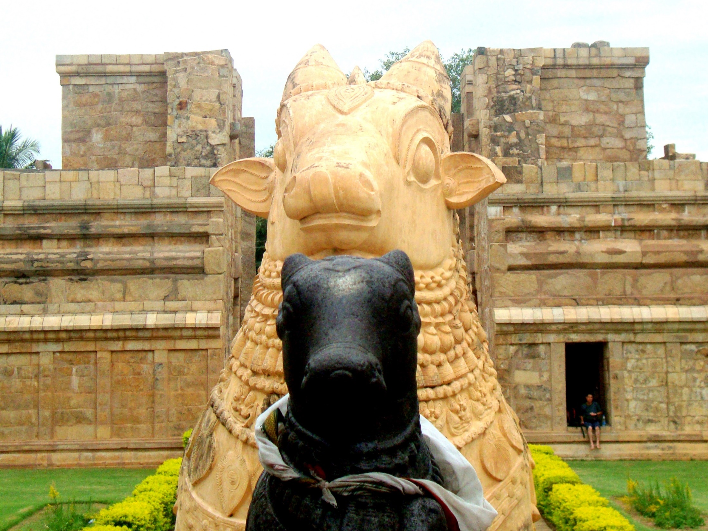
IDOLS
Ron Bert
January 1, 2023

Slide 3
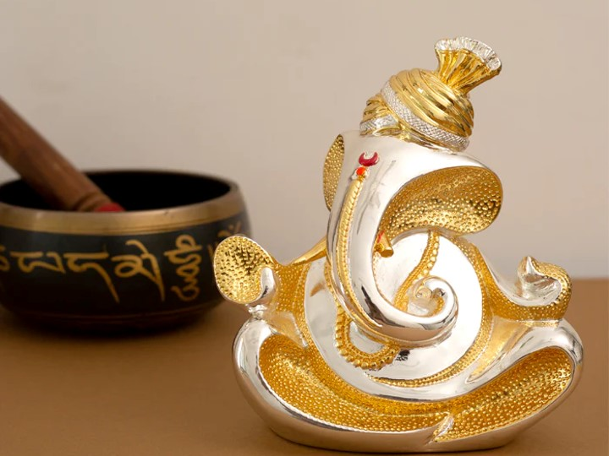
The idols of the nations are silver and gold, The work of men's hands. They have mouths, but they do not speak; Eyes they have, but they do not see; They have ears, but they do not hear; Nor is there any breath in their mouths. Those who make them are like them; So is everyone who trusts in them. — Psalms 135:15-18
idols of the nations
silver
idols of the nations
work of men's hands
silver and gold
● have mouths; do not speak
● Eyes they have; do not see
● They have ears; do not hear
● No breath in their mouths
who trusts in them is like them
and gold
work of men's hands
work of men's hands
have mouths
do not
;
speak
Eyes they have
do
not see
They have ears
do
;
DEAD
not hear
breath in
;
No
their mouths
like them
is
trusts in
like them
in
who trusts in them
→
trusts in

Slide 4
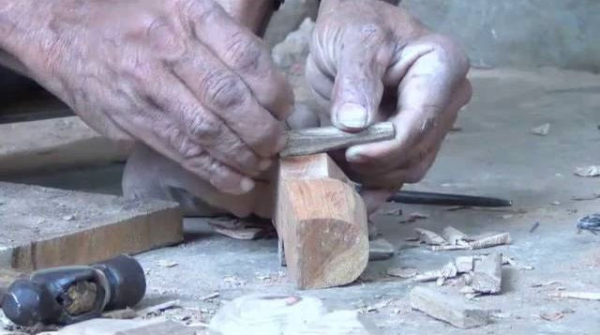
Woe to him who says to wood, 'Awake!' To silent stone, 'Arise! It shall teach!' Behold, it is overlaid with gold and silver, Yet in it there is no breath at all. — Habakkuk 2:19
Woe to him
who says to
wood,
who says to silent wood, stone
'Awake! Arise! It shall teach!'
↓
Woe to him
'Awake!
silent
stone
Arise! It
shall teach!'
Woe to him
Life
Woe to him
no breath at all
no breath at all

Slide 5
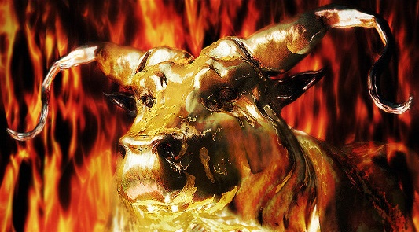
Now they sin more and more, And have made for themselves molded images, Idols of their silver, according to their skill; All of it is the work of craftsmen. They say of them, "Let the men who sacrifice kiss the calves!" — Hosea 13:2
sin more and more
made molded images
Idols of their silver
↓
according to their skill
work of craftsmen
They say, "Let the men kiss them"
sin more and more
made
molded
images
Idols of their silver
according to their skill
work of craftsmen
They say
→
←
,
them
"Let the men
kiss
"
kiss
Love
kiss

Slide 6
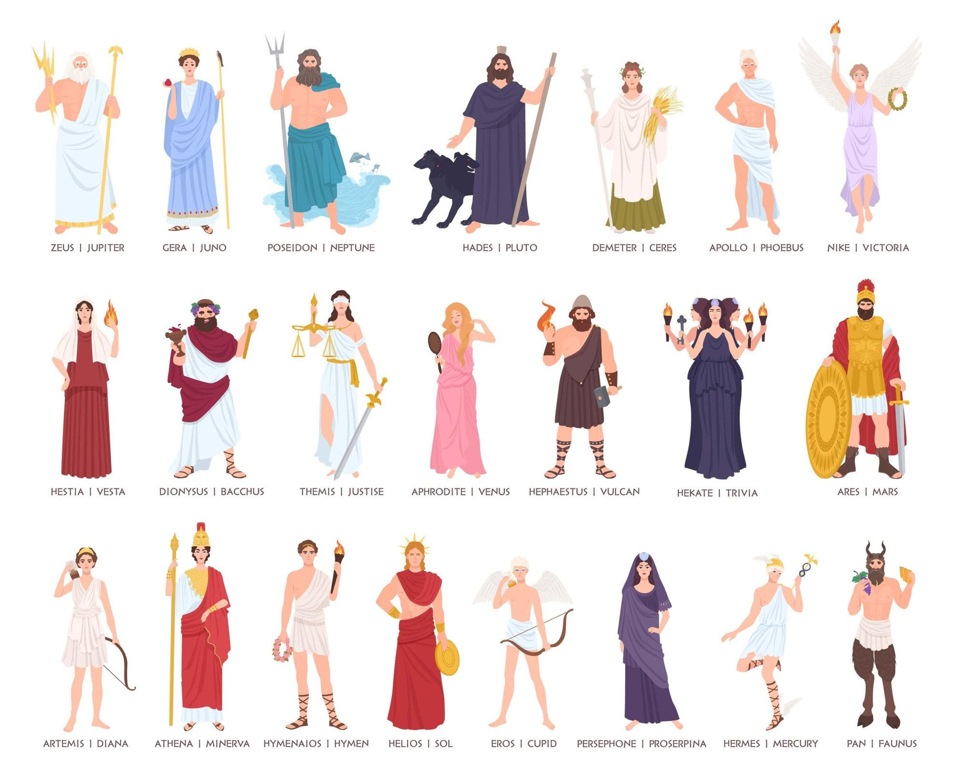
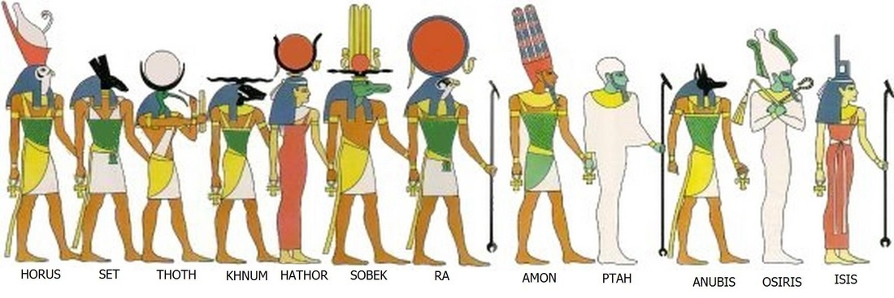
However every nation continued to make gods of its own, and put them in the shrines on the high places which the Samaritans had made, every nation in the cities where they dwelt. — 2nd Kings 17:29
However every nation continued to make gods of its own, and put them in the shrines on the high places which the Samaritans had made, every nation in the cities where they dwelt. — 2nd Kings 17:29
every nation continued
to make gods of its own

Slide 7
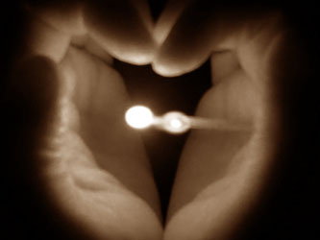
If we had forgotten the name of our God, Or stretched out our hands to a foreign god, Would not God search this out? For He knows the secrets of the heart. — Psalms 44:20-21
forgotten the name of
forgotten the name of
God
our God
stretched
our God
stretched
God knows
the secrets of the heart
hands to a foreign god
hands to a foreign god
knows
the secrets of the heart

Slide 8
Thus says the LORD: "Cursed is the man who trusts in man And makes flesh his strength, Whose heart departs from the LORD. — Jeremiah 17:5
Cursed
trusts in man
flesh his strength
heart departs
from the LORD
↓
Cursed
in
trusts in man
flesh his strength
heart departs
from the LORD
LORD
→

Slide 9
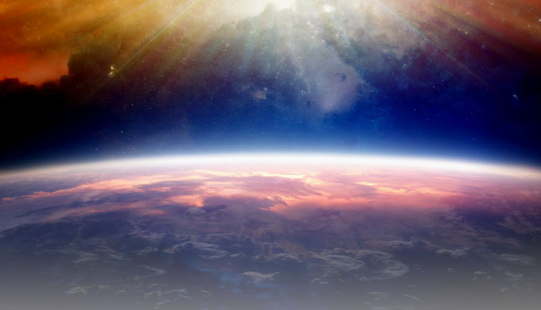
"And now, Israel, what does the LORD your God require of you, but to fear the LORD your God, to walk in all His ways and to love Him, to serve the LORD your God with all your heart and with all your soul, and to keep the commandments of the LORD and His statutes which I command you today for your good? Indeed heaven and the highest heavens belong to the LORD your God, also the earth with all that is in it." — Deuteronomy 10:12-14
s
God requires
to fear the LORD your God
to walk in all His ways
to love Him
to serve the LORD your God
with all your heart and soul
to keep His commandments and statutes
today for your good
God requires
God require
to fear the LORD
your God
to walk in all His ways
to
→
to
love Him
to serve the LORD your God
with
→
to
all your heart and
soul
to
→
to
keep
commandments
and
→
to
His
statutes
today
for your good
→
to
→
today for your good

Slide 10
He has made the earth by His power, He has established the world by His wisdom, And has stretched out the heavens at His discretion. When He utters His voice, There is a multitude of waters in the heavens: "And He causes the vapors to ascend from the ends of the earth. He makes lightning for the rain, He brings the wind out of His treasuries." — Jeremiah 10:12-13
He
by His power
He has made the earth
by His power
by His wisdom
stretched out the heavens
at His discretion
● He causes the vapors to ascend
● He makes lightning for the rain
● He brings the wind
out of His treasuries
He has made the earth
→
by His
wisdom
stretched out the
→
heavens
at His discretion
↘
↙
He
↓
causes the vapors to ascend
He
He
He makes lightning
for the rain
He brings the wind
out of
He
His treasuries
out of His treasuries

Slide 11
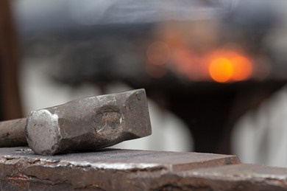
Everyone is dull-hearted, without knowledge; Every metalsmith is put to shame by an image; For his molded image is falsehood, And there is no breath in them. They are futile, a work of errors; In the time of their punishment they shall perish. — Jeremiah 10:14-15
Everyone is dull-hearted
without knowledge
shame by molded falsehood image
They are futile
a work of errors
In the time of their punishment they shall perish
Everyone is dull-hearted
without
knowledge
shame by
image
molded
falsehood
↓
They
are futile
a work of errors
In the
time of their punishment
they
shall perish
Die
Without GOD

Slide 12
"Cast away from you all the transgressions which you have committed, and get yourselves a new heart and a new spirit. For why should you die, O house of Israel? For I have no pleasure in the death of one who dies," says the Lord GOD. "Therefore turn and live!" — Ezekiel 18:31-32
GOD has no pleasure
in the death of one who dies
get yourselves a new heart
and a new spirit
Cast away committed transgressions
For why should you die?
Therefore turn and live!
Cast away
transgressions
↑
committed
get yourselves
s
→
a new heart
and a new spirit
new spirit
←
For why should you die
↓
?
ha
no pleasure
in the death of one who dies
↑
GOD
Therefore
→
turn and live!

Slide 13
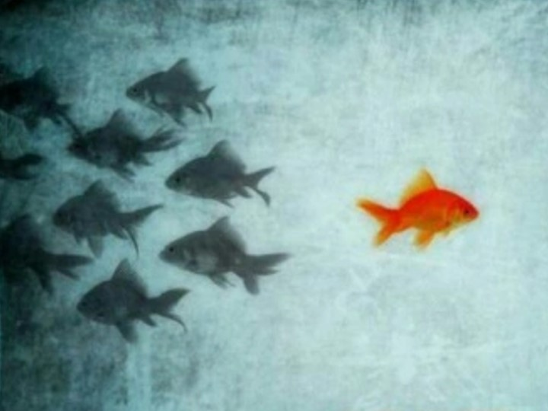
"Say to them: 'As I live,' says the Lord GOD, 'I have no pleasure in the death of the wicked, but that the wicked turn from his way and live. Turn, turn from your evil ways! For why should you die, O house of Israel?' — Ezekiel 33:11
As I live
Lord GOD
wicked
why should
you die?
and
live
Turn
from
your
Turn from your wicked ways and live!
ways
why should
you die
!
?

Slide 14
"Yet from the days of your fathers You have gone away from My ordinances And have not kept them. Return to Me, and I will return to you," Says the LORD of hosts. "But you said, 'In what way shall we return?' " — Malachi 3:7
Return to Me, and
I will return to you
In what way shall we return?
You have not kept My ordinances
You have
My
ordinances
not kept
Return to Me, and
I will
In
return to you
In what way
shall we return?
not kept My ordinances

Slide 15
"Therefore say to the house of Israel, 'Thus says the Lord GOD: "Repent, turn away from your idols, and turn your faces away from all your abominations." — Ezekiel 14:6
Therefore says the Lord GOD:
"Repent, turn away from
all your abominations."
Therefore
says the Lord GOD:
"Repent, turn away from
all your abominations."
→
←

Slide 16
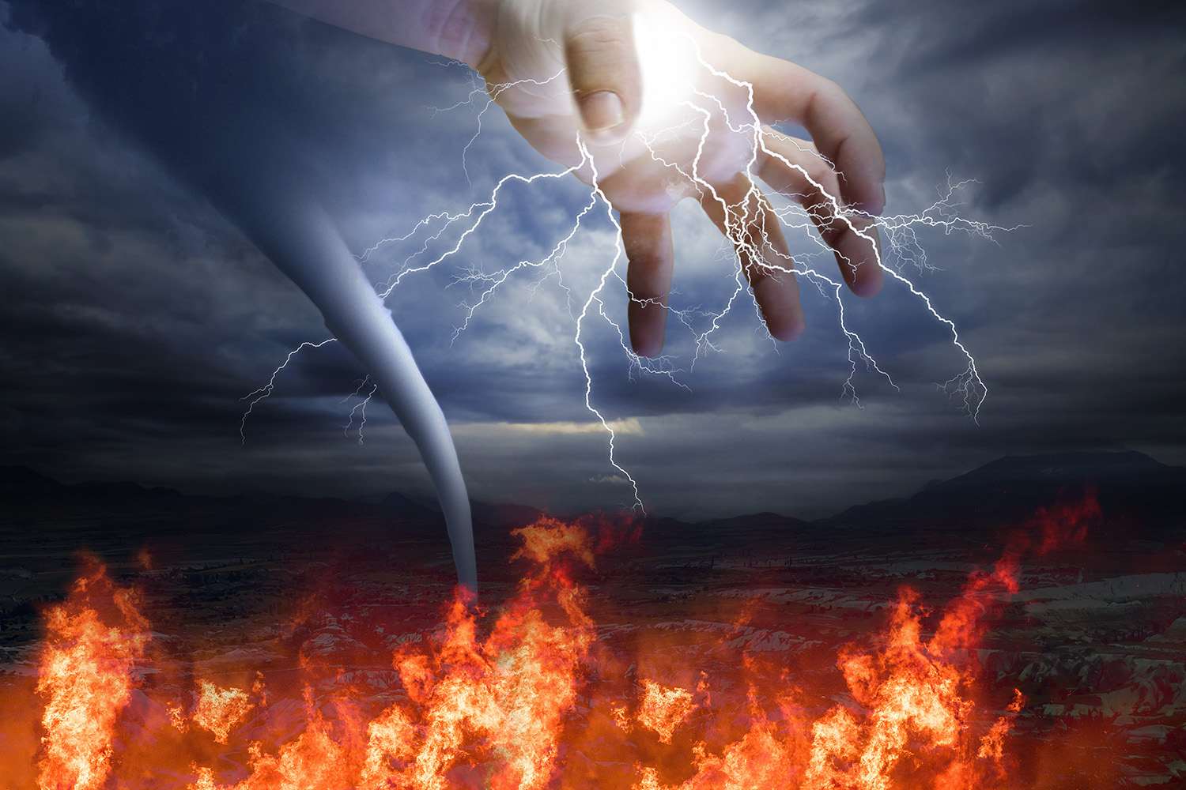
Therefore put to death your members which are on the earth: fornication, uncleanness, passion, evil desire, and covetousness, which is idolatry. Because of these things the wrath of God is coming upon the sons of disobedience, in which you yourselves once walked when you lived in them. — Colossians 3:5-7
put to death on the earth:
● fornication
● uncleanness
● passion
● evil desire
● covetousness, which is idolatry
Because of these the wrath of God
is coming upon the disobedience
Therefore
put to death
on the earth:
fornication
uncleanness
passion
evil desire
covetousness, which
is idolatry
Because of these
the wrath of God
is coming upon
the
disobedience
wrath of God

Slide 17
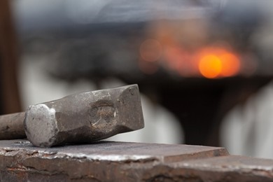
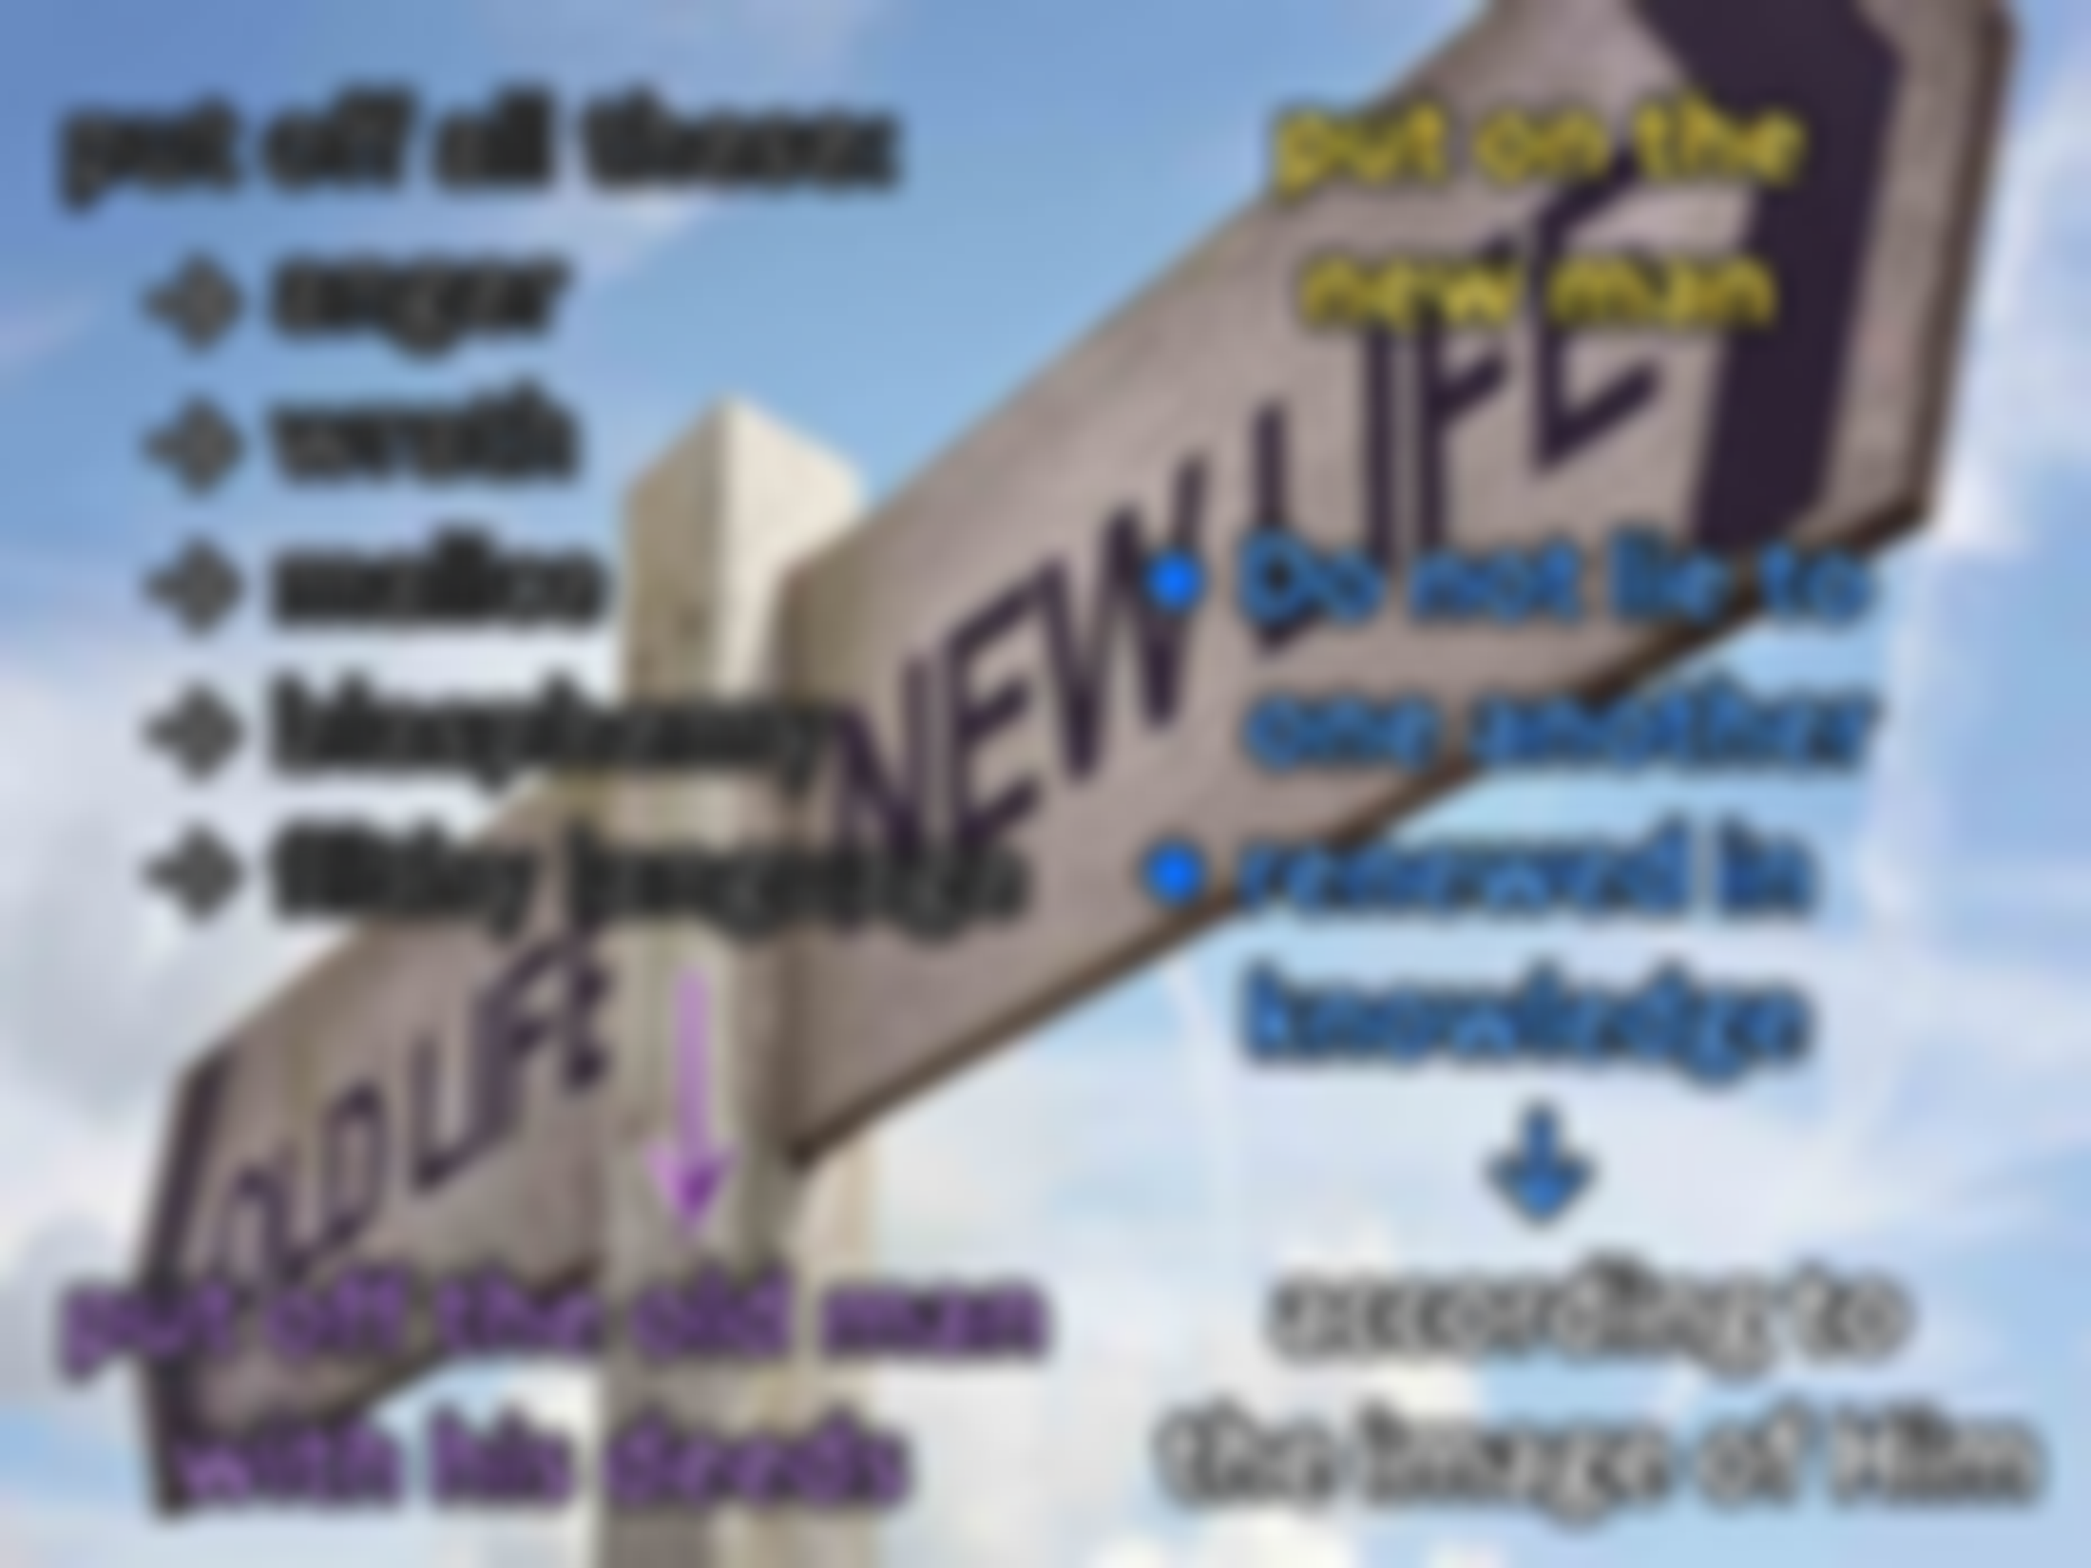
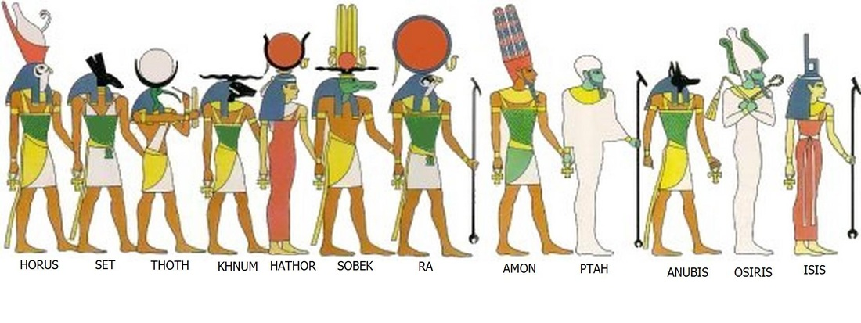
But now you yourselves are to put off all these: anger, wrath, malice, blasphemy, filthy language out of your mouth. Do not lie to one another, since you have put off the old man with his deeds, and have put on the new man who is renewed in knowledge according to the image of Him who created him, … — Colossians 3:8-10
put on the
new man ● Do not lie to one another ● renewed in
knowledge ↓ according to
the image of Him
put
put off all these:
anger
wrath
malice
blasphemy
filthy language
put off the old man
with his deeds
off all these:
anger
wrath
malice
→
blasphemy
filthy language
→
Do not lie to
one
→
another
put off
→
the old man
with his deeds
→
put on the
new man
renewed in
knowledge
according to
the image of Him

Slide 18
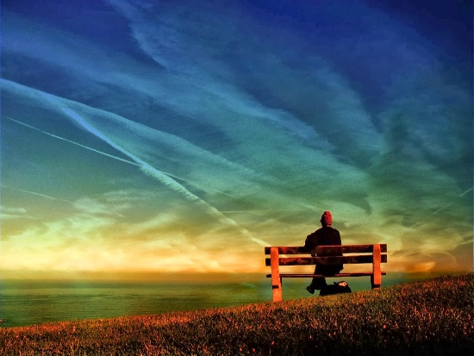

Slide 19
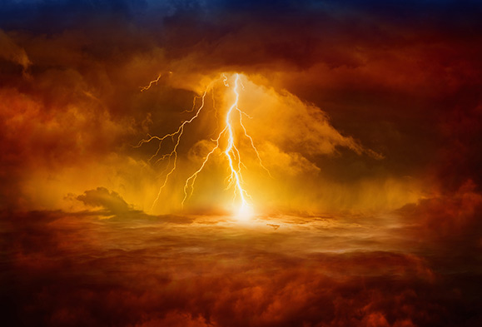
→ The worship of idols leaves the spirit dead
→ All should beware of the worship of things over God
→ Skills used for false worship is sinful
→ Countless gods fill the histories of man up to today
→ Hearts that depart from the LORD are cursed
→ God requires our love/walk in His ways for our good
→ God is the creator of all things by His power
→ Put off one’s transgressions and put on a new heart
→ God has no pleasure in the death of the wicked
→ Return to God and He will return to you
→ Proclaimed of old the LORD calls for all to repent
→ Put to death evil desire, & covetousness = idolatry
→ Do not lie and be renewed in the knowledge of God
God calls for honest hearts

Slide 21
Please visit http://www.RonBert.com/idols.htm to explore further
Ronald Bert Channel on
Notes:
Eternity never ends.

