Slide 2
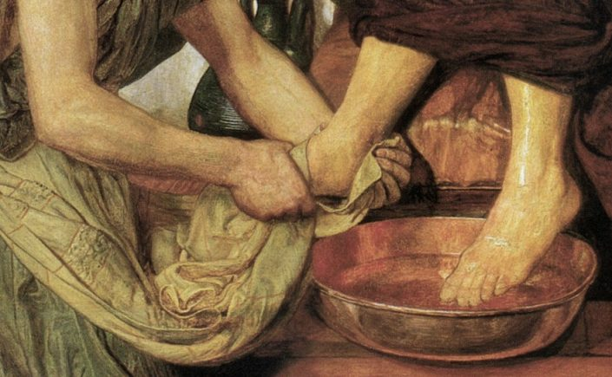
Honoring Servants of God
Ron Bert
August 1, 2021

Slide 3
So they were offended at Him. But Jesus said to them, "A prophet is not without honor except in his own country and in his own house." — Matthew 13:57
honor
honor
without honor
. .
in
in his own house
. .
Notes:
Contempt and acts of arrogance have stolen truth for the sake of evil selfish intents. What thoughts we honor declares who we are, despicable or magnanimous.

Slide 4
Not unto us, O LORD, not unto us, But to Your name give glory, Because of Your mercy, Because of Your truth. — Psalms 115:1
O LORD
. .
to Your name give glory
grace
glory
mercy truth
Because of Your mercy Because of Your truth
mercy
truth
Notes:
All glory, when given to God, frees a heart to stand on skies high.

Slide 5
grace

Slide 6
Let no corrupt word proceed out of your mouth, but what is good for necessary edification, that it may impart grace to the hearers. And do not grieve the Holy Spirit of God, by whom you were sealed for the day of redemption. — Ephesians 4:29-30
r
g
i
e
v
e
grace
grieve
. .
grieve
do not grieve the Holy Spirit
Holy Spirit
Notes:
In His grace blessings have poured out. Without applying His truths calamity ensues for all festering hearts.

Slide 7
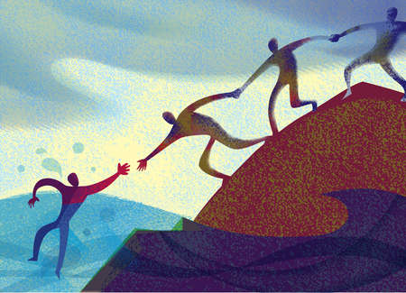
Let all bitterness, wrath, anger, clamor, and evil speaking be put away from you, with all malice. And be kind to one another, tenderhearted, forgiving one another, just as God in Christ forgave you. — Ephesians 4:31-32
anger
bitterness
wrath
clamor
be:
tenderhearted
kind to one another
forgiving one another
malice
be
kind to one another
tenderhearted
forgiving one
another
evil speaking
Notes:
We’ve all heard to be or not to be. God has announced His BE's. God’s will is for us to lift one another. The bottom is no higher than the top.

Slide 8
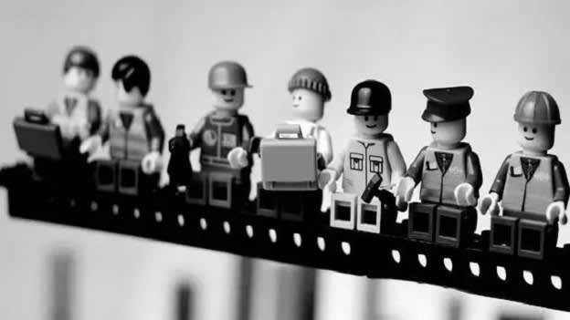
Therefore comfort each other and edify one another, just as you also are doing. And we urge you, brethren, to recognize those who labor among you, and are over you in the Lord and admonish you, and to esteem them very highly in love for their work's sake. Be at peace among yourselves. — 1st Thessalonians 5:11-13
in
love
esteem them very highly in love for their work's sake
comfort each other
comfort each other
recognize those who labor among you
recognize those who labor
recognize those who labor
in the Lord
esteem them
very highly in love
for their work's sake
for their work's sake
for their work's sake
recognize those who labor among you
recognize those who labor among you
Be at peace among yourselves
in the Lord
in
the Lord
Notes:
The Lord is the supporting beam. Let those that praise Him and diligently seek His truths be honored in love.

Slide 9
SPIRIT
SALT
recognize those who labor among you
Notes:
Love is over all, and what flavors life.

Slide 10
salt
Notes:
This spirit of salt rises from Jesus and the truth He delivers.

Slide 11
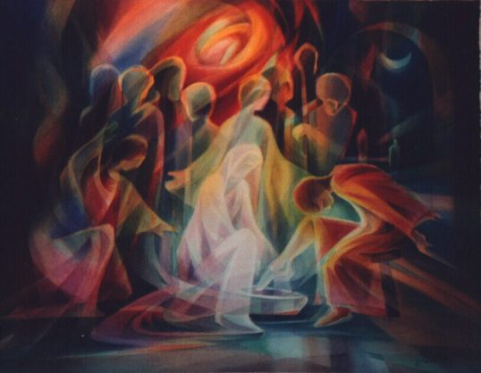
"Salt is good, but if the salt loses its flavor, how will you season it? Have salt in yourselves, and have peace with one another." — Mark 9:50
in
yourselves
have
peace with one another
salt
salt
salt
Notes:
The salt of life is the message of Christ. Our passion is what gives us that spice of truth.

Slide 12
God

Slide 13
Therefore by Him let us continually offer the sacrifice of praise to God, that is, the fruit of our lips, giving thanks to His name. But do not forget to do good and to share, for with such sacrifices God is well pleased. — Hebrews 13:15-16
by Him
by Him
JESUS
praise to God
praise to God
giving thanks
giving thanks
God
God
Notes:
In His truth and light of life we are to employ goodness in our hearts.

Slide 14
do not forget
do not forget
good and to share

Slide 15
Obey those who rule over you, and be submissive, for they watch out for your souls, as those who must give account. Let them do so with joy and not with grief, for that would be unprofitable for you. — Hebrews 13:17
Obey
rule
Obey
be submissive
be submissive
rule
Let them do so
Let them do so
with grief
with joy and not with grief
with joy and not with grief
unprofitable
for you
with grief unprofitable for you
Notes:
Tears bring with them reasons not always understood. For unsettled souls attacking what they lack tortures all who surround them.

Slide 16
Let the elders who rule well be counted worthy of double honor, especially those who labor in the word and doctrine. — 1st Timothy 5:17
rule
honor
especially those who labor in the
especially those who labor in the
honor
word and doctrine
word and doctrine
Notes:
Labors toward clearer truth should be rewarded for the sake of the effort itself.

Slide 17
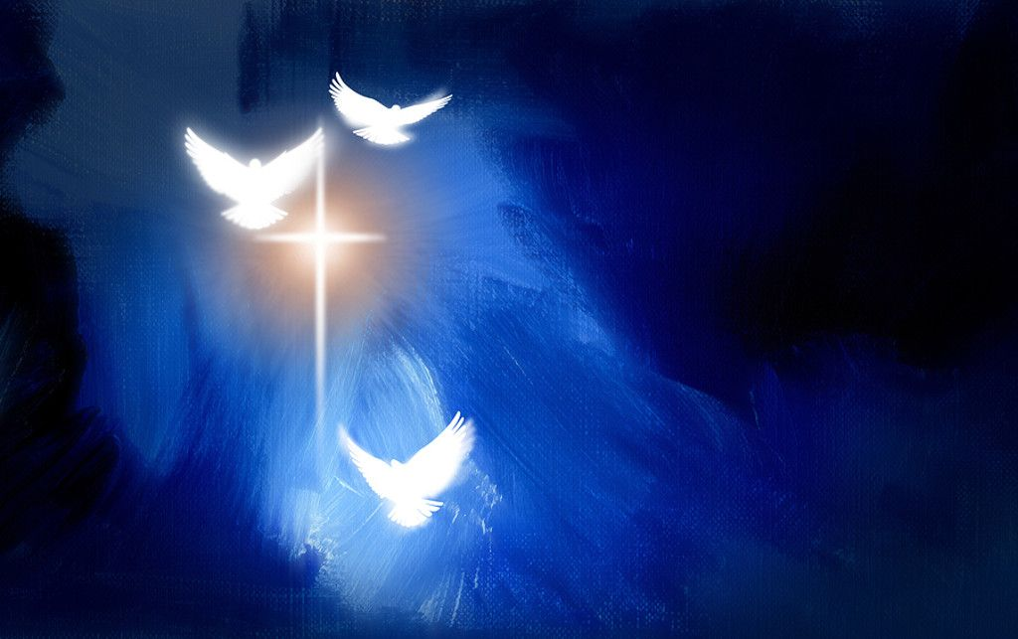
honor
honor

Slide 18
Honor all people. Love the brotherhood. Fear God. Honor the king. — 1st Peter 2:17
Honor all people
Love the brotherhood
Fear God
Honor the king
→
Honor
Honor all people
Love the
Honor
Honor
Honor
Honor
Honor
Honor
Honor
Honor
Honor
→
Fear God
brotherhood
→
Honor
Honor the king
→
Honor
Notes:
Is there anyone who does not want to be saved? Only a seared conscience without hope bent on evil is furthest away. Hope is a fundamental and foundational quality of life.

Slide 19
Let nothing be done through selfish ambition or conceit, but in lowliness of mind let each esteem others better than himself. — Philippians 2:3
self-importance
conceit
conceit
humble
. .
esteem
lowliness of mind
better than himself
better than himself
Notes:
All would hope for an umbrella of security where want is satisfied, and love nurtures the pure child we all once had in innocence.

Slide 20
As each one has received a gift, minister it to one another, as good stewards of the manifold grace of God. — 1st Peter 4:10
each one has received a gift
share abilities
. .
minister it to one another
. .
good stewards
good stewards
. .
grace of God
Notes:
Each of us has a light from within. God wills we find and use what He has given, no matter how small or large, to give it our all. While we are on the earth, He calls us out to use these given gifts for the edification of all. God is One and looks to His people to be the same.

Slide 21
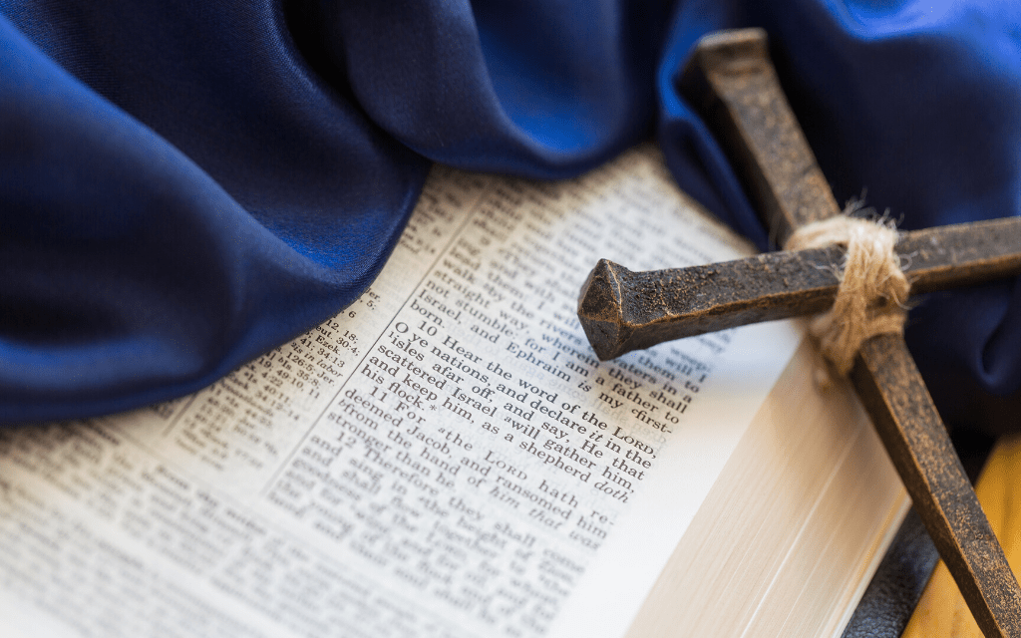
For the law was given through Moses, but grace and truth came through Jesus Christ. — John 1:17
grace and truth
through Jesus Christ
grace Jesus Christ
. .
grace and truth
grace and truth
through Jesus Christ
Notes:
Without the coming of Jesus, how now could we know truth or grace that God has delivered to us?
How many across the ages have been unable to help the ones they love?

Slide 22
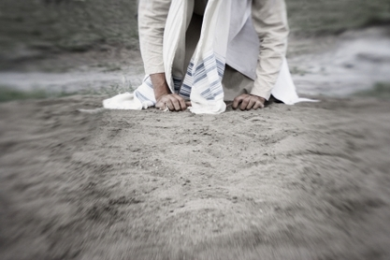
"For He will be delivered to the Gentiles and will be mocked and insulted and spit upon." — Luke 18:32
spit upon
"For He will be delivered to the Gentiles and will be mocked and insulted and spit upon." — Luke 18:32
spit upon
Notes:
Jesus went to His knees for each one of us.

Slide 23
If you are reproached for the name of Christ, blessed are you, for the Spirit of glory and of God rests upon you. On their part He is blasphemed, but on your part He is glorified. But let none of you suffer as a murderer, a thief, an evildoer, or as a busybody in other people's matters. — 1st Peter 4:14-15
. .
If you are reproached
Christ
Christ
Spirit of glory and of God
rests upon you
righteous
spit upon
a murderer, a thief, an
evildoer, or as a busybody
unrighteous
Notes:
Shame on all those cursing what is noble in all efforts to improve living for all.

Slide 24
a murderer - a thief - an evildoer - a busybody -
Spirit of glory
God rests
upon you

Slide 25
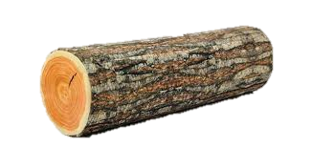
Have I therefore become your enemy because I tell you the truth? — Galatians 4:16
Notes:
When someone accuses another, it often is a shortcoming they themselves possess; four fingers pointing back at the stick thrower. The old Biblical adage of removing the log from your own eye before you condemn your brother applies here.

Slide 26
For I say, through the grace given to me, to everyone who is among you, not to think of himself more highly than he ought to think, but to think soberly, as God has dealt to each one a measure of faith. — Romans 12:3
think
of
self
highly
sober
think highly of self ≠ sober faith
faith
Notes:
The Bible declares arrogance is a sin that destroys peace and damages faith.

Slide 27
For as we have many members in one body, but all the members do not have the same function, so we, being many, are one body in Christ, and individually members of one another. Having then gifts differing according to the grace that is given to us, let us use them: if prophecy, let us prophesy in proportion to our faith; — Romans 12:4-6
in
one body in Christ
Christ
one body in Christ
gifts differing
gifts differing
given to us
given to us
use them
use them
Notes:
God spreads the candy of life plentifully. A store full of fruits is instore for all the faithful who endure alone, in fellowship with all. Different stages are upon all as fingerprints lay uniquely upon each. To be alive is to know verse dead in a speechless loneliness, without the supporting efforts of others. Everyone needs help, and denying this is what creates arrogant isolated contemptuous hearts.

Slide 28
… or ministry, let us use it in our ministering; he who teaches, in teaching; he who exhorts, in exhortation; he who gives, with liberality; he who leads, with diligence; he who shows mercy, with cheerfulness. Let love be without hypocrisy. Abhor what is evil. Cling to what is good. — Romans 12:7-9
ministry
ministering
who teaches
ministry ↔ ministering
who teaches ↔ in teaching
who exhorts ↔ in exhortation who gives ↔ with liberality
who leads ↔ with diligence
who shows mercy ↔ cheerfulness
in teaching
who exhorts
in
exhortation
who gives
with
liberality
who leads
with
diligence
who shows mercy
cheerfulness
Notes:
When one compares oneself to another or others a stance of elevation occurs. If we become the standard, then all else falls short. It is only when we see the gifts given by God, with humble thankful hearts, that spiritual freedom arrives, and the anchors from others fade. One must kick away judgments that lead to nowhere, and it is God who is the only judge. It takes discipline to place calm over the crazy in each of us.

Slide 29
Be kindly affectionate to one another with brotherly love, in honor giving preference to one another; not lagging in diligence, fervent in spirit, serving the Lord; rejoicing in hope, patient in tribulation, continuing steadfastly in prayer; distributing to the needs of the saints, given to hospitality. — Romans 12:10-13
Be kindly affectionate
in
Be kindly affectionate in honor
giving preference to one another
● not lagging in diligence
● fervent in spirit, serving the Lord
● rejoicing in hope
● patient in tribulation
● continuing steadfastly in prayer
● distributing to saints needs
● given to hospitality
in
honor
giving preference to one
in
another
not lagging in diligence
in
fervent in spirit, serving the Lord
in
rejoicing in hope
patient in
in
tribulation
continuing steadfastly
in
in prayer
distributing to
needs
saints
given to hospitality
Notes:
Many principles that guide the goodness of a soul are instructed in the Bible. It is filled with challenges to overcome and apply character traits that are not always easy to do. Knowing truth is the first step on the upward path.

Slide 30
Bless those who persecute you; bless and do not curse. Rejoice with those who rejoice, and weep with those who weep. Be of the same mind toward one another. Do not set your mind on high things, but associate with the humble. Do not be wise in your own opinion. — Romans 12:14-16
men
same mind toward one another
same mind toward one another
Do not be wise in your
Do not be wise in your
arrogance
own opinion
own opinion
Notes:
There are unhappy people who will blame you for their grief. This does not rise to the principles the Bible teaches and generally these complainers are found emanating from spiritually immature arrogant souls.

Slide 31
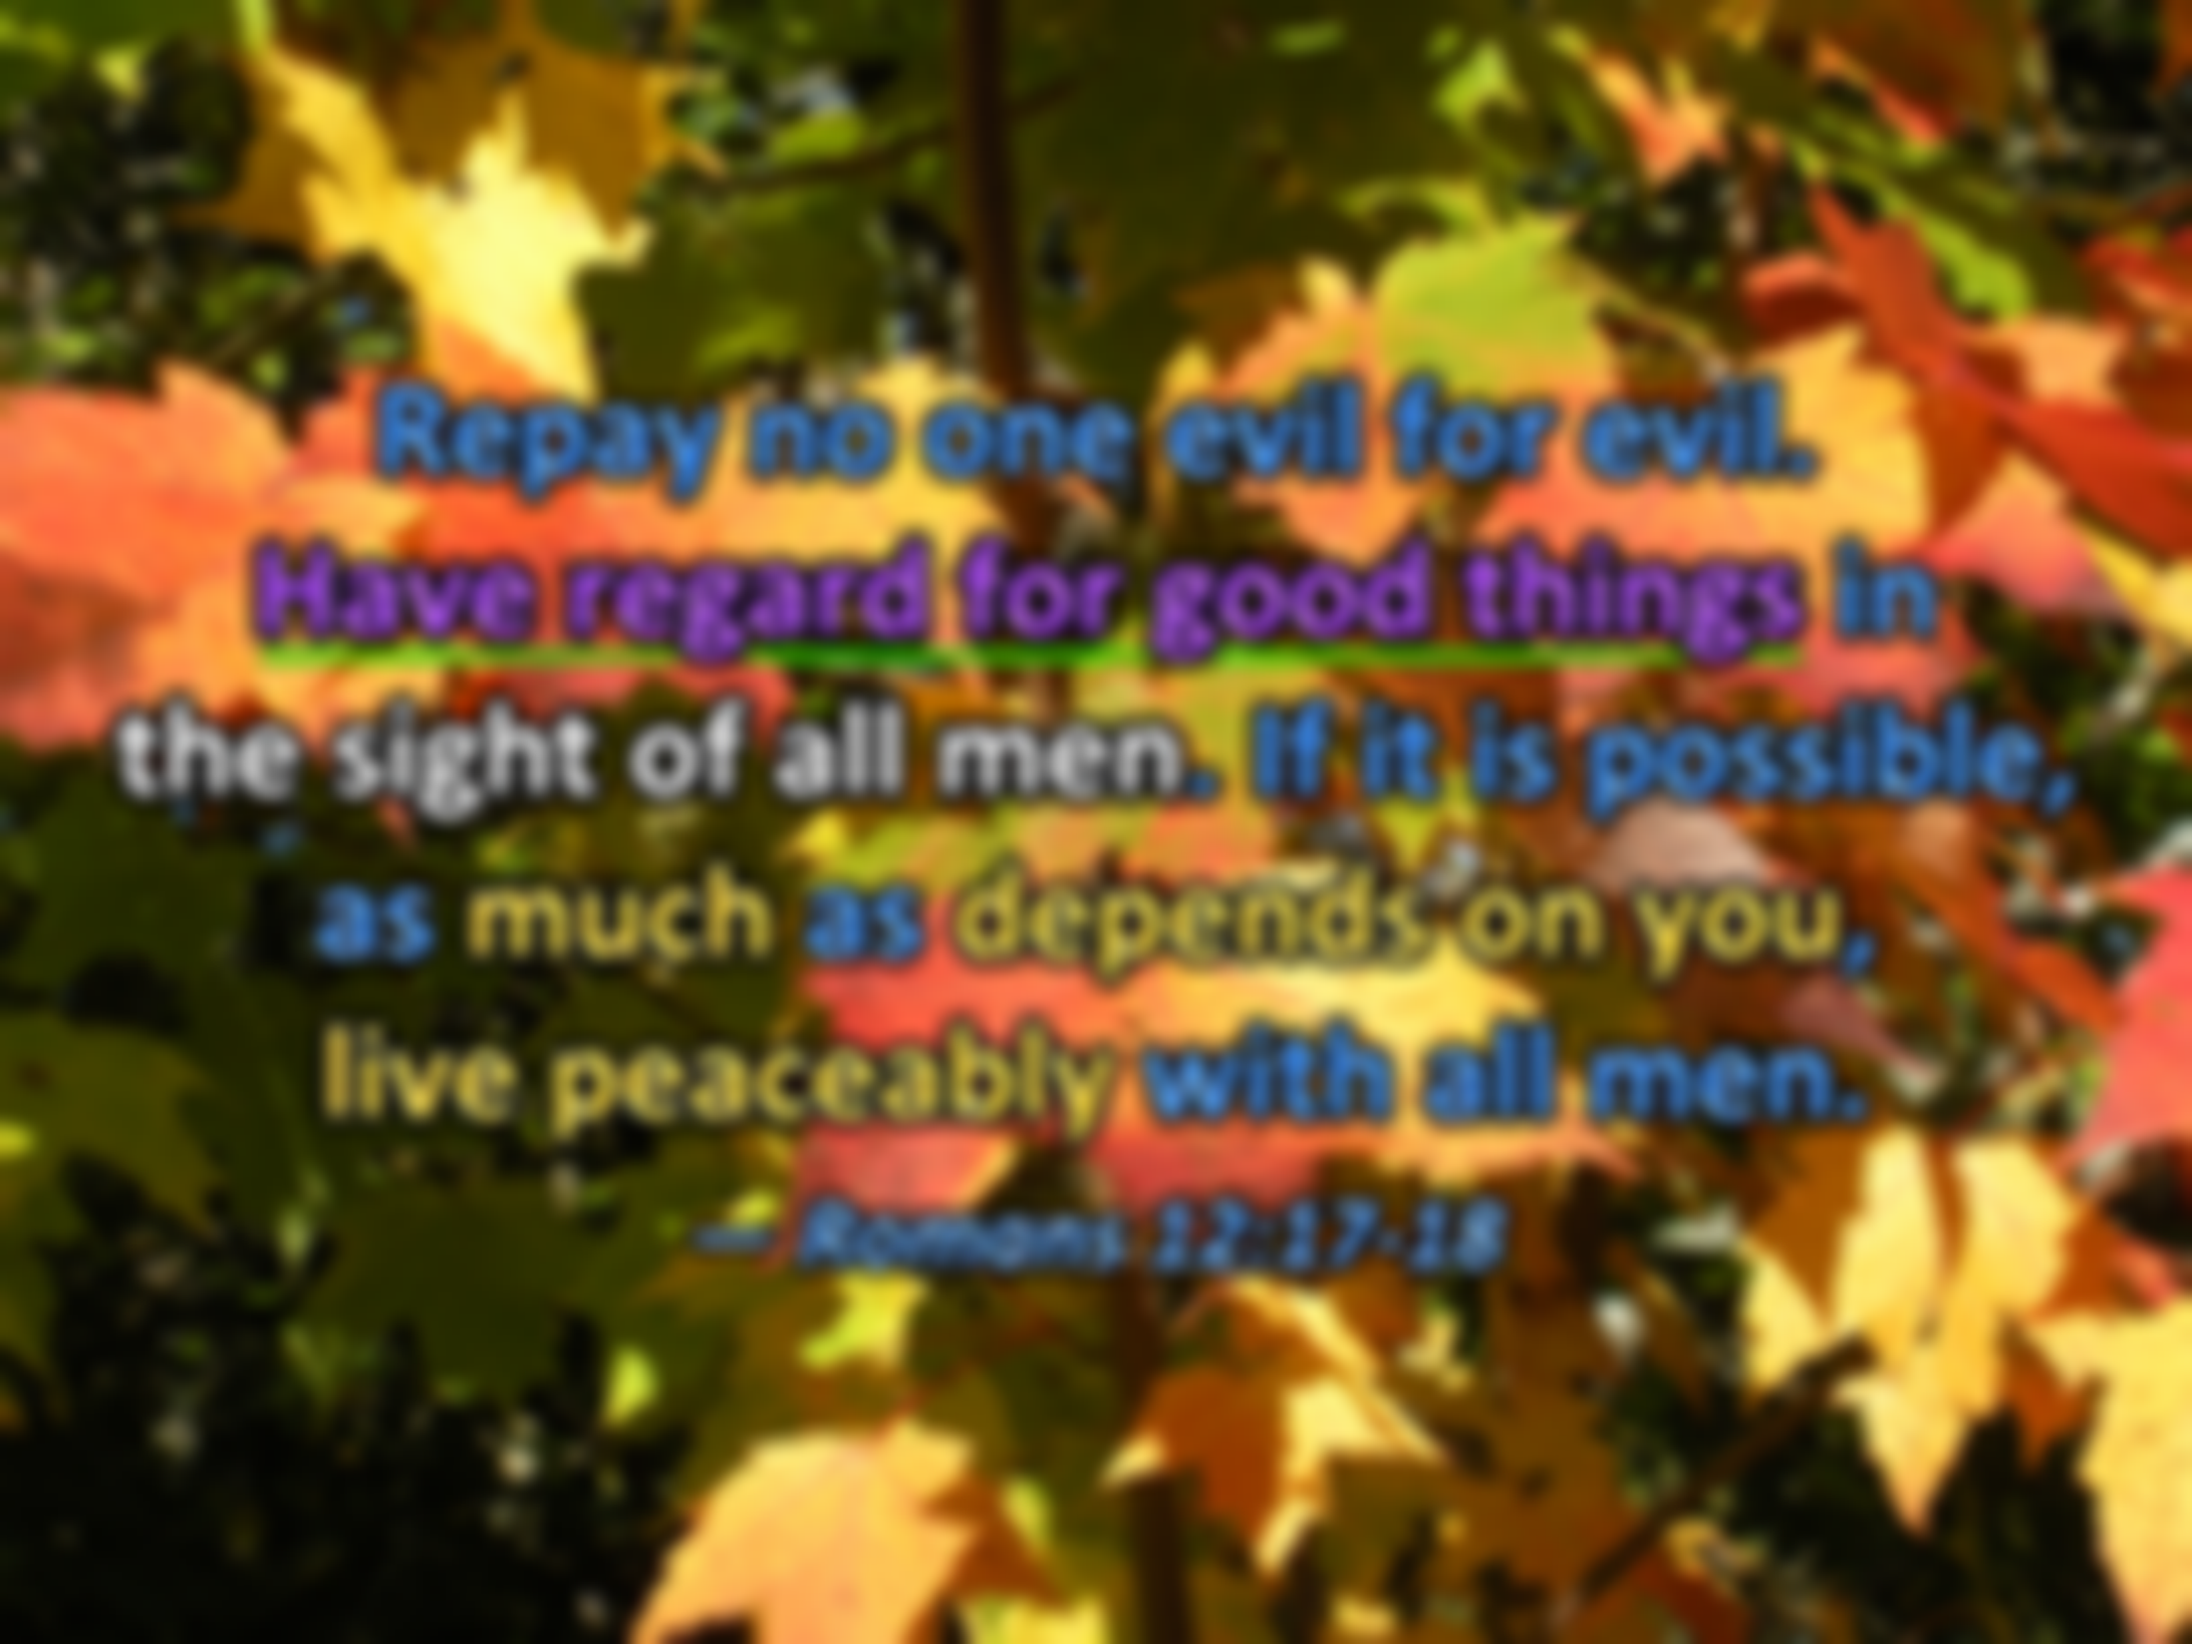
Repay no one evil for evil. Have regard for good things in the sight of all men. If it is possible, as much as depends on you, live peaceably with all men. — Romans 12:17-18
. .
Have regard for good things
the sight of all men
men
Notes:
Time will expose us to atrocities from friends, family, country, and earth. It can eat one alive without standing on the shoulders of God. Having purpose, and peace with this, helps all those we encounter. It is disgruntled souls that rock the calm as bulls in glass houses. Their venom will always strike as long as they see self over God’s grace.

Slide 32
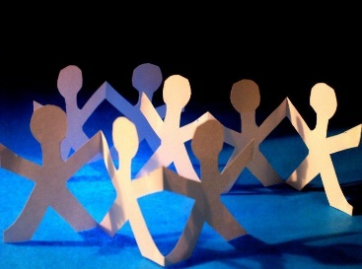
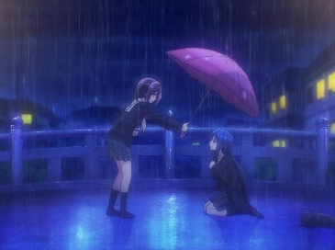
Notes:
Can we rise from the tears of discord? How many across the ages have been unable to help the ones they love? Division has never gained the hope all cry for.

Slide 33
→ A prophet has no honor in his own house
→ Do not grieve the Holy Spirit with a bitter heart
→ Recognize those who labor in works & esteem them
→ Passion for the word is what spices the heart
→ It is unprofitable to cause grief to one’s leaders
→ Let elders rule well with double honor
→ Care for and put others above yourself
→ Grace and truth came through Jesus
→ Jesus, the greatest servant, was spit upon
→ Being criticized for Christ condemns accusers
→ The truth can be offensive to those holding shame
→ Do not think higher about oneself but seek soberly
→ Each has use differing given gifts according to grace
Hardship lies on the path for all that pursue truth
Notes:
Hardship lies on the path for all that pursue truth

Slide 35
Please visit http://www.LoveFromGod.com to explore further
Ronald Bert Channel on
Notes:
Eternity never ends.

