Slide 2
Of the Heart
Ron Bert
January 22, 2023

Slide 3
Keep your heart with all diligence, For out of it spring the issues of life. — Proverbs 4:23
persistence
attentiveness
thoroughness
heart
heart
carefulness
diligence
of life

Slide 4
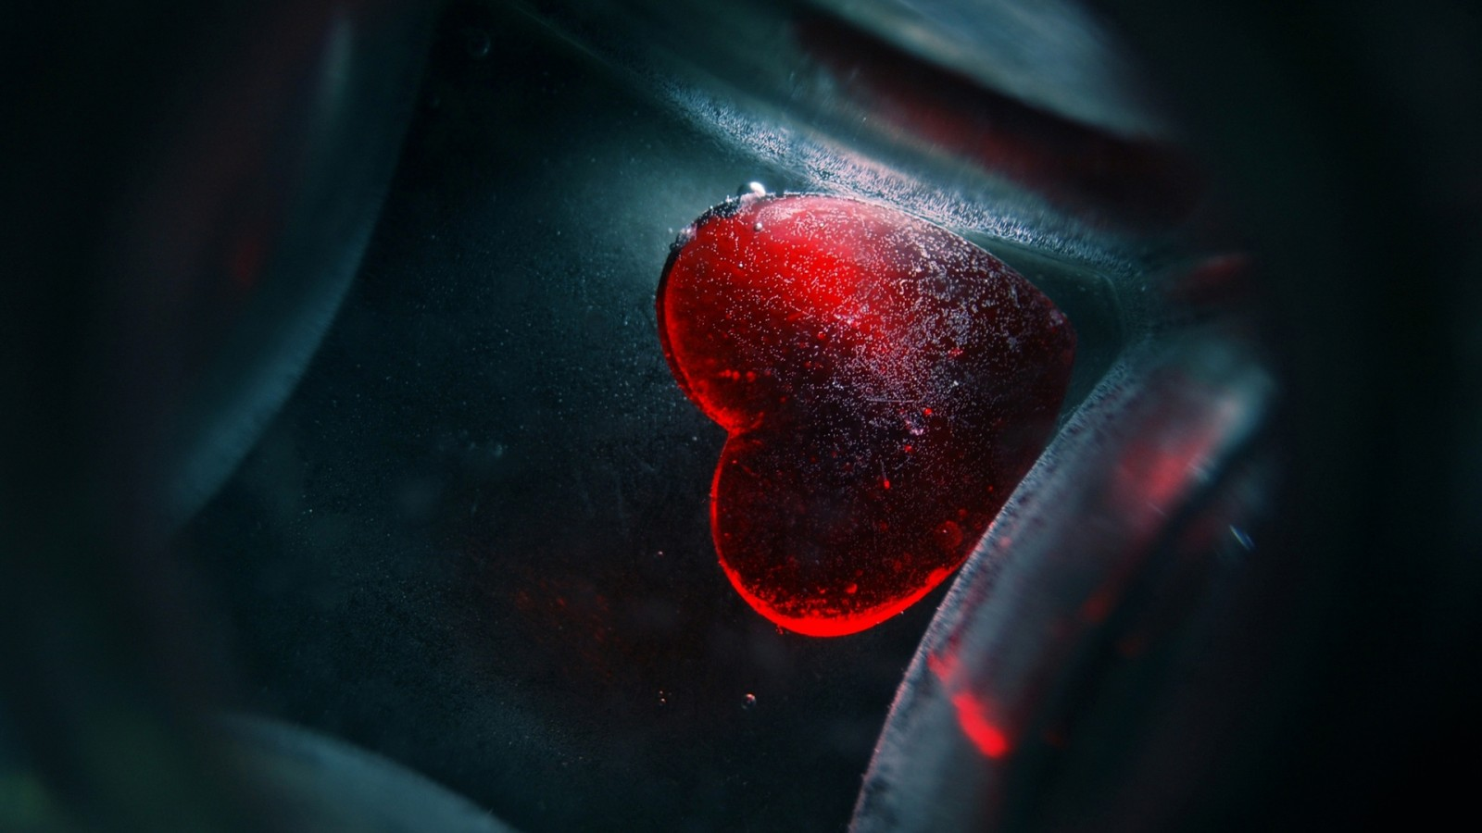
Anxiety in the heart of man causes depression, But a good word makes it glad. — Proverbs 12:25
pleasant
a good word
makes it glad
in the heart
Anxiety
causes depression
in the heart
Anxiety
heart
causes depression
a good word
in
makes it glad
obnoxious

Slide 5
s
hearts

Slide 6
Be anxious for nothing, but in everything by prayer and supplication, with thanksgiving, let your requests be made known to God; and the peace of God, which surpasses all understanding, will guard your hearts and minds through Christ Jesus. — Philippians 4:6-7
surpasses all understanding
the peace of God
will guard your hearts and minds
through Christ Jesus
in everything:
● by prayer and supplication
● with thanksgiving requests made
Be anxious for nothing
Be anxious for nothing
the peace of God
↓
in everything
by prayer and
supplication
with thanksgiving
requests
Christ Jesus
hearts
made
the peace of God
to God
to God
↑
:
in
surpasses all understanding
prayer
prayer
will guard your hearts and minds
thanksgiving
thanksgiving
through Christ Jesus
→
←

Slide 7
A merry heart does good, like medicine, But a broken spirit dries the bones. — Proverbs 17:22
Rejoice in the Lord always. Again I will say, rejoice! — Philippians 4:4
in
A merry heart does good, like medicine, But a broken spirit dries the bones. — Proverbs 17:22
A merry heart does good, like medicine, But a broken spirit dries the bones. — Proverbs 17:22
A merry heart does good
A merry heart does good
Rejoice always, pray without ceasing, in everything give thanks; for this is the will of God in Christ Jesus for you. — 1st Thessalonians 5:16-18
Rejoice always
Rejoice always
pray without ceasing
pray without ceasing
in everything give thanks
in
in everything give thanks
will of God
in
Christ Jesus
will of God

Slide 8
A merry heart makes a cheerful countenance, But by sorrow of the heart the spirit is broken. The heart of him who has understanding seeks knowledge, But the mouth of fools feeds on foolishness. All the days of the afflicted are evil, But he who is of a merry heart has a continual feast. — Proverbs 15:13-15
A merry heart
by sorrow of
the heart the
spirit is broken
the mouth of fools feeds on foolishness
All the days of the afflicted are evil
A merry heart
has a continual feast, a cheerful
countenance
The heart of
him who has
understanding
seeks knowledge
a cheerful
countenance
,
by sorrow of
the
heart the
spirit is broken
The heart
of
him who has
understanding
seeks knowledge
the mouth
of fools
feeds on foolishness
All
the days of the
afflicted are evil
has
seeks
a continual
feast
Notes:
Life is a meal of choice

Slide 9
Life is a meal of choice
Life is a meal
of choice
Notes:
Life is a meal of choice

Slide 10
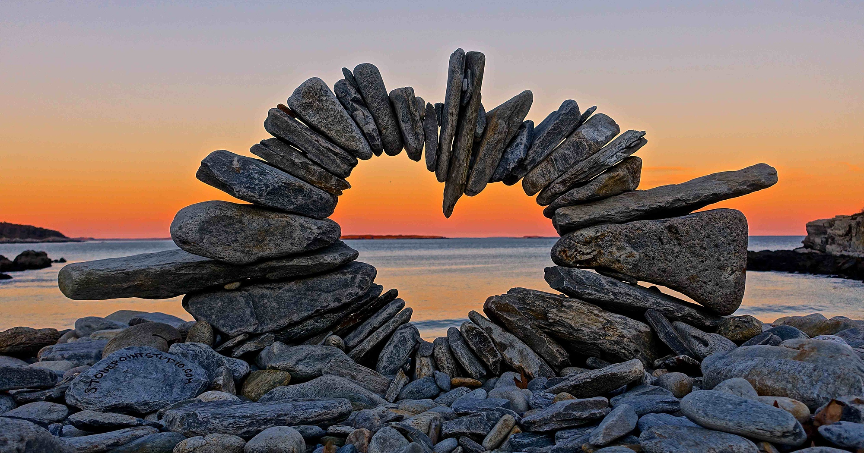
Search me, O God, and know my heart; Try me, and know my anxieties; And see if there is any wicked way in me, And lead me in the way everlasting. — Psalms 139:23-24
Recovery
O God
Search me
know my heart
Try me, and know my anxieties see any wicked way in me
lead me in the way everlasting
Search me
O God
know
my heart
Try me, and know my
TEST
know
ASK
know
know
anxieties
see
any
know
know
Life is a meal of choice
wicked way in me
lead me
Try
Sin
in
in the way everlasting
lead
in
the way
Oblivion
SHOW

Slide 11
But God demonstrates His own love toward us, in that while we were still sinners, Christ died for us. — Romans 5:8
His own love
Finally then, brethren, we urge and exhort in the Lord Jesus that you should abound more and more, just as you received from us how you ought to walk and to please God; for you know what commandments we gave you through the Lord Jesus. — 1st Thessalonians 4:1-2
abound more and more
in the Lord Jesus
in the Lord Jesus
in
Lord Jesus
Christ
died for us
you should
abound more and
you should
J
E
S
U
S
you
received
how to walk
to please God
through the Lord Jesus
you
you
received
more
LOVES
LOV S
how
to walk
to
know
please God
YO
YOU
Lord Jesus
through the Lord Jesus
Notes:
The word proclaims the desire of God for man’s liberty, and in submission to His love the heart sees.

Slide 12
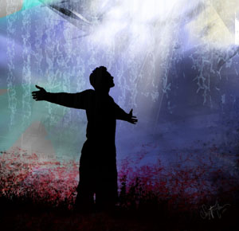
For this is the will of God, your sanctification: that you should abstain from sexual immorality; that each of you should know how to possess his own vessel in sanctification and honor, not in passion of lust, like the Gentiles who do not know God; — 1st Thessalonians 4:3-5
Heb 12:14
Tit 3:8
Pursue peace
caution
self-control
know how to possess
know
know
impulse
know
in
how to possess
in
Eph 4:22
1Co 7:9
sanctification and honor
not in
in
Lust Passion
passion of lust
Notes:
With a clean heart love lasts forever. In accepting the heart of Jesus one finds the truth of God’s redemption for eternal life.
Heb 12:14 Pursue peace with all people, and holiness, without which no one will see the Lord: 15 looking carefully lest anyone fall short of the grace of God; lest any root of bitterness springing up cause trouble, and by this many become defiled;
Tit 3:8 This is a faithful saying, and these things I want you to affirm constantly, that those who have believed in God should be careful to maintain good works. These things are good and profitable to men.
Eph 4:22 that you put off, concerning your former conduct, the old man which grows corrupt according to the deceitful lusts,
1Co 7:9 but if they cannot exercise self-control, let them marry. For it is better to marry than to burn with passion.

Slide 13
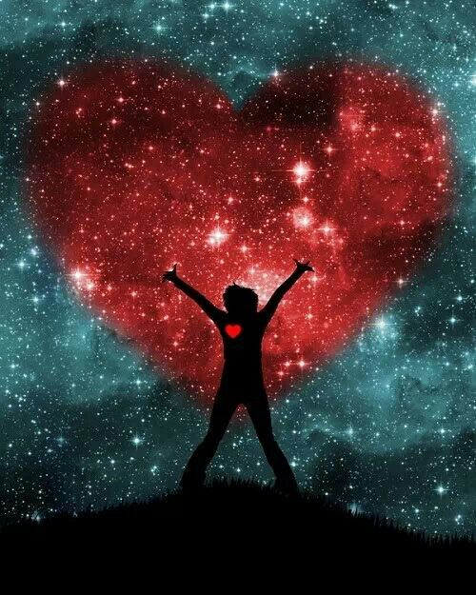
The LORD looks from heaven; He sees all the sons of men. From the place of His dwelling He looks On all the inhabitants of the earth; He fashions their hearts individually; He considers all their works. — Psalms 33:13-15
The LORD looks from heaven
He sees all the sons of men
inhabitants of the earth
● He fashions hearts individually
● He considers all their works
The LORD looks from heaven
He
↓
sees all the sons of men
He sees
He sees
heart
inhabitants of the earth
He
hearts individually
fashions
heart
He considers all their works
heart
individual
individual
works
works

Slide 14
The fool has said in his heart, "There is no God." They are corrupt, They have done abominable works, There is none who does good. The LORD looks down from heaven upon the children of men, To see if there are any who understand, who seek God. — Psalms 14:1-2
The LORD looks down from heaven
To see if there are any:
● who understand
● who seek God
fools say in heart, "There is no God." They are:
● corrupt
● do abominable works
● none who does good
fool
s
sa
in
heart,
"There is no God
corrupt
"
y
:
They are
do
abominable works
heart
none who does good
The LORD looks down from heaven
To see
:
if there are any
who understand
who seek God

Slide 15
My son, if you receive my words, And treasure my commands within you, So that you incline your ear to wisdom, And apply your heart to understanding; — Proverbs 2:1-2
treasure my commands within you
if you receive my words
incline your ear to wisdom
apply your heart
to understanding
if you receive my words
↓
Find
Understanding
treasure my commands
if
within you
incline
your ear to wisdom
apply
↓
your heart
to understanding
apply
apply

Slide 16
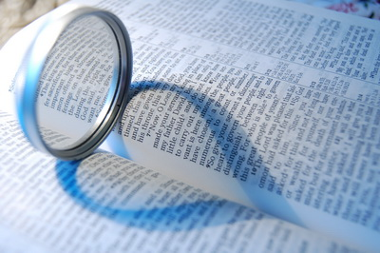
Apply your heart to instruction, And your ears to words of knowledge. — Proverbs 23:12
teach us
to
So teach us to number our days, That we may gain a heart of wisdom. — Psalm 90:12
teach us
to gain a heart of wisdom
Apply your heart to instruction your ears to words of knowledge
gain a heart of
heart
wisdom
Apply your heart to instruction
Apply
Apply
your ears to words of
knowledge

Slide 17
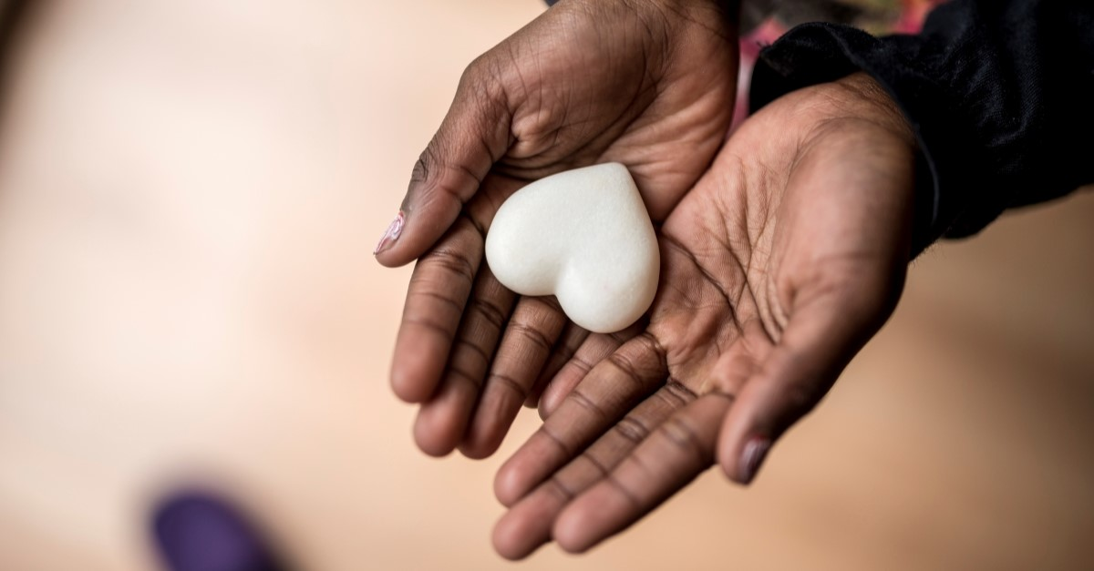
Create in me a clean heart, O God, And renew a steadfast spirit within me. — Psalm 51:10
Recognize
O LORD; O God
Teach me Your way
Create in me a clean heart
renew a steadfast spirit within
me
I will walk in Your truth
Unite my heart to fear Your name
. .
Create in me a clean heart
O God
↓
renew a steadfast spirit
Ask
Teach
me
within
me
Create
in
me
renew
Desire
me
Your way
Teach me Your way
Teach me Your way, O LORD; I will walk in Your truth; Unite my heart to fear Your name. — Psalms 86:11
O LORD;
I will
Test
↙
↓
↘
walk in Your truth
Unite
heart
in
truth
Unite my heart
walk in Your truth
walk
in
. .
. .
to fear Your name
heart
. .

Slide 18
For it is the God who commanded light to shine out of darkness, who has shone in our hearts to give the light of the knowledge of the glory of God in the face of Jesus Christ. — 2nd Corinthians 4:6
God commanded light to shine
out of darkness
shone in our hearts
to give the light
of the knowledge of the glory
of God in the face of Jesus Christ
God
commanded
light to shine
out of darkness
in
hearts
to give the
in our hearts
shone in our hearts
in
. .
light
of the knowledge of the glory
of God in the face of Jesus Christ
→
knowledge
→
in
Jesus Christ
in

Slide 19
For this reason I bow my knees to the Father of our Lord Jesus Christ, from whom the whole family in heaven and earth is named, that He would grant you, according to the riches of His glory, to be strengthened with might through His Spirit in the inner man, that Christ may dwell in your hearts through faith; that you, being rooted and grounded in love, may be able to comprehend with all the saints what is the width and length and depth and height -- to know the love of Christ which passes knowledge; that you may be filled with all the fullness of God. — Ephesians 3:14-19
the Father
Christ may dwell in your hearts through faith rooted and grounded in love
He would grant you, according to the riches
of His glory, may be able to be
strengthened with might
through His Spirit in the inner man
● comprehend with all the saints
the width and length and depth and height
● know love of Christ which passes knowledge may be filled with all the fullness of God
Christ
Lord Jesus Christ
He
would grant you,
according to the riches
of His
glory,
strengthened with might
through
↓
His Spirit in the inner man
Christ may dwell
in your hearts through faith
be
→
rooted and grounded in love
may be able to
comprehend with all the saints
the
comprehend
comprehend
width and length and depth and height
width
length
depth
height
know
love of Christ which passes
knowledge
may be filled with all
know
Christ
know
the fullness of God
God

Slide 20
… that their hearts may be encouraged, being knit together in love, and attaining to all riches of the full assurance of understanding, to the knowledge of the mystery of God, both of the Father and of Christ, in whom are hidden all the treasures of wisdom and knowledge. — Colossians 2:2-3
hearts may be encouraged
knit together in love
attaining to all riches
of the full assurance of understanding
to the knowledge of the mystery of God
both of the Father and of Christ
in whom are hidden all the treasures
of wisdom and knowledge
may
the
in
love
hearts may be encouraged
knit together in love
attaining
attaining
attaining
to all riches
of the full assurance of
understanding
to the knowledge of the
mystery of God
both of the Father and
Holy Spirit
→
the knowledge
the knowledge
of Christ
in whom are hidden all the
of the Father and of Christ
treasures
of wisdom and knowledge
↓
in

Slide 21
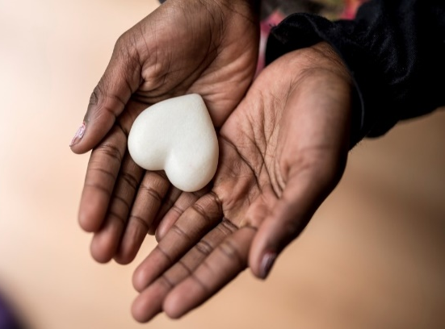
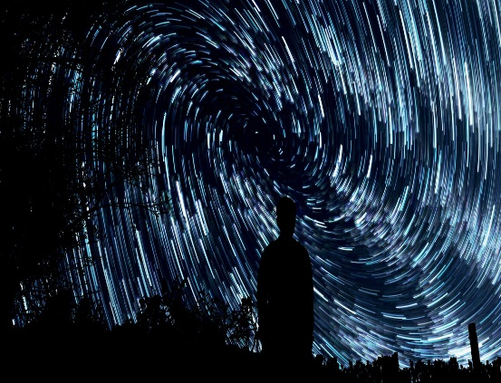

Slide 22
→ Due diligence upwells the refreshments of life
→ Anxiety brings grief but good words lift a heart’s joy
→ Faith guards a peaceful heart with thankful prayers
→ Faithful hearts ask God to know, test, and show us
→ God’s word instructs us how we ought to walk
→ One needs to possess one’s spirit for sanctification
→ God from heaven considers each heart’s actions
→ God’s words of wisdom is the treasure of awareness
→ One has to desire a clean steadfast heart
→ For a heart to come to God it must learn His truth
→ God’s light shines through the knowledge of Christ
→ God wills we comprehend & be filled in His riches
→ We should attain confidence, wise in His knowledge
All hearts rest upon the gift of God’s light

Slide 24
Of the Heart
2
Ron Bert
February 5, 2023

Slide 25
He has made everything beautiful in its time. Also He has put eternity in their hearts, except that no one can find out the work that God does from beginning to end. — Ecclesiastes 3:11
He has made everything beautiful in its time
no one can find out the work that God does from beginning to end
He has put eternity in their hearts
He has
He has made everything
beautiful in its time
He has
put eternity in their hearts
Almighty God
no one can find out the work that
God does from beginning to end
that
no one can find out the work
→
God
God does from beginning
to end
He has

Slide 26
But He said, "You cannot see My face; for no man shall see Me, and live." — Exodus 33:20
not see
. .
Me
Me
Notes:
Job 26:7 He stretches out the north over empty space; He hangs the earth on nothing.
Heb 4:13 And there is no creature hidden from His sight, but all things are naked and open to the eyes of Him to whom we must give account.
Isa 40:28 Have you not known? Have you not heard? The everlasting God, the LORD, The Creator of the ends of the earth, Neither faints nor is weary. His understanding is unsearchable.
De 5:24 "And you said: 'Surely the LORD our God has shown us His glory and His greatness, and we have heard His voice from the midst of the fire. We have seen this day that God speaks with man; yet he still lives.

Slide 27
All seeing
Hebrews 4:13
Stretches out
Job 26:7
not see
Me?
not see Me?
Ps 147:5 Infinite
Unsearchable understanding
Isaiah 40:28
Speaks with man
Deuteronomy 5:24
Notes:
Job 26:7 He stretches out the north over empty space; He hangs the earth on nothing.
Ps 147:5 Great is our Lord, and mighty in power; His understanding is infinite.
Isa 40:28 Have you not known? Have you not heard? The everlasting God, the LORD, The Creator of the ends of the earth, Neither faints nor is weary. His understanding is unsearchable.
Heb 4:13 And there is no creature hidden from His sight, but all things are naked and open to the eyes of Him to whom we must give account.
De 5:24 "And you said: 'Surely the LORD our God has shown us His glory and His greatness, and we have heard His voice from the midst of the fire. We have seen this day that God speaks with man; yet he still lives.

Slide 28
Blessed are the pure in heart, For they shall see God. — Matthew 5:8
pure in heart
shall see God
pure in heart
LORD searches
all hearts
shall see God

Slide 29
"As for you, my son Solomon, know the God of your father, and serve Him with a loyal heart and with a willing mind; for the LORD searches all hearts and understands all the intent of the thoughts. If you seek Him, He will be found by you; but if you forsake Him, He will cast you off forever." — 1st Chronicles 28:9
the LORD searches all hearts understands intent of all thoughts
know the God of your father
serve Him
● with a loyal heart
● with a willing mind
If you seek Him, you will find Him
know
the God of your father
serve
Him
with a loyal heart
with a
→
ind
the LORD searches
know
God
willing mind
know
LORD searches
all hearts
LORD searches
all hearts
understands
all
God
all hearts
intent of
thoughts
If you seek
Him,
will
f
you
Him
↙
↓
↘
seek
will find Him

Slide 30
'Then I will give them a heart to know Me, that I am the LORD; and they shall be My people, and I will be their God, for they shall return to Me with their whole heart.' — Jeremiah 24:7
I will give them a heart
to know Me, that I am the LORD
I will be their God
and they shall be My people
they shall return to Me
with their whole heart
God
I will give them a heart
to
to know Me
to know Me
know Me, that I am the LORD
and
they shall be My people
I will
God
they shall return
be their God
God
to Me
with their whole heart
↑
whole heart

Slide 31
"So God, who knows the heart, acknowledged them by giving them the Holy Spirit, just as He did to us, and made no distinction between us and them, purifying their hearts by faith." — Acts 15:8-9
God knows the heart
gives the Holy Spirit
purifying hearts by faith
God
God
knows the heart
e
giv
the Holy Spirit
s
by faith
by faith
purifying
hearts by faith

Slide 32
… and said, "Assuredly, I say to you, unless you are converted and become as little children, you will by no means enter the kingdom of heaven. — Matthew 18:3
to enter the kingdom of heaven
converted and become
as little children
to
converted and
become
as little children
enter the
kingdom
of heaven

Slide 33
But the LORD said to Samuel, "Do not look at his appearance or at the height of his stature, because I have refused him. For the LORD does not see as man sees; for man looks at the outward appearance, but the LORD looks at the heart." — 1st Samuel 16:7
the LORD does not see as man sees
the LORD looks at the heart
for man looks
at the outward appearance
the LORD
heart
→
the LORD looks at the heart
←
does not see as man sees
for man
looks
at the outward appearance
heart
the LORD looks at the heart
↙
↘
$

Slide 34
The preparations of the heart belong to man, But the answer of the tongue is from the LORD. All the ways of a man are pure in his own eyes, But the LORD weighs the spirits. — Proverbs 16:1-2
preparations of the heart
belong to man
All the ways of a man
are pure in his own eyes
But the answer is from the LORD
the LORD weighs the spirits
preparations of the heart
belong to man
But the answer
↘
↙
is from the LORD
All the ways of a man
are pure
in his own eyes
the LORD
heart
weighs the spirits
=

Slide 35
Commit your works to the LORD, And your thoughts will be established. The LORD has made all for Himself, Yes, even the wicked for the day of doom. Everyone proud in heart is an abomination to the LORD; Though they join forces, none will go unpunished. — Proverbs 16:3-5
Commit your works to the LORD
your thoughts will be established
Everyone proud in heart
is an abomination to the LORD
Though they join forces
none will go unpunished
The LORD has made all for Himself, even the wicked for the day of doom
Commit your works to the LORD
your thoughts will be
established
The LORD has made all
←
LORD
for Himself,
even the wicked
=
LORD
for the day of doom
Everyone
proud in heart
is an abomination to
the LORD
Though they join forces
has made all
none will go unpunished
has made all

Slide 36
The spirit of a man is the lamp of the LORD, Searching all the inner depths of his heart. — Proverbs 20:27
forms the spirit
Zec 12:1
spirit will return to God
who gave it Ec 12:6
The spirit of a man
is the lamp of the LORD
Searching all the inner
depths of his heart
The spirit of a man
is the lamp of
lamp
LORD
Searching all the inner
the LORD
Almighty gives
me life Job 33:4
gives breath to
the people Isaiah 42:5
depths of his heart
Notes:
Zec 12:1 ¶ The burden of the word of the LORD against Israel. Thus says the LORD, who stretches out the heavens, lays the foundation of the earth, and forms the spirit of man within him:
Ec 12:6 Remember your Creator before the silver cord is loosed, Or the golden bowl is broken, Or the pitcher shattered at the fountain, Or the wheel broken at the well. 7 Then the dust will return to the earth as it was, And the spirit will return to God who gave it.
Isa 42:5 ¶ Thus says God the LORD, Who created the heavens and stretched them out, Who spread forth the earth and that which comes from it, Who gives breath to the people on it, And spirit to those who walk on it:
Job 33:4 The Spirit of God has made me, And the breath of the Almighty gives me life.
Job 32:8 But there is a spirit in man, And the breath of the Almighty gives him understanding.

Slide 37
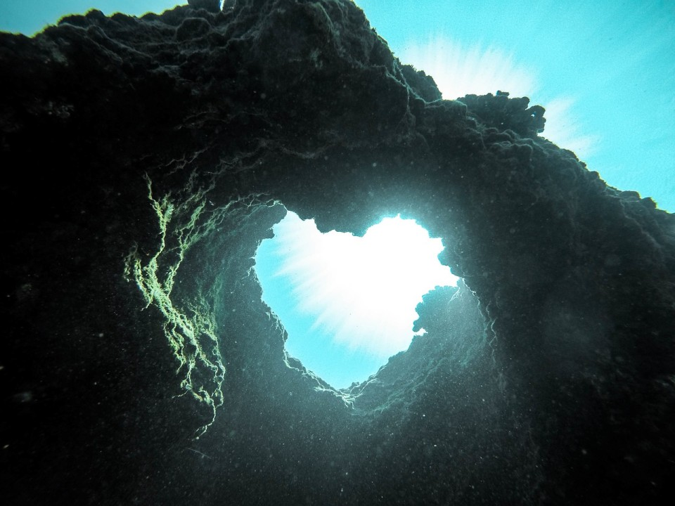
A man's steps are of the LORD; How then can a man understand his own way? — Proverbs 20:24
A man's steps are of the LORD; How then can a man understand his own way? — Proverbs 20:24
A man's steps are of the LORD
A man's steps are of the LORD the LORD weighs the hearts How can a man understand his own way? Every way of a man is right in his own eyes a way that seems right to a man But its end is the way of death
How
can a man
understand
his own way?
There is a way that seems right to a man, But its end is the way of death. — Proverbs 16:25
a way that seems right
to a man
But its end is the way
Every way of a man is right in his own eyes, But the LORD weighs the hearts. — Proverbs 21-2
of death
Every way of a man
is right in his
Every way of a man is right in his own eyes, But the LORD weighs the hearts. — Proverbs 21-2
own eyes
the LORD weighs
the hearts

Slide 38
There are many plans in a man's heart, Nevertheless the LORD'S counsel - that will stand. — Proverbs 19:21
who trusts in the LORD
will be prospered
whoever walks wisely
will be delivered
who is proud of heart stirs up strife
who trusts in his own heart is a fool
He who is of a proud heart stirs up strife, But he who trusts in the LORD will be prospered. He who trusts in his own heart is a fool, But whoever walks wisely will be delivered. — Proverbs 28:25-26
who is
of
proud
heart stirs
many plans in a man's heart
Nevertheless the LORD'S
counsel - that will stand
in
heart
up strife
who trusts in the
many plans in a man's
LORD
will be prospered
who
heart
Nevertheless the LORD'S
trust
heart
trusts in his own heart is a fool
counsel - that will stand
walks wisely
whoever walks wisely
will be
LORD'S
delivered
Notes:
As the ocean has waves, so are the plans of man. Where does one find the beach of rest?

Slide 39
who trusts in the LORD
will be prospered
whoever walks wisely
will be delivered
who is proud of heart stirs up strife
who trusts in his own heart is a fool
who
trust
be
who
wise
be
who
heart
who
trust
heart

Slide 40
Trust in the LORD with all your heart, And lean not on your own understanding; In all your ways acknowledge Him, And He shall direct your paths. Do not be wise in your own eyes; Fear the LORD and depart from evil. – Proverbs 3:5-7
Trust in the LORD with all your heart, And lean not on your own understanding; In all your ways acknowledge Him, And He shall direct your paths. Do not be wise in your own eyes; Fear the LORD and depart from evil. – Proverbs 3:5-7
Trust in the LORD with all your
LORD
Trust in the LORD with all your heart
Fear the LORD and depart from evil
acknowledge Him in all your ways
And He shall direct your paths
Do not be wise in your own eyes
lean not on your own understanding
with all your
heart
heart
lean not on your own
LORD
Turn
depart from evil
. .
understanding
in all your ways
Trust
Trust
know
Trust
acknowledge Him
And He shall
know
direct your paths
direct your paths
Do not be wise
heart
heart
heart
heart
in your own eyes
Fear the LORD
wise
wise
and depart from evil
Notes:
God cannot be out smarted. Ask, and He will lead you in the path of His powerful light.

Slide 41
A man's heart plans his way, But the LORD directs his steps. — Proverbs 16:9
good
The steps of a good man are ordered by the LORD, And He delights in his way. — Psalm 37:23
Truly, this only I have found: That God made man upright, But they have sought out many schemes." — Ecclesiastes 7:29
ordered
LORD
ordered by the LORD
→
ordered by the LORD
many schemes
many schemes
direct
heart plans
heart plans
heart
direct
Notes:
The heart remains free to choose and if godly pursuits guide one, direction is made available by His word; it is given to all to know.

Slide 42
O LORD, I know the way of man is not in himself; It is not in man who walks to direct his own steps. — Jeremiah 10:23
the way of man is not in himself
It is not in
man who
walks to
direct his
own steps
know
the way of man
in
know
is not in himself
It is not in
man
↓
Now may the Lord direct your hearts into the love of God and into the patience of Christ. — 2nd Thessalonians 3:5
who
walks to
direct
direct his
own steps
in
love
direct
patience
Christ

Slide 43
You also be patient. Establish your hearts, for the coming of the Lord is at hand. — James 5:8
=
the coming of the Lord is at hand
You also be patient
Establish your hearts
You also be patient
Establish
your hearts
the coming of
hearts
the Lord is at hand
be
be

Slide 45
→ God has put eternity in the hearts of the faithful
→ To find God, know and serve Him with a loyal heart
→ God makes Himself known so as to return to Him
→ God knows the heart made pure by faith
→ God requires a pure heart as a child’s heart
→ While man sees outward, God sees the inner heart
→ Man cannot understand his way without the LORD
→ While man justifies himself, the LORD will judge
→ As man declares what is right, it may end in death
→ Man has many plans but the LORD’s Word rules
→ God delights in a good man who steps in His ways
→ Man cannot direct his own steps void of God’s Word
→ Patience establishes a heart waiting on the Lord
Loyal Hearts find God in Service to His Word

Slide 47
Of the Heart
3
Ron Bert
March 5, 2023

Slide 48
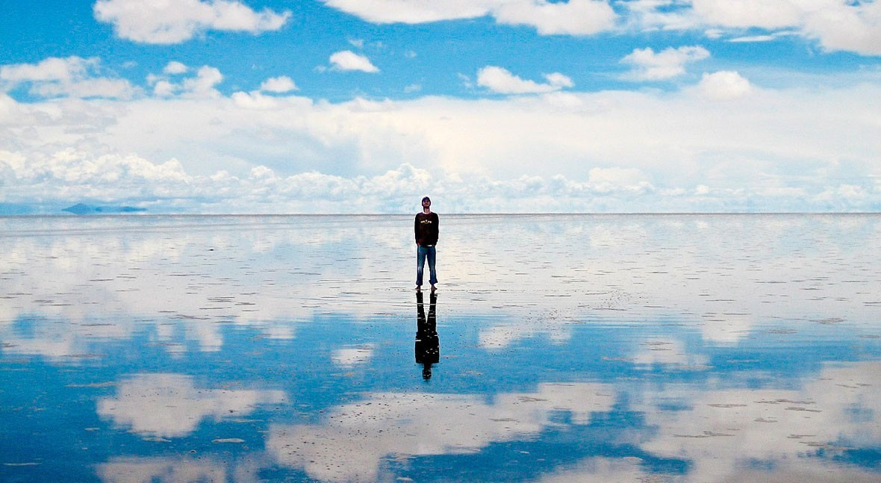
As in water face reflects face, So a man's heart reveals the man. — Proverbs 27:19
heart reveals
heart reveals

Slide 49
"A good man out of the good treasure of his heart brings forth good things, and an evil man out of the evil treasure brings forth evil things. But I say to you that for every idle word men may speak, they will give account of it in the day of judgment. For by your words you will be justified, and by your words you will be condemned." — Matthew 12:35-37
treasure of heart
good man evil man
↓ ↓
brings forth brings forth
good things evil things
↘ ↙
in the day of judgment
give account for every idle word
↓ ↓
justified condemned
good man
treasure
of
heart
brings forth
good things
evil man
brings forth
evil things
every idle
give
account
in the day of judgment
in
for
word
→
justified
revealed
condemned

Slide 50
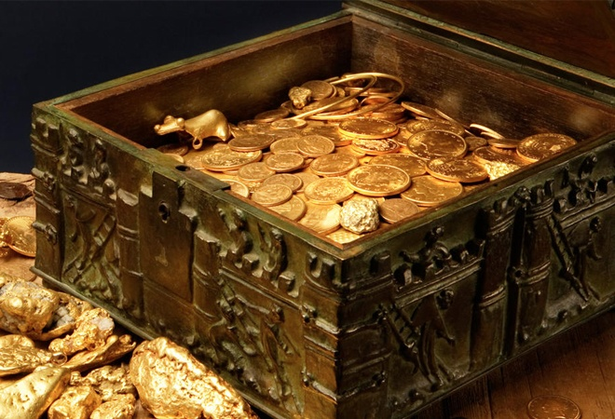
"A good man out of the good treasure of his heart brings forth good; and an evil man out of the evil treasure of his heart brings forth evil. For out of the abundance of the heart his mouth speaks." — Luke 6:45
out of the
abundance of the heart
the mouth speaks
out of the
abundance of the heart
the
abundance of the heart
mouth speaks

Slide 51
Strengths
Giving
abundance of the heart
Loving
abundance of the heart
Desire
Abilities
Compassion
Listening
Treasure
Notes:
Abundance of heart
Giving
Listening
Loving
Ability
Strengths
Treasure

Slide 52
So let each one give as he purposes in his heart, not grudgingly or of necessity; for God loves a cheerful giver. — 2nd Corinthians 9:7
Weakness
cheerful giver
Selfish
Hating
let each one give
as he
give
give
God loves a cheerful giver
↖ ↑ ↗
let each one give
as he purposes in his heart
not grudgingly or of necessity
purposes in his heart
heart
not
heart
grudgingly or of necessity
abundance of the heart
abundance of the heart
God loves a cheerful giver
Desire
Sorrow
Contempt
Obstinate
Treasure
Notes:
Abundance of heart
Giving
Listening
Loving
Ability
Strengths
Treasure

Slide 53
... let us draw near with a true heart in full assurance of faith, having our hearts sprinkled from an evil conscience and our bodies washed with pure water. — Hebrews 10:22
draw near with a true heart
↓
in full assurance of faith
↙
having hearts
↓ from an evil conscience
↓
bodies washed with pure water
draw near with a true
in
heart
in full assurance of faith
having
hearts
from
an evil conscience
bodies
washed with pure water

Slide 54
"He who believes in Me, as the Scripture has said, out of his heart will flow rivers of living water." — John 7:38
He who believes in Me
out of his heart
will flow rivers of living water

Slide 55
He who believes in Me out of his heart will flow rivers of living water
He who believes in Me
Out of his heart
heart
heart
heart
heart
heart
heart
heart
heart
heart
heart
heart
Will flow rivers of living water

Slide 56
"For where your treasure is, there your heart will be also." – Matthew 6:21
"For where your treasure is, there your heart will be also." – Matthew 6:21
"For where your treasure is, there your heart will be also." – Matthew 6:21
heart
"For where your treasure is, there your heart will be also." – Luke 12:34
"For where your treasure is, there your heart will be also." – Luke 12:34
"For where your treasure is, there your heart will be also." – Luke 12:34
heart

Slide 57
Do not let your adornment be merely outward--arranging the hair, wearing gold, or putting on fine apparel -- rather let it be the hidden person of the heart, with the incorruptible beauty of a gentle and quiet spirit, which is very precious in the sight of God. — 1st Peter 3:3-4
not
very precious in the sight of God
not merely outward
the hidden person of the heart
with the incorruptible beauty
of a gentle and quiet spirit
in
merely outward
↓
the
hidden person of the heart
with
the incorruptible beauty
of a
gentle and quiet spirit
very precious in the sight of God

Slide 58
For we do not commend ourselves again to you, but give you opportunity to boast on our behalf, that you may have an answer for those who boast in appearance and not in heart. — 2nd Corinthians 5:12
do not
commend ourselves
give you opportunity to boast on
an answer
Accept Truth
do not
commend
ourselves
give
you opportunity
to boast on
an
answer
↘
in
those who boast
Deny Truth
those who boast in appearance and not in heart
appearance
and not in heart

Slide 59
Do you look at things according to the outward appearance? If anyone is convinced in himself that he is Christ's, let him again consider this in himself, that just as he is Christ's, even so we are Christ's. — 2nd Corinthians 10:7
Do you look at things according to the outward appearance?
convinced Christ in you?
consider this in you
that just as you are Christ's
even so we all are Christ's
you
you
Do you look at things according
you
to the outward appearance?
?
Christ
a
convinced
in
l
Christ
Christ
→
Christ
consider this in
l
that just
as
even so we
are Christ's
Christ
are Christ's
Christ's
all
Christ
←
Christ's

Slide 60
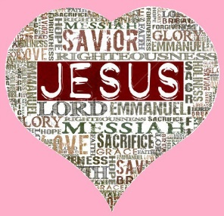
Christ
Christ
And you are Christ's,
and Christ is God's
God's
God's
God's
– 1st Corinthians 3:23
Notes:
The mature Christian acknowledges that Christ God creator of all is in us all. He sent Himself that we may know Him.

Slide 61
For if we live, we live to the Lord; and if we die, we die to the Lord. Therefore, whether we live or die, we are the Lord's. — Romans 14:8
live or die
we are the Lord's
if we live
we live to
the Lord
the Lord
if we live
we live to
if we die
we die to
the Lord
live or die
we are the Lord's
if we die
we die to
the Lord

Slide 62
Therefore we do not lose heart. Even though our outward man is perishing, yet the inward man is being renewed day by day. — 2nd Corinthians 4:16
do not lose heart
do not lose heart
inward man is being renewed day by day
outward man
is
perishing
inward man is
being renewed
day by day
outward man is perishing

Slide 63
And let us not grow weary while doing good, for in due season we shall reap if we do not lose heart. — Galatians 6:9
while doing good
do not
● grow weary
● lose heart
in due season we shall reap
grow weary
while
doing good
in due season we
heart
heart
shall reap
do not
lose heart

Slide 64
And because you are sons, God has sent forth the Spirit of His Son into your hearts, crying out, "Abba, Father!" — Galatians 4:6
God has sent forth
the Spirit of His Son
because you are sons
into your hearts, crying out
"Abba, Father!"
God
God
↓
because you are sons
God has sent forth
the Spirit of His
Son
into your hearts, crying out
heart
"Abba, Father!"
heart
heart
→

Slide 65
Therefore, having been justified by faith, we have peace with God through our Lord Jesus Christ, through whom also we have access by faith into this grace in which we stand, and rejoice in hope of the glory of God. — Romans 5:1-2
grace
↕
access
↑
by faith
↗ ↖
peace with God
through our Lord Jesus Christ
we stand and rejoice
hope of the glory of God
justified by faith
we have peace with God
through our Lord Jesus Christ
whom also we have access
by faith into this grace
in which we stand, and rejoice
in hope of the glory of God
justified
peace with God
we have peace with God
by faith
God
through our Lord Jesus Christ
Jesus Christ
through our Lord Jesus Christ
↓
whom also we have
hope
access
access
by faith into this grace
in
by faith
grace
which we stand, and rejoice
in
Lord Jesus Christ
hope of the glory of God
God
→
in
we stand
and rejoice
→
in
hope of the glory of God
hope

Slide 66
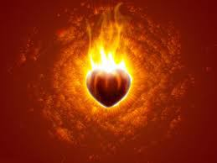
And not only that, but we also glory in tribulations, knowing that tribulation produces perseverance; and perseverance, character; and character, hope. Now hope does not disappoint, because the love of God has been poured out in our hearts by the Holy Spirit who was given to us. — Romans 5:3-5
endurance
God of hope
enduran e
tribulation
suff ring
suffering
suffering
e
tribulation
hope
perseverance
perseverance
character
hope
hope
character
hope
of
hope
God
in
in our hearts
character
charact r
Holy Spirit
e
c
Notes:
Hope leads us through all suffering in view of His promise of love. Doesn't hope often passionately burn upon one’s heart? Without hope the light of the heart dims. It is God’s garden and He is cultivating life to live eternally with Him. Suffering deepening endurance developing character purifying hope is God’s fishing hook.

Slide 67
Hope deferred makes the heart sick, But when the desire comes, it is a tree of life. – Proverbs 13:12
hope
Hope
heart
tree of life
heart
Notes:
All endure through the pools of misery in discovering life.

Slide 68
Be of good courage, And He shall strengthen your heart, All you who hope in the LORD. — Psalms 31:24
courage
out
heart
strengthen
your heart
heart
Wait on the LORD; Be of good courage, And He shall strengthen your heart; Wait, I say, on the LORD! — Psalms 27:14
Wait
Wait
ou
t
Wait
Wait

Slide 69
Trust in Him at all times, you people; Pour out your heart before Him; God is a refuge for us. Selah — Psalms 62:8
heart
heart
Trust in Him at all times, you people; Pour out your heart before Him; God is a refuge for us. Selah — Psalms 62:8
Trust in Him at all times, you people; Pour out your heart before Him; God is a refuge for us. Selah — Psalms 62:8
in
Trust in Him
our heart
rejoices in Him
Because we trust
in His holy name
our heart
rejoices in Him
↓
Because we trust
in His holy name
Pour out your heart
out
For our heart shall rejoice in Him, Because we have trusted in His holy name. — Psalms 33:21
our heart
. .
s
rejoice
in Him
in
Him
Because we
trust
in His
But I have trusted in Your mercy; My heart shall rejoice in Your salvation. — Psalms 13:5
trusted in Your mercy
in
. .
↓
heart
holy name
heart
salvation
in
His holy name

Slide 70
Beware, brethren, lest there be in any of you an evil heart of unbelief in departing from the living God; but exhort one another daily, while it is called "Today," lest any of you be hardened through the deceitfulness of sin. For we have become partakers of Christ if we hold the beginning of our confidence steadfast to the end, while it is said: "Today, if you will hear His voice, Do not harden your hearts as in the rebellion." — Hebrews 3:12-15
Christ
we have become partakers of Christ if
Today hear His voice
exhort one another daily
hold confidence to the end
Do not harden your hearts:
● as in the rebellion
● through the deceitfulness of sin
an evil heart of unbelief departs
from the living God
an evil heart of unbelief
depart
from the living God
exhort one
another daily
through the
deceitfulness of sin
we have become
partakers of Christ if
hold
heart
heart
confidence
s
to
the end
:
Today
↓
hear His voice
Do not harden your hearts
as in the rebellion

Slide 71
"Let your heart therefore be loyal to the LORD our God, to walk in His statutes and keep His commandments, as at this day." — 1st Kings 8:61
loyal heart to the LORD our God
this day
● walk in His statutes
● keep His commandments
heart
↓
loyal
to the LORD our God
walk in His statutes
keep His
commandments
this day

Slide 72
Now may our Lord Jesus Christ Himself, and our God and Father, who has loved us and given us everlasting consolation and good hope by grace, comfort your hearts and establish you in every good word and work. — 2nd Thessalonians 2:16-17
our God and Father who loves us
our Lord Jesus Christ Himself
given us
● everlasting consolation
● good hope by grace
comfort and establish our hearts
in every good word and work
our Lord Jesus Christ
Jesus Christ
Himself
our God and Father
who
s
given us
love
us
everlasting consolation
good
hope by grace
comfort
our
hearts
and establish
in every
good word and work
→
in

Slide 73
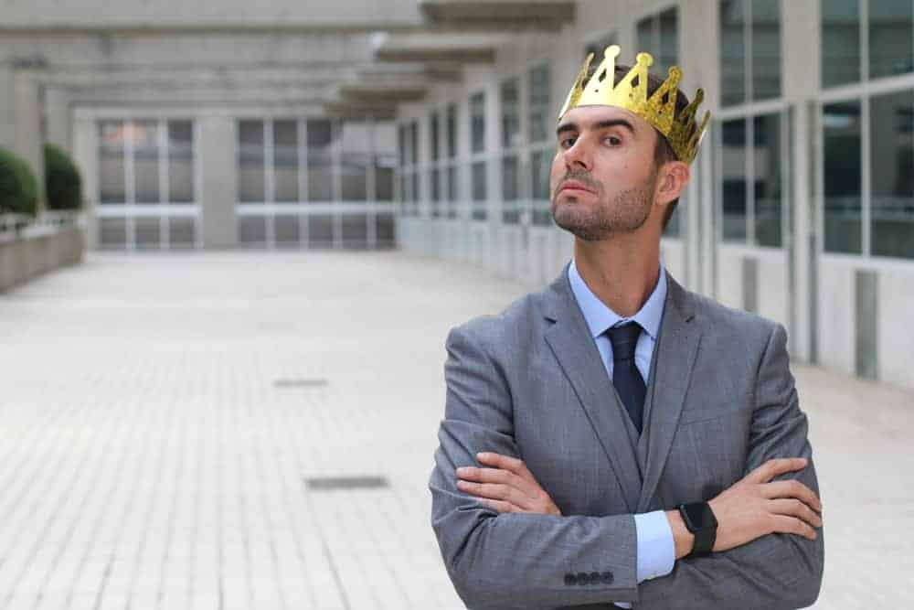
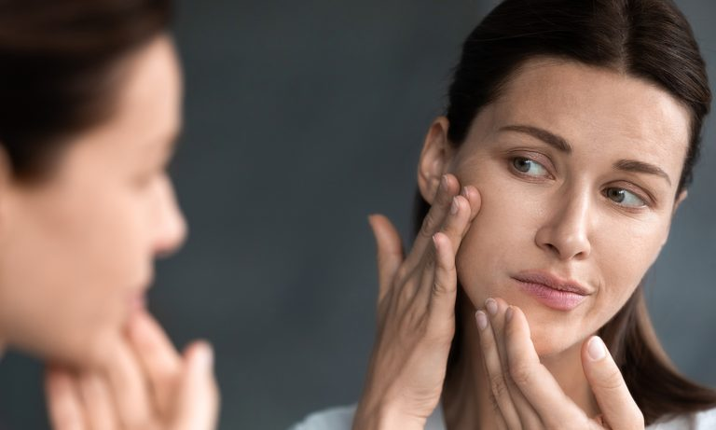
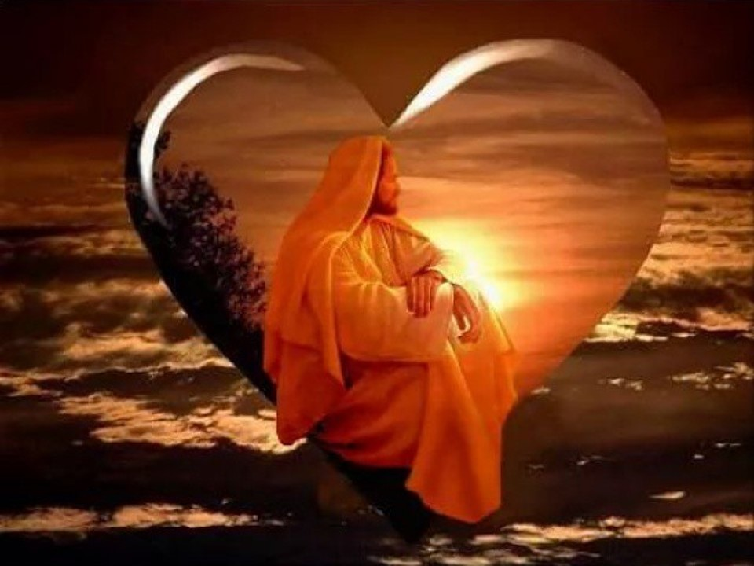
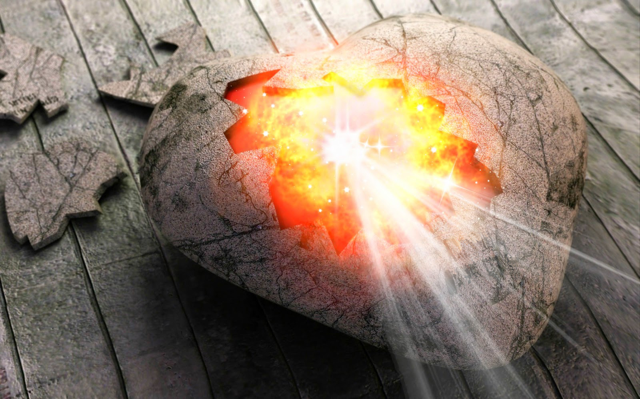
But sanctify the Lord God in your hearts, and always be ready to give a defense to everyone who asks you a reason for the hope that is in you, with meekness and fear; — 1st Peter 3:15
Lord God
sanctify the Lord God
in your hearts
always be ready to give
a defense to everyone who asks
a reason for the hope in you
with meekness and fear
sanctify the Lord God
in your
↓
hearts
always be ready to
give
a defense to everyone who
asks
a reason for the hope
in you
with meekness
↑
↑
and fear
hope

Slide 74
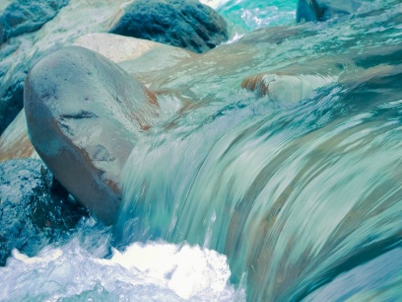

Slide 75
→ The heart is a window to the mirror of the soul
→ Accountability and judgment comes by one’s words
→ The heart contains treasures that guide the spirit
→ Belief in God brings out the best one can be
→ God’s sees beauty in the heart of a quiet spirit
→ Hypocrites boast in appearance but not in heart
→ In life or death all are subject to God through Christ
→ Faith in God gives peaceful access to His good grace
→ Hope is where hearts reaches for God
→ Knowing God fulfills the deepest desires to live
→ Trusting & waiting on God strengthens the heart
→ A hardened heart denies the assurances of God
→ God’s word comes to comfort & establish our hearts
To appreciate life, it is God who gives life
Notes:
To appreciate life, it is God who gives life

Slide 77
Please visit http://www.RonBert.com to explore further
Ronald Bert Channel on
Notes:
Eternity never ends.

