Slide 1
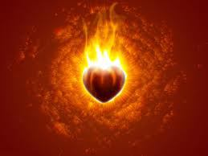

And not only that, but we also glory in tribulations, knowing that tribulation produces perseverance; and perseverance, character; and character, hope. Now hope does not disappoint, because the love of God has been poured out in our hearts by the Holy Spirit who was given to us. — Romans 5:3-5
endurance
God of hope
enduran e
tribulation
suff ring
suffering
suffering
e
perseverence
character
hope
hope
hope
of
hope
God
in our hearts
character
charact r
Holy Spirit
e
c
Notes:
Hope leads us through all suffering in view of His promise of love. Doesn't hope often passionately burn upon one’s heart? Without hope the light of the heart dims. It is God’s garden and He is cultivating life to live eternally with Him. Suffering deepening endurance developing character purifying hope is God’s fishing hook.

