Slide 2
God Upon Us
Ron Bert
December 27, 2020
Notes:
We were made to reflect the qualities of God.

Slide 3
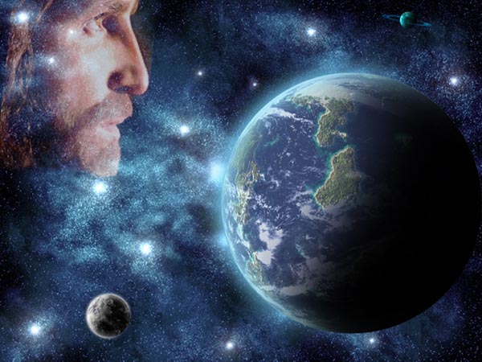
Then she called the name of the LORD who spoke to her, You-Are-the-God-Who-Sees; for she said, "Have I also here seen Him who sees me?" — Genesis 16:13
God
God
God
God
God
God
God
God
God
God
God
God
God
God
God
God
God
God
You-Are-the-God-Who-Sees
You-Are-the-God-Who-Sees
God
Notes:
God sees all, and has given us all the vision of forever, laid before each of us.

Slide 4
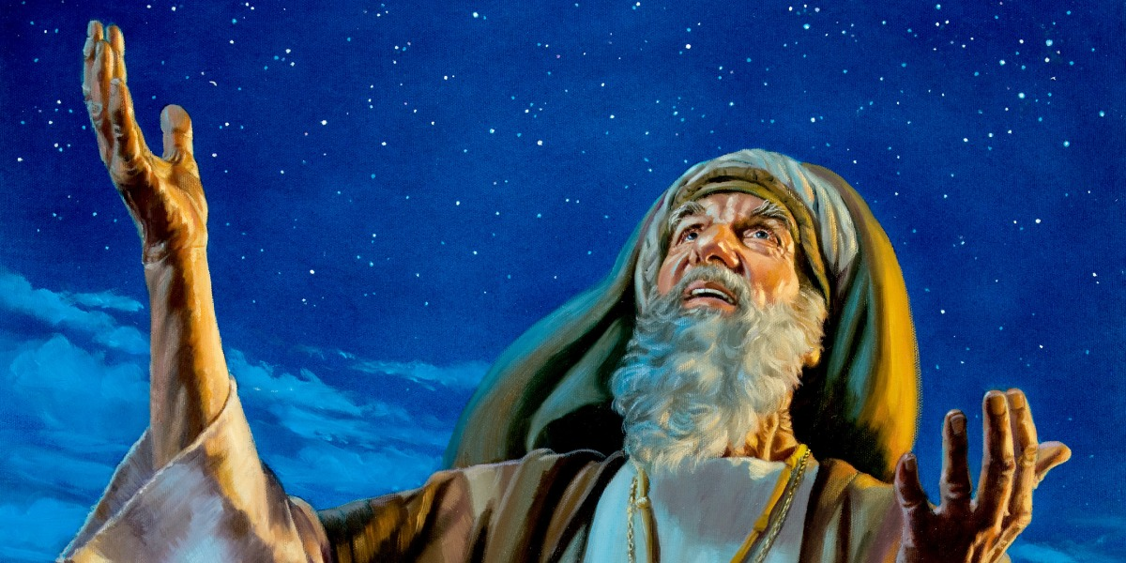
When Abram was ninety-nine years old, the LORD appeared to Abram and said to him, "I am Almighty God; walk before Me and be blameless. — Genesis 17:1
LORD
LORD
I am
I am
Almighty God
God
Almighty God
Omnipresent
All-powerful
Omnipotent
Immense
Invincible
Notes:
God does not answer to us, as we are His creation, and He seeks those becoming in the image that He is.

Slide 5
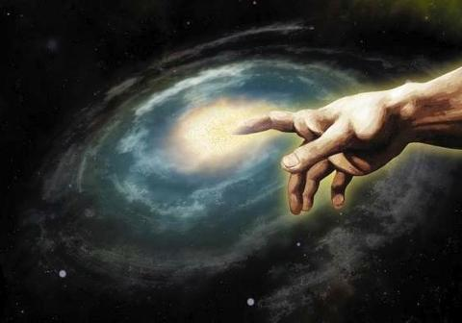
"I am the Alpha and the Omega, the Beginning and the End," says the LORD, "who is and who was and who is to come, the Almighty." — Revelation 1:8
I am the Alpha and the Omega
I am the Alpha and the Omega
Whole of All
Beginning
End
LORD
LORD
the Almighty
the Almighty
Notes:
From beginning to end, God encompasses all reality unseen or knowable to those in His creation. His magnificence is beyond measure.

Slide 6
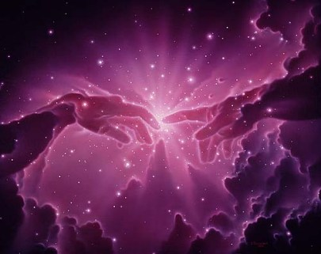
"Thus says the LORD, the King of Israel, And His Redeemer, the LORD of hosts: 'I am the First and I am the Last; Besides Me there is no God.'" — Isaiah 44:6
JESUS
King of Israel
King of Israel
God
LORD
LORD
LORD of hosts
LORD of hosts
God
Notes:
God is singular in His multifaceted self.

Slide 7
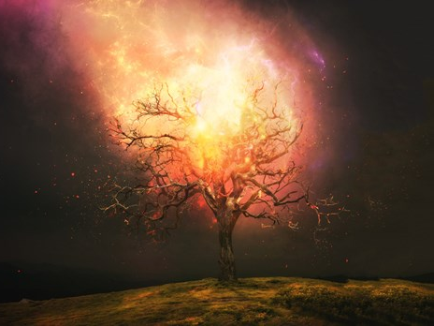
Then Moses said to God, "Indeed, when I come to the children of Israel and say to them, 'The God of your fathers has sent me to you,' and they say to me, 'What is His name?' what shall I say to them?" And God said to Moses, "I AM WHO I AM." And He said, "Thus you shall say to the children of Israel, 'I AM has sent me to you.'" — Exodus 3:13-14
God
God
God
God
What is His name?
What is His name?
I AM WHO I AM
I AM WHO I AM
Notes:
God needs no utterable name to be that He is. Time is His creation waiting for souls to acknowledge His presence in the liberty He has given.

Slide 8
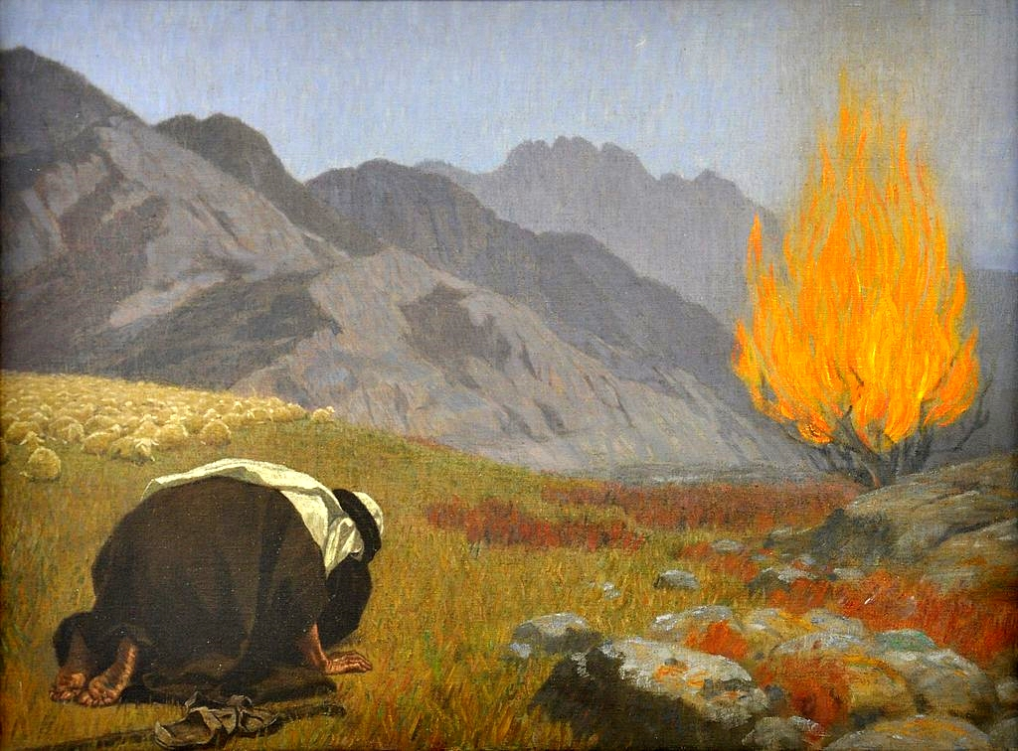
Moreover God said to Moses, "Thus you shall say to the children of Israel: 'The LORD God of your fathers, the God of Abraham, the God of Isaac, and the God of Jacob, has sent me to you. This is My name forever, and this is My memorial to all generations.'" — Exodus 3:15
Moses
God of
Abraham
. .
souls
God
God
God
God
God of
souls
God of
. .
. .
souls
Abraham
Notes:
Humble hearts are the only ones able to feel the magnitude of God.

Slide 9
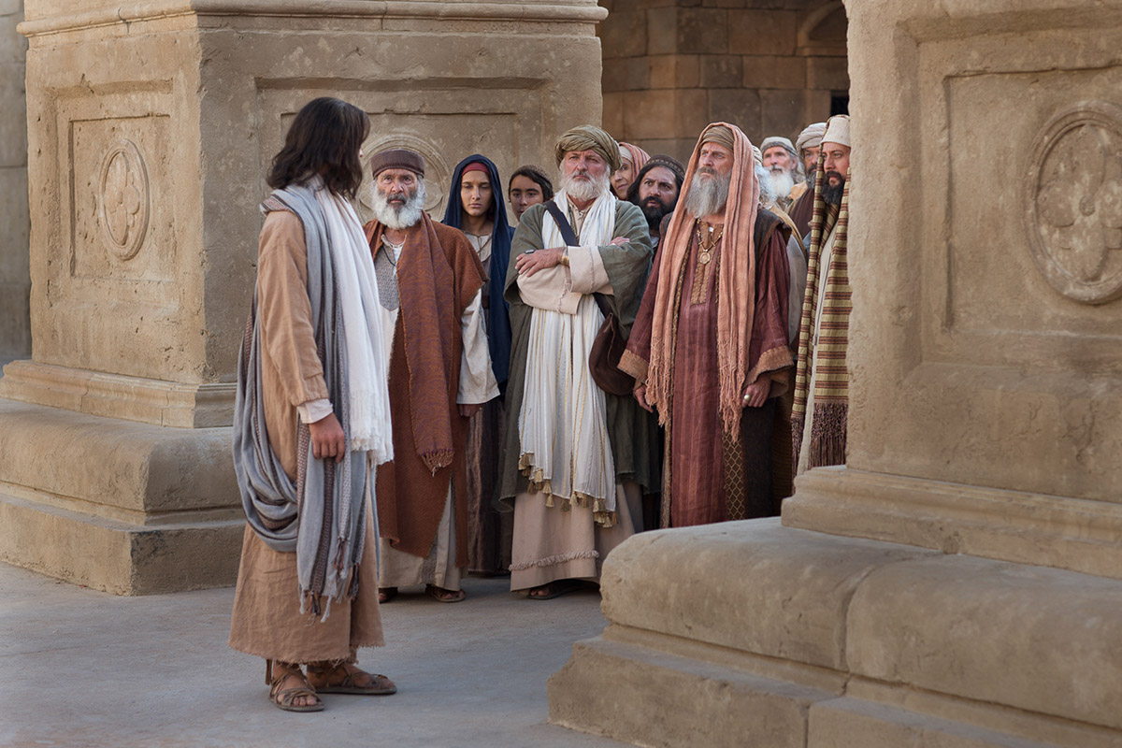
Jesus said to them, "Most assuredly, I say to you, before Abraham was, I AM." — John 8:58
. .
Abraham
. .
I AM
before Abraham was, I AM
Notes:
Jesus, the great explainer, showed how each of us maintains I AM. In His Spirit we live.

Slide 10
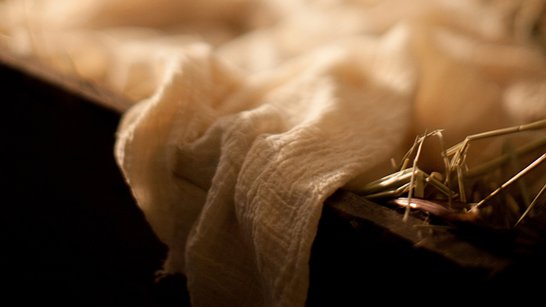
"Therefore the Lord Himself will give you a sign: Behold, the virgin shall conceive and bear a Son, and shall call His name Immanuel." — Isaiah 7:14
the Lord Himself
the Lord Himself
Immanuel
Immanuel
Immanuel
Immanuel
Notes:
Across the ages, His coming is of the most significant, in knowing God, and His reasons for life in His creation.

Slide 11
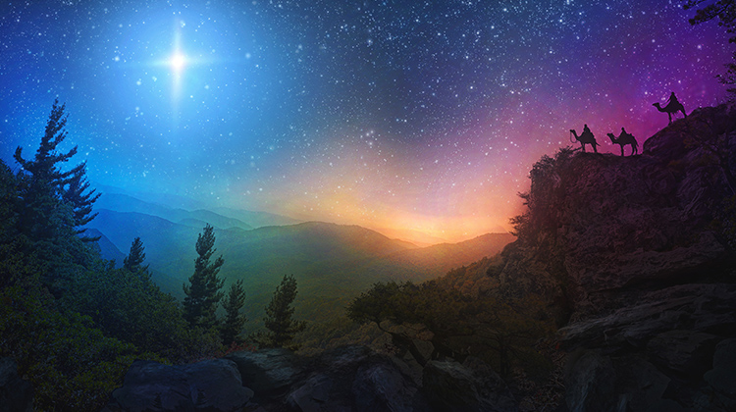
"Behold, the virgin shall be with child, and bear a Son, and they shall call His name Immanuel," which is translated, "God with us." — Matthew 1:23
Son
Son
Immanuel
. .
God with us
Notes:
The robes of truth extend well past our perception, to see the whole of it all. The future is predicated on the past which is exacted by the present.

Slide 12
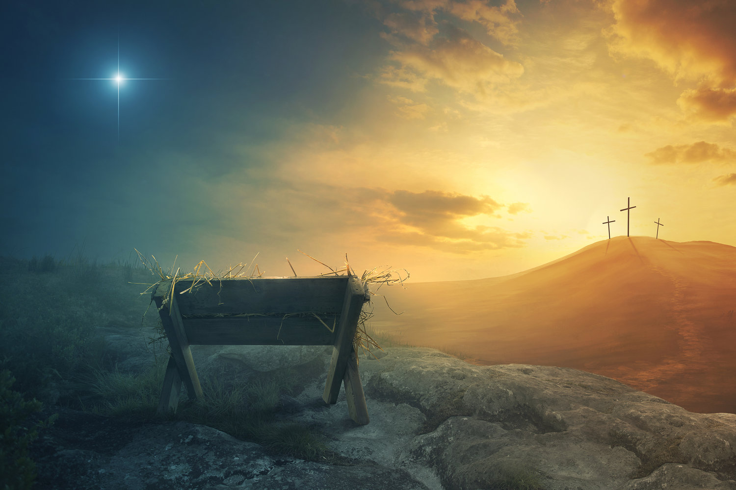
For unto us a Child is born, Unto us a Son is given; And the government will be upon His shoulder. And His name will be called Wonderful, Counselor, Mighty God, Everlasting Father, Prince of Peace. — Isaiah 9:6
For unto us a Child is born, Unto us a Son is given; And the government will be upon His shoulder. And His name will be called Wonderful, Counselor, Mighty God, Everlasting Father, Prince of Peace. — Isaiah 9:6
Son
Son
Notes:
To earth a prince has arrived offering salvation to all who believe.

Slide 13
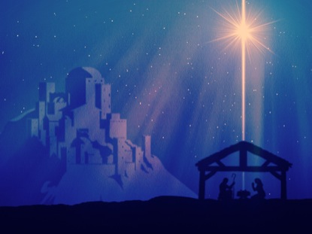
"And she will bring forth a Son, and you shall call His name JESUS, for He will save His people from their sins." — Matthew 1:21
He is
Son
JESUS
JESUS
He
. .
is
save His people from
their sins
. .
Notes:
The Son of God owns all hearts under His care. His light is the beacon of life welling up from love’s radiance itself.

Slide 14
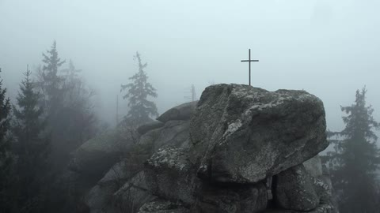
He is the Rock, His work is perfect; For all His ways are justice, A God of truth and without injustice; Righteous and upright is He. — Deuteronomy 32:4
A God of truth
without injustice
↓
He is the Rock
His work is perfect
all His ways are justice
Righteous and upright is He
He is
His work is perfect
He is the Rock
all His ways are justice
A God
of truth
without injustice
Righteous and upright is He
Notes:
God determines reality for the benefit of all, in the solid truth of His creation. His will holds us tightly in His plan of unity to come to His love.

Slide 15
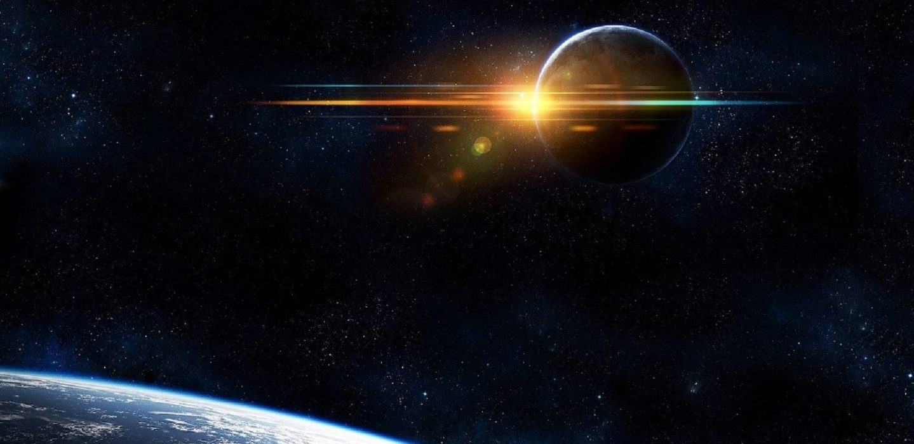
"… until the Ancient of Days came, and a judgment was made in favor of the saints of the Most High, and the time came for the saints to possess the kingdom." — Daniel 7:22
High
the Most High
High
the Most High
Notes:
God desires we live in harmony with what He has provided without refusing the gifts He has given.

Slide 16
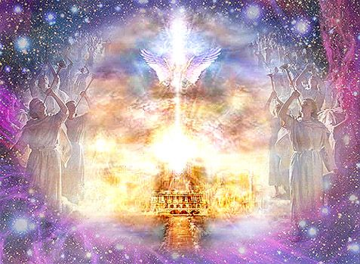
"He will be great, and will be called the Son of the Highest; and the Lord God will give Him the throne of His father David." — Luke 1:32
life-giving spirit
. .
Highest
High
Son of the Highest
Lord God Highest
God
Lord God
David
living being
Notes:
Due to our disobedience, it was necessary for God to take tangible, physical, identifiable form, to clarify His preeminence; a call to return.
1st Co 15:45 And so it is written, "The first man Adam became a living being." The last Adam became a life-giving spirit.

Slide 17
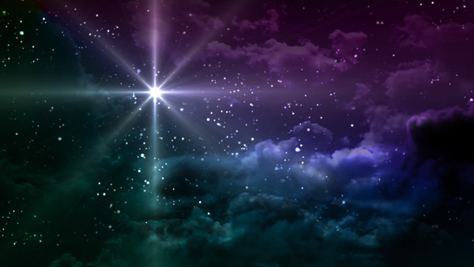
In the beginning was the Word, and the Word was with God, and the Word was God. — John 1:1
God
God
Word
Word
Word
of
Word of God
Notes:
God’s word reigns supreme.

Slide 18
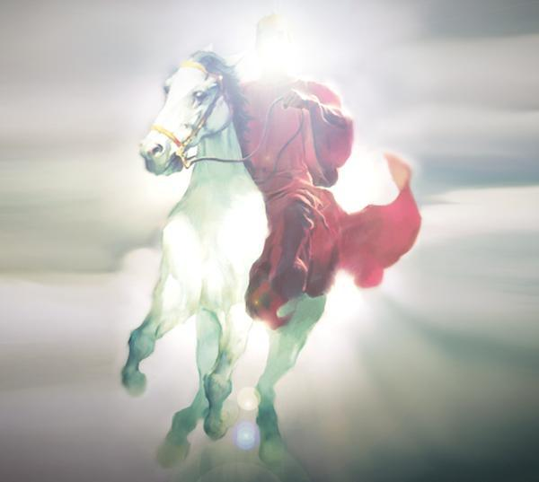
He was clothed with a robe dipped in blood, and His name is called The Word of God. — Revelation 19:13
robe
robe
Sacrifice
Life
His name
His name
Word of God
The Word of God
The Word of God
TRUTH
Notes:
Truth has the measure of judgment in relation to His heart of light’s life. His robe is an act of honor and sacrifice.

Slide 19
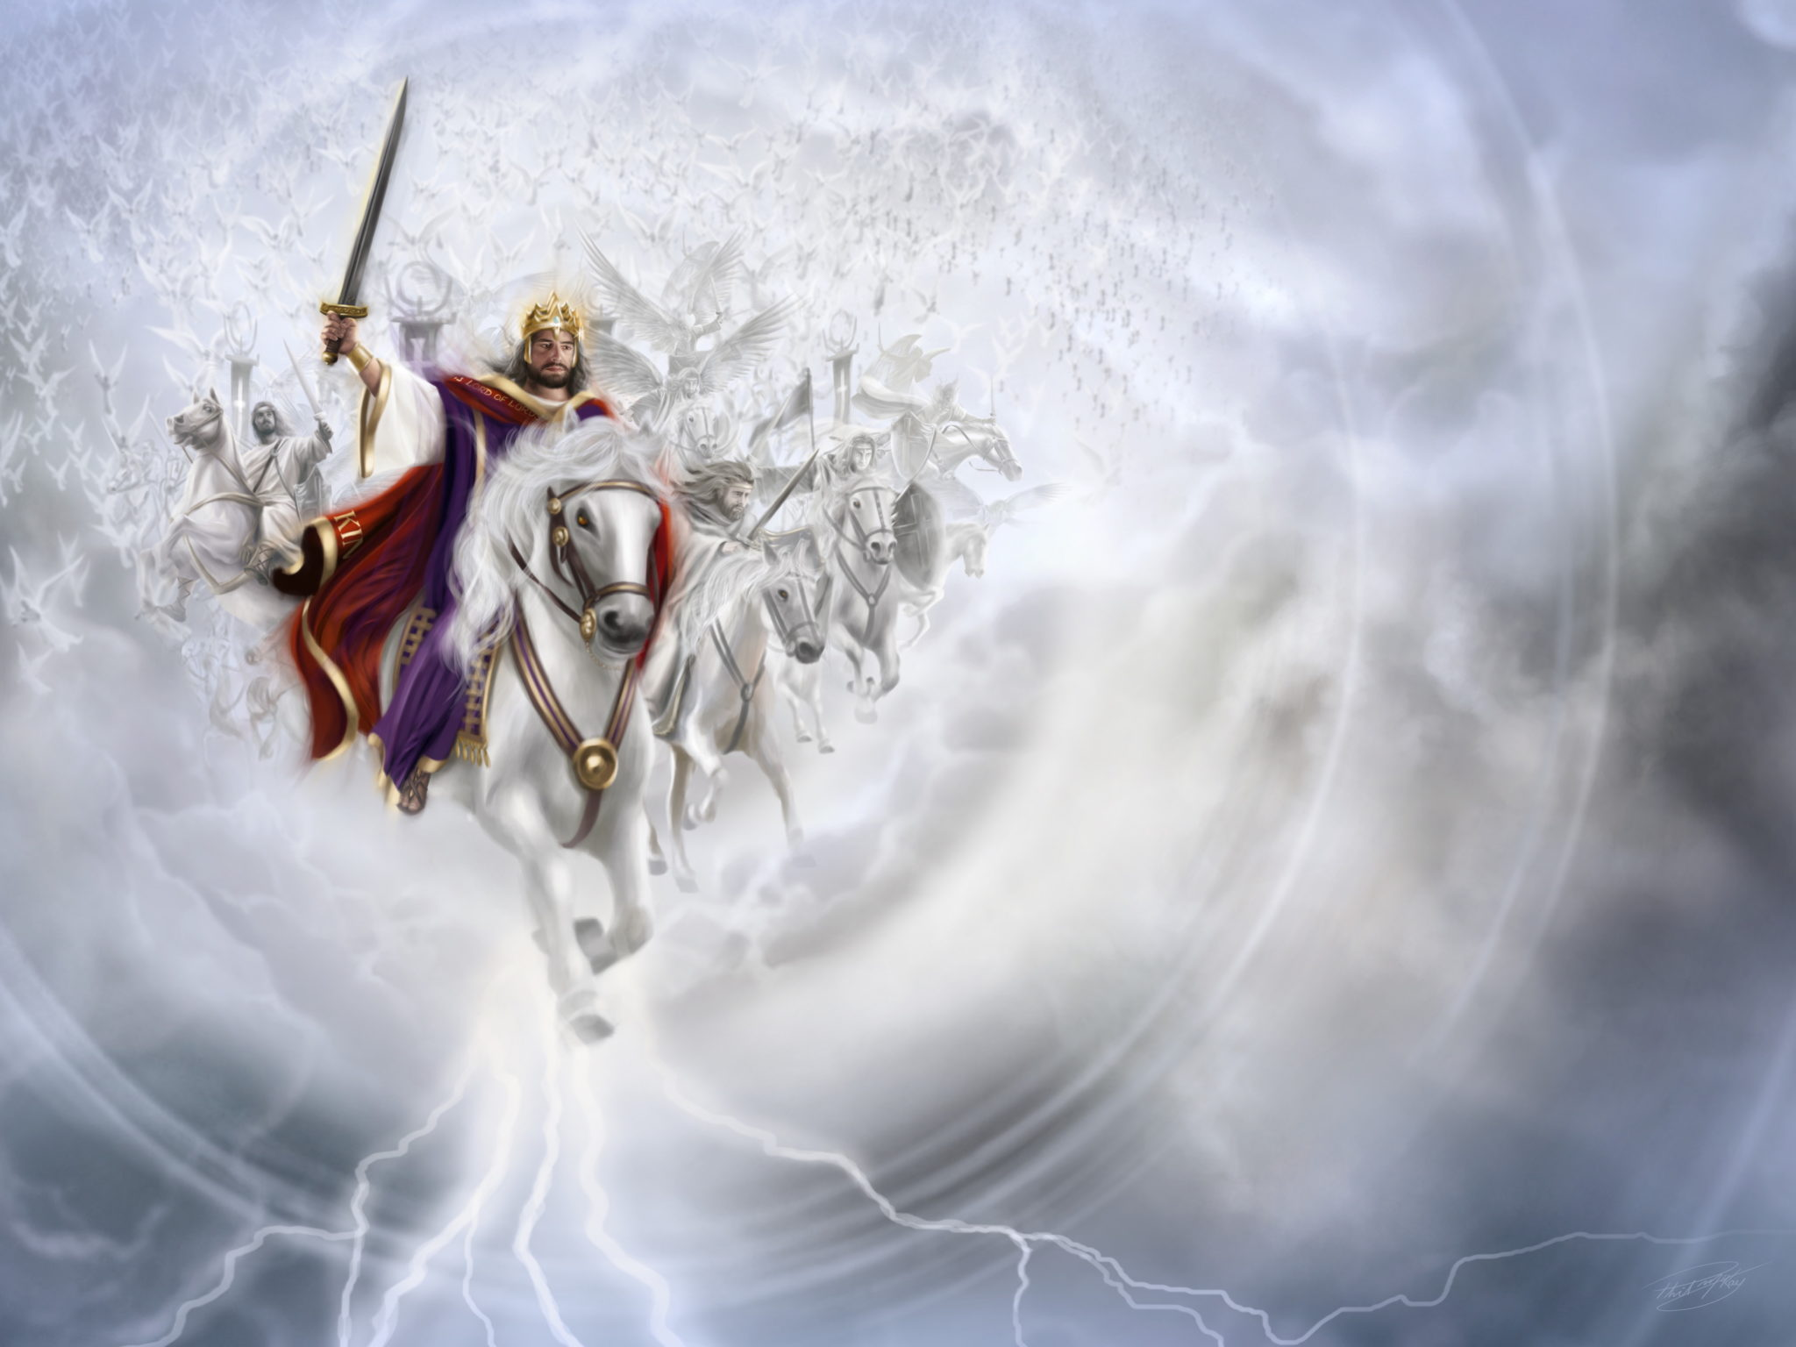
And He has on His robe and on His thigh a name written: KING OF KINGS AND LORD OF LORDS. — Revelation 19:16
robe
. .
KING OF KINGS AND LORD OF LORDS
Notes:
There is no battle where God has not prevailed, though death consumes the flesh. His call is a rise to life from the death of sin

Slide 20
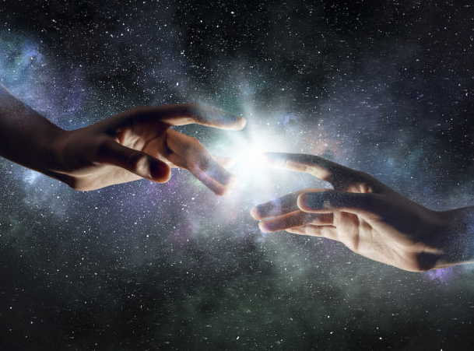
Then Jesus spoke to them again, saying, "I am the light of the world. He who follows Me shall not walk in darkness, but have the light of life." — John 8:12
I am the light
I am
I am the light
I am
of life
Notes:
Make no mistake, God wills all to return to His light of love which supplies eternal life.

Slide 21
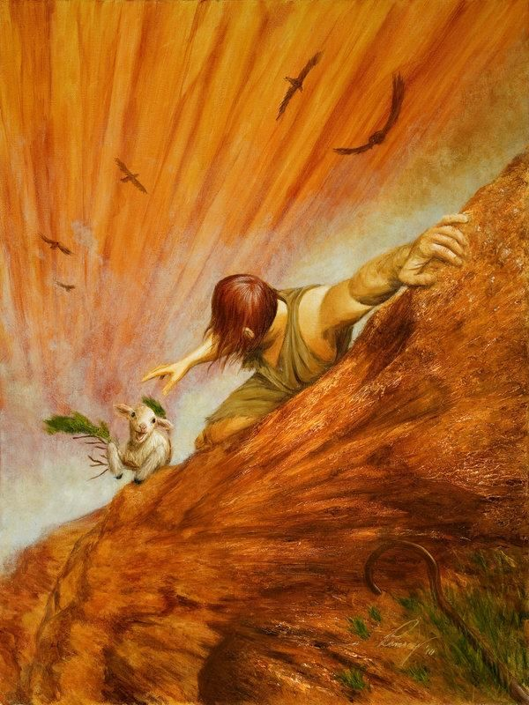
"I am the good shepherd. The good shepherd gives His life for the sheep." — John 10:11
. .
I am
I am the good
sacrifice
shepherd
shepherd
gives His life
sacrifice
Notes:
God has no desire to let go of that which He created to have an equal appreciation of life shared.

Slide 22
The next day John saw Jesus coming toward him, and said, "Behold! The Lamb of God who takes away the sin of the world!" — John 1:29
. .
Lamb of God
Lamb of God
BOTTOM
Notes:
Jesus, God Himself, sacrificed His life so we may know the purpose of why we are, and how to live under the hail of His love.

Slide 23
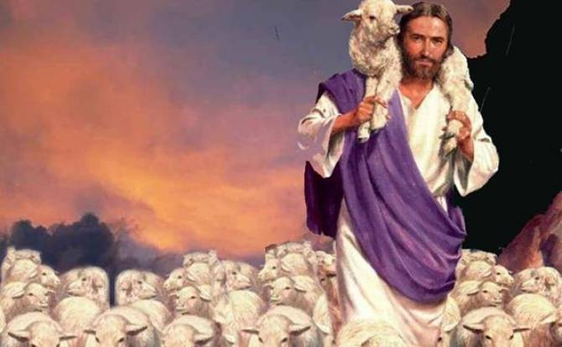
… and when the Chief Shepherd appears, you will receive the crown of glory that does not fade away. — 1st Peter 5:4
TOP
. .
Chief Shepherd
crown of glory
crown of glory
Notes:
Dripped in glory, His care for each of us is incomparable across all essence.

Slide 24
Jesus said to her, "I am the resurrection and the life. He who believes in Me, though he may die, he shall live." — John 11:25
. .
I am
I am the
I am
. .
resurrection and the life
shall live
Notes:
To live forever, one has to believe in the God that offers it.

Slide 25
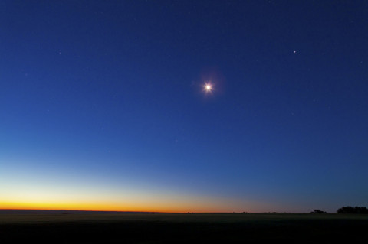
"I, Jesus, have sent My angel to testify to you these things in the churches. I am the Root and the Offspring of David, the Bright and Morning Star." — Revelation 22:16
"I, Jesus, have sent My angel to testify to you these things in the churches. I am the Root and the Offspring of David, the Bright and Morning Star." — Revelation 22:16
I am
Root
Root
Notes:
Many occurrences of God touch the truth we all have the pleasure of coming to know.

Slide 26
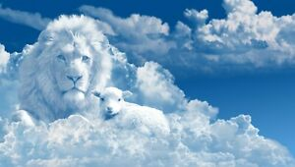
But one of the elders said to me, "Do not weep. Behold, the Lion of the tribe of Judah, the Root of David, has prevailed to open the scroll and to loose its seven seals." — Revelation 5:5
. .
Lion of the tribe of Judah
Lion of the tribe of Judah
Root
Notes:
Each mortal heart yearns for a message of salvation. The story, and exchange, told in His word gives us one truth, loudly heard above the silence of acquiescence.

Slide 27
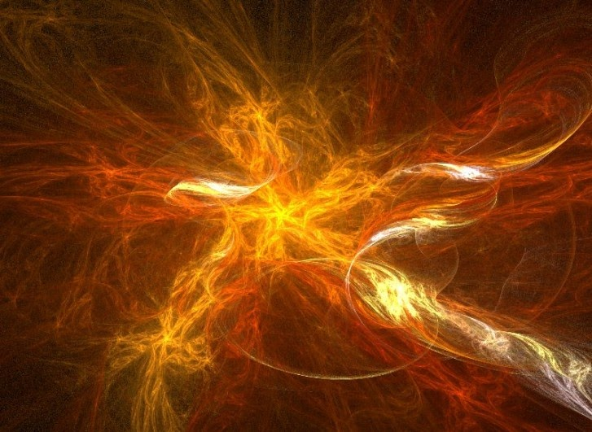
He is the image of the invisible God, the firstborn over all creation. — Colossians 1:15
He is
. .
image of the invisible God
Notes:
An entrance to eternity has been established by God for all those who wish to come to His will and nature.

Slide 28
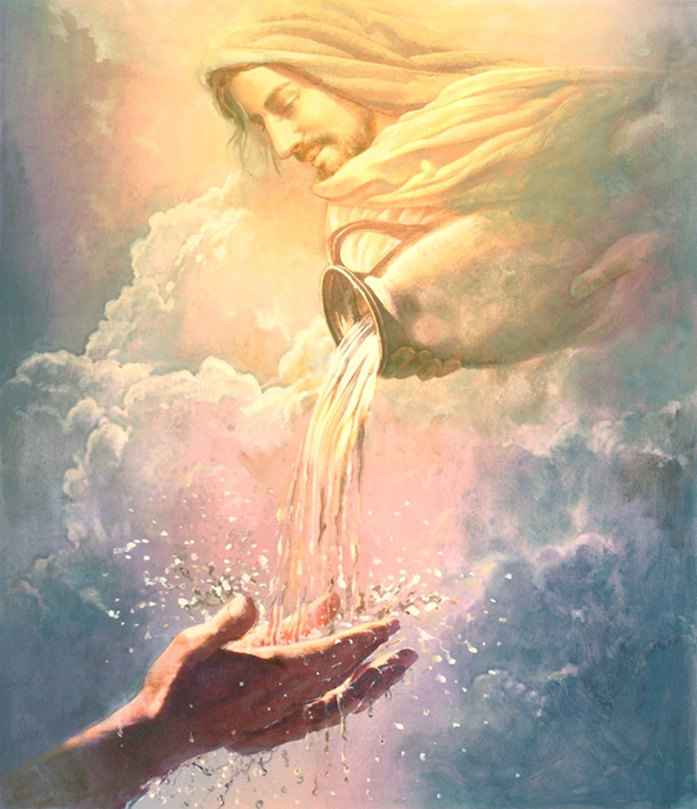
And so it is written, "The first man Adam became a living being." The last Adam became a life-giving spirit. — 1st Corinthians 15:45
Whoever transgresses and does not abide in the doctrine of Christ does not have God. He who abides in the doctrine of Christ has both the Father and the Son. — 2nd John 1:9
Whoever transgresses and does not abide in the doctrine of Christ does not have God. He who abides in the doctrine of Christ has both the Father and the Son. — 2nd John 1:9
X
last Adam
last Adam
JESUS
Christ
life-giving spirit
life-giving spirit
Christ
Notes:
For us to live, God has made it clear to all young and old, wise and ignorant, He is the one we need to come to.

Slide 29
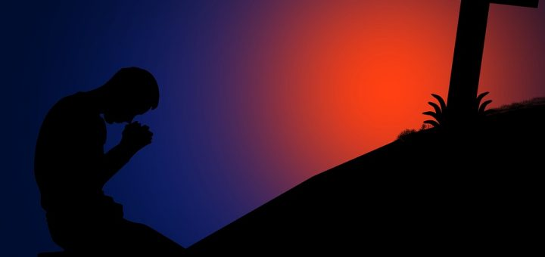
For there is one God and one Mediator between God and men, the Man Christ Jesus, — 1st Timothy 2:5
one
one
. .
. .
the Man
Christ
Christ Jesus
Notes:
To welcome His coming, salvation rests upon His truth, and His defense, of each soul who believes.

Slide 30
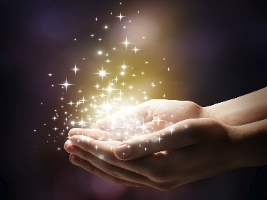
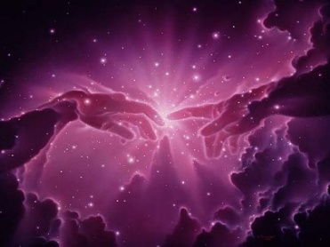
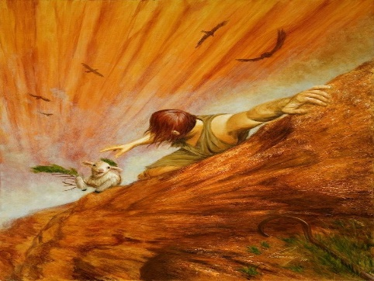
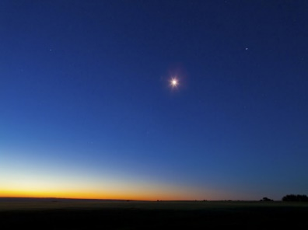
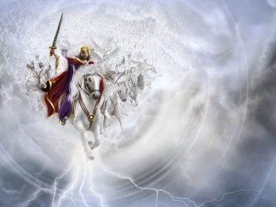

Slide 31
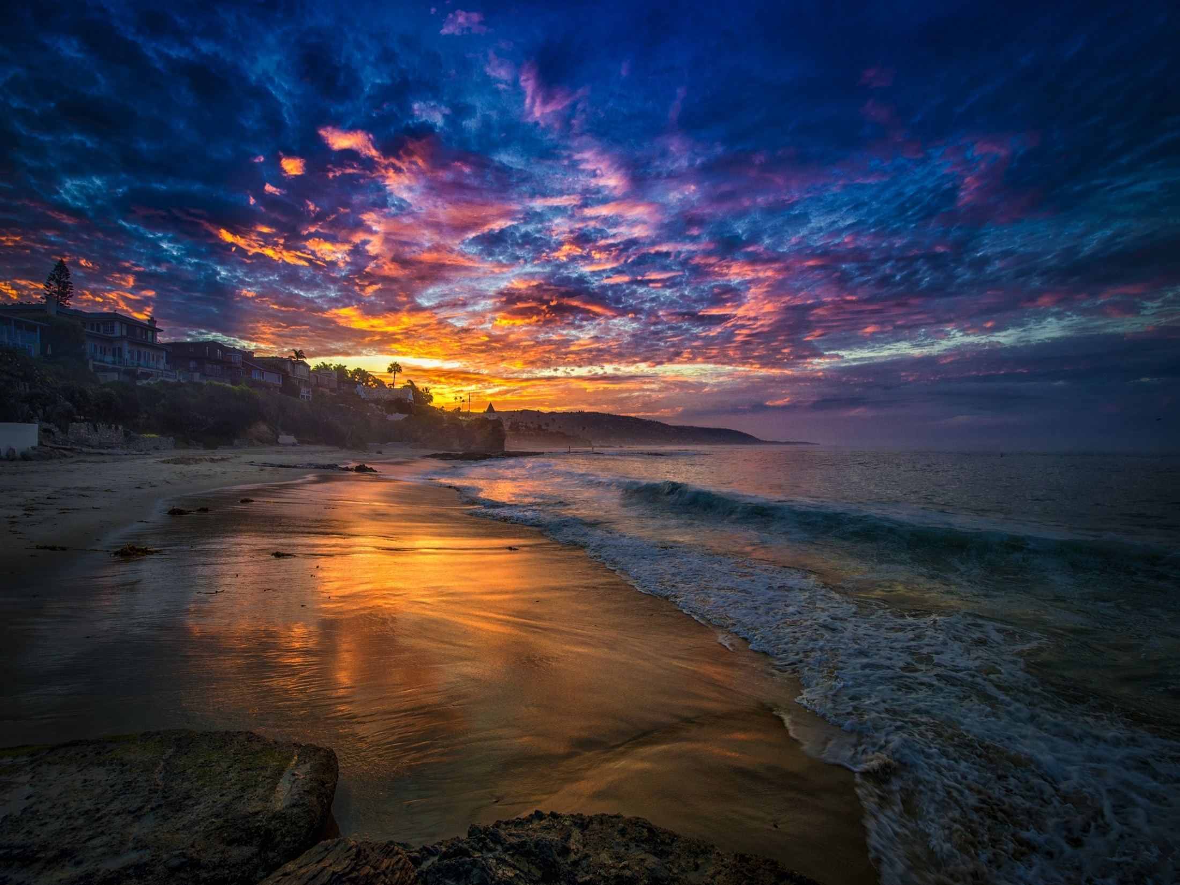
→ God sees all where nothing is hidden
→ The Lord above is God Almighty the great I AM
→ There is no other God besides the Lord of hosts
→ Jesus, before Abraham, sits on David’s throne
→ A virgin birth of Immanuel (God with us)
→ The Son of God’s name is Jesus
→ God is truth without injustice; Righteous & upright
→ Jesus is the light of the world; the word of God
→ Jesus is the good shepherd offering crowns of glory
→ Jesus is the resurrection and life to who believe
→ Jesus is the firstborn over all creation
→ Jesus is a life-giving spirit
→ Jesus is the only mediator between God and men
God will always be there for those that truly love Him
Notes:
God will always be there for those that truly love Him.

Slide 33
Please visit http://www.LoveFromGod.com to explore further
Ronald Bert Channel on
Notes:
Eternity never ends.

