Slide 2
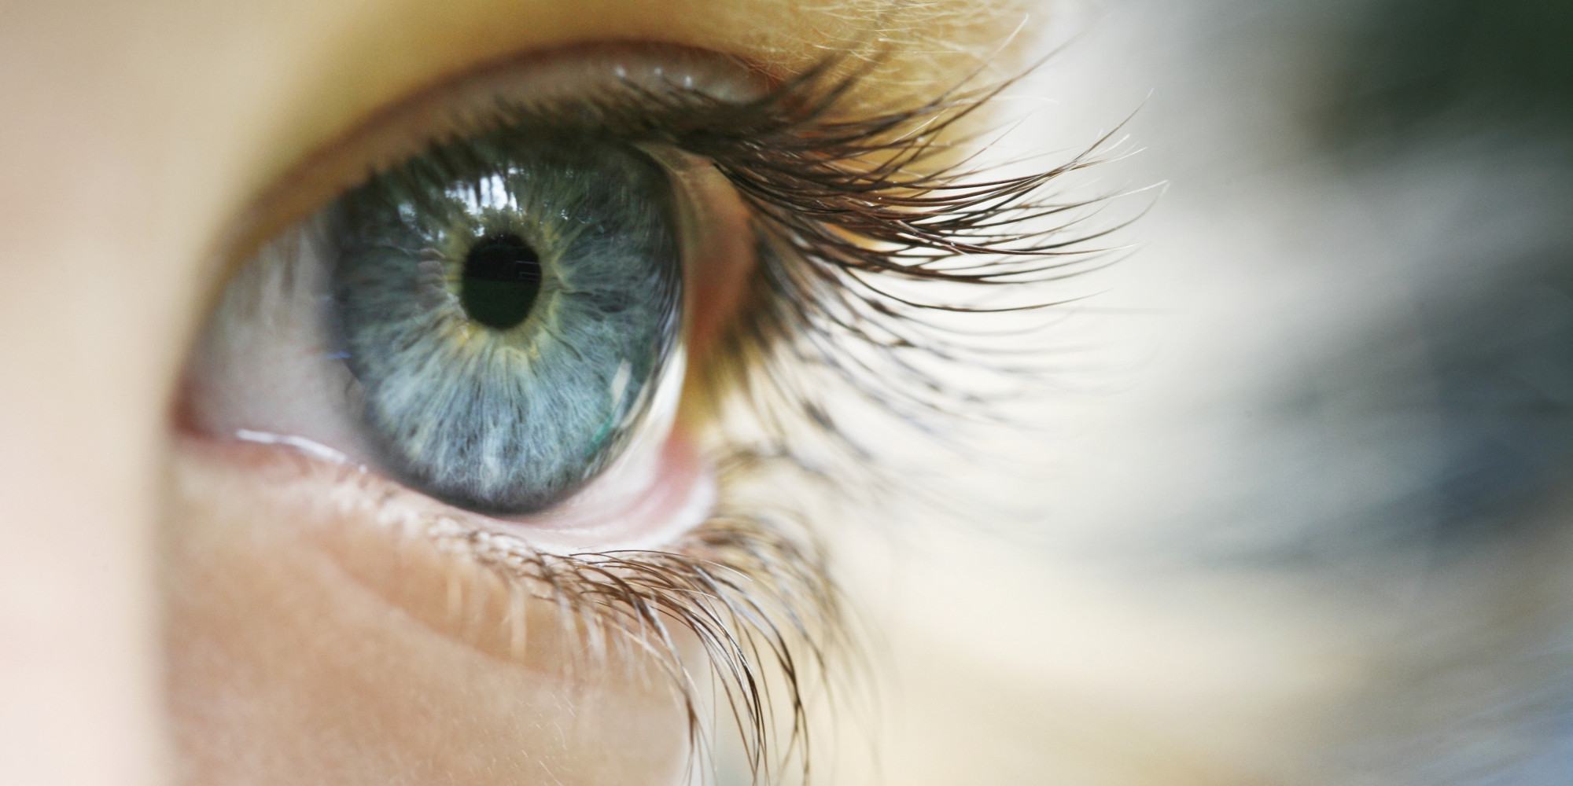
Give Me Sight
Ron Bert
November 1, 2020

Slide 3
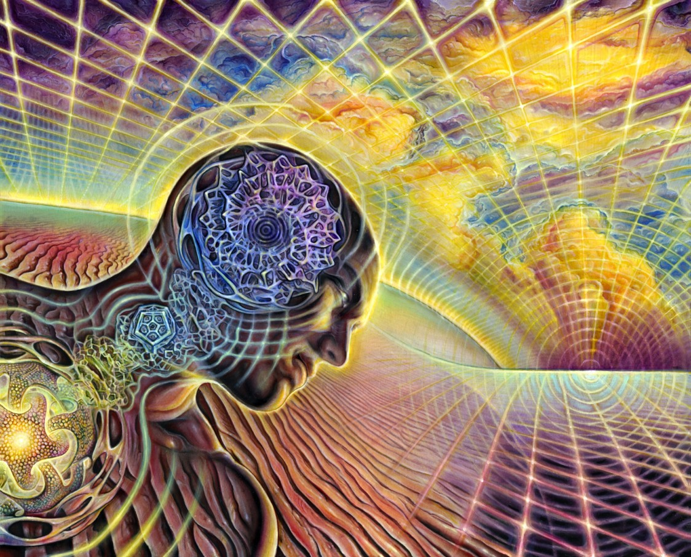
The hearing ear and the seeing eye, The LORD has made them both. — Proverbs 20:12
hearing ear
hearing ear
seeing eye
seeing eye
LORD
LORD
Notes:
As we gaze out into reality our senses themselves are God’s gift for us to achieve independent awareness. Innumerable is all that is God’s creation, which is.

Slide 4
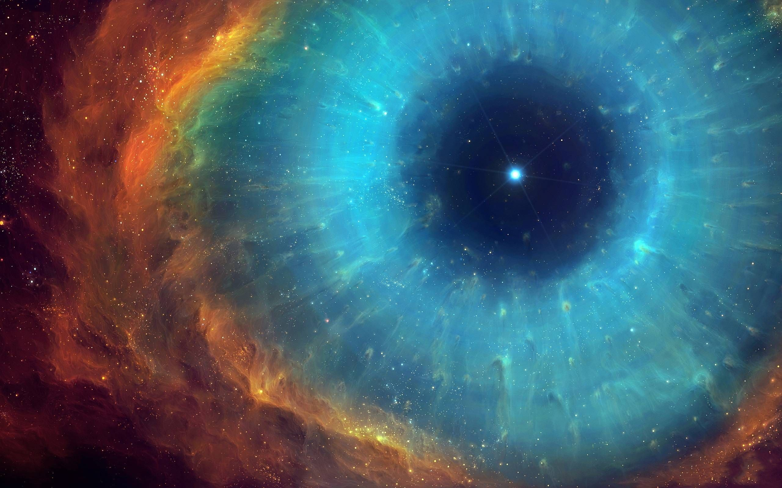
"For His eyes are on the ways of man, And He sees all his steps." — Job 34:21
His eyes
LORD
ways of man
ways of man
He sees all
He sees all
Notes:
God’s creation is an expanse to share the truth of eternity, and for us, a time of words to find and work out these facts alone, under His hopeful watch.

Slide 5
And there is no creature hidden from His sight, but all things are naked and open to the eyes of Him to whom we must give account. — Hebrews 4:13
all things
ways of man
ways of man
eyes
Him to whom we
must
Him to whom we
eyes
account
account
Notes:
He sees all whether we believe or not, observe or ignore. As all swim in the shark tank of man, God views all of our actions. As inevitable as mortal death is, so too is our rise to His judgment of all that we are. Will we be the fish He seeks? What is the lens we peer through? Do we live in a tank of patient compassion or a greedy frenzy for more?

Slide 6
Woe to those who call evil good, and good evil; Who put darkness for light, and light for darkness; Who put bitter for sweet, and sweet for bitter! Woe to those who are wise in their own eyes, And prudent in their own sight! — Isaiah 5:20-21
Woe to those who
call evil good
Woe to those
Woe to those
Woe to those who:
call evil good
and good evil
put darkness for light
and light for darkness
put bitter for sweet
and sweet for bitter
and good evil
put darkness
for light
and light for darkness
put bitter for sweet
and
sweet for bitter
eyes
Notes:
Quite a dichotomy when human beings twist truth for perverted advantage. The truth can not be reversed. Many religious organizations cater to the crowd, the mistake made from the very beginning, choosing man’s desires over God’s. It is a challenge for the noble where liars are exalted and the virtuous are told to remain quiet.

Slide 7
"Hear, you deaf; And look, you blind, that you may see. — Isaiah 42:18
blind
Hear
Hear
look
blind
look
may
that you may see
that you may see
Notes:
While ignorance is common to man, there is a distinction for those choosing to remain purposely oblivious and those who wish to know. God wants us to hear and look to His creation so the truth will be ours, to whom none can steal it away. Is not truth the blossom of knowledge and the fragrance of wisdom?

Slide 8
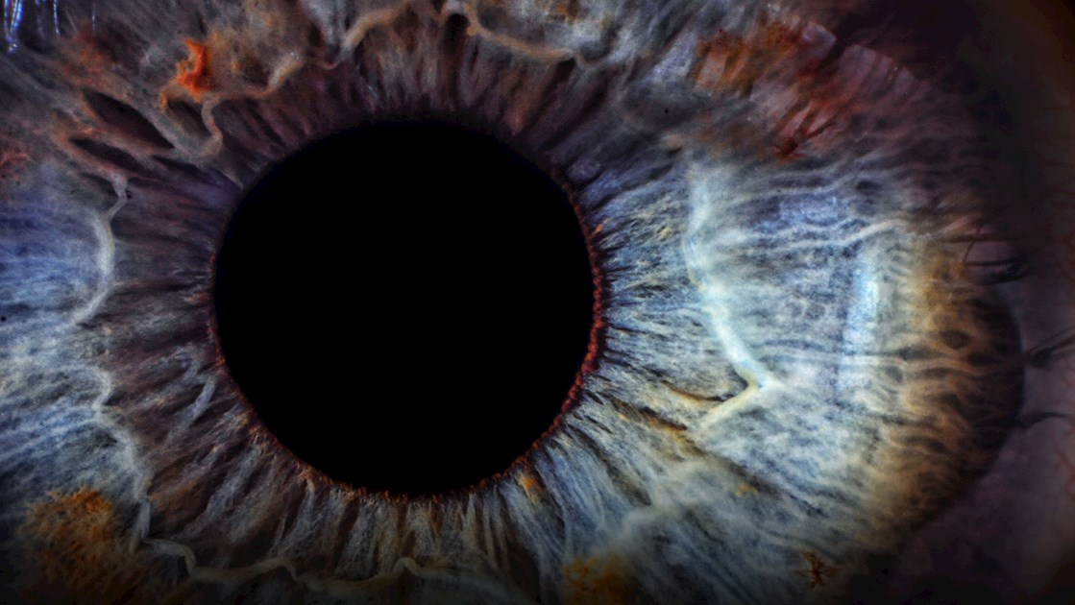
The LORD opens the eyes of the blind; The LORD raises those who are bowed down; The LORD loves the righteous. — Psalms 146:8
LORD
LORD
eyes
eyes
blind
LORD
LORD
LORD
LORD
Notes:
When one genuinely humbles the heart, before God’s unending presence, unseen truths come into view.

Slide 9
Open my eyes, that I may see Wondrous things from Your law. — Psalms 119:18
eyes
Open my eyes, that I may see
eyes
Open my eyes, that I may see
Notes:
The word has been given for all to have His truth, if the desire of a soul to know His creator has spark. Vision’s deepest sight is in the wisdom one maintains.

Slide 10
Let your eyes look straight ahead, And your eyelids look right before you. Ponder the path of your feet, And let all your ways be established. Do not turn to the right or the left; Remove your foot from evil. — Proverbs 4:25-27
honesty
look straight
eyes
look straight
look straight
eyes
ways be established
ways be established
Remove your foot from evil
Notes:
God wills that we remain sure and straight in our presence with Him, and one another. This involves honest relations concerning truth. The examination of His word teaches us what is evil and good. While we all have sinned, knowledge is power to advance from polluted origins. We are told not to lie against the truth.

Slide 11
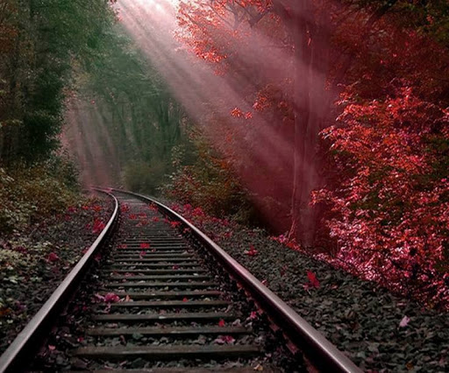
Better is the sight of the eyes than the wandering of desire. This also is vanity and grasping for the wind. — Ecclesiastes 6:9
eyes
X
desire
wandering of desire
wandering of desire
eyes
Notes:
Control of thoughts has always been God’s first law of order. To imagine must be tempered with goodness if progress over destruction is to be had.

Slide 12
Rejoice, O young man, in your youth, And let your heart cheer you in the days of your youth; Walk in the ways of your heart, And in the sight of your eyes; But know that for all these God will bring you into judgment. — Ecclesiastes 11:9
Walk
Walk
eyes
in
in the sight of your eyes
eyes
in the sight of your eyes
God will bring you into judgment
God will bring you into judgment
Notes:
To be free and young, no other event has a higher sense of innocence and love; just to be. The razors of life tear the heart, too often deepening with memories of grief. Joy is the candy all hope for.

Slide 13
In that day the deaf shall hear the words of the book, And the eyes of the blind shall see out of obscurity and out of darkness. — Isaiah 29:18
words of the book
. .
Truth
eyes
blind shall see
. .
out of darkness
. .
Notes:
In Jesus, the light of God inflames all who would see its value. Knowledge of His word holds the path of enlightenment.

Slide 14
sight

Slide 15
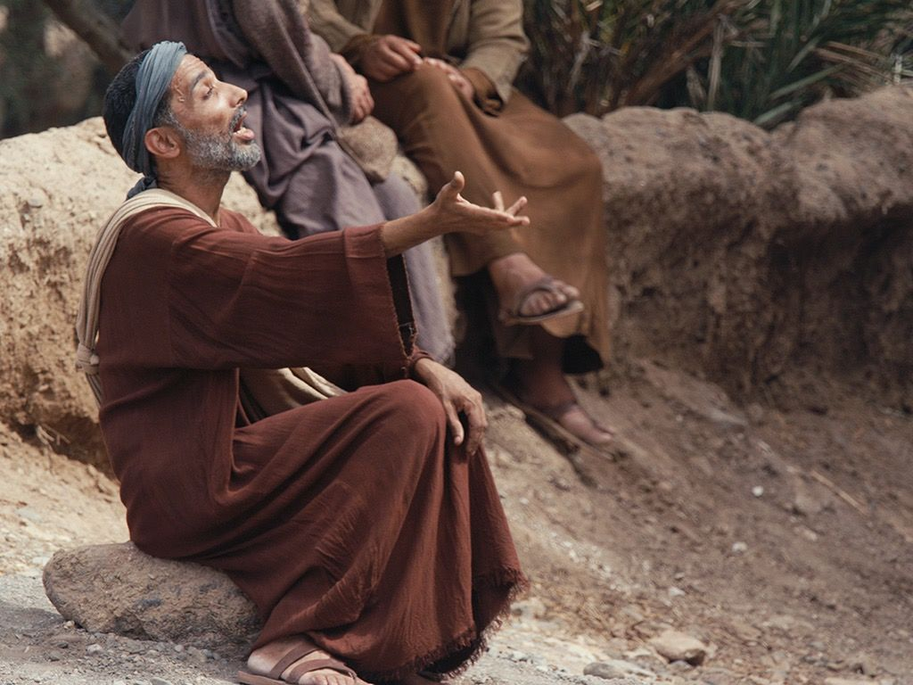
So Jesus answered and said to him, "What do you want Me to do for you?" The blind man said to Him, "Rabboni, that I may receive my sight." Then Jesus said to him, "Go your way; your faith has made you well." And immediately he received his sight and followed Jesus on the road. — Mark 10:51-52
So
that I may receive
that I may receive
my sight
Jesus
sight
my sight
faith has made you well
So received, follow Jesus
,
faith has
made you well
follow Jesus
received
follow
Notes:
To be spiritually healed, one has to first desire it. No matter the blues that surround a heart, the sense of truth comes from the inside touch, more so than the outside temporary masks that fades before us all. Faith heals the heart when Jesus is followed.

Slide 16
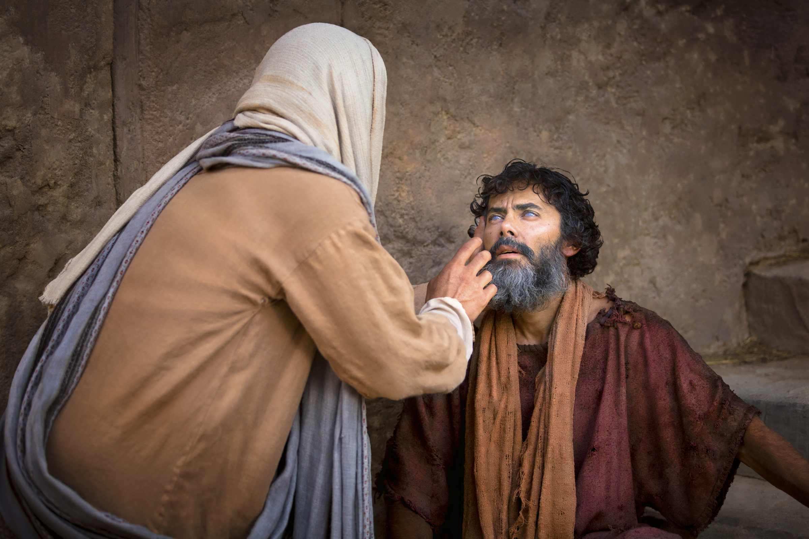
'… to open their eyes, in order to turn them from darkness to light, and from the power of Satan to God, that they may receive forgiveness of sins and an inheritance among those who are sanctified by faith in Me.' — Acts 26:18
to the power of God
↓
that they may receive:
● forgiveness of sins
● an inheritance
who are sanctified
by faith in Me
to
to open their eyes
to open their eyes
from darkness to light
from darkness to light
the power of
God
that they may receive
forgiveness of sins
an
inheritance
who
are sanctified
by faith in Me
in
by faith in Me
Notes:
Our one and only God, in His infinite wisdom, came to share salvations plan, to redeem us from all the paths of death; death of life and of truth. Faith in what rises past the material brings us into the presence of God Himself. It is His desire for us to see why we are, to purely love, and to feel this truth.

Slide 17
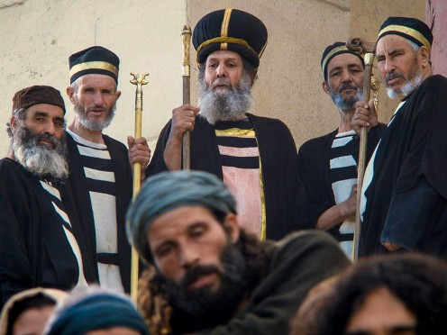
Now the Pharisees, who were lovers of money, also heard all these things, and they derided Him. And He said to them, "You are those who justify yourselves before men, but God knows your hearts. For what is highly esteemed among men is an abomination in the sight of God. — Luke 16:14-15
ridiculed
scorned
condemned
mocked
scoffed
God
God
God knows your hearts
God knows your hearts
Notes:
Elitism can nurture selfish power mongers despising those who do not adhere to their strict controls. When it is said power corrupts and absolute power corrupts absolutely, it dwells in the heart of pride, and it is arrogance that often covers lies to the self, and blinds those who dish its poison as nectar. Wisdom and recklessness do no go hand in hand.

Slide 18
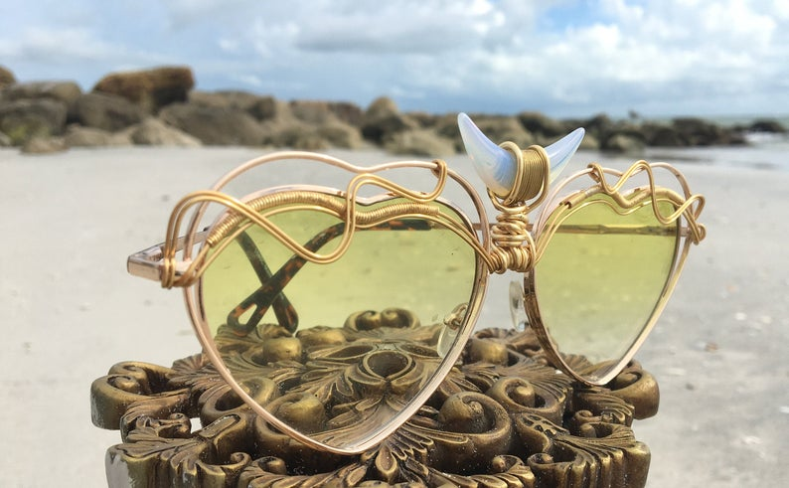
God
God
God

Slide 19
But the LORD said to Samuel, "Do not look at his appearance or at the height of his stature, because I have refused him. For the LORD does not see as man sees; for man looks at the outward appearance, but the LORD looks at the heart." — 1st Samuel 16:7
LORD
LORD
LORD
the LORD looks at the heart
LORD
. .
Notes:
However, in God’s illuminations of truth, blessings come from within, where a soul hides no secrets from God. God has all-seeing heart vision.

Slide 20
But we have renounced the hidden things of shame, not walking in craftiness nor handling the word of God deceitfully, but by manifestation of the truth commending ourselves to every man's conscience in the sight of God. — 2nd Corinthians 4:2
the word of God
God
God
God
. .
manifestation of the truth
. .
Notes:
Honesty is the high water of God, and it holds the principles of a true living conscience.

Slide 21
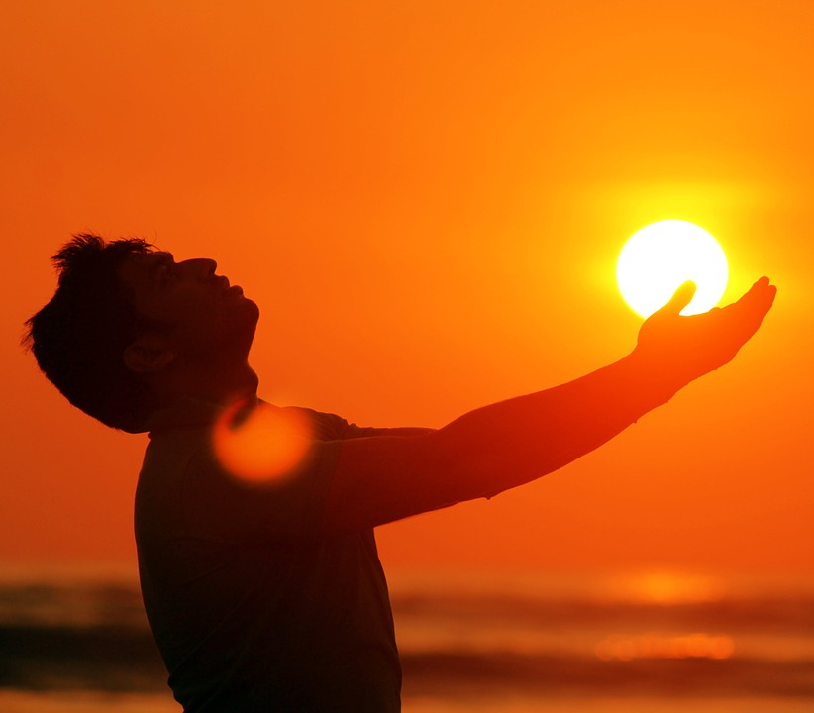
Humble yourselves in the sight of the LORD, and He will lift you up. — James 4:10
will lift you
the LORD
the LORD
will lift you
Notes:
To reach eternity, one has to come to eternity.

Slide 22
Blessed are the pure in heart, For they shall see God. — Matthew 5:8
Carefree
in
pure in heart
pure in heart
shall see God
shall see God
Peace
Notes:
Again, innocence is such a fleeting occurrence for the young of heart. In accepting God, He has delivered a return to innocence when we receive the simple pureness of His promise. Rising past what is seen, for all that is unseeable, to know Him deepens the draw of eternity, and the essence of His whole love.

Slide 23
For we walk by faith, not by sight. — 2nd Corinthians 5:7
faith
faith
Notes:
To find the largest part of the self, trust in life beyond the flesh delivers a greater purpose, and has the force of true presence.

Slide 24
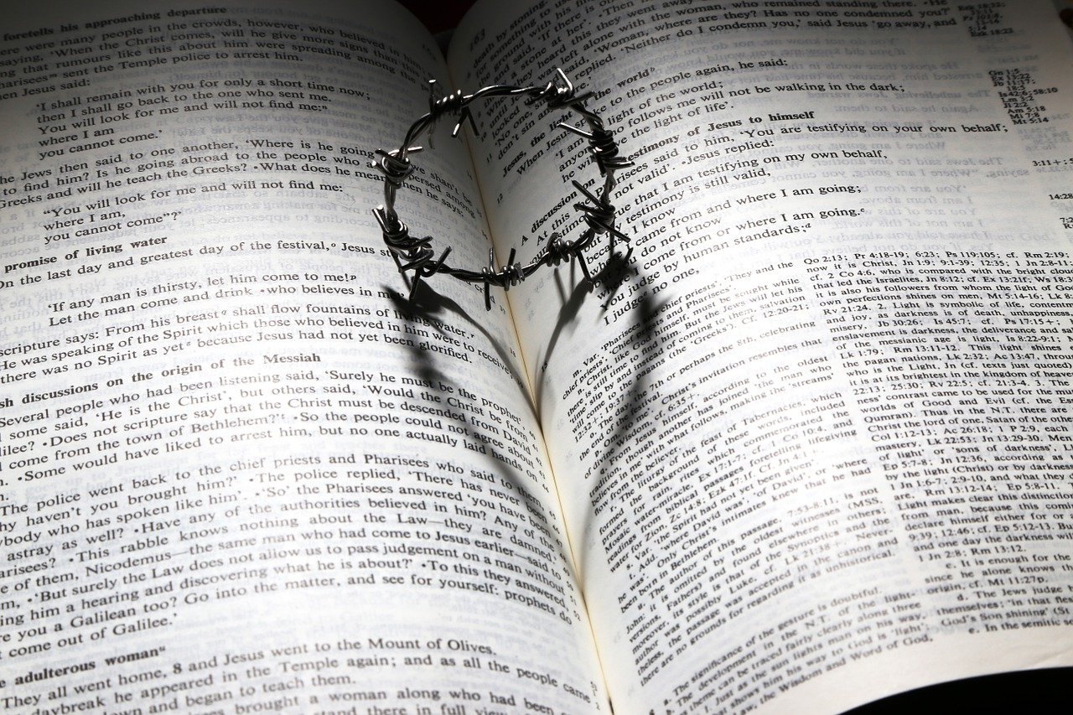
Now faith is the substance of things hoped for, the evidence of things not seen. — Hebrews 11:1
faith
evidence of
things not seen
evidence of
things not seen
Notes:
No book has greater truth to know than the Bible. It surely opens the soul to live where death dwells.

Slide 25
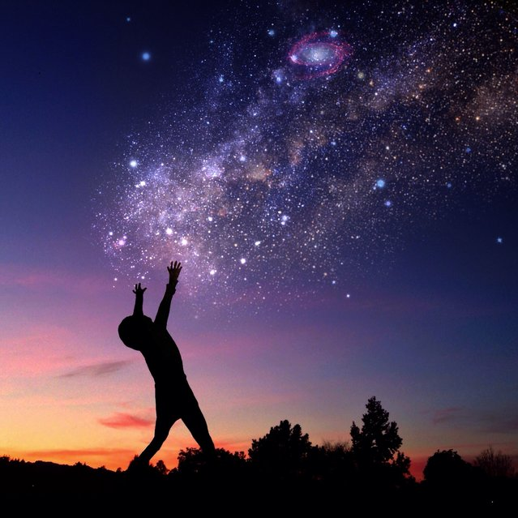
… while we do not look at the things which are seen, but at the things which are not seen. For the things which are seen are temporary, but the things which are not seen are eternal. — 2nd Corinthians 4:18
eternal
eternal
Notes:
Thank God for His creation showing us more than one could ever know. It is a test, a birth, in to having sense between extremes of sadness’ valleys, to joys upon mountain views, all to temper character through conquering wicked temptations. Vision is where the cost has been paid through the journeys travel. What an eternal sight we already have been given in the moment. Earth alone has an eternity of views.

Slide 26
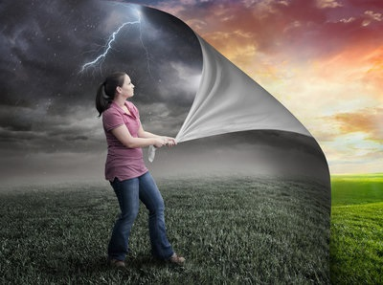
(for not the hearers of the law are just in the sight of God, but the doers of the law will be justified; — Romans 2:13
eternal
justified
just in the sight of God
just in the sight of God
doers
justified
doers
Notes:
To be the ultimate good soul above judgment, the spirit shares in actions of love and sacrifice, to get it done, without regard for self-seeking credit. If one’s goal is eternal rewards, God must take precedence. To be justified, the eternal veil must be uncovered and the weight of life carried. Part of faith is doing the believing.

Slide 27
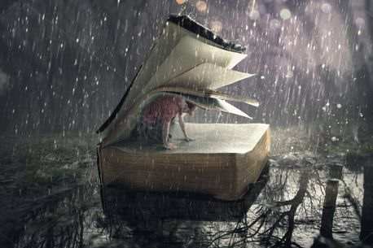
Therefore by the deeds of the law no flesh will be justified in His sight, for by the law is the knowledge of sin. — Romans 3:20
deeds
deeds
justified
no flesh will be justified
no flesh will be justified
in His sight
the law
in His sight
Notes:
While we all fall short of His expectations, and standards of goodness, His redeeming force is greater than our sins. By grace He welcomes all those who desire to come to Him past previous errors of judgment.

Slide 28
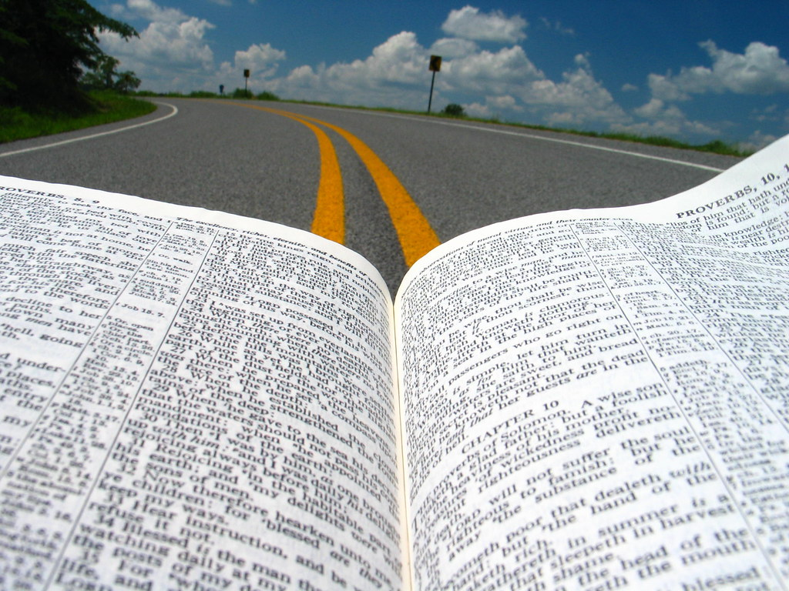
What shall we say then? Is the law sin? Certainly not! On the contrary, I would not have known sin except through the law. For I would not have known covetousness unless the law had said, "You shall not covet." — Romans 7:7
the law
the law
the law
Notes:
When truth arrives, it can be the greatest of all challenges to forgive one self for failings of character, while rising to the occasion of goodness in one’s own sight, as well as His. It is His word that teaches hope in hopelessness, forgiveness in all that is unforgivable. Thankful adherence to His word over the contempt and dissent of cynicism gives birth to a wise enduring life.

Slide 29
Therefore, having been justified by faith, we have peace with God through our Lord Jesus Christ, through whom also we have access by faith into this grace in which we stand, and rejoice in hope of the glory of God. — Romans 5:1-2
justified by faith
peace with God
through Jesus Christ
↓
access by faith
grace
↑
in hope of the glory of God
justified
by faith
peace with God
through
Christ
Jesus Christ
Jesus Christ
access by faith
grace
in hope of the glory of God
in
glory of
of God
Notes:
Faith is what completes all else. Hope is what we stand on.

Slide 30
But even if our gospel is veiled, it is veiled to those who are perishing, whose minds the god of this age has blinded, who do not believe, lest the light of the gospel of the glory of Christ, who is the image of God, should shine on them. — 2nd Corinthians 4:3-4
gospel
image of God shine on them glory of Christ ↑ lest the light of the gospel ↕ who do not believe minds blinded gospel veiled who are perishing ↓
veiled
who are
Christ
perishing
minds
blinded
who do not
light of the gospel
believe
lest the light of the gospel
light of the gospel
. .
glory of
Christ
glory of Christ
image of God
of God
shine on
should shine
. .
them
Notes:
So sad the blind who see not the brilliance of God’s eternal light.

Slide 31
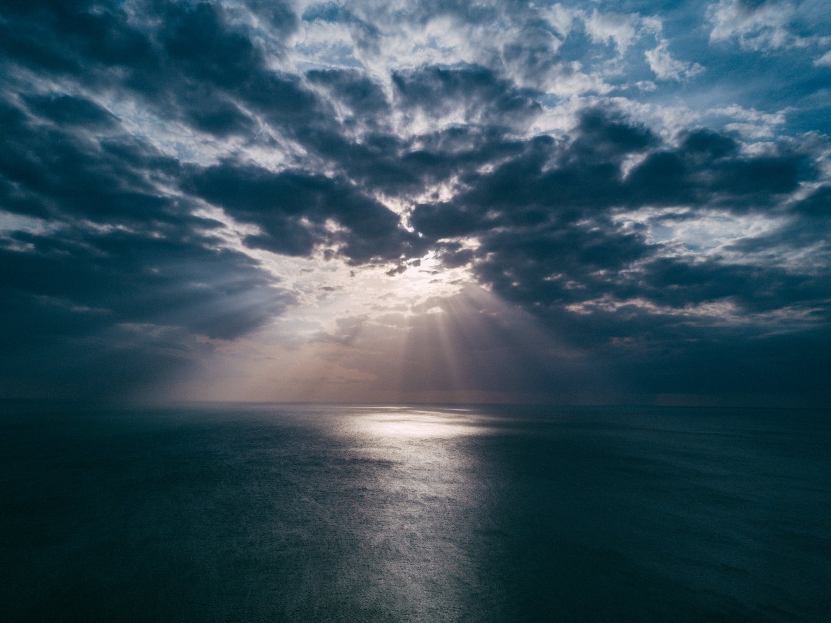
Behold, He is coming with clouds, and every eye will see Him, even they who pierced Him. And all the tribes of the earth will mourn because of Him. Even so, Amen. — Revelation 1:7
every eye will see Him
. .
Amen
Notes:
God’s return to each of our lives is inevitable. Will we be ready waiting or absent to that eternal role call from above?

Slide 32
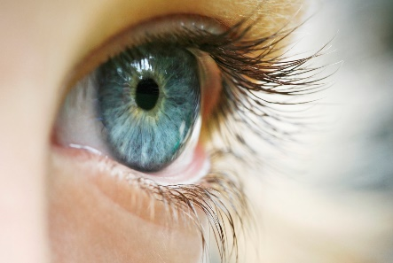
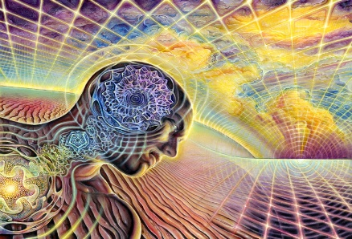
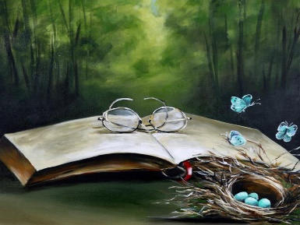
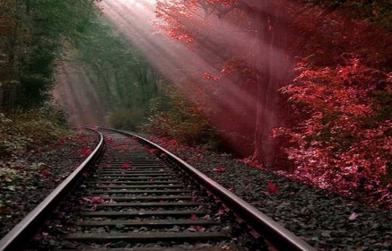
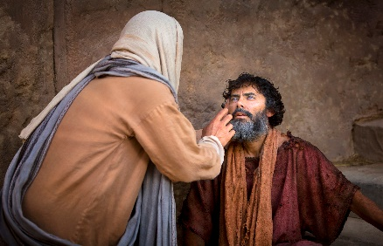
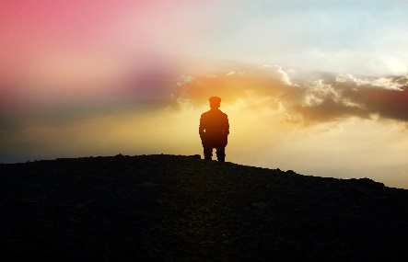
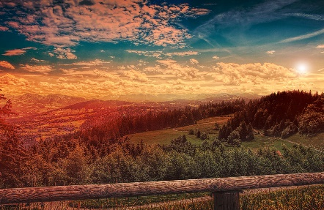
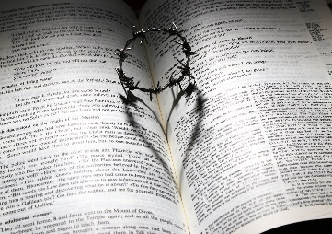
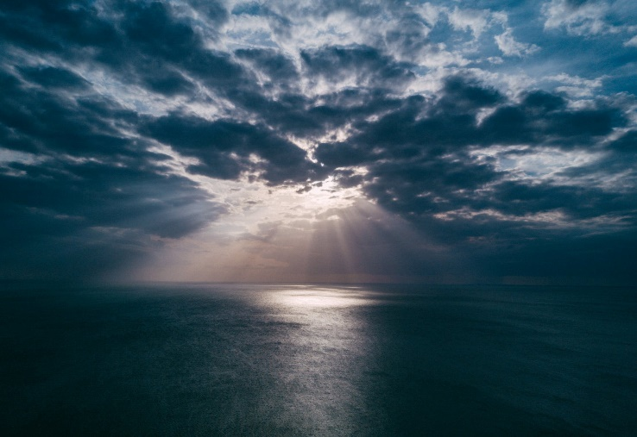
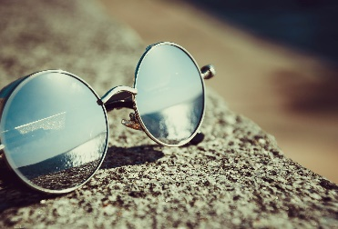
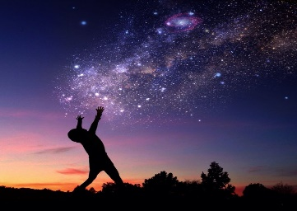
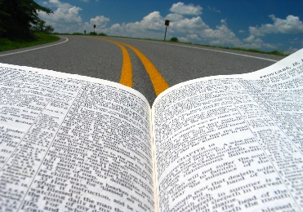

Slide 33
→ Hearing and seeing is a creation of God
→ All will give account for deeds done
→ Hypocrites and liars God despises
→ Have a straight course sure of character
→ Focus without wandering desires is favored
→ Unconditional faith heals the soul
→ Covetous desires of man fail to please God
→ His freedom is only found in a humble heart
→ Faith is a higher sense of eternal truths
→ No one can be justified in the flesh by actions
→ The Bible exposes sin and what God regards Holy
→ We are justified by faith under His grace
→ The glory of Christ is God’s own image
Truth delivered by God angers the simple and sets the faithful free

Slide 35
Please visit http://www.RonBert.com to explore further
Ronald Bert Channel on
Notes:
Eternity never ends.

