Slide 2
Forgetfulness
Ron Bert
November 7, 2021

Slide 3
Only take heed to yourself, and diligently keep yourself, lest you forget the things your eyes have seen, and lest they depart from your heart all the days of your life. And teach them to your children and your grandchildren, …" — Deuteronomy 4:9
take heed
take heed
take heed
and
diligently keep
take heed and diligently keep
→ lest you forget the things
→ lest you depart of heart
teach children and grandchildren
diligently keep
diligently keep
diligently keep
lest you
forget
forget
forget the things
you
depart
depart
lest
depart
heart
of
teach
children
and
grandchildren
Notes:
Memory and understanding are used to lift our children, and without it, disorder burns the ignorant.

Slide 4
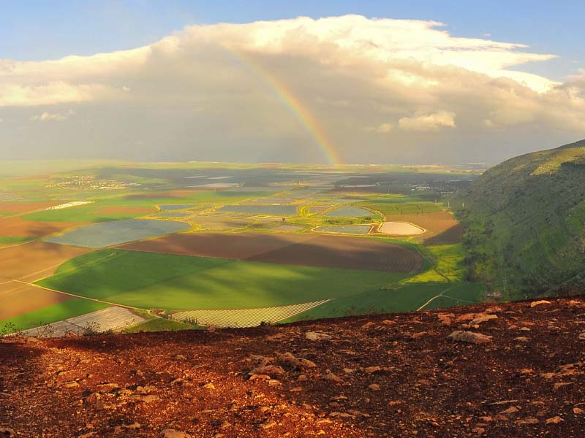
"So it shall be, when the LORD your God brings you into the land of which He swore to your fathers, to Abraham, Isaac, and Jacob, to give you large and beautiful cities which you did not build, houses full of all good things, which you did not fill, hewn-out wells which you did not dig, vineyards and olive trees which you did not plant-when you have eaten and are full-" — Deuteronomy 6:10-11
LORD your God
LORD your God
Satisfied
and are full
and are full
Notes:
The music of truth holds no lie.

Slide 5
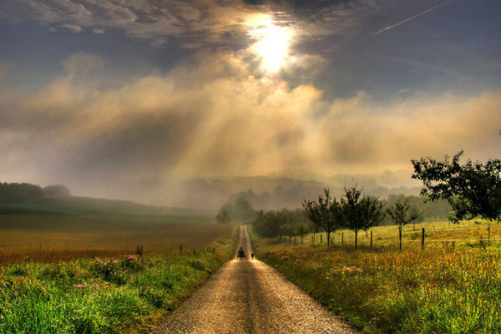
"... then beware, lest you forget the LORD who brought you out of the land of Egypt, from the house of bondage. You shall fear the LORD your God and serve Him, and shall take oaths in His name. You shall not go after other gods, the gods of the peoples who are all around you …" — Deuteronomy 6:12-14
then beware, lest you forget
then beware, lest you forget
LORD your God
God
God
God
not go after other gods
not go after other gods
Notes:
Forgetting God should invoke fear of calamities to come.

Slide 6
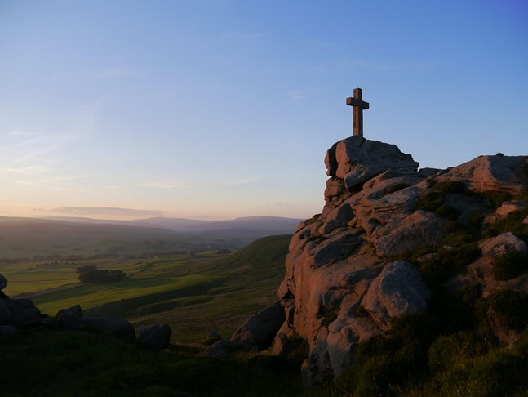
Of the Rock who begot you, you are unmindful, And have forgotten the God who fathered you. — Deuteronomy 32:18
unmindful
unmindful
God
God
Notes:
Only travesty comes upon those that forget God.

Slide 7
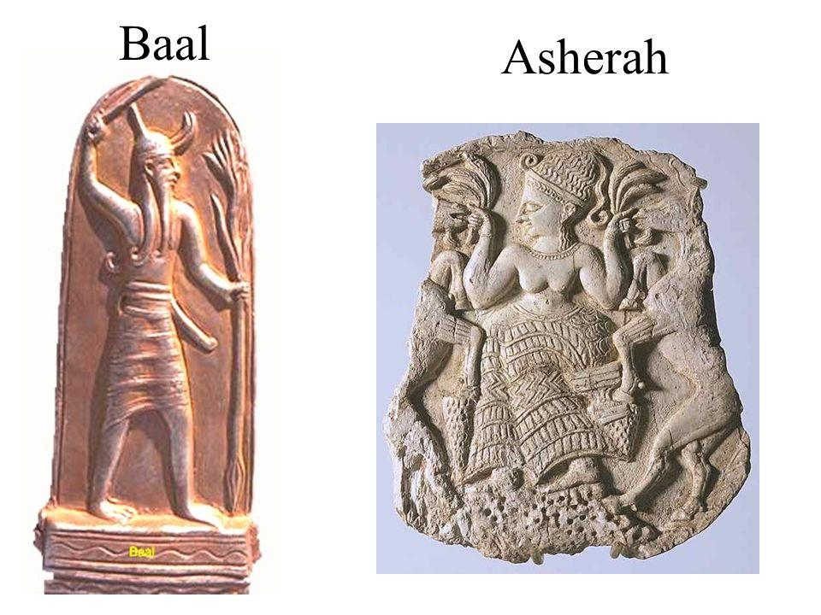
So the children of Israel did evil in the sight of the LORD. They forgot the LORD their God, and served the Baals and Asherahs. — Judges 3:7
the LORD their God
They forgot
They forgot
God
the LORD their God
Notes:
Men are more accustomed to worshipping desires of their own making over what God has commanded.

Slide 8
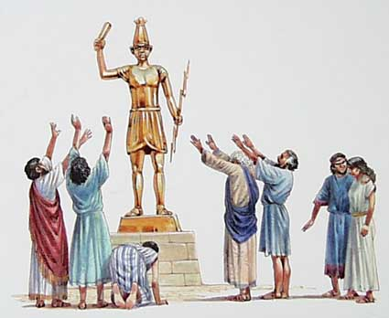
Thus the children of Israel did not remember the LORD their God, who had delivered them from the hands of all their enemies on every side; — Judges 8:34
did not
did not
remember
remember
God
the LORD their God
God
Notes:
To abandon God for substitutions, of catering to the tangible flesh, only delivers emptiness and loss of true spirit.

Slide 9
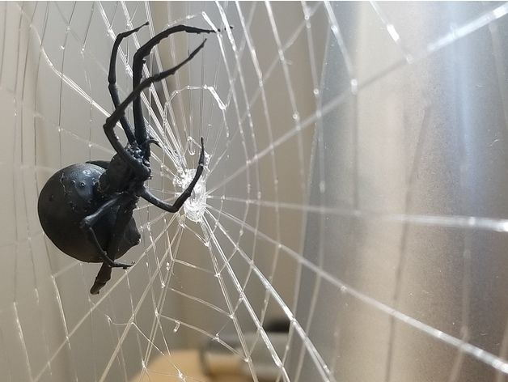
"Can the papyrus grow up without a marsh? Can the reeds flourish without water? While it is yet green and not cut down, It withers before any other plant. So are the paths of all who forget God; And the hope of the hypocrite shall perish, Whose confidence shall be cut off, And whose trust is a spider's web." — Job 8:11-14
God
all who forget God
all who forget God
God
shall perish
shall perish
be cut off
be cut off
Notes:
Trusting in man over God leads to oblivion.

Slide 10
The wicked shall be turned into hell, And all the nations that forget God. For the needy shall not always be forgotten; The expectation of the poor shall not perish forever. Arise, O LORD, Do not let man prevail; Let the nations be judged in Your sight. Put them in fear, O LORD, That the nations may know themselves to be but men. Selah — Psalms 9:17-20
forget
God
forget
Do not let man prevail
Do not let man prevail
Notes:
Hell is the absence of all heaven. Hell has no expression where gloom surrounds desolation.

Slide 11
Bless the LORD, O my soul, And forget not all His benefits: — Psalms 103:2
forget
forget not
forget not
forget
Notes:
To recall the blessings of God enlarges keen awareness.

Slide 12
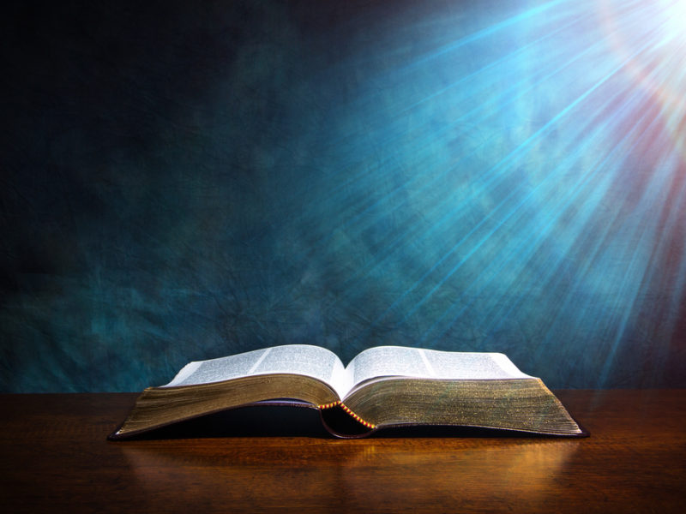
My son, do not forget my law, But let your heart keep my commands; — Proverbs 3:1
do not forget my law
do not forget my law
forget
heart
keep
forget
Notes:
Finding God’s word opens a heart to endless fruits.

Slide 13
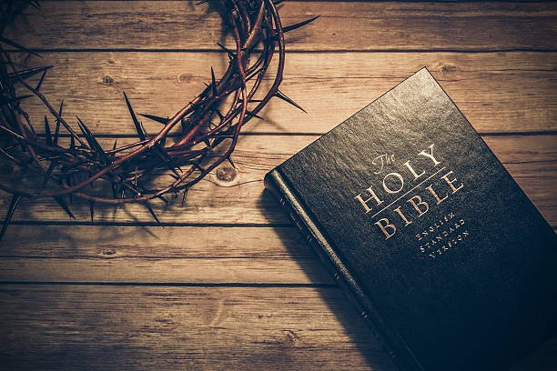
Get wisdom! Get understanding! Do not forget, nor turn away from the words of my mouth. — Proverbs 4:5
forget
Do not forget
Do not forget
forget
the words
the words
Notes:
No trap can contain those that cherish His truths.

Slide 14
"Can a woman forget her nursing child, And not have compassion on the son of her womb? Surely they may forget, Yet I will not forget you." — Isaiah 49:15
forget
forget
forget
forget
they may forget
I will not
they may forget
I will not
forget
forget you
forget you
forget
Notes:
Memories can be like shadows fading as the dust blows away.

Slide 15
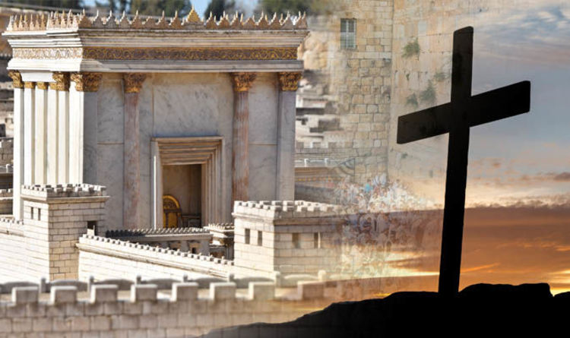
Can a virgin forget her ornaments, Or a bride her attire? Yet My people have forgotten Me days without number. — Jeremiah 2:32
forgotten Me
forget
have forgotten Me
forgotten Me
have forgotten Me
Notes:
Jesus had to come into the world as everyone had lost the true meaning of who God was, and is.

Slide 16
"Because My people have forgotten Me, They have burned incense to worthless idols. And they have caused themselves to stumble in their ways, From the ancient paths, To walk in pathways and not on a highway, …" — Jeremiah 18:15
My people have
My people
My people have
My people
forgotten Me
forgotten Me
forgotten Me
To walk in
Notes:
Man made pathways will never achieve the highway God lays.

Slide 17
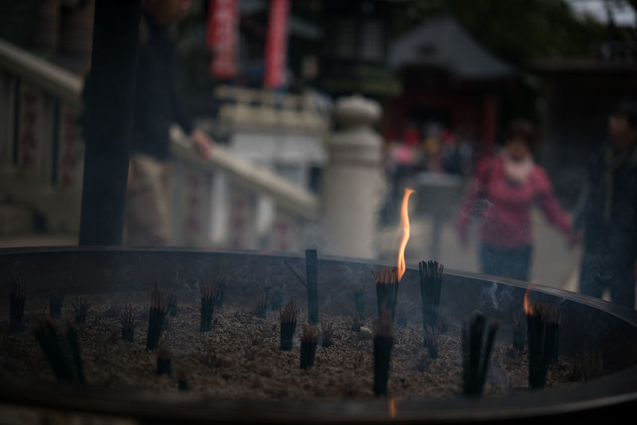
My people are destroyed for lack of knowledge. Because you have rejected knowledge, I also will reject you from being priest for Me; Because you have forgotten the law of your God, I also will forget your children. — Hosea 4:6
My people are destroyed for lack of knowledge. Because you have rejected knowledge, I also will reject you from being priest for Me; Because you have forgotten the law of your God, I also will forget your children. — Hosea 4:6
My people
forgotten
forgotten
. .
our children
Notes:
Key to godliness, through the ages, is knowledge of His Holy nature.

Slide 18
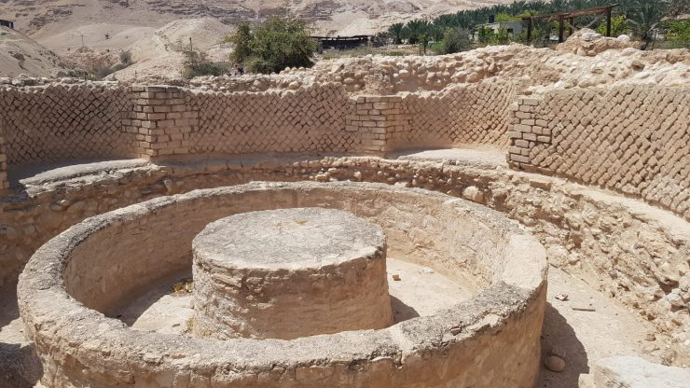
"For Israel has forgotten his Maker, And has built temples; Judah also has multiplied fortified cities; But I will send fire upon his cities, And it shall devour his palaces." — Hosea 8:14
. .
forgotten
forgotten his
Maker
Maker
But
!
But
Notes:
Ornate churches and or temples do not necessarily reflect worship of God if filled with the idols of man.

Slide 19
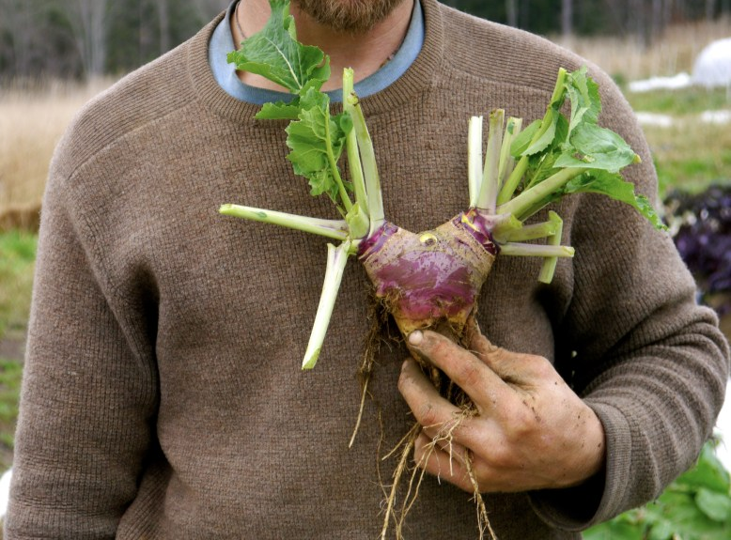
But do not forget to do good and to share, for with such sacrifices God is well pleased. — Hebrews 13:16
But
. .
do not forget to do good
share
sacrifices
sacrifices
Notes:
Doing good and sharing touches the very edges of heaven’s truth.

Slide 20
But also for this very reason, giving all diligence, add to your faith virtue, to virtue knowledge, to knowledge self-control, to self-control perseverance, to perseverance godliness, to godliness brotherly kindness, and to brotherly kindness love. — 2nd Peter 1:5-7
brotherly kindness
self-control
faith
virtue
perseverance
godliness
self-control
knowledge
our Lord Jesus
sacrifices
love
knowledge
perseverance
godliness
brotherly
virtue
faith
kindness
love
Notes:
Qualities of godly excellence takes a focused mind and spirit. An ongoing incorporating of all these character attributes is the holy halo of spirit.

Slide 21
For if these things are yours and abound, you will be neither barren nor unfruitful in the knowledge of our Lord Jesus Christ. For he who lacks these things is shortsighted, even to blindness, and has forgotten that he was cleansed from his old sins. — 2nd Peter 1:8-9
if these things are yours
if these things are yours
knowledge of our Lord Jesus
knowledge of our Lord Jesus
our Lord Jesus
Lord
Lord Jesus
lacks these
Christ
lacks these
Christ
Christ
things
things
forgotten
forgotten
cleansed from
old sins
Lord
old sins
cleansed from
Notes:
Neglecting pursuing a character of God in Christ snubs life itself.

Slide 22
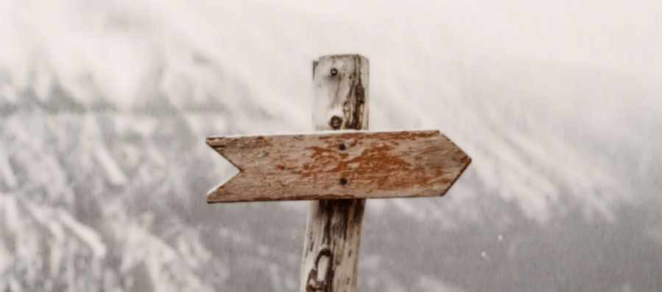
Beloved, I now write to you this second epistle (in both of which I stir up your pure minds by way of reminder), that you may be mindful of the words which were spoken before by the holy prophets, and of the commandment of us, the apostles of the Lord and Savior, … — 2nd Peter 3:1-2
pure minds
reminder
be mindful
reminder
be mindful
of the words
of the words
the words
Lord
Notes:
There is only one direction to God, and it comes by the word He has once delivered. Man’s fantasies, additions, or replacements will not nullify His established commands.

Slide 23
… knowing this first: that scoffers will come in the last days, walking according to their own lusts, and saying, "Where is the promise of His coming? For since the fathers fell asleep, all things continue as they were from the beginning of creation." — 2nd Peter 3:3-4
scoffers
will
walk
pure minds
their own lusts
Where is
His coming?
in
scoffers will walk in their own lusts
Where is His coming?
Notes:
Mockers will be plentiful, claiming false bigotry accusations, against the true faithful. God will not show favor with liars without knowledge of His truths.

Slide 24
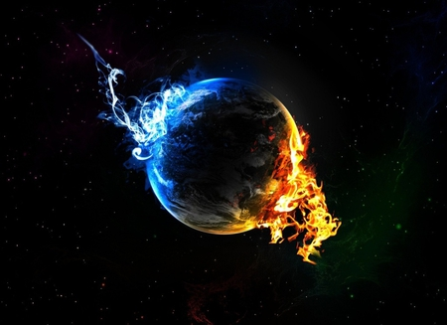
For this they willfully forget: that by the word of God the heavens were of old, and the earth standing out of water and in the water, by which the world that then existed perished, being flooded with water. But the heavens and the earth which are now preserved by the same word, are reserved for fire until the day of judgment and perdition of ungodly men. — 2nd Peter 3:5-7
willfully forget
willfully forget
forget
forget
the day of judgment
the day of judgment
ungodly men
ungodly men
Notes:
Earth is a creation of God, He holds, to redeem those lost, until He declares the end of time.

Slide 25
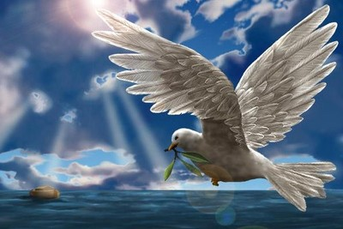
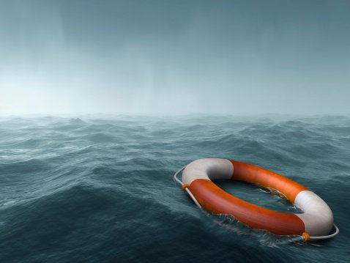
But, beloved, do not forget this one thing, that with the Lord one day is as a thousand years, and a thousand years as one day. The Lord is not slack concerning His promise, as some count slackness, but is longsuffering toward us, not willing that any should perish but that all should come to repentance. — 2nd Peter 3:8-9
. .
do not forget
concerning His promise:
● timeless
● The Lord is not slack
is longsuffering toward us
● not willing that any should perish
● all should come to repentance
i
t
The
unyielding
patient
. .
concerning His
Lord is not slack
not slack
forget
=
promise
me
l
ess
is longsuffering toward us
not
willing that any should perish
all should come to repentance
Notes:
As time has a final moment, a new age awaits for all those faithful to His call. Loving today has more than we can lose to the winds of tomorrow. Shadows of missed moments from the past causes one to drown in misery. The present is the only gift we have. Tell me now, what is life and where dwells its’ importance?

Slide 26
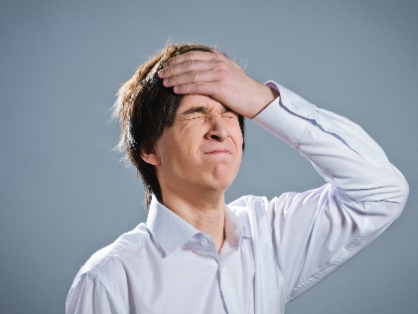
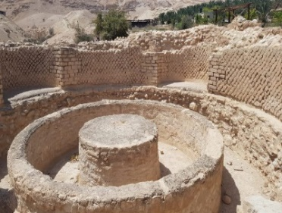
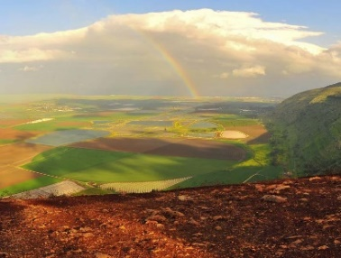
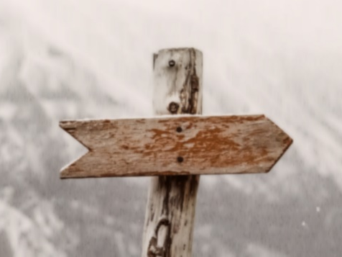
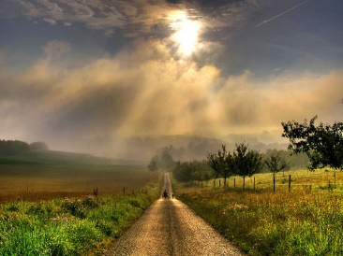

Slide 27
→ Take heed and diligently keep to the word of God
→ Those that forget God trust in evil
→ All the nations that forget God will be turned to hell
→ Do not forget or turn from the words of wisdom
→ Mothers may forget a child, but God will not forget
→ Forgetting God causes one to stumble in their ways
→ Godly people are destroyed for lack of knowledge
→ Many forget God building temples to man’s glory
→ Do not forget to do good and share
→ Not forgetting noble qualities abounds in the Lord
→ The Bible is a reminder to be mindful of holiness
→ Last days: scoffers will deny the promise of God
→ People willfully forget the word of God
The Spirit calls out in an ocean of despair
Notes:
The Spirit calls out in an ocean of despair.

Slide 28
Notes:
The Holy Spirit is waiting to deliver peace to all hearts who believe.

Slide 30
Please visit http://www.LoveFromGod.com to explore further
Ronald Bert Channel on
Notes:
Eternity never ends.

