Slide 2

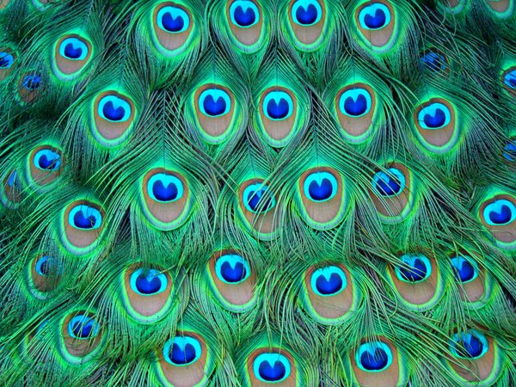
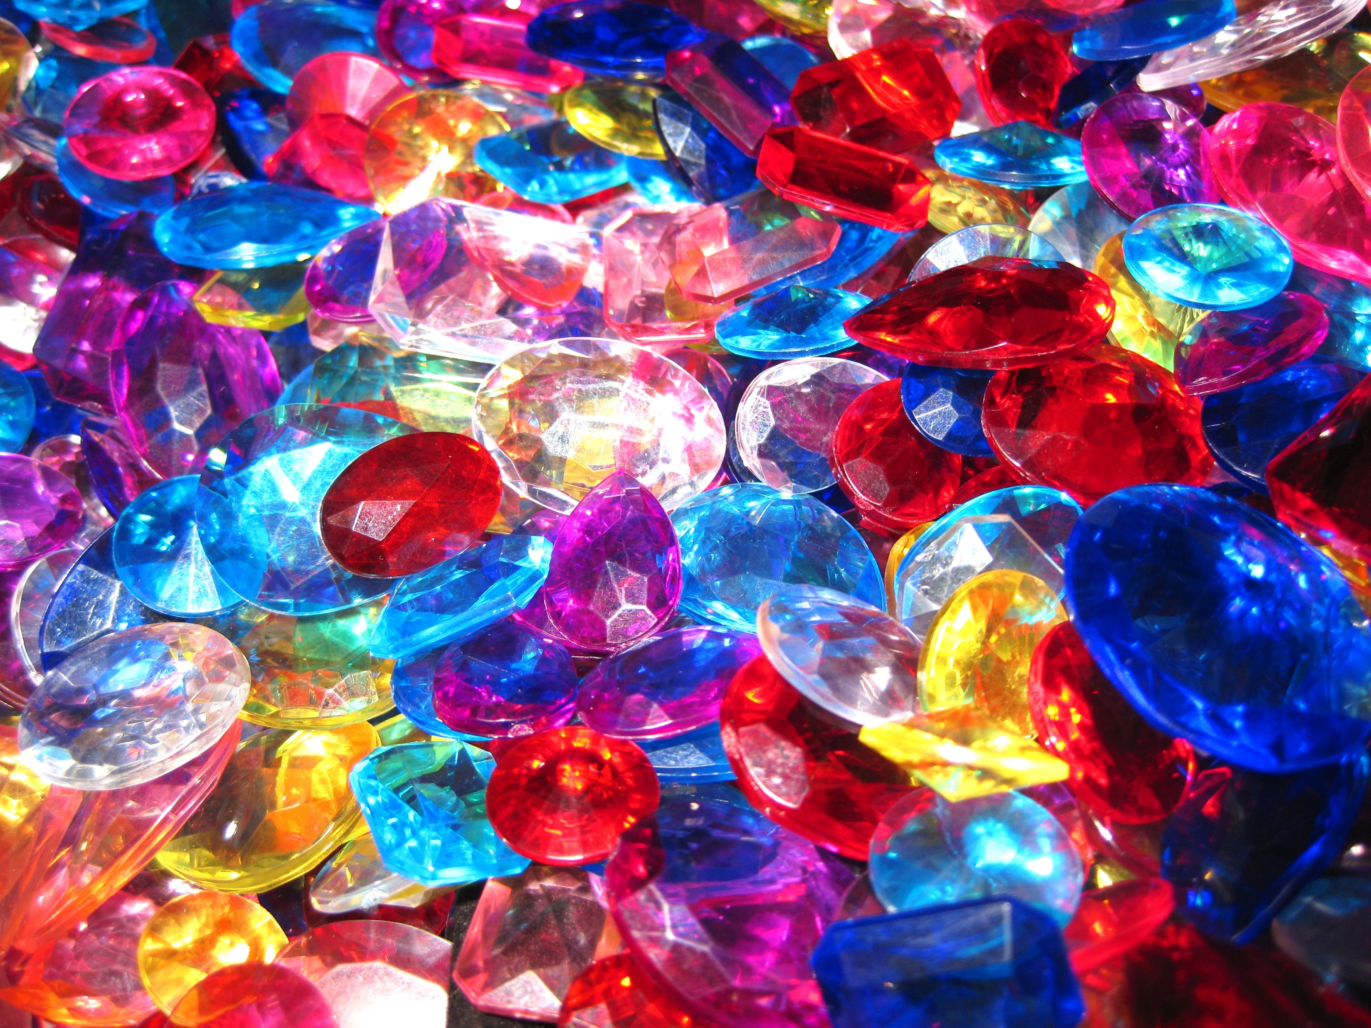
Fools
Ron Bert
October 27, 2019

Slide 3

[To the Chief Musician. A Psalm of David.] The fool has said in his heart, "There is no God." They are corrupt, They have done abominable works, There is none who does good. — Psalms 14:1
fool
There is no God
fool

Slide 4
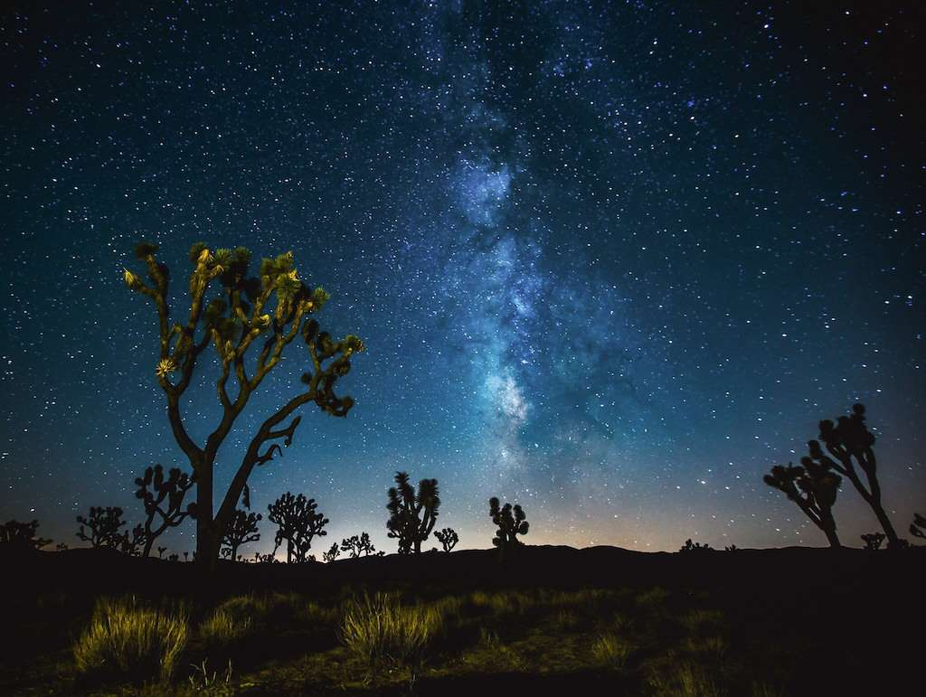
O LORD, how great are Your works! Your thoughts are very deep. A senseless man does not know, Nor does a fool understand this. — Psalms 92:5-6
great works!
great
works!
fool
A
does not
senseless
fool
understand
know
or
fool
A fool does not know or understand
Notes:
If one does not embrace God in this world, indeed, he or she remains a limited creature of the flesh. The desert of the world is not the Kingdom of God. Our bodies will return to the dust while God remains. To ignore Him is to reject Him.

Slide 5
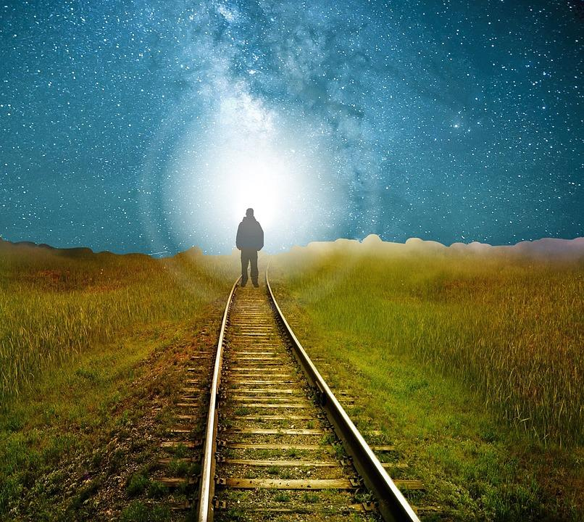
The fear of the LORD is the beginning of knowledge, But fools despise wisdom and instruction. — Proverbs 1:7
wisdom
knowledge
instruction
knowledge
fools
fool
wisdom
instruction
fools
Notes:
Without instruction, knowledge, and the wisdom that accompanies it, one remains more humanist that spiritual. To reach for the heavens one must put on these badges. Fools are guided by short sided selfish whims of impulse, not really having insight or direction other than desperation. We were created to be thoughtful, not mindless.

Slide 6

Understand, you senseless among the people; And you fools, when will you be wise? — Psalms 94:8
unconscious
mindless
oblivious
idiotic
irrational
deadened
fools
senseless
fools

Slide 7
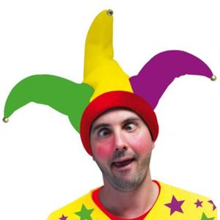
"How long, you simple ones, will you love simplicity? For scorners delight in their scorning, And fools hate knowledge." — Proverbs 1:22
simple
ridiculing
fool
fools
. .
Notes:
ridicule

Slide 8
fool
fool
Notes:
ridicule

Slide 9
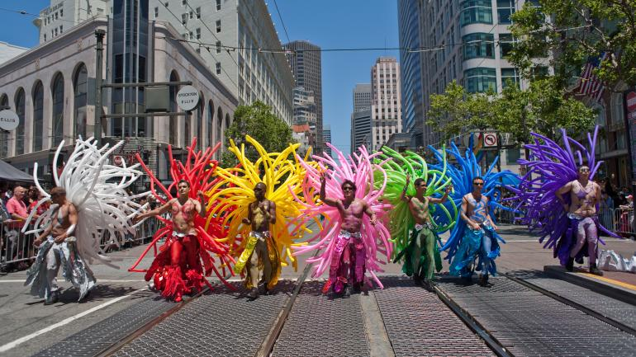
Do not speak in the hearing of a fool, For he will despise the wisdom of your words. — Proverbs 23:9
ool
F
fool
s
Fools

Slide 10


"Do not give what is holy to the dogs; nor cast your pearls before swine, lest they trample them under their feet, and turn and tear you in pieces." — Matthew 7:6
… as also in all his epistles, speaking in them of these things, in which are some things hard to understand, which untaught and unstable people twist to their own destruction, as they do also the rest of the Scriptures. — 2nd Peter 3:16
dog
pearls
dog
untaught
unstable people twist
Fools
Notes:
Power to the people does not necessarily reflect power to God. Followers of men can and does discount the will of God Almighty Himself. The moral majority is an illusion where it has always been the moral minority. Follow Me was the call of Jesus to all wishing salvation from the confines of manmade corruption and tyranny.

Slide 11
dog
n
Notes:
For all those that perceive they are free to do as they will, without accountability to God, are not one in His Spirit. They are united in their sin and will find His grace unobtainable upon judgment of character according to His will and standards. Sexual revolutions have perhaps been the downfall of all nations striving to unite by delivering only contempt and confusion as they selfishly cry wandering without leadership. Revelation does not equate to the lawlessness, and God throughout time has warned sin no favor with Him. To be in His light is to come out of the darkness.

Slide 12

As a dog returns to his own vomit, So a fool repeats his folly. — Proverbs 26:11
fool
dog
fool
repeats
fool
fool
Notes:
Dogs and fools alike wander about in a stupor not knowing or caring to know.

Slide 13

A whip for the horse, A bridle for the donkey, And a rod for the fool's back. Do not answer a fool according to his folly, Lest you also be like him. Answer a fool according to his folly, Lest he be wise in his own eyes. — Proverbs 26:3-5
fool
fool
fool
arrogant

Slide 14

If a wise man contends with a foolish man, Whether the fool rages or laughs, there is no peace. — Proverbs 29:9
fool
fool
rages or laughs
Notes:
Fools are generally hotheads and have very thin skin when it come to depth of character. In ridicule they can dish it out, but in return, very little criticism or rebuke sets off their I immediate rage. It has been my experience there are more raging fools than laughing. Laughing is a cover-up whereas rage is an easier flow for the miserable unthankful complainer.

Slide 15
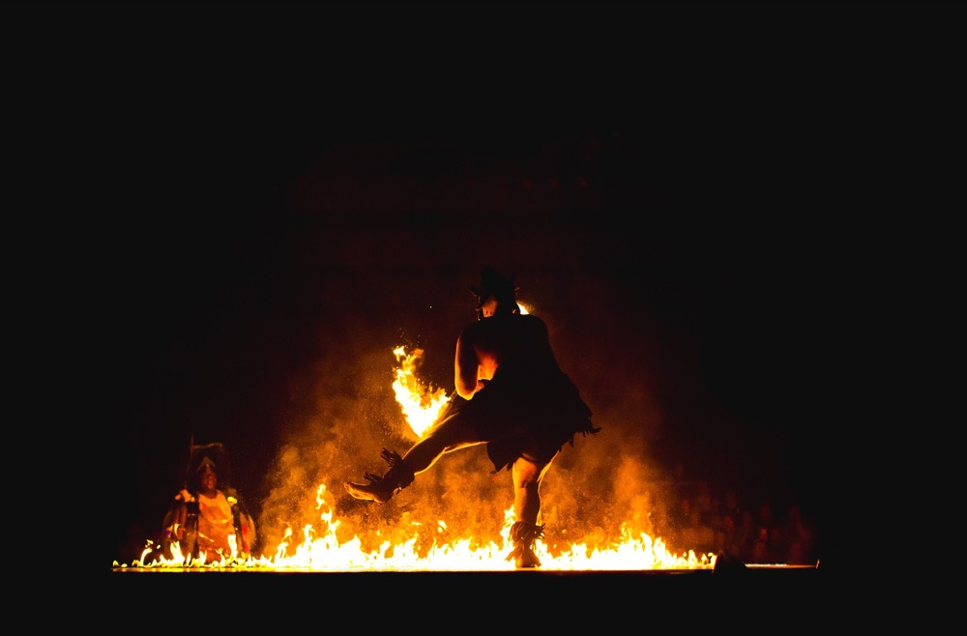
For like the crackling of thorns under a pot, So is the laughter of the fool. This also is vanity. — Ecclesiastes 7:6
fool
fool

Slide 16

It is honorable for a man to stop striving, Since any fool can start a quarrel. — Proverbs 20:3
pushy
defensive
fool
fool

Slide 17

A wise man fears and departs from evil, But a fool rages and is self-confident. — Proverbs 14:16
fool
fool

Slide 18


Do you see a man wise in his own eyes? There is more hope for a fool than for him. — Proverbs 26:12
Pride
fool
fool

Slide 19

The lips of the wise disperse knowledge, But the heart of the fool does not do so. — Proverbs 15:7
fool
shares
fool
fool
fool
withdrawn
Notes:
A fool can be a bull in a glass house, but in truth, most fools hide behind the fear of insecurity in the depths of their turmoil. Recall, where there is a fool there can be no peace or unity of thought.

Slide 20

A fool's lips enter into contention, And his mouth calls for blows. A fool's mouth is his destruction, And his lips are the snare of his soul. — Proverbs 18:6-7
fool
blows
fool
blows
his lips
snare of his soul
his lips
snare of
fool
his soul
snare of his soul

Slide 21

Whoever hides hatred has lying lips, And whoever spreads slander is a fool. — Proverbs 10:18
insults
fool
fool

Slide 22
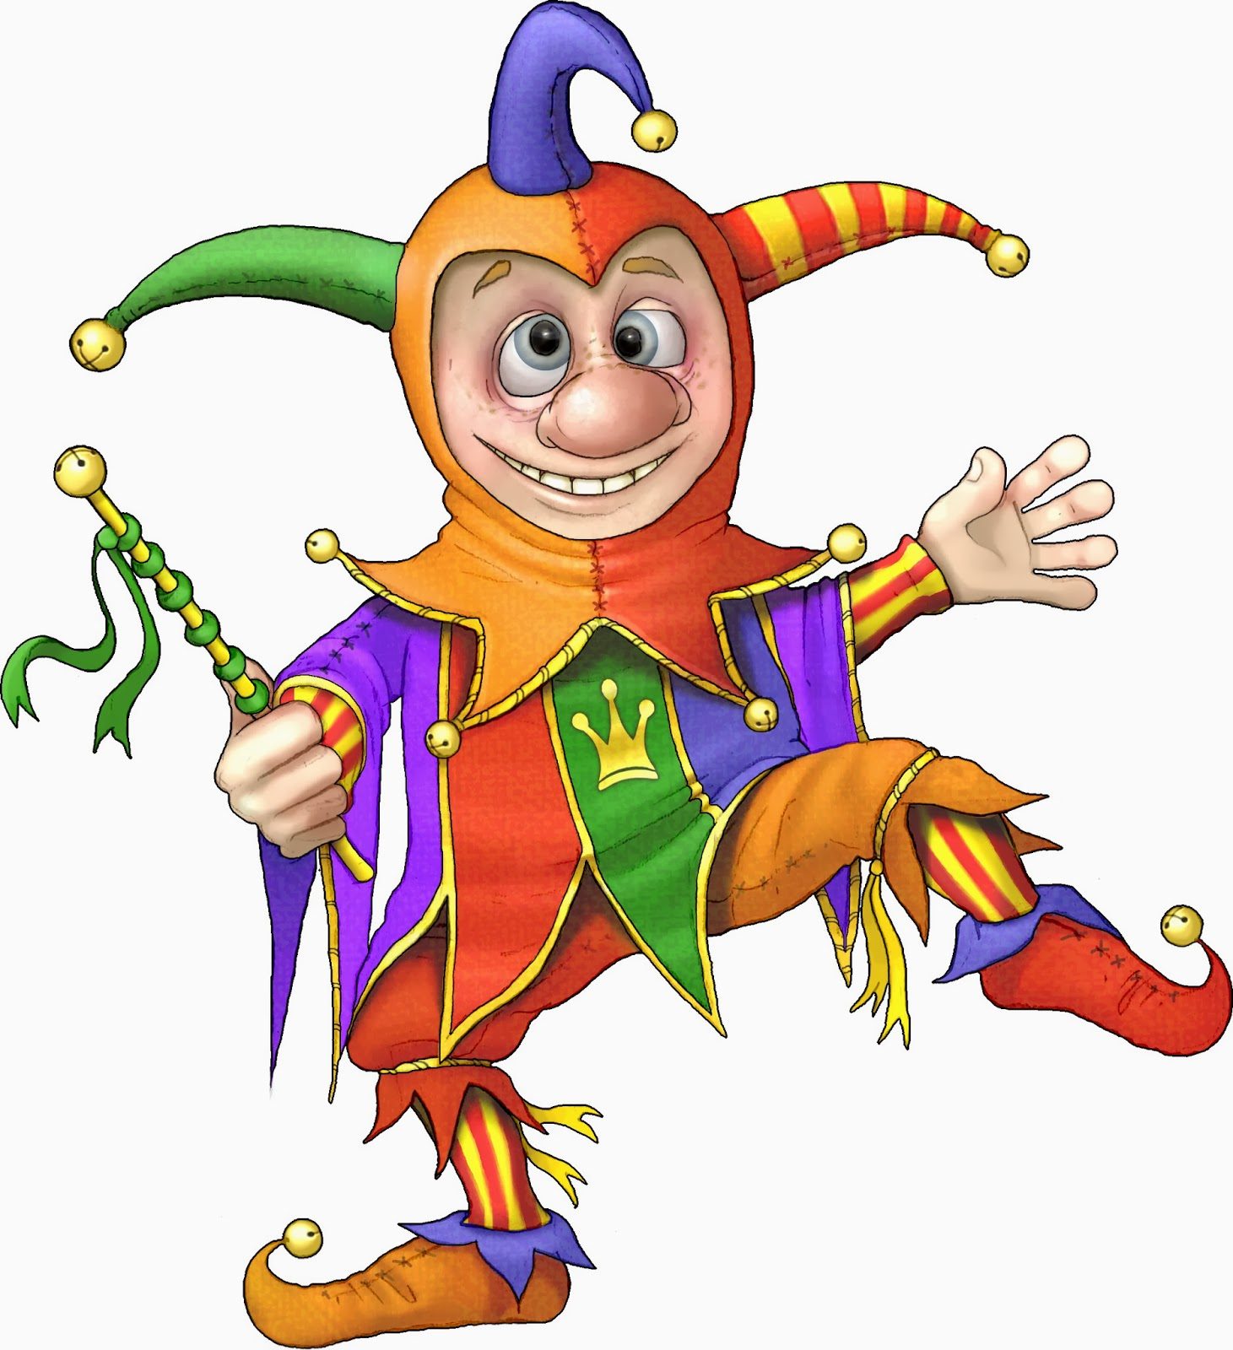
Better is the poor who walks in his integrity Than one who is perverse in his lips, and is a fool. — Proverbs 19:1
integrity
fool
in
perverse in his lips
fool
Notes:
Fools do not have integrity, which is to remain steadfast, for their houses are built upon the sand.

Slide 23
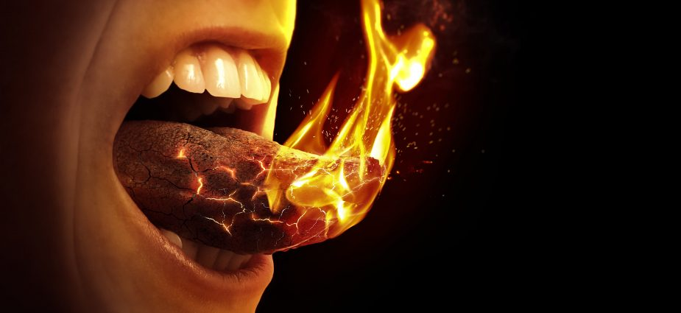
Do you see a man hasty in his words? There is more hope for a fool than for him. — Proverbs 29:20
hasty
fool
Notes:
Hasty words often rhyme with nasty.

Slide 24
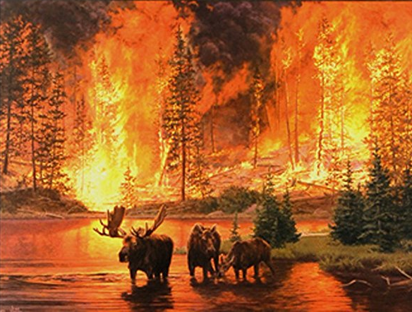
Even so the tongue is a little member and boasts great things. See how great a forest a little fire kindles! — James 3:5

Slide 25
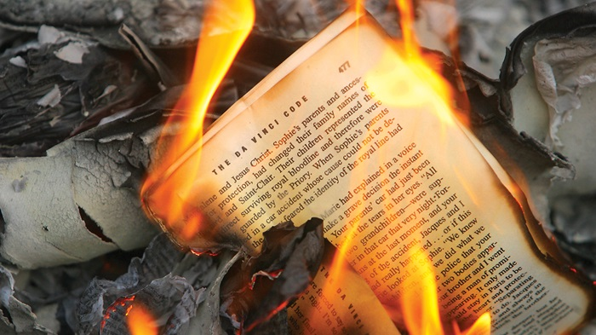
The heart of him who has understanding seeks knowledge, But the mouth of fools feeds on foolishness. — Proverbs 15:14
. .
fool
fool
Notes:
Fake news has torched all civilizations with a plethora of liars. God loves all and will forgive all sins, and if you believe this you surly are a fool waiting for His breath of truth, which strips all lies as we all fall before Him.

Slide 26








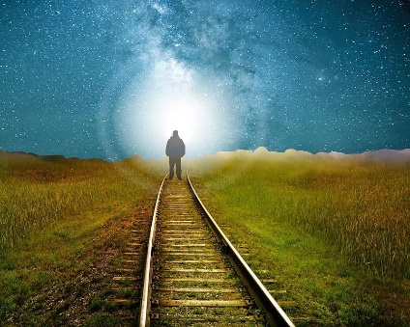




fool

Slide 27


Slide 29

Fools 2
Ron Bert
November 3, 2019

Slide 30
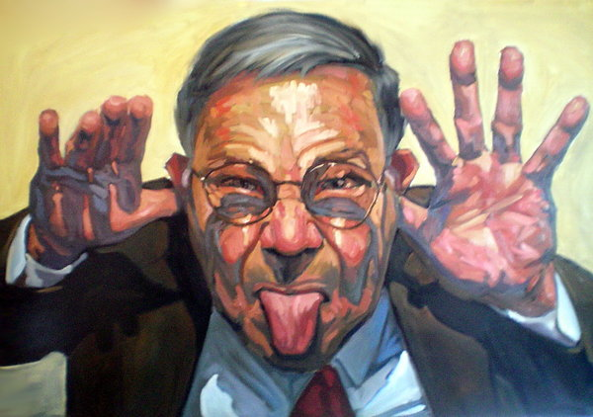
"Forsake foolishness and live, And go in the way of understanding. He who corrects a scoffer gets shame for himself, and he who rebukes a wicked man only harms himself. Do not correct a scoffer, lest he hate you; Rebuke a wise man, and he will love you. " — Proverbs 9:6-8
fool
understand
understand:
꙰ correct a scoffer
→ get shame and harm
→ he will hate you
҉ Rebuke a wise man
→ he will love you
correct
a scoffer
get
shame
and
harm
fool
he
hate you
Rebuke a wise
will
man
he will love you
Notes:
The Bible states fools will not like you with wisdom delivered from above. Most will not hear choosing rather to dismiss what will eventually convict their actions; His Word. One of the easiest things a fool can do is to hate others.

Slide 31
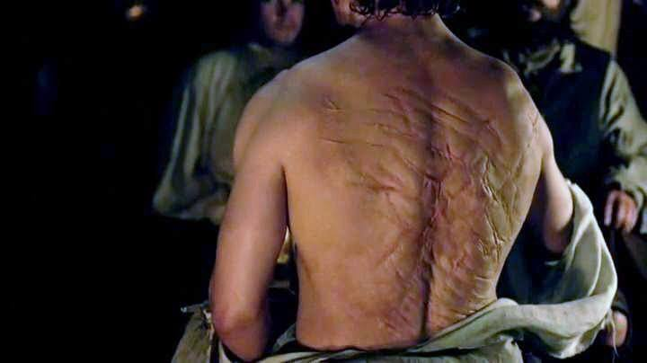
Rebuke is more effective for a wise man Than a hundred blows on a fool. — Proverbs 17:10
Spirit
fool
Mind
torture
fool
fool
fool

Slide 32
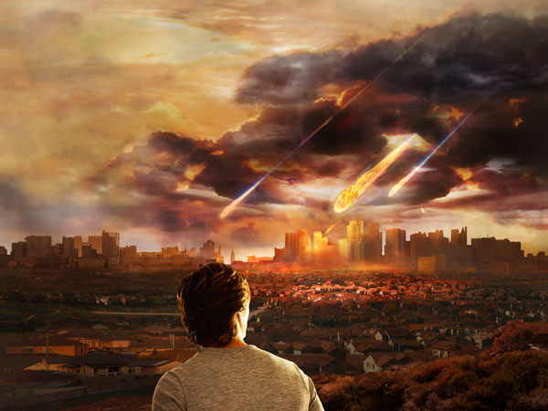
Wisdom is in the sight of him who has understanding, But the eyes of a fool are on the ends of the earth. A foolish son is a grief to his father, And bitterness to her who bore him. — Proverbs 17:24-25
fool
Stuff
Fantasy
fool
fool
Notes:
A fool only sees permanence in the world, with eternity only a shadow of what will never be. This world was made shallow to test the height of character under weights absent of feathers.

Slide 33

He who begets a scoffer does so to his sorrow, And the father of a fool has no joy. — Proverbs 17:21
fool
fool
Notes:
Fools can certainly hurt you and each of us has been hurt by a fool.

Slide 34

A fool despises his father's instruction, But he who receives correction is prudent. — Proverbs 15:5
fool
hates
fool
humble
wise
Notes:
Hate is the barrier curtailing all that is greater in appreciation of true wisdom delivered to the humble.

Slide 35
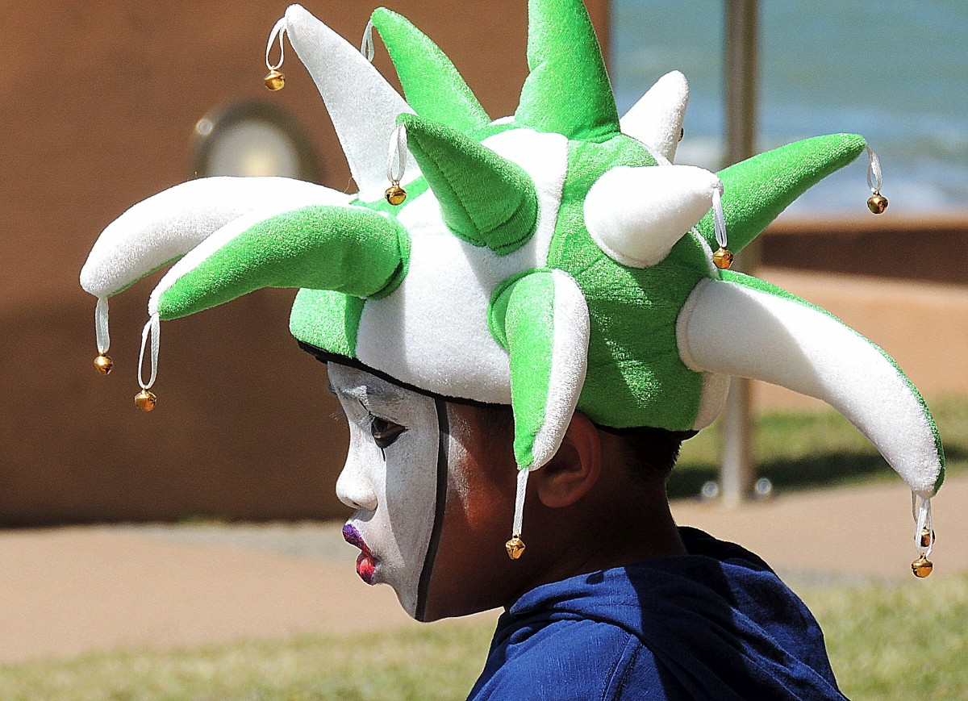
A wise son makes a father glad, But a foolish man despises his mother. Folly is joy to him who is destitute of discernment, But a man of understanding walks uprightly. — Proverbs 15:20-21
fool
fool
fool
lacking good judgment
fool
Notes:
A fool generally cannot see past his own face.

Slide 36
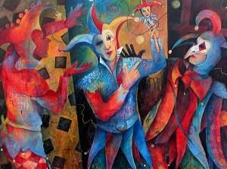
Go from the presence of a foolish man, When you do not perceive in him the lips of knowledge. The wisdom of the prudent is to understand his way, But the folly of fools is deceit. Fools mock at sin, But among the upright there is favor. — Proverbs 14:7-9
fool
Possess your soul
fool
fools
deceit
mock at sin
fool
laugh
Notes:
Lu 21:19 "By your patience possess your souls.”

Slide 37

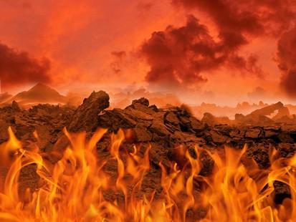

The wise shall inherit glory, But shame shall be the legacy of fools. — Proverbs 3:35
Heaven
fool
glory
shame
fool
Hell
Notes:
To leave being a dumb fool, one must rise to become a smart fool, in that letting truth shine in upon the sin to reveal regret that softens the soul.

Slide 38
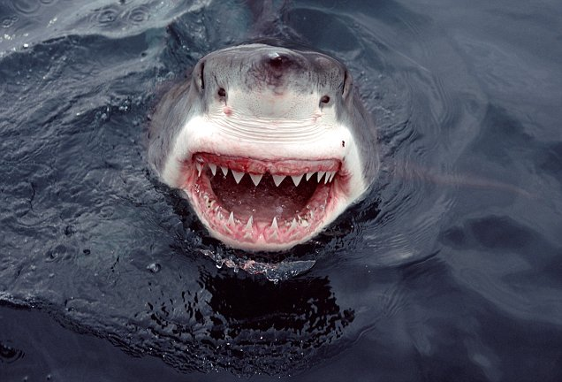
A fool vents all his feelings, But a wise man holds them back. — Proverbs 29:11
fool
fool
Notes:
Many situations can trigger a foolish a heart, but to be reserved is control through the power of wisdom. We are all in the arena of sharks circling.

Slide 39
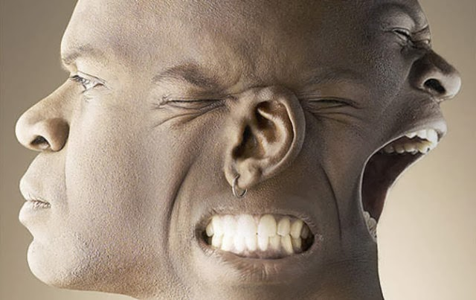
A fool has no delight in understanding, But in expressing his own heart. — Proverbs 18:2
fool
fool
fool
fool
Notes:
If you want to leave the fool behind, one must hear what the Spirit says to the churches.

Slide 40

The way of a fool is right in his own eyes, But he who heeds counsel is wise. A fool's wrath is known at once, But a prudent man covers shame. — Proverbs 12:15-16
fool
fool
fool

Slide 41

A foolish woman is clamorous; She is simple, and knows nothing. — Proverbs 9:13
fool
fool

Slide 42

The wise woman builds her house, But the foolish pulls it down with her hands. He who walks in his uprightness fears the LORD, But he who is perverse in his ways despises Him. In the mouth of a fool is a rod of pride, But the lips of the wise will preserve them. — Proverbs 14:1-3
fool
pulls it down
perverse
despises
fool
pride
Notes:
The things that tear a fool apart are found in perversity, despising others, and a swelling smugness. A fool tears things down rather than building it up.

Slide 43

Do not hasten in your spirit to be angry, For anger rests in the bosom of fools. — Ecclesiastes 7:9
fool
fool
fool
fool
Notes:
The proof is in the nail. Direction guides the heart.

Slide 44
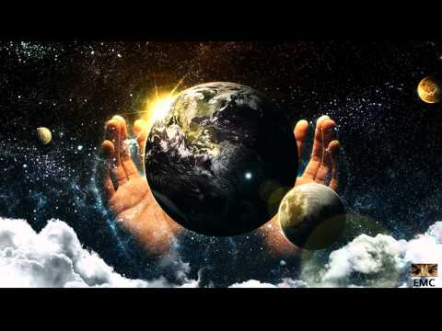
A soft answer turns away wrath, But a harsh word stirs up anger. The tongue of the wise uses knowledge rightly, But the mouth of fools pours forth foolishness. The eyes of the LORD are in every place, Keeping watch on the evil and the good. — Proverbs 15:1-3
soft
OR
harsh
is
the LORD is watching
fool
fool
the LORD
ing
watch
Notes:
Soft or harsh, each of us has to examine the most inner self to discover ones true worth. To lie is to remain oblivious that we all need to improve under the wise eye of God.

Slide 45

Then He spoke a parable to them, saying: "The ground of a certain rich man yielded plentifully. And he thought within himself, saying, 'What shall I do, since I have no room to store my crops?' So he said, 'I will do this: I will pull down my barns and build greater, and there I will store all my crops and my goods." — Luke 12:16-18
Notes:
God has given to each of us, some more abundantly than others. When a lack of thankfulness, for what one does have, pervades the conscience, greed can focus on what takes a soul away from a godly presence.

Slide 46
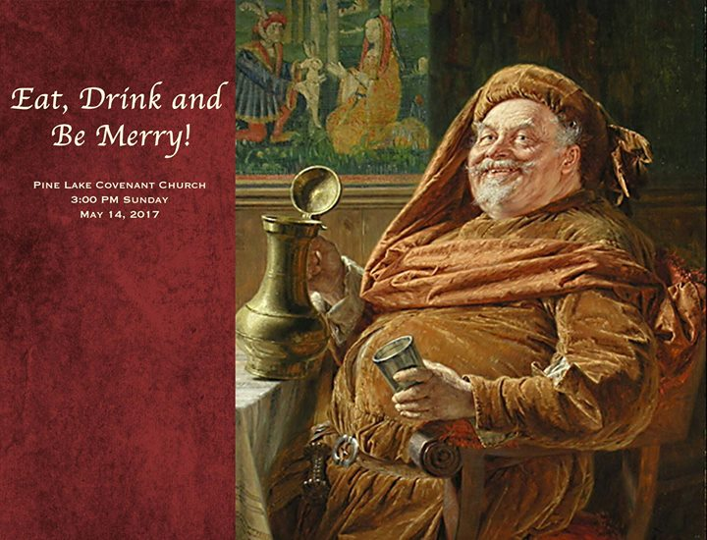
"… 'And I will say to my soul, "Soul, you have many goods laid up for many years; take your ease; eat, drink, and be merry."' But God said to him, 'Fool! This night your soul will be required of you; then whose will those things be which you have provided?’” — Luke 12:19-20
Fool
Notes:
Without a constant awareness of God, in humble acknowledgement, the moment can deliver troubled expulsion upon facing deliverance at eternal judgment.

Slide 47

Do not be deceived, God is not mocked; for whatever a man sows, that he will also reap. For he who sows to his flesh will of the flesh reap corruption, but he who sows to the Spirit will of the Spirit reap everlasting life. — Galatians 6:7-8
sows to his flesh
sows to his flesh = corruption
sows to the Spirit = everlasting life
corruption
sows to the Spirit
everlasting life

Slide 48

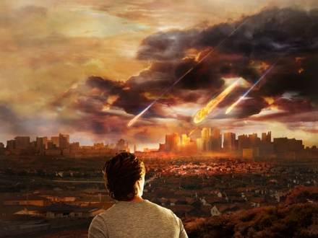



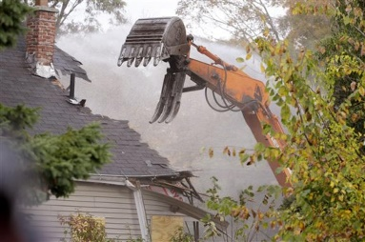


Slide 49
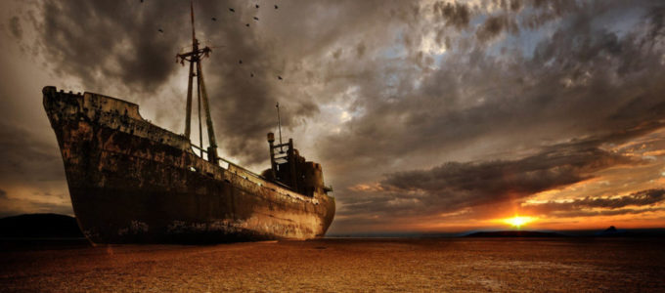


→ Only a fool denies God is real
→ Fools despise wisdom and instruction
→ The wise have no unity with raging or laughing fools
→ A fool rages and is self-confident
→ A fool’s mouth is his worst enemy
→ Perverse lips & spreading slander is a fool’s delight
→ Wise correction of a fool invites his contempt
→ Sorrow, grief, & bitterness on the parents of a fool
→ Shame is the legacy of a fool
→ A fool speaks impulsively lacking all control
→ A fool’s way is right in his own eyes
→ A foolish woman is loud and destructive
→ Anger rests in the bosom of fools
The madness of a fool views no self-control → Sees no harbor
Notes:
The madness of a fool views no self-control

Slide 51
Fools 3
Ron Bert
November 24, 2019
Notes:
Fools may consider strength of humble spirit out of reach, perhaps even dismissing the need for an improving change as they frolic in their sins.

Slide 52

To do evil is like sport to a fool, But a man of understanding has wisdom. — Proverbs 10:23
fool
evil
fool
fool
wise
fool
evil
wise
Notes:
Evil plots with no mercy mired in hate and discontent.

Slide 53

A desire accomplished is sweet to the soul, But it is an abomination to fools to depart from evil. He who walks with wise men will be wise, But the companion of fools will be destroyed. — Proverbs 13:19-20
Purpose
fool
evil
wise
fool
companion
fool
Notes:
As the ditch is deep, foolish associations will lead to the demise of good behaviors, and deposit only what is foul. God purposed creation and we in His image to find purpose as well. Foolishly we all battle sins in coming to know becoming either earthly fools or ones with eyesight on heaven. Better to be a heavenly fool rather than one of earthly fadings.

Slide 54

For the turning away of the simple will slay them, And the complacency of fools will destroy them; — Proverbs 1:32
disregard
fool
satisfaction
fool
Notes:
Fools desire an escape from misery and take little account of the fall that lays before them. Pits remain deepening when one cannot come to senses of truth with restraint.

Slide 55

The wise in heart will receive commands, But a prating fool will fall. — Proverbs 10:8
BLAH
BLAH
BLAH
instructions
fool
BLAH
fool
BLAH
BLAH
Notes:
Fools often cling to desperation and have an insatiable desire to be noticed. Within hours you may know more about their jobs, complaints, marital problems or lack of, to their financial woes, without them ever even asking your name or any other concern than themselves.

Slide 56
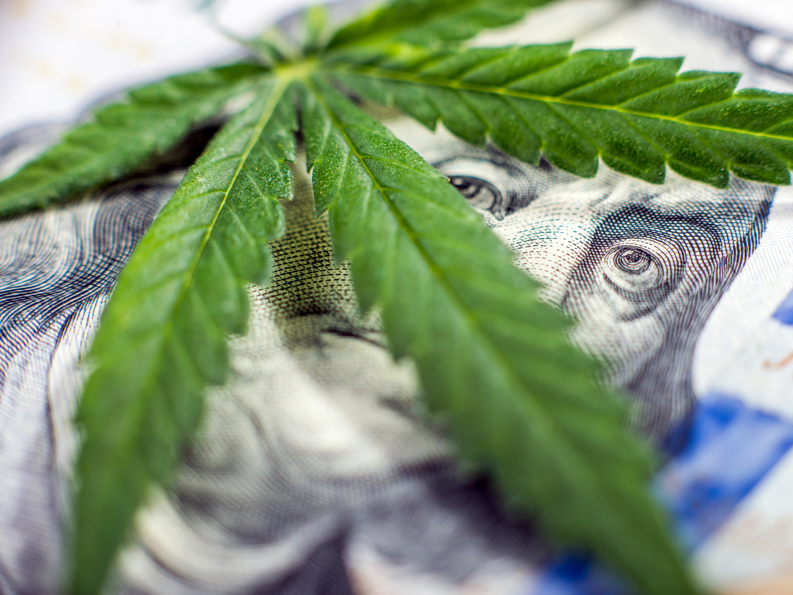
The heart of the wise is in the house of mourning, But the heart of fools is in the house of mirth. — Ecclesiastes 7:4
fool
sorrows
fool
pleasure
Notes:
With so many “legal” mind altering substances available today, the power to resist is not for the faint hearted. In this world one cannot be sane without sorrow. If one only pursues pleasures without thought of tears for the children, how despicable is he or she who cares only for self. The deeper essence of a soul is found in love of others over self.

Slide 57

Then I saw that wisdom excels folly As light excels darkness. The wise man's eyes are in his head, But the fool walks in darkness. Yet I myself perceived That the same event happens to them all. So I said in my heart, "As it happens to the fool, It also happens to me, And why was I then more wise?" Then I said in my heart, "This also is vanity." — Ecclesiastes 2:13-15
fool
in
thoughtful
fool
eyes are in his head
the fool walks
in darkness
Notes:
Certainly, there is much more foolishness that buries the masses, than wisdom that guides the children.

Slide 58
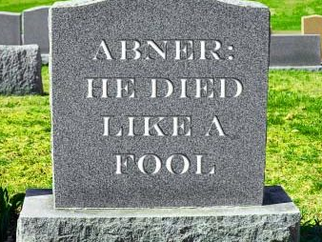
For there is no more remembrance of the wise than of the fool forever, Since all that now is will be forgotten in the days to come. And how does a wise man die? As the fool! Therefore I hated life because the work that was done under the sun was distressing to me, for all is vanity and grasping for the wind. — Ecclesiastes 2:16-17
fool
temporary
fool
I hated life
futility
Notes:
No intelligence can achieve that nirvana souls seek. For all that we are or can become, it is worthless without God. For as dust has no living value, without love from above, presence has no worth.
Ro 8:20 For the creation was subjected to futility, not willingly, but because of Him who subjected it in hope;

Slide 59

For we ourselves were also once foolish, disobedient, deceived, serving various lusts and pleasures, living in malice and envy, hateful and hating one another. — Titus 3:3
fool
❷
❸
❶
❹
❺
❻
fool
Notes:
In becoming creatures of God, awareness through experience either lifts or sinks a heart. To establish excellence, our minds must rule over impulsive desires spanning what is wicked, pursuing mercy and compassion which opens a wise heart’s freedom, and this is acceptable to God.

Slide 60
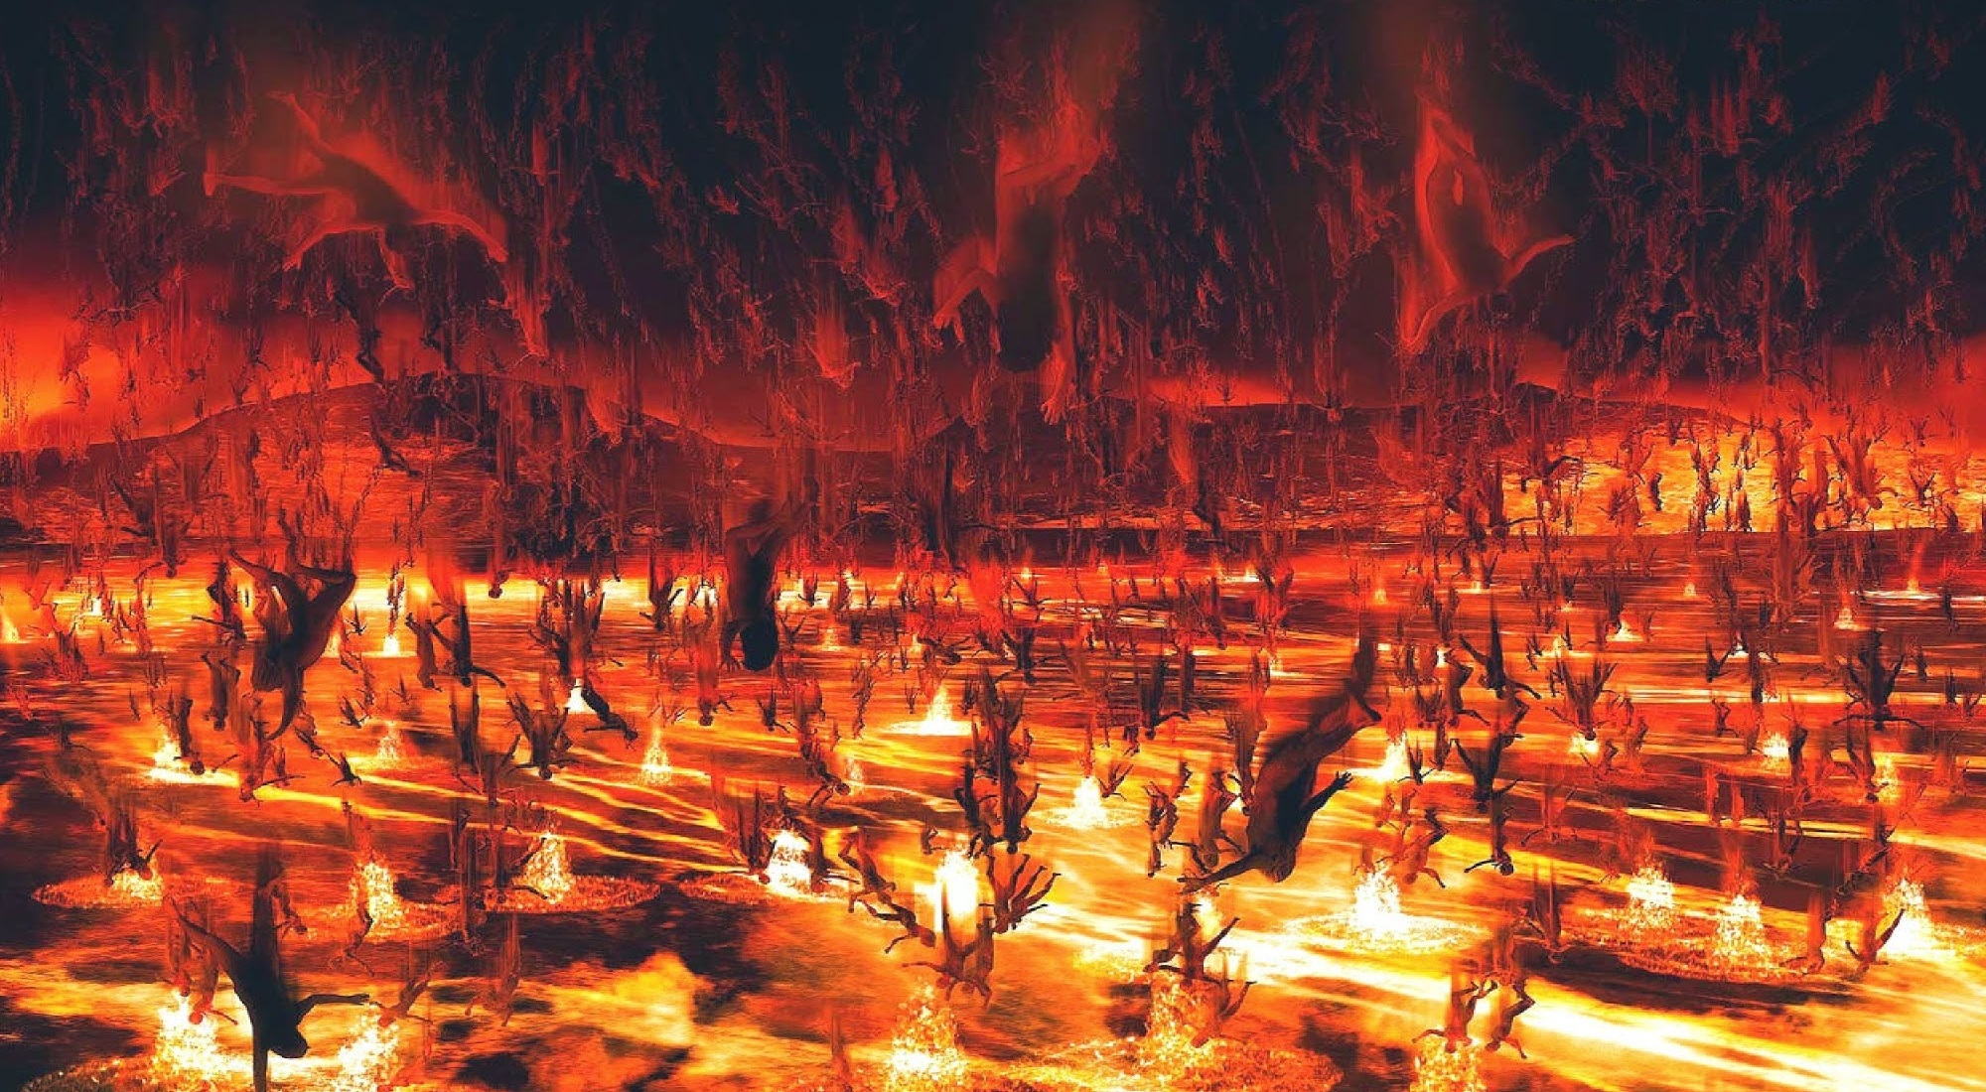
"But I say to you that whoever is angry with his brother without a cause shall be in danger of the judgment. And whoever says to his brother, 'Raca!' shall be in danger of the council. But whoever says, 'You fool!' shall be in danger of hell fire." — Matthew 5:22
disgusted
stupid
fool
dumb
fool
HATE
---
Notes:
Wishing death upon fellow humans is one of the most condemning judgments that can fall upon us, when God asks if we heard His call to life.

Slide 61

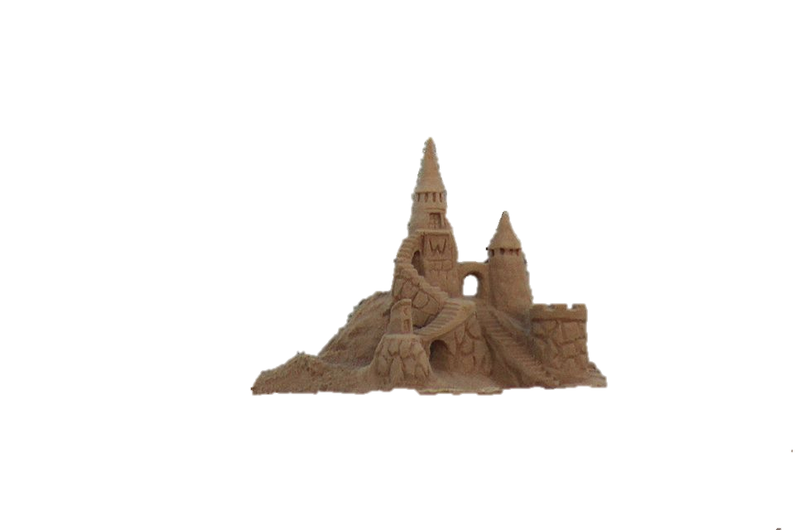

"But everyone who hears these sayings of Mine, and does not do them, will be like a foolish man who built his house on the sand:" — Matthew 7:26
not do
them
fool
not do them
fool
Notes:
A wave of truth approaches and all false facades will crumble in His presence. If one cannot hear His call to rise in goodness, more so angry with self faults over blaming others, delusions of living through external assumptions denies one’s self actuations of spirit in truth.

Slide 62
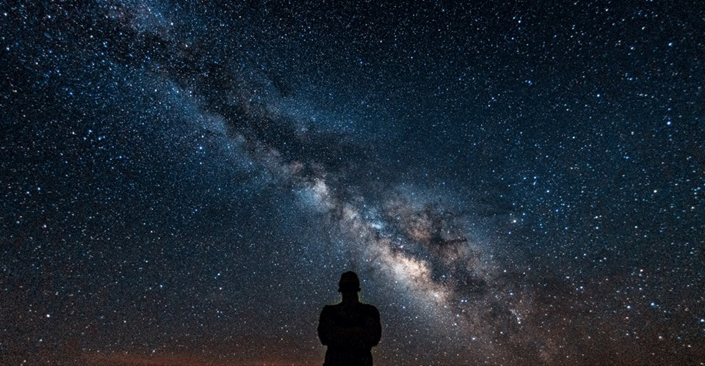
For since the creation of the world His invisible attributes are clearly seen, being understood by the things that are made, even His eternal power and Godhead, so that they are without excuse, because, although they knew God, they did not glorify Him as God, nor were thankful, but became futile in their thoughts, and their foolish hearts were darkened. Professing to be wise, they became fools, … — Romans 1:20-22
God
God
did not
honor
God
God
foolish hearts were darkened
fool
Notes:
Because He is, we have life, and can choose to live in hope or fall to something less than what pleases Him. Do we cherish ourselves over the father that created us? Divine or despicable defines destination.

Slide 63
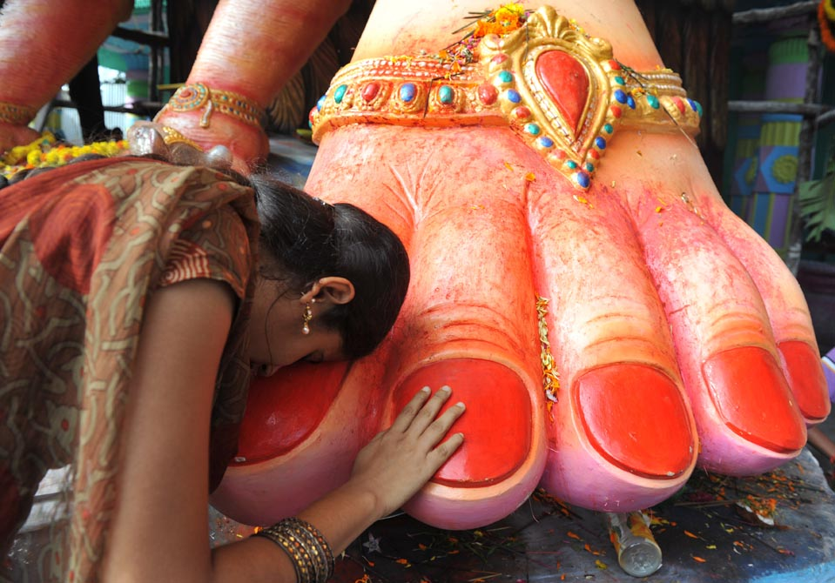
… and changed the glory of the incorruptible God into an image made like corruptible man--and birds and four-footed animals and creeping things. Therefore God also gave them up to uncleanness, in the lusts of their hearts, to dishonor their bodies among themselves, who exchanged the truth of God for the lie, and worshiped and served the creature rather than the Creator, who is blessed forever. Amen. — Romans 1:23-25
f
corruptible
dishonor God corruptible lusts
God
lusts
dishonor
th
i
God
faith
served the creature
a
Notes:
No matter of substance should be worshipped, and objects of our worship have no value when exalted above He who created them. As creatures we rise from the dust to return as it were; what in creation has more value than the spirit that sustains our very souls in existence itself. As a sword that cuts is not greater than He who allowed it to be, His word transcends all vibrations where sounds form.

Slide 64

But do you want to know, O foolish man, that faith without works is dead? — James 2:20
do
do
do
do
faith
Notes:
Working for a higher sense of identity, in service with one another, is the path He declares all should follow.

Slide 65
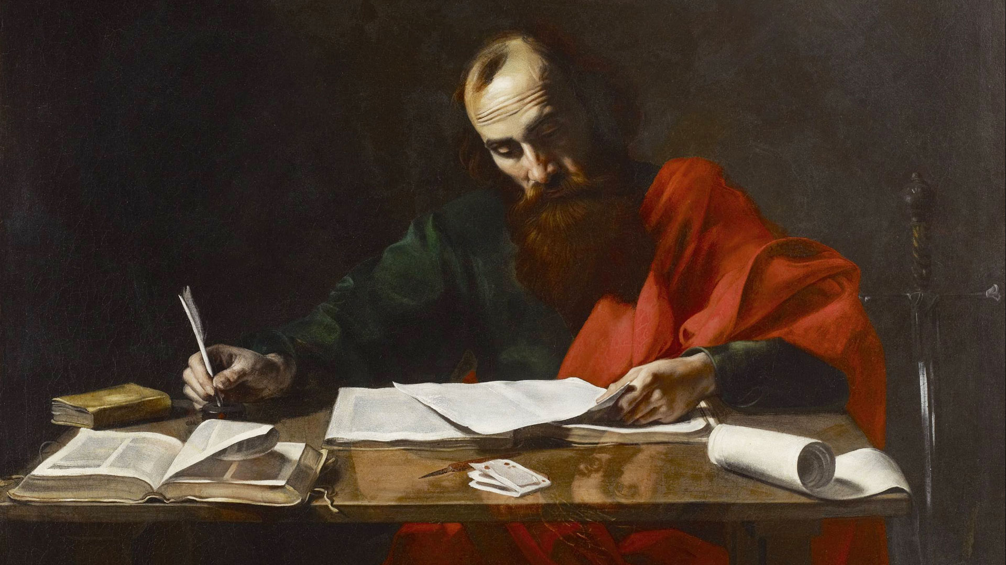
But what I do, I will also continue to do, that I may cut off the opportunity from those who desire an opportunity to be regarded just as we are in the things of which they boast. For such are false apostles, deceitful workers, transforming themselves into apostles of Christ. And no wonder! For Satan himself transforms himself into an angel of light. — 2nd Corinthians 11:12-14
do
do
transform
regarded just as we are
boast
messengers
→ Not by man
false apostles
deceitful
transform
→ By the word
transform
Notes:
There are fools who are best at exceptional and most spectacular lies, testing honest hearts with their deceptions. Hearsay religions do not adhere to the word of God preferring to cater to the whims of man over God.

Slide 66
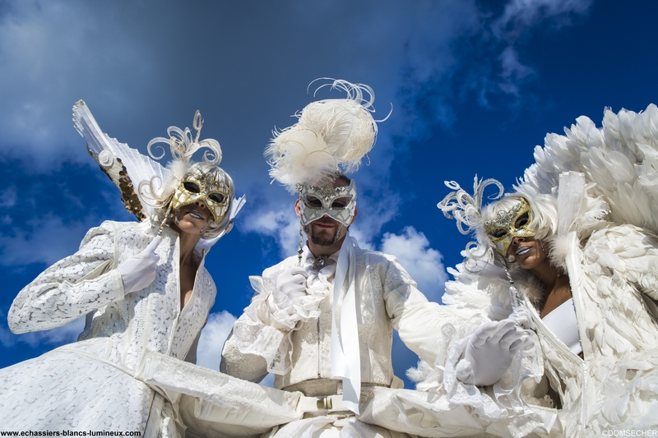
Therefore it is no great thing if his ministers also transform themselves into ministers of righteousness, whose end will be according to their works. I say again, let no one think me a fool. If otherwise, at least receive me as a fool, that I also may boast a little. What I speak, I speak not according to the Lord, but as it were, foolishly, in this confidence of boasting. — 2nd Corinthians 11:15-17
m
m
transform
fool
end
judged
k
works
k
fool
mask
as
m
mask
fool
as
mask
k
fool
foolishly
as
boasting
Notes:
Many proclaimed good deeders play on innocent sympathies to achieve their selfish ends.

Slide 67
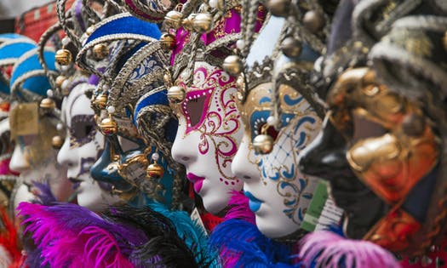
Seeing that many boast according to the flesh, I also will boast. For you put up with fools gladly, since you yourselves are wise! For you put up with it if one brings you into bondage, if one devours you, if one takes from you, if one exalts himself, if one strikes you on the face. — 2nd Corinthians 11:18-20
fool
put up with fools gladly
slavery
consumes
fool
steals
elevates
violence
Notes:
Fools can be extremely crafty in knowledge, manipulating fellows. Fools can best get along with other fools. As misery loves company, so too does a fool love other fools.

Slide 68
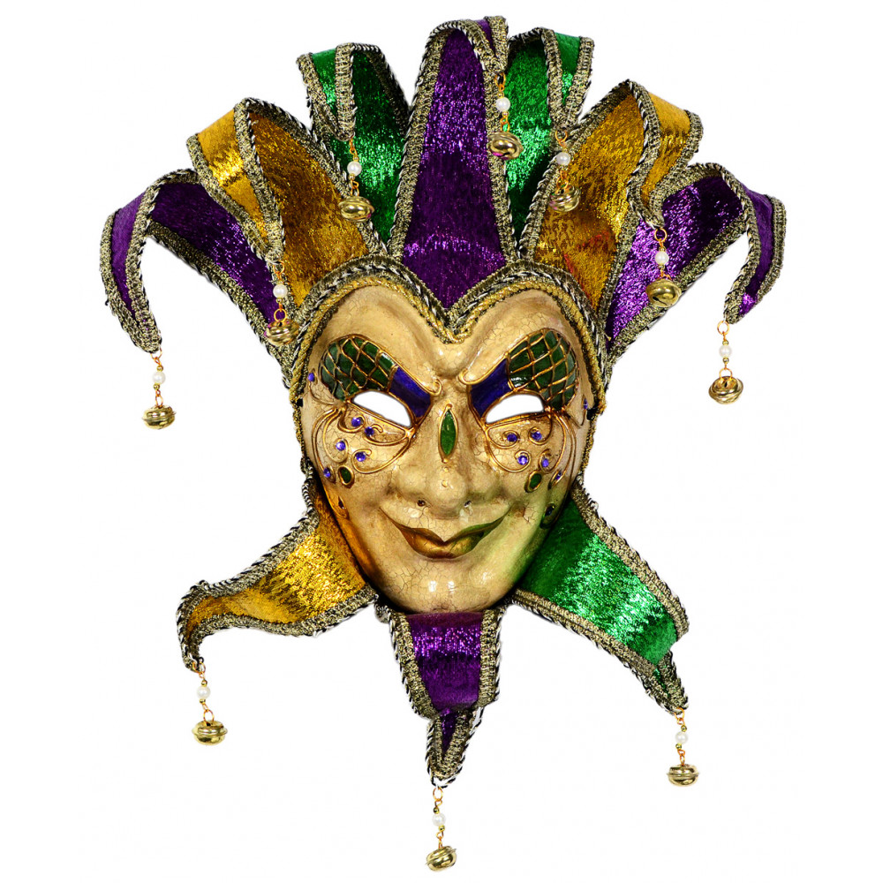
To our shame, I say that we were too weak for that! But in whatever anyone is bold -- I speak foolishly -- I am bold also. Are they Hebrews? So am I. Are they Israelites? So am I. Are they the seed of Abraham? So am I. Are they ministers of Christ? -- I speak as a fool -- I am more: in labors more abundant, in stripes above measure, in prisons more frequently, in deaths often. — 2nd Corinthians 11:21-23
To our shame
?
fool
Notes:
Pride has the stealthy mask of a fool. Arrogance rises from the cruelty in a heart.

Slide 69
If anyone teaches otherwise and does not consent to wholesome words, even the words of our Lord Jesus Christ, and to the doctrine which accords with godliness, he is proud, knowing nothing, but is obsessed with disputes and arguments over words, from which come envy, strife, reviling, evil suspicions, useless wranglings of men of corrupt minds and destitute of the truth, who suppose that godliness is a means of gain. From such withdraw yourself. Now godliness with contentment is great gain. For we brought nothing into this world, and it is certain we can carry nothing out. — 1st Timothy 6:3-7
To our shame
otherwise
o
teach
ol
s
fools teach otherwise:
● proud, knowing nothing
● obsessed with arguments
● envy, strife, reviling
● evil suspicions
● useless wranglings
● corrupt minds
● destitute of the truth
● suppose godliness
is a means of gain
proud,
knowing
nothing
obsessed with
godliness with
contentment
is great gain
arguments
envy,
strife, reviling
evil suspicions
useless wranglings
f
corrupt minds
destitute of the
truth
suppose
godliness
is a means of
gain
godliness with
contentment
is great gain

Slide 70
And having food and clothing, with these we shall be content. But those who desire to be rich fall into temptation and a snare, and into many foolish and harmful lusts which drown men in destruction and perdition. For the love of money is a root of all kinds of evil, for which some have strayed from the faith in their greediness, and pierced themselves through with many sorrows. But you, O man of God, flee these things and pursue righteousness, godliness, faith, love, patience, gentleness. — 1st Timothy 6:8-11
desire
pursue:
● righteousness
● godliness
● faith
● love
● patience
● gentleness
fool
many foolish and harmful lusts
fool
pursue
righteousness
godliness
faith
love
patience
gentleness

Slide 71
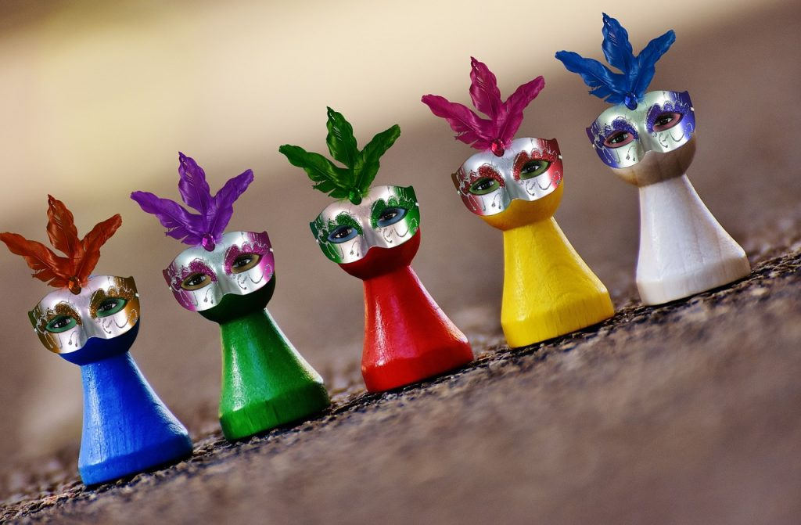
He who is of a proud heart stirs up strife, But he who trusts in the LORD will be prospered. He who trusts in his own heart is a fool, But whoever walks wisely will be delivered. — Proverbs 28:25-26
e
wise
fool
trusts in his own heart is a fool
wis
The lips of the righteous feed many, But fools die for lack of wisdom. — Proverbs 10:21
Notes:
God in His purpose has one path to salvation including His wisdom for man to know. Arrogance is the seed of anger.

Slide 72
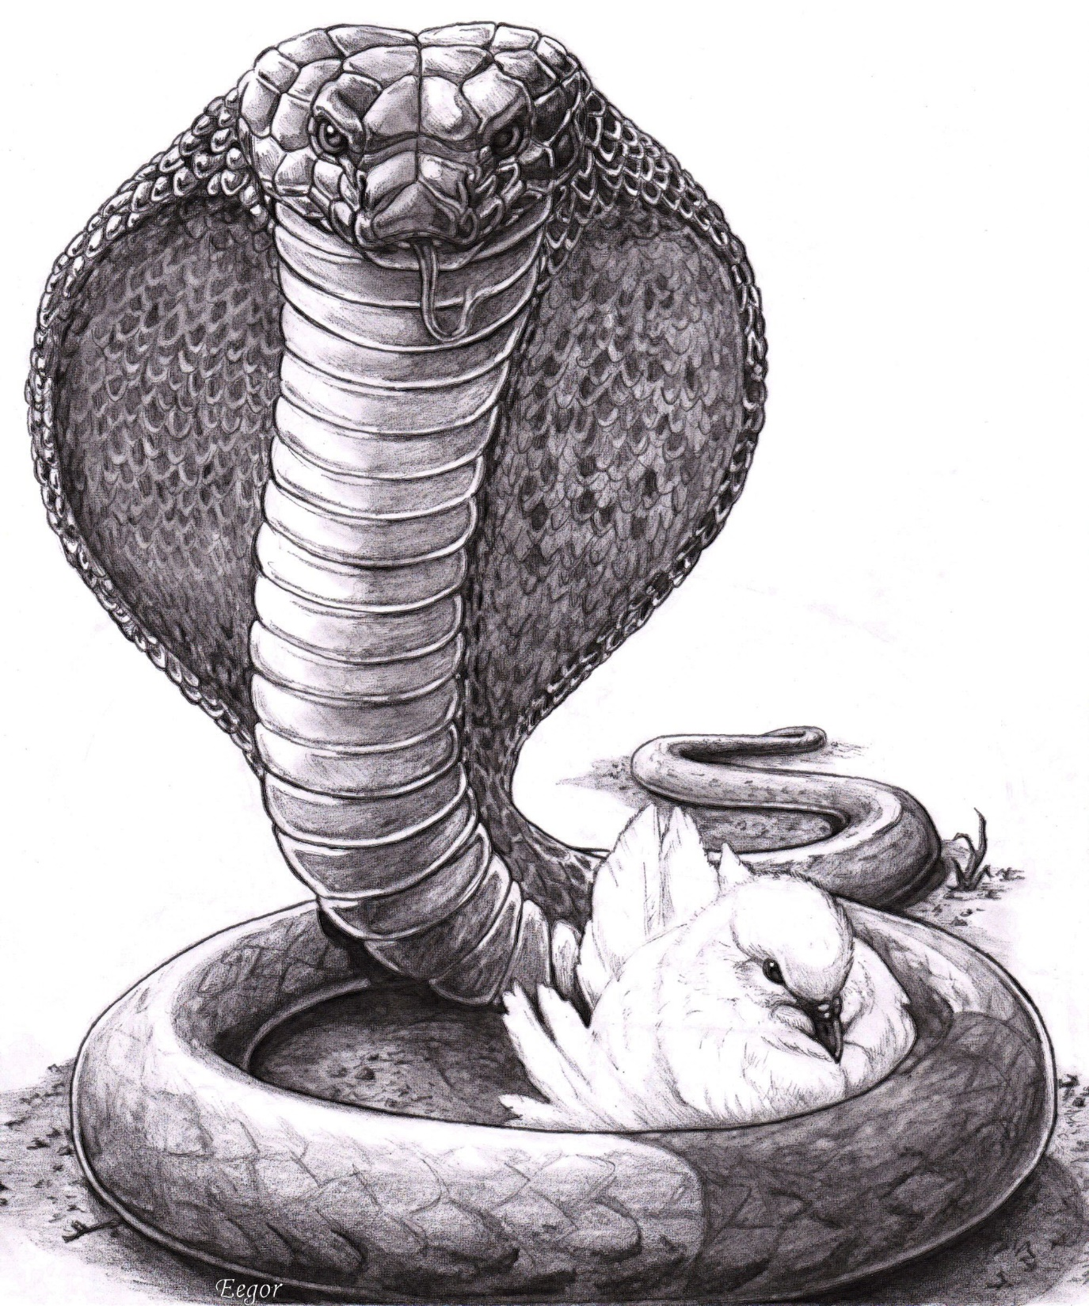
"Behold, I send you out as sheep in the midst of wolves. Therefore be wise as serpents and harmless as doves." — Matthew 10:16
discerning
sheep
sheep
wise
love
Notes:
Difficulties in life will never cease in the flesh, but to rise in spirit has no measurable comparison, leaving the desires of the earth behind for untold glories ahead.

Slide 73

Therefore let us keep the feast, not with old leaven, nor with the leaven of malice and wickedness, but with the unleavened bread of sincerity and truth. I wrote to you in my epistle not to keep company with sexually immoral people. Yet I certainly did not mean with the sexually immoral people of this world, or with the covetous, or extortioners, or idolaters, since then you would need to go out of the world. — 1st Corinthians 5:8-10
sheep
immoral
people
covetous
extortioners
idolaters
Notes:
To put off those unspeakable qualities and share belief in God has challenged all who choose to believe.

Slide 74
Therefore let us keep the feast, not with old leaven, nor with the leaven of malice and wickedness, but with the unleavened bread of sincerity and truth. I wrote to you in my epistle not to keep company with sexually immoral people. Yet I certainly did not mean with the sexually immoral people of this world, or with the covetous, or extortioners, or idolaters, since then you would need to go out of the world. — 1st Corinthians 5:8-10
not with
malice
not with malice and wickedness
but with sincerity and truth
and wickedness
but with
sincerity and truth
immoral
people
covetous
idolaters
extortioners

Slide 75

See then that you walk circumspectly, not as fools but as wise, redeeming the time, because the days are evil. — Ephesians 5:15-16
cautiously
. .
thoughtfully
watchfully
vigilantly
. .

Slide 76




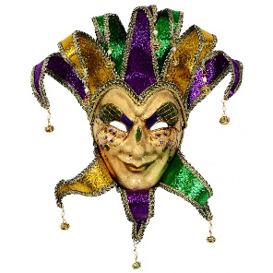

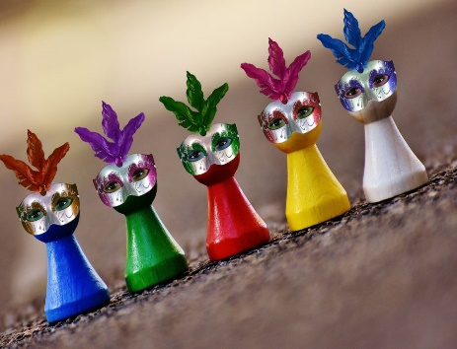
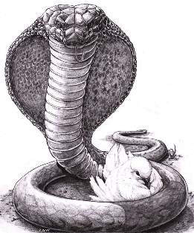

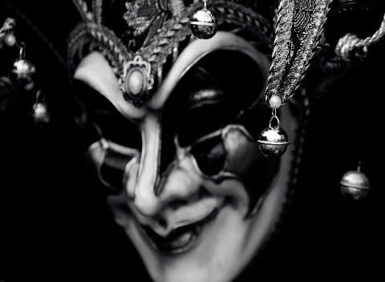


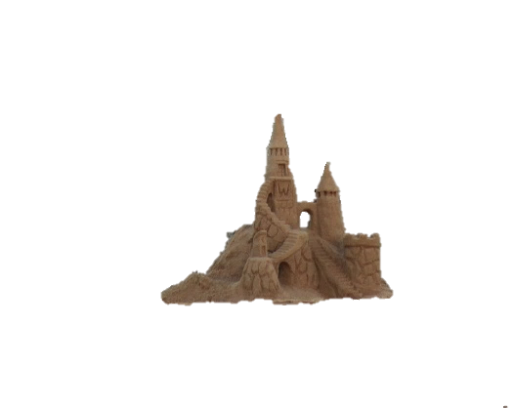



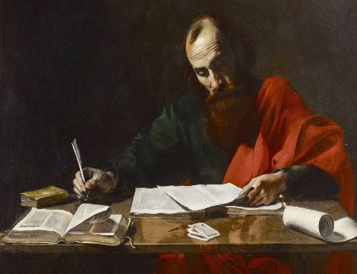


Slide 77









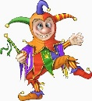





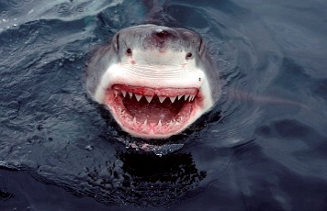

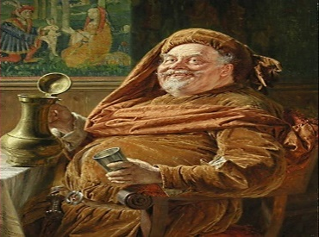
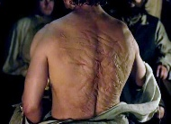








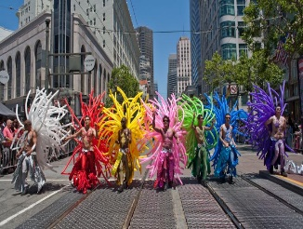





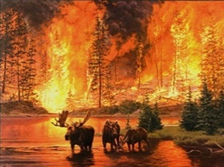


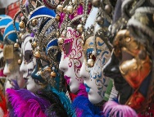























Slide 78
→ A fool finds evil as fun
→ A fool as a companion will lead to destruction
→ Fools tend to be simple minded and lethargic
→ Fools seek pleasures where forgetfulness dwells
→ Fools walk in darkness
→ In time both the wise man and fool die as the fool
→ A fool heeds not the word of God but blames others
→ Hypocrites who claim wisdom fall on their own lies
→ A greedy fool is unprepared for God’s judgment
→ Faith without works is the regard of a fool
→ Many boast in self-goodness void of holiness
→ Trusting in one’s own proud heart is foolish
→ Walk circumspectly, not as fools but as wise
A fool has no pleasure in the wisdom God offers
Notes:
A fool has no pleasure in the wisdom God offers

Slide 80

Please visit http://www.LoveFromGod.com to explore further
Ronald Bert Channel on
Notes:
Eternity never ends.

