Slide 1
Notes:
Darkness has no liberation.

Slide 2
FAITH COMES BY THE WORD
Ron Bert
May 21, 2017

Slide 3
All Scripture is given by inspiration of God, and is profitable for doctrine, for reproof, for correction, for instruction in righteousness, that the man of God may be complete, thoroughly equipped for every good work. — 2nd Timothy 3:16-17
Lord
Lord
Lord
Lord
Lord
Lord
Lord
Lord
gospel of Christ
Scripture
God
And the things that you have heard from me among many witnesses, commit these to faithful men who will be able to teach others also. — 2nd Timothy 2:2
And the things that you have heard from me among many witnesses, commit these to faithful men who will be able to teach others also. — 2nd Timothy 2:2
For I am not ashamed of the gospel of Christ, for it is the power of God to salvation for everyone who believes, for the Jew first and also for the Greek. — Romans 1:16
God
For in it the righteousness of God is revealed from faith to faith; as it is written, "The just shall live by faith." — Romans 1:17
heard
gospel of Christ
heard
gospel of Christ
Receive
revealed from faith to faith
revealed
Return
written
revealed from faith to faith
salvation
for instruction
written
for instruction
believes
believes
believes
revealed
Faith
Faith
Faith
Faith

Slide 4
For this reason I, Paul, the prisoner of Christ Jesus for you Gentiles -- if indeed you have heard of the dispensation of the grace of God which was given to me for you, how that by revelation He made known to me the mystery (as I have briefly written already, by which, when you read, you may understand my knowledge in the mystery of Christ), which in other ages was not made known to the sons of men, as it has now been revealed by the Spirit to His holy apostles and prophets: that the Gentiles should be fellow heirs, of the same body, and partakers of His promise in Christ through the gospel, … — Ephesians 3:1-6
grace of God
heard
grace of God
God
grace of God
by revelation
made
by revelation
known
briefly
briefly
written already
when you read
written already
when you read
written
understand my knowledge
in
understand my knowledge
Christ
revealed
Ephesians 3:1-6
revealed
revealed
by the Spirit
by the Spirit
partakers of His promise
partakers of His promise
through the gospel
Ephesians 3:1-6
Notes:
If one does not believe God had His hand upon what has been delivered in written form, then one doubts the power of God. Faith has no question of His clarity which has been once delivered for all the saints that follow Him.

Slide 5
But I make known to you, brethren, that the gospel which was preached by me is not according to man. For I neither received it from man, nor was I taught it, but it came through the revelation of Jesus Christ. — Galatians 1:11-12
Lord
grace of God
But I make known to you, brethren, that the gospel which was preached by me is not according to man. For I neither received it from man, nor was I taught it, but it came through the revelation of Jesus Christ. — Galatians 1:11-12
Revealed
See with what large letters I have written to you with my own hand! — Galatians 6:11
Ephesians 3:1-6
came through
came through
revelation of Jesus Christ
revelation of Jesus Christ
Paul
Wrote
Jesus Christ

Slide 6
Beloved, while I was very diligent to write to you concerning our common salvation, I found it necessary to write to you exhorting you to contend earnestly for the faith which was once for all delivered to the saints. — Jude 1:3
Lord
Beloved, while I was very diligent to write to you concerning our common salvation, I found it necessary to write to you exhorting you to contend earnestly for the faith which was once for all delivered to the saints. — Jude 1:3
common salvation
necessary to write to you
necessary to write to you
Revealed
for the faith
for the faith
once for all
once for all
Paul
Wrote

Slide 7
For whatever things were written before were written for our learning, that we through the patience and comfort of the Scriptures might have hope. — Romans 15:4
Lord
For whatever things were written before were written for our learning, that we through the patience and comfort of the Scriptures might have hope. — Romans 15:4
Revealed
hope
for the faith
Scriptures
hope
Scriptures
hope
hope
Paul
Wrote

Slide 8
Now faith is the substance of things hoped for, the evidence of things not seen. — Hebrews 11:1
CHRIST
Lord
Lord
He is the image of the invisible God, the firstborn over all creation. — Colossians 1:15
VERTICAL
VERTICAL
faith
Now faith is the substance of things hoped for, the evidence of things not seen. — Hebrews 11:1
Revealed
faith
God
God
over all
things hoped for
hope
things hoped for
over all
things not seen
not seen
things not seen
HORIZONTAL
HORIZONTAL
FAITH
Paul
Wrote
FAITH

Slide 9
If anyone thinks himself to be a prophet or spiritual, let him acknowledge that the things which I write to you are the commandments of the Lord. — 1st Corinthians 14:37
Lord
If anyone thinks himself to be a prophet or spiritual, let him acknowledge that the things which I write to you are the commandments of the Lord. — 1st Corinthians 14:37
If anyone thinks himself to be a prophet or spiritual, let him acknowledge that the things which I write to you are the commandments of the Lord. — 1st Corinthians 14:37
If anyone thinks himself to be a prophet or spiritual, let him acknowledge that the things which I write to you are the commandments of the Lord. — 1st Corinthians 14:37
acknowledge
Revealed
God
over all
things which I write
things which I write
commandments of the Lord
commandments of the Lord
Lord
Lord
Lord
Lord
Lord
Lord
Lord
Lord
Lord
Paul
Wrote
Notes:
Jim Jones 1979 Jonestown, Guiana Nov 18, 1978 - 918 suicides - George Moscone and Harvey Milk are murdered on Nov 27, 1978
David Koresh Branch Davidians - Waco Tx - April 19, 1993 89 (4 ATF/6 Davidians) dead - 79 burned
Marshall Applewhite Heavens Gate Mar 26, 1997 · Rancho Sante Fe, CA -39 dead

Slide 10
Now these things, brethren, I have figuratively transferred to myself and Apollos for your sakes, that you may learn in us not to think beyond what is written, that none of you may be puffed up on behalf of one against the other. — 1st Corinthians 4:6
writ
t
Beloved, I now write to you this second epistle (in both of which I stir up your pure minds by way of reminder), that you may be mindful of the words which were spoken before by the holy prophets, and of the commandment of us, the apostles of the Lord and Savior, … — 2nd Peter 3:1-2
Beloved, I now write to you this second epistle (in both of which I stir up your pure minds by way of reminder), that you may be mindful of the words which were spoken before by the holy prophets, and of the commandment of us, the apostles of the Lord and Savior, … — 2nd Peter 3:1-2
Lord
Now these things, brethren, I have figuratively transferred to myself and Apollos for your sakes, that you may learn in us not to think beyond what is written, that none of you may be puffed up on behalf of one against the other. — 1st Corinthians 4:6
by way of reminder
by way of reminder
mindful of the words
mindful of the words
not to think beyond
think beyond
not to think beyond
Revealed
en
what is written
written
what is written
think beyond
puffed up
puffed up
Lord
Lord
Paul
Wrote

Slide 11
"Behold the proud, His soul is not upright in him; But the just shall live by his faith." — Habakkuk 2:4
Lord
Revealed
think beyond
puffed up
faith
Paul
Wrote
We

Slide 12
For this reason we also thank God without ceasing, because when you received the word of God which you heard from us, you welcomed it not as the word of men, but as it is in truth, the word of God, which also effectively works in you who believe. — 1st Thessalonians 2:13
Lord
For this reason we also thank God without ceasing, because when you received the word of God which you heard from us, you welcomed it not as the word of men, but as it is in truth, the word of God, which also effectively works in you who believe. — 1st Thessalonians 2:13
received the word
received the word
word
Revealed
Revealed
you heard
you heard
not as the word of men
word
word
the word of God
word
in
works in you
works in you
Paul
Wrote
We
believe
believe
believe
believe
believe
believe

Slide 13
So then faith comes by hearing, and hearing by the word of God. — Romans 10:17
Lord
faith
Revealed
faith comes
by hearing
faith
faith comes
the word of God
For we walk by faith, not by sight. — 2nd Corinthians 5:7
For we walk by faith, not by sight. — 2nd Corinthians 5:7
For we walk by faith, not by sight. — 2nd Corinthians 5:7
we walk by faith
word
we walk by faith
Paul
Wrote
We
Notes:
How do we get the faith God wants us to have?

Slide 14
But without faith it is impossible to please Him, for he who comes to God must believe that He is, and that He is a rewarder of those who diligently seek Him. — Hebrews 11:6
Lord
But without faith it is impossible to please Him, for he who comes to God must believe that He is, and that He is a rewarder of those who diligently seek Him. — Hebrews 11:6
faith
who comes
who comes
Revealed
Read
must believe
must believe
seek Him
seek Him
Paul
Wrote
We

Slide 15
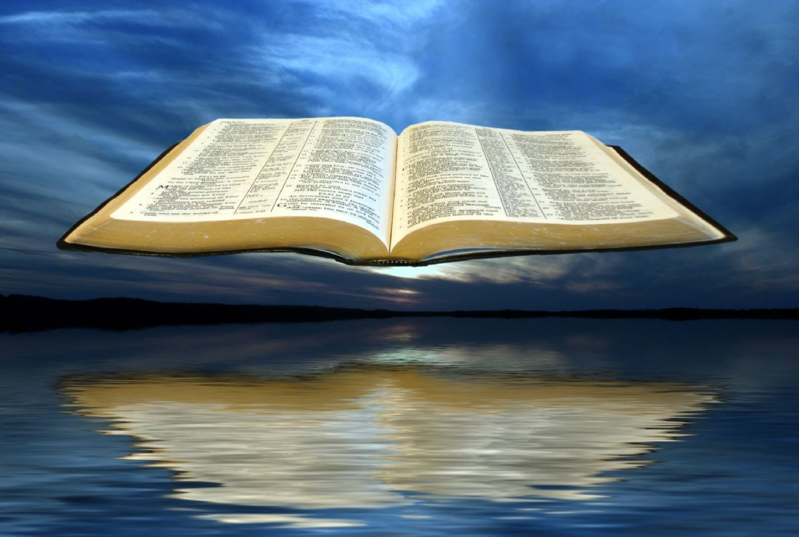
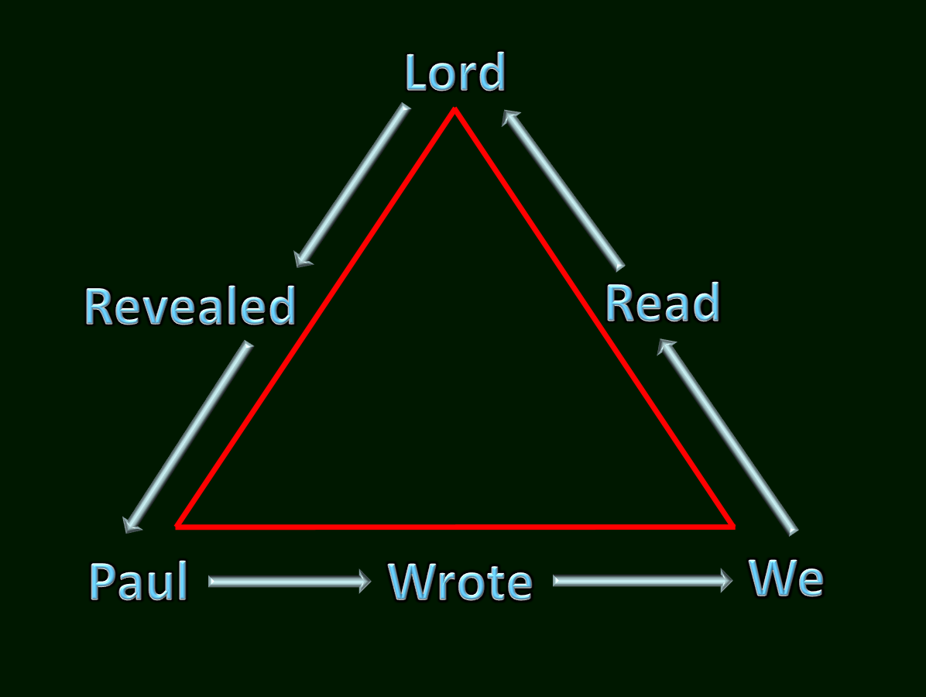
"For I have not shunned to declare to you the whole counsel of God." — Acts 20:27
Lord
Revealed
Read
… by which, when you read, you may understand my knowledge in the mystery of Christ), — Ephesians 3:4
… by which, when you read, you may understand my knowledge in the mystery of Christ), — Ephesians 3:4
… by which, when you read, you may understand my knowledge in the mystery of Christ), — Ephesians 3:4
… by which, when you read, you may understand my knowledge in the mystery of Christ), — Ephesians 3:4
when you read
when you read
God
"For I have not shunned to declare to you the whole counsel of God." — Acts 20:27
understand my knowledge
in
whole counsel of God
understand my knowledge
whole counsel of God
God
Christ
Paul
Wrote
We

Slide 16
Therefore lay aside all filthiness and overflow of wickedness, and receive with meekness the implanted word, which is able to save your souls. — James 1:21
God
But He said, "More than that, blessed are those who hear the word of God and keep it!" — Luke 11:28
receive
receive
hear
hear
implanted word
implanted word
God
keep it
word of God
keep it
save your soul

Slide 17
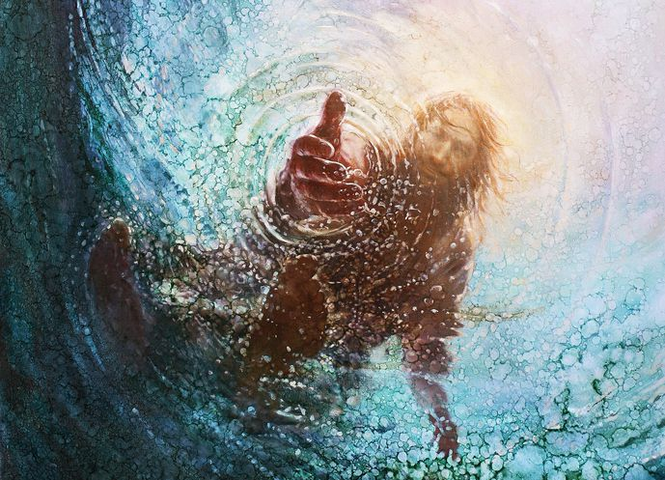
GOD
GO
DIVINE
DIV
NE
DIV
N
God
WE
O
D
WO
D
WORD
FAITH
RECIEVE
HEAR
HEARD

Slide 18
→ All Scripture is given for instruction in righteousness
→ God’s righteousness is revealed from faith to faith
→ God’s grace gives us understanding & knowledge
→ The gospel came through the revelation of Christ
→ Our common salvation is in one faith once delivered
→ Scripture tones our patience and comforts in hope
→ Faith is larger than seeing - in hope of what is better
→ Thinking beyond what is written leads to corruption
→ God’s word effectively works in those who believe
→ Faith comes by hearing, and hearing by God’s word
→ Faith in His truth pleases God in a call to seek Him
→ Paul stated the whole counsel of God for us to read
→ The implanted word is able to save your soul
God’s Word
Reveals True Faith
Notes:
God’s Word Reveals True Faith

Slide 20
Please visit http://www.RonBert.com to explore further
Ronald Bert Channel on
Notes:
Eternity never ends.

