Slide 1
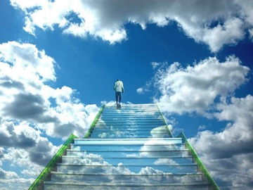

BELIEF
A
C
T
A
C
T
I
O
N
BELIE
BEL EF
BE
I
LIE
F
A
I
T
H
O
N
N
Notes:
Belief

