Slide 2

ENVY
Ron Bert
December 16, 2018

Slide 3
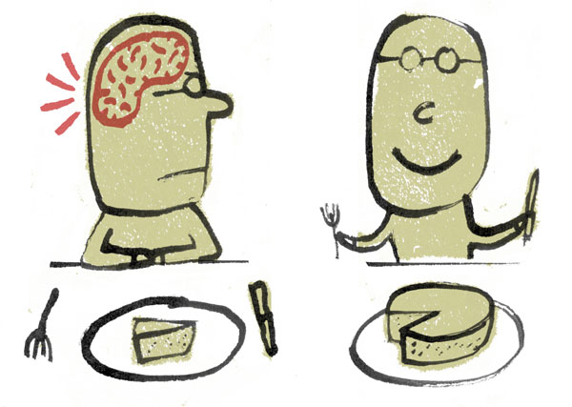
For wrath kills a foolish man, And envy slays a simple one. — Job 5:2
wrath kills
envy slays

Slide 4
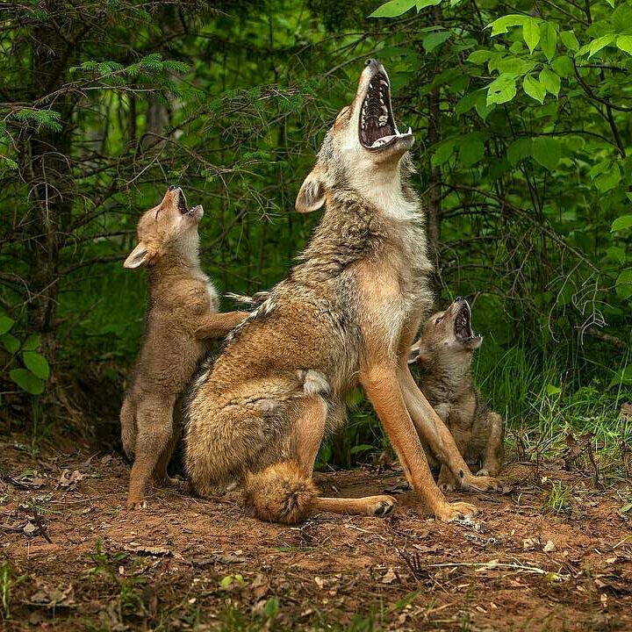
They wander up and down for food, And howl if they are not satisfied. — Psalms 59:15

Slide 5

But as for me, my feet had almost stumbled; My steps had nearly slipped. For I was envious of the boastful, When I saw the prosperity of the wicked. — Psalms 73:2-3
stumble
envy
env
envious
y
prosperity

Slide 6
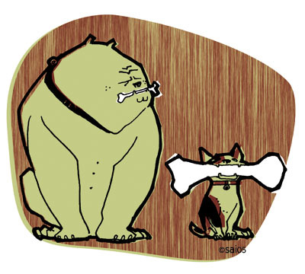
A sound heart is life to the body, But envy is rottenness to the bones. — Proverbs 14:30
envy
envy
bone

Slide 7
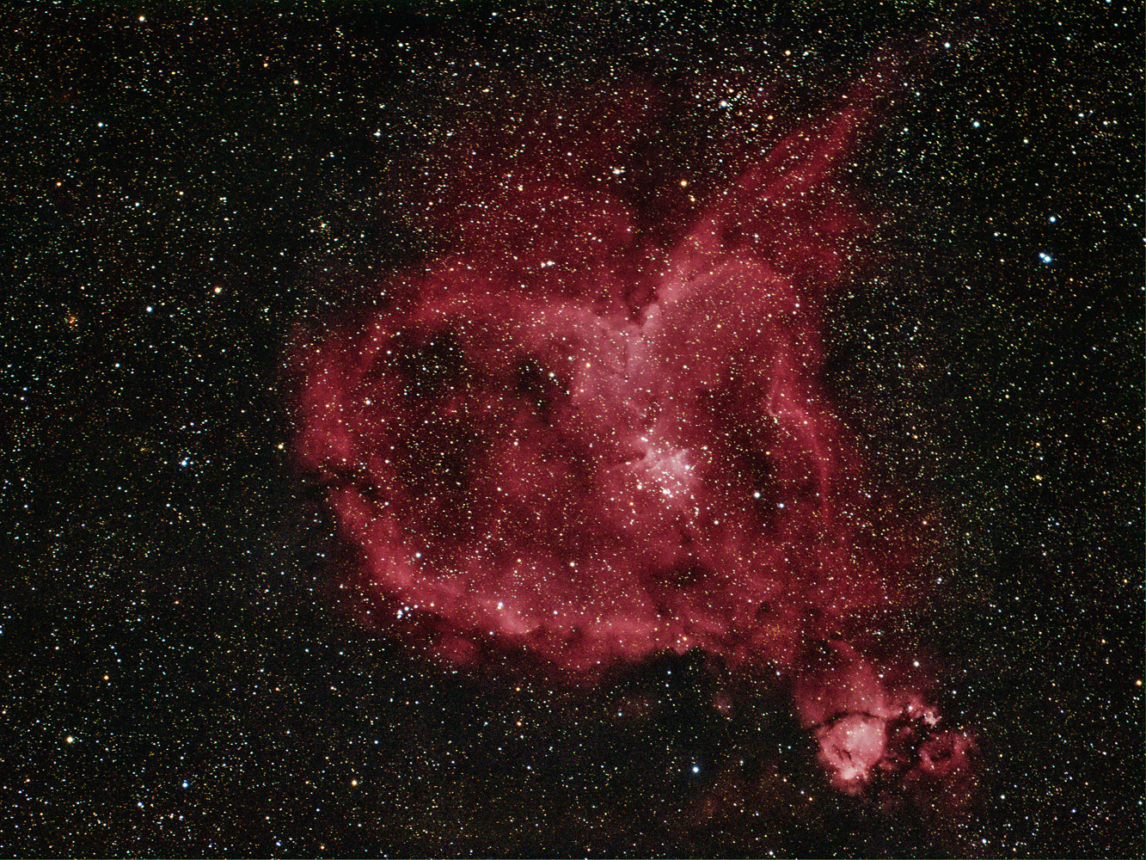
Do not let your heart envy sinners, But be zealous for the fear of the LORD all the day; For surely there is a hereafter, And your hope will not be cut off. Hear, my son, and be wise; And guide your heart in the way. — Proverbs 23:17-19
envy
focused
all the day
eternal life
hope
be wise
in
in the way

Slide 8

Do not be envious of evil men, Nor desire to be with them; For their heart devises violence, And their lips talk of troublemaking. — Proverbs 24:1-2
If anyone among you thinks he is religious, and does not bridle his tongue but deceives his own heart, this one's religion is useless. — James 1:26
self-control
desire
does not bridle
violence
troublemaking

Slide 9


And even as they did not like to retain God in their knowledge, God gave them over to a debased mind, to do those things which are not fitting; … — Romans 1:28
not like to
in
retain God in their knowledge
those things
not fitting
Notes:
God tests us in the flesh to expose our strength over it, not to succumb to our weakness of reckless desires, and to submit to its’ carnal indulgences. Absent of what God wants, uncontrolled desires have the potential to unleash heinous uncaring empathetic results causing grief among the meek. Anger has never rejoiced in peace.

Slide 10

… being filled with all unrighteousness, sexual immorality, wickedness, covetousness, maliciousness; full of envy, murder, strife, deceit, evil-mindedness; they are whisperers, backbiters, haters of God, violent, proud, boasters, inventors of evil things, disobedient to parents, undiscerning, untrustworthy, unloving, unforgiving, unmerciful; — Romans 1:29–31
envy

Slide 11

… who, knowing the righteous judgment of God, that those who practice such things are deserving of death, not only do the same but also approve of those who practice them. — Romans 1:32
judgment of God
judgment of God
practice
s
in
death
death
to who
practice sin
t
o
who
practice

Slide 12

Now the works of the flesh are evident, which are: adultery, fornication, uncleanness, lewdness, idolatry, sorcery, hatred, contentions, jealousies, outbursts of wrath, selfish ambitions, dissensions, heresies, envy, murders, drunkenness, revelries, and the like; of which I tell you beforehand, just as I also told you in time past, that those who practice such things will not inherit the kingdom of God. — Galatians 5:19-21
judgment of God
envy
envy
who practice such things
envy
not inherit the kingdom of God

Slide 13

But the fruit of the Spirit is love, joy, peace, longsuffering, kindness, goodness, faithfulness, gentleness, self-control. Against such there is no law. And those who are Christ's have crucified the flesh with its passions and desires. If we live in the Spirit, let us also walk in the Spirit. Let us not become conceited, provoking one another, envying one another. — Galatians 5:22-26
fruit of the Spirit =
self-control
have crucified
desires
pride
not
envying one another
envy

Slide 14

Again, I saw that for all toil and every skillful work a man is envied by his neighbor. This also is vanity and grasping for the wind. — Ecclesiastes 4:4
envied
vanity
unreality
pointlessness
worthlessness
hollowness
uselessness
emptiness
futility
shallow

Slide 15

Do not curse the king, even in your thought; Do not curse the rich, even in your bedroom; For a bird of the air may carry your voice, And a bird in flight may tell the matter. — Ecclesiastes 10:20
in
Do not
Do not
thought

Slide 16

Do not grumble against one another, brethren, lest you be condemned. Behold, the Judge is standing at the door! — James 5:9
Do not

Slide 17

Who is wise and understanding among you? Let him show by good conduct that his works are done in the meekness of wisdom. But if you have bitter envy and self-seeking in your hearts, do not boast and lie against the truth. This wisdom does not descend from above, but is earthly, sensual, demonic. — James 3:13-15
envy and self-seeking
bitter envy and self-seeking
envy and self-seeking
earthly, sensual, demonic

Slide 18
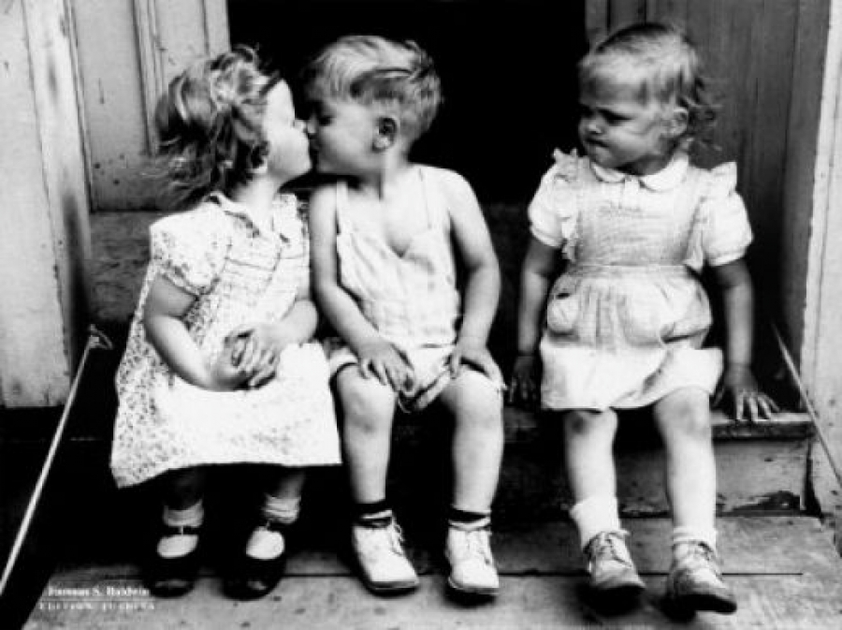
For where envy and self-seeking exist, confusion and every evil thing are there. But the wisdom that is from above is first pure, then peaceable, gentle, willing to yield, full of mercy and good fruits, without partiality and without hypocrisy. — James 3:16-17
hypocrisy
envy
envy
envy and self-seeking
wisdom
from above
thankful
hypocrisy
Notes:
Many live in the shadows of their own lies. There are visibly good people holding hidden dark hearts. To come clean with God one must rise to be honest with self, which then enables that genuineness that assists all in the hope we live for.

Slide 19

Therefore, laying aside all malice, all deceit, hypocrisy, envy, and all evil speaking, as newborn babes, desire the pure milk of the word, that you may grow thereby, if indeed you have tasted that the Lord is gracious. Coming to Him as to a living stone, rejected indeed by men, but chosen by God and precious, you also, as living stones, are being built up a spiritual house, a holy priesthood, to offer up spiritual sacrifices acceptable to God through Jesus Christ. — 1st Peter 2:1-5
X
hypocrisy
envy
spiritual sacrifices

Slide 20

I fed you with milk and not with solid food; for until now you were not able to receive it, and even now you are still not able; for you are still carnal. For where there are envy, strife, and divisions among you, are you not carnal and behaving like mere men? — 1st Corinthians 3:2-3
I fed you with milk and not with solid food; for until now you were not able to receive it, and even now you are still not able; for you are still carnal. For where there are envy, strife, and divisions among you, are you not carnal and behaving like mere men? — 1st Corinthians 3:2-3
envy and strife
conflict
strife
trouble
friction
contention
envy
fighting
strife
and

Slide 21

Some indeed preach Christ even from envy and strife, and some also from good will: The former preach Christ from selfish ambition, not sincerely, supposing to add affliction to my chains; — Philippians 1:15-16
preach Christ
envy
and
strife
envy and strife
strife and envy
selfish ambition
not sincerely

Slide 22

Let us walk properly, as in the day, not in revelry and drunkenness, not in lewdness and lust, not in strife and envy. But put on the Lord Jesus Christ, and make no provision for the flesh, to fulfill its lusts. — Romans 13:13-14
in
partying
not in
in
immorality
in
not in
l
not in
life
strife and envy
ife
strife and envy
But put on
Lord Jesus Christ
Notes:
People make the mistake of looking at creation’s temporary possessions over the Creator of eternal life. Contemplations of what others possess and desiring those things can distract one’s attention away from godliness, peace of heart, and thankfulness that makes one whole.

Slide 23

And He said to them, "Take heed and beware of covetousness, for one's life does not consist in the abundance of the things he possesses." — Luke 12:15
covetousness
covetousness
life
Notes:
Possessions

Slide 24
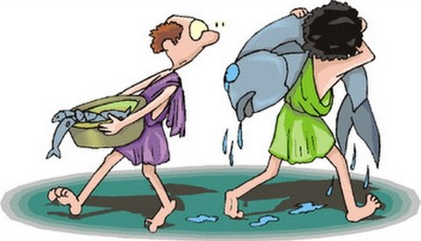
Let your conduct be without covetousness; be content with such things as you have. For He Himself has said, "I will never leave you nor forsake you."
So we may boldly say: "The LORD is my helper; I will not fear. What can man do to me?" — Hebrews 13:5-6
covetousness
v
e
be content
envy
y
n

Slide 25

Love suffers long and is kind; love does not envy; love does not parade itself, is not puffed up; — 1st Corinthians 13:4
love does not envy
envy

Slide 26

If anyone teaches otherwise and does not consent to wholesome words, even the words of our Lord Jesus Christ, and to the doctrine which accords with godliness, … — 1st Timothy 6:3

Slide 27

… he is proud, knowing nothing, but is obsessed with disputes and arguments over words, from which come envy, strife, reviling, evil suspicions, useless wranglings of men of corrupt minds and destitute of the truth, who suppose that godliness is a means of gain. From such withdraw yourself. Now godliness with contentment is great gain. — 1st Timothy 6:4-6
proud
godliness with contentment = great gain
strife
envy
destitute of the truth
godliness with contentment
great gain

Slide 28

→ Envy tortures the inside heart of a simpleton
→ Envy brings rottenness to the essence of life
→ Do not envy but maintain zealousness for the Lord
→ Forgetting God & practicing envy leads to death
→ Do not provoke arguments envying one another
→ Envy is earthly, sensual, and demonic
→ Envy and self-seeking embrace confusion and evil
→ Lay aside envy & seek out, build up in the pure word
→ False preachers swell in selfish ambition, insincerity
→ Walk not in envy and lust but in Jesus Christ
→ Love does not envy
→ In envy, slurs, evil suspicions, is argumentativeness
→ Godliness with contentment is great gain
Envy fills the needles of greed piercing all peace of heart
Notes:
Envy fills the needles of greed piercing all peace of heart

Slide 30

Please visit http://www.LoveFromGod.com to explore further
Ronald Bert Channel on
Notes:
Eternity never ends.

