Slide 1
Notes:
Darkness is numb to light.

Slide 2

Drinking
Ron Bert
October 14, 2018
Notes:
Drinking alcohol is the main reason for selfishness and destroyed relationships. Nothing should be done to relinquish His glory.

Slide 3

Wine is a mocker, Strong drink is a brawler, And whoever is led astray by it is not wise. — Proverbs 20:1
Wine
Wine
mocker
Strong drink
brawler
not wise
Notes:
Verbal looseness and cruel outbursts are inflamed by drunken arrogant stupors. Strong drink does not add to one’s peace of mind. Depression follows intoxication. To be wise is to pay attention to how God teaches us concerning drinking and its uses and or consequences. Wisdom does not search for an escape as much as a solution and wise are those who have learned to control infantile outbursts.

Slide 4
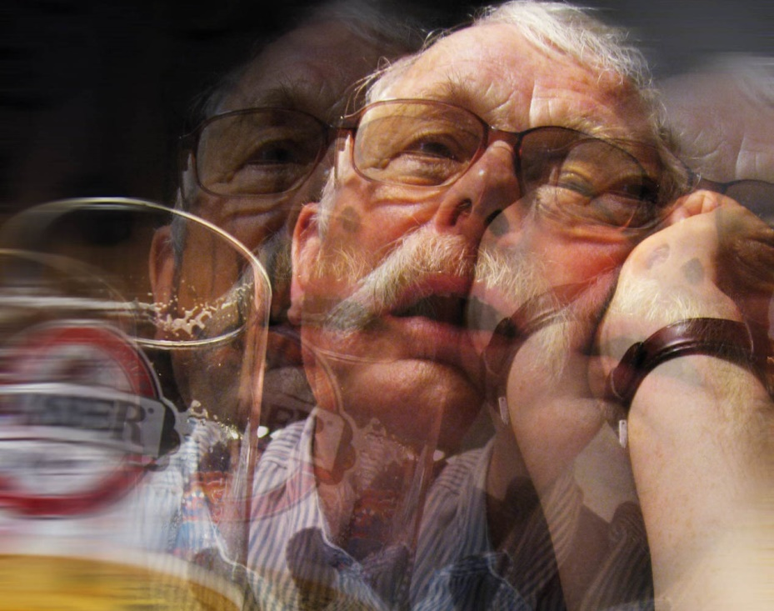
Do not mix with winebibbers, Or with gluttonous eaters of meat; For the drunkard and the glutton will come to poverty, And drowsiness will clothe a man with rags. — Proverbs 23:20-21
wine
Wine
drunkard
come to poverty
drowsiness
wine
Notes:
Blurred vision shuts down the sensible nature one must have to be responsible. What a bleak outcome to only remain in a dizzy.

Slide 5
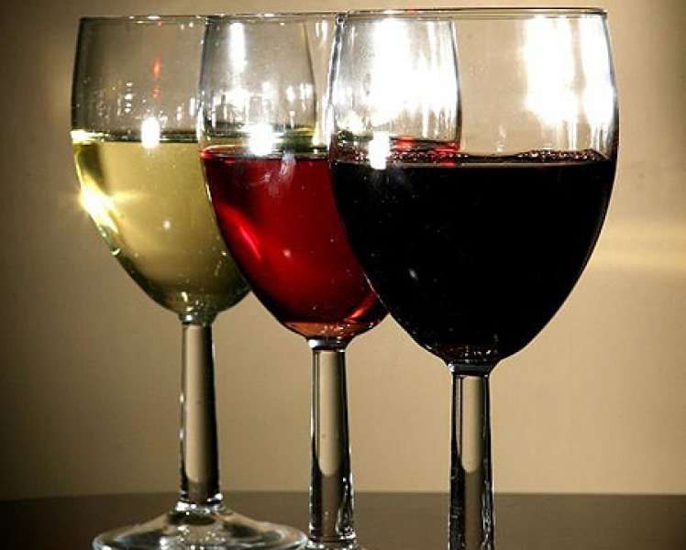
Who has woe? Who has sorrow? Who has contentions? Who has complaints? Who has wounds without cause? Who has redness of eyes? Those who linger long at the wine, Those who go in search of mixed wine. — Proverbs 23:29-30
wine
who linger
in
in search
wine
Notes:
Desire for alcohol as a pain numbing agent is the most common reason for drinking. People want to escape from the toils of living. Drinking actually perpetuates the cycle of afflictions in supporting continuing woes.

Slide 6

Do not look on the wine when it is red, When it sparkles in the cup, When it swirls around smoothly; At the last it bites like a serpent, And stings like a viper. Your eyes will see strange things, And your heart will utter perverse things. — Proverbs 23:31-33
wine
see strange things
utter perverse things
Notes:
The imagination of covering suffering with the magical powers of swirling wine deceptively lures one to the curse it delivers.

Slide 7
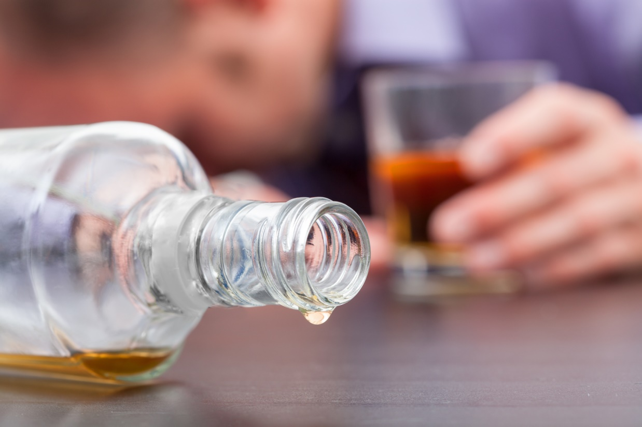
Yes, you will be like one who lies down in the midst of the sea, Or like one who lies at the top of the mast, saying: "They have struck me, but I was not hurt; They have beaten me, but I did not feel it. When shall I awake, that I may seek another drink?" — Proverbs 23:34-35
I did not feel it
I awake
seek another drink
seek
Notes:
Drinkers seek to not feel the life they dread as deathfulness is the wish that leads to that next drink. I just want to disappear or go away; many suicides have high intoxication levels and it is common among the famous; lonely overdose. - Without relying on God tragedies ensue.

Slide 8
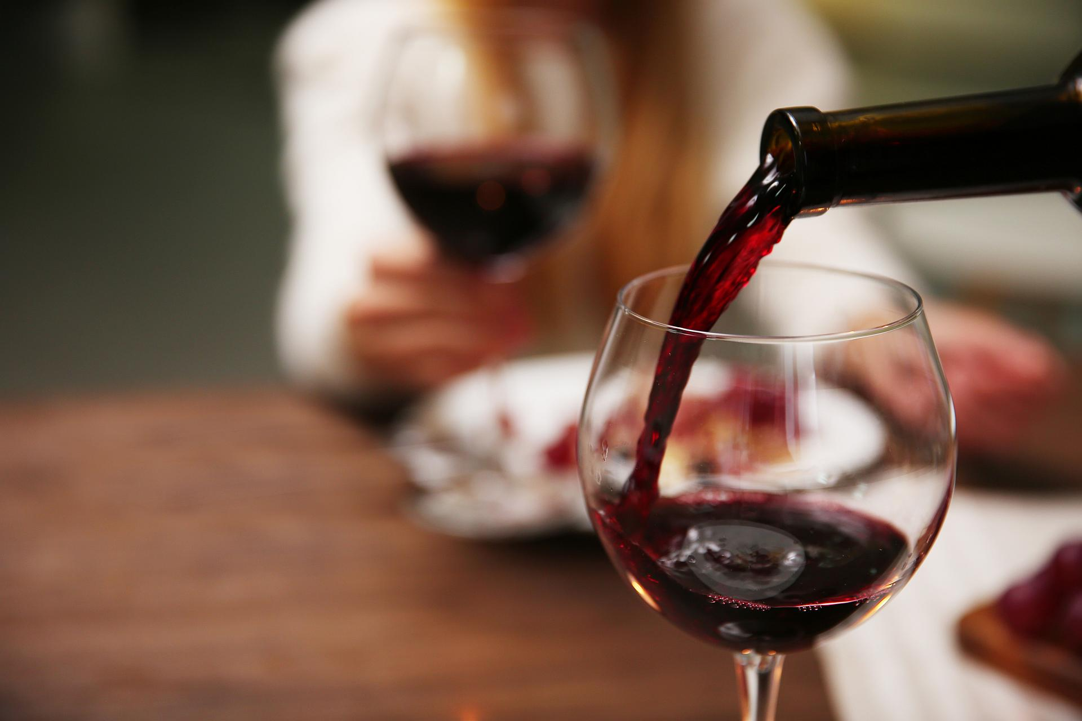
It is not for kings, O Lemuel, It is not for kings to drink wine, Nor for princes intoxicating drink; Lest they drink and forget the law, And pervert the justice of all the afflicted. Give strong drink to him who is perishing, And wine to those who are bitter of heart. Let him drink and forget his poverty, And remember his misery no more. — Proverbs 31:4-7
not for kings
to drink wine
intoxicating drink
drink
drink
drink
drink
drink
drink
Give
to him who is perishing
medical
Notes:
The Word of God is clear that wine is to be used for medicinal purposes and as a sympathetic anesthetic for the terminally impoverished as the end knocks. Its’ excessive intake is not meant for those healthy filled with life, and certainly not for one in leadership positions. Why or how could a poison killing substance be condoned by any rational sentient creatures? To escape the pains of living? Better anesthetics have been developed in our times so alcohol has become superfluous from its original ancient intent. We are controlled by what we desire.

Slide 9
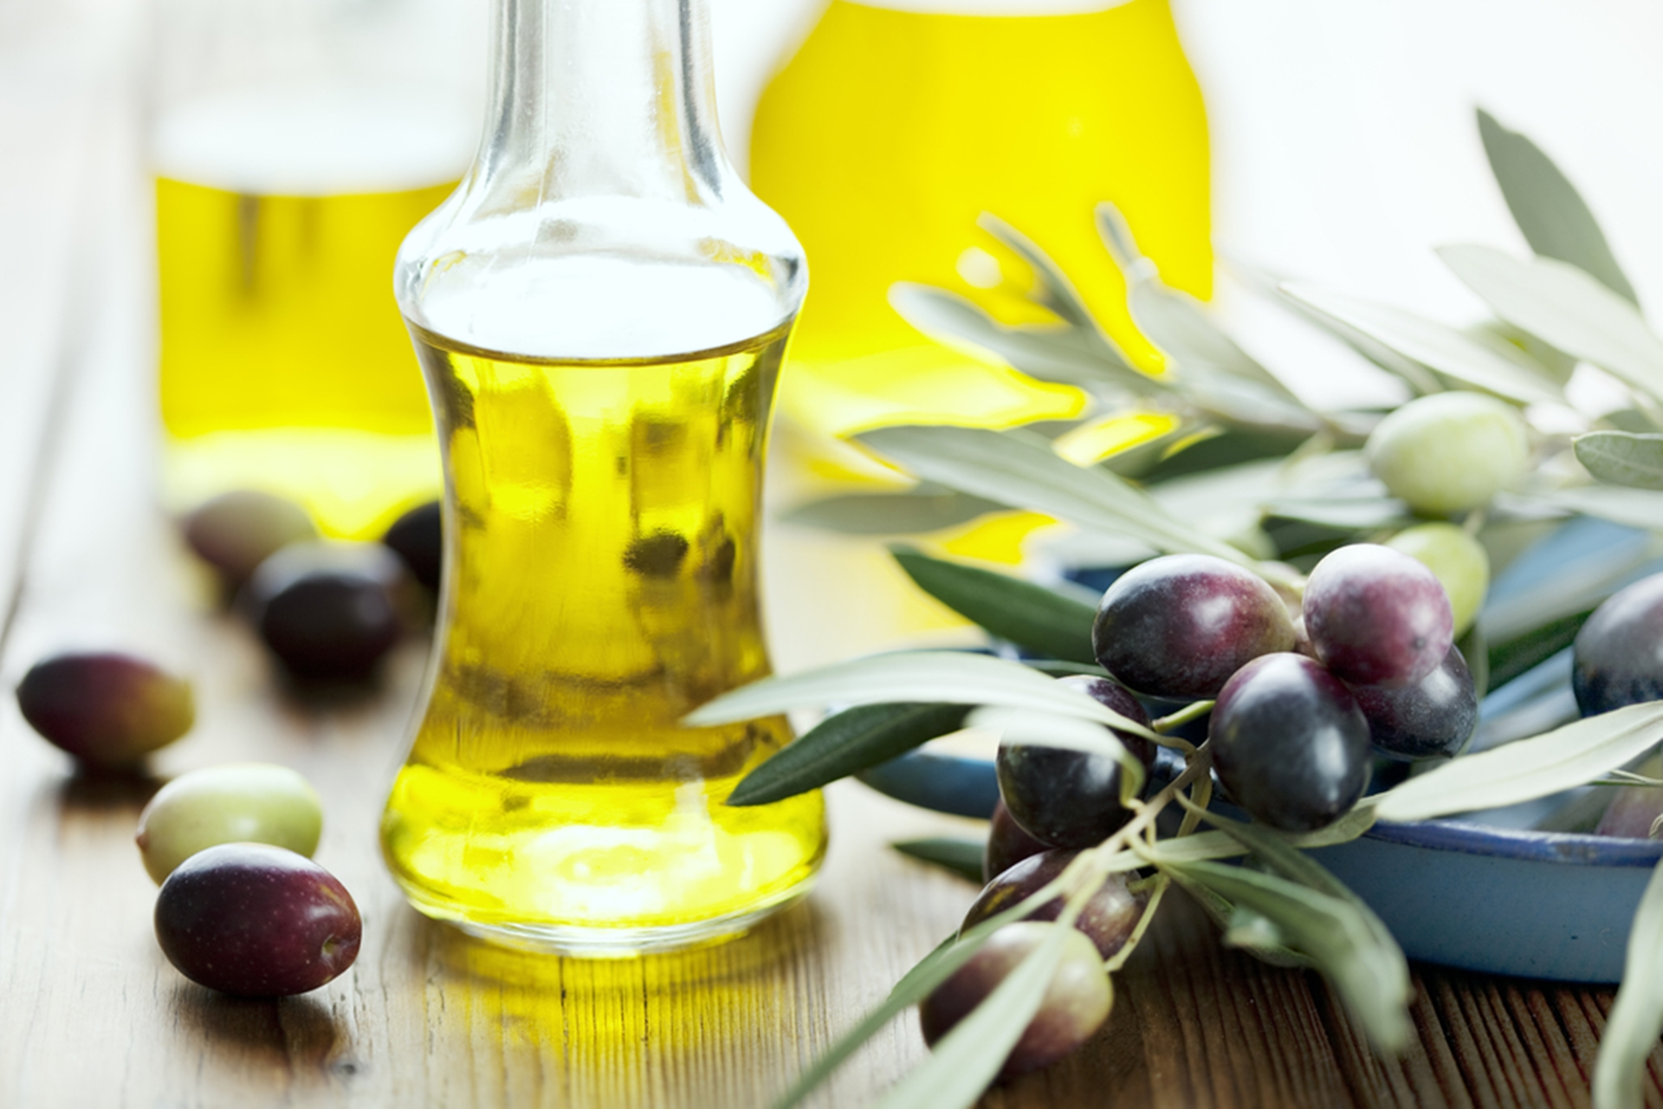
No longer drink only water, but use a little wine for your stomach's sake and your frequent infirmities. — 1st Timothy 5:23
drink
a little wine
for
infirmities
Notes:
Fruit of the vine comes in various forms. The fruit of olive trees pressed in winepresses have long been known for healing powers. Everything created by God is evidence for the benefit of man and not intended to advance his demise. One does not jump into a fire to get warm. The Bible does not advocate casual and habitual social drinking as a form of spiritual and or physical healing for the healthy. What has been created for moderate use as medicine has too often transferred to that of vices for those escapists from reality. Today, psychotic drugs abound. God’s call is not one to escape from living, but to endure through its’ becoming, while acknowledging His glory for the greater good of all.

Slide 10
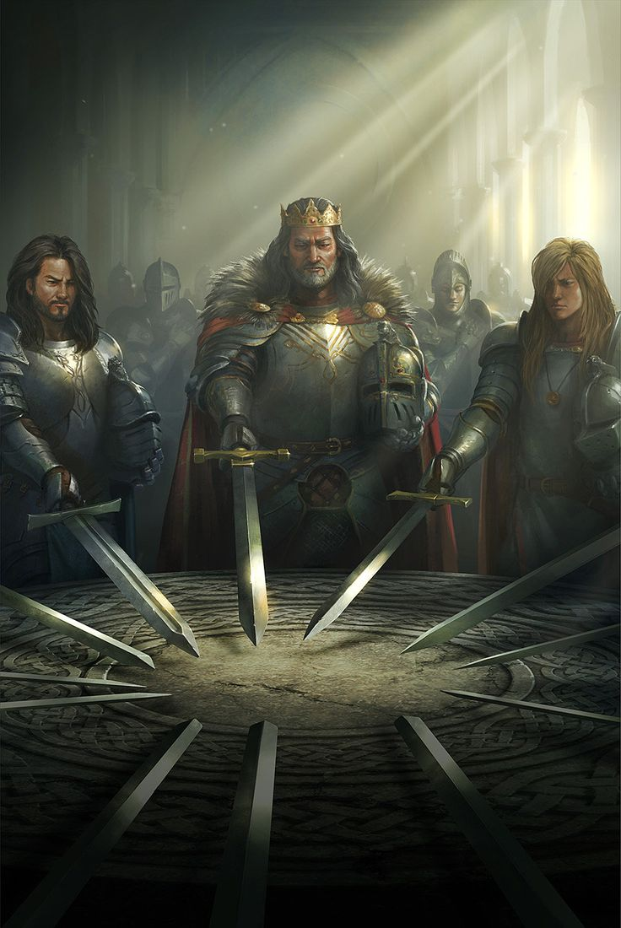
Blessed are you, O land, when your king is the son of nobles, And your princes feast at the proper time - For strength and not for drunkenness! — Ecclesiastes 10:17
Blessed
For strength
not
drunkenness
Notes:
Blessings come through strength of sobriety and the lack of drunkenness.

Slide 11
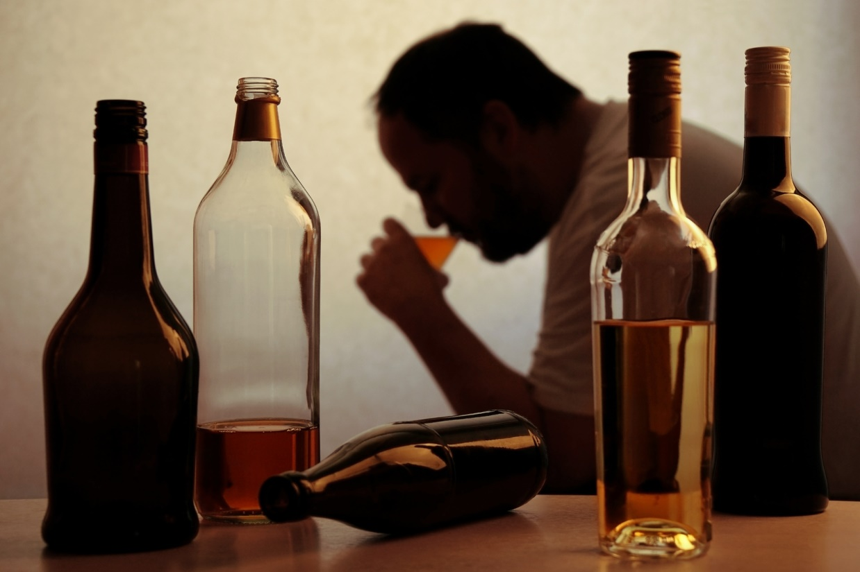
Woe to those who rise early in the morning, That they may follow intoxicating drink; Who continue until night, till wine inflames them! The harp and the strings, The tambourine and flute, And wine are in their feasts; But they do not regard the work of the LORD, Nor consider the operation of His hands. Therefore my people have gone into captivity, Because they have no knowledge; Their honorable men are famished, And their multitude dried up with thirst. — Isaiah 5:11-13
Woe
Woe
intoxicating drink
Woe
do not regard the work of
the LORD
intoxicating drink
no knowledge
Notes:
Drinking alcohol is a dead thirst. To break the cycle of woe, love for the Lord must be found and maintained. Love for family and others helps remove one from the isolation drinking produces. Steadfast saints are among those thirsting His living water where it rises from the heart.

Slide 12
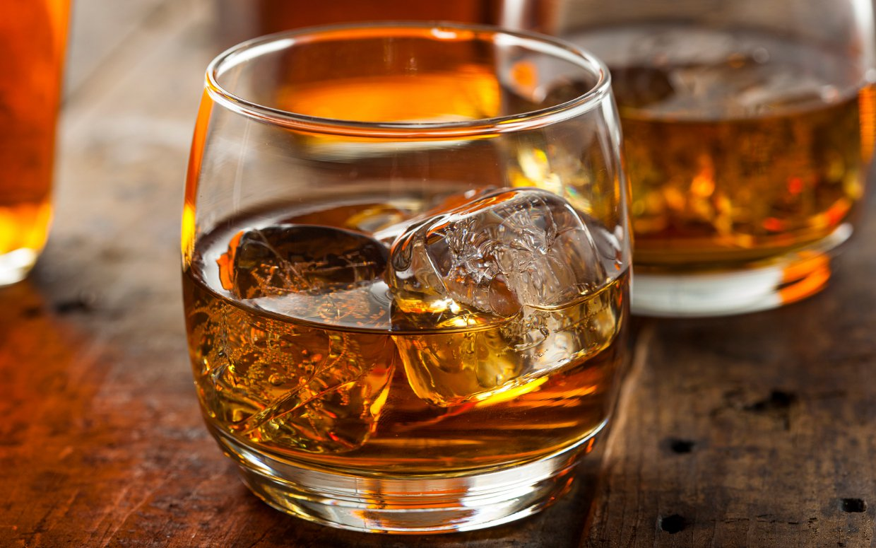
Woe to men mighty at drinking wine, Woe to men valiant for mixing intoxicating drink, … — Isaiah 5:22
Woe
intoxicating drink
Notes:
There is nothing to be proud of in “out drinking” fools in the pool.

Slide 13
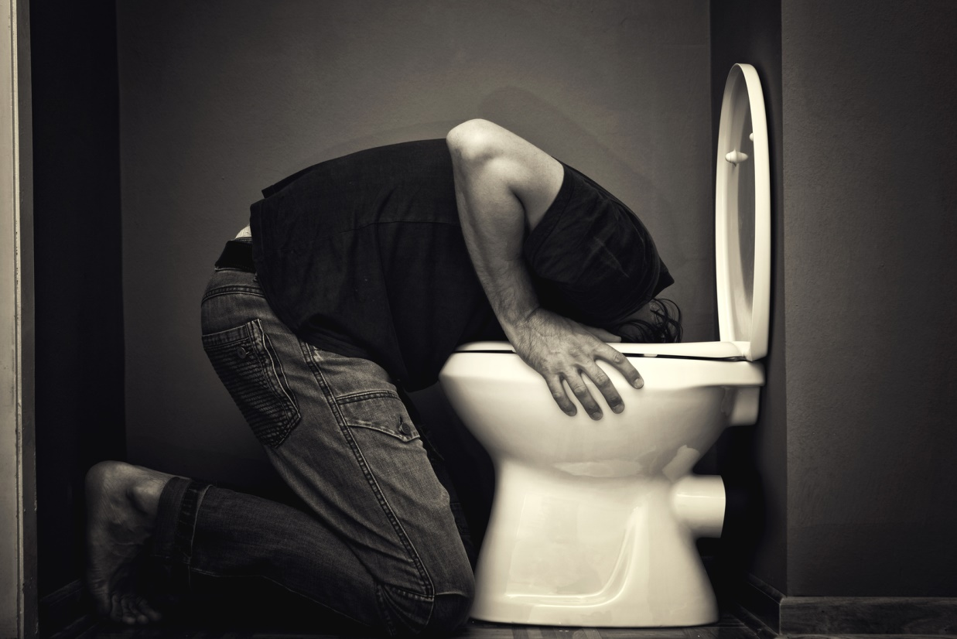
The LORD has mingled a perverse spirit in her midst; And they have caused Egypt to err in all her work, As a drunken man staggers in his vomit. — Isaiah 19:14
a drunken man staggers
in
vomit
Notes:
As a drunken man staggers where is the glory, for God or self? All can testify that vomit is a wrenching experience best left as a memory. For the boozer, it is a recycling event.

Slide 14
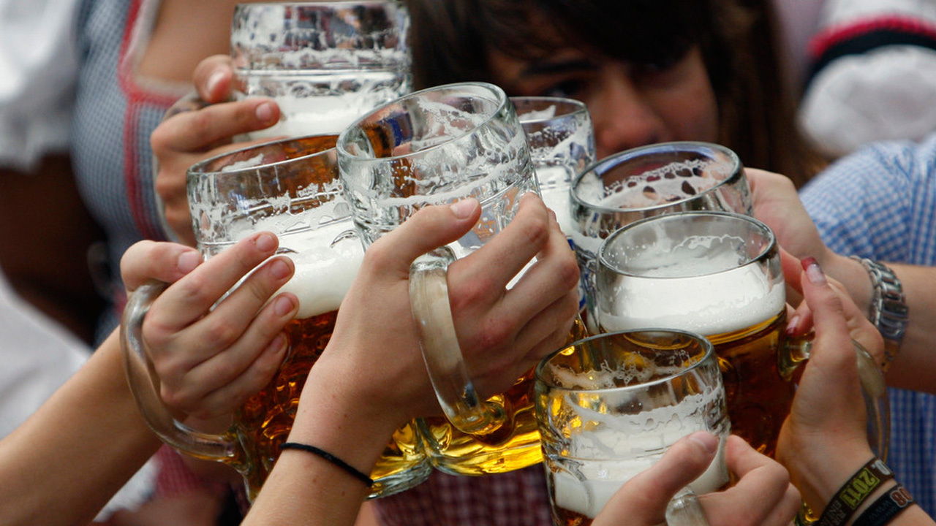
And in that day the Lord GOD of hosts Called for weeping and for mourning, For baldness and for girding with sackcloth. But instead, joy and gladness, Slaying oxen and killing sheep, Eating meat and drinking wine: "Let us eat and drink, for tomorrow we die!" — Isaiah 22:12-13
repentance
But instead
revelry
for tomorrow we die
Notes:
God has always instructed mankind to repent of or turn from wrong doings. More often man, head over heels, jumps into the very thing he should be repenting of. Revelry without regard is carelessness. Seeing only the temporary is a limited experience.

Slide 15
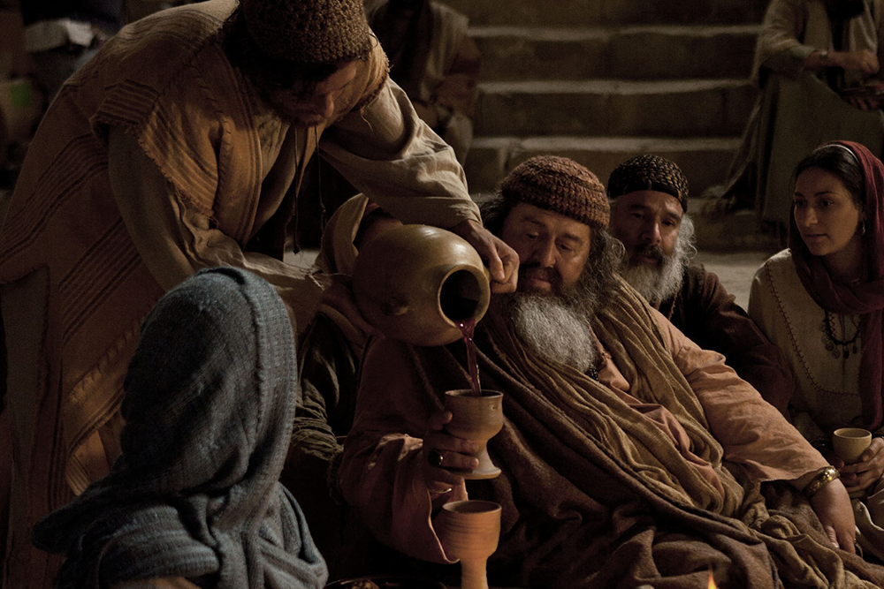
Woe to the crown of pride, to the drunkards of Ephraim, Whose glorious beauty is a fading flower Which is at the head of the verdant valleys, To those who are overcome with wine! — Isaiah 28:1
Woe to
pride
drunkards
drunkards
. .
overcome with wine
Notes:
With all the symptoms of drunkenness, and being overcome by it, it reduces to a vegetative state of despicable sloths.

Slide 16

The crown of pride, the drunkards of Ephraim, Will be trampled underfoot; — Isaiah 28:3
drunkards
squashed
flattened
pounded
defeated
trampled
crushed
leveled
trampled
Notes:
There is no saving grace for the dazed.

Slide 17

But they also have erred through wine, And through intoxicating drink are out of the way; The priest and the prophet have erred through intoxicating drink, They are swallowed up by wine, They are out of the way through intoxicating drink; They err in vision, they stumble in judgment. — Isaiah 28:7
out of the way
priest
prophet
swallowed up
out of the way
drink
drink
drink
drink
in
err in vision
in
stumble in judgment
Notes:
No good results come from the effects of one in a drunken stupor.

Slide 18

Yes, they are greedy dogs Which never have enough. And they are shepherds Who cannot understand; They all look to their own way, Every one for his own gain, From his own territory. "Come," one says, "I will bring wine, And we will fill ourselves with intoxicating drink; Tomorrow will be as today, And much more abundant." — Isaiah 56:11-12
greedy
cannot understand
own gain
wine
wine
wine
intoxicating drink
T omorrow
drink
Tomorrow as today
as today
Notes:
Many drinkers see no end to the pleasures they indulge in condemning those that would prefer to remain sober. Unbeknownst is what the Bible makes clear, in that drinkers are inherently self centered and selfish, along with being purposely oblivious; denial. There are those that while the day is the day, they desire to drink with no end. Often drinks are used to loose passions of lust.

Slide 19

"Harlotry, wine, and new wine enslave the heart." — Hosea 4:11
new wine
wine
wine
new wine
fermented
enslave
unfermented
Notes:
We are prisoners to the desires of our heart. To unlock the window to true love one must soar past those afflictions that keep that window closed. External desires cannot surpass the upwelling inspirations love delivers to those who possess it. Inward peace cannot be obtained by outward vices. Those enslaved are not free but weighted down with woes. The Bible makes a clear distinction between wine and new wine as separate.

Slide 20
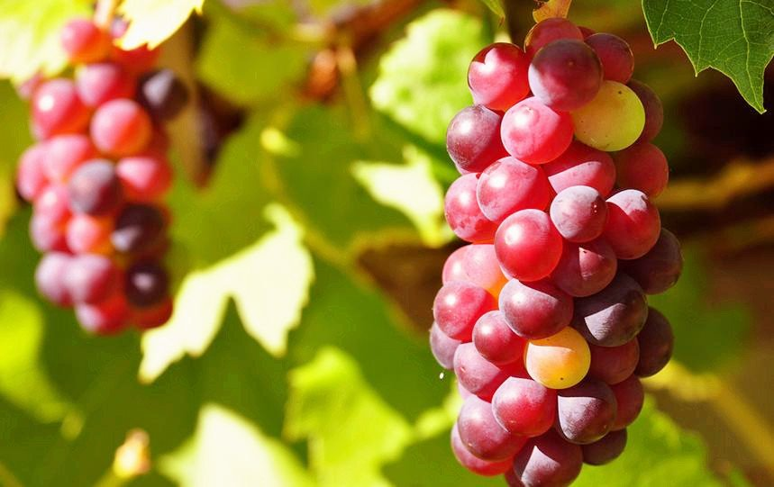
Thus says the LORD: "As the new wine is found in the cluster, And one says, 'Do not destroy it, For a blessing is in it,' So will I do for My servants' sake, That I may not destroy them all." — Isaiah 65:8
new wine
found in the cluster
new wine
Notes:
Clearly new wine is the sweetness found in freshly squeezed fruit of the vine. Both unfermented and fermented wine was available in the first century, as it is also today. Todays production methods and alcohol content is certainly higher than in previous times. There is an avalanche of sinful mind bending juice. Even water can kill you if taken in excessive amounts. Moderation in all things is the balance God calls out for in the wise.

Slide 21
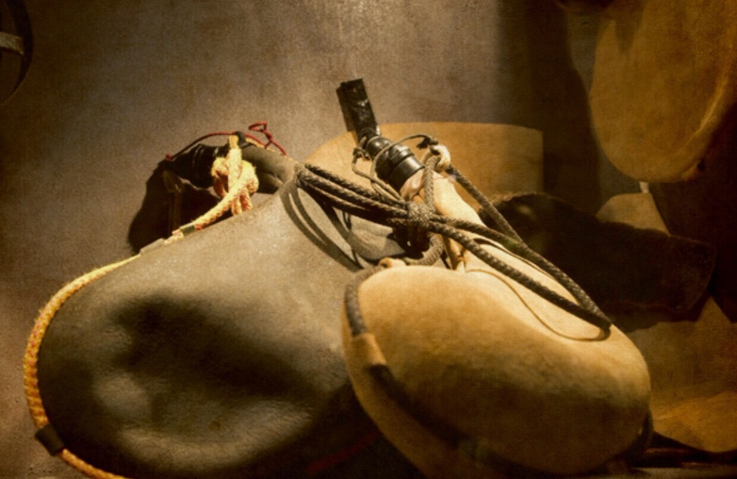
"And no one puts new wine into old wineskins; or else the new wine bursts the wineskins, the wine is spilled, and the wineskins are ruined. But new wine must be put into new wineskins." — Mark 2:22
new wine
new wine
new wine
Notes:
Again, unfermented new wine has yet to be fermented into fully intoxicating wine. Jesus came to save sinners, not to extricate those vices of sin where man had errored from understanding the will, and or intent, of God. Indulgence often dismisses wisdom. Knowledge, or lost knowledge is what destroys a people. There is a way that seems right to man but its end is in death. Excuses for irresponsibility have never revealed truth.

Slide 22
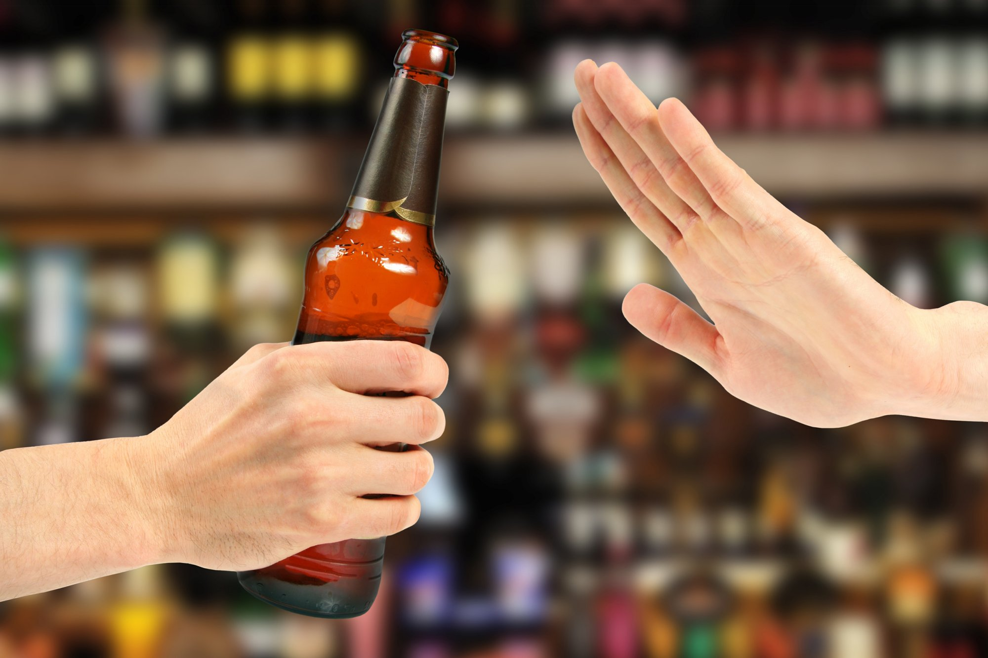
"Woe to him who gives drink to his neighbor, Pressing him to your bottle, Even to make him drunk, That you may look on his nakedness! You are filled with shame instead of glory. You also - drink! And be exposed as uncircumcised! The cup of the LORD'S right hand will be turned against you, And utter shame will be on your glory." — Habakkuk 2:15-16
Pressing
drink
The LORD is all seeing
utter shame
on you
Notes:
As they say, misery loves company. If one does not drink when offered, rejection and scorn is part of the offering arrogant souls defense. Sober people are, I believe, envied, and therefore attacked and or just ignored. Alcoholics find it easy to throw people away.

Slide 23
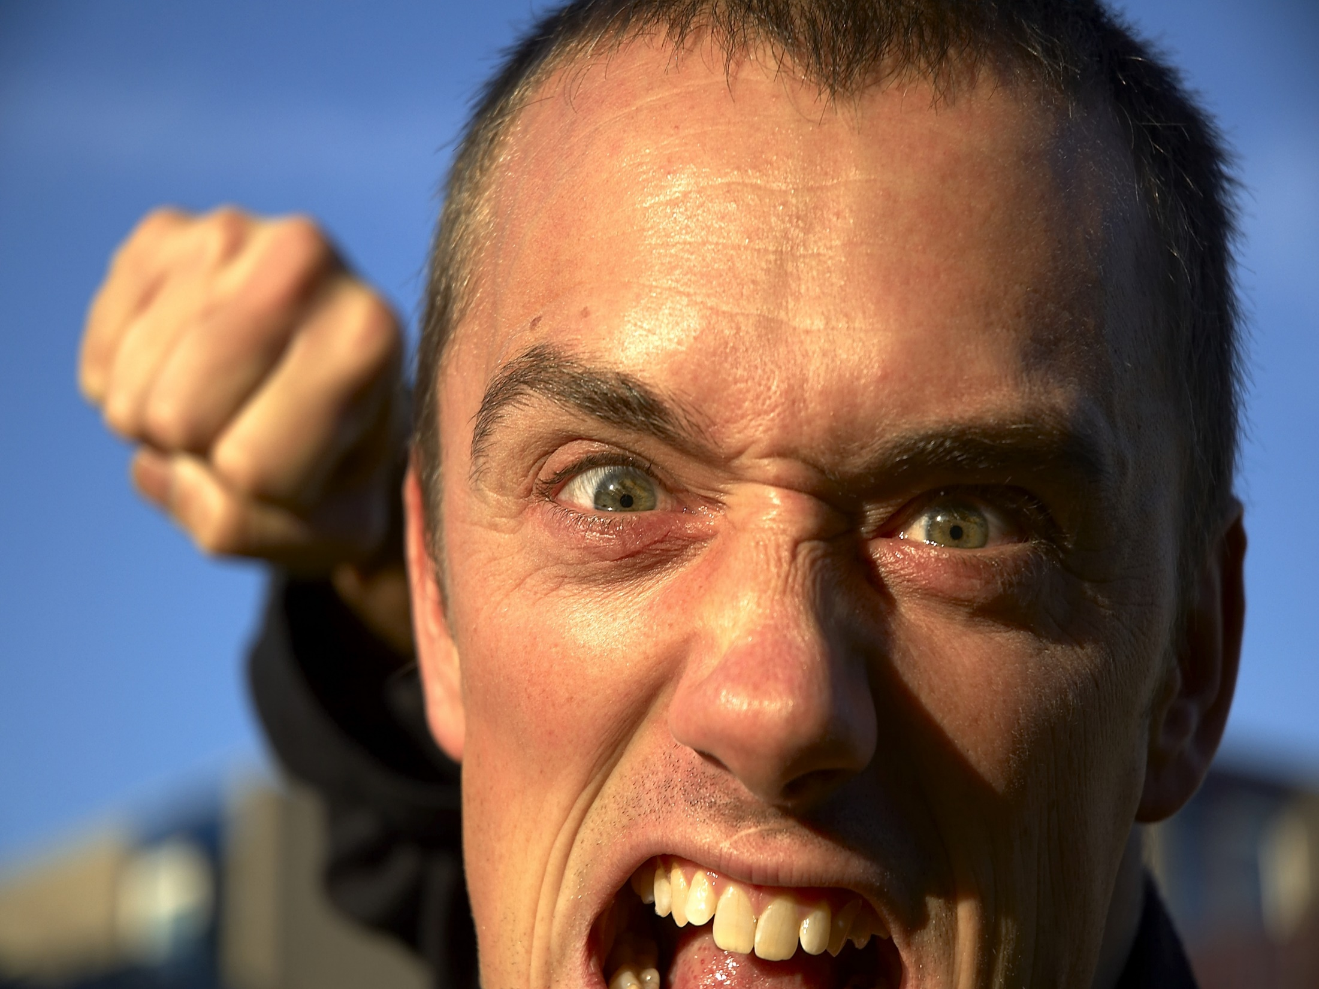
"But if that servant says in his heart, 'My master is delaying his coming,' and begins to beat the male and female servants, and to eat and drink and be drunk, the master of that servant will come on a day when he is not looking for him, and at an hour when he is not aware, and will cut him in two and appoint him his portion with the unbelievers." — Luke 12:45-46
drink
drunk
will cut him in two
Notes:
To ignore the warnings and consequences of drinking given to us through His Word, angry souls mired in their own grief will have no excuse as God casts them off.

Slide 24

Do not be overly wicked, Nor be foolish: Why should you die before your time? — Ecclesiastes 7:17
Why should you die
Notes:
One has to gain the courage to overcome weaknesses to enjoy the powers God offers to those who embrace His ways, over that of mans. One must rise to desire life over death to overcome that deadly disease, called by any vice, a fools escape.

Slide 25
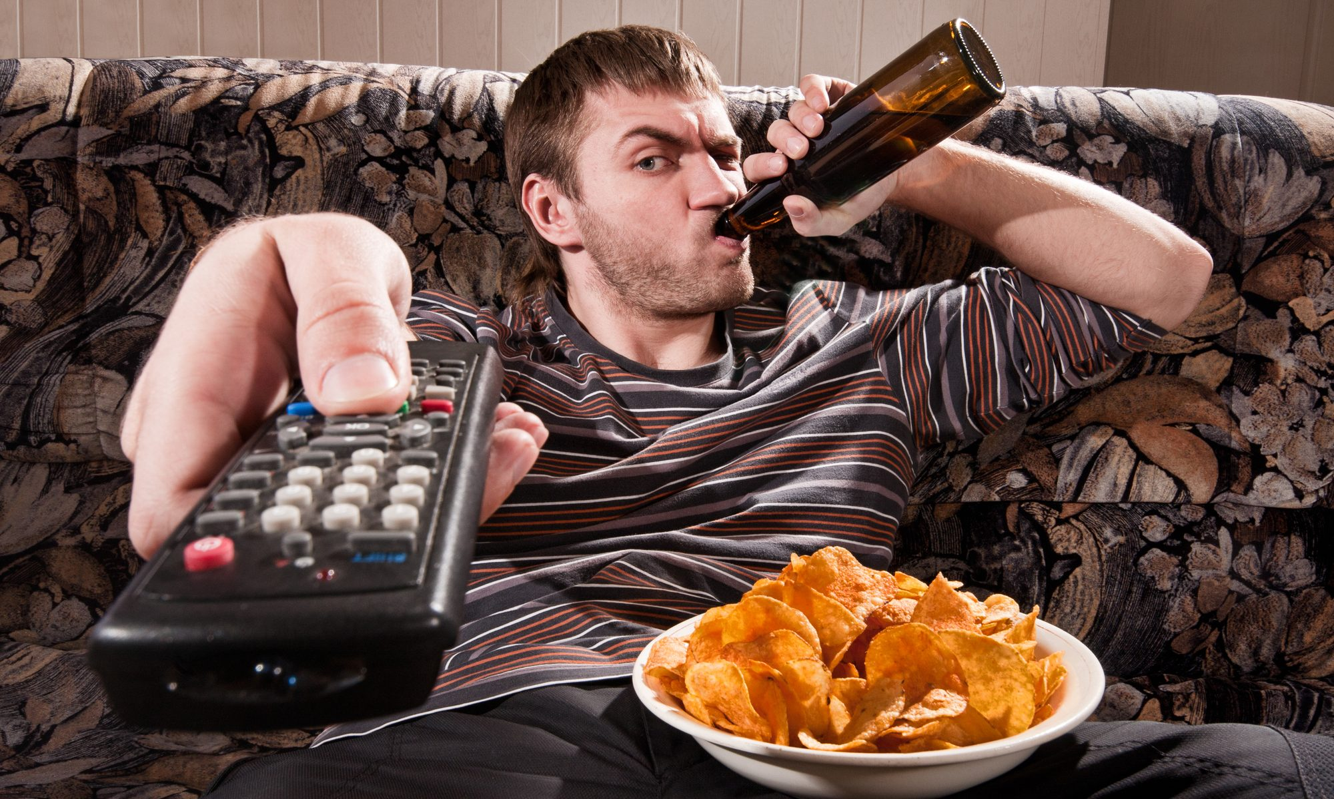
"But take heed to yourselves, lest your hearts be weighed down with carousing, drunkenness, and cares of this life, and that Day come on you unexpectedly." — Luke 21:34
take heed
carousing
drunkenness
cares of this life
carousing
drunkenness
cares of this life
that Day
come on you unexpectedly
that Day come on you unexpectedly
Notes:
Many have become self absorbed couch game playing drinking fools stumbling from one stupor to the next. Potato chips help grease the channel changer to the station of no where. His warning stands in the face of mans foibles. Dangerous are the times in they attempt to deceive with false pleasures. In God is the highest one can obtain.

Slide 26


→ Alcohol is a mocker, brawler, & not wise
→ Don’t mix with alcoholics led to poverty/drowsiness
→ Bingers wallow in woes, contentions, false injuries
→ Drunks will see strange things & utter perversities
→ Alcoholics don’t feel physical pain - waking for more
→ Give strong drink to those perishing abating misery
→ Use a little wine for frequent infirmities
→ Blessed are you when the leaders are not drunkards
→ Drinkers do not regard the work of the LORD
→ Alcohol swallows one in err both vision & judgment
→ Harlotry, wine, and new wine enslave the heart
→ Giving alcohol to a neighbor is to one’s own shame
→ Beware and avoid revelries causing harsh judgment
Only the sober can fully realize His truths
Notes:
Only the sober can fully realize His truths.

Slide 27
Notes:
Darkness's anthem is silence.

Slide 28
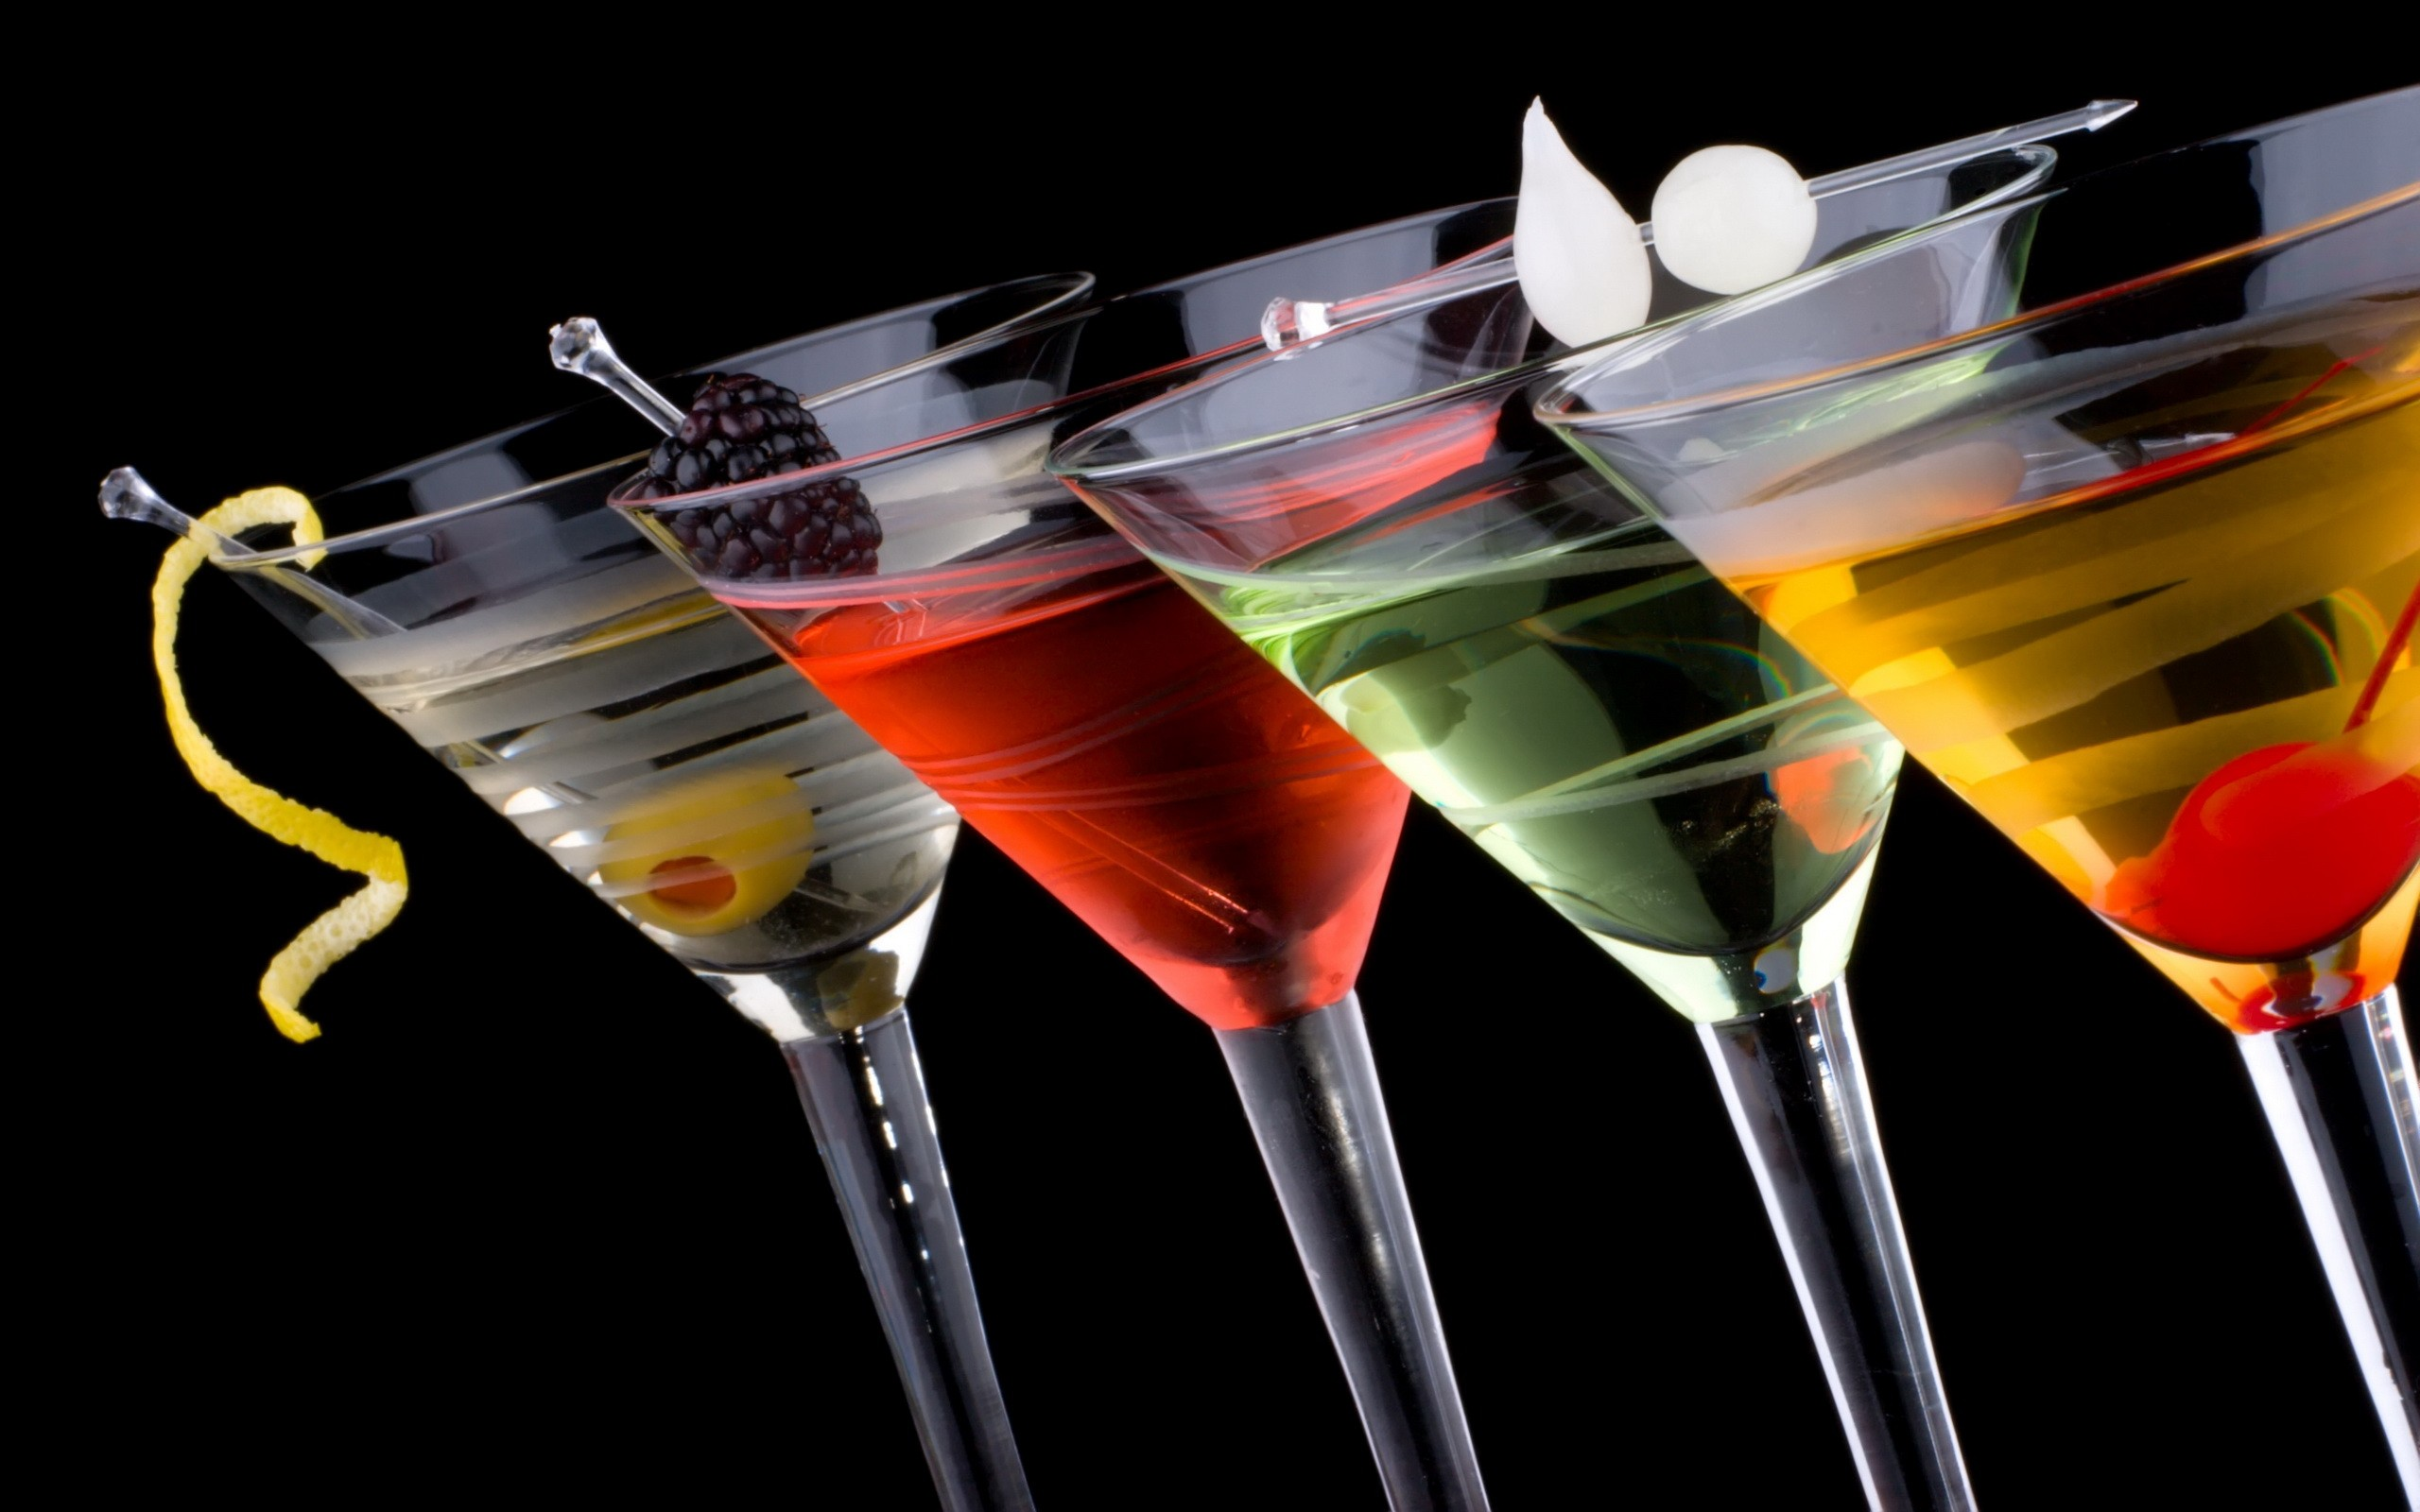
Drinking
2
Ron Bert
October 21, 2018
Notes:
Drinking is glamorized by venture capitalists as guaranteed to lighten hearts in the unity of joy. A lie always remains a lie no matter how many believe it.

Slide 29

You are all sons of light and sons of the day. We are not of the night nor of darkness. Therefore let us not sleep, as others do, but let us watch and be sober. For those who sleep, sleep at night, and those who get drunk are drunk at night. But let us who are of the day be sober, putting on the breastplate of faith and love, and as a helmet the hope of salvation. — 1st Thessalonians 5:5-8
darkness
darkness
watch and be sober
be sober
be sober
heart
of faith
mind
and love
hope
of salvation
Notes:
To remain in darkness can only define those spiritually blind. Elements of God’s word instruct us how to live soberly in the hope of His eventual coming. How can one be watchful if darkness commands?

Slide 30

The night is far spent, the day is at hand. Therefore let us cast off the works of darkness, and let us put on the armor of light. Let us walk properly, as in the day, not in revelry and drunkenness, not in lewdness and lust, not in strife and envy. But put on the Lord Jesus Christ, and make no provision for the flesh, to fulfill its lusts. — Romans 13:12-14
cast off
works of darkness
darkness
armor of light
walk
not in
in
drunkenness
lusts
put on the Lord Jesus Christ
Jesus
lusts
Notes:
We are told to remain in the light of spiritual adeptness, not in the quagmire of passion’s desperation where sin flourishes. Lust is the curse of a heart and the thief of peace. To live life to ones fullest potential, one must be a master over lust, and the evils it inspires.

Slide 31
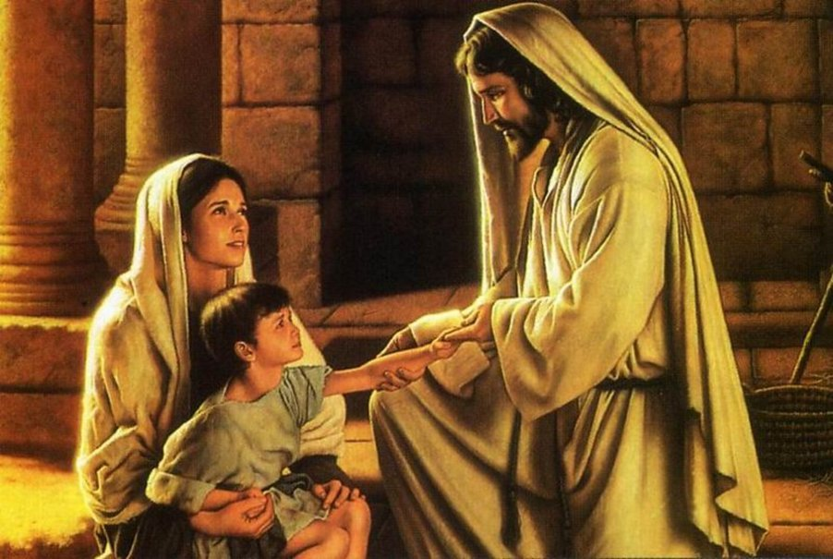
Therefore, since Christ suffered for us in the flesh, arm yourselves also with the same mind, for he who has suffered in the flesh has ceased from sin, that he no longer should live the rest of his time in the flesh for the lusts of men, but for the will of God. — 1st Peter 4:1-2
the will
arm yourselves
same mind
lusts
no longer
in
in
lusts of men
lusts
for the will of God
the will
Notes:
God commands us to put on those qualities He reflects in the goodness that He is. What fills a heart declares the character one sings. He wants us to shed desires and lusts to honestly and humbly love one another without expectations. Lust is unrestrained desire which all of us have battled if we choose to climb that challenging ladder of righteousness.

Slide 32
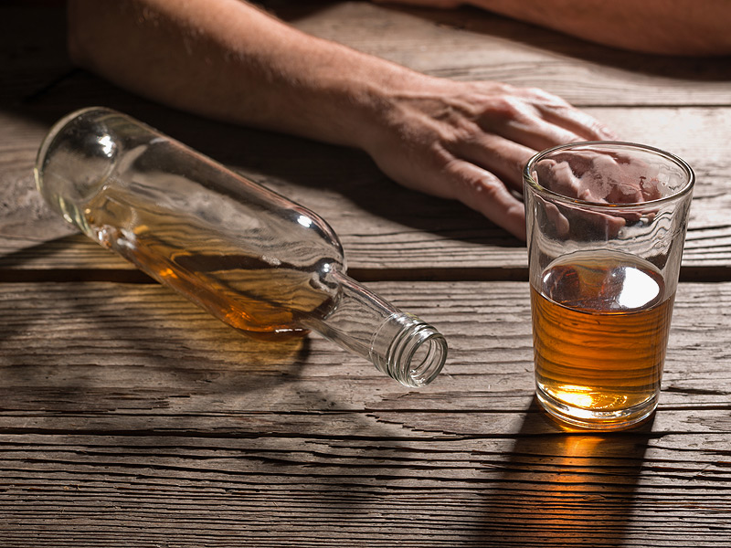
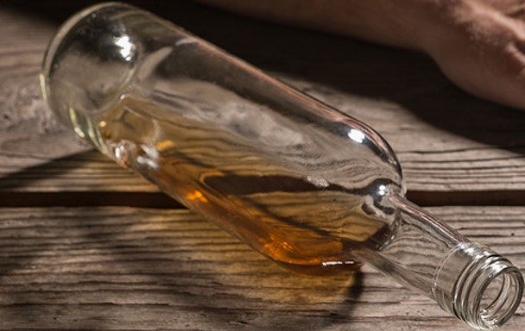
For we have spent enough of our past lifetime in doing the will of the Gentiles -- when we walked in lewdness, lusts, drunkenness, revelries, drinking parties, and abominable idolatries. In regard to these, they think it strange that you do not run with them in the same flood of dissipation, speaking evil of you. — 1st Peter 4:3-4
the will
walk
in
in
lust
drunkenness
lusts
drunkenness
lust
do not run with them
Notes:
Is your lust in the bottle of despair? If you have been a drinker, now emancipated from its’ control, those who remain ensnarled in its’ domination will belittle you. The pattern most lustful souls have is to change those that they ‘possess’ - unaware God’s will is for us to just accept one another, for who we are, and wish for the greatest we can be. In evaluating self, over condemning others, this allows love to rise. We were created to encourage one another. To beat the demons from within one must find a way to shine the light of love on that deepest darkness, which holds one under, in the shackles of hopelessness. The greatest light comes not from ourselves, but from He who gave life life. The greatest blessings from within come from Him.

Slide 33
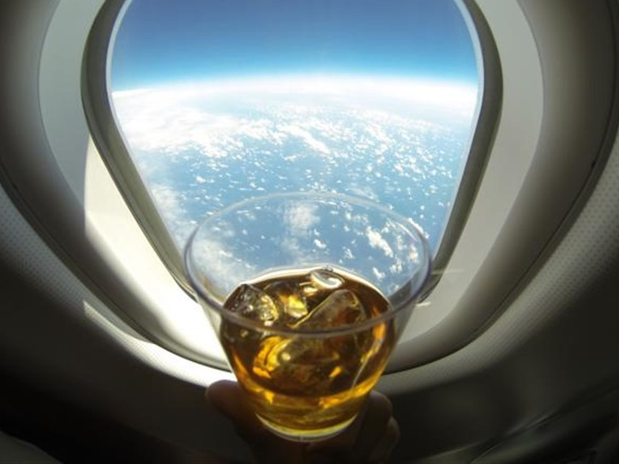
Do not love the world or the things in the world. If anyone loves the world, the love of the Father is not in him. For all that is in the world -- the lust of the flesh, the lust of the eyes, and the pride of life -- is not of the Father but is of the world. And the world is passing away, and the lust of it; but he who does the will of God abides forever. — 1st John 2:15-17
in
love of the Father
in
in
lust
lust
lust
lust
lust
the will
Notes:
How high can one get before realizing God is above all? His will is for us to be as we are, humbly, without portentousness. To artificially induce a high will never achieve the heights He intended for those that love Him where simplicity rides upon the clouds. The stars shine below heavens glory.

Slide 34
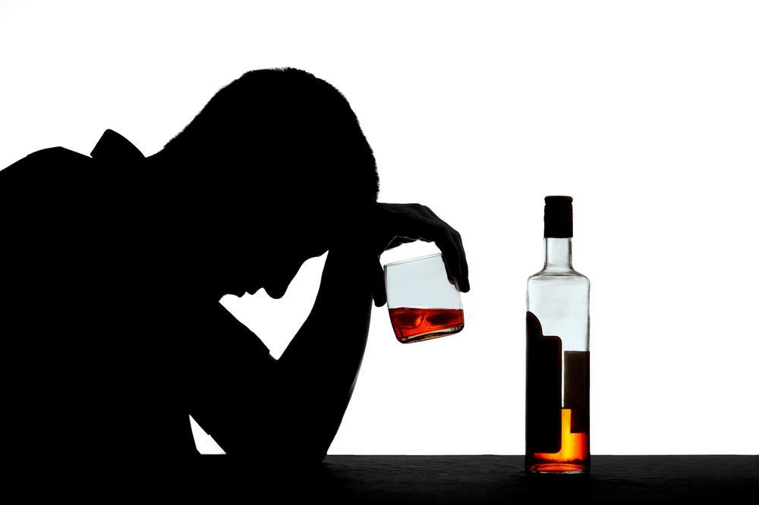
Therefore do not let sin reign in your mortal body, that you should obey it in its lusts. — Romans 6:12
do not
sin
Desires
Yearning
Covetousness
Longing
Craving
Envy
Urge
in
lusts
obey it in its lusts
lusts
lust
Notes:
If one has no control over the vice that stimulates them, who would be the master? Fleshly weakness is not where the spiritually strong reside. A life with purpose has an agenda to climb over that of descending. To overcome death, one must learn to live, and in Him is the life of all men.

Slide 35
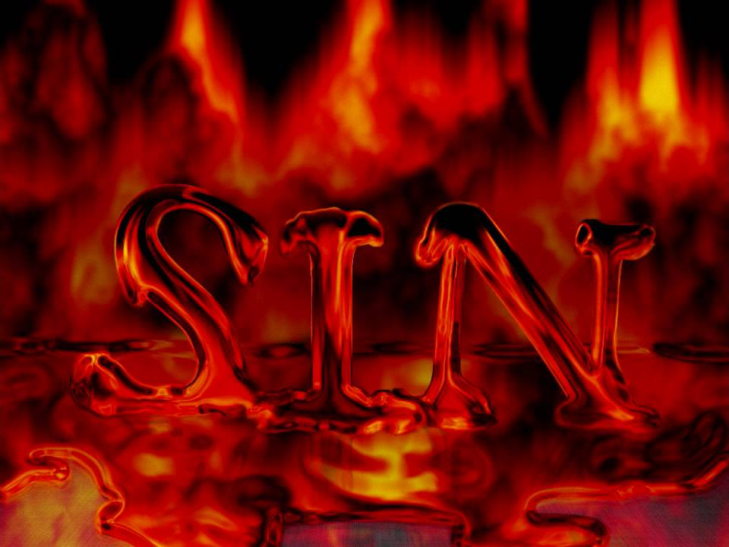
Beloved, I beg you as sojourners and pilgrims, abstain from fleshly lusts which war against the soul, … — 1st Peter 2:11
flesh
abstain from fleshly lusts
flesh
lusts
Notes:
Sin is the wickedness that lies underneath all that is decent. It invades where it can craving to stumble those who hope for more. Sin is a tortuous ladder rising out of the bowels of despair.

Slide 36
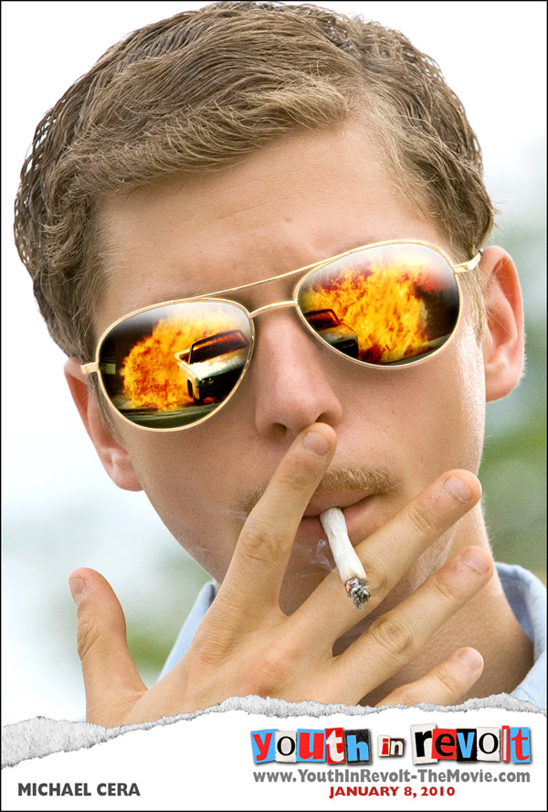
Now the works of the flesh are evident, which are: adultery, fornication, uncleanness, lewdness, idolatry, sorcery, hatred, contentions, jealousies, outbursts of wrath, selfish ambitions, dissensions, heresies, envy, murders, drunkenness, revelries, and the like; of which I tell you beforehand, just as I also told you in time past, that those who practice such things will not inherit the kingdom of God. — Galatians 5:19-21
flesh
inherit
drunkenness
drunkenness
will not inherit the kingdom of God
not
inherit
Notes:
For all hearts in His light, no sinful flame is to cold that it will not burn the coals of regret.

Slide 37
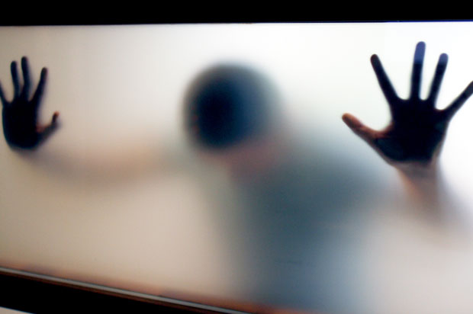
Do you not know that the unrighteous will not inherit the kingdom of God? Do not be deceived. Neither fornicators, nor idolaters, nor adulterers, nor homosexuals, nor sodomites, nor thieves, nor covetous, nor drunkards, nor revilers, nor extortioners will inherit the kingdom of God. — 1st Corinthians 6:9-10
inherit
inherit
inherit
nor drunkards
Notes:
To be condemned under sin will tear one in half. Enough said.

Slide 38
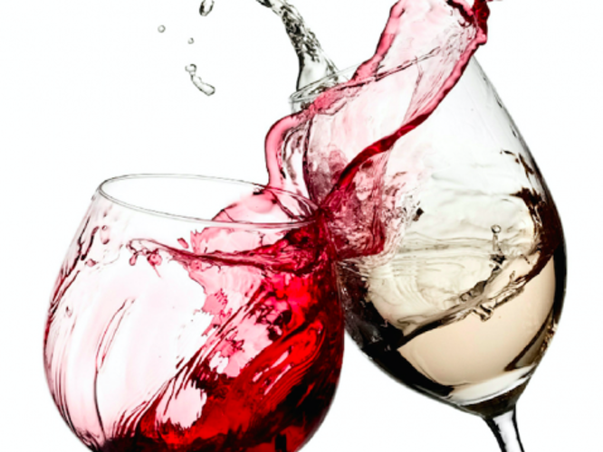
Therefore do not be unwise, but understand what the will of the Lord is. And do not be drunk with wine, in which is dissipation; but be filled with the Spirit, speaking to one another in psalms and hymns and spiritual songs, singing and making melody in your heart to the Lord, giving thanks always for all things to God the Father in the name of our Lord Jesus Christ, submitting to one another in the fear of God. — Ephesians 5:17-21
do not be unwise
do not
do not be drunk
in
in
in
God
Notes:
The Bible tells us not to be drunk. I agree with one drink is to much and not enough. For that matter, any pain numbing vice detracts from certain sober appreciation. The collision of drunkenness and God’s word are not compatible.

Slide 39
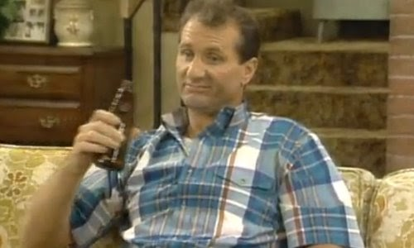
But now I have written to you not to keep company with anyone named a brother, who is sexually immoral, or covetous, or an idolater, or a reviler, or a drunkard, or an extortioners -- not even to eat with such a person. — 1st Corinthians 5:11
not to keep company with
eat
in
a drunkard
eat
Notes:
People that excessively drink are not regarding the will of God, who says not to. For those that struggle in desire of quitting, fill yourself with the Spirit and help will come; pray. I was an excessive drinker and it was His Word and a growing desire to please Him that led to my sobriety. His Word is the ladder that lifts one out of the hole of no return.

Slide 40
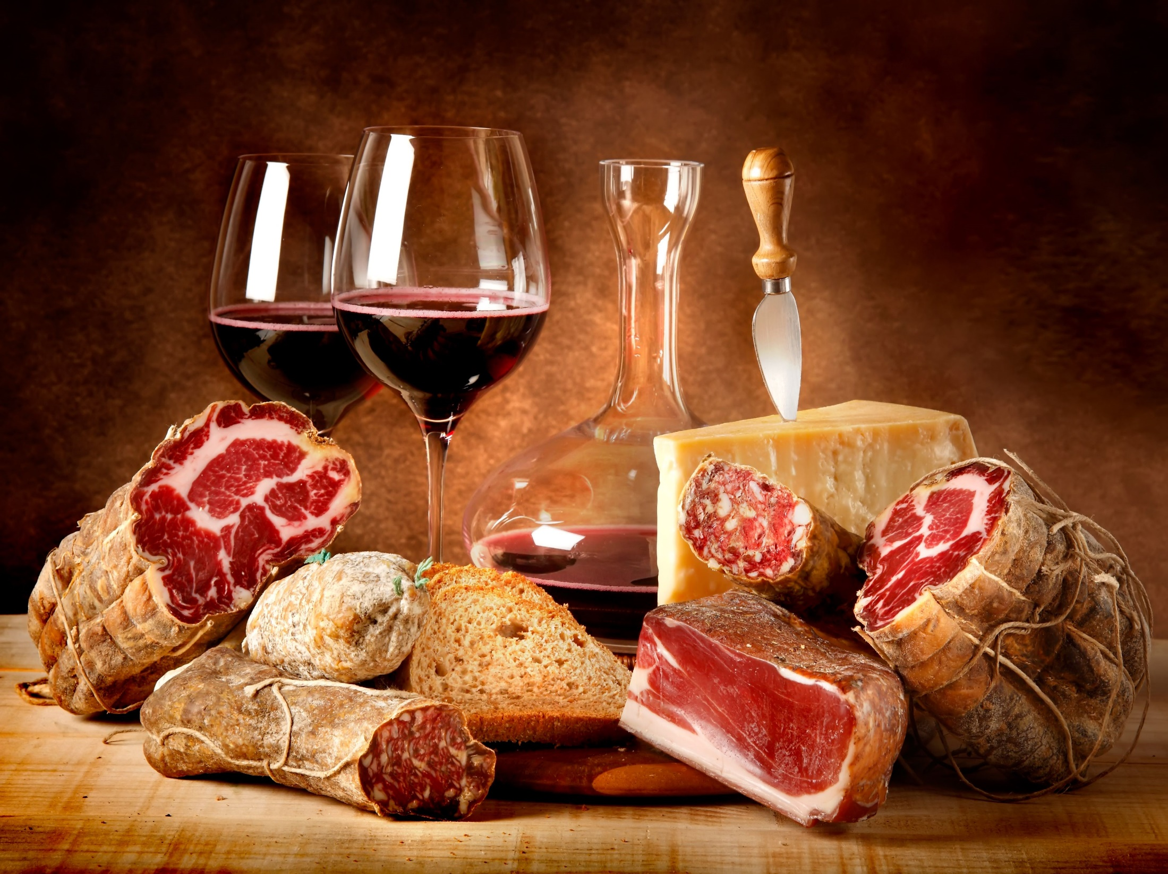
It is good neither to eat meat nor drink wine nor do anything by which your brother stumbles or is offended or is made weak. — Romans 14:21
eat
eat
nor do anything
stumble
offend
made weak
Notes:
God wants us to consider others before ourselves. Empathy is a very high and lofty godly quality. God looks for us to become stronger, not weaker.

Slide 41
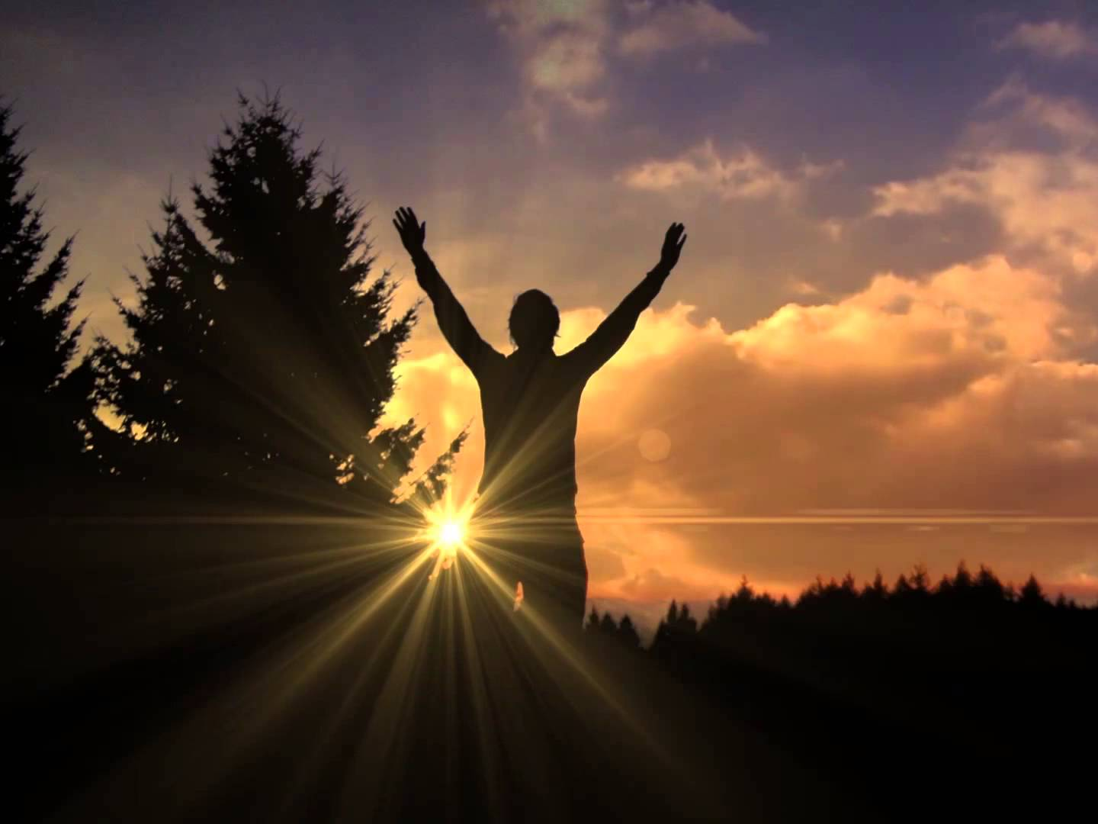
Therefore, whether you eat or drink, or whatever you do, do all to the glory of God. Give no offense, either to the Jews or to the Greeks or to the church of God, … — 1st Corinthians 10:31-32
eat
whatever you do
do all to the glory of God
God
no offense
God
God
Notes:
If it is one’s desire to do all to the glory of God, this is the epitome of one’s faith.

Slide 42
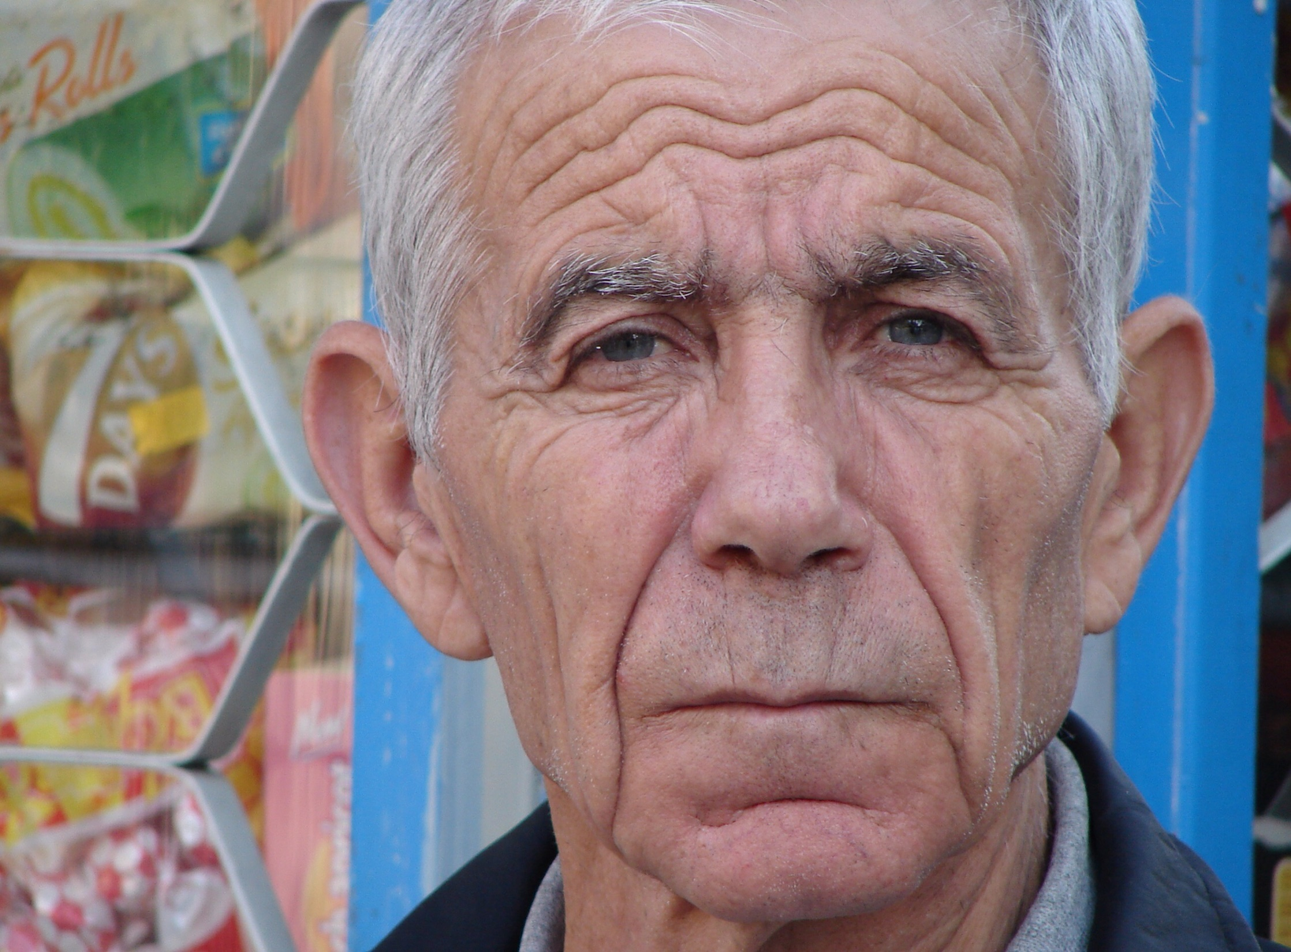
But as for you, speak the things which are proper for sound doctrine: that the older men be sober, reverent, temperate, sound in faith, in love, in patience; — Titus 2:1-2
speak
sober
for sound doctrine
older men be sober
in
sober
in
faith
God
in
love
in
patience
Notes:
God expects the wealth of wisdom to shine forth from older men. A lifetime spent from one stupor to another shortens the value, one could bestow, upon others as a legacy. Juice can flow uphill.

Slide 43

A bishop then must be blameless, the husband of one wife, temperate, sober-minded, of good behavior, hospitable, able to teach; not given to wine, not violent, not greedy for money, but gentle, not quarrelsome, not covetous; — 1st Timothy 3:2-3
leaders
sober-minded
sober
not given to wine
not greedy
not greedy
Notes:
There is no doubt God calls for responsibility and compassion for others. He astoundingly calls for our leaders to be sober-minded. Recklessness is held in the bosom of fools.

Slide 44

Likewise deacons must be reverent, not double-tongued, not given to much wine, not greedy for money, … — 1st Timothy 3:8
not given to much wine
not greedy
Notes:
Greed and the desire for more consumes a soul in darkness.

Slide 45

… the older women likewise, that they be reverent in behavior, not slanderers, not given to much wine, teachers of good things — Titus 2:3
not given to much wine
Notes:
Women are included in God’s call for goodness in sober mindedness and speech.

Slide 46
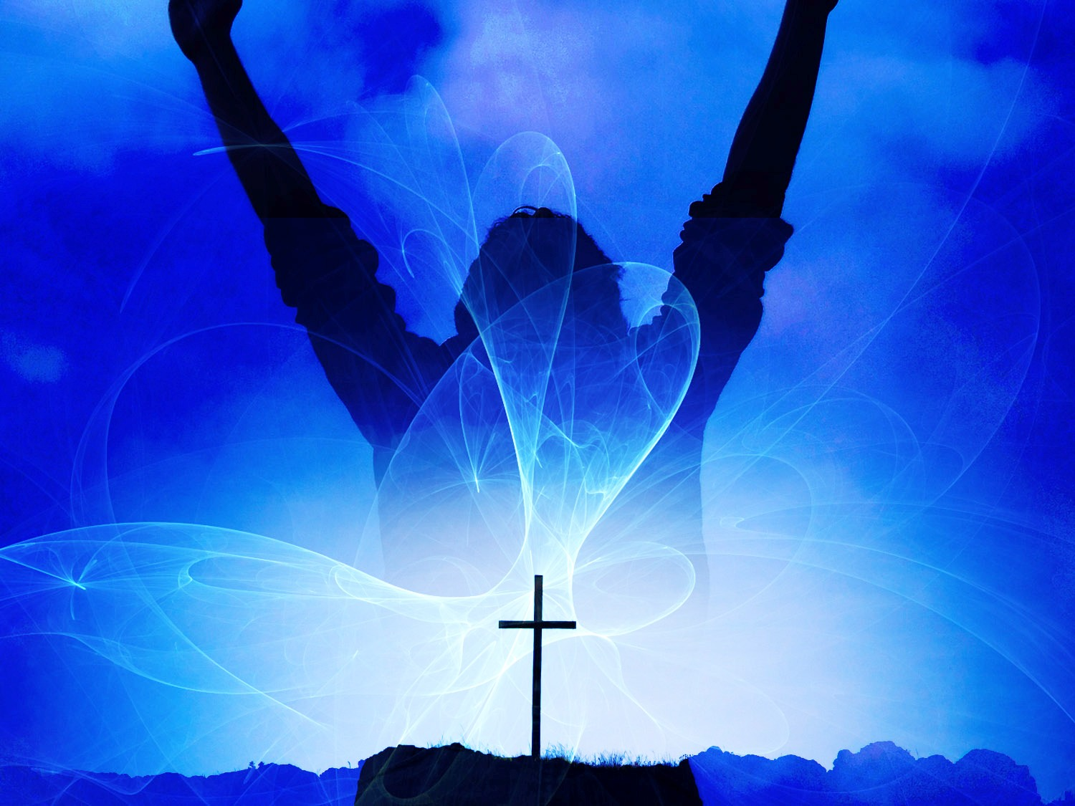
Therefore gird up the loins of your mind, be sober, and rest your hope fully upon the grace that is to be brought to you at the revelation of Jesus Christ; — 1st Peter 1:13
sober
be sober
sober
Jesus Christ
Notes:
If God calls us to be sober, there can be no excuse, for using alcohol, as one drink will impair one.

Slide 47
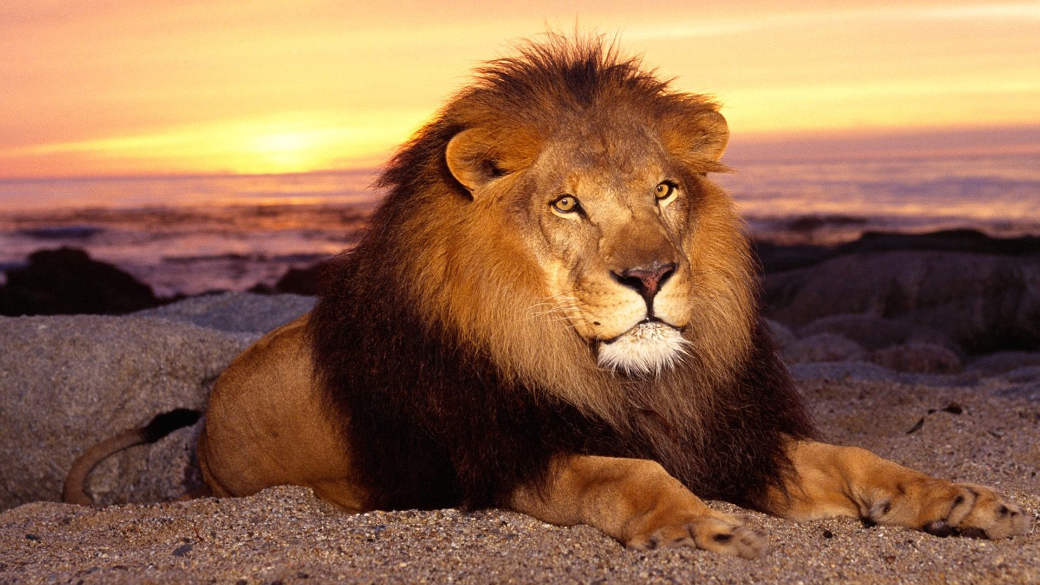

Be sober, be vigilant; because your adversary the devil walks about like a roaring lion, seeking whom he may devour. — 1st Peter 5:8
Be sober
sober
devour
Notes:
Without employing all of one’s senses, one runs the risk of falling and or catering to the lustful desires of the flesh. Satan’s desire is for our demise into the darkness turning away from the light of God’s healing truths.

Slide 48
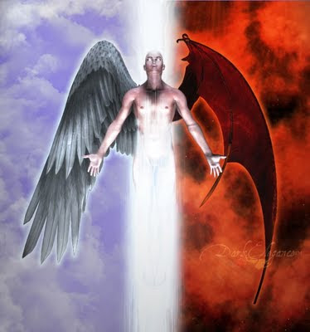
Test all things; hold fast what is good. Abstain from every form of evil. — 1st Thessalonians 5:21-22
Alcohol kills everything that lives
Alcohol preserves everything that is dead
Notes:
A choice is at the crossroads everyday, and we must choose correctly if we wish to honor His will. To His glory He has given us this ability of choice. In putting alcohol to the test, it shows that it kills everything that lives, and preserves everything that is dead. It is something that should not be ingested unless subjected to an injurious medical condition. Our social neurosis is to ignore the truth.

Slide 49
→ Walk properly not in revelry and drunkenness/lusts
→ Do not love the world or the things in the world
→ Do not let sin reign in you or obey it in its lusts
→ Abstain from fleshly lusts which war against / soul
→ Drunkards will not inherit the kingdom of God
→ Do not be drunk but be filled with the Spirit
→ Do not to keep company or dine with drunkards
→ Curtail anything causing 1 to stumble or made weak
→ Whatever you do, do all to the glory of God
→ Speak things which are proper for sound doctrine
→ Leaders and all wise should not be given to wine
→ Be sober/vigilant resting hope fully on grace in God
→ Test everything holding good abstaining from all sin
His will is for us
to rise in Him
Notes:
His will is for us to rise to Him.

Slide 50
Notes:
Darkness has no promise.

Slide 51

Please visit http://www.LoveFromGod.com to explore further
Ronald Bert Channel on
Notes:
Eternity never ends.

