Slide 1
Notes:
Darkness yields up no notice

Slide 2

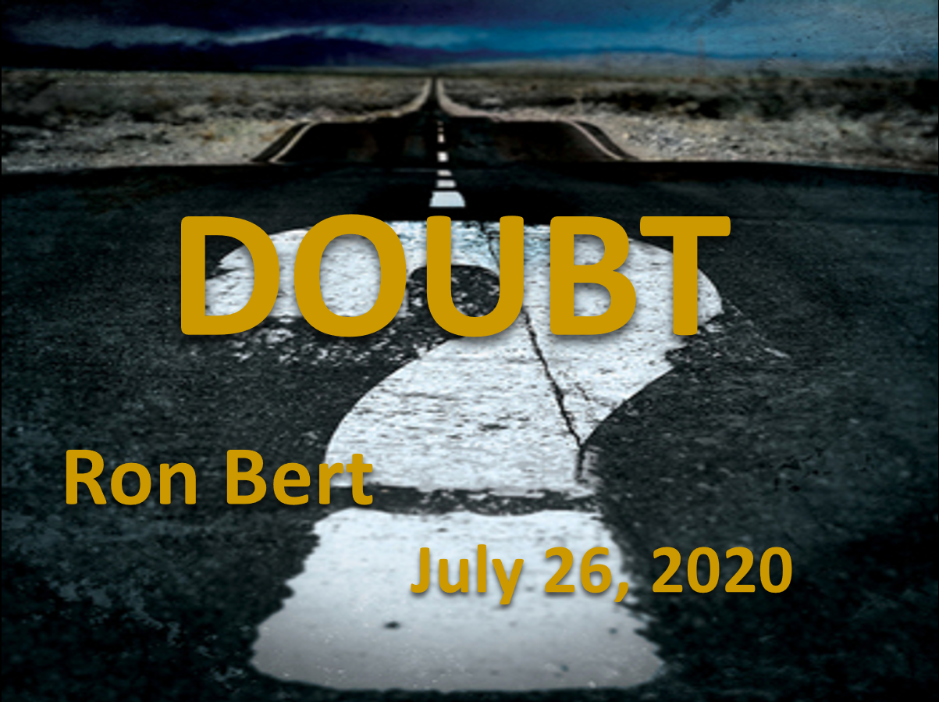


DOUBT
Ron Bert
July 26, 2020
Notes:
Doubt plagues all hearts it touches.

Slide 3

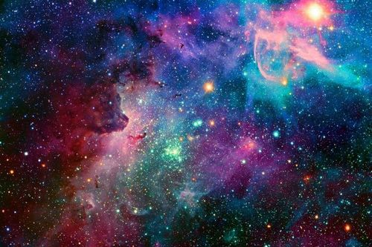

He has made everything beautiful in its time. Also He has put eternity in their hearts, except that no one can find out the work that God does from beginning to end. — Ecclesiastes 3:11
God
in
eternity in their hearts
eternity in their hearts
God
Notes:
Eternity blazes before all as He wishes for us to simply remember Him.

Slide 4



If any of you lacks wisdom, let him ask of God, who gives to all liberally and without reproach, and it will be given to him. But let him ask in faith, with no doubting, for he who doubts is like a wave of the sea driven and tossed by the wind. For let not that man suppose that he will receive anything from the Lord; he is a double-minded man, unstable in all his ways. — James 1:5-8
God
gives
understanding
in
ask in faith
ask in faith
no doubting
doubts
no doubting
doubts
doubts
not
receive anything
confusion
Notes:
True understanding rises past the curse of confusion.
Amos 4:13 For behold, He who forms mountains, And creates the wind, Who declares to man what his thought is, And makes the morning darkness, Who treads the high places of the earth-The LORD God of hosts is His name.

Slide 5

Do you have faith? Have it to yourself before God. Happy is he who does not condemn himself in what he approves. But he who doubts is condemned if he eats, because he does not eat from faith; for whatever is not from faith is sin. — Romans 14:22-23
Happy
is
is
not condemn himself
Happy = not condemn himself
he who doubts = condemned
not from faith = sin
he who
doubts
doubts
is
condemned
is
faith
not from
faith
is
sin
is
Notes:
Peace of heart comes in satisfied relations with conscience.

Slide 6
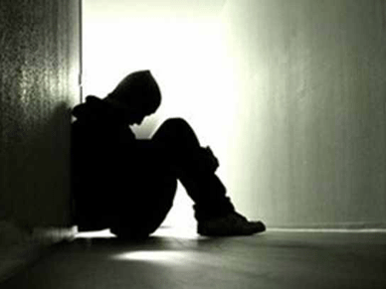
Jesus answered them, "Most assuredly, I say to you, whoever commits sin is a slave of sin. — John 8:34
e
as
e
b
l
is
=
commits sin is a slave of sin
in
sin
commits sin is a slave of sin
baseline
sin
. .
Notes:
One’s baseline with sin defines whether one reaches for godliness or not.

Slide 7

Beware, brethren, lest there be in any of you an evil heart of unbelief in departing from the living God; but exhort one another daily, while it is called "Today," lest any of you be hardened through the deceitfulness of sin. — Hebrews 3:12-13
evil heart of
unbelief
departing from the
living God
evil heart of unbelief
departing from the living God
hardened
through deceitfulness of sin
Doubt
depart
depart
hardened
through
deceitfulness of sin
sin
Notes:
The world is scattered with mistrust filled with indecisions leading to departing belief in God through the deceitfulness of sin consumed in hate of heart.

Slide 8

I desire therefore that the men pray everywhere, lifting up holy hands, without wrath and doubting; — 1st Timothy 2:8
e
y
e
lift
eye
without wrath
without wrath
doubt
doubt
Notes:
God hopes faithful everywhere find love in His desire for peace within.

Slide 9

Hell and Destruction are never full; So the eyes of man are never satisfied. — Proverbs 27:20
Hell and Destruction are never full; So the eyes of man are never satisfied. — Proverbs 27:20
. .
full of labor
All things are full of labor; Man cannot express it. The eye is not satisfied with seeing, Nor the ear filled with hearing. — Ecclesiastes 1:8
eye
cannot express it
not
satisfied
not satisfied
Notes:
In all the expressions life displays, His gifts are unending. The world of things can never yield up contentment of heart, that must be seized in the spirit one walks in from moment to moment.

Slide 10
Hell and Destruction are never full; So the eyes of man are never satisfied. — Proverbs 27:20
Hell and Destruction are never full; So the eyes of man are never satisfied. — Proverbs 27:20
full of labor
full of labor
All things are full of labor; Man cannot express it. The eye is not satisfied with seeing, Nor the ear filled with hearing. — Ecclesiastes 1:8
cannot express it
WOE

Slide 11

"Your life shall hang in doubt before you; you shall fear day and night, and have no assurance of life. In the morning you shall say, 'Oh, that it were evening!' And at evening you shall say, 'Oh, that it were morning!' because of the fear which terrifies your heart, and because of the sight which your eyes see." — Deuteronomy 28:66-67
in
life shall hang in doubt
hang in doubt
hang in doubt
Faith
fear day and night
Lens
have no assurance of life
sure of life
sur
e
of life
● life shall hang in doubt
● fear day and night
● have no assurance of life
focus
eyes see
eyes see
Notes:
There is no doubt that life is filled with challenges. Challenges of strength and weakness, sorrows upon joys, life upon death.

Slide 12
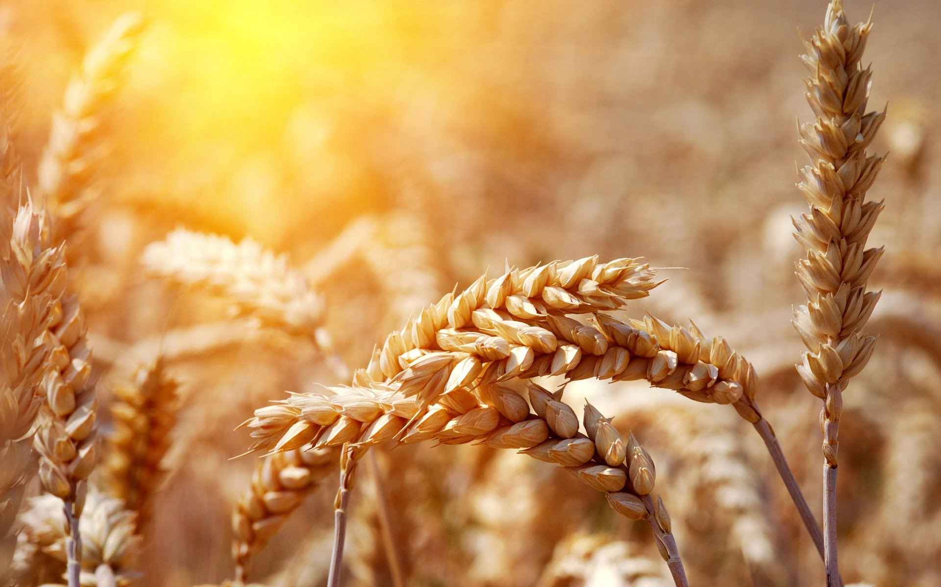
"But God draws the mighty away with His power; He rises up, but no man is sure of life. He gives them security, and they rely on it; Yet His eyes are on their ways. They are exalted for a little while, Then they are gone. They are brought low; They are taken out of the way like all others; They dry out like the heads of grain. — Job 24:22-24
=
sure of life
His
His eyes are on
eyes
His eyes are on
their ways
their ways
eyes
Notes:
Are your eyes on the wheat or the weeds?

Slide 13

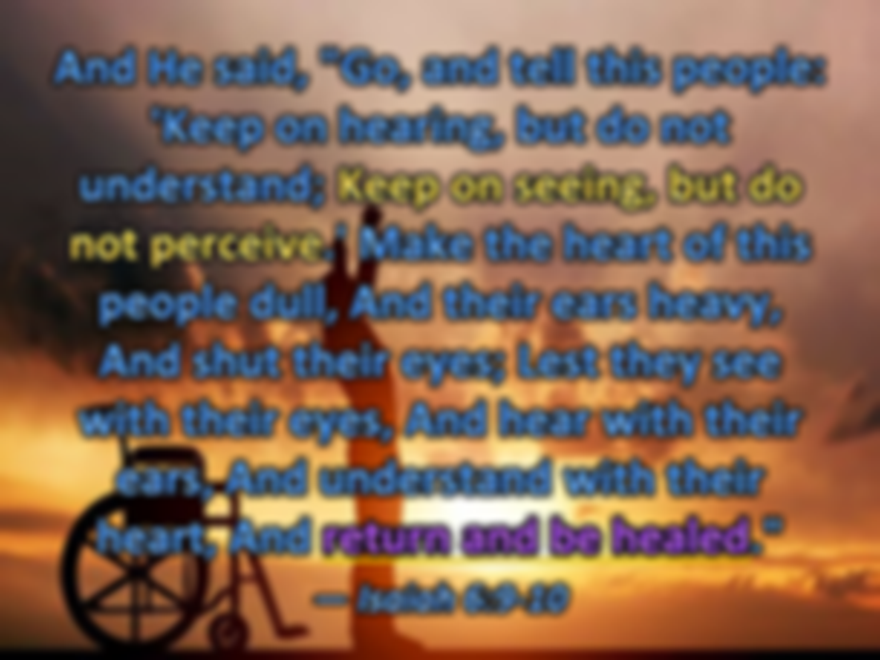


And He said, "Go, and tell this people: 'Keep on hearing, but do not understand; Keep on seeing, but do not perceive.' Make the heart of this people dull, And their ears heavy, And shut their eyes; Lest they see with their eyes, And hear with their ears, And understand with their heart, And return and be healed." — Isaiah 6:9-10
eyes
Understand with the heart
Understand with the heart
eyes
doubt
return and be healed
return and be healed
return and be healed
Notes:
To be healed one can only surrender to that which made us, in faith His glory is to come releasing us from such bondage the flesh confines us in.

Slide 14
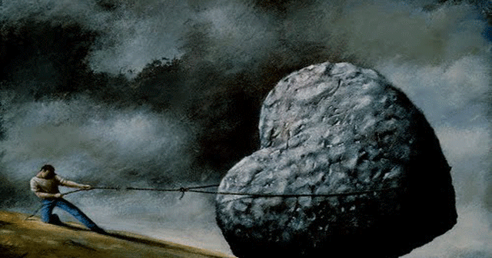
Therefore they could not believe, because Isaiah said again: "He has blinded their eyes and hardened their hearts, Lest they should see with their eyes, Lest they should understand with their hearts and turn, So that I should heal them." — John 12:39-40
Lest they should see
eyes
Lest they should see
eyes
heart
eyes
Lest they should
understand
heart
Understand with the heart
I should heal them
I should heal them
Lest they should understand
Notes:
Stones of heart throw life into the wind unable to lift the lightest of thoughts.

Slide 15
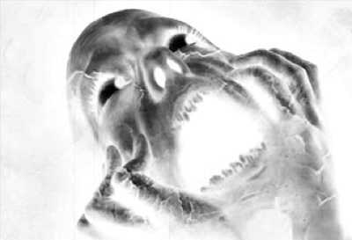
Then He said to them, "O foolish ones, and slow of heart to believe in all that the prophets have spoken! — Luke 24:25
heart
believe
believe
heart
doubt
Notes:
The mask of deception is a hard nut to crack freeing one to see truth above self.

Slide 16
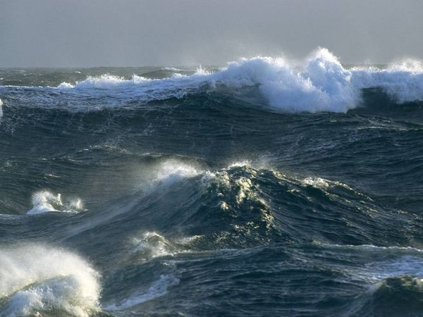
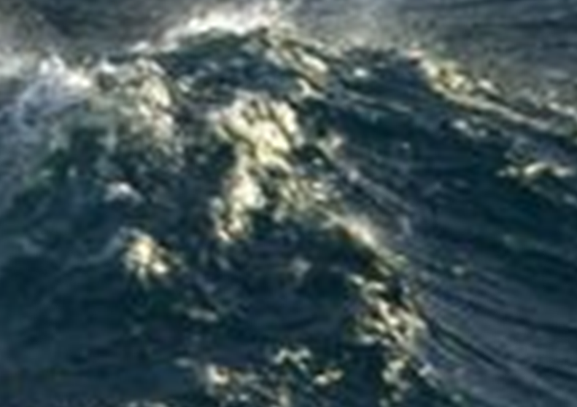
And they came to Him and awoke Him, saying, "Master, Master, we are perishing!" Then He arose and rebuked the wind and the raging of the water. And they ceased, and there was a calm. — Luke 8:24
calm
Faith
fear
perishing
heart
believe
calm
Notes:
Fear inhibits all to see through the fog of darkness illuminating His calm resolve.

Slide 17

Then He arose and rebuked the wind, and said to the sea, "Peace, be still!" And the wind ceased and there was a great calm. But He said to them, "Why are you so fearful? How is it that you have no faith?" And they feared exceedingly, and said to one another, "Who can this be, that even the wind and the sea obey Him!" — Mark 4:39-41
calm
Doubt
Why are you so fearful
Why are you
Why are you so fearful
faith
Why are you
Notes:
God is greater than any storm willing that all come to His reservoir of peace.

Slide 18
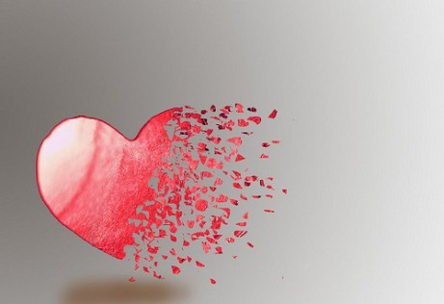
Now as they said these things, Jesus Himself stood in the midst of them, and said to them, "Peace to you." But they were terrified and frightened, and supposed they had seen a spirit. And He said to them, "Why are you troubled? And why do doubts arise in your hearts?" — Luke 24:36-38
Jesus
Jesus
Jesus
Why are you troubled?
Why are you troubled?
Why are you
why do doubts arise
why do doubts arise
heart
Notes:
It is doubt that steals what He has freely given; eternal life.

Slide 19

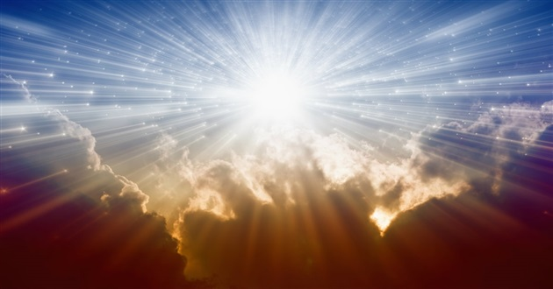
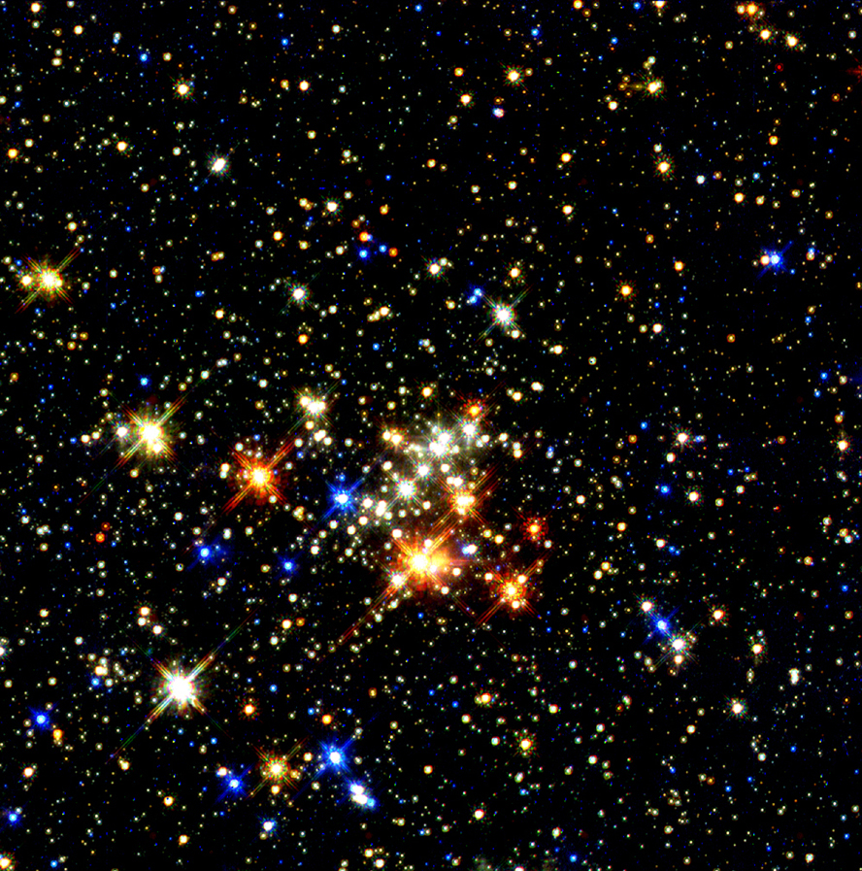
And He opened their understanding, that they might comprehend the Scriptures. Then He said to them, "Thus it is written, and thus it was necessary for the Christ to suffer and to rise from the dead the third day, and that repentance and remission of sins should be preached in His name to all nations, beginning at Jerusalem." — Luke 24:45-47
understanding
understanding
Jesus
Christ
it is written
it is written
softening of heart
healed
turn
repentance and remission
repentance and remission
Christ
of sins
of sins
Notes:
Keen understanding is for those that truly believe clearly how He draws us to His light in the goodness that He is.

Slide 20


But even if our gospel is veiled, it is veiled to those who are perishing, whose minds the god of this age has blinded, who do not believe, lest the light of the gospel of the glory of Christ, who is the image of God, should shine on them. — 2nd Corinthians 4:3-4
perishing
doubt
perishing
gospel
truth
Christ
God
shine
shine
Notes:
God holds no partiality while we remain under the test of choices. Darkness unfolds before us all, and how we respond to desires of self declares how He will receive us.

Slide 21

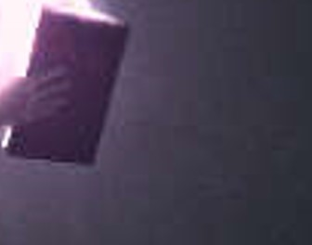
And for this reason God will send them strong delusion, that they should believe the lie, that they all may be condemned who did not believe the truth but had pleasure in unrighteousness. — 2nd Thessalonians 2:11-12
Sin
Worry
denial
doubt
strong delusion
strong delusion
Doubt
X
God
God
truth
pleasure in unrighteousness
pleasure in unrighteousness
Greed
Notes:
Many delusions lure souls from acknowledging the truth of His words.

Slide 22
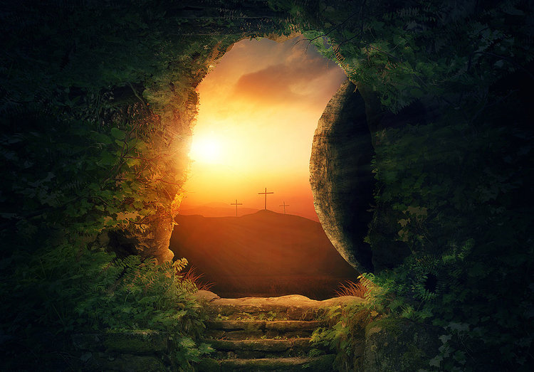
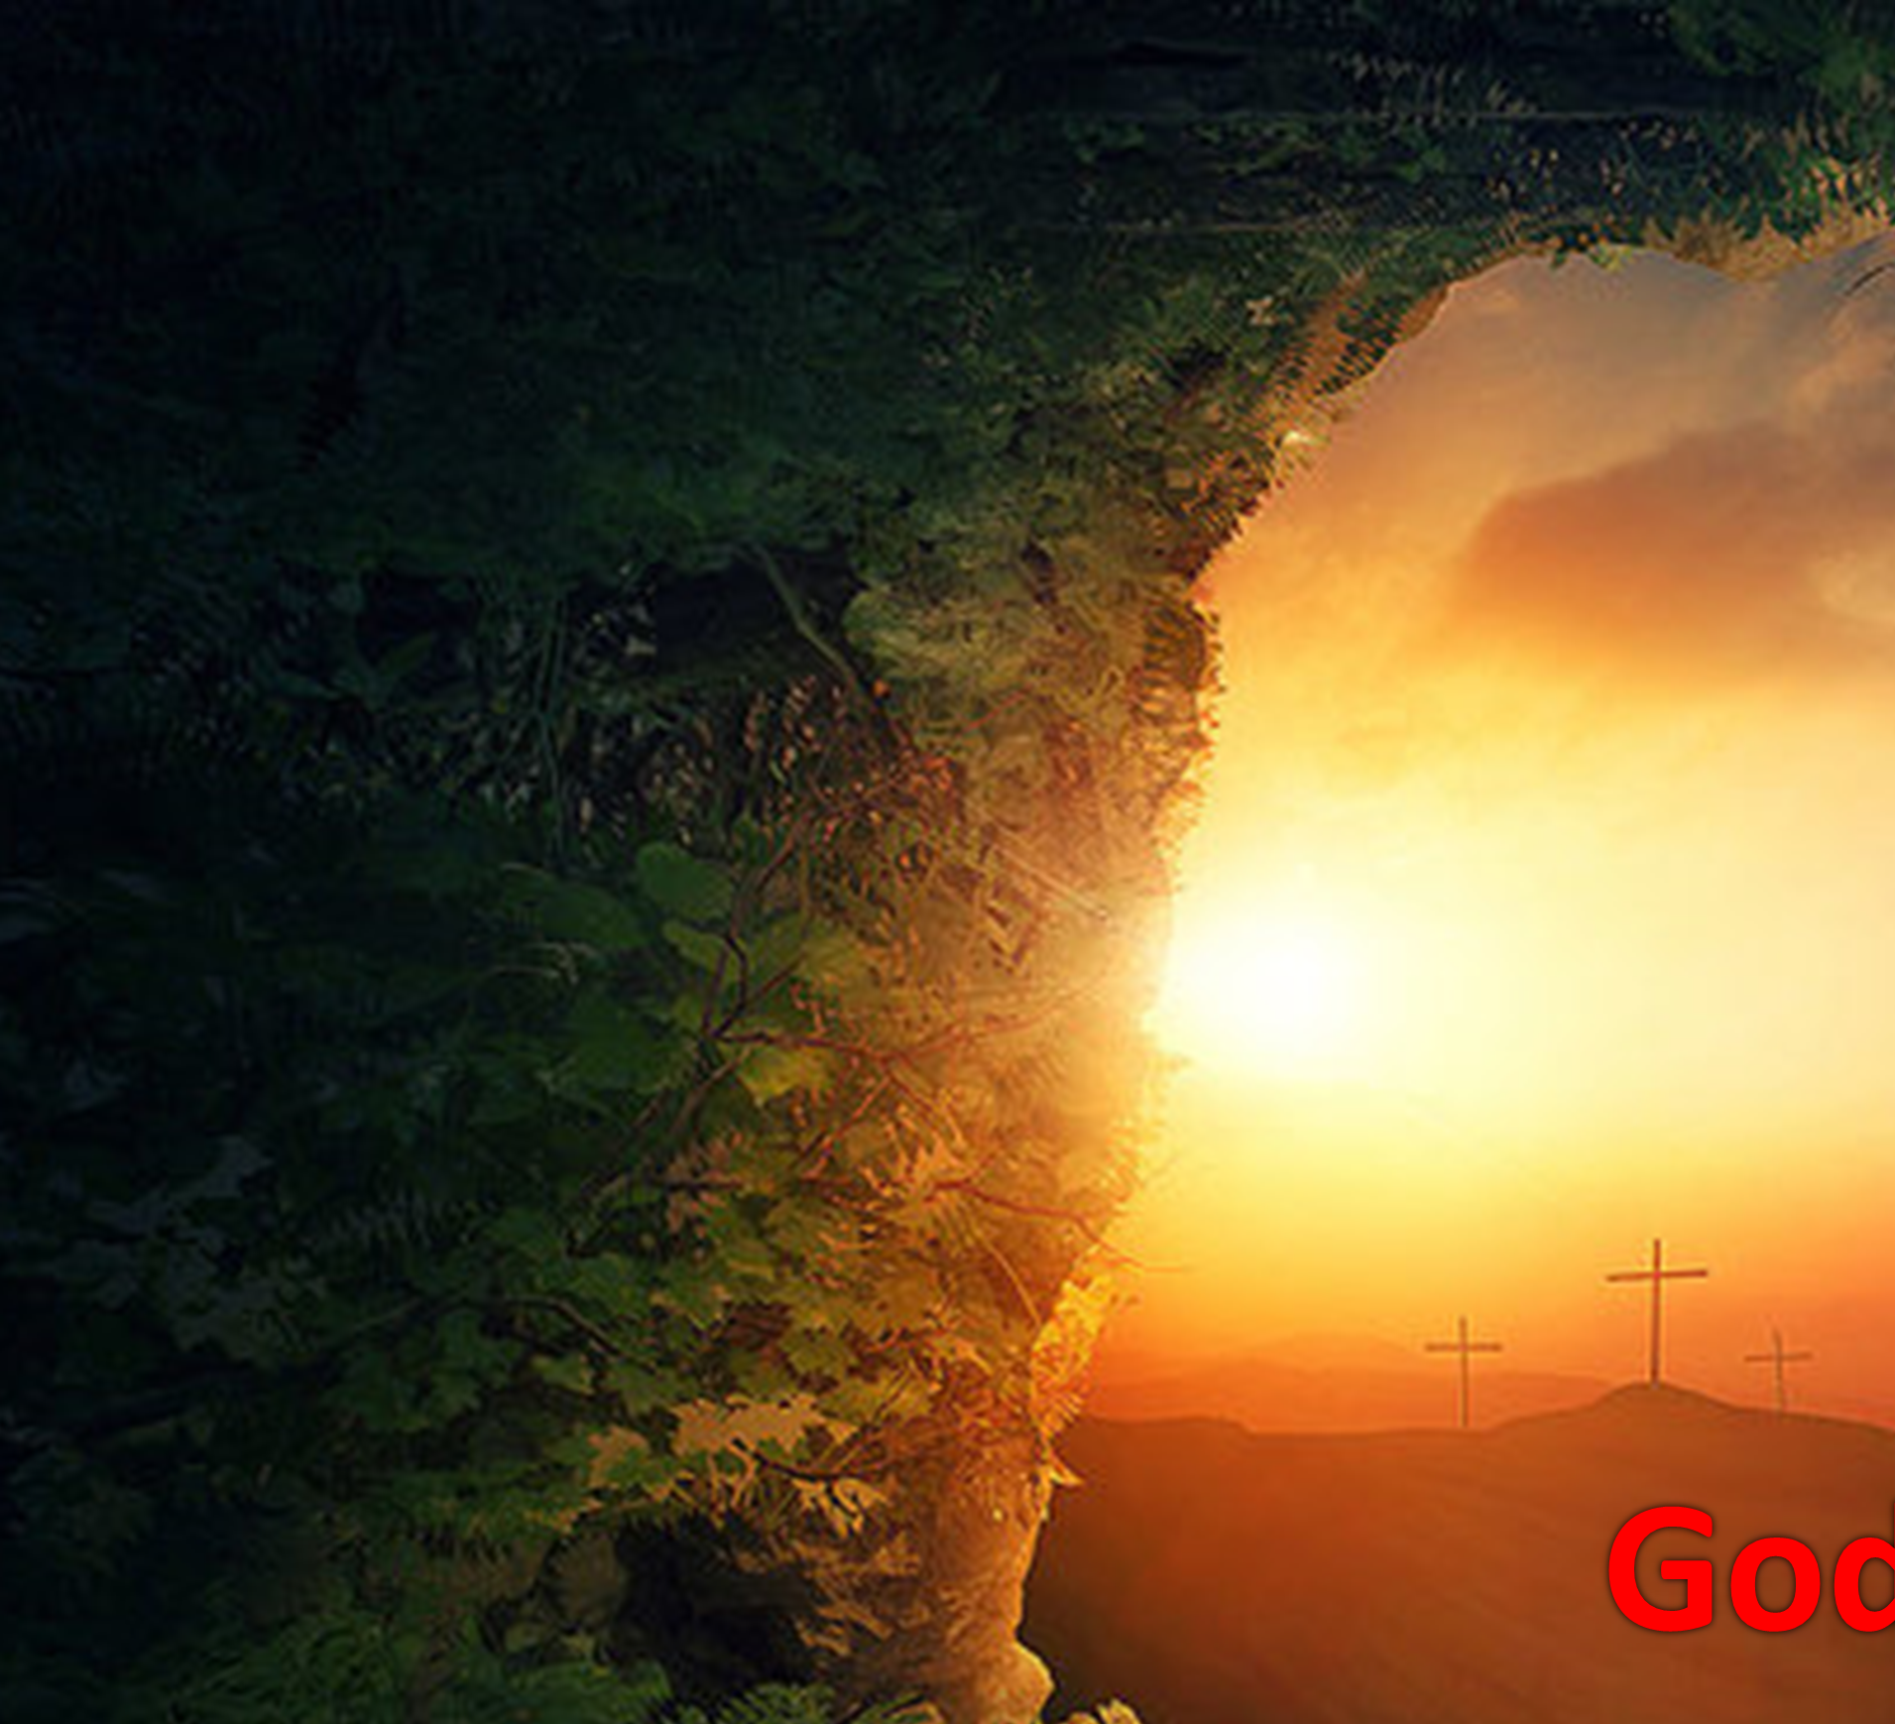
Where is the wise? Where is the scribe? Where is the disputer of this age? Has not God made foolish the wisdom of this world? For since, in the wisdom of God, the world through wisdom did not know God, it pleased God through the foolishness of the message preached to save those who believe. — 1st Corinthians 1:20-21
God
God
X
through wisdom
God
through wisdom
God
God
believe
believe
Notes:
Patience is godliness under the pressures of not having. Faith is belief in that which rises beyond the nothingness as death unfolds before us all.

Slide 23


Do not be unequally yoked together with unbelievers. For what fellowship has righteousness with lawlessness? And what communion has light with darkness? And what accord has Christ with Belial? Or what part has a believer with an unbeliever? — 2nd Corinthians 6:14-15
Do not be
d
Do not be
with unbelievers
with unbelievers
n
i
righteousness
lawlessness
m
light
darkness
mind
Christ
Belial
believer
unbeliever
believe
Notes:
The unchanging colors of truth do not fade as darkness holds no light.

Slide 24
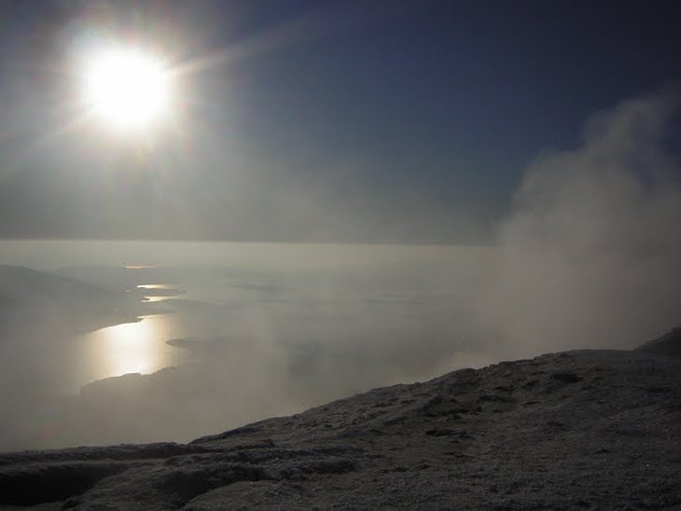

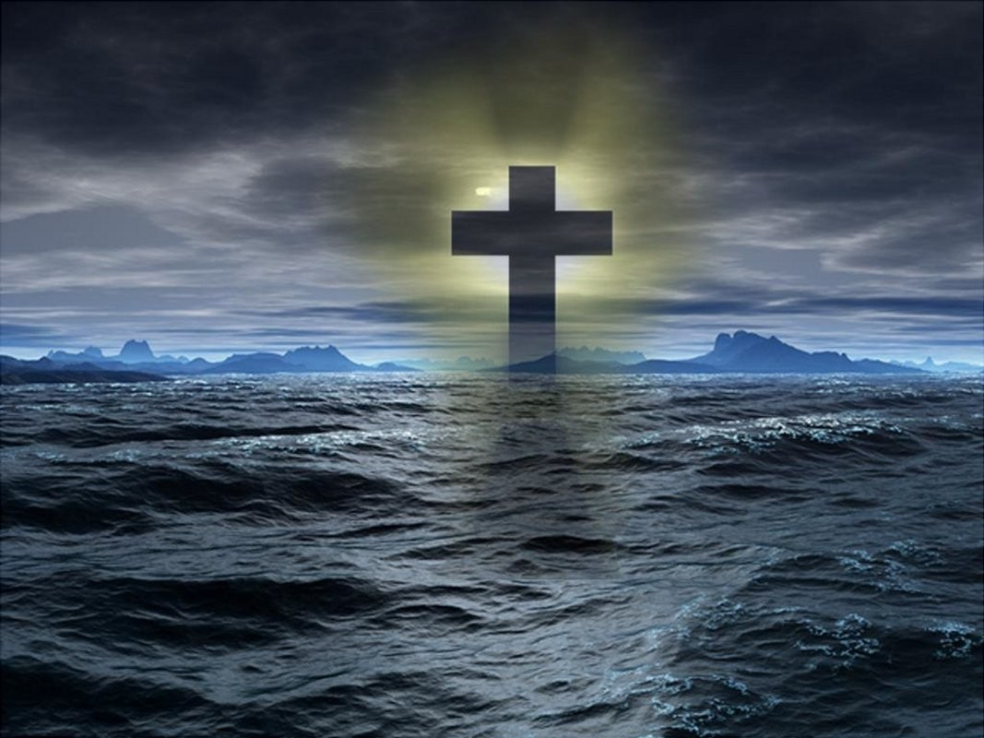
For God has not given us a spirit of fear, but of power and of love and of a sound mind. — 2nd Timothy 1:7
spirit
fear
power
love
sound mind
mind

Slide 25


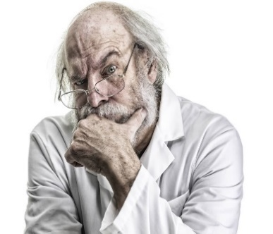




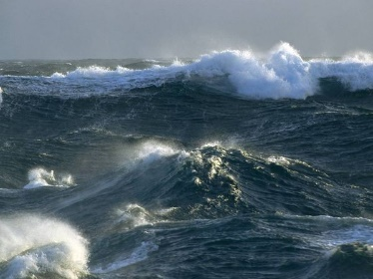

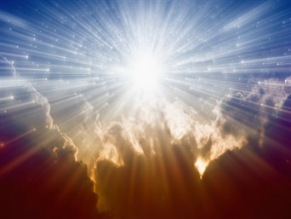
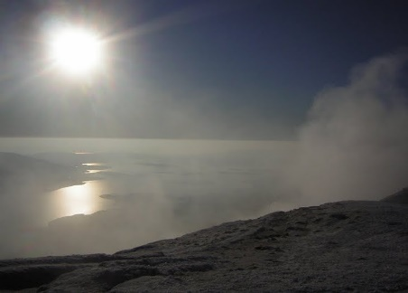

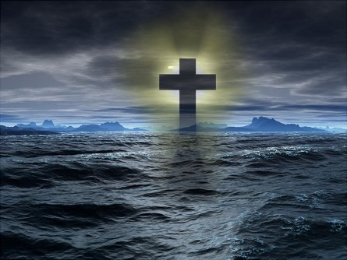




Slide 26

→ God has put eternity upon the hearts of man
→ Doubt prevents the blessings God offers
→ True faith rises above the passions of sin
→ Whoever commits sin is a slave of sin
→ Unbelief is an evil against our living God
→ Sufferings bound in faithless wrath drives despair
→ Life’s purpose is the question God gives to all
→ Spiritual healing comes to those hearts who believe
→ No storm can steal the blessings God has promised
→ Regret & duty receives the gift of remission of sins
→ God will not stop delusions lusting liars believe
→ God’s lessons rise from a deepest nature of true life
→ Do not be unequally yoked with unbelievers
Upon the waves God holds the anchor
Notes:
Upon the waves God holds the anchor

Slide 27
Notes:
Darkness possesses no laughter.

Slide 28

Please visit http://www.LoveFromGod.com to explore further
Ronald Bert Channel on
Notes:
Eternity never ends.

