Slide 2
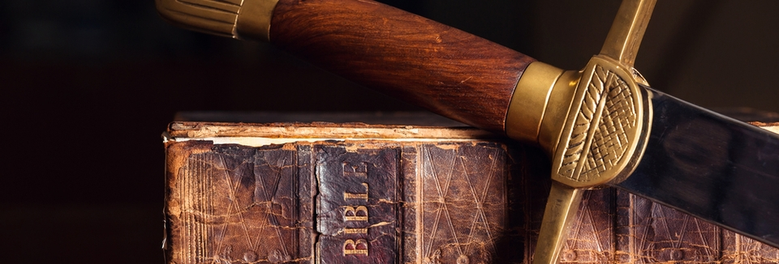
Diligently
BIBLE
Ron Bert
BIBLE
July 7, 2019

Slide 3
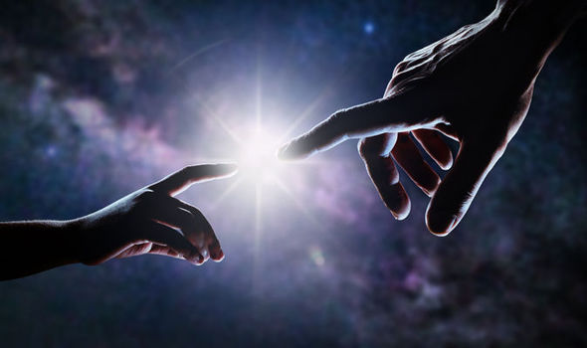
But without faith it is impossible to please Him, for he who comes to God must believe that He is, and that He is a rewarder of those who diligently seek Him. — Hebrews 11:6
is
Now faith is the substance of things hoped for, the evidence of things not seen. — Hebrews 11:1
faith ↔ hearing
hearing ↔ word of God
So then faith comes by hearing, and hearing by the word of God. — Romans 10:17
faith ↔ hearing
faith
hearing
faith
For we walk by faith, not by sight. — 2nd Corinthians 5:7
faith
hope
faith
faith
faith ↔
faith
↔ word of God
hearing
hearing ↔ word of God
hearing
word of God
word of God
But without faith it is impossible to please Him, for he who comes to God must believe that He is, and that He is a rewarder of those who diligently seek Him. — Hebrews 11:6
But without faith it is impossible to please Him, for he who comes to God must believe that He is, and that He is a rewarder of those who diligently seek Him. — Hebrews 11:6
faith
=
faith = hope
BIBLE

Slide 4
Hope
Word of God
faith
But without faith it is impossible to please Him, for he who comes to God must believe that He is, and that He is a rewarder of those who diligently seek Him. — Hebrews 11:6
must
believe

Slide 5
For with the heart one believes unto righteousness, and with the mouth confession is made unto salvation. — Romans 10:10
But without faith it is impossible to please Him, for he who comes to God must believe that He is, and that He is a rewarder of those who diligently seek Him. — Hebrews 11:6
But without faith it is impossible to please Him, for he who comes to God must believe that He is, and that He is a rewarder of those who diligently seek Him. — Hebrews 11:6
comes to
But without faith it is impossible to please Him, for he who comes to God must believe that He is, and that He is a rewarder of those who diligently seek Him. — Hebrews 11:6
But without faith it is impossible to please Him, for he who comes to God must believe that He is, and that He is a rewarder of those who diligently seek Him. — Hebrews 11:6
But without faith it is impossible to please Him, for he who comes to God must believe that He is, and that He is a rewarder of those who diligently seek Him. — Hebrews 11:6
But without faith it is impossible to please Him, for he who comes to God must believe that He is, and that He is a rewarder of those who diligently seek Him. — Hebrews 11:6
But without faith it is impossible to please Him, for he who comes to God must believe that He is, and that He is a rewarder of those who diligently seek Him. — Hebrews 11:6
diligent
diligently
Be diligent to present yourself approved to God, a worker who does not need to be ashamed, rightly dividing the word of truth. — 2nd Timothy 2:15
diligent
And Jesus said to them, "I am the bread of life. He who comes to Me shall never hunger, and he who believes in Me shall never thirst. — John 6:35
And Jesus said to them, "I am the bread of life. He who comes to Me shall never hunger, and he who believes in Me shall never thirst. — John 6:35
Jesus
believe
believe
Conscientiously
"Let not your heart be troubled; you believe in God, believe also in Me." — John 14:1
substance
worker
comes to
in
does not need to be ashamed
Meticulously
not ashamed
in
Jesus
rightly dividing the word of truth
in Me
applying
Industriously
Thoroughly

Slide 6
Hope
Word of God
But without faith it is impossible to please Him, for he who comes to God must believe that He is, and that He is a rewarder of those who diligently seek Him. — Hebrews 11:6
But without faith it is impossible to please Him, for he who comes to God must believe that He is, and that He is a rewarder of those who diligently seek Him. — Hebrews 11:6
But without faith it is impossible to please Him, for he who comes to God must believe that He is, and that He is a rewarder of those who diligently seek Him. — Hebrews 11:6
diligently
diligently
Worker

Slide 7
I love those who love me, And those who seek me diligently will find me. — Proverbs 8:17
diligently
seek
seek
diligently
find
find

Slide 8
Keep your heart with all diligence, For out of it spring the issues of life. — Proverbs 4:23
Keep
diligently
life

Slide 9
You have commanded us To keep Your precepts diligently. — Psalms 119:4
keep
diligently
keep
keep
His Ways
keep
Your precepts
diligently
faith

Slide 10
"Only take heed to yourself, and diligently keep yourself, lest you forget the things your eyes have seen, and lest they depart from your heart all the days of your life. And teach them to your children and your grandchildren, …" — Deuteronomy 4:9
heart
take heed
diligently keep yourself
→ lest you
forget
depart
→ teach
your children
grandchildren
take heed
diligently
keep
diligently keep yourself
lest you
diligent
forget
diligent
depart
forget
heart
teach
your children
grandchildren

Slide 11
The plans of the diligent lead surely to plenty, But those of everyone who is hasty, surely to poverty. — Proverbs 21:5
diligent
plans
diligent
impatient

Slide 12
Be diligent to know the state of your flocks, And attend to your herds; — Proverbs 27:23
love
diligent
hope
spirit
attend to
diligent
patient
prayer

Slide 13
Be kindly affectionate to one another with brotherly love, in honor giving preference to one another; not lagging in diligence, fervent in spirit, serving the Lord; rejoicing in hope, patient in tribulation, continuing steadfastly in prayer; — Romans 12:10-12
love
in
hope
diligence
spirit
in
diligent
diligence
in
patient
in
in
prayer
in

Slide 14
And we desire that each one of you show the same diligence to the full assurance of hope until the end, that you do not become sluggish, but imitate those who through faith and patience inherit the promises. — Hebrews 6:11-12
And we desire that each one of you show the same diligence to the full assurance of hope until the end, that you do not become sluggish, but imitate those who through faith and patience inherit the promises. — Hebrews 6:11-12
And we desire that each one of you show the same diligence to the full assurance of hope until the end, that you do not become sluggish, but imitate those who through faith and patience inherit the promises. — Hebrews 6:11-12
And we desire that each one of you show the same diligence to the full assurance of hope until the end, that you do not become sluggish, but imitate those who through faith and patience inherit the promises. — Hebrews 6:11-12
diligence
diligence
of hope
do
do
through faith
promises

Slide 15
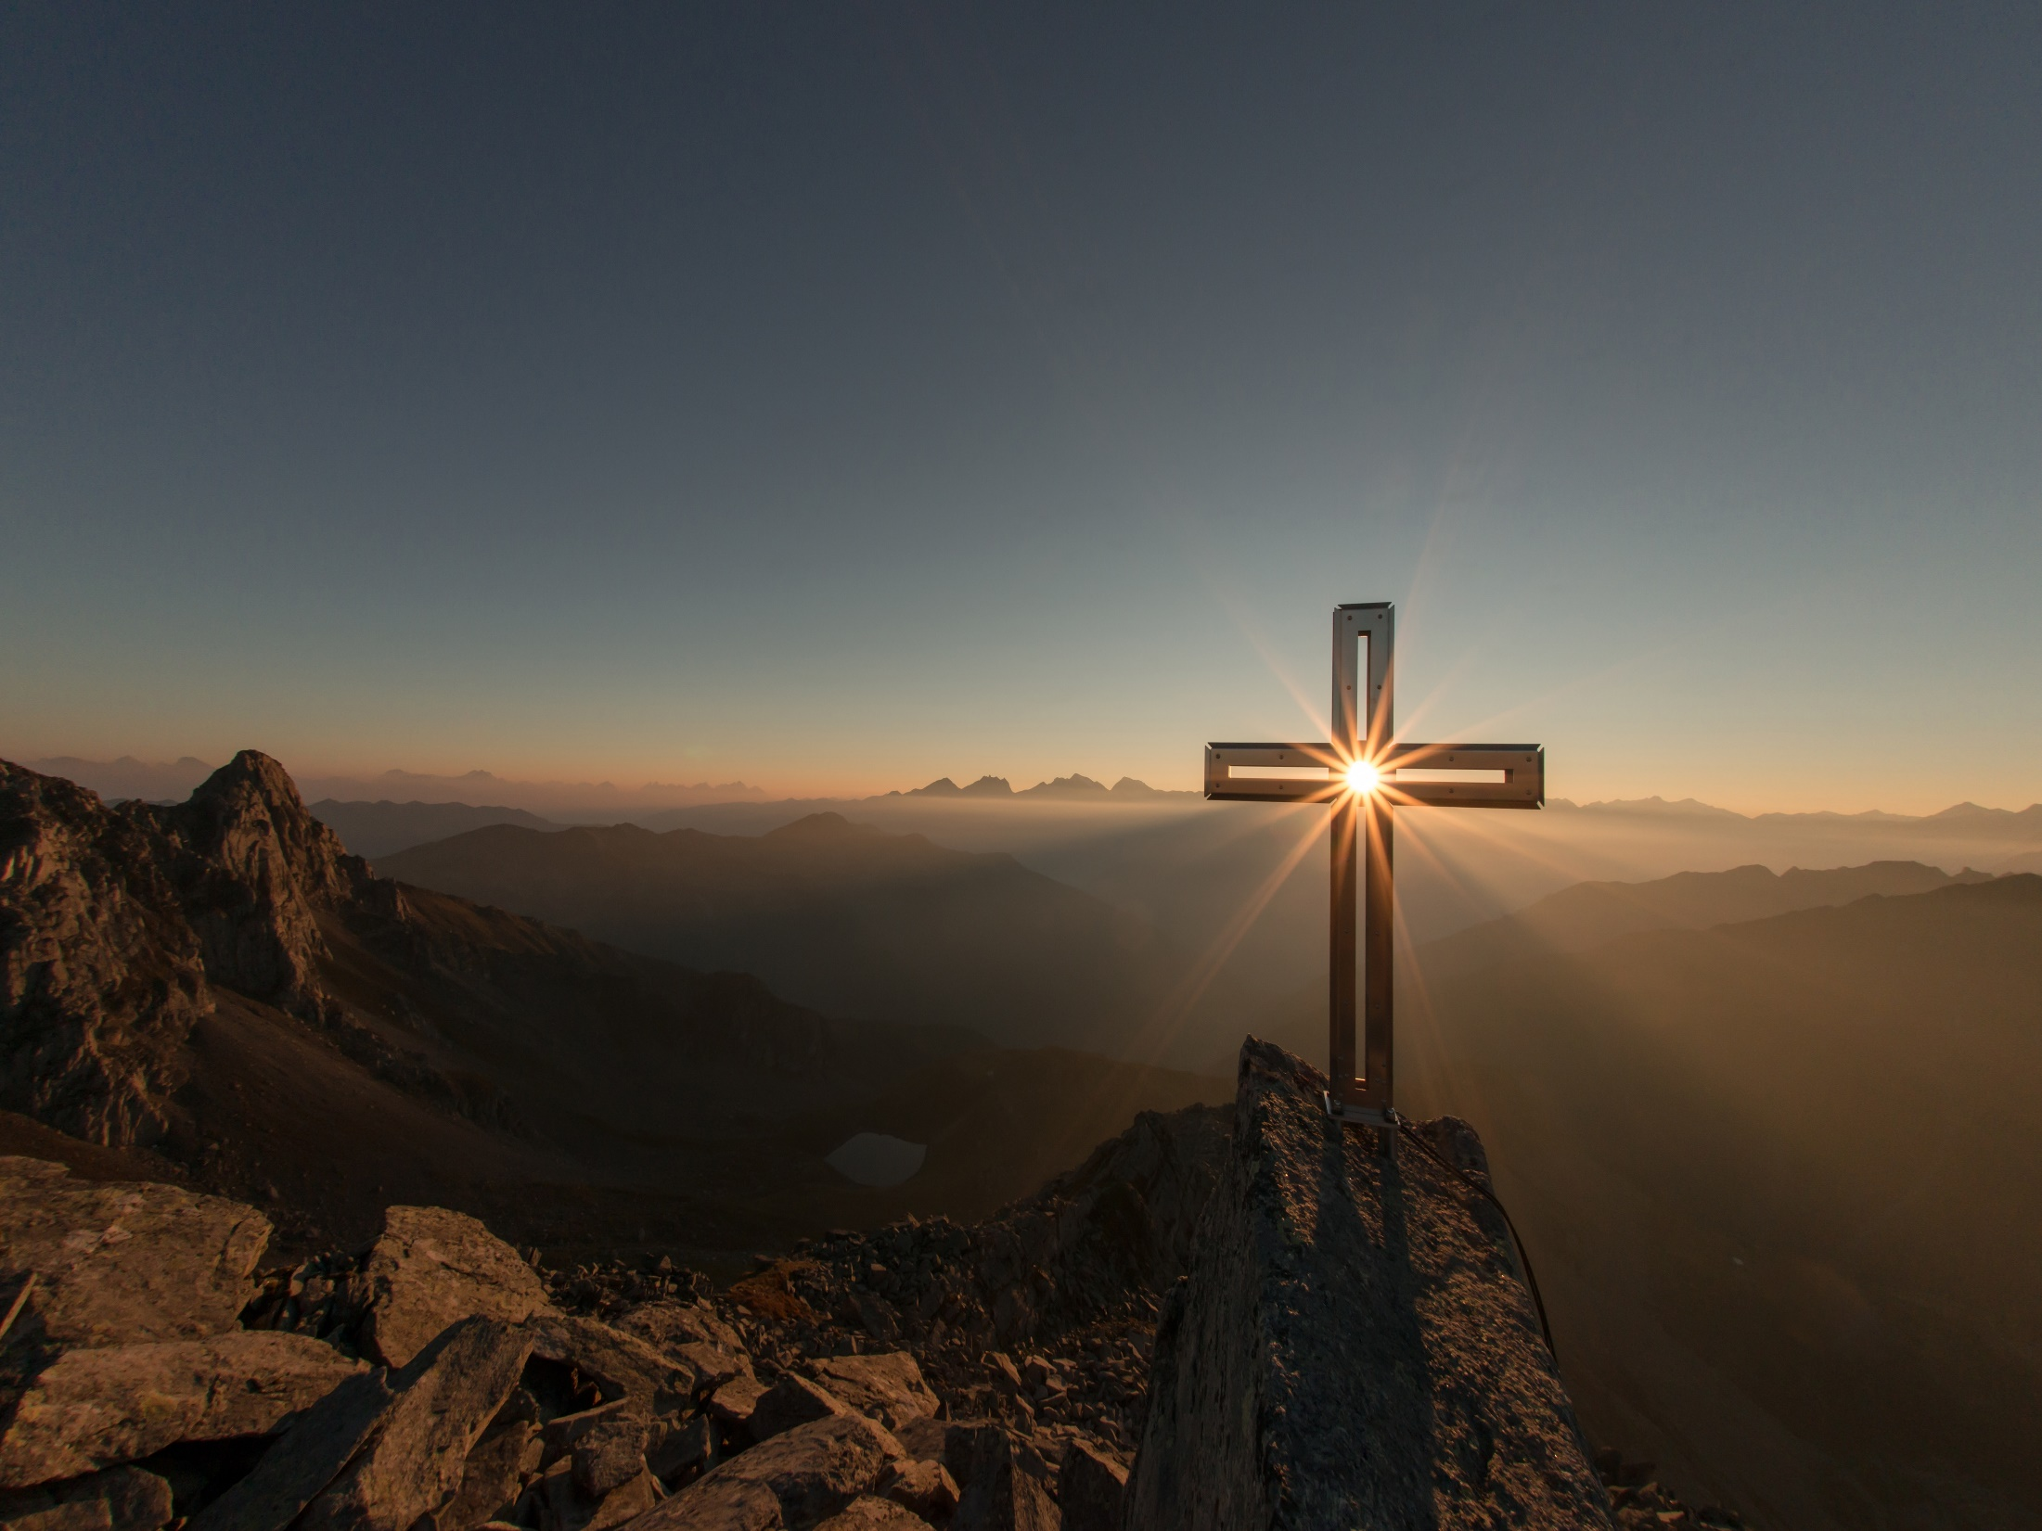
But also for this very reason, giving all diligence, add to your faith virtue, to virtue knowledge, to knowledge self-control, to self-control perseverance, to perseverance godliness, to godliness brotherly kindness, and to brotherly kindness love. — 2nd Peter 1:5-7
all diligence
diligence
love
faith
virtue
self-control
entrance
godliness
perseverance
knowledge
brotherly
kindness

Slide 16
Therefore, brethren, be even more diligent to make your call and election sure, for if you do these things you will never stumble; for so an entrance will be supplied to you abundantly into the everlasting kingdom of our Lord and Savior Jesus Christ. — 2nd Peter 1:10-11
diligent
your call
Faith
Virtue
Knowledge
Self-Control
Perseverance
Godliness
Brotherly Kindness
Love
diligent
entrance

Slide 17
Therefore, beloved, looking forward to these things, be diligent to be found by Him in peace, without spot and blameless; — 2nd Peter 3:14
beware
be
war
diligent
e
found
in
spot
sin

Slide 18
You therefore, beloved, since you know this beforehand, beware lest you also fall from your own steadfastness, being led away with the error of the wicked; but grow in the grace and knowledge of our Lord and Savior Jesus Christ. To Him be the glory both now and forever. Amen. — 2nd Peter 3:17-18
beware
being led away
error of the wicked
grow
in
X
in the grace and knowledge
Lord and Savior Jesus Christ
glory

Slide 19
→ To please God, one must believe that He is
→ He rewards those that diligently seek Him
→ Faith is hope of what cannot be seen
→ For we walk by faith, not by sight
→ From the heart one believes as confessions save
→ Rightly dividing the word finds God’s approval
→ Love of God drives a diligent heart to find Him
→ A diligent heart flourishes upon the issues of life
→ Be diligent & forget not but teach what you know
→ Diligence prepares one to live a more secure life
→ Do not lag in diligence, fervent in spirit, serving God
→ Be diligent, not sluggish, with faith and patience
→ Diligently unceasingly add virtues to your character
Diligence is a soul’s heart of peace
Notes:
Diligence is a soul’s heart of peace

Slide 22
Please visit http://www.LoveFromGod.com to explore further
Ronald Bert Channel on
Notes:
Eternity never ends.

