Slide 2

Cure for All
Ron Bert
May 3, 2020

Slide 3
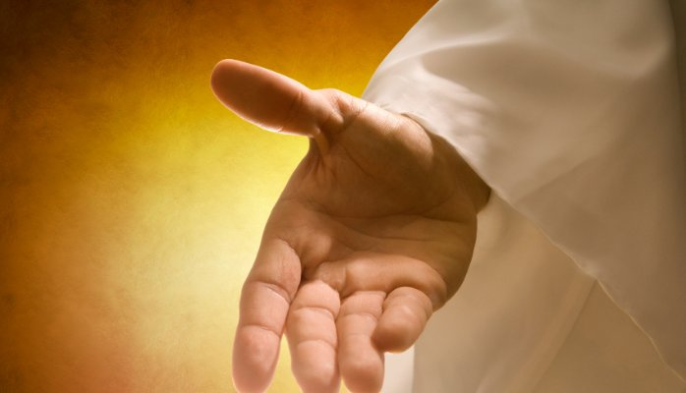
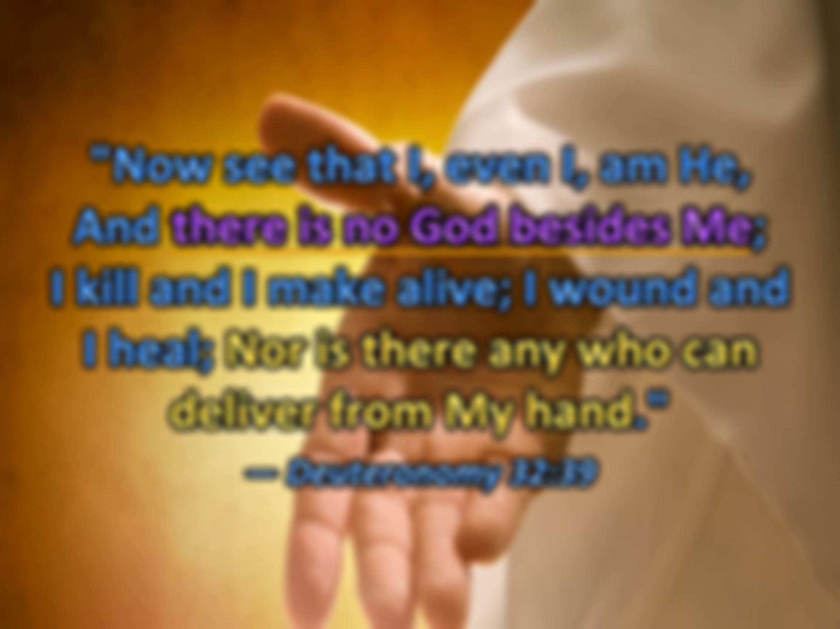


"Now see that I, even I, am He, And there is no God besides Me; I kill and I make alive; I wound and I heal; Nor is there any who can deliver from My hand." — Deuteronomy 32:39
God
I am He, God:
● I kill
● I make alive
● I wound
● I heal
I
am He,
God
there is no God besides Me
God
there is no God besides Me
I kill
I make alive
I wound
I heal
→ only Savior
Notes:
As God is the only singular creator and savior, of His creation, one would be best served to pay attention to His declarations and pleas for our return.

Slide 4


… and said, "If you diligently heed the voice of the LORD your God and do what is right in His sight, give ear to His commandments and keep all His statutes, I will put none of the diseases on you which I have brought on the Egyptians. For I am the LORD who heals you." — Exodus 15:26
heed
heed
God
God
do what is right in His sight
do what is right in His sight
give ear to His commandments
keep
keep all His statutes
keep
God
God
For I am the LORD who heals you
LORD
Notes:
God has given us His word to see. Healing of the soul comes by faith and trust in God’s power to save us from the flesh. To drop this offering of God can only result in catastrophe. God has to be the treasure without price for a heart to be established. Too often God’s word is thrown away while making decisions in life.

Slide 5
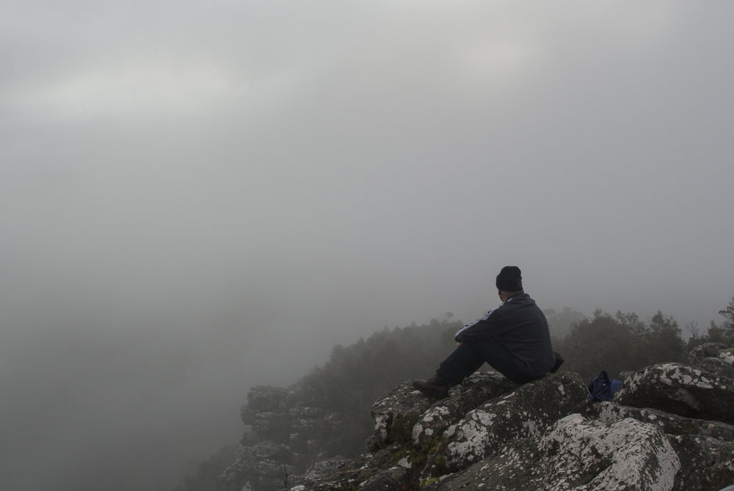
And they were greatly astonished, saying among themselves, "Who then can be saved?" But Jesus looked at them and said, "With men it is impossible, but not with God; for with God all things are possible." — Mark 10:26-27
And they were greatly astonished, saying among themselves, "Who then can be saved?" But Jesus looked at them and said, "With men it is impossible, but not with God; for with God all things are possible." — Mark 10:26-27
Who then can be saved?
Who then can be saved?
God
God
God
Notes:
Looking out into the world can be like seeing through a fog bank. Faith God can clear the way inspiring much more in us.

Slide 6

"Behold, I am the LORD, the God of all flesh. Is there anything too hard for Me?" — Jeremiah 32:27
God of all flesh
God
God of all flesh
Notes:
It is said God is the rock of our salvation and this is due to His solid truth.

Slide 7

My son, give attention to my words; Incline your ear to my sayings. Do not let them depart from your eyes; Keep them in the midst of your heart; For they are life to those who find them, And health to all their flesh. — Proverbs 4:20-22
My words:
depart not from
Keep them in the
midst of your heart
life to those who find them
health to all their flesh
My
words
give attention to my words
give attention to my words
not
depart
from
not let them depart from your eyes
not let them depart from your eyes
Keep
in
Keep
Keep them in the
midst of your
heart
life to those
who find them
health to
life
life
all their flesh
Notes:
God requests we pay attention to His words, and not let these truths become absent to our presence. The greatest vision comes from within.

Slide 8
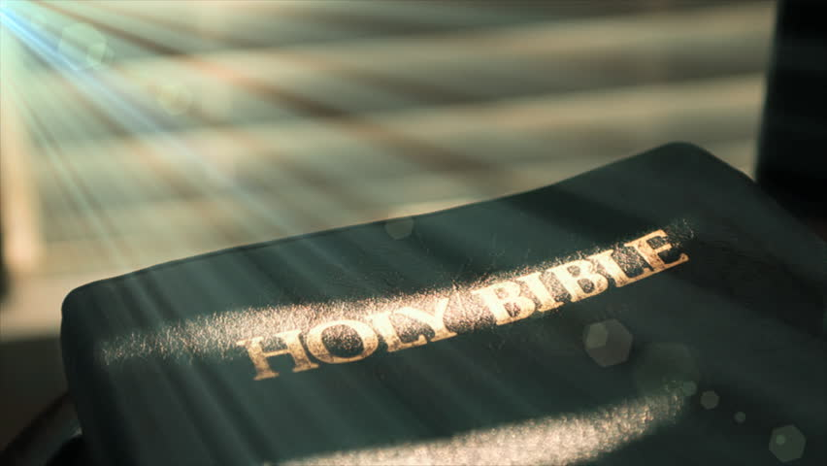
Then they cried out to the LORD in their trouble, And He saved them out of their distresses. He sent His word and healed them, And delivered them from their destructions. — Psalms 107:19-20
LORD
LORD
LORD
in
in their trouble
in their trouble
sent His word and healed them
sent His word and healed them
LORD
Notes:
The time to cry out to God is not just in our troubles, but in our thankful times, for the healing from those very troubles. As Abraham Lincoln was told by a fellow patriot, “This too shall pass;” we need to see the shadows pass to His light. True joy is a pursuit that can only be found in Him. When they say time heals all wounds, it is God that softens our hearts with His promise of eternity. His light of truth shines on all of our lives.

Slide 9
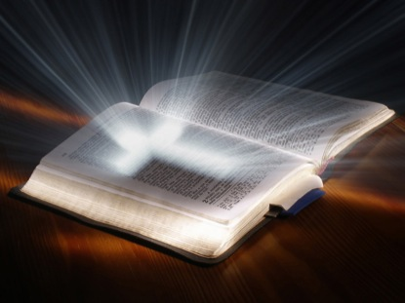
The LORD is near to those who have a broken heart, And saves such as have a contrite spirit. Many are the afflictions of the righteous, But the LORD delivers him out of them all. — Psalms 34:18-19
LORD
LORD is near to
. .
a broken heart
saves
. .
LORD
delivers
Notes:
Who could reasonably not have a broken heart, in all that is about the earth, with death and hardships surrounding us all. It is the word of God that heals and comforts in days of heavy afflictions. His promise not to abandon us leaves us not alone. As a horse, the master simply wants to love his servant.

Slide 10
brokenhearted

Slide 11

He heals the brokenhearted And binds up their wounds. — Psalms 147:3
broken
brokenhearted
broken
Notes:
His word is here for us to know the truth of what God will do, and what He has done. Coming to God lifts the mending of the spirit.

Slide 12

A merry heart does good, like medicine, But a broken spirit dries the bones. — Proverbs 17:22
A merry heart does good
. .
medicine
broken
Notes:
Gladness and laughter is the song of heaven. It is the purpose of medicine to heal. Our healing medicine is faith.

Slide 13
Heal me

Slide 14

Heal me, O LORD, and I shall be healed; Save me, and I shall be saved, For You are my praise. — Jeremiah 17:14
LORD
O LORD
→ Heal me, and I shall be healed
→ Save me, and I shall be saved
You are my praise
LORD
Heal me
O LORD
, and I
shall be healed
Save me,
TRUST
and I shall be saved
You are my praise
Notes:
Great faith never questions what God will do for those that serve Him. God has poured out His truth abundantly, so any who question will have no excuse at the moment of His revealing. Would not all want to be saved by the light of the LORD? Faith is knowing it will come to be. It is not necessarily that one has obtained salvation or a healing, such as yet, but belief points to the eventuality.

Slide 15
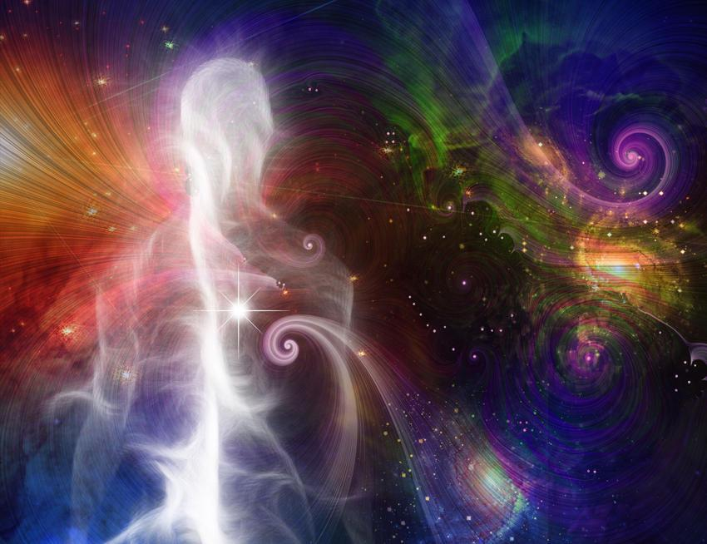
Bless the LORD, O my soul, And forget not all His benefits: Who forgives all your iniquities, Who heals all your diseases, Who redeems your life from destruction, Who crowns you with lovingkindness and tender mercies, Who satisfies your mouth with good things, So that your youth is renewed like the eagle's. — Psalms 103:2-5
O soul forget not all His benefits:
→ Who forgives all your iniquities
→ Who heals all your diseases
→ Who redeems your life
from destruction
→ Who crowns you with
tender mercies
→ Who satisfies your mouth
with good things
Thank
LORD
O
soul
forget
not all His benefits:
Who forgives all
your iniquities
Who heals all your
diseases
Who redeems your life
from
destruction
Who crowns you with
tender mercies
Who satisfies your mouth
with good
things
Notes:
The LORD God, who draws existence itself, is our crown of glory.

Slide 16
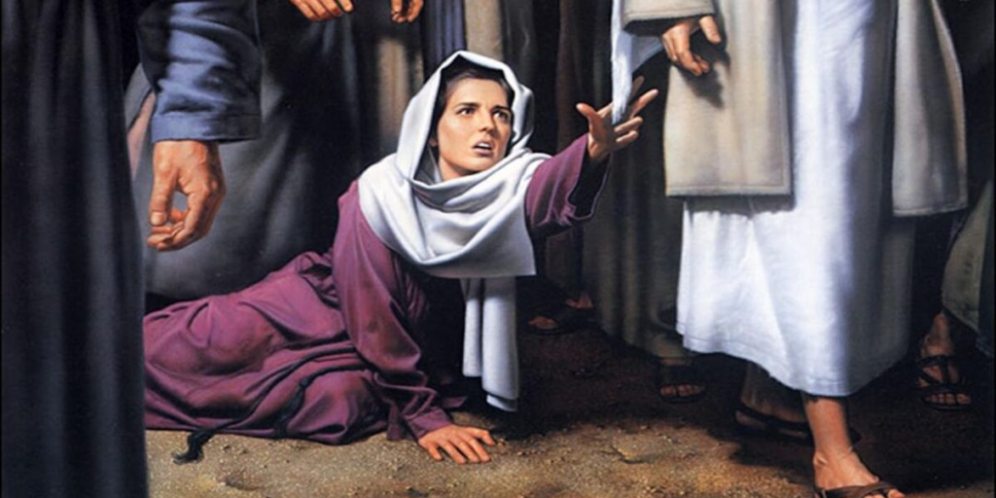
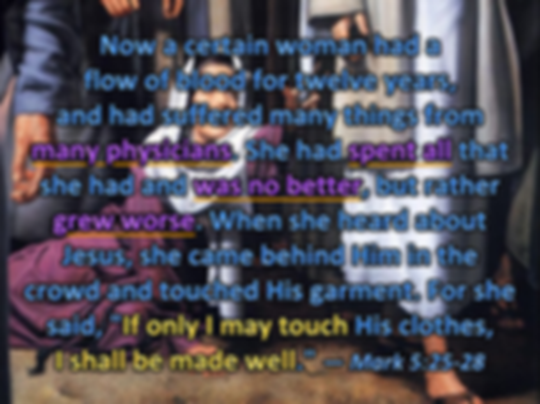

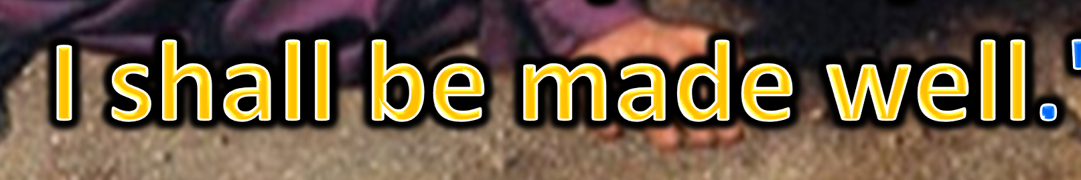
Now a certain woman had a flow of blood for twelve years, and had suffered many things from many physicians. She had spent all that she had and was no better, but rather grew worse. When she heard about Jesus, she came behind Him in the crowd and touched His garment. For she said, "If only I may touch His clothes, I shall be made well." — Mark 5:25-28
of
many physicians
spent all
many physicians
spent all
touch of Jesus
was no better
was no better
grew worse
grew worse
Jesus
touch
Notes:
There are so many illnesses, social and physical, that man cannot cure, and it is left up to the Lord. The Lord transcends beyond space and time in life, as is His dwelling place. No greater cure can be had but to fall into the hands of God Himself, who commands all. Unwavering faith will be rewarded.

Slide 17
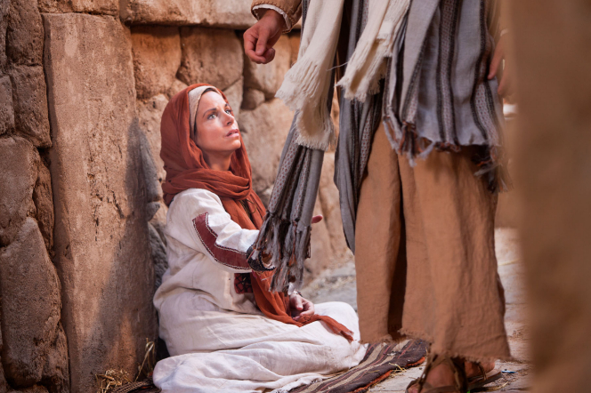
Immediately the fountain of her blood was dried up, and she felt in her body that she was healed of the affliction. And Jesus, immediately knowing in Himself that power had gone out of Him, turned around in the crowd and said, "Who touched My clothes?" But His disciples said to Him, "You see the multitude thronging You, and You say, 'Who touched Me?'" — Mark 5:29-31
she was healed
affliction
she was healed
affliction
Who touched Me?
Who touched Me?
Notes:
Faith is often silent in its humble hope, yet God notices all that is genuine. It is the desire of God that we declare our faith openly, and in truth, not hiding from Him or others. Jesus looks for confessions of faith.

Slide 18
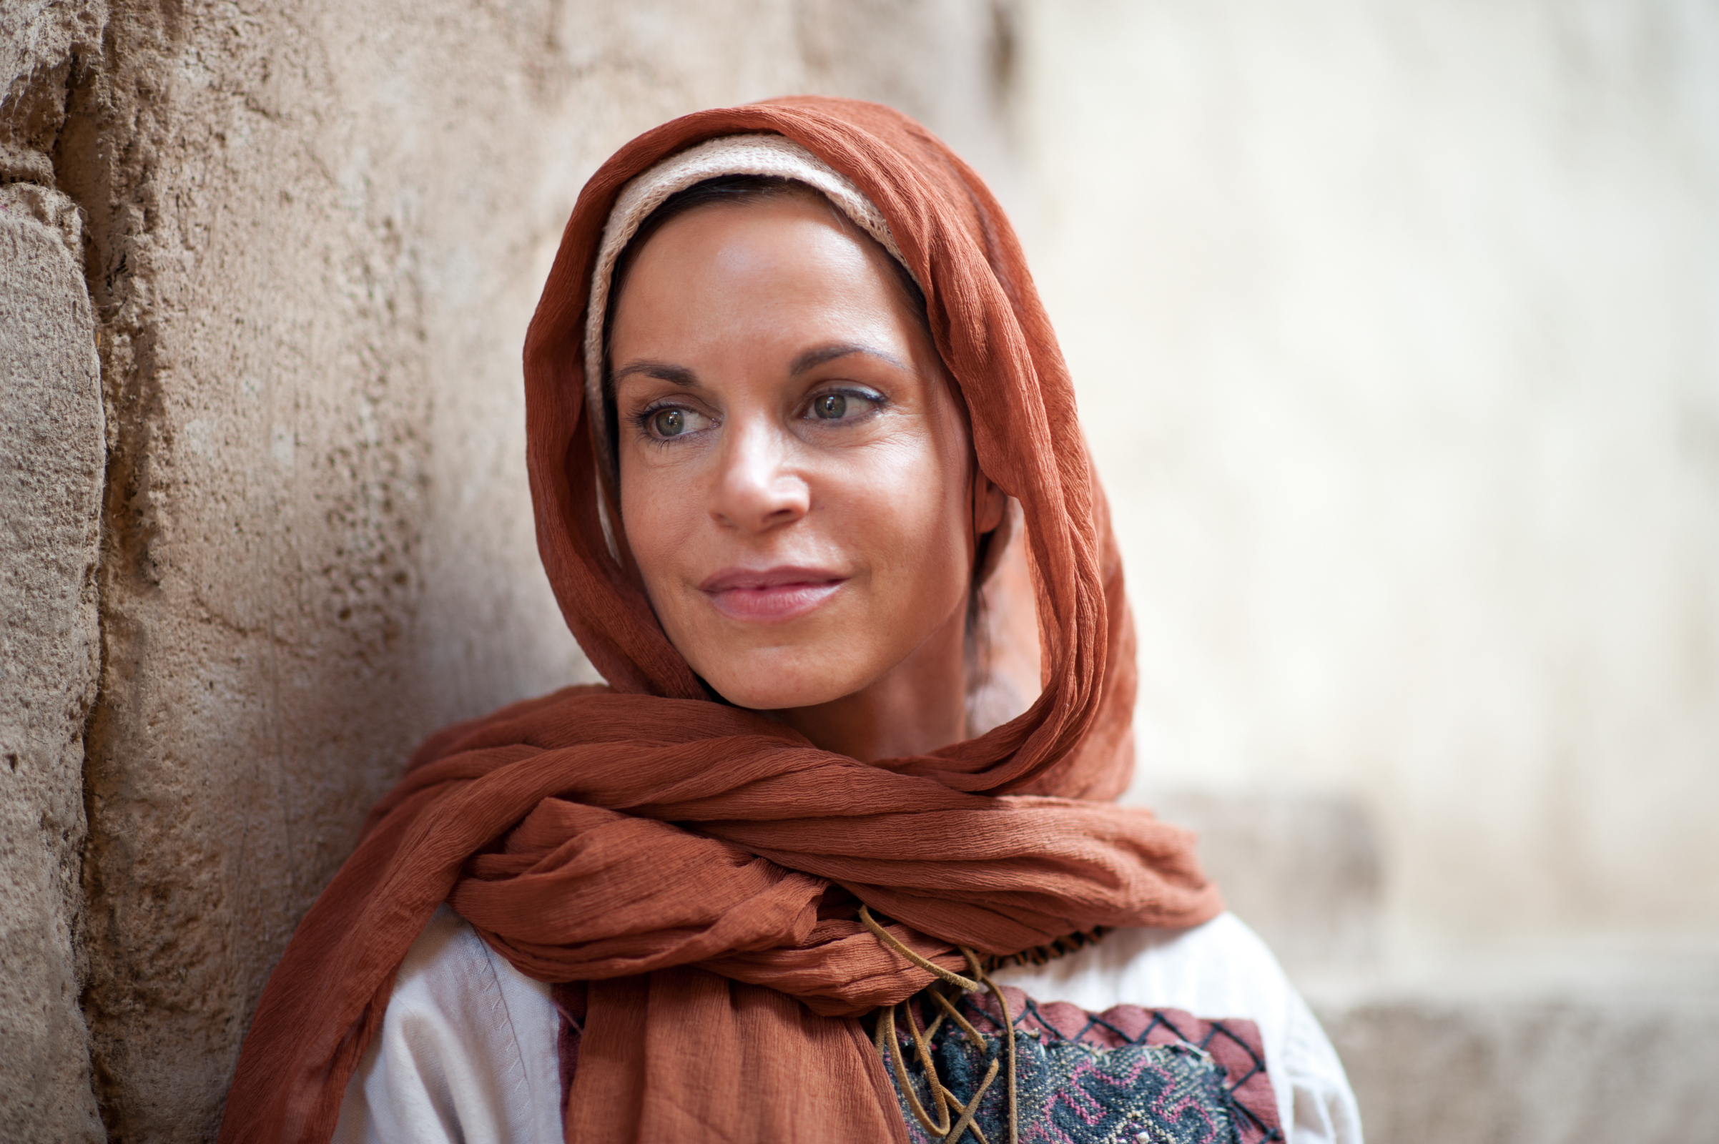
And He looked around to see her who had done this thing. But the woman, fearing and trembling, knowing what had happened to her, came and fell down before Him and told Him the whole truth. And He said to her, "Daughter, your faith has made you well. Go in peace, and be healed of your affliction." — Mark 5:32-34
And He looked around to see her who had done this thing. But the woman, fearing and trembling, knowing what had happened to her, came and fell down before Him and told Him the whole truth. And He said to her, "Daughter, your faith has made you well. Go in peace, and be healed of your affliction." — Mark 5:32-34
affliction
affliction
Notes:
The greatest healing to be had comes by faith. The sight of faith is found in belief.

Slide 19
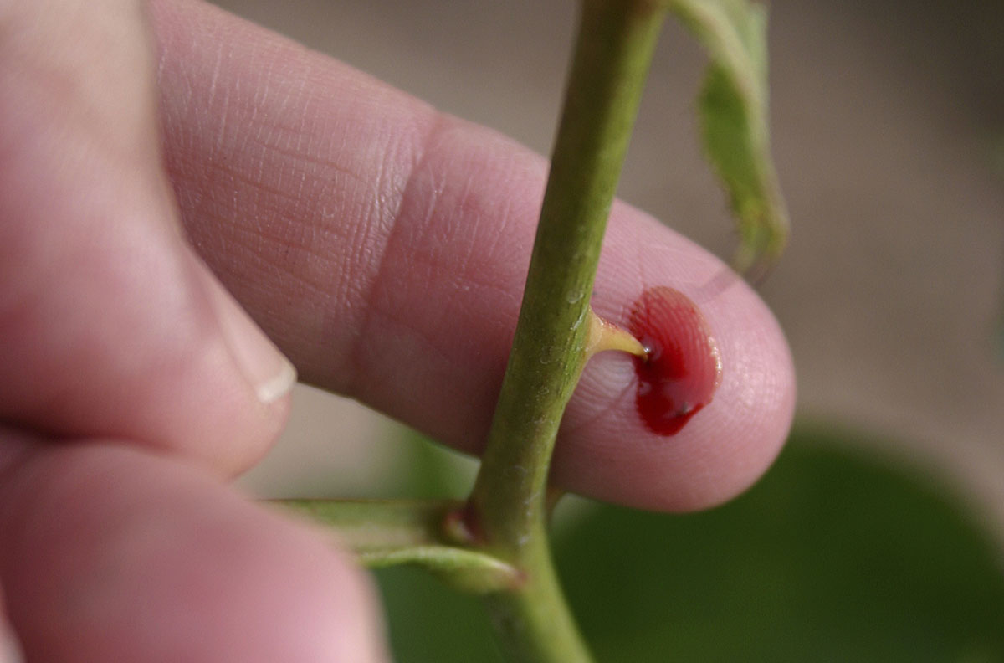
And lest I should be exalted above measure by the abundance of the revelations, a thorn in the flesh was given to me, a messenger of Satan to buffet me, lest I be exalted above measure. Concerning this thing I pleaded with the Lord three times that it might depart from me. And He said to me, "My grace is sufficient for you, for My strength is made perfect in weakness." Therefore most gladly I will rather boast in my infirmities, that the power of Christ may rest upon me. — 2nd Corinthians 12:7-9
affliction
My grace is sufficient
My grace is sufficient
My strength is made perfect in weakness
My strength is made perfect in weakness
power of Christ
Christ
power of Christ
may rest upon me
may rest upon me
Notes:
Each of us has an affliction unique to each. It is God testing our strength and resolve to believe without question. Skeptics argue unable to achieve. Trust without question is faith. Knowing God has the power is what keeps us strong.

Slide 20


The glory of young men is their strength, And the splendor of old men is their gray head. Blows that hurt cleanse away evil, As do stripes the inner depths of the heart. — Proverbs 20:29-30
splendor
cleanse
cleanse
the inner depths
. .
heart
Notes:
Patient endurance has a long path of experience if seasoned in time. Settled souls are what lifts the rest of us to maturity. Throughout the ages, it has been the inner depth of character that has inspired all people. Depth of character renders humble calm with careful ears.

Slide 21
humble
wisdom

Slide 22
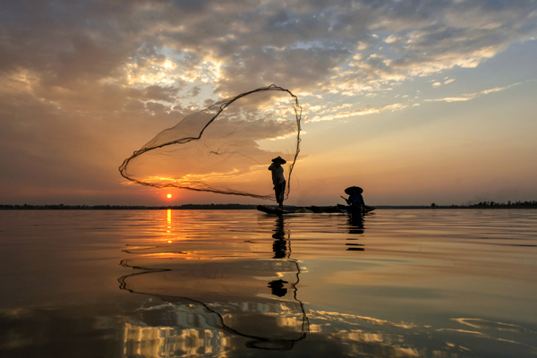
Therefore humble yourselves under the mighty hand of God, that He may exalt you in due time, casting all your care upon Him, for He cares for you. — 1st Peter 5:6-7
humble
humble
humble
under the mighty hand of God
under the mighty hand of God
Notes:
Without a humble heart, arrogance will destroy you if consumed in comparisons and unjustified judgments of others.

Slide 23

Is anyone among you sick? Let him call for the elders of the church, and let them pray over him, anointing him with oil in the name of the Lord. And the prayer of faith will save the sick, and the Lord will raise him up. And if he has committed sins, he will be forgiven. Confess your trespasses to one another, and pray for one another, that you may be healed. The effective, fervent prayer of a righteous man avails much. — James 5:14-16
pray for
pray for
one another, that you may be healed
one another, that you may be healed
Notes:
We must continue to pray for each other, as it in itself, helps heal the self.

Slide 24

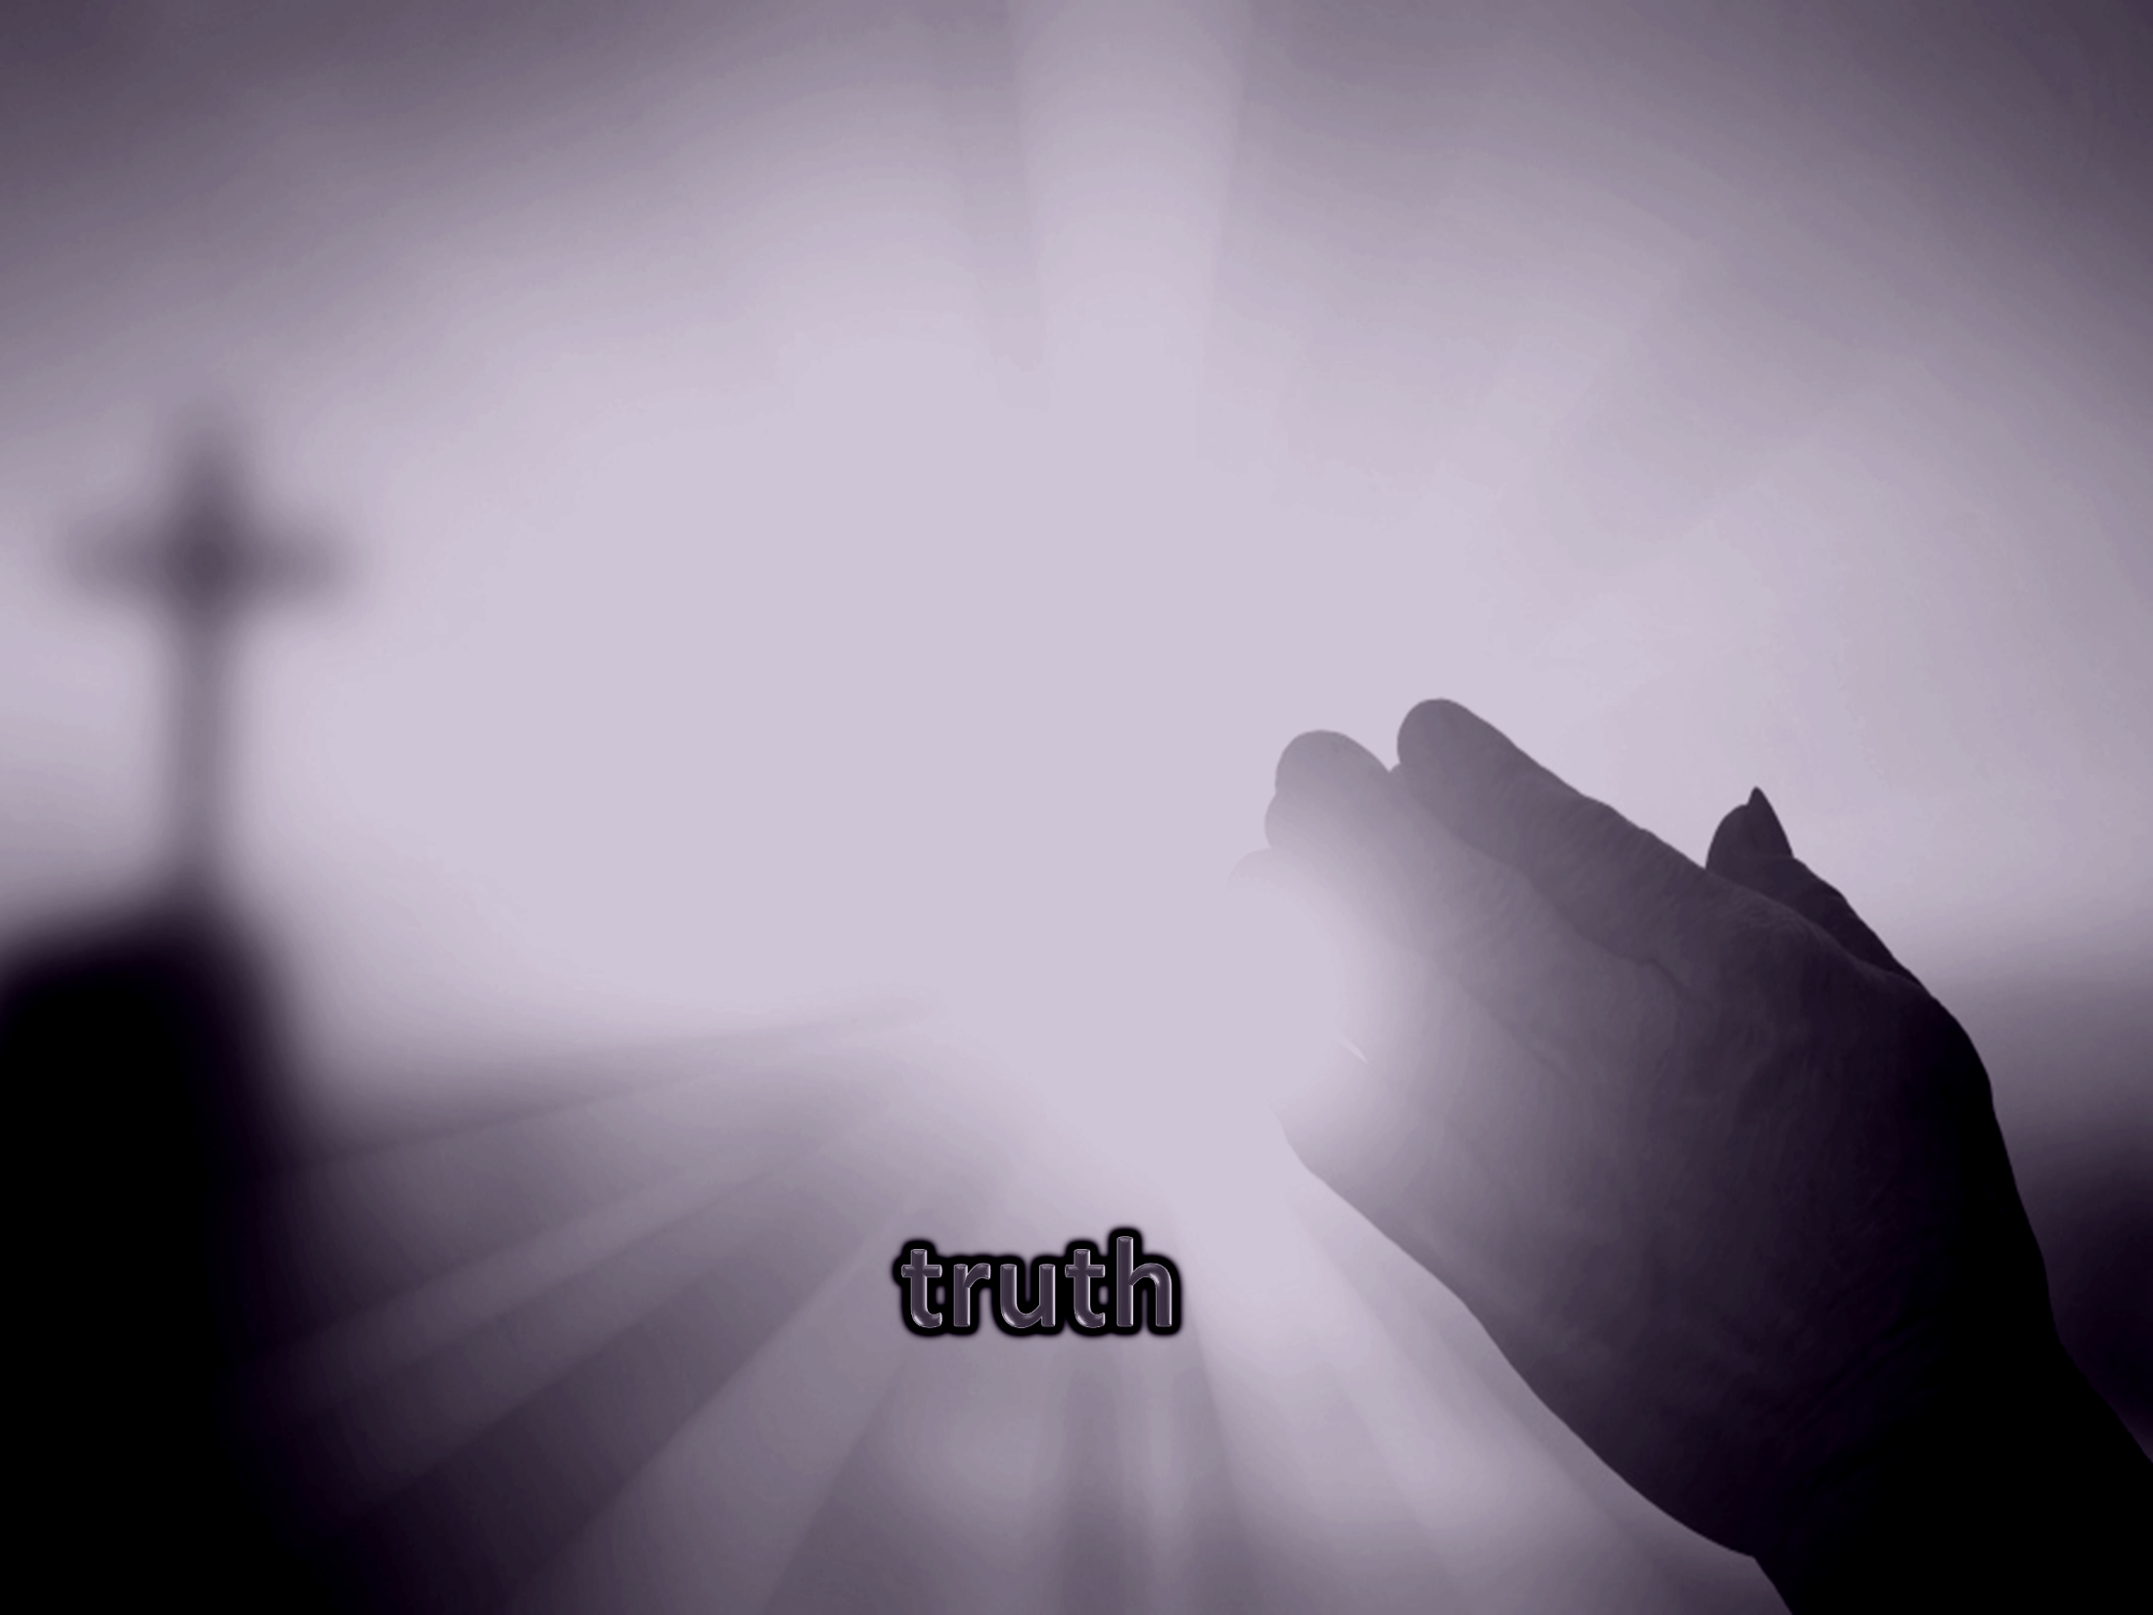

Beloved, I pray that you may prosper in all things and be in health, just as your soul prospers. For I rejoiced greatly when brethren came and testified of the truth that is in you, just as you walk in the truth. — 3rd John 1:2-3
in
walk in the truth
walk in the truth
Notes:
Above all, the bottom line to all, is truth.

Slide 25
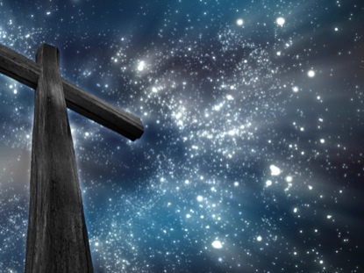
… who Himself bore our sins in His own body on the tree, that we, having died to sins, might live for righteousness -- by whose stripes you were healed. — 1st Peter 2:24
live for righteousness
by
by
live for righteousness
whose stripes you were healed
Notes:
By what other salvation are we saved? By a concoction of man? It is by Jesus Christ God offers His grace. Jesus showed by enduring suffering, and never loosing faith, that the resurrection to life comes.

Slide 26
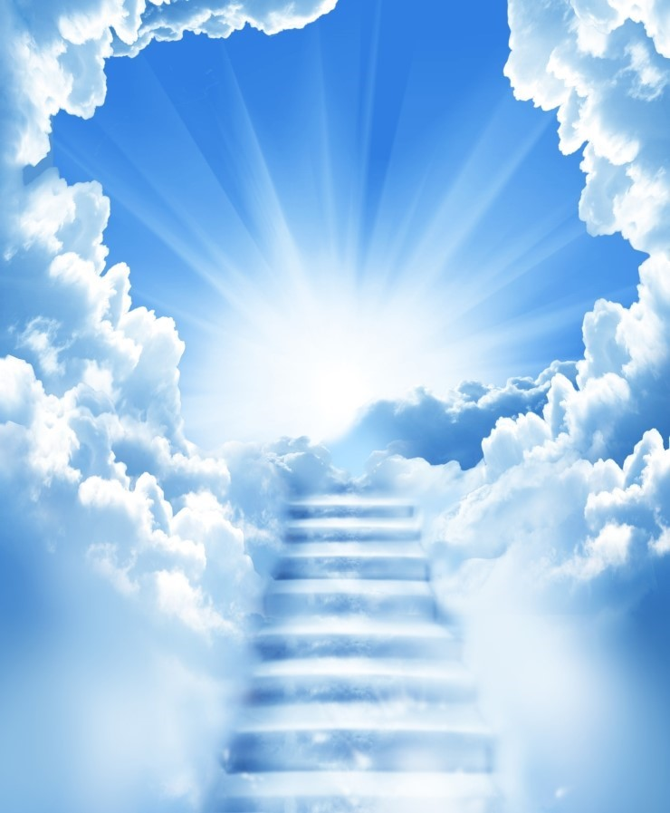
And my God shall supply all your need according to His riches in glory by Christ Jesus. — Philippians 4:19
in
by
riches in glory by Christ Jesus
Christ Jesus
. .
Notes:
Something greater than imaginable is ahead for all who believe.

Slide 27


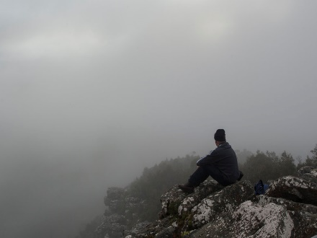

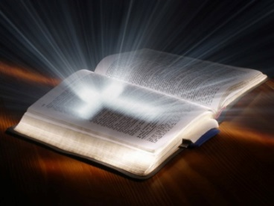







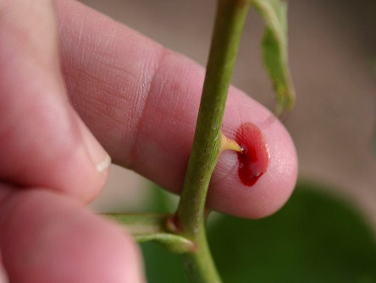


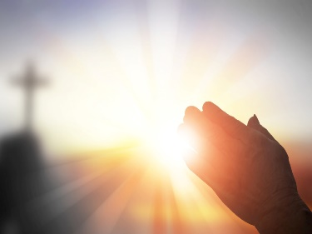
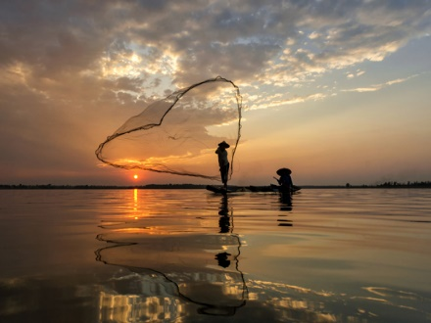
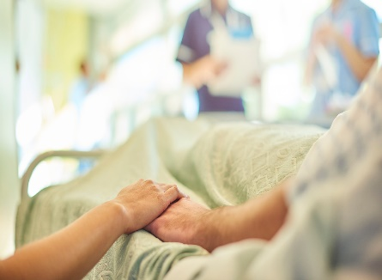


Slide 28
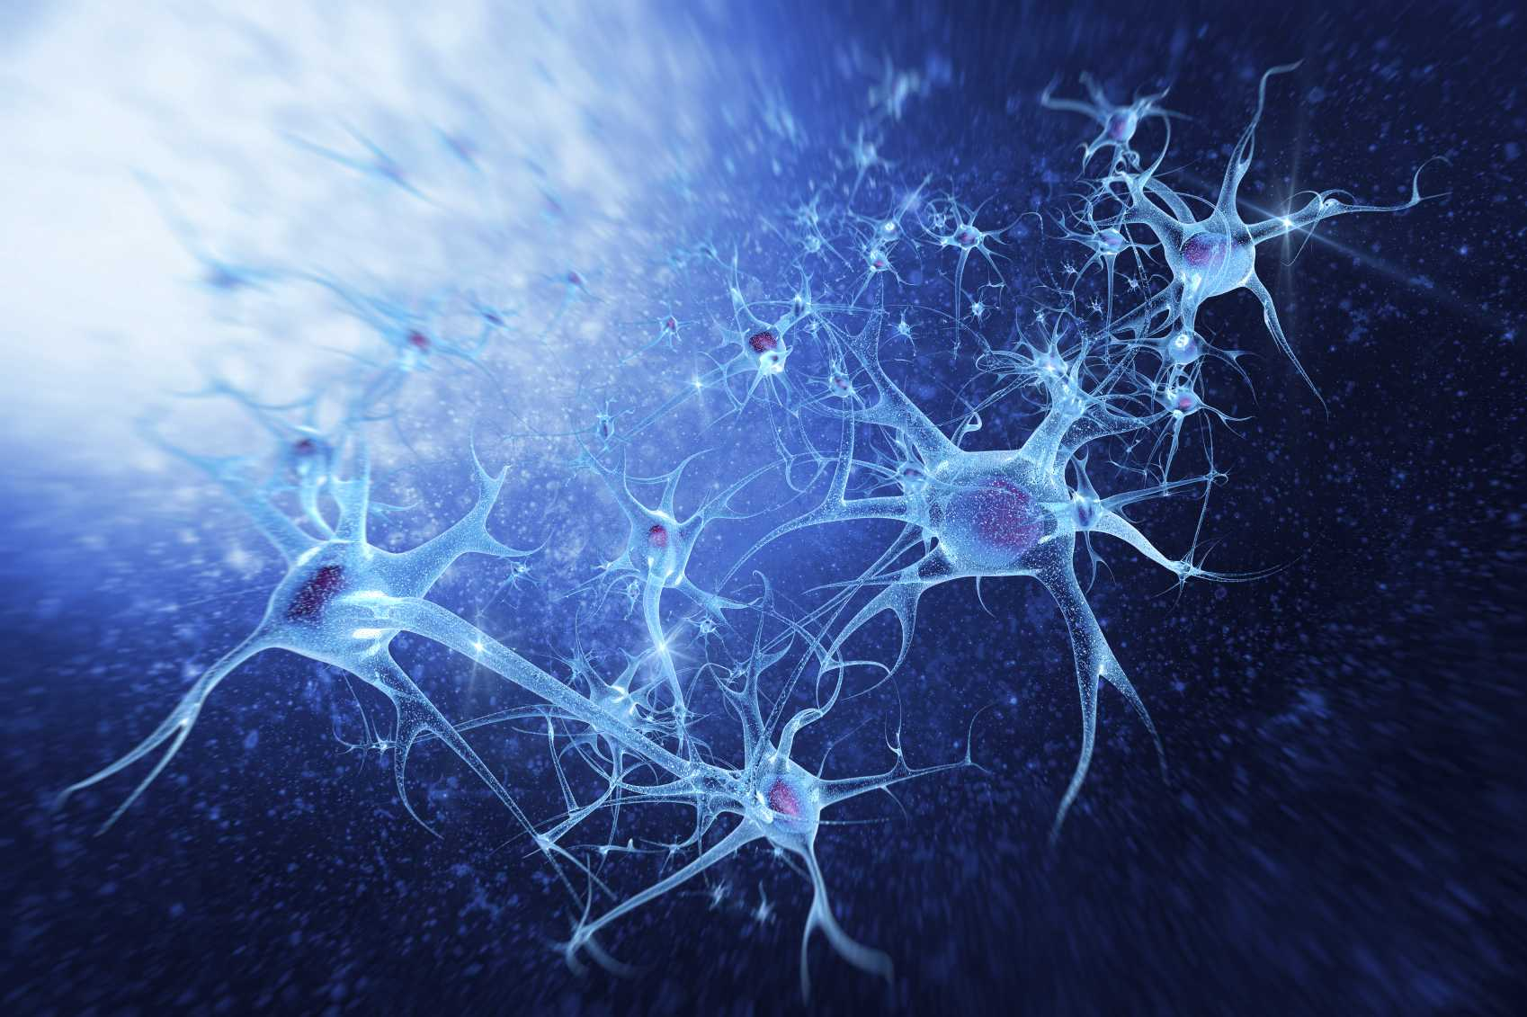
→ Deliverance is only by God who heals and destroys
→ Salvation of sinners is possible through Jesus
→ The word of God is health to all the flesh
→ God’s word heals and delivers one from troubles
→ God cares for us through all our afflictions
→ Great faith and trust continually praises God
→ Faith heals through the power of God
→ More than the flesh, faith sustains the soul
→ Pain and suffering can deepen the heart’s wisdom
→ Humble hearts trust God’s ability to accomplish all
→ Prayer heals the sick and lifts the sorrowful
→ Jesus’ sacrifice heals us to know true God
→ The glory of Jesus Christ supplies all our needs
God’s ocean of life remains with the faithful
Notes:
God’s ocean of life remains with the faithful

Slide 30

Please visit http://www.RonBert.com to explore further
Ronald Bert Channel on
Notes:
Eternity never ends.

