Slide 1
Notes:
Darkness has no spark.

Slide 2
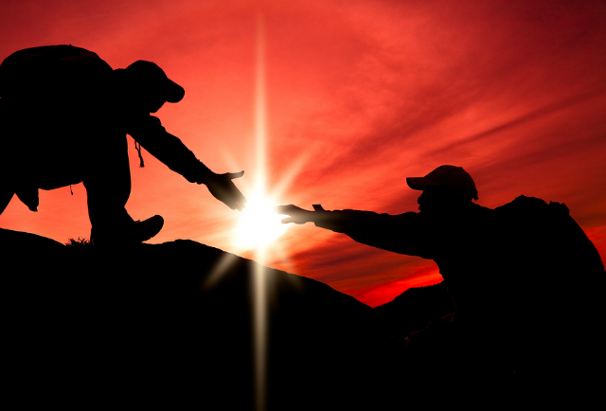

Courage of Faith
courage
Ron Bert
January 15, 2017
July 4, 2021
Notes:
Courage is filled with the exuberance of fear in the midst of applying confidence.

Slide 3

"Be strong and of good courage, do not fear nor be afraid of them; for the LORD your God, He is the One who goes with you. He will not leave you nor forsake you." — Deuteronomy 31:6
courage
do not fear nor be afraid
courage
do not fear nor be afraid
LORD your God
LORD
God
LORD your God
who goes with you
who goes with you
Notes:
Is God with you or is He someone you call for? Many times we search for something already here. To know Him is to know He waits closer than we can know; from the core of each of our cells. In His image God gave us the power of autonomy. In life we all must face the dichotomy of being lonely verses being alone. To be lonely is to deny others are present in an isolated chasm of self inflicted torture. We are all alone among one another; it is a blessing, not a curse, and we need to come to know He is here with us embracing our freedom. Time is a temporary condition and is the incubator of us all. The permanence of our destination with Him depends on our choices, while alone in isolation, to remain steadfast in His distant most closest call.

Slide 4

"Have I not commanded you? Be strong and of good courage; do not be afraid, nor be dismayed, for the LORD your God is with you wherever you go." — Joshua 1:9
command
afraid
courage
afraid
do not be afraid
do not be afraid
Notes:
All of our paths involve ever-ending change. He tells us to rely on His strength and walk with courage in Him.

Slide 5
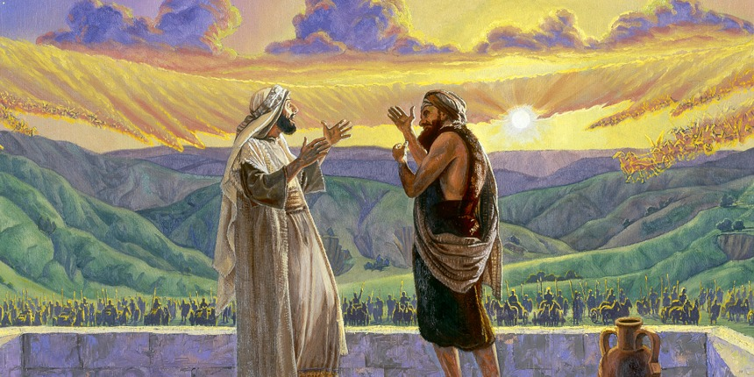
So he answered, "Do not fear, for those who are with us are more than those who are with them." — 2nd Kings 6:16
fear
not
not
fear
afraid
Notes:
Men that arrogantly believe they are great over others are no better than ants baking under the sun. His powers are multi-dimensional and He cares for each of us more than the flesh we cherish. Fear confronts us with issues of belief in so much more ways than words can express. From high to low and all in-between, questions of life in death are at the forefront of all.

Slide 6
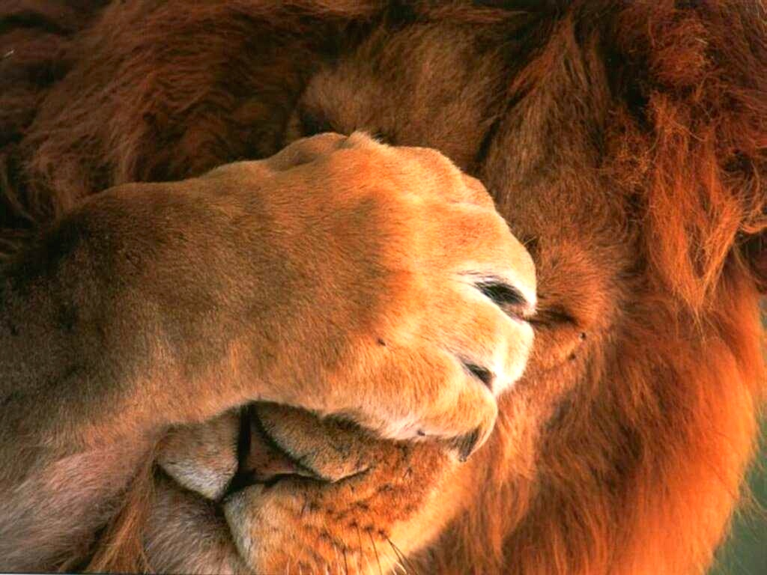
"' Fear not, for I am with you; Be not dismayed, for I am your God. I will strengthen you, Yes, I will help you, I will uphold you with My righteous right hand.'" — Isaiah 41:10
fear
not
Fear not
I am with you
I am your God
● I am with you
● I am your God
● I will strengthen you
● I will help you
● I will uphold you
I am
fear
I will strengthen you
I will
I am
I am
help you
I will uphold you
I will
I will
I will
I will
Notes:
External fear is a lack of faith in His presence. If we fear we doubt His promise. His promise stands where mankind fails. For a sad statement on humanity, in a thousand promises of man, rarely is one found true.

Slide 7
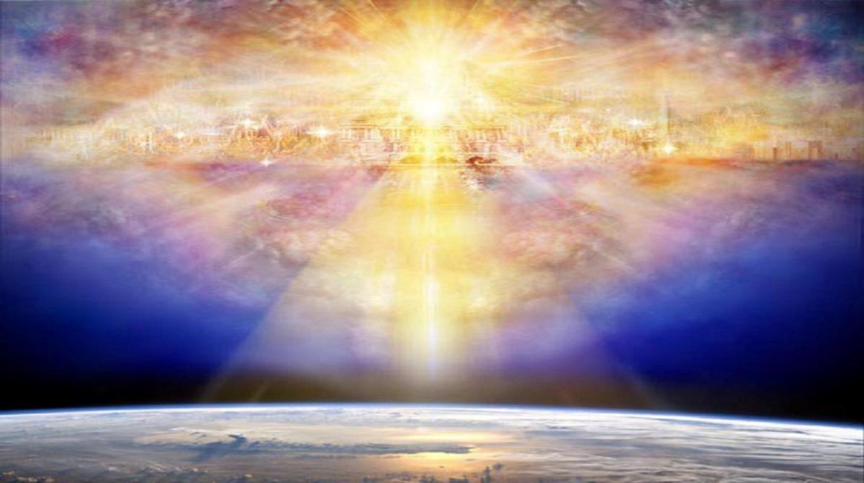
Oh, how great is Your goodness, Which You have laid up for those who fear You, Which You have prepared for those who trust in You In the presence of the sons of men! — Psalms 31:19
God
God
Y ou
Y ou
fear
Y ou
Y ou
Wait
Wait
Wait on the LORD; Be of good courage, And He shall strengthen your heart; Wait, I say, on the LORD! — Psalms 27:14
trust
in
Be of good courage, And He shall strengthen your heart, All you who hope in the LORD. — Psalms 31:24
trust
In the presence
Y ou
confess
unashamed
strengthen your heart
strengthen your heart
Wait
of men
Wait
→
in
LORD
hope
hope in the LORD
LORD
hope in the LORD
Notes:
Trust in His presence is acceptance of His presence. The Great You is upon us. If a nation wishes to have His blessing upon them, He can not be a closet God. Our faith must be an outward proclamation. Courage in Him strengthens the heart while our hope deepens to that which is higher.

Slide 8
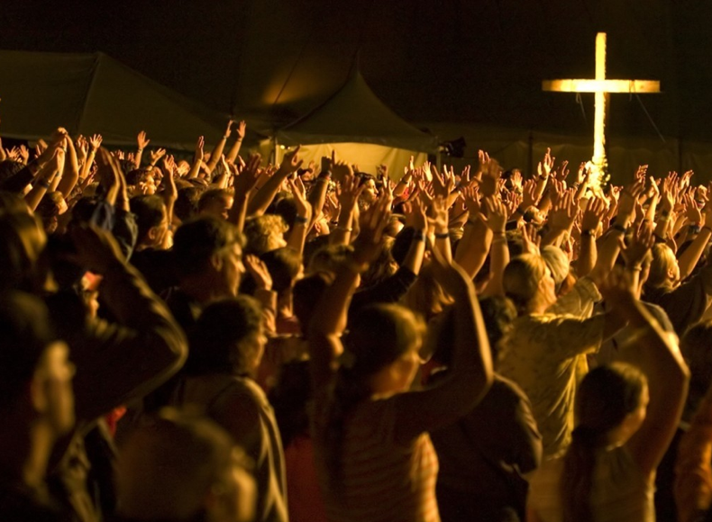
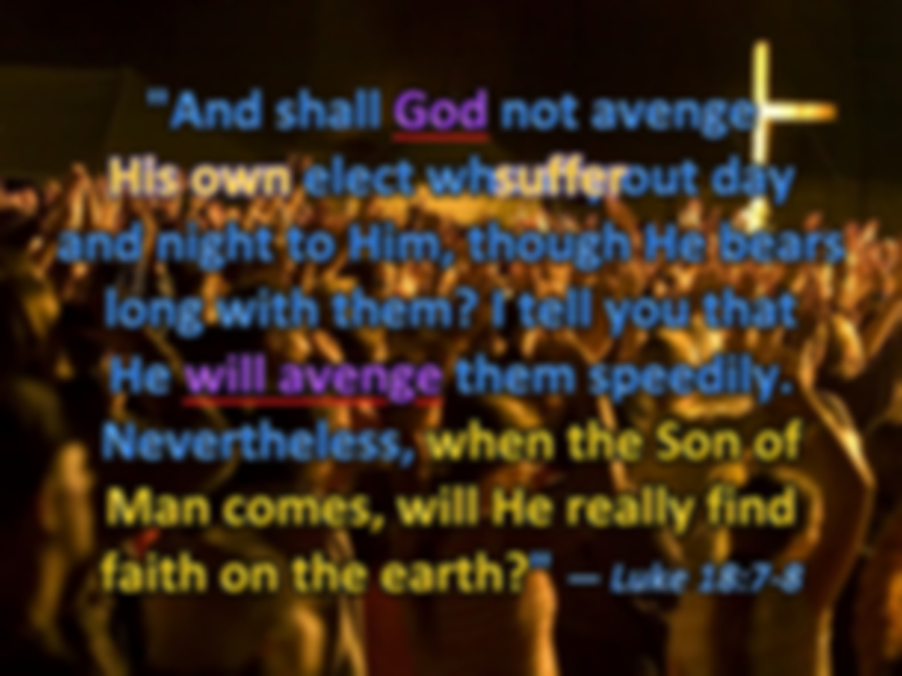


"And shall God not avenge His own elect who cry out day and night to Him, though He bears long with them? I tell you that He will avenge them speedily. Nevertheless, when the Son of Man comes, will He really find faith on the earth?" — Luke 18:7-8
God
God
God
God
His own
suffer
will avenge
will avenge
faith
faith
Notes:
Since time is temporary, it is inevitable upon its’ end that His judgment will be. As a day is as a thousand years so too shall the vapor of our lives quickly meet with Him.

Slide 9
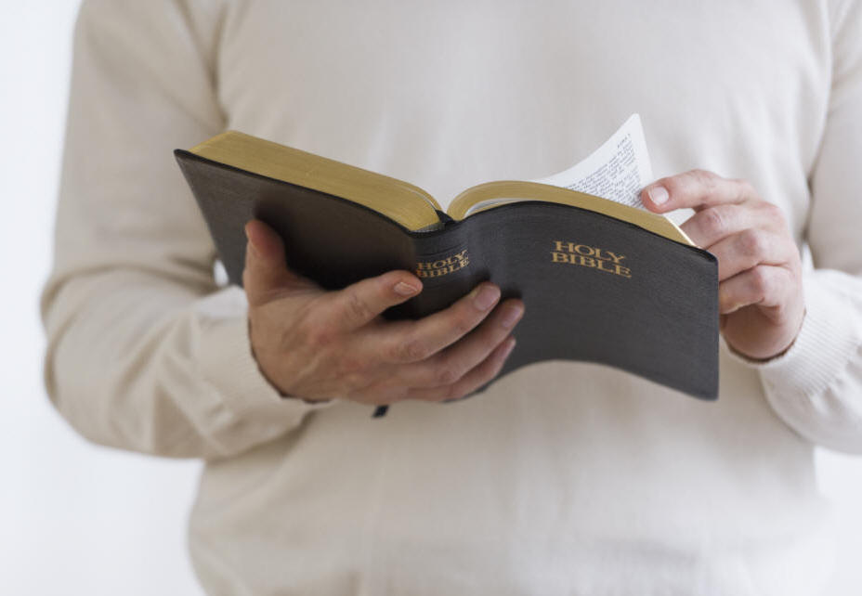
Let a man so consider us, as servants of Christ and stewards of the mysteries of God. Moreover it is required in stewards that one be found faithful. — 1st Corinthians 4:1-2
servants of Christ
Christ
servants of Christ
faithful
in
faithful
found
faith
found
faith
Notes:
While here alive in the flesh, each of us needs to consider our responsibilities to the good call of God. Essential is the study of His word. Without mustering the strength to hear, the weak choose to ignore it, in the lazy oceans of their minds. Truly, only the strong survive.

Slide 10
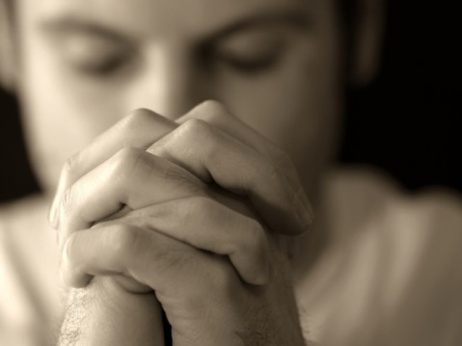
Let us hold fast the confession of our hope without wavering, for He who promised is faithful. — Hebrews 10:23
hold fast
hold fast
faithful
promise
Notes:
As He is faithful, so should we be. Union has no separation.

Slide 11
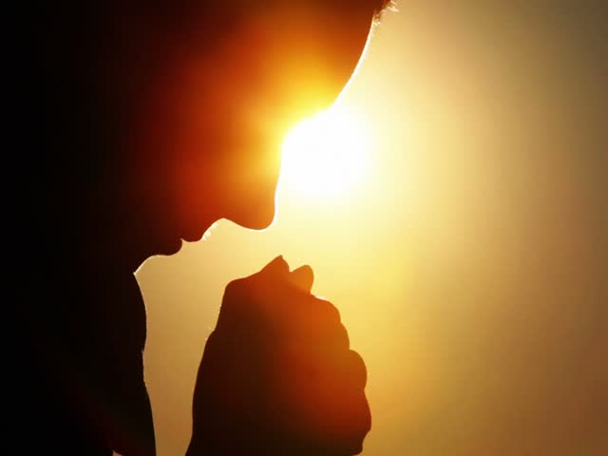
Let your conduct be without covetousness; be content with such things as you have. For He Himself has said, "I will never leave you nor forsake you." So we may boldly say: "The LORD is my helper; I will not fear. What can man do to me?" — Hebrews 13:5-6
our conduct
our conduct
your conduct
you
be without
your conduct
Peace
covetousness
be content
Faith
Shines
Integrity
Godliness
be content
be without covetousness
Gentleness
Righteousness
I will not fear
man
Love
Patience
Notes:
Desire has defeated many from the freedom of being. Conduct is a practice of mastering ones own thoughts. Without self control in Him, no man has the power to break the seal of sinful barrages. Only by self direction can one be set to leave (depart) or stay in belief. Choices define our destiny in Him over darkness's oblivion.

Slide 12
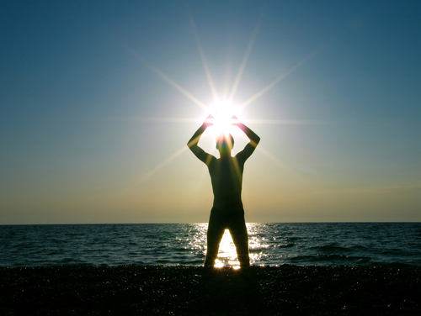
Only let your conduct be worthy of the gospel of Christ, so that whether I come and see you or am absent, I may hear of your affairs, that you stand fast in one spirit, with one mind striving together for the faith of the gospel, … — Philippians 1:27
our conduct
stand
stand
stand fast
stand fast
together
Notes:
Judgment is serious and it will be based upon our reaction to His call to be unified in Him. Without His knowledge a blind stupor fills the land with the chaos of wickedness. Truly, my people are destroyed for lack of knowledge.

Slide 13
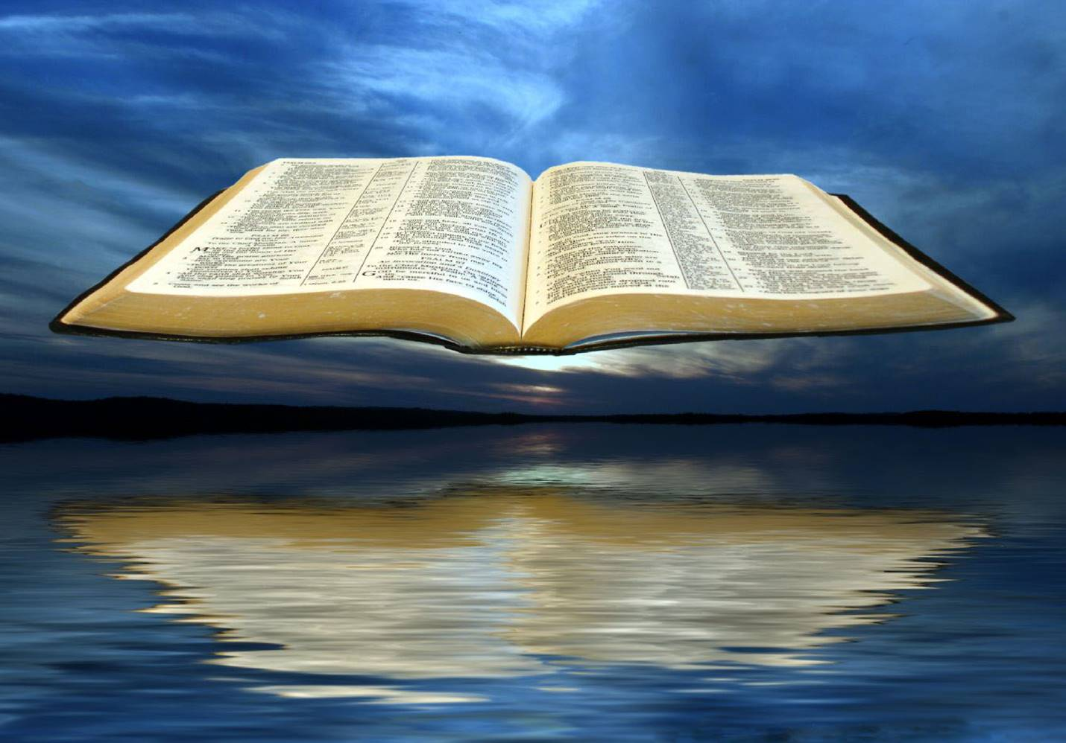
Moreover, brethren, I declare to you the gospel which I preached to you, which also you received and in which you stand, by which also you are saved, if you hold fast that word which I preached to you -- unless you believed in vain. — 1st Corinthians 15:1-2
gospel
preached
received
stand
in
saved
if
hold fast
hold fast
word
stand
Notes:
It is His word that inspires us closer to the truth where love stands unimpeded.

Slide 14

Therefore, having been justified by faith, we have peace with God through our Lord Jesus Christ, through whom also we have access by faith into this grace in which we stand, and rejoice in hope of the glory of God. — Romans 5:1-2
grace
peace with God
Jesus Christ
justified by faith
access by
rejoice in hope
stand
justified
by faith
peace with God
Jesus Christ
faith
access by
grace
stand
faith
stand
rejoice
in hope
in
Notes:
Faith has the strength of confidence.

Slide 15
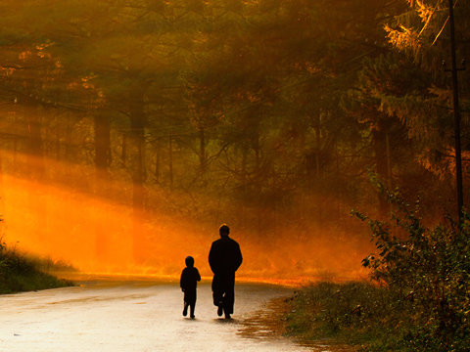
Well said. Because of unbelief they were broken off, and you stand by faith. Do not be haughty, but fear. — Romans 11:20
stand
faith
doubt
stand
faith
stand by faith
proud
by
stand by faith
humble
Notes:
A spiritual divide lays across the land. Division only comes by the bickering of man in his arrogance. Fear of God rises past man to the blessings He holds for each of us who humbly love Him. We stand on heaven’s endless rock.

Slide 16
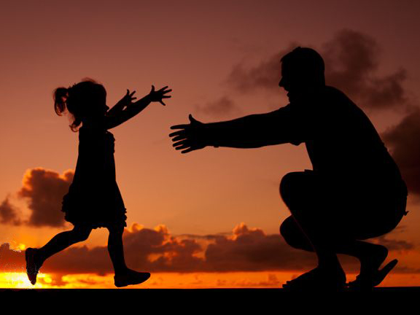
Watch, stand fast in the faith, be brave, be strong. Let all that you do be done with love. — 1st Corinthians 16:13-14
love
stand
faith
stand fast
in
stand fast
faith
love
Notes:
Love if not simple is of the greatest of losses. Who can say they are not short on love in a world such as ours? With so many dysfunctional families, all could admit we should have loved more and bickered less. With so much disharmony, what becomes of our closest loves if we turn from God, and make something less greater, or never come to know Him? These lost spawn the theater killers, explosive truck drivers, and airport ravagers of our times.

Slide 17
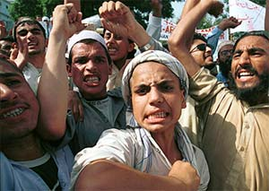
"And because lawlessness will abound, the love of many will grow cold. But he who endures to the end shall be saved. And this gospel of the kingdom will be preached in all the world as a witness to all the nations, and then the end will come." — Matthew 24:12-14
love
he who endures
he who endures
shall be saved
shall be saved
world
world
Notes:
And while love is lacking, angers are multiplied as blame ravages the hearts of all. Love can be elusive to those of faithless rage. Pure love descends from heaven and is offered to all, no matter where we come to be. Man or God? The choice should be clear without dispute. Give me God over man!

Slide 18
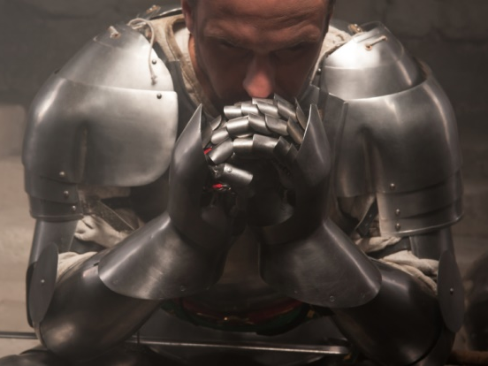
Finally, my brethren, be strong in the Lord and in the power of His might. Put on the whole armor of God, that you may be able to stand against the wiles of the devil. — Ephesians 6:10-11
in
Stand
be strong
in
the Lord
put on
the power of His
put on
might
world
Stand
stand against
Stand against
devil
devil
Notes:
It is a test for all and any to remain spiritually strong in the face of so many assaulting conflicts. The Lord’s very word is challenged to the core of truth or not. Pray His light reveals the liberty of His love.

Slide 19
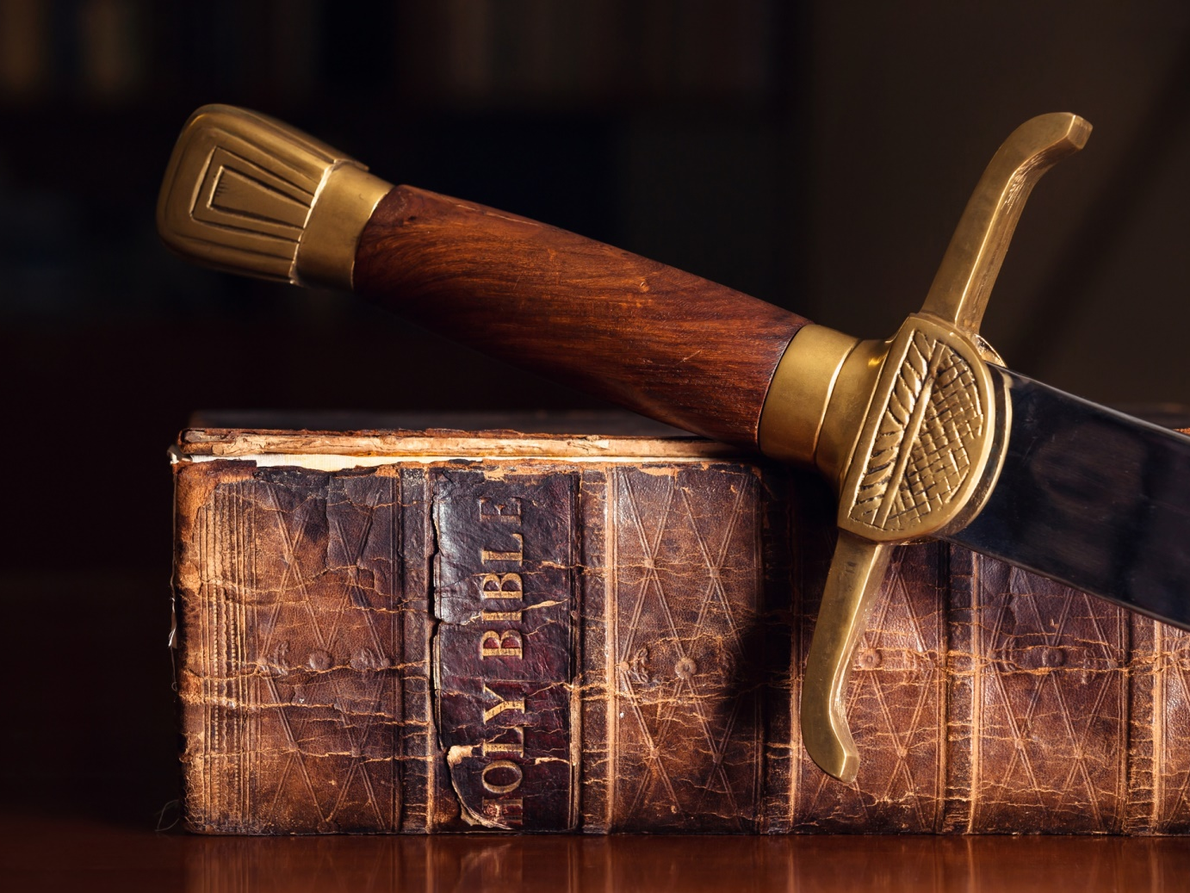
Stand therefore, having girded your waist with truth, having put on the breastplate of righteousness, and having shod your feet with the preparation of the gospel of peace; — Ephesians 6:14-15
Stand
truth
put on
righteousness
preparation
gospel of peace
preparation
Notes:
Knowing and practicing the word not only increases excellence of character, but one’s abilities to defend the faith and help lift others lost in the despair of flesh, especially to prevail over miseries.

Slide 20
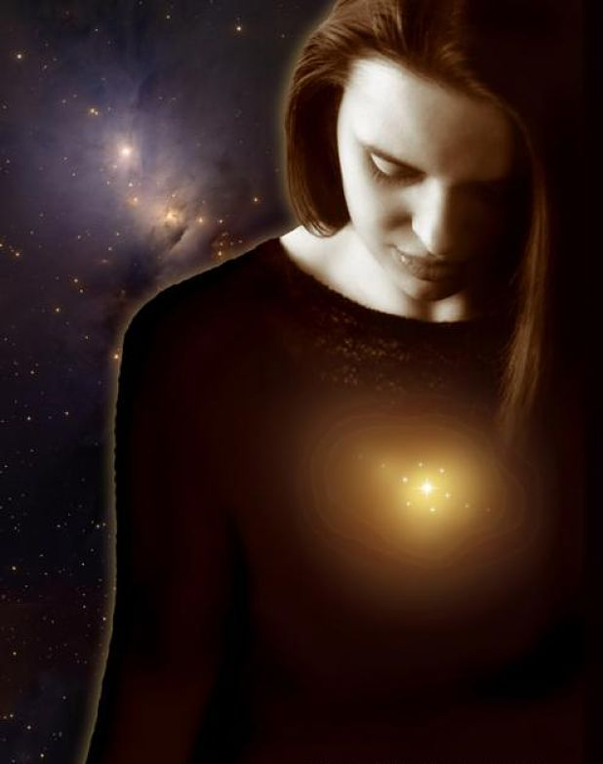
You are of God, little children, and have overcome them, because He who is in you is greater than he who is in the world. — 1st John 4:4
of God
of God
Spirit of Christ
Notes:
It is a light from within given from above that saves us.

Slide 21
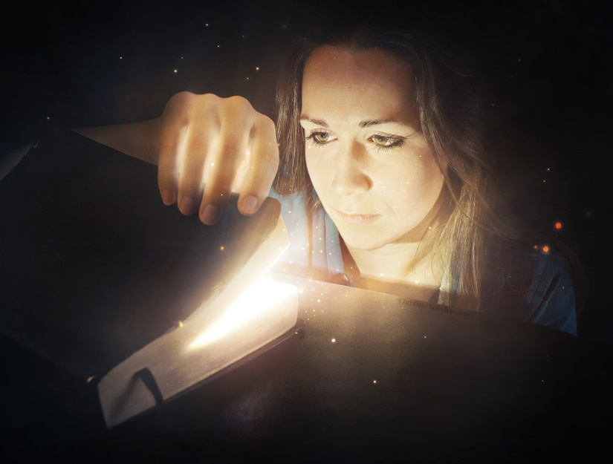
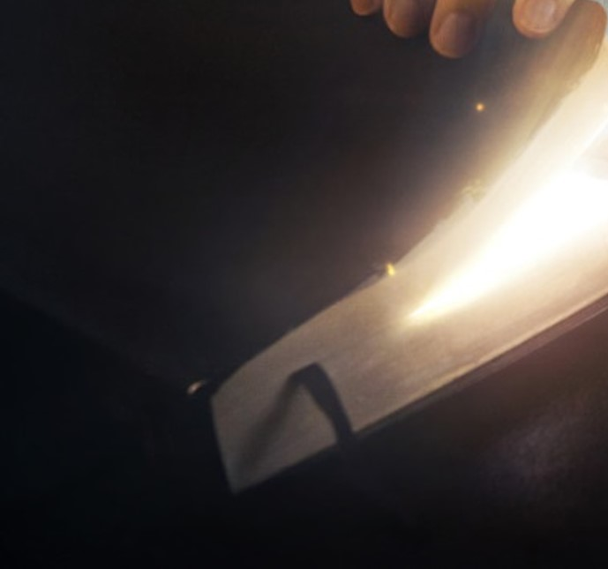
For whatever is born of God overcomes the world. And this is the victory that has overcome the world -- our faith. — 1st John 5:4
of God
overcome
our faith
our faith
Notes:
We see because He has shown us how. Christ is the victory that sets us free.

Slide 22

I can do all things through Christ who strengthens me. — Philippians 4:13
spirit of power
of love
of a sound mind
For God has not given us a spirit of fear, but of power and of love and of a sound mind. — 2nd Timothy 1:7
spirit
of power
of a sound
of love
our faith
mind
Notes:
Faith is stronger than the stars rising to heaven itself. Odds may seem overwhelming but we must remember that our courage is greater than our fears, if we are in truth, in God.

Slide 23

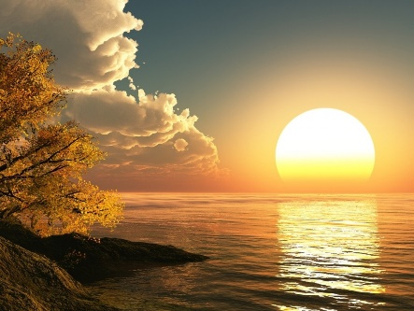


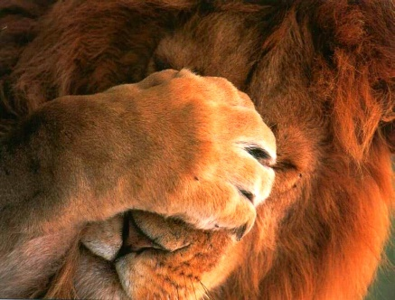

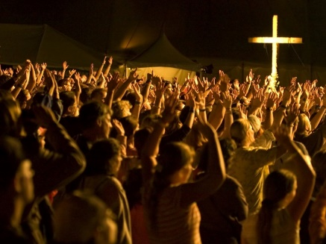

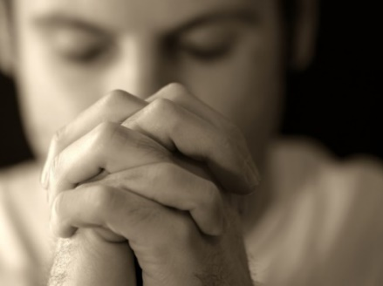


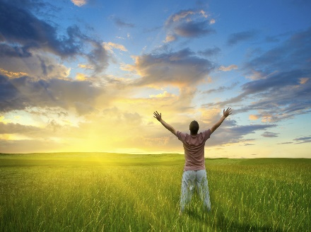


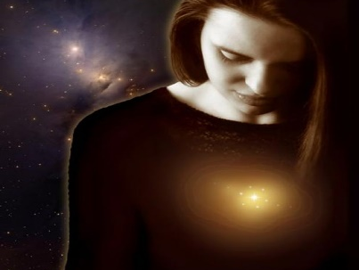
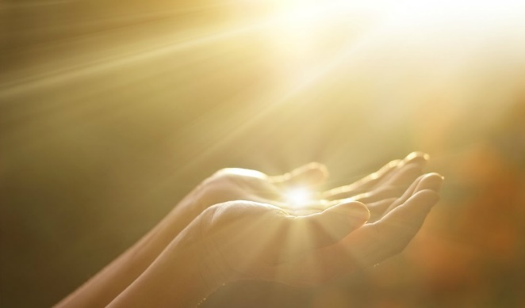




Slide 24


→ Be strong and of good courage - He is with you in all
→ More is with us than those who are against us
→ It is required in stewards that one be found faithful
→ Hold fast the confession of our hope not wavering
→ Good courage of heart is to wait on the Lord
→ Stand fast in one spirit, one mind, unity for the faith
→ If you hold fast standing in the word you are saved
→ Our faith justifies us through Christ
→ As love grows cold, endure to the end and be saved
→ Be strong in the Lord and in the power of His might
→ Stand being prepared with the gospel of peace
→ God in you is greater than he who is in the world
→ Born/God our victory is faith overcoming the world
His peace yields unending courage
Notes:
His peace yields unending courage.

Slide 25
Notes:
Darkness has noiseless silence.

Slide 26

Please visit http://www.RonBert.com to explore further
Ronald Bert Channel on
Notes:
Eternity never ends.

